Slide 1
EIC Detector for K/π structure
Some initial thoughts: R. Yoshida JLab
Notes:
Title Page

Slide 2
Topics (not an outline!)
Sullivan process and some kinematics
Acceptance
e-Pi (e-K) final state
leading neutron (Λ)
Detectors
Zero Degree Calorimeter
Forward Spectrometer
Notes:
Interior Page Design 1

Slide 3
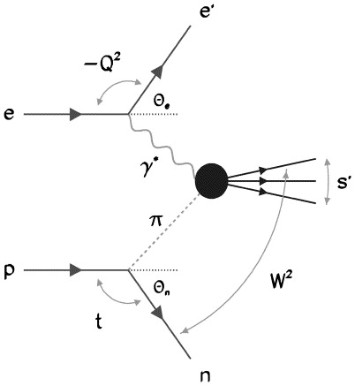
Kaon and Pion Structure at an EIC
DIS on Kaon
DIS on pion
K
Λ
Need to measure these

Slide 4
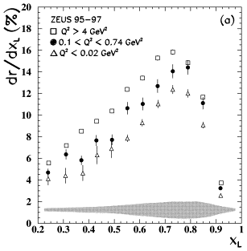
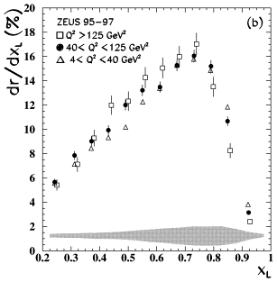
Neutron spectrum
Measurements from ZEUS (e p -> e n X): X_{L} = E_{neutron}/E_{beam}
Expect E_{neutrons} ~ 0.5-0.8 x E_{beam} → E _{pi} ~ 0.2-0.5 x E_{beam}

Slide 5
Interaction Region Concept
Possible to get ~100% acceptance for the whole event
Ion beamline
Electron beamline
Total acceptance detector (and IR)

Slide 6
Example kinematics for EIC
X_{L} = 0.5 E_{beam} = 100 GeV
E_{pi} = 50 GeV, E _{electron}= 10 GeV: √s = 45 GeV
For x_{pi} = 0.2: The collision is central-ish in the central detector:
At y = 0.8 : Q² = 320 GeV²
10 GeV quark
10 GeV electron
Pion

Slide 7
EIC Detector and IR Layout
Extended detector: 80+ m
JLEIC
eRHIC
EIC detectors must be extremely well integrated with the accelerator

Slide 9
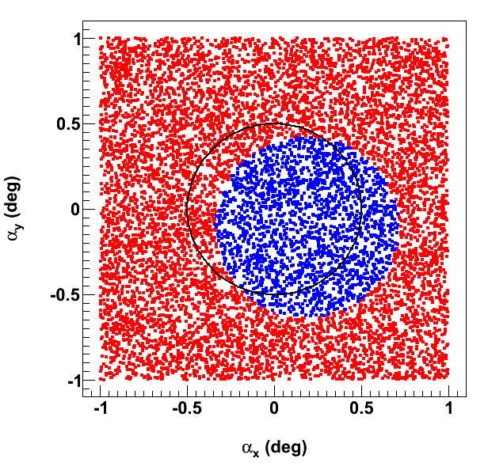
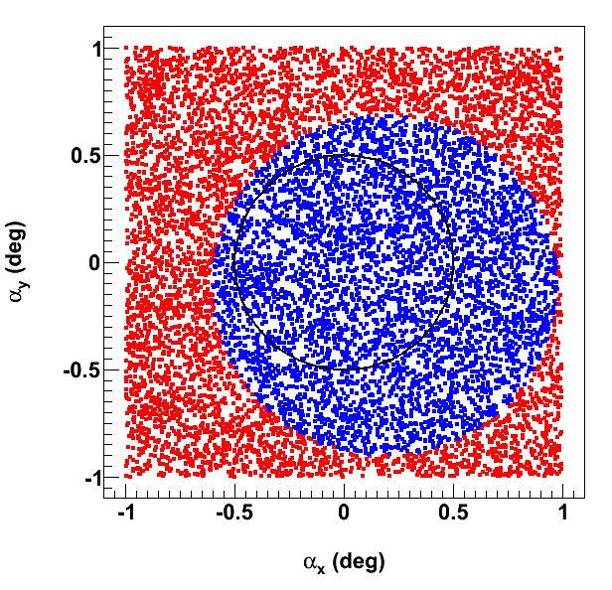
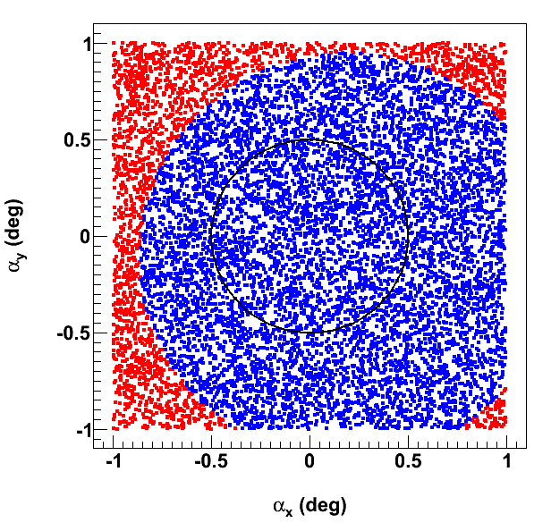
Downstream Ion FFB Acceptance for Neutrons
Neutrons uniformly distributed within ±1° horizontal & vertical angles around proton beam
Each quad aperture = B max / (field gradient @ 100 GeV/c)
6 T max
9 T max
12 T max
← electron beam

Slide 11
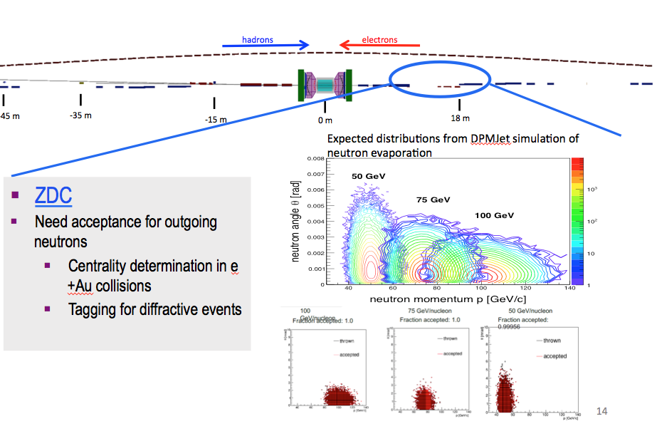
eRHIC Forward Hadron Detector Concept
Richard Petti Spin 2016

Slide 13
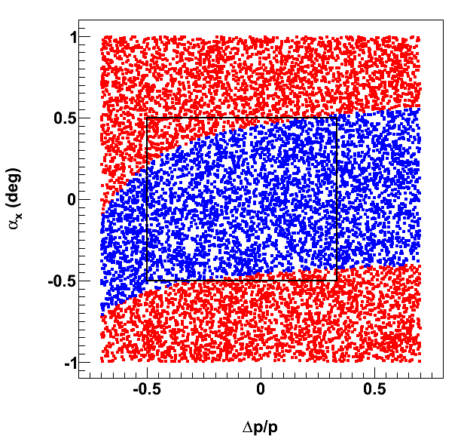
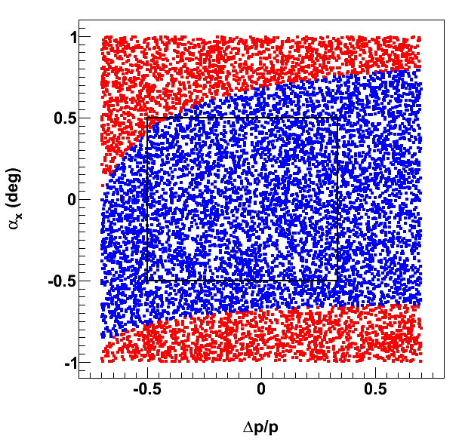
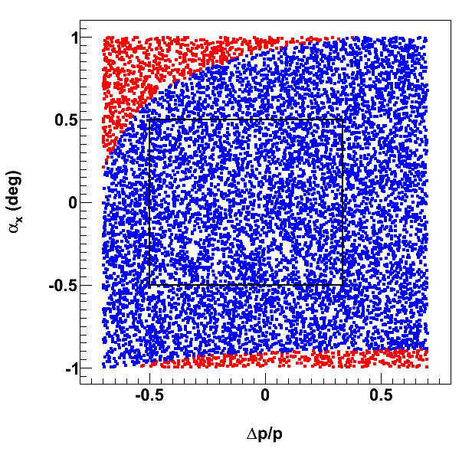
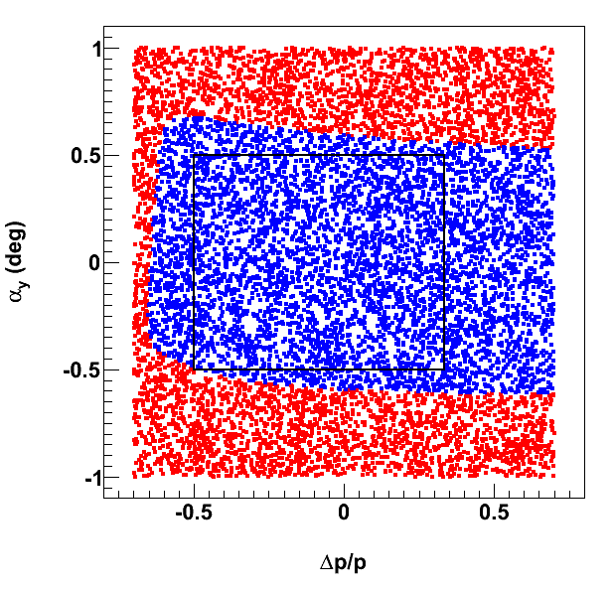
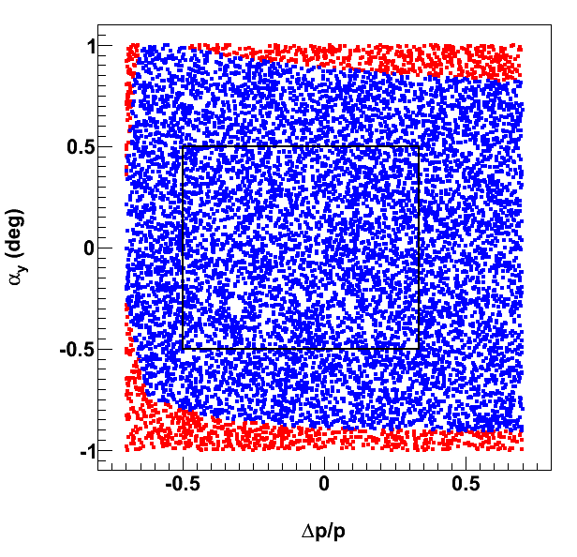
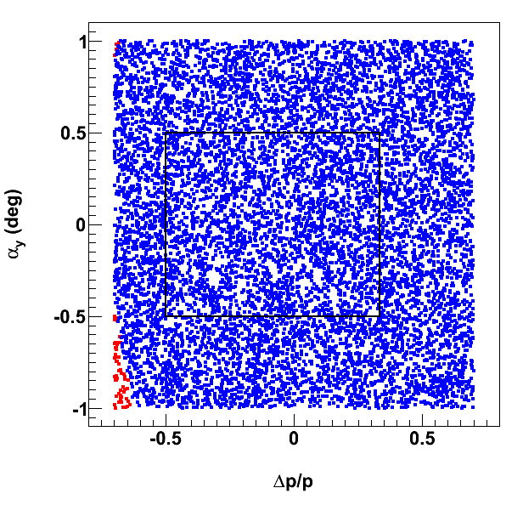
Downstream Ion FFB Acceptance for Protons
Quad apertures = B max / (field gradient @ 100 GeV/c)
6 T max
9 T max
12 T max
← electron beam

Slide 14
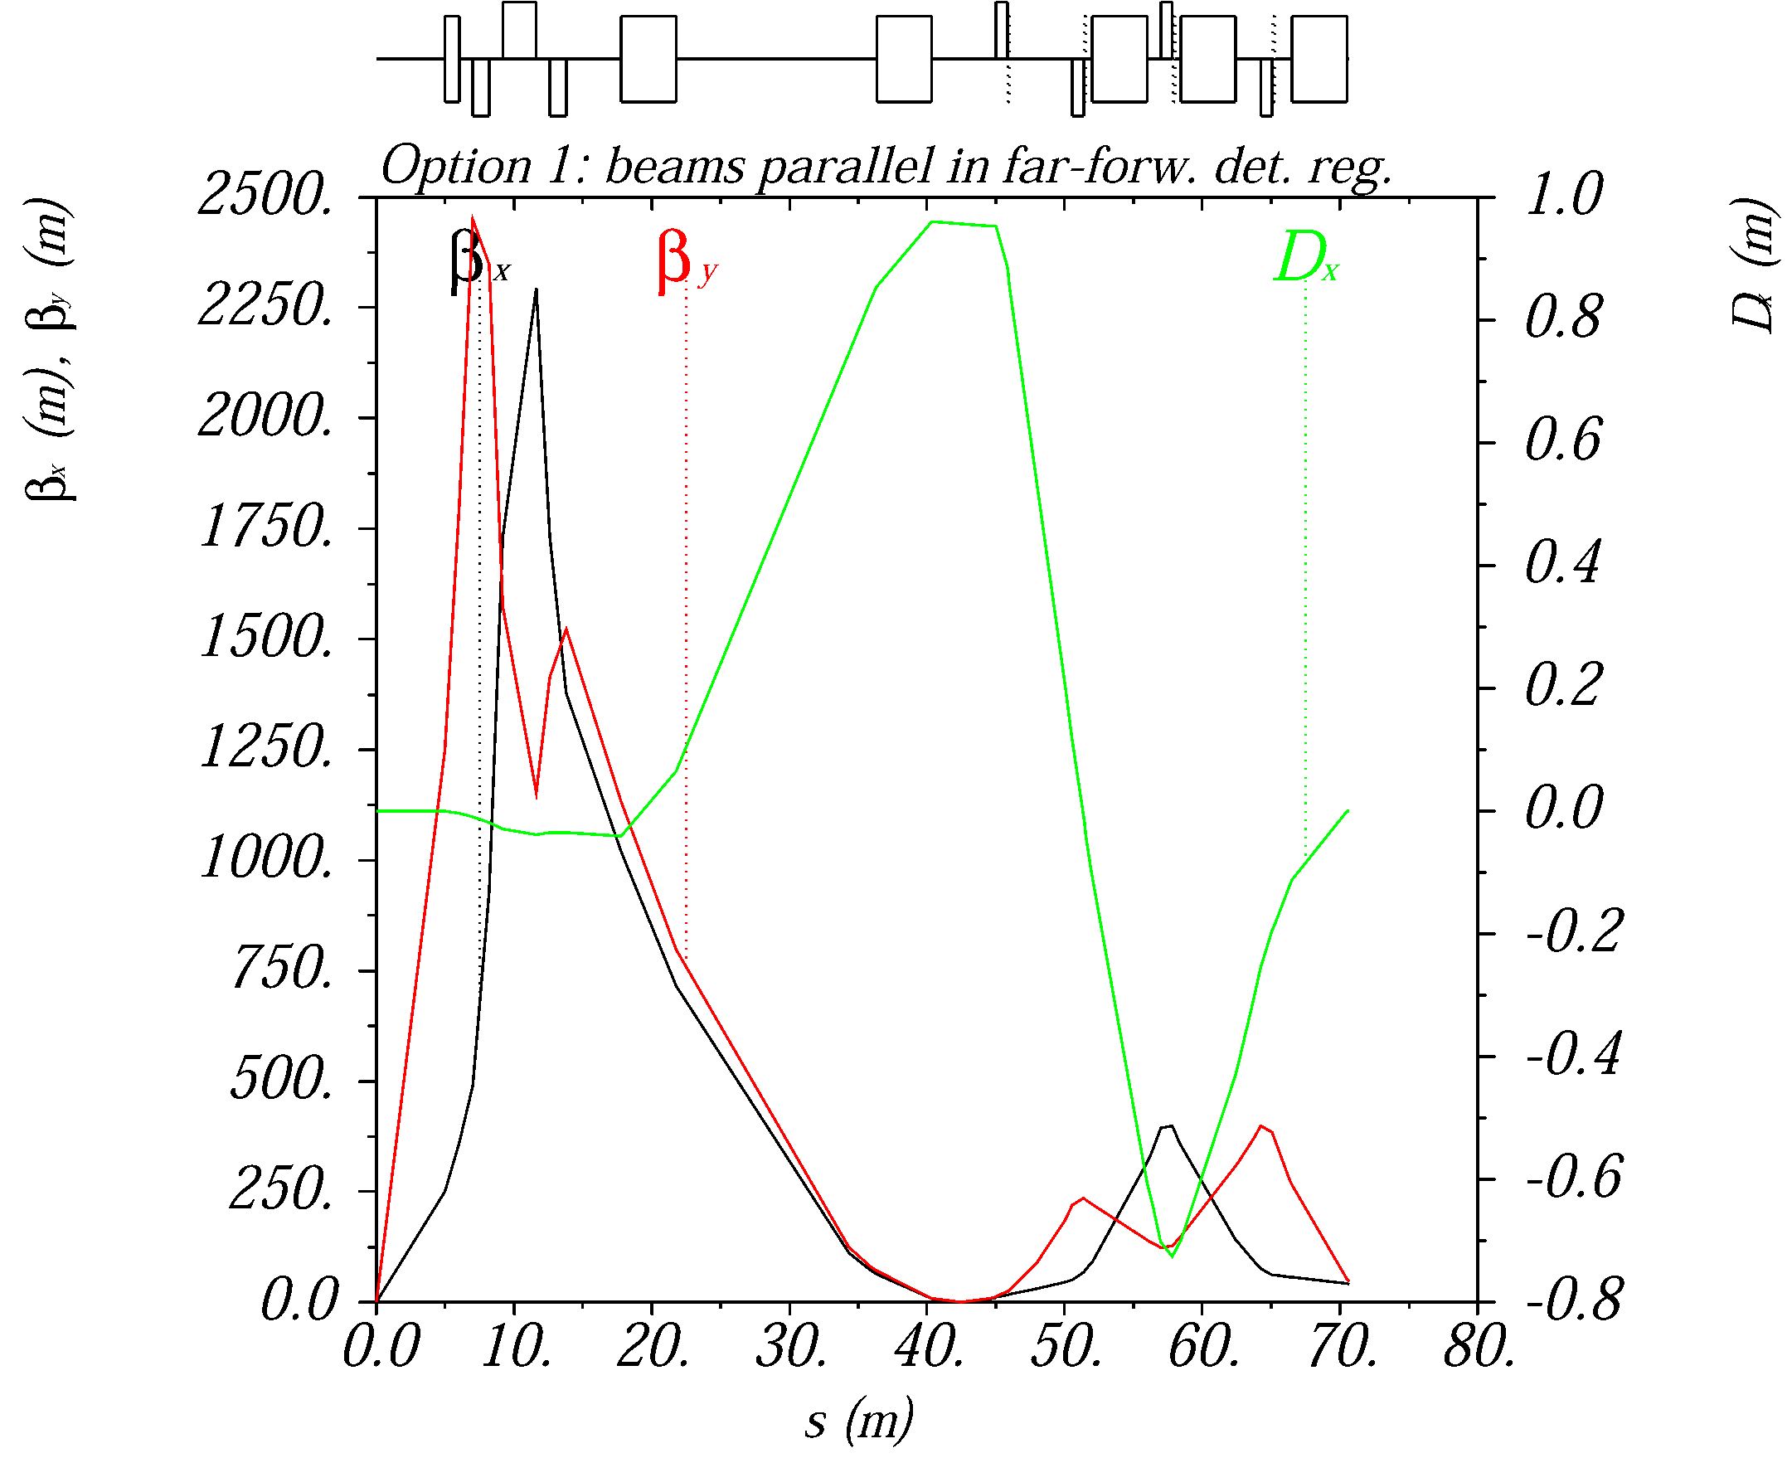
Ion optics for near-beam detection
Extended detector: 80+ m
A large dispersion at the detection point separates scattered (off-momentum) particles from the beam.
A second focus and small emittance (cooling) allows moving detectors closer to the beam
2nd focus on
Roman pots

Slide 15
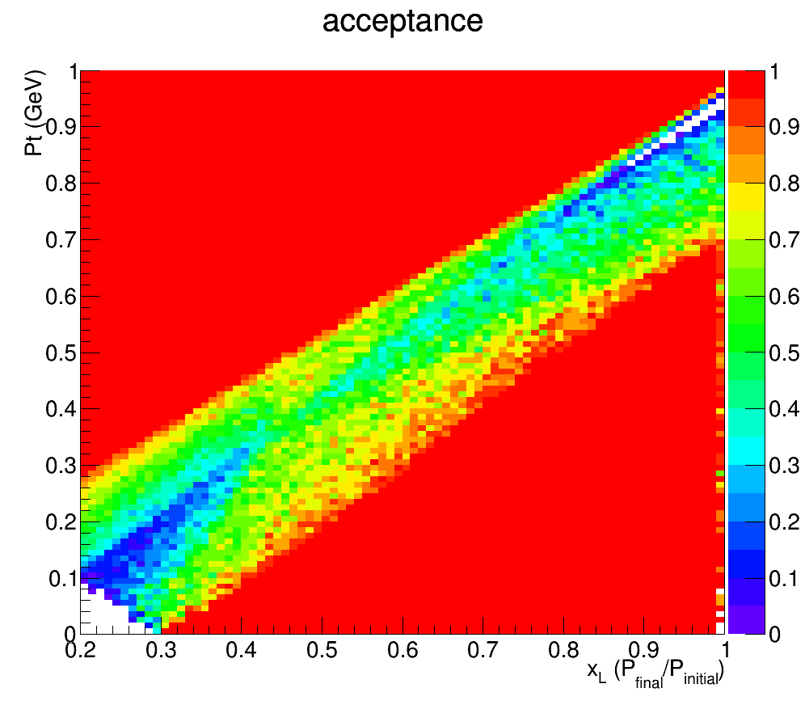
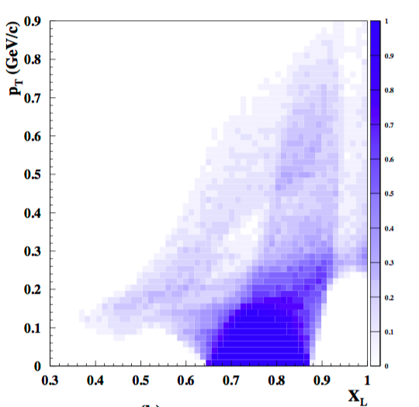
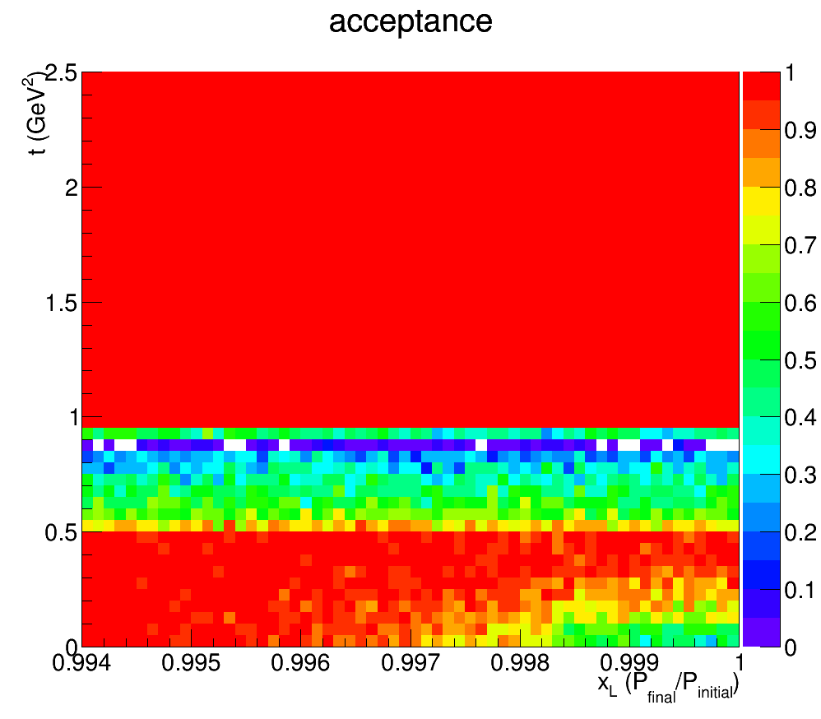
Acceptance for p’ in DDIS
JLEIC
ZEUS
Leading Proton Spectrometer
P_{t}
1
(GeV)
Region 1
Region 2 (Hi. Res)
0
0.2
1
X_{L}
t
2.5
(GeV²)
Acceptance in diffractive peak (X_{L}>~.98)
ZEUS: ~2%
JLEIC: ~100%
0.994
1
X_{L}

Slide 16
eRHIC Forward Hadron Detector Concept
Richard Petti Spin 2016

Slide 17
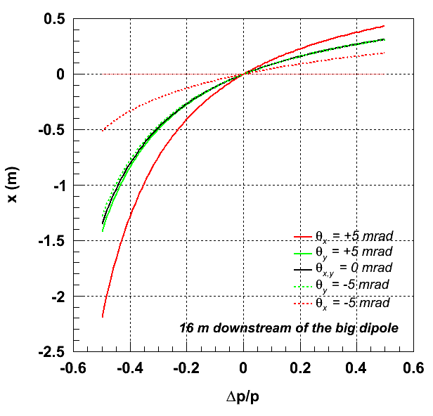
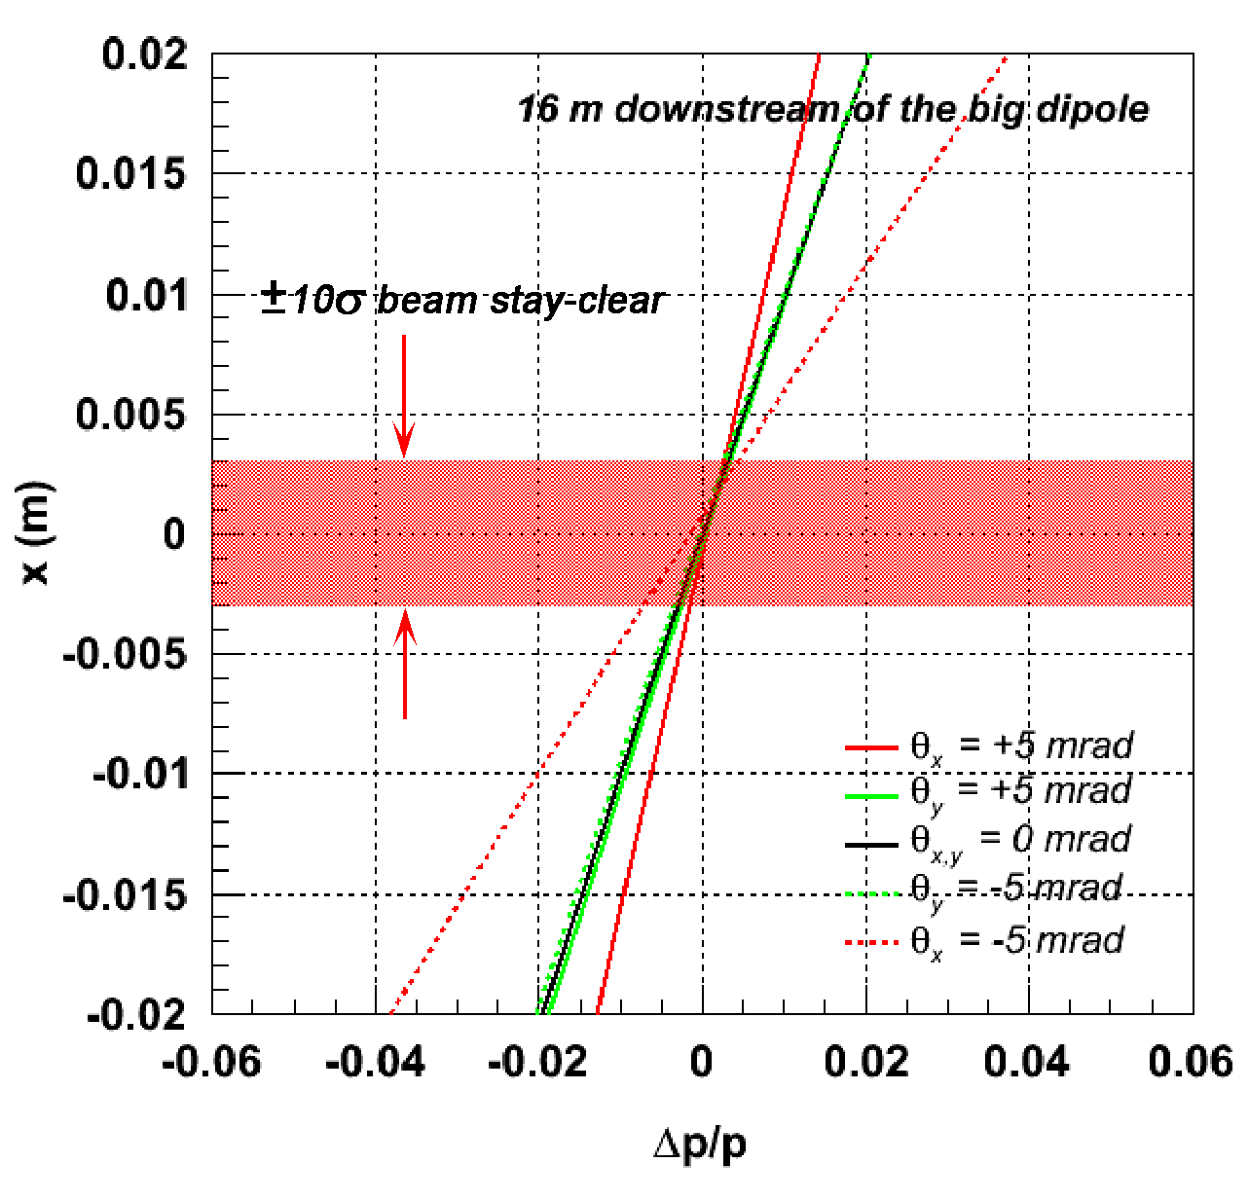
Forward Ion Momentum & Angle Resolution
Protons with Δp/p spread launched at different angles to nominal trajectory
|Δp/p| > 0.005 @ θ_{x,y} = 0
±10σ @ 60 GeV/c
← electron beam
For ZEUS LPS: resolution in X_{L} was about 0.5% and Pt resolution was 5 MeV

Slide 18
How efficiently can we do this? Kijun’s talk?

Slide 19
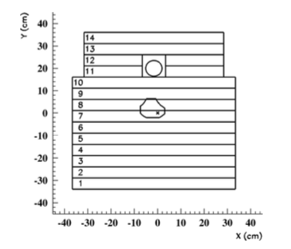
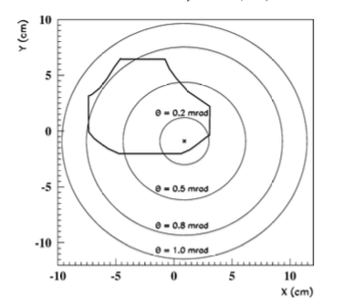
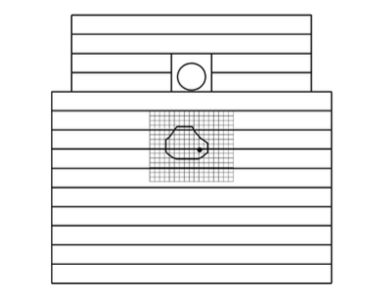
ZEUS Forward Neutron Calorimeter
Lead-Scintillator (compensating) calorimeter
7 interaction-length
Had resolution of 65%/√E
“Forward Neutron Tracker” was installed later
(Width ~1.5 cm)
500 GeV Neutron → 3% Energy Resolution

Slide 20
EIC Zero Degree Calorimeter
E_{EIC} = E_{HERA}/10, so now neutrons are ~50 GeV
65%/√E →9% resolution
ZEUS Uranium-Scintillator Calorimeter was 35%/√E so 5% resolution.
Is this good enough? Do we need something better? What is the position
resolution we need?
What about Λ -> n pi ? 36% br. Is it possible? Better acceptance than p pi?
Can we reconstruct this?

Slide 21
Some Thoughts
Experimentally, measurements of K, pi structure over high and medium x looks feasible.
Detailed studies of acceptance and resolutions are needed.
Looks like we need a pretty good neutron calorimeter to do the job.
Next step would be a more rigorous feasibility study.
Notes:
Interior Page Design 1

