Slide 1

The complete Hitchhiker’s Guide to unpolarized
Parton Distribution Functions
Pavel Nadolsky
Southern Methodist University
CTEQ-TEA collaboration
Argonne National Laboratory
Experience from studying nucleon PDFs,
Possibly applicable to pion and kaon PDFs

Slide 2

CTEQ-TEA (Tung et al.) working group
CTEQ-TEA (Tung et al.) working group
Shanghai Jiao Tong University: J. Gao
University of Manchester/Kennesaw State: M. Guzzi
Michigan State University: J. Huston, J. Pumplin,
D. Stump, C. Schmidt, J. Winter, C.-P. Yuan
Southern Methodist University: T.-J. Hou,
P. Nadolsky, B. T. Wang, K. P. Xie
Xinjiang University: S. Dulat

Slide 3
Global analysis of PDFs is a vast research subject
Theory
Precision PDFs, specialized PDFs
Statistics
Hessian, Monte-Carlo techniques, neural networks, reweighting, meta-PDFs…
Experi-ment
New collider and fixed-target measurements
“All you really need to know
for the moment is that the [PDF –P.N.] universe is a lot more complicated than you might think, even if you start from a position of thinking it’s pretty damn complicated in the first place.”

Slide 4
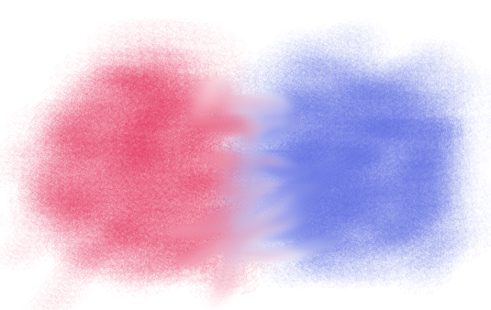

Today’s situation in the unpolarized PDF analysis is reminiscent of early 1990’s
C
H
A
O
S
Beautiful
precise
new
calculations
(NNLO in $α_{s}$)
Beautiful
precise
new
measurements
An interesting spot
to be
Inaccurate Reality?
Definitive Guide?

Slide 5
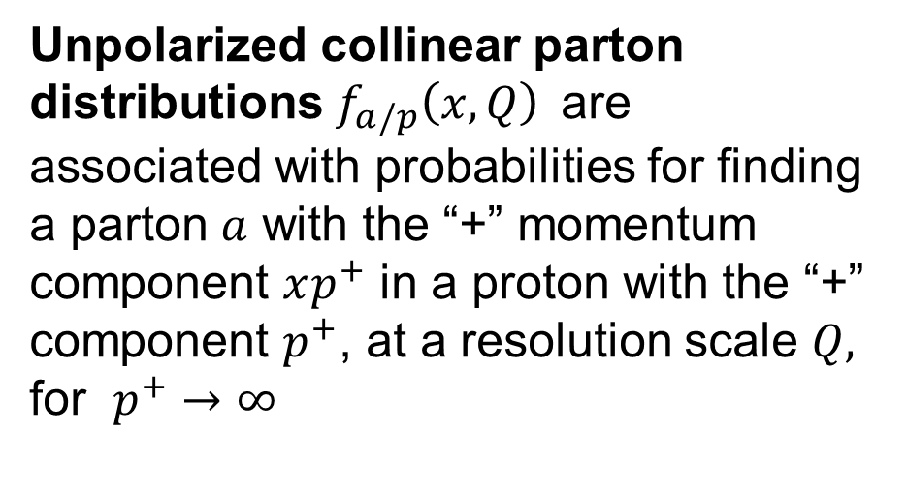
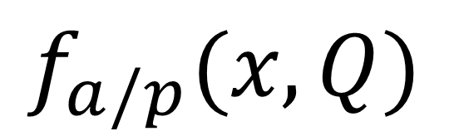
$$f_{a/p}(x,Q)$$
Unpolarized collinear parton distributions $f_{a/p}\left(x,Q\right)$are associated with probabilities for finding a parton $a$ with the “+” momentum component $xp^{+}$ in a proton with the “+” component $p^{+}$, at a resolution scale $Q,$ for $p^{+}→∞$

Slide 6
High-energy hadronic cross sections in QCD
confinement
asymptotic
freedom
factorization
scale
invariance
universality
Long distances
Short distances

Slide 7
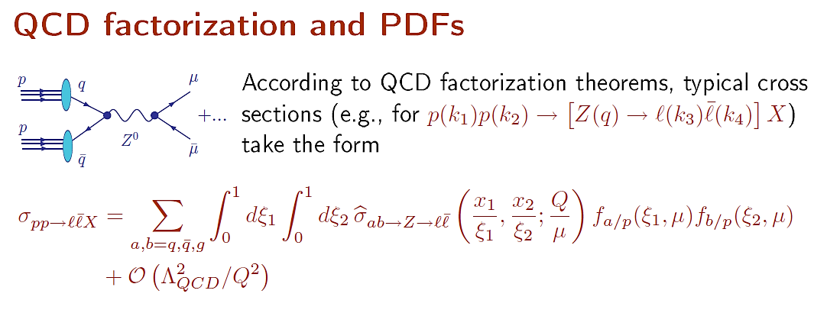
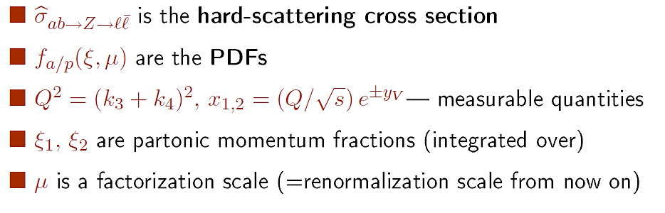

Slide 8
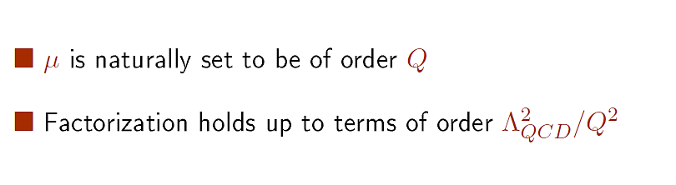

Slide 9
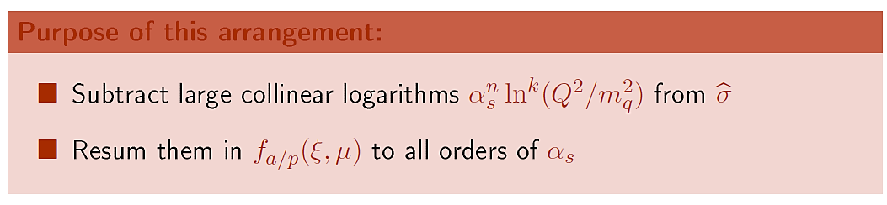

Slide 10
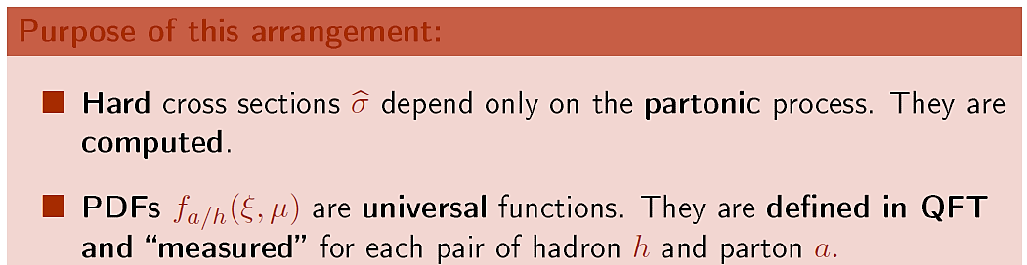

Slide 12
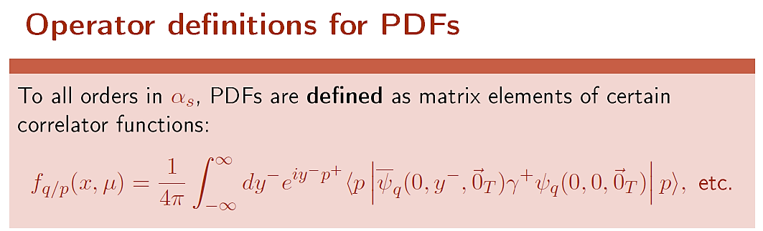
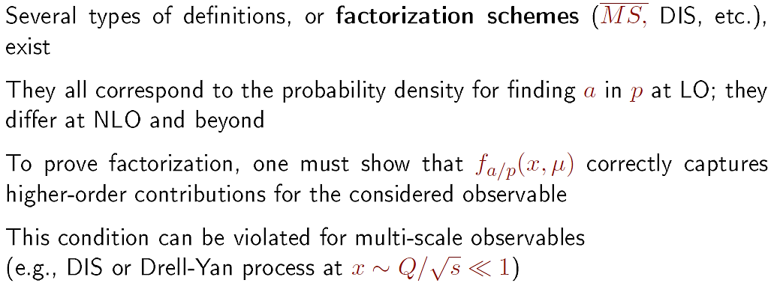

Slide 13
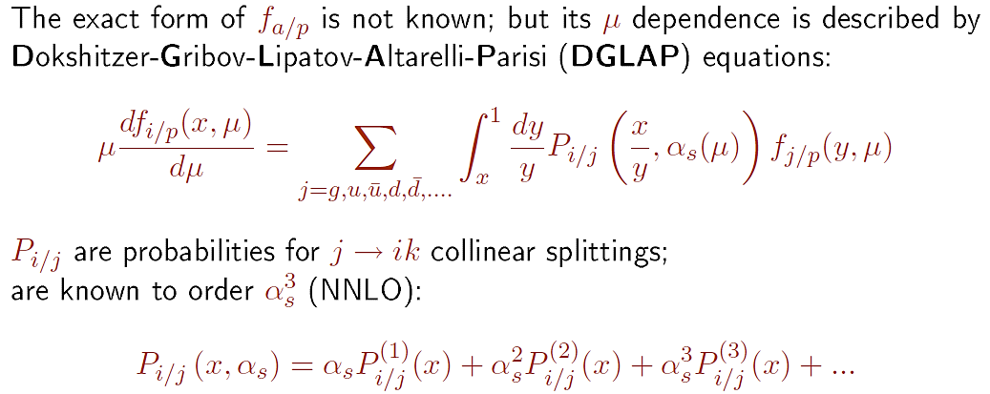

Slide 14
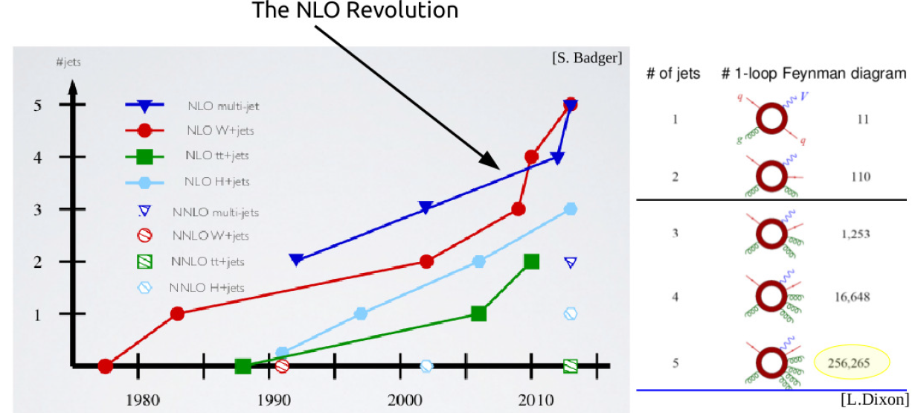
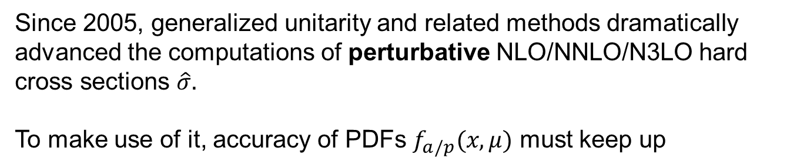
Perturbative QCD loop revolution
Since 2005, generalized unitarity and related methods dramatically advanced the computations of perturbative NLO/NNLO/N3LO hard cross sections $\hat{σ}.$
To make use of it, accuracy of PDFs $f_{a/p}(x,μ)$ must keep up

Slide 15
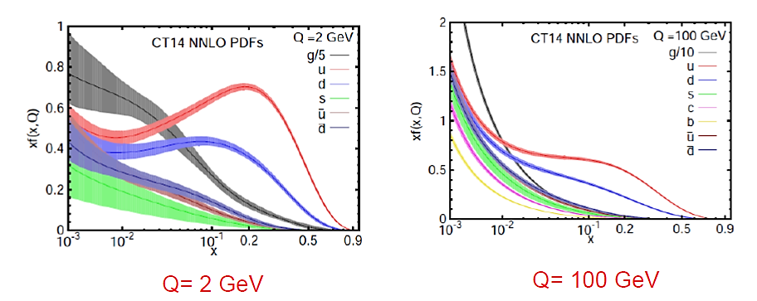
General-purpose CT14 PDFs (S. Dulat et al., arXiv:1506.07443)
Phenomenological parametrizations of PDFs are provided with estimated uncertainties of multiple origins (uncertainties of measurement, theoretical model, parametrization form, statistical analysis, …)
The shape of PDFs is optimized w.r.t. hundreds of nuisance parameters

Slide 16
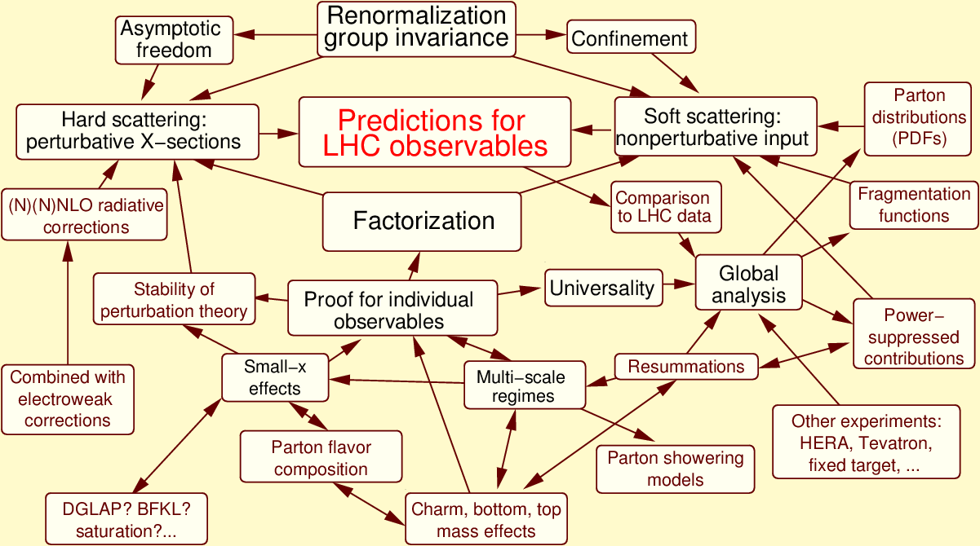
Concepts of perturbative QCD at the LHC
At the (N)NNLO accuracy level, multiple aspects affect the PDF behavior

Slide 17
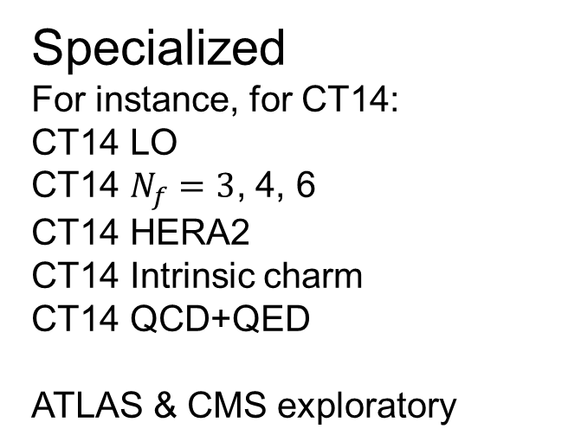
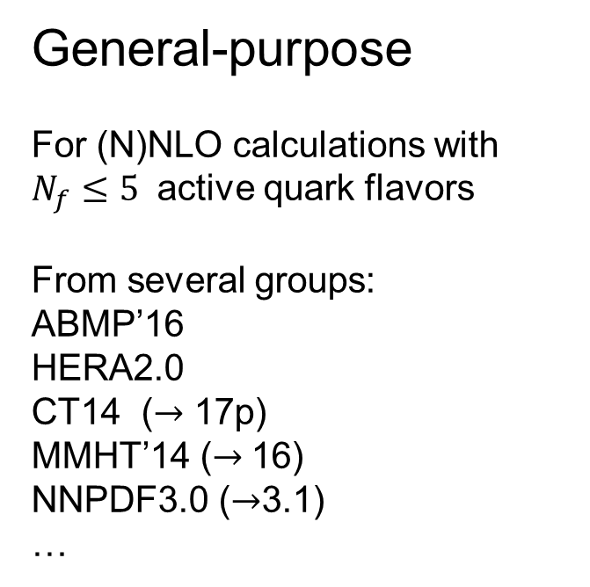
Classes of PDFs
General-purpose
For (N)NLO calculations with $N_{f}≤5$ active quark flavors
From several groups:
ABMP’16
HERA2.0
CT14 ($→$ 17p)
MMHT’14 ($→$16)
NNPDF3.0 ($→$3.1)
…
Specialized
For instance, for CT14:
CT14 LO
CT14 $N_{f}=3$, 4, 6
CT14 HERA2
CT14 Intrinsic charm
CT14 QCD+QED
ATLAS & CMS exploratory
Combined
PDF4LHC’15=CT14+MMHT’14+NNPDF3.0

Slide 18
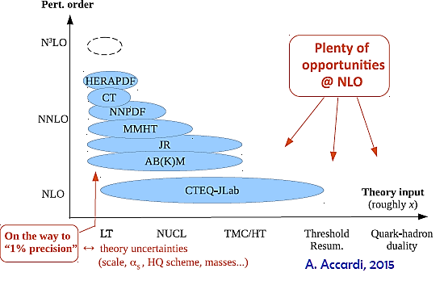

Slide 19
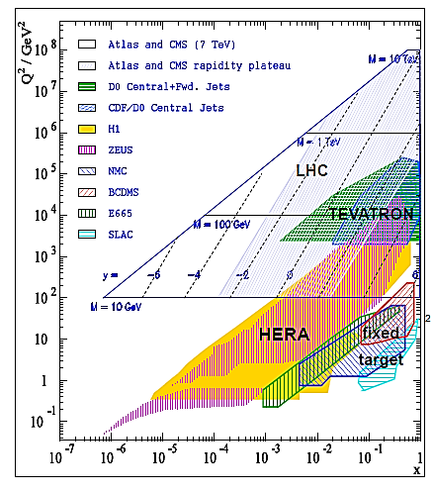
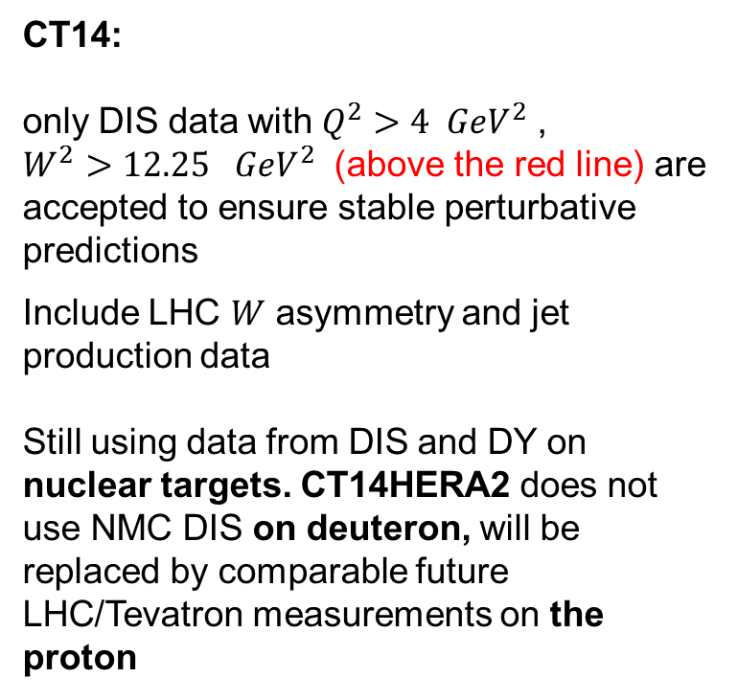
Map of experiments as a function of $x$ and $Q$
For nucleon PDFs, experimental measurements are selected so as to reduce dependence on theoretical input beyond the leading power in perturbative QCD
CT14:
only DIS data with $Q^{2}>4 GeV^{2}$, $W^{2}>12.25 GeV^{2}$ (above the red line) are accepted to ensure stable perturbative predictions
Include LHC $W$ asymmetry and jet production data
Still using data from DIS and DY on nuclear targets. CT14HERA2 does not use NMC DIS on deuteron, will be replaced by comparable future LHC/Tevatron measurements on the proton
+

Slide 20
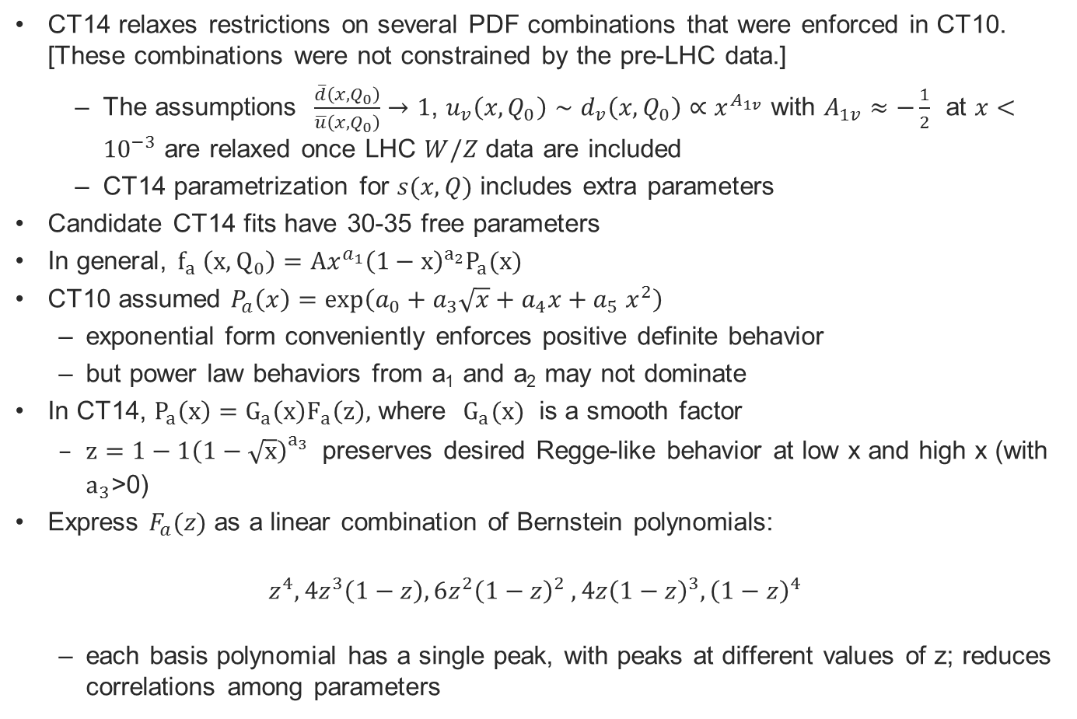
CT14: parametrization forms
CT14 relaxes restrictions on several PDF combinations that were enforced in CT10. [These combinations were not constrained by the pre-LHC data.]
  The assumptions $\frac{\overline{d}\left(x,Q_{0}\right)}{\overline{u}\left(x,Q_{0}\right)}→1$, $u_{v}\left(x,Q_{0}\right)∼d_{v}\left(x,Q_{0}\right)∝x^{A_{1v}}$ with $A_{1v}≈−\frac{1}{2}$ at $x<{10}^{−3}$ are relaxed once LHC $W/Z$ data are included
  CT14 parametrization for $s(x,Q)$ includes extra parameters
Candidate CT14 fits have 30-35 free parameters
In general, $f_{a} \left(x,Q_{0}\right)=Ax^{a_{1}}{\left(1−x\right)}^{a_{2}}P_{a}(x)$
CT10 assumed $P_{a}\left(x\right)=\exp\left(a_{0}+a_{3}\sqrt{x}+a_{4}x+a_{5} x^{2}\right)$
  exponential form conveniently enforces positive definite behavior
  but power law behaviors from a₁ and a₂ may not dominate
In CT14, $P_{a}\left(x\right)=G_{a}\left(x\right)F_{a}\left(z\right),$ where $G_{a}(x)$ is a smooth factor
  $z=1−1{\left(1−\sqrt{x}\right)}_{}^{a_{3}}$ preserves desired Regge-like behavior at low x and high x (with $a_{3}$>0)
Express $F_{a}(z)$ as a linear combination of Bernstein polynomials:
$$z^{4}, 4z^{3}\left(1−z\right), 6z^{2}{\left(1−z\right)}^{2} ,4z{\left(1−z\right)}^{3},{\left(1−z\right)}^{4}$$
  each basis polynomial has a single peak, with peaks at different values of z; reduces correlations among parameters

Slide 21

(N+1)-dim. perspective eliminates wrong N-dim. solutions
It makes reality slightly less inaccurate

Slide 22
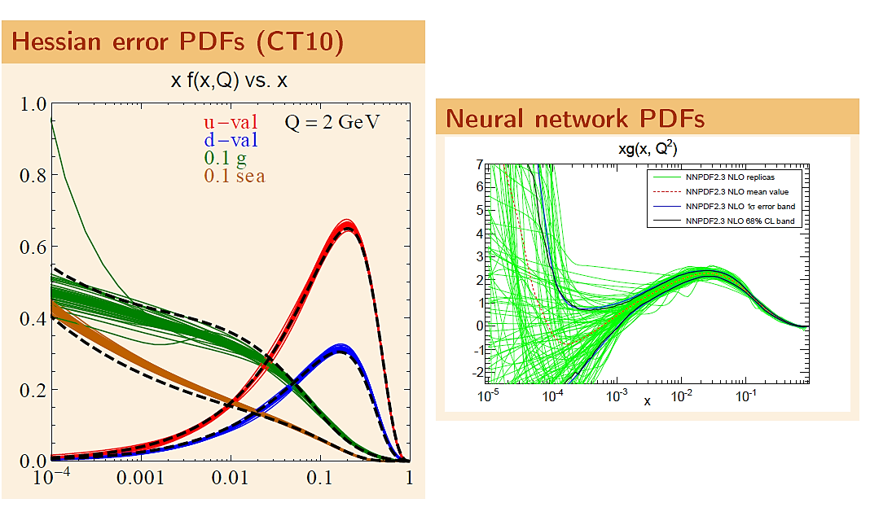

Slide 23
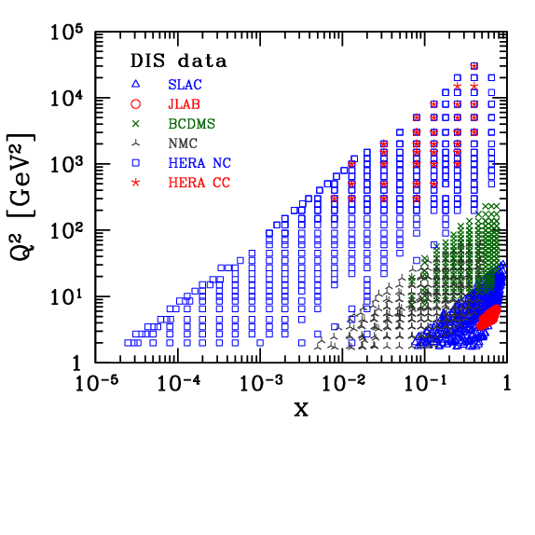
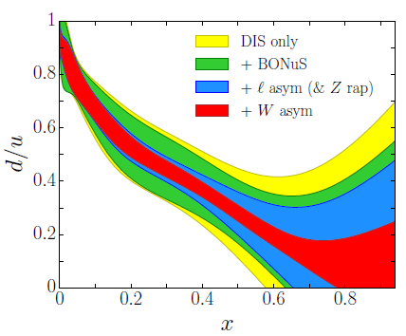
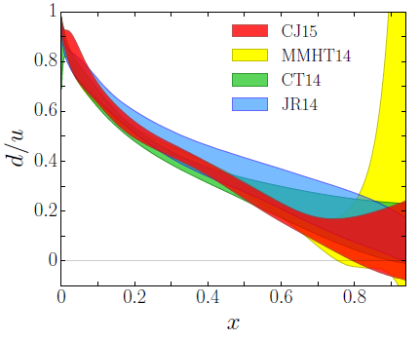
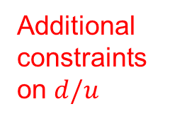
CJ15: DIS data for $Q^{2}>1.3 GeV^{2}$, $W^{2}>3 GeV^{2}$
Additional constraints on $d/u$

Slide 24
Flavor composition of PDFs

Slide 25
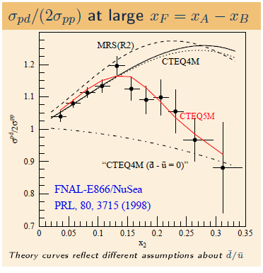

SU(2) and charge symmetry breaking
$\overline{d}\left(x\right)≠\overline{u}\left(x\right),$ $q(x)≠\overline{q}(x)$
May be caused by
DGLAP evolution
Fermi motion
Electromagnetic effects
Nonperturbative meson fluctuations
Chiral symmetry breaking
Instantons
…

Slide 26




Extrinsic and intrinsic sea PDFs
($\overline{q}=\overline{u},\overline{d}, \overline{s},\overline{c}, \overline{b})$
“Extrinsic” sea
(maps on disconnected diagrams of lattice QCD for both
heavy and light flavors?)
“Intrinsic” sea (excited Fock
nonpert. states, maps on connected
diagrams of lattice QCD?)
$$\overline{q}$$
$$\overline{q}(x)$$
p
Extrinsic
Total
Intrinsic
p
x
0.1
$$\overline{q}$$

Slide 27
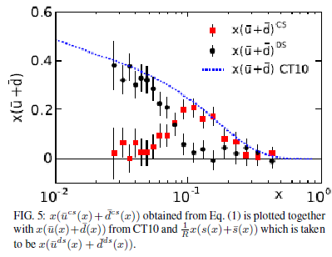
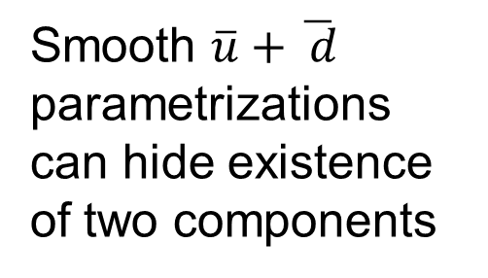
Extrinsic and intrinsic sea PDFs
Smooth $\overline{u}+\overline{ d}$ parametrizations can hide existence of two components
Liu, Chang, Cheng, Peng, 1206.4339

Slide 28
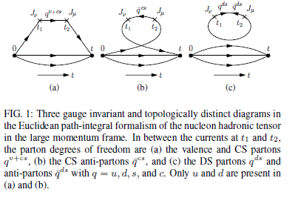
(Dis)connected topologies in lattice QCD
Liu, Chang, Cheng, Peng, 1206.4339

Slide 29
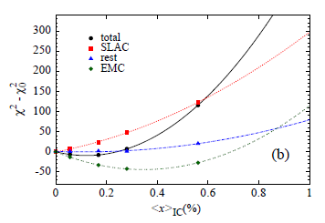
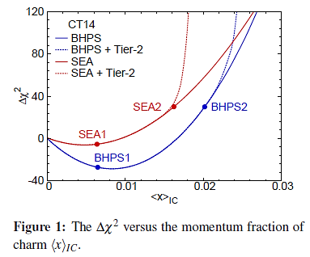
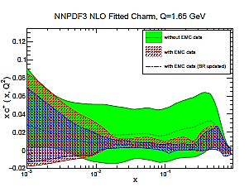
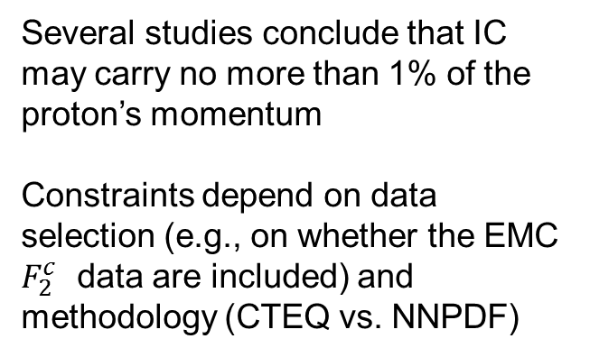
PDFs with fitted charm or intrinsic charm (IC)
Several studies conclude that IC may carry no more than 1% of the proton’s momentum
Constraints depend on data selection (e.g., on whether the EMC $F_{2}^{c}$ data are included) and methodology (CTEQ vs. NNPDF)
NLO
Jimenez-Delgado et al.,
1408.1708
NNLO
NLO
arXiv:1605.06515
PoS DIS2015 (2015) 166

Slide 30


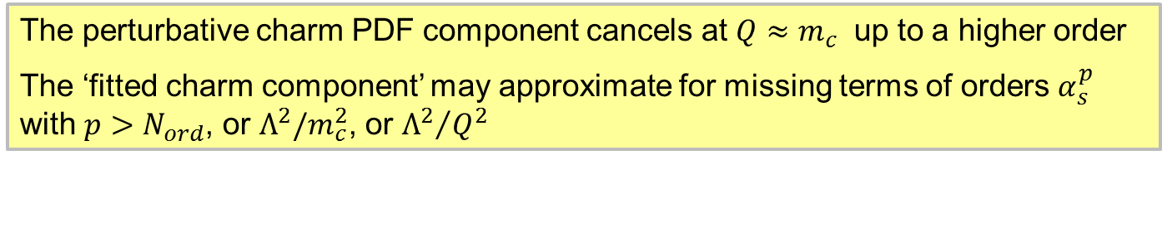


PDF fits may include a ``fitted charm’’ PDF
``Fitted charm’’ = ``nonperturbative charm’’
+ other (possibly not universal)
higher O($α_{s}$) / higher power terms
QCD factorization theorem for DIS structure function $F(x,Q)$ [Collins, 1998]:
All $α_{s}$orders:
The PDF fits implement this formula up to (N)NLO ($N_{ord}=1$ or 2):
PDF fits:
The perturbative charm PDF component cancels at $Q≈m_{c}$ up to a higher order
The ‘fitted charm component’ may approximate for missing terms of orders $α_{s}^{p}$ with $p>N_{ord}$, or $Λ^{2}/m_{c}^{2}$, or ${Λ^{2}}/{Q^{2}}$

Slide 31
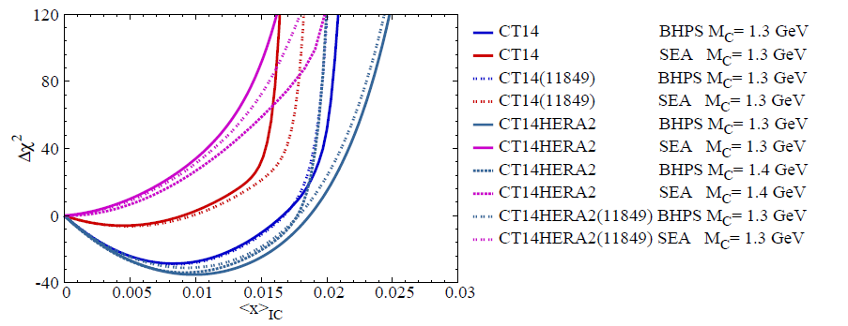
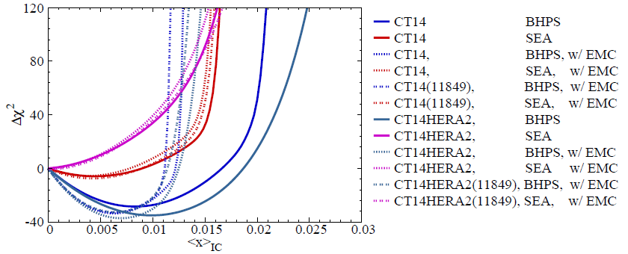


In-depth study of CT14 IC fits (T.-J. Hou)
11849: $Q_{0}=1$GeV, MMHT-like $g(x,Q_{0})$
For the Brodsky-Hoyer-Peterson-Sakai (BHPS) parametrization,
a marginally better $χ^{2}$ for IC with ${〈x〉}_{IC}≈1\%$
For SEA parametrization, IC with ${〈x〉}_{IC}≈1.5\%$ is allowed within uncertainty

Slide 32
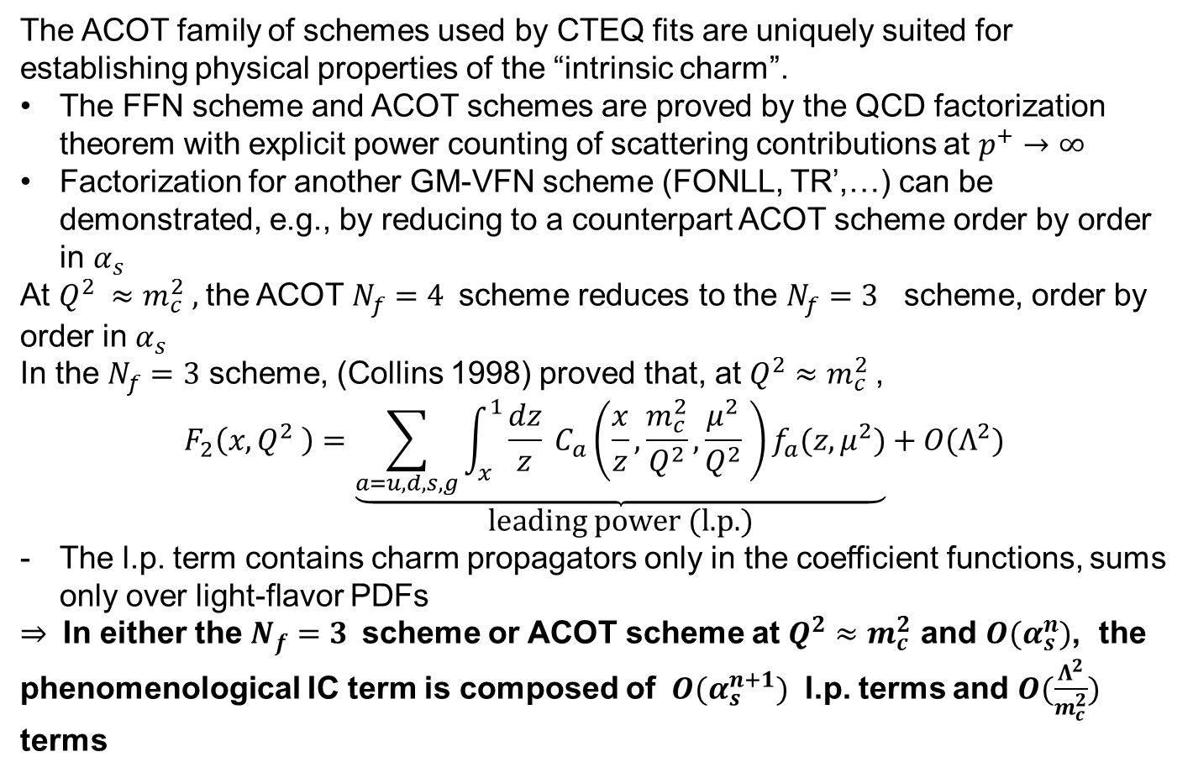
What is intrinsic charm, according to QCD theory?
The ACOT family of schemes used by CTEQ fits are uniquely suited for establishing physical properties of the “intrinsic charm”.
The FFN scheme and ACOT schemes are proved by the QCD factorization theorem with explicit power counting of scattering contributions at $p^{+}→∞$
Factorization for another GM-VFN scheme (FONLL, TR’,…) can be demonstrated, e.g., by reducing to a counterpart ACOT scheme order by order in $α_{s}$
At $Q^{2} ≈m_{c}^{2} ,$the ACOT $N_{f}=4$scheme reduces to the $N_{f}=3$ scheme, order by order in $α_{s}$
In the $N_{f}=3$ scheme, (Collins 1998) proved that, at $Q^{2}≈m_{c}^{2}$,
$$F_{2}\left(x,Q^{2} \right)=\underset{\text{leading} \text{power}\text{ (}\text{l}\text{.}\text{p}\text{.)}}{\underbrace{\sum_{a=u,d,s,g}{\int_{x}^{1}{\frac{dz}{z} C_{a}\left(\frac{x}{z},\frac{m_{c}^{2}}{Q^{2}},\frac{μ^{2}}{Q^{2}} \right)f_{a}(z,μ^{2})}}}}+O(Λ^{2})$$
The l.p. term contains charm propagators only in the coefficient functions, sums only over light-flavor PDFs
$⇒$ In either the $N_{f}=3$scheme or ACOT scheme at $Q^{2}≈m_{c}^{2}$ and $O(α_{s}^{n})$, the phenomenological IC term is composed of $O(α_{s}^{n+1})$ l.p. terms and $O(\frac{Λ^{2}}{m_{c}^{2}})$ terms

Slide 33
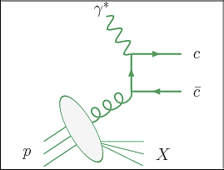
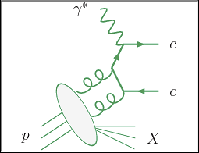
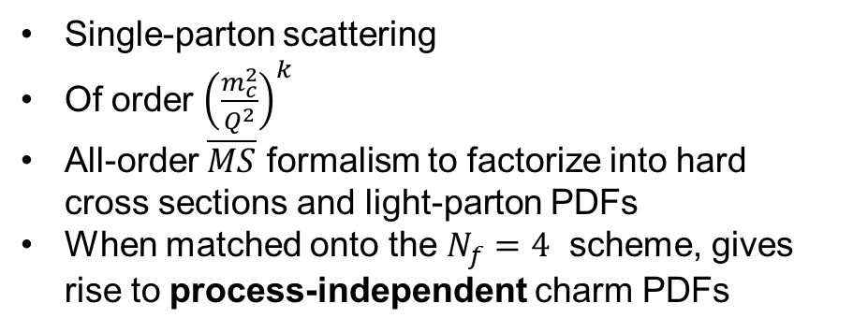
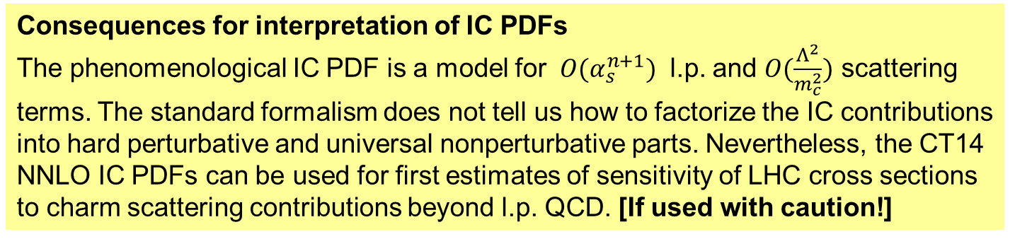
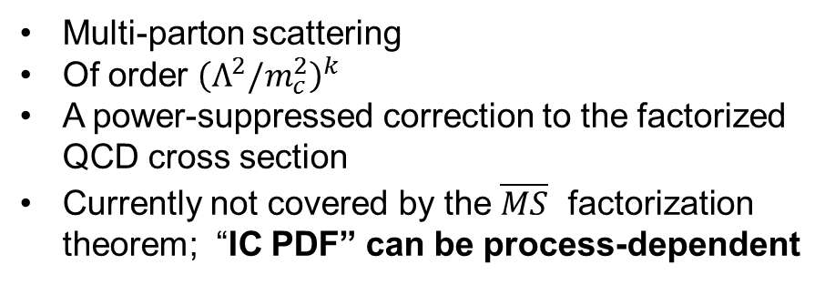
Charm scattering contributions at $Q^{2}≈m_{c}^{2}$, sample diagrams
Leading-power charm
Single-parton scattering
Of order ${\left(\frac{m_{c}^{2}}{Q^{2}}\right)}^{k}$
All-order $\overline{MS}$ formalism to factorize into hard cross sections and light-parton PDFs
When matched onto the $N_{f}=4$ scheme, gives rise to process-independent charm PDFs
Fitted (intrinsic) charm
Multi-parton scattering
Of order ${\left(Λ^{2}/m_{c}^{2}\right)}^{k}$
A power-suppressed correction to the factorized QCD cross section
Currently not covered by the $\overline{MS}$ factorization theorem; “IC PDF” can be process-dependent
Consequences for interpretation of IC PDFs
The phenomenological IC PDF is a model for $O(α_{s}^{n+1})$ l.p. and $O(\frac{Λ^{2}}{m_{c}^{2}})$ scattering terms. The standard formalism does not tell us how to factorize the IC contributions into hard perturbative and universal nonperturbative parts. Nevertheless, the CT14 NNLO IC PDFs can be used for first estimates of sensitivity of LHC cross sections to charm scattering contributions beyond l.p. QCD. [If used with caution!]

Slide 34
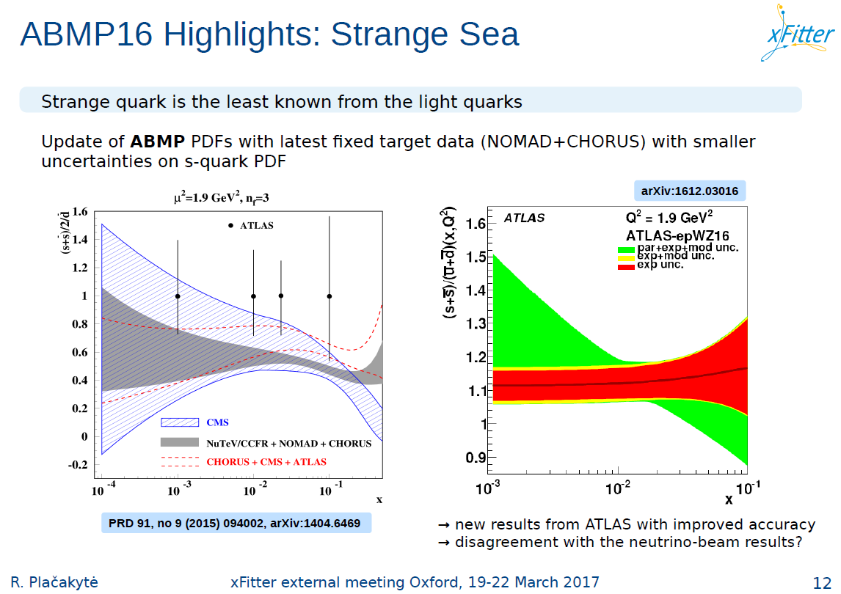

Slide 35
Frequently asked questions
What is the meaning (definition) of my PDF?
Do I measure what I claim to be measuring?
How large are higher-order contributions?
How should the PDF uncertainties be estimated?
How much am I biased by my parametrization of PDFs?
Are there hidden PDF uncertainties?
All these questions must be addressed when trying to measure the pion and kaon PDFs

