Slide 1
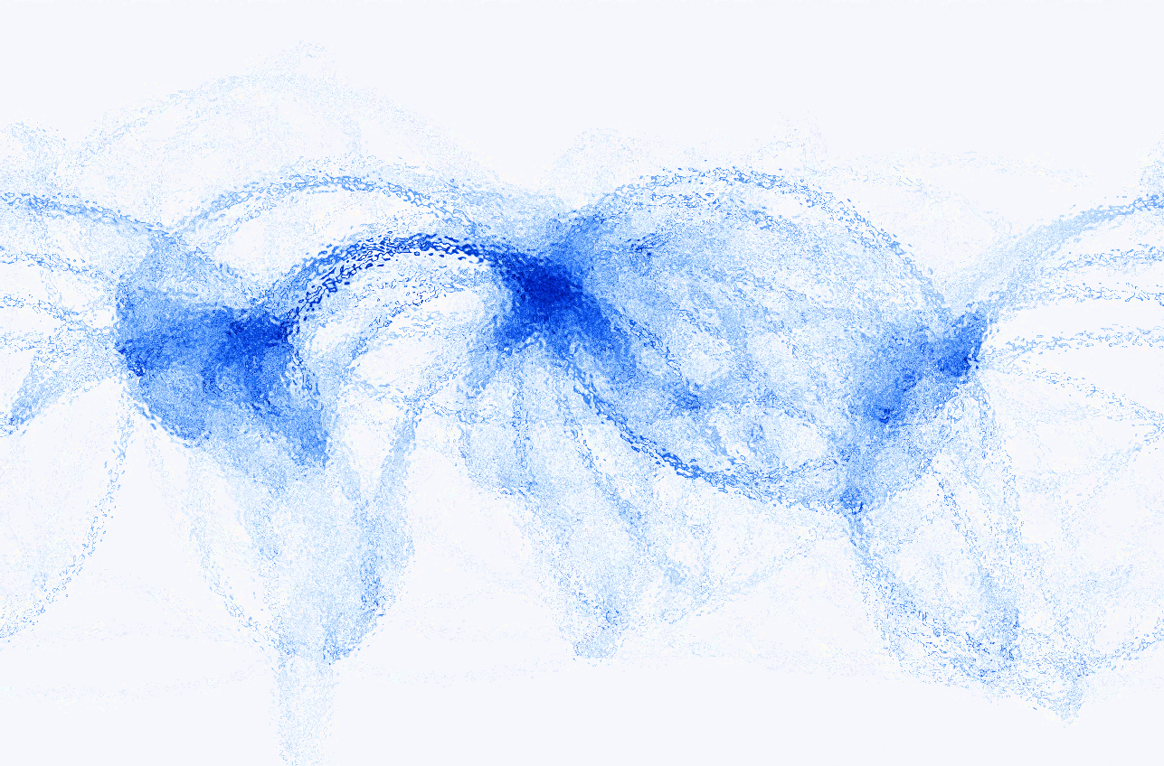
Our-of-equilibrium Spin systems with a Quantum Simulator
Jiehang Zhang
NPQI workshop, Mar. 30, 2018
Christopher Monroe group,
University of Maryland
JZ et al., Nature, 551, 601–604 (2017).

Slide 2
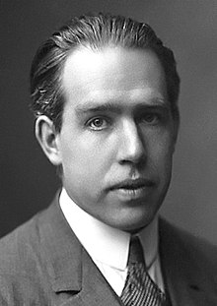
The exponential beast: two rules of quantum mechanics
Rule # 1:
The Hilbert space scales exponentially.
Rule #2:
Rule #1 only works when you’re not looking.
Niels Bohr:
“We are all agreed that your theory is crazy.” (1958)

Slide 3
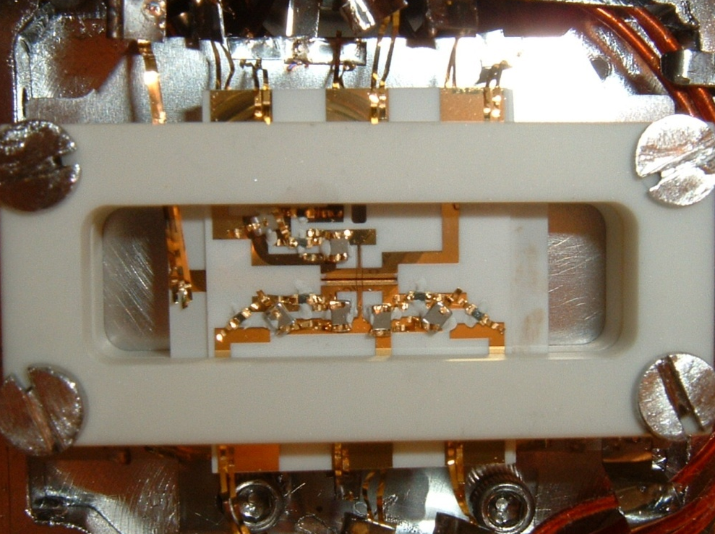
¹⁷¹Yb⁺ hyperfine clock qubits.
eg: AFM ordering of 14 spins
R. Islam, et al., Science 340, 583 (2013)
F=1
²P_{1/2}
F=0
369.5 nm
200μm
F=1
²S_{1/2}
|↑_{z}⟩
12.648231 GHz
F=0
|↓_{z}⟩
Notes:
Change the purple color. Near perfect detection, that’s all.

Slide 4
Effective Hamiltonian:
Global interactions and individual addressing
Transverse field Ising model
$$H_{eff}=\sum_{i<j}{J_{ij}σ_{i}^{x}}σ_{j}^{x}$$
$$+ B\sum_{i}{σ_{i}^{z}}$$
$$+\sum_{i}{D_{i}σ_{i}^{z}}$$
Long-range Ising interactions from spin-dependent dipole forces
$$J_{ij}≈\frac{J_{0}}{{|i−j|}^{α}}$$
$$\left(0<α<3\right)$$
$J_{0}$~ kHz
Transverse fields by asymmetric detuning of force
Individual local field via Stark shifts:
A. C. Lee, JZ, et al., Phys. Rev. A 94, 042308 (2016)
Notes:
Spin dependence force, transverse: naturally gives a antiferromagnetic interaction. Make it clear the laser hits the ion chain.

Slide 5
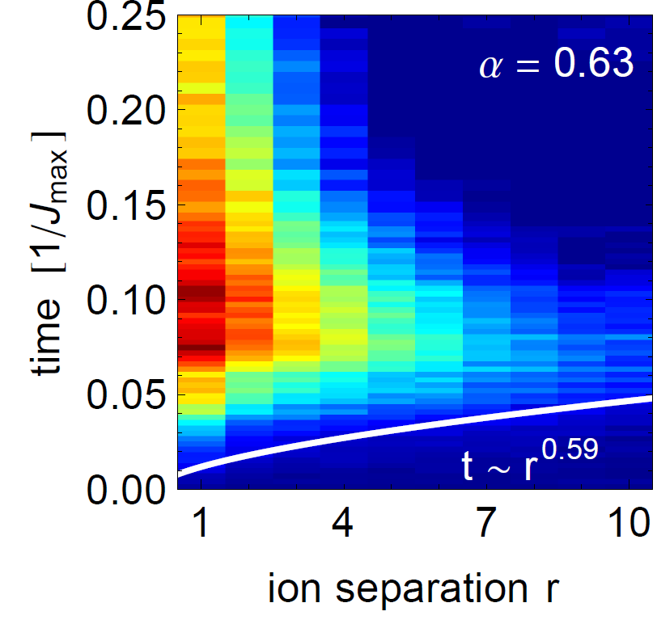
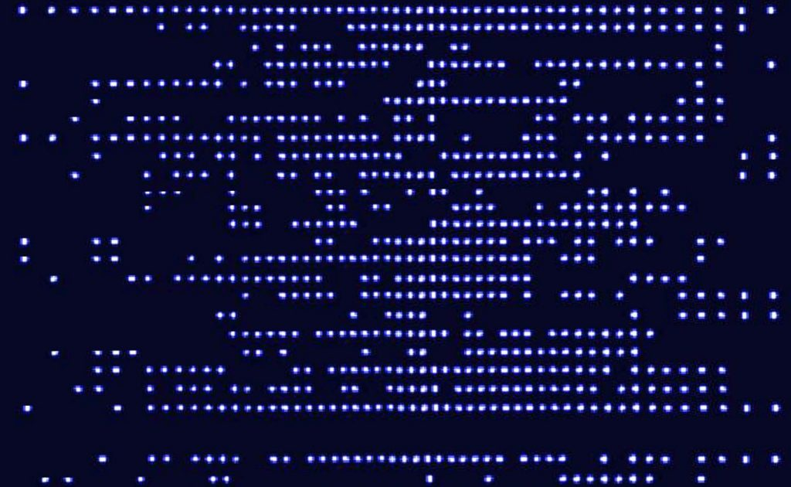
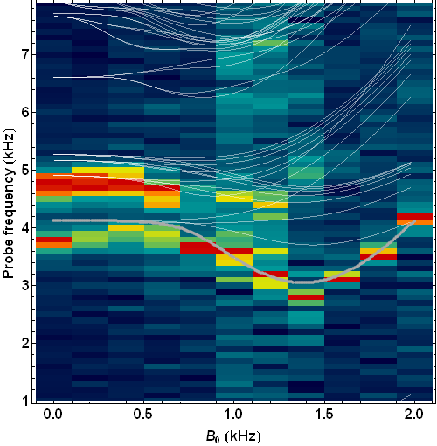
Equilibrium
Dynamical problems
Correlation propagation [1]
Lieb-Robinson bounds
Failures of quantum thermalization [2,3]
Localization and Prethermalization
Dynamical phase transition [4]
50+ qubit quantum simulator
Discrete time crystal [5]
A novel driven phase of matter
Adiabatic processes [1]
Frustrated ground states
Many-body spectroscopy [2]
Probing low-lying excited states
Spin-1 simulation [3]
Interacting “qutrits”
[1] P. Richerme, et al., Nature 511, 198–201 (2014).
[2] J. Smith, et al., Nat. Phys. 12, 907–911 (2016).
[3] B. Neyenhuis, JZ et al., Science Advances 3(8), e1700672 (2017).
[4] JZ, et al., Nature, 551, 601–604 (2017).
[5] JZ et al., Nature 543, 217–220 (2017).
[1] R. Islam, et al., Science 340, 583 (2013).
[2] C. Senko, et al., Science 345, 430 (2014).
[3] C. Senko, et al., PRX 5, 021026 (2015).

Slide 6
Equilibrium
Dynamical problems
Correlation propagation [1]
Lieb-Robinson bounds
Failures of quantum thermalization [2,3]
Localization and Prethermalization
Dynamical phase transition [4]
50+ qubit quantum simulator
Discrete time crystal [5]
A novel driven phase of matter
Adiabatic processes [1]
Frustrated ground states
Many-body spectroscopy [2]
Probing low-lying excited states
Spin-1 simulation [3]
Interacting “qutrits”
[1] P. Richerme, et al., Nature 511, 198–201 (2014).
[2] J. Smith, et al., Nat. Phys. 12, 907–911 (2016).
[3] B. Neyenhuis, JZ et al., Science Advances 3(8), e1700672 (2017).
[4] JZ, et al., Nature, 551, 601–604 (2017).
[5] JZ et al., Nature 543, 217–220 (2017).
[1] R. Islam, et al., Science 340, 583 (2013).
[2] C. Senko, et al., Science 345, 430 (2014).
[3] C. Senko, et al., PRX 5, 021026 (2015).

Slide 7
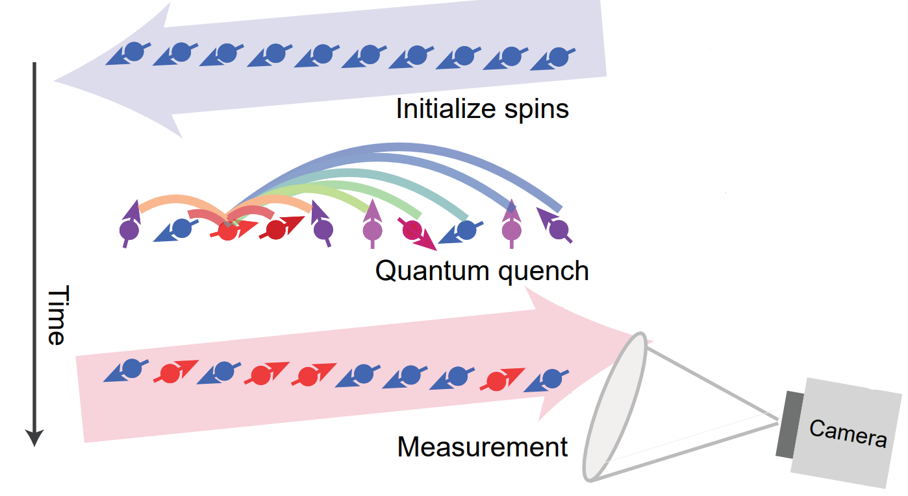
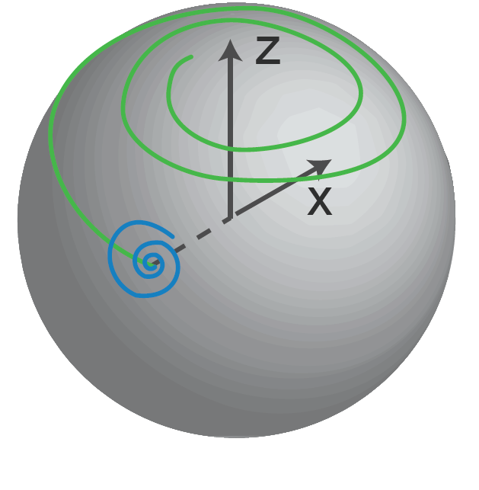
Dynamical phase transition
$$H=\sum_{i<j}{J_{ij}σ_{i}^{x}}σ_{j}^{x}+B\sum_{i}{σ_{i}^{z}}$$
JZ et al., Nature, 551, 601–604 (2017).

Slide 8
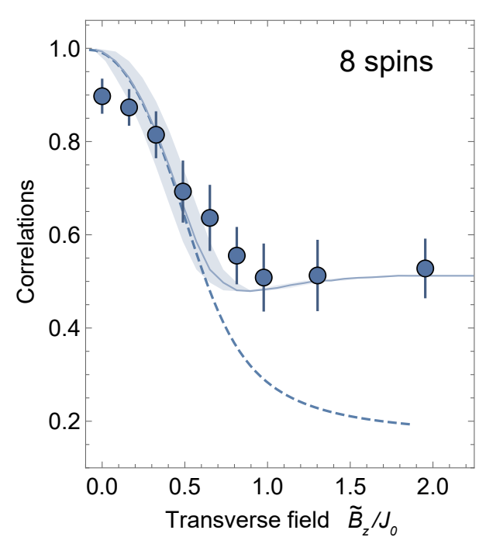
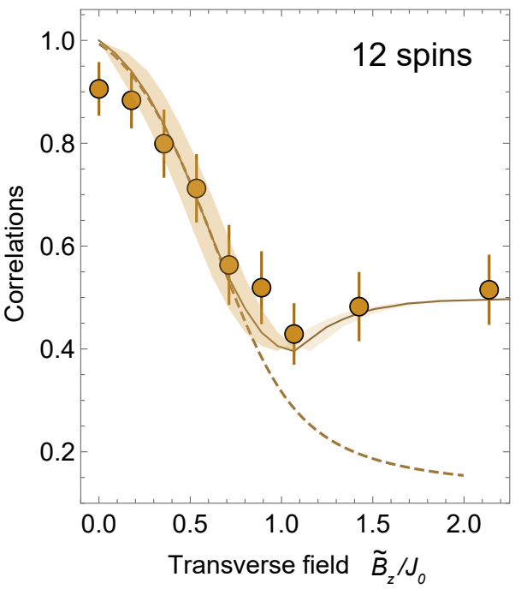
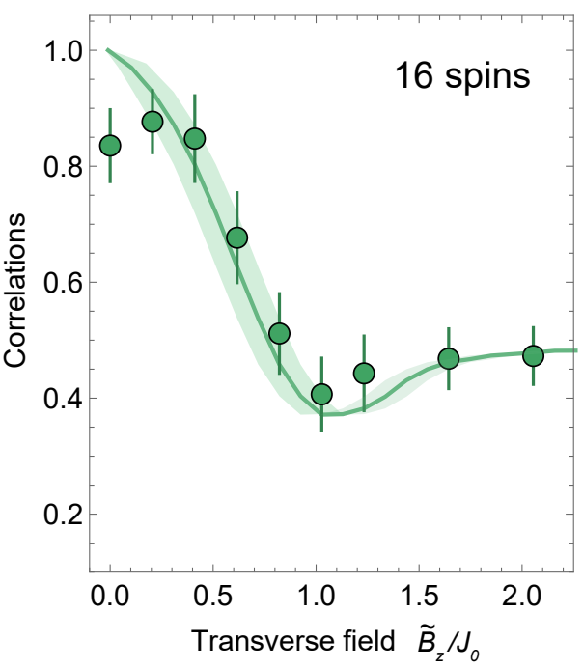
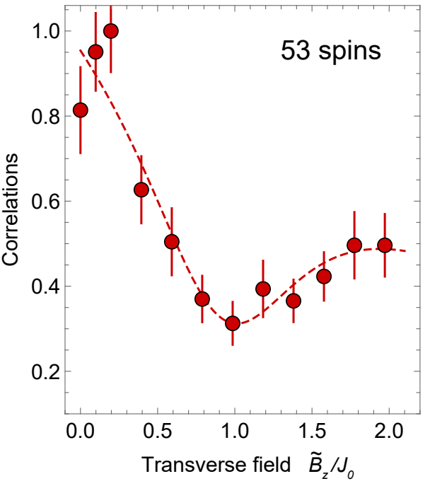
Dynamical phase transitions: Second order correlations
Evolution up to$(2πJ_{0})t \sim 5$
Interaction decay exponent
α ≈ 0.9
$$\frac{1}{N^{2}}\sum_{i,j}{\left\langle σ_{i}^{x}σ_{j}^{x}\right\rangle }$$
JZ et al., Nature, 551, 601–604 (2017).

Slide 9
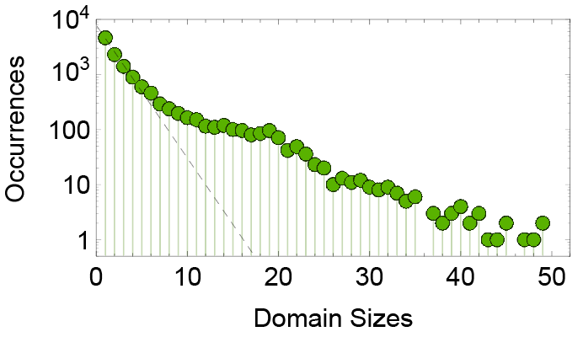
Post-quench domain distributions.
Initial state:
JZ et al., Nature, 551, 601–604 (2017).

Slide 10
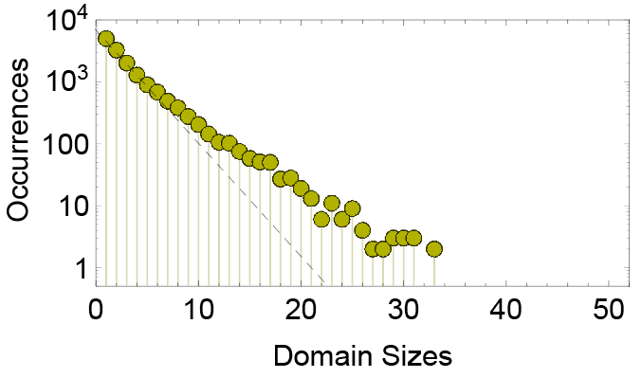
Post-quench domain distributions.
Initial state:
JZ et al., Nature, 551, 601–604 (2017).

Slide 11
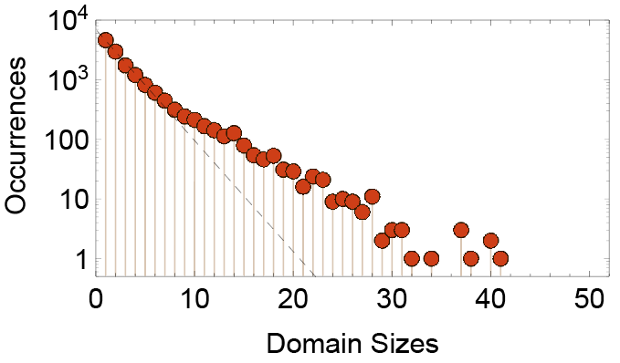
Post-quench domain distributions.
Initial state:
JZ et al., Nature, 551, 601–604 (2017).

Slide 12
Distribution of large domains
JZ et al., Nature, 551, 601–604 (2017).

Slide 13
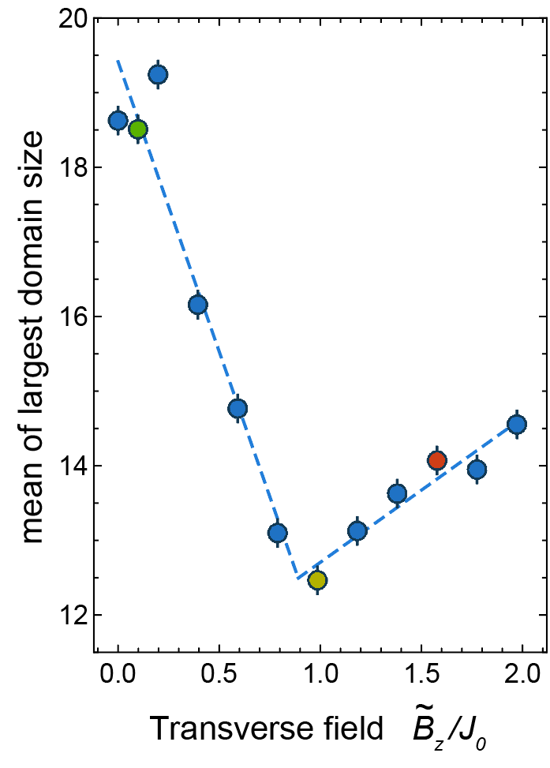
Distribution of large domains
Colored dots correspond to the domain statistics shown before
JZ et al., Nature, 551, 601–604 (2017).

Slide 14
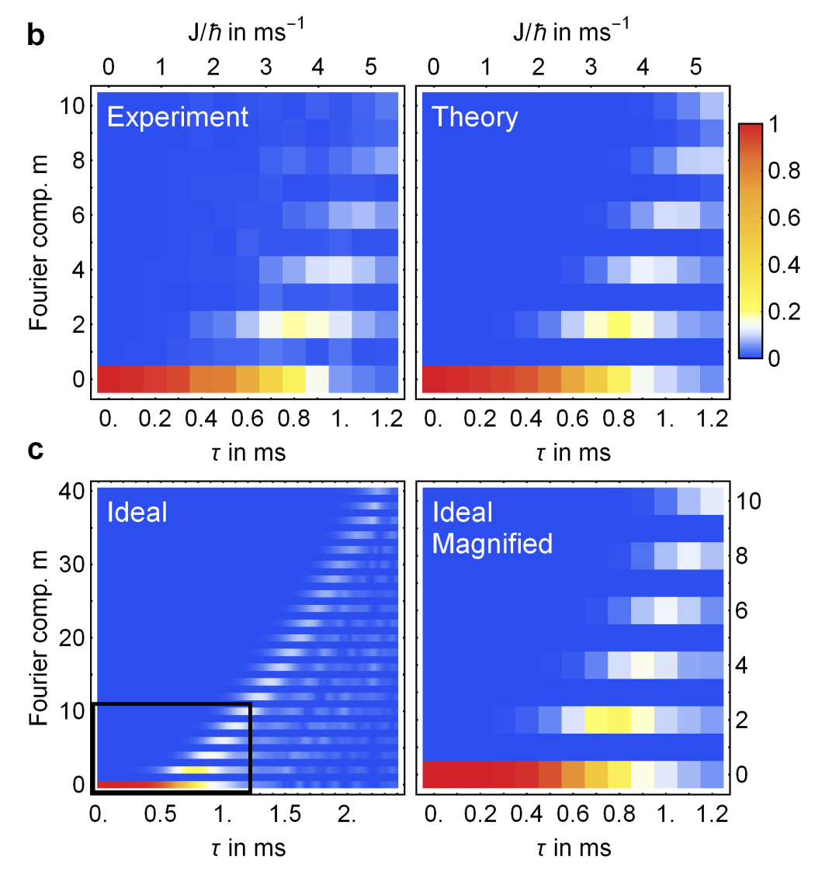
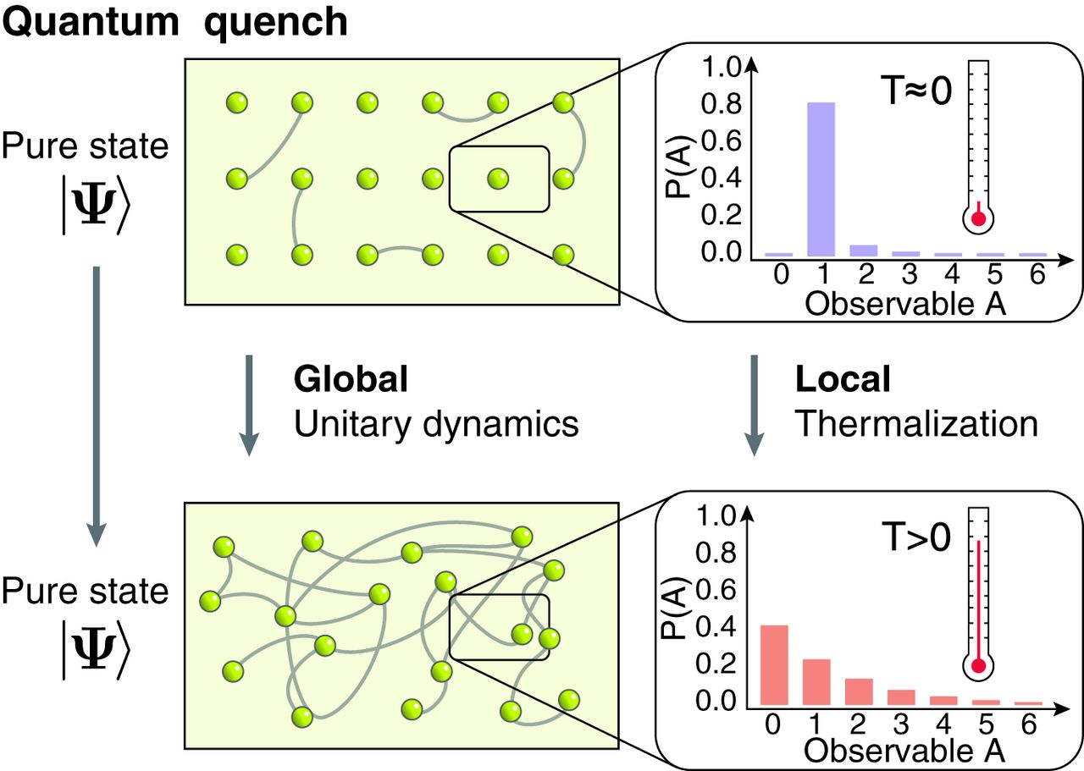
Quantum many-body chaos? Thermalization?
J. Bollinger group:
M. Gärttner, et al., Nat. Phys. 13, 781-785 (2017)
M. Greiner group:
Kaufman, et al., 353(6301) 794-800 (2016)

Slide 15
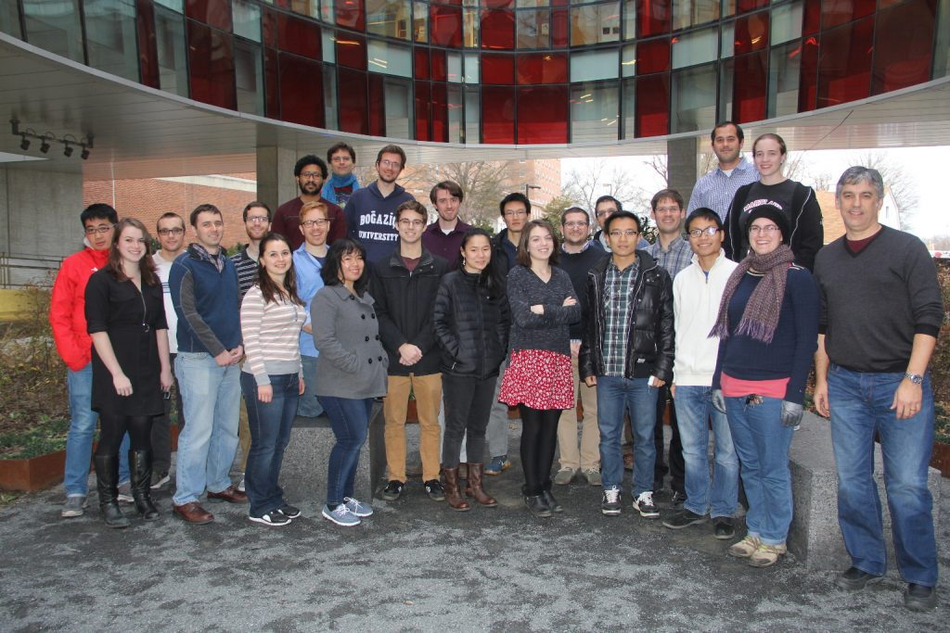
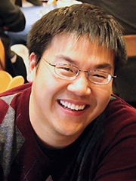
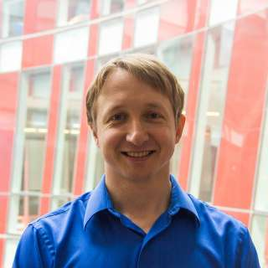
Acknowledgements
QSIM Team
PI: Chris Monroe
Post-docs:
Jiehang Zhang
Paul Hess
Guido Pagano
Theory Collaborations:
Norman Yao
Alexey Gorshkov
Zhe-Xuan Gong
Mohammad Hafezi
Andrew Childs
Andrew Potter
Ashvin Vishwanath
Graduate Students:
Antonis Kyprianidis
Patrick Becker
Kate Collins
Harvey Kaplan
Wen Lin Tan
Notes:
All these laser beams that set up the spin-spin interactions, we can use the same tools for quantum computing.
Put the nature cover, remove the arxiv citations.

Slide 16
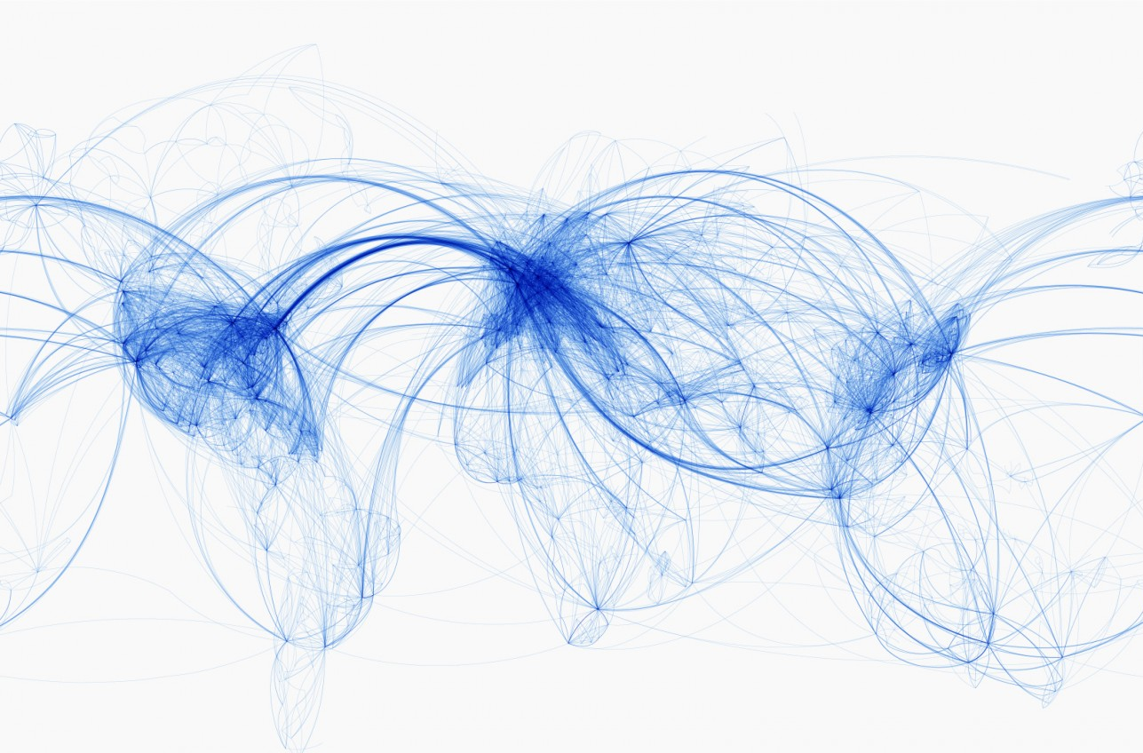
Quantum
Many-body
Physics
Thank you!
Statistical
Mechanics
Information
Science

Slide 17
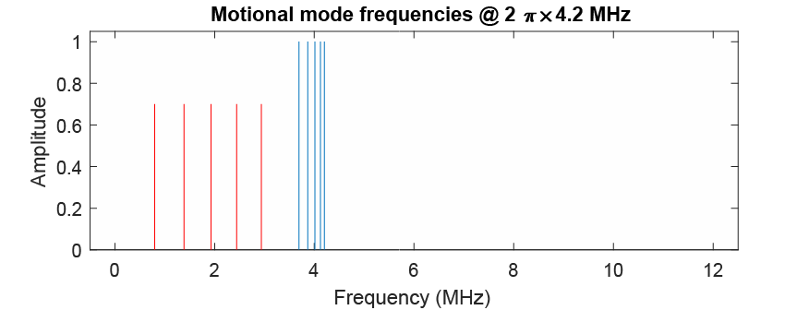
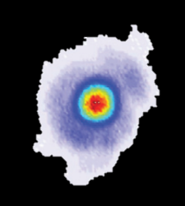
Arbitrary interactions:
normal mode addressing

Slide 18
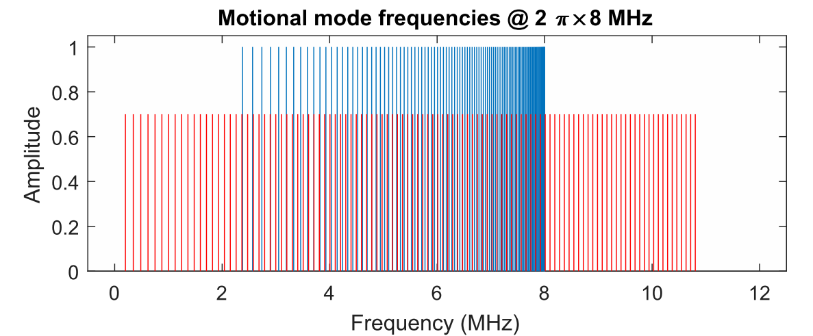
Motional mode spectrum for 100 ions

Slide 19
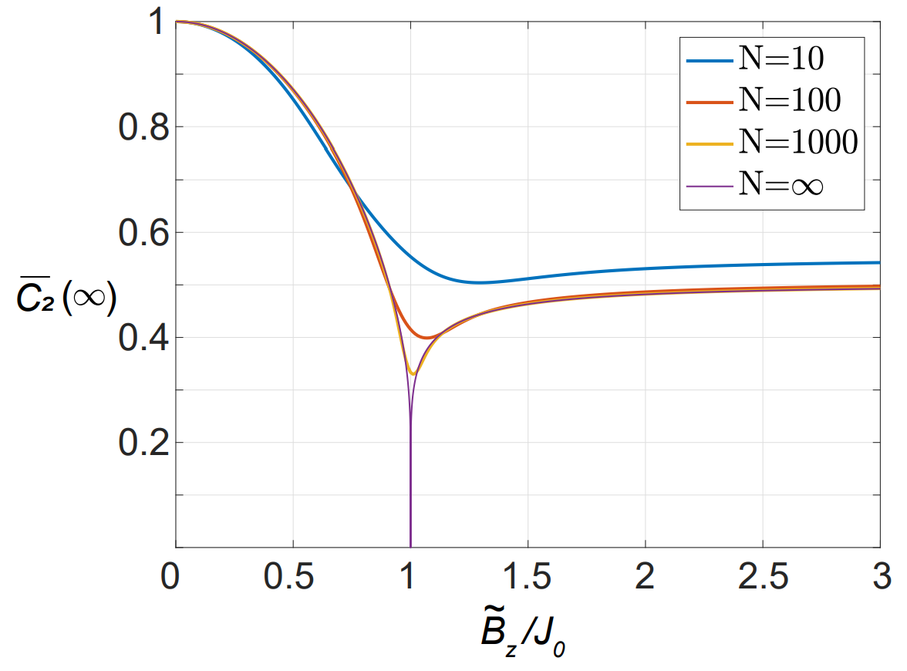
Theory at the all-to-all limit (α = 0)
Special point where a permutation symmetry exist, i.e. all spins are interchangeable.
Phase transition manifested in logarithmic “dip” in the second order correlation.
α ≠ 0 remains an open question.
J. Zhang et al., arXiv 1708.01044 (2017), Nature, in press

Slide 20
Spin detection:
High-resolution fluorescence imaging
Ion positions are determined by illuminating the chain for less than 20 ms.
State of each spin is then measured in 300 μs detection time
All many-body correlations available in a single shot
eg: AFM ordering of 14 spins
R. Islam, et al., Science 340, 583 (2013)

Slide 21
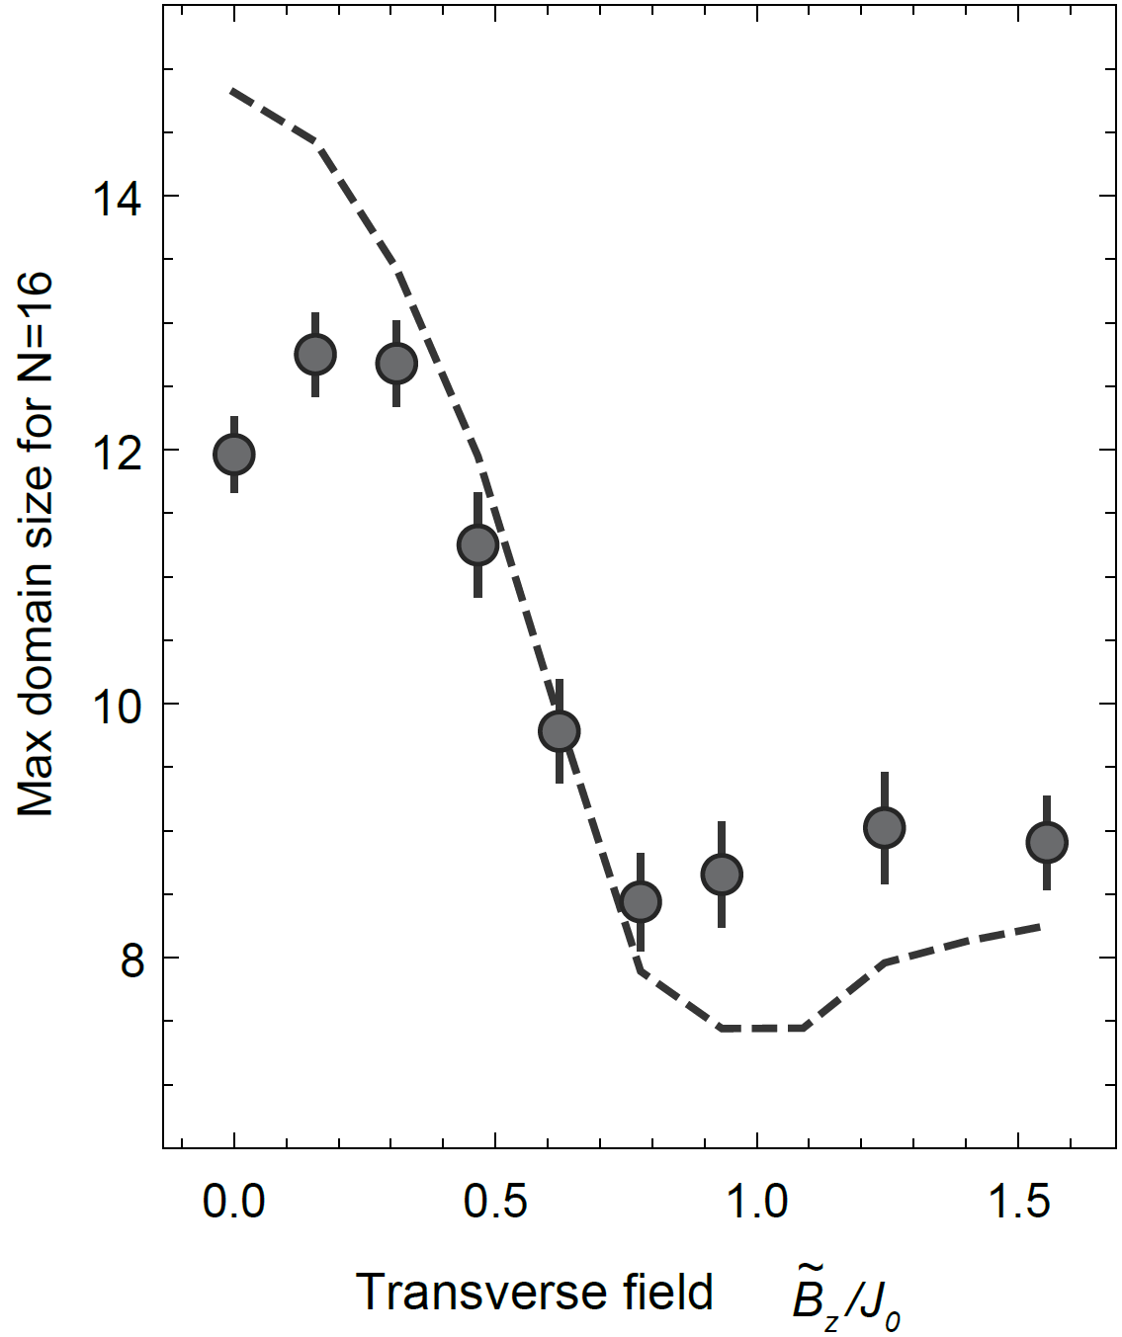
Formation probabilities for 16 spins
K. Naja and M. A. Rajabpour, Phys. Rev. B 93, 125139 (2016).

