Slide 1
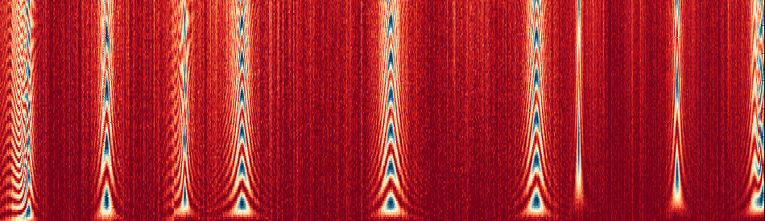




Modular Superconducting Quantum Computing
Srivatsan Chakram, Alex Ma, Yao Lu, Ravi Naik, Nelson Leung, Clai Owens, Brendan Saxberg, Nate Earnest, Abigail Shearrow, Jens Koch
David Schuster
Department of Physics and James Franck Institute, University of Chicago

Slide 2
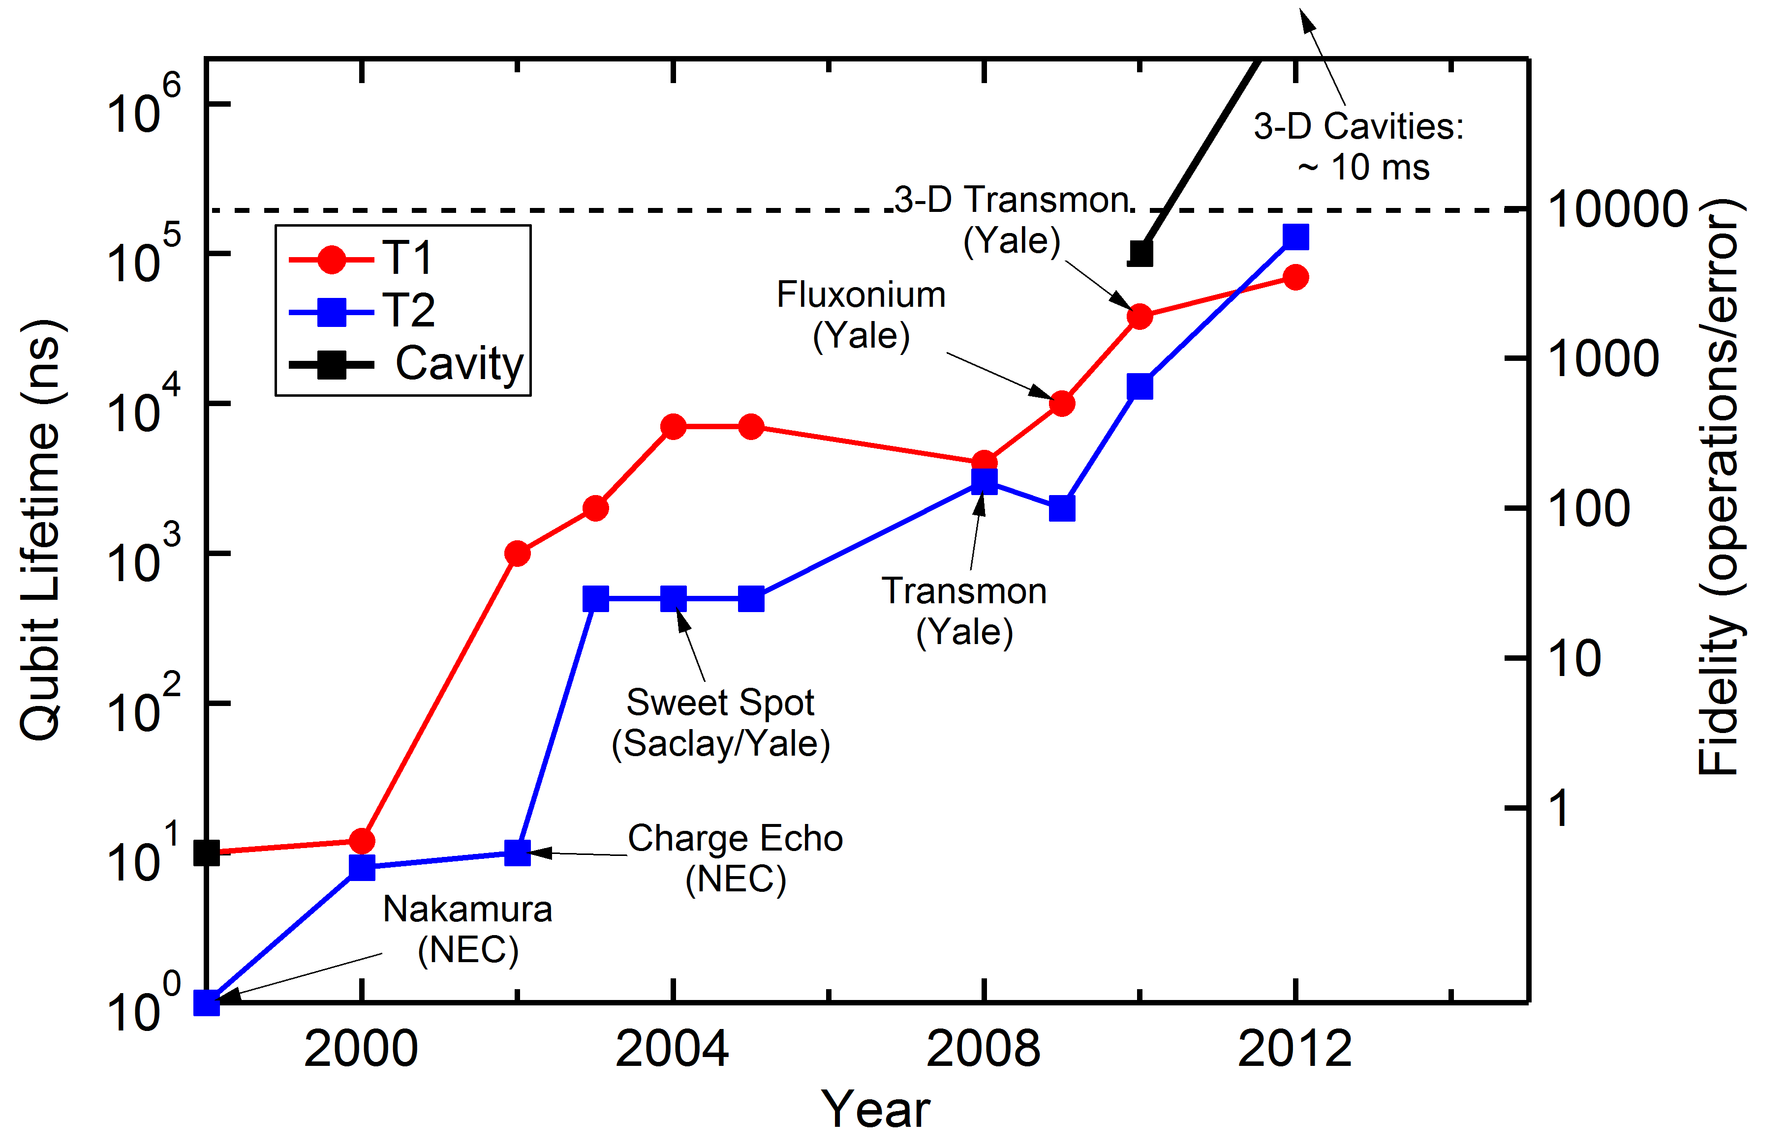
Schoelkopf’s law – Coherence 10x every 3 yrs!
Heavy fluxonium
(chicago)
Quantum Error Correction threshold?
2D transmon
IBM
On the threshold of error correction!
Reason to believe we can get to >1s!

Slide 3
Ignition!
Quantum Error correction is the equivalent of ignition
Where you get exponential gain with more fuel (qubits)

Slide 4
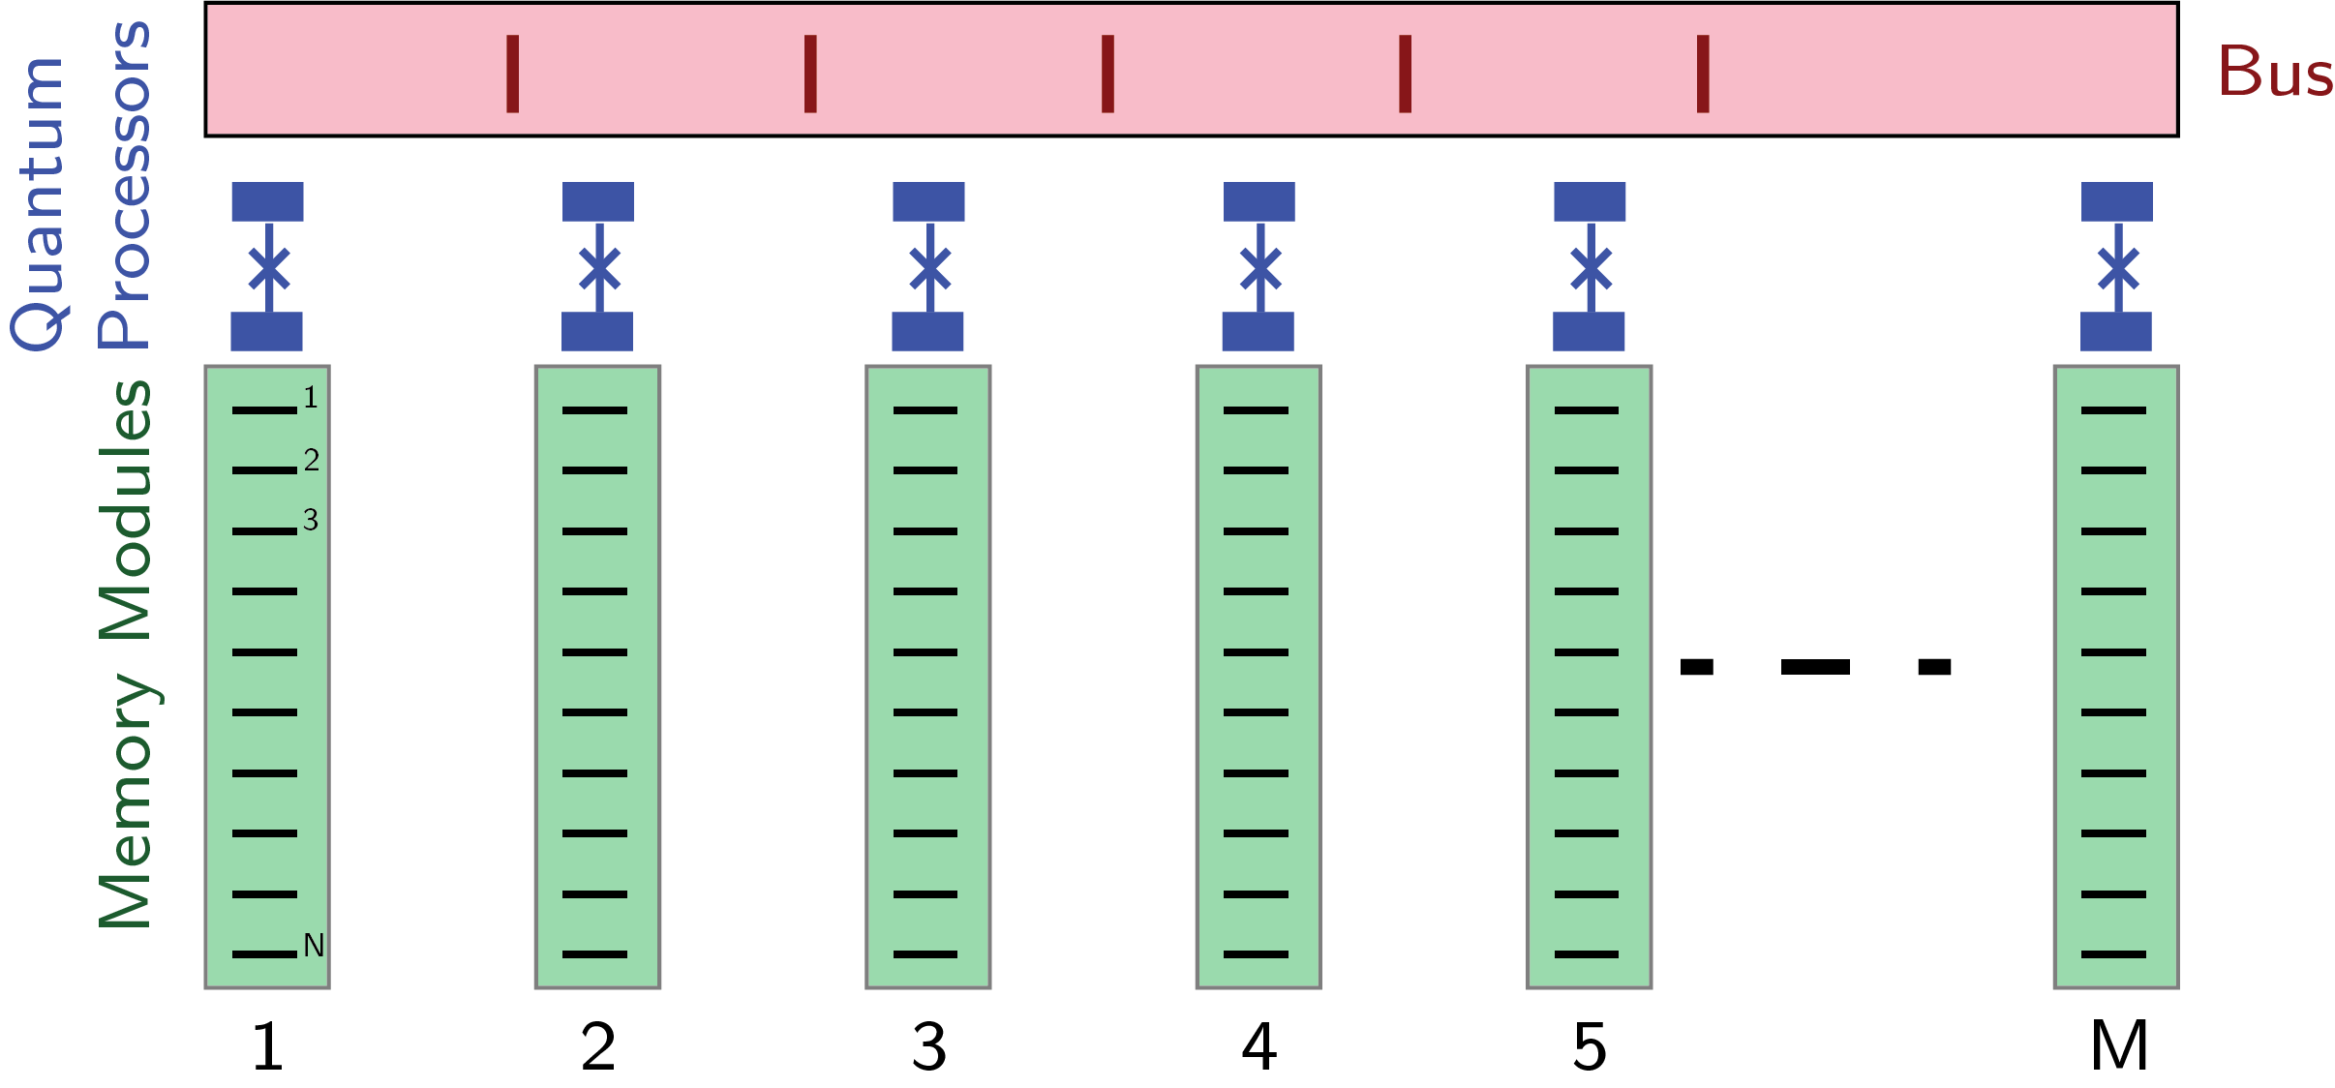
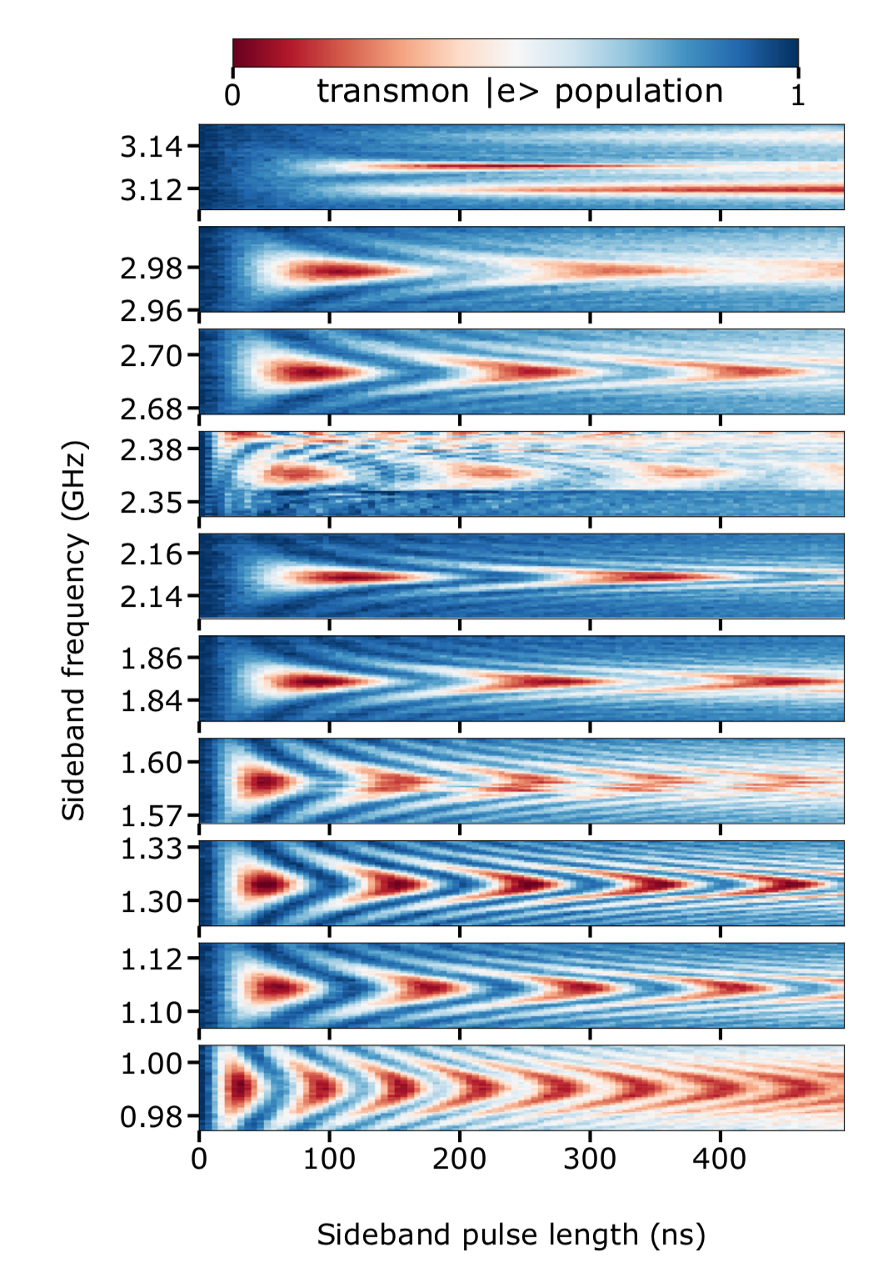
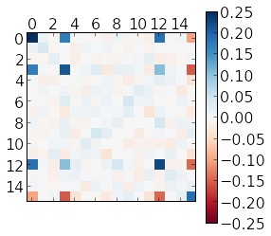
Outline
A modular architecture for
superconducting quantum computing
Multimode Circuit QED
Universal local operations
Deterministically transmitting quantum information

Slide 5
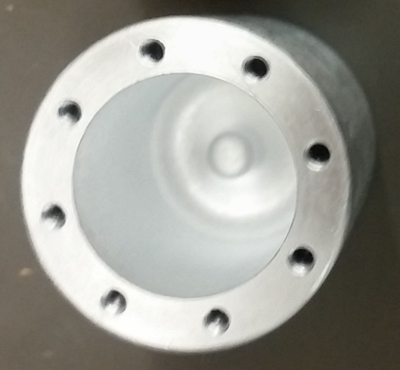
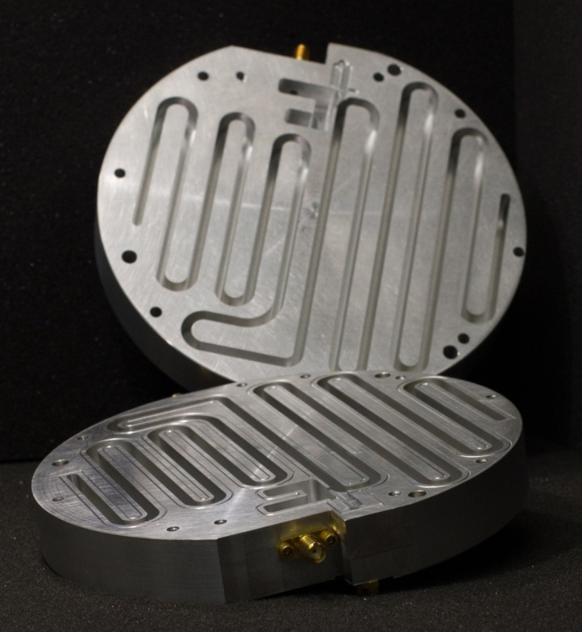
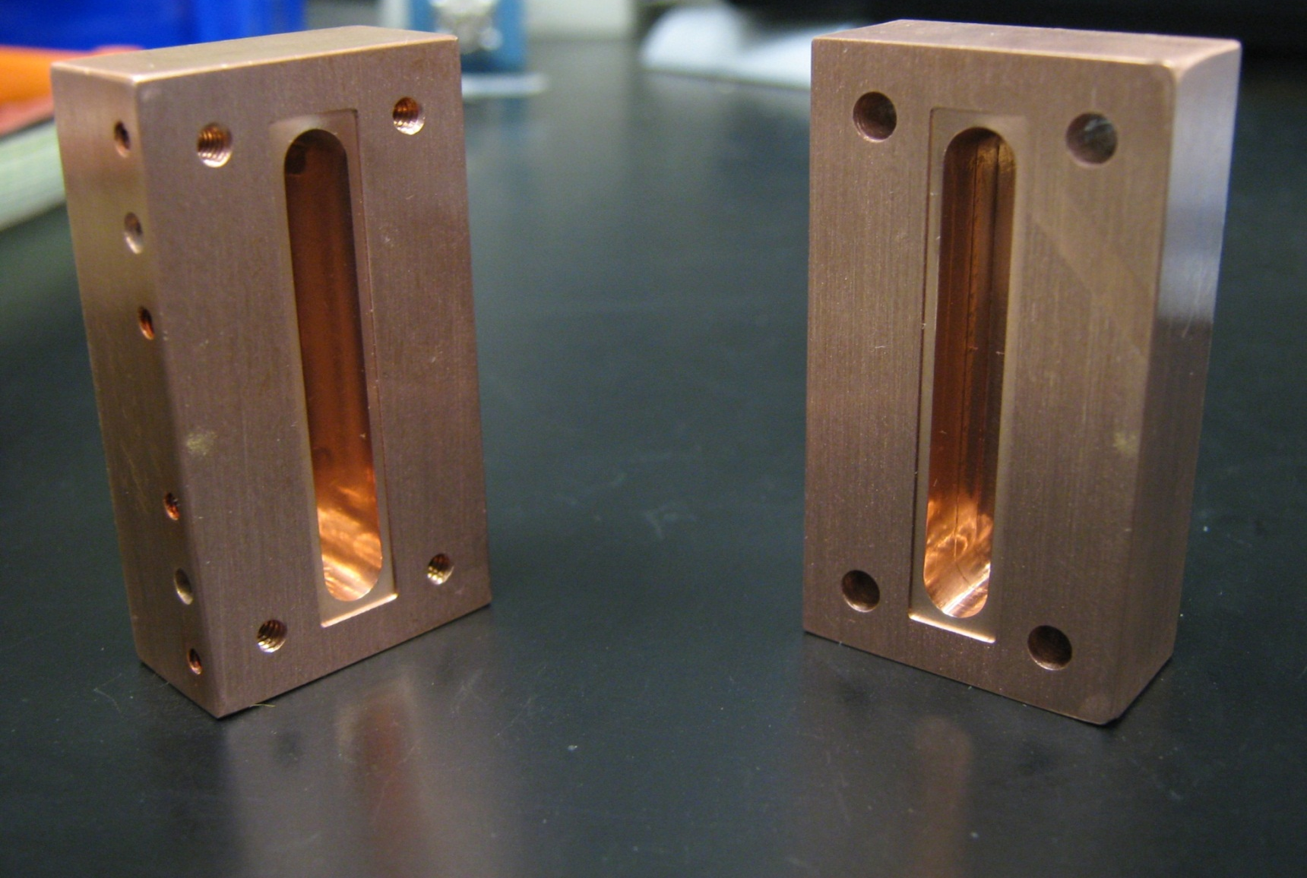

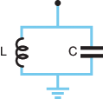
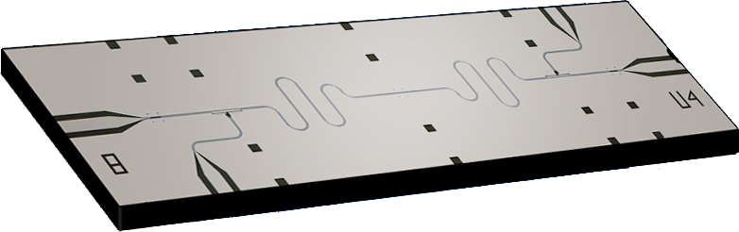
Microwave photons in a superconducting box
If we take a single resonant mode of any of these boxes it looks like a harmonic oscillator
Many types of “boxes”

Slide 6
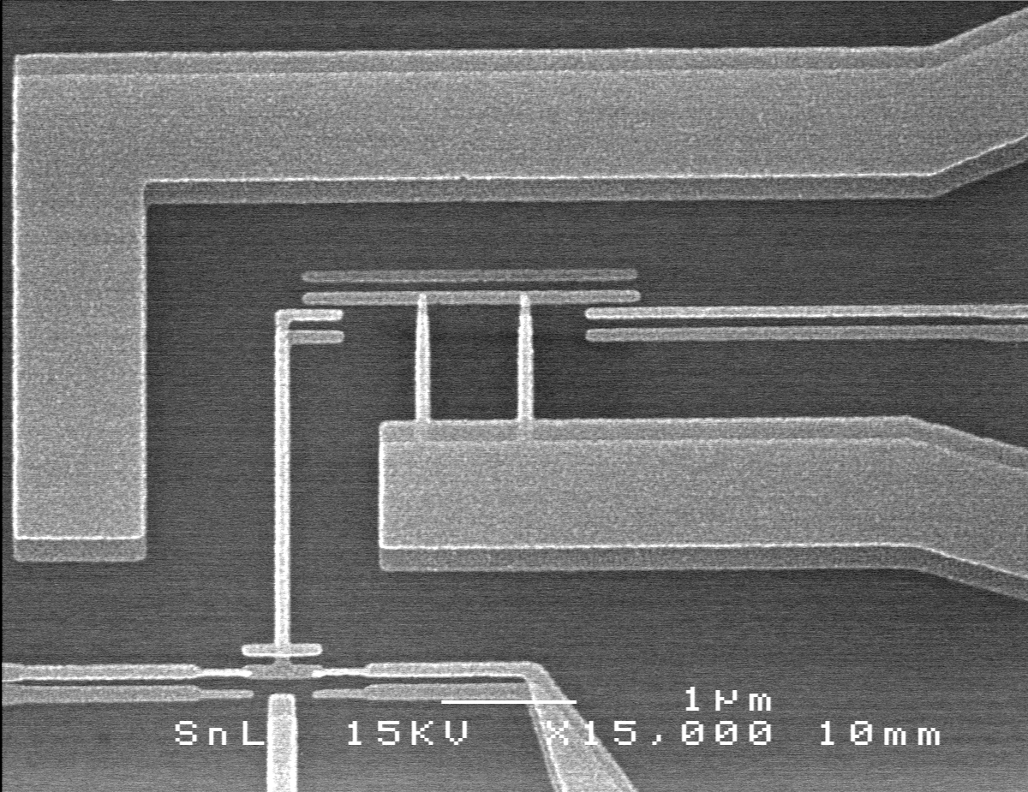
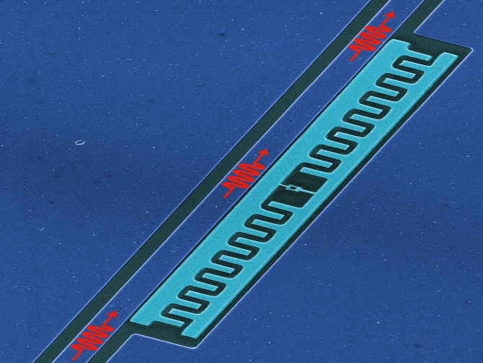
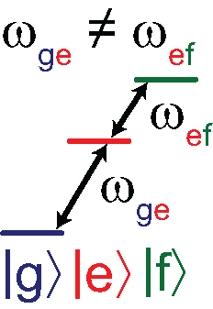
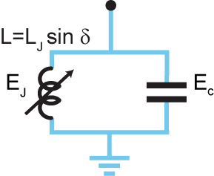
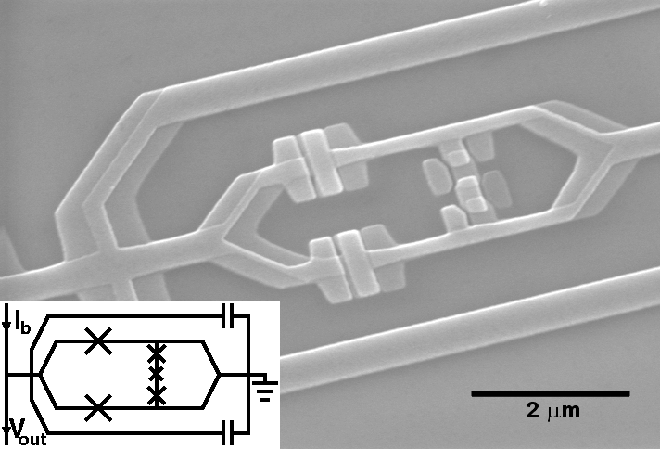
Superconducting qubits (two level system)
Many flavors of qubit
Key element is the Josephson Junction
Anharmonic Oscillator
Charge
Transmon
Flux
Junction acts as non-linear inductor
Bottom two (or several) individually addressable

Slide 7
A photonic modular architecture for SC qubits
Advantages:
10-100 qubits per module
10x fewer transmons, 10x less classical hardware
Fully connected: 2 hops between any pair of bits, M-bits in parallel
Compatible with hardware efficient error correction

Slide 8
Modular Universal Quantum Logic
Single qubit gate (2 swaps)
Intra-module two qubit gate (4 swaps)
Inter-module two qubit gate (8 swaps)
Only two types of operations (rotation and swap)
Inter-module almost as fast as intra-module
Can run M instructions in parallel

Slide 9
A network of two multimode-processors
2 chips each with:
1 Transmon control
1 Measurement channel
8 data qubit modes
1 communication link
Many photonic qubits
Multiplexed control
Universal Multimode Ops
Modular architecture
Notes:
As was described in previous talks, we have a nice multimode CQED architecture with multiple photonic qubits over which we have multimplexed control using a single flux tunable transmon qubit. In this talk we describe how we perform multiplexed state characterization. This is necessary because we have I transmon, and therefore one measurement channel.
In this talk we will describe how we use our toolbox of single of and two-qubit operations

Slide 10

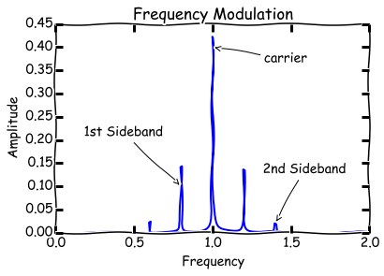
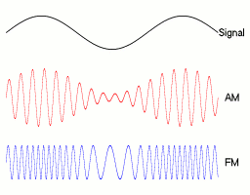
How does an FM radio work?
Carrier Frequency
Modulation signal

Slide 11
Stimulated Vacuum Rabi Oscillations

Slide 12
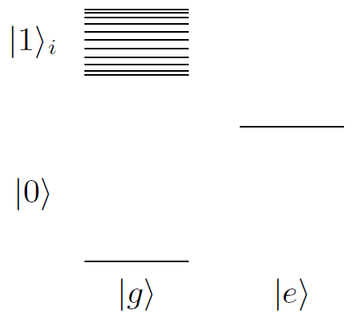
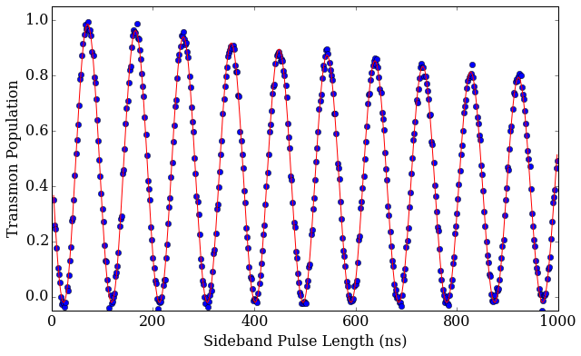
Stimulated Vacuum Rabi Oscillations
Multimode State
Transmon State
We use a parametric drive to stimulate a vacuum Rabi Oscillation with any mode
Address many modes with just a single transmon and set of controls

Slide 13
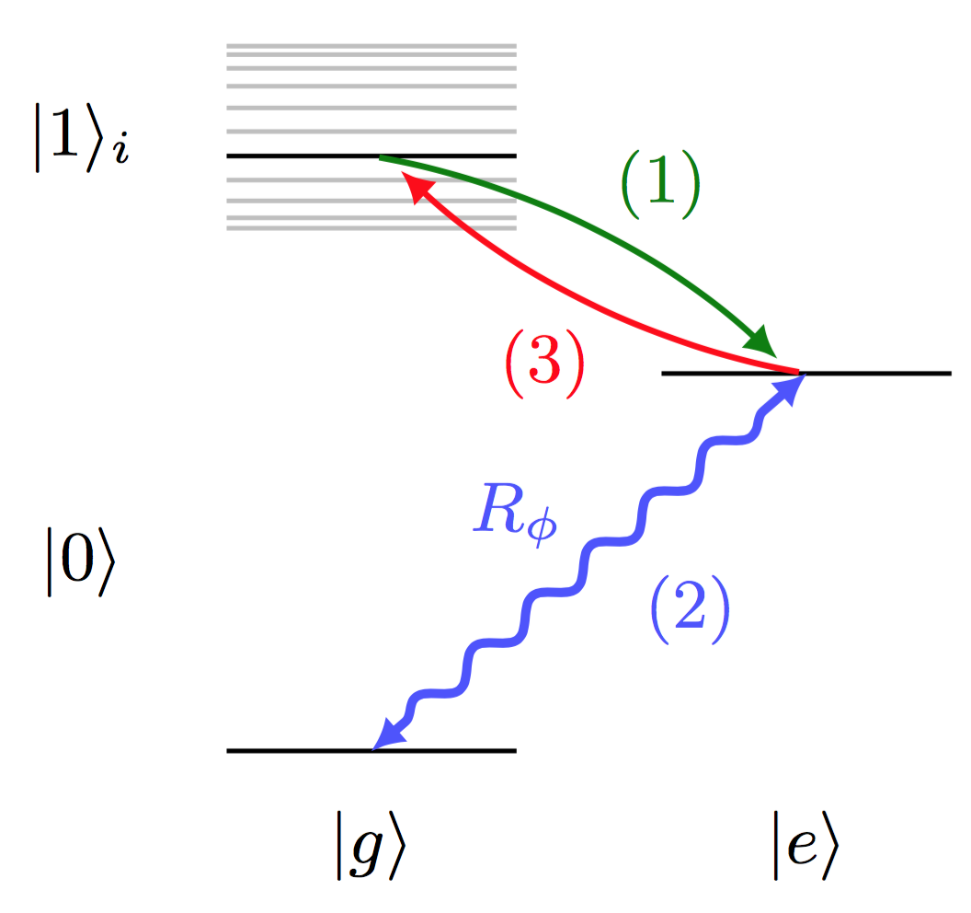

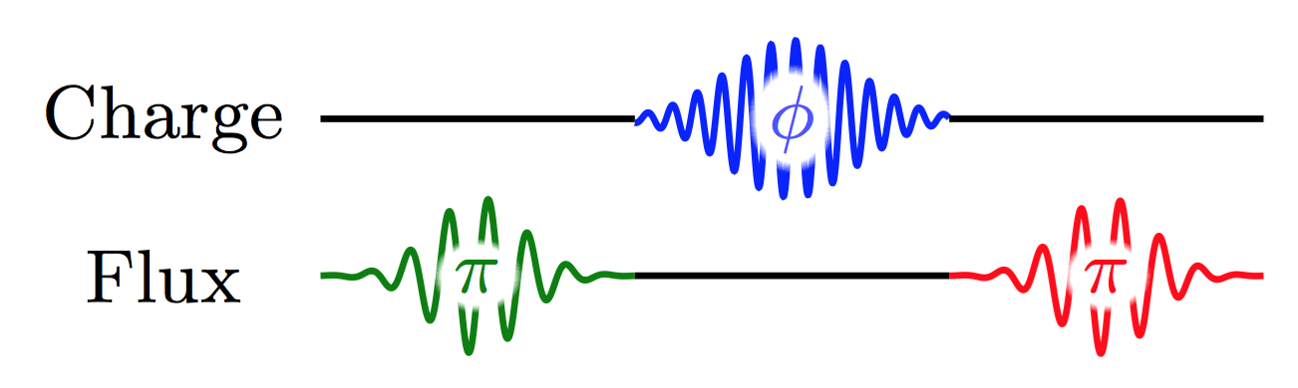
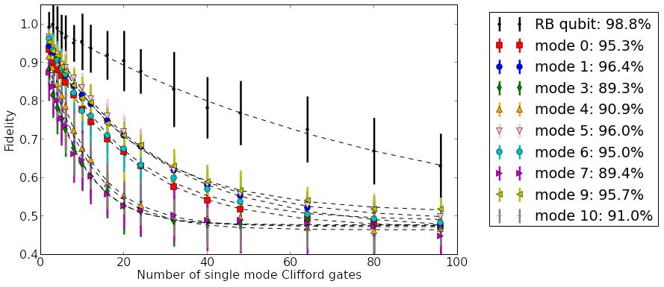
Randomized Benchmarking of light
Qubit
rotate
swap
swap
Qubit: >98%
Cavity mode
Fidelity: 90-97%

Slide 14
Anatomy of a multimode gate
CZ

Slide 15
Anatomy of a multimode gate
CZ
CNOT

Slide 16
Anatomy of a multimode gate
Dispersive shift
Stimulated AC Stark shift
Qubit DC offset during Gate
Working to model, compensate these higher order terms

Slide 17
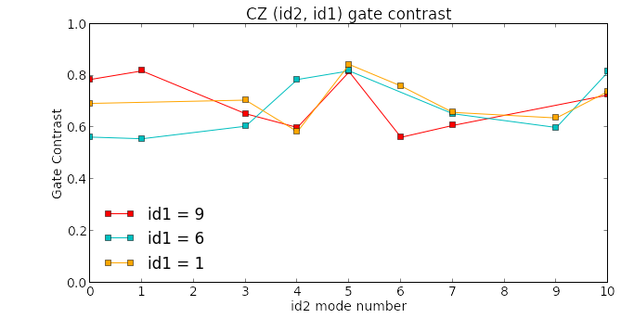
Process tomography of multimode gates
CZ
Fidelity ~80% for gate
Random access quantum information processors. Nat. Comm. 8, 1904 (2017)

Slide 18
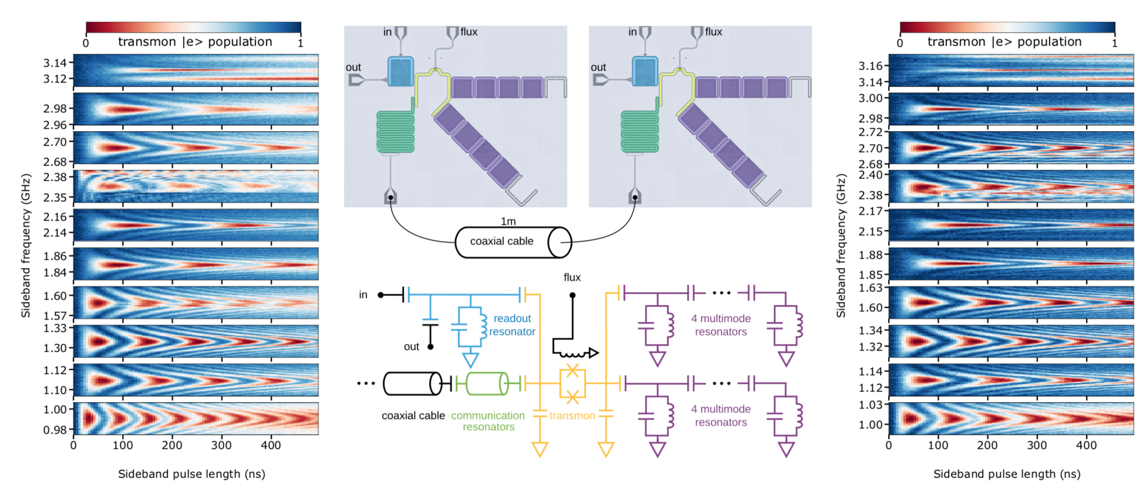
Shuttling single photons
Readout
Everything is accessed with sideband swaps.
Communication looks just like memory!
Multimode Memory
Communication

Slide 19
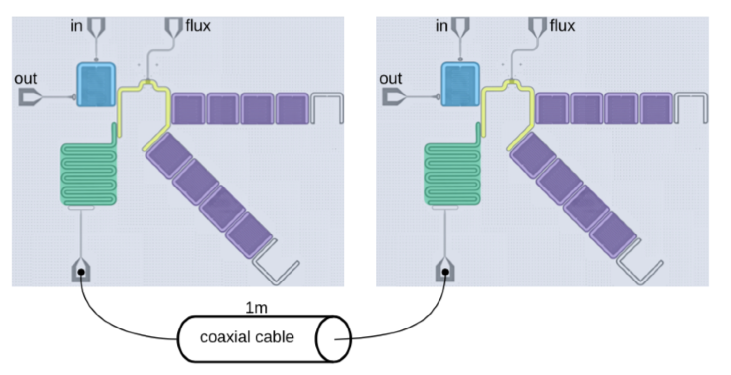
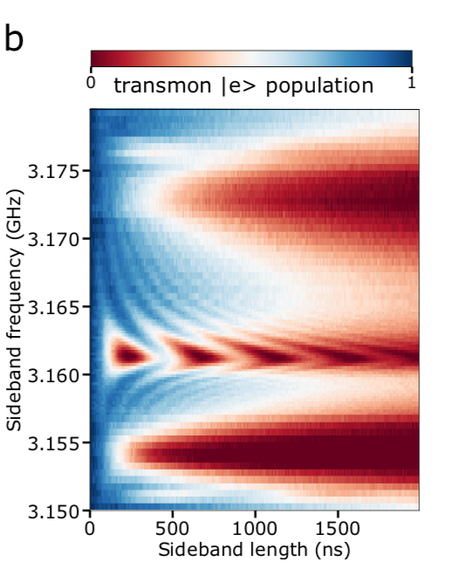
Low loss communication channel
Model as 3 modes in series
Comm – cable – Comm
Dark mode is protected against loss in cable!
T1: 550ns
T2*: 1us
T1 = 550ns

Slide 20
Bi-directional photon transfer
Qubit 1
Qubit 2
1. Put single photon in sender
2. Swap into “dark” mode
3. Swap into receiver
Can speed things up by sending and receiving simultaneously.
Notes:
we can simultaneously turn on both sideband pulses with equal amplitude, till the photon is maximally transferred from one side to another. This scheme has two advantages: one, the transfer time is shorter than two complete sideband pi pulses,

Slide 21
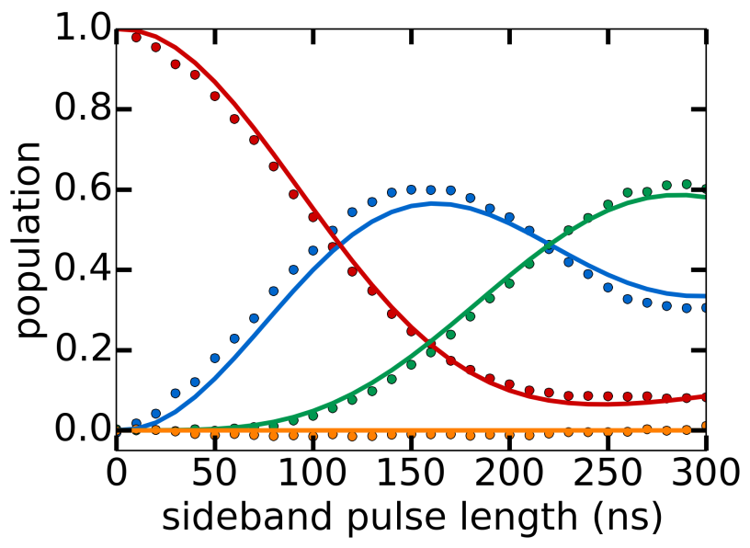
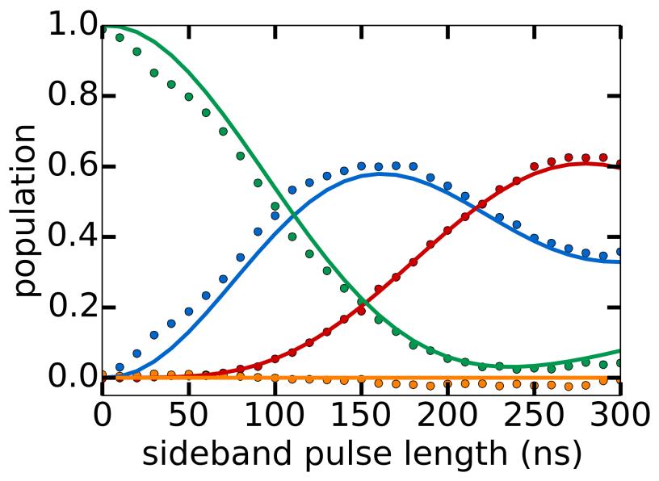
Bidirectional photon transfer
Qubit 1
Qubit 1
Qubit 2
Qubit 2
eg
gg
ge
ge
gg
eg
P_{gg1}
P_{gg1}
ee
P_{eg0}
ee
P_{ge0}
1 to 2 fidelity: P_{ge0} ≈ 61 %
Loss mechanism:
  qubit and channel decay: P_{gg0} ≈ 24%
  qubit dephasing: P_{gg1}+ P_{eg0} ≈ 15%
2 to 1 fidelity: P_{eg0} ≈ 62 %
Loss mechanism:
  qubit and channel decay: P_{gg0} ≈ 24%
  qubit dephasing: P_{gg1}+ P_{eg0} ≈ 14%
Notes:
Similarly, the dephasing of the sender qubit also leads to some population residue not transferred. Numerical simulation shows that the total qubit dephasing loss contributes to a 15% and a 14% infidelity in these two transfer processes.

Slide 22
Bell state generation
Sending half the photon creates Bell state
Qubit 1
Qubit 2
Loss mechanism:
  qubit and channel decay: 0.1
  qubit dephasing: 0.1
Notes:
From master equation simulation, we estimate that the qubit and channel decay loss, and qubit dephasing loss each accounts for half of the infidelity.

Slide 23
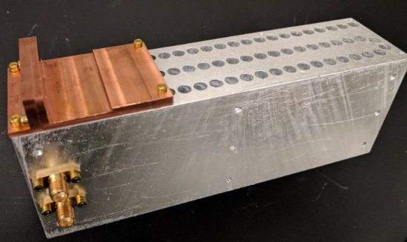
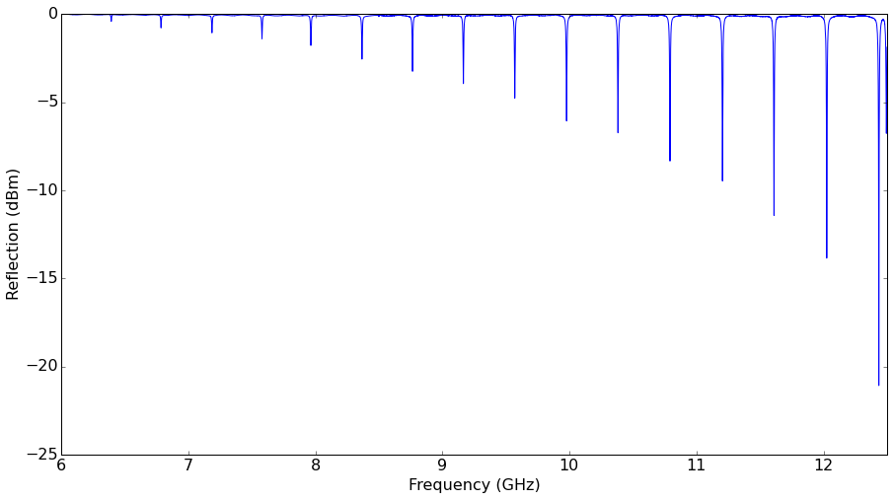
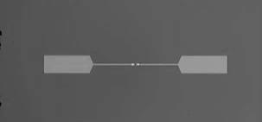
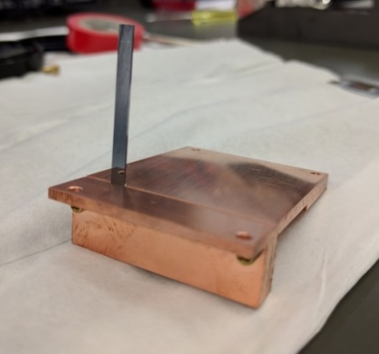
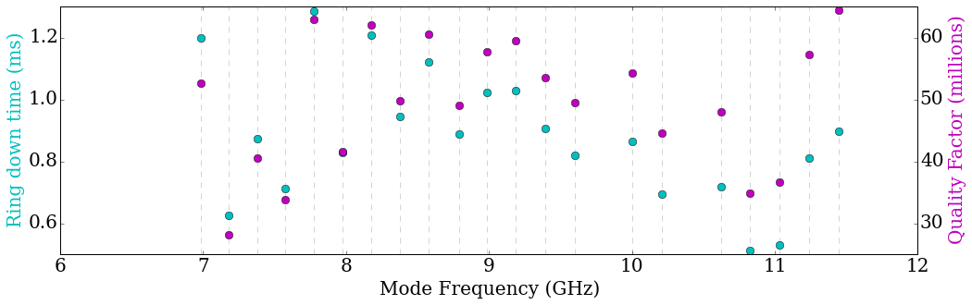
Realizing higher Q - 3D modules
A box with no seams.
10-50 Modes
Engineered dispersion uniformly spaced (400MHz)

Slide 24
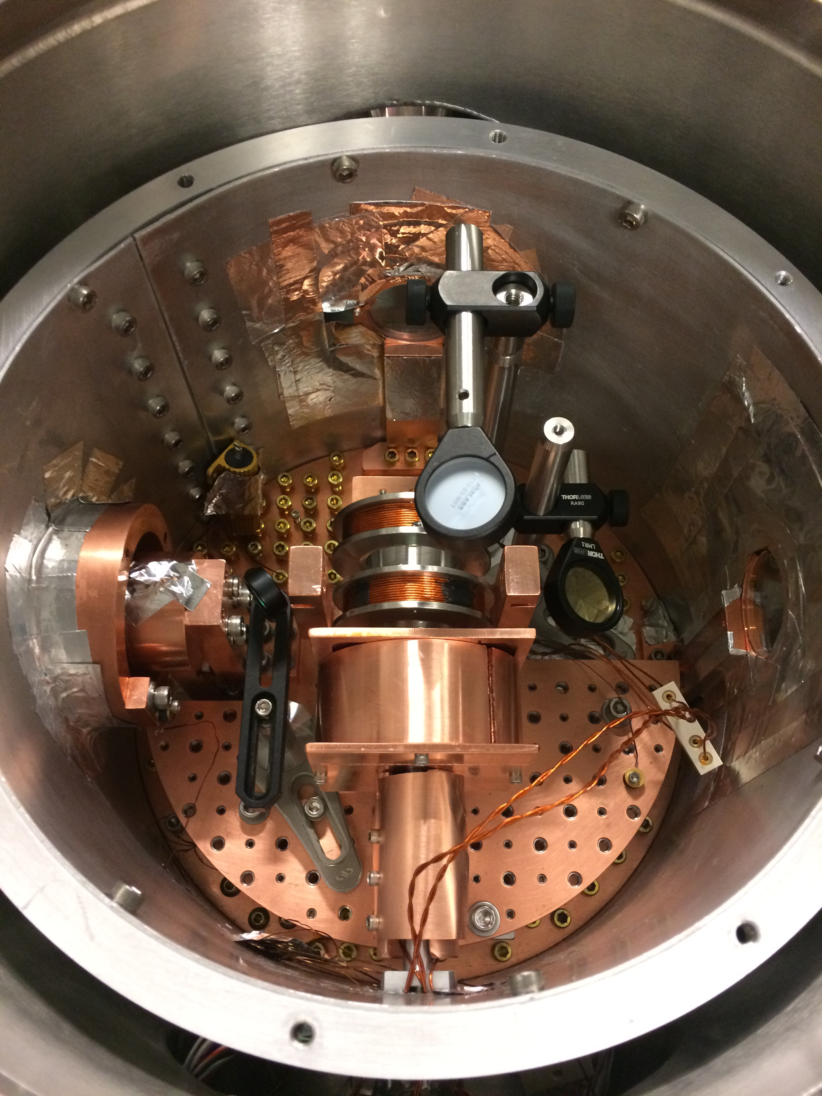
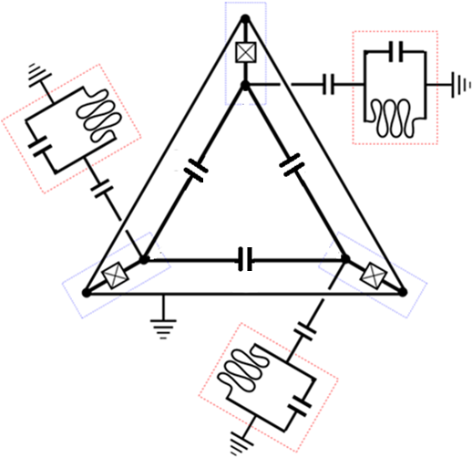
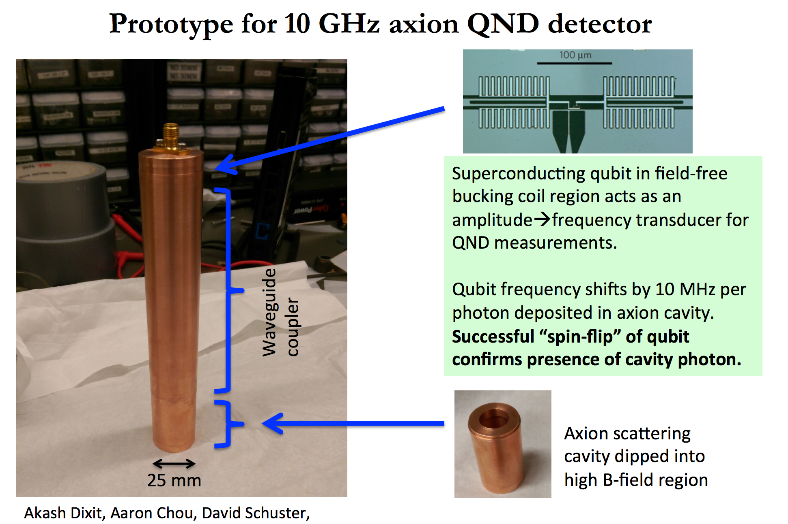
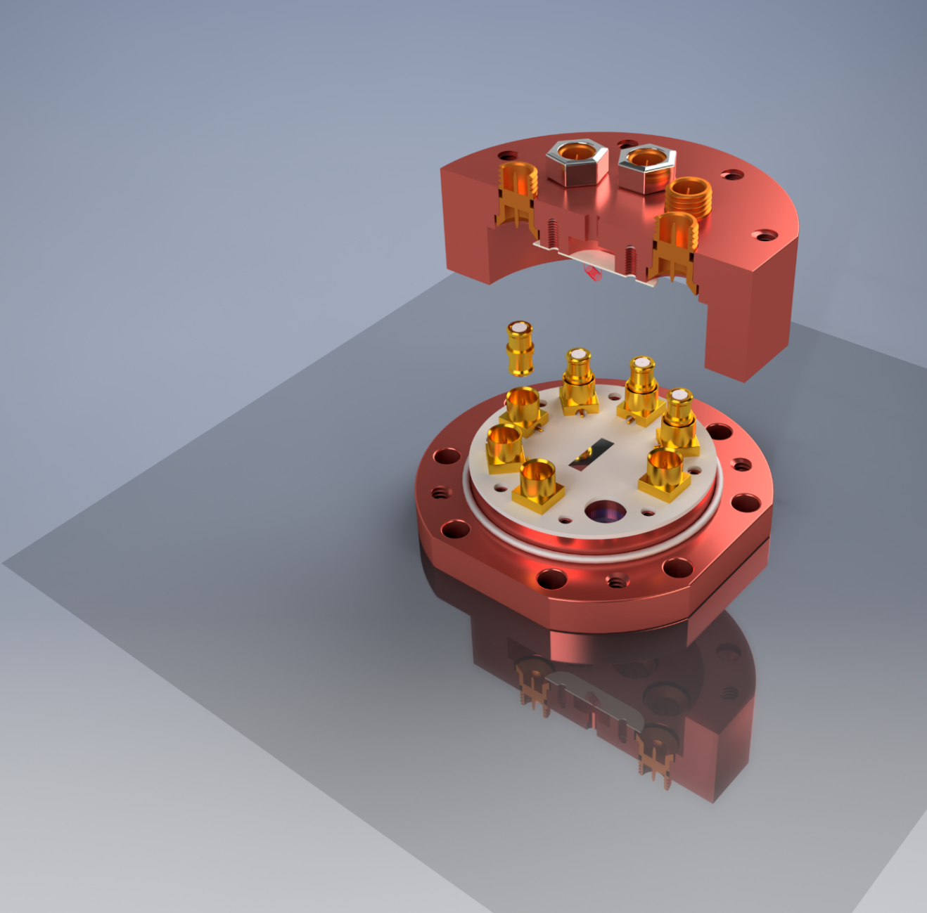
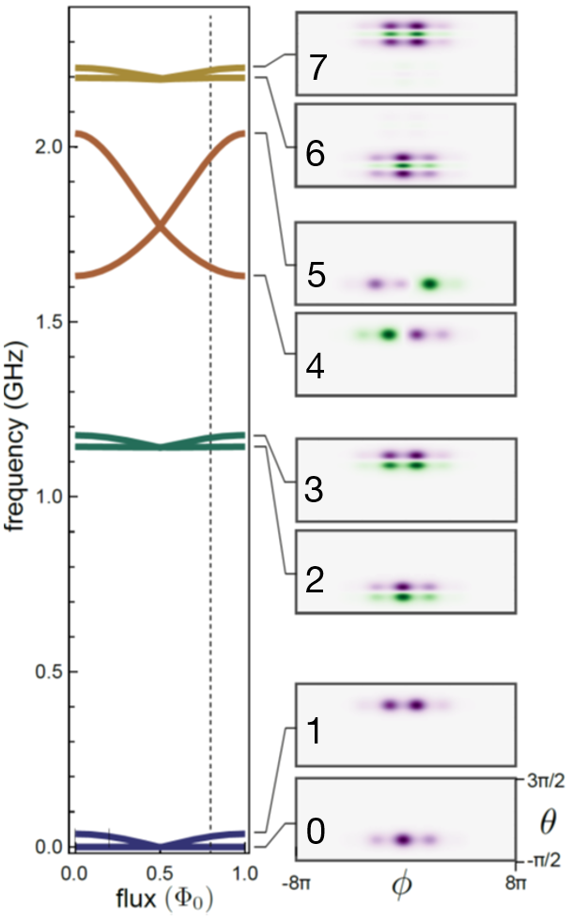
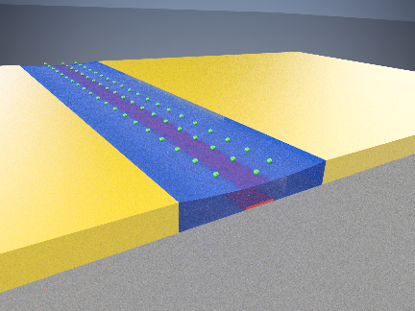
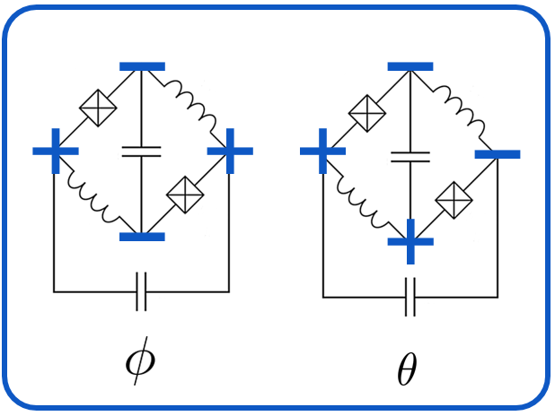
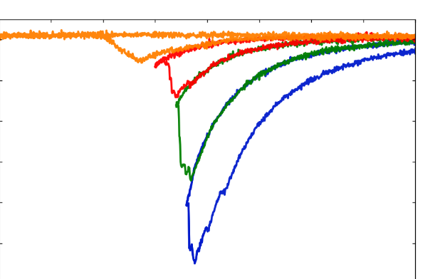
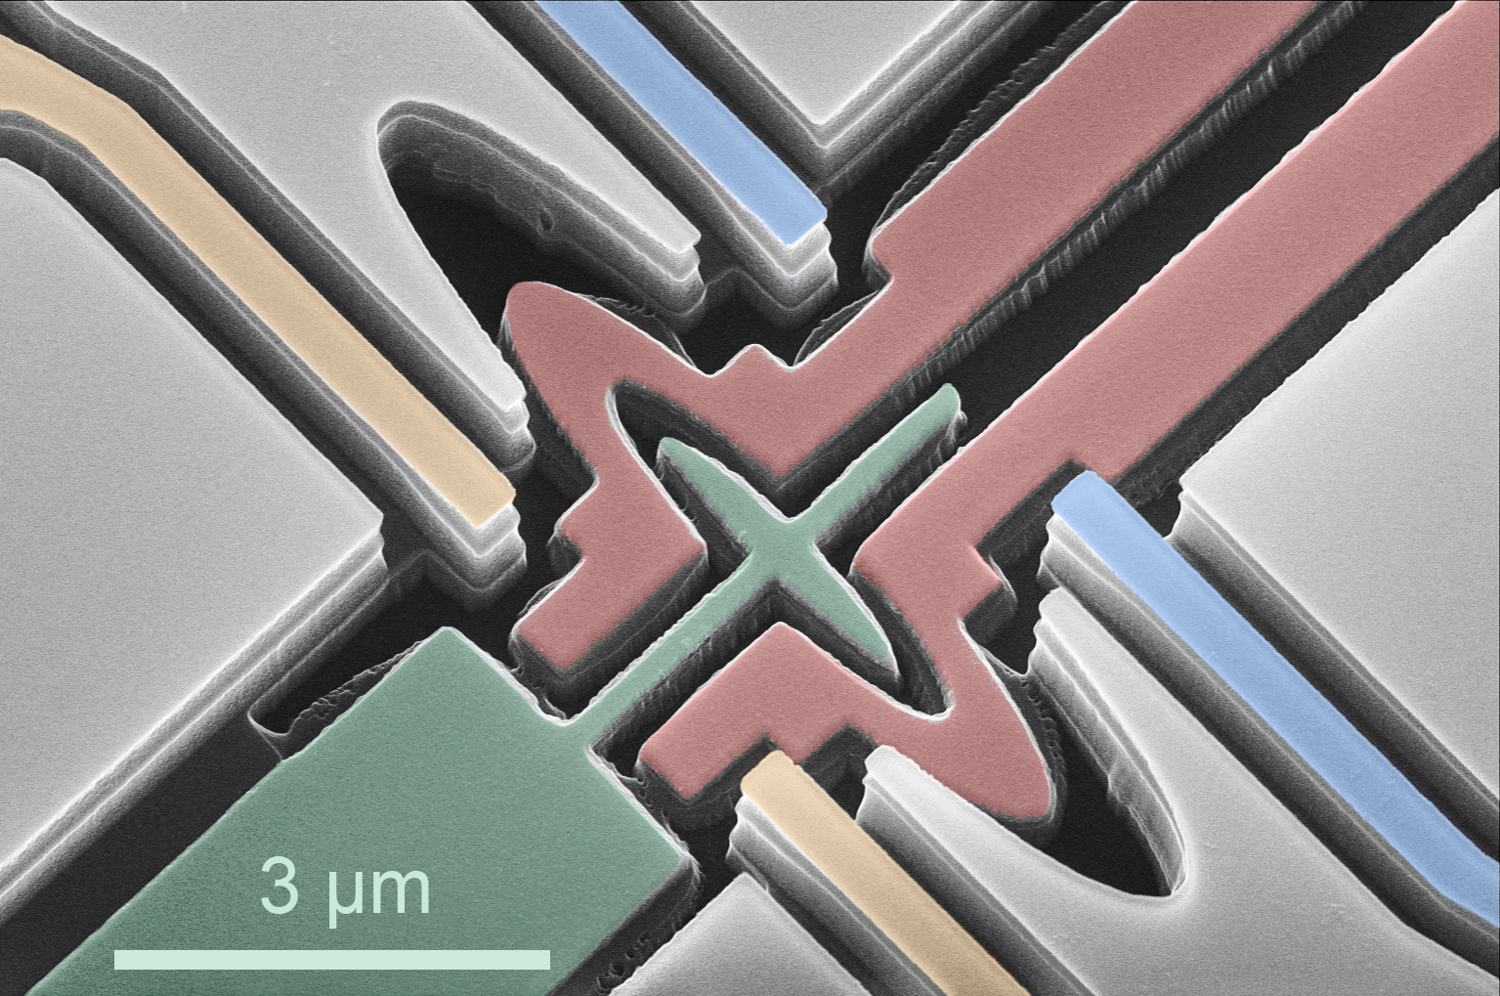
Other exciting projects in the lab
Rydberg
Optical/Microwave CQED
w/ Jon Simon
Autonomous error correction
Searching for Dark Matter
w/ Aaron Chou, and others at FNAL
w/ E. Kapit
cQED with
electrons on helium
Protected qubits
PRX 6, 011031 (2016)
PRB 90, 094518 (2014)

Slide 25
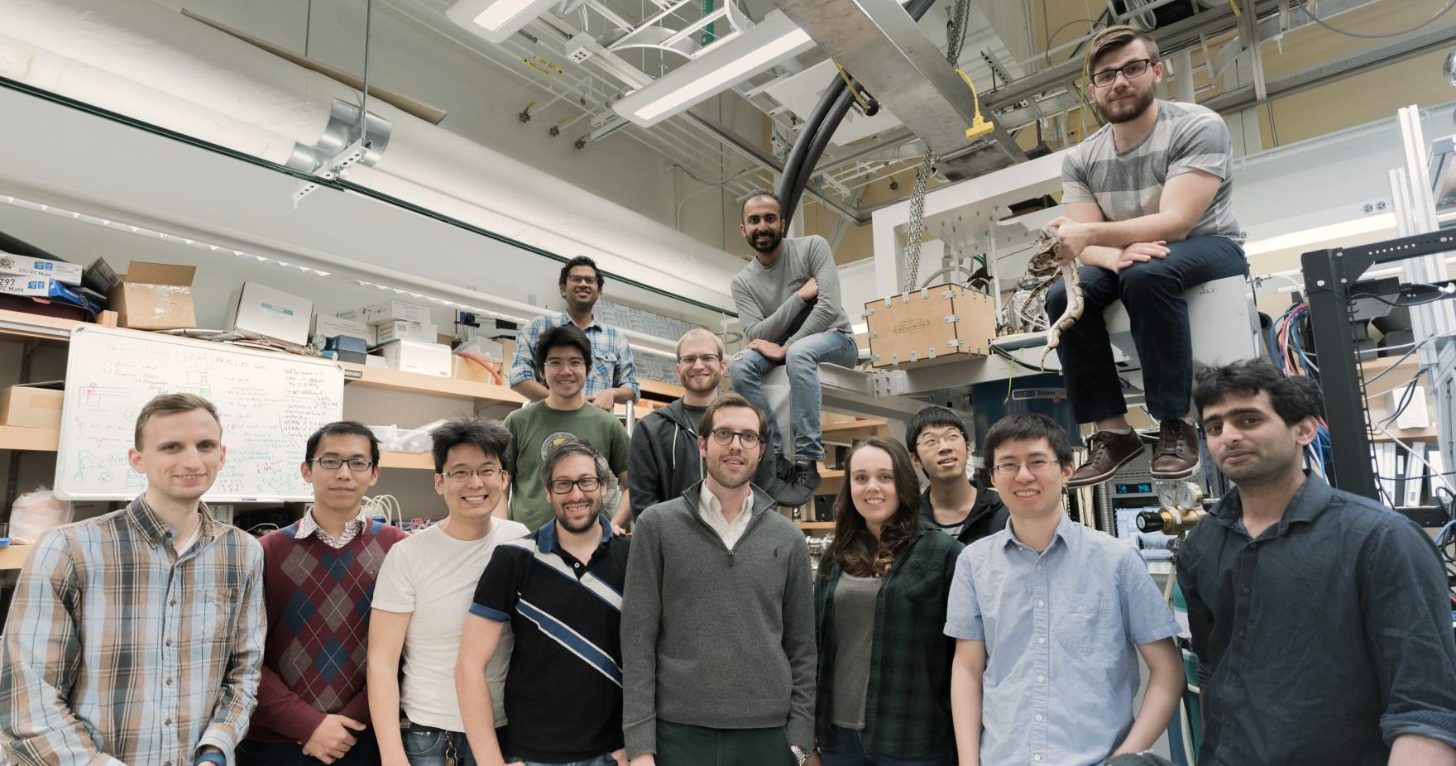
The group

Slide 26
Conclusions
Modular superconducting architecture with
random access, reduced resources
Universal quantum logic within a module
Bi-directional coherent communication
~60% single photon fidelity
Remote Bell state generation
~80% Bell state fidelity
Higher Q 3D implementations soon
Superconducting Qubits can be used directly
as sensors

