Slide 1





Towards scalable circuit model quantum computing
with neutral atom qubits
M. Saffman

Slide 2
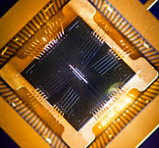
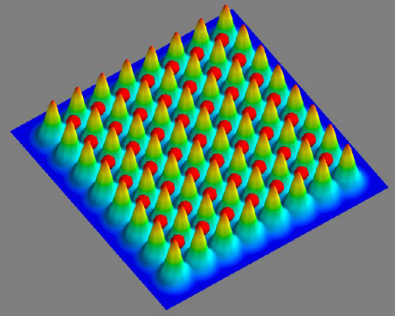
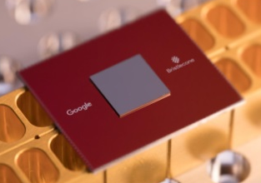
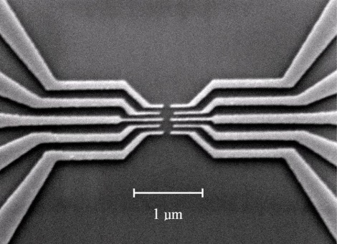
Challenges of Quantum Computing
Leading approaches
Qubit isolation from the environment to preserve quantum states
High fidelity quantum logic gates
Qubit measurement without Xtalk
Quantum error correction costs
X10 to X1000 qubit overhead
trapped ions
neutral atoms
superconductors
2D quantum dots

Slide 3
Dichotomy of Quantum Computing
need full control
strong coupling
weak coupling to environment
need coupling for QEC

Slide 5
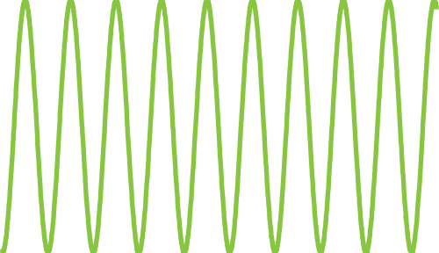
Neutral atom qubits
|1>
τ=34 years (300 K bath)
f=4
Cs 6s_{1/2}
ν₀=9,192,631,770 Hz
|0>
f=3
m=0
Quadratic Zeeman: ν=ν₀ + 8.55 x 10¹⁰ B₀ δB Hz/T
B₀ = 10⁻⁴ T, δB= 10⁻⁸ T
Δν ∼ 0.1 Hz

Slide 6

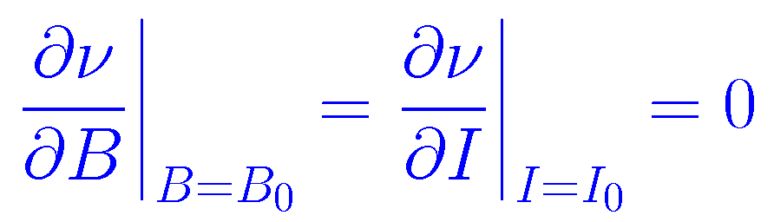
Neutral atom qubits
Optical Trap
|1>
τ=34 years
f=4
Cs 6s_{1/2}
ν₀
I(x)
|0>
f=3
m=0
Tensor polarizability & hyperpolarizability δν ∼ α I + β I²
Adding sidebands to trap light can make traps doubly magic.
A. Carr & MS, PRL 117, 150801 (2016)

Slide 7
Neutral atom qubits
Optical Trap
|1>
f=4
Cs 6s_{1/2}
ν₀
I(x)
|0>
f=3
m=0
Coherence times as high as 10 sec. have been measured in optically trapped qubit arrays.
(Dave Weiss, PSU)
Decoherence rate ~ 0.1 s⁻¹

Slide 8
Neutral atom approach
strong interaction
3 GHz @ 3 μm
Rydberg
Atoms
Cs 100s
Rydberg
lifetime
0.3 ms
E field
sensitivity
12 orders of magnitude!
hyperfine
clock qubits
long coherence
~ 10 s
weak interaction
0.001 Hz @ 3 μm

Slide 9
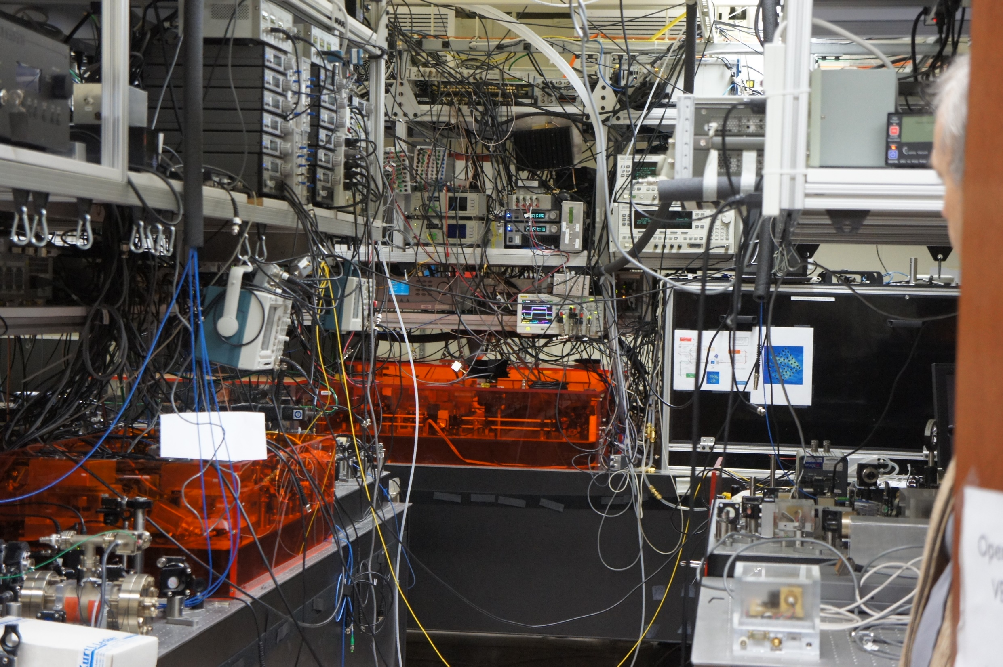
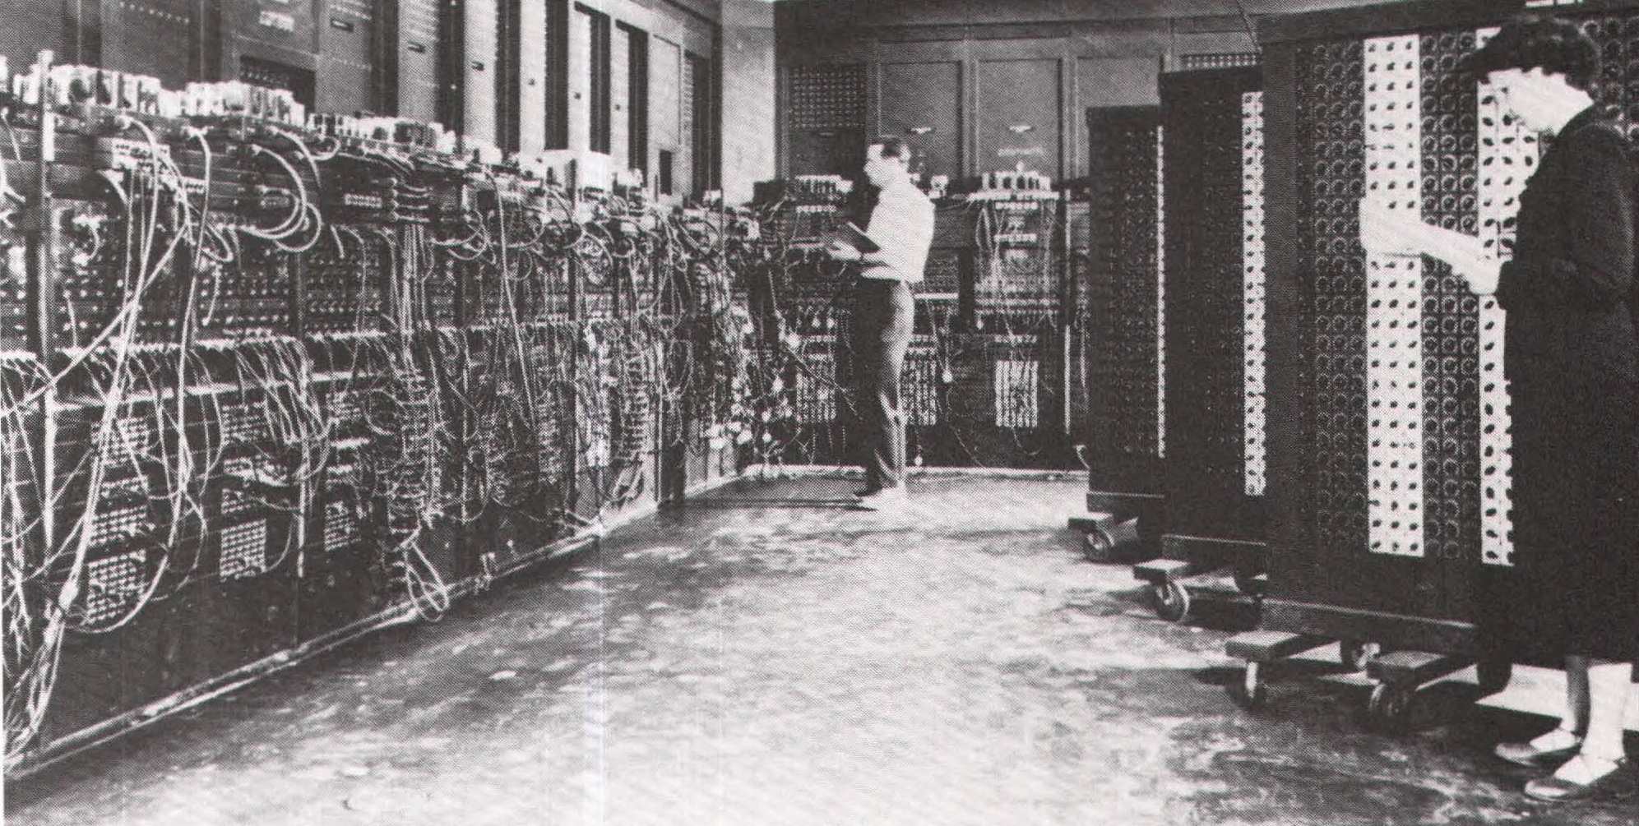

Slide 10

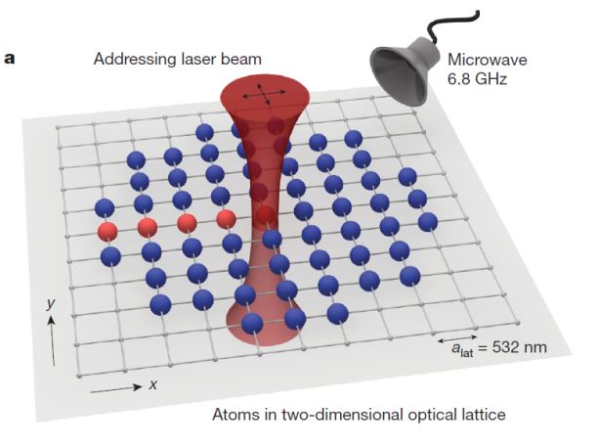
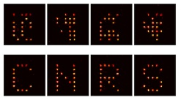
Atomic qubits in optical lattices & Rydberg interactions
New Mexico, Wuhan
2 sites
Harvard 100 sites,
atom rearrangement
1D
~100 sites, 2D array,
red detuned
100 sites, 2D array,
red detuned
49 sites, 2D array,
blue detuned
2D
Max Planck, Garching
Institut d’Optique
Wisconsin
3D
125 sites, blue detuned
PSU – not yet Rydberg

Slide 11
Lattice design
121 site array in progress
line array - twice more efficient use of optical power
insensitive to optical perturbations
2D array
of
3D optical
traps
Gaussian beam array
Gaussian line array
PRA 88, 013420 (2013)
M. Lichtman thesis (2015)

Slide 12
Rydberg trapping
PRA 84, 043408 (2011)
Blue detuned light traps ground and Rydberg states at intensity minimum.
2D array
of
3D traps
Cs 61d_{3/2}
Population in trap & Rydberg state
trap on τ = 102 μs
trap off τ = 17 μs
Gaussian beam array
wait time (μs)
Accounting for spontaneous lifetime & blackbody repopulation this implies a mechanical trap lifetime
τ_{mech} =0.35 ms >> τ_{spont}

Slide 13
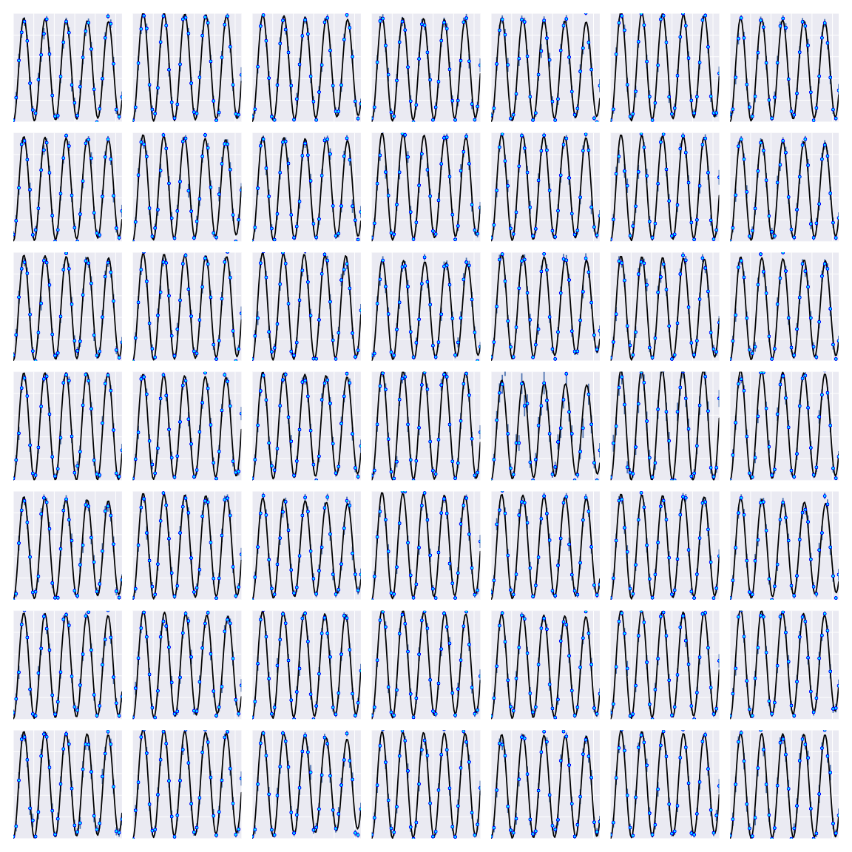
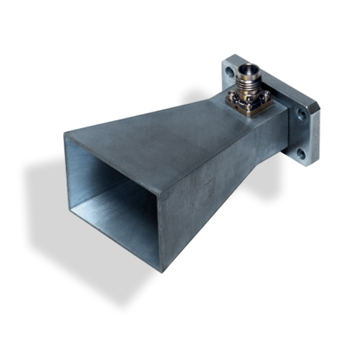
Single qubit gates - global
Cs clock state qubits
f=4
|1>
9.2 GHz
f=3
|0>
m_{f}=0
Bias field of 1.5 G
Microwaves 10 kHz Rabi frequency

Slide 14
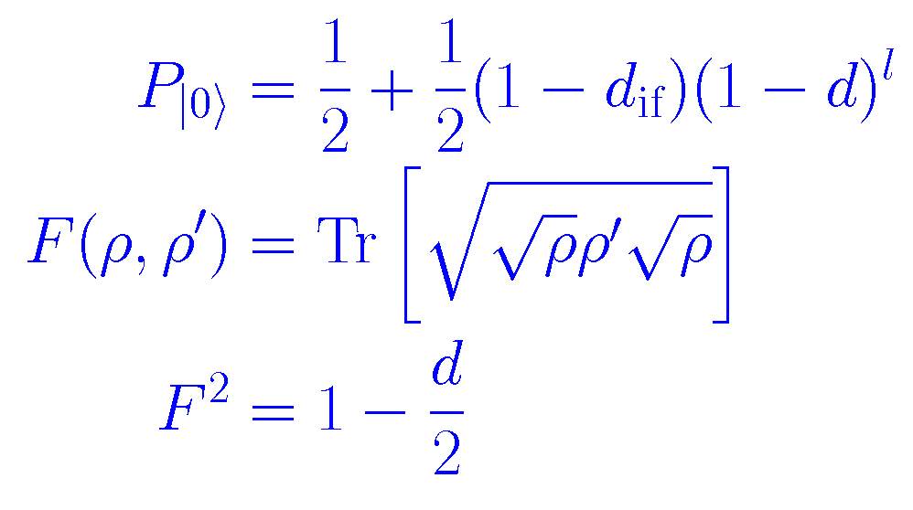
Randomized benchmarking
T.Xia, M. Lichtman et al.
PRL 114, 100503 (2015)
Quantify gate fidelity with
random sequence of Clifford gates
Fidelity ~ 0.999
Close to threshold for
quantum error correction

Slide 15
Single qubit gates – site selected
Stark shift target site with 2D acousto-optic scanner
Microwave
+ Stark shift laser

Slide 16
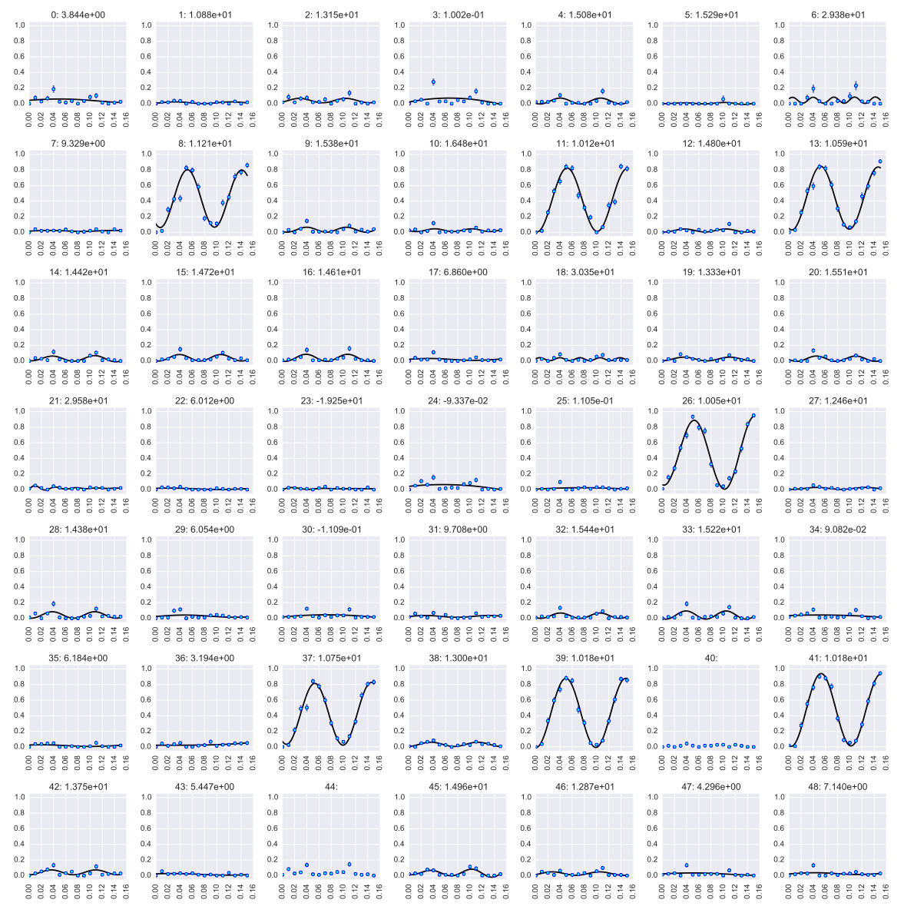
Single qubit gates – multiple sites 2D
Fidelity ~ 0.99 <Xtalk> ~ 0.01
Sequential addressing
Switching time < 1 μs
Crosstalk is accumulated in
all 7 rotations
~ few %.

Slide 17
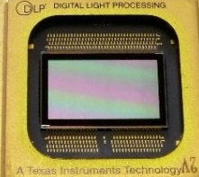
Single qubit gates – Scalability
Scalable error correction requires parallel gate operations.
Crossed AOMs access one site at a time.
Row parallel single site gates with multichannel AO deflector.
N times optical power cost for N sites.
fan out
AO deflector
Full parallel operation with spatial light modulator
N² times optical power cost for N² array.
SLM
>10⁶ pixels

Slide 18
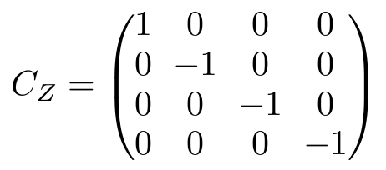
Rydberg blockade C_{Z} gate
Jaksch, et al. PRL (2000)
Ω
ω_{q}
Ideal C_{Z} Gate
ω_{q}, B >> Ω >> 1/τ_{Ryd}

Slide 19
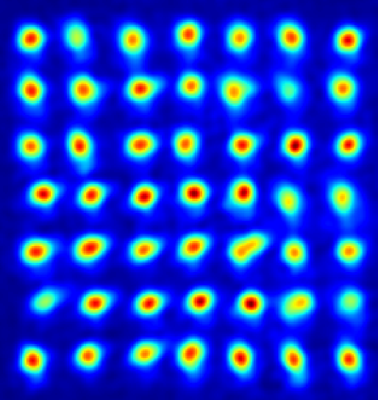
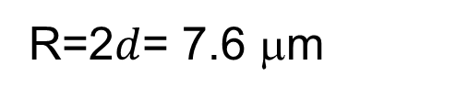
CNOT experiment
PRA 92, 022336 (2015)
82s_{1/2}
Ground-Rydberg
Rabi oscillations
B(R)/2π = 23 MHz
1038 nm
R=2$d$= 7.6 μm
7p_{1/2}
Ω_{Ry}/2π = .65 MHz
| > + | >
control
459 nm
6s_{1/2}
target

Slide 20
CNOT sequence & Bell states
PRA 92, 022336 (2015)
CNOT
Bell State
|c>
|1>
(π/2)_{x}
(π/2)_{φ}
(π/2)_{x}
Z_{φ}
(π/2)_{θ}
|1>
(π/2)_{x}
Z_{φ}
(π/2)_{θ}
(π/2)_{φ}
|t>
State preparation
F=98%
Bell state: F=0.73 +/- 0.05
F=0.79 +/- 0.05 (post selected)
CNOT truth table
F=82%
CNOT eye diagram
1.0
.97
.98
.97
F limited by SPAM errors, atom motion (Doppler), perturbing fields, laser noise, beam position noise, physics.
θ (radians)

Slide 21
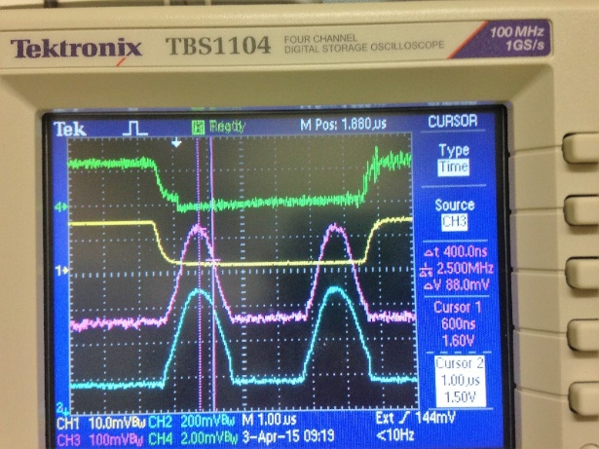
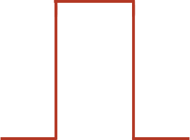
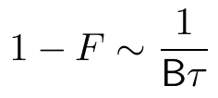
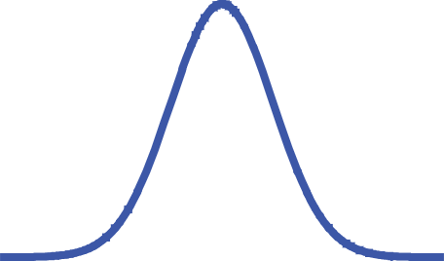
Improved CNOT protocols
Pulse shaping
Two-atom dark state
1-F<10⁻⁴

Slide 22
Two qubit gates – Scalability
1/R⁶ vdW interaction
Dense parallel operations not possible due to long range Rydberg interaction
R/d > 5
gives
Xtalk < 10⁻⁴
R
d

Slide 23
Multi-qubit gates
Can turn a bug into a feature for
multi-qubit gate operations.
Native CNOT^{k} & C_{k}NOT gates.
Wisconsin, Aarhus, Innsbruck….
Aarhus, Wisconsin
Wisconsin
UCL, London

Slide 24
Hardware outlook
Parameter Today Near term realism
Number qubits 80/121 600/900 laser&optics upgrade
Fidelity qubit measurement 0.99@10 msec >0.99@1 msec higher NA lens
Fidelity one-qubit gate 0.99-0.999@100 μs >0.999@200 ns Raman laser
Fidelity two-qubit gate 0.73@3 μs >0.99@500 ns sideband cooling,
laser noise reduction

Slide 25
Quantum simulator
Many proposals for cold atom quantum simulators. Erez Zohar yesterday
Rydberg versions

Slide 26
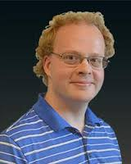
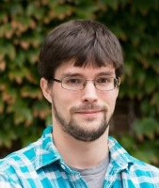
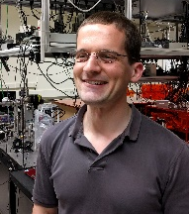
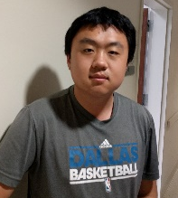
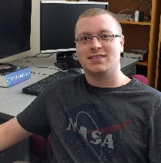
Summary
Neutral atom qubits
Optical wiring
Rydberg interactions for entangling gates
Atom-photon interface for connectivity
| > + | >
Trent
Graham
Matt Ebert
Garrett
Hickman
Xiaoyu Jiang
Cody Poole

