Slide 1
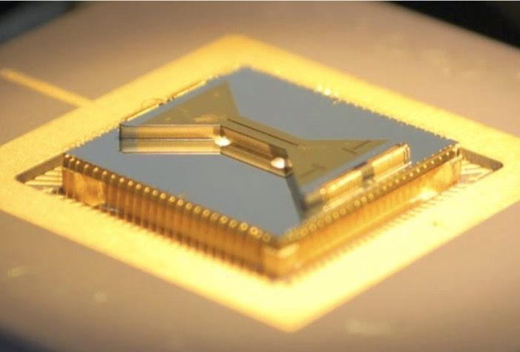





University
of
Maryland
……………
1 mm
Center for
Quantum
Information
& Computer
Science
QuICS
Reconfigurable Quantum Computers and Simulators with Atomic Ions
Christopher Monroe
University of Maryland, JQI, QuICS, and IonQ Inc.

Slide 2
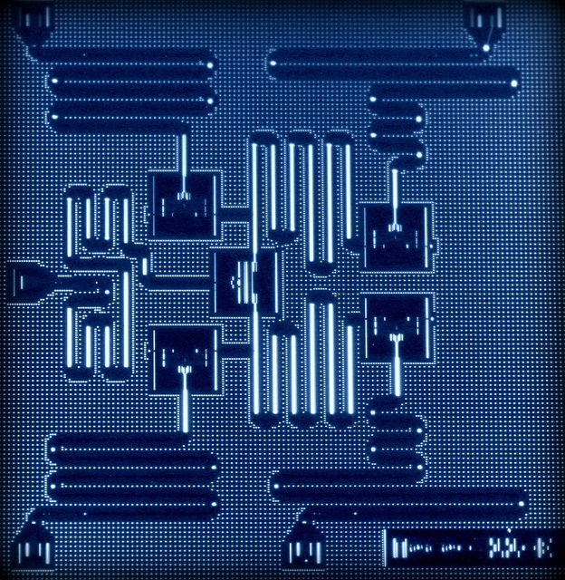
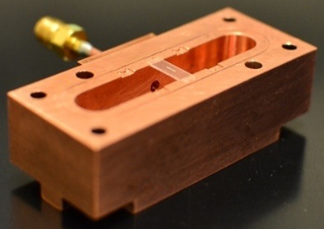
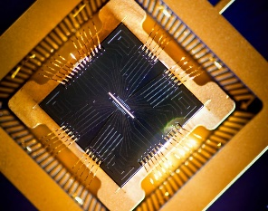
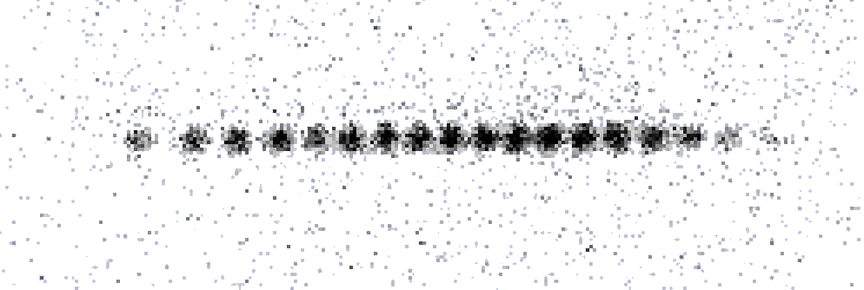
Two Quantum Technologies Ready for Building
Superconducting Circuits
Investments
FEATURES & STATE-OF-ART
connected with waveguides
~10 qubits demonstrated
fast clock speed
printable circuits and VLSI
CHALLENGES
short (10⁻⁶ sec) memory
0.05K cryogenics
all qubits different
limited connectivity
not reconfigurable
IARPA
DoD
Lincoln Labs
IBM
Intel/Delft
Google/UCSB
Rigetti Computing
Quantum Circuits, Inc.
Superconducting qubit: phase/charge/current, capacitive or microwave photon couplings
Trapped Atomic Ions
Investments
lasers
photon
FEATURES & STATE-OF-ART
very long (>>1 sec) memory
~20 qubits demonstrated
qubits all identical
fully connected
connections reconfigurable
CHALLENGES
lasers & optics
high vacuum
slow clock speed
engineering needed
IARPA
DoD
Lincoln Labs
Sandia
UK Gov’t
Honeywell
IonQ, Inc.
individual
atoms
Atomic qubits connected through
charge-coupled motion, shuttling, or photons
Notes:
My background – now times are changing.

Slide 3
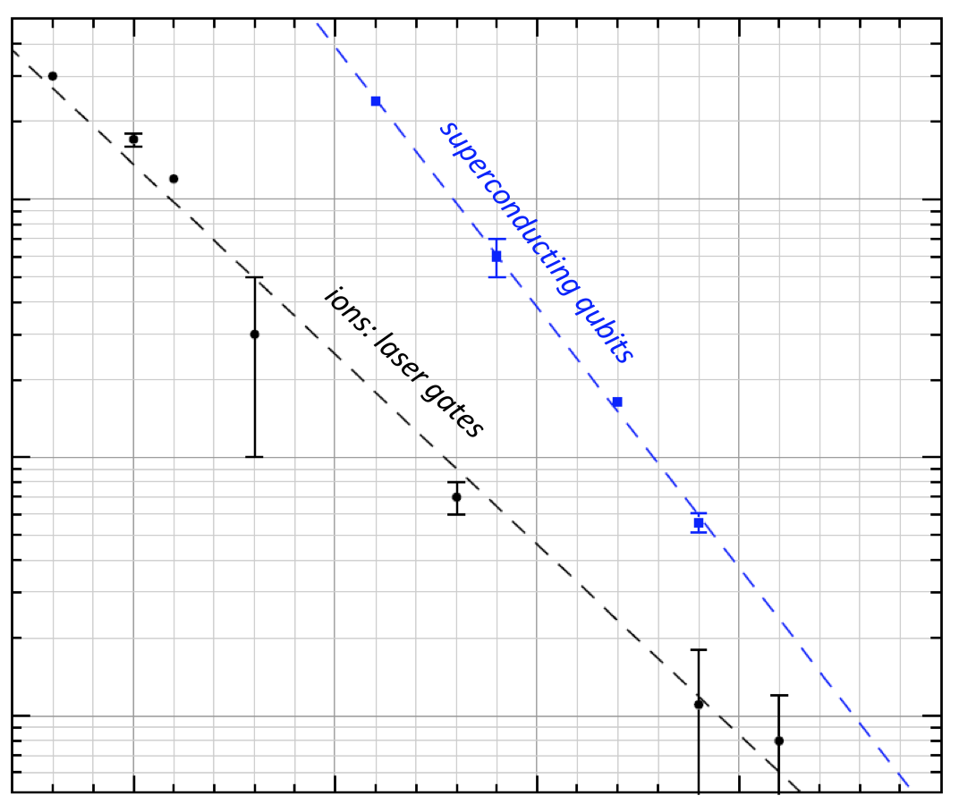
History of 2-Qubit Gate Performance
0.1
Error
per
Gate
0.01
0.001
2000 2005 2010 2015 2020
Year

Slide 4
Atomic Qubit (¹⁷¹Yb⁺)
²S_{1/2}
|↑⟩ = |1,0⟩
ν_{HF}/2π = 12.642 812 118 GHz
|↓⟩ = |0,0⟩

Slide 5
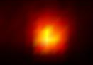
¹⁷¹Yb⁺ Qubit Detection
γ/2π = 20 MHz
²P_{1/2}
2.1 GHz
Probability
|↑⟩
369 nm
0
10
20
30
40
50
60
# photons collected in 50 μs
²S_{1/2}
|↑⟩
ν_{HF}/2π = 12.642 812 118 GHz
|↓⟩

Slide 6
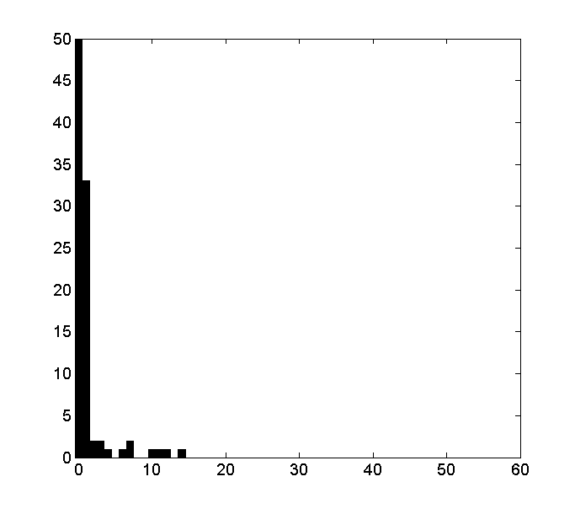
¹⁷¹Yb⁺ Qubit Detection
High-NA collection + SNSPD (J. Kim, Duke)
- 6.5% of fluorescence detected
- 99.93% qubit detection in 12 μs
γ/2π = 20 MHz
²P_{1/2}
2.1 GHz
Probability
|↓⟩
|↑⟩
369 nm
0
10
20
30
40
50
60
# photons collected in 50 μs
²S_{1/2}
|↑⟩
ν_{HF}/2π = 12.642 812 118 GHz
|↓⟩

Slide 7
¹⁷¹Yb⁺ Qubit Manipulation
²P_{3/2}
γ/2π = 20 MHz
66 THz
33 THz
²P_{1/2}
355 nm
(100 MHz, 10psec)
²S_{1/2}
|↑⟩
|↓⟩
ν_{HF} = 12.642 812 118 GHz
D. Hayes et al., PRL 104, 140501 (2010)

Slide 8


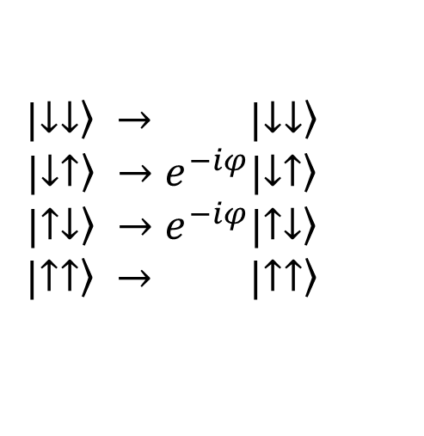
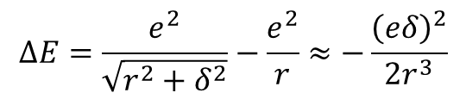

Entangling Trapped Ion Qubits
r
~5 μm
↑
↑
↓
↓
δ
$$∆E=\frac{e^{2}}{\sqrt{r^{2}+δ^{2}}}−\frac{e^{2}}{r}≈−\frac{{\left(eδ\right)}^{2}}{2r^{3}}$$
δ ~ 10 nm
eδ ~ 500 Debye
dipole-dipole coupling
$$|\left.↓↓\right\rangle → |\left.↓↓\right\rangle$$
$$|\left.↓↑\right\rangle →e^{−iφ}|\left.↓↑\right\rangle$$
$$|\left.↑↓\right\rangle →e^{−iφ}|\left.↑↓\right\rangle$$
$$|\left.↑↑\right\rangle → |\left.↑↑\right\rangle$$
$$φ=\frac{∆Et}{ℏ}=\frac{e^{2}δ^{2}t}{2ℏr^{3}}$$
$$=\frac{π}{2}$$
for full
entanglement
Native Ion Trap Operation: “Ising” gate
Cirac and Zoller (1995)
Mølmer & Sørensen (1999)
Solano, de Matos Filho, Zagury (1999)
Milburn, Schneider, James (2000)
T_{gate} ~ 10−100 μs
F ~ 98% – 99.9%
$XX\left[φ\right]=e^{−iσ_{x}^{(1)}σ_{x}^{(2)}φ}$

Slide 9
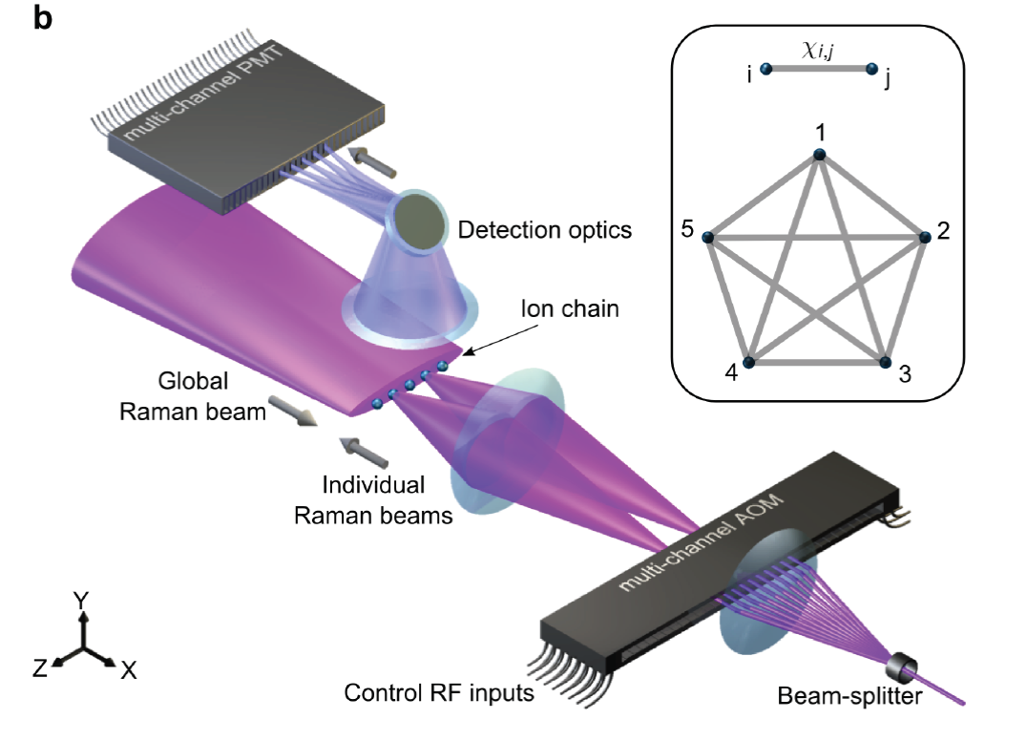
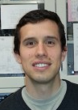
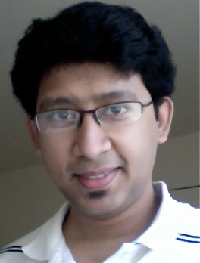
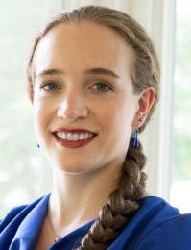
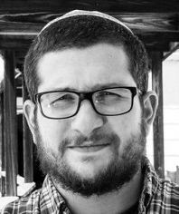
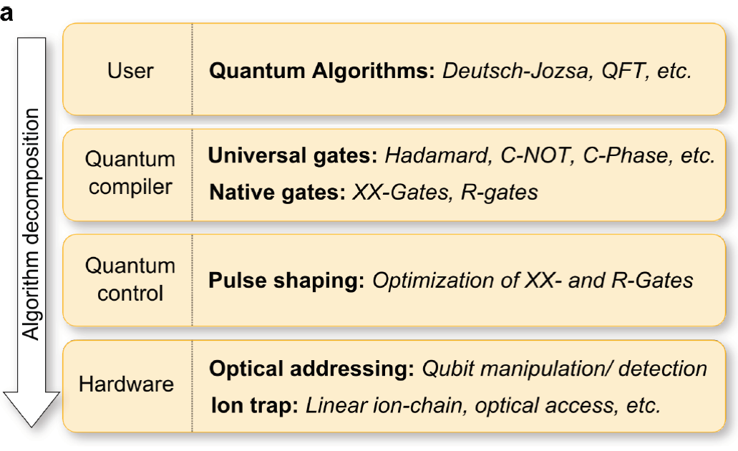
Suite of Algorithms implemented on trapped ion qubits
application | # qubits | # 2Q gates | # 1Q gates | fidelity | reference | collaborator
CNOT | 2 | 1 | 3 | 99% | Nature 536, 63 (2016)
QFT Phase est. | 5 | 10 | 70-75 | 61.9% | Nature 536, 63 (2016)
QFT period finding | 5 | 10 | 70-75 | 695-97% | Nature 536, 63 (2016)
Deutsch-Jozsa | 5 | 1-4 | 13-34 | 93%-97% | Nature 536, 63 (2016)
Bernstein-Vazirani | 5 | 0-4 | 10-38 | 90% | Nature 536, 63 (2016)
Hidden Shift | 5 | 4 | 42-50 | 77% | PNAS 114, 13 (2017) | Microsoft
Grover Phase | 3 | 10 | 35 | 85% | Nat. Comm. 8, 1918 (2017) | NSF
Grover Boolean | 5 | 16 | 49 | 83% | Nat. Comm. 8, 1918 (2017) | NSF
Margolus | 3 | 3 | 11 | 90% | PNAS 114, 13 (2017) | Microsoft
Toffoli | 3 | 5 | 9 | 90% | PNAS 114, 13 (2017) | Microsoft
Toffoli-4 | 5 | 11 | 22 | 71% | Debnath Thesis | NSF
Fredkin Gate | 3 | 7 | 14 | 86% | arXiv:1712.08581 (2017) | Intel
Fermi-Hubbard Sim. | 5 | 31 | 132 |  | arXiv:1712.08581 (2017) | Intel
Scrambling Test | 7 | 15 | 30 | 75% | In preparation (2018) | Perimeter, UCB
Game Theory | 5 | 5 | 15 |  | In preparation (2018) | Army Res. Lab.
Machine Learning | 4 | 6 | 8 | 90% | arXiv:1801.07686 (2018) | NASA
[[4,2,2]] Error Det. | 5 | 6-7 | 20-25 | 98%-99.9% | Sci. Adv. 3, e1701074 (2017) | Duke
Full Adder | 4 | 4 | 16 | 83% | Figgatt Thesis | NSF
Simultaneous CNOT | 4 | 2 | 8 | 94% | Figgatt Thesis | NSF
Deuteron Simulation | 3 | 21 | 11 |  | In progress | ORNL
Norbert Linke Shantanu Debnath Caroline Figgatt Kevin Landsman
Full “Quantum Stack” architecture

Slide 10
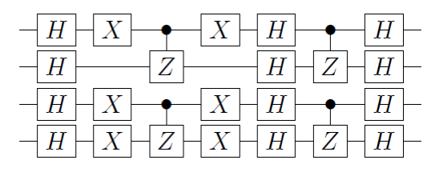
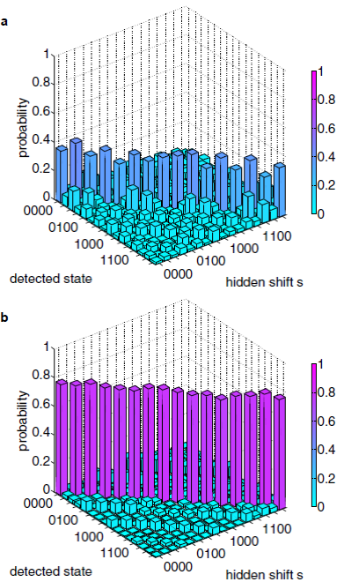
Hidden Shift algorithm
Given two N-bit functions f (x) = g (x+s)
find the hidden shift s
Classical: 2^{N/2} queries of f (x)
Quantum: 1 query
4-qubit
circuit for
s = 1010
5-qubit ion trap QC
(UMaryland)
5-qubit superconductor QC
(IBM Quantum Experience)
full
connectivity
‘star’
connectivity
N. Linke, et al., PNAS 114, 13 (2017)

Slide 11
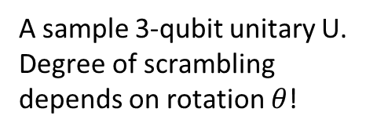
N. Yao (UC Berkeley)
B. Yoshida (Perimeter Inst.)
K. Landsman et al. (UMD)
Scrambling litmus test circuit (7 qubits)
Quantum scrambling
Not just entanglement but the “complete diffusion” of entanglement within a system
relevant to information evolution in black holes
P. Hayden and J. Preskill, J. HEP 9, 120 (2007)
arb. Input state
successful teleportation
if U is “scrambling”
A sample 3-qubit unitary U.
Degree of scrambling depends on rotation $θ$!
U
:

Slide 12
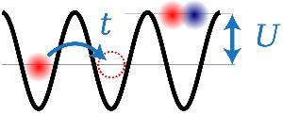

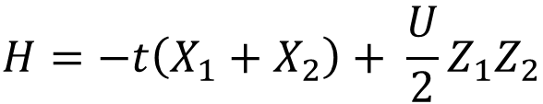
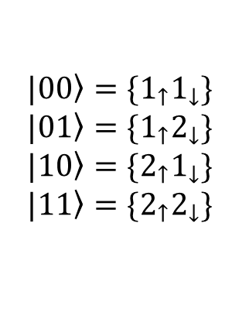
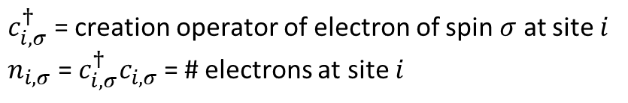
Simulating the 2-site Fermi-Hubbard Model
N. Linke, et al.,arXiv:171208581 (2017)
Two-site electronic Fermi-Hubbard model
$c_{i,σ}^{†}$ = creation operator of electron of spin $σ$ at site $i$
$n_{i,σ}$ = ${c_{i,σ}^{†}c}_{i,σ}$ = # electrons at site $i$
$$i j$$
$$|\left.00\right\rangle =\{1_{↑}1_{↓}\}$$
$$|\left.01\right\rangle =\{1_{↑}2_{↓}\}$$
$$|\left.10\right\rangle =\{2_{↑}1_{↓}\}$$
$$|\left.11\right\rangle =\{2_{↑}2_{↓}\}$$
2 sites: encoding into 2 qubits (given conservation of electron number and total spin)
$$H=−t\left(X_{1}+X_{2}\right)+ \frac{U}{2}Z_{1}Z_{2}$$
X, Z = qubit Pauli matrices
Notes:
CSS codes have separate X-type and Z-type stabilizers

Slide 13
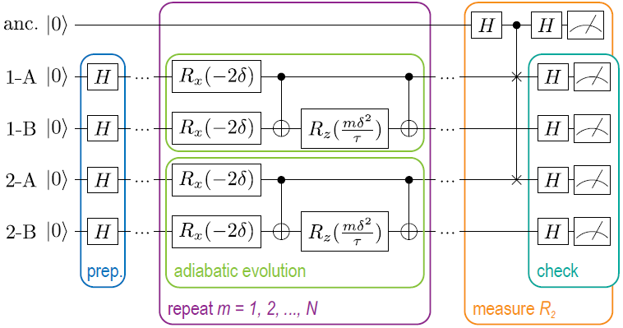
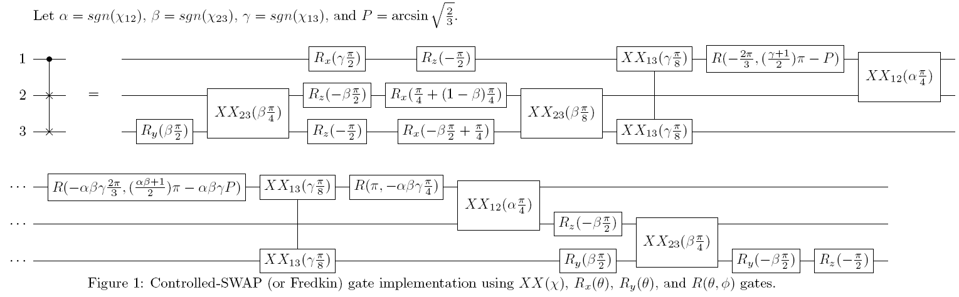

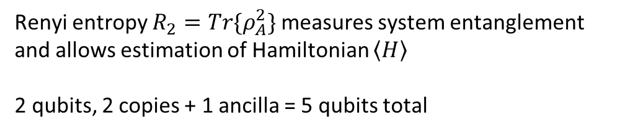
Simulating the 2-site Fermi-Hubbard Model
N. Linke, et al.,arXiv:171208581 (2017)
Renyi entropy $R_{2}=Tr\{ρ_{A}^{2}\}$ measures system entanglement
and allows estimation of Hamiltonian $\left\langle H\right\rangle$
2 qubits, 2 copies + 1 ancilla = 5 qubits total
C-NOT gate
Trotter circuit to evaluate Hamiltonian
C-Swap gate
Number of iterations $N=Uτ/δ$
Implemented up to $N=6$ iterations: 132 single-qubit gates, 31 dual-qubit gates

Slide 14
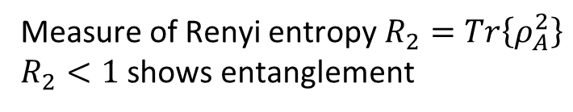

Simulating the 2-site Fermi-Hubbard Model
N. Linke, et al.,arXiv:171208581 (2017)
Measure of Renyi entropy$R_{2}=Tr\left\{ρ_{A}^{2}\right\}$
$R_{2}<1$ shows entanglement
Measure of $\left\langle H\right\rangle =−t\left(\left\langle X_{1}\right\rangle +\left\langle X_{2}\right\rangle \right)+ \frac{U}{2}\left\langle Z_{1}Z_{2}\right\rangle$

Slide 15
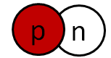
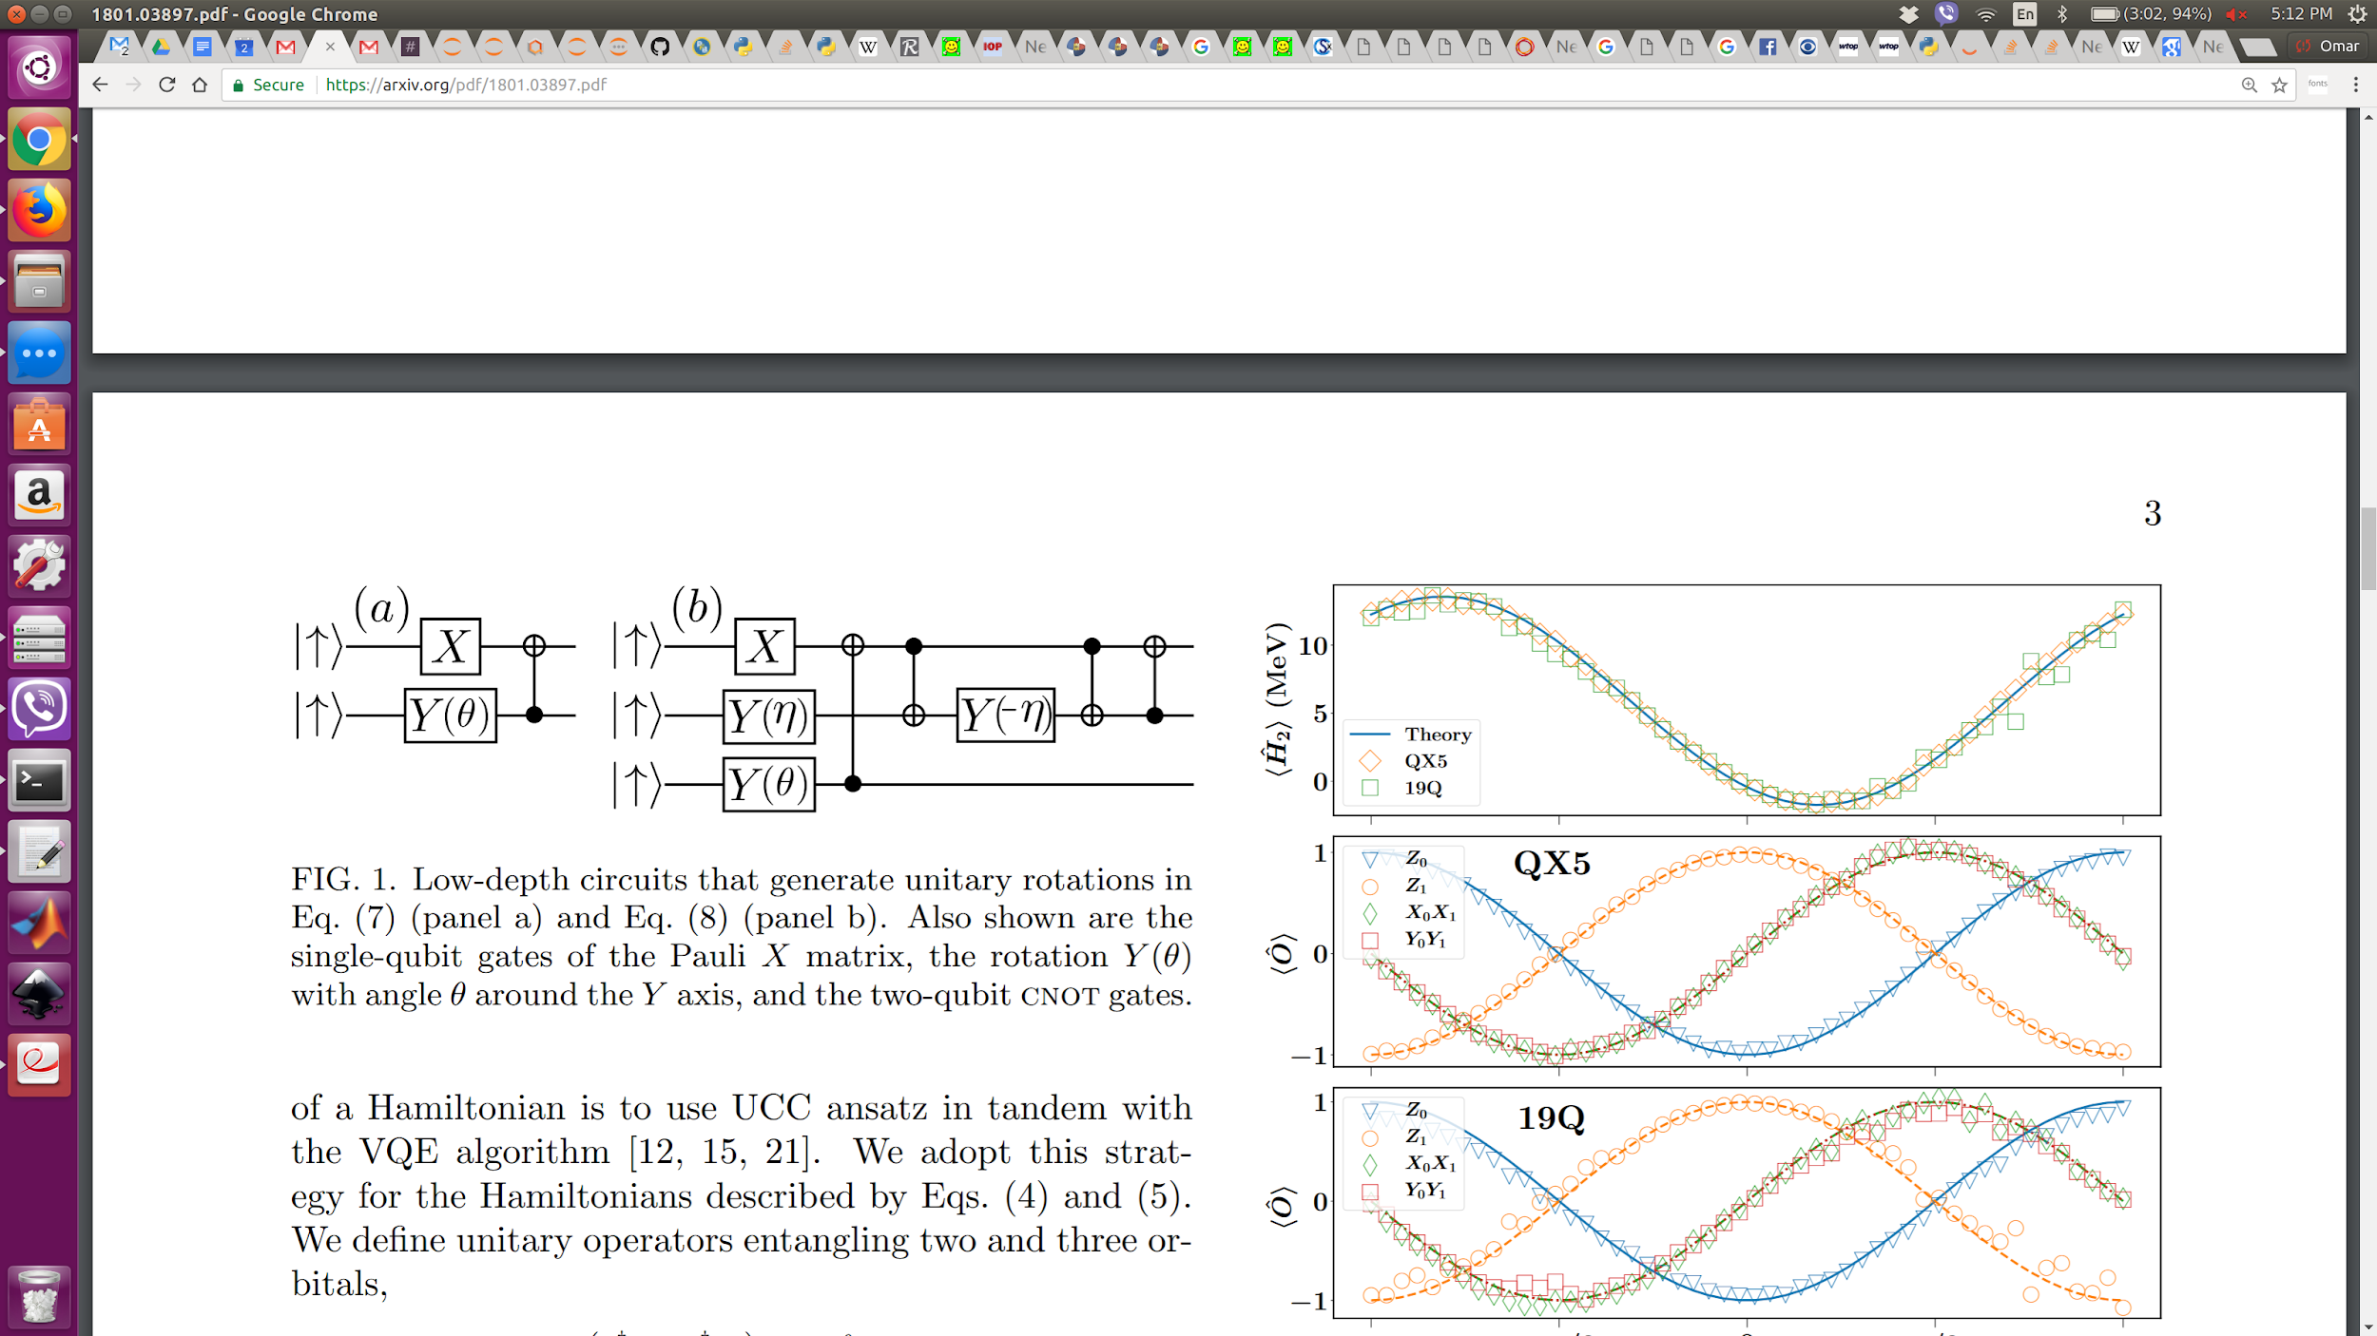
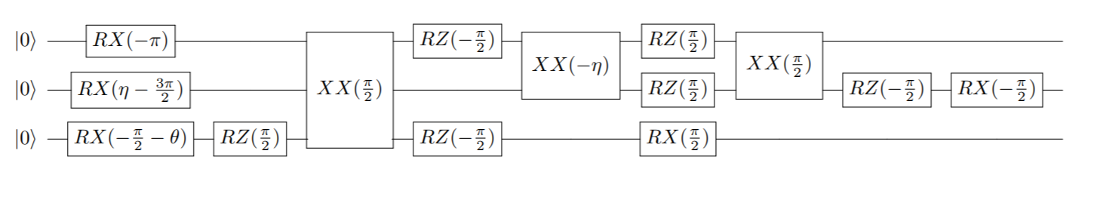
Simulating the Ground State of Deuteron
ORNL (R. Pooser, E. Dumitrescu, P. Lougovski, A. McCaskey)
UMD (K. Landsman, N. Linke, D. Zhu, CM)
IonQ (Y. Nam, O. Shehab, CM)
canonical
UCC ansatz
… compiled
to our native
gate set
H = (15.531709)I + (0.218291)Z₀ − (6.125)Z₁ − (9.625)Z₂
−(2.143304)X₀X₁ −(2.143304)Y₀Y₁ −(3.913119)X₁X₂ − (3.913119)Y₁Y₂
E.F. Dumitrescu et al., arXiv 1801.03897 (2018)

Slide 16
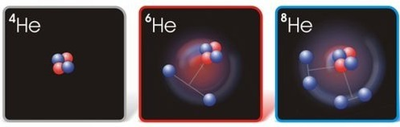
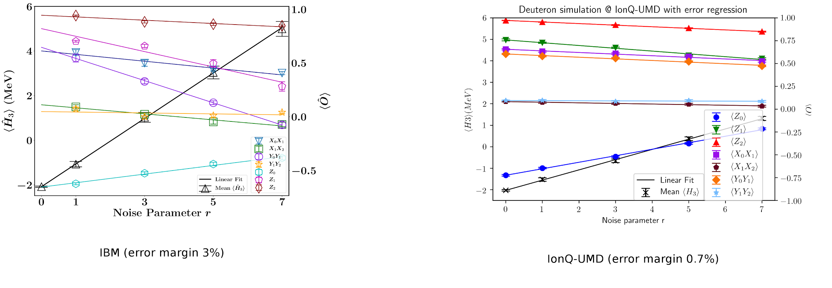
Simulating the Ground State of Deuteron
Ground state energy for theoretically determined optimal angles:
Up Next
(?)
(Note: implementing 3-qubit ansatz on Rigetti system was not possible)

Slide 17
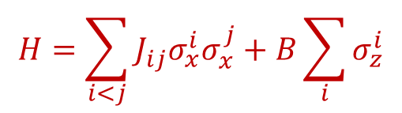
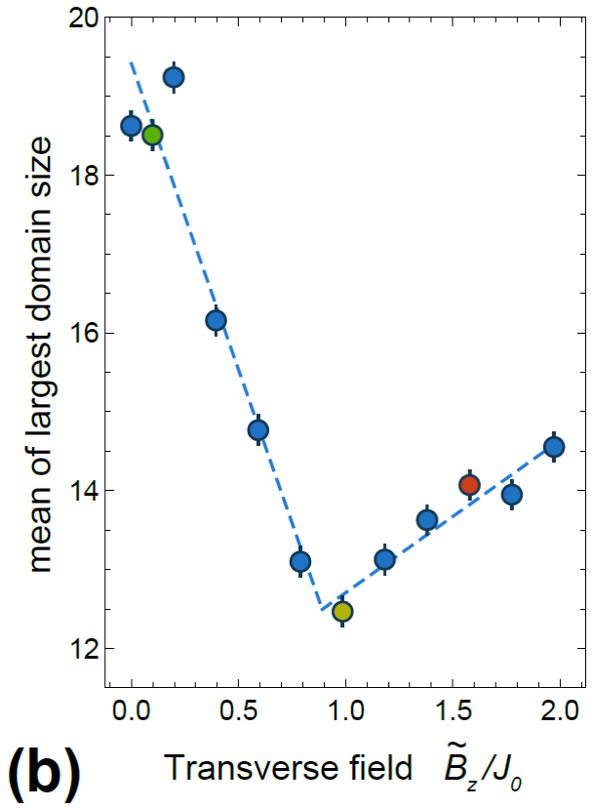
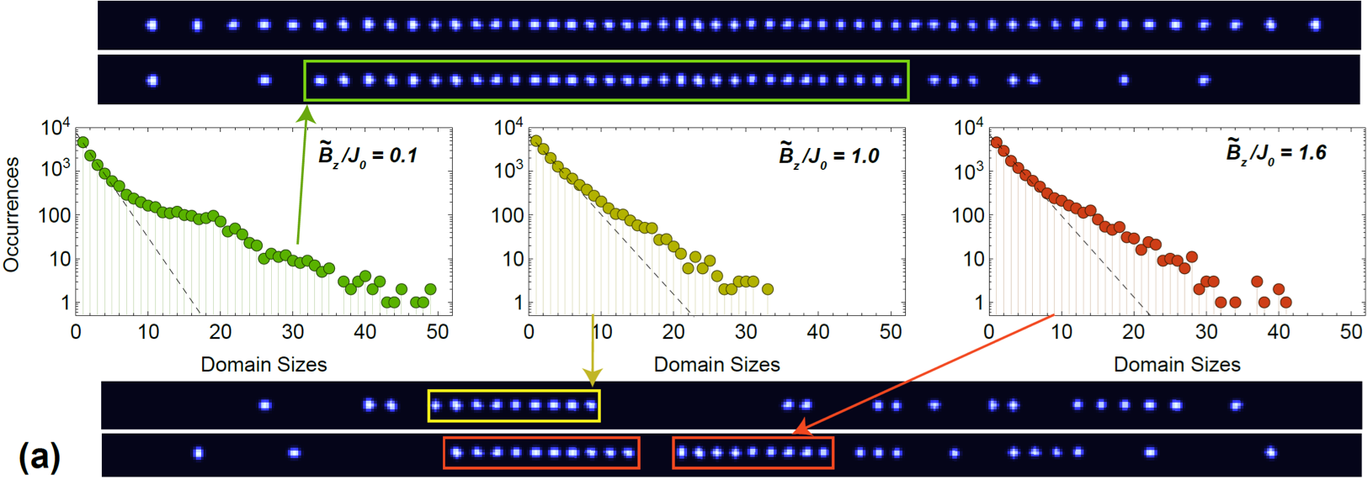
Quantum Simulation with 50+ Qubits
J. Zhang et al., Nature 551, 601 (2018)
(See Friday talk!)
Prepare qubits (spins) along x
Apply “all-on-all” entangling gates (long-range transverse Ising model)
Measure each qubit along x
Dynamical Phase Transition
N=53 qubits
M. Heyl, et al., Phys. Rev. Lett. 110, 135704 (2013)
P. Jurcevic, et al., Phys. Rev. Lett. 119, 080501 (2017)
J. Zhang, et al., Nature 551, 601 (2017)

Slide 18
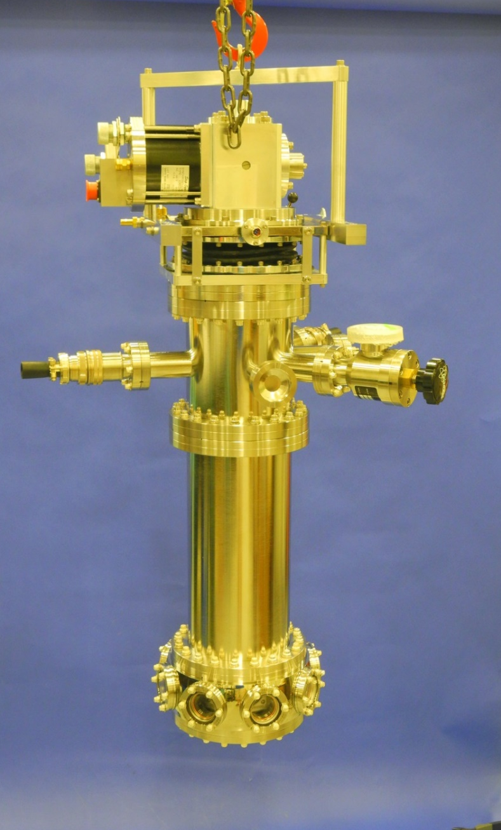
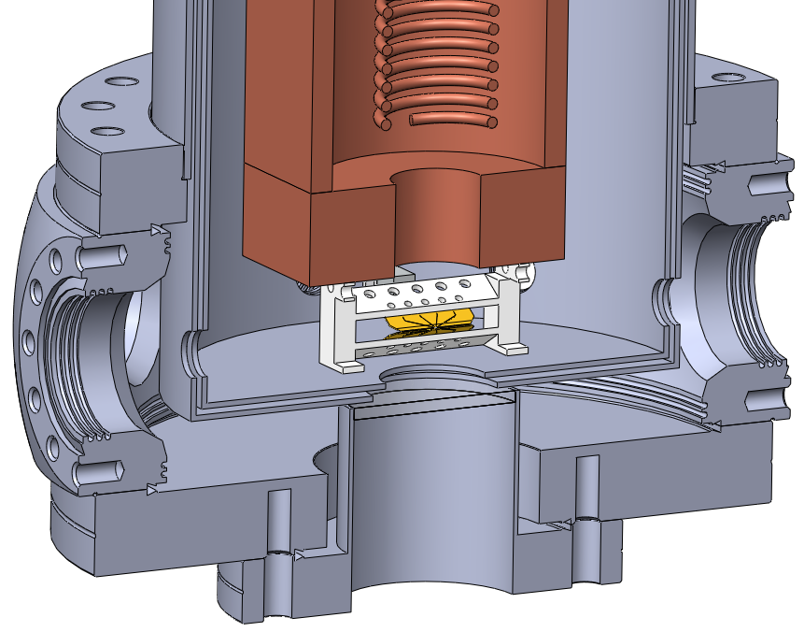

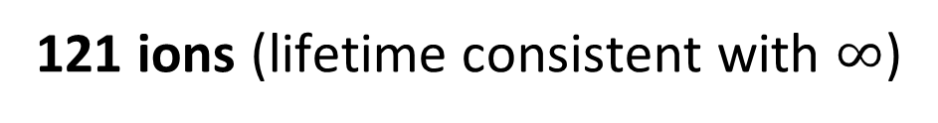
Scaling Up: 4K environment (better vacuum!)
5-segment linear rf ion trap
(Au on Al₂O₃ blades, 200μm)
4 K Shield
40 K Shield
300 K
Phil Richerme
Paul Hess
Guido Pagano
121 ions (lifetime consistent with $∞$)

Slide 19
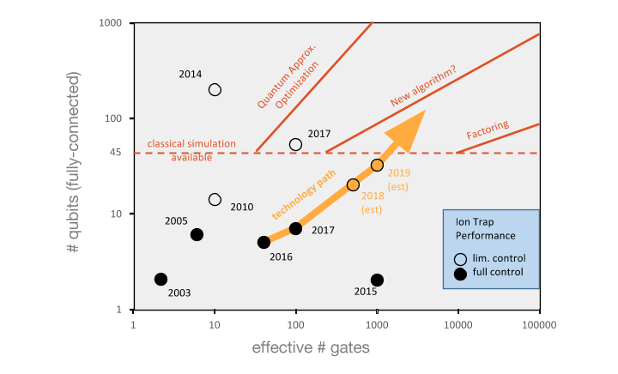
Quantum Number vs. Gate Count

Slide 20
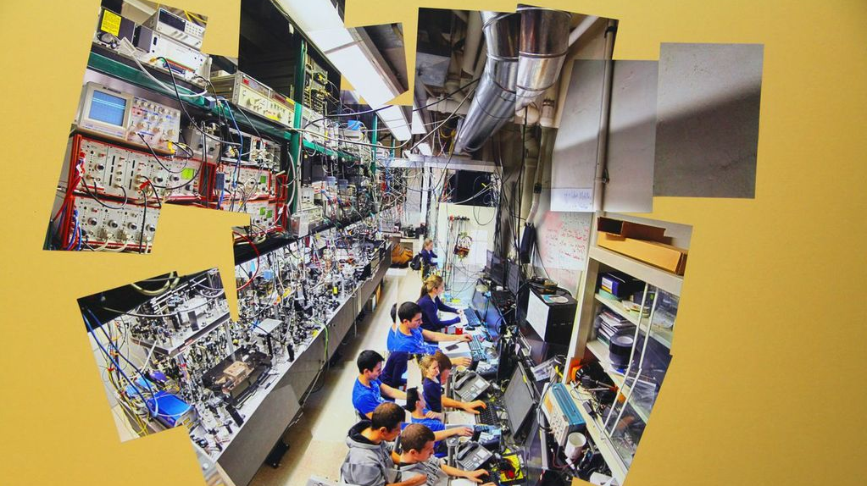
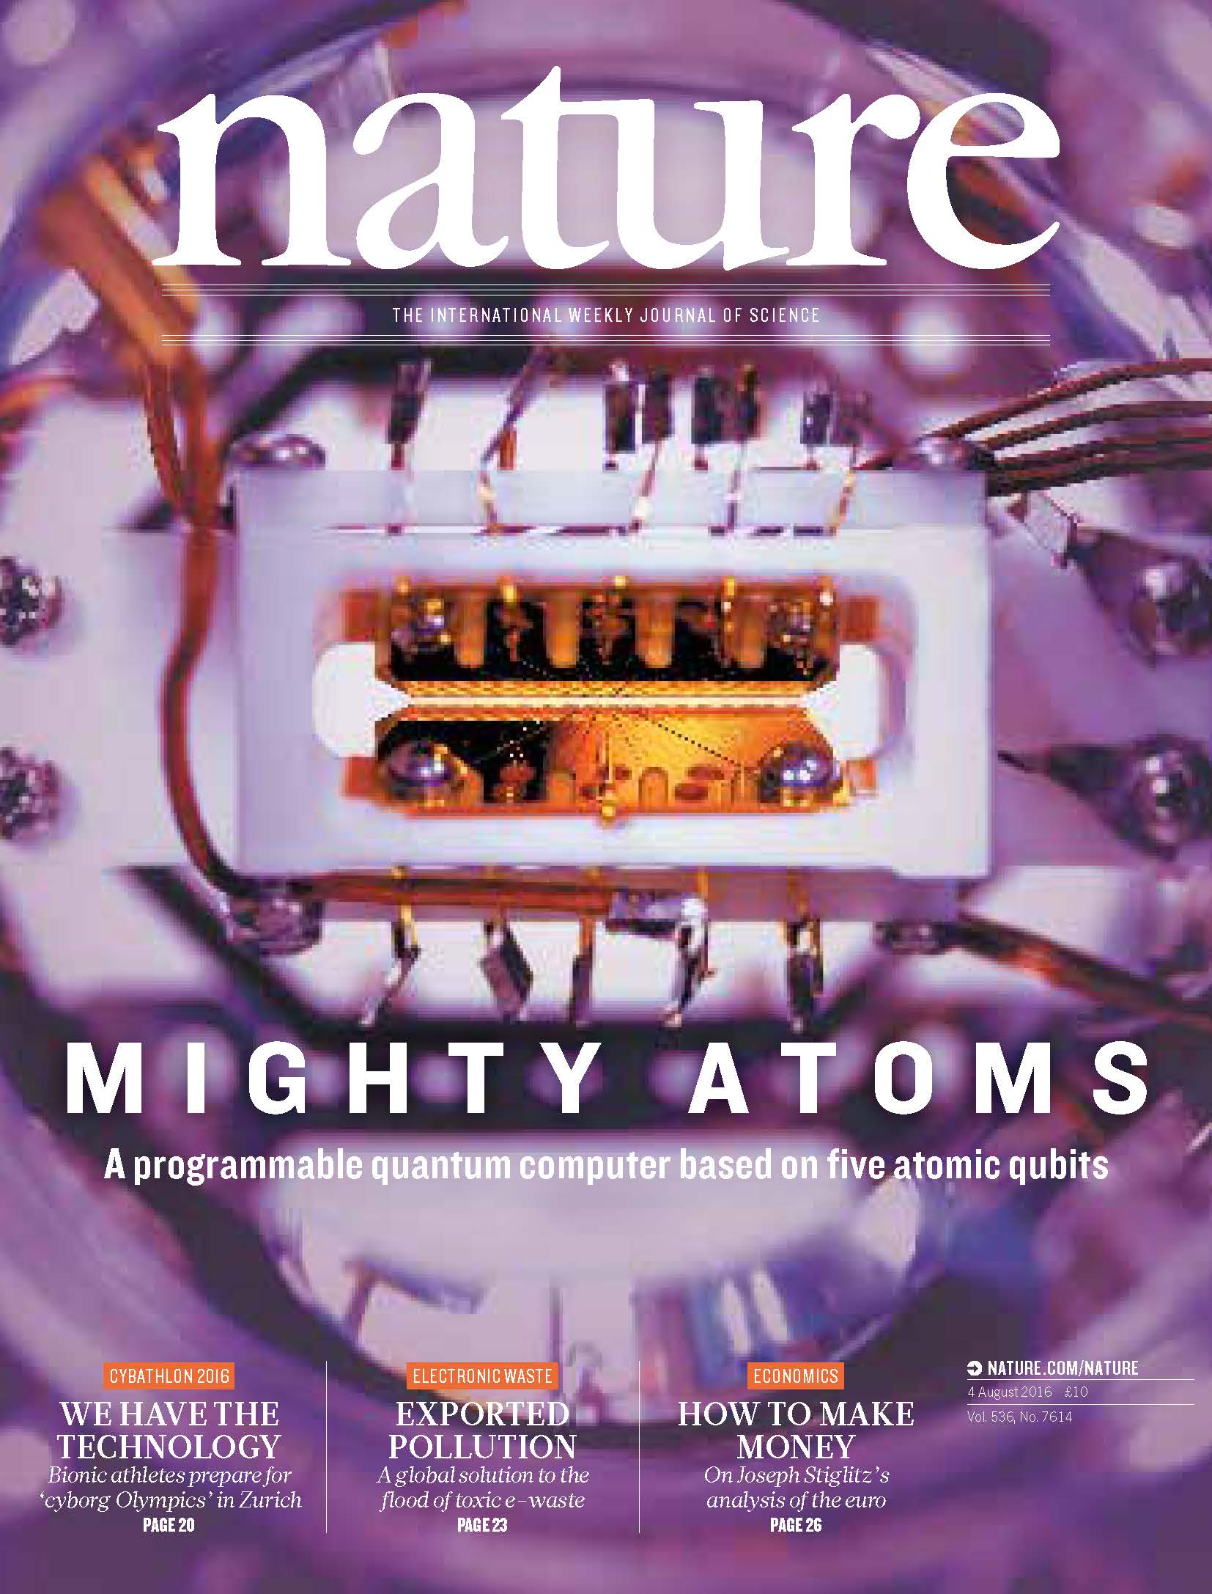
Ion Trap Lab at
JQI-Maryland

Slide 21
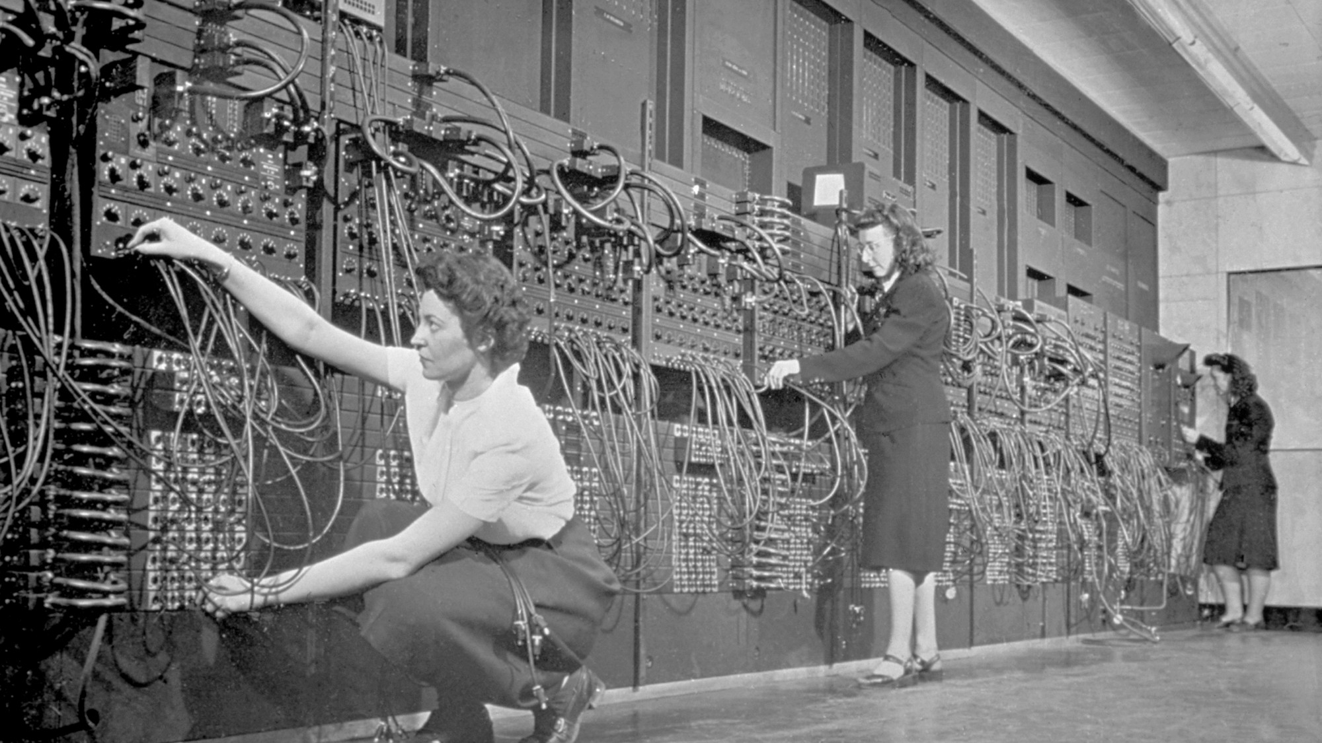
ENIAC (1946)
Vacuum tube triode
Notes:
Electronic Numerical Integrator and Computer

Slide 22
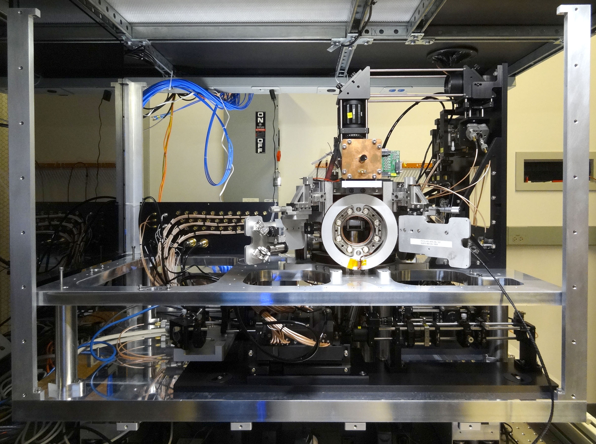

Slide 23
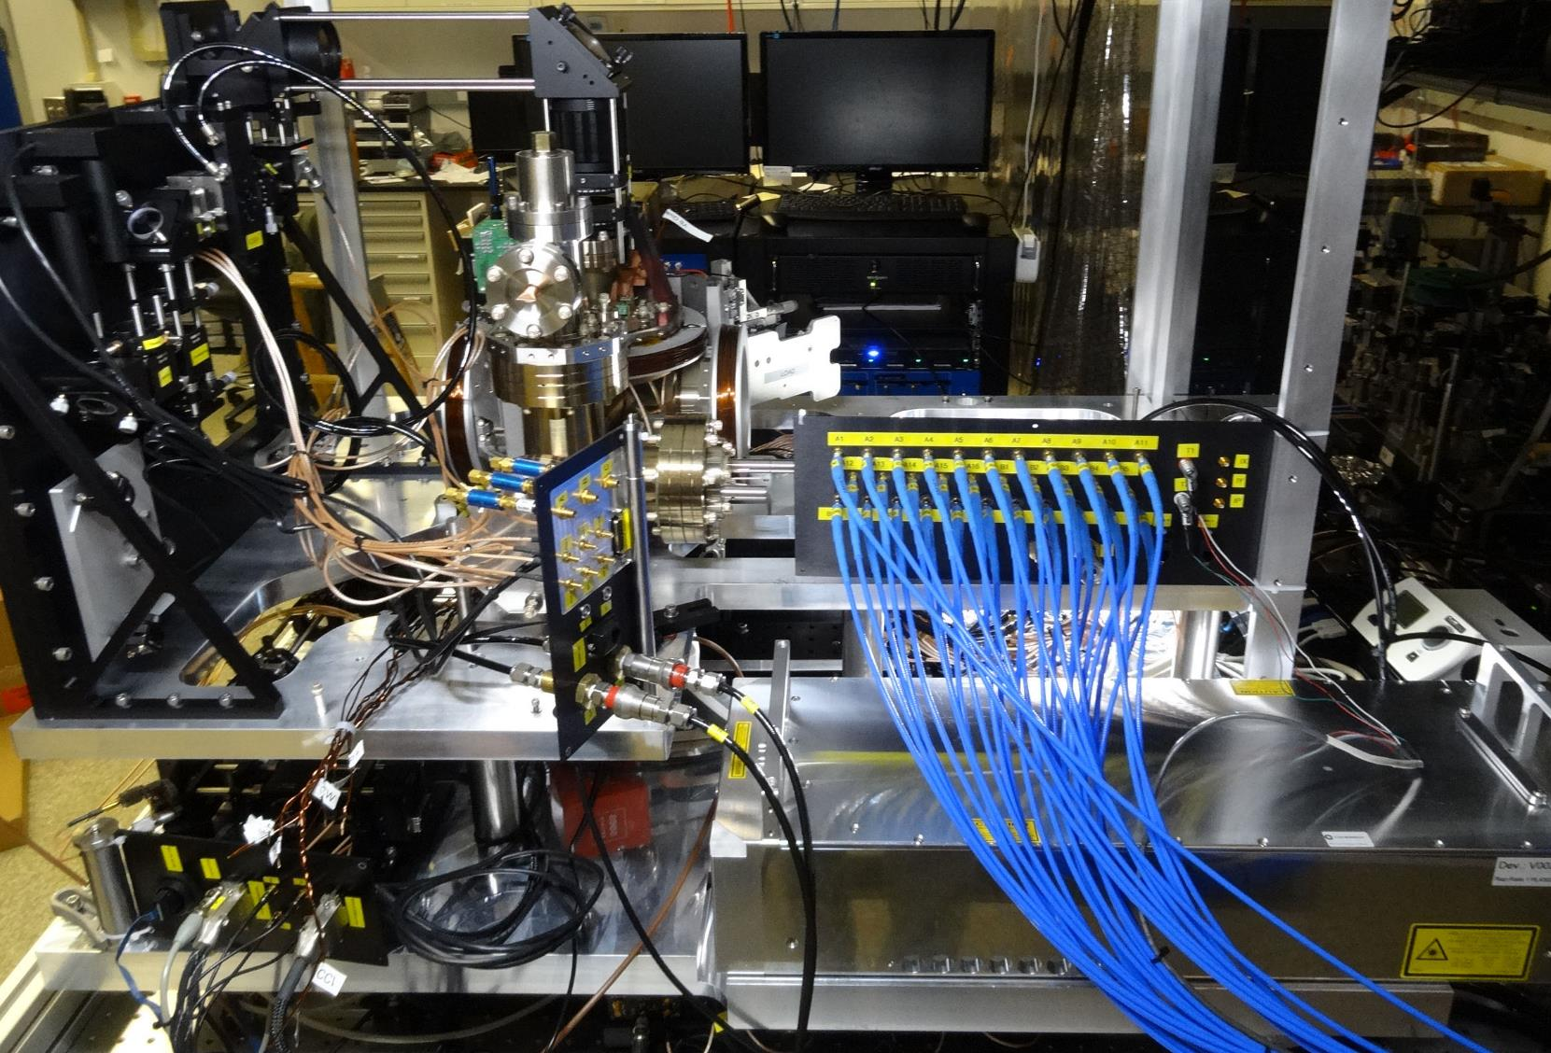

Slide 24
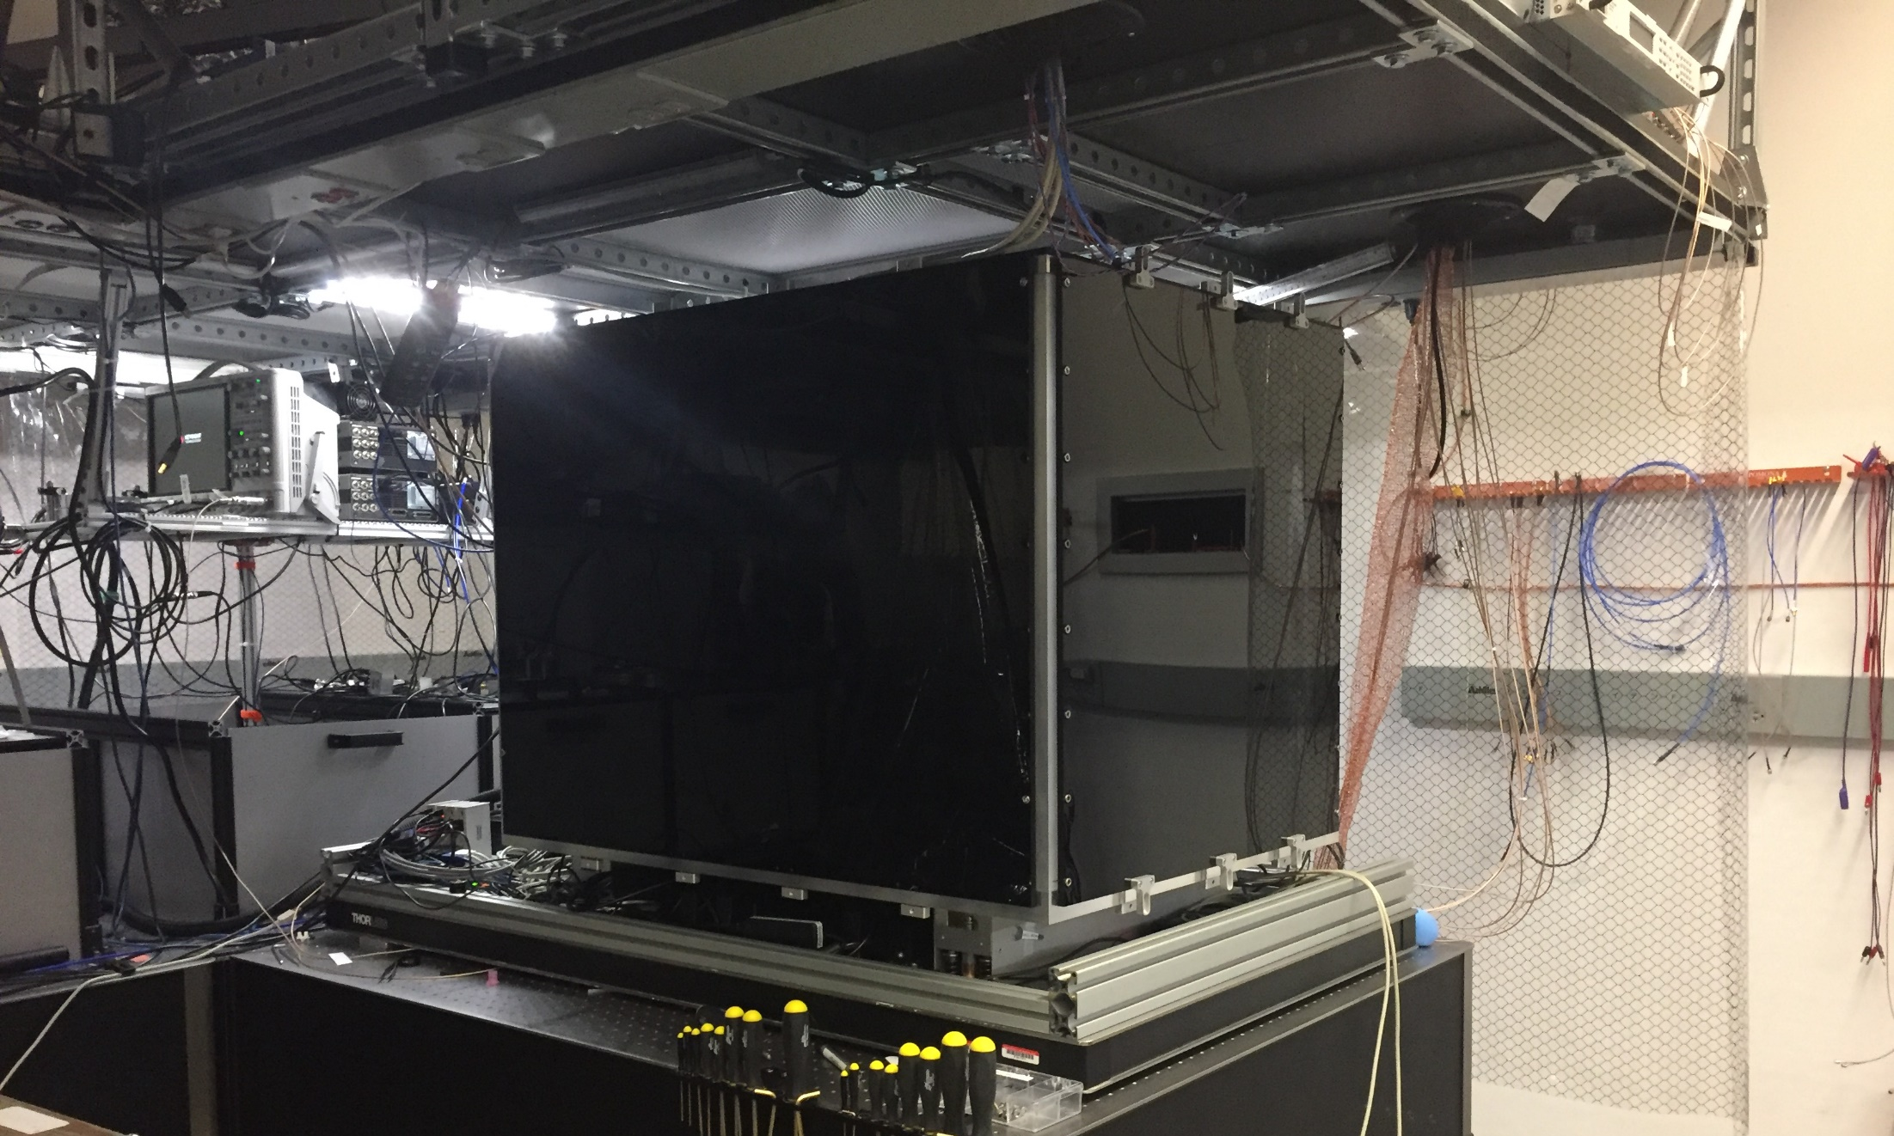







Slide 25
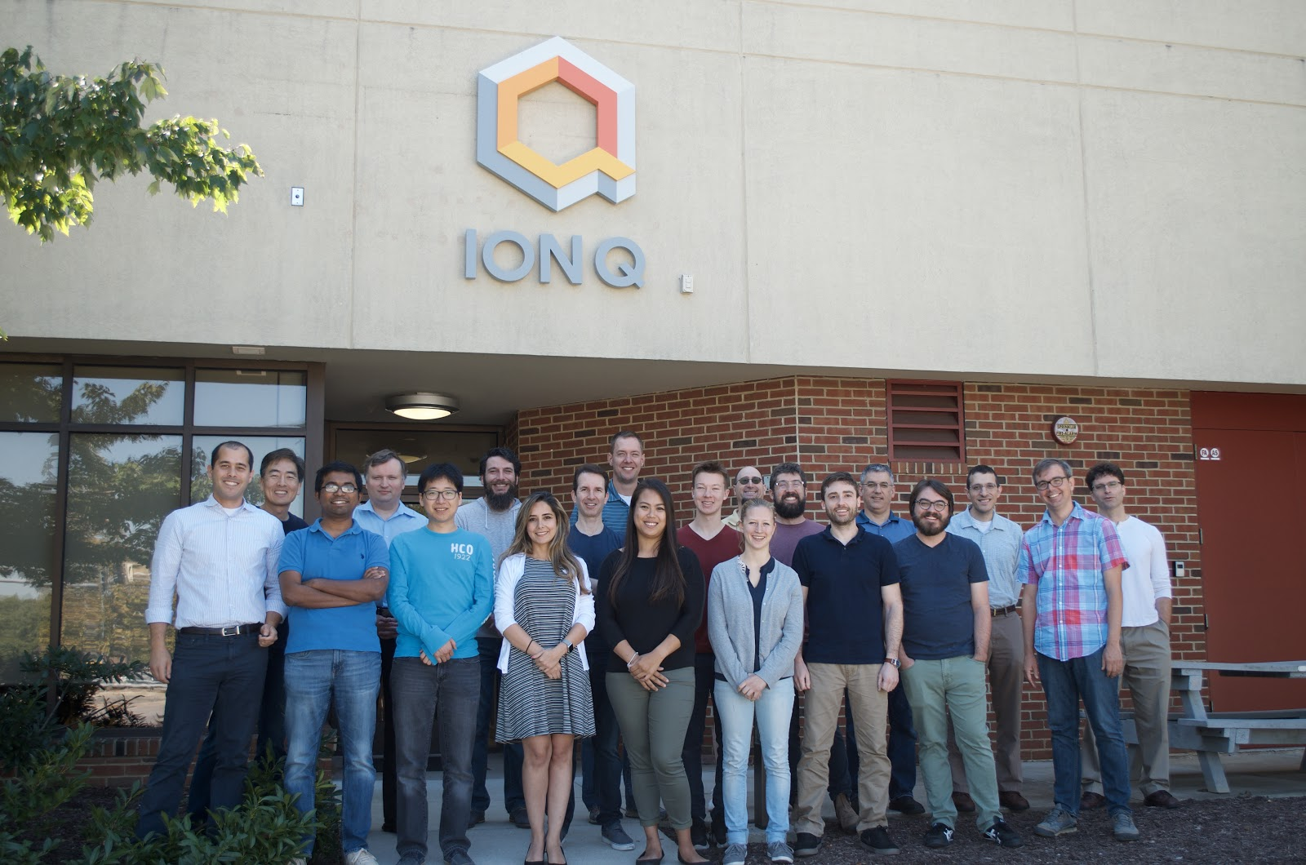
www.ionq.co
College Park, MD
27 employees

Slide 26
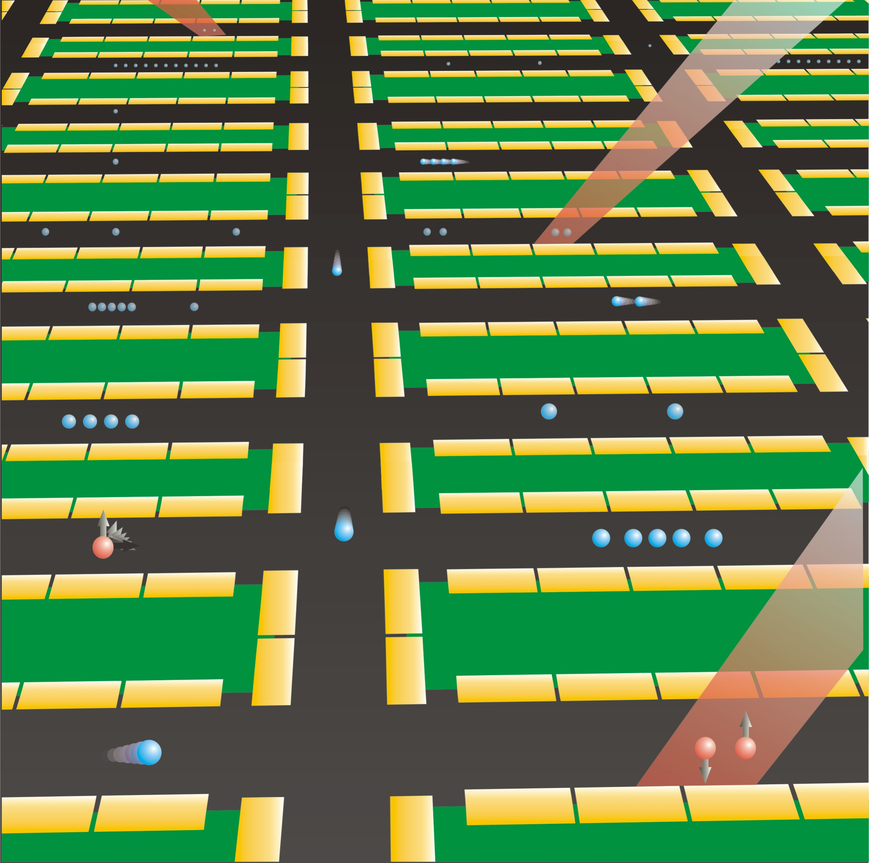
Scaling Atomic Ion Qubits I
D. Kielpinski, CM, D. Wineland, Nature 417, 709 (2002)

Slide 27
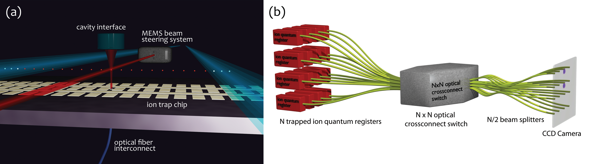
Scaling Atomic Ion Qubits II
Link to Photonic Networks
Duan and Monroe, Rev. Mod. Phys. 82, 1209 (2010)
Li and Benjamin, New J. Phys. 14, 093008 (2012)
Monroe, et al., Phys. Rev. A 89, 022317 (2014)

Slide 28
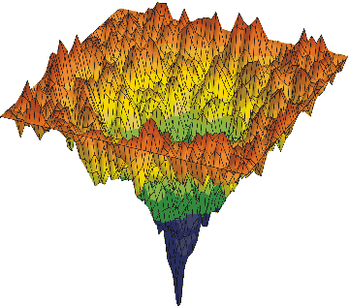





Broad Area of Application: Quantum Optimization
x₂
  Minimizing complex functions by “simultaneously sampling”
  entire space through quantum superposition
  Logistics Pattern Recognition
  Operations Research Machine Learning
  Decision Making Material Simulations
x₁
global minimum
of f (x₁,x₂ )
  Examples
  Quadratic Optimization
  Minimize
  this function is similar to
  the total energy of
  a magnetic network
  Quantum Chemistry
  “Traveling Salesman” problem
            complex material
            properties
            molecular function
            light harvesting
            processes
$$f(x1, x2,…)=\sum_{i<j}{q_{ij}x_{i}x_{j}+\sum_{i}{c_{i}x_{i}}}$$
what is the
shortest path
through N cities?

Slide 29





Bill Phillips
NIST/JQI
“A quantum computer differs more from a classical computer……
…than a classical computer differs from an ABACUS”

Slide 30










Trapped Ion Quantum Information
www.iontrap.umd.edu
Postdocs
Kristi Beck
Paul Hess (Middlebury)
Mike Goldman
Marty Lichtman
Steven Moses (Honeywell)
Guido Pagano
Jiehang Zhang
Grad Students
Patrick Becker
David Campos (IonQ)
Allison Carter
Kate Collins
Clay Crocker
Shantanu Debnath (IonQ)
Laird Egan
Caoline Figgatt (Honeywell)
Jessica Hankes
Volkan Inlek (Duke)
Kevin Landsman
Aaron Lee (Northrop)
Kale Johnson (Yale)
Harvey Kaplan
Antonis Kyprianidis
Ksenia Sosnova
Wen-Lin Tan
Jake Smith (Northrop)
Ken Wright (IonQ)
Daiwei Zhu
Research Scientists
Jonathan Mizrahi (IonQ)
Kai Hudek (IonQ)
Marko Cetina
Jason Amini (IonQ)
Norbert Linke
Key Collaborators
Ken Brown (GaTech/Duke)
Luming Duan (Michigan/Tsinghua)
D. Maslov (NSF)
M. Roetteler (Microsoft)
David Huse (Princeton)
Jungsang Kim (Duke)
Alexey Gorshkov (NIST)
Mohammad Hafezi (UMD)
Norman Yao (Berkeley)
US Army Research
Office and Laboratory
Undergrads
Eric Birckelbaw
Micah Hernandez
Sophia Scarano

