Slide 1

Desktop superconducting photon detectors and … computers?
Quantum Opus, LLC
Aaron J. Miller, PhD
Founder, President

Slide 2
Outline
Superconducting photon detection
      Ideal photon detectors
      Superconducting Transition-Edge Sensors
      Superconducting Nanowire Detectors
Quantum Opus commercial nanowire detectors
      Laboratory system
      Desktop system
New applications of a cool technology
      Optical Communication
      Cryogenic Computing
      Quantum Sensing

Slide 3
Motivation for Single-Photon Detection
  Fundamental quantum information science
  Quantum key distribution
  Random number generation
  LiDAR – from 10 cm to 1 cm, range from 1 km to 10s km
  Single-molecule fluorescence
  Oxygen singlet detection for drug delivery studies
  Non-invasive “x-rays”
  Ultra-low-power telecommunication (Mars-link, battlefield)

Slide 4
The ideal detector
Eisaman, Fan, Migdall, Polyakov (2011)*:
We consider an ideal single-photon detector to be one for which: the detection efficiency (the probability that a photon incident upon the detector is successfully detected) is 100%, the dark-count rate (rate of detector output pulses in the absence of any incident photons) is zero, the dead time (time after a photon-detection event during which the detector is incapable of detecting a photon) is zero, and the timing jitter (variation from event to event in the delay between the input of the optical signal and the output of the electrical signal) is zero.
* Review of Scientific Instruments 82, 071101 (2011)
Ideal Specs.
DE = 100%
DCR = 0 cts/s
Dead-time = 0 s
Jitter = 0 s

Slide 5
Motivation for superconducting detectors
Fundamental excitation energy meV instead of eV
Simple device design—usually cleaner response
Low operating temperature helps thermal noise limits
Performance benefits outweigh cryogenic costs
Relatively new technology—innovations are frequent
Two main “winning” photon counting technologies:
TES, SNSPD

Slide 6

Superconductivity
Useful features of superconductors
  True zero dc resistance
  Sharp transition via I, H, T
  Large resistance change
  (Relatively) simple electro-thermal system with rapid thermalization
  Extremely low noise
  TES vs Nanowire…

Slide 7
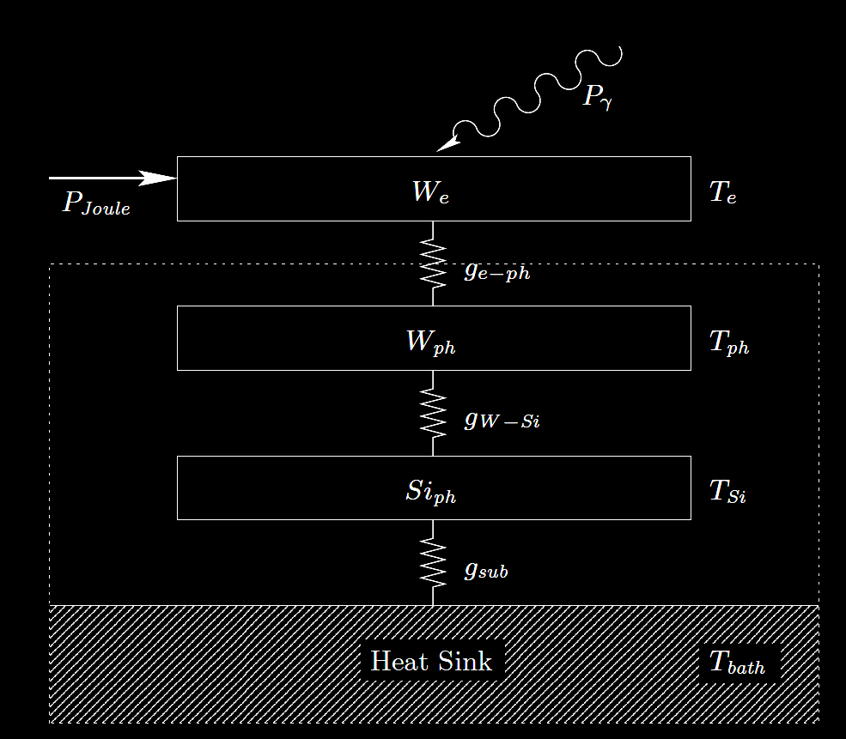
Transition-edge sensor (TES) electrothermal system
Negative Feedback
Resistance
Temperature
Voltage biased—
as T increases, V²/R heating decreases…
→ Negative Electro-Thermal Feedback

Slide 8
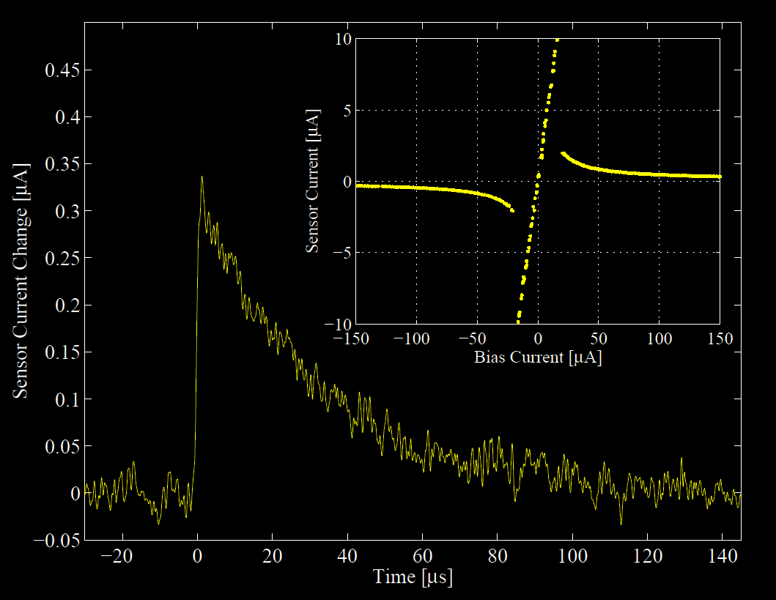
Detecting photons with a W-TES

Slide 9
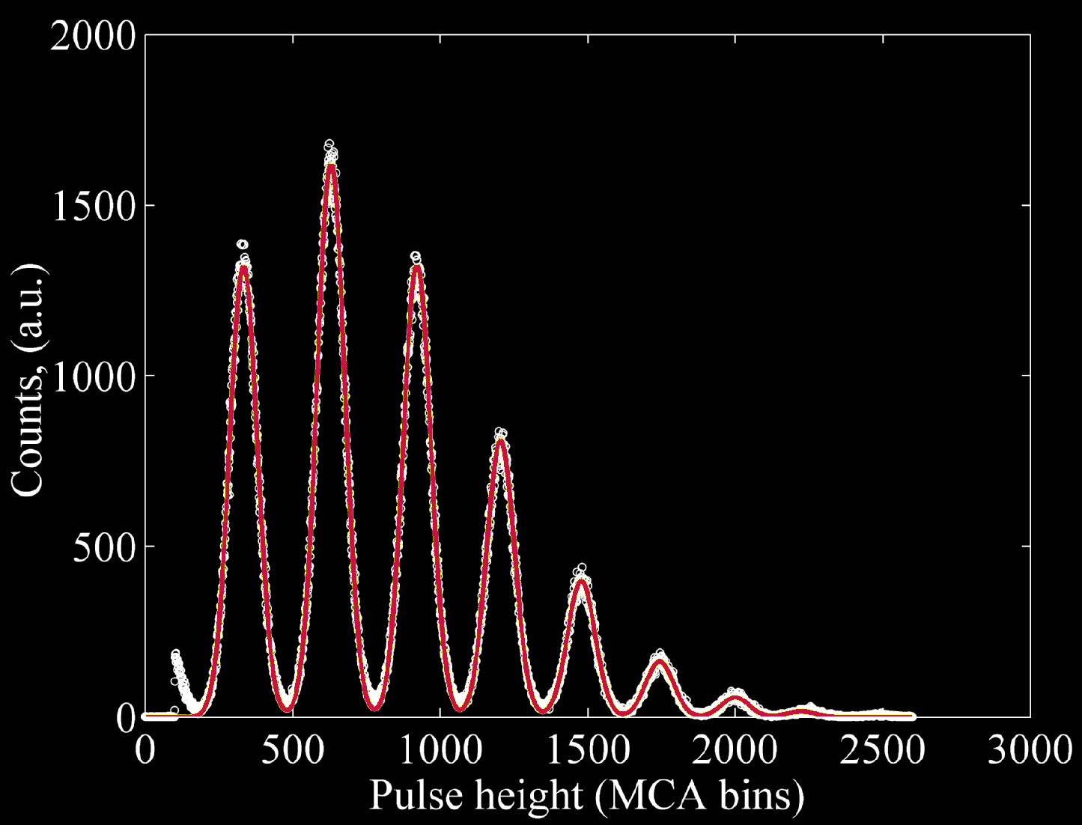
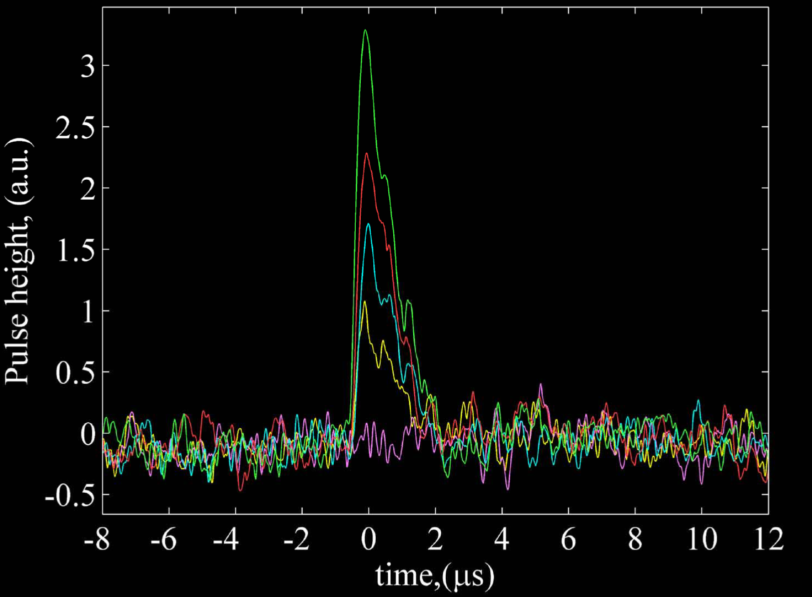
Photon number resolution of TES devices
n = 4
n = 2
n = 1
n = 3
TES devices have demonstrated revolutionary performance from meV to MeV
n = 2
n = 1
Lita, Miller, Nam, OPTICS EXPRESS, 3 March 2008 v16(5) 3032

Slide 10
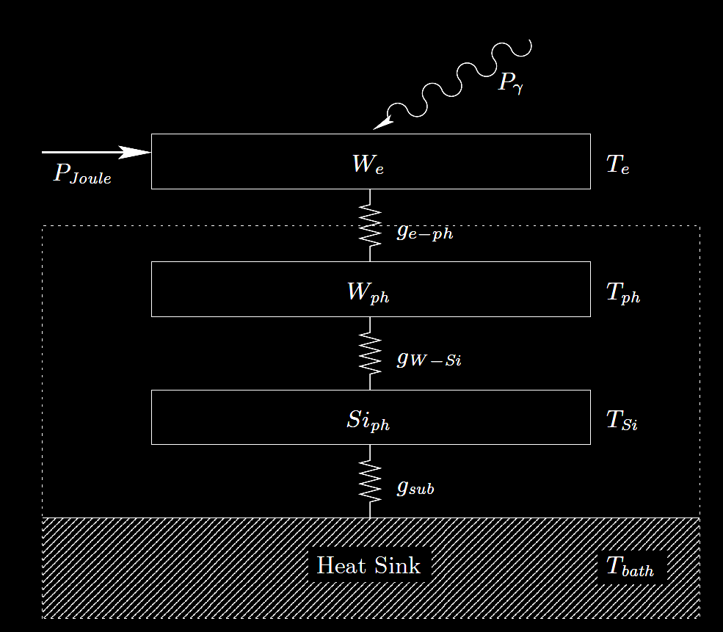
Nanowire (SNSPD) electrothermal system
Resistance
Positive Feedback
Temperature
Current biased—
if T increases, I²R heating increases…
→ Positive Electro-Thermal Feedback

Slide 11
Convenient Conceptual Principle of Operation
I < I_{c}
R = small, V = 0
Photon
R = small, V = 0
R = big, V > 0

Slide 12
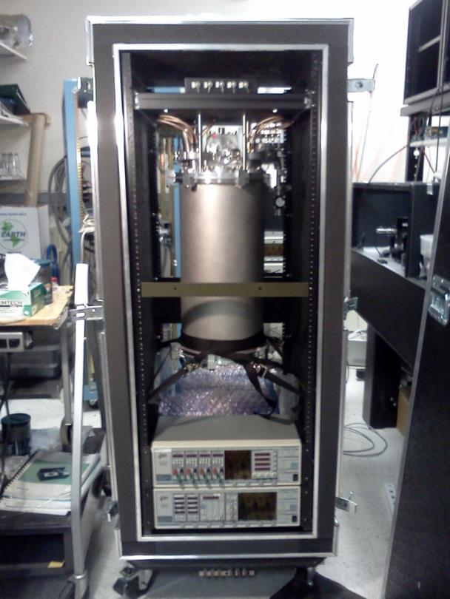
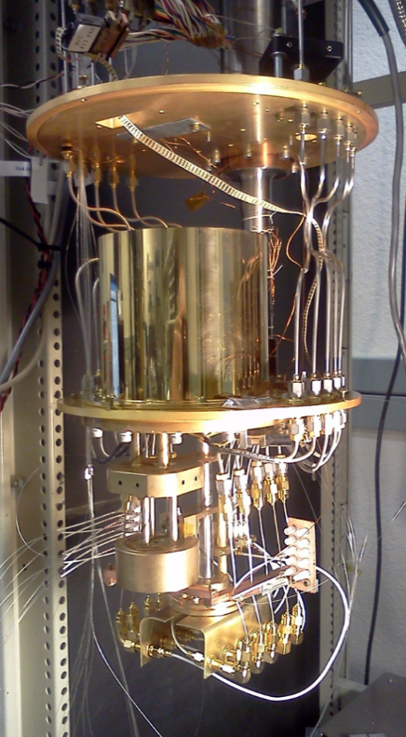
Demonstrated Performance
QO founder assisted in the construction and demonstration of NIST 8-channel high-efficiency nanowire system – first in the world.
First 8-channel >1520nm system with SDE >80% on all channels

Slide 13
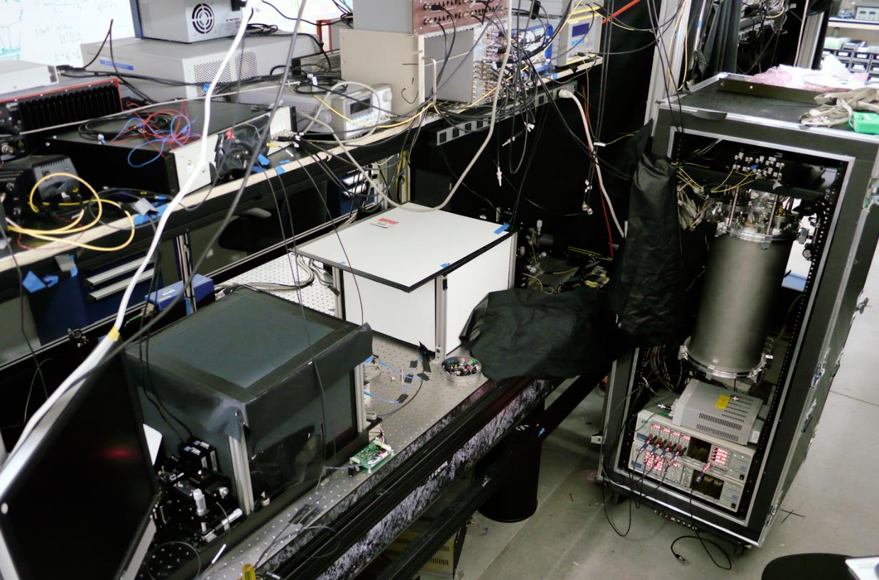
Demonstrated Performance
NIST 8-channel system demonstrated on-site at the Institute for Quantum Computing (U. Waterloo)

Slide 14
Revolutionary Performance
Without nanowire devices
Goal of cascaded spontaneous parametric down conversion to generate entangled “triplets” of photons.
Waterloo group previously demonstrated a generation rate of 7 triplets per hour using InGaAs/InP SPDs (10-25% DE, DCR 10²-10⁴ cts/sec)[1]
With nanowire devices
Detection efficiencies between 80% and 90% on all channels
Triplet rate increased to ~600 triplets per hour an 87x increase
Measurement performed in one week that would have taken almost two years.
Published 2014 in Nature Photonics[2]
[1] L. K. Shalm, et al., Three-photon energy-time entanglement.
Nature Physics 9, 19-22 (2013).
[2] D. R. Hamel, et al., Direct generation of three-photon polarization entanglement, Nature Photonics 8, 801–807 (2014)

Slide 15
Challenges with the NIST system
Bulky
Expensive
Fragile
Sorption-cooled ³He/⁴He unit required 2 hrs. of downtime every recharge (8 hrs.)
Not commercially available

Slide 16
Commercial goals for SNSPDs
    Broadband – Visible, NIR (esp. telecom bands)
    High detection efficiency (> 80% @ 1550 nm)
    Low dark-count rate (intrinsic < 100 cts/sec, ungated)
    Low dead time (< 25 ns)
    Low jitter (< 50 ps)
    Ungated operation
    No damage from light overload
    Control and read-out with conventional electronics
    “Invisible” cryogenics

Slide 17
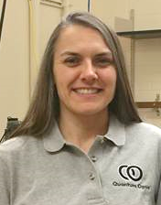

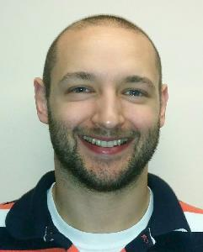

Quantum Opus
Founded in March 2013—three founding members and private equity.
Aaron J. Miller, PhD
B.A. in Physics/Mathematics, Albion College,1995
Ph.D. in Physics, Stanford University, 2001
Postdoc/Staff Scientist NIST 2001-2005
Asst./Assoc. Professor, Albion College 2005-2015
Amy Conover, MS
Assembly and Measurement Technician
QA and process control
Holly B. Miller, MBA
B.A. in Economics and French, Albion College, 1996
CPA with Coopers and Lybrand, PwC
Internal and external audit, ethics
MBA, Finance Concentration, MSU 2015
Tim Rambo, PhD
B.A. in Physics, Comp. Sci, Albion College, 2009
Ph.D. EECS, Northwestern, 2016
Josh A. Cassada, PhD
B.A. in Physics, Albion College,1995
Ph.D. in Physics, U. Rochester, 2000
13 years Navy pilot and instructor
Worked for ~6 mo. on process dev.
Selected for Astronaut program June 2013

Slide 18
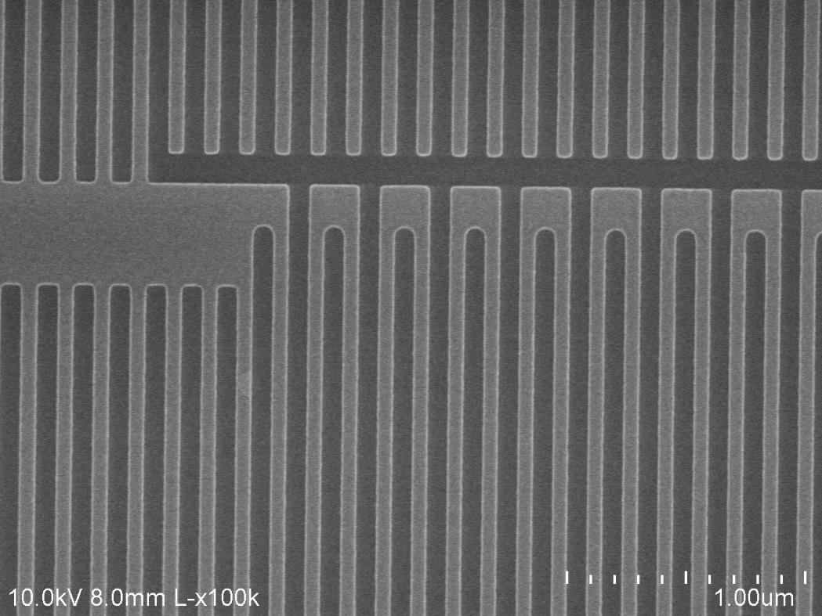
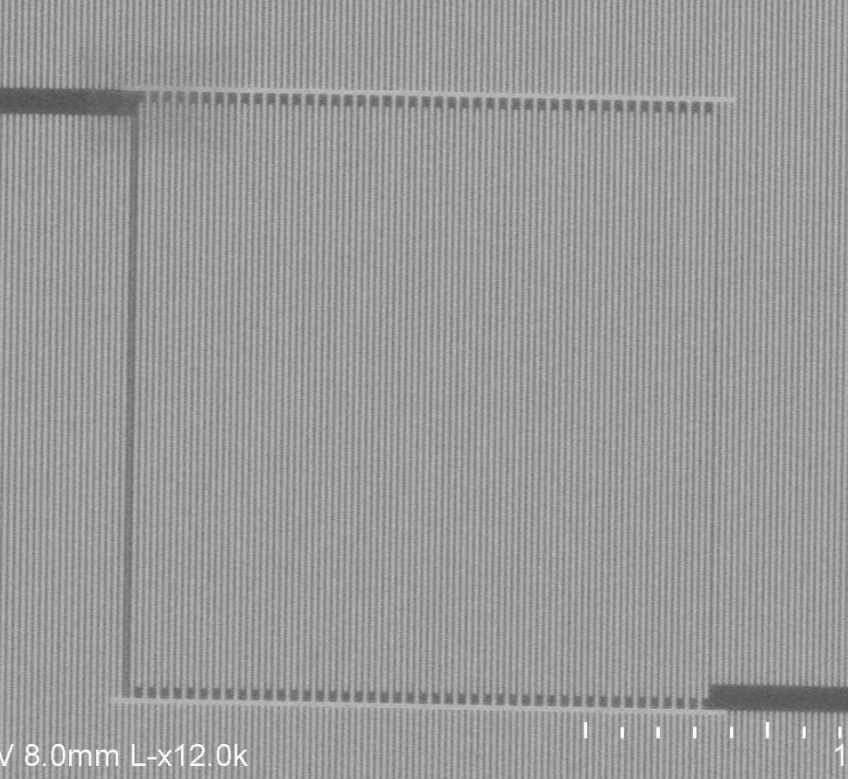
Nanowire device

Slide 19
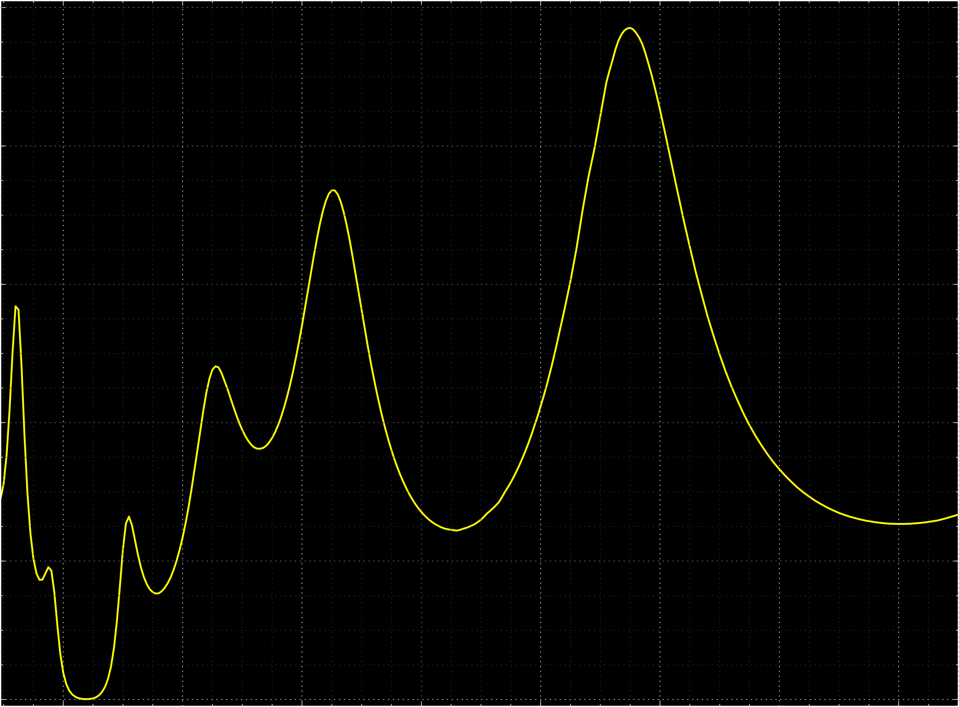
Layer Design
> 90% absorption (TE) at target wavelengths in NIR
Incident Light
100%
Si₃N₄
SiO₂
 TE
Absorption
Wiring
Superconductor
SiO₂
1.55 µm
Metal Mirror
SiO₂
0%
0.6
1.0
1.4
1.8
Wavelength (µm)
Si

Slide 20
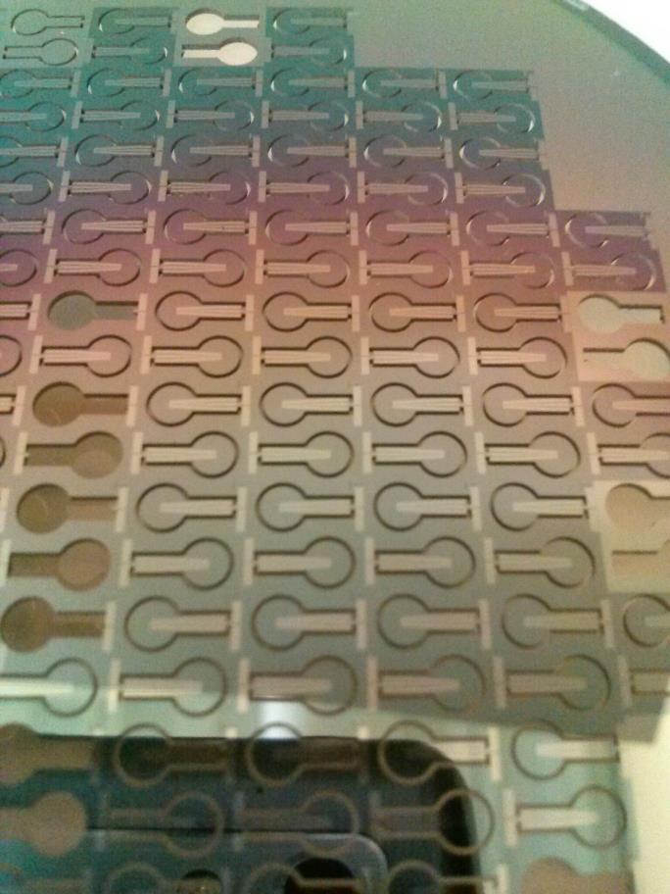
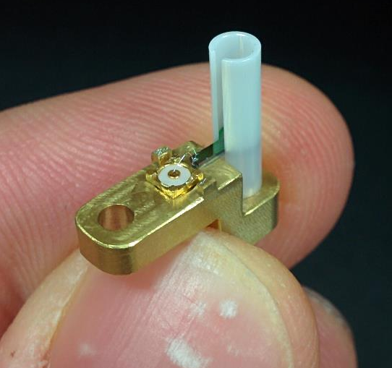
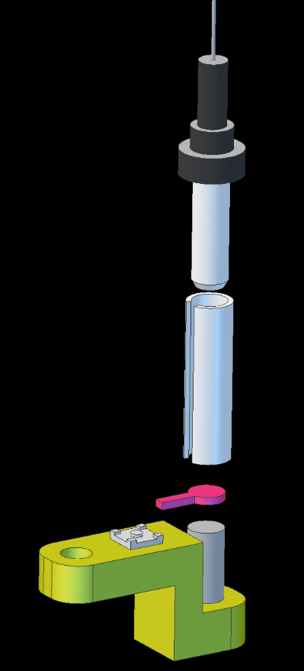
Device Assembly and Optical Alignment
Zirconia fiber ferrule
Zirconia sleeve
SNSPD Chip
Coax connector
Sapphire rod
M2 Mounting hole

Slide 21
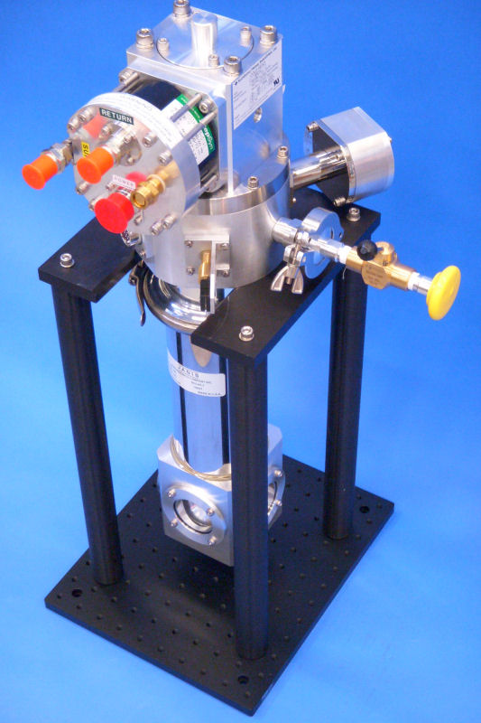
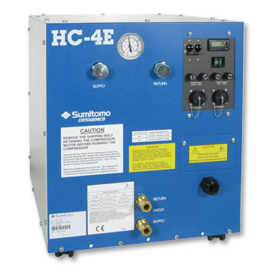
SHI Cryogenics Components: a typical configuration for commercial systems.
Cold Head
Compressor
One of our commercial goals: design a more compact system

Slide 22
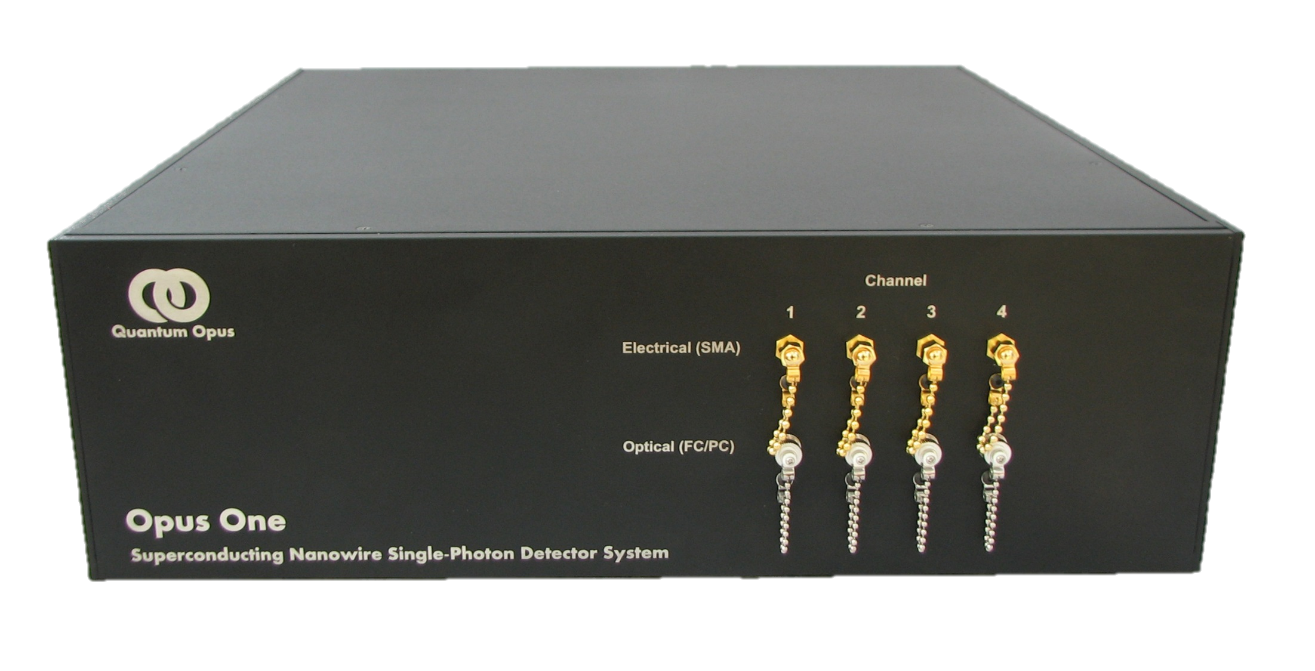
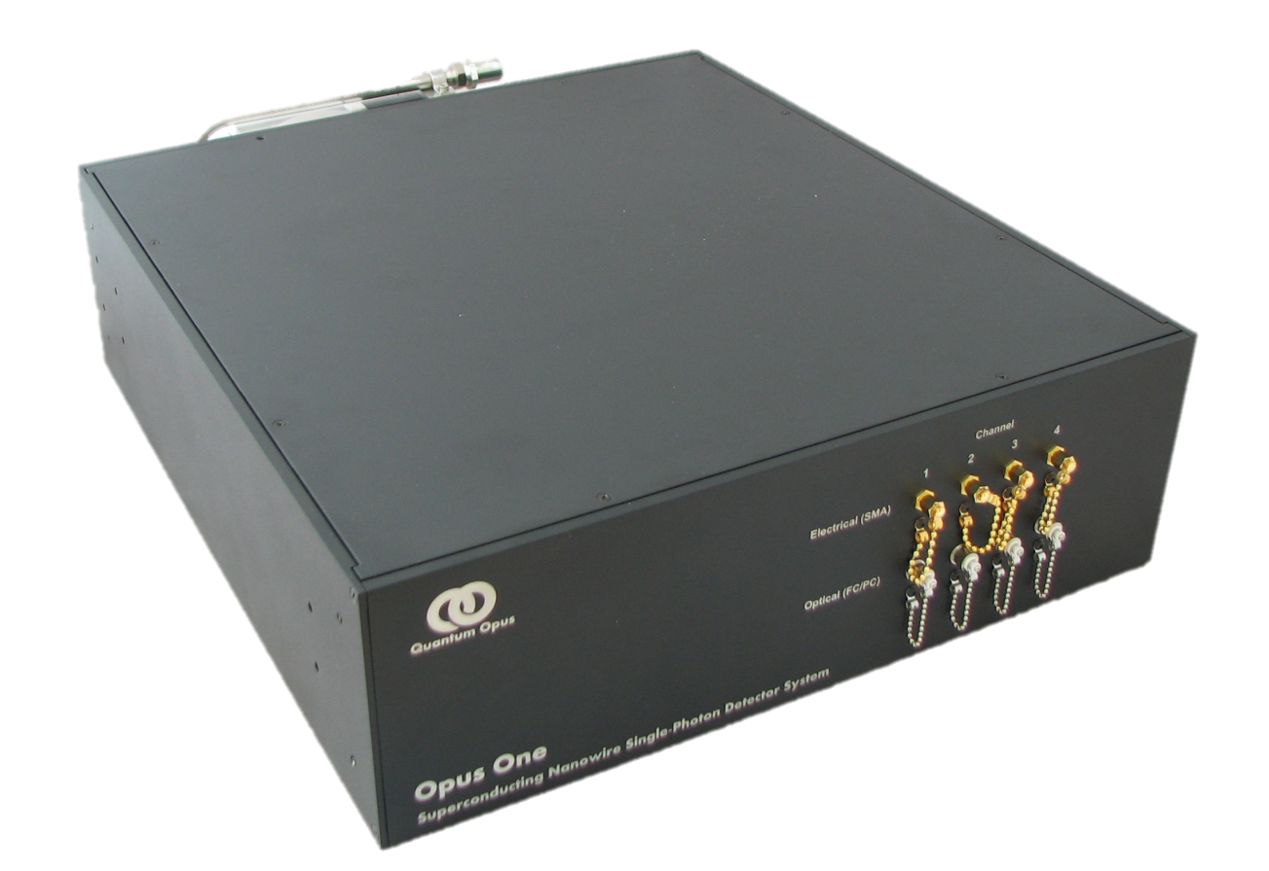
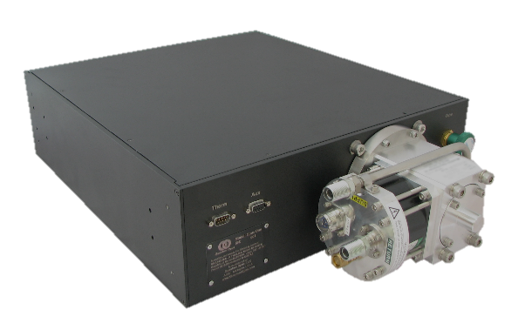
Opus One
Physical
3U 19” Rack Mount
Modular construction
Upgradable to 32 ch
Convenient electronics
Optical/Electrical
NIR DE = 80 % (1550 nm)
Dead time < 25 ns
Jitter < 60 ps
DCR < 100 cts/sec
Permission granted to distribute within NASA

Slide 23
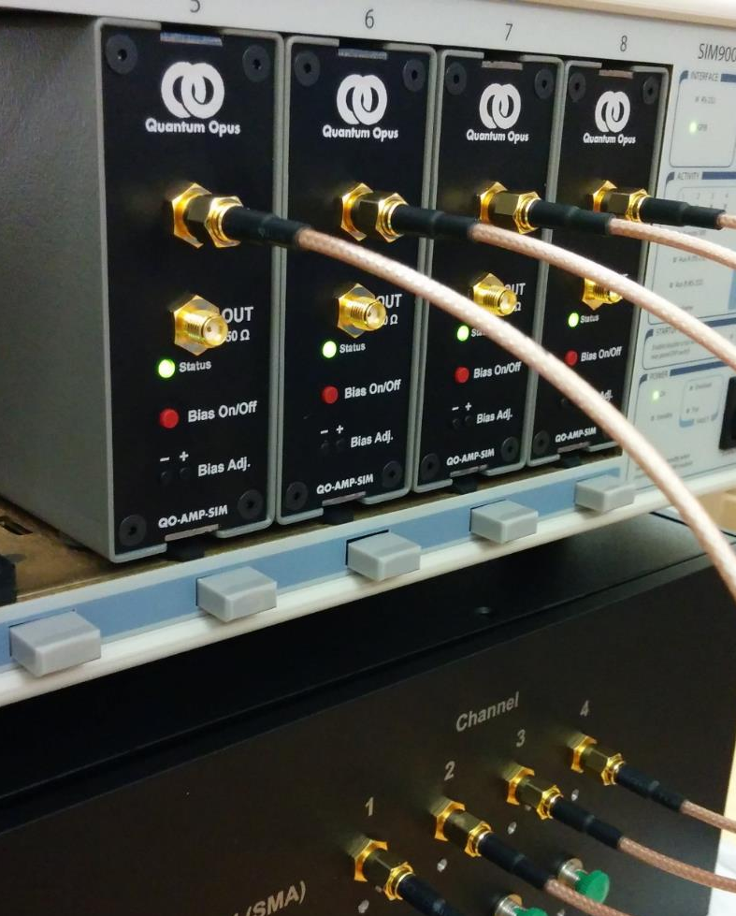
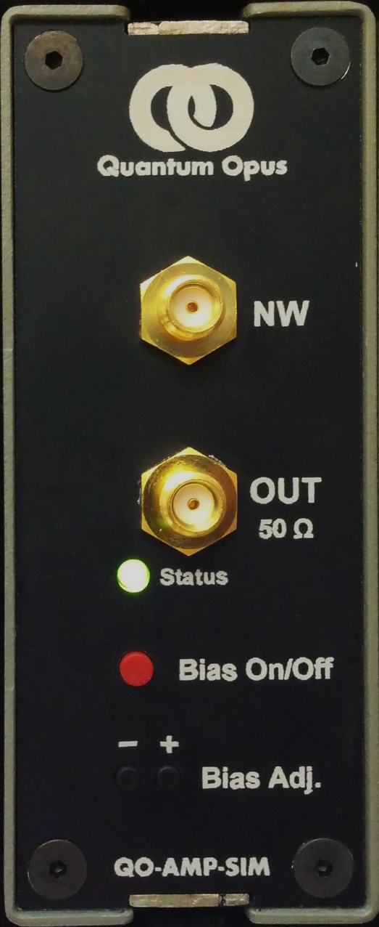
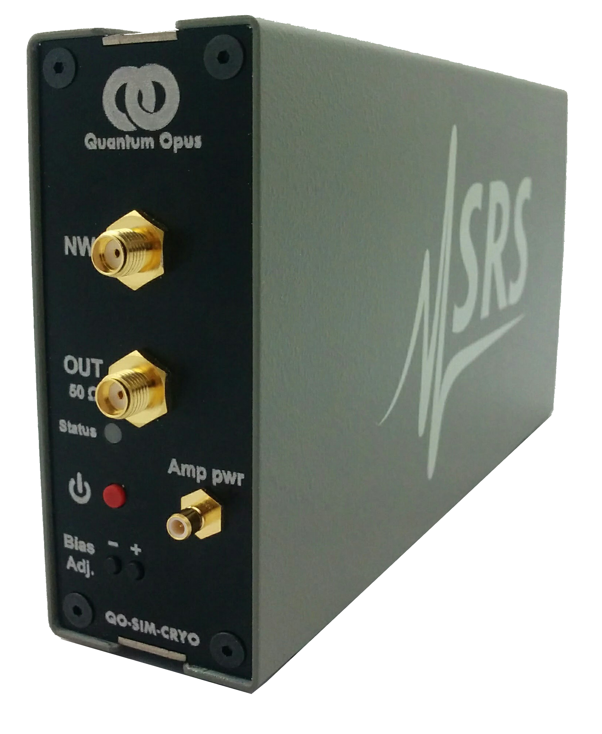
Modular Electronics
Low-noise, high-speed amplifier and bias module integrates with SIM rack for computer control and monitoring
Permission granted to distribute within NASA

Slide 24
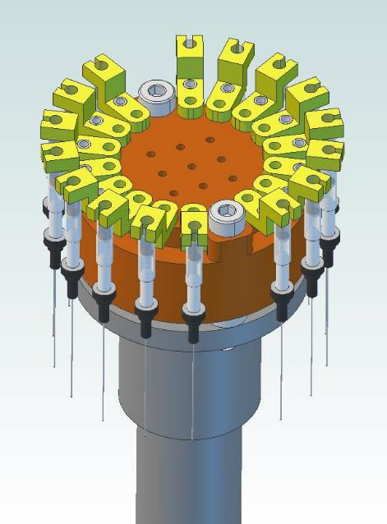
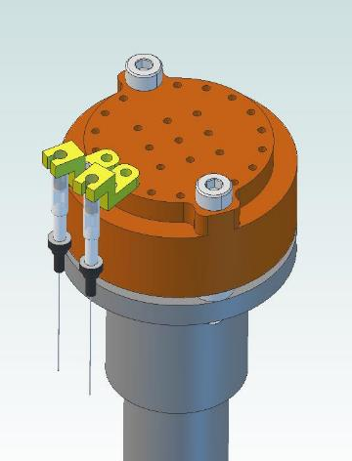
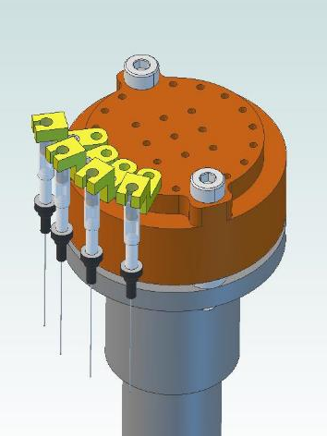
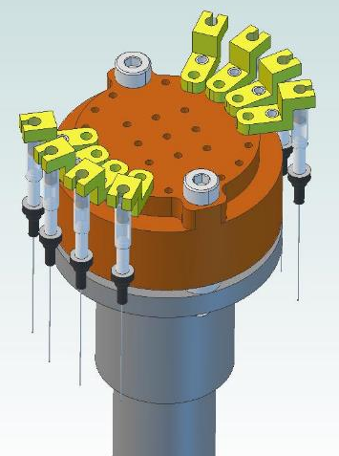
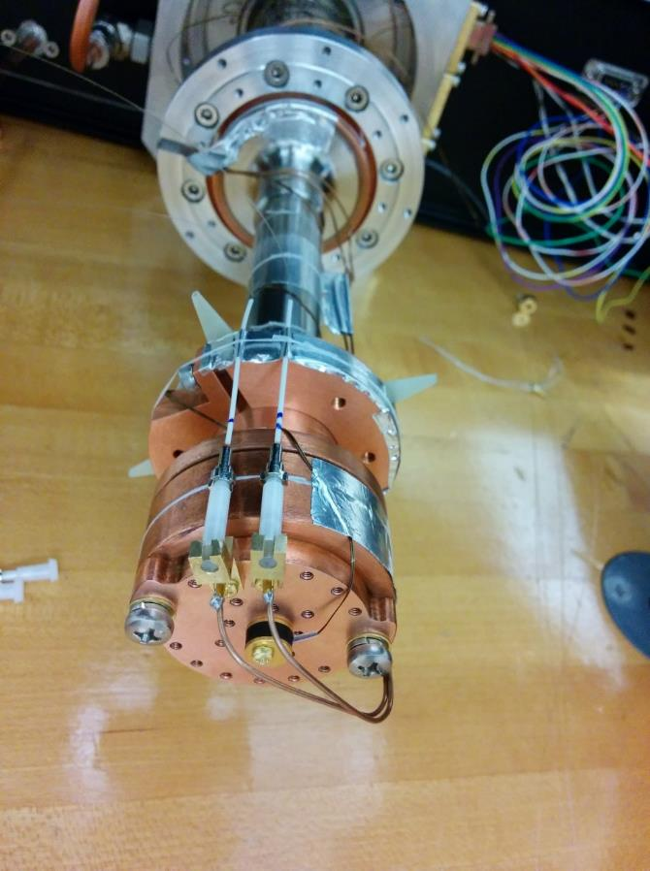
Expandable to 16 detectors
2 Devices
4 Devices
8 Devices
16 Devices
Two high-efficiency superconducting nanowire detectors coupled to SMF28e fibers and coaxial readout cables.

Slide 25
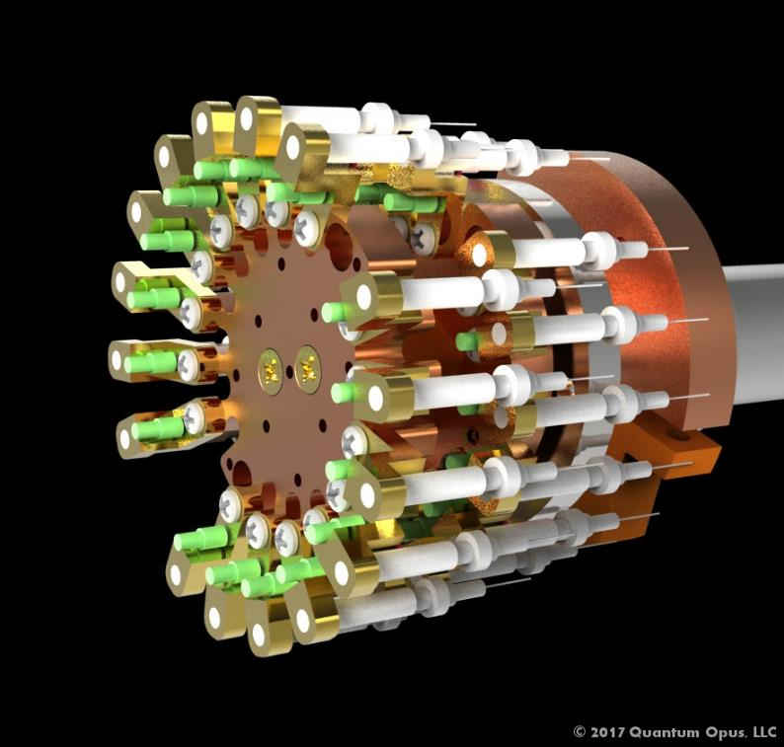
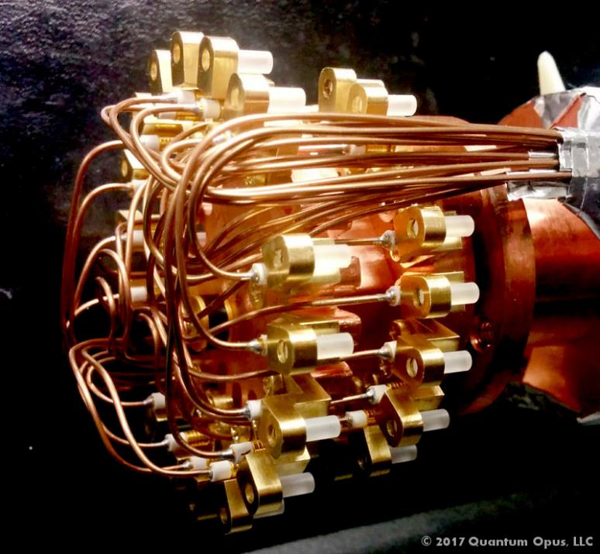
Custom 32-channel System

Slide 26
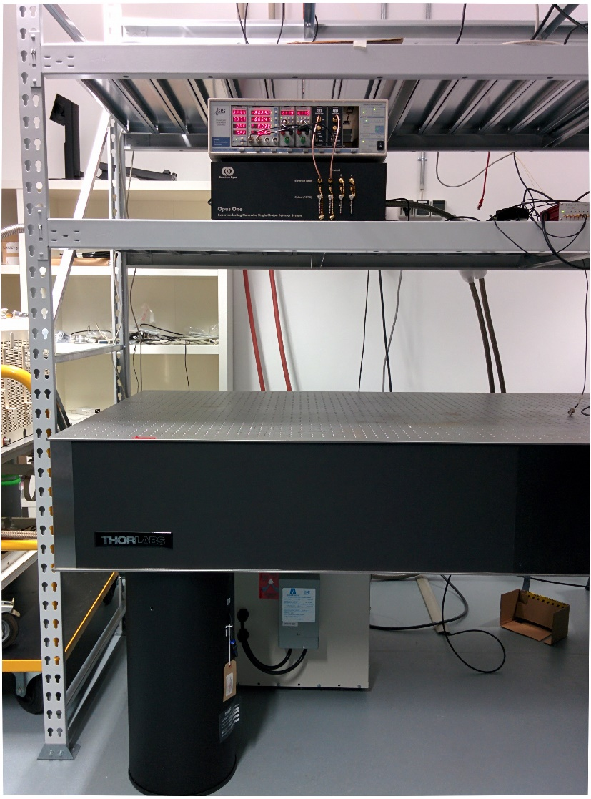
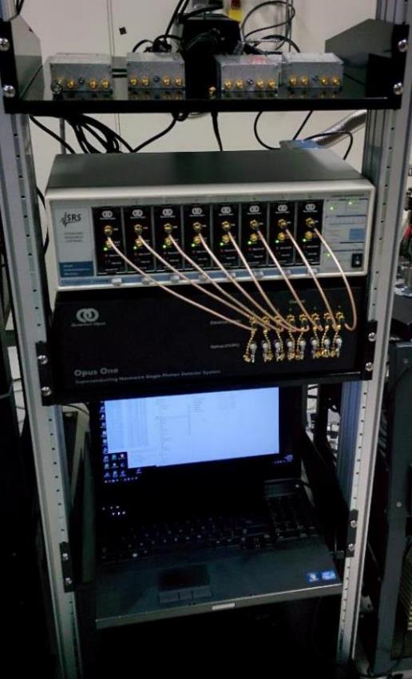
Customer installation examples
Shelf above optical table
Standard 19-inch rack
Opus One cryostat and electronics
Water-cooled Compressor
Copyright © 2017 Quantum Opus, LLC
www.QuantumOpus.com

Slide 27
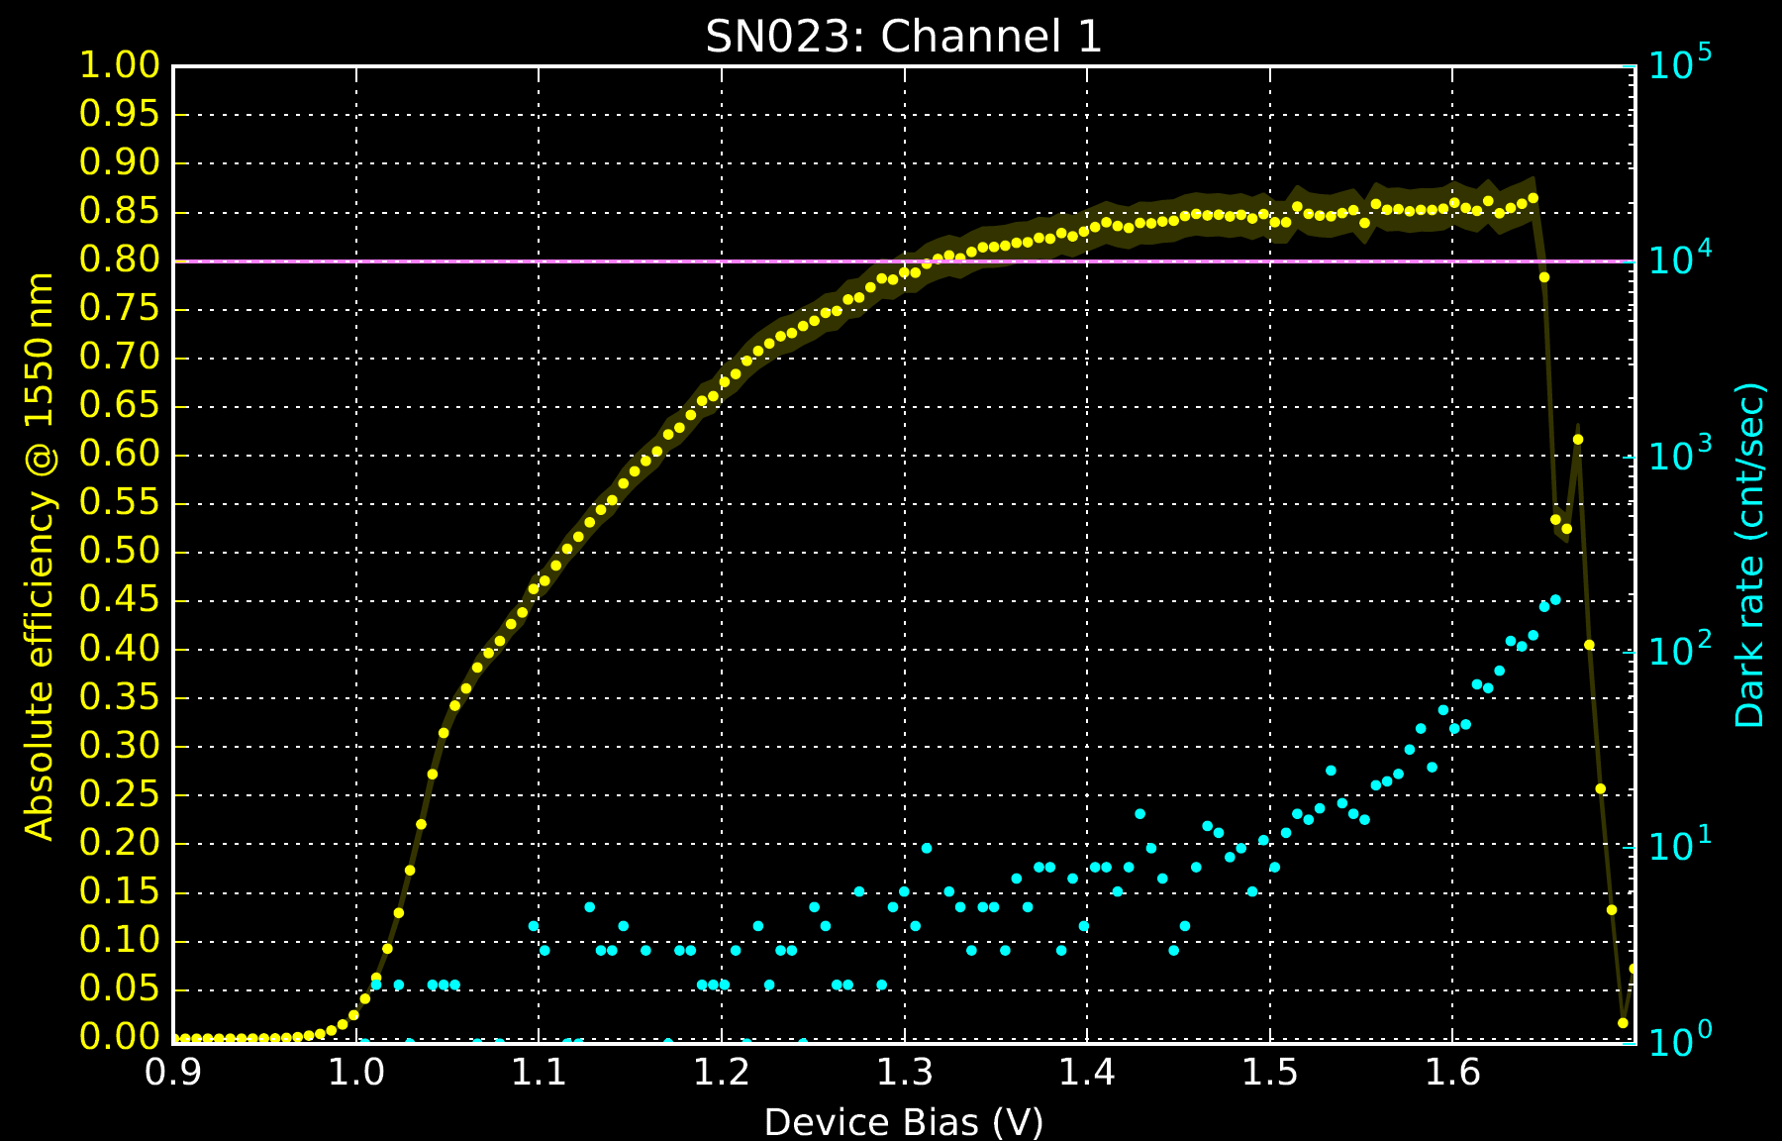
Recent system performance: Efficiency

Slide 28
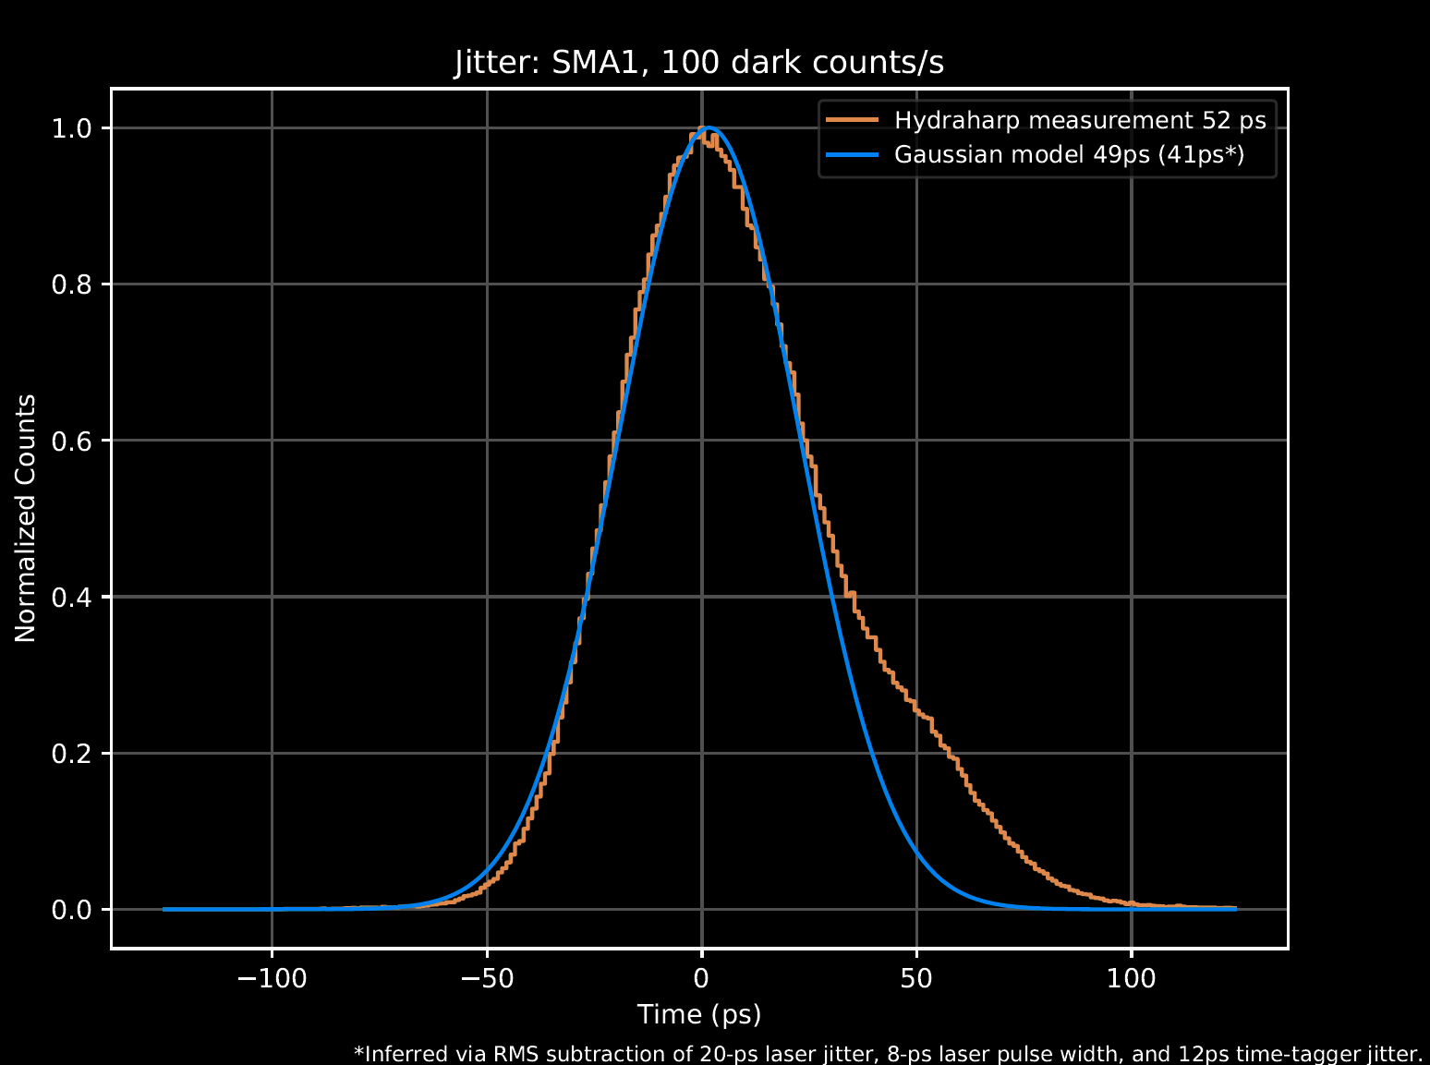
Recent system performance: Jitter

Slide 29
Current Research and Development
Decreased polarization dependence (goal: <5%)
Increased collection area (goal: 30+ µm MM fiber)
Increased count rate, PNR (goal: G-cnt/sec)
Multimode fiber coupling
Compact multi-channel instrumentation (goal: 100s)
Increased efficiency (goal: 90% at 1550nm)
Compact cryogenics

Slide 30
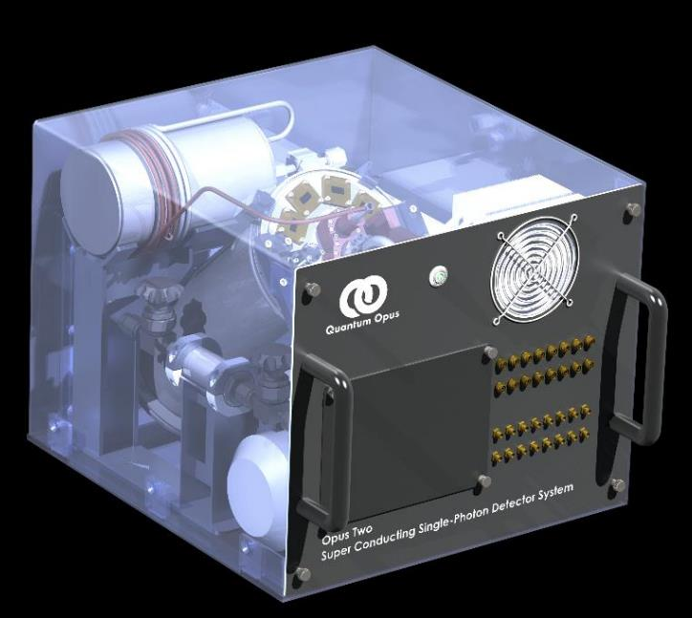



The Opus Two — The world’s first desktop <2 K Cryosystem
Continuous system operation; expected service interval 20,000 hours.
Ultra-compact cryocooler and electronics draw <300 Watts
Fully air-cooled
Base temperature: 1.8K (<1 K option)
32+ detectors per system
Available Summer 2018
8U
356 mm
(14 in)
457 mm (18 in)
432 mm (17 in)

Slide 31
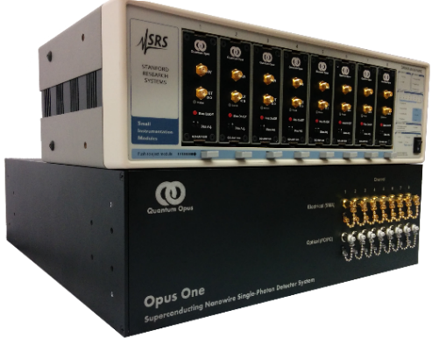
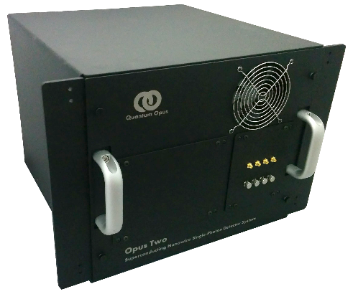

SBIR-funded revolutionary performance
Opus One
Opus Two
System Style | 6U Rack-Mount Laboratory | Ultra-Compact Low-Power
System Wall Power Draw | 2.5 kW | 0.3 kW
Operating Temperature | 2.5 K | 1.8 K (<1 K option)
Enclosure Cooling | Water or Air | Air
System Volume | 0.16 m³(10000 in³) | 0.07 m³ (4300 in³)
System Weight | 160 kg (350 lbs) | 30 kg (70 lbs)

Slide 32
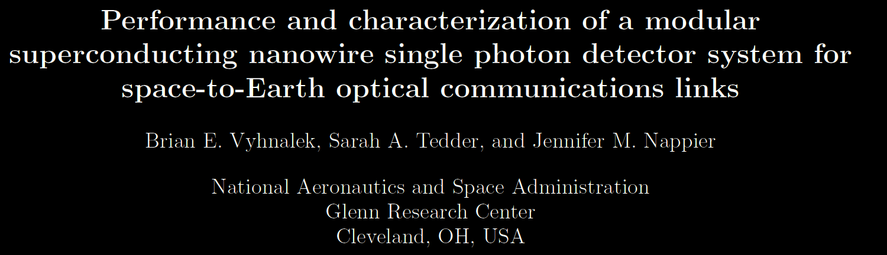
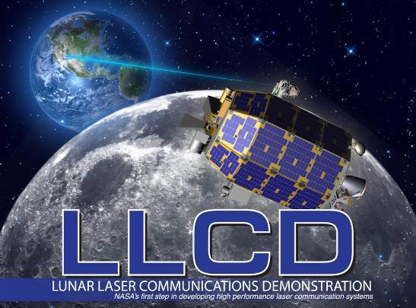
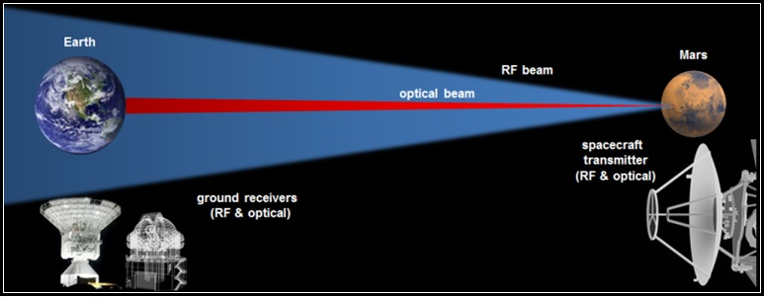
Optical Space Communication
iROC

Slide 33
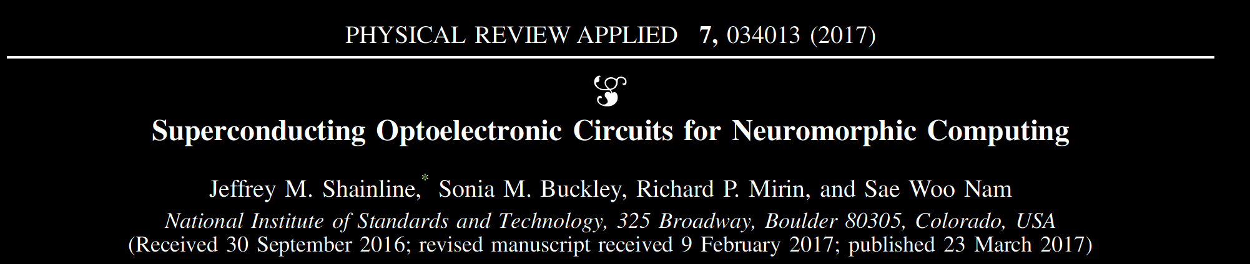
Not quantum… but also not von Neumann
SNSPD: 20 aJ/synapse event
BIO: 1 pJ/synapse event
CMOS: 20 pJ/synapse event
Brain: ~10¹⁴ synapse events/sec
Achieve this rate at 2 mW of cooling @ 2K, 200 W wall draw

Slide 34
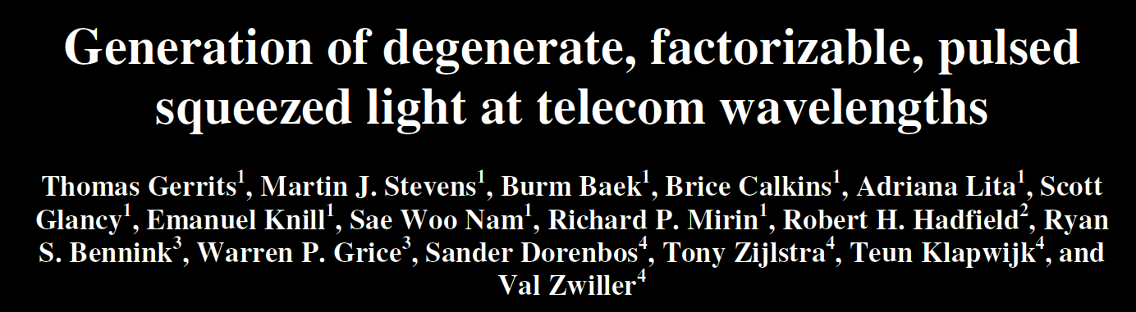

Slide 35
Plans and Possibilities
Custom superconducting device fabrication
  Novel device architectures
  Integrated optics and detectors
Multi-element devices, photon number resolution
Fiber quantum repeaters in telecom closet
Cryogenic logic development
Mid-infrared and ultraviolet photon counting
Thermal imaging at NIR
α, β, γ, e⁻ particle detection
Terahertz sensing and imaging
Low wall-draw cooling for microwave LNAs
Desktop Dilution Refrigerator? 500nW cooling at 50 mK

Slide 36
