Slide 1
Overview of QIS and Quantum Emulation studies at University of Illinois
>> Prospects for studying dynamical gauge fields
with cold atoms and molecules
[ Paul Kwiat, Virginia Lorenz, Brian DeMarco ]
Bryce Gadway
University of Illinois at Urbana-Champaign
Intersections between Nuclear Physics and Quantum Information (NPQI workshop)
Argonne National Laboratory – 2 pm, March 29, 2018
Notes:
Connectivity, just not through quantum tunneling

Slide 2
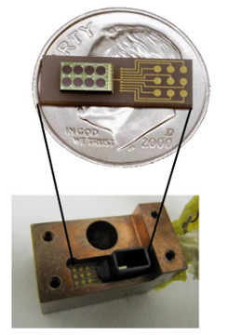
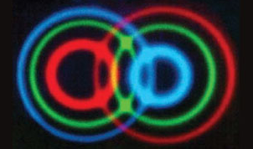
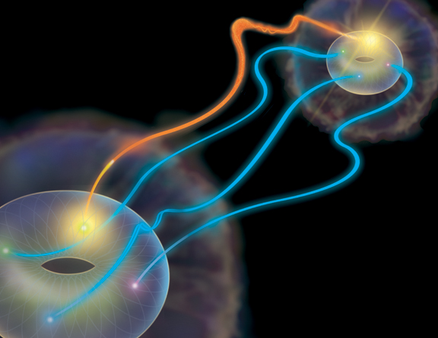
Kwiat Group: Quantum Information Science
Improving quantum technologies
Development of entangled photon and single-photon sources
Development of single-photon detectors
Improving efficiency of photon collection in noisy environments
More fundamental studies
Bell-like tests of nonlocal realism
Superdense encoding of quantum information
Teleportation and quantum communications
Few- and single-photon detection by humans

Slide 3
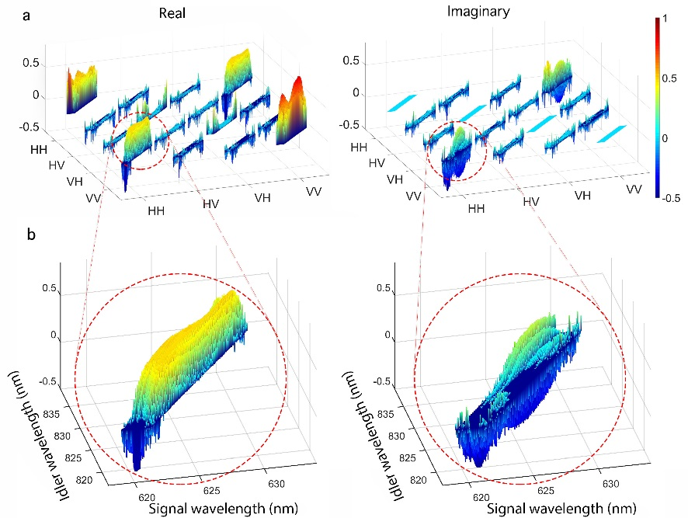
Lorenz Group: Quantum Optics and Spectroscopy
Motivation: quantum information applications,
fundamental studies
Engineering photonic quantum states for quantum applications
High-resolution, high-efficiency measurement techniques for characterization of photonic quantum states in multiple degrees of freedom
Quantum memories for telecom broadband photonic quantum states, fundamental studies of influence of light-matter interaction on photon-pair properties
Notes:
MRSEC – Metallic antiferromagnetic materials

Slide 4
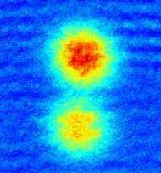
DeMarco group
Optical lattice quantum emulation
⁴⁰K
$$|↑〉$$
$$|↓〉$$
$$H=−t\sum_{〈ij〉}{c_{i}^{†}c_{j}}+U\sum_{i}{n_{↓i}n_{↑j}}$$
Hubbard model
Minimal model for strongly interacting quantum matter

Slide 5
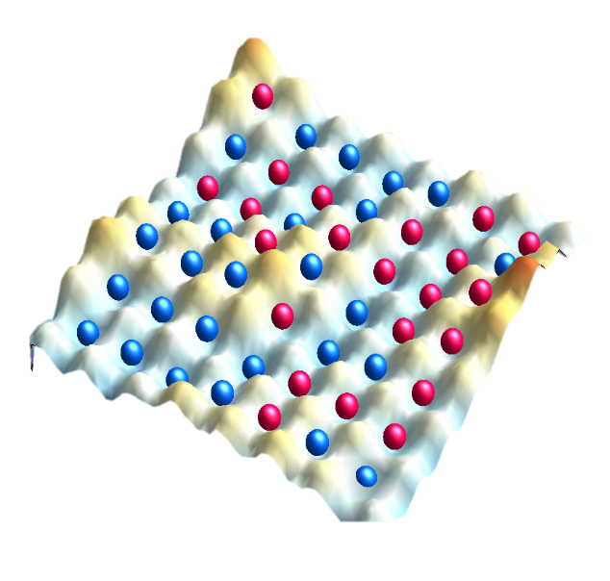
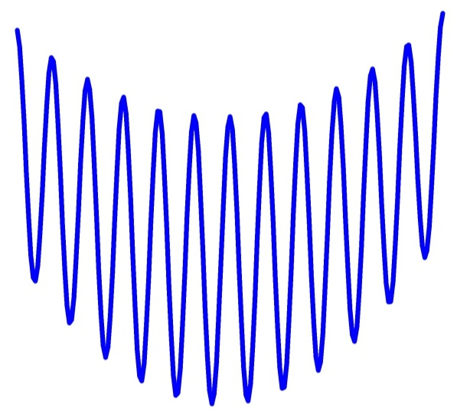
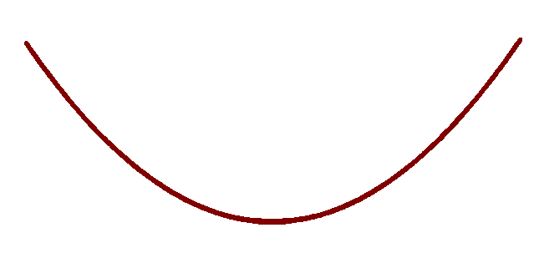
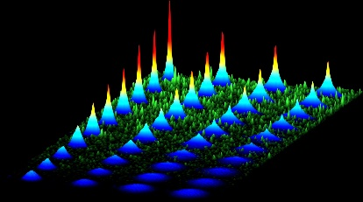
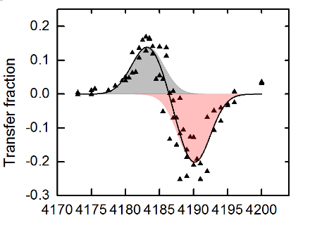
Spin-dependent
lattices & potentials
Disorder
$$2U$$
$$U$$
$|$↑$〉$
$|$↓$〉$
$Δω/2π$ (kHz)
Correlated Tunneling

Slide 6
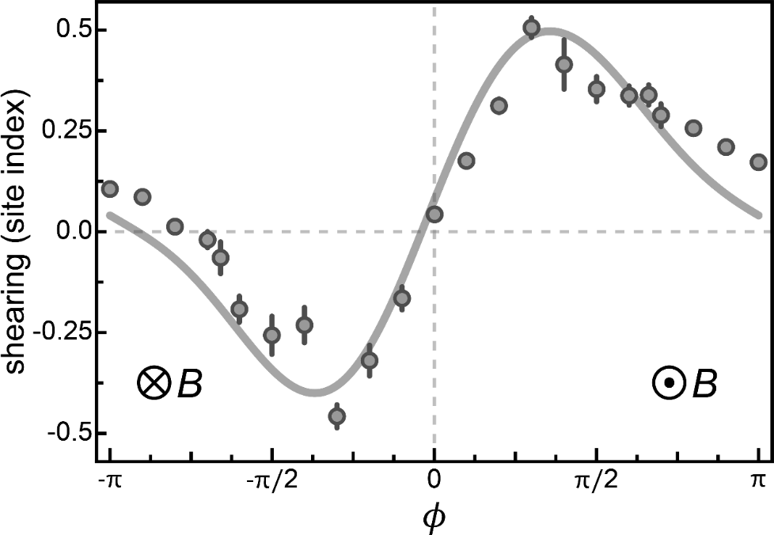
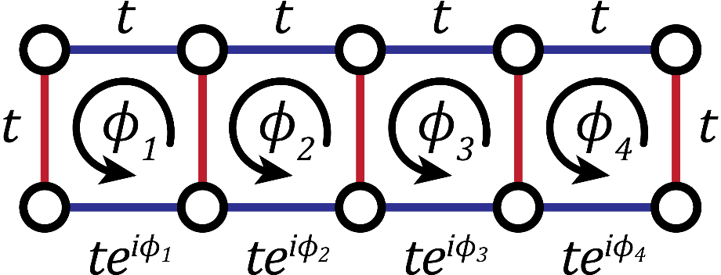
Gadway group
Quantum simulation with
non-standard, synthetic lattices
$${∆E}_{45}$$
$${∆E}_{34}$$
w/ cold atoms & molecules
$${∆E}_{23}$$
$${∆E}_{12}$$
Designer classical gauge fields

Slide 7
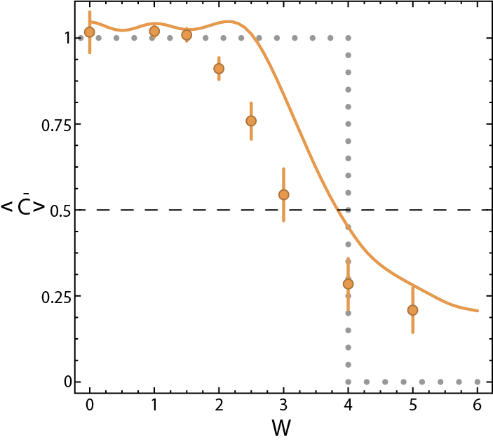
Gadway group
Quantum simulation with
non-standard, synthetic lattices
$${∆E}_{45}$$
$${∆E}_{34}$$
$${∆E}_{23}$$
$${∆E}_{12}$$
disorder strength
winding
number
Interplay of:
- topology & disorder
- topology & interactions
- disorder & interactions
disorder strength

Slide 8
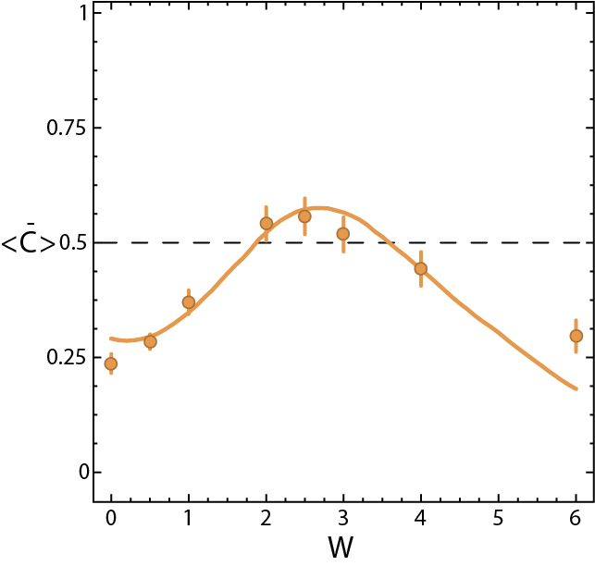
Gadway group
Quantum simulation with
non-standard, synthetic lattices
$${∆E}_{45}$$
$${∆E}_{34}$$
$${∆E}_{23}$$
$${∆E}_{12}$$
topological
Anderson insulator
disorder strength
winding
number
Interplay of:
- topology & disorder
- topology & interactions
- disorder & interactions
disorder strength

Slide 9
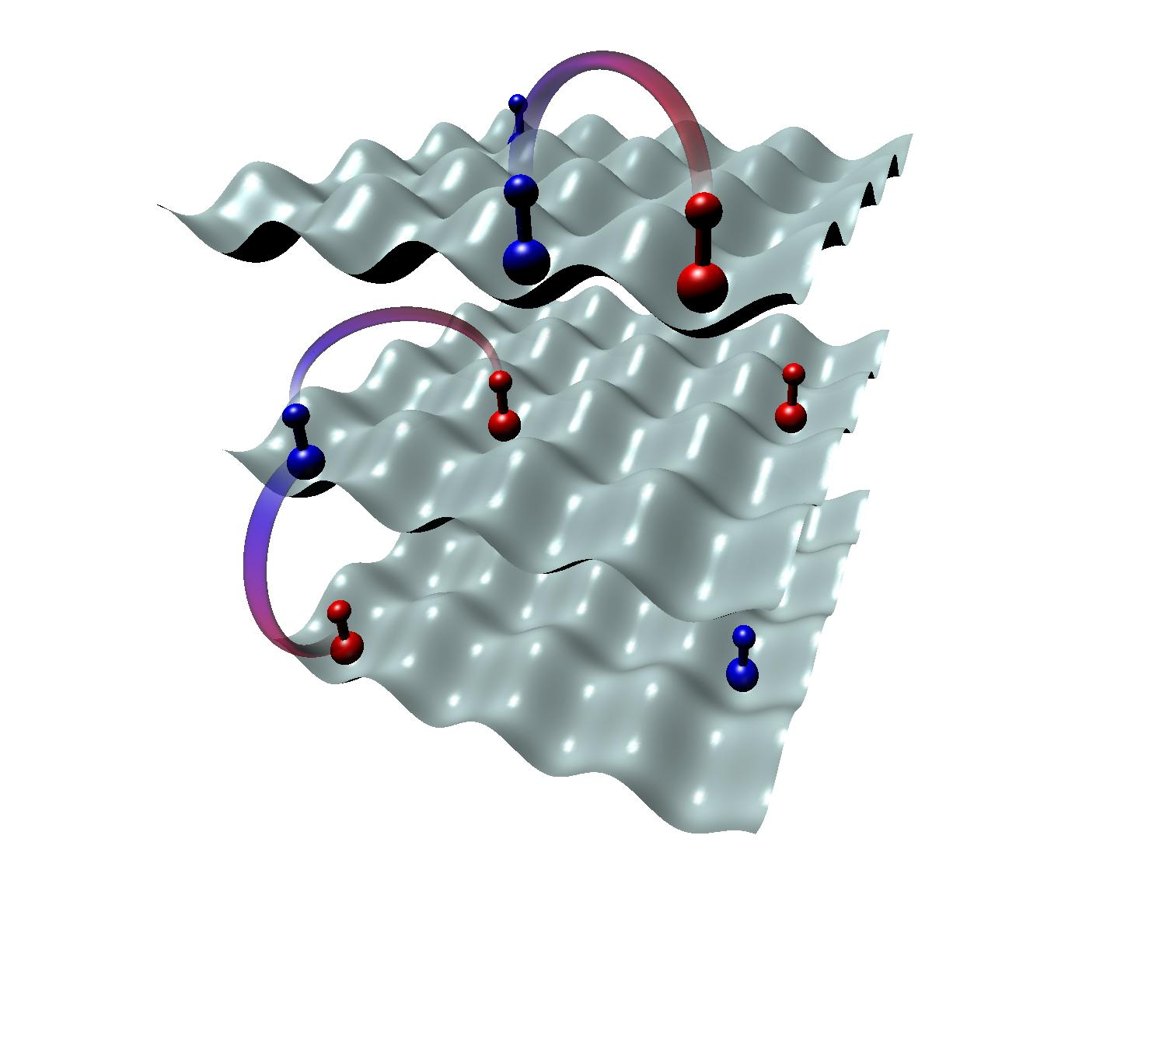
Gadway / DeMarco – ultracold molecules
Harnessing dipolar exchange interactions
for the emulation of lattice gauge theories

Slide 10
Gadway / DeMarco – ultracold molecules
Requires extreme control, not very forgiving for cold atoms
→ molecules are a natural fit
Quantum field theory
Lattice gauge theory
Quantum link model
Multiple species (2 bosons, 1 fermion)
Spin-dependent tunneling / site energies
Control of all interactions [must be stable]
Keep entropy low
→ gauge invariance only at low T, low S/N
Banerjee, et al. PRL 109, 175302 (2012)

Slide 11
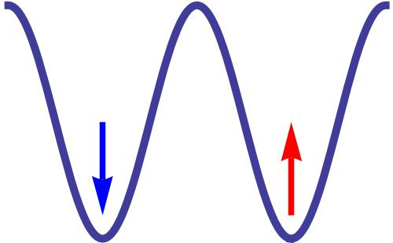
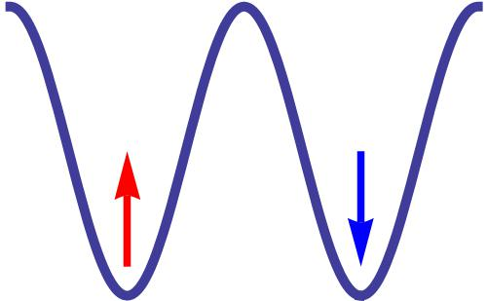
Emulating LGTs with ultracold molecules
atoms → molecules
particle hopping → spin “hopping” by dipolar exchange
correlated hopping (low S/N, low t/U) → naturally imposed by dipolar exchange
spin-dependent potentials → local “magnetic fields” / light shifts
start with “low” entropy by motion → motion frozen out, initial spin entropy = 0
gauge invariance / Gauss’ law imposed by hand

Slide 12
Emulating LGTs with ultracold molecules
internal rotational states
J = 3
J = 2
J = 1
J = 0

Slide 13
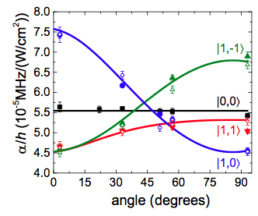
Emulating LGTs with ultracold molecules
internal rotational states
free space
common light shift
J = 3
J = 2
J = 1
J = 0
anisotropic polarizability
Neyenhuis, et al. PRL (2012)

Slide 14
Emulating LGTs with ultracold molecules
internal rotational states
free space
($I,\hat{ε}$)
state-dep. light shift
J = 3
J = 2
J = 1
J = 0

Slide 15
Emulating LGTs with ultracold molecules
($I_{1},{\hat{ε}}_{1}$)
, ($I_{2},{\hat{ε}}_{2}$)
, ($I_{3},{\hat{ε}}_{3}$)

Slide 16
Emulating LGTs with ultracold molecules
Banerjee, et al. PRL 109, 175302 (2012)

Slide 17
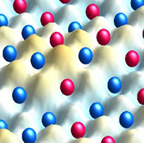
Thanks! Questions?

