Slide 1





Building a room temperature quantum computer
Eden Figueroa
Quantum Information Technology Laboratory

Slide 2
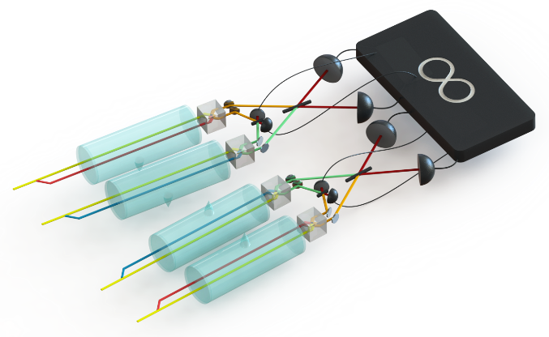
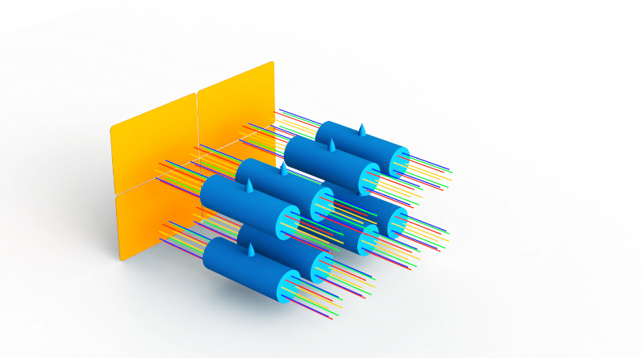
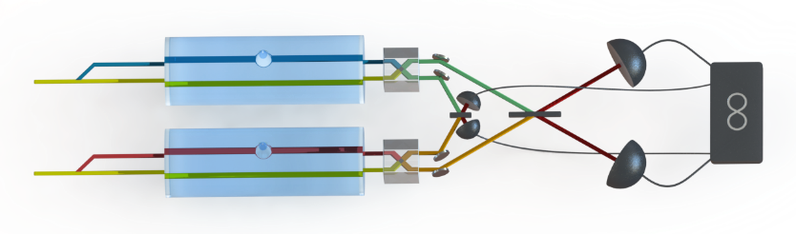

Room temperature quantum computer concept
Many-device entanglement.
Room temperature operation.
Programmable.
Individual quantum systems (nodes) combine to serve as building blocks of a quantum communication network
An example of a quantum system is the quantum memories we have developed.
First RT Quantum Memory surpassing all the classical limits.
Quantum buffer
and measurement
stations
Quantum
Processing
Unit
Quantum memories for light qubits.
Photon-photon phase gates.
Deterministic
Entanglement
Sources
Phys. Rev. Applied 8, 034023 (2017).
arXiv:1803.07012

Slide 3
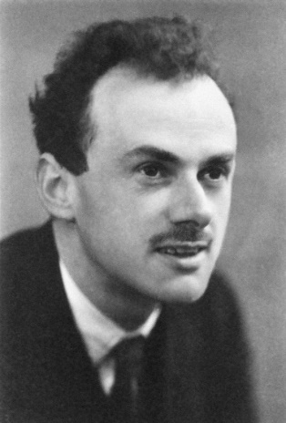
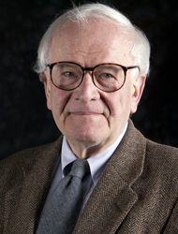
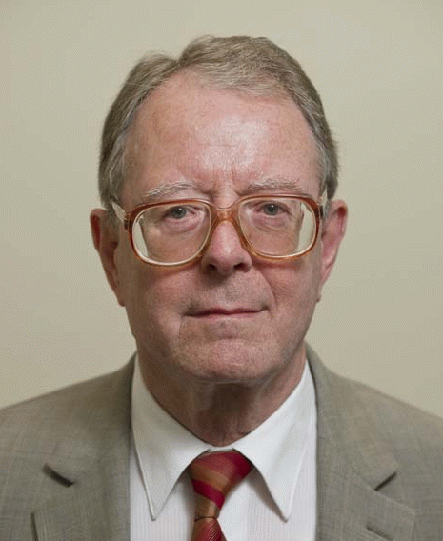
Bridge between AMO and NP: Dirac and Jackiw-Rebbi equations
- The Dirac equation merges quantum mechanics with special relativity.
- The Jackiw-Rebbi model describes a Dirac field coupled to a soliton field.
- A kink in the soliton yields a topologically protected zero-energy mode.

Slide 4
Dirac dynamics using spinor of light
Spinor of light:
The spinor obeys a Dirac-like equation:
PRL 105, 173603 (2010).
Scientific Reports 4, 6110 (2014).

Slide 5
Creating spinors of light experimentally
arXiv:1711.09346

Slide 6
Quantum simulation of Dirac and Jackiw-Rebbi spinor dynamics
“Realizing JR would require beams of relativistic particles interacting with Fermi quantum fields. This realization of the same physics requires only diode lasers and a cell of Rb atoms.”

Slide 7
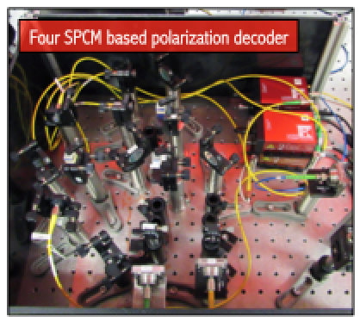
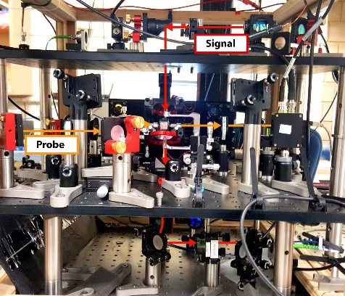
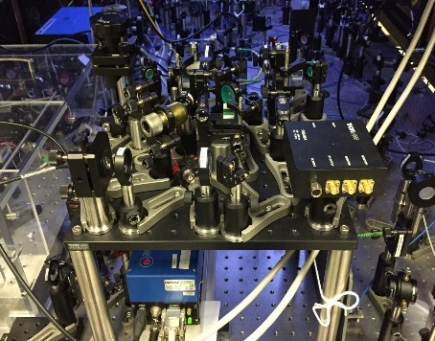
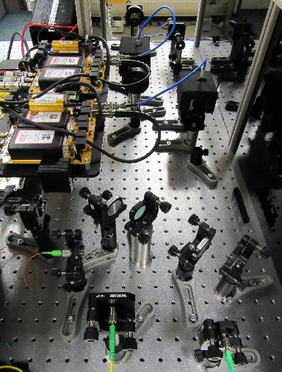
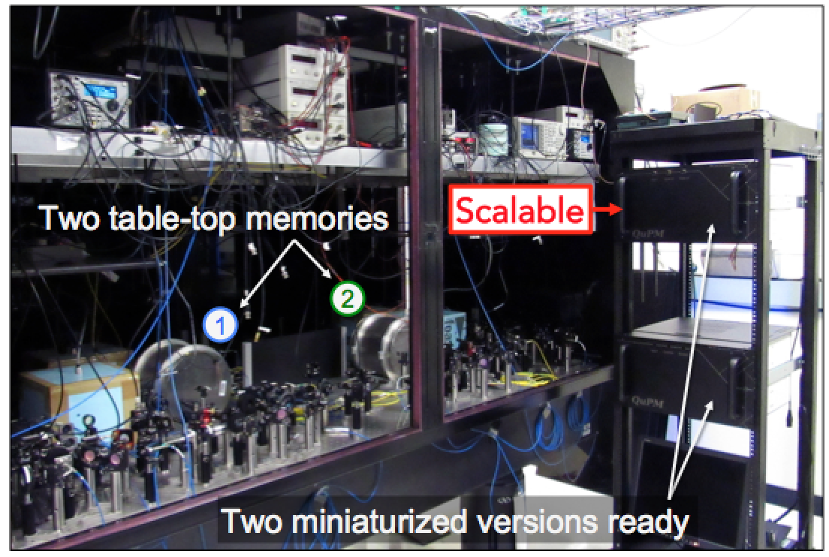
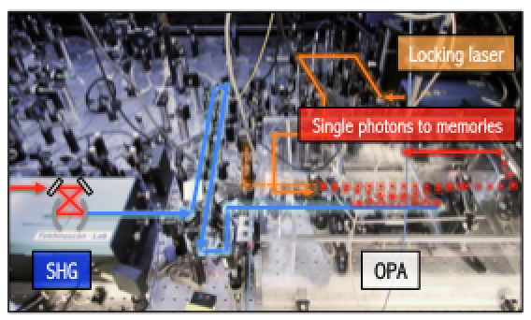
Quantum processing network in Stony Brook (in collaboration with BNL)
Quantum processing units
Cavity QED gate
RT phase gate
~15 interconnectable
quantum devices
Photon Sources
Bell measurements
Ancilla qubits
Homodyne detectors
Measurement
stations
Entangled photons
- Largest quantum
processing network
of its kind.
Network of quantum memories

