Slide 1
Quantum computing at ORNL…and beyond
Presented at the
NP-QI Workshop, ANL
David J. Dean
Director, Physics Division
Chicago
March 28, 2018

Slide 2
Outline
Why do we compute?
Trends in Classical and quantum computing
ORNL efforts in QC and Quantum Materials
Application to the Deuteron

Slide 3
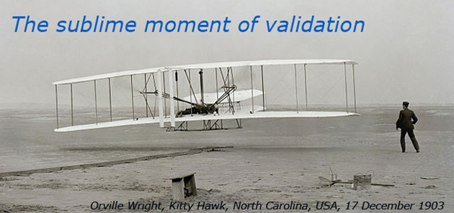
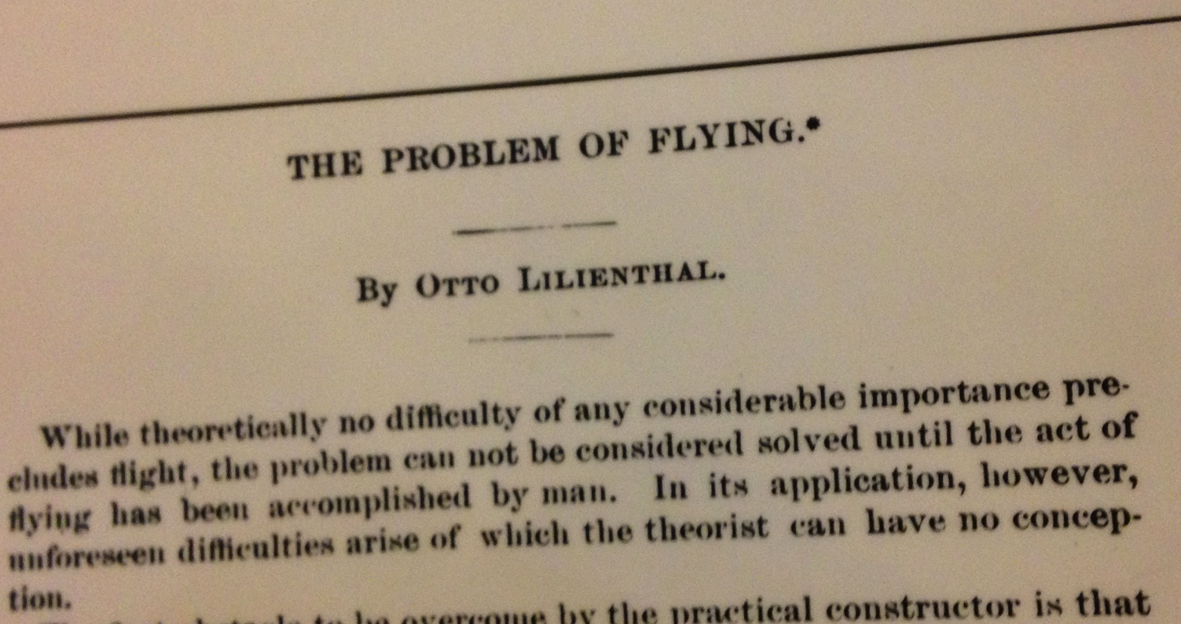
Why, how and purpose of computing
Why
  Very few instances of analytical, closed form, real life solutions exist.
  Nonlinearity and emergent behavior exist everywhere
How
  We employ methods of Validation and Verification (V&V)
    Doing the problem right (numerically sound approaches)
    Doing the right problem (physically sound approaches)
Purpose
  We compare theory (as codified in equations) to experiment
  We discover new phenomena
  We predict the outcomes of experiments to test theory
  We quantify our uncertainties (UQ)
We ‘always’ apply liberal amounts of physics intuition

Slide 4
Trends in High Performance Computing

Slide 5
Development with time (top500.org)

Slide 6
A big issue: power
Incremental cost of running RHIC: $550k/week
Incremental cost of running Titan: $140k/week
Incremental cost of running Sunway: $258k/week
(assume $0.1/kW-h)
June 2005 Tflop/kW = 0.191
Nov. 2017 Tflop/kW = 6.05
32x technology improvement

Slide 7
Beyond exascale landscape
Quantum, Neuromorphic
Squeeze out everything one can from CMOS
Beyond CMOS
Materials Science; Device Physics; Software

Slide 8
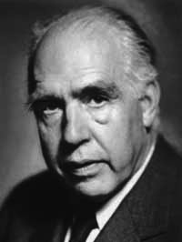
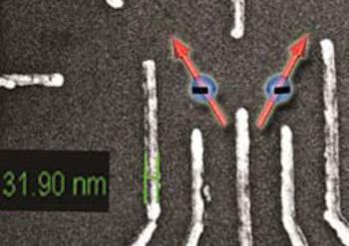
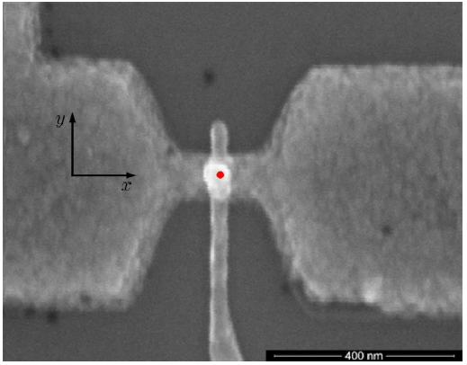
Quantum computing in context
In the sciences
If quantum mechanics hasn’t profoundly shocked you, you haven’t understood it yet. – Niels Bohr
1980s– 1990s
  A curious idea; first quantum algorithms
2000s
  Proof-of-principle demonstrations
  Initial QC hardware
  Error correction and control theory
2010s
  Focus on practicality and improving quality and control
  Circuit synthesis
Si Ge qubits
Julich
Phosphorous donor
Sydney
Current status
  Qubit fragility presents tremendous challenges
  Attempt to broaden suite of applications
Scientific motivator: “…potential ability to realize full control of large-scale quantum coherent systems…”
BES: Challenges at the frontiers of matter and energy, 2015
Quantum Pathfinder and Quantum Algorithms funding awarded by ASCR (FY17)
BES: Quantum Information Science Round Tables (October, 2017)
HEP funding in FY18 PBR, NP interest – INT and this workshop

Slide 9
Science 354, 1091 (2016) – 2 December
characterize
HREM, APT, SPM
Multiscale modeling
Classical quantum interface
From mK to 300K
Program Qubits
QIS and other groups
IBM 50 Qubit prototype

Slide 10
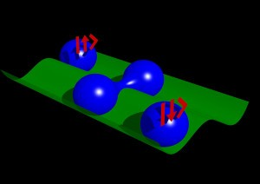
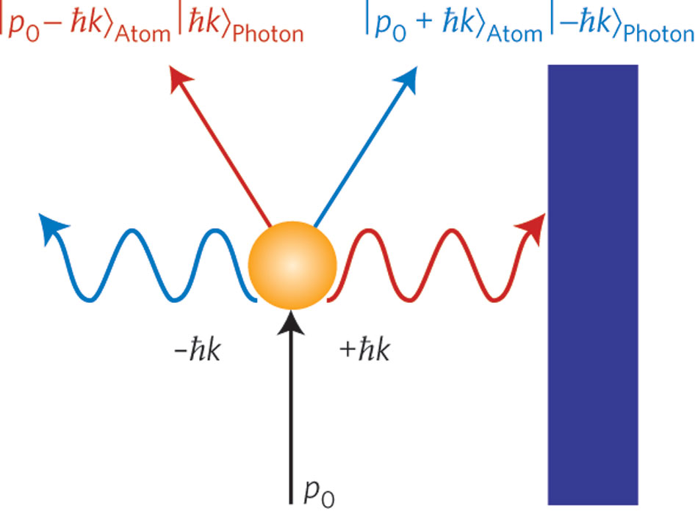
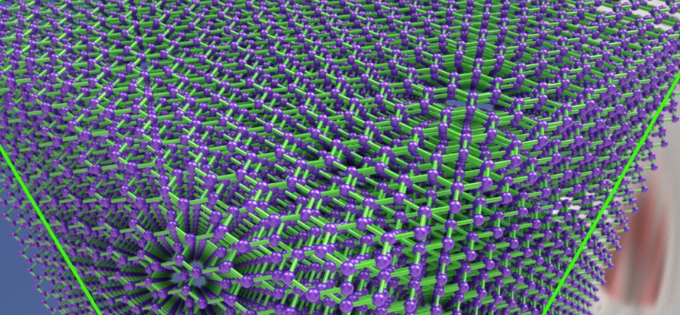
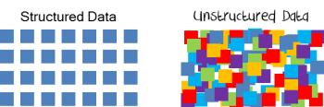
Quantum computing and its algorithms
1 = on
0 = off
|1⟩
|0⟩
Classical:
Definite state
Must prepare
and probe with external fields
Quantum: State superposition
21=7*3
Shor’s
algorithm
Quantum many-body simulation: Feynman, Lloyd
Grover’s algorithm (or inversion)
~15 algorithms exist; others can be expected as QC develops

Slide 11
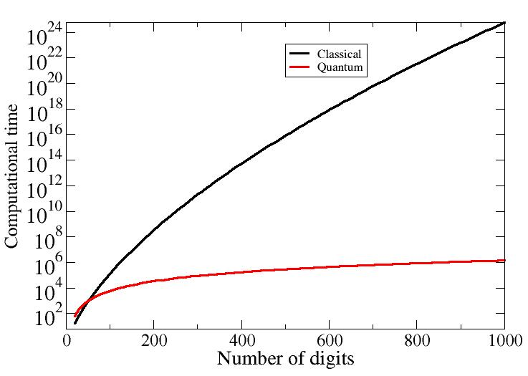
Quantum computing could crack some really tough problems!
The promise of quantum computing:
Scaling of some of the most difficult algorithms
Quantum
O((log N)²(log log N)(log log log N))
Classical
O(e1.9 (log N)^1/3 (log log N)^2/3)
Shor’s factorization
algorithm
Today AES-256
http://math.nist.gov/quantum/zoo/

Slide 12


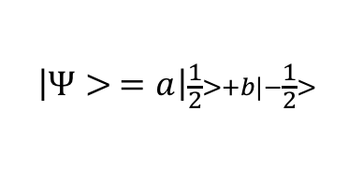
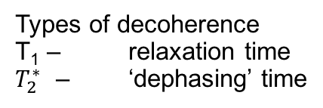
How to make a qubit
B-field splits the orbital into its projections
m_{s}=+1/2
$$U=\frac{1}{2}gμ_{B}B$$
Energy
RF induced transition
m_{s}=-1/2
$$U=−\frac{1}{2}gμ_{B}B$$
B₀=0
B₀>0
Magnetic field
Veldhorst et al., Nature 526, 410 (2015)
Electrons are spin ½ fermions
Order of magnitude estimates…
Landau g factor ~1
μ_{B}=5.8x10⁻⁵ eV/Tesla
B=1 Tesla
ε=0.7 K
1 K = 20 GHz
Types of decoherence
T₁ – relaxation time
$T_{2}^{∗}$ – ‘dephasing’ time
$$\left|Ψ> =a\right|\frac{1}{2}>+b|−\frac{1}{2}>$$
|a|²+|b|²=1

Slide 13
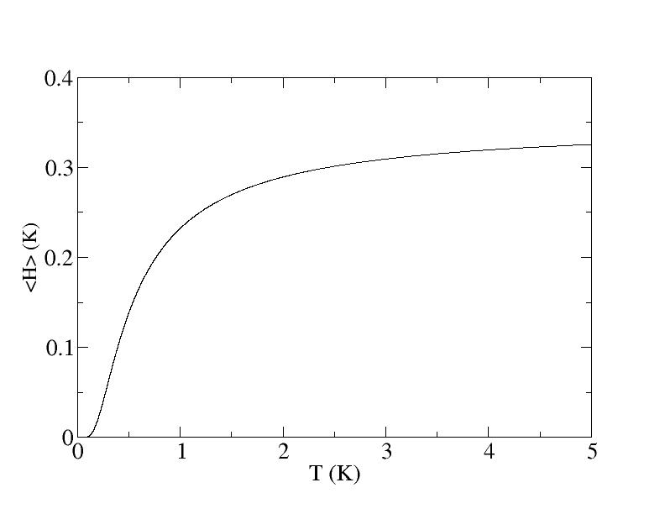
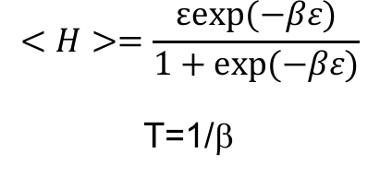
Thermal effects
Landau g factor ~1
μ_{B}=5.8x10⁻⁵ eV/Tesla
B=1 Tesla
ε=0.7 K
1 K = 20 Ghz
$$<H>=\frac{εexp⁡(−βε)}{1+exp⁡(−βε)}$$
T=1/β
ε=gμ_{Β}B
0
Implies very low temperature operation (mK)

Slide 14
Quantum Computing at ORNL

Slide 15


ORNL Quantum computing materials and interfaces strategy
Opportunity
ORNL assets
Strategy
Integrate core competencies
in materials, modeling,
and isotopes to establish
a broad R&D effort
in quantum computing
Create S&T base to drive computing beyond exascale
and into quantum computing
Develop tools necessary
to characterize and design
high-fidelity physical qubits
Explore methods to interface qubits
to traditional computers
Develop a multi-qubit research
test bed
Research methods to program
multi-qubit systems
Foster multiagency ties
to secure long-term funding
Expertise in quantum information science
and quantum computing
Unique resources
for materials characterization
Strengths in first principles theory, modeling, and simulation for quantum materials
National User Facilities:
CNMS, OLCF, SNS
Outcome
Cross-cutting R&D portfolio
establishing ORNL as a national leader in quantum computing
Notes:
Opportunity:
Utilize core competencies in materials, modeling, and isotopes to establish a broad, multi-directorate and multi-sponsor R&D effort in quantum computing
Create a science and technology base to drive computing beyond exascale
Support near term advances in quantum materials
Develop transition opportunities for quantum technology
ORNL expertise:
Quantum information
Quantum Information Science group and Quantum Computing Institute within CCSD
Materials R&D
Unique materials characterization capability
First principles theory, modeling and simulation for quantum materials
CNMS and SNS/HFIR
Computing and computational science
Stable isotope enrichment
National security R&D
Strategy:
Develop tools necessary to characterize and design high-fidelity physical qubits
Explore methods to interface qubits to traditional computers
Develop a multi-qubit research test bed at ORNL
Research methods to program multi-qubit systems
Foster multi-agency ties that enable long term funding
15

Slide 16

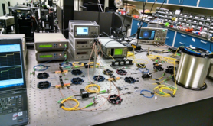
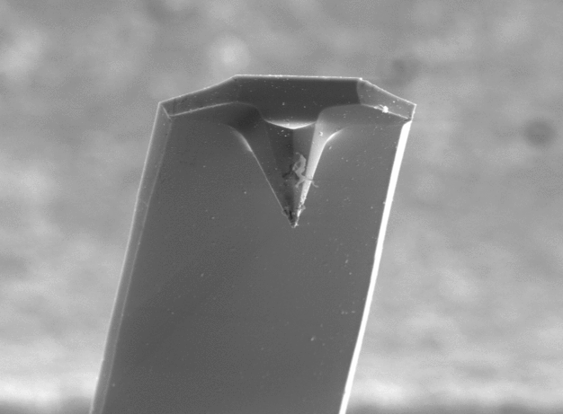
The Quantum Information Science Group supports research and development in a variety of quantum technologies
Sub-radiant
Super-radiant
Optical Pumping
Quantum Sensing
Quantum Computing
Quantum Communication
Compressive Quantum Imaging
Quantum Plasmonic Sensors
Ultra-sensitive MEMS Displacement
Standoff Spectroscopy
Opto-mechanical Force Microscopy
Circuit Model Simulations
Analog Digital Quantum Simulations
Physical Qubits Modeling
Quantum Characterization, Verification and Validation
Quantum Networks
Quantum Key Distribution
Quantum Secret Sharing
Quantum Random Number Generators
More information:
https://www.ornl.gov/division/csed/quantum-information
Contact: gricew@ornl.gov

Slide 17
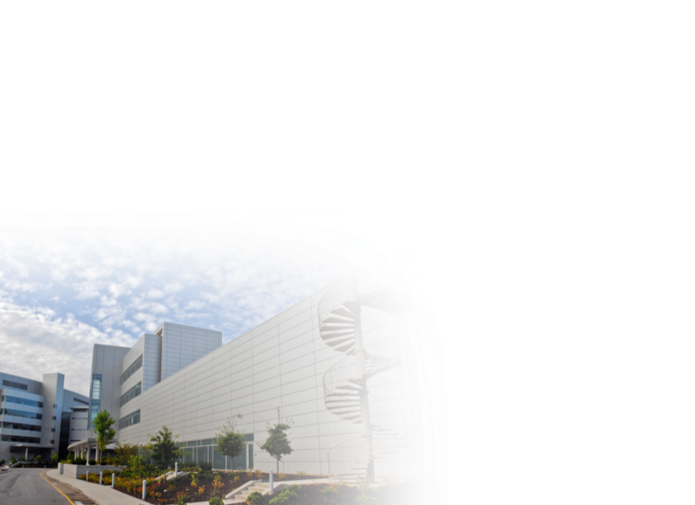
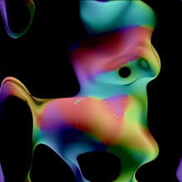
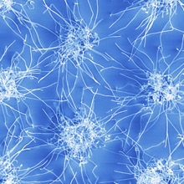
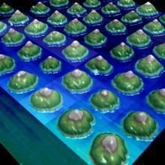
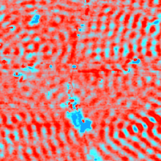
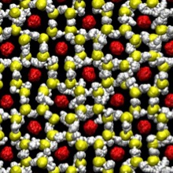
Center for Nanophase Materials Sciences provides capabilities for qubit research
Synthesis
Nanofabrication
Advanced microscopy
Functional characterization
Theory and modeling
2D, precision synthesis, selective deuteration
Direct-write, microfluidics, cleanroom
AFM (a CNMS specialty), STM, aberration-corrected TEM/STEM, atom probe tomography
Laser spectroscopy, transport, magnetism, electromechanics
Nanomaterials Theory Institute; gateway to leadership-class high-performance computing

Slide 18
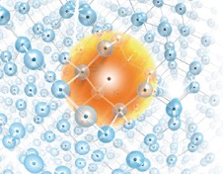
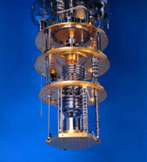
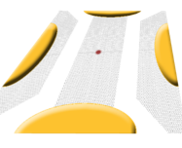

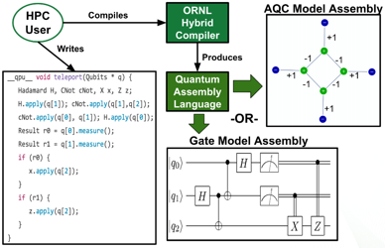
Current Quantum Computing LDRD initiative (FY16-18)
77 K
quantum interconnect
77 K
4.2K
4.2K
100 μK
stage
100 μK
stage
quantum
channel
quantum
channel
classical
control
Classical End User 300 K
classical
control
classical
control
P donor in Si
(Humble, Lupini)
Dilution Fridge A
Dilution Fridge B
Qubit operations
Heat dissipation
(Peters)
Graphene Qubit
(Jesse)
Quantum/Classical Interfaces (Lougovski)
Sub-radiant
Model, M
Data, Dt
Prediction
Super-radiant
Optical Pumping
Qubit fidelity modeling
(Bennink)
Dissipative QC (Evans)
Qubit Compiler
(McCaskey)

Slide 19
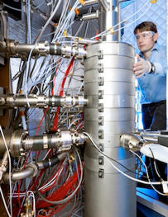
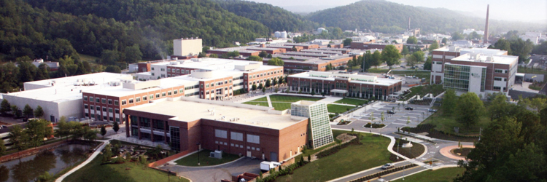
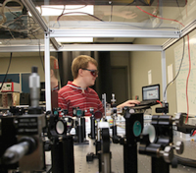

The Quantum Computing Institute provides lab-wide integration of our unique capabilities and partnerships
ORNL interaction point for resources in quantum computing
  Our mission is to foster collaborations and partnerships in developing quantum computing for scientific applications of next generation computing systems
The QCI leverages expertise across ORNL:
Focused Research, Community Outreach, Partnerships, User Support, Facilities
40+ staff and associates working on collaborative research
Quantum Information
Computer Science
Mathematics
Modeling and Simulation
Material Science
Electrical Engineering
Characterization
Physics
More information available at quantum.ornl.gov

Slide 20

































Our partnership network leverages expertise from academia, industry, and government

Slide 21
Current activities and near-term opportunities in QC
At ORNL
  FY16 – FY18 Quantum Computing Materials and Interfaces LDRD focused on the testbed concept; QCI,…
  ASCR (funded): Pathfinder Testbed (Pooser, PI)
  ASCR (funded): Quantum Algorithms (Loubovski, PI)
Nationally
  BES Round Table Reports on QIS
    Possible funding opportunity to follow (through Linda Horton)
  NP White Paper on QC
    Significant FY18 or FY19 funding for enriched materials production for QC (PBR)
  HEP workshops on QC and QIS
    Quantum sensing is the main focus
    RFPs are on the street
  Congressional (House S&T Committee) discussing a ‘national quantum initiative’

Slide 22
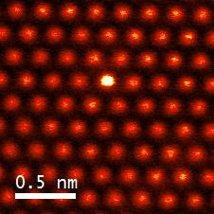
Quantum Materials
Yang et al., Nature 542, 75 (2017)
Lupini LDRD
Nat. Phys. 13, 1056 (2017)
  The Science
Strongly correlated electron systems and emergent behavior
Requires a strong theoretical basis
Requires advanced characterization techniques
Neutrons provide an excellent probe of magnetic properties
Light sources yield structural info
Why it is important
Miniaturization of electronics toward <7 nm structures requires quantum mechanics
Strong connection to quantum information and quantum computing
Used in sensors, high-density memory…
ORNL Strategy
Pursue both basic and applied R&D
Identify expertise gaps and utilize LDRD to fill them
Capitalize on current strengths in neutron scattering from these materials and computation of their properties

Slide 23
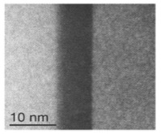
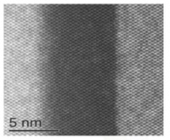
Partnerships: Interfacial optimization for improved qubit devices
Understand electrostatically gated quantum dot structures
in SiGe/Si/SiGe heterostructures
Collaboration to investigate SiGe/Si/SiGe interfacial structures and chemistries
at the sub-Å level
80 Å Si
SiGe
80 Å Si
SiGe
Partner grows SiGe/Si/SiGe via chemical vapor deposition (CVD) and molecular beam epitaxy (MBE) under various deposition conditions
80 Å Si
ORNL optimizes CVD and MBE processing variables and reliably produces high-fidelity interfaces through application of expertise
in aberration-corrected Z-contrast STEM imaging, electron energy loss spectroscopy, and atom probe tomography to provide the single-atom-level understanding of defects, interfacial steps/terraces, chemistry, composition,
and structural thermal stability
80 Å Si
Atom probe tomography map
of a double-Si-well heterostructure
(Si: grey; Ge: red)
Z-contrast STEM images of
80 Å Si well reveal an atomically “sharp” Si/SiGe interface and
a “10 Å diffuse” Si/SiGe interface
Notes:
Ward: gain a deeper understanding of electrostatic and exchange field biasing effects arising at the interface of ionic liquid / strongly correlated oxide interfaces. An approach that combines the complexity of soft matter with the complexity of strongly correlated solids, to create a new paradigm in controllability and design of functionalities in materials
MSTD, CSD, NcSD

Slide 24
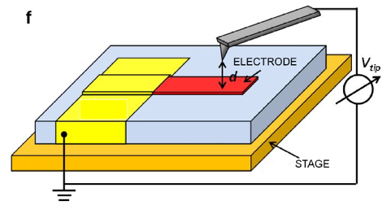
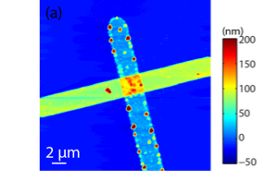
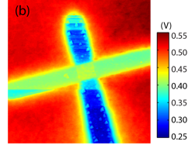
Kelvin probe force microscopy with MIT Lincoln Laboratory
Understanding anomalous heating of ion-trap qubits using Kelvin probe force microscopy (KPFM)
and X-ray photoelectron spectroscopy
Understanding surface contamination
of superconducting qubits: Standard AFM and KPFM imaging on model Au/Si sample
Topography
CPD
Small blue dots: Distortions in work function map may be due to localized distortions in the electric field caused by residual contaminants (both distortions and contaminants may be detectible using this technique)
Kelvin probe AFM: DC/AC biased probe detects electrostatic forces on a sample surface, mapping work function on a surface with nanometer precision
L. Collins et al., “Multifrequency spectrum analysis using fully digital
G-mode-Kelvin probe force microscopy,” Nanotechnol. In press

Slide 25
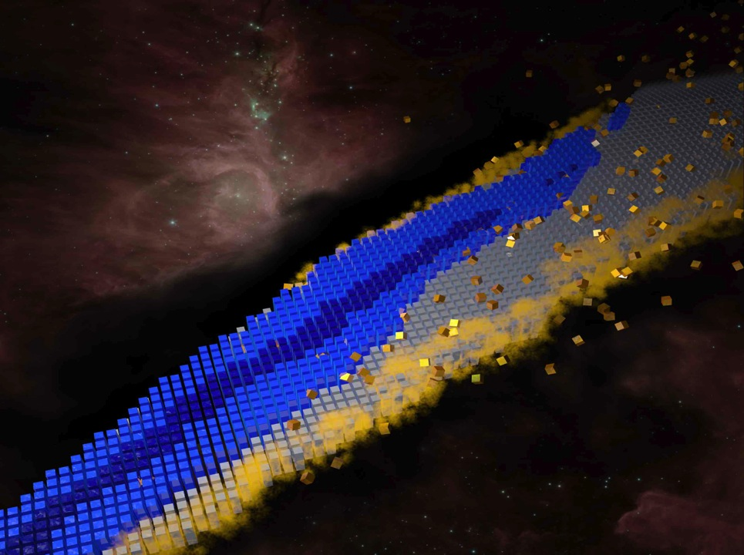
Nuclear physics application: the deuteron

Slide 26
Game plan (“simplest deuteron”)
1. Hamiltonian from pionless EFT at leading order; fit to deuteron binding energy; constructed in harmonic-oscillator basis of ³S₁ partial wave [à la Binder et al. (2016); Bansal et al. (2017)]; cutoff at about 150 MeV.
2. Map single-particle states |n⟩ onto qubits using |0⟩ = |↑⟩ and |1⟩ = |↓⟩. This is an analog of the Jordan-Wigner transform.
3. Solve H₁, H₂ (and H₃) and extrapolate to infinite space using harmonic oscillator variant of Lüscher’s formula [More, Furnstahl, Papenbrock (2013)]

Slide 27
Variational wave function
Wave functions on two qubits
Wave functions on three qubits
Minimize number of two-qubit CNOT operations to mitigate low two-qubit fidelities (construct a “low-depth circuit”)

Slide 28
Hamiltonian expectation value on two qubits
Quantum-classical hybrid algorithm VQE [Peruzzo et al. 2014; McClean et al 2016]:
Expectation values on QPU. Minimization on CPU.

Slide 29
Three qubits
Three qubits have more noise. Insert r pairs of CNOT (unity operators) to extrapolate to r=0. [See, e.g., Ying Li & S. C. Benjamin 2017]

Slide 30
Final results
Deuteron ground-state energies from a quantum computer compared to the exact result, E∞=-2.22 MeV.
[Dumitrescu, McCaskey, Hagen, Jansen, Morris, Papenbrock, Pooser, Dean, Lougovski, arXiv:1801.03897]

Slide 31
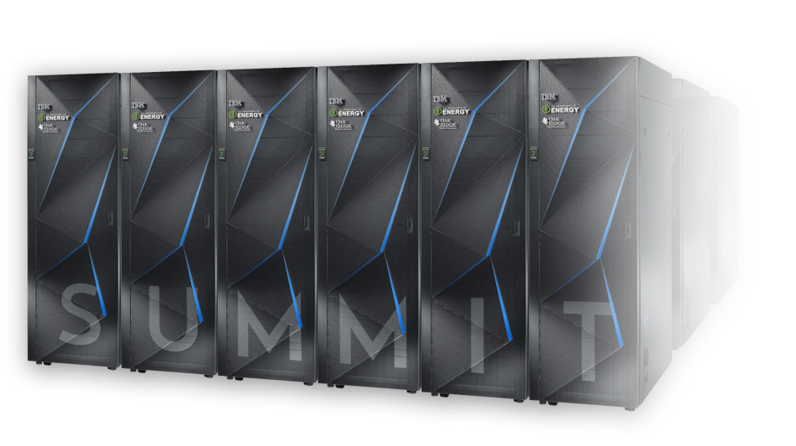



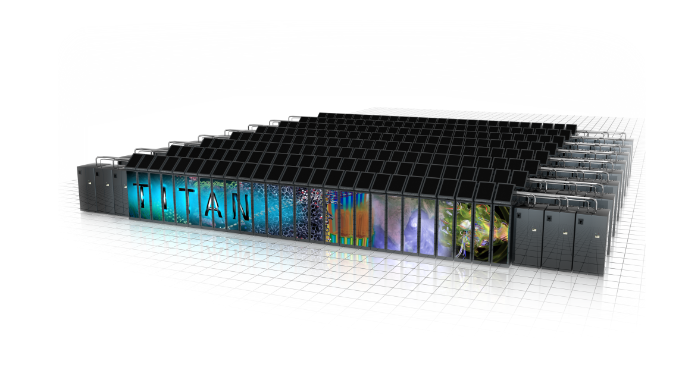
Discussion
Pre-exascale
Exascale
Quantum
Petascale

