Slide 1
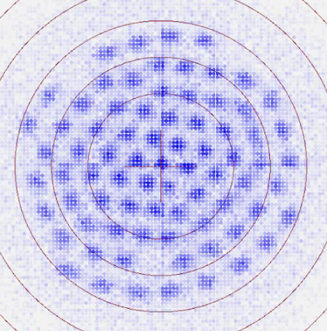




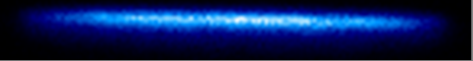
Quantum sensing and simulation with single plane crystals of trapped ions
John Bollinger
NIST-Boulder
Ion storage group
Justin Bohnet (Honeywell), Kevin Gilmore, Elena Jordan, Brian Sawyer (GTRI) ,
Joe Britton (ARL)
theory –Rey goup (JILA/NIST)
Freericks group (Georgetown)
Dan Dubin (UCSD)
• motional amplitude sensing
• quantum simulation – measure quantum dynamics with OTOC
+V
B
+V

Slide 2
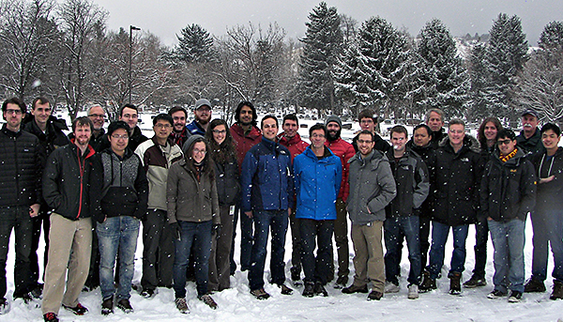
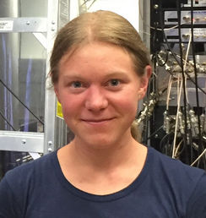
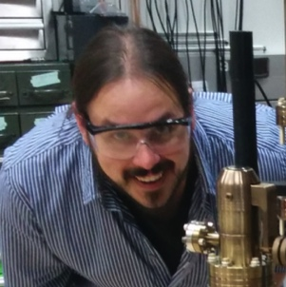
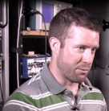
NIST ion storage group
Justin Bohnet
Kevin Gilmore
Elena Jordan
Brian Sawyer
GTRI
Joe Britton
ARL

Slide 3


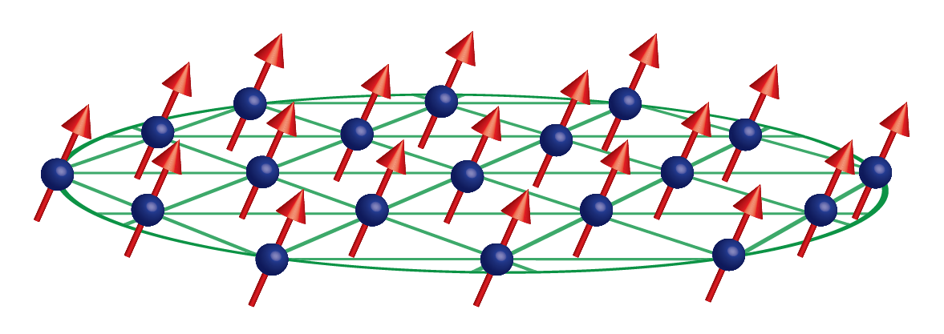
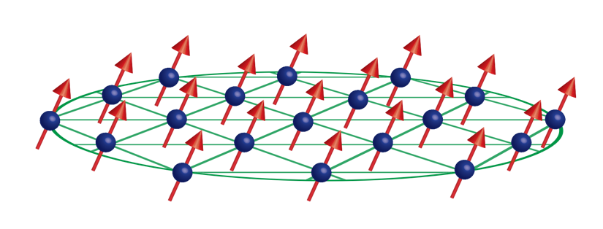
Outline:
● Penning trap features
- high field qubit, modes
● sensing small COM (center-of-mass) motion
- spin-dependent forces
● Quantum simulation with ion crystals in a Penning trap
- engineering Ising interactions with spin-dependent forces
- Loschmidt echo and out-of-time order correlation functions

Slide 4
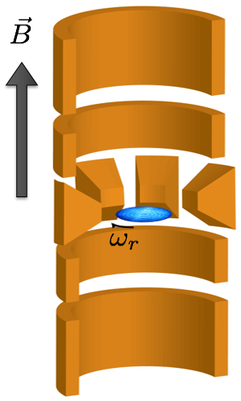

Penning trap: many particle confinement with static fields
● radial confinement due to rotation –
ion plasma rotates v_{θ} = ω_{r} r due to ExB fields
in rotating frame, Lorentz force is directed radially inward
rotating
frame
n_{B}
Density n_{o}
⁹Be⁺, B₀ = 4.5 T
ω_{m}
Ω_{c} / 2
Ω_{c} − ω_{m}
$\frac{Ω_{c}}{2π}\sim$ 7.6 MHz, $\frac{ω_{z}}{2π}\sim$ 1.6 MHz, $\frac{ω_{m}}{2π}\sim$ 160 kHz
Rotation frequency ω_{r}

Slide 5
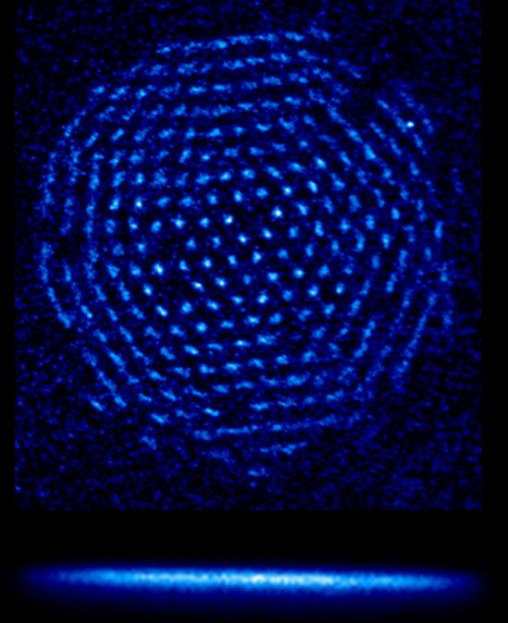
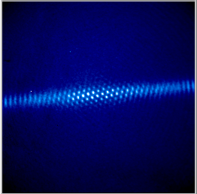
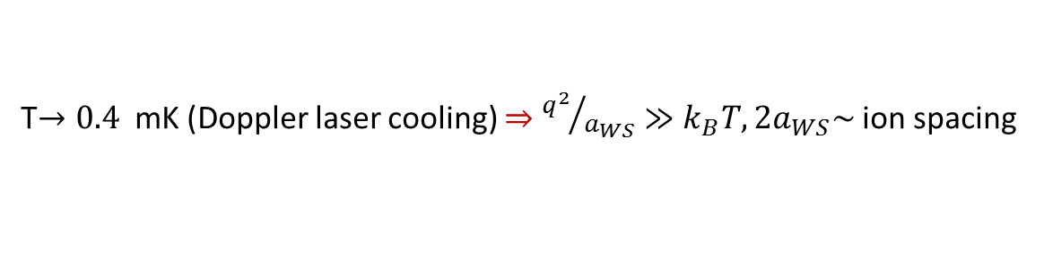
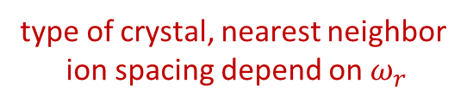
Ion crystals form as a result of minimizing Coulomb potential energy
T$→0.4$ mK (Doppler laser cooling) $⇒$ ${q^{2}}/{a_{WS}}≫k_{B}T, 2a_{WS}\sim$ion spacing
type of crystal, nearest neighbor
ion spacing depend on $ω_{r}$
n_{B}
Density n_{o}
Mitchell et.al., Science (1998)
ω_{m}
Ω_{c} / 2
Ω_{c} − ω_{m}
single planes
Rotation frequency ω_{r}
bcc crystals with N>100 k
observed with:
Bragg scattering
ion fluorescence imaging
B
14 μm
0.5 mm
Notes:
Ion crystals form as a result of the laser cooling. The type of crystal that forms depends on the crystal size and shape.
With 3d crystals with several hundred thousand ions we observe body-centered-cubic crystals, while with single planes we observe an approximate triangular lattice.
The experiments I will discuss today employ these single plane crystals with up to a few hundred ions. However I think we now understand how we can extend this work to these much larger 3-dimensional crystals.

Slide 6
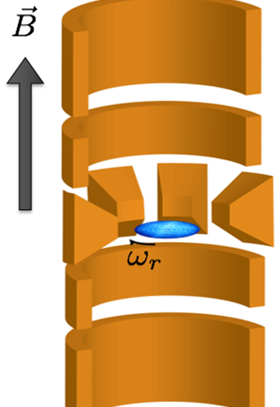
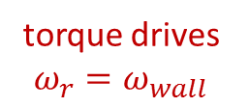








Precise $ω_{r}$ control with a rotating electric field
$$V_{sector}=V_{Wall}\sin\left(ω_{drive}t+φ\right)$$
90º
$φ=$0º
$$ω_{r}$$
rotating
wall
electrodes
180º
270º
$$ω_{wall}$$
$$ω_{r}$$
270º
180º
$$ω_{wall}$$
360º
90º
torque drives
$ω_{r}=ω_{wall}$
$$ω_{wall}=ω_{drive}/2$$
Notes:
Emphasize that this is a key technique in our work, and this is how we implement it.
Ion crystals in a Penning trap rotate, but we precisely control this rotation with a rotating electric field, sometimes called a rotating wall. We apply sinusoidal voltages with different phase shifts to 8 azimuthally segmented electrodes in the center of the trap. This configuration of voltages generates a rotating quadrupole field. This rotating quadrupole potential distorts the boundary of the array and applies a torque that drives the actual rotation frequency of the array to equal that of the rotating wall

Slide 7
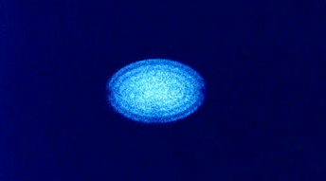

Precise $ω_{r}$ control with a rotating electric field
$$V_{sector}=V_{Wall}\sin\left(ω_{drive}t+φ\right)$$
90º
$φ=$0º
$$ω_{r}$$
rotating
wall
electrodes
180º
270º
$$ω_{wall}$$
$$ω_{r}$$
270º
180º
$$ω_{wall}$$
360º
90º
torque drives
$ω_{r}=ω_{wall}$
$$ω_{wall}=ω_{drive}/2$$
B
Notes:
This control of the ion array rotation works exceeding well, and is an important tool for us. This shows a video of a side-view image of a small ion cloud under control of the rotating wall. During the video we adiabatically lower the rotating wall frequency. The ion cloud shape follows: The cloud goes from three planes to 2 planes to a single plane.

Slide 8
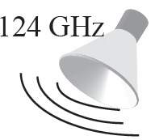
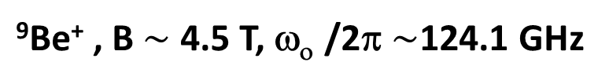
Be⁺ high magnetic field qubit
⁹Be⁺ , B$\sim$ 4.5 T, ω_{ο} /2π $\sim$124.1 GHz
m_{J}
+3/2
~ 80 GHz
2p ²P_{3/2}
+1/2
-1/2
B
-3/2
2p ²P_{1/2}
+1/2
-1/2
~ 40 GHz
Doppler
cooling
cooling
+1/2 = | ↑ ›
2s ²S_{1/2}
repump
124 GHz
-1/2 = | ↓ ›
repump

Slide 9





Transverse (drumhead) modes
$E×B$ modes
transverse modes
cyclotron modes
$$ω_{m}$$
$$ω_{z}$$
$$Ω_{c}$$
Notes:
In addition to the spin degree of freedom, the other ingredient in a trapped ion quantum simulation is the motional degree of freedom, or normal modes.
A crystal for N ions has 3N normal modes, which separate into three bands for single-plane crystals.

Slide 10
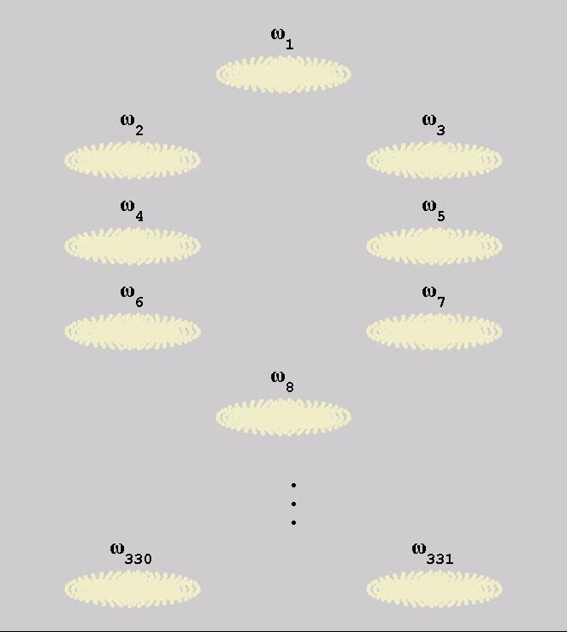

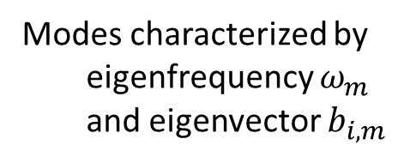
Transverse (drumhead) modes
$E×B$ modes
transverse modes
cyclotron modes
$$ω_{m}$$
$$ω_{z}$$
$$Ω_{c}$$
Freericks group, PRA (2013)
Baltrush, Negretti, Taylor,
Calarco, PRA (2011)
Dubin, UCSD
Frequency $ω_{m} ⟶$
Modes characterized by
eigenfrequency $ω_{m}$
and eigenvector $b_{i,m}$
Notes:
In our work we use spin-dependent forces to couple to the axial drumhead modes.
Movie from theory code.

Slide 11
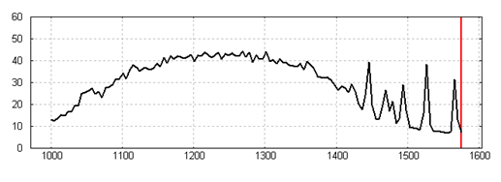




Transverse (drumhead) modes
$E×B$ modes
transverse modes
cyclotron modes
$$ω_{m}$$
$$ω_{z}$$
$$Ω_{c}$$
Spin precession
Spin-dependent force frequency $μ$ (kHz)
Measure mode spectrum with
spin-dependent force
tilt mode
COM mode
$$ω_{z}$$
Notes:
We can sensitively detect these modes using a technique I am about to describe. When the frequency of a spin-dependent force matches the frequency of a mode, we get spin precession, which we can straight forwardly measure. Here we sweep across the bandwidth of the drumhead modes. From about 1 MHz to 1.6 MHz. We can resolve some of the higher frequency modes.
I do not show the corresponding theory calculation, but get good agreement with expected drumhead mode frequencies.

Slide 12
Outline:
● Penning trap features
- high field qubit, modes
● sensing small COM (center-of-mass) motion
- spin-dependent forces
● Quantum simulation with ion crystals in a Penning trap
- engineering Ising interactions with spin-dependent forces
- Loschmidt echo and out-of-time order correlation functions

Slide 13
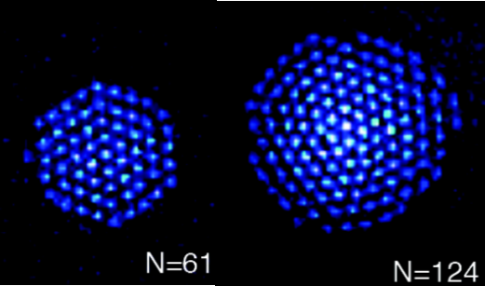
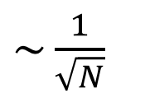

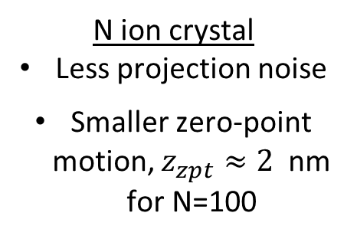


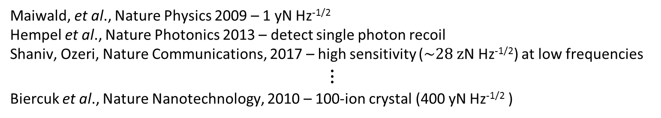
Motional amplitude sensing or
Trapped ions as sensitive $\vec{E}$-field and force detectors
Maiwald, et al., Nature Physics 2009 – 1 yN Hz^{-1/2}
Hempel et al., Nature Photonics 2013 – detect single photon recoil
Shaniv, Ozeri, Nature Communications, 2017 – high sensitivity ($\sim 28 z$N Hz^{-1/2}) at low frequencies
⋮
Biercuk et al., Nature Nanotechnology, 2010 – 100-ion crystal (400 yN Hz^{-1/2} )
Basic idea: map motional amplitude onto spin precession
N ion crystal
Less projection noise
Smaller zero-point motion, $z_{zpt}≈2$ nm for N=100
Single ion
N ion crystal
$\sim \frac{1}{\sqrt{N}}$
$$⟺$$
$$⟺$$
N+1
levels
Notes:
It is well known that trapped ions are sensitive electric field and force detectors. There have been a number of really nice demonstrations, mostly involving single or a pair of trapped ions. This last reference uses a small crystal of 100 ions, and large numbers of ions can be an advantage.
The basic idea in our protocol, irrespective of ion number, is to couple the ions’ motion to its spin and map a very weakly excited motional amplitude onto the spin state via precession. Then, we can detect the spin state with high signal to noise. For a single ion this means mapping the motional state onto a 2-level system, which when read out provides 1 bit of information.
A given force/ion will excite the center of mass mode of an N ion crystal to the same amplitude as a single ion. This weakly excited COM motion can be mapped onto the N+1 levels of the Dicke spin manifold. Reading out this spin state provides more information in a single experimental trial than can be obtained with a two-level system. Equivalently, for many ions the projection noise is reduced.
So, an N-ion crystal can provide a greater single/noise in a single measurement than single ions. In addition, another potential advantage is that the quantum fluctuations of the COM mode are smaller such that a given amplitude displacement is larger relative to the q fluc for many ions vs a single ion.

Slide 14
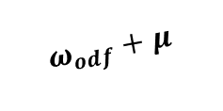

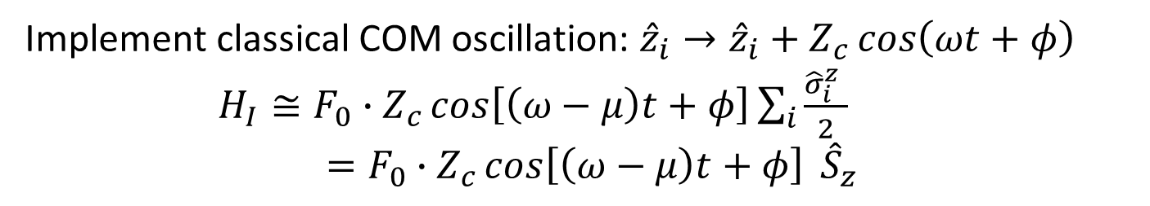
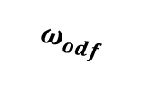

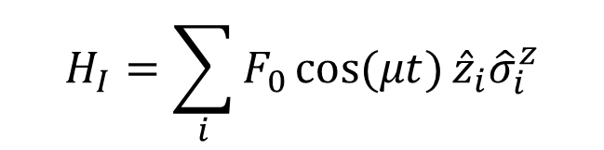



Sensing small center-of-mass motion
$$\hat{z}$$
$$\hat{x}$$
$$\hat{y}$$
$$ω_{odf}$$
$$δk$$
$$H_{I}=\sum_{i}{F_{0}\cos{(μt)}{{\hat{z}}_{i}\hat{σ}}_{i}^{z}}$$
$$20°$$
$$ω_{odf}+μ$$
900 nm
Implement classical COM oscillation: ${\hat{z}}_{i}→{\hat{z}}_{i}+Z_{c}\cos\left(ωt+φ\right)$
$H_{I}≅F_{0}∙Z_{c}\cos\left[\left(ω−μ\right)t+φ\right]\sum_{i}{\frac{{\hat{σ}}_{i}^{z} }{2}}$
$=F_{0}∙Z_{c}\cos\left[\left(ω−μ\right)t+φ\right] {\hat{S}}_{z}$
For $μ=ω$, produces spin precession with rate $∝F_{0}⋅Z_{c}cos⁡(φ)$
Notes:
So, how do we map motion onto spin precession. We use a spin-dependent force, and this cartoon sketches the basic set-up. We cross two off-resonant laser beams at a 20 degree angle. This generates a 1-D optical lattice. By setting a frequency difference between the beams, this becomes a moving lattice, and as the intensity maxima and minima wash across the ion array, the ions experience a force due to the gradient in the laser intensity. The frequency of the force is just the difference in the laser beam frequencies. And we can adjust the frequency and polarization of the laser beams so that the force on the spin up state is equal and opposite to the force on spin down.
The interaction we generate is this – we couple the spin degree of freedom of each ion to is axial coordinate.
Suppose a classical, spin-independent motion already exists, which we denote here by capital Z_c for classical. You can see if we plug this cosine term into this expression, we will get a product of two cosines, which mixes down and gives an interaction with a time dependence at the difference frequency between the spin-dependent force frequency \mu and the classical motion omega. If the center of mass motion and spin-dependent force have the same frequency, we get a time-independent Hamiltonian proportional to z-component of the composite spin of the system. An interaction linear in S_z gives rise to spin precession, where the rate of precession is proportional to the amplitude of motion (Z_c) and the phase \phi between the motion and spin-dependent force.
Spin precession, of course, is something that is straight forward for us to measure in a Ramsey style experiment.

Slide 15
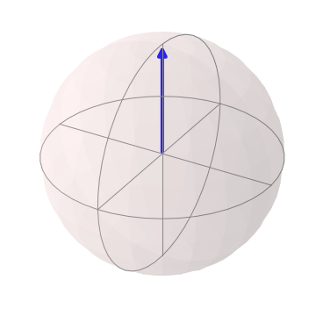
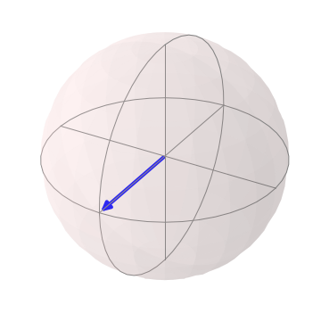
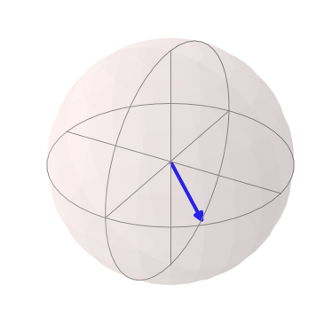
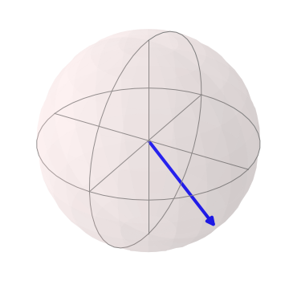
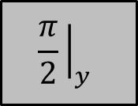
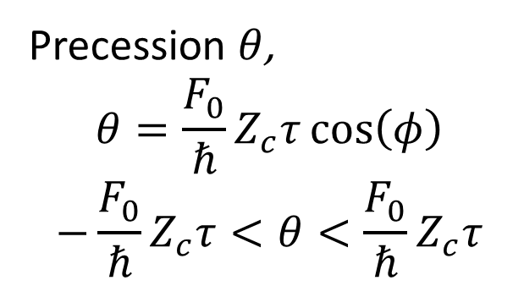





Measuring spin precession
Cool & Prepare
$$\frac{π}{2}{\left.​\right|}_{y}$$
ODF
$$\frac{π}{2}{\left.​\right|}_{y}$$
Detect
$$τ$$
$$θ$$
$$θ$$
Precession $θ$,
$$θ=\frac{F_{0}}{ℏ}Z_{c}τ\cos\left(φ\right)$$
$$−\frac{F_{0}}{ℏ}Z_{c}τ<θ<\frac{F_{0}}{ℏ}Z_{c}τ$$
Probability of measuring spin up:
$$\left\langle P_{↑}\right\rangle = \frac{1}{2}\left(1−e^{−Γτ}\left\langle \cos{θ}\right\rangle \right)$$
$= \frac{1}{2}\left(1−e^{−Γτ}J_{0}\left(\frac{F_{0}}{ℏ}Z_{c}τ\right)\right)$

Slide 16
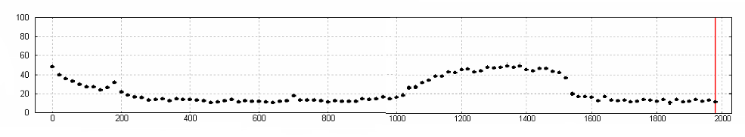









Measuring spin precession
COM mode
$\left\langle P_{↑}\right\rangle$ (%)
$$ω$$
ODF Difference Frequency $μ$ (kHz)
$$\hat{z}$$
$$ω$$
$$\hat{x}$$
$$\hat{y}$$
$\left\langle P_{↑}\right\rangle$ (%)
ODF Difference Frequency $μ$ (kHz)
tilt mode
COM mode
$$ω_{z}$$
Notes:
This shows measured spin precession, or more properly, spin dephasing, as the frequency of the spin dependent force is swept from DC to 2 MHz. The signal we see here is due to thermal and zero-point fluctuations of the drumhead modes. This background is due to off-resonant light scatter. The low frequency rise has several possible sources.
To characterize the precision with which we can measure small COM motion, it is desirable to avoid the thermal and zero-point fluctuations of the drumhead modes. Therefore we impose a small, constant amplitude COM motion with an rf drive at 400 kHz, which is far off-resonant from the drumhead modes. From the voltage of this drive we can determine the amplitude of the center-of-mass mode we are generating.

Slide 17
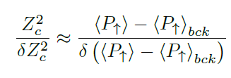
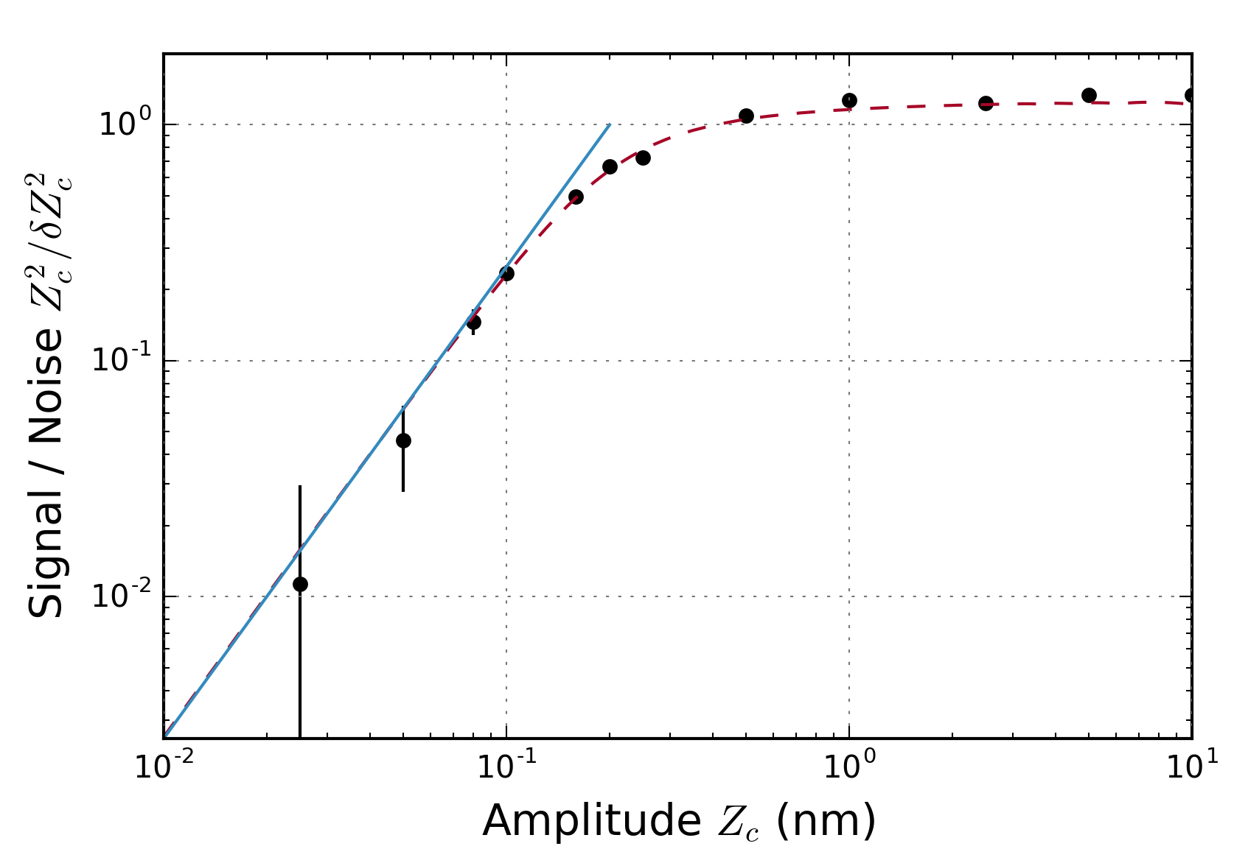
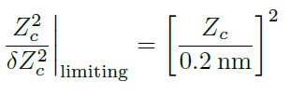
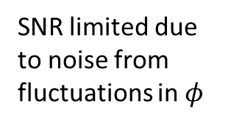
Sensitivity limits/ signal-to-noise
SNR limited due to noise from fluctuations in $φ$
Single trial
50 pm – smallest detected amplitude
Small signal limits due to:
projection noise
spontaneous emission
Gilmore et al.,
PRL 2017

Slide 18
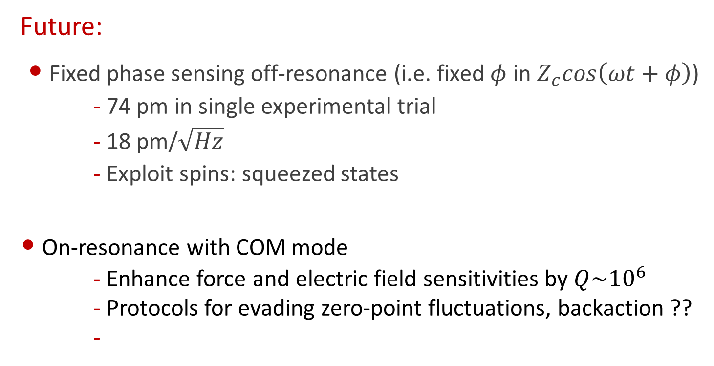
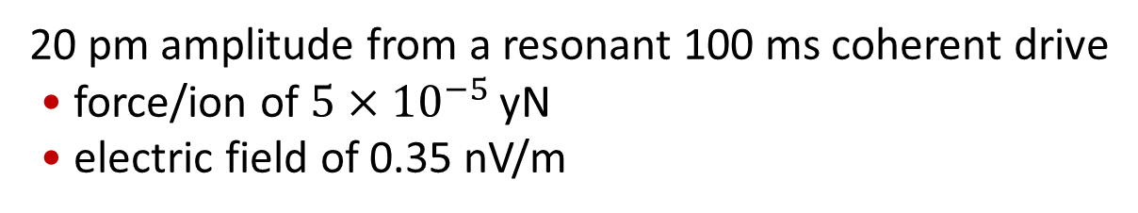
Sensing small center-of-mass motion
Future:
• Fixed phase sensing off-resonance (i.e. fixed $φ$ in $Z_{c}cos\left(ωt+φ\right)$)
  - 74 pm in single experimental trial
  - 18 pm/$\sqrt{Hz}$
  - Exploit spins: squeezed states
• On-resonance with COM mode
- Enhance force and electric field sensitivities by $Q\sim {10}^{6}$
- Protocols for evading zero-point fluctuations, backaction ??
-
20 pm amplitude from a resonant 100 ms coherent drive
• force/ion of $5×{10}^{−5}$ yN
• electric field of 0.35 nV/m
Notes:
There is some interesting future work to be done here. Amplitude sensing with a fixed phase phi can be much more sensitive, as we are first order sensitive to the amplitude Z_c. We estimate a sensitivity of 74 pm in a single experimental trial, and 18 picometers in a second with our repetition rate. We can improve this sensitivity by employing squeezed spin states, which I talked about earlier.
Sensing motion resonate with the COM mode becomes a very sensitive probe of weak forces and electric fields. Maintaining this sensitivity (74 pm in a single measurement) on resonance will require protocols for evading back action and sensitivity to zero point fluctuations. A 20 pm amplitude measurement provides sub- nV/m electric field sensitivity. What is this good for? One possibility is that this nV/m sensitivity could be useful for searches of the light dark matter candidates hidden photons and axions.

Slide 19
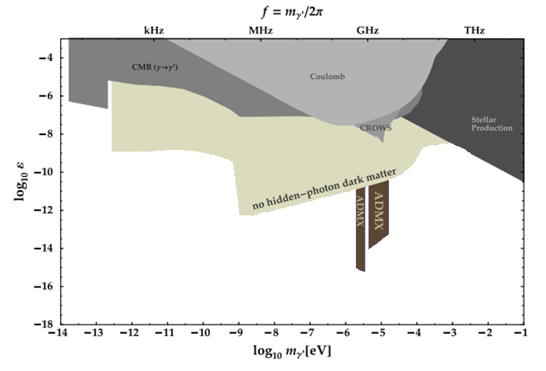



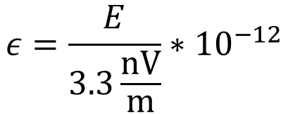
Potential for dark matter search
(axions and hidden photons)
20 pm amplitude from a resonant 100 ms coherent drive
• force/ion of $5×{10}^{−5}$ yN
• electric field of 0.35 nV/m
S. Chaudhuri, et al.,
Phys. Rev. D (2015).
kHz
MHz
GHz
THz
$$ε=\frac{E}{3.3\frac{nV}{m}}∗{10}^{−12}$$
$$\log_{10}{ε}$$
$$\log_{10}{m} [eV]$$
Notes:
The detection of a 20 pm amplitude resulting from a 100 ms coherent drive on the 1.57 MHz COM mode is sensitive to a force/ion of 5×10−5 yN , corresponding to an electric field of 0.35 nV/m.
A nV/m sensitivity is what is required to establish new limits on dark matter candidates like hidden photons and axions. This plot is taken from this reference and shows current limits on the coupling of hidden photons to normal matter. The red area here shows limits we could potentially establish with trapped ions operating with trapped axial frequencies varying from 50 kHz to 5 MHz and a sensitivity of 0.3 V/m.

Slide 20
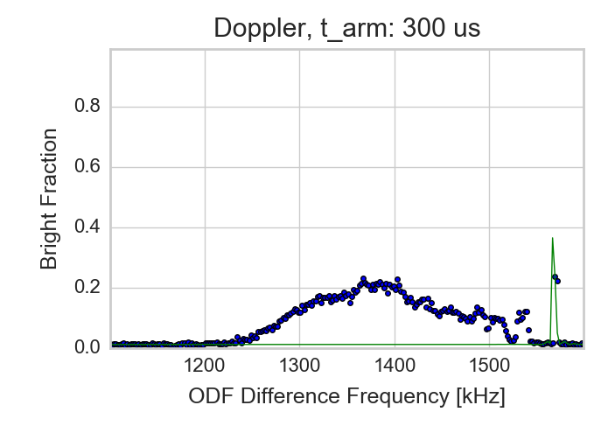
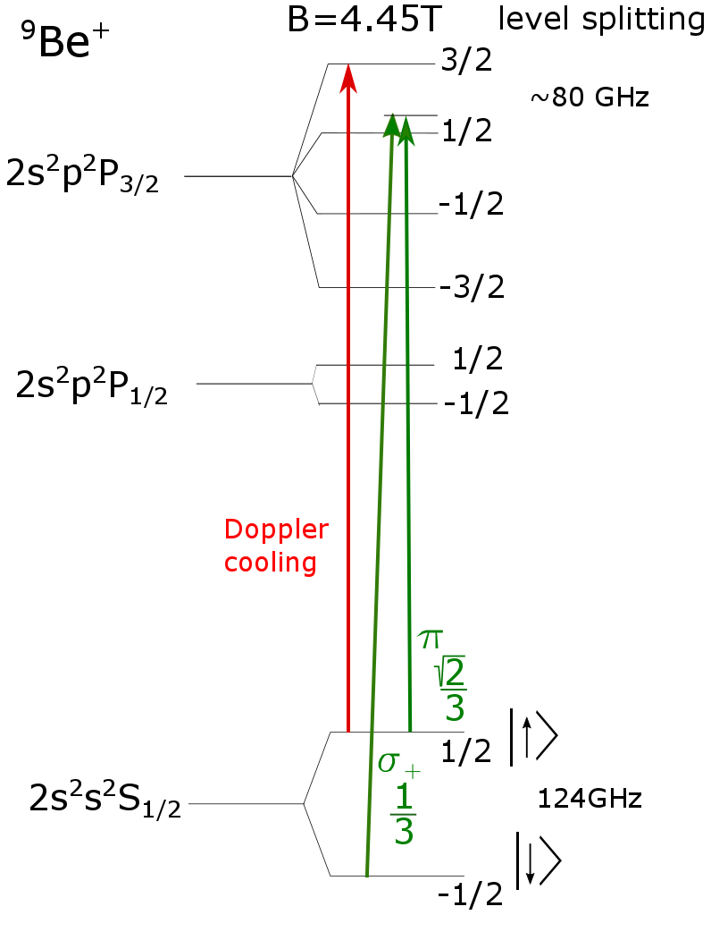
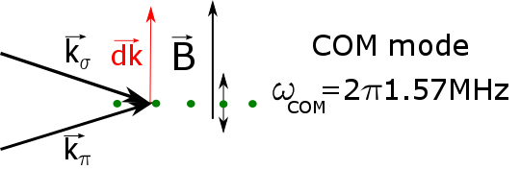
Technical improvement: EIT cooling
Morigi PRA 67 (2003); exp results with smaller ion numbers: Innsbruck, NIST

Slide 21
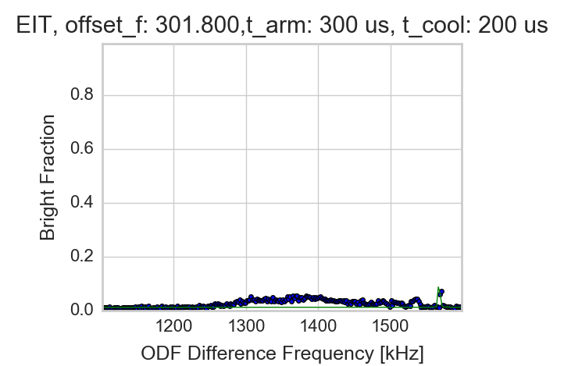
Technical improvement: EIT cooling
Morigi PRA 67 (2003); exp results with smaller ion numbers: Innsbruck, NIST

Slide 22
Outline:
● Penning trap features
- high field qubit, modes
● sensing small COM (center-of-mass) motion
- spin-dependent forces
● Quantum simulation with ion crystals in a Penning trap
- engineering Ising interactions with spin-dependent forces
- Loschmidt echo and out-of-time order correlation functions

Slide 23
Sensing small center-of-mass motion
$$\hat{z}$$
$$\hat{x}$$
$$\hat{y}$$
$$ω_{odf}$$
$$δk$$
$$H_{I}=\sum_{i}{F_{0}\cos{(μt)}{{\hat{z}}_{i}\hat{σ}}_{i}^{z}}$$
$$20°$$
$$ω_{odf}+μ$$
900 nm
Implement classical COM oscillation: ${\hat{z}}_{i}→{\hat{z}}_{i}+Z_{c}\cos\left(ωt+φ\right)$
$H_{I}≅F_{0}∙Z_{c}\cos\left[\left(ω−μ\right)t+φ\right]\sum_{i}{\frac{{\hat{σ}}_{i}^{z} }{2}}$
$=F_{0}∙Z_{c}\cos\left[\left(ω−μ\right)t+φ\right] {\hat{S}}_{z}$
Notes:
I will start this section with a slide that I showed previously. The interaction we set up with the 1-d optical lattice is this expression. Now previously I treated this interaction as a passive interaction. I assumed some classical COM motion existed, and substituted this for axial coordinate for each ion. This treatment is of course approximate. In general the spin-dependent force will also drive spin-dependent motion. And it turns out that this driven spin-dependent motion can induce effective spin-spin interactions.

Slide 24
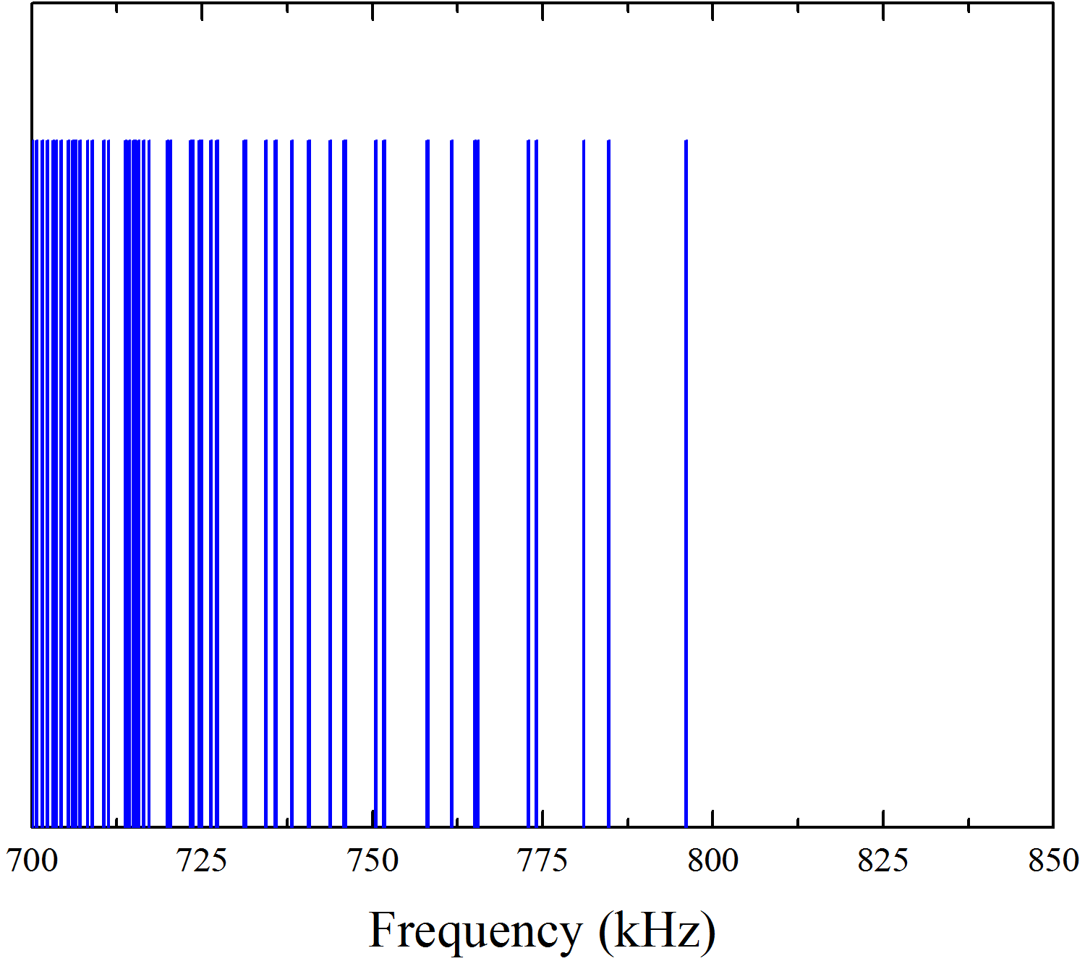







Engineering quantum magnetic couplings
higher frequency drumhead modes
$$μ$$
detuning
from COM
N drumhead eigenvalues $ω_{m}$ and
eigenvector ${\vec{b}}_{m}$
1400
1600
frequency$⟶$
(kHz)
Infinite range $⟹$Single axis twisting
$H_{Ising}=\frac{J}{N}\sum_{i<j}{σ_{i}^{z}σ_{j}^{z}}=\frac{2J}{N}S_{z}^{2}$
where $S_{z}=\sum_{i}{\frac{σ_{i}^{z}}{2}}$
generates a “cat state” $\frac{1}{\sqrt{2}}\left\{|{\left.↑↑↑∙∙∙↑\right\rangle }_{x}+|{\left.↓↓↓∙∙∙↓\right\rangle }_{x}\right\}$
at long times $τ$, such that $\frac{2J}{N}τ=\frac{π}{2}$
dipole-dipole coupling
Notes:
The formal treatment of this problem is sketched here. The axial coordinate can be expanded in terms of the drumhead modes, illustrated here, so this makes it clear we are coupling the spin degrees of freedom to the drumhead modes.
We can do some math, and solve for the evolution operator for this time dependent Hamiltonian. It is the product of two terms, one that produces spin-phonon coupling. This can be a useful metrology tool, and relevant for the 2nd experiment I am going to talk about.
This 2nd term is an induced Ising interaction between pairs of spins, and what the math gets us is a formula for the pairwise coupling coefficients in terms of a sum over all the drumhead modes of the difference between the spin dependent force frequency and the mode frequency. Now, in the experiment that I am going to show you we tune the spin-dependent force frequency \mu close to the center-of-mass mode (omega_1 or omega_z). In this case, because of the resonant energy denominator, only the term due to the center-of-mass mode contributes. The Ising coupling is independent of the spacing between ions and can be factored out of the sum.
In this infinite range limit, the Ising interaction can be written in terms of the composite spin of the array, capital S sub z. This interaction proportional to S sub z squared is often called the single axis twisting, and it is well known that this interaction can generate a so-called cat state of the spins at long times.

Slide 25







Benchmarking quantum dynamics
● employ infinite range interactions $H_{Ising}≈\frac{2J}{N}S_{z}^{2}$, $S_{z}≡\sum_{i}{σ_{i}^{z}}/2$
● prepare eigenstate of , turn on
Cool
Detect
µWave
$$τ$$
$$U_{R}$$
ODF
Ising
time
$$\hat{z}$$
general rotation
measure global spin
polarization $\left\langle {\hat{S}}_{z}\right\rangle$,
variance $ΔS_{z}^{2}=\left\langle {\left({\hat{S}}_{z}−\left\langle {\hat{S}}_{z}\right\rangle \right)}^{2}\right\rangle$
$$\hat{x}$$
$$\hat{y}$$

Slide 26




Benchmarking quantum dynamics
Bohnet et al., Science 352, 1297 (2016)
$$\hat{z}$$
N=85
$$\hat{x}$$
$$\hat{y}$$
•Measurements of Ramsey squeezing parameter $⇒$
prove entanglement for $25<N<220$
•Largest inferred squeezing: -6.0 dB

Slide 27
Benchmarking quantum dynamics
Bohnet et al., Science 352, 1297 (2016)
$$\hat{z}$$
N=85
$$\hat{x}$$

Slide 28


Out-of-time-order correlation functions
$F(t)≡\left\langle ψ | W{\left(t\right)}^{†}V^{†}W\left(t\right)V | ψ\right\rangle$ where $W\left(t\right)=e^{iHt}W\left(0\right)e^{−iHt},$
$\left[V,W(0)\right]=0$
$Re\left[F(t)\right]=1−\left\langle {\left|\left[W\left(t\right),V\right]\right|}^{2}\right\rangle /2$
$⇒$ measures failure of initially commuting
operators to commute at later times
$⇒$ quantifies spread or scrambling of quantum
information across a system’s degrees of freedom
Swingle et al., arXiv:1602.06271; Shenker et al., arXiv:1306.0622; Kitaev (2014)
Difficult to measure $⟺$ requires time-reversal of dynamics
time reversal is possible in many quantum simulators!
Notes:
So what is an out-of-time-order correlation function?
This is the object of interest. It is the expectation value of a product of two operators, V and W. V and W are unitary operators which commute at time t=0. However, in evaluating the out-of-time correlator, V is evaluated at time t=0, while W is evaluated at time t.
Why this quantity is of interest can be seen by rewriting it as follows … . At time t=0 V and W commute, so F is one, but at later times the real part of F will decrease because V and W no longer commute. In other words the OTOC F measures the failure of initially commuting operators to commute at later times. Moreover, this quantity has been proposed as a means of quantifying the spread or scrambling of information across a quantum many-body systems degrees of freedom.
However, this out-of-time-order correlation function is a very difficult to measure in a general quantum many-body setting. And this is because it requires time reversal of the dynamics. If you think about it, one way to measure this quantity is to apply V, then propagate forward in time and evaluate W, then propagate back in time, apply V dagger, then forward in time again and so forth.
However, many quantum simulators have sufficient control that time reversal of the dynamics is possible. So measurement of these (an?) OTOC becomes feasible.

Slide 29


Time reversal of the Ising dynamics
$H_{Ising}=\frac{J}{N}\sum_{i<j}{{\hat{σ}}_{i}^{z}{\hat{σ}}_{j}^{z}}$, $\frac{J}{N}≅\frac{F_{0}^{2}}{ℏ4mω_{z}}∙\frac{1}{μ−ω_{z}}$
Change $μ=ω_{z}+δ$ (antiferromagnetic)
to $μ=ω_{z}−δ$ (ferromagnetic)

Slide 30





Multiple quantum coherence protocol
• Probe higher-order coherences and correlations (Pines group, 1985)
$|\left.ψ_{0}\right\rangle$
$$\left\langle S_{x}\right\rangle , {\left|\left\langle ψ_{0}|ψ_{f}\right\rangle \right|}^{2}$$
$$H_{Ising}$$
$$−H_{Ising}$$
prepare
measure
Notes:
We use this ability to time reverse the dynamics to implement a many-body echo. We follow a protocol invented in NMR known as multiple quantum coherences. This protocol can be used to measure out-of-time-order correlation functions, but first let me describe the basic multi-quantum coherence protocol.
The basic scheme is shown here. As in all our experiments I have discussed we start with the spins polarized along x. We then apply the infinite range Ising interaction. We then invert the Ising interaction evolution by changing the sign of the Hamiltonian. In between we apply rotations about the x-axis (the Bloch vector axis) by variable angles \phi between zero and 2\pi. If we do not do a rotation, we should get back our original polarized state – that case is shown by the blue. If we do a non-zero rotation, in general we will end up with different state than the initial state. An example is shown by the green state.
At the end of this sequence we do a measurement. We conducted experiments with two different final measurement – we could measure the overlap of the final state with the original fully polarized state, or we measured the magnetization along the original x-direction. In my talk today I will only show the magnetization measurements.

Slide 31









Multiple quantum coherence protocol
$|\left.ψ_{0}\right\rangle$
$$\left\langle S_{x}\right\rangle$$
$$H_{Ising}$$
$$−H_{Ising}$$
prepare
measure
$$\left\langle S_{x}\right\rangle =\left\langle {Ψ_{0}| e}^{iH_{Ising}τ} e^{iφS_{x}}{ e}^{−iH_{Ising}τ}S_{x}{ e}^{iH_{Ising}τ}{ e}^{−iφS_{x}}{ e}^{−iH_{Ising}τ}|Ψ_{0}\right\rangle$$
$$=\frac{2}{N}\left\langle {Ψ_{0}| e}^{iH_{Ising}τ} W^{†}{ e}^{−iH_{Ising}τ}V^{†}{ e}^{iH_{Ising}τ} W{ e}^{−iH_{Ising}τ}V|Ψ_{0}\right\rangle$$
$$W^{†}(t)$$
$$V^{†}(0)$$
$$W(t)$$
V$(0)$
Out-of-time-order correlation (OTOC) function
$⇒$ quantifies spread or scrambling of quantum
information across a system’s degrees of freedom
Swingle et al., arXiv:1602.06271; Shenker et al., arXiv:1306.0622; Kitaev (2014)
Notes:
Here we write out an expression for the magnetization measurement with the multi-quantum coherence sequence. That this expression is an example of an out-of-time-order correlation function can be seen by grouping the operators as indicated here. So W is the Heisenberg operator associated with the rotations, and V is S_x. We take advantage of the fact that our initial state is an eigenstate of S_x to insert another S_x here.

Slide 32





Multiple quantum coherence protocol
$|\left.ψ_{0}\right\rangle$
$$\left\langle S_{x}\right\rangle$$
$$H_{Ising}$$
$$−H_{Ising}$$
prepare
measure
$$\left\langle S_{x}\right\rangle =\left\langle {Ψ_{0}| e}^{iH_{Ising}τ} e^{iφS_{x}}{ e}^{−iH_{Ising}τ}S_{x}{ e}^{iH_{Ising}τ}{ e}^{−iφS_{x}}{ e}^{−iH_{Ising}τ}|Ψ_{0}\right\rangle$$
$$=\sum_{m}{\left\langle Ψ|C_{m}|Ψ\right\rangle { e}^{iφm}}$$
$$C_{m}=\sum{σ_{1}^{z}σ_{4}^{y}…σ_{k}^{z}}$$
$$≡|\left.Ψ\right\rangle$$
At least m terms
$m^{th}$ order Fourier coefficient $\left\langle Ψ|C_{m}|Ψ\right\rangle$ indicates
$|\left.Ψ\right\rangle$ has correlations of at least order $m$
Notes:
I emphasize that we measure the S_x OTOC as a function of the rotation angle \phi, and, motivated by the multi-quatum coherence protocol, we study the Fourier components of of these measurements wrt \phi. One can show that the terms contributing to the mth coefficient consist of correlation functions of at least order m. So if we observe an mth order Fourier component, we know that our state has correlations of at least order m.
By Fourier transforming the magnetization with respect to phi, we can thus observe the subsequent buildup of higher order correlations.

Slide 33







MQC protocol – $\left\langle S_{x}\right\rangle$ measurement
$|\left.ψ_{0}\right\rangle$
$$\left\langle S_{x}\right\rangle$$
$$H_{Ising}$$
$$−H_{Ising}$$
prepare
measure
$$H_{Ising}=J/N\sum_{i<j}{σ_{i}^{z}σ_{j}^{z}}$$
$$J≲5kHz$$
$$N=111$$
$$Γ=93Hz$$
[Gärttner, Bohnet et al. Nature Physics 2017]
33
Notes:
experimental results: We are looking at 111 ions, initially prepared all pointing along the x-direction of the spin. Again, we evolve rotate and evolve backwards, and then measure the magnetization. For each data-point, this is repeated about 500 times.
If we don’t rotate in the middle of the sequence, the state should return exactly to the initial state. If we look at phi=0, the revival is not perfect and decays as a function of time. This is due to experimental imperfections. At non-zero rotation angle the magnetization will not fully revive. The solid and dashed lines are theoretical estimates that include know experimental imperfections. The good agreement with theory confirms that the time reversal works and the experimental imperfections are well under control. However, the aspect of these measurements that I would like to emphasize is that Fourier components of these measurements reflect the growth of correlations in the prepared states

Slide 34
Fourier transform of magnetization
[Gärttner, Bohnet et al. Nature Physics 2017]
Measure build-up of 8-body correlations
Only global spin measurement
Illustrates how OTOCs measure spread of quantum information
Notes:
This slide shows the magnitude of the Fourier components, as a function of interaction time, obtained from both the measurements and the theory curve of the previous slide. Each column corresponds the Fourier spectrum at one evolution time. We observe the build-up of higher order Fourier components, corresponding to higher order correlations. As the higher order correlations build-up, the lower order correlations disappear. Experimentally we are able to measure the generation of 8-body correlations
If we ignore decoherence the agreement is still quite good, showing that we are really observing the coherent many-body dynamics. If decoherence can be reduced further it will be possible to go to longer times where an even more intriguing structure is expected to emerge.
So, one point I would like to make is that the multi-quantum coherence protocol has enabled a more detailed benchmarking of quantum dynamics in our 2D trapped ion arrays. We were successfully able to benchmark up to 8-spin correlations. Intriguingly, this more detailed benchmarking only requires global spin measurements – the easiest observable to implement.
Also, I think this analysis of OTOCs in terms of Fourier amplitudes provides a nice illustration of how measuring an OTOC can provide information on the spread of quantum information across a quantum many body’s degrees off freedom.

Slide 35


Summary:
• trapped ion crystals – motional amplitude sensing below
the zero-point fluctuations
• employed spin-squeezing, OTOCs to benchmarked quantum dynamics with long range Ising interactions
Future directions:
•transverse field, variable range interaction, longitudinal fields
• spin-phonon models (Dicke model)
$−δa^{†}a−\frac{g_{0}}{\sqrt{N}}\left(a+a^{†}\right)S_{z}+B_{⊥}S_{x}$ arXiv:1711.07392
• mitigate decoherence, improve single ion readout
• 3-dimensional crystals with thousands of ions?
$$\sum_{i<j}{J_{i,j}σ_{i}^{z}}σ_{j}^{z}+B_{⊥}\sum_{i}{σ_{i}^{x}}+\sum_{i}{h_{i}σ_{i}^{z}}$$

Slide 36









Lab selfie $∼2014$
$$2017$$
Joe Britton
ARL
Justin Bohnet
Honeywell
Brian Sawyer
GTRI
Kevin Gilmore
CU grad student
Elena Jordan
Leopoldina PD
Theory
Ana Maria
Rey
Martin
Gärttner
Michael Wall
Arghavan
Safavi-Naini
Michael
Foss-Feig (ARL)
Notes:
Close with a big thank you to the people who did the work! The human interactions make the work we do a lot more fun.

Slide 37


Benchmarking quantum dynamics and entanglement
N = 85
Time dependence of squeezed and
anti-squeezed variance
Bohnet et al.,
Science352 (2016)
Notes:
This looks at the evolution of the squeezed and anti-squeezed quadratures of the spin-noise as a function of interaction time. It contains the maximum and minimum variances from these three curves, plus additional measurements at three more interaction times. The solid lines are theory including decoherence due to spontaneous emission.
Experimentally we did not always precisely hit the minimum variance, and the green shaded region indicates the variance expected within 5 degrees of the minimum. Once again there is reasonably good agreement between theory that includes spontaneous emission and experiment, especially for the squeezed quadrature.
The squeezed variance goes through a minimum, as expected by theory.
Extra:
The antisqueezed variance should continue to grow, in this case of 86 spins to about 19 dB. The fact that it is starting to decrease here is presumably due to spontaneous emission.

Slide 38







Writing a spin gradient
method: generate Stark shift gradient in the rotating frame
$μ$W
$$π/2$$
$$π/2$$
ODF, beat note = crystal rot $ω_{r}$
$μ=ω_{r}$ produces static Stark shift in the rotating frame
Random field Ising model

Slide 39






In-plane modes
Freericks group, PRA 87 (2013)
$E×B$ modes
transverse modes
cyclotron modes
$$ω_{m}$$
$$ω_{z}$$
$$Ω_{c}$$
Lowest frequency ExB modes
Lowest frequency cyclotron modes
Notes:
We use the drum head modes for quantum simulation, but for completeness I thought I would show a calculation of the in-plane modes as well. There are two bands of in-plane modes, the low frequency ExB modes and the high frequency cyclotron modes. Shown here are the lowest frequency modes of each band, in the rotating frame of the crystal.
These modes have interesting and somewhat unusual structure, in part because there is a magnetic field ( a real gauge field, not an artificial gauge field) in our system. The ExB modes in particular have interesting vortex structures.
Unfortunately we do not know how to use these modes for quantum simulation, the main reason is that it seems hard to use them to generate sufficiently strong interactions and stay in the Lamb Dicke regime.

