Slide 1
Combined Analysis of pion-exchange effects
on DIS and DY processes
T.-S. H. Lee
Argonne National Laboratory
Motivated by discussions with
Roy Holt

Slide 2
Started with a collaboration in 2008-2009
Objective:
Extract the neutron structure function
from the data of d(e,e’) X
J. Arrington, F. Coester, R. Holt, T.-S. H. Lee, J. J.Phys. G36 (2009) 025005

Slide 3
(F. Coester)
Rest frame of deuteron
+
I = j + j
1
2

Slide 4
Deuteron structure function
Neutron structure function
Momentum distribution of neutron

Slide 5
( DIS limit ) :
Usual convolution formula

Slide 6
Ratios = F / F are determined
2n
2p
2
2
Q = 12 GeV

Slide 7
2
2
Consistent with the data at Q = 4-8, 8-16, 16-32 GeV

Slide 8
Systematic uncertainty of the extracted ratios

Slide 9
Other uncertainty ?
π
Pion - exchange is well-established mechanism
Pions can contribute to deuteron structure function

Slide 10
Note: F >> F at x > 0.6
2π
2N
Pion contribution could be large

Slide 11
γ*
π
How to calculate the contribution from ?

Slide 12
Approach:
extend the nuclear Hamiltonian to include
and degrees of freedom
π
Δ
Apply πNN model
(developed in 1979-1990 by Betz, Lee, Matsuyama)
Consistent with the data of
πN -> π N (E < 300 MeV)
NN-> NN, πNN (E < 1000 MeV)
πd-> πd, πNN, NN (E < 300 MeV)
π
N
π

Slide 13
πNN model and
Roy Holt
1. Demise of
Dibaryon resonance (six-quark)
2. Starting point of the investigation of
Transition from hadronic picture to
Quark-gluon picture of nuclei

Slide 14
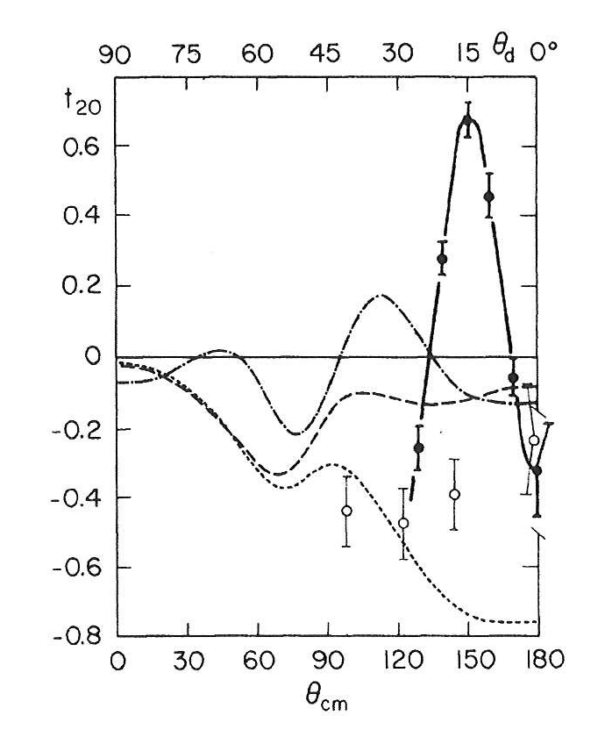
SIN data
Ulbreicht et al., PRL, 48, 311(1981)
Discover
Dibaryon resonance (six-quarks)
Betz-Lee, 1981
Holt et al, PRL, 43, 1229 (1979)

Slide 15
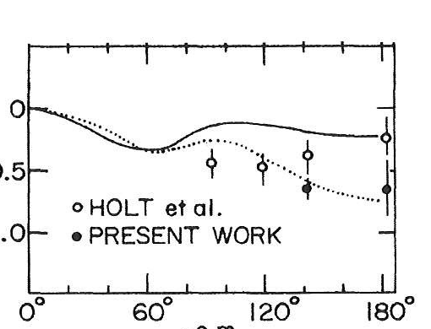
SIN data
Ulbreicht et al., PRL, 48, 311(1981)
Holt et al, PRL, 43, 1229 (1979)
LAMPF data.
E. Ungricht et al., PRC 31, 934(1985)
No
Dibaryon resonance

Slide 16
Big question of 1980’s :
At what energy the transition from
nucleon-meson picture to quark-gluon picture
of nuclei takes place ?
Brodsky and Hiller : should happen at few GeV

Slide 17
γ d -> np
πNN Model
QCD
Meson-exchange
Counting rule
|
transition
E = 2 - 4 GeV
E = ?
tr
Holt and collaborators
proposed to exlore

Slide 18
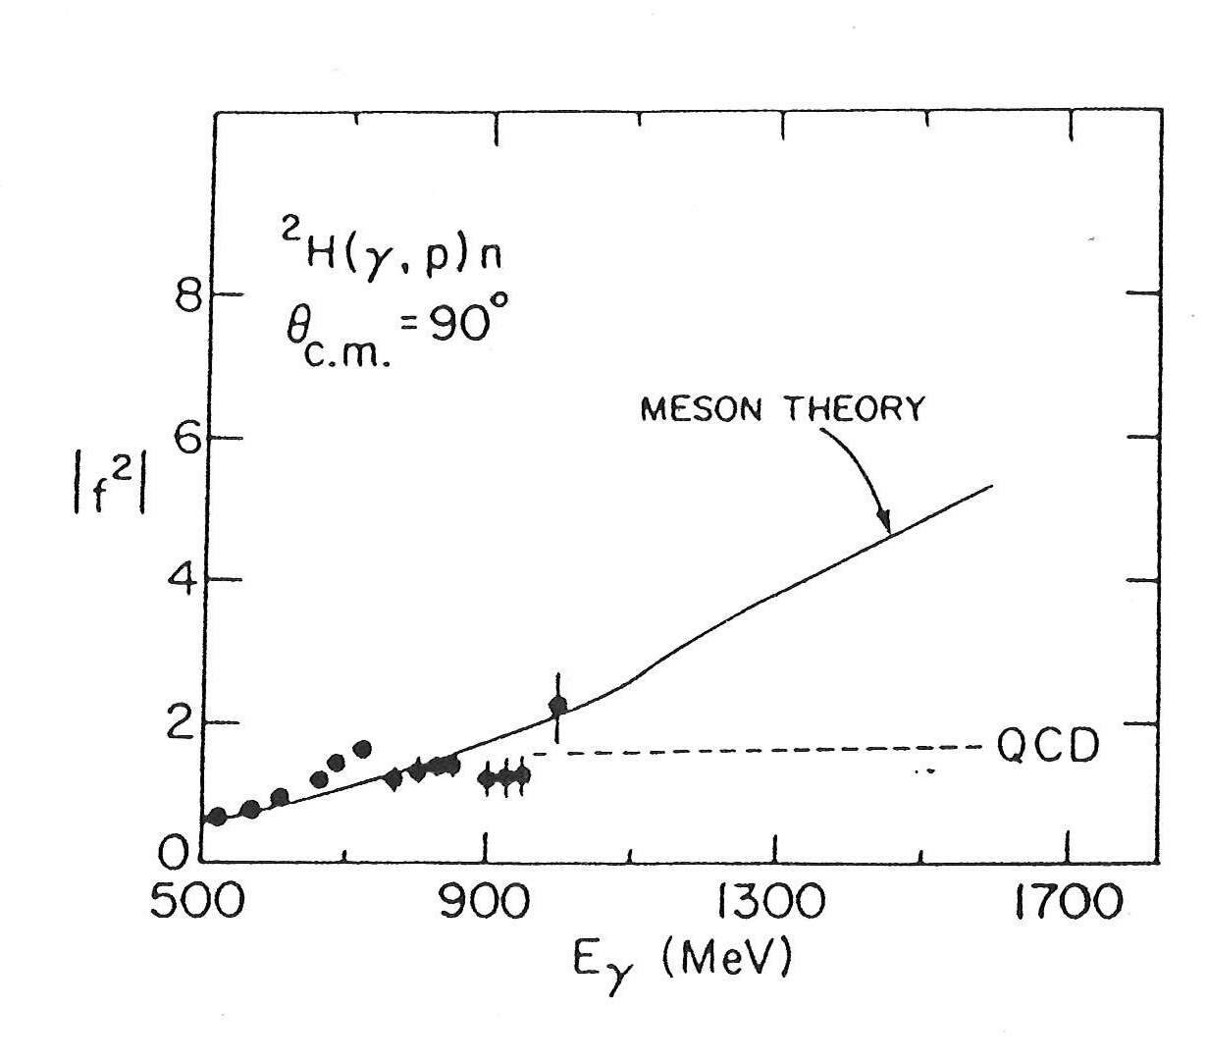
Prediction (1985) was motivated by a discussion with
Roy Holt on the transition from nucleon-meson picture
to quark-gluon picture of nuclei

Slide 19
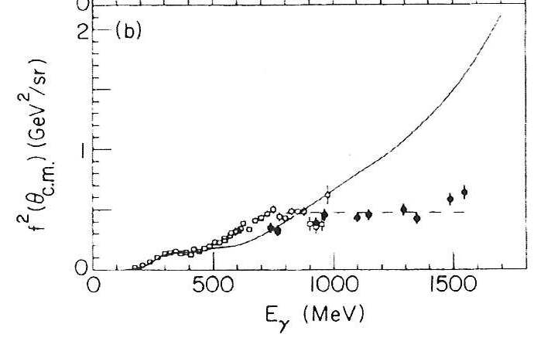
Prediction of 1985
J. Napolitano et al., PRL 22, 2530 (1988)

Slide 20
Return to the subject of this talk:
Calculation of pion-exchange contribution to F
by applying πNN model
2d
N -> π N

Slide 21
Deuteron in the πNN model
N -> π N
Solution:
+ . . . .

Slide 22
N -> π N
form factor is mainly determined
By fitting the πN scattering data
(Kamano, Lee, 2012)

Slide 23
N -> π N
form factor determined from πN data
Λ = 850 MeV
(Kamano, Lee, 2012)

Slide 24
From the generated wavefunction
Pion momentum distribution

Slide 25
Momentum distributions generated from πNN model

Slide 26
Pion contribution to F
2d
Pion structure function
Pion momentum distribution

Slide 27
(N)
(π)
R= (F +F )/(2 F )
2d
2d
2p
Λ = 1200
Pion-exchange effect
Determined by πN data)

Slide 28
Note: F >> F at x > 0.6
2π
2N
Our finding: Pion contribution is significant

Slide 29
For He, He
4
3
To be calculated
(N)
(π)
R=(F + F ) /(A F )
2A
2A
2p
Momentum distributions
are from ANL-V18(Wiringa)

Slide 30
Drell-Yan process of p-d reaction
Objective : Examine Fermi motion and
pion-exchange effects
H. Kamano, T.-S. H. Lee, Phys. Rev. D86, 094037 (2012)

Slide 31
To include Fermi motion effect
Develop convolution formula
within the instant form of relativistic quantum
mechanics developed by Dirac.
Advantage:
The nuclear momentum distributions
can be calculated from the available
nuclear models with realistic NN potentials
(ANL-V18, CD-Bonn etc)

Slide 32
Note: u(π) >> u(p), d(p) at large x > 0.6
Contribution from pions in deuteron could be large
PDF of N and π

Slide 33
2. To investigate pion-exchange effects
calculated momentum distributions
in deuteron within the model
πNN
(developed in 1979-1990 by Betz, Lee, Matsuyama)
Consistent with the data of
πN -> π N (E < 300 MeV)
NN-> NN, πNN (E < 1000 MeV)
πd-> πd, πNN, NN (E < 300 MeV)

Slide 34
Cross section of pp DY process
PDF of nucleon
*
-
-
-
q q -> ϒ -> μ μ

Slide 35
Cross section of proton-deuteron DY process
Nucleon momentum distribution
Pion momentum distribution
PDF of nucleon
PDF of pion

Slide 36
Need to calculate momentum distribution in
fast moving deuteron by using
Simple formula (consistent with Instant form of RQM):
moving d
d at rest

Slide 37
Momentum distribution at rest frame of deuteron

Slide 38
Momentum distribution in a fast moving deuteron

Slide 39
Ratio = σ(p-d)/[2σ(p-p)]

Slide 40
Ratio = σ(p-d)/[2σ(p-p)] at large x = 0.6
1

Slide 41
Note: u(π) >> u(p), d(p) at large x > 0.6
Our finding: Pion contribution is significant

Slide 42
Concluding remarks
To determine PDF at large x, it is essential
to perform combined analysis of the data
of DIS and DY processes.
To pin down the pion-exchange effects,
it is essential to perform analysis within
a nuclear model with π degree of freedom
Necessary next step :
upgrade the model of 1980-1990 to
fit the NN data after 1990.
πNN

Slide 43
Thanks to many-year’s discussions and
exchanges with
Roy Holt

Slide 44
Backup slides

Slide 49
