Slide 1
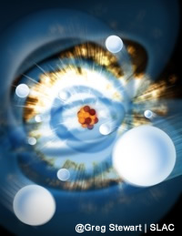
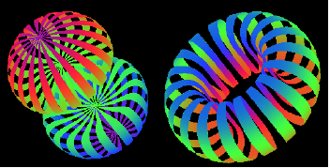
Electron Probes of Structure – from Deuteron to Lysozyme
Linda Young
Argonne National Laboratory
Nuclear Physics Symposium
Exploring the Heart of Matter
In honor of Roy Holt
26-27 September 2014
Notes:
Tale of two cities – the best of times the worst of times…
The long reach of Roy Holt ••• from circular electron storage rings to linear accelerators…
Thank Mette for opportunity to visit LSU and deliver a Public Lecture. Nice to visit for the first time …. Today I will tell you about something that is regarded as a frontier in lasers and in x-ray science – most notably the birth of the world’s first hard x-ray free electron laser, some of the first experiments there, which I had the privilege of leading and some improvements in the source that may lead to the dream of single molecule imaging.
The merger of x-rays and lasers have produced an x-ray source that has a peak brightness a billion times greater than any synchrotron. Understanding how to use such a source, for chemical or other applications, is a challenge – and one that feel starts with understanding the femtosecond atomic response to ultraintense x-ray pulses.
This first x-ray free-electron laser is named LCLS and is located at your sister facility – SLAC. I have tried to structure the talk to have some resonanve with you since, as you may know, some of the world’s high energy physics labs, for example SLAC and DESY, are now turning into photon science labs – read x-ray science labs.
The new radiation source we’re talking about is the LCLS – the world’s first hard x-ray free electron laser – which lased for the 1st time April 10, 2009 at a wavelength of 1.5 Å
………..
It’s interesting that this conference is set just 60 miles from Hughes Research Lab where the very first ruby laser was born and reported in Nature 50 years ago.
The logo of the conference illustrates our first experiments at LCLS which explored the electronic response of atoms to ultraintense x-rays.

Slide 2
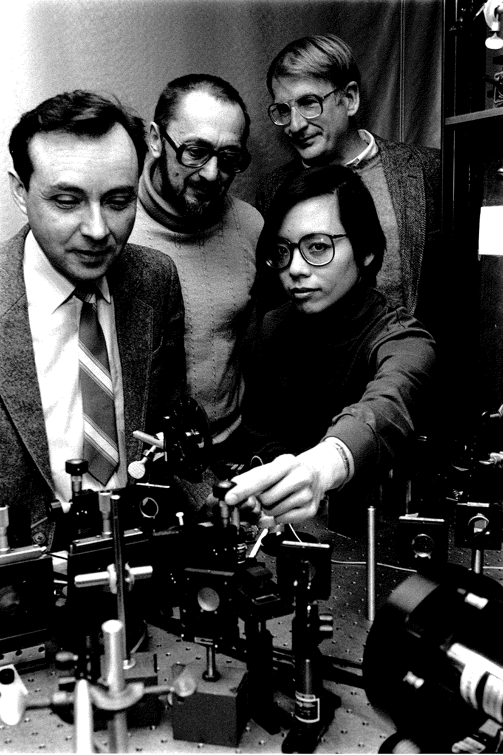
Days of the Deuteron at the Dynamitron
Why was I involved with Roy?
Internal target
Laser-driven source of polarized deuterium atoms
Spin-exchange Optical Pumping as a Source of Spin-Polarized Atomic Deuterium
2.1 x 10¹⁷ D - atoms/s @ 73% polarization
K. P. Coulter et al., PRL (1992)
Typical atomic beam source
~1x10¹⁶ atoms/s

Slide 3




Preparing for Siberia
The might of Russia will grow through Siberia.

Slide 4
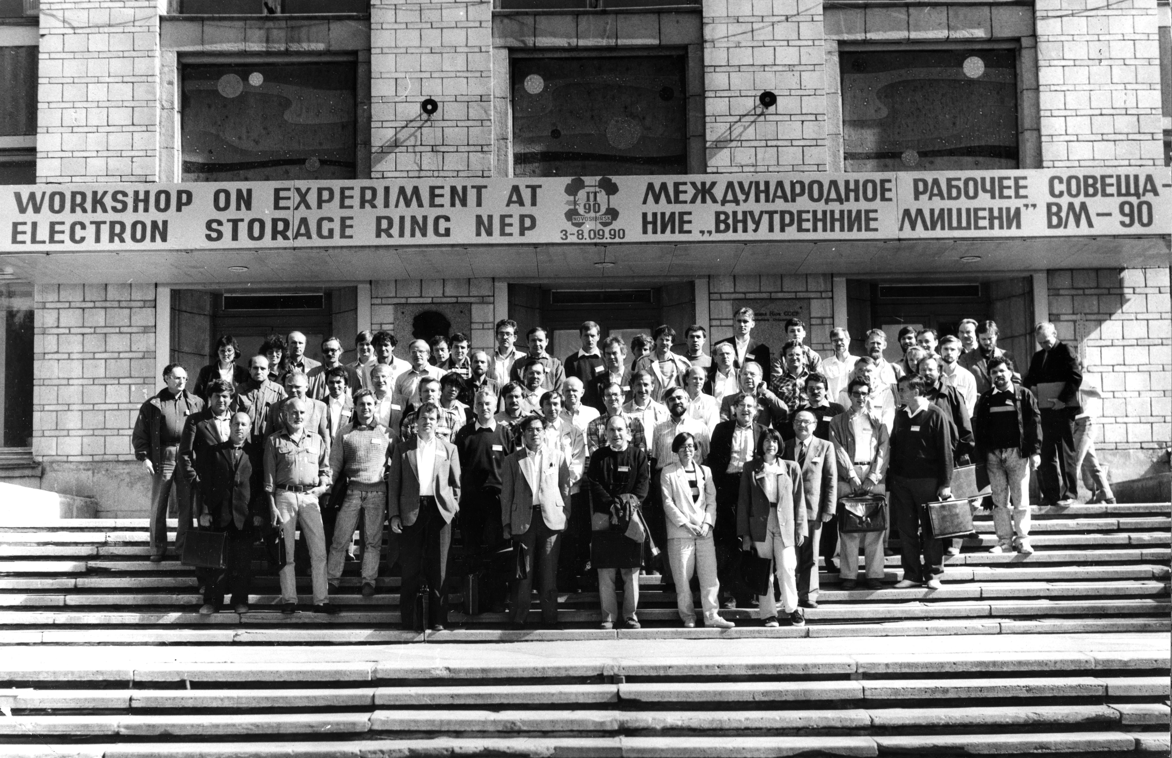

Slide 5
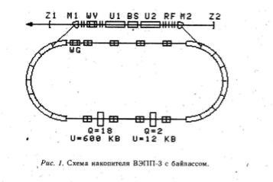
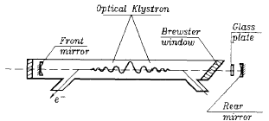
Other uses for VEPP-3 : FEL Physics
FEL bypass on the VEPP-3 storage ring
(Budker INP, 1987-1995).
1985-1994: visible and UV range FEL was built
Long electromagnetic undulators of original design
Short-wavelength record for FEL (0.24 micron)
Linewidth narrowing by intracavity Fabry Perot etalon
1995-6 dismantled and shipped to Duke University
Courtesy Efim Gluskin
Notes:
1985-1994 – visible and UV range FEL was built.
long electromagnetic undulators of original design;
short-wavelength record for FEL (0.24 micron);
linewdith narrowing by intracavity Fabry-Perot etalon;
electron outcoupling of radiation in FEL was proposed and tested.

Slide 6
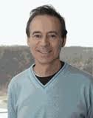
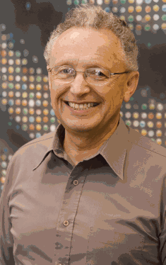

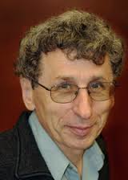
Novosibirsk transplanted – effects on APS and AMO
ACCELERATOR PHYSICS
Sasha Zholents
Efim Gluskin
ATOMIC PHYSICS
Dima Budker
Victor Flambaum
Tanya Zelevinsky
Sasha
Efim
Dima
Victor

Slide 7
A tale of two times
High/medium energy physics to “photon” physics

Slide 8
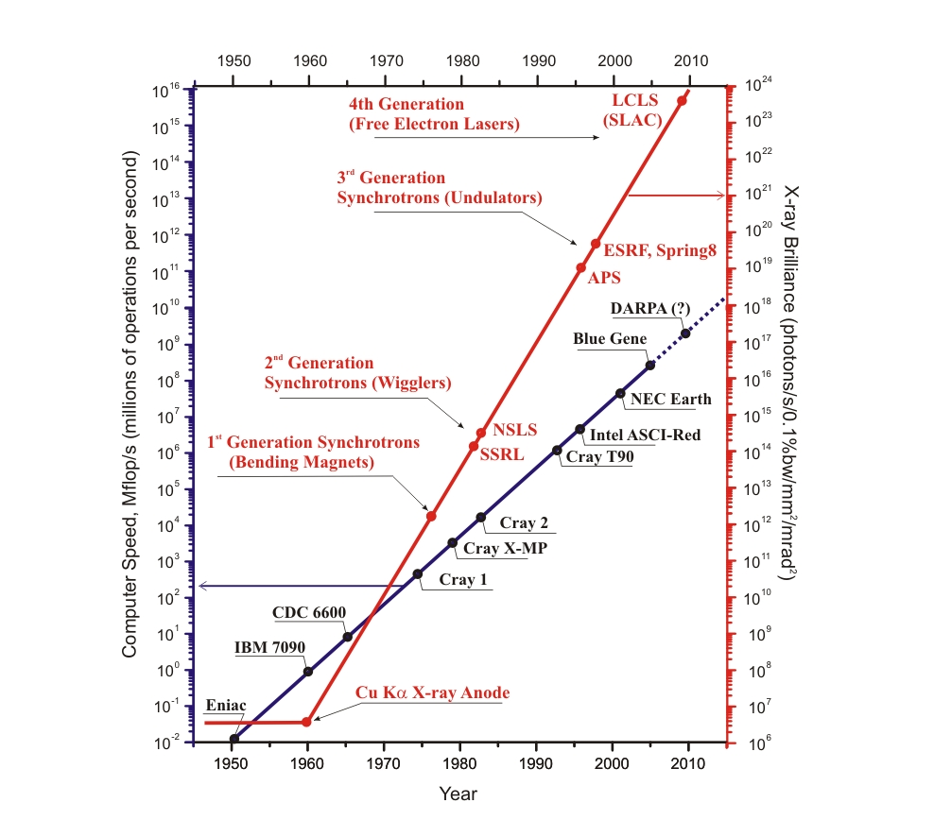
Moore’s law for X-ray Sources
(Energy Recovery Linacs)
18 orders
of magnitude
in 5 decades!
12 orders
of magnitude
in 6 decades
Notes:
Many important aspects of batteries cannot be studied in model systems, e.g., failure due to thermal runaway can only be reproduced and understood in fully encased cells where gas and heat are contained. High-energy x-ray methods allow study on actual cells, revealing nanoscale physical and chemical structures.
Nanostructured electrodes combine higher charge storage and diffusivity, which are key to the energy storage needs for transportation and renewable energy. Li-air batteries offer the ultimate in energy storage density but face major roadblocks; for example, the difficult problem of developing metal catalysts to break Li-O bonds at the air electrode

Slide 9
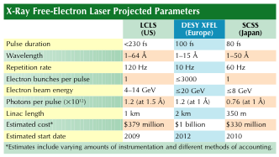
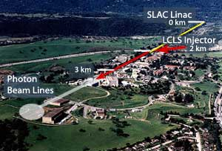
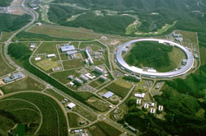
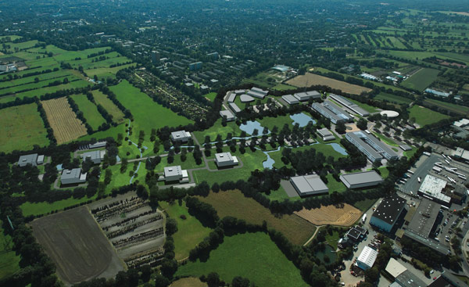
XFELs are here (LCLS & SACLA) and more are coming soon!
Physics Today, May 2005
LCLS
2009
SCSS – now SACLA
DESY X-FEL
2011
2017

Slide 10
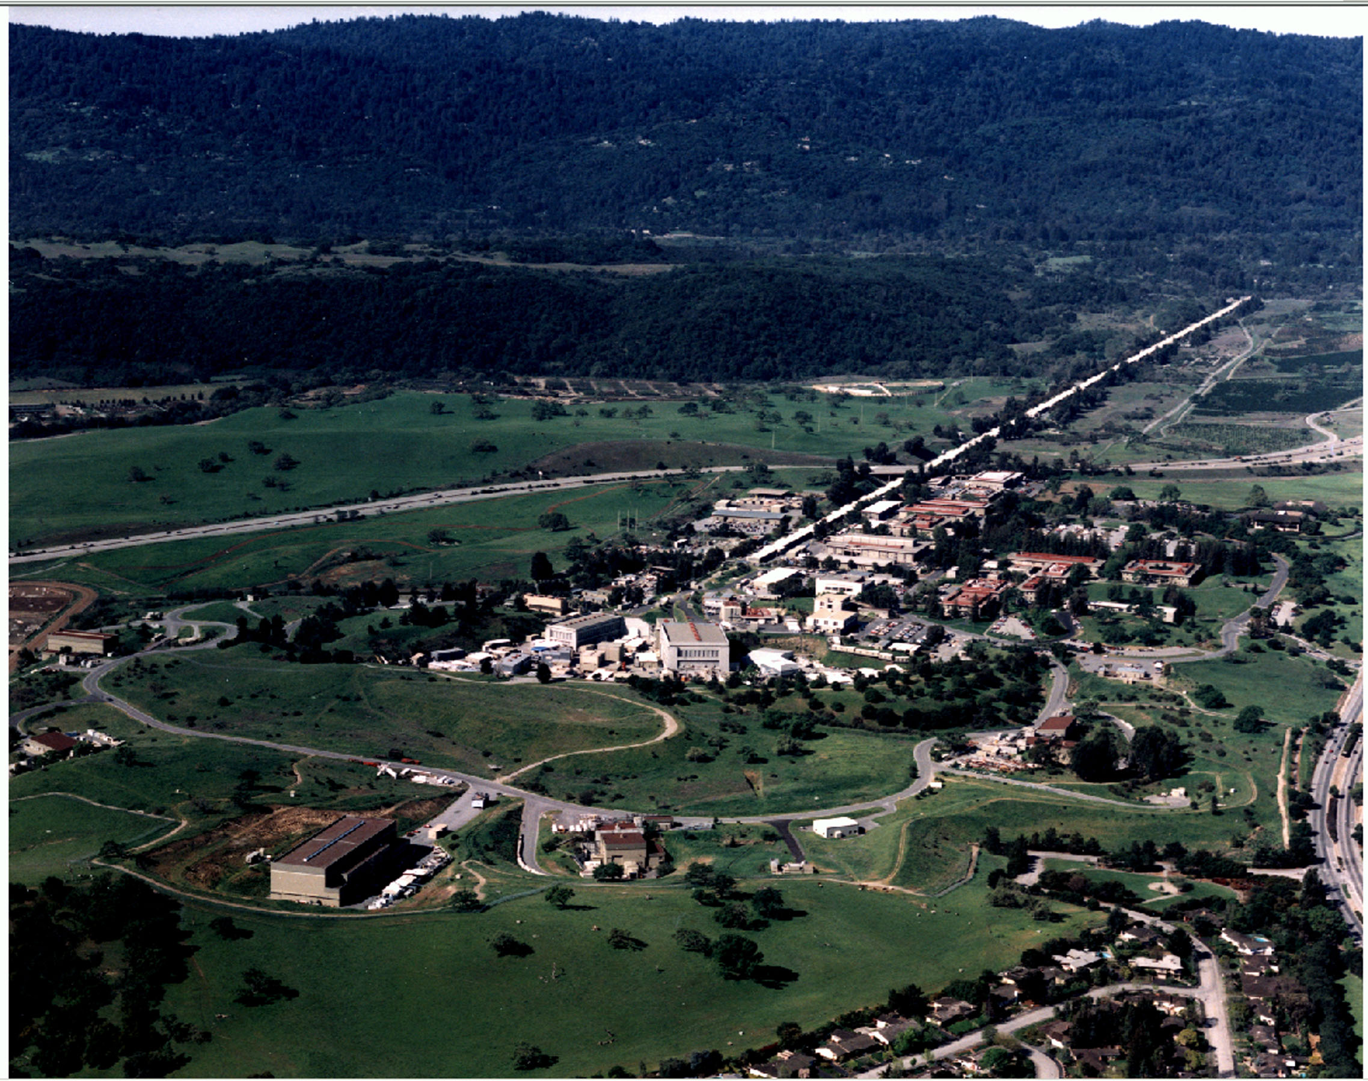
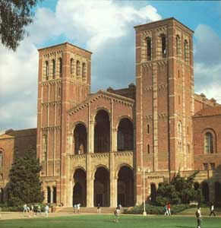



Linac Coherent Light Source at SLAC
X-FEL based on last 1-km of existing 3-km linac
Proposed by C. Pellegrini in 1992
1.5-15 Å
(14-4.3 GeV)
Injector (35º)
at 2-km point
Existing 1/3 Linac (1 km)
New e⁻ Transfer Line (340 m)
X-ray Transport Line (200 m)
Undulator (130 m)
Near Experiment Hall
UCLA
Far Experiment
Hall
LLNL

Slide 11
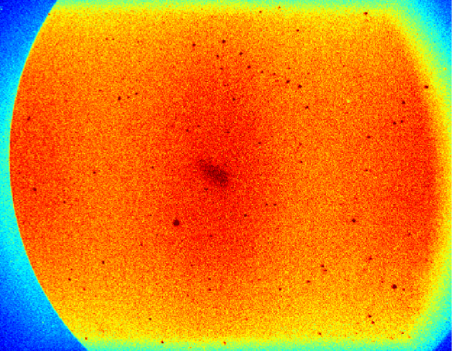
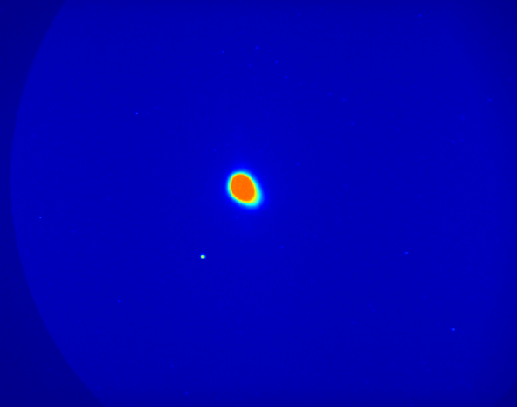
April 10, 2009: LCLS lases at 1.5 Angstroms
LCLS
21:03:03
21:33:52
2009
In my life before SLAC, I had the privilege to participate (in various capacities) in the design, construction and commissioning of two linacs, two synchrotrons, four storage rings and three FELs (free-electron lasers). Now I have had the privilege to be in SLAC's Main Control Center on April 10, when the Linac Coherent Light Source became a 1.5 Ångstrom laser. I don't expect I will ever, as long as I live, see such a beautiful, smooth turn-on of any light source. With each undulator placed on the beam path, the FEL power increased by a factor of about 2.3; two hours into the first attempt at lasing, the pinpoint of FEL light from twelve undulators was nearly 2,000-fold more intense than plain old undulator radiation. The team called it quits at 11:30 p.m. that night. When they returned at 8:00 a.m. the next morning, the FEL light came back as soon as the shutter was opened.
- John Galayda
10 mm
From John Galayda
Notes:
1 km lasing medium
Self amplified spontaneous emission
Each undulator increases power by 2.3
2 hrs later - 12 undulators and a pinpoint of light
Quit

Slide 12
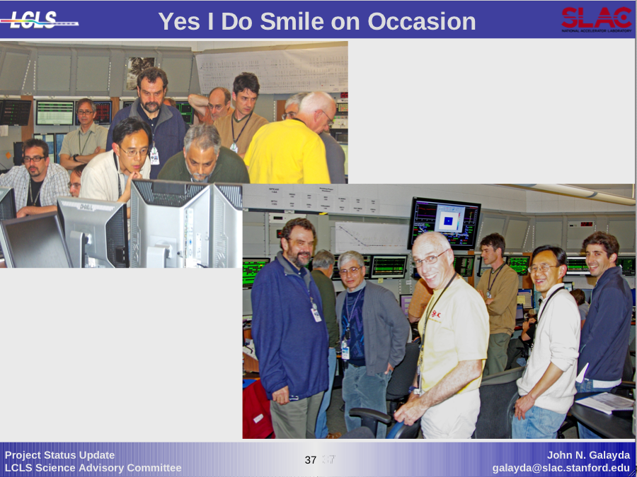

Slide 13
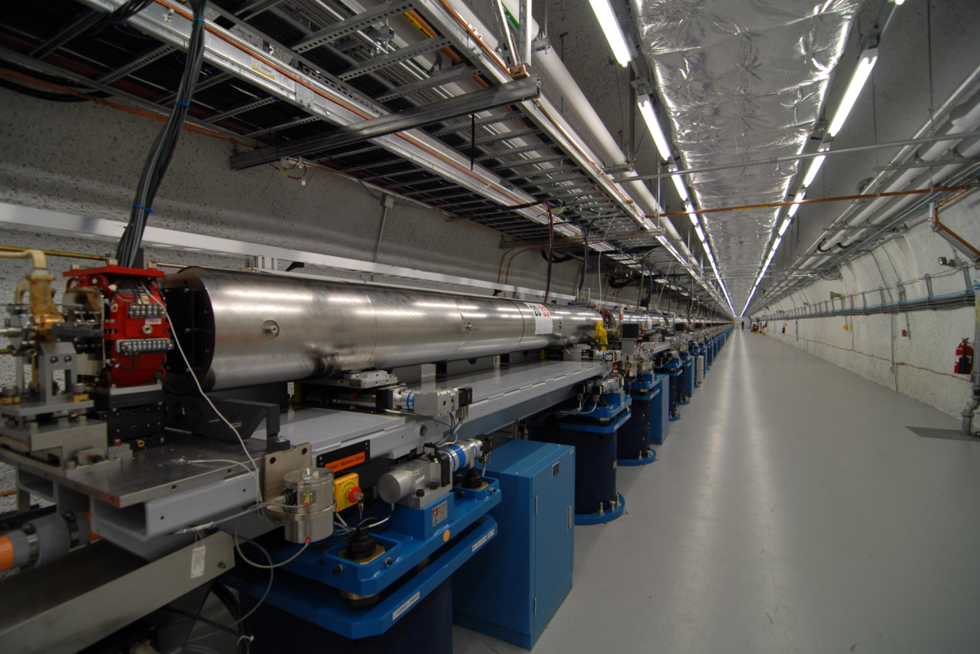
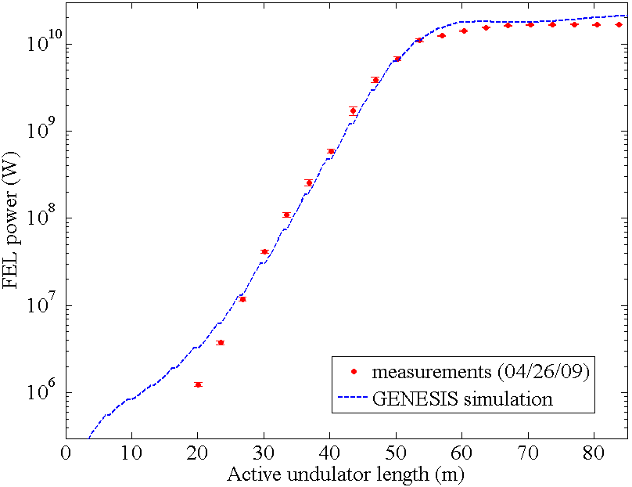
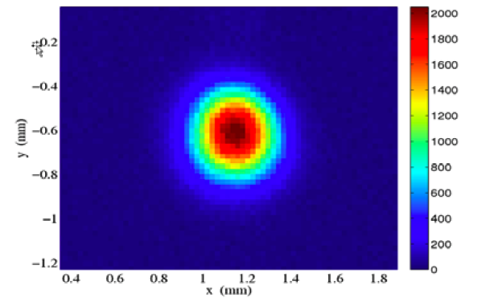
LCLS saturation at 1.5 Å
84 meters of FEL Undulator Installed
YAG screen 50 m downstream
0.25 nC
bunch charge
YAG screen
50 m downstream
• Saturation after ~65 meters of undulator!
Paul Emma PAC 2009 proceedings
Notes:
Image on a YAG screen 50 m after last undulator (21 x 3.4m undulator)
Saturation after 20 x 3.4 m undulators

Slide 14
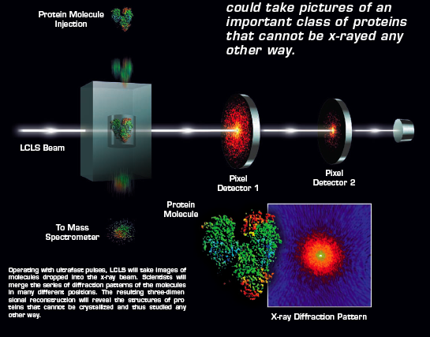
Single molecule imaging

Slide 15
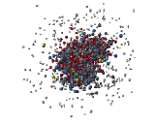


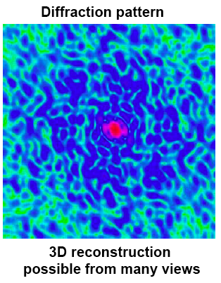
AMO questions at the ultraintense x-ray frontier
Before During ~10 fs After ~50 fs
fundamental nature of x-ray
damage at high intensity
-Coulomb explosion
-electronic damage
-behavior at 10²² W/cm² - 1Å
• nonlinear x-ray processes
role of coherence
• quantum control of
inner-shell processes
3x10¹² x-rays
100 nm spot
12 keV
10 fs ⇒ 10²² W/cm²
Neutze, Wouts, van der Spoel, Weckert, Hajdu Nature 406, 752 (2000)

Slide 16
LCLS Experiment 1 – Oct 1, 2009
Nature of the electronic response to
10⁵ x-rays/Å²
80 - 340 fs
800 - 2000 eV
~10¹⁸ W/cm²
Original single molecule imaging parameters, Neutze et al. Nature (2000)
3 x 10¹² x-rays/(100 nm)² = 3 x 10⁶ x-rays/Å²
10 fs
~10²² W/cm²

Slide 17
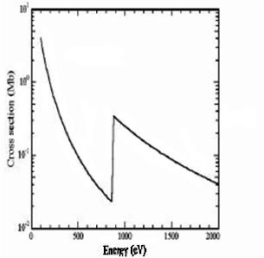
Our approach to understanding ultraintense x-ray interactions
Start with a well-characterized target
Probe changes in interaction from outer- to inner-shell between 800-2000 eV
Binding energies in neutral neon
2p : ~21 eV
2s : ~48 eV
1s : ~870 eV
Inner-shell excitation
Auger yield 98%
Auger clock - τ_{1s}: 2.4 fs
neon photoabsorption
n=2

Slide 18
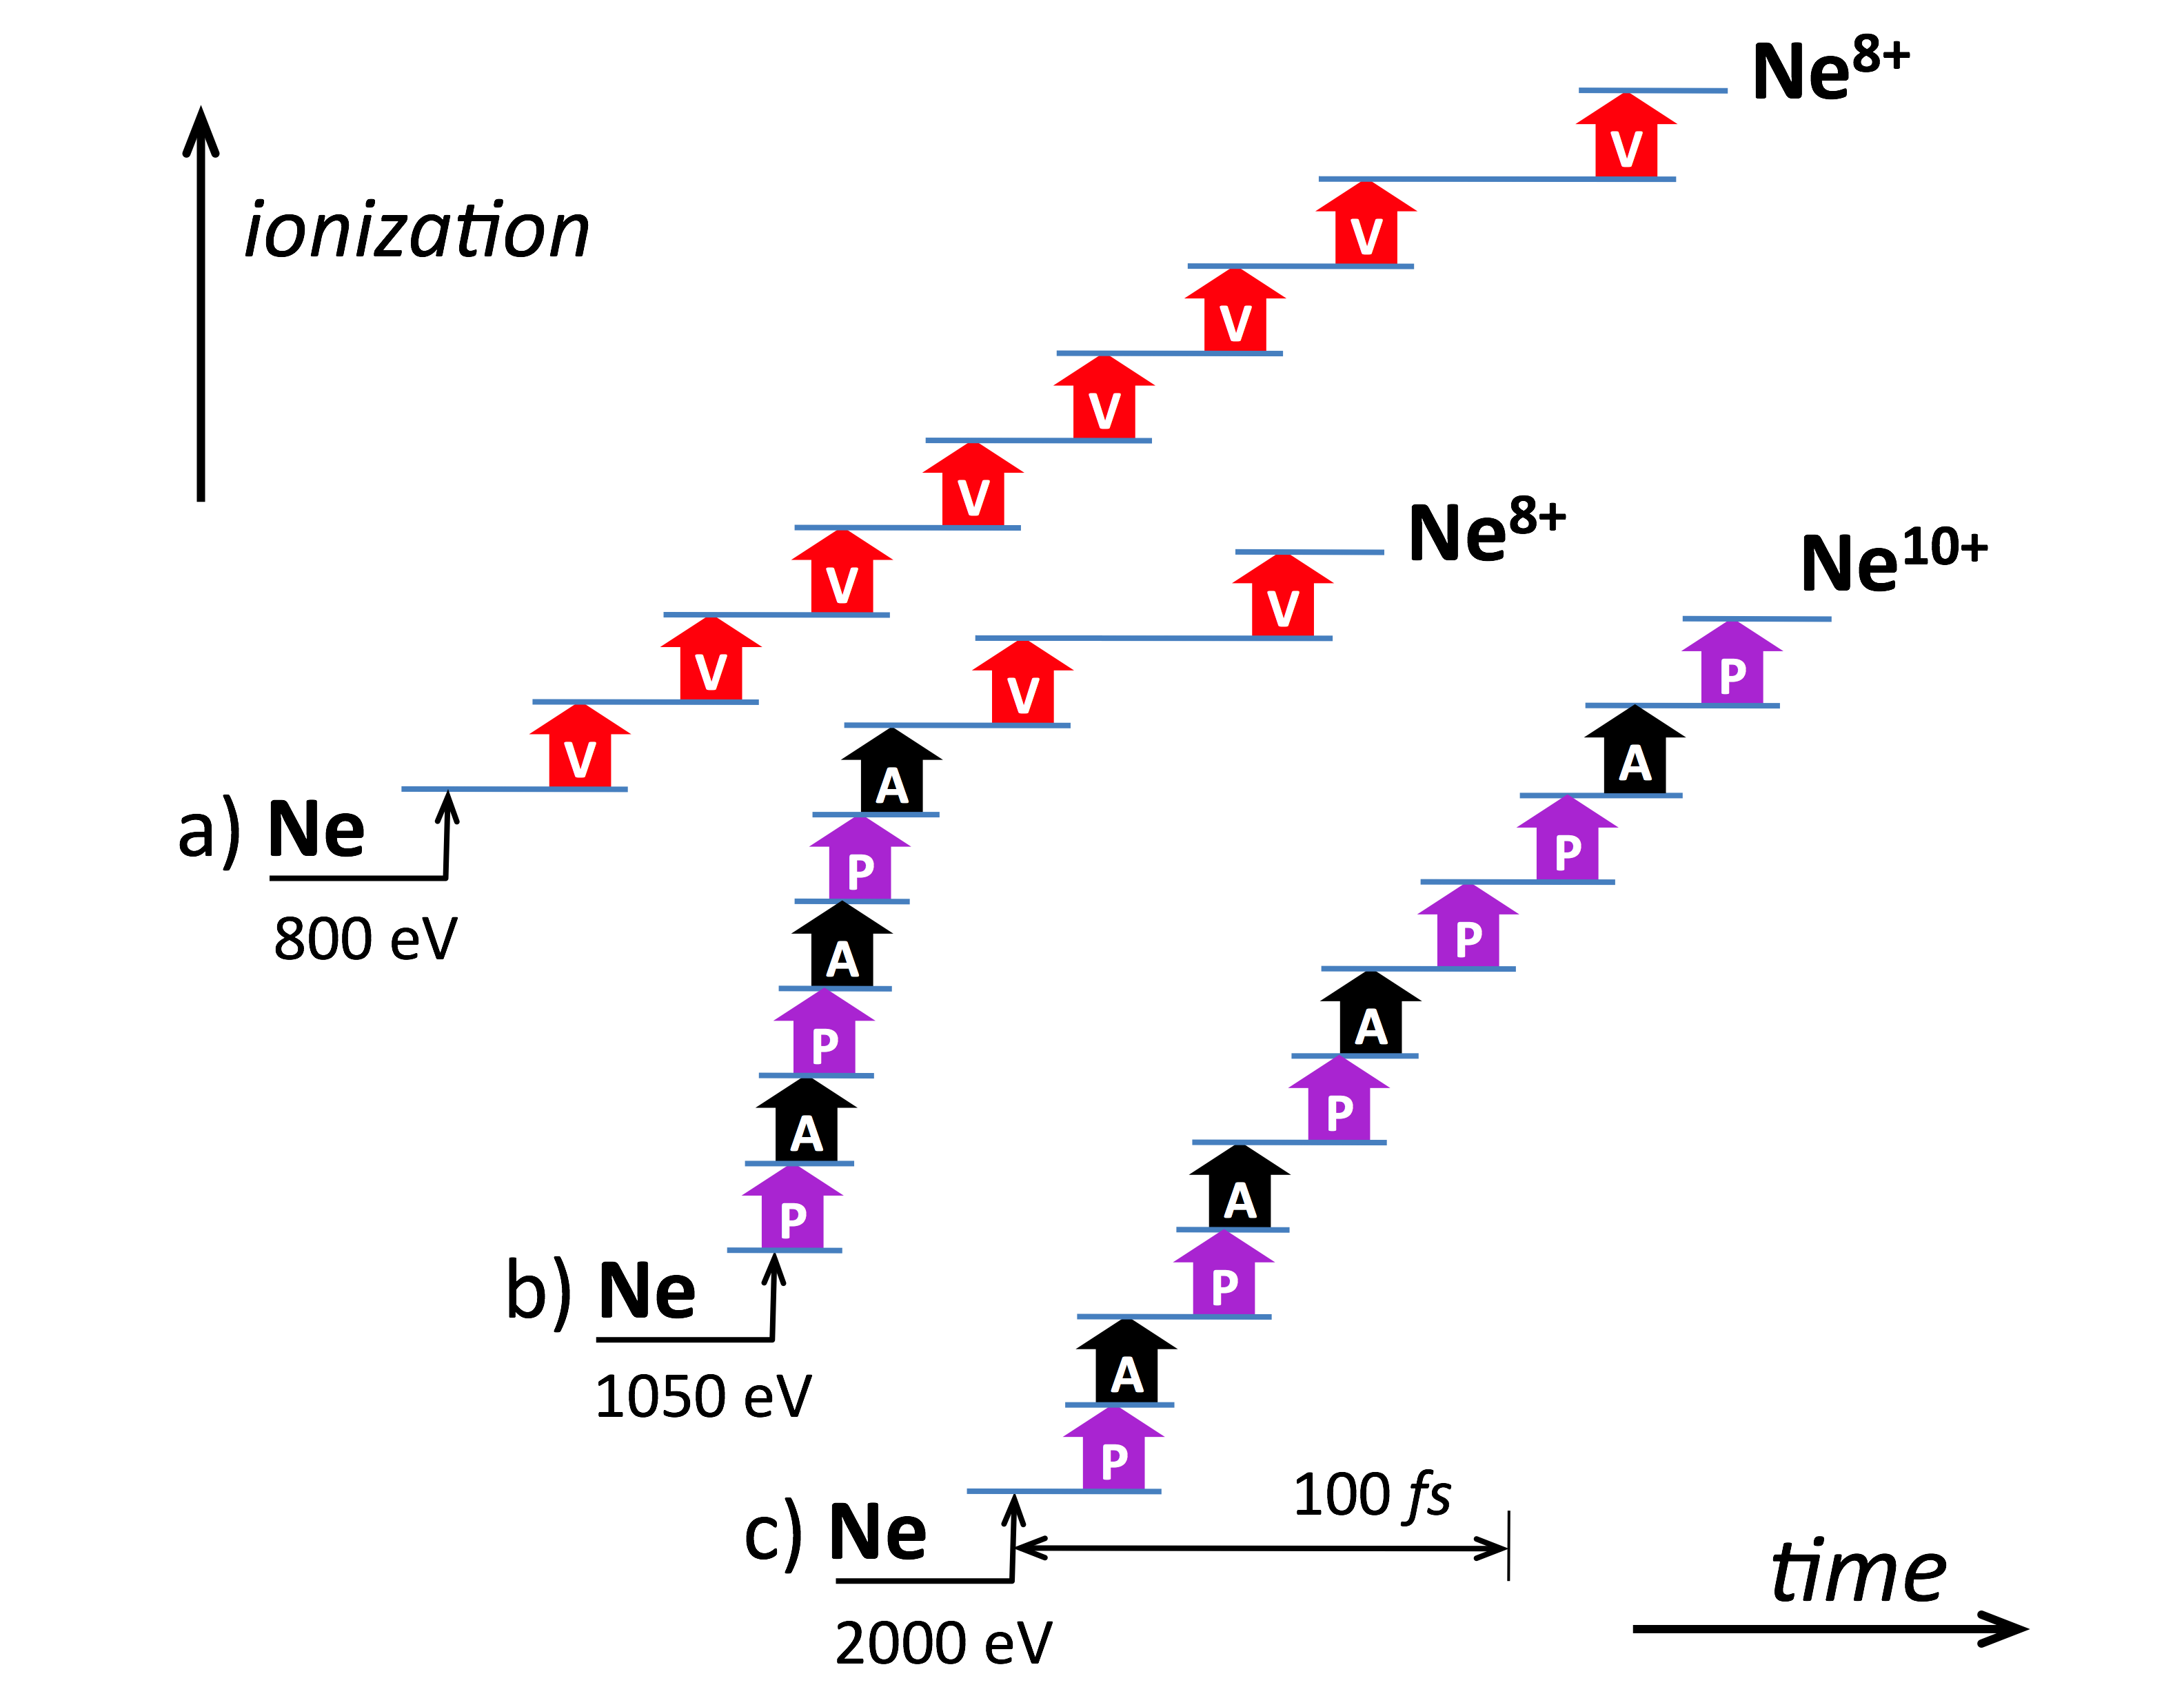
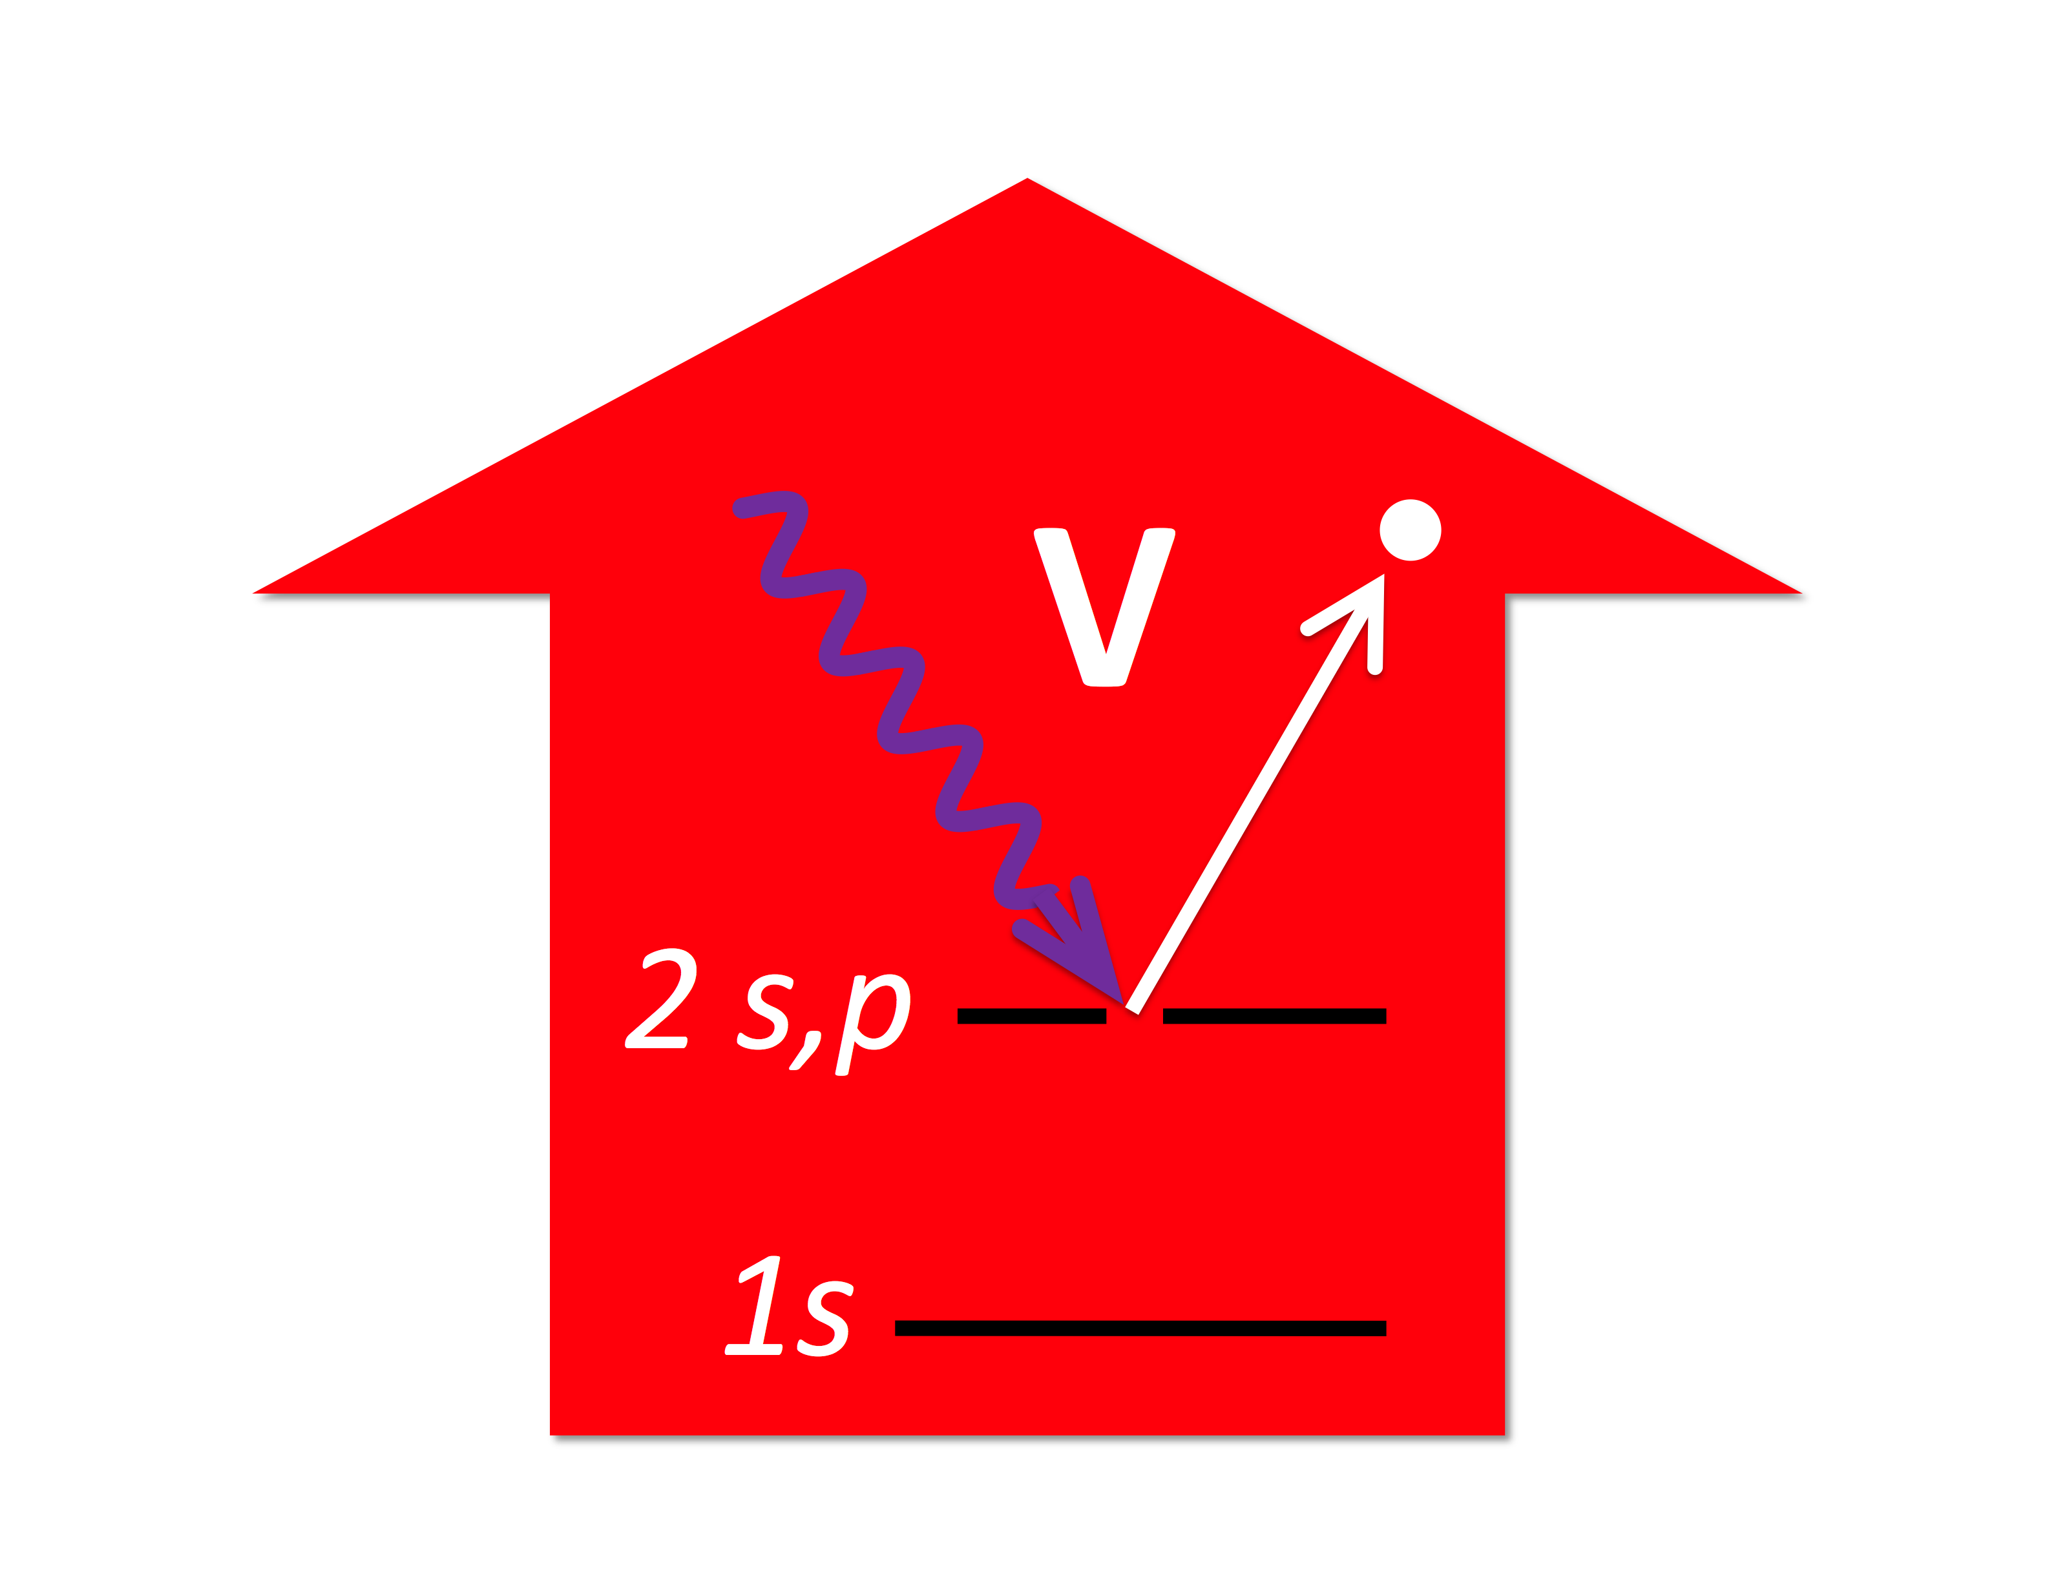
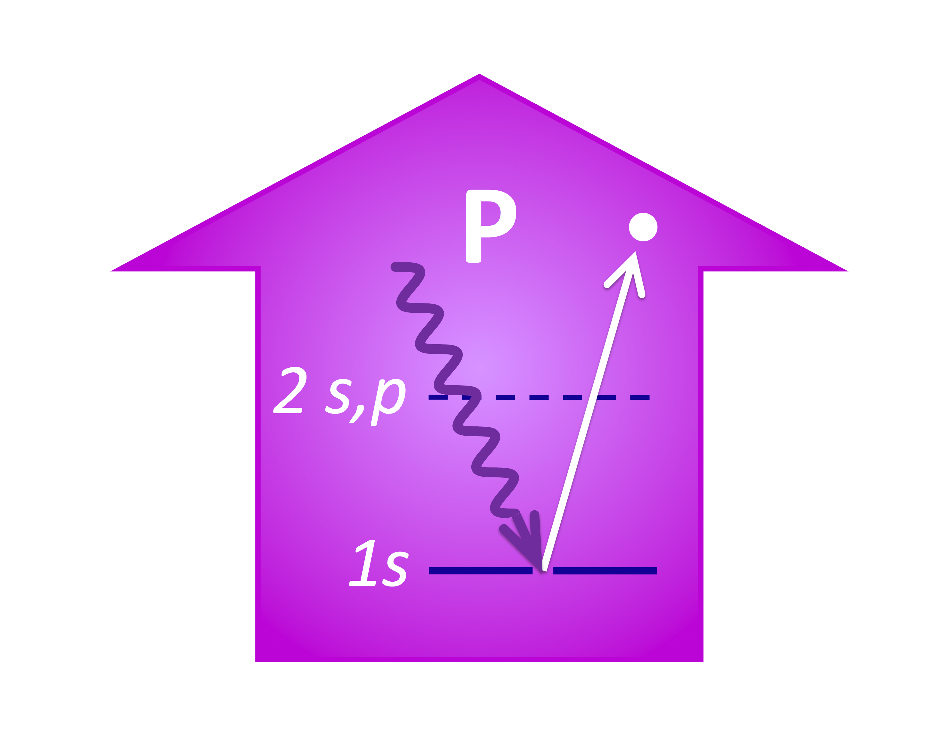
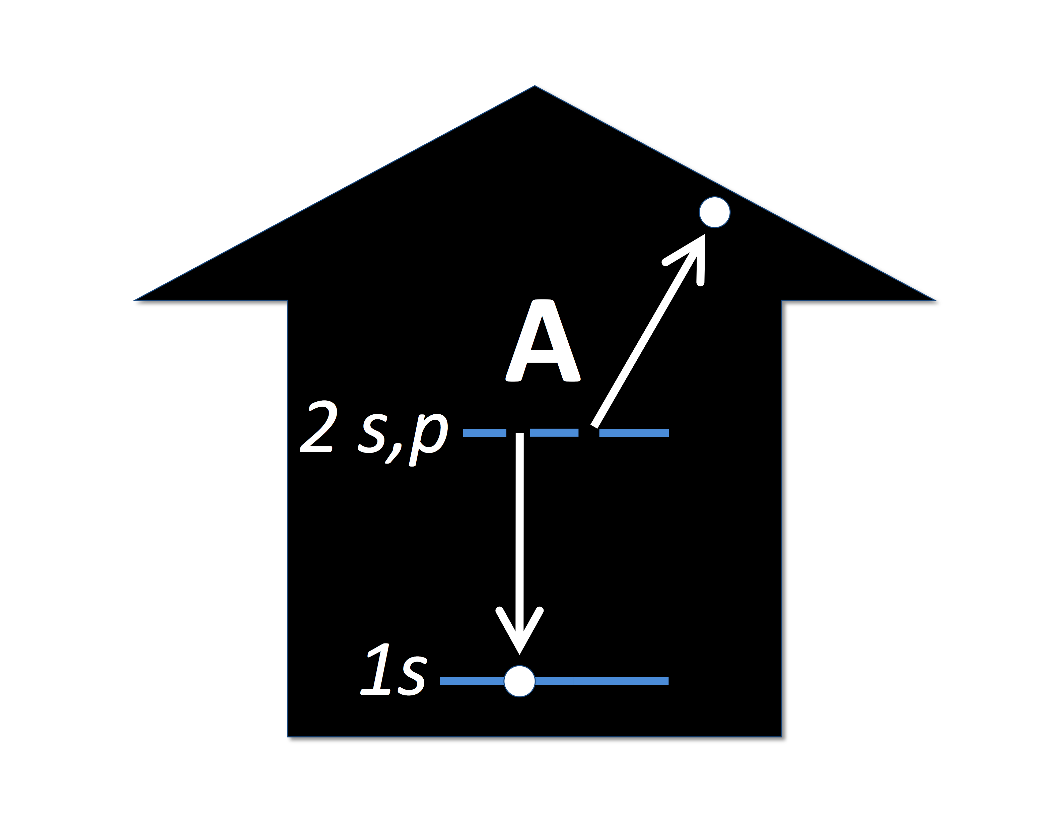
Valence ionization, core ionization and Auger decay
Sequential single photon processes dominate the interaction
Notes:
To scale at 150 x-rays/Angstrom^2/fs

Slide 19
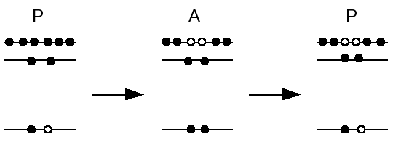
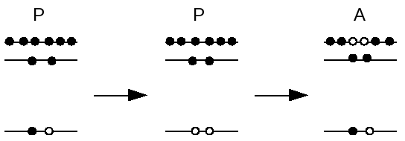
How does one arrive at a particular charge state?
Low
Intensity
PAP
High
Intensity
PPA
Hollow atoms produced at high x-ray intensity
Electron spectroscopy can define the mechanism
Notes:
Both cases end up with same final ionic state, but don’t know how got there.
Need electron spectroscopy to distinguish.

Slide 20
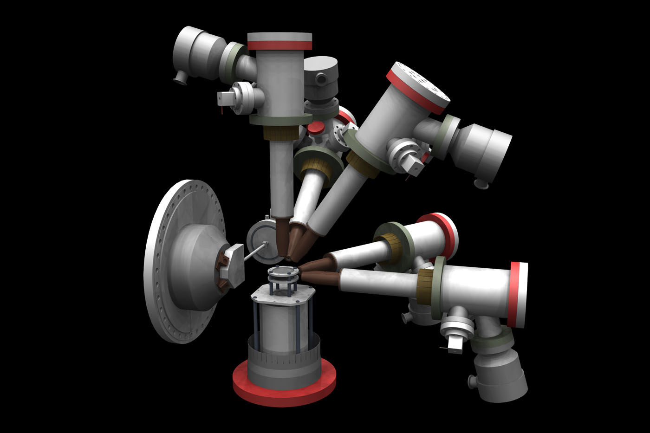
High field physics chamber
5 eTOFs for angular distributions
Ne gas jet
ion TOF
John Bozek
Christoph Bostedt
Notes:
X-ray focus 1 micron - 10^18 w/cm2
John Bozek & Christoph Bostedt

Slide 21
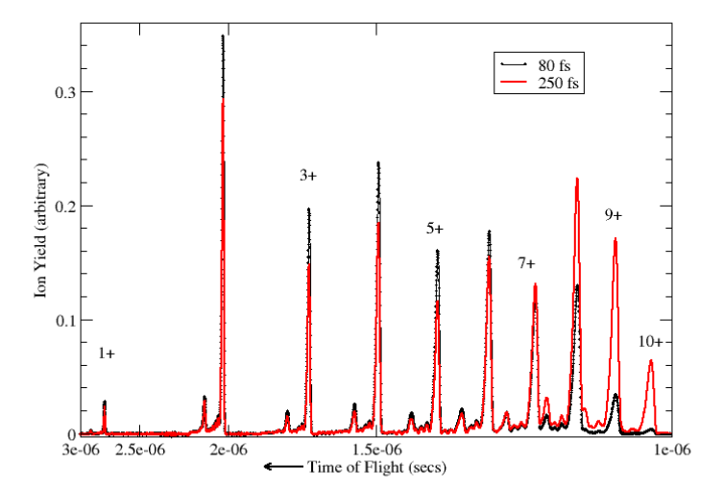
Day 1 – two interesting observations
Single ~100 fs pulse at 2000 eV fully strips neon
6-photon, 10-electron process
Shorter pulses with equal pulse energy & fluence suppress absorption & damage.

Slide 22
Theory can model ultraintense x-ray-induced electronic damage in neon
Theory
• Intensity averaged
• Fluence determined
by experiment
Consistent with
“measured” pulse
energy and focus.
Sang-Kil Son, Robin Santra – refined calcs include shakeoff
Notes:
Use Rohringer/Santra rate equations.
Implement intensity averaging.
Fluence set by Ne 9+/10+ ratio at 2000 eV. Gives the absolute yields as well.
Fluence set by charge state ratios at 800 eV.
Smallish discrepancies are due to the neglect in the simple rate equations of the shake-off and Double Auger processes, which have been included in a recent theory by SangKil Song and Robin Santra.

Slide 23
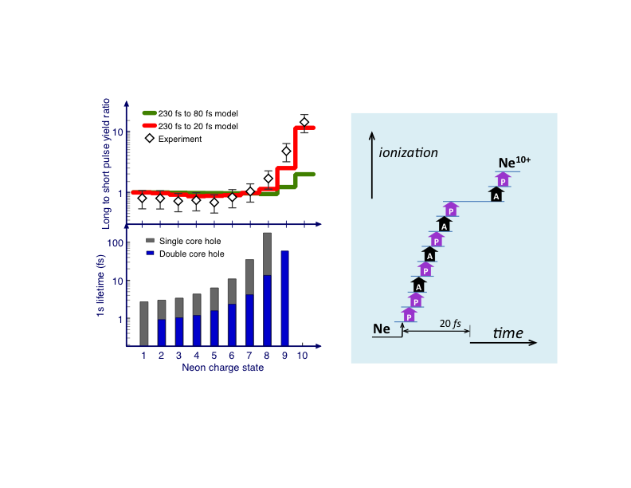
Atoms become transparent at high x-ray intensity !
- x-ray absorption is due to the presence of 1s electrons
- high x-ray intensities eject 1s electrons rendering the atom transiently transparent
- slowing atomic clocks create transparency at surprisingly long timescales
Notes:
Graphic to scale for 2000 x-rays/Angstrom^2/fs

Slide 24
Electron spectrometers track ionization mechanism
X-ray energy = 1050 eV
“Slow” 1s photoelectrons along x-ray polarization axis
“Fast” valence photoelectrons and Augers along polarization axis
Clean hollow atom signature
double-core-hole Auger
θ = 90º
Notes:
1s photoelectrons along polarization axis - shown in purple

Slide 25
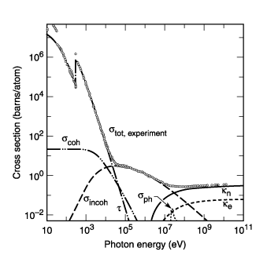
Absorption vs scattering: normal and hollow atoms
carbon
0.8 - 8 keV
σ_{photo} σ_{Compton}
σ_{elastic} σ_{elastic}
2 keV 360 0.05
8 keV 20 0.60
8 keV hollow 2
Impact of hollow atom formation on coherent x-ray scattering
Sang-Kil Son, LY, RS
Phys. Rev A. (2011)
Notes:
Primary ionization:
Photoabsorption Compton Rayleigh Photoabsorption/Rayleigh Photo/Compton
1 keV = 44000 0.25 21.5 2046 160,000
2 keV = 6000 0.77 16.6 361 8000
8 keV = 85 barns 2.5 4.18 20.3 34
12 keV = 23 barns 2.85 2.6 10 8
Compton scattering
Decay paths:
Auger
Radiative
Fragmentation:
Electron scattering
photo e⁻ 43 nm/fs
Auger e⁻ 7 nm/fs
Coulomb explosion

Slide 26
Summary of ultra-intense x-ray interaction phenomena
Target changes during a 100 fs x-ray pulse at fluences similar to that for single molecule imaging
- six-photon, ten-electron stripping of neon ( ~10¹²/µm²)
- multiphoton absorption probability high when fluence > 1/σ
Intensity-induced x-ray transparency – a general phenomena
- transient x-ray transparency caused by formation of hollow atoms
- hollow atoms σ_{scatt}/σ_{abs} is increased – advantageous for imaging
Straightforward rate equation calculations capture essential physics
Controlled inner-shell electron dynamics (Rabi-flopping, atomic inner shell laser…)
X-ray pump/x-ray probe experiments in progress may be informative
Notes:
For example: sigma = 6,000 barns for Carbon at 2 keV – so a fluence of 1/6e-21 = 1.7e20/cm^2 = 1.7 e12/micron^2 required. Spence’s experiment had 100x less
For example: sigma = 40,000 barns for Neon at 2 keV – so a fluence of 1/4e-20cm^2 = 2.5e19/cm^2 = 2.5e11/micron^2 (we had ~10^13/micron^2)
We exceeded this by 10x in the neon experiment
Hollow carbon at 1 A: has scatt/abs = 2 versus scatt/abs = 0.1

Slide 27
Improving the X-ray Laser

Slide 28
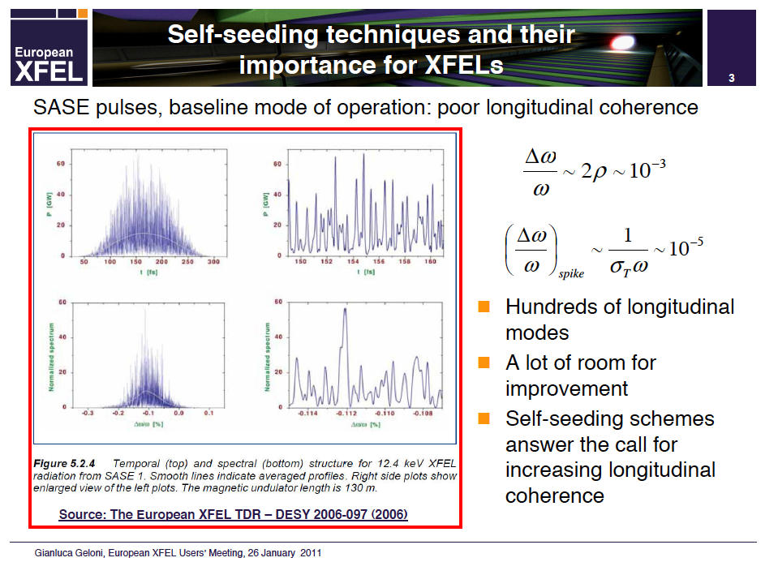
The chaotic truth about current XFELs

Slide 29
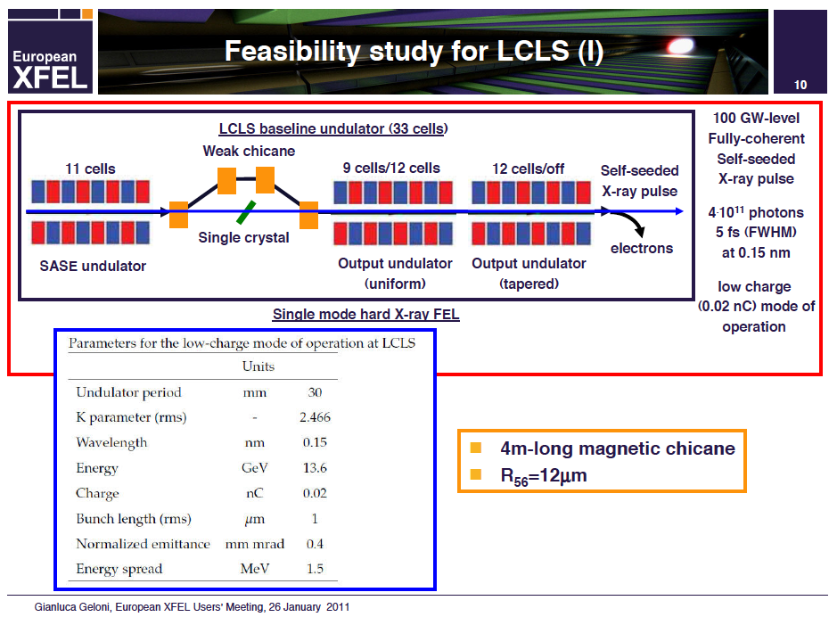
How to obtain longitudinally coherent x-ray laser pulses?
Implementation by
SLAC/Argonne/TISNCM

Slide 30
Hard x-ray self seeding at LCLS

Slide 31
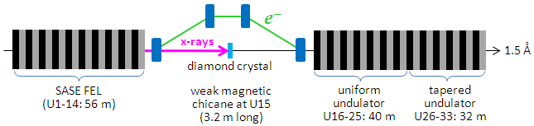


Hard x-ray self-seeding demonstrated in Jan 2012
J. Amann et al. Nature Photonics (Aug 2012)
On the road to a terawatt XFEL and original specifications for single-molecule imaging

Slide 32
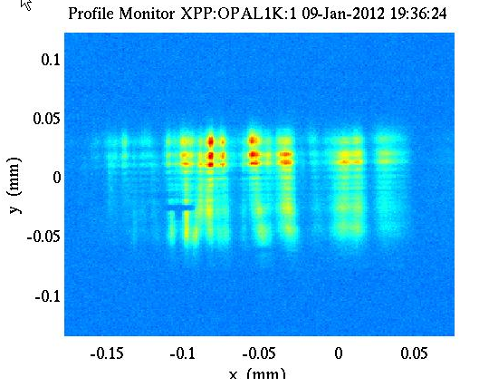
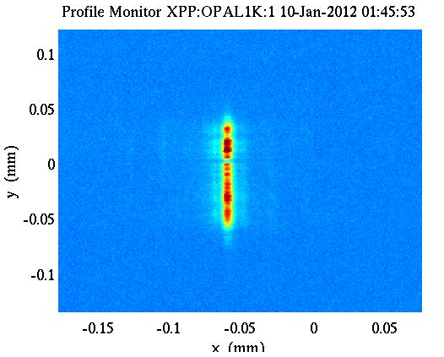
Hard x-ray self seeding demo – P. Emma et al
Diamond OUT
Diamond IN
Bandwidth <10⁻⁴ at 8-9 keV and tunable
But … did not achieve saturation and power jitter still present
Seeding important – as seeding + tapered undulator provide a route to terawatt FELs

Slide 33
Toward Single Molecule Imaging with X-rays

Slide 34
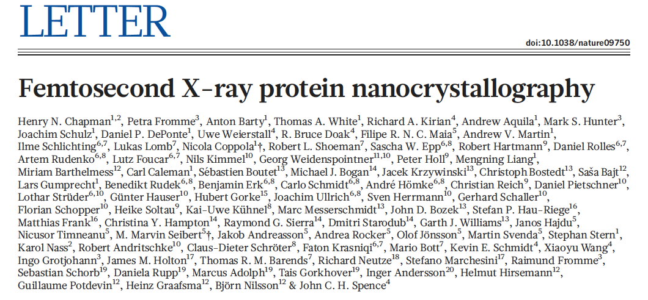
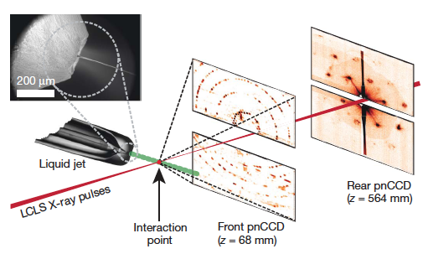
Nature 470, 73 (2011)
Photosystem I
membrane protein, 1 MDa
3,000,000 diffraction patterns
Crystals 200 nm - 2µm
Resolution 8.5Å
Match synchrotron structure
Dose: 700MGy
Typical synch dose: 30 MGy
Notes:
Nature Feb 3, 2011

Slide 35

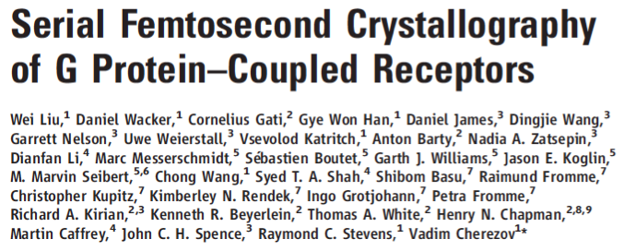
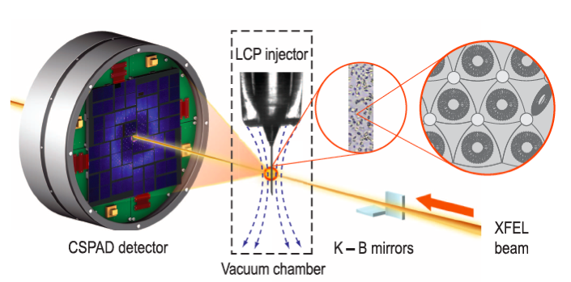
Science 342, 1521 (2013)
Human Serotonin Receptor
~5x5x5 µm crystals
Total sample 300 µg
X-rays: 9.5 keV, 50 fs, 50 µJ
~4 million diff patterns (10 hrs)
32,819 patterns indexed
Room temperature structure
2.8 Å resolution

Slide 36



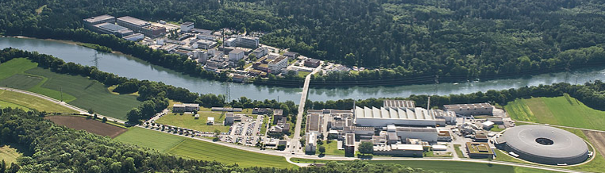

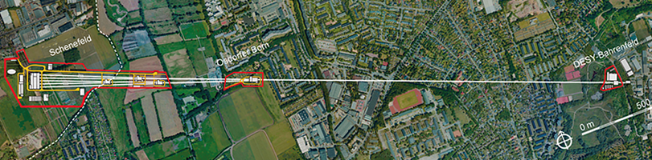

International opportunities here and on the horizon

Slide 37
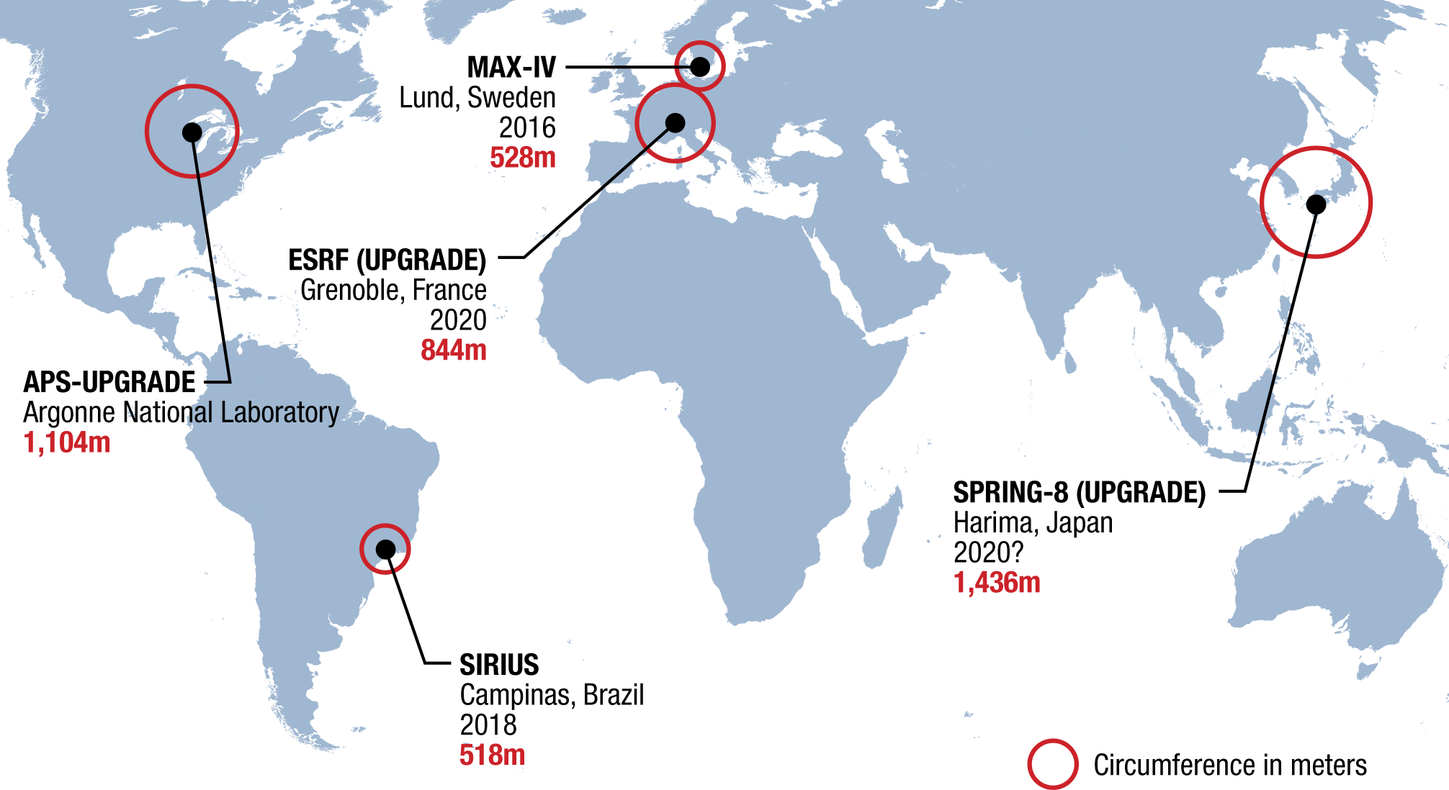
Multiple diffraction-limited storage ring projects are under way

Slide 38
Thank you Roy -
for including me on your scientific adventures
for introducing me to your illustrious circle
for enlightening insights
for being a trusted consultant
All the best for many more years as a Mozart!

