Slide 1

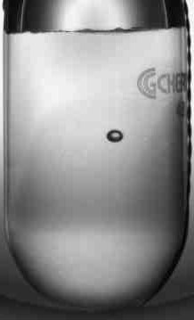
Nuclear astrophysics with γ-rays
Work supported by the US Department of Energy, Office of Nuclear Physics, under Contracts DE-AC02-06CH11357 and DE-FG02-97ER41033.
Superheated Target for Astrophysics Research (STAR)
Claudio Ugalde
Argonne National Laboratory
University of Illinois at Chicago
University of Chicago
Nuclear physics symposium in honor of Roy Holt, 2014
Notes:
Mention (g,a) and (a,g) relation

Slide 2
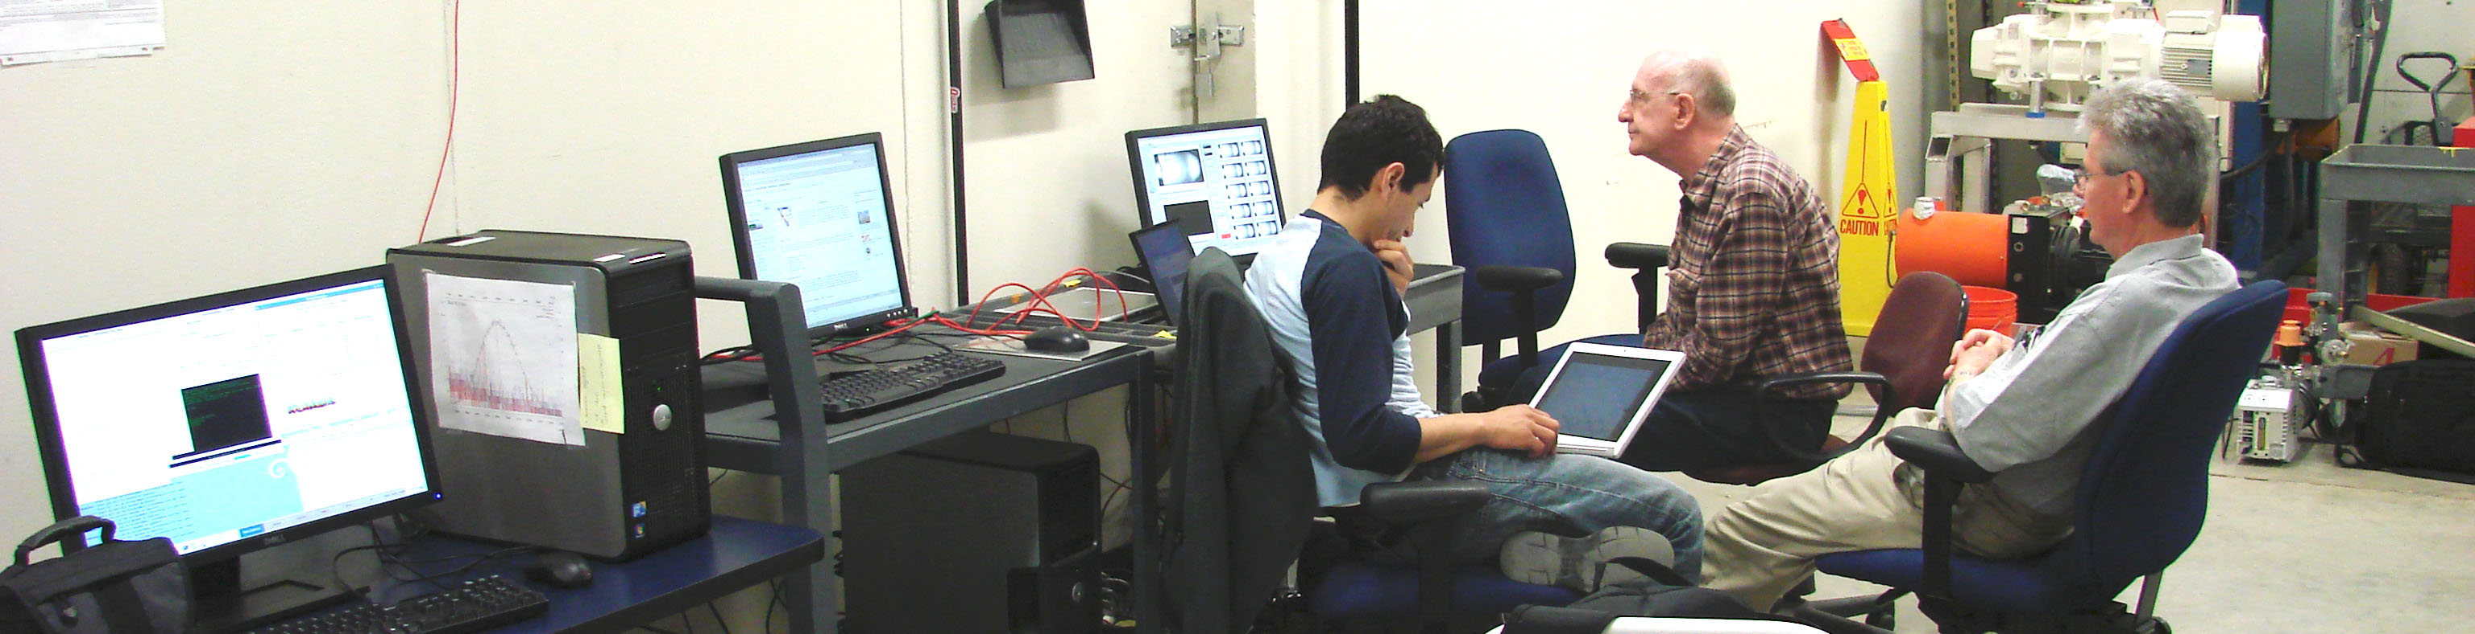


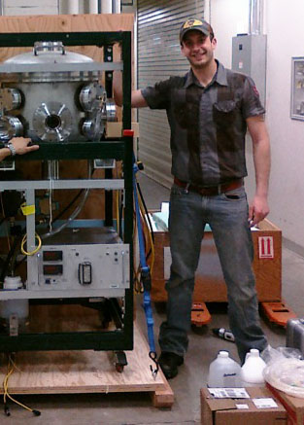


B. DiGiovine
D. Henderson
R. J. Holt
K. E. Rehm
C. Ugalde
R. Suleiman
A. Freyberger
J. Grames
R. Kazimi
M. Poelker
R. Mammei
D. Meekins
Y. Roblin
V. Vylet,
G. Kharashvili
P. Degtiarenko
LLNL
A. Tonchev
LANL
G. Rusev
A. Robinson
A. Sonnenschein

Slide 3
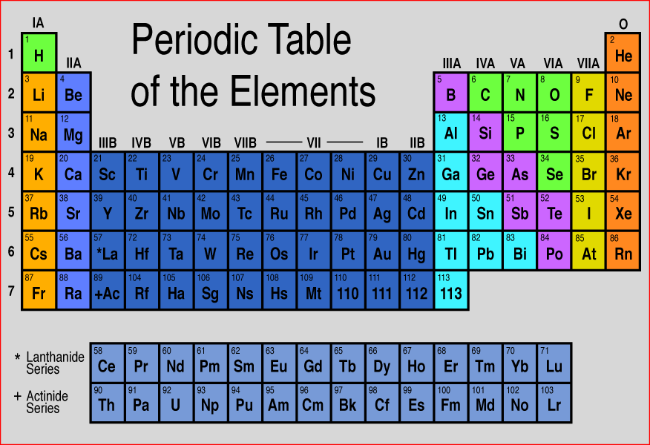
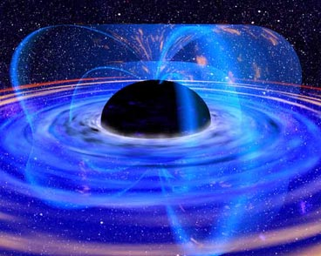
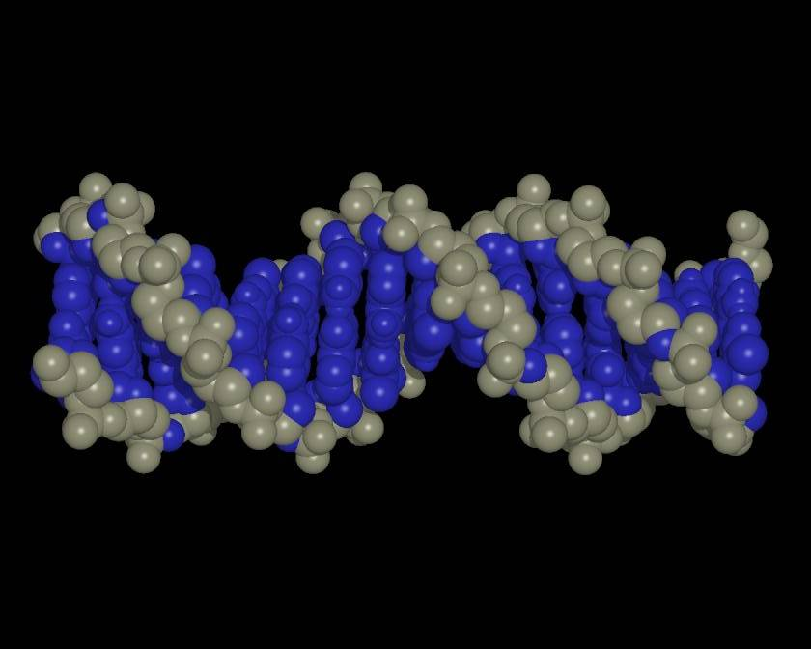
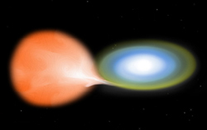
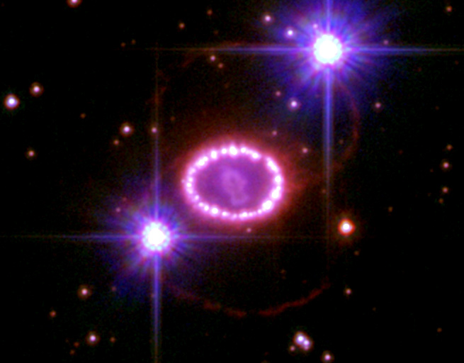
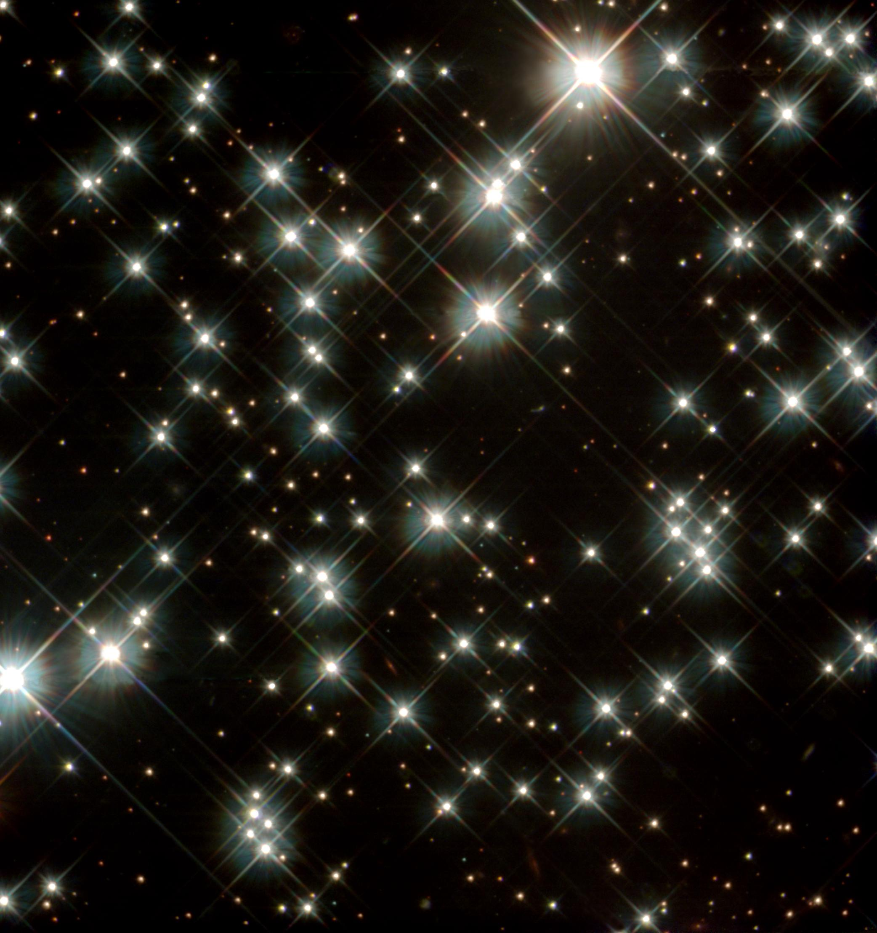
¹²C(α,γ)¹⁶O Reaction
Key reaction for nucleosynthesis in massive stars, progenitors of Type Ia Supernovae,
White Dwarf ages.
Affects the synthesis of most of the elements of the periodic table
Determines whether for a given initial mass, a star will become a black hole or a neutron star
The variation of the C/O ratio in the progenitor might be a cause of the variation of SNIa brightness
Sets the C to O ratio in the universe
Determines the minimum mass a star requires to become a core collapse supernova
Affects the constraints
on the age of stellar
populations from White Dwarfs
Notes:
Core size and mass defines structure, evolution, and composition

Slide 4
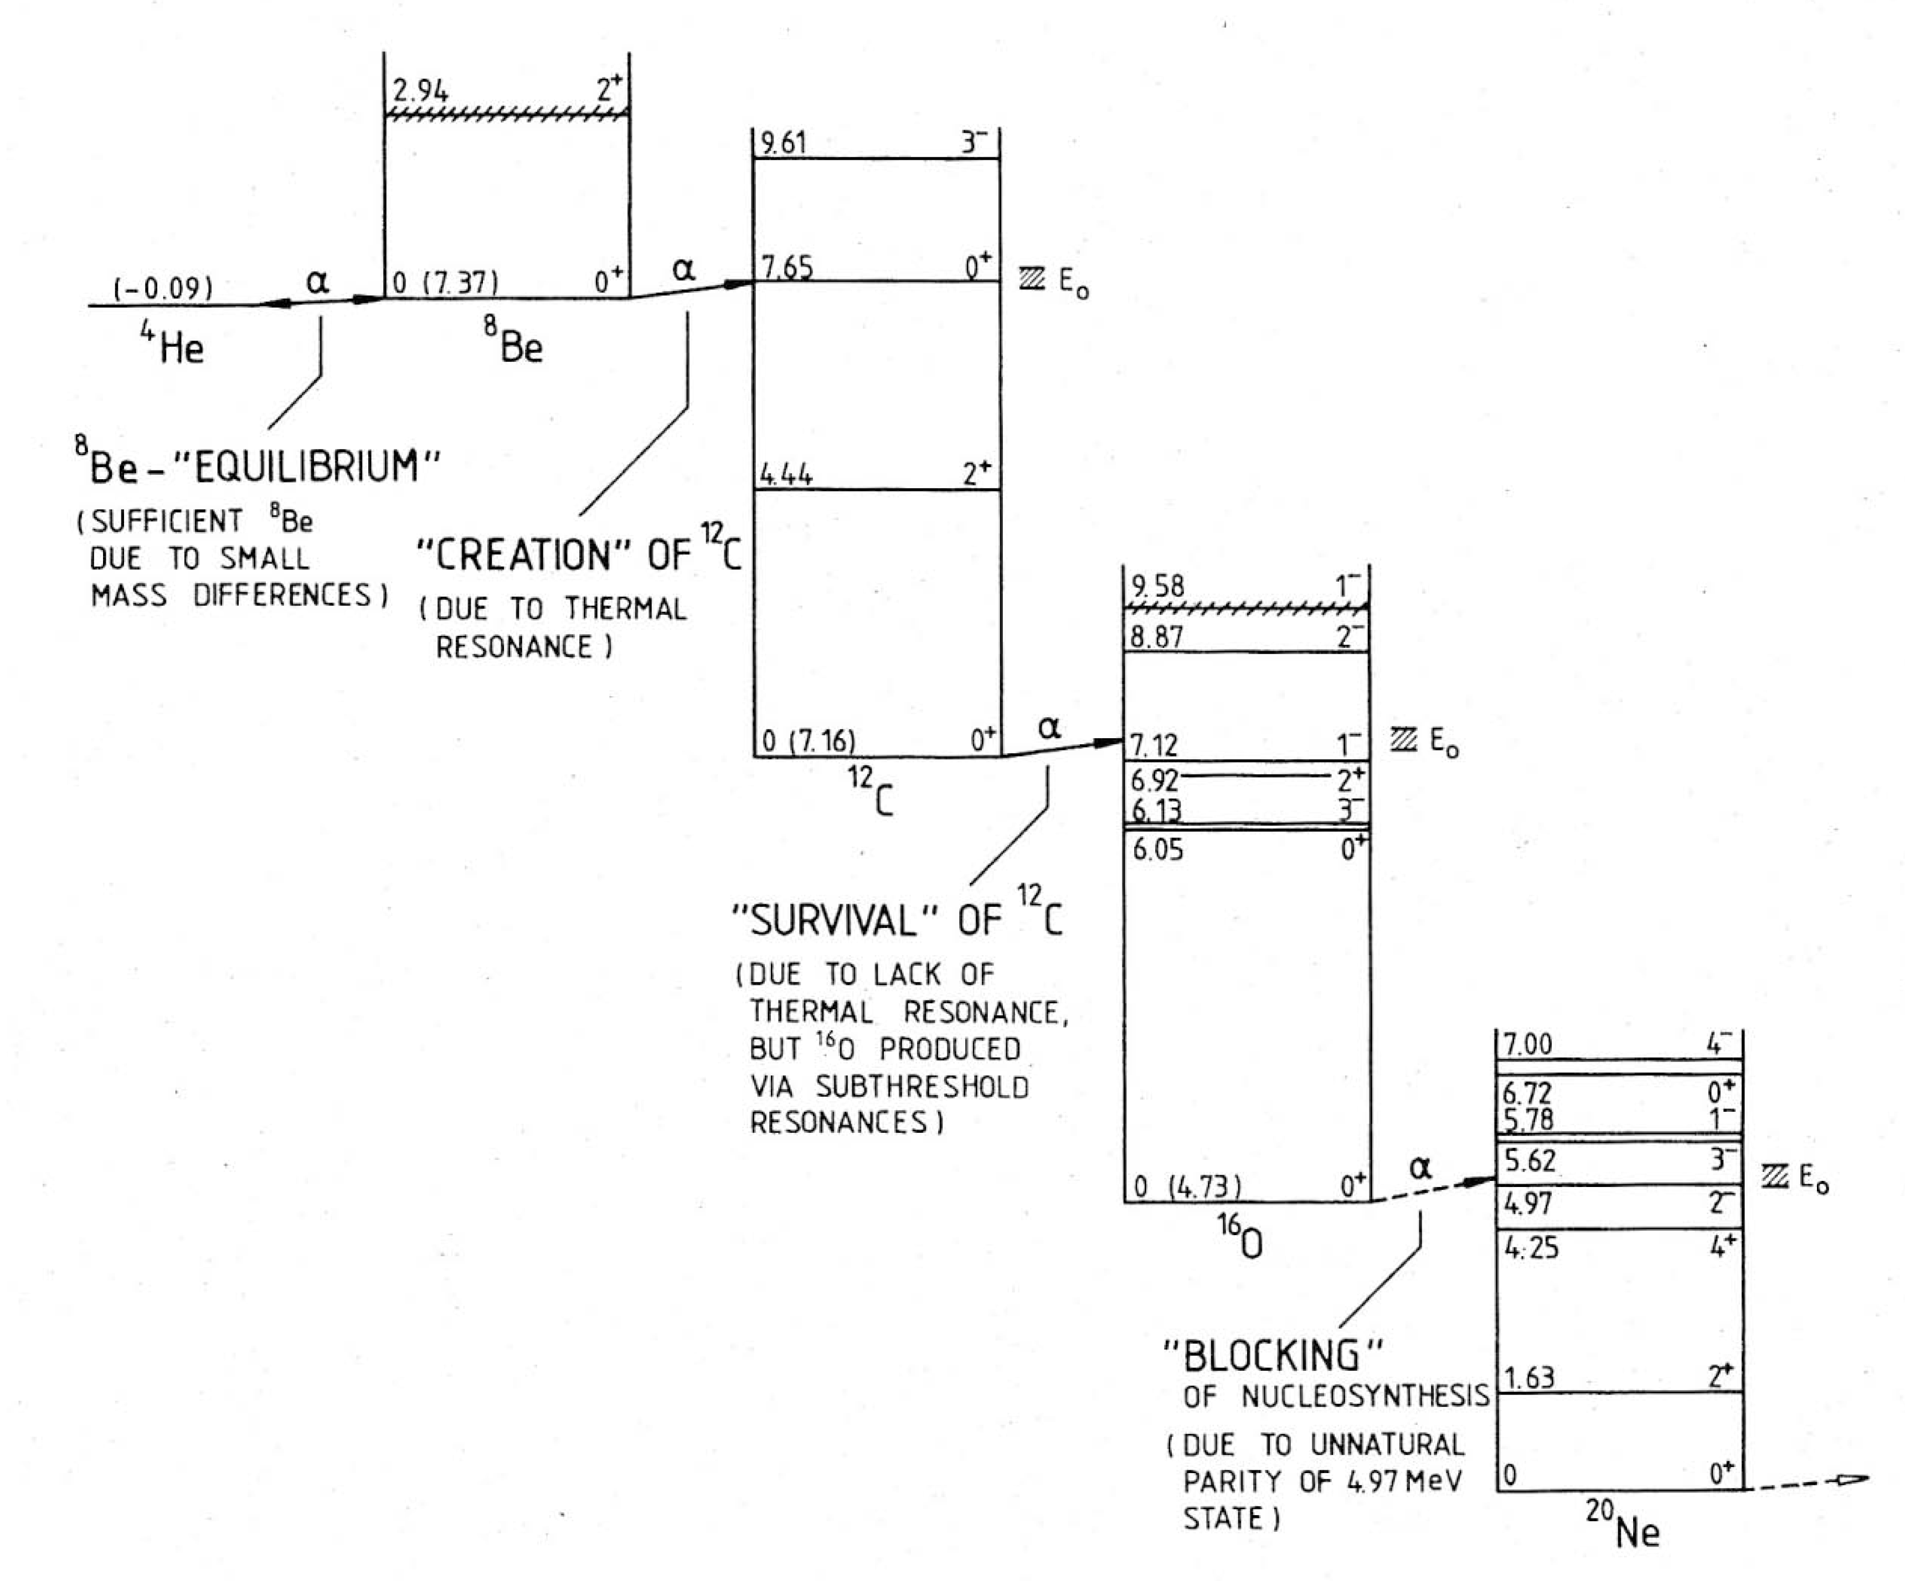
Gamow window
Helium burning
(T ~0.15 GK)
Rolfs and Rodney, 1988
Notes:
8Be short lifetime
Importance of core in subsequent stages

Slide 5
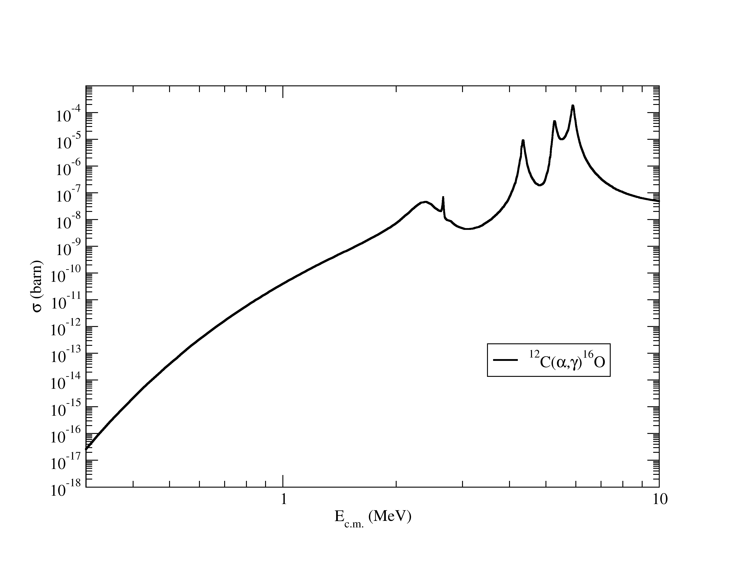
Experiment record
Kunz et al. 2001
(100% error bar)
He burning
σ ~ 1 x 10⁻¹⁷ barn
Yield ~ N₁N₂σg

Slide 6
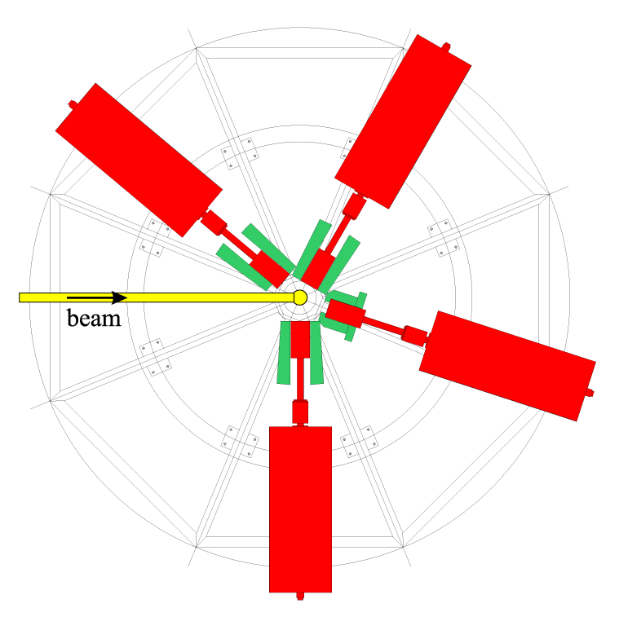
Kunz 2001 (Stuttgart)
beam
target
signal
α + ¹²C --> ¹⁶O + γ
4 MV Dynamitron, 480 μA ⁴He beam
¹²C implanted targets on gold substrate
4 large HPGe, with active BGO shield
N1= 2x10¹⁸ Carbon implanted particles
N2= 0.5 mA = 3.12 x 10¹⁵ α-particles/s
in 1 year (Gamow window)
N1 N2 = 1.97 x 10⁴¹
Yield = 2 events in one year
E_{c.m.} = 0.95 - 2.80 MeV

Slide 7
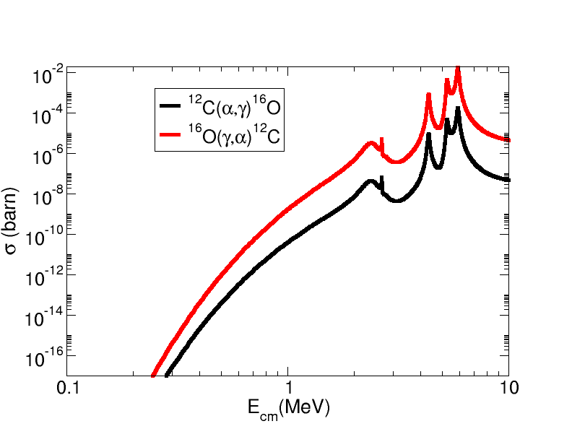
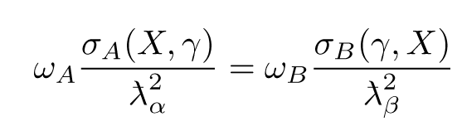
Time reversal symmetry: x100 gain in cross section
¹²C
¹⁶O
α
γ

Slide 8
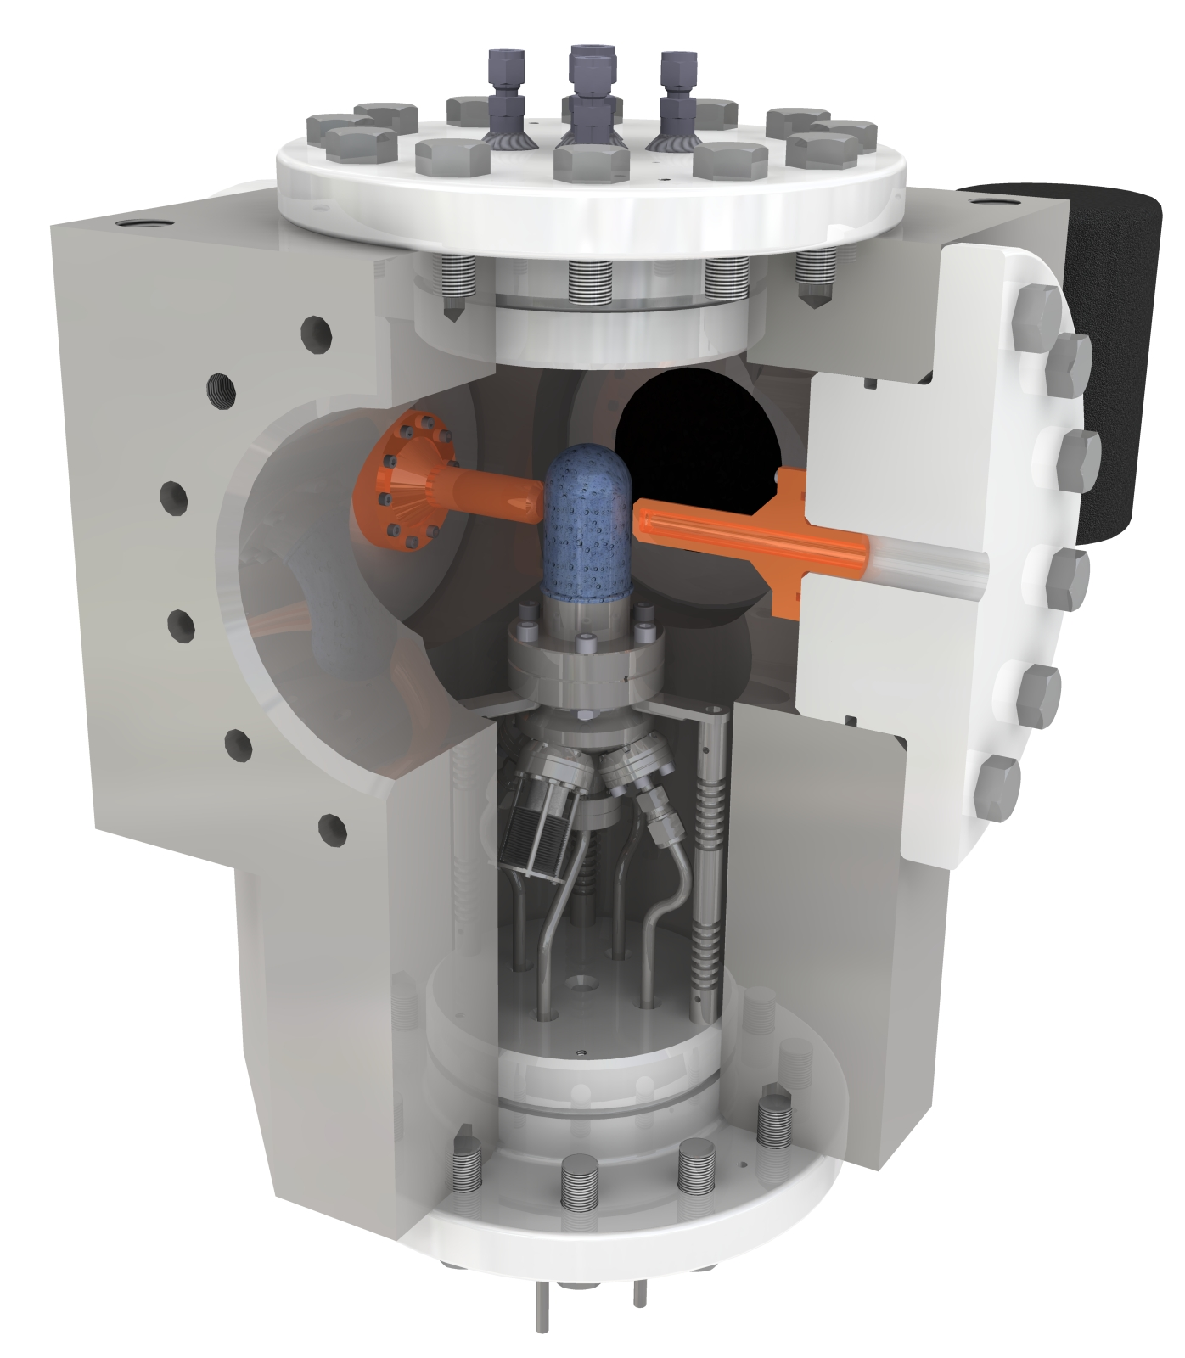
New approach:
Inverse reaction + Bubble chamber + γ ray beam
beam
target
signal
Extra gain (x100) by measuring time inverse reaction
The target density is up to x10⁶ higher than conventional gas targets.
Superheated water will nucleate from α and ¹²C recoils
The detector is insensitive to γ-rays (at least 1 part in 10¹¹)
Idea tested at HIγS
γ + ¹⁶O --> ¹²C + α
Monochromatic γ beam
Oxygen bubble chamber

Slide 9
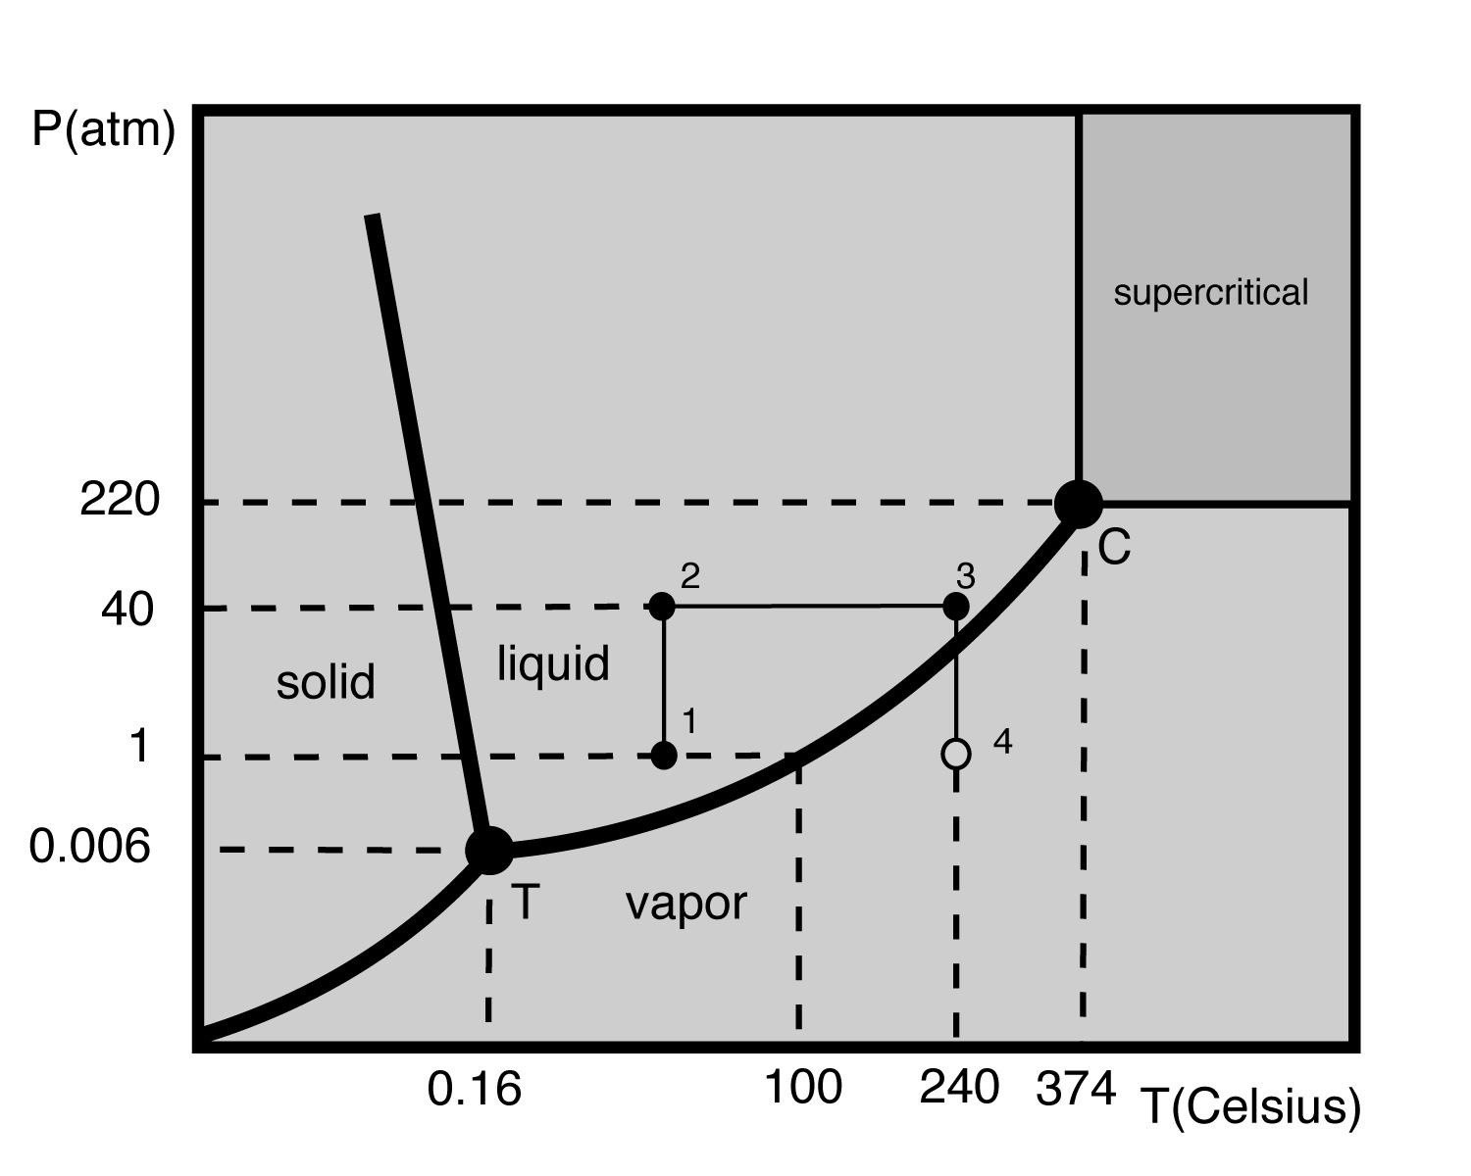
Superheating of liquids
Water
Superheat

Slide 10
Superheating of liquids
Water
Superheat
Very challenging
engineering
Test feasibility with
a liquid requiring
technical simplicity
(C₄F₁₀)

Slide 11
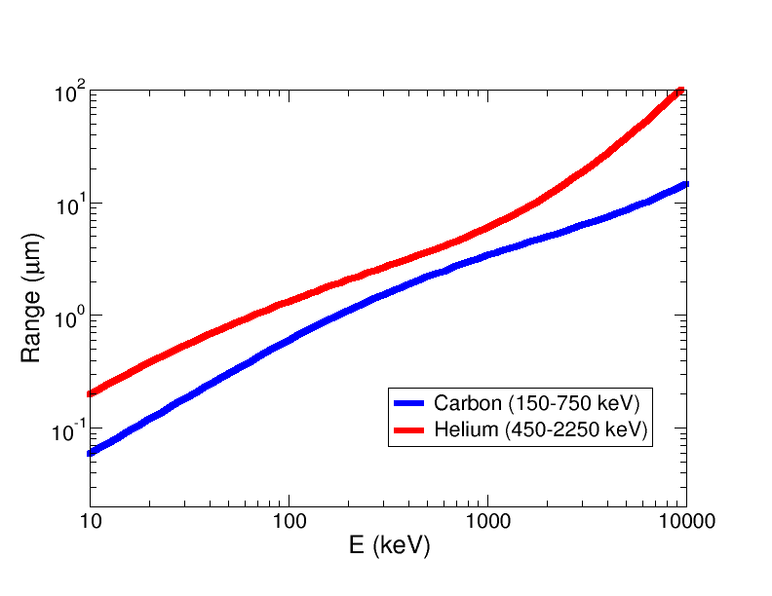
Ranges in water

Slide 12
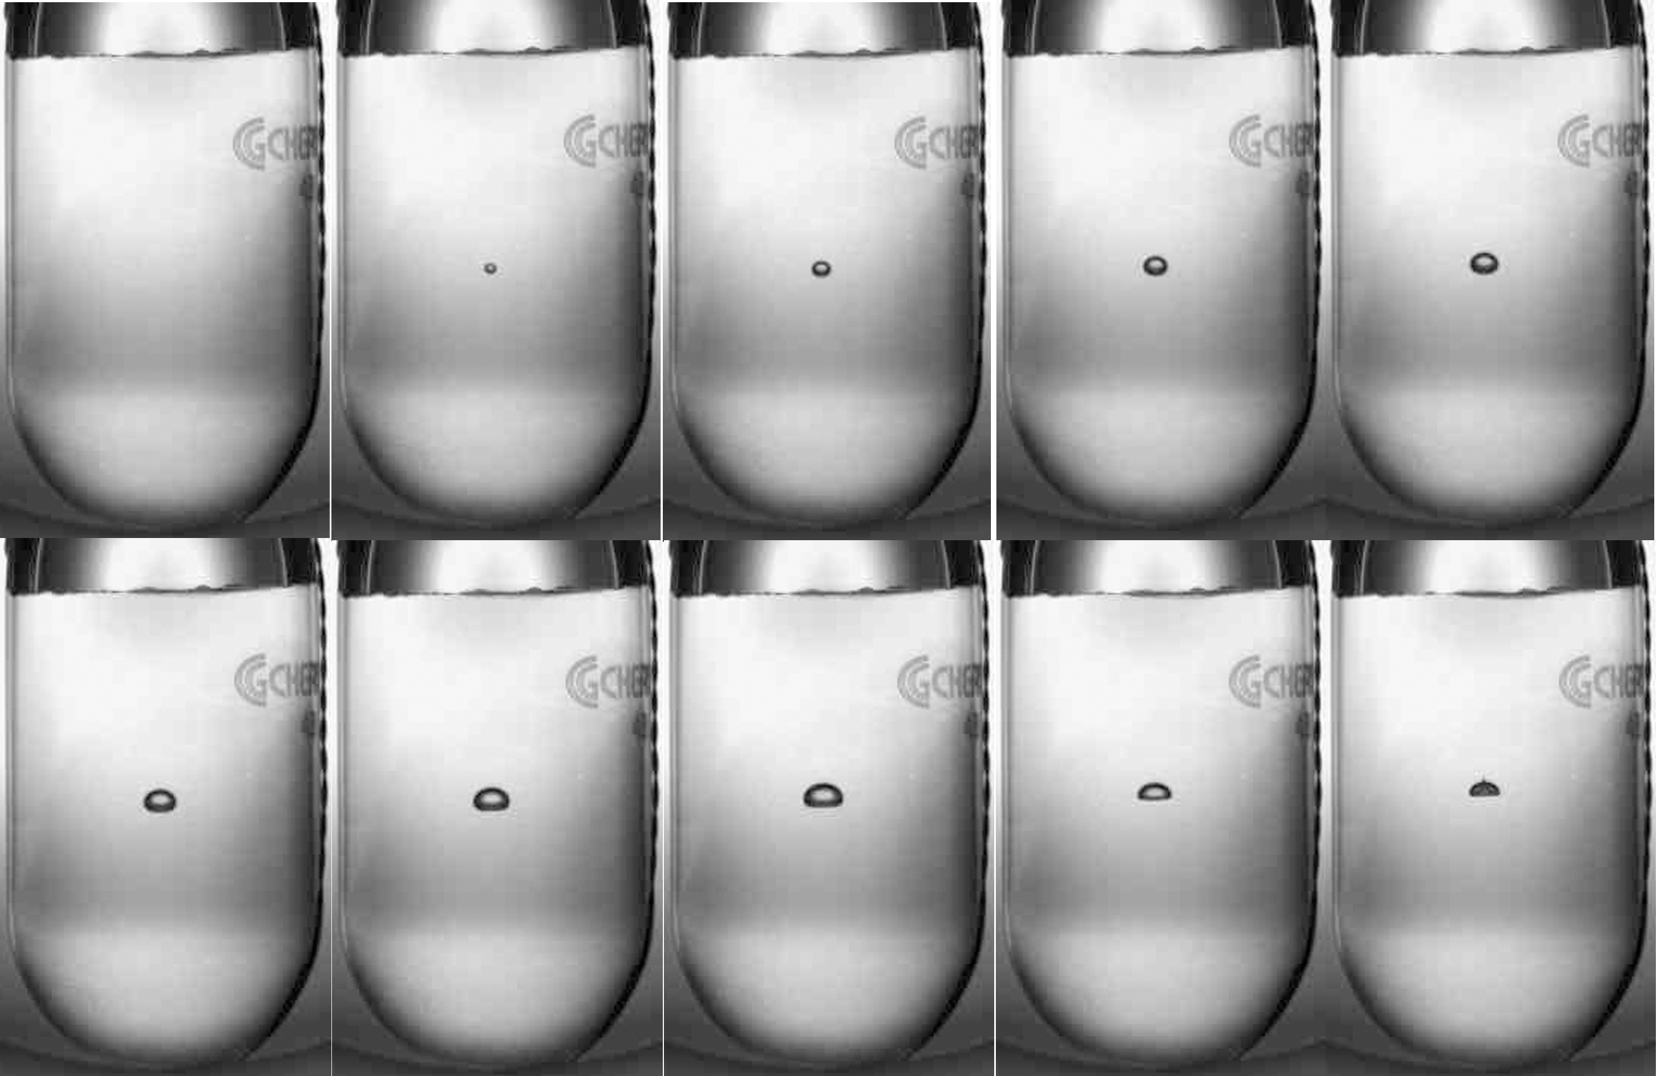
Bubble growth and quenching. ¹⁹F(γ,α)¹⁵N in R134a
Δt = 10 ms

Slide 13
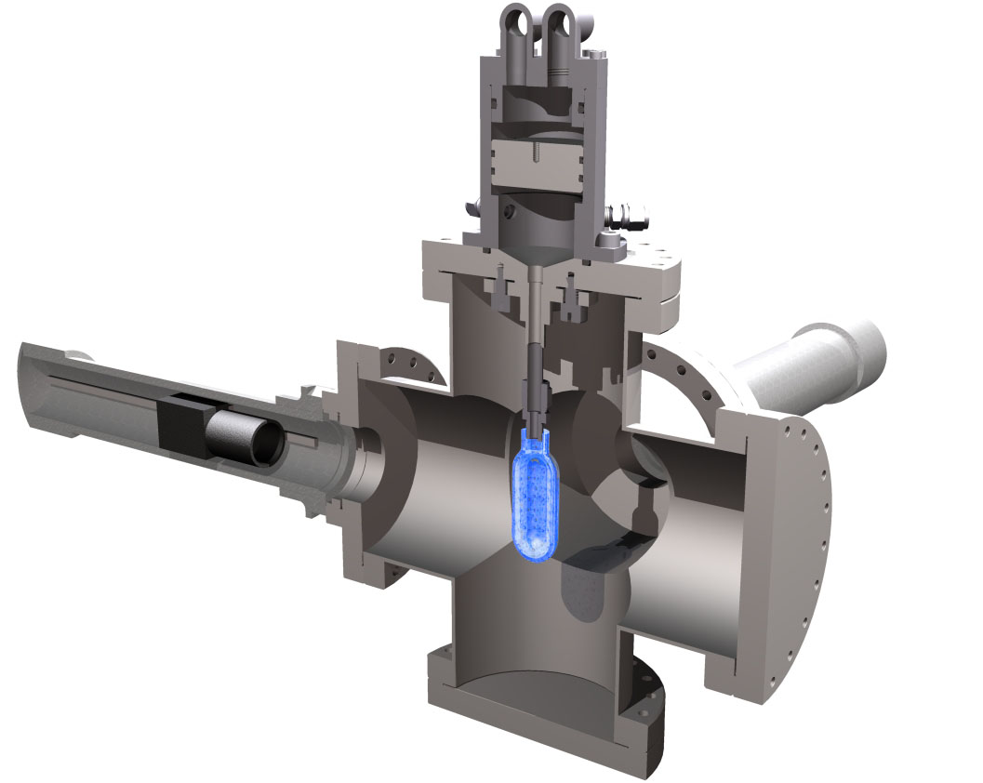
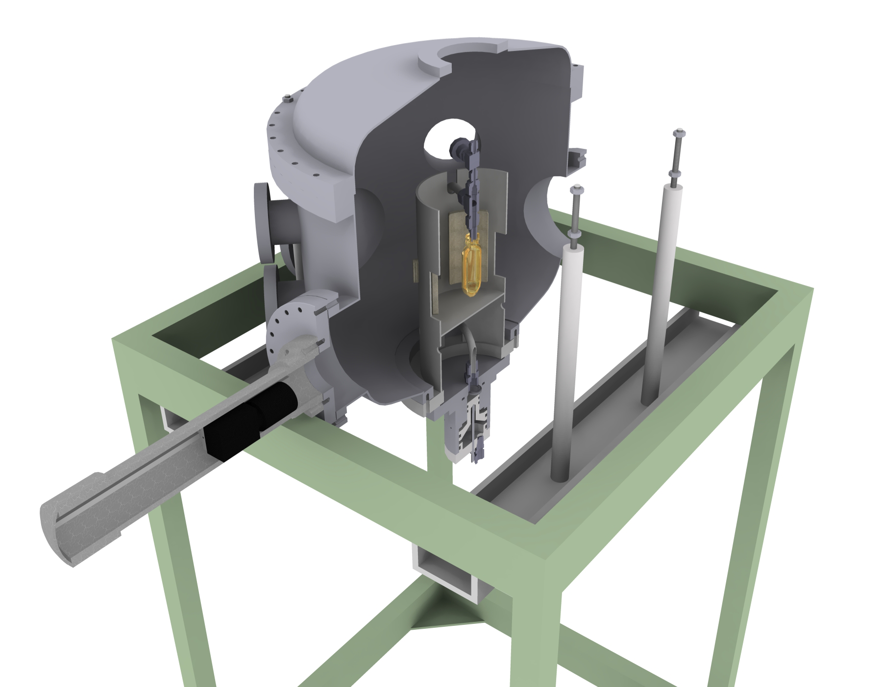
Liquids tested
CH₂FCF₃ (R134a)
C₄F₁₀
H₂O
N₂O
CO₂
v1
v3
v2

Slide 14
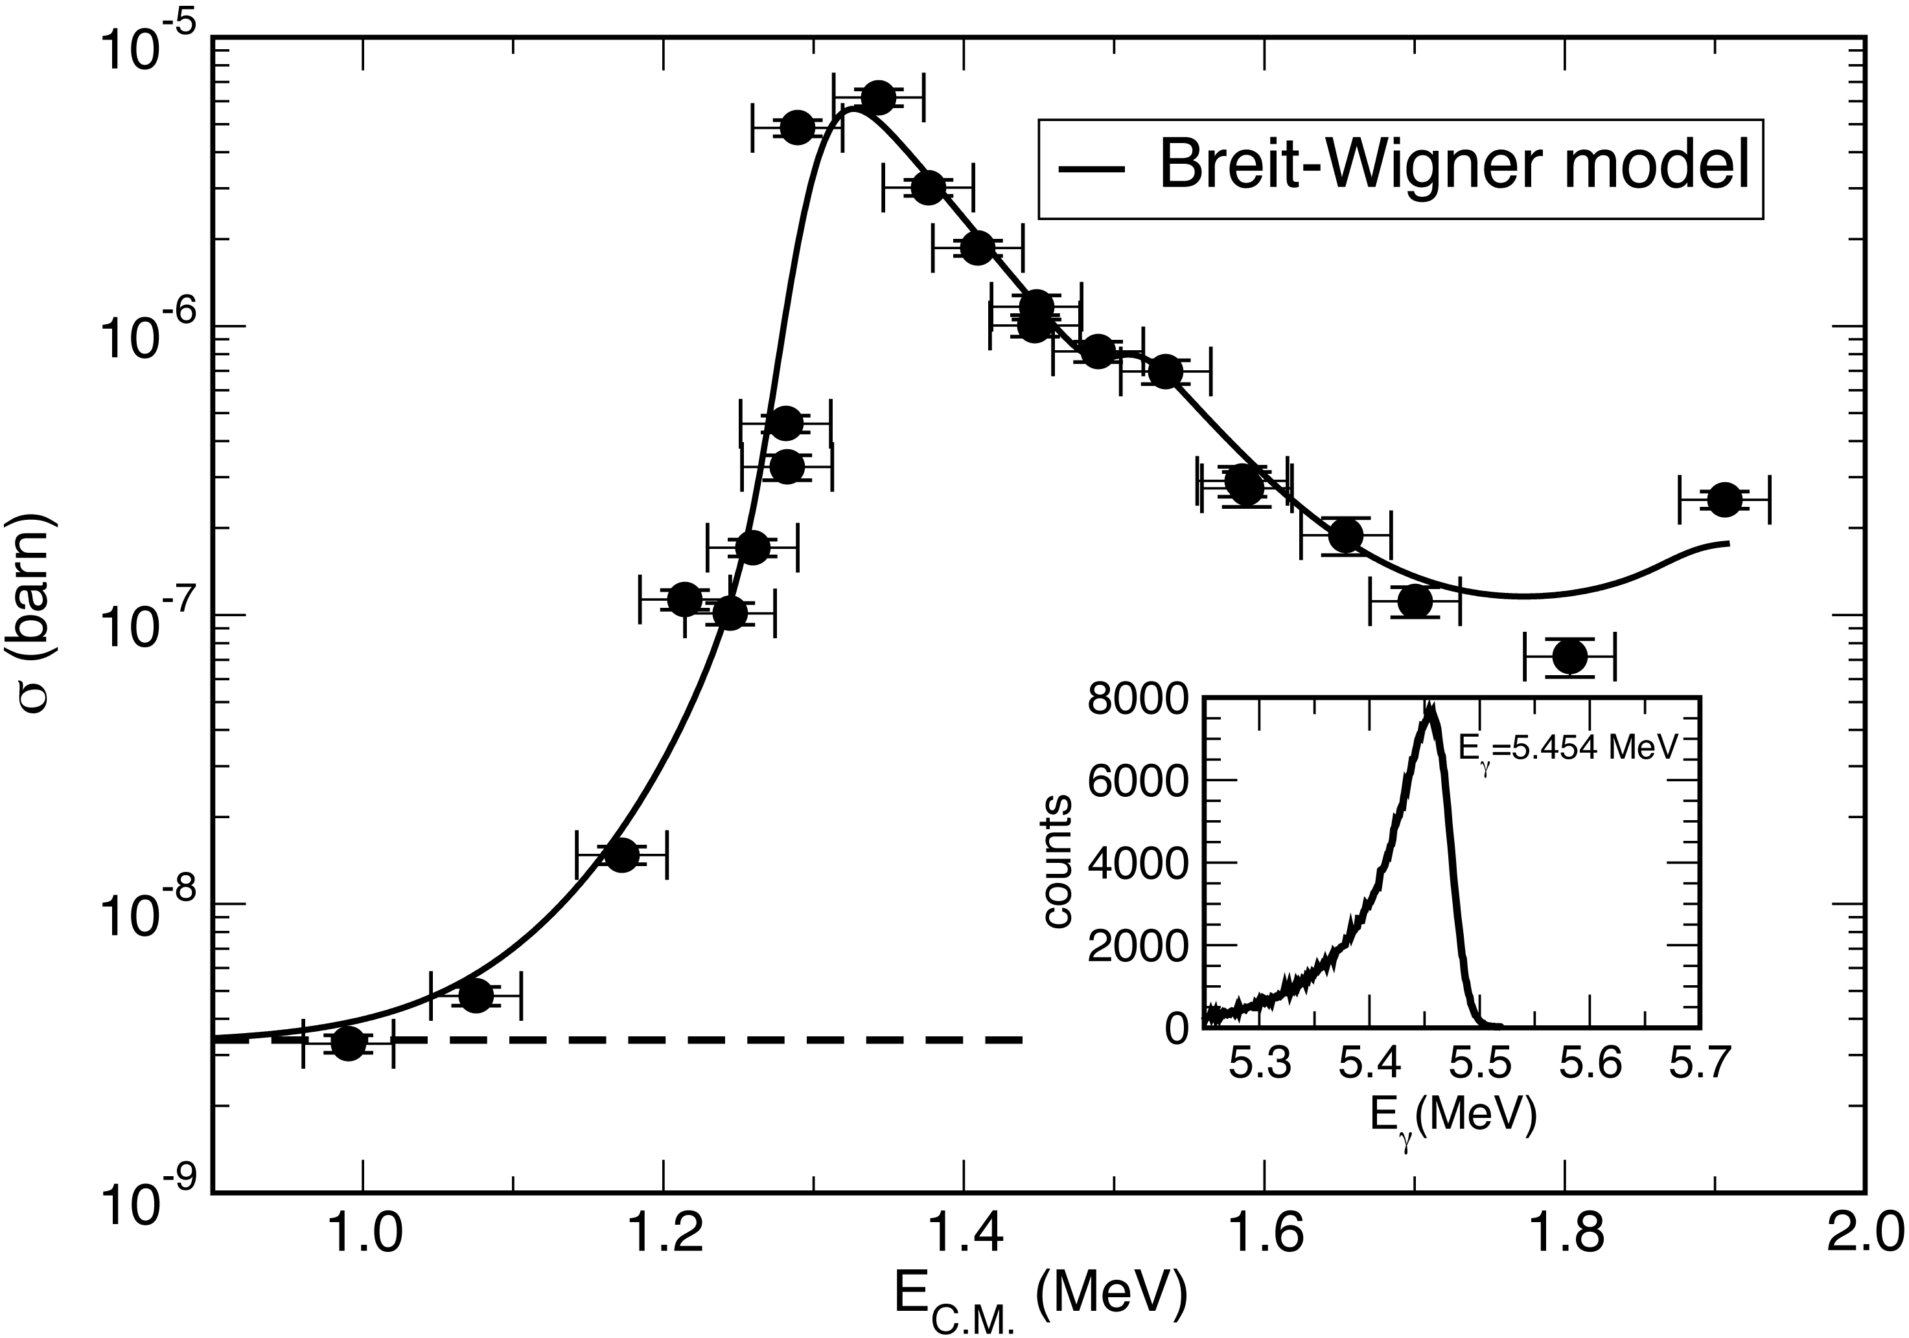
¹⁵N(α,γ₀)¹⁹F

Slide 15
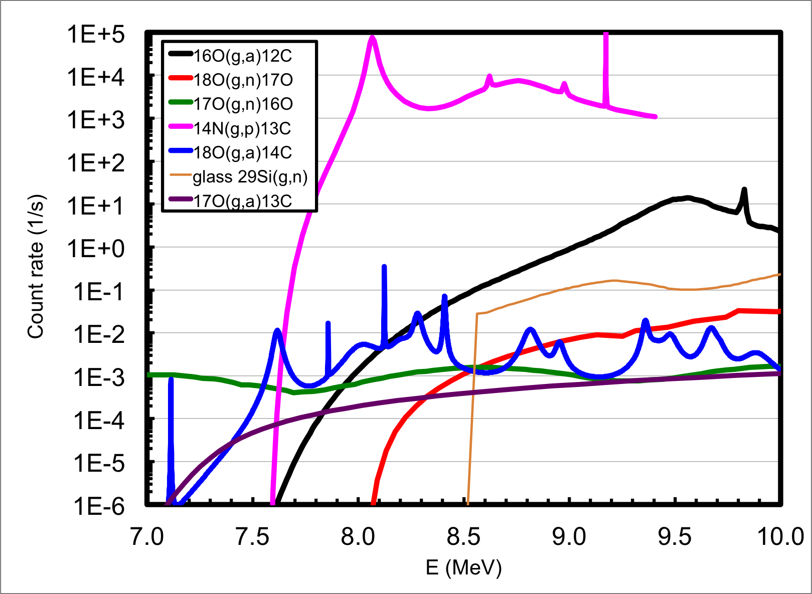
N₂O count rate contributions, Iγ = 1 x 10⁸ γ/s
L = 3.6 cm, x1000 depleted liquid

Slide 16
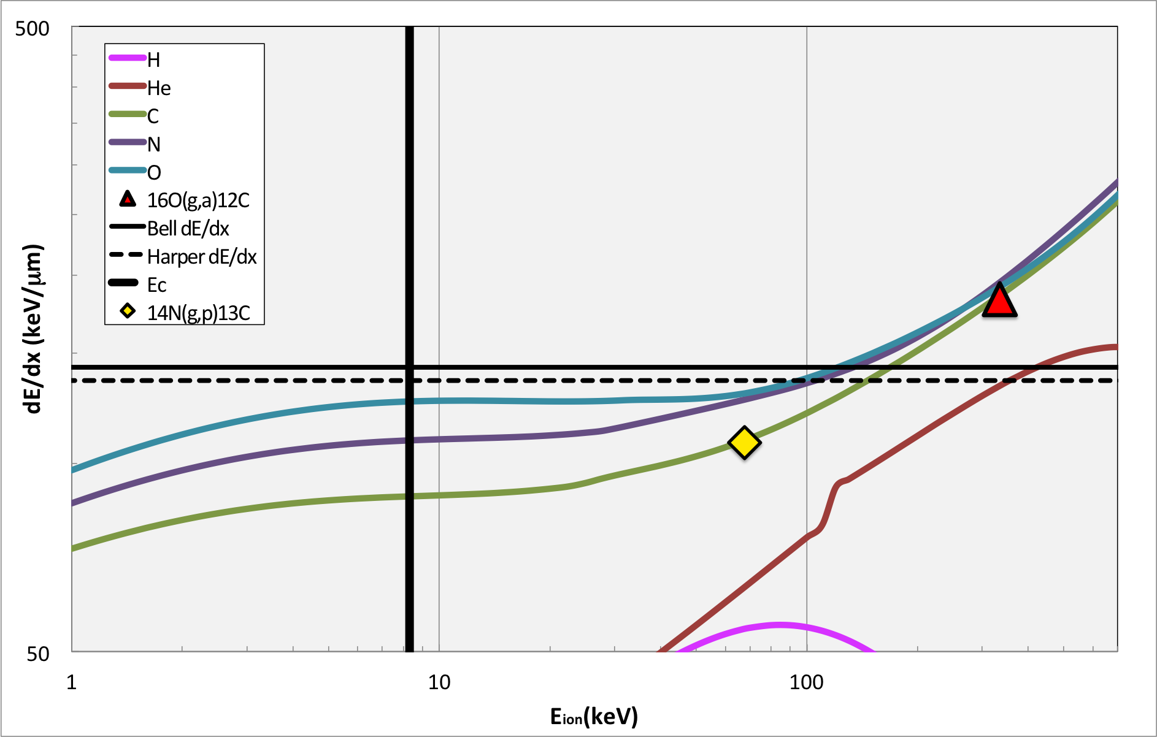
N₂O thresholds, Superheat = 3.3 ^{O}C, Eγ=8.5 MeV

Slide 17
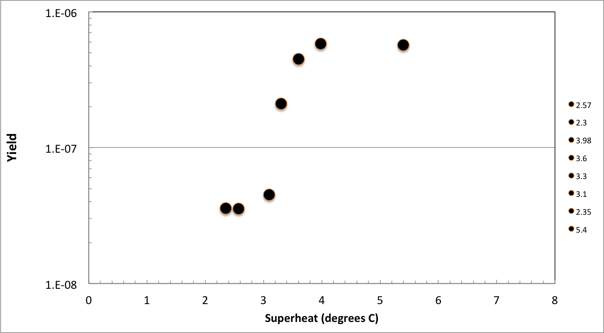
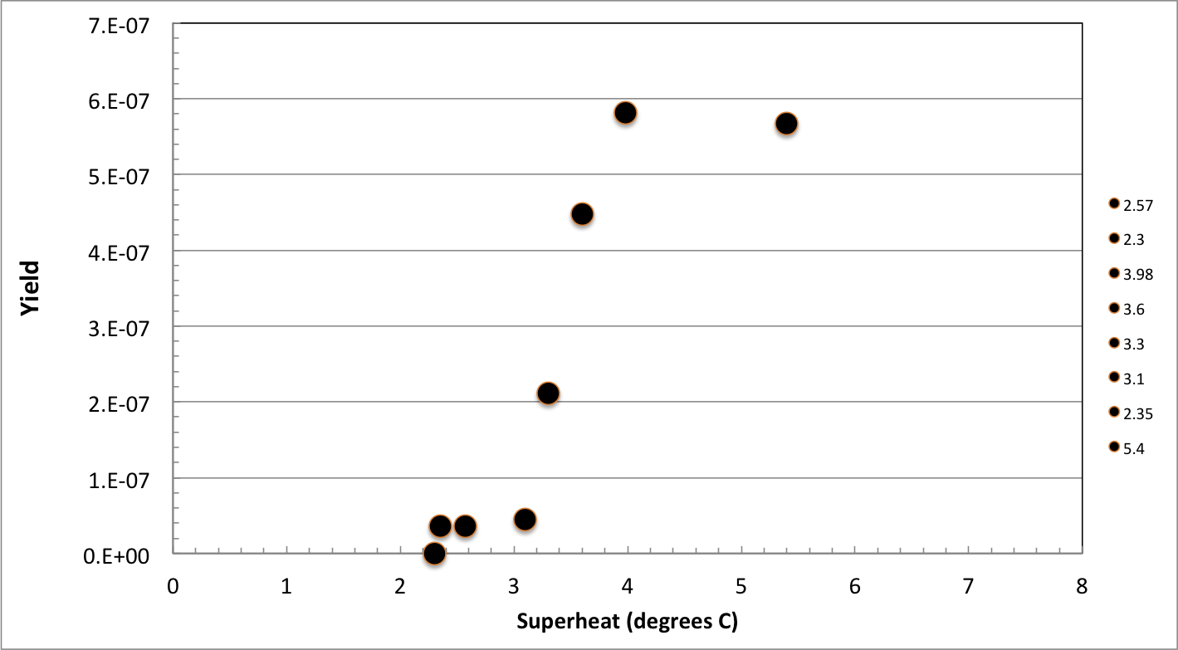
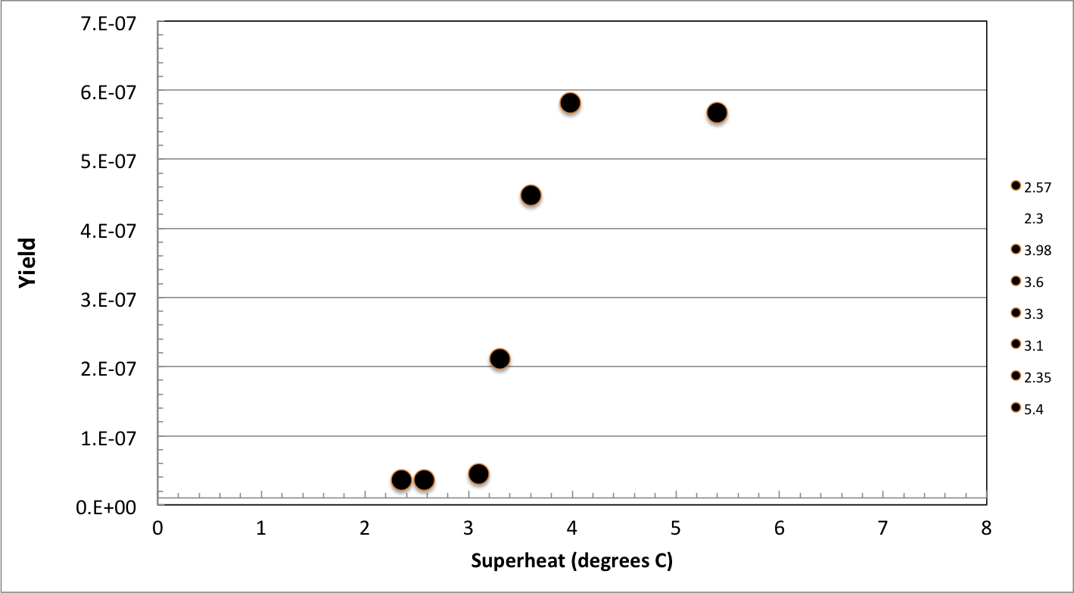
N₂O efficiency curve, HIγS April 2013. Eγ = 9.7MeV
γ+¹⁴N,
γ+¹⁶O
γ+¹⁶O

Slide 18
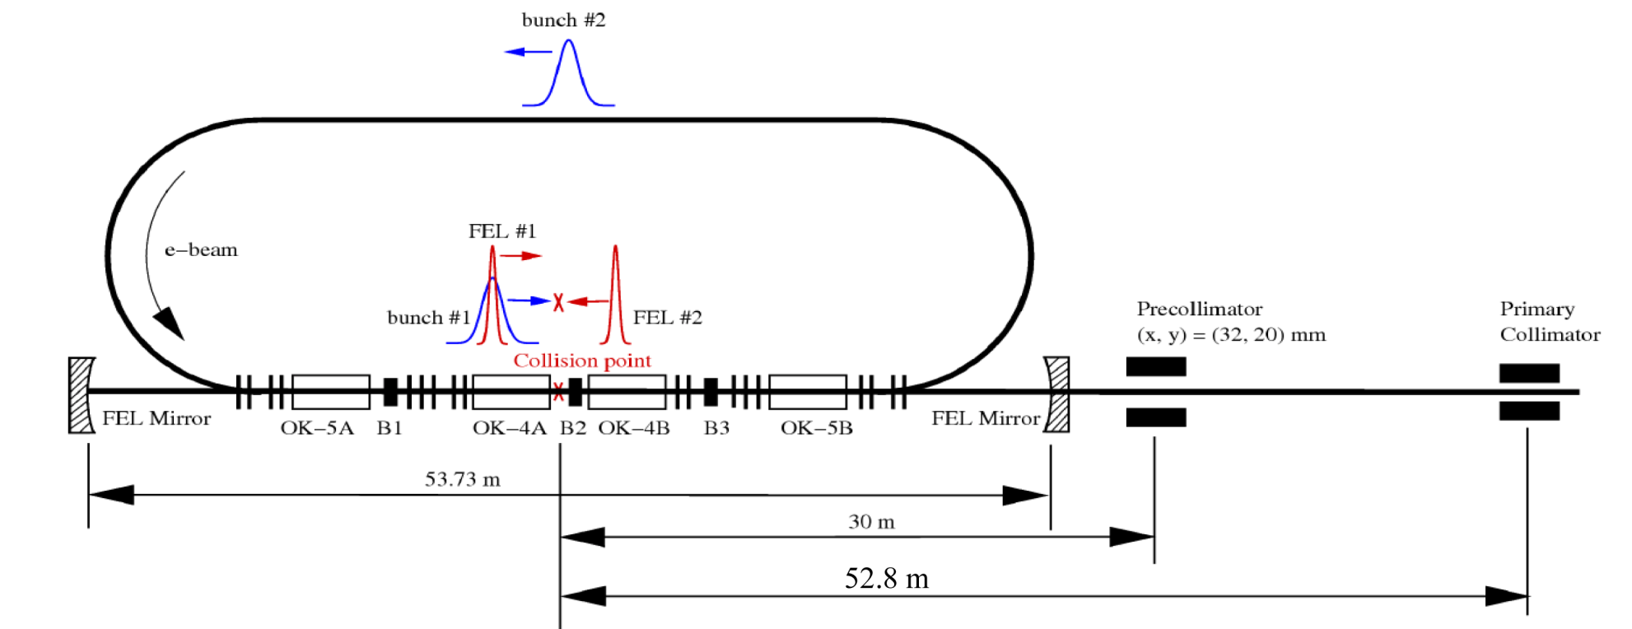
HIγS Photon Beam
Notes:
Bremsstrahlung -> go to JLab

Slide 19
¹⁵N(α,γ₀)¹⁹F

Slide 20
HIγS Photon Beam
E (electron) ~ 500 MeV, I_{e}=50mA
+
2 x10⁻¹⁰ torr vacuum
Notes:
Bremsstrahlung -> go to JLab

Slide 21



HIγS Photon Beam
E (electron) ~ 500 MeV, I_{e}=50mA
+
2 x10⁻¹⁰ torr vacuum
Strong Bremsstrahlung
background component
Notes:
Bremsstrahlung -> go to JLab

Slide 22
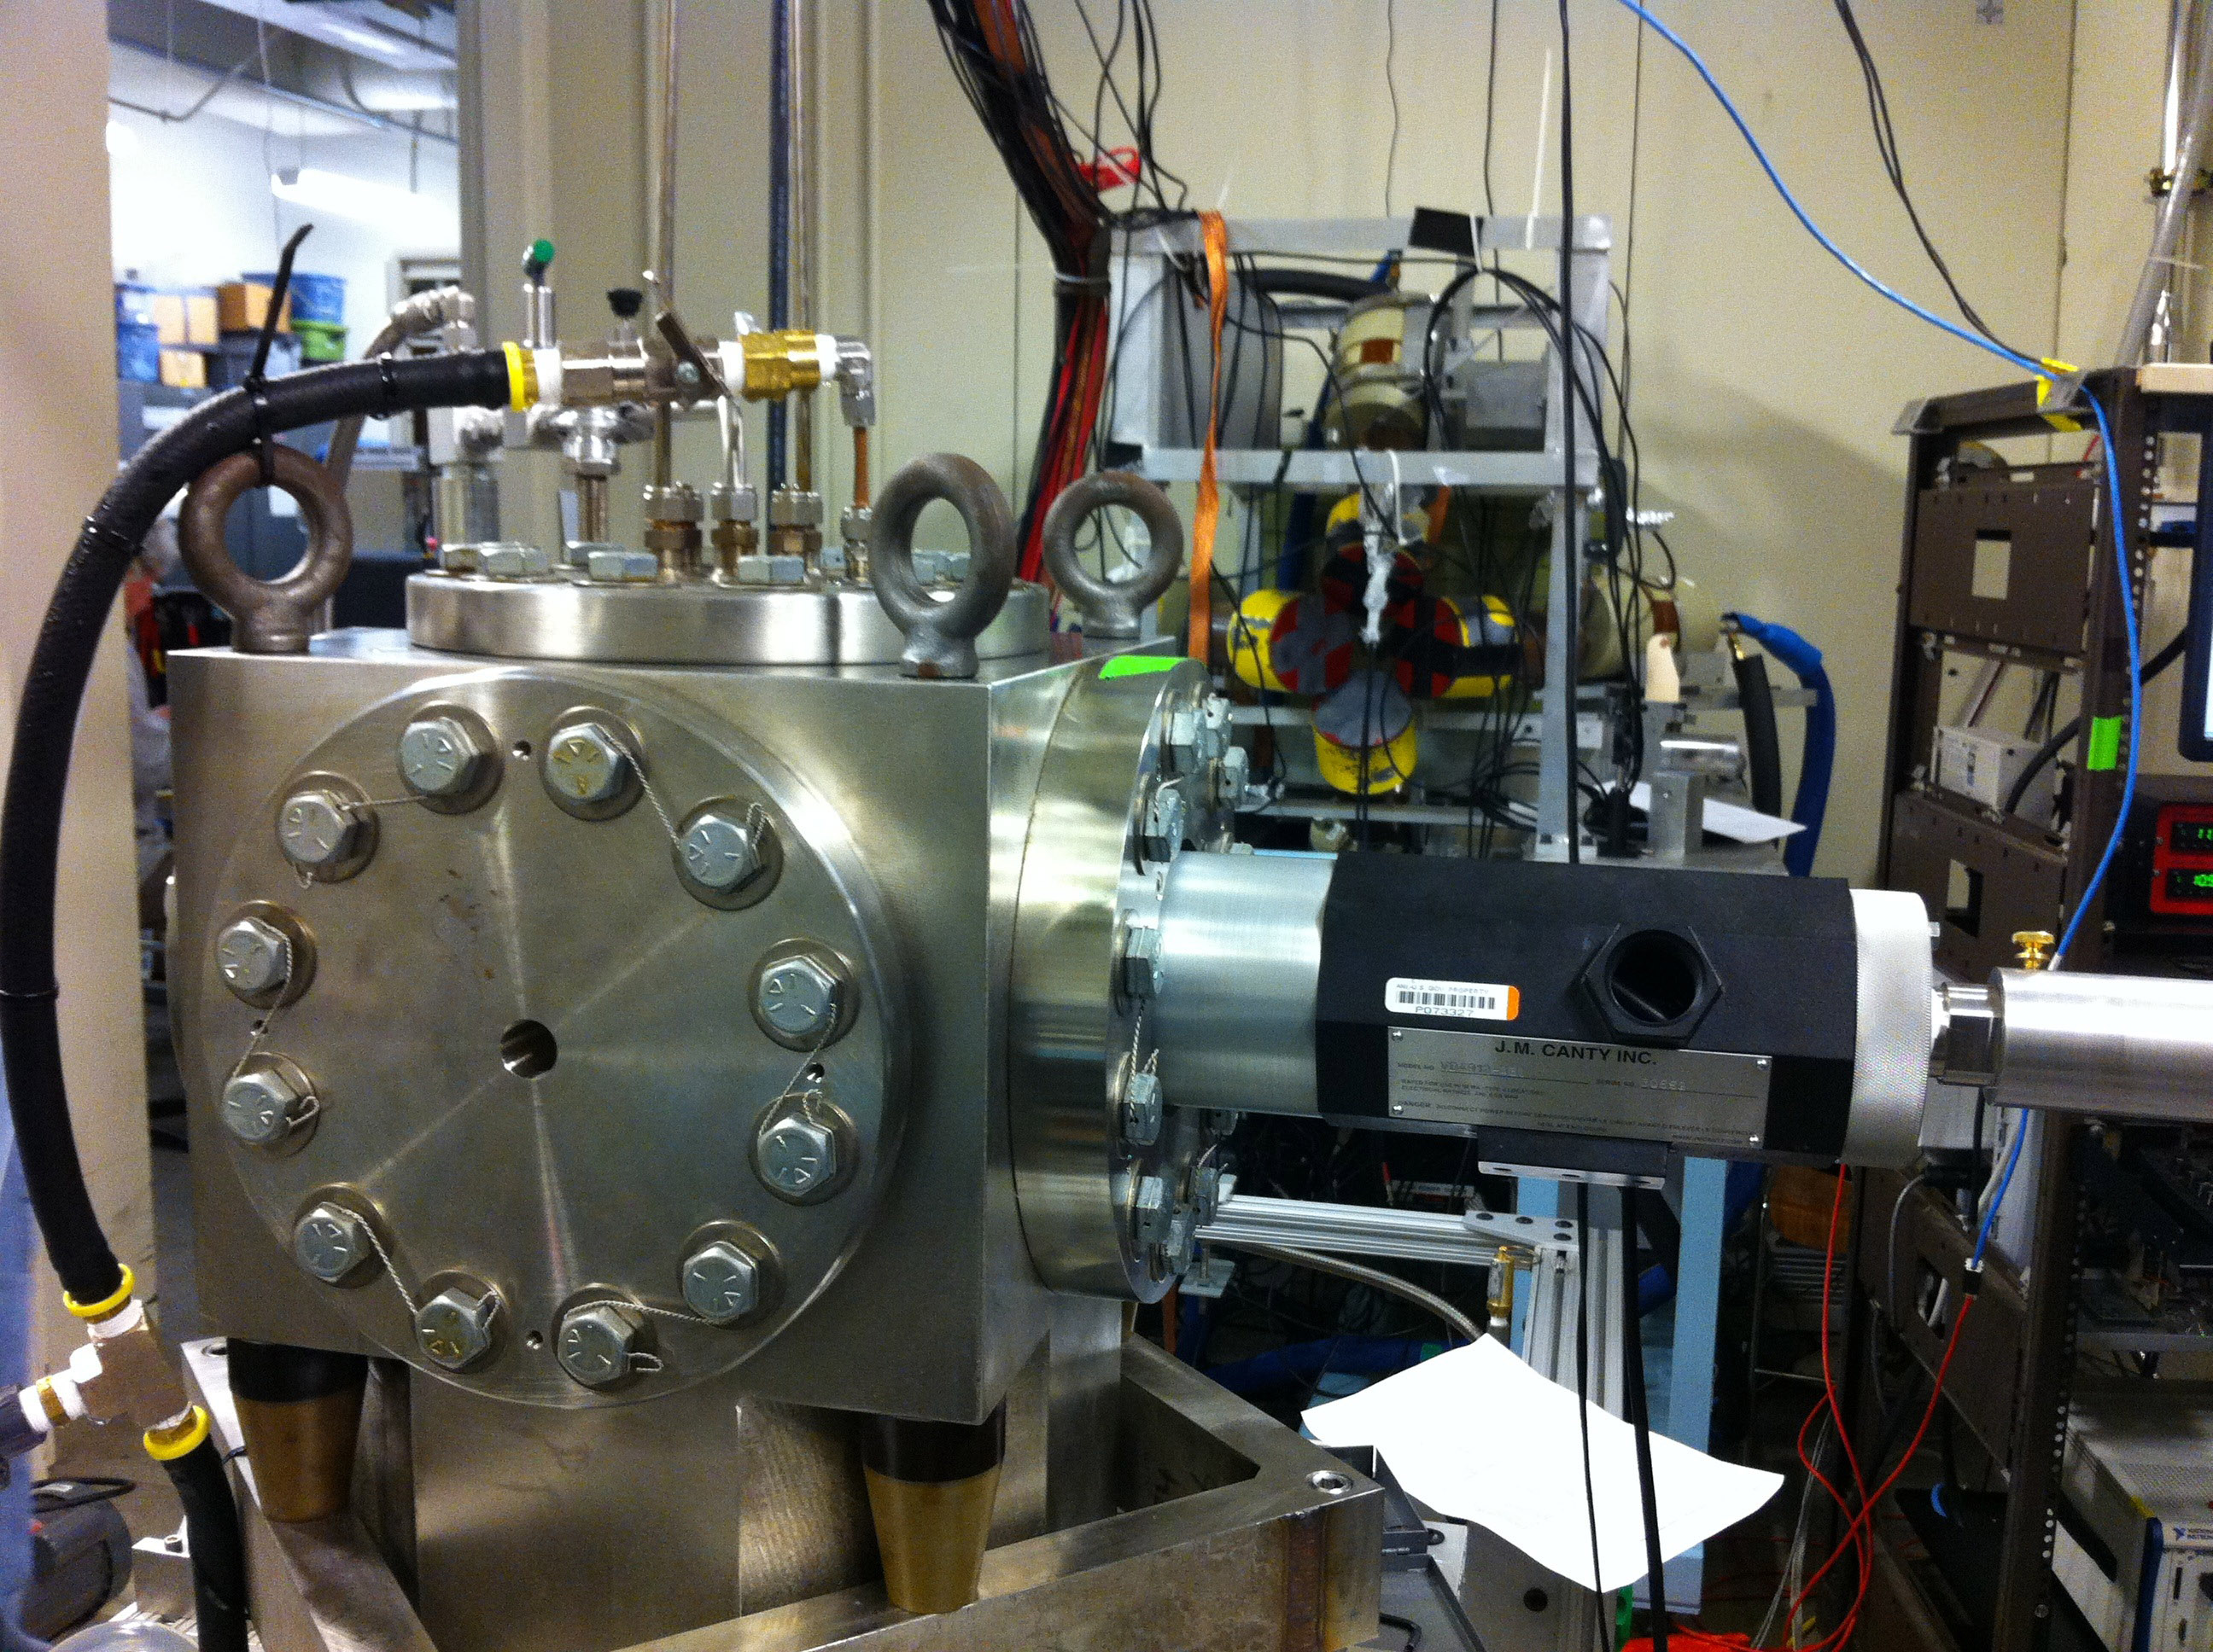
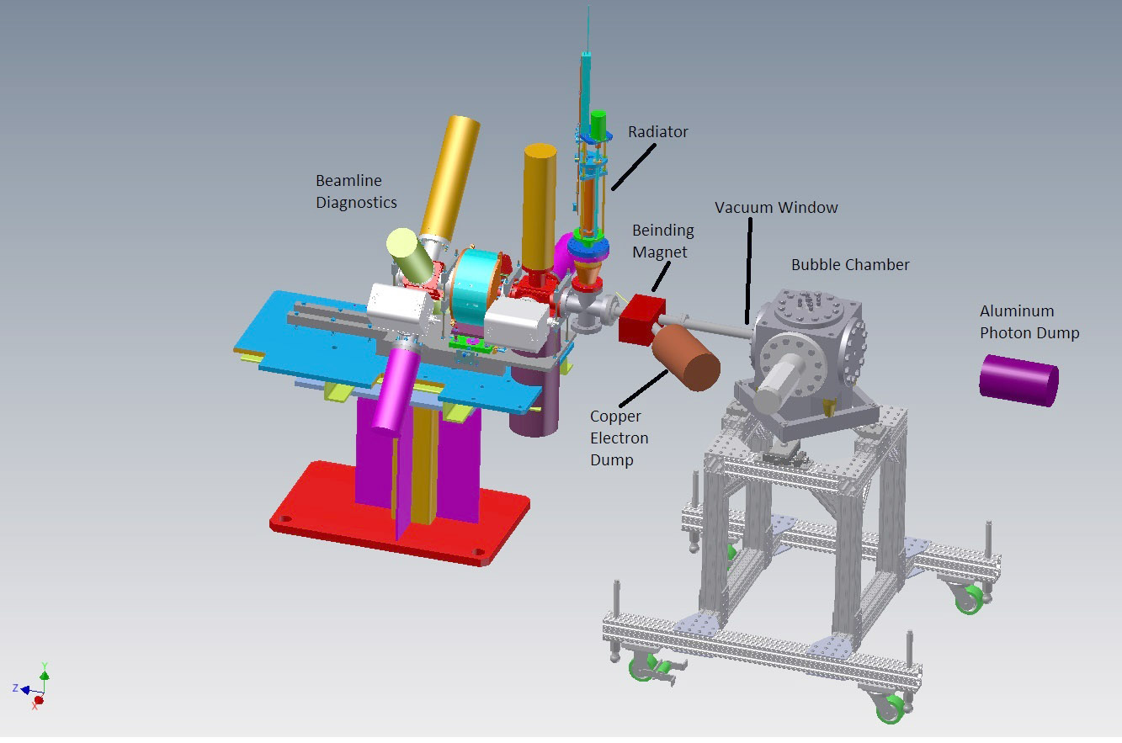
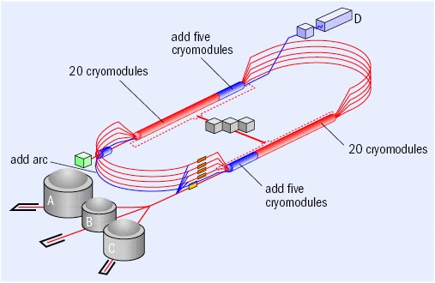
Bremsstrahlung beams at Jefferson Lab
Proposal approved by PAC40
Experimental setup
in construction (2014)

Slide 23
Experimental setup- Injector at JLab
Electron Beam
3.0 – 8.5 MeV
0.01 – 100 µA
Sweep Magnet
Al Photon Dump
10 cm long
20 cm diameter
Cu Vacuum Window 10 mil
Cu Radiator
0.02 mm
Cu Photon
Collimator
50 cm
50 cm
Cu Inner
Pipe
Al Beam Pipe
Bubble Chamber
Superheated N₂O
3 cm long
15°C, 60 atm
Cu Electron Dump

Slide 24
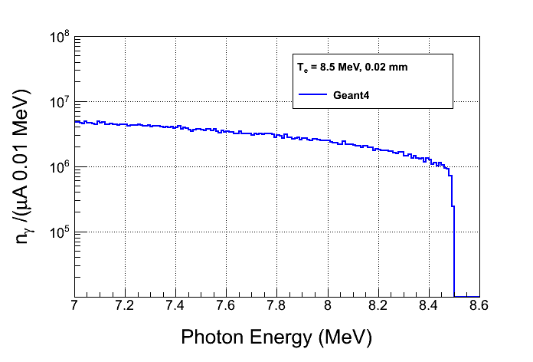

Slide 25
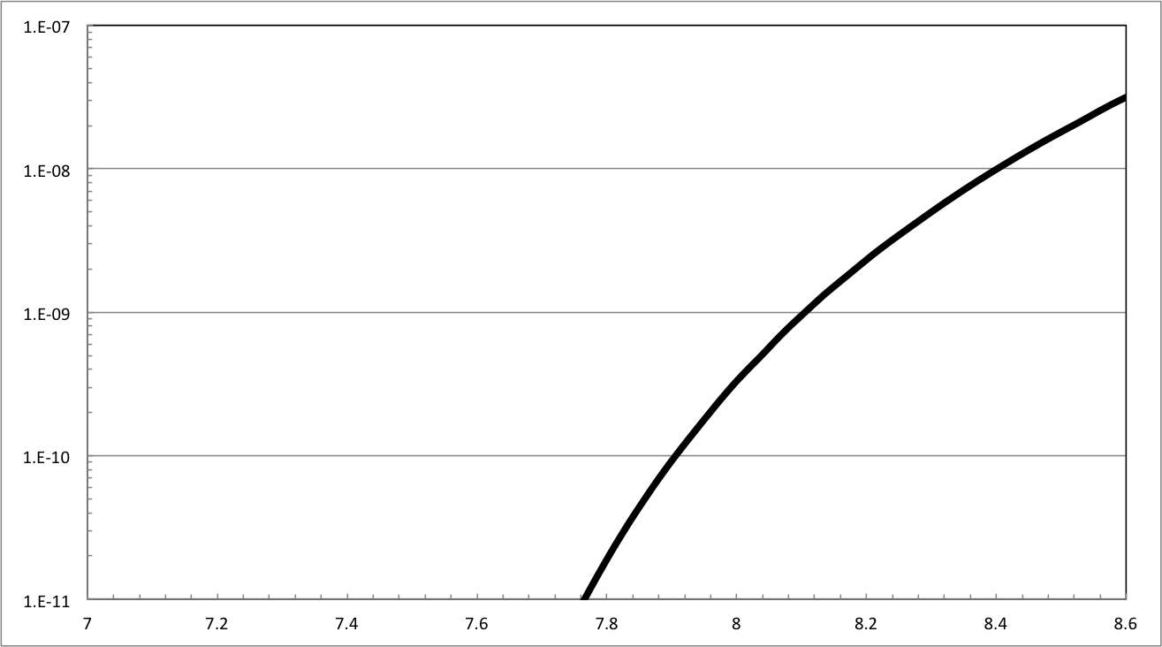
σ for ¹⁶O(γ,α)¹²C
Notes:
Mention unfolding

Slide 26
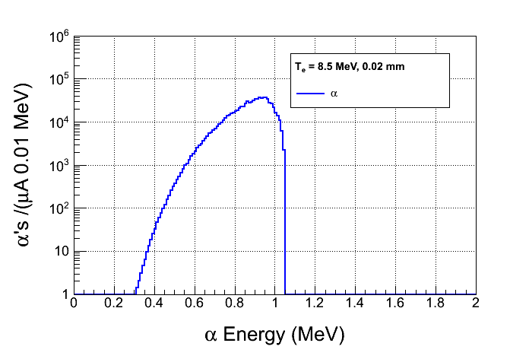
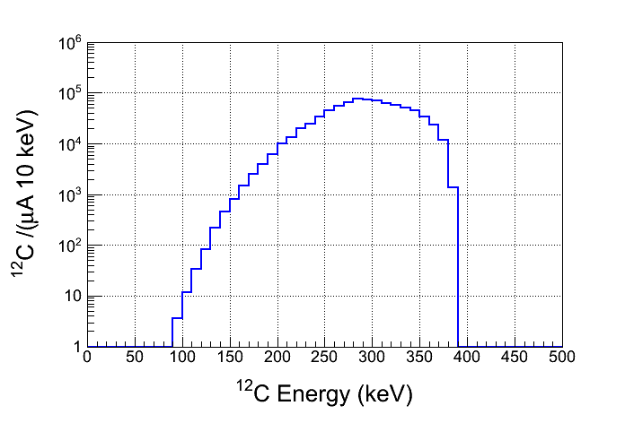
¹⁶O
¹²C
γ
α

Slide 27
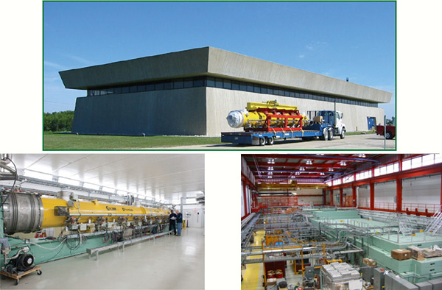

Advanced Superconducting Test Accelerator (ASTA)

Slide 28
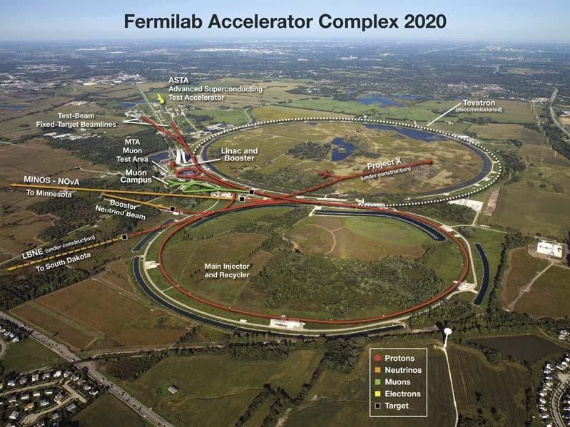

Slide 29
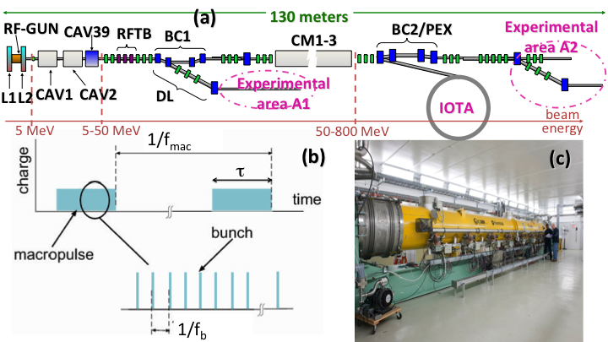
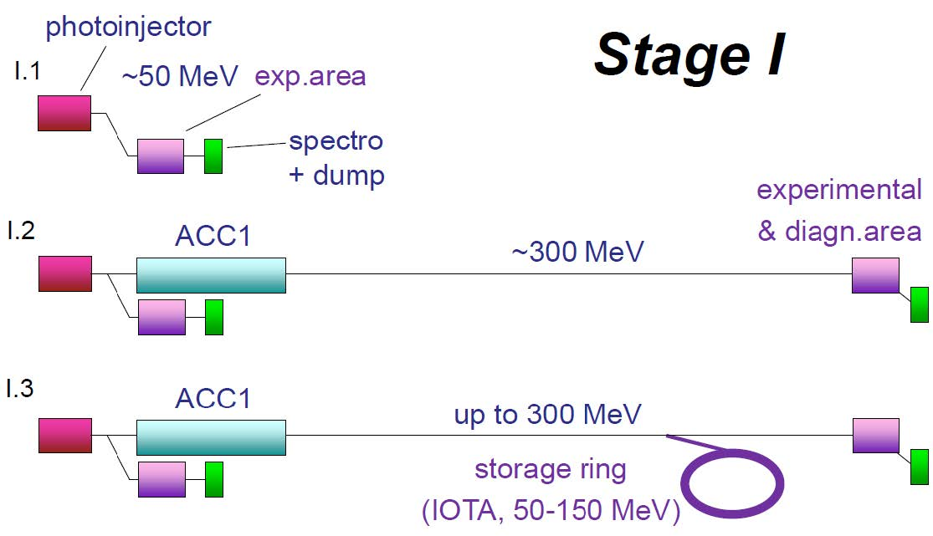
ASTA (Fermilab)
Accelerator physics R&D
Test-bed for superconducting RF accelerators
(ProjectX, ILC, FRIB)
Electron beams Ee = 0.8-1.5 GeV
High repetition rate, high average power
Exceptional beam stability
Small storage ring (IOTA)
ICS proposal submitted.

Slide 30
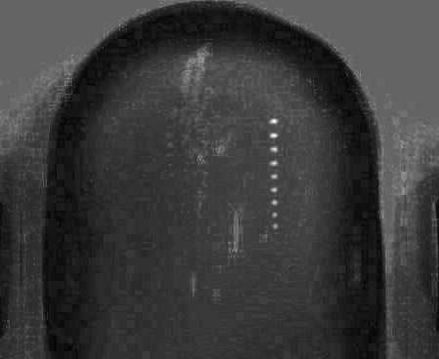
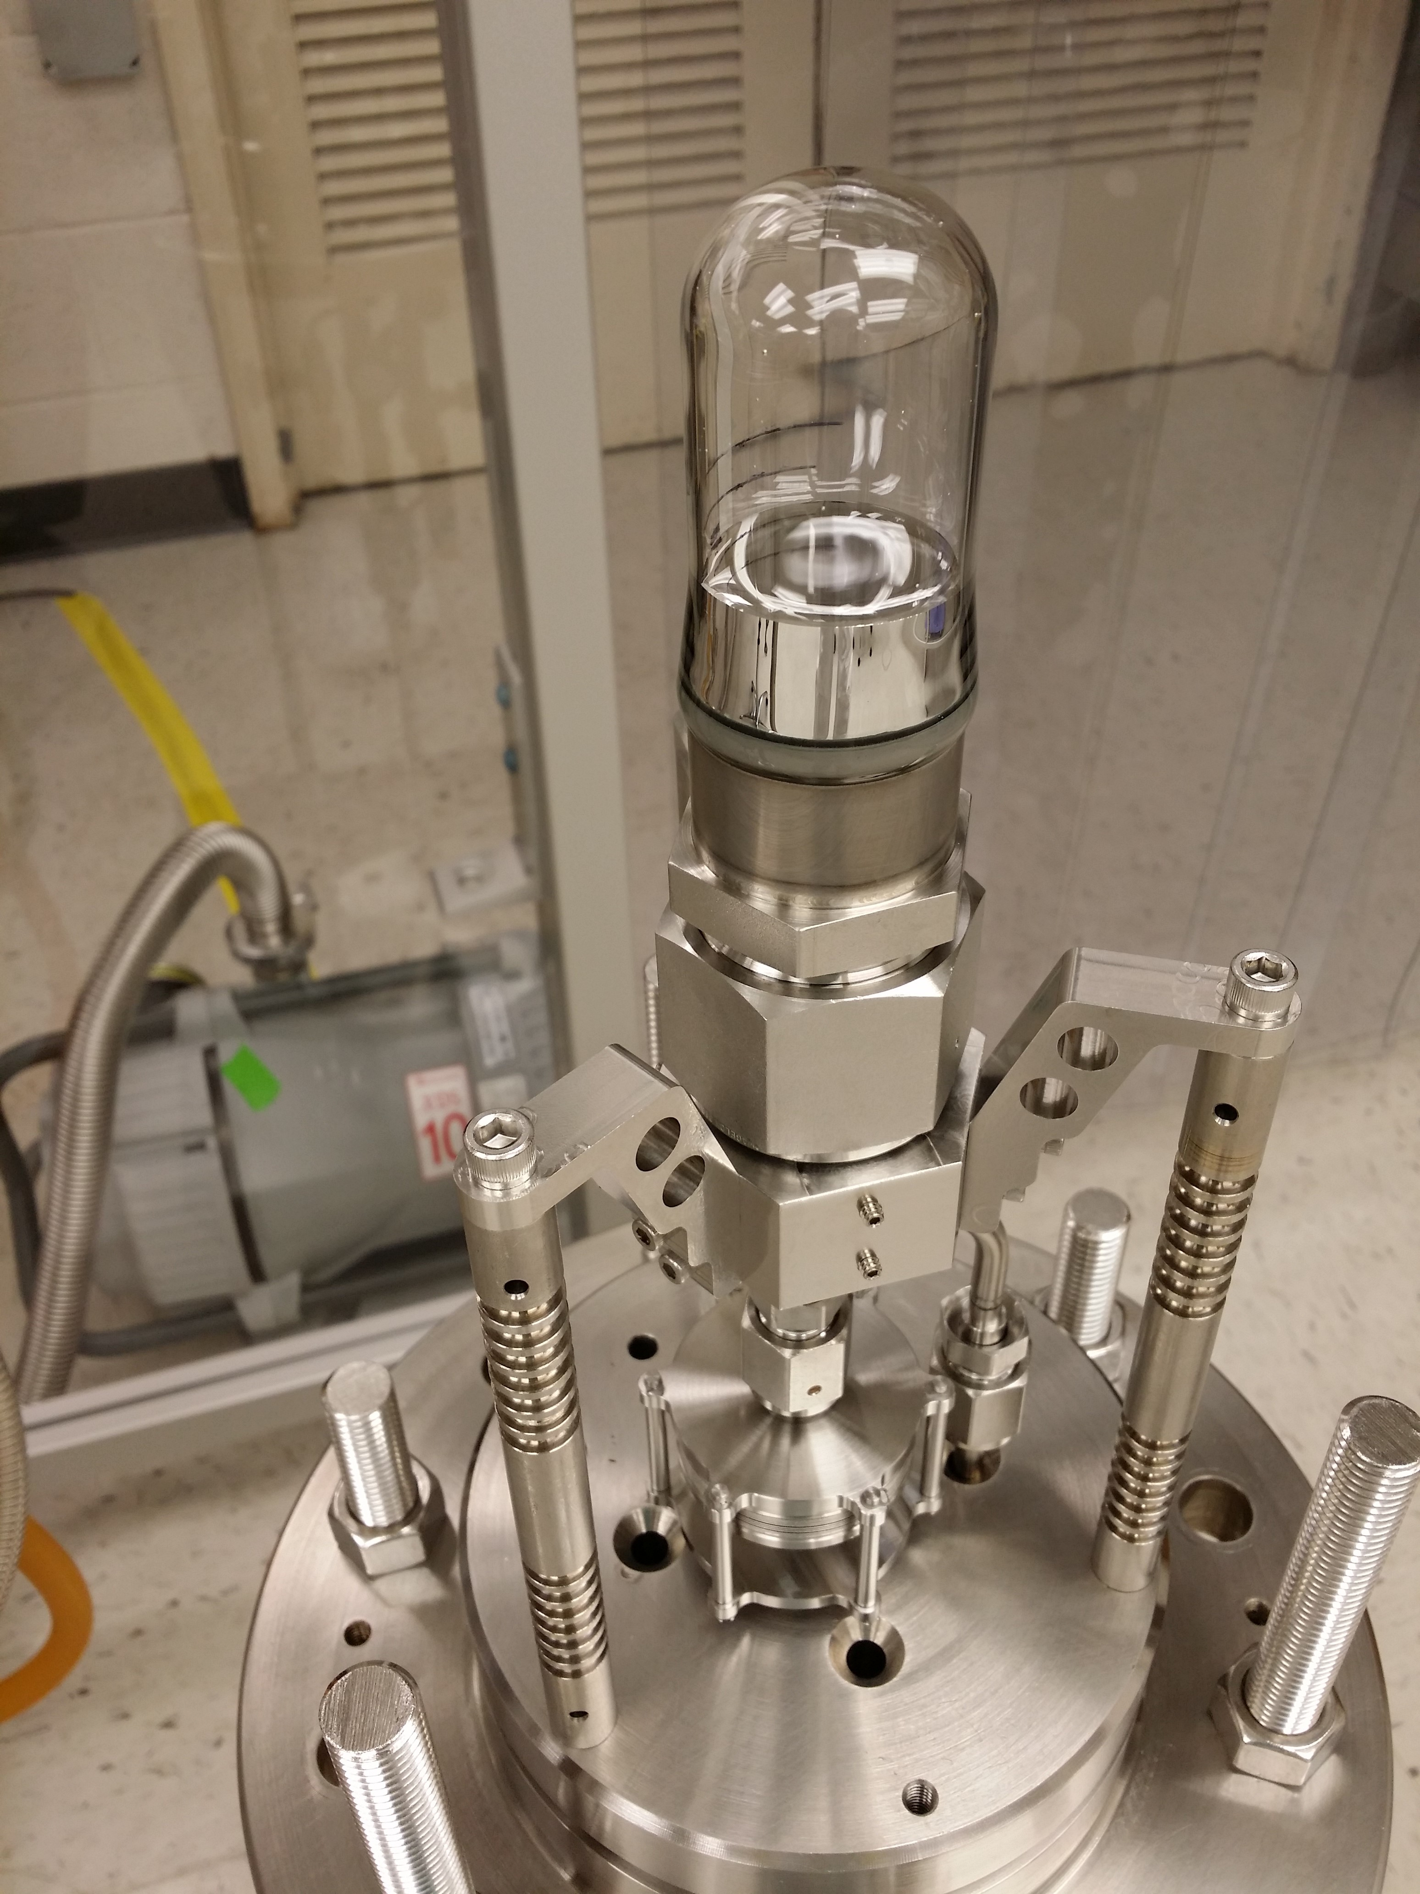
N₂O (water as buffer fluid)
First γ + oxygen -> alpha + carbon bubble
April 2013
Challenges:
2 fluid bubble chamber requires liquids to be immiscible
Buffer fluid needs to be able to wet glass
Courtesy of B. DiGiovine

Slide 31
Outlook
(values in the Gamow window ~1x10⁻¹⁷ barn), Ecm = 300 keV, Eγ=7.5 MeV
DIANA + JENSA (DUSEL)
N1= 1x10¹⁹ helium particles gas target
N2= 10 mA =6.24 x 10¹⁶ carbon part/s
in 1 year
N1 N2 = 1.97 x 10⁴³
Yield = 200 events in one year
Kunz 2001
N1= 2x10¹⁸ Carbon implanted particles
N2= 0.5 mA = 3.12 x 10¹⁵ α-particles/s
in 1 year
N1 N2 = 1.97 x 10⁴¹
Yield = 2 events in one year
LUNA-MV (Gran Sasso)
N1= 2x10¹⁸ Carbon implanted particles
N2= 0.5 mA = 3.12 x 10¹⁵ α-particles/s
in 1 year
N1 N2 = 1.97 x 10⁴¹
Yield = 2 events in one year
Bubble + HIγS2
N1= 3.35x10²³ particles in liquid target
N2= 2 x 10¹⁰ γ/s
in 1 year
N1 N2 = 2.11 x 10⁴¹
Reciprocity -> x100
Yield = 200 events in one year

Slide 32
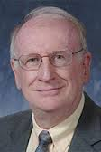
Conclusions
We have provided a proof of principle of operation of the bubble chamber as a LOW RATE COUNTER. This is ideal for nuclear astrophysics applications.
Inverse Compton beam: Bremsstrahlung from the electrons in the ring manifests mainly as neutrons. Particle ID would help separating these events from the α-particle + heavy ion signal.
Bremsstrahlung beam: Infrastructure in place. First experiments early 2015.
Electron beam energy needs excellent determination.
Main challenges:
Maximize beam intensity at lowest energies
Minimize beam bandwidth (or beam end point dispersion)
Maximize level of depletion of heavy oxygen in liquid
Need excellent characterization of γ-ray beam
Thanks, Roy!

Slide 34
ASTA ICS (Fermilab)

Slide 35
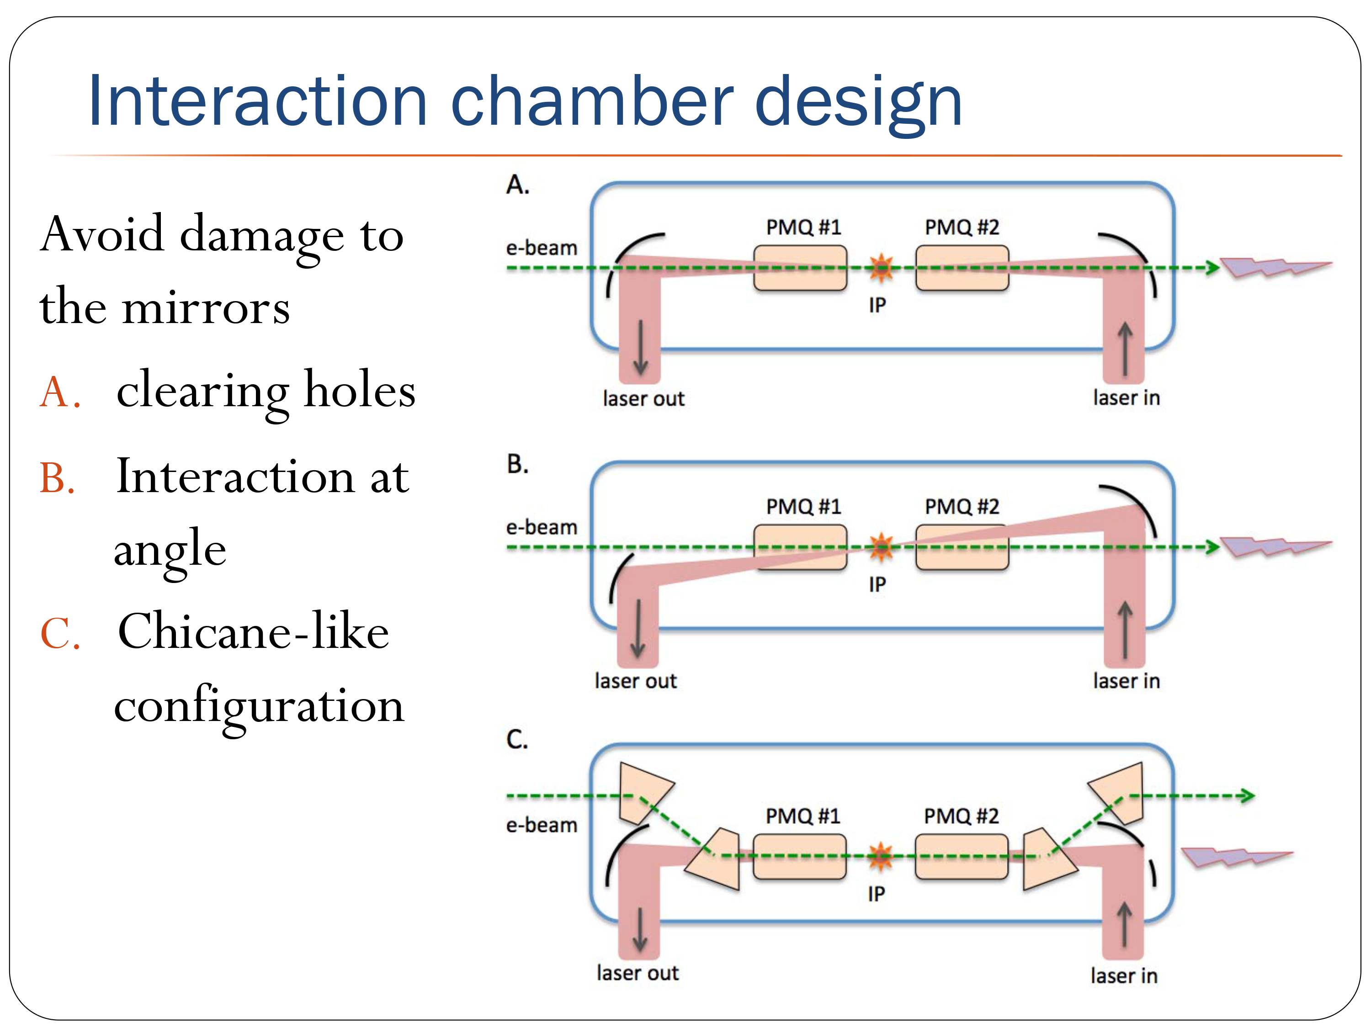
Alex Murokh, 2013

Slide 36
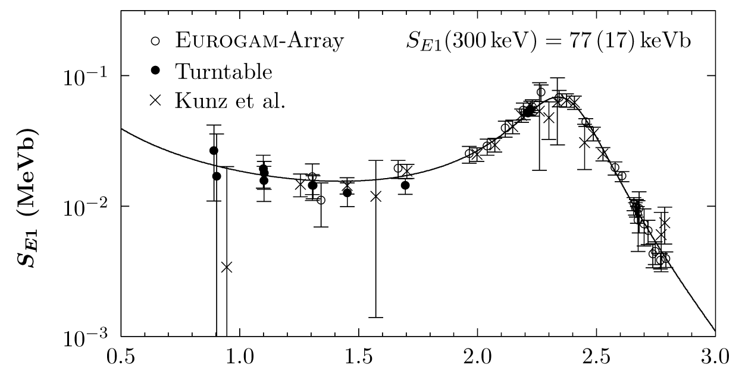
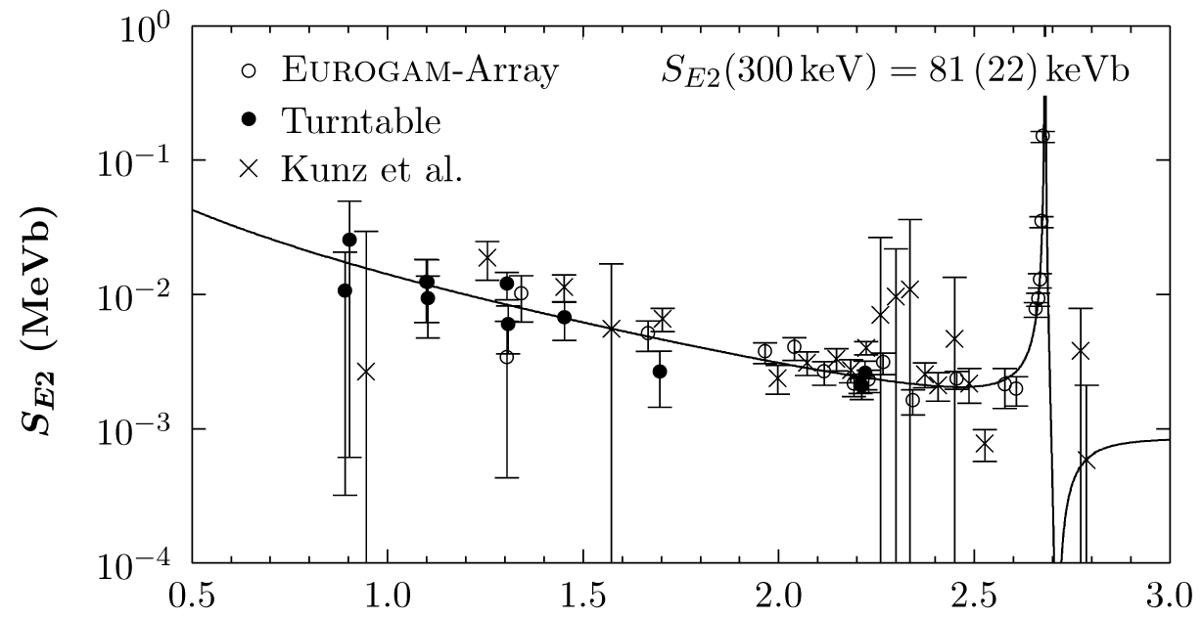

Slide 37
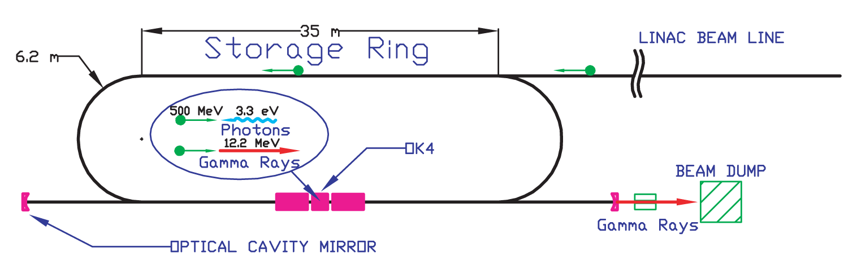
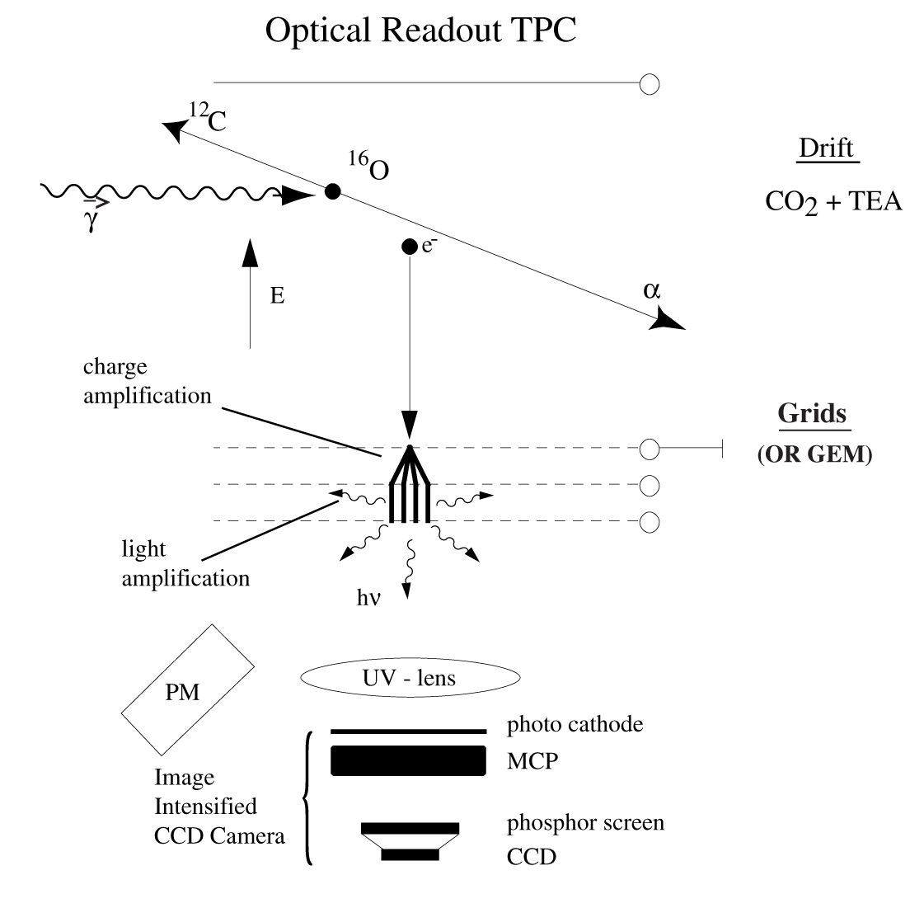
Gai (Avery Point)
beam
target
signal
signal
γ + ¹⁶O --> ¹²C + α
1 x 10⁸ γ ray beam, HIγS
CO₂ + C₆H₁₅N (triethylamine) active gas target

Slide 38
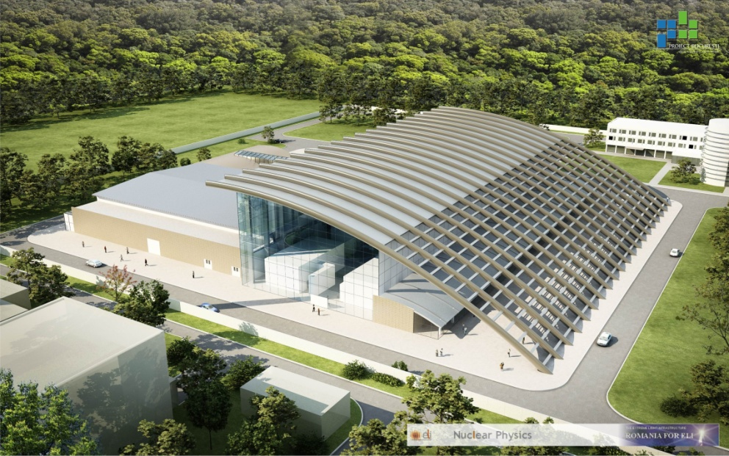
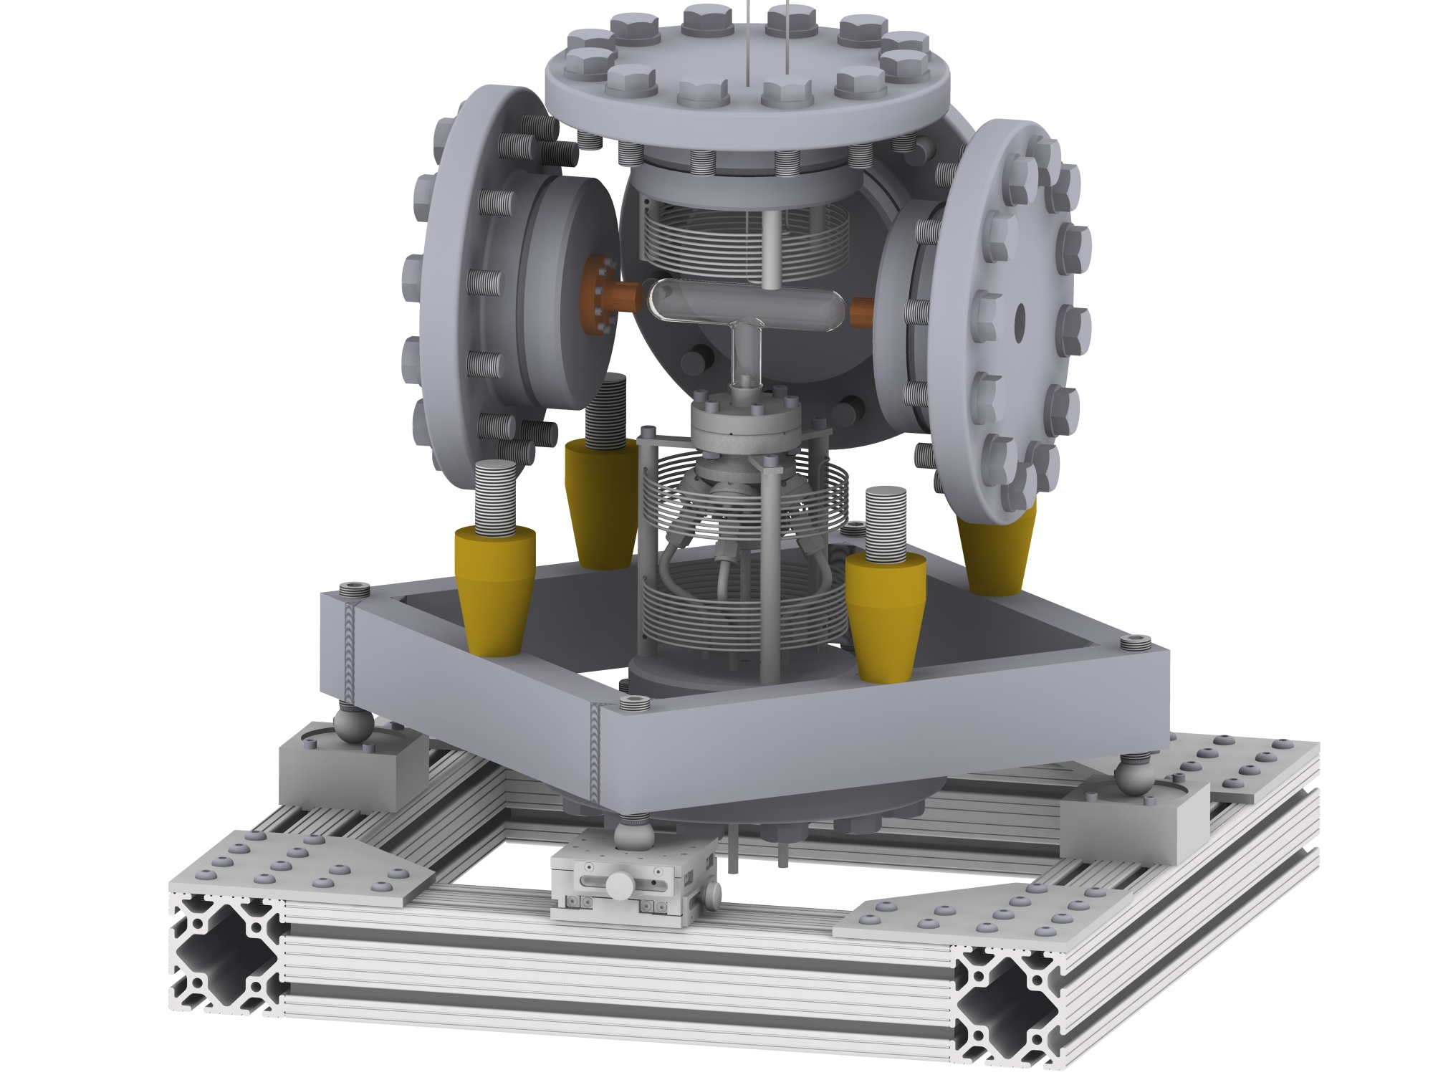

ELI-NP
Romania 2017
V. Zamfir 2011
Bubble + ELI-NP (Phase 1)
N1= 3.35x10²³ particles in liquid target
N2= 1 x 10¹³ γ/s
in 1 year
N1 N2 = 2.11 x 10⁴⁴
Reciprocity -> x100
Yield = 200,000 events in one year
Phase 1
Very intense (10¹³ γ/s), brilliant γ-ray beam, 0.1 % bandwidth, with E= 19 MeV
Phase 2 (2018-2020) -> 10¹⁵ γ/s

Slide 39
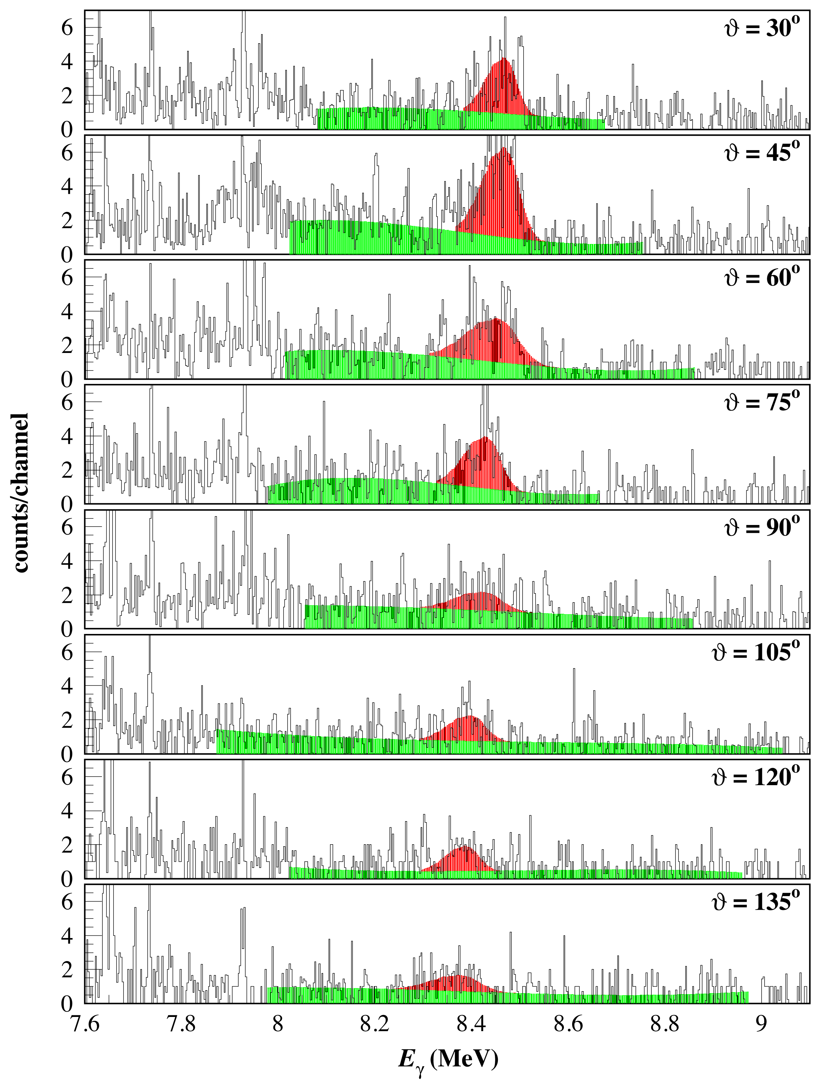
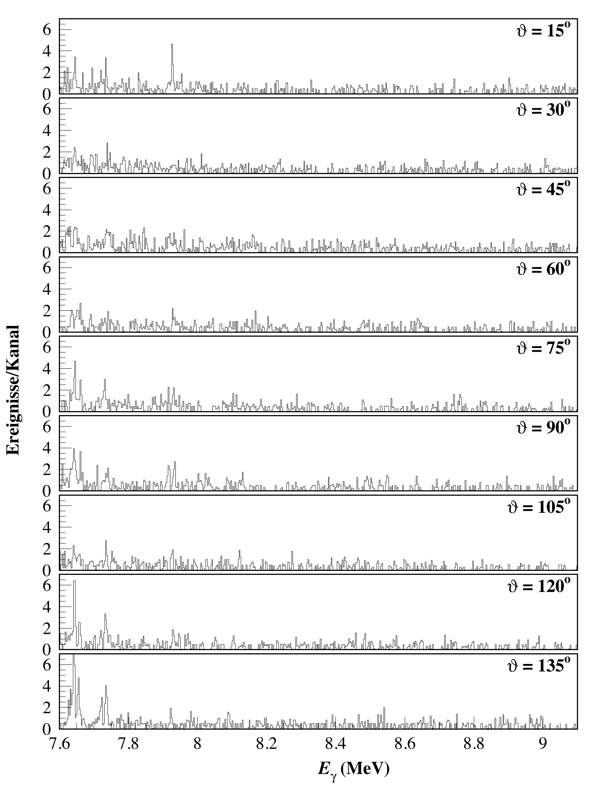
E=1.254 MeV
E=0.945 MeV

Slide 40



Acoustic signals (STAR at Duke)

Slide 41

Kyushu (Japan)
beam
target
signal
¹²C + α --> ¹⁶O + γ
10 MV Tandem, 15 pμA ¹²C beam
Pulsed beam
⁴He windowless gas target
Detection of ¹⁶O (one charged state)
Recoil separator
Target took 15 years to develop
24 torr, 4.5 cm thick (world record)
5 counts/day @ Ecm=0.7 MeV
BG reduction 10¹⁶ so far (need x1000 better)

Slide 42

Shanghai
beam
target
signal
signal
γ + ¹⁶O --> ¹²C + α
γ ray beam, Shanghai Laser Electron Gamma Source (SLEGS)
Polarized photons
3.5 GeV electron beam
Light source CO₂ laser @10 kW
Beam flux 5 x 10⁸ γ/s @ 2% resolution
Time projection chamber (???)
Could measure E=0.8 MeV with 20-30% uncertainty

Slide 43


St. George (Notre Dame)
beam
target
signal
signal
¹²C + α --> ¹⁶O + γ
Couder 2008
Kontos 2012
Recoil mass separator
Time of flight capabilities
5 MV vertical accelerator
Windowless gas target (HIPPO) @ 2.7x10¹⁷ atoms/cm², 2.1 mm
High beam currents (< 10 mA)
Array of Ge detectors in close geometry

Slide 44

Erna (Caserta)
beam
target
signal
signal
¹²C + α --> ¹⁶O + γ
Di Leva 2008
Recoil mass separator
Time of flight capabilities
3 MV Pelletron
Windowless gas target 4x10¹⁷ atoms/cm²

Slide 45

DIANA (DUSEL)
target
beam
signal
α + ¹²C --> ¹⁶O + γ
Deep Underground facility
Ultra high density gas target (JENSA collaboration)
High beam currents ( ~10 mA)
Array of Ge detectors in close geometry

Slide 46


First HIγS experiment and ¹⁹F(γ,α)¹⁵N

Slide 47



Water bubble chamber
L~ 10cm
γ beam
P~75 atm
T=250 C
Courtesy of B. DiGiovine
47
47

Slide 48

Astrophysical S-factor for ¹²C(α,γ)¹⁶O
Stellar helium burning at E=300 keV
S = E σ exp(2πη)
Author | S(300keV) (keV-b)
Buchmann (2005) | 102-198
Caughlan and Fowler (1988) | 120-220
Hammer (2005) | 162+-39

Slide 49

Statistical error bars
Notes:
The statistical error bars listed in the proposal and shown in the figures do not include the background subtraction. When we do background subtraction of 18O with depletion = 5000, then the statistical error bars will be 18-7% as the beam energy is increased. So for the lowest beam energy, where we spend most of the beam time (100 hours), the statistical error (17%) is comparable to the systematic error (29%).

Slide 50


Slide 51


From experiments
N₂
N₁
Yield
Yield ~ N₁N₂σg
g = ε *(1-bkgd/signal)
0 < g < 1

Slide 52


S(300)
Kunz 2001, Matei 2006

