Slide 1
Precision Measurements with Free Neutrons
Why am I here?
What’s Roy got to do with it?
What’s the physics?
  Polarized Neutron Beta-decay Asymmetry
    UCNA
  Neutron Electric Dipole Moment (EDM)
    nEDM
Brad Filippone
Heart of Matter
9/26/14

Slide 2
My Interactions with RJH
As a Grad Student at Argonne
  wrong floor, wrong wing, wrong physics
As a collaborator
  I finally switched to the right physics
  SLAC exps. (NE1,2,3,4,5,6,7,8,9…???)
  JLAB exps. (E8x, E9x, …)
  HERMES
  But then I switched to precision neutron exps… (no more Roy?)

Slide 3
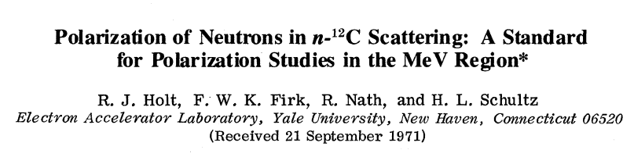
RJH + precision polarized neutron exps.
  Roy can’t say no to a review committee
    UCNA Technical Review - 11/2002
    NSAC Review of Fundamental Neutron Physics - 4/2003
    Neutron EDM (nEDM) Annual Review - 8/2007
    nEDM Annual Review - 3/2010
    nEDM Annual Review - 12/2013
  Also Roy’s early work with polarized neutrons
Roy keeps us on the straight & narrow path

Slide 4
In Addition → Roy is part of the ²²⁵Ra EDM exp.
Like nEDM, ²²⁵Ra also looking for hadronic EDM
²²⁵Ra is way ahead of the neutron EDM experiment
But Roy is helping nEDM catch up

Slide 5
Priorities of NSAC subcommittee on Fundamental Physics with Neutrons (2011) (How did Roy miss this one?)
I. The search for a neutron electric dipole moment with the nEDM
Experiment
II. Continuation of the UCNA experiment to obtain improved precision on λ, the ratio of the weak axial-vector to vector charge of the neutron
III. Completion of the NPDGamma experiment to obtain a precision
measurement of the weak isovector nucleon‐nucleon pion coupling constant
IV. Investment in the Nab apparatus with the main goal to determine λ to unprecedented precision using a complementary observable
V. Continuation of the NIST-hosted experiment to perform the most
precise cold beam-based measurement of the neutron lifetime

Slide 6
Discuss UCNA first
UCNA = Ultra-Cold Neutron Asymmetry experiment

Slide 7
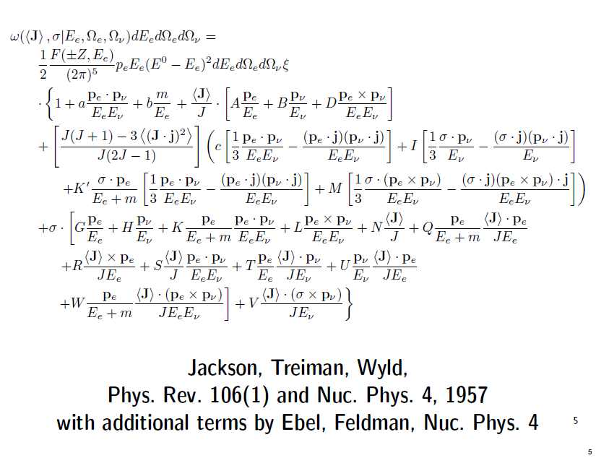
Neutron Decay Rate
A-correlation

Slide 8
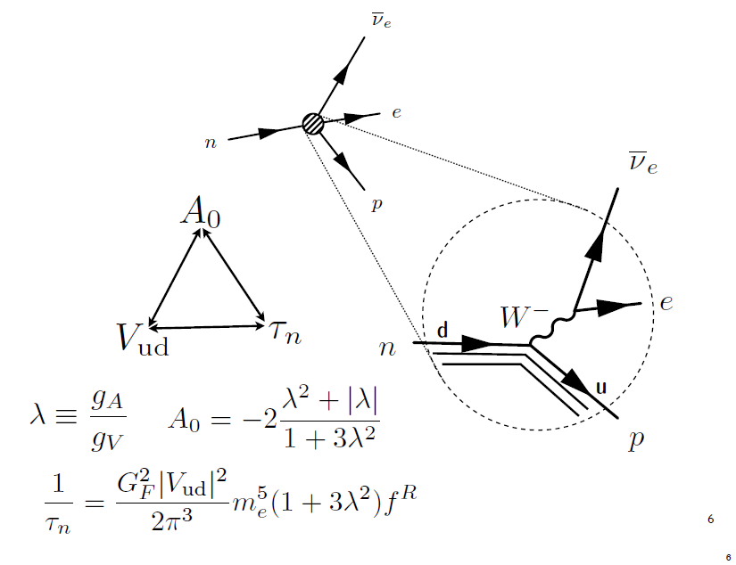
Lifetime (τ_{n}) and A-correlation
Electro-weak Standard Model

Slide 9
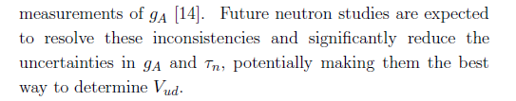
V_{ud} AND CKM UNITARITY
Particle Data Group
Goals of UCNA:
Precision measurement of g_{A}/g_{V}
Precision measurement of V_{ud}
Test Unitarity of quark weak-mixing matrix (Cabbibo-Kobayashi-Maskawa)
  Evidence for physics beyond the Standard Model
  Few TeV scale probed with ~ few 0.1% scale measurements

Slide 10
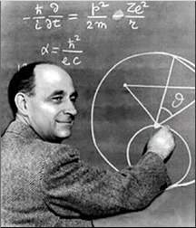
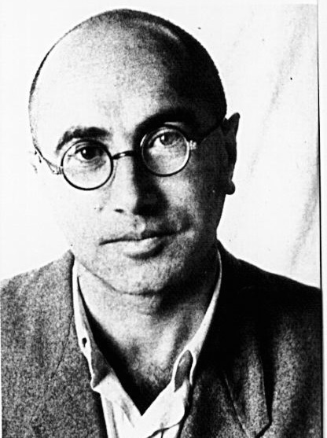
Ultra-Cold Neutrons (UCN)
(Fermi/Zeldovich)
  Very slow neutrons
    (v < 8 m/s ’ λ > 500 Å )
    that cannot penetrate into
  certain materials due to positive
  scattering length

Slide 11
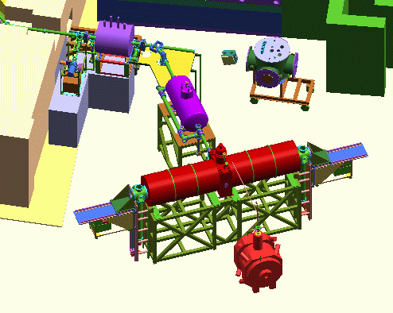
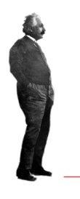
UCNA @ LANSCE (Area B)
Neutron Polarizing Magnets
UCN Guides
UCN Source
Superconducting Spectrometer
Electron Detectors

Slide 12
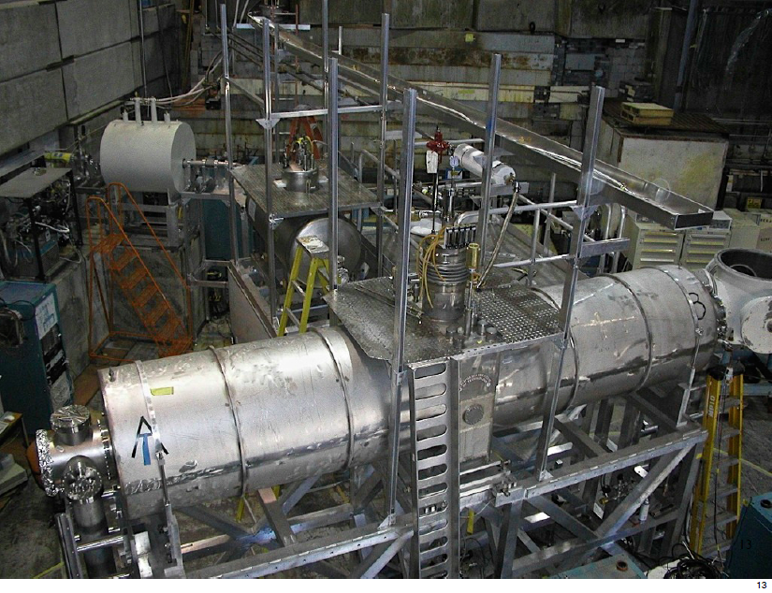
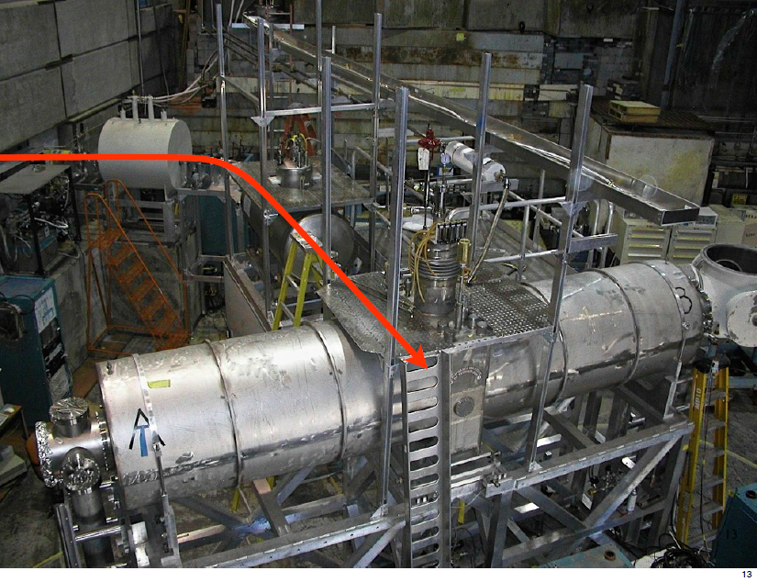
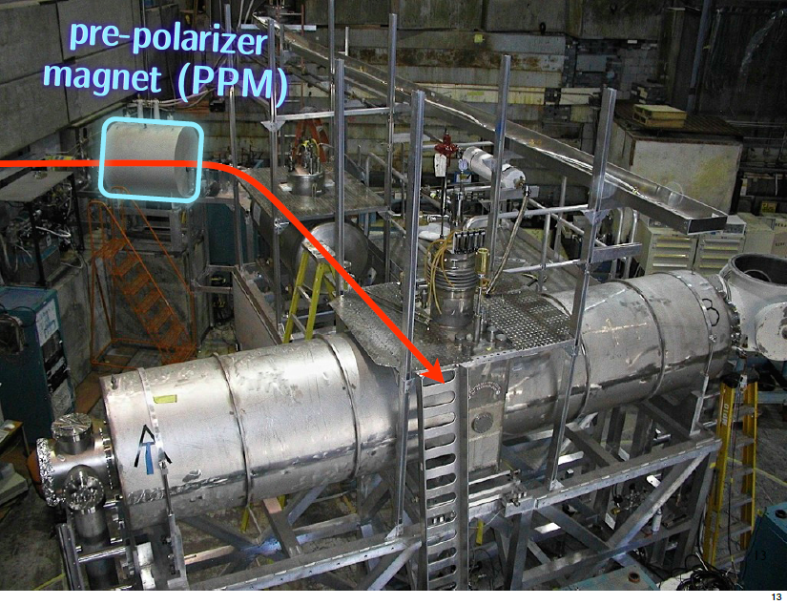
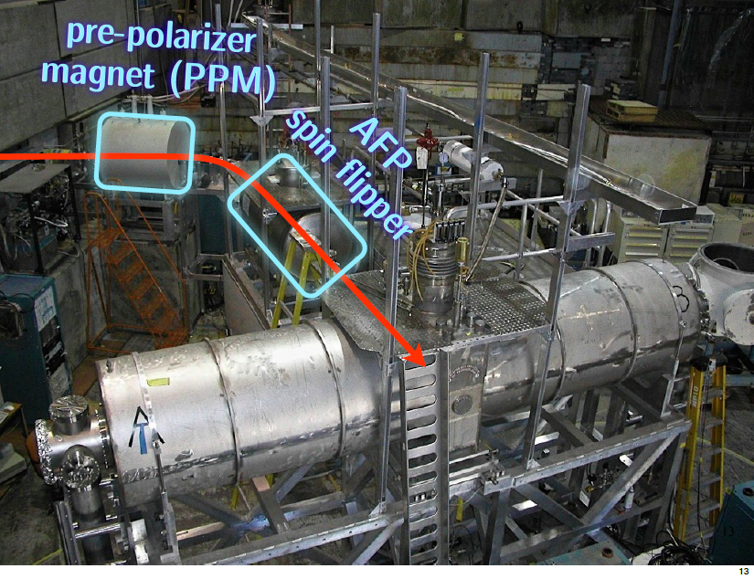
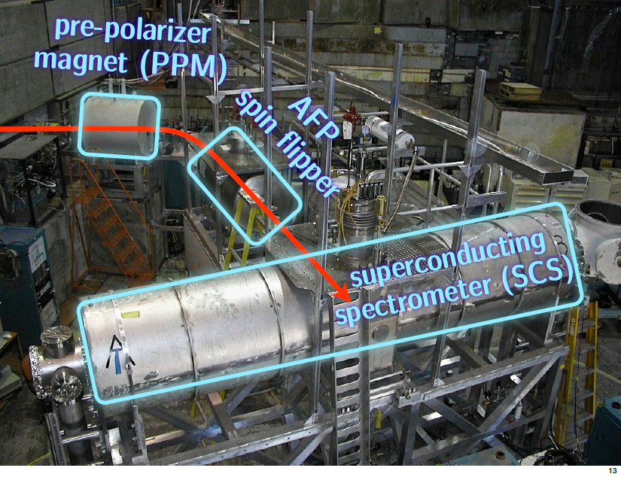

Slide 13
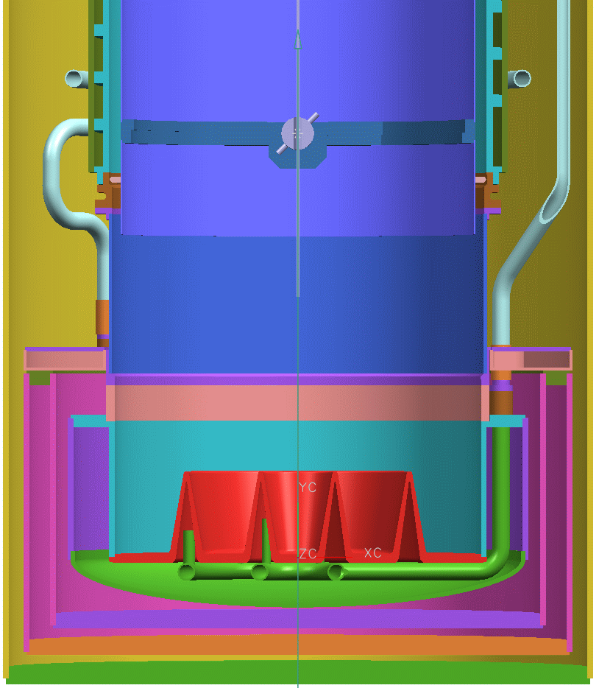
UCNA SD₂ source
Flapper
Valve
Solid Deuterium
Proton bunch
Tungsten Target

Slide 14
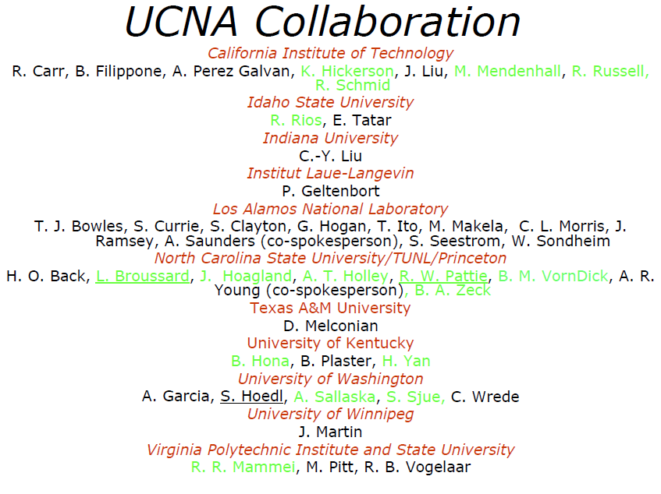
UCNA Collaboration
S. Slutsky. C. Swank,
,B. A. Zeck

Slide 15
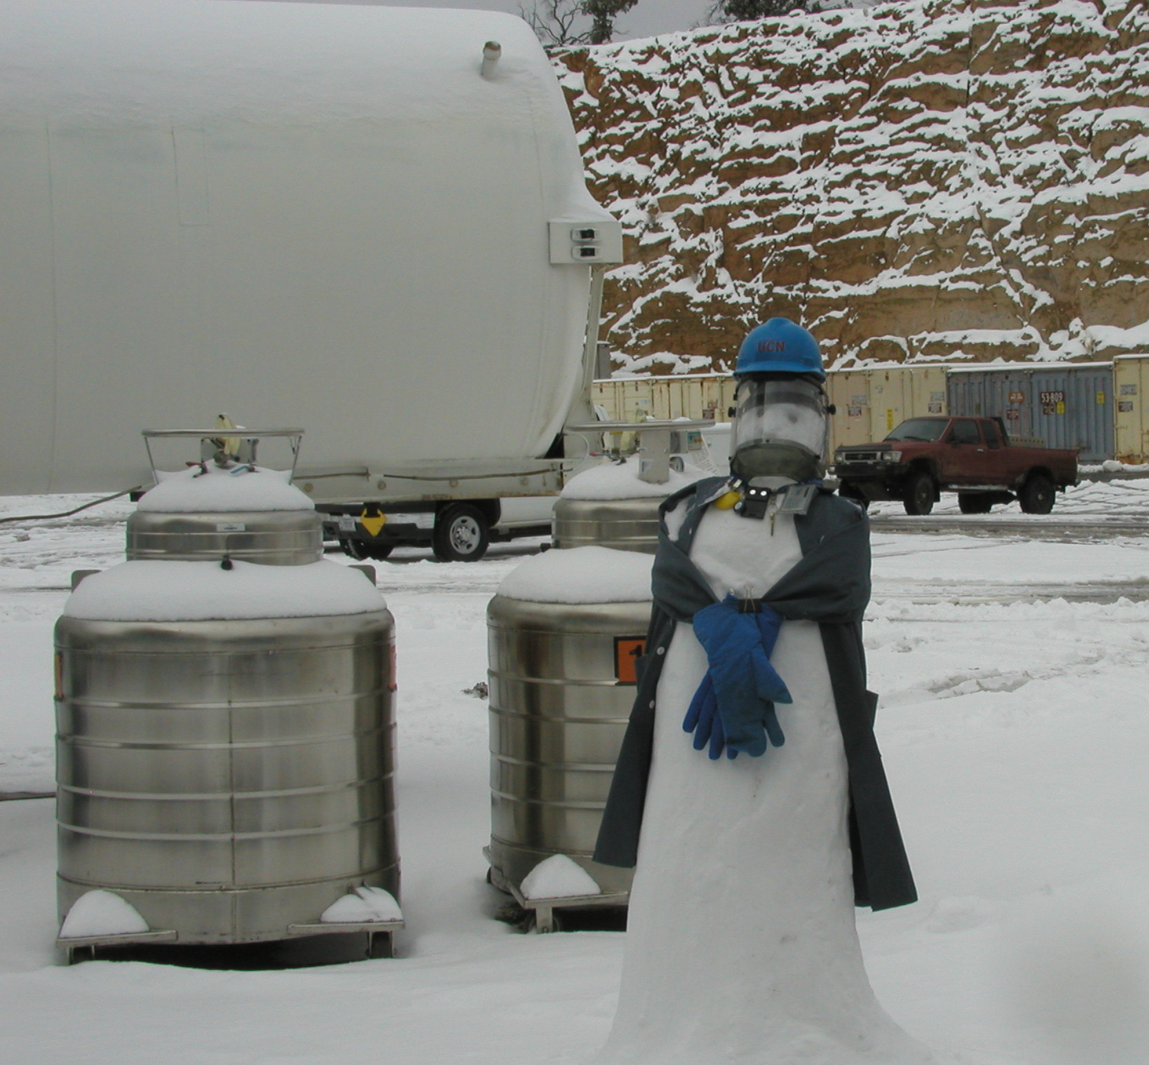
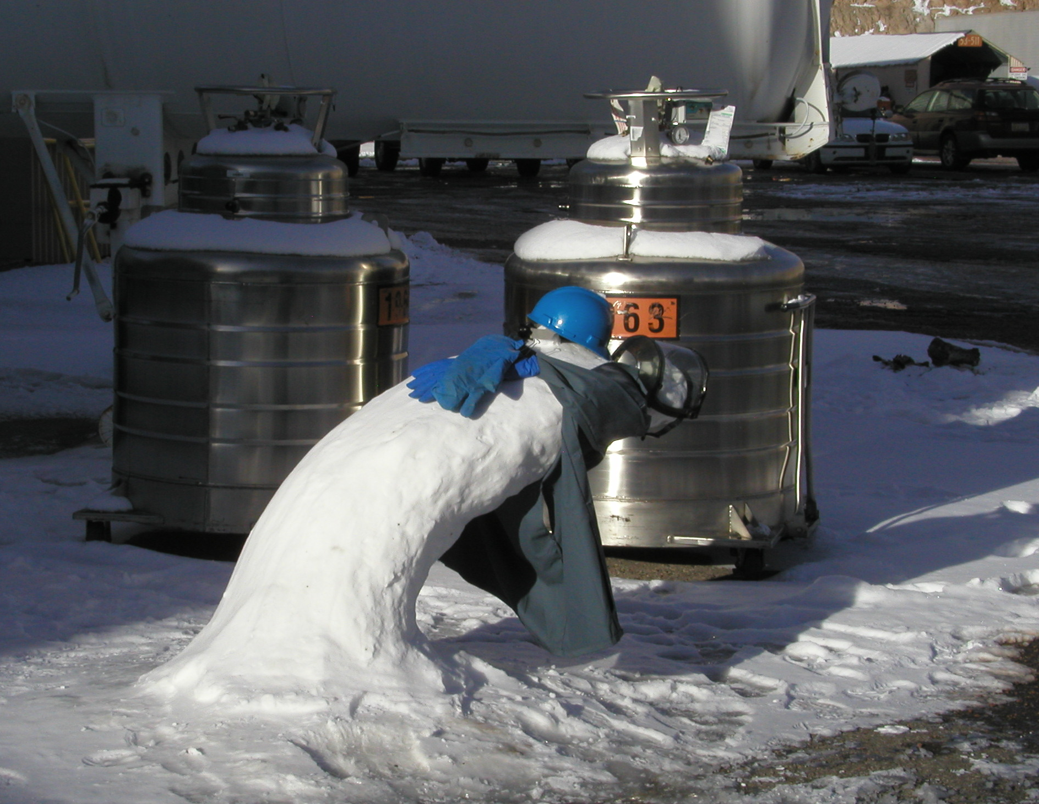
UCNA → Cryogenic exp.
3 Superconducting Magnets
Solid D₂ UCN source
2 He Liquifiers (1700 liters/day)
End of Shift
Beginning of UCNA Shift

Slide 16
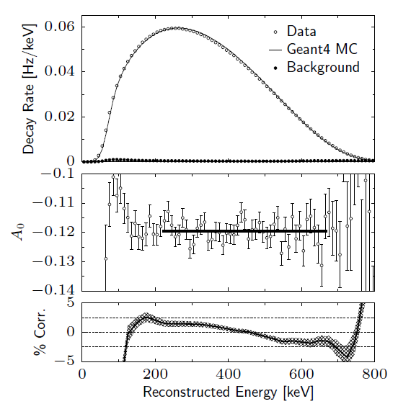
Latest Published Results from UCNA
Optimal range for
Statistics + Systematics

Slide 17
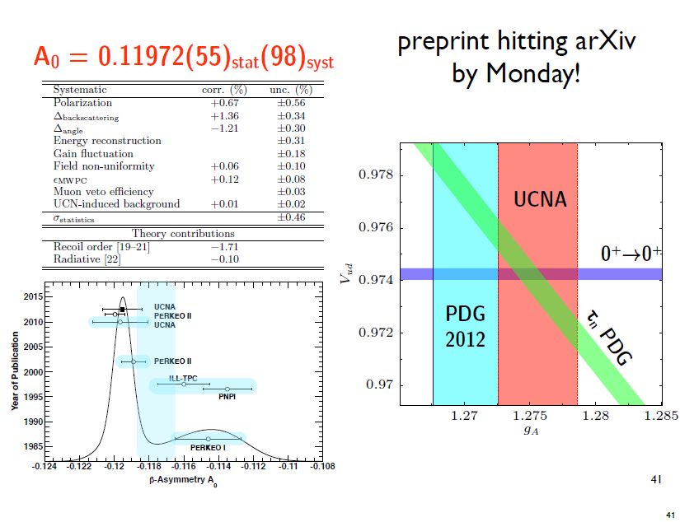
Latest Results from UCNA
A₀ = -0.11954(55)_{stat}(98)_{syst}
Mendenhall, et al
Phys. Rev. C 87, 032501 (2013)
Note: Michael Mendenhall (Caltech) just won DNP thesis prize

Slide 18
Impact on V_{ud}
Systematics further improved to < 0.5%
New UCNA data being analyzed should reduce error bar by factor of ~ 1.7
New data run (higher UCN flux) could reduce error bar by factor of 3

Slide 19
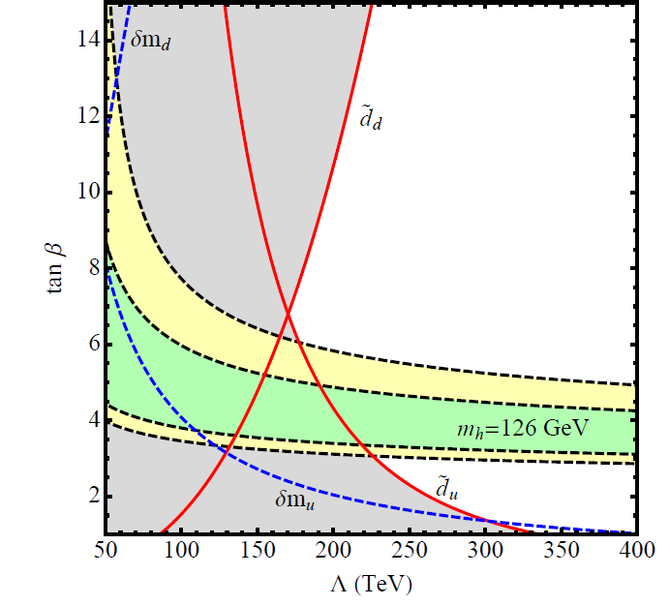
Impact of non-zero EDM
Must be new Physics
Sharply constrains
models beyond the
Standard Model
(especially with
LHC data)
May account for matter-
antimatter asymmetry of
the universe
McKeen,Pospelov&Ritz
hep-ph 1303.1172
Heavy sfermions >50 TeV
1 TeV gauginos
Present EDM Limits
New nEDM at 3x10⁻²⁸ e-cm
moves limits off graph

Slide 20
P5 (Particle Physics Project Prioritization Panel) Report 6/14
Many extensions of the Standard Model, including Supersymmetry,
have additional sources of CP non-conservation. Among the most powerful probes of new physics that does not conserve CP are the electric dipole moments (edm’s) of the neutron, electron and proton. Searches for the edm’s of neutrons and electrons are already sensitive to contributions from new particle masses at the 10–100 TeV scale, with substantial improvements in reach expected over the next decade. A new direct neutron edm experiment is planned at Oak
Ridge National Laboratory.

Slide 21
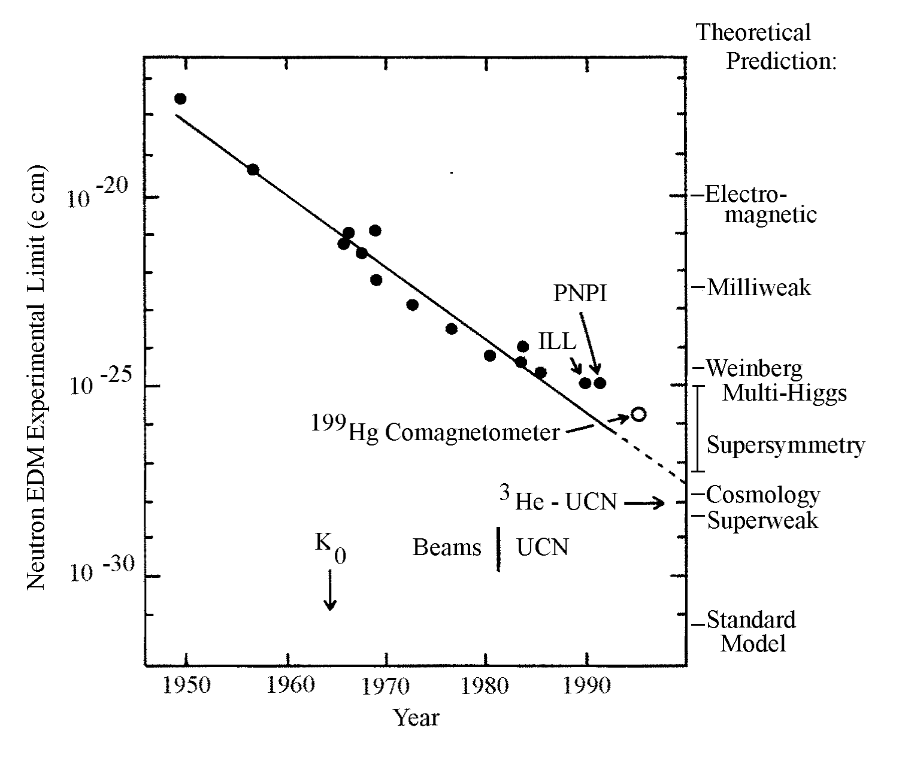
New technology improving EDM sensitivity
Trapped UCN
Future neutron
EDM
1950
2000
2010

Slide 22
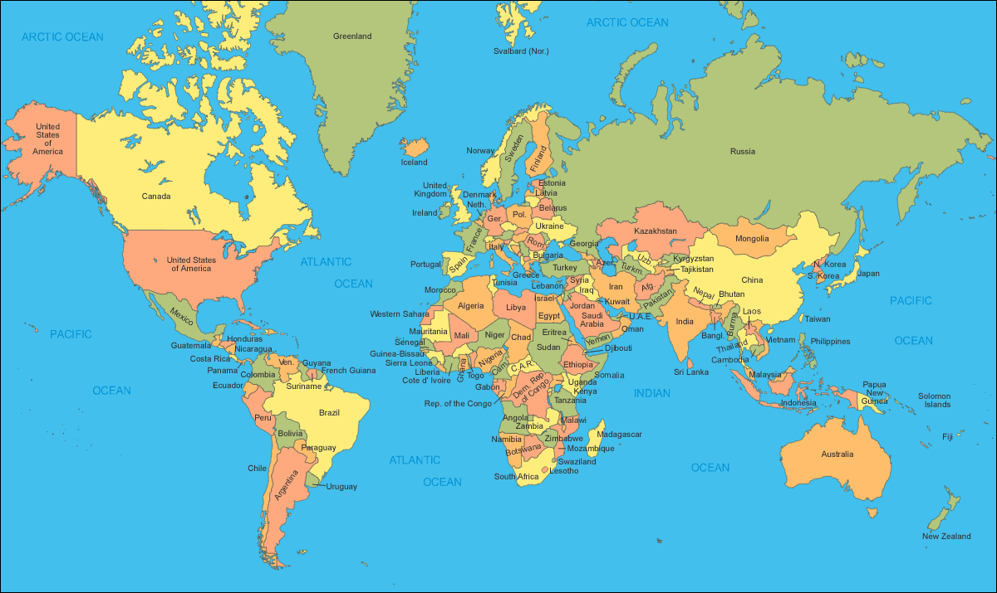

Worldwide neutron EDM Searches
PNPI
TRIUMF
ILL
FRMII
PSI
J-PARC
LANL
SNS
RCNP

Slide 23
Worldwide neutron EDM Searches
Experiment | UCN source | cell | Measurement techniques | σ_{d} Goal (10⁻²⁸ e-cm)
ILL - CryoEDM | Superfluid ⁴He | ⁴He | Cryo HV, SuperCond., Ramsey technique, external SQUID mag. | < 5
ILL-PNPI | ILL turbine PNPI/Solid D₂ | Vac. | Ramsey technique for ω E=0 cell for magnetometer | Phase1<100 < 10
ILL Crystal | Cold n Beam | solid | Crystal Diffraction Non-Centrosymmetric crystal | < 100
PSI EDM | Solid D₂ | Vac. | Ramsey for ω, external Cs & ³He, Hg co-magnetom. Xe or Hg comagnetometer | Phase1 ~ 50 Phase 2 < 5
Munich FRMII | Solid D₂ | Vac. | Room Temp. , Hg Co-mag., also external Cs mag. | < 5
RCNP/TRIUMF | Superfluid ⁴He | Vac. | Small vol., Xe co-mag. @ RCNP Then move to TRIUMF | < 50 < 5
SNS nEDM | Superfluid ⁴He | ⁴He | Cryo-HV, ³He capture for ω, ³He co-mag. with SQUIDS & dressed spins, supercond. | < 5
JPARC | Solid D₂ | Vac. | Under Development | < 5
JPARC | Solid D₂ | Solid | Crystal Diffraction Non-Centrosymmetric crystal | < 10?
LANL | Solid D₂ | Vac. | R & D | ~ 30
Present neutron EDM limit < 300
= sensitivity < 5 x 10⁻²⁸ e-cm

Slide 24
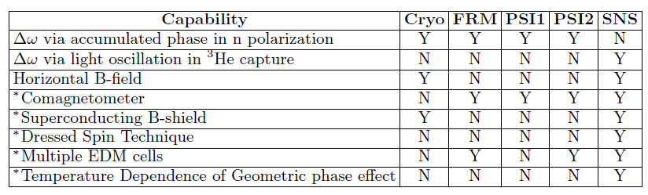
Comparison of Capabilities for High Sensitivity experiments
Last five items (marked with *) denote a systematics advantage

Slide 25
Key Features of SNS nEDM experiment
Production of Ultra-Cold Neutrons (UCN) in superfluid LHe
Polarized ³He co-magnetometer
  Also functions as neutron spin precession monitor via spin-dependent n-³He capture cross section
    Detected via wavelength-shifted scintillation light in LHe
  Ability to vary influence of external B-fields via “dressed spins”
    Extra RF field allows control of n & ³He relative precession frequency
  Can study dependence on B-field, B-gradients & ³He density
Highly uniform E and B fields
Superconducting Magnetic Shield
Two cells with opposite E-field
Control of central temperature
  Can vary ³He diffusion which changes geometric phase effect on ³He

Slide 26
nEDM Collaboration
R. Alarcon, R. Dipert
Arizona State University
G. Seidel
Brown University
E. Hazen, A. Kolarkar, J. Miller, L. Roberts
Boston University
D. Budker, B.K. Park
UC Berkeley
R. Carr, B. Filippone, M. Mendenhall, C. Osthelder, S. Slutsky,
C. Swank
California Institute of Technology
M. Ahmed, M. Busch, P. –H. Chu, H. Gao
Duke University
I. Silvera
Harvard University
M. Karcz, C.-Y. Liu, J. Long, H.O. Meyer, M. Snow
Indiana University
L. Bartoszek, D. Beck, C. Daurer, J.-C. Peng, T. Rao, S. Williamson, L. Yang
University of Illinois Urbana-Champaign
C. Crawford, T. Gorringe, W. Korsch,
E. Martin, N. Nouri, B. Plaster
University of Kentucky
S. Clayton, M. Cooper, S. Currie, T. Ito, Y, Kim, M. Makela, J. Ramsey, A. Roberts, W.Sondheim
Los Alamos National Lab
K. Dow, D. Hasell, E. Ihloff, J. Kelsey, J. Maxwell, R. Milner, R. Redwine, E. Tsentalovich, C. Vidal
Massachusetts Institute of Technology
D. Dutta, E. Leggett
Mississippi State University
R. Golub, C. Gould, D. Haase, A. Hawari, P. Huffman, E. Korobkina, K. Leung, A. Reid, A. Young
North Carolina State University
R. Allen, V. Cianciolo, Y. Efremenko, P. Mueller,
S. Penttila, W. Yao
Oak Ridge National Lab
M. Hayden
Simon Fraser University
G. Greene, N. Fomin
University of Tennessee
S. Stanislaus
Valparaiso University
S. Baeβler
University of Virginia
S. Lamoreaux
Yale University

Slide 27
Status of nEDM @ SNS
Nuclear Science Advisory Committee (NSAC) Review of Fundamental Physics with Neutrons (12/11)
  nEDM is highest priority of sub-field
  nEDM should focus on Critical R&D for 2 yrs
    Several key elements need to be demonstrated
Funded as R&D project (2012/2013)
    Reviewed every 4 months via external Technical Review Committee
NSF/DOE review 12/13 = “Do or Die”

Slide 28
NSF/DOE Review (12/13)
Key Technical milestones largely met
  High Electric Fields
    ~ 100kV/cm in medium scale apparatus
  Uniform Magnetic Fields
    few ppm/cm gradients at low T & B-field
  Polarized ³He transport demonstrated
    Large scale LHe film burner demonstrated
  Progress on Neutron storage/SQUIDS/Light Collection
Thanks Roy!

Slide 29
Path to build experiment
Collaboration proposed a 4-yr “Demonstration” phase (Critical Component Demonstration – CCD)
  Continue as an R&D project to build
  high-fidelity, full-scale “prototypes” of the most difficult subsystems
  Working prototypes are then part of the experiment

Slide 30
Funding & Schedule for nEDM
4-yr NSF proposal for CCD approved ~6.5M$
Anticipate 4-yr DOE Funding for CCD ~7M$
Continuation of external Technical Review Committee
Need additional ~ 25M$ after CCD
Could complete construction of more conventional systems after additional ~ 2 yrs
Commissioning underway by 2019-2020

Slide 31
Very Recently: Alternatives Analysis Completed
Experience with focused R&D coupled with developments in field
Alternatives analysis modifies design to simply access & reduce risk
Technical Review Committee met 9/13/2014 & endorsed design modifications (Thanks Lu !)

Slide 32
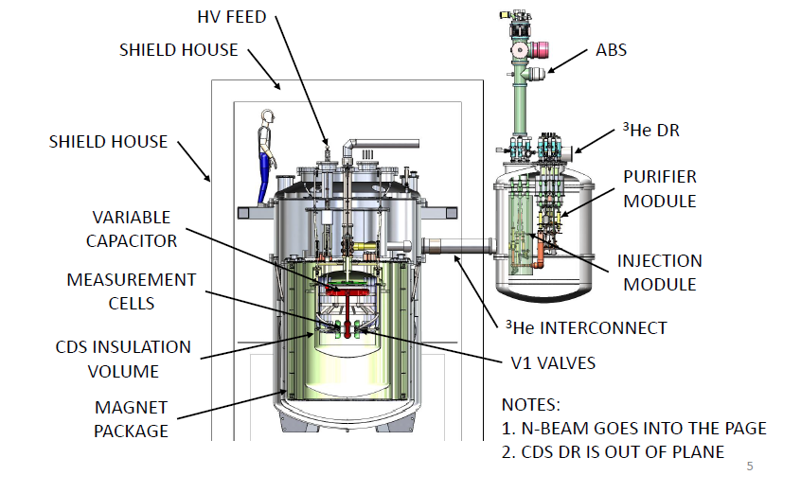
Key Changes in Alternatives Analysis:
  Central Detector System & Magnets mounted Vertically
  Separate function into modules (Cells/HV, Magnet, ³He)
  Use Magnetically Shielded House rather than custom “skin”
3He ATOMIC BEAM SOURCE
MAGNETIC SHIELD HOUSE
3He DILUTION REFRIGERATOR
CENTRAL DETECTOR SYSTEM

Slide 33
Summary
Precision experiments with free neutrons probe key features of the both the Standard Model and Models beyond SM
Hopefully (!), Roy will continue to provide superb advice to DOE & NSF

Slide 34
Extra Slides

Slide 35
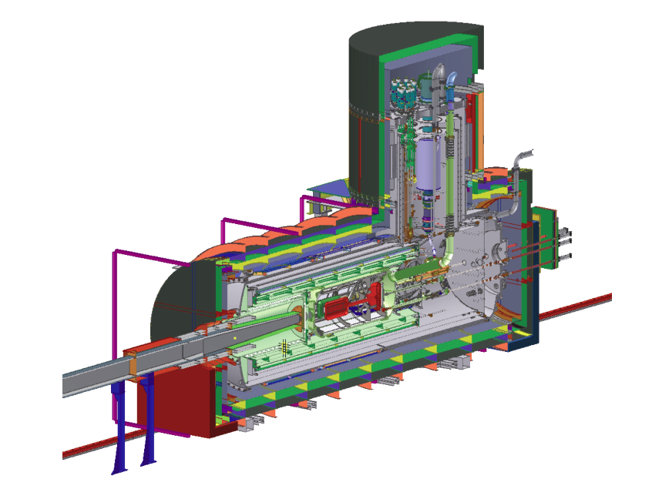
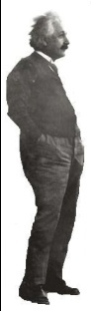
SNS Measurement cycle
Load collection volume with polarized ³He atoms
Transfer polarized ³He atoms into the measurement cell
Illuminate measurement cell with polarized cold neutrons to produce polarized UCN
Apply a π/2 pulse to rotate spins perpendicular to B₀
Measure precession frequency
Remove reduced polarization ³He atoms from measurement cell
Flip E-field & go to 1.
³He functions as “co-magnetometer”
Since d_{3He}<<d_{n} due to e⁻-screening

Slide 36
Example of future Neutron EDM Sensitivity
 | ILL published | EDM @ SNS
N_{UCN} | 1.3 x 10⁴ | 4 x 10⁵
|E| | 10 kV/cm | 70 kV/cm
T_{m} | 130 s | 1000 s
m (cycles/day) | 270 | 25
σ_{d} (e-cm)/day | 3 x 10⁻²⁵ | 3.5 x 10⁻²⁷
Improved
Sensitivity
x 5.5
x 7
x 2.3
x ~ 90

Slide 37
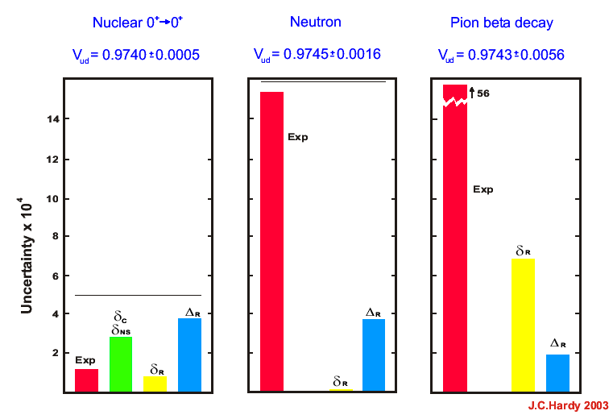
Uncertainties in V_{ud}
Electroweak corrections
(Z⁰ and hadron loops)
Neutron has potential to
yield most precise result
Recently cut in half by
Marciano & Sirlin

Slide 38
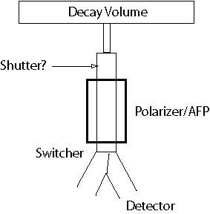
Depolarization Measurements
New UCN Shutter
AFP (spin flipper)
UCN in
Sample during bottle emptying: change state of AFP at end of run cycle and monitor depolarized UCN leaking back to detector

Slide 39
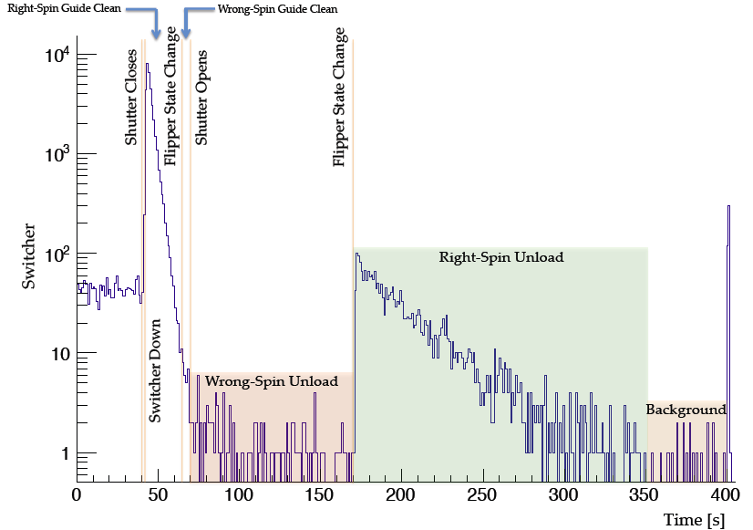
Example of Depol. data
(taken after each 1hr beta decay run)
Sensitivity ~ 0.1% per hour

