Slide 1
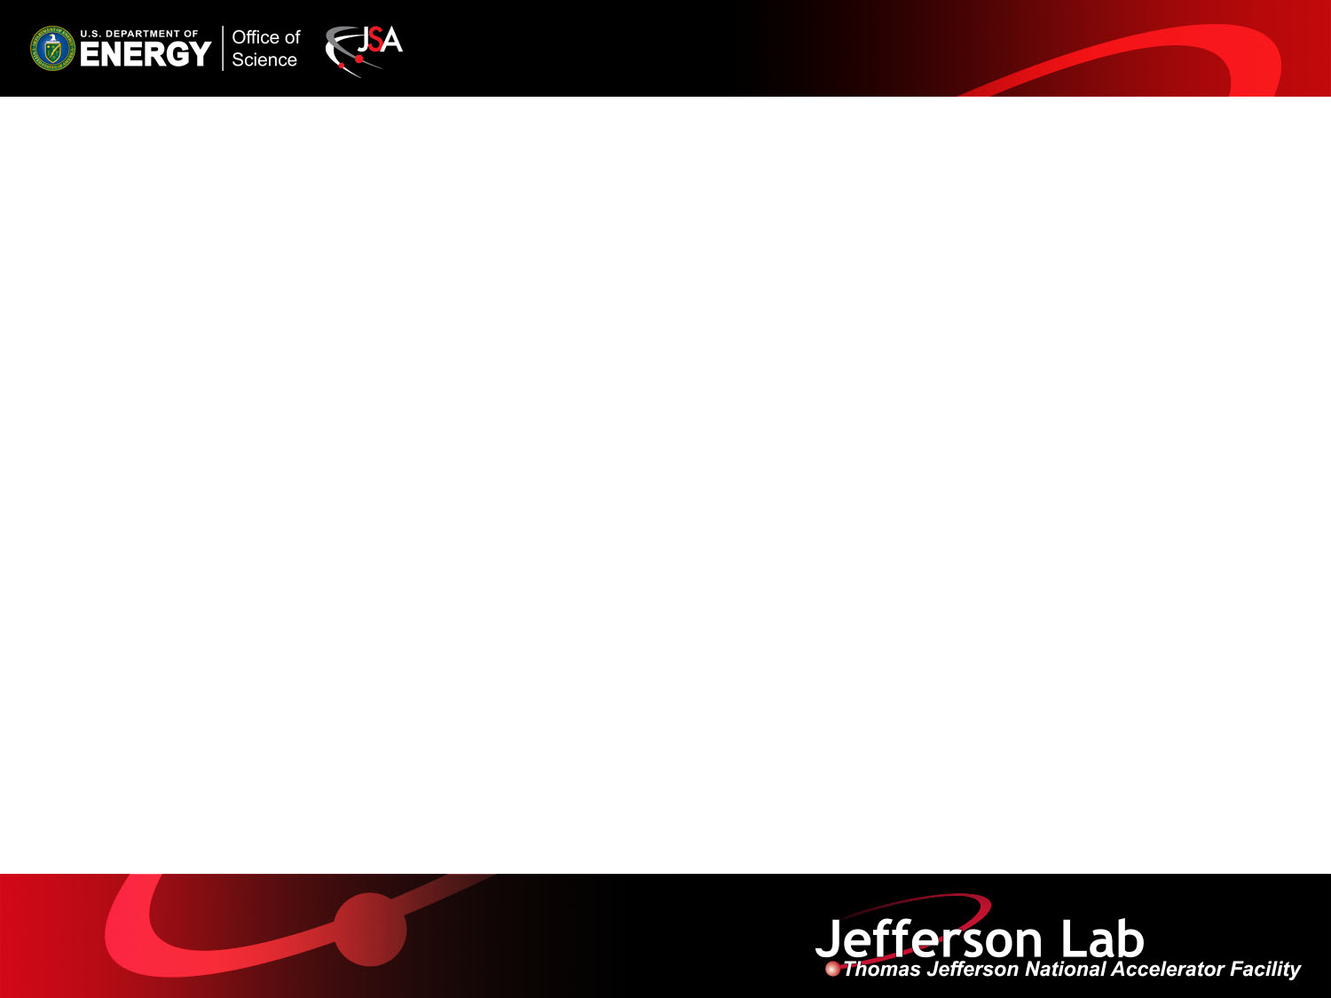
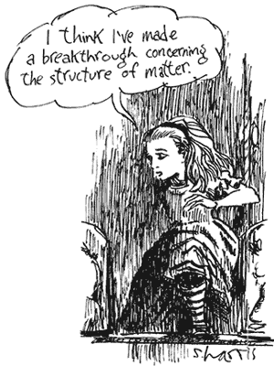
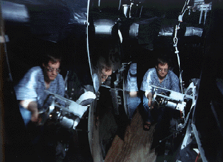
Parity Violation in
Electron Scattering
R. D. McKeown
Jefferson Lab
College of William and Mary
Symposium for Roy Holt
September 26 , 2014

Slide 2
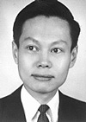

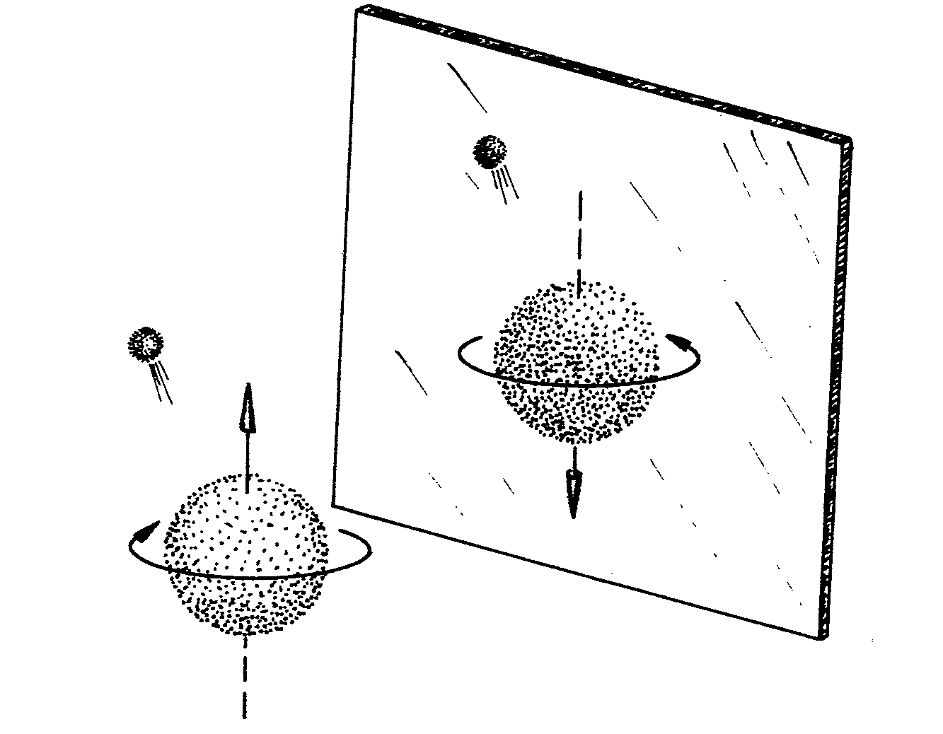
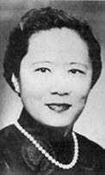
1956 - REVOLUTION
(A. Zee)
FOR THE FIRST TIME –
A FORCE OF NATURE WAS
ASYMMETRIC

Slide 3
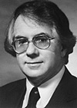
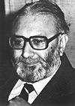

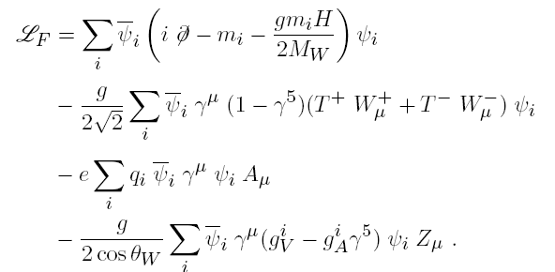
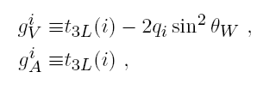
The STANDARD MODEL (1967)
Neutral Currents
Parity Violation

Slide 4
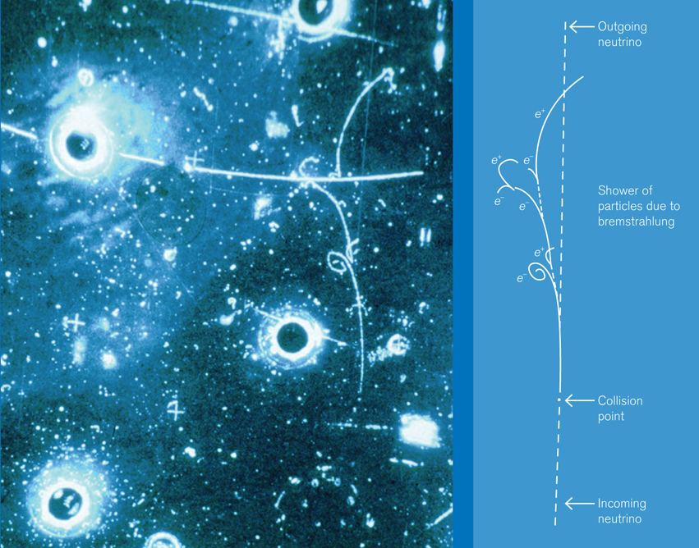
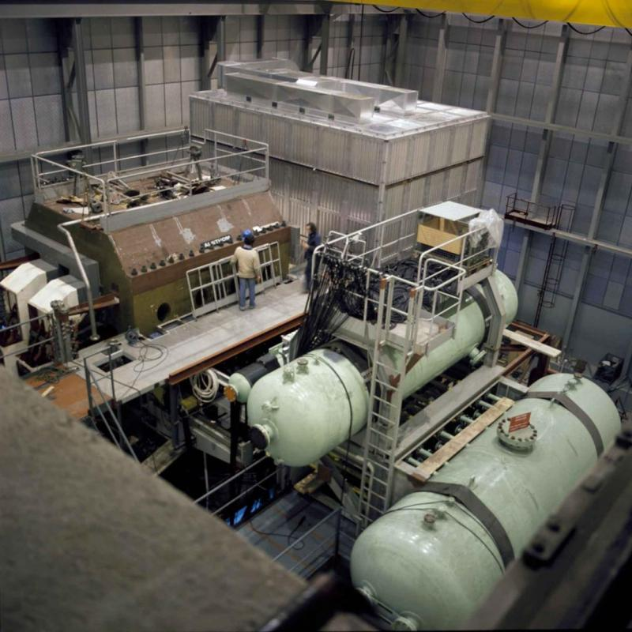
1972 – Neutral Currents Observed

Slide 5
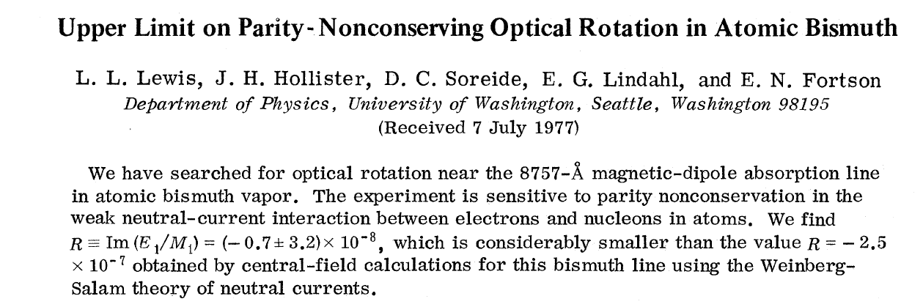
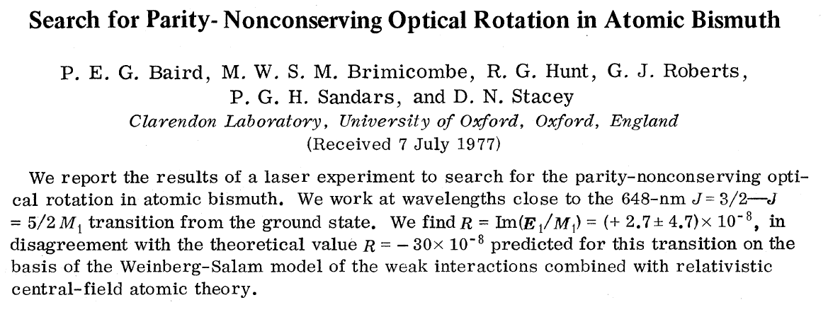
But Trouble with Atoms…

Slide 6
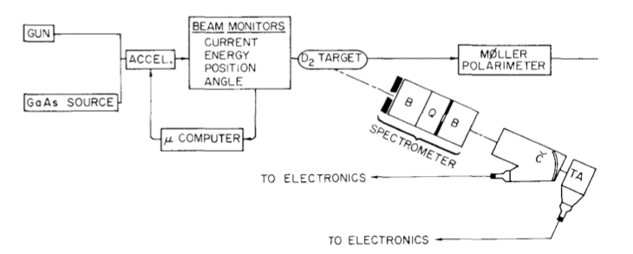
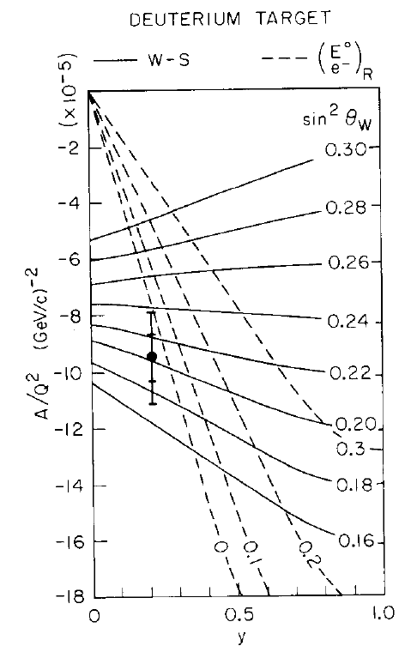
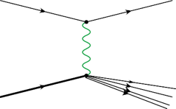
To The Rescue…
SLAC E122 – C. Y. Prescott, et al.
Parity Violation in Deep Inelastic Scattering
γ
+
Z

Slide 7
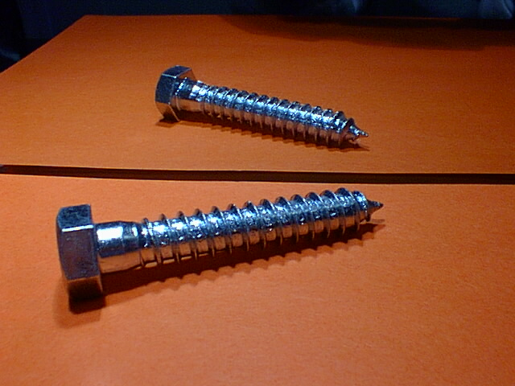

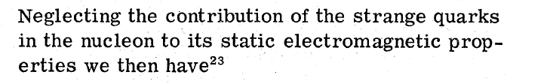
Elastic Electron Scattering?
Polarized electrons on unpolarized target
γ
Z⁰
γ
2
For a proton: (Cahn & Gilman 1978)
Forward angles
Backward angles

Slide 8
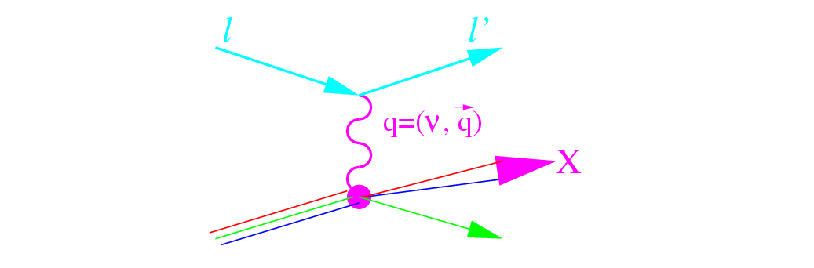

Proton Spin Crisis
1988 – EMC discovers violation of Ellis-Jaffe sum rule in spin-dependent deep inelastic scattering
Δs=0 → I_{EJ} = 0.185
I_{exp} ≈ 0.12
S_{q}= ½(Δu+ Δd+ Δs) ≈ 0.1 « ½

Slide 9
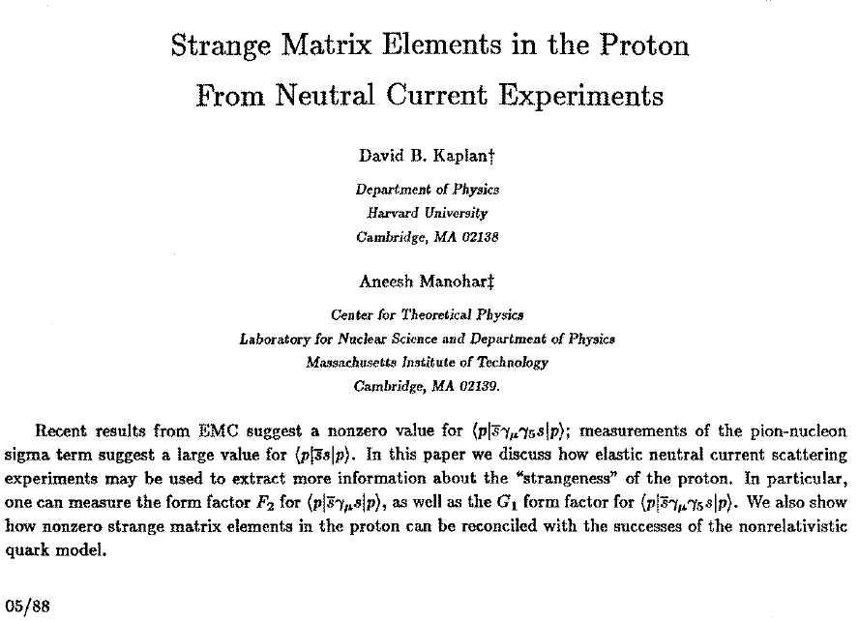
Kaplan and Manohar 1988

Slide 10
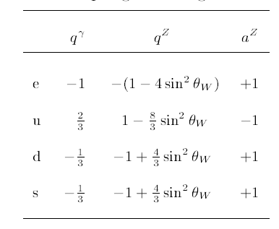
Electroweak Charged Fermion Couplings

Slide 11
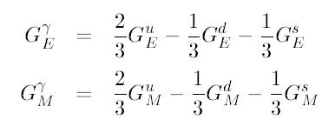


Neutral Weak Form Factors
Electromagnetic interaction
Neutral weak interaction
γ
Z⁰
G_{E}^{Z,p}, G_{M}^{Z,p}
G_{A}^{Z,p}
G_{E}^{γ,p}, G_{M}^{γ,p}
p
p

Slide 12


Use Isospin Symmetry
(p  n) = (u  d)
For vector form factors theoretical CSB estimates indicate < 1% violations (unobservable with currently anticipated uncertainties)
(Miller PRC 57, 1492 (1998) Lewis and Mobed, PRD 59, 073002(1999)
Beyond 1st order... (Ramsey-Musolf, et al.)

Slide 13
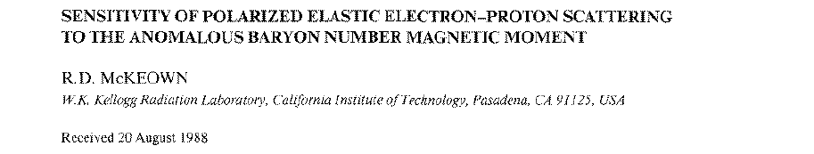
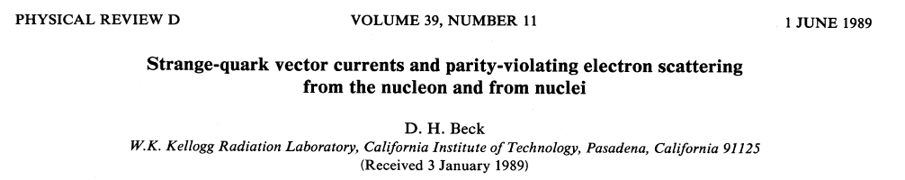
Revisit PV Electron Scattering

Slide 14
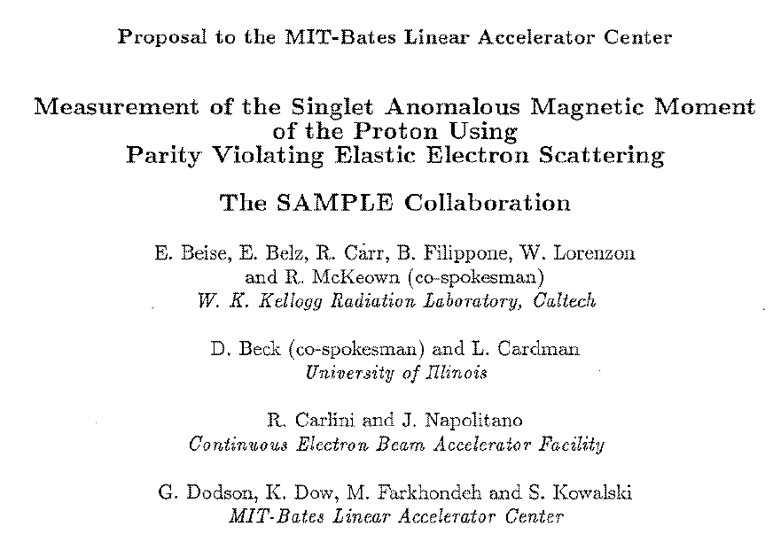
Proposal to MIT/Bates (Dec. 1989):

Slide 15
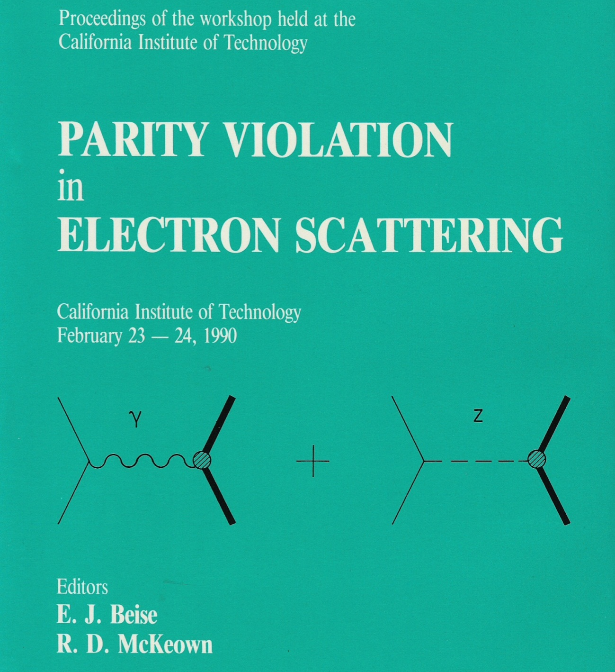

Slide 17
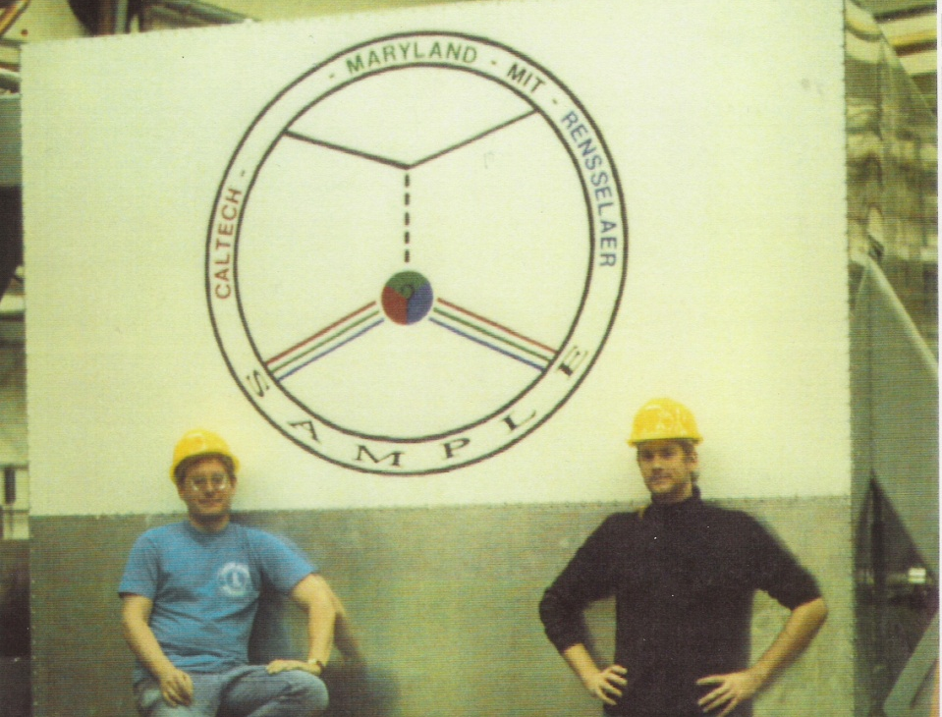
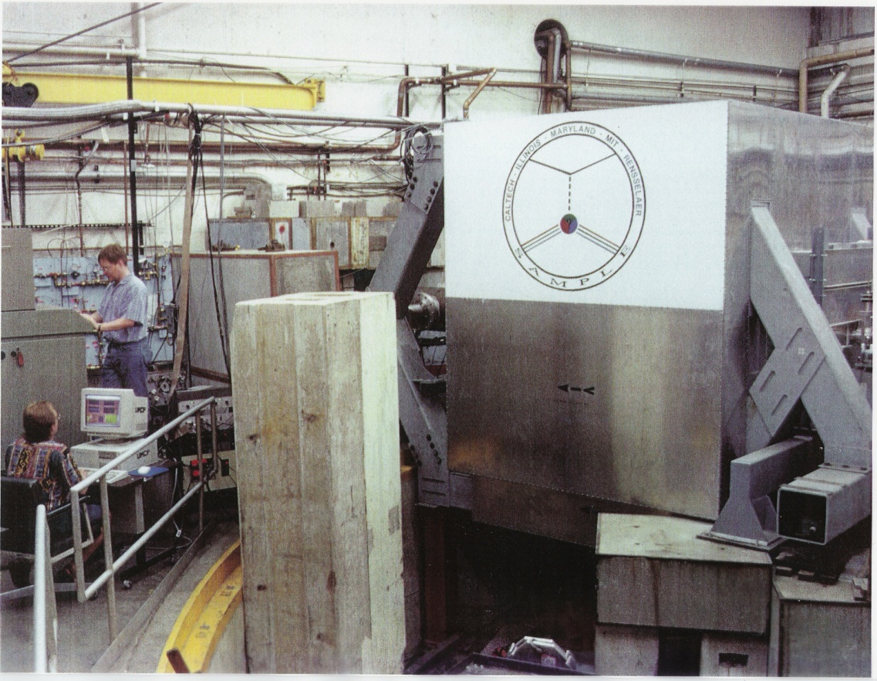
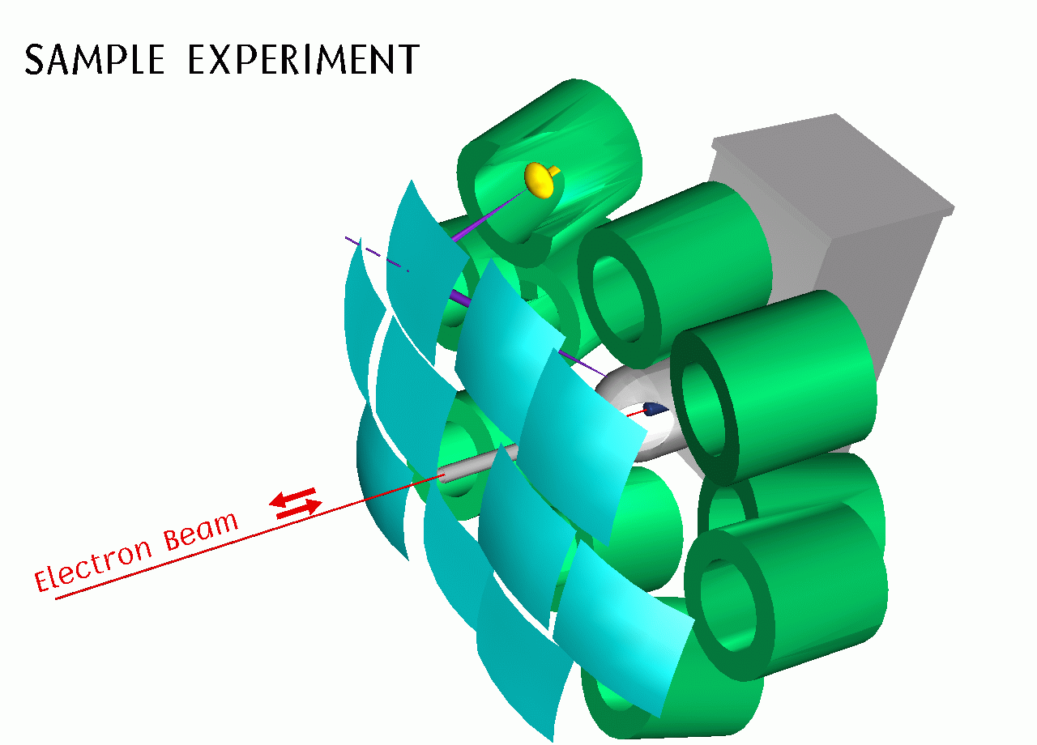
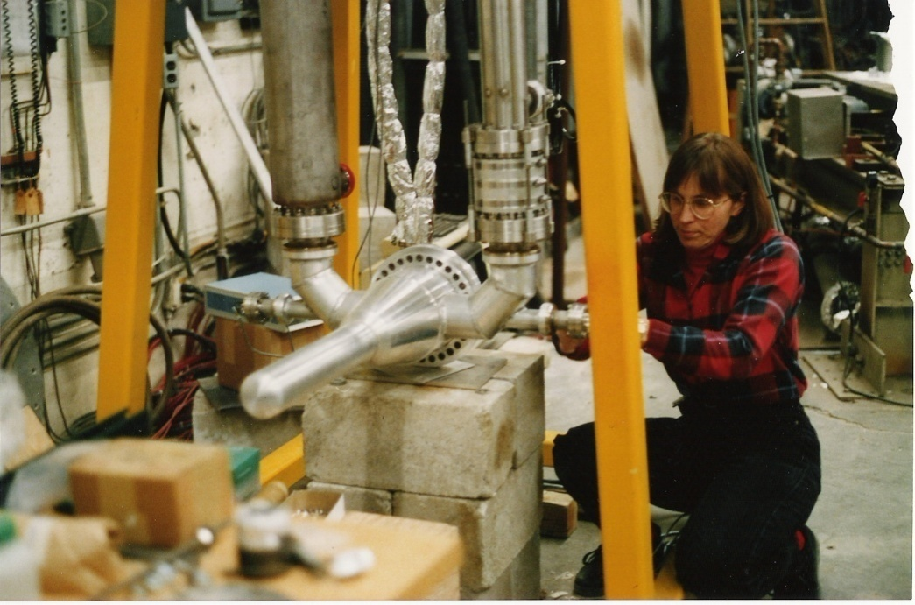

Slide 18


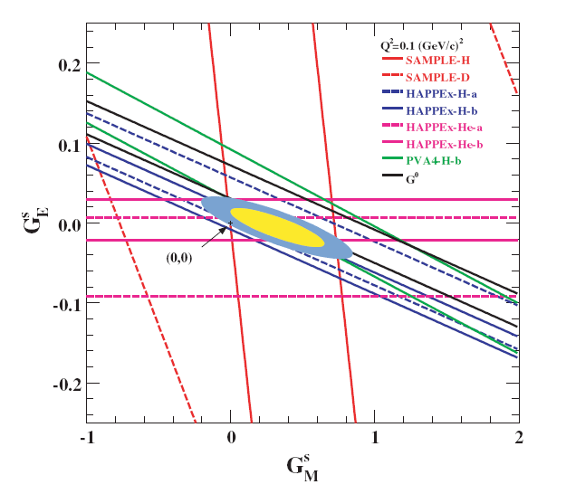
(Note: one of several similar analyses)

Slide 19

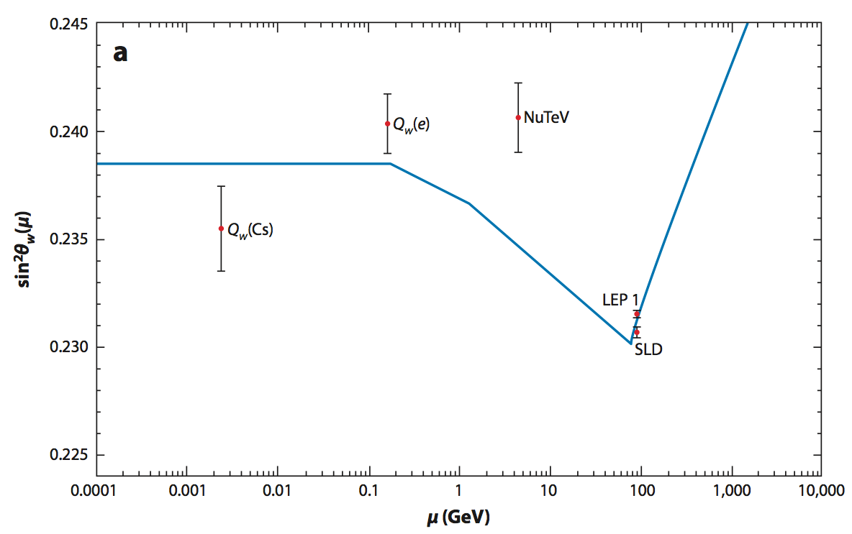
Testing the Standard Model
1-loop Radiative corrections:
“Running” of
sin²θ_{W}:

Slide 20
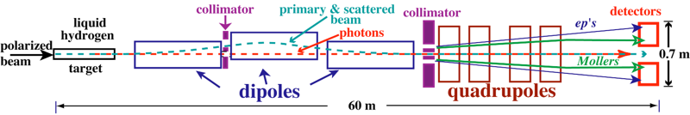
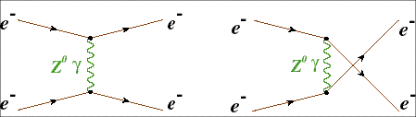
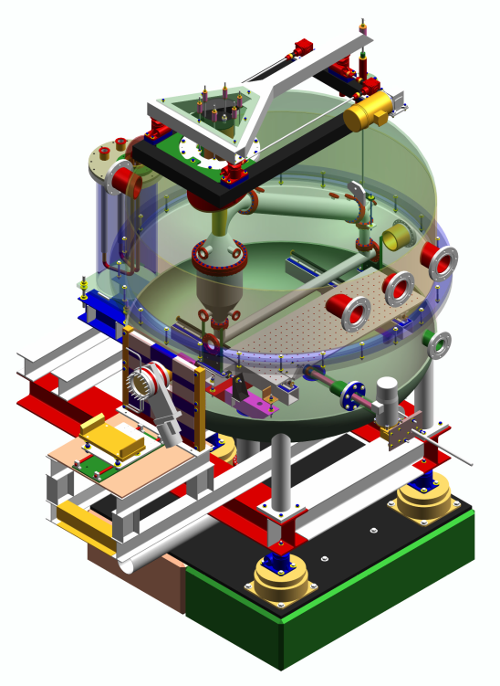

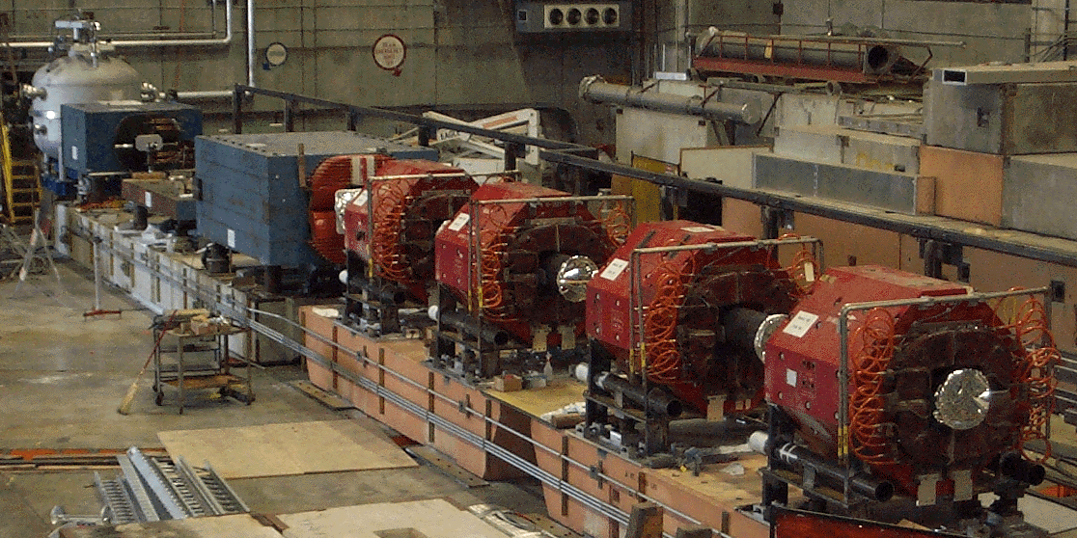
SLAC E158
Parity Violation in Moller Scattering 1997-2004
A_{PV} = (-131 ± 14 ± 10) x 10⁻⁹

Slide 21
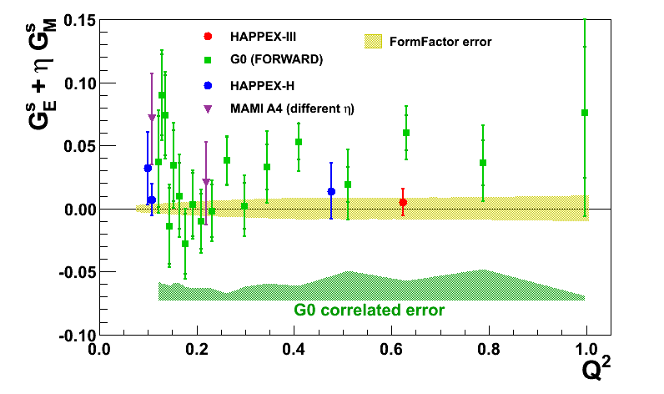
Parity Violation at JLab
Nucleon Strangeness Form Factors (complete)
HAPPEX (Hall A)
G0 (Hall C)
Neutron Skin
  PREX
  CREX
Precision Tests of Standard Model
  Qweak (Under analysis)
  MOLLER
  SoLID

Slide 22
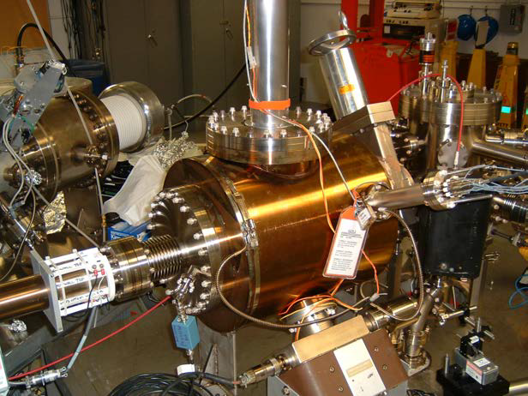

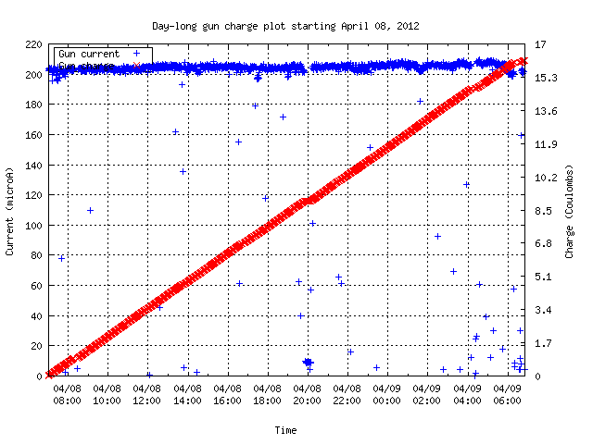
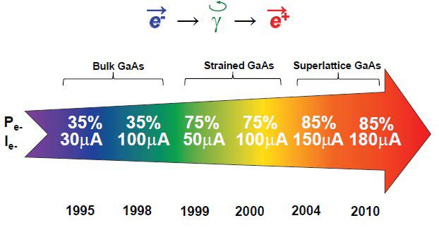
Polarized Source Developments
Matthew Poelker
2011 E. O. Lawrence Award
Record beam delivery during 24 hours (2012)
Beam Current
Charge from photogun
Polarized source history at JLab
Record Performance (2012): 180 mA at 89% polarization

Slide 23
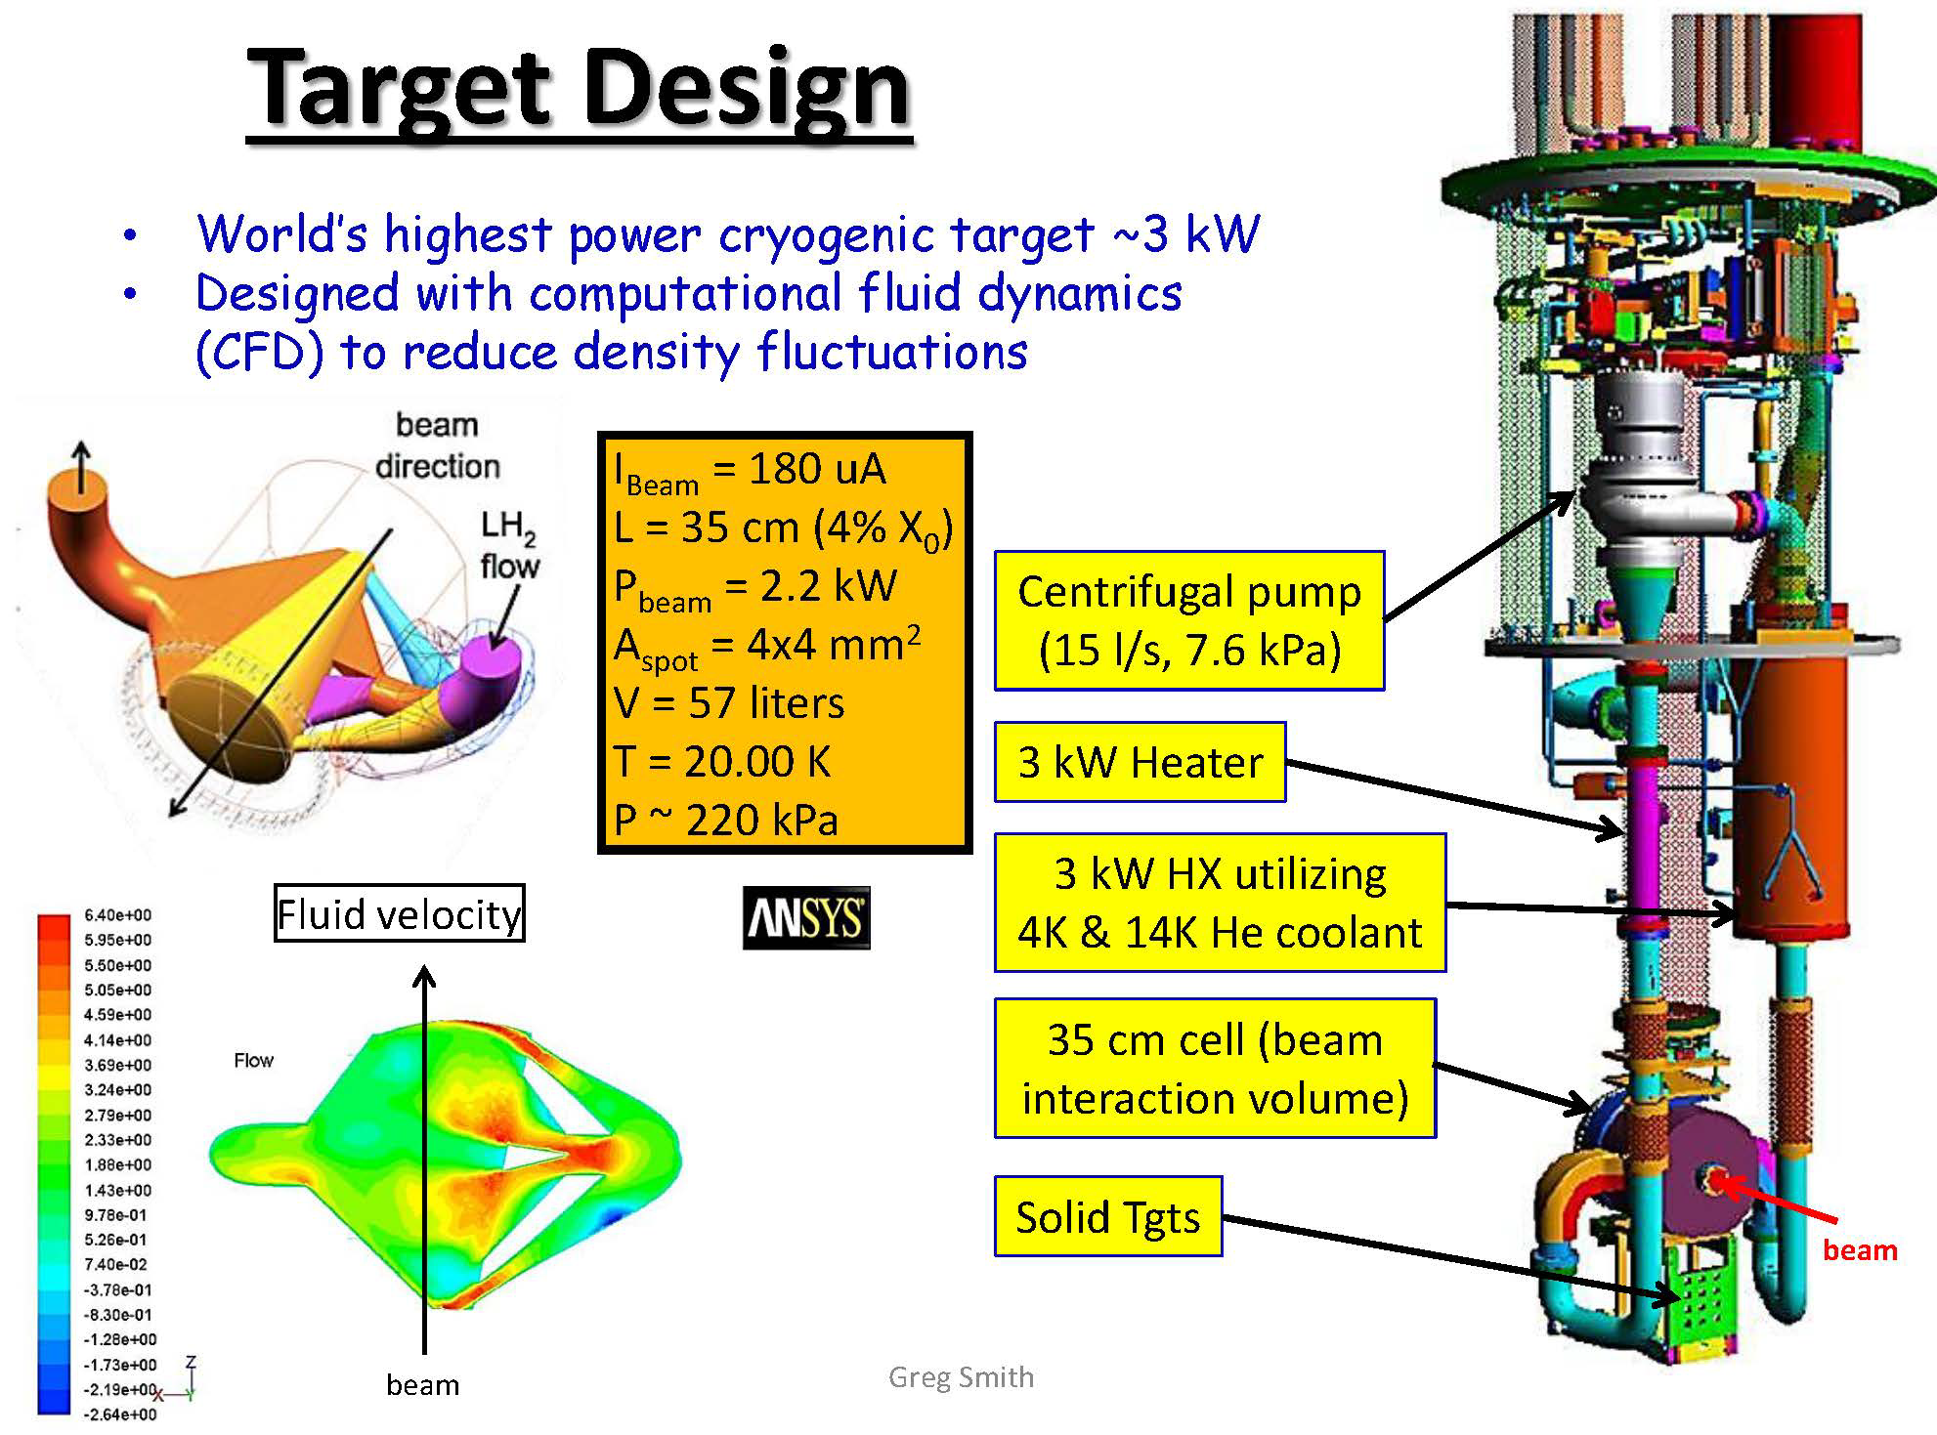
Hydrogen Targets
Silviu Covrig
2012 DOE
Early Career
Awardee

Slide 24
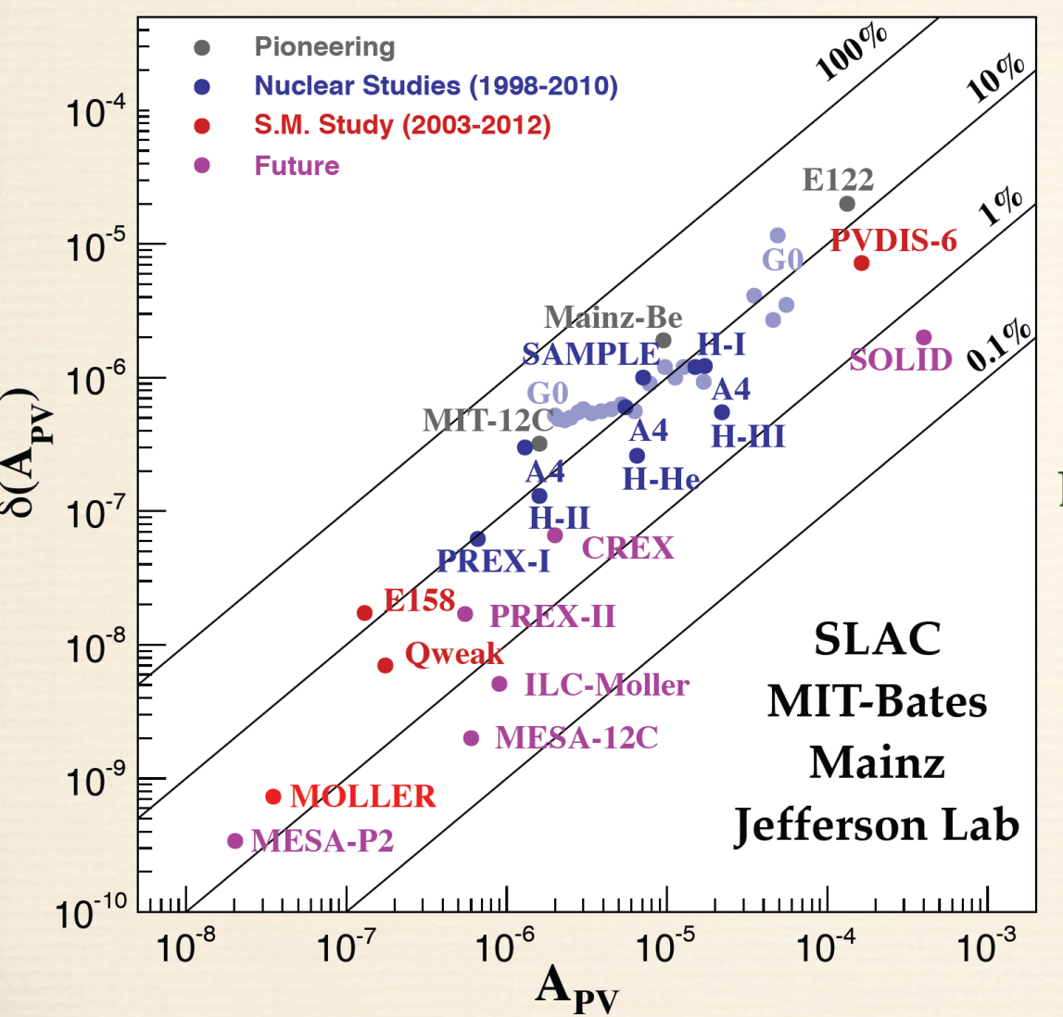
Four Decades of Progress
Photocathodes
Polarimetry
High power cryotargets
Nanometer beam stability
Precision beam diagnostics
Low noise electronics
Radiation hard detectors
Parity-violating electron scattering has become a precision tool

Slide 25
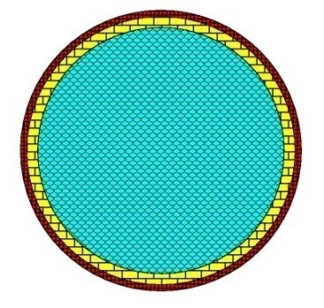
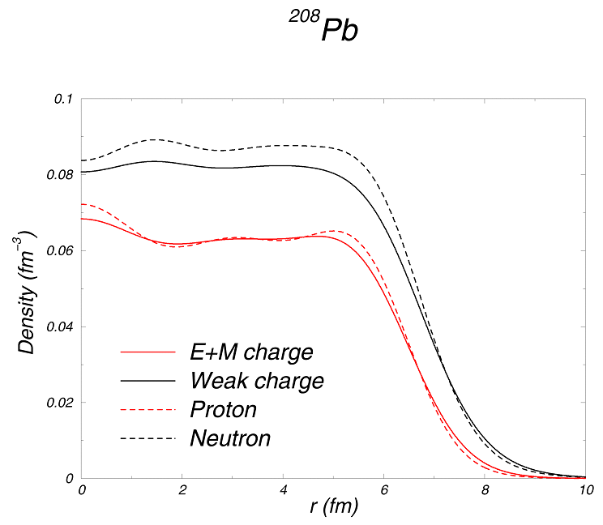
Measuring the Neutron “Skin” in the Pb Nucleus
Q_{w}^{p}=(1 – 4 sin² θ_{W})
Q_{W}^{n} = -1
Weak interaction selects neutrons
Parity violating electron scattering
Sensitive to neutron distribution
Neutron Star
Lead Nucleus
10 km
10 fm
skin
crust
Applications : Nuclear Physics, Neutron Stars,
Atomic Parity, Heavy Ion Collisions

Slide 26
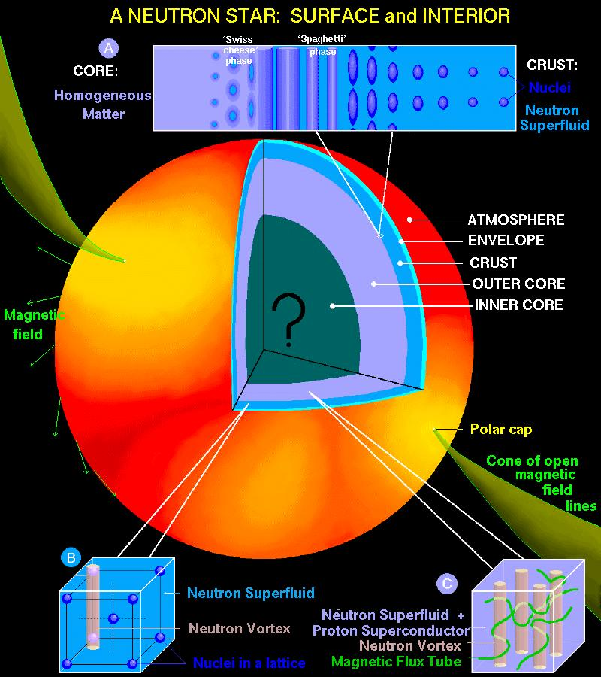
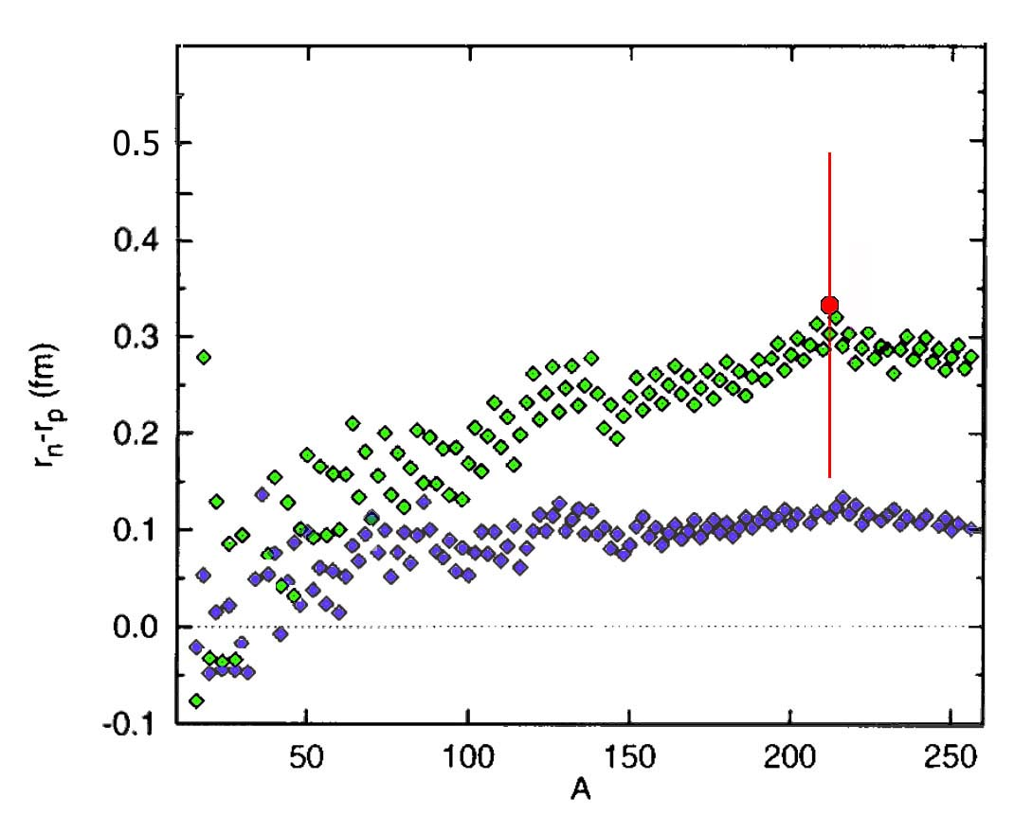
Lead (²⁰⁸Pb) Radius Experiment: PREX
First measurement: clear indication of neutron skin
Future measurement: constrain symmetry EOS
PREX I
PREX II (Projected)
A neutron skin of 0.2 fm or more has implications for our understanding of neutron stars and their ultimate fate.
Relativistic mean field
Nonrelativistic skyrme

Slide 27
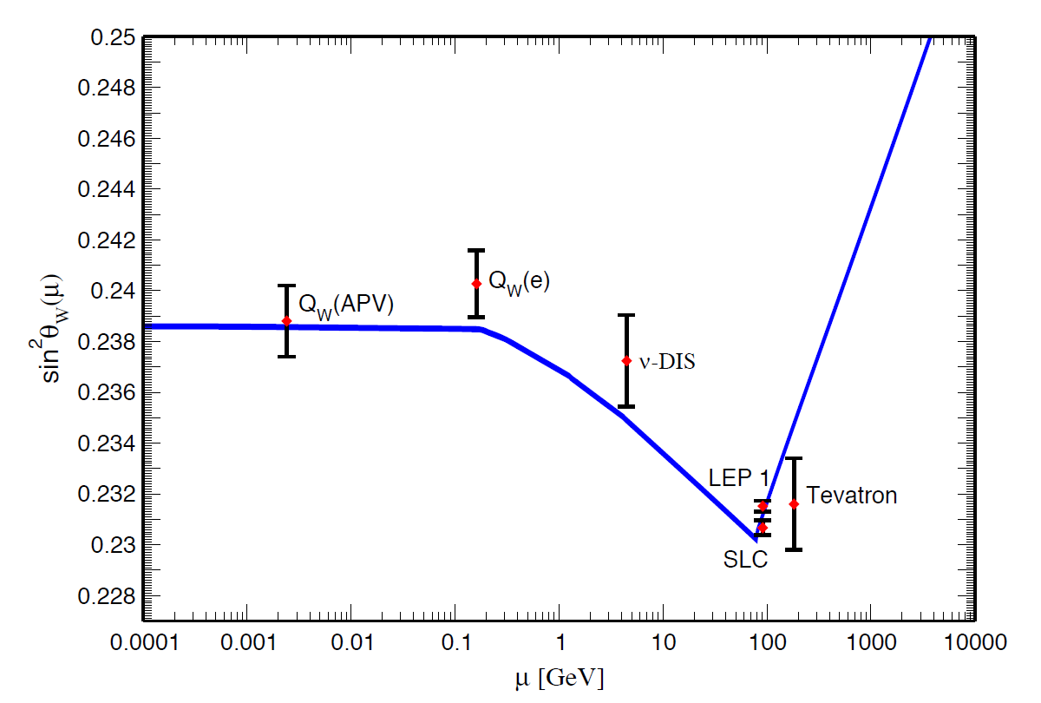
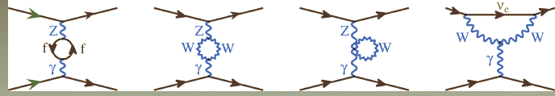
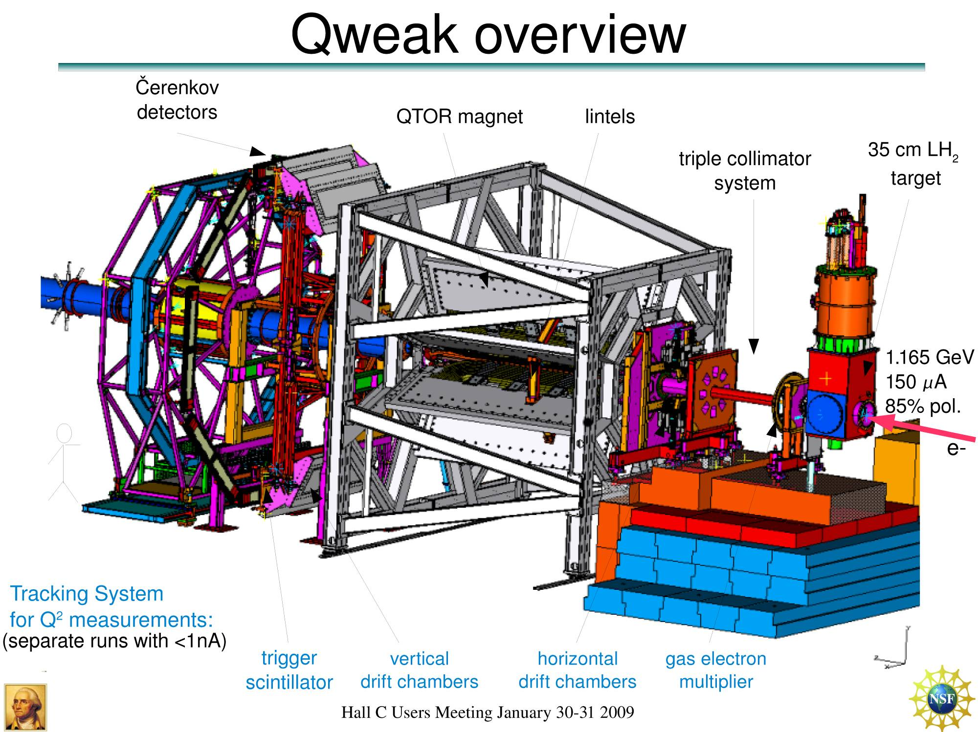

Qweak
Precise determination of
the weak charge of the proton
Q_{w}= -2(2C_{1u}+C_{1d})
=(1 – 4 sin² θ_{W})
Luminosity
monitors
Luminosity
monitors
scanner

Slide 28
Global Fit: 1/25th of Qweak Data + Higher Q² PVES Results
A = -279 ± 35 ± 31 ppb
Q^{p}_{W} = 0.064 ± 0.012
(only 1/25th of all data collected)
SM value = 0.0710(7)
Λ/g_{e-p} ~ 1.1 TeV (95% CL)

Slide 29


MOLLER Experiment
Proposal for precision measurement of
parity-violating Moller scattering
Spokesperson: K. Kumar, Stony Brook
Hall A
detector
systems
hybrid
toroid
upstream
toroid
liquid
hydrogen
target
Hoping to establish as an MIE project with DOE, starting FY17
28 m
A_{PV} = 35.6 ppb
Luminosity: 3x10³⁹ cm²/s
75 μA 80% polarized 11GeV
δ(A_{PV}) = 0.73 parts per billion
δ(Q_{eW}) = ± 2.1 % (stat.) ± 1.0 % (syst.)
electron
beam

Slide 30


SoLID
See X. Zheng talk

Slide 31

Electron Ion Collider Projection
200 fb⁻¹

Slide 32
Summary
Parity-violating electron scattering has been an important experimental tool for
  Establishing the Standard Model
  Testing the Standard Model
  Determining the flavor structure of the nucleon
  Measuring the neutron radii of nuclei
The precision and sensitivity of the techniques continue to improve
Perhaps it will have a role in finding defects in the Standard Model and point the way to new physics

