Slide 1
ANL EIC Workshop
Concluding Remarks

Slide 2
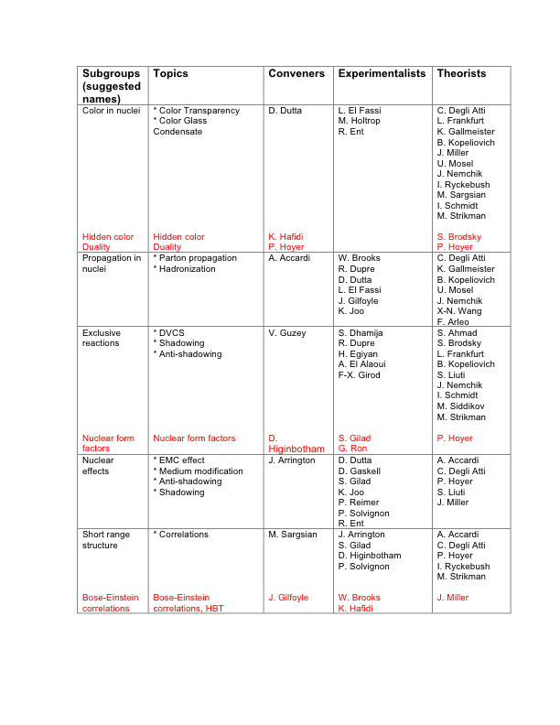
Effort organization - 1

Slide 3
Effort organization - 2

Slide 4
Timeline
Next couple of weeks
- Working group chairs send a compilation of the physics topics discussed in the workshop
- Organize a phone conference to set the priorities and identify at least one interesting topic to study and the persons interested (this is special opportunity for young people!)
Next month
Prepare a draft version of the white paper (“nuclear Chromo-Dynamics” section)
Next two months
- Finalize the simulations: Define the energy, luminosity, angular range and resolution
- Agree on two or three flagship measurements to present in the June users group meeting
Next six months
Expand our efforts to new topics and finalize* our section in the EIC white paper
(Seattle meeting)

Slide 5
Thank you for your outstanding participation and I hope that we will keep the momentum and succeed to make an excellent case for the physics we all love !

