Slide 1
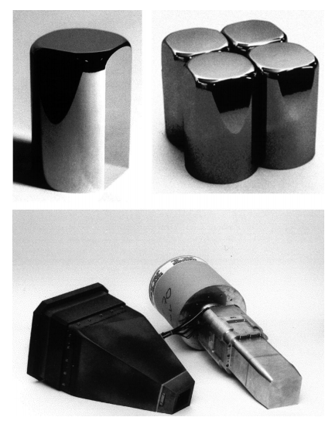
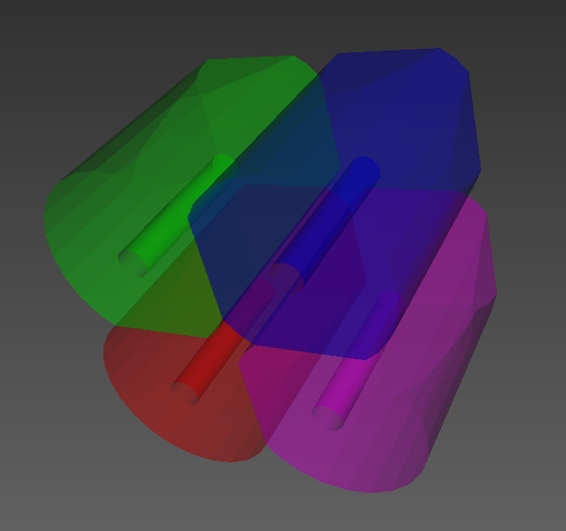
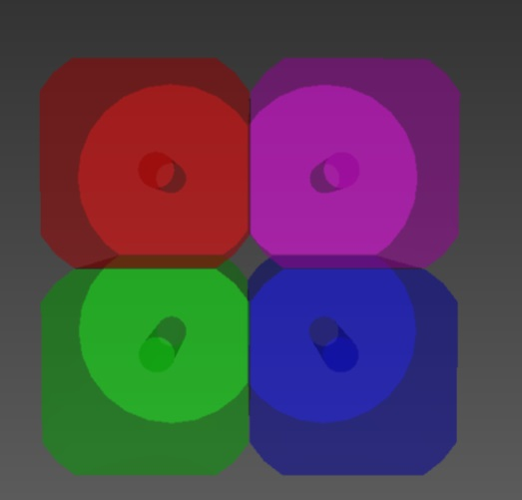
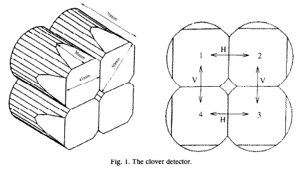
Modification of Geant4 simulation
reference materials
real geometry
Detailed crystal structures included

Slide 2
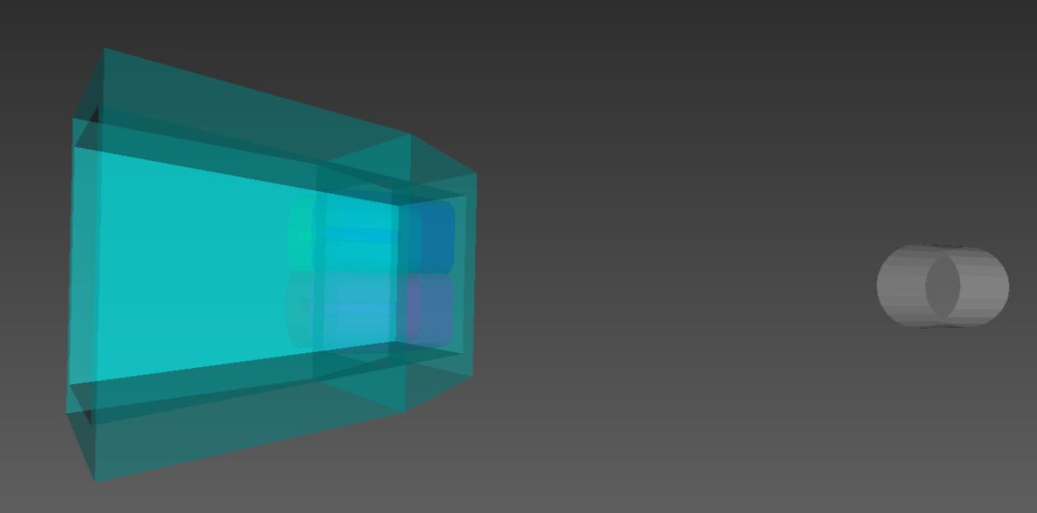
Checking of single Clover against NaI
NaI + source (25 cm away) for checking of the absolute photopeak efficiency
Clover
1330 keV gamma
10⁶ events generated
NaI
(φ7.62cm×7.62cm)
 | photo peak count | detection efficiency
NaI | 1337 | 1.337×10⁻³
Clover Crystal #1 | 327 | 24.5% (Relative)
Clover Crystal #2 | 330 | 24.7% (Relative)
Clover Crystal #3 | 308 | 23.0% (Relative)
Clover Crystal #4 | 340 | 25.4% (Relative)
before Add back | 1305 | 97.6% (Relative)
after Add back | 2013 | 150.6% (Relative)
Literature value: 1.2X10⁻³
add-back factor: 1.54

Slide 3
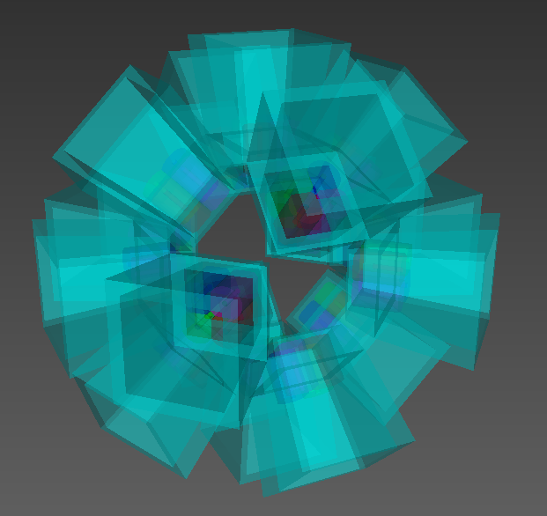
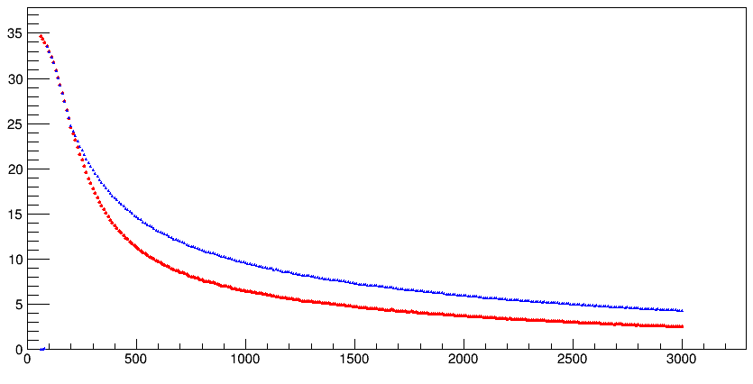
Geant4 simulation
photo peak efficiency [%]
Detector geometry
after Add back
before Add back
Energy [keV]

