Slide 1


Quest for the Anti-Quark Sea: E906/SeaQuest
Kazutaka Nakahara
University of Maryland College Park
for the
E906 Collaboration
ECT* Conference, Drell-Yan Workshop, Trento, Italy
May 2012

Slide 2
SeaQuest Collaboration
● Abilene Christian University:
Donald Isenhower, Tyler Hague, Rusty Towell, Shon
Watson
● Academia Sinica:
Wen-Chen Chang, Yen-Chu Chen, Shiu Shiuan-Hal, Da-Shung Su
● Argonne National Laboratory:
John Arrington, Donald F. Geesaman (co-spokesperson),
Kawtar Hafidi, Roy Holt, Harold Jackson, David
Potterveld, Paul E. Reimer (co-spokesperson),
Joshua Rubin
● University of Colorado:
Ed(ward) Kinney, Joseph Katich, Po-Ju Lin
● Fermi National Accelerator Laboratory:
Chuck Brown, Dave Christian, Jin-Yuan Wu
● University of Illinois:
Bryan Dannowitz, Markus Diefenthaler, Bryan Kerns, Naomi C.R Makins, R. Evan McClellan, Jen-Chieh Peng
● KEK:
Shin'ya Sawada
● Ling-Tung University:
Ting-Hua Chang
● Los Alamos National Laboratory:
Christine Aidala, Gerry Garvey, Mike Leitch, Han Liu, Ming
Liu, Pat McGaughey, Joel Moss, Andrew Puckett
● University of Maryland:
Betsy Beise, Kazutaka Nakahara
● University of Michigan:
Chiranjib Dutta, Wolfgang Lorenzon, Richard Raymond, Michael
Stewart
● National Kaohsiung Normal University:
Rurngsheng Guo, Su-Yin Wang
● University of New Mexico:
Younus Imran
● RIKEN:
Yoshinori Fukao, Yuji Goto, Atsushi Taketani, Manabu Togawa
● Rutgers University:
Lamiaa El Fassi, Ron Gilman, Ron Ransome, Brian Tice, Ryan
Thorpe, Yawei Zhang
● Tokyo Tech:
Shou Miyaska, Kenichi Nakano, Florian Sanftl, Toshi-Aki Shibata
● Yamagata University:
Yoshiyuki Miyachi
ECT* Conference, Trento, Italy May 2012

Slide 3
Physics – structure of nucleons and nuclei
  Structure of the anti-quark sea
  J/ψ
Experiment/Commissioning Run
ECT* Conference, Trento, Italy May 2012

Slide 4
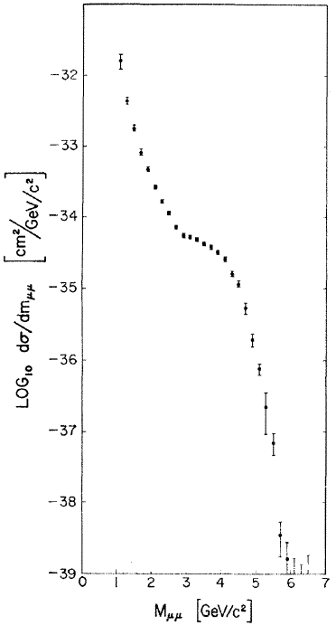
First, a bit of history...
First seen in 1970 at BNL/AGS
Proton-uranium collision
Not enough resolution to see resonant structure
Extensively used to probe nucleon structure
Anti-quark structure of nucleons and nuclei? u = d? EMC Effect?
J/ψ: nucleon gluon distributions, nuclear dependence
ECT* Conference, Trento, Italy May 2012

Slide 5
Drell-Yan, DIS, and Parton Distributions
DIS and Drell-Yan
both powerful tools in probing parton distributions in nucleons and nuclei
complementary in many respects
E906 Drell-Yan:
Fixed target experiment: LH₂, LD₂, and 3 solid targets
Probe anti-quark structure of nucleons
  d/u in the sea – how is the sea generated?
Do parton distributions differ between nucleons and nuclei?
Simultaneous di-muon measurements of J/ψ probe gluon distributions of nucleons
ECT* Conference, Trento, Italy May 2012

Slide 6
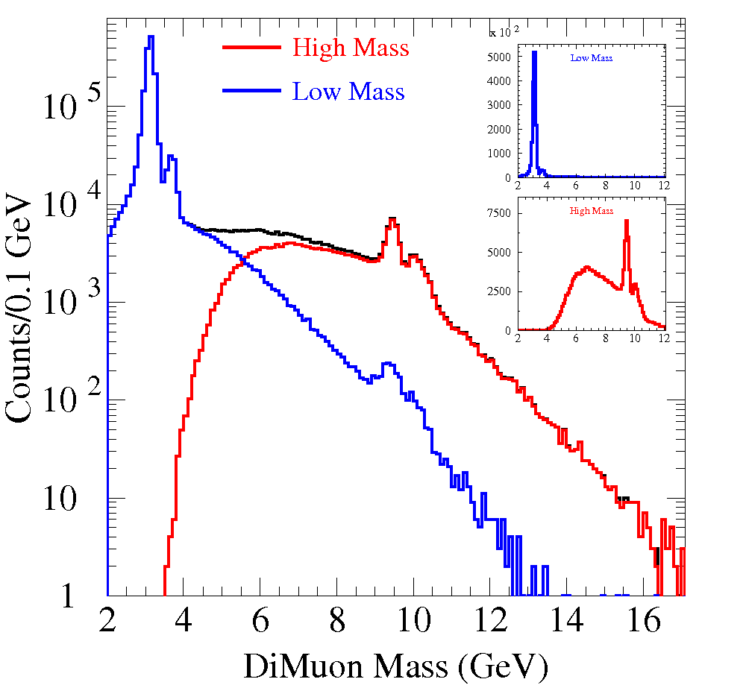
Expected Mass Spectrum
How is the nucleon sea generated?
Filter out resonances, and focus on DY.
Mass spectra from E866/NuSea
ECT* Conference, Trento, Italy May 2012

Slide 7
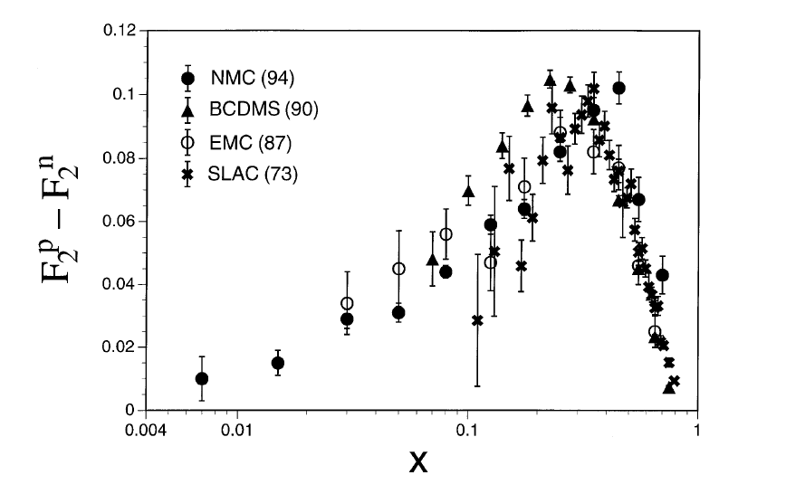
E906/Drell-Yan: u = d ?
pp, pd
How is the sea generated?
Drell-Yan is sensitive to anti-quarks – specific to the sea
Gluon splitting would suggest symmetry
Gottfried Sum Rule:
S_{G} = 1/3 if u = d
Charge Symmetry
New Muon Collaboration (NMC), Phys. Rev. D50 (1994) R1
S_{G} = 0.235 +/- 0.026
ECT* Conference, Trento, Italy May 2012

Slide 8
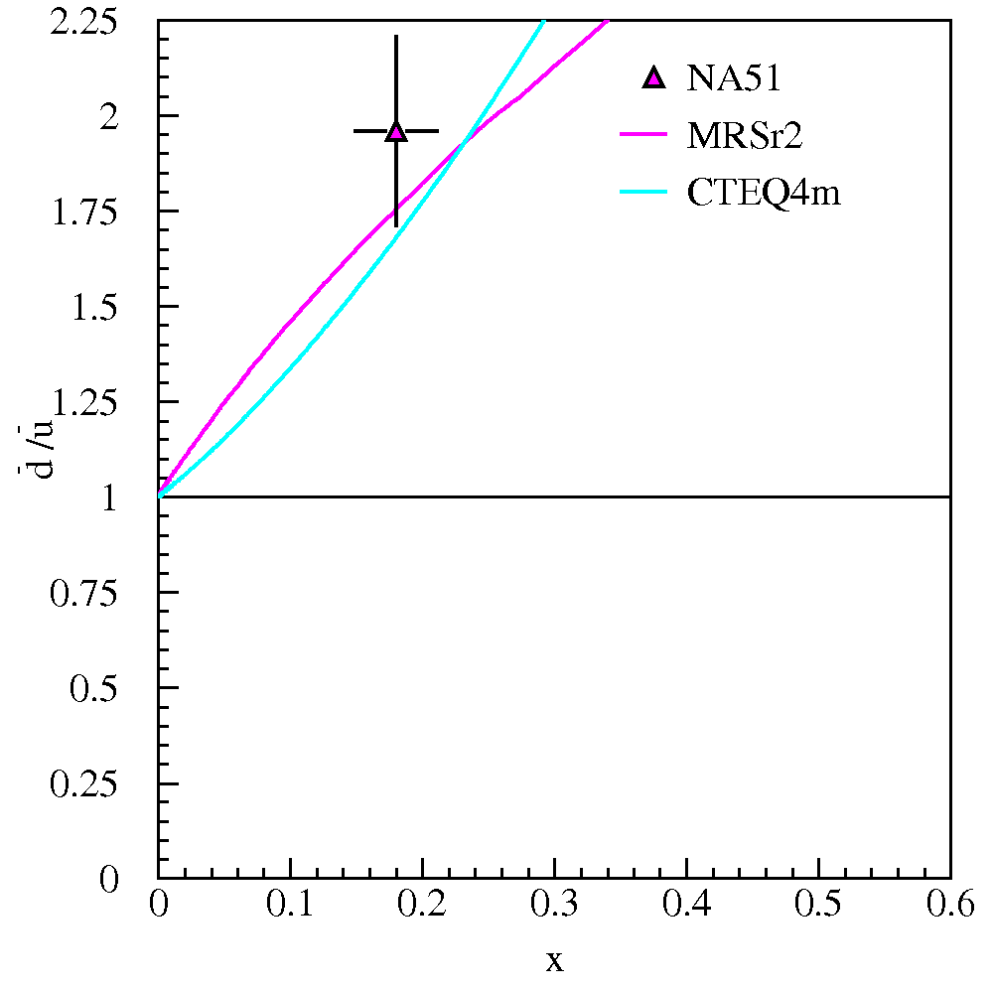
Direct Measurements
ECT* Conference, Trento, Italy May 2012

Slide 9
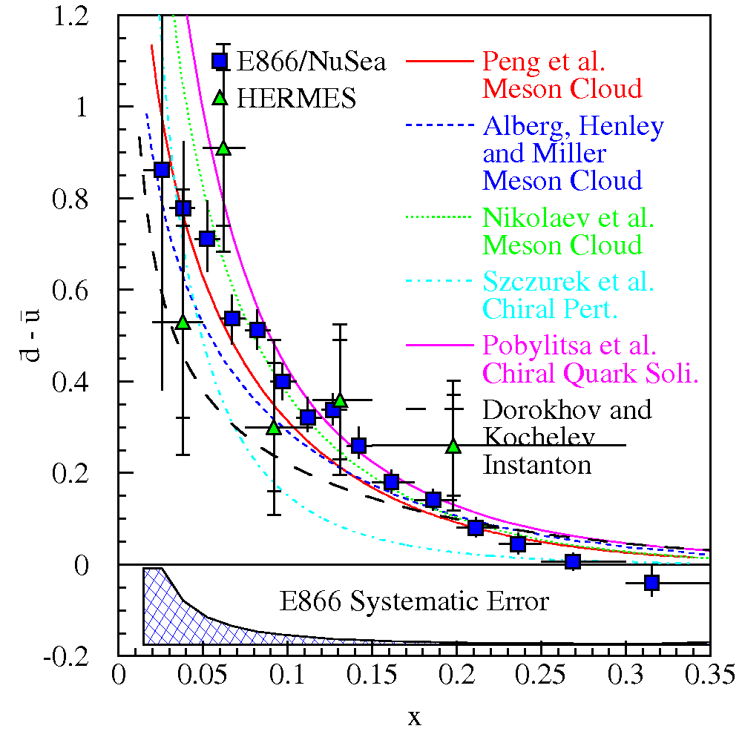
Origins of the quark sea?
Various models attempt to explain the cause
Gluon splitting would be symmetric
Valence quark effect?
Non-perturbative models?
  Meson cloud model p → π⁺ n?
  Chiral models u→d π⁺ , d→ u π⁻ ?
Deviation at higher x ➔ probe higher x
ECT* Conference, Trento, Italy May 2012

Slide 10
E866 Drell-Yan
Fermilab Meson East Building
800 GeV proton beam
0.04 < x < 0.35
Uncertainties dominated by statistics (~1% systematic uncertainties in cross section ratio)
ECT* Conference, Trento, Italy May 2012

Slide 11
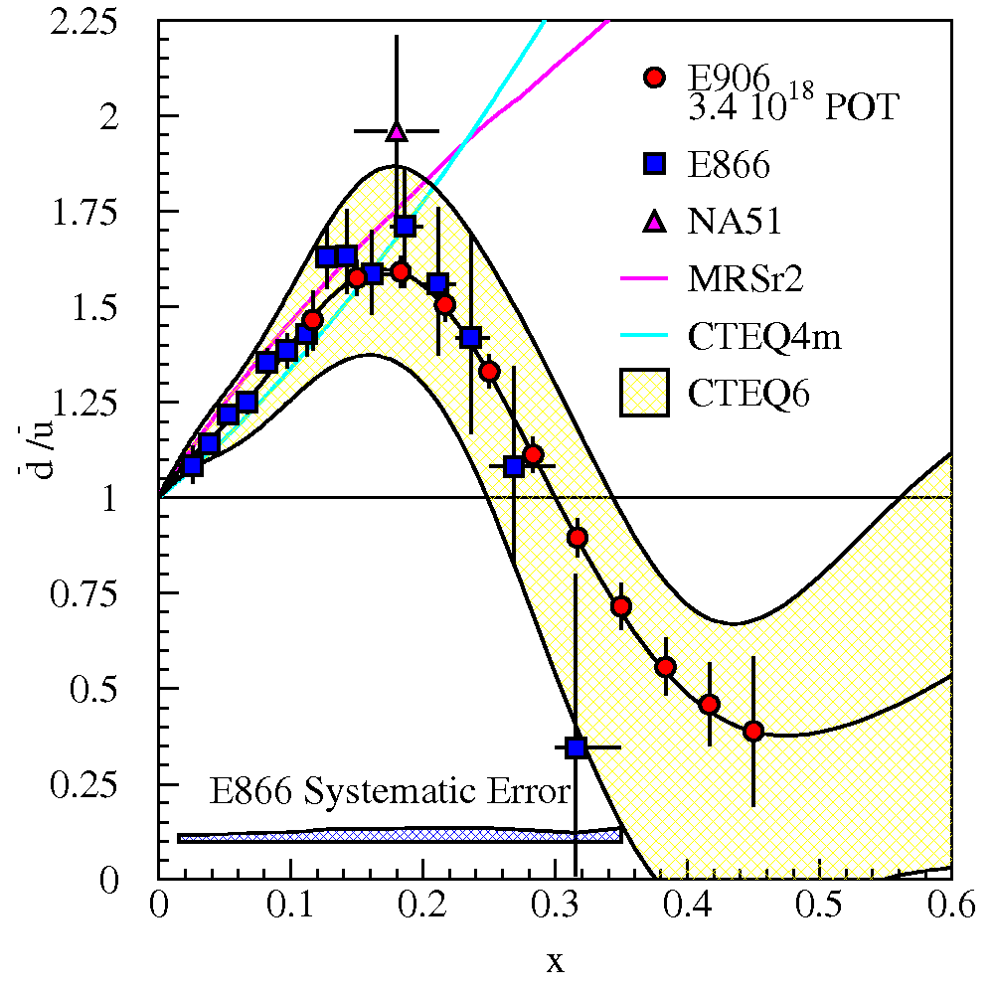
E906 Drell-Yan
120 GeV proton beam (E866: 800 GeV)
  cross section scales as 1/s:
  7x statistics
  background scales as s:
  7x luminosity
  50x statistics
Systematic uncertainties ~1%
What happens at high x?
ECT* Conference, Trento, Italy May 2012

Slide 12
So much for nucleons...
What about parton distributions in nuclei?
Nuclear Modifications
ECT* Conference, Trento, Italy May 2012

Slide 13
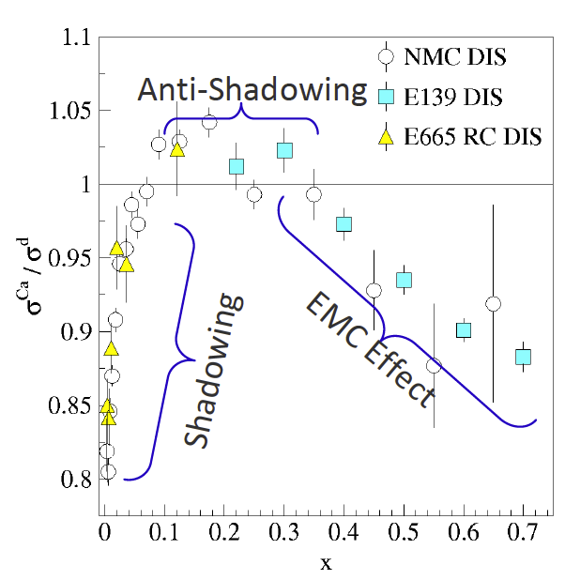
Nuclear Modification
Nuclear Modification in DIS
Shadowing at low x
Enhancement below x ~0.3
Suppression at larger x
Structure functions include both quark and anti-quark contributions
Measured for a broad range of targets
(Ann. Rev. Nucl. Part. Phys., Geesaman, Sato and Thomas)
Nuclear Modification in Drell-Yan (E772)
Drell-Yan accesses the anti-quark component
Binding mediated by pion exchange
Exchanged mesons contain anti-quarks ➔ enhancement
PRL 64 (1990) 2479
No evidence of anti-quark enhancement in nuclei ➔ where did the pions go?
ECT* Conference, Trento, Italy May 2012

Slide 14
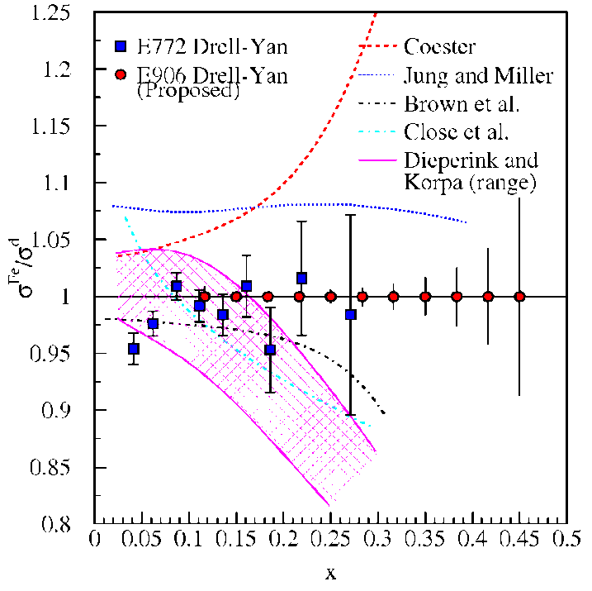
Nuclear Modification: E906
Nuclear Targets: Carbon, Iron, Tungsten
Nuclear Modification- complementary with DIS, extends previous Drell-Yan measurements
  Extend to x ~ 0.45
E772: 800GeV proton beam
Models must explain both Drell-Yan and DIS.
ECT* Conference, Trento, Italy May 2012
Notes:
What will E906 do? Higher x, more statistics.

Slide 15
Now filter out DY, and focus on
J/ψ resonance.
Mass spectra from E866/NuSea
ECT* Conference, Trento, Italy May 2012

Slide 16
Why J/ψ?
Are gluon distributions similar between p and n?
cc deconfinement ➔ J/ψ suppression in QGP
  J/ψ suppression competing against multiple effects: Absorption, CNM induced nuclear dependence
Often assumed, but not necessarily fundamental
qq annihilation ➔ dimuon pair
gluon-gluon fusion
ECT* Conference, Trento, Italy May 2012

Slide 17
J/ψ Production: p-d, p-p
gluon-gluon fusion
Lingyan Zhu et al., PRL, 100 (2008) 062301 (arXiv: 0710.2344)
Gluon distributions between p and n are very similar
E866: Upsilon production
E906: J/ψ production
ECT* Conference, Trento, Italy May 2012

Slide 18
Again, what about bound systems?
cc deconfinement ➔ J/ψ suppression in QGP
  J/ψ suppression during QGP formation competing against multiple effects: absorption, energy loss within nuclei, etc
  How can we understand these “other processes”?
ECT* Conference, Trento, Italy May 2012

Slide 19
J/ψ Nuclear Dependence
Suppression of J/ψ yield per nucleon
ECT* Conference, Trento, Italy May 2012
Notes:
pictures of both interactions

Slide 20
J/ψ Nuclear Dependence
Suppression of J/ψ yield per nucleon
absorption ~ x_{F}=0?
  cc dissociation through interaction within nucleus or with comoving secondaries
parton/gluon energy loss?
  loss in both initial and final states
q, g
Cannot account for the suppression ➔ remains a mystery
ECT* Conference, Trento, Italy May 2012

Slide 21
Can we study some of these effects?
Go back to DY for a second...
ECT* Conference, Trento, Italy May 2012

Slide 22
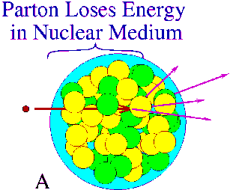
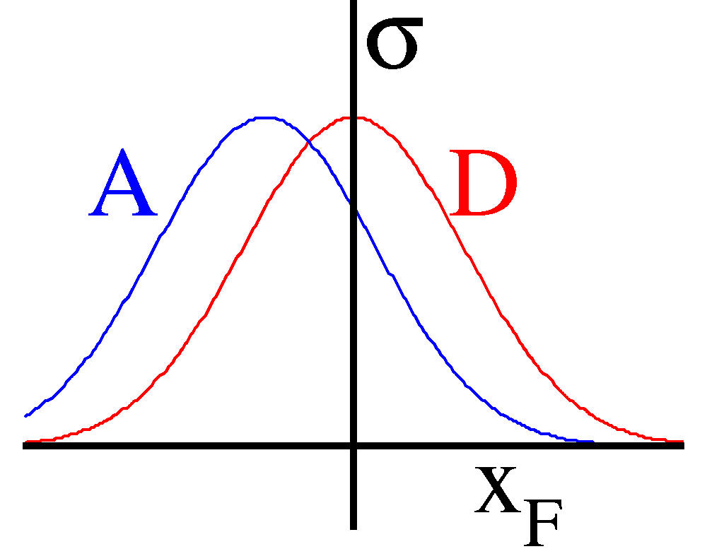
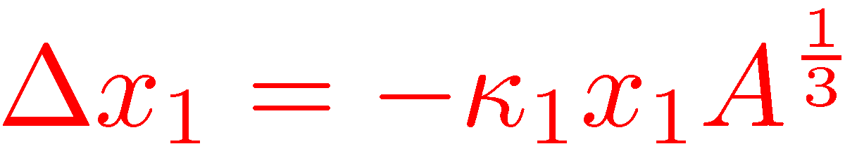
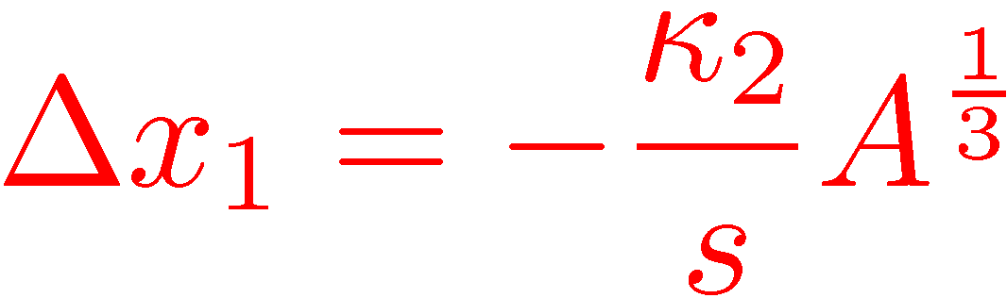
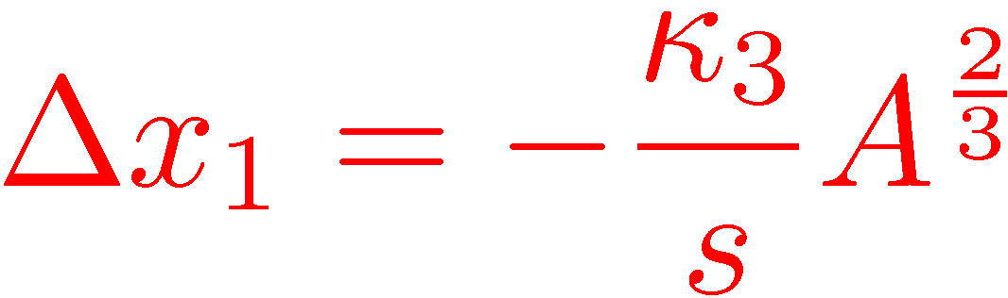
Partonic Energy Loss: pA₁/pA₂
An understanding of partonic energy loss in both cold and hot nuclear matter is paramount to elucidating RHIC data.
Energy loss through cold nuclear matter
Pre-interaction parton moves through cold nuclear matter and loses energy
Apparent (reconstructed) kinematic values (x₁ or x_{F})is shifted
Fit shift in x₁ relative to deuterium (E906)
Models:
  Galvin and Milana
  Brodsky and Hoyer
  Baier et al.
ECT* Conference, Trento, Italy May 2012
Notes:
Partonic energy loss. How do partons lose energy in nuclear medium (pre-interaction)?
Results in shift in x of cross section. E866 = limits on energy loss set. Shadowing seen at
low x…DIS and DY shadowing are quantitatively similar.

Slide 23
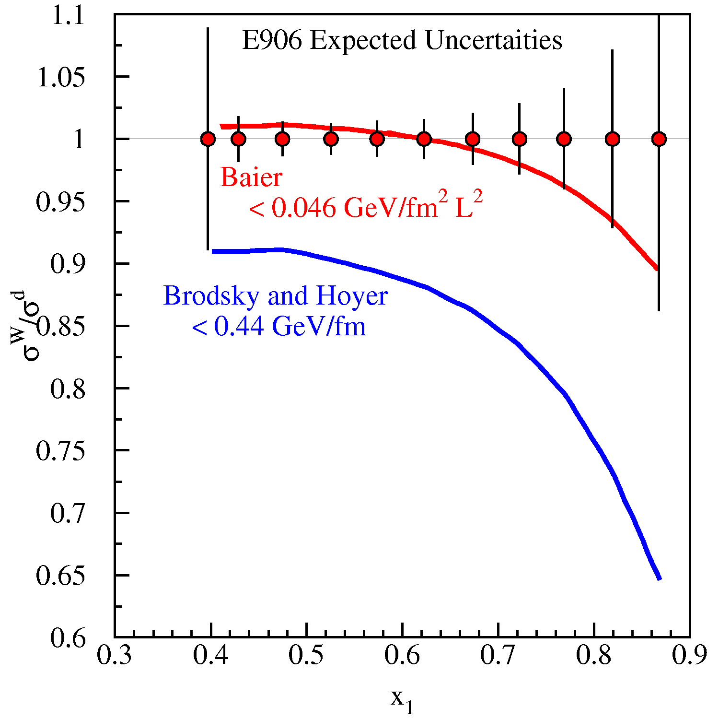
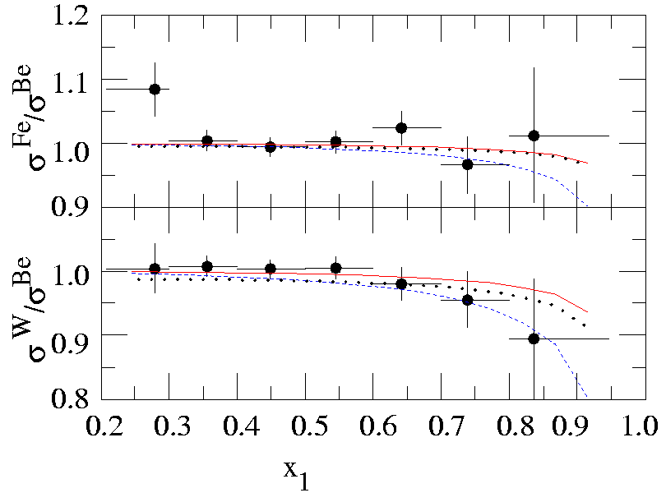
Energy loss ~ 1/s
  larger at 120 GeV
Sufficient statistics to remove shadowing contribution for low x₂
Measurements instead of limits
Fits on E866 data reveal no energy loss.
Correct for shadowing with DIS
  X₂ anti-correlates with x₁ and x_{F} ➔ shadowing contributions at large x₁
  Caveat: A correction must be made for shadowing because of x₁—x₂ correlations
  E866 used an empirical correction based on EKS fit to DIS and Drell-Yan.
Better data outside of shadowing region needed
E906 expected uncertainties
Shadowing region removed
LW10504
Energy loss upper limits based on E866 Drell-Yan measurement
ECT* Conference, Trento, Italy May 2012
Notes:
Galvin and Milana – parametrization form based on analogy to transverse spin asymmetry in direct photon production.
- Brodsky and Hoyer – parametrization form based on analogy to photon bremsstrahlung

Slide 24
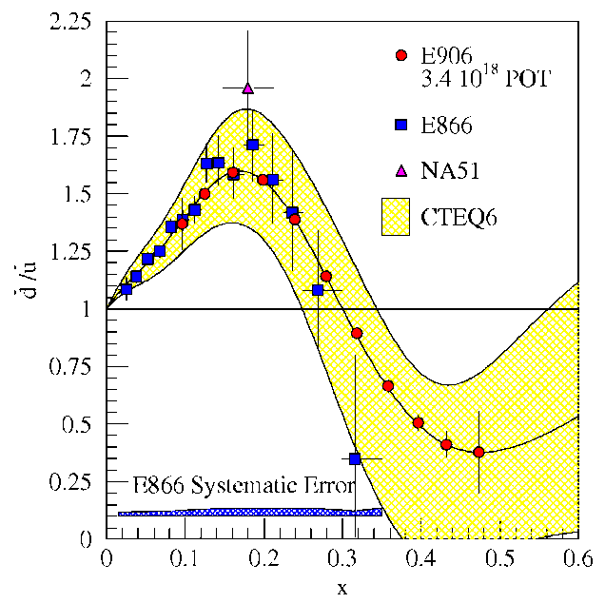
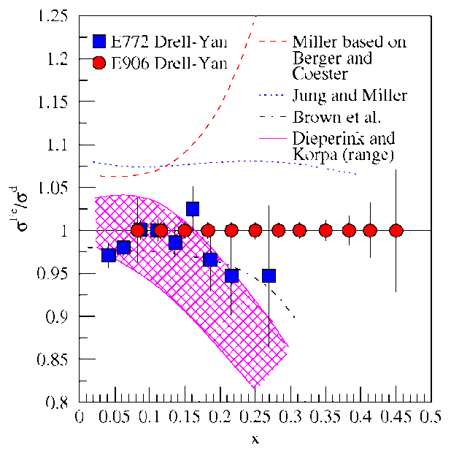
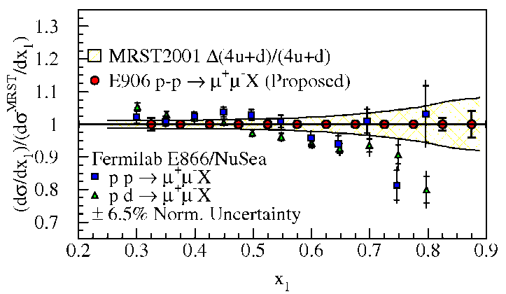
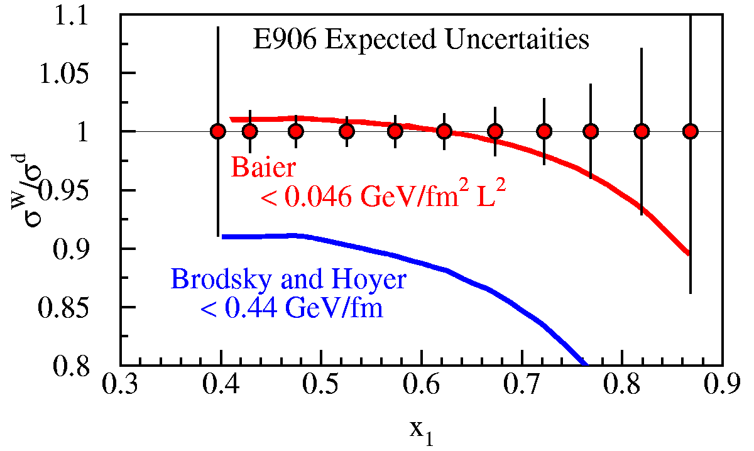
Drell-Yan fixed target experiments at Fermilab
What is the structure of the nucleon?
  What is ?
  What is the origin of the
  sea quarks?
  What is the high x
  structure of the proton?
What is the structure of nucleonic matter?
  Where are the nuclear pions?
  Is anti-shadowing a valence effect?
Do colored partons lose energy in cold nuclear matter?
SeaQuest: 2012-2014
  significant increase in physics reach
Beyond SeaQuest
  Polarized Drell-Yan
  Pionic Drell-Yan
Notes:
While providing direct input to the parton distributions fits, the ultimate impact of E906 will be to provide a better understanding on the physical mechanism which generates the sea of the proton.

Slide 25
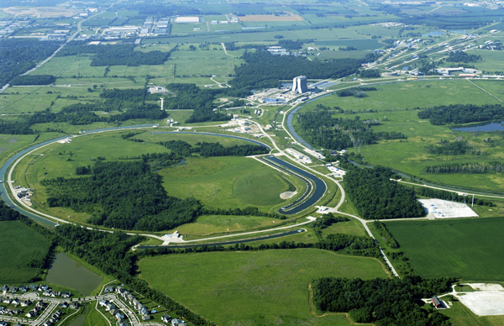
Fixed Target Beam lines
Tevatron 800 GeV
Main Injector 120 GeV
ECT* Conference, Trento, Italy May 2012

Slide 26
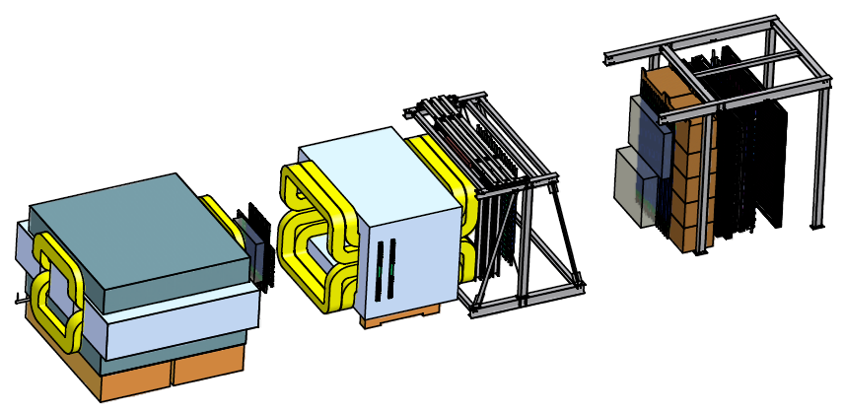
What are we really going to measure?
Station 4:
Hodoscope array
Prop tube tracking
Station 2 and 3:
Hodoscope array
Drift Chamber tracking
Station 1:
Hodoscope array
MWPC tracking
Solid Iron Focusing Magnet, Hadron absorber and beam dump
Mom. Meas.
(KTeV Magnet)
4.9m
Hadron Absorber
(Iron Wall)
Liquid H₂, d₂, and solid targets
25m
Drawing: T. O’Connor and K. Bailey
ECT* Conference, Trento, Italy May 2012

Slide 27
Reduce, Reuse, Recycle
St. 4 Prop Tubes: Homeland Security via Los Alamos
St. 3 & 4 Hodo PMT’s: E-866, HERMES, KTeV
St. 1 & 2 Hodoscopes: HERMES
St. 2 & 3- tracking: E-866
St. 2 Support Structure: KTeV
Target Flasks: E-866
Cables: KTeV
2nd Magnet: KTeV Analysis Magnet
Hadron Absorber: Fermilab Rail Head???
Solid Fe Magnet Coils: E-866 SM3 Magnet
Shielding blocks from old beamline (Fermilab Today)
Solid Fe Magnet Flux Return Iron: E-866 SM12 Magnet
ECT* Conference, Trento, Italy May 2012

Slide 28
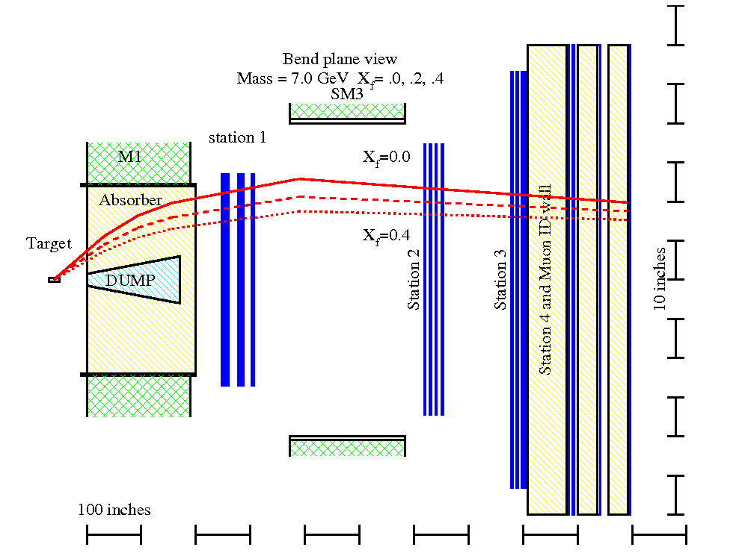
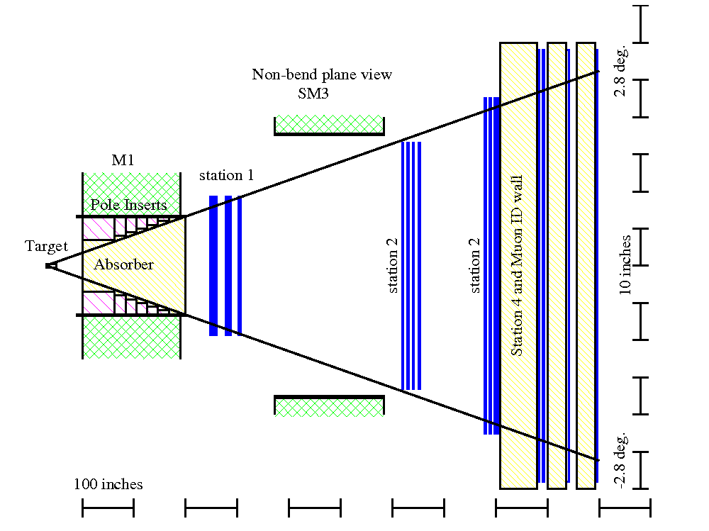
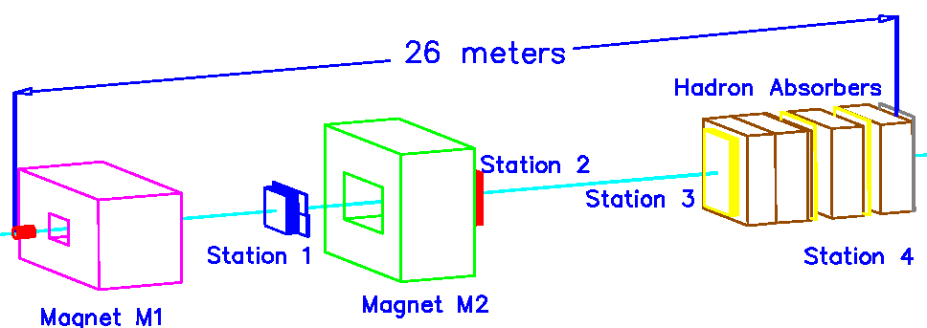
E906 Detector
Trigger electronics
Scintillator Hodoscopes
ECT* Conference, Trento, Italy May 2012

Slide 29
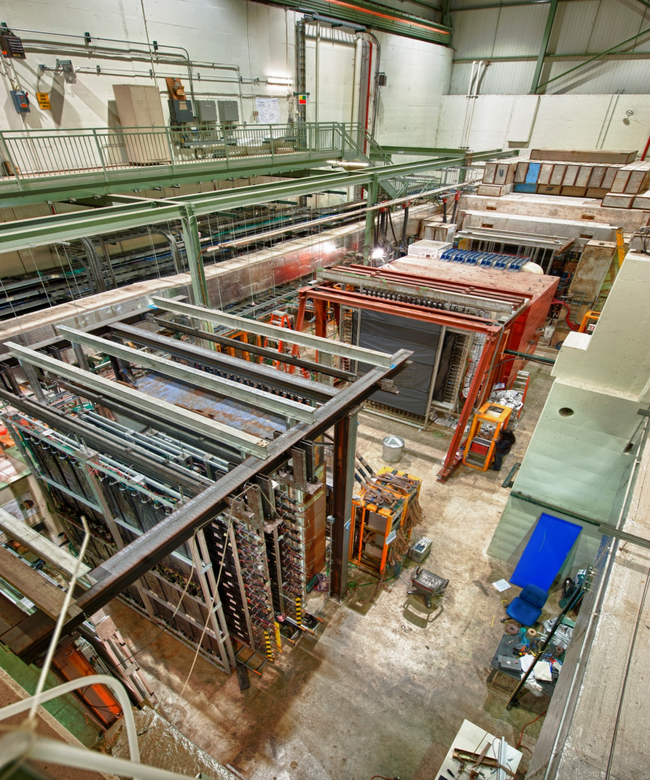
Commissioning Run
Late February 2012 – April 30th 2012
First Beam in E906/SeaQuest: March 8th
All systems worked
Some need improvement
ECT* Conference, Trento, Italy May 2012

Slide 30
BEAM
120 GeV/c protons, 19ns intervals (53 MHz)
1E12/s: 5s spill at 1 minute intervals
Structure at intermediate frequencies (~1-1000Hz) is important!
Extensive tuning by the Fermilab Accelerator Division throughout the run
Fixed Target Beam lines
Tevatron 800 GeV
Main Injector 120 GeV
ECT* Conference, Trento, Italy May 2012

Slide 31
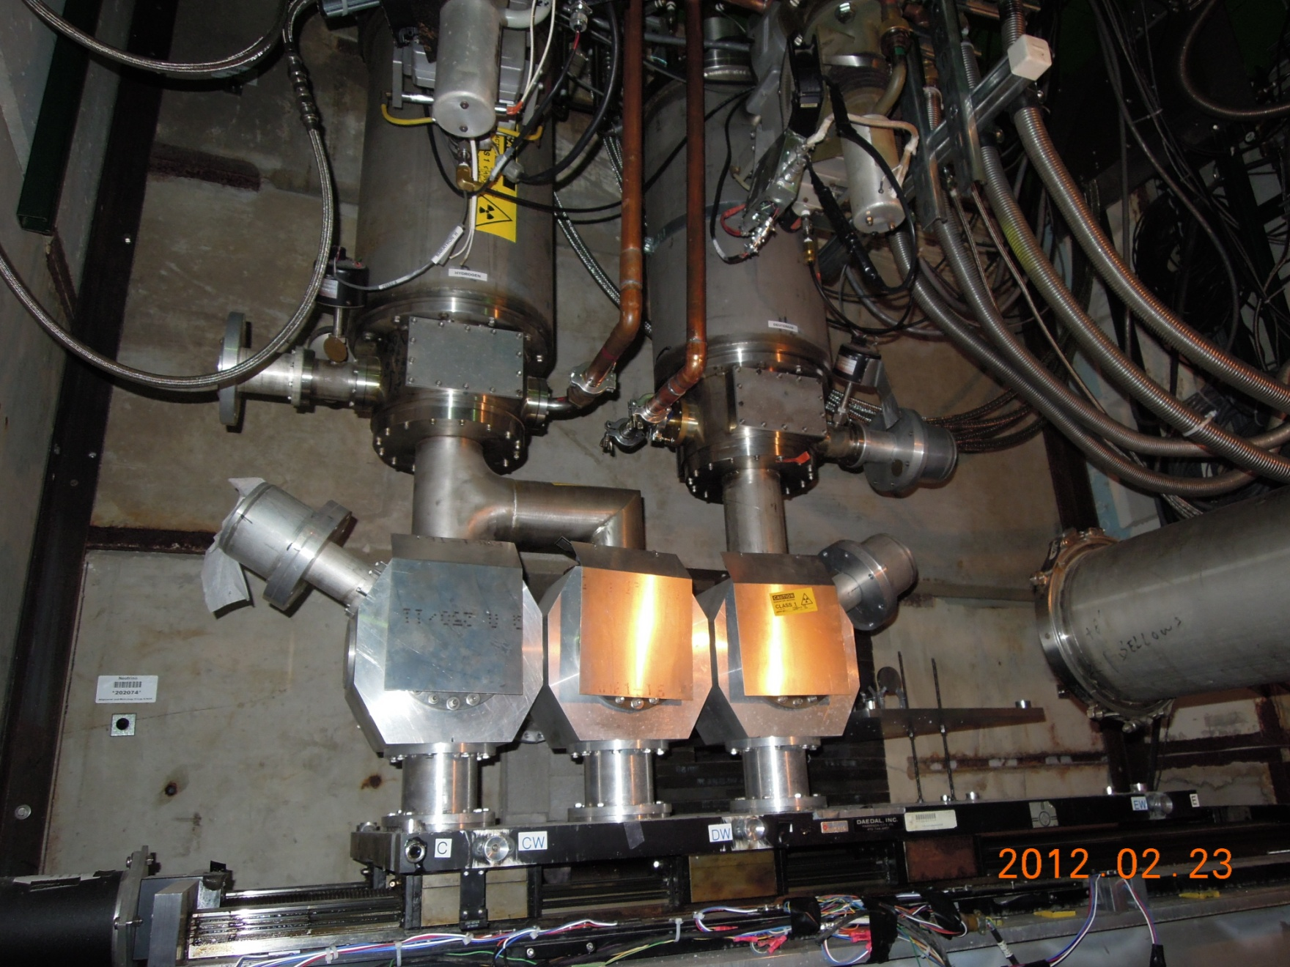
Target Setup
7 Targets
Liquid H₂
Empty Flask
Liquid D₂
“no target”
Fe
C
W
Ca
Motion table
PLC Controlled
ECT* Conference, Trento, Italy May 2012

Slide 32
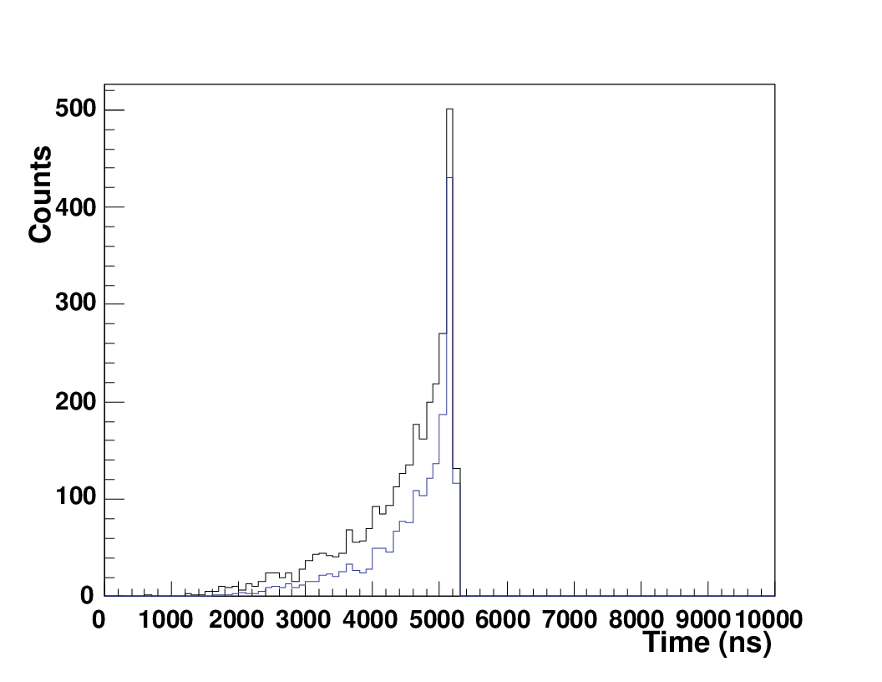
DAQ
CODA (CEBAF Online Data Acquisition) and VME-based Readout Controllers (ROCs = CPUs), TDCs and Scalers
Custom made Time-to-Digital convertor (TDC) cards
Each detector station has a set of dedicated crates/Readout Controllers (ROCs) ➔ deadtime detemined by slowest ROC
Common Stop trigger – Both NIM electronics and FPGA
Store event by event in MySQL ➔ analysis and displays
No “zero-suppression” ➔ large deadtime ~90μs / TDC
TDC Spectra: Prop tube drift time
ECT* Conference, Trento, Italy May 2012

Slide 33
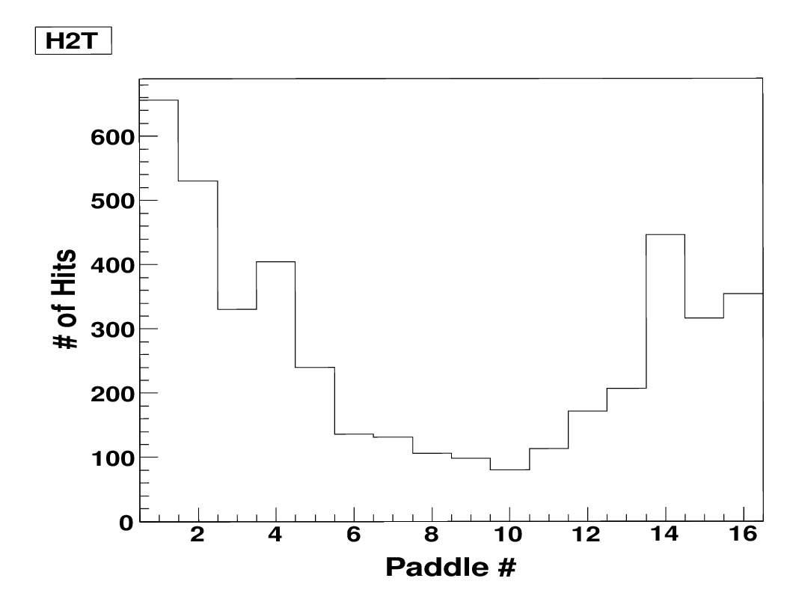
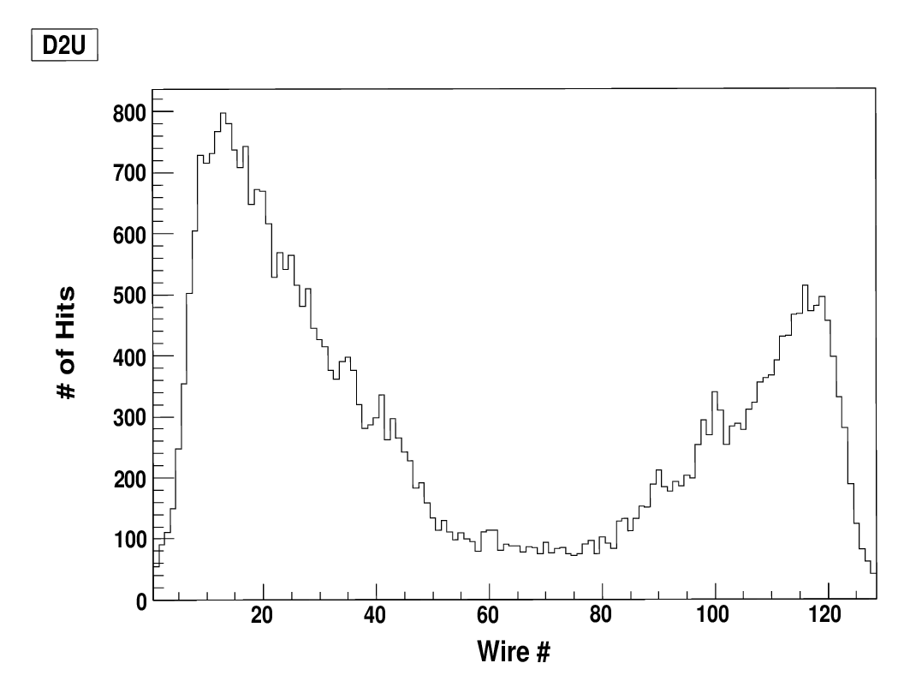
Detectors
Hodoscopes – provides triggers
Wire Chambers/Proportional Tubes
μ⁺
μ⁻
μ⁺
μ⁻
Detectors showed hits consistent with their orientation/geometry.
Final check of their calibration on-going.
New Station 1 and Station3- chambers for next run!
ECT* Conference, Trento, Italy May 2012

Slide 34
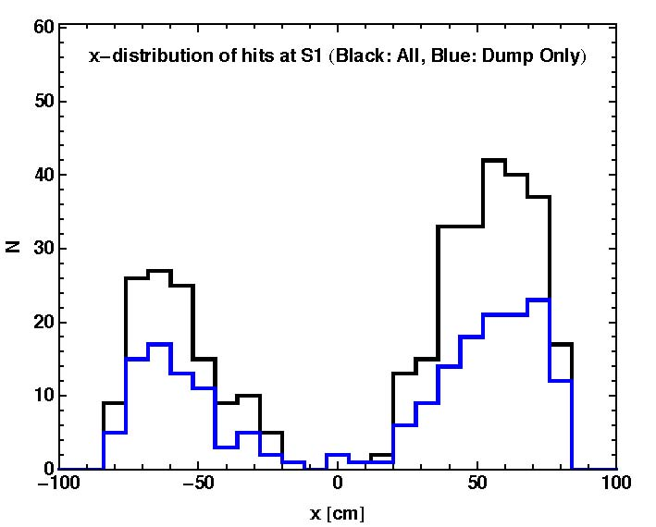
Background
Data
MC
Understand sources of background between peaks.
  for analysis
  shielding for next run?
ECT* Conference, Trento, Italy May 2012

Slide 35
Mysteries
Deadtime:
Each detector station has a set of dedicated crates/Readout Controllers (ROCs) ➔ deadtime detemined by slowest ROC
  Front-end DAQ deadtime ~0.7ms - mostly from TDCs
  BUT, measured event rate is ~50-100Hz (~10 ms deadtime)
  Where is the bottleneck?
  “SPLAT” events:
  detector stations inundated by high rates
    - Background? From where?
    - Beam scraping?
    - Electronic noise/oscillations?
ECT* Conference, Trento, Italy May 2012

Slide 36
Beam Structure
Raw detector rates using a fast pulser trigger ➔ intermediate frequency structure of beam intensity
Beam structure causes low duty factor, high effective deadtime, and high singles rates (“Splat”)
Hypothesis: Beam tune significantly alters our data-taking rate.
low duty factor
~<few ms> intervals between pulses with high instantaneous luminosity
ECT* Conference, Trento, Italy May 2012

Slide 37
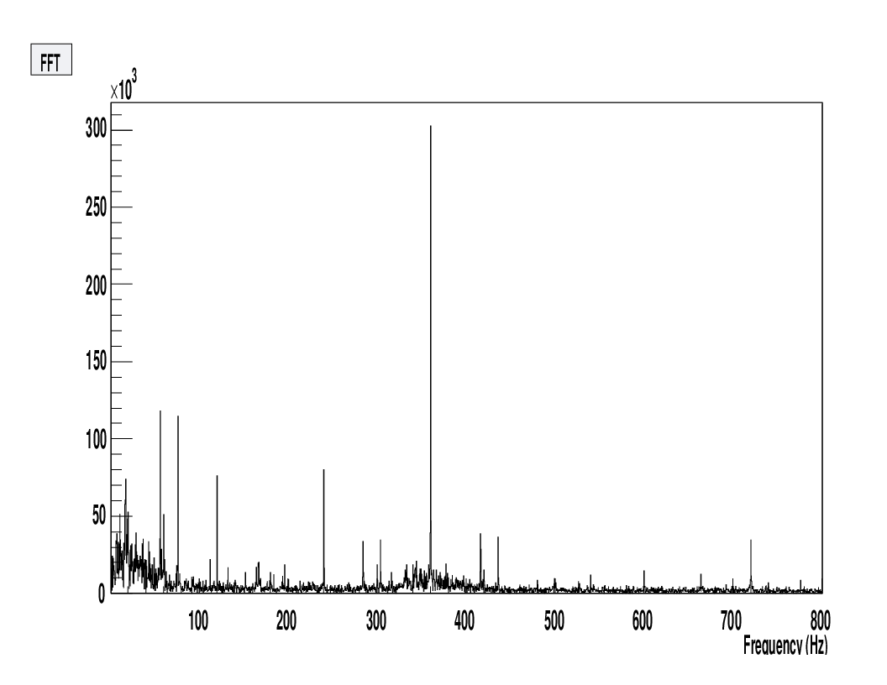
Sizable 60Hz components (and sub-harmonics)
Largest: 360Hz
➔ Main Injector power supplies? possibly...but...there must be more to the story
Hypothesis: Beam tune significantly alters our data-taking rate.
low duty factor
~<few ms> intervals between pulses with high instantaneous luminosity
Fermilab has never done a slow spill extraction from the Main Injector...but...
we need smoother bunches (improve duty factor) to improve event rate
ECT* Conference, Trento, Italy May 2012

Slide 38
Background and “Splat”
Large number of hits on all stations from high instantaneous beam rate
  makes track reconstruction difficult (if not impossible) for those events
Again, smooth out beam OR… block the “Splat” somehow
ECT* Conference, Trento, Italy May 2012

Slide 39
“Splat” block scheme formulated
- “Inhibit card” to veto events with large number of hits
- 160ns integration window – count hodoscope hits (is it greater than threshold?)
ECT* Conference, Trento, Italy May 2012

Slide 40
Inhibit card results in cleaner hits, higher event rate
ECT* Conference, Trento, Italy May 2012

Slide 41
“Splat” block scheme formulated
- “Inhibit card” to veto events with large number of hits
- 160ns integration window – count hodoscope hits (is it greater than threshold?)
yes, most of the luminosity is lost to blocking
beam tune improvement is best option
ECT* Conference, Trento, Italy May 2012

Slide 42
Main Injector Shutdown began (5/1/2012) – 11 months
2E12 protons/s
Reconstructable dimuon events seen!!
Analysis underway
All subsystems worked – improvements for production run are underway
  TDC zero-suppression – significantly improve deadtime
  Improve beam structure
  Understand and block background
  Detector upgrades station1 and station3
Next run to commence - 2013
ECT* Conference, Trento, Italy May 2012

Slide 44
Partonic Energy Loss: E906
Energy loss ~ 1/s
  larger at 120 GeV
Sufficient statistics to remove shadowing contribution for low x₂
Measurements instead of limits
JLab Seminar 6/03/2011
Notes:
What will E906 do? Instead of setting limits on energy loss, we’ll have a measurement.
Enough statistics to remove shadowing contributions at low x2.

Slide 45
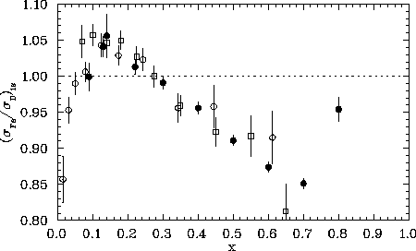
EMC Effect
EMC: hollow circles
SLAC: solid circles
BCDMS: squares
Nuclear Modification
ECT* Conference, Trento, Italy May 2012

Slide 46
Nucleon Structure
3 valence quarks
Naively, sea generated from gluon splitting
How is the nucleon sea generated? u = d?
Gluon distributions differ between protons/neutrons?
ECT* Conference, Trento, Italy May 2012

Slide 47
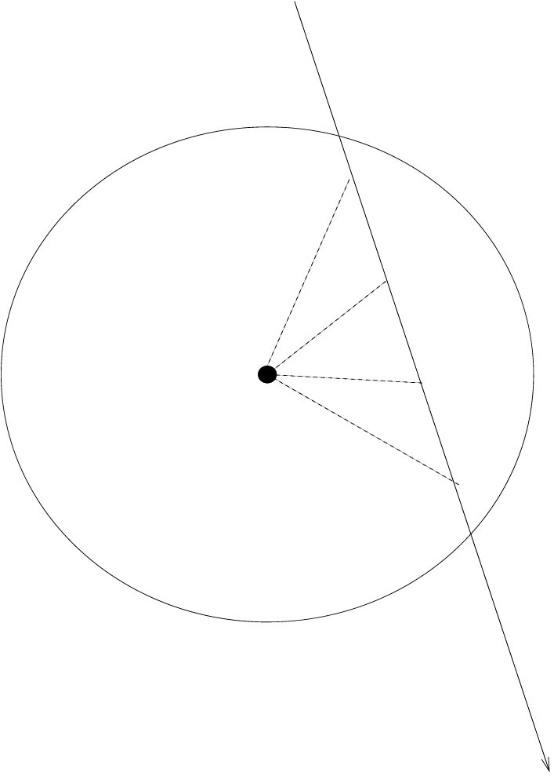
Proportional Tubes
Proportional tube drift time
Drift times of wire chambers and
proportional tubes agree with simulation
Chamber Gas:
P8 (92%Ar, 8%Methane) + 4% CF4
Single Tube
Cross-Sectional View
Ions
P8 + 4% CF₄
μ
ECT* Conference, Trento, Italy May 2012

