Slide 1
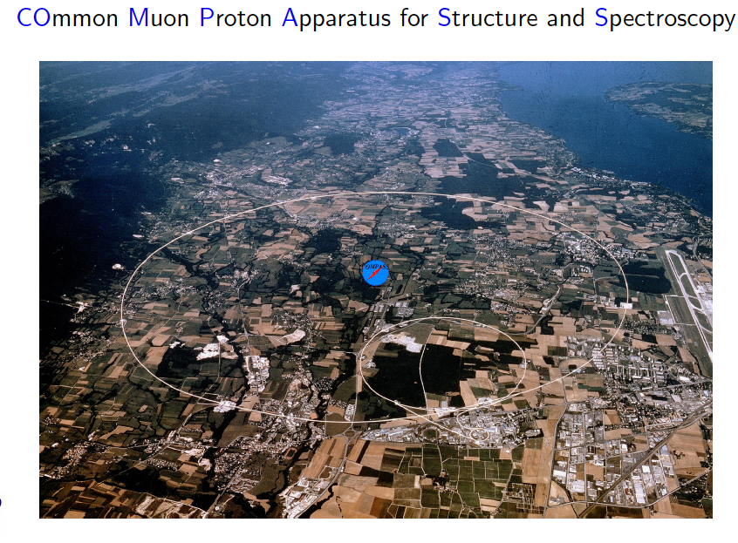


Physics to be explored by the un-polarized Drell-Yan program in COMPASS experiment
ECT* Workshop on Drell-Yan Scattering and the Structure of Hadrons
21-25 May 2012
Wen-Chen Chang
Institute of Physics, Academia Sinica, Taiwan
on behalf of COMPASS Collaboration

Slide 2
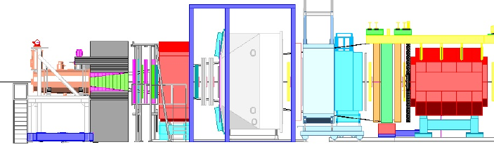
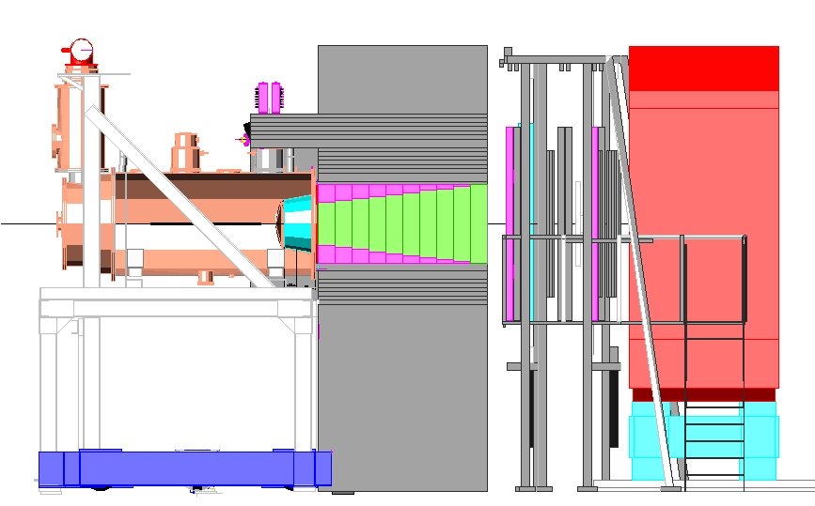
DY@COMPASS - set-up π⁻ p → μ⁻ μ X
π⁻
190 GeV
Key elements:
COMPASS Polarized NH3 Target
Tracking system (both LAS abs SAS) and beam telescope in front of PT
Muon trigger (in LAS is of particular importance - 60% of the DY acceptance)
RICH1, Calorimetry – also important to reduce the background (the hadron flux downstream of the hadron absorber ~ 10 higher then muon flux)
Details referred to Catarina Quintans’s talk on May 23rd.

Slide 3
Outline
Brief review of pion-induced DY experiment
What do we learn?
  Boer-Mulders function vs. QCD vacuum effect
  Pion distribution amplitude and partonic structure
Test of flavor dependency of EMC effect.
Performance of COMPASS experiment.
Summary

Slide 4
Uniqueness of Pion-induced DY
Valence anti-quark in the pion: pion beam is more effective in producing large-mass DY than proton beam.
Sensitive to the valence quark of nucleon target.
Up to now the only way to explore pion structure.

Slide 5
Pion-induced Drell-Yan Experiments:
Measurement of Angular Distributions
FNAL CIP (1979) (252-GeV π−)
CERN NA3 (1981) (150-GeV π− )
CERN NA10 (1986) (194-GeV π− )
FNAL E615 (1989) (252-GeV and 80-GeV π− ; 252-GeV π+)

Slide 6
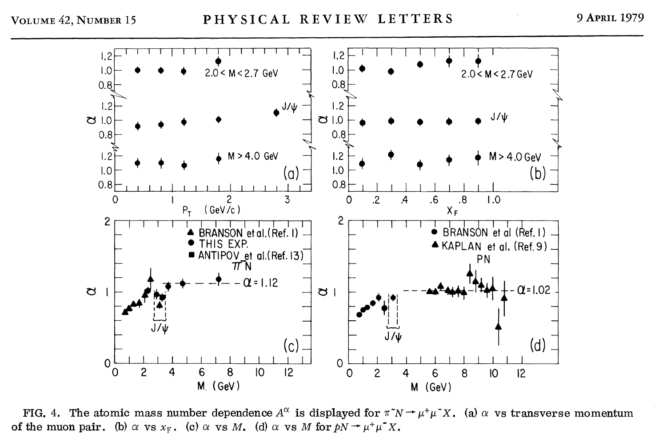
CIP (PRL 42, 944, (1979)) :
Atomic Mass Number Dependence
α=1.12
α=1.02
Consistent with quark-antiquark annihilation DY model.

Slide 7
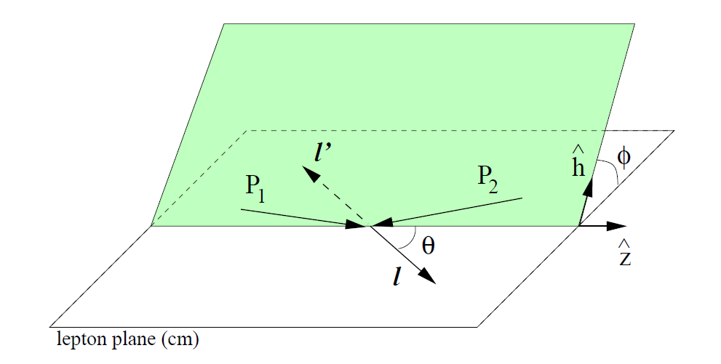
Angular Distribution of Lepton Pair in Drell-Yan process

Slide 8
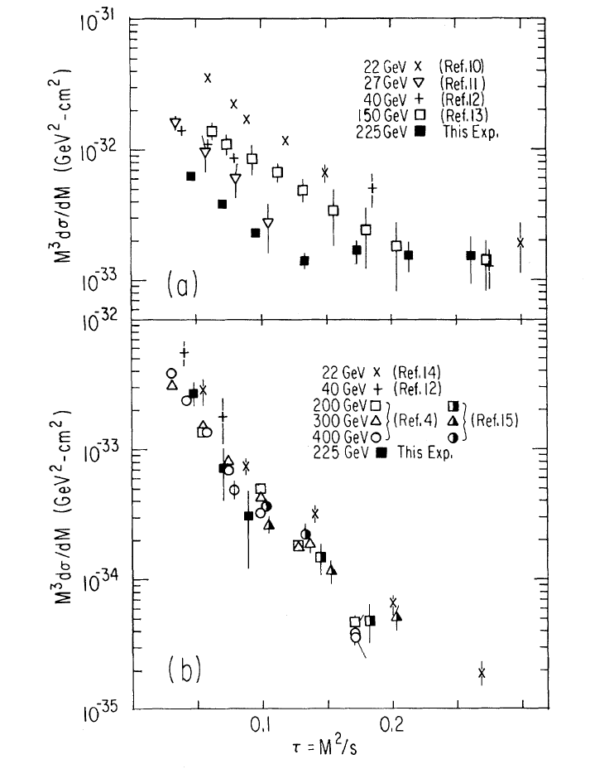
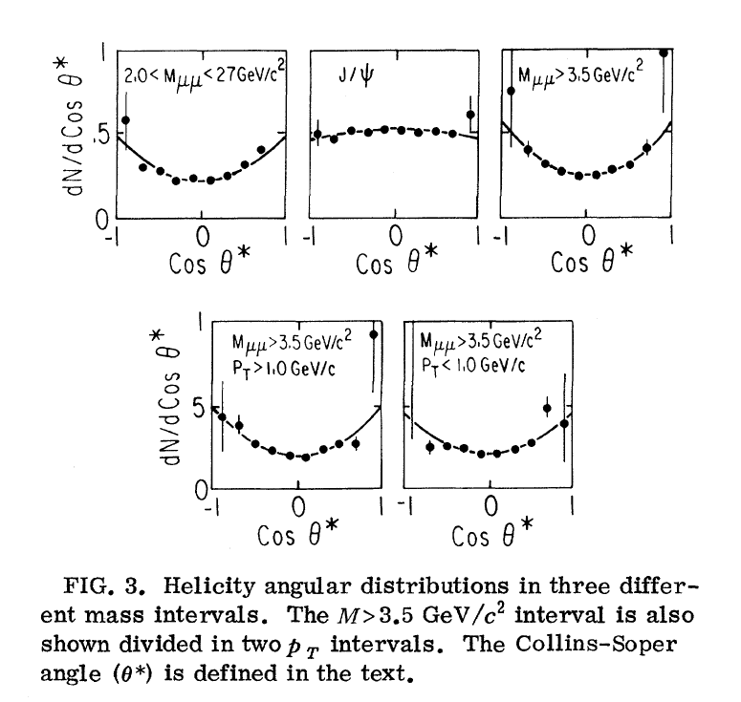
CIP (PRL 42, 948, (1979)) :
Scaling of M²/s

Slide 9
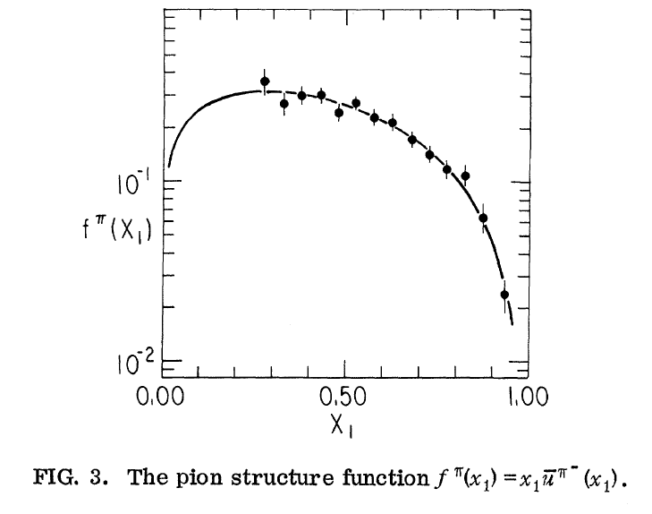
CIP (PRL 42, 951, (1979)) :
Pion Structure Function

Slide 10
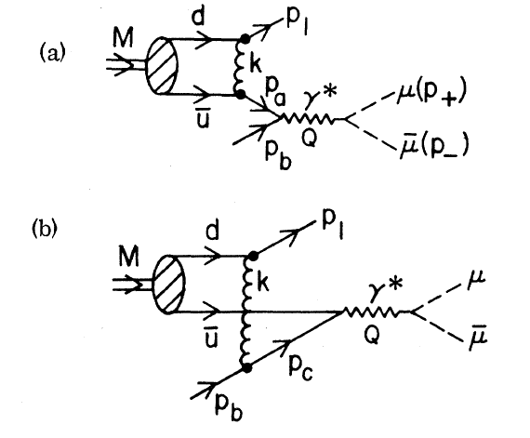
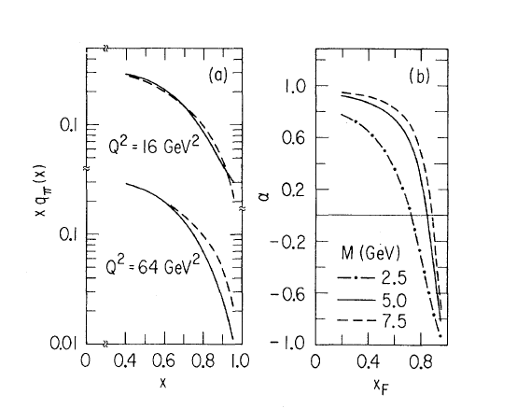
Berger and Brodsky (PRL 42, 951, (1979)) :
Higher Twist Effect at large x₁

Slide 11
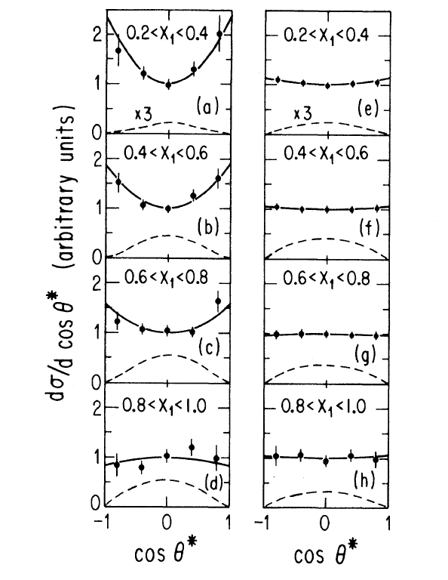
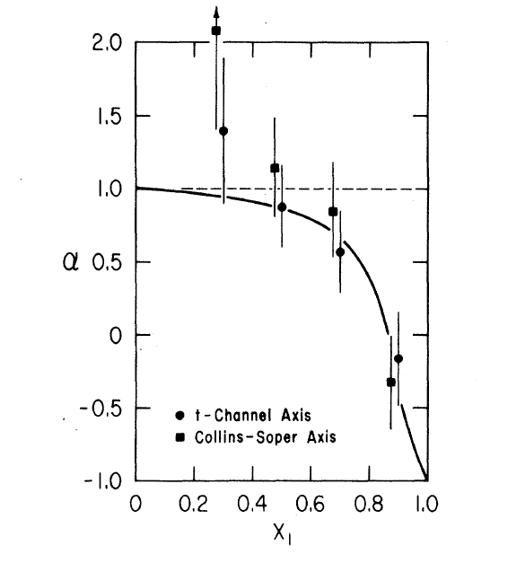
CIP (PRL 43, 1219, (1979)) :
Longitudinally Polarized Photon at large x₁

Slide 12
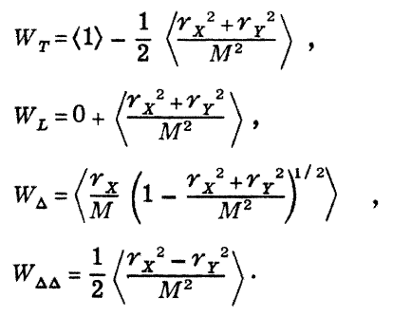
Lam-Tang Relation (1978)
: NLO pQCD

Slide 13
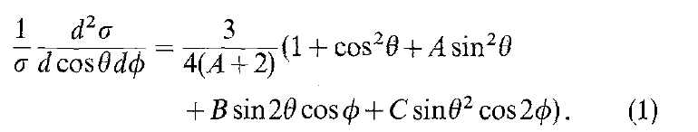
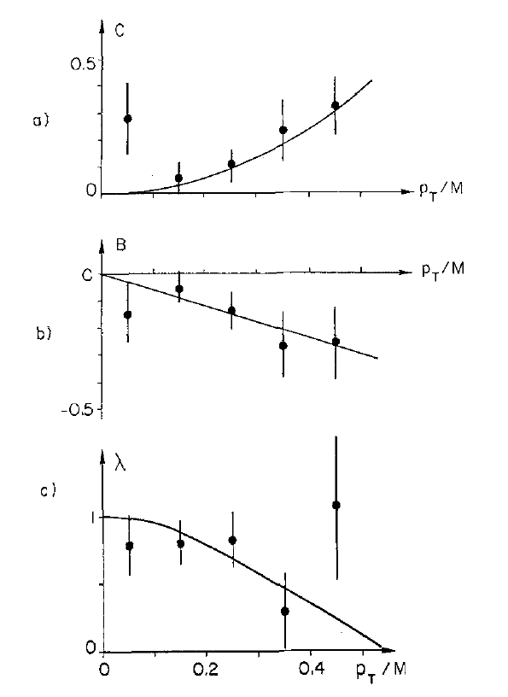
NA3 (Z. Phys. C 11, 195 (1981)) :
Consistent with LT Relation and absence of Higher Twist Effect
------- λ=(1-2ν)

Slide 14
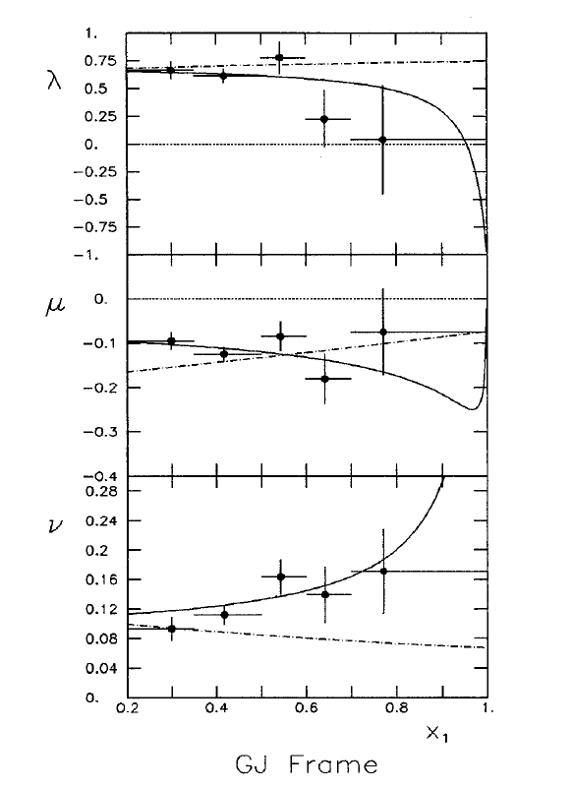
NA10 (Z. Phys. C 31, 513 (1986)):
Observation of Higher Twist Effect

Slide 15
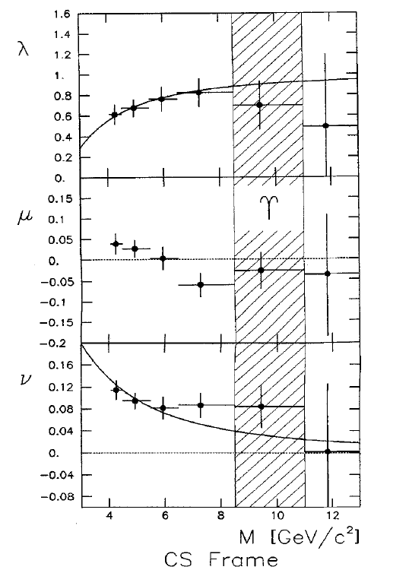
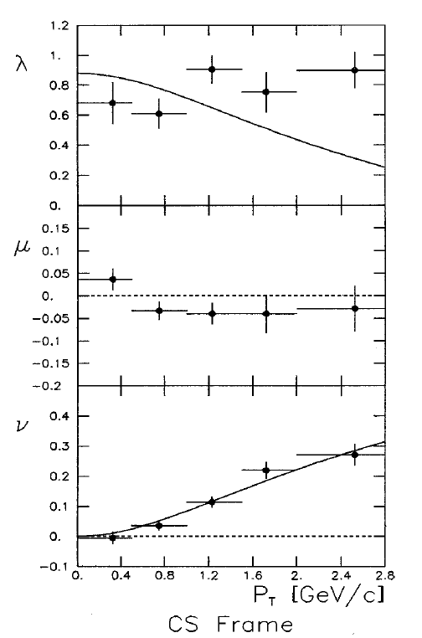
NA10 (Z. Phys. C 31, 513 (1986)):
Violation of LT relation

Slide 16
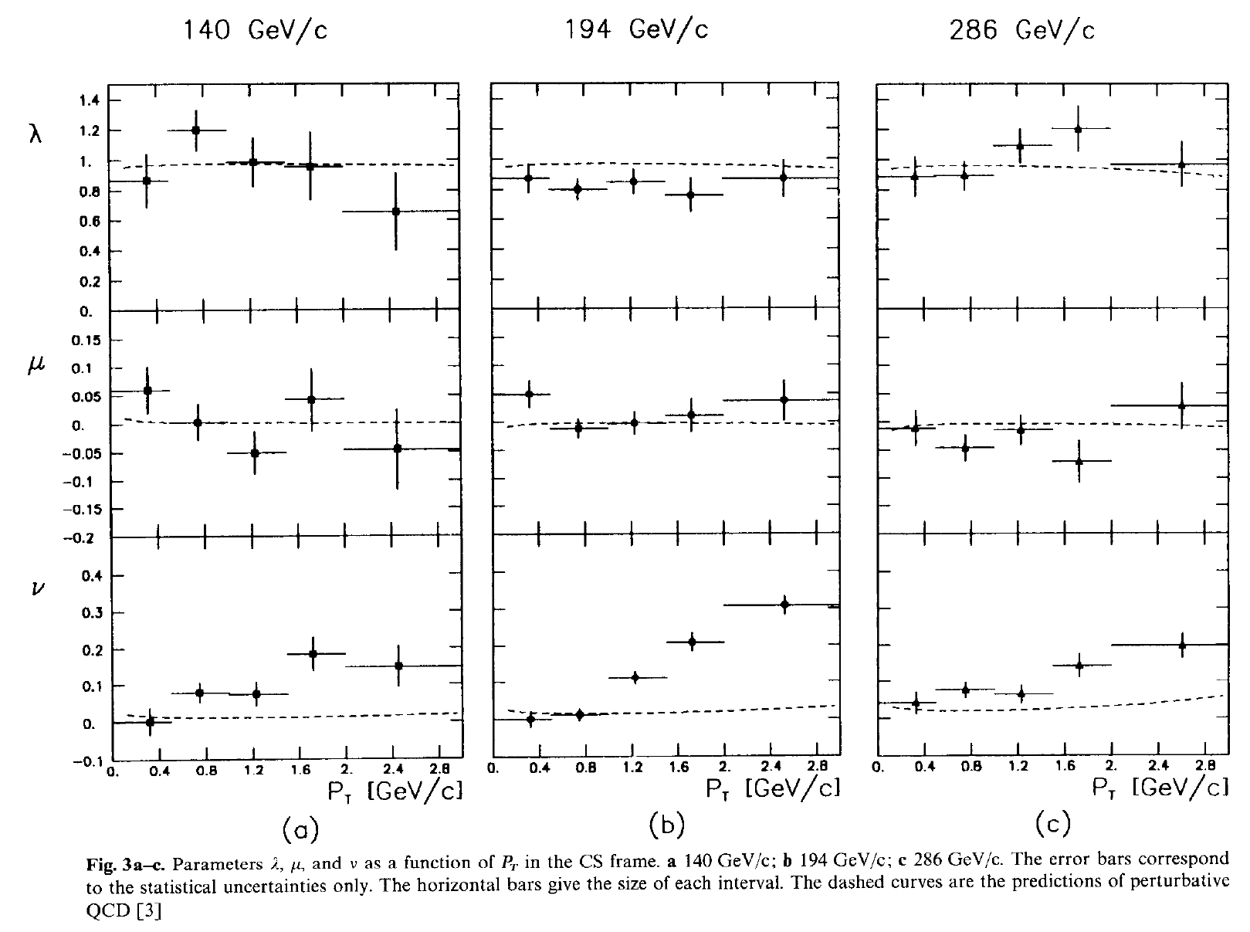
NA10 (Z. Phys. C 37, 545 (1988)):
Violation of LT Relation

Slide 17
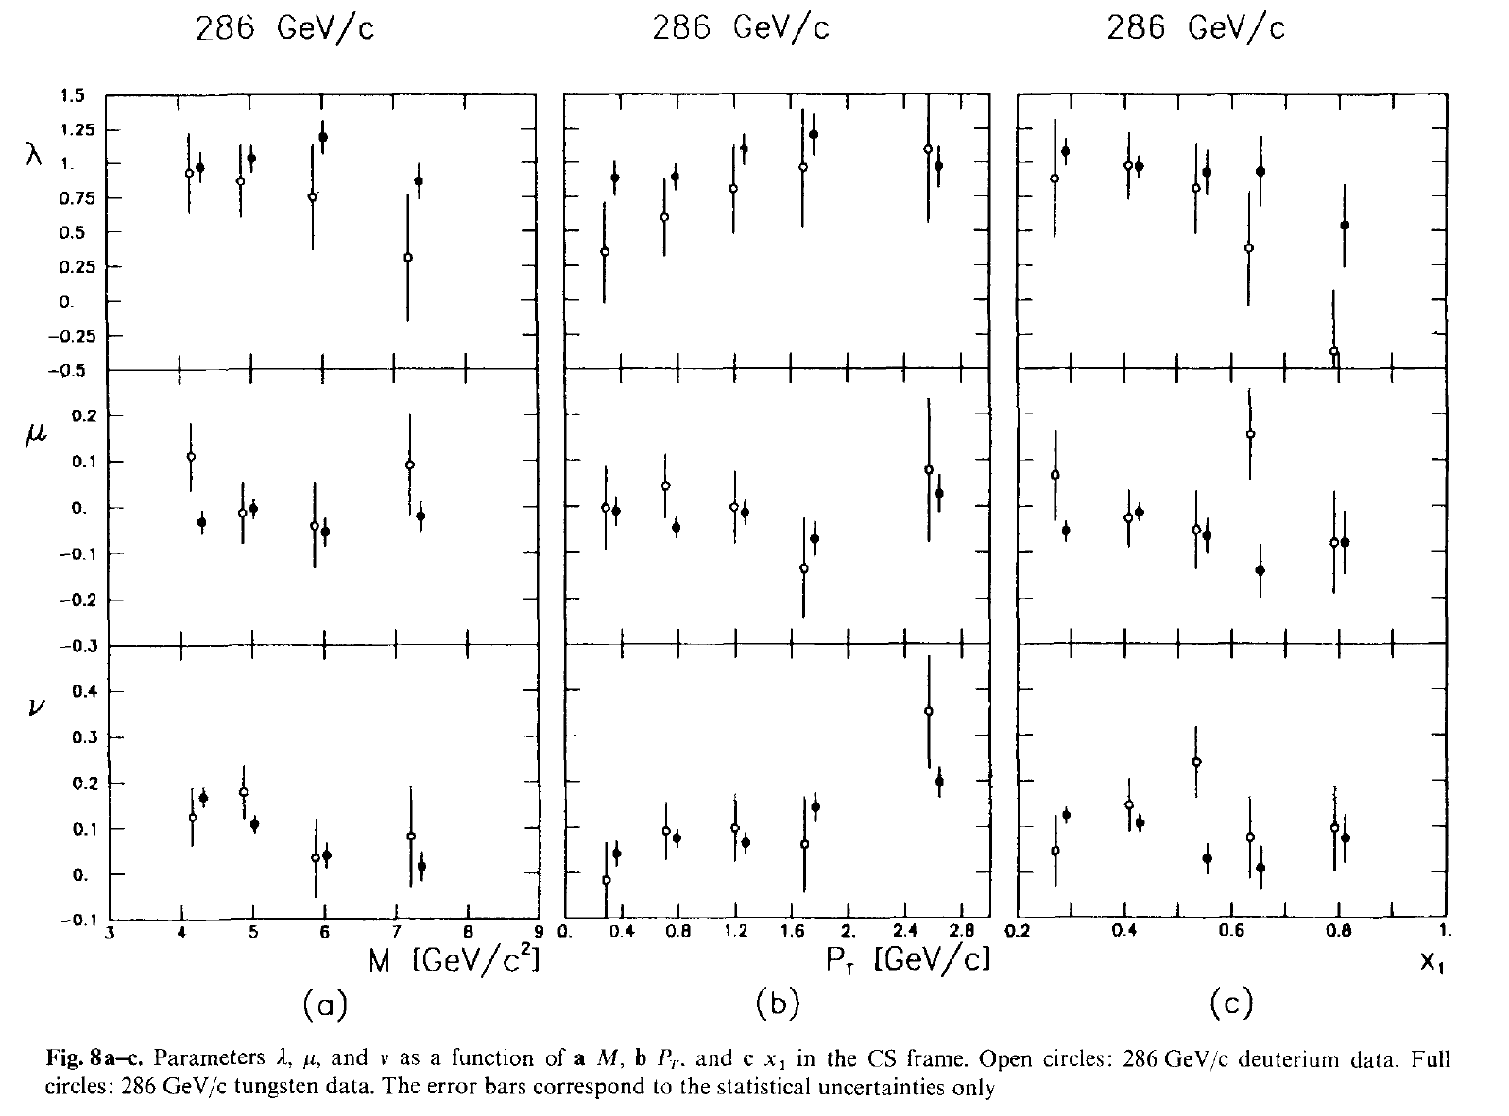
NA10 (Z. Phys. C 37, 545 (1988)):
First data with Deuterium Target
Violation of LT relation is NOT due to nuclear effect.

Slide 18
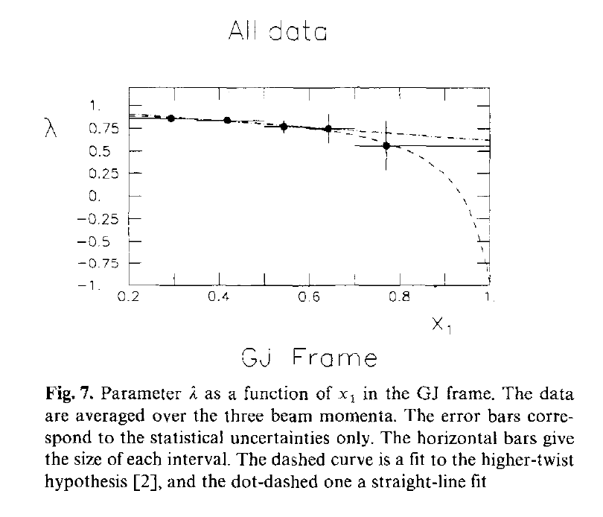
NA10 (Z. Phys. C 37, 545 (1988)):
Higher Twist Effect?

Slide 19
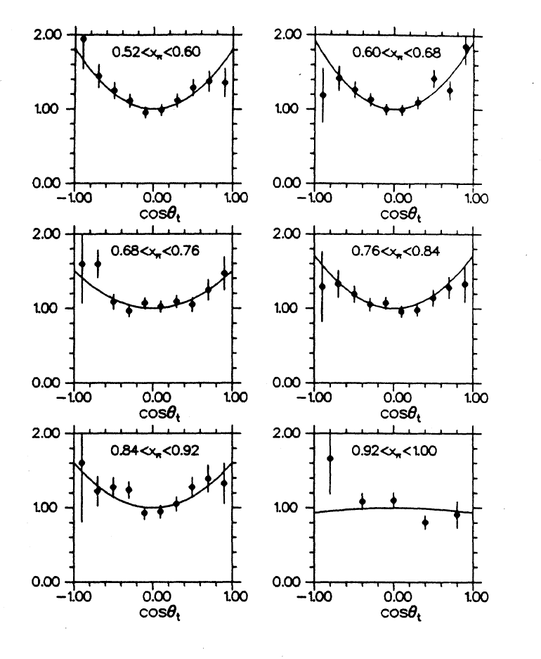
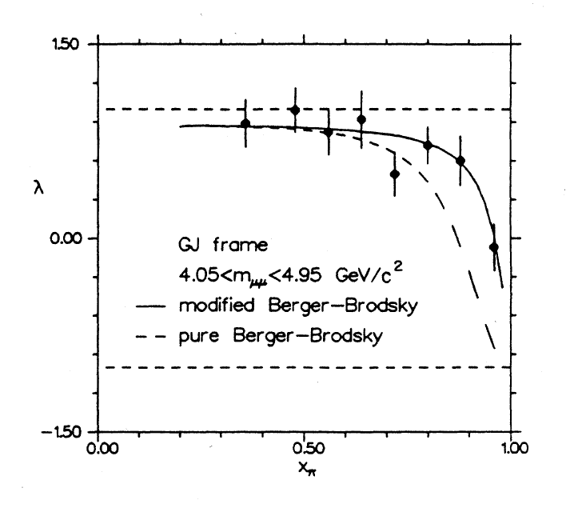
E615 (PRD 39, 92 (1989)):
Higher Twist Effect

Slide 20
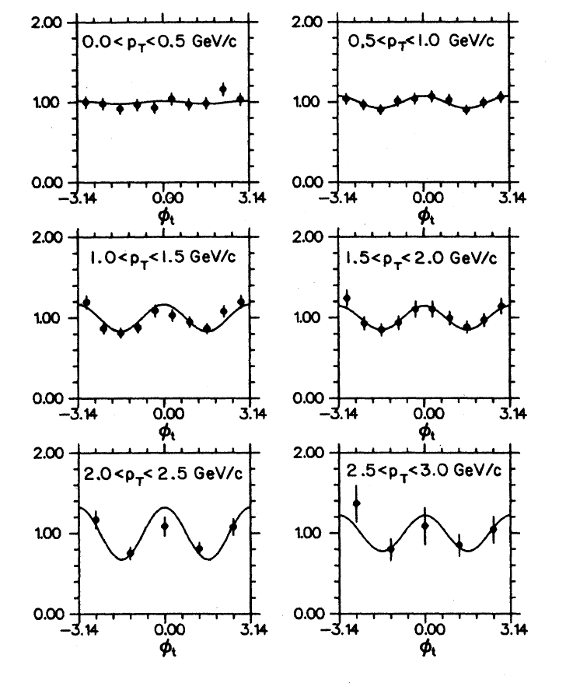
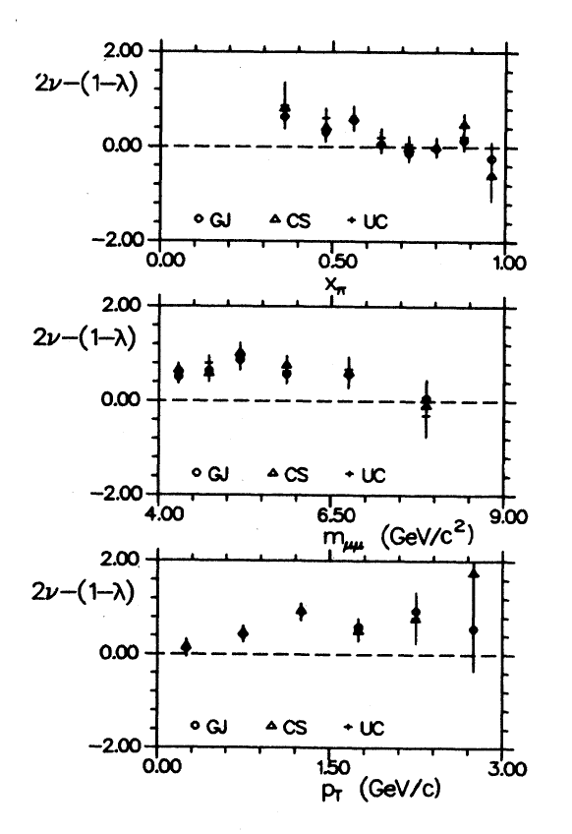
E615 (PRD 39, 92 (1989)):
Violation of LT Relation

Slide 21
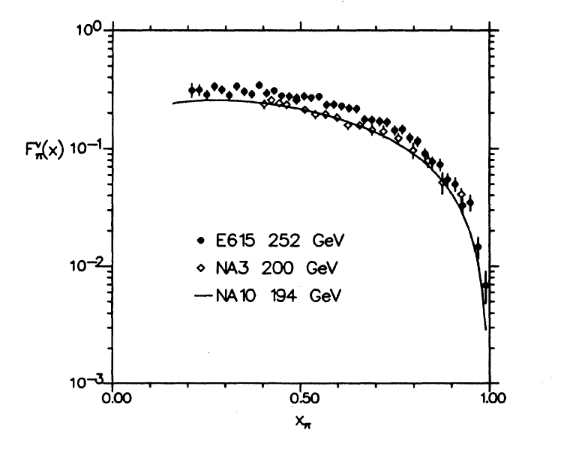
E615 (PRD 39, 92 (1989)):
Improved Pion Structure Function at large x_{π}

Slide 22
Observation of LT violation and Higher Twist Effect
 | CIP | NA3 | NA10 | E615
Violation of LT Relation |  | NO | YES | YES
Higher Twist Effect | YES | NO |  | YES

Slide 23
Boer-Mulders Function
& QCD Vacuum Effect

Slide 24
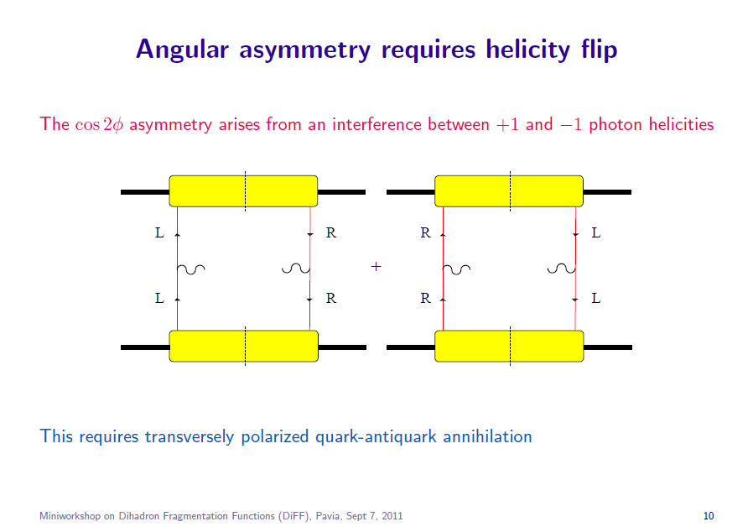
D. Boer

Slide 25
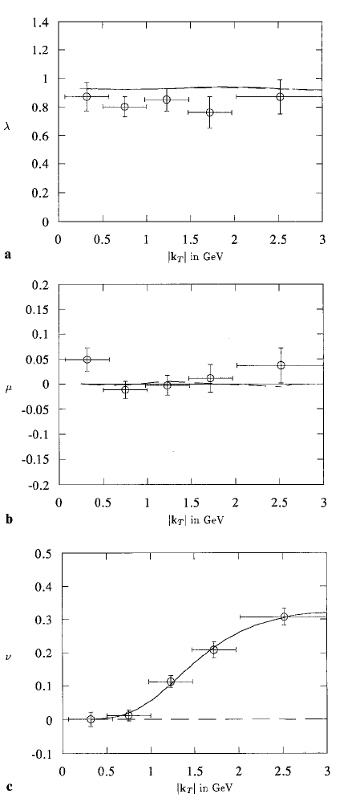
Brandenburg, et. al (Z. Phy. C60,697 (1993)):
QCD Vacuum Effect
On average no quark polarization, but a spin correlation between an annihilating quark and antiquark is caused by nontrivial QCD vacuum.

Slide 26
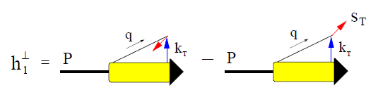
Boer (PRD 60, 014012 (1999)):
Hadronic Effect

Slide 27
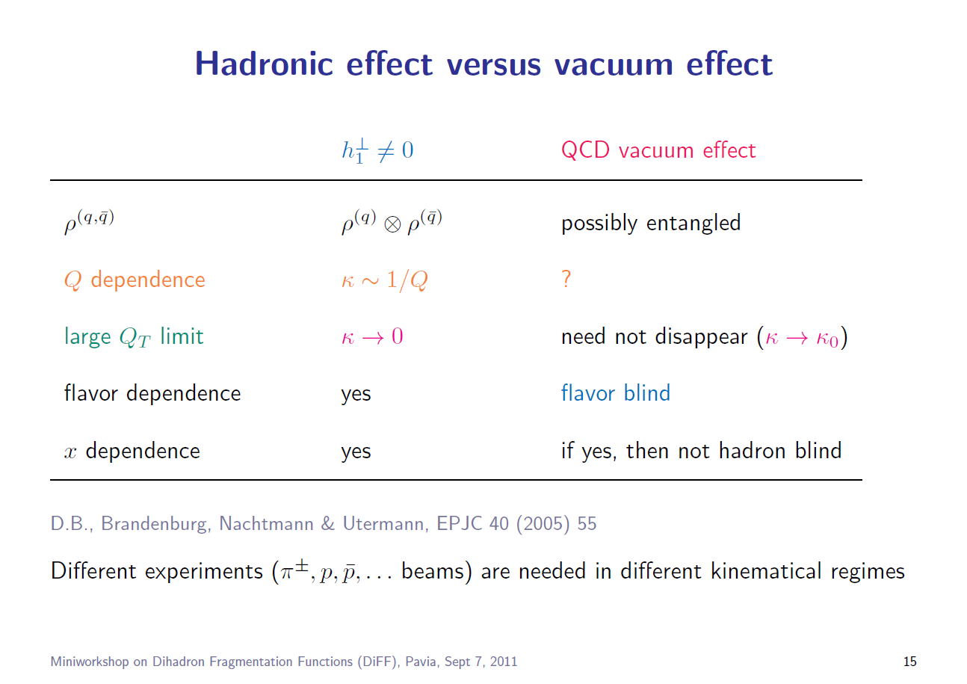
D. Boer

Slide 28
E866 (PRL 99 (2007) 082301; PRL 102 (2009) 182001): Azimuthal cos2Φ Distribution in pp and pD Drell-Yan
ν(π⁻W→µ⁺µ⁻X)~ [valence h₁┴(π)] * [valence h₁┴(p)]
ν(pd→µ+µ-X) ~ [valence h₁┴(p)] * [sea h₁┴(p)]
Sea-quark BM functions are much smaller than valence quarks

Slide 29
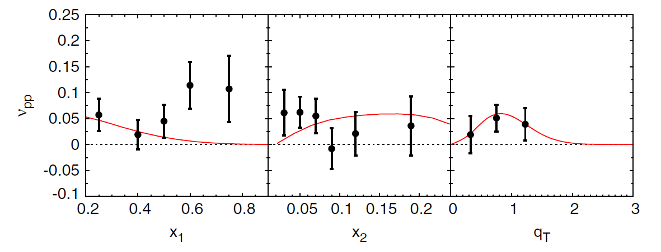

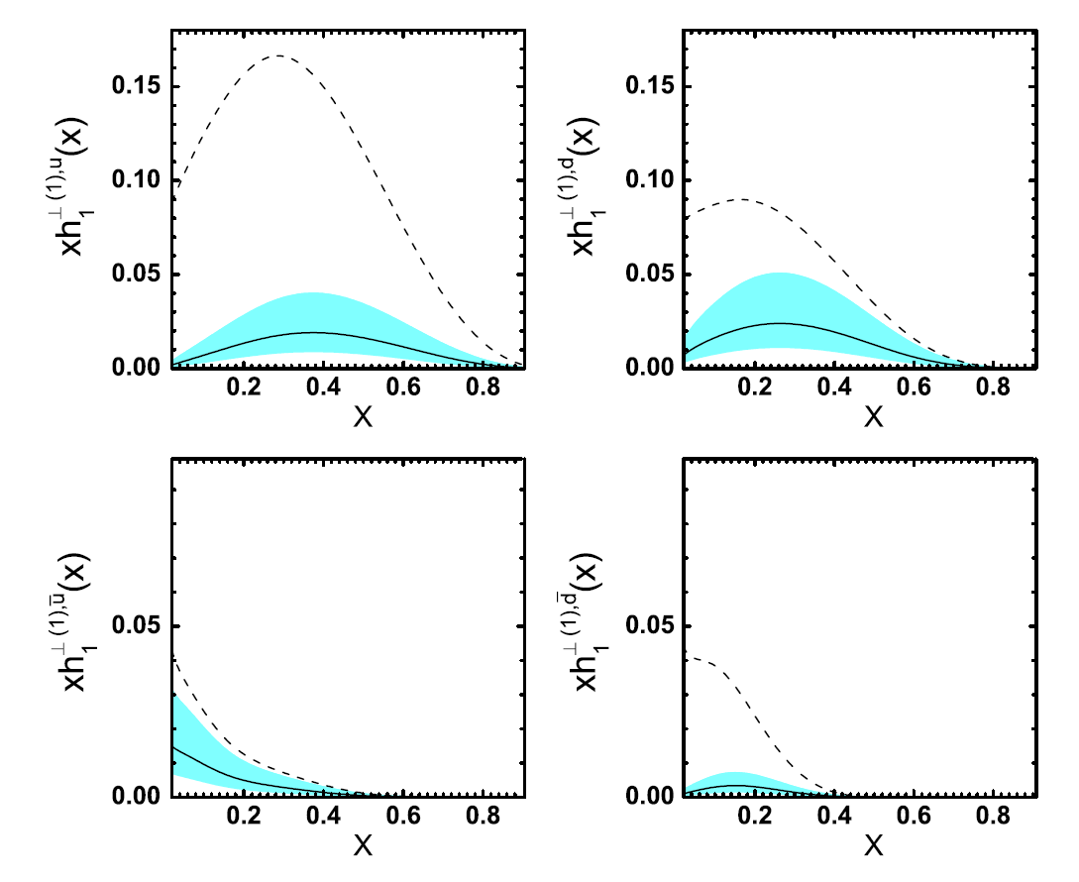
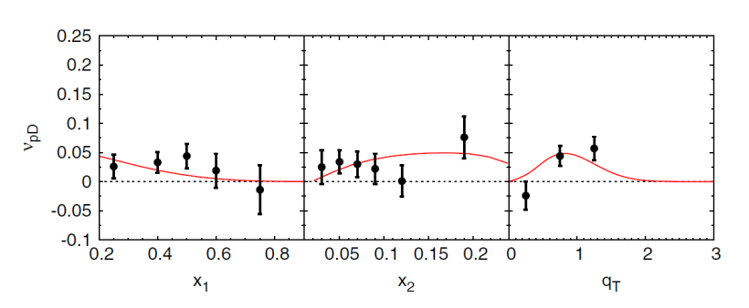
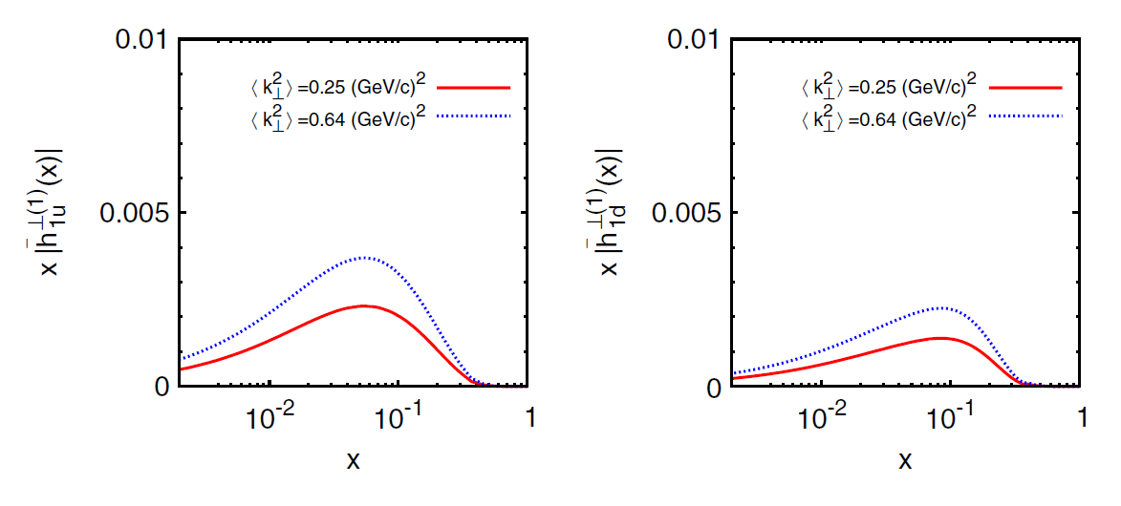
Boer-Mulders functions from unpolarized pD and pp Drell-Yan data
Z. Lu and I. Schmidt,
PRD 81, 034023 (2010)
V. Barone et al.,
PRD 82, 114025 (2010)
Sign of BM functions and flavor dependence?

Slide 30
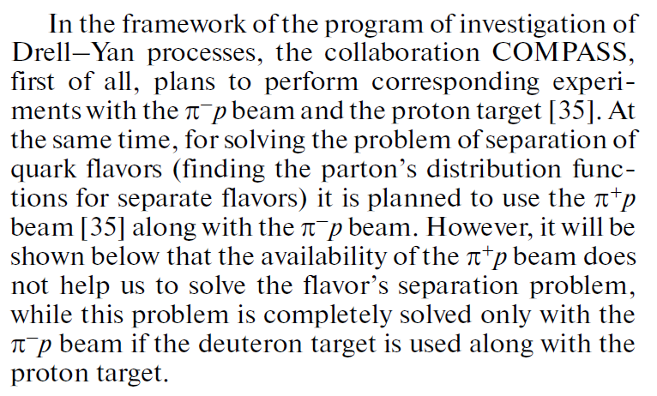
Sissakian et al. (Phys. Of Part. And Nucl. 41, 64 (2010)):
Flavor Separation

Slide 31
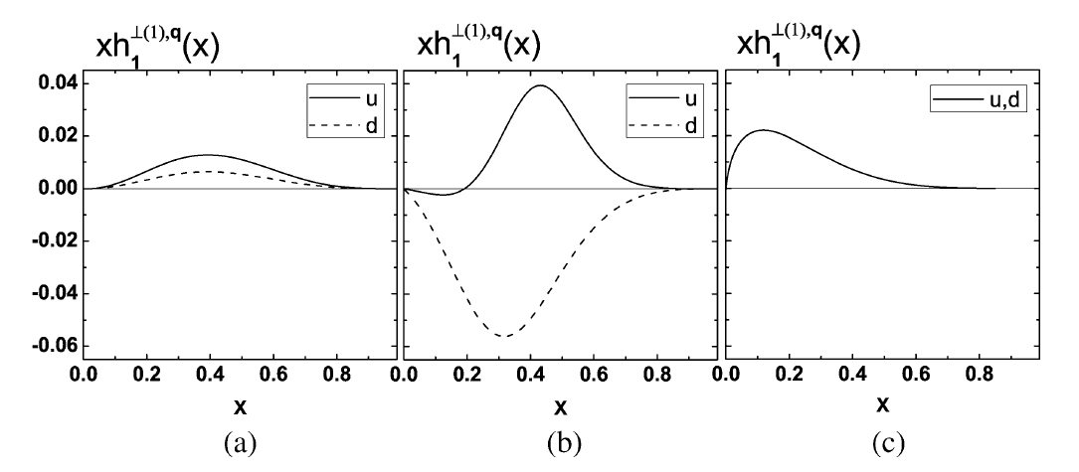
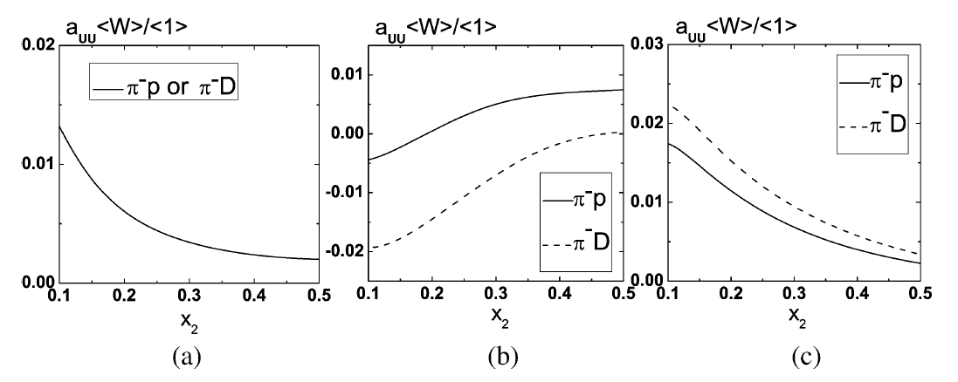
Z. Lu et al. (PLB 639 (2006) 494):
Flavor separation of the Boer–Mulders function
MIT Bag Model
Spectator Model
Large Nc limit
Deuterium target

Slide 32
Pion Structure Function
&
Pion Distribution Amplitude

Slide 33
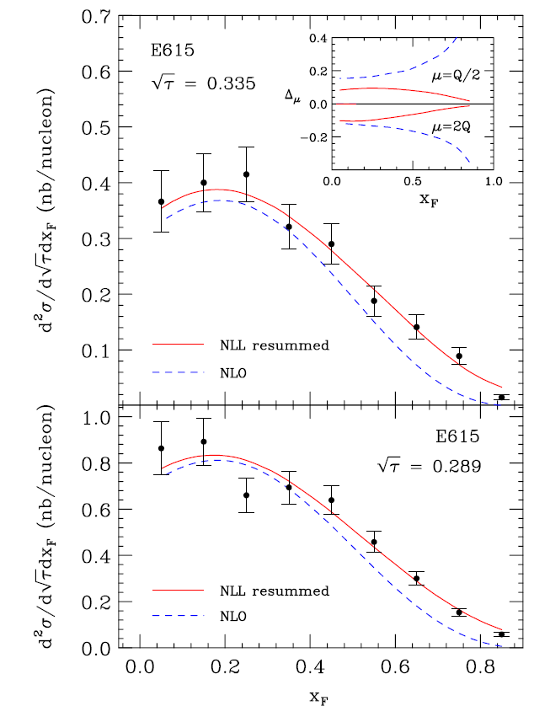
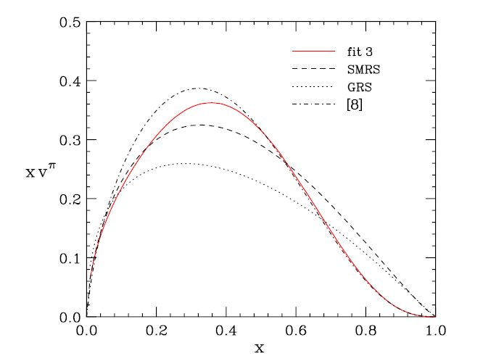
Aicher et al. (PRL 105, 252003 (2010)):
NLO Threshold Resummation
Softer valence distribution

Slide 34
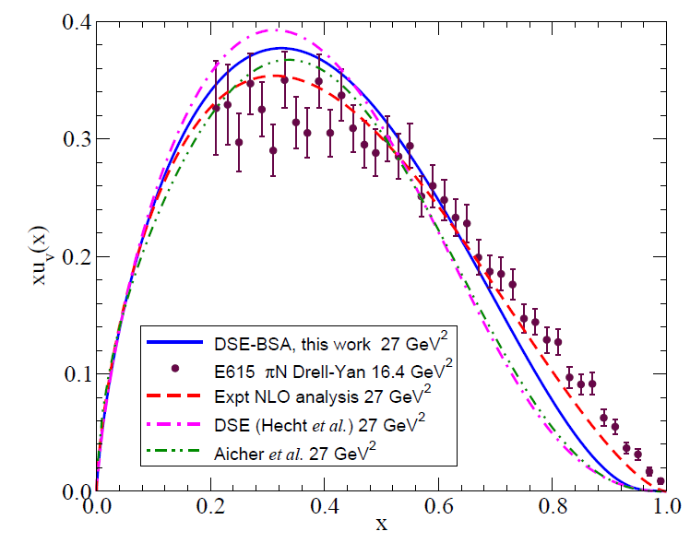
Nguyen et. al (PRC 83, 062201 (2011)):
Dyson-Schwinger equations

Slide 35

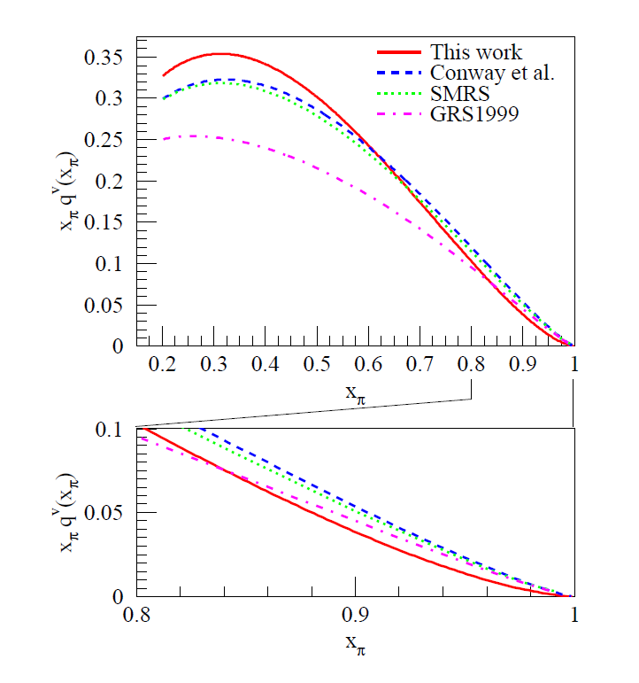
Reimer, et al. (AIP Conf. Proc. 1369, 153 (2011)):
New NLO Fit
Higher Twist Effect

Slide 36
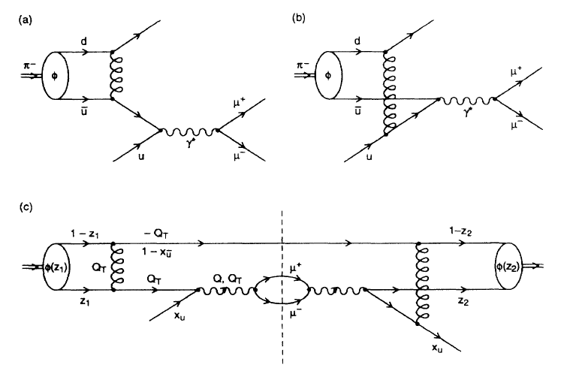
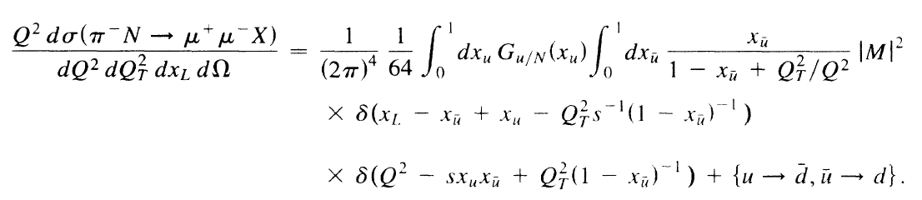

Brandenburg et al. (PRL 73, 939 (1994)):
Pion Distribution Amplitude
Pion distribution amplitude: distribution of LC momentum fractions
in the lowest-particle number valence Fock state.

Slide 37
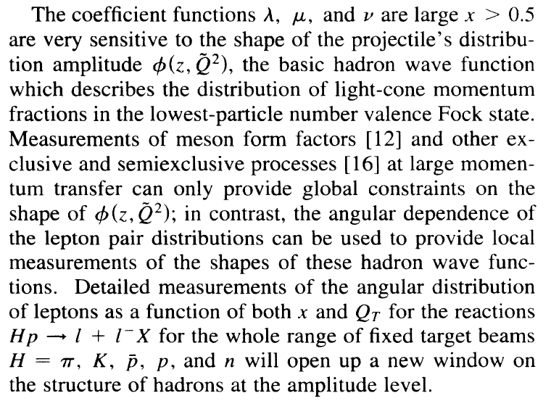
Brandenburg et al. (PRL 73, 939 (1994)):
Pion Distribution Amplitude

Slide 38
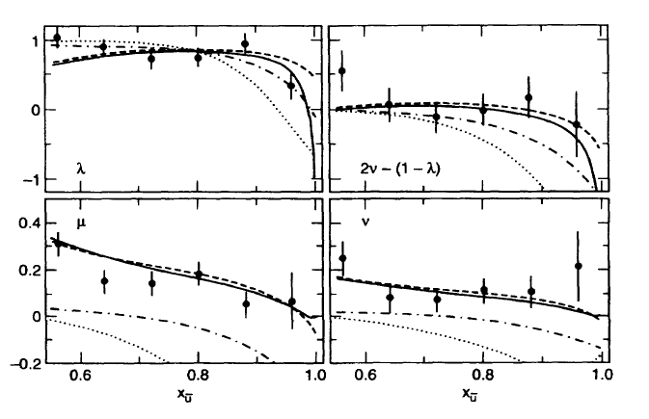
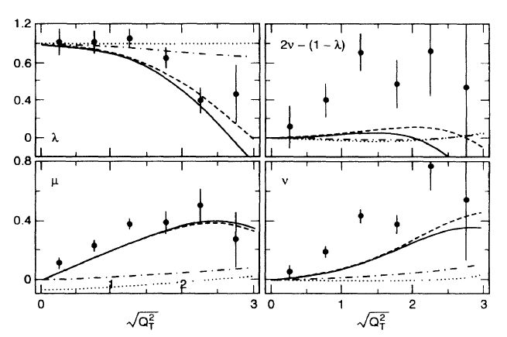
Brandenburg et al. (PRL 73, 939 (1994)):
Pion Distribution Amplitude
• :E615
• :E615
Improved measurement

Slide 39
Flavor Dependency of EMC Effect

Slide 40
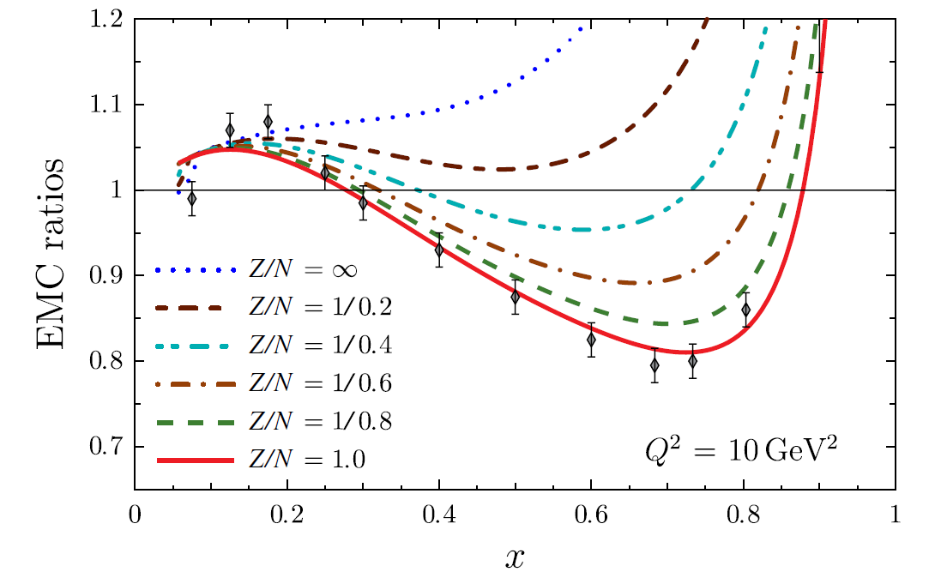
Cloet et. al (PRL 102, 252301, 2009):
Flavor dependence of the EMC effects ?
The isovector mean-field generated in Z≠N nuclei can modify nucleon’s u and d PDFs in nuclei.

Slide 41
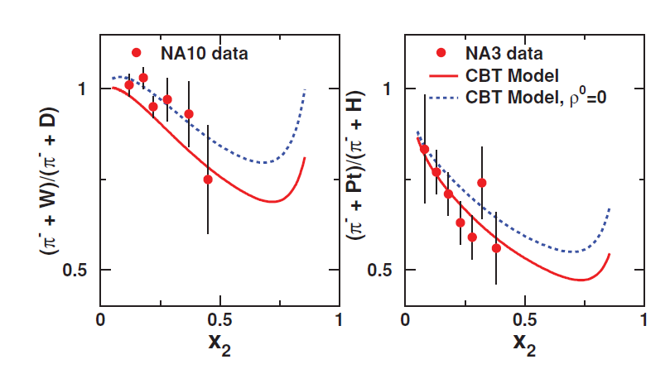
Dutta et al. (PRC 83, 04220, 2011):
Pion-induced Drell-Yan and the flavor-dependent EMC effect

Slide 42
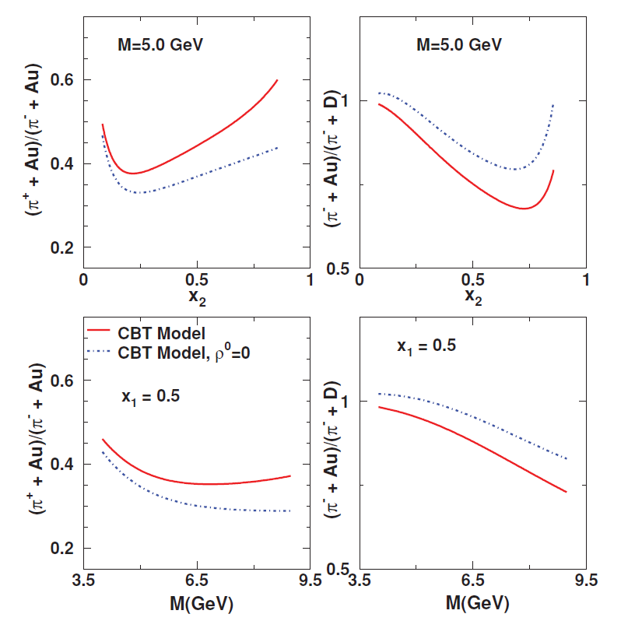
Dutta et al. (PRC 83, 04220, 2011):
Pion-induced Drell-Yan and the flavor-dependent EMC effect

Slide 43
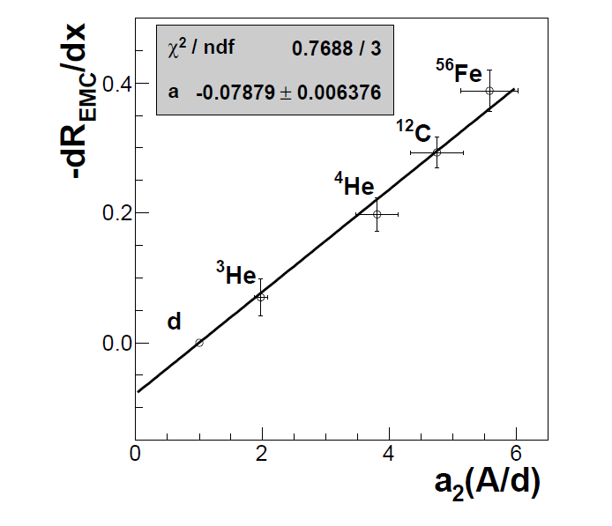
Weinstein et. al (PRL 106 , 052301 (2011)):
EMC & Short Range Correlation (SRC)
SRC is related with isoscalar p-n interaction.
Nuclei target

Slide 44
CERN COMPASS

Slide 45

25 Years after E615, could COMPASS perform a better measurement?

Slide 46

Acceptance of Dimuon Events:
FNAL E615 vs. CERN COMPASS
E615
COMPASS
The strike back of CERN DY experiment!

Slide 47

Expected Event Rate
E615 (252 GeV π− + W): 27,977 events
C. Quintans, IWHSS’ 12

Slide 48
Sensitivity on Mass Dependence of λ, μ, and ν (420k events)
• :E615 Dashed band: COMPASS

Slide 49
Sensitivity on x_{π} dependence of λ, μ, and ν (420k events)
• :E615 Dashed band: COMPASS

Slide 50
Sensitivity on p_{t} dependence of λ, μ, and ν (420k events)
• :E615 Dashed band: COMPASS

Slide 51

NH₃ + Thin Nuclei Targets

Slide 52
Summary
A precision measurement to be performed in the pion-induced unpolarized COMPASS DY program will offer better understanding on QCD, TMD PDF, pion structure and nuclear medium effect.
Unpolarized COMPASS DY program:
  NH₃: BM function, pion structure function and pion distribution amplitude (higher twist effect).
  Nuclei target: flavor dependency of EMC effect.
  LD₂: flavor separation of BM function.

