Slide 1
Deconstructing QCD’s
Goldstone
modes
Published collaborations:
2010-present
Rocio BERMUDEZ (U Michoácan);
Chen CHEN (ANL, IIT, USTC);
Xiomara GUTIERREZ-GUERRERO (U Michoácan);
Trang NGUYEN (KSU);
Si-xue QIN (PKU);
Hannes ROBERTS (ANL, FZJ, UBerkeley);
Lei CHANG (ANL, FZJ, PKU);
Huan CHEN (BIHEP);
Ian CLOËT (UAdelaide);
Bruno EL-BENNICH (São Paulo);
David WILSON (ANL);
Adnan BASHIR (U Michoácan);
Stan BRODSKY (SLAC);
Gastão KREIN (São Paulo)
Roy HOLT (ANL);
Mikhail IVANOV (Dubna);
Yu-xin LIU (PKU);
Robert SHROCK (Stony Brook);
Peter TANDY (KSU)
Craig Roberts
Physics Division
Students
Early-career
scientists
Notes:
30+10 … plainly, I have too many transparencies.

Slide 2
Something completely different

Slide 3
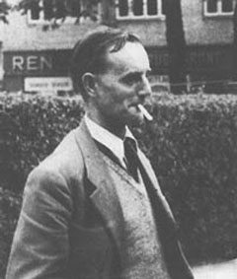
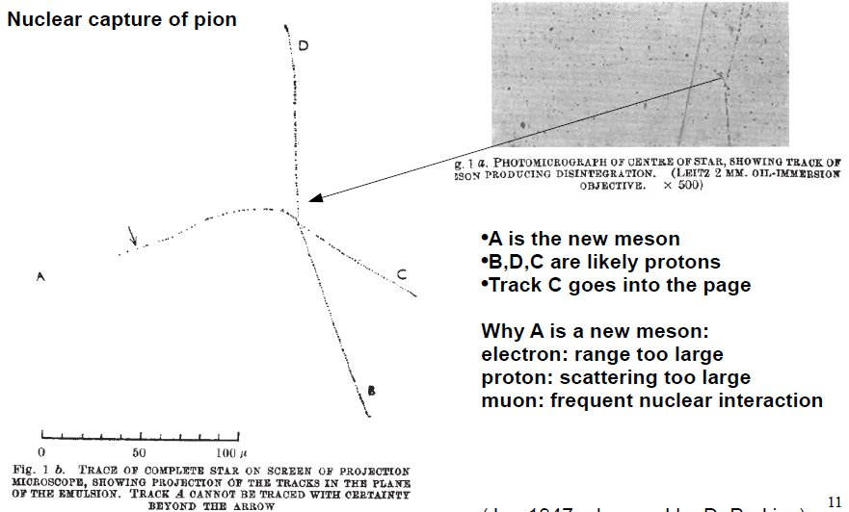
Nature’s strong messenger – Pion
1947 – Pion discovered by Cecil Frank Powell
Studied tracks made by cosmic rays using
photographic emulsion plates
Despite the fact that
Cavendish Lab said method is
incapable of “reliable and
reproducible precision
measurements.”
Mass measured in scattering
≈ 250-350 m_{e}
Notes:
(6)

Slide 4
Nature’s strong messenger – Pion
The beginning of Particle Physics
Then came
Disentanglement of confusion
between ₍₁₉₃₇₎ muon and pion – similar masses
Discovery of particles with “strangeness” (e.g., kaon₁₉₄₇₋₁₉₅₃)
Subsequently, a complete spectrum of mesons and baryons
with mass below ≈1 GeV
28 states
Became clear that
pion is “too light”
- hadrons supposed to be heavy, yet …
π | 140 MeV
ρ | 780 MeV
P | 940 MeV
Notes:
(6)

Slide 5
Simple picture - Pion
Gell-Mann and Ne’eman:
Eightfold way₍₁₉₆₁₎ – a picture based
on group theory: SU(3)
Subsequently, quark model –
where the u-, d-, s-quarks
became the basis vectors in the
fundamental representation
of SU(3)
Pion =
Two quantum-mechanical constituent-quarks - particle+antiparticle -
interacting via a potential
Notes:
(6)

Slide 6
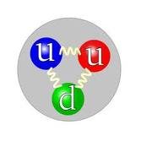
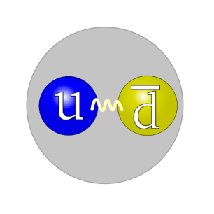
Modern Miracles in Hadron Physics
proton = three constituent quarks
M_{proton} ≈ 1GeV
Therefore guess M_{constituent−quark} ≈ ⅓ × GeV ≈ 350MeV
pion = constituent quark + constituent antiquark
Guess M_{pion} ≈ ⅔ × M_{proton} ≈ 700MeV
WRONG . . . . . . . . . . . . . . . . . . . . . . M_{pion} = 140MeV
Rho-meson
Also constituent quark + constituent antiquark
– just pion with spin of one constituent flipped
M_{rho} ≈ 770MeV ≈ 2 × M_{constituent−quark}
What is “wrong” with the pion?

Slide 7
Dichotomy of the pion
How does one make an almost massless particle from two massive constituent-quarks?
Naturally, one could always tune a potential in quantum mechanics so that the ground-state is massless
– but some are still making this mistake
However:
current-algebra (1968)
This is impossible in quantum mechanics, for which one always finds:
Notes:
(8)

Slide 8
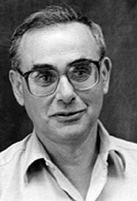
Dichotomy of the pion Goldstone mode and bound-state
The correct understanding of pion observables; e.g. mass, decay constant and form factors, requires an approach to contain a
well-defined and valid chiral limit;
and an accurate realisation of dynamical chiral symmetry breaking.
HIGHLY NONTRIVIAL
Impossible in quantum mechanics
Only possible in asymptotically-free gauge theories

Slide 9
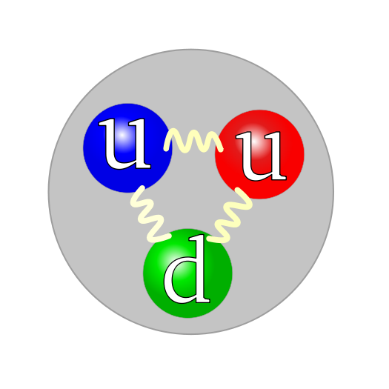
Hadron Theory
proton
pion
The structure of matter

Slide 10
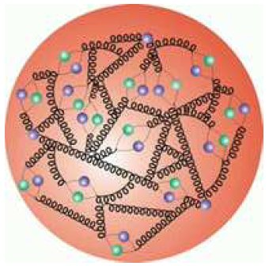
Pion distribution function
The pion plays a key role in nucleon and nuclear structure. It has been used ; e.g., to explain
the long-range nucleon-nucleon interaction, forming a basic part of the “Standard Model” of nuclear physics
and also the flavor asymmetry observed in the quark sea in the nucleon.
However, compared to that of other hadrons, the pion mass is anomalously small.
This owes to dynamical chiral-symmetry breaking
Any veracious description of the pion must properly account for its dual role as a quark-antiquark bound state and the Nambu-Goldstone boson associated with DCSB.
It is this dichotomy and its consequences that make an experimental and theoretical elucidation of pion properties so essential to understanding the strong interaction.

Slide 11
Kaon distribution function
The valence structure of the kaon is comprised of a light up or down quark (or antiquark) and a strange antiquark (or quark).
If our understanding of meson structure is correct, then the large difference between the current mass of the s quark and that of the u and d quarks should give rise to some interesting effects in the kaon structure function.
For example, owing to its larger mass, the s quark should carry more of the charged kaon’s momentum than the u quark.
Hence the u_{v} quark distribution in the kaon should be weighted to lower values in x than that in the pion.
If such a shift exists, then what sets the scale … current-quark mass or something else?

Slide 12
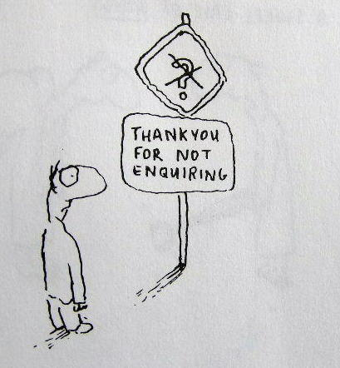
QCD’s Challenges
Understand emergent phenomena
Quark and Gluon Confinement
No matter how hard one strikes the proton,
one cannot liberate an individual gluon or quark
Dynamical Chiral Symmetry Breaking
Very unnatural pattern of bound state masses;
e.g., Lagrangian (pQCD) quark mass is small but
. . . no degeneracy between J^{P}=+ and J^{P}=− (parity partners)
Neither of these phenomena is apparent in QCD’s Lagrangian Yet they are the dominant determining characteristics of
real-world QCD.
QCD
– Complex behaviour from apparently simple rules.

Slide 13
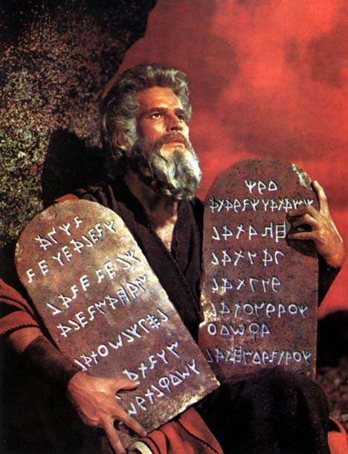
Universal Truths
Hadron spectrum, elastic and transition form factors, parton distribution functions provide unique information about long-range interaction between light-quarks and distribution of hadron's characterising properties amongst its QCD constituents.
Dynamical Chiral Symmetry Breaking (DCSB) is most important mass generating mechanism for visible matter in the Universe.
Higgs mechanism is (almost) irrelevant to light-quarks.
Running of quark mass entails that calculations at even modest Q² require a Poincaré-covariant approach.
Covariance + M(p²) require existence of quark orbital angular momentum in hadron's rest-frame wave function.
Confinement is expressed through a violent change of the propagators for coloured particles & can almost be read from a plot of a states’ dressed-propagator.
It is intimately connected with DCSB.

Slide 14
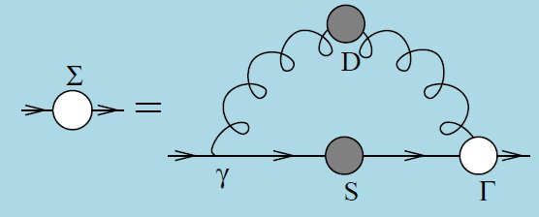
Dyson-Schwinger Equations
Strong QCD and Dyson-Schwinger Equations Craig D. Roberts, arXiv:1203.5341 [nucl-th] Notes based on 5 lectures to the conference on "Dyson-Schwinger Equations & Faà di Bruno Hopf Algebras in Physics and Combinatorics (DSFdB2011)", Institut de Recherche Mathématique Avancée, l'Universite de Strasbourg et CNRS, Strasbourg, France, 27.06-01.07/2011."IRMA Lectures in Mathematics & Theoretical Physics," published by the European Mathematical Society (EMS)
Collective perspective on advances in Dyson-Schwinger Equation QCD,
Adnan Bashir, et al., arXiv:1201.3366 [nucl-th], Commun. Theor. Phys. to appear. Summary of lectures delivered by the authors at the Workshop on AdS/CFT and Novel Approaches to Hadron and Heavy Ion Physics, 11 Oct. -- 3 Dec. 2010, hosted by the Kavli Institute for Theoretical Physics, China, at the Chinese Academy of Sciences
Selected highlights from the study of mesons Lei Chang, Craig D. Roberts and Peter C. Tandy arXiv:1107.4003 [nucl-th], Chin. J. Phys. 49 (2011) pp. 955-1004
Notes:
Not because best … best is meaningless here … horses for courses. But because DSEs provides unique insights into connection between QCD’s emergent phenomena and experiment.

Slide 15
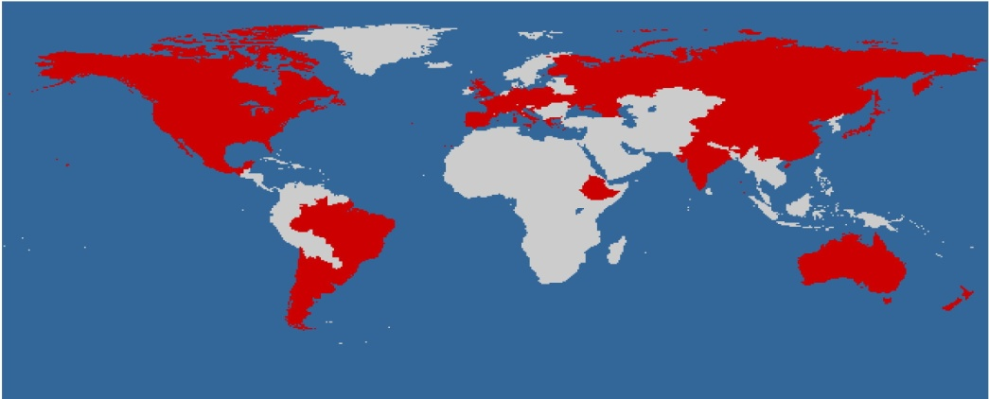
Dyson-Schwinger Equations
Well suited to Relativistic Quantum Field Theory
Simplest level: Generating Tool for Perturbation Theory . . . Materially Reduces Model-Dependence … Statement about long-range behaviour of quark-quark interaction
NonPerturbative, Continuum approach to QCD
Hadrons as Composites of Quarks and Gluons
Qualitative and Quantitative Importance of:
Dynamical Chiral Symmetry Breaking
– Generation of fermion mass from nothing
Quark & Gluon Confinement
– Coloured objects not detected,
Not detectable?
Approach yields
Schwinger functions; i.e.,
propagators and vertices
Cross-Sections built from
Schwinger Functions
Hence, method connects
observables with long-
range behaviour of the
running coupling
Experiment ↔ Theory
comparison leads to an
understanding of long-
range behaviour of
strong running-coupling
Notes:
Not because best … best is meaningless here … horses for courses. But because DSEs provides unique insights into connection between QCD’s emergent phenomena and experiment.

Slide 16
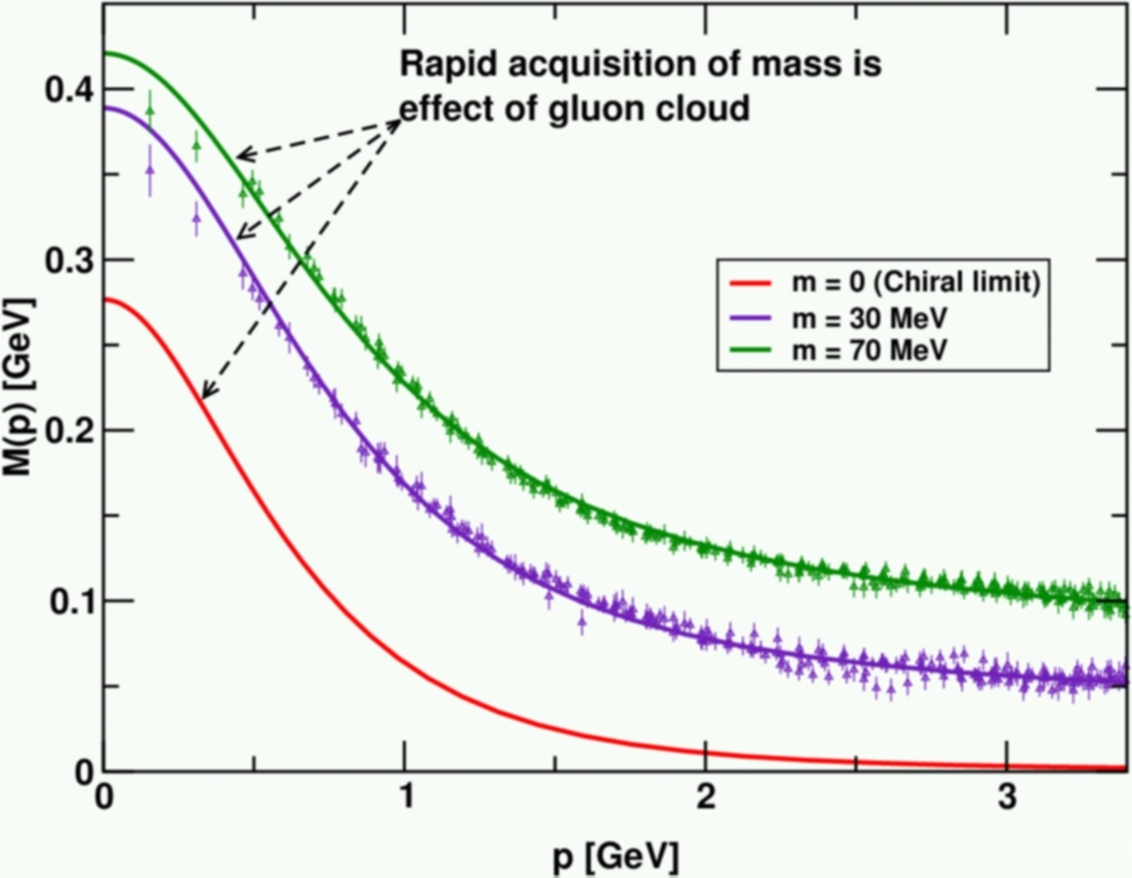
Necessary Precondition
Mass function exhibits inflexion
point at Q_{IR} ≈ m_{G} ≈ 0.6GeV
So … pQCD is definitely invalid
for momenta Q<Q_{IR}
E.g., use of DGLAP equations
cannot be justified in QCD at
Q<Q_{IR}=0.6GeV, irrespective of order.
Distribution Functions of the Nucleon and Pion in the Valence Region, Roy J. Holt and Craig D. Roberts, arXiv:1002.4666 [nucl-th],
Rev. Mod. Phys. 82 (2010) pp. 2991-3044
Experiment ↔ Theory comparison
leads to an understanding of long-range
behaviour of strong running-coupling
However, if one wants to draw reliable
conclusions about Q²-dependence of
QCD’s running coupling,
Then, approach must veraciously
express Q²-dependence of
QCD’s running masses
True for ALL observables
From spectrum …
through elastic
& transition form factors …
to PDFs and GPDs … etc.
Essentially nonperturbative

Slide 17
Confinement

Slide 18
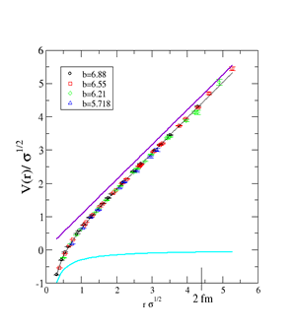
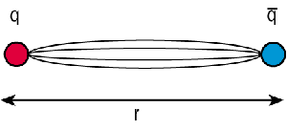
Confinement
X
Colour singlets
Gluon and Quark Confinement
No coloured states have yet been observed to reach a detector
Empirical fact. However
There is no agreed, theoretical definition of light-quark confinement
Static-quark confinement is irrelevant to real-world QCD
There are no long-lived, very-massive quarks
But light-quarks are ubiquitous
Confinement entails quark-hadron duality; i.e., that
all observable consequences of QCD can, in principle, be computed using an hadronic basis.

Slide 19
Confinement
G. Bali et al., PoS LAT2005 (2006) 308
“Note that the time is not a linear function of the distance but dilated within the string breaking region. On a linear time scale string breaking takes place rather rapidly. […] light pair creation seems to occur non-localized and instantaneously.”
Infinitely heavy-quarks plus 2 flavours with mass = m_{s}
Lattice spacing = 0.083fm
String collapses
within one lattice time-step
R = 1.24 … 1.32 fm
Energy stored in string at
collapse E_{c}^{sb} = 2 m_{s}
(mpg made via
linear interpolation)
No flux tube between
light-quarks,
nor in qQ systems
B_{s}
anti-B_{s}

Slide 20
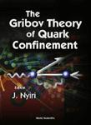
Confinement
Confinement is expressed through a dramatic change in the analytic structure of propagators for coloured particles & can almost be read from a plot of a states’ dressed-propagator
Gribov (1978); Munczek (1983); Stingl (1984); Cahill (1989);
Roberts, Williams & Krein (1992); Tandy (1994); …
Normal particle
Confined particle
complex-P²
complex-P²
timelike axis: P²<0
Real-axis mass-pole splits, moving into pair(s) of complex conjugate poles or branch points,
or more complicated nonanalyticities …
Spectral density no longer positive semidefinite
& hence state cannot exist in observable spectrum

Slide 21
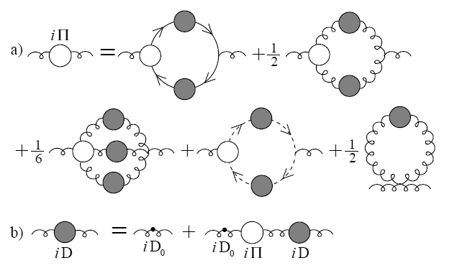
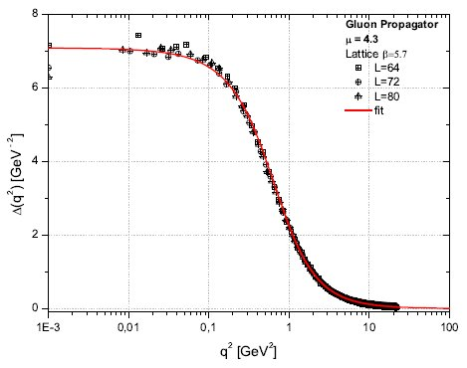
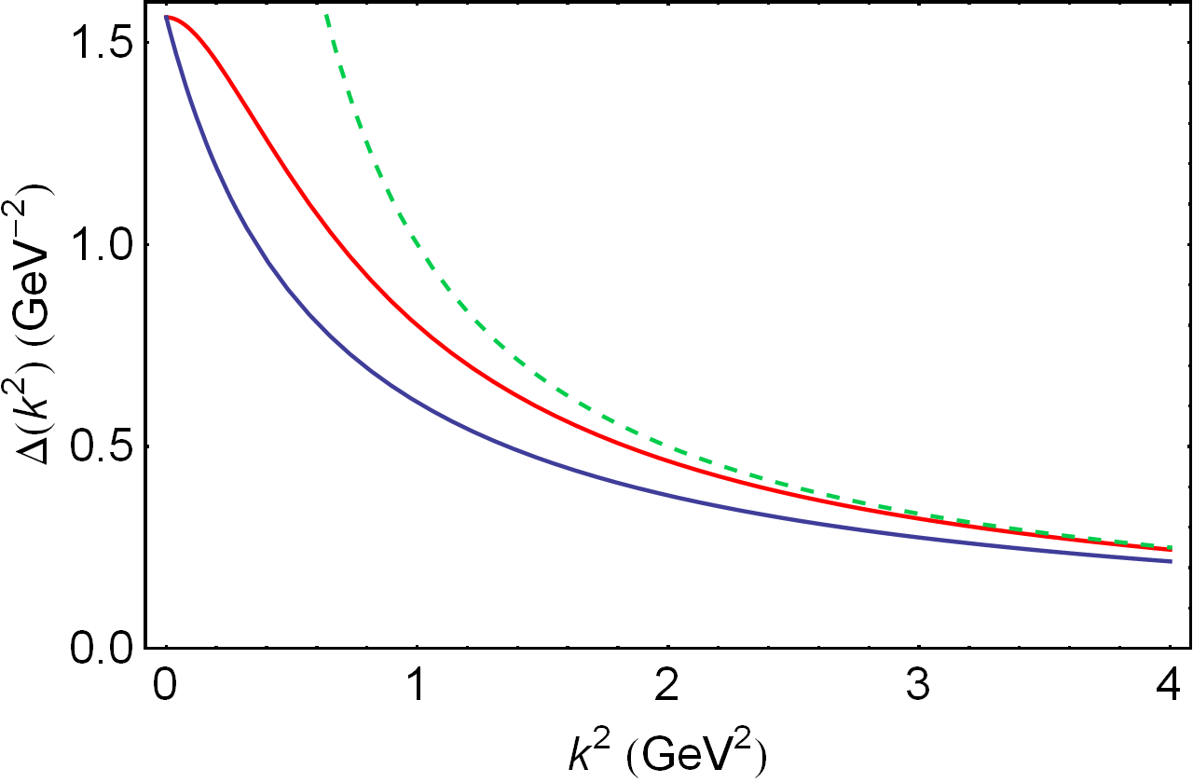
Dressed-gluon propagator
A.C. Aguilar et al., Phys.Rev. D80 (2009) 085018
Gluon propagator satisfies
a Dyson-Schwinger Equation
Plausible possibilities
for the solution
DSE and lattice-QCD
agree on the result
Confined gluon
IR-massive but UV-massless
m_{G} ≈ 2-4 Λ_{QCD}
IR-massive but UV-massless, confined gluon
perturbative, massless gluon
massive , unconfined gluon

Slide 22
Charting the interaction between light-quarks
This is a well-posed problem whose solution is an elemental goal of modern hadron physics.
The answer provides QCD’s running coupling.
Confinement can be related to the analytic properties of QCD's Schwinger functions.
Question of light-quark confinement can be translated into the challenge of charting the infrared behavior
of QCD's universal β-function
This function may depend on the scheme chosen to renormalise the quantum field theory but it is unique within a given scheme.
Of course, the behaviour of the β-function on the perturbative domain is well known.

Slide 23
Charting the interaction between light-quarks
Through QCD's DSEs, the pointwise behaviour of the β-function determines the pattern of chiral symmetry breaking.
DSEs connect β-function to experimental observables. Hence, comparison between computations and observations of
Hadron mass spectrum
Elastic and transition form factors
Parton distribution functions
can be used to chart β-function’s long-range behaviour.
Extant studies show that the properties of hadron excited states are a great deal more sensitive to the long-range behaviour of the β-function than those of the ground states.

Slide 24
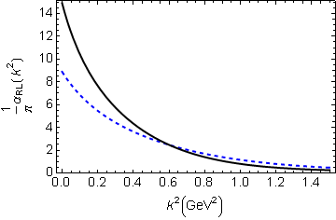
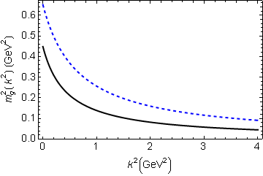
DSE Studies – Phenomenology of gluon
Qin et al., Phys. Rev. C 84 042202(Rapid Comm.) (2011)
Rainbow-ladder truncation
Wide-ranging study of π & ρ properties
Effective coupling
Agrees with pQCD in ultraviolet
Saturates in infrared
α(0)/π = 8-15
α(m_{G}²)/π = 2-4
Running gluon mass
Gluon is massless in ultraviolet
in agreement with pQCD
Massive in infrared
m_{G}(0) = 0.67-0.81 GeV
m_{G}(m_{G}²) = 0.53-0.64 GeV

Slide 25
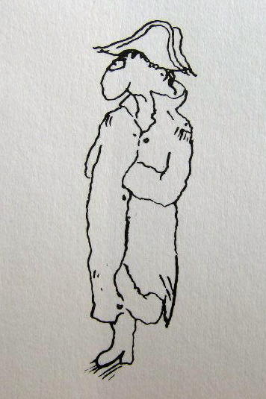
Dynamical Chiral Symmetry Breaking

Slide 26
Dynamical Chiral Symmetry Breaking
Strong-interaction: QCD
Confinement
Empirical feature
Modern theory and lattice-QCD support conjecture
that light-quark confinement is a fact
associated with violation of reflection positivity;
i.e., novel analytic structure for propagators and vertices
Still circumstantial, no proof yet of confinement
On the other hand, DCSB is a fact in QCD
It is the most important mass generating mechanism for visible matter in the Universe.
Responsible for approximately 98% of the proton’s mass.
Higgs mechanism is (almost) irrelevant to light-quarks.

Slide 27
Frontiers of Nuclear Science: Theoretical Advances
In QCD a quark's effective mass depends on its momentum. The function describing this can be calculated and is depicted here. Numerical simulations of lattice QCD (data, at two different bare masses) have confirmed model predictions (solid curves) that the vast bulk of the constituent mass of a light quark comes from a cloud of gluons that are dragged along by the quark as it propagates. In this way, a quark that appears to be absolutely massless at high energies (m =0, red curve) acquires a large constituent mass at low energies.
C.D. Roberts, Prog. Part. Nucl. Phys. 61 (2008) 50
M. Bhagwat & P.C. Tandy, AIP Conf.Proc. 842 (2006) 225-227
Notes:
(20)

Slide 28
Frontiers of Nuclear Science: Theoretical Advances
In QCD a quark's effective mass depends on its momentum. The function describing this can be calculated and is depicted here. Numerical simulations of lattice QCD (data, at two different bare masses) have confirmed model predictions (solid curves) that the vast bulk of the constituent mass of a light quark comes from a cloud of gluons that are dragged along by the quark as it propagates. In this way, a quark that appears to be absolutely massless at high energies (m =0, red curve) acquires a large constituent mass at low energies.
Mass from nothing!
DSE prediction of DCSB confirmed

Slide 29
Frontiers of Nuclear Science: Theoretical Advances
In QCD a quark's effective mass depends on its momentum. The function describing this can be calculated and is depicted here. Numerical simulations of lattice QCD (data, at two different bare masses) have confirmed model predictions (solid curves) that the vast bulk of the constituent mass of a light quark comes from a cloud of gluons that are dragged along by the quark as it propagates. In this way, a quark that appears to be absolutely massless at high energies (m =0, red curve) acquires a large constituent mass at low energies.
Hint of lattice-QCD support
for DSE prediction of violation of reflection positivity

Slide 30
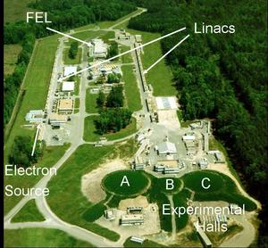
12GeV The Future of JLab
Numerical simulations of lattice QCD (data, at two different bare masses) have confirmed model predictions (solid curves) that the vast bulk of the constituent mass of a light quark comes from a cloud of gluons that are dragged along by the quark as it propagates. In this way, a quark that appears to be absolutely massless at high energies (m =0, red curve) acquires a large constituent mass at low energies.
Jlab 12GeV: Scanned by 2<Q²<9 GeV²
elastic & transition form factors.

Slide 31
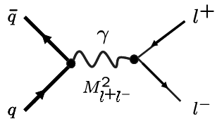
The Future of Drell-Yan
π or K
N
Numerical simulations of lattice QCD (data, at two different bare masses) have confirmed model predictions (solid curves) that the vast bulk of the constituent mass of a light quark comes from a cloud of gluons that are dragged along by the quark as it propagates. In this way, a quark that appears to be absolutely massless at high energies (m =0, red curve) acquires a large constituent mass at low energies.
Pion and kaon valence-quark PDFs probe this critical and complementary region

Slide 32
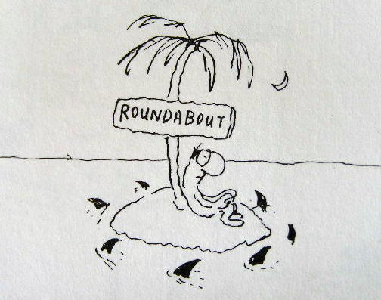
Persistent Challenge
Truncation

Slide 33
Persistent challenge in application of DSEs
Infinitely many coupled equations:
Kernel of the equation for the quark self-energy involves:
D_{μν}(k) – dressed-gluon propagator
Γ_{ν}(q,p) – dressed-quark-gluon vertex
each of which satisfies its own DSE, etc…
Coupling between equations necessitates a truncation
Weak coupling expansion
⇒ produces every diagram in perturbation theory
Otherwise useless
for the nonperturbative problems in which we’re interested
Invaluable check on practical truncation schemes

Slide 34
Persistent challenge - truncation scheme
Relationship must be preserved by any truncation
Highly nontrivial constraint
FAILURE has an extremely high cost
– loss of any connection with QCD
Symmetries associated with conservation of vector and axial-vector currents are critical in arriving at a veracious understanding of hadron structure and interactions
Example: axial-vector Ward-Takahashi identity
Statement of chiral symmetry and the pattern by which it’s broken in quantum field theory
Quark propagator satisfies a
gap equation
Axial-Vector vertex
Satisfies an inhomogeneous Bethe-Salpeter equation
Kernels of these equations are completely different
But they must be intimately related

Slide 35
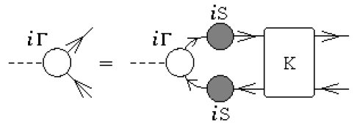
Persistent challenge - truncation scheme
These observations show that symmetries relate the kernel of the gap equation – nominally a one-body problem, with that of the Bethe-Salpeter equation – considered to be a two-body problem
Until 1995/1996 people had
no idea what to do
Equations were truncated,
sometimes with good
phenomenological results,
sometimes with poor results
Neither good nor bad
could be explained
quark-antiquark scattering kernel

Slide 36
Persistent challenge - truncation scheme
Happily, there are now two
nonperturbative & symmetry preserving
truncation schemes
1995 – H.J. Munczek, Phys. Rev. D 52 (1995) 4736, Dynamical chiral symmetry breaking, Goldstone’s theorem and the consistency of the Schwinger-Dyson and Bethe-Salpeter Equations
1996 – A. Bender, C.D. Roberts and L. von Smekal, Phys.Lett. B 380 (1996) 7, Goldstone Theorem and Diquark Confinement Beyond Rainbow Ladder Approximation
2009 – Lei Chang and C.D. Roberts, Phys. Rev. Lett. 103 (2009) 081601, 0903.5461 [nucl-th], Sketching the Bethe-Salpeter kernel
Enables proof of numerous exact results

Slide 37
Some of many
Exact Results

Slide 38
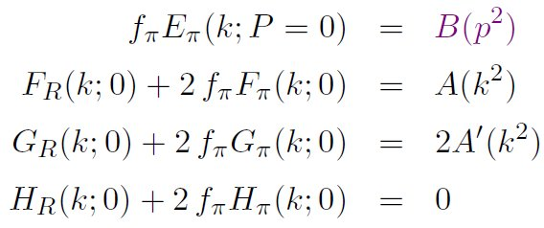
Pion’s Goldberger -Treiman relation
Maris, Roberts and Tandy
nucl-th/9707003, Phys.Lett. B420 (1998) 267-273
Pion’s Bethe-Salpeter amplitude
Solution of the Bethe-Salpeter equation
Dressed-quark propagator
Axial-vector Ward-Takahashi identity entails
Pseudovector components
necessarily nonzero.
Cannot be ignored!
Exact in
Chiral QCD
Miracle: two body problem solved, almost completely, once solution of one body problem is known

Slide 39
Dichotomy of the pion Goldstone mode and bound-state
f_{π} E_{π}(p²) = B(p²)
Goldstone’s theorem
has a pointwise expression in QCD;
Namely, in the chiral limit the wave-function for the two-body bound-state Goldstone mode is intimately connected with, and almost completely specified by, the fully-dressed one-body propagator of its characteristic constituent
The one-body momentum is equated with the relative momentum of the two-body system

Slide 40
Form Factors Elastic Scattering
Form factors have long been recognised as a basic tool for elucidating bound-state properties.
They are of particular value in hadron physics because they provide information on structure as a function of Q², the squared momentum-transfer:
Small-Q² is the nonperturbative domain
Large-Q² is the perturbative domain
Nonperturbative methods in hadron physics must explain the behaviour from Q²=0 through the transition domain, whereupon the behaviour is currently being measured
Experimental and theoretical studies of hadron electromagnetic form factors have made rapid and significant progress during the last several years, including new data in the time like region, and material gains have been made in studying the pion form factor.
Despite this, many urgent questions remain unanswered

Slide 41
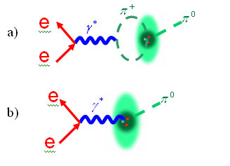
Some questions
How can we use experiment to chart the long-range behaviour of the β-function in QCD?
Given the low mass of the pion and its
strong coupling to protons and neutrons,
how can we disentangle spectral features
produced by final-state interactions from
the intrinsic properties of hadrons?
At which momentum-transfer does the transition from nonperturbative -QCD to perturbative- QCD take place?
…

Slide 42
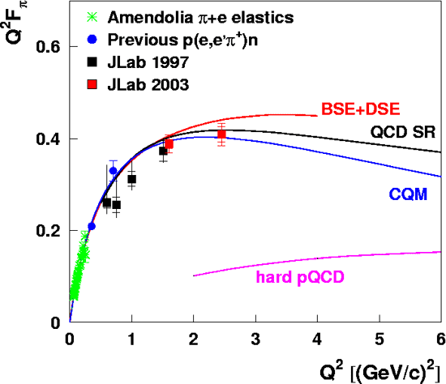
Illustration: Pion form factor
Many theorists have pretended that computing the pion form factor is easy
Problems:
Those theorists have no understanding of DCSB
There are no pion targets and hence it is difficult to obtain an unambiguous measurement of the pion form factor
Notwithstanding these difficulties, the DSEs provide an excellent tool, because so many exact results are proved for the pion
A quantitative prediction was obtained by combining
Dressed-rainbow gap equation
Dressed-ladder Bethe-Salpeter equation
Dressed impulse approximation for the form factor

Slide 43
Electromagnetic pion form factor
Leading-order in a nonperturbative, symmetry-preserving truncation scheme
Valid formulation of the DSEs preserves all symmetry relations between the elements
All elements determined ONCE Gap Equation’s kernel is specified
Enormous power to predict and correlate observables
Γ_{μ}(p,q) – Dressed-quark-photon vertex:
Computed via inhomogeneous
Bethe-Salpeter equation
S(p) – dressed-quark propagator:
computed via the Gap Equation
Γ_{π}(k;P) – Pion Bethe-Salpeter amplitude:
computed via the Bethe-Salpeter equation

Slide 44
Electromagnetic pion form factor
Leading-order in a nonperturbative, symmetry-preserving truncation scheme
Valid formulation of the DSEs preserves all symmetry relations between the elements
All elements determined ONCE Gap Equation’s kernel is specified
Enormous power to predict and correlate observables
After solving gap and Bethe-Salpeter equations, one four-dimensional integral remains to be done.
Γ_{μ}(p,q) – Dressed-quark-photon vertex:
Computed via Bethe-Salpeter equation
Γ_{π}(k;P) – Pion Bethe-Salpeter amplitude:
computed via the Bethe-Salpeter equation
S(p) – dressed-quark propagator:
computed via the Gap Equation
Result is successful prediction of F_{π}(Q²) by Maris and Tandy, Phys.Rev. C 62 (2000) 055204, nucl-th/0005015

Slide 45
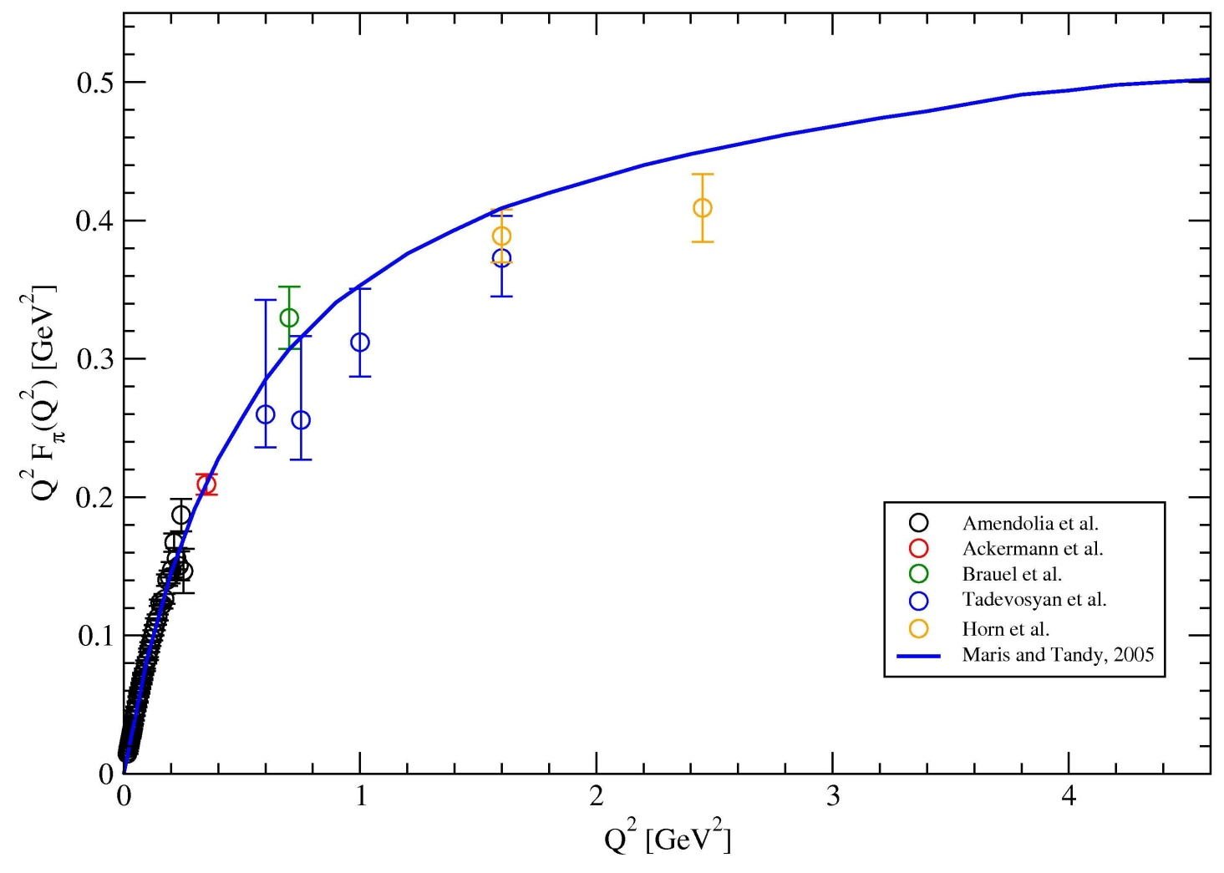
Electromagnetic pion form factor
Result is successful prediction of F_{π}(Q²) by Maris and Tandy, Phys.Rev. C 62 (2000) 055204, nucl-th/0005015
Prediction published in 1999. Numerical technique improved subsequently, producing no material changes
Data from Jlab published in 2001
DSE Computation has one parameter, m_{G}≈0.6GeV, and unifies F_{π}(Q²) with numerous other observables
One-parameter RGI-improved interaction unifies 40+ mesons and nucleon observables with rms relative-error of 15%.
Efficacious extant tool for JLab physics

Slide 46
Pion’s Goldberger -Treiman relation
Maris, Roberts and Tandy, nucl-th/9707003,
Phys.Lett. B420 (1998) 267-273
Corrected an error, which had prevented progress for 18years
Pion’s Bethe-Salpeter amplitude
Solution of the Bethe-Salpeter equation
Dressed-quark propagator
Axial-vector Ward-Takahashi identity entails
Pseudovector components
necessarily nonzero.
Cannot be ignored!
Exact in
Chiral QCD

Slide 47
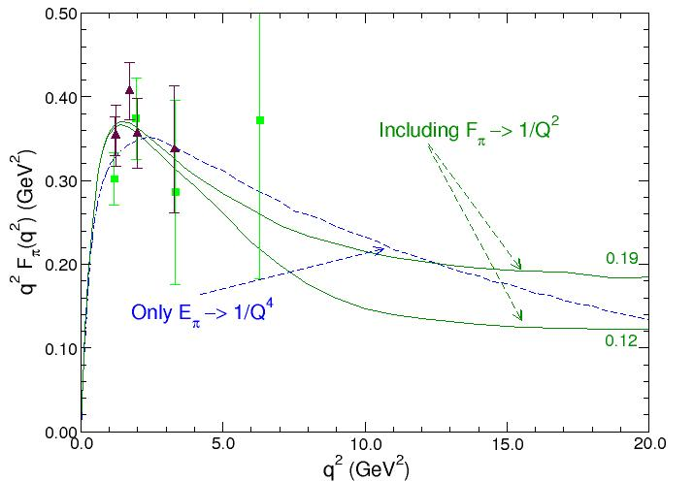
Pion’s GT relation Implications for observables?
Maris and Roberts, nucl-th/9804062,
Phys.Rev. C 58 (1998) 3659-3665
Pseudovector components
dominate in ultraviolet:
(½Q)² = 2 GeV²
pQCD point for M(p²)
⇒ pQCD at Q² = 8 GeV²

Slide 48
Looking deeper

Slide 49
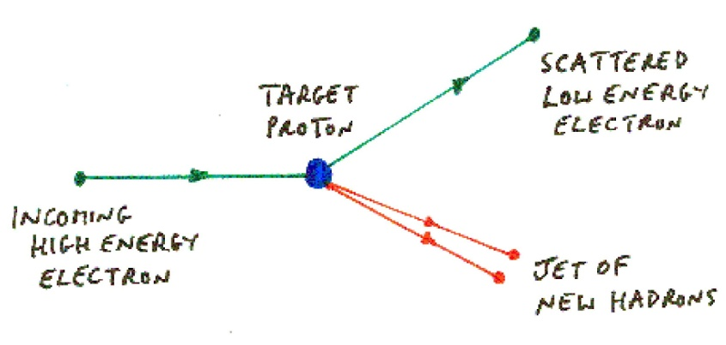
Deep inelastic scattering
Quark discovery experiment at SLAC
(1966-1978, Nobel Prize in 1990)
Completely different to elastic scattering
Blow the target to pieces instead of keeping only those events where it remains intact.
Cross-section is interpreted as a measurement of the momentum-fraction probability distribution for quarks and gluons within the target hadron: q(x), g(x)
Probability that a quark/gluon within the target will carry a fraction x of the bound-state’s light-front momentum
Distribution Functions of the Nucleon and Pion in the Valence Region, Roy J. Holt and Craig D. Roberts, arXiv:1002.4666 [nucl-th], Rev. Mod. Phys. 82 (2010) pp. 2991-3044

Slide 50
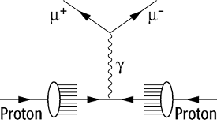
Models of the Pion’s valence-quark distributions
Pion
(1−x)^{β} with β=0 (i.e., a constant – any fraction is equally probable! )
AdS/QCD models using light-front holography
Nambu–Jona-Lasinio models, when a translationally invariant regularization is used
(1−x)^{β} with β=1
Nambu–Jona-Lasinio NJL models with a hard cutoff
Duality arguments produced by some theorists
(1−x)^{β} with 0<β<2
Relativistic constituent-quark models, with power-law depending on the form of model wave function
(1−x)^{β} with 1<β<2
Instanton-based models, all of which have incorrect large-k² behaviour

Slide 51
Models of the Pion’s valence-quark distributions
Pion
(1−x)^{β} with β=0 (i.e., a constant – any fraction is equally probable! )
AdS/QCD models using light-front holography
Nambu–Jona-Lasinio models, when a translationally invariant regularization is used
(1−x)^{β} with β=1
Nambu–Jona-Lasinio NJL models with a hard cutoff
Duality arguments produced by some theorists
(1−x)^{β} with 0<β<2
Relativistic constituent-quark models, depending on the form of model wave function
(1−x)^{β} with 1<β<2
Instanton-based models
Completely unsatisfactory.
Impossible to suggest that there’s even qualitative agreement!

Slide 52
DSE prediciton of the Pion’s valence-quark distributions
Pion
Consider a theory in which quarks scatter via a vector-boson exchange interaction whose k²>>m_{G}² behaviour is (1/k²)^{β},
Then at a resolving scale Q₀
u_{π}(x;Q₀) ~ (1-x)^{2β}
namely, the large-x behaviour of the quark distribution function is a direct measure of the momentum-dependence of the underlying interaction.
In QCD, β=1 and hence
^{QCD} u_{π}(x;Q₀) ~ (1-x)²

Slide 53
DSE prediciton of the Pion’s valence-quark distributions
Pion
Completely unambigous!
Direct connection between experiment and theory, empowering both as tools of discovery.
Consider a theory in which quarks scatter via a vector-boson exchange interaction whose k²>m_{G}² behaviour is (1/k²)^{β},
Then at a resolving scale Q₀
u_{π}(x;Q₀) ~ (1-x)^{2β}
namely, the large-x behaviour of the quark distribution function is a direct measure of the momentum-dependence of the underlying interaction.
In QCD, β=1 and hence
^{QCD} u_{π}(x;Q₀) ~ (1-x)²

Slide 54
“Model Scale”
At what scale Q₀ should the prediction be valid?
Hitherto, PDF analyses within models have used the resolving scale Q₀ as a parameter, to be chosen by requiring agreement between the model and low-moments of the PDF that are determined empirically.
Essentially nonperturbative domain
Pion
Modern DSE studies have exposed a natural value for the model scale; viz.,
Q₀ ≈ m_{G} ≈ 0.6 GeV
which is the location of the inflexion point in the chiral-limit dressed-quark mass function

Slide 55
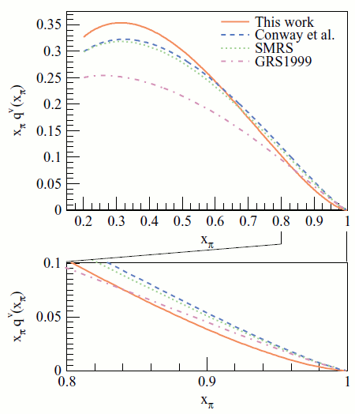
Empirical status of the Pion’s valence-quark distributions
Pion
Owing to absence of pion targets, the pion’s valence-quark distribution functions are measured via the Drell-Yan process:
π p → μ⁺ μ⁻ X
Three experiments: CERN (1983 & 1985)
and FNAL (1989). No more recent
experiments because theory couldn’t
even explain these!
Problem
Conway et al. Phys. Rev. D 39, 92 (1989)
Wijesooriya et al. Phys.Rev. C 72 (2005) 065203
Behaviour at large-x inconsistent with
pQCD; viz,
expt. (1-x)^{1+ε}
cf. QCD (1-x)^{2+γ}

Slide 56
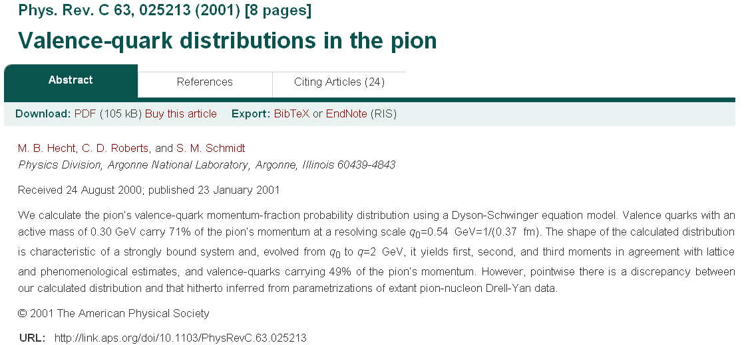
QCD-based calculation

Slide 57
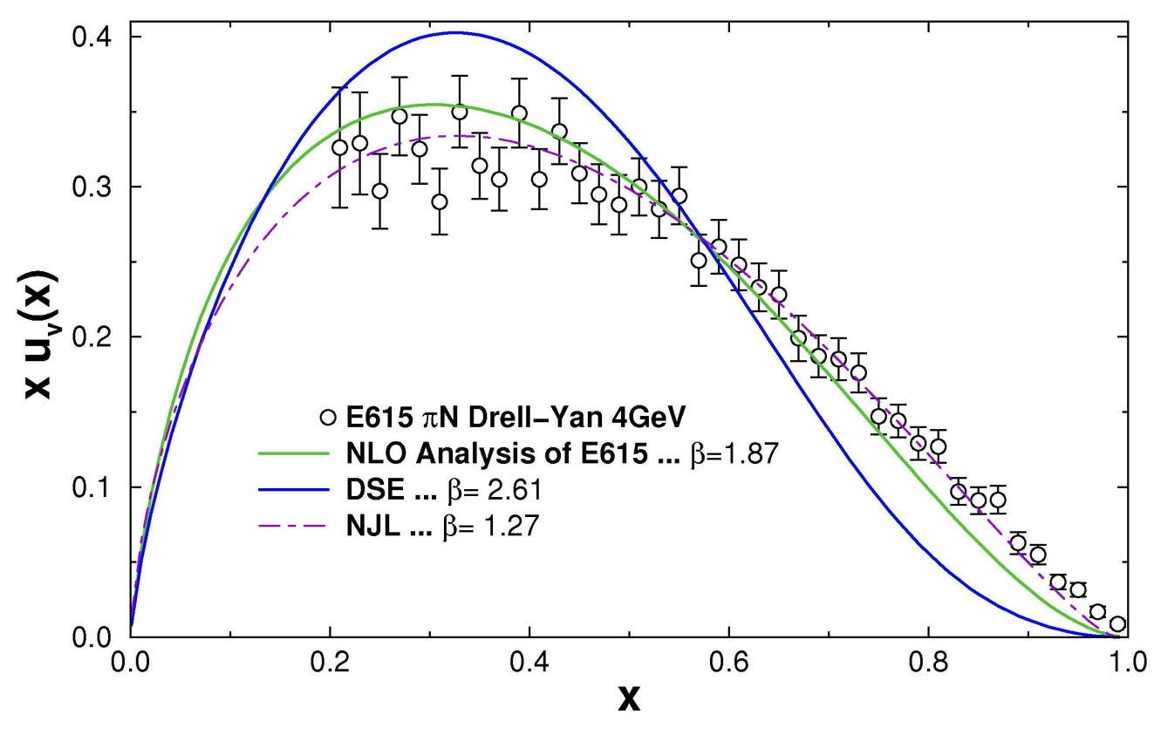
Computation of q_{v}^{π}(x)
Hecht, Roberts, Schmidt
Phys.Rev. C 63 (2001) 025213
As detailed in preceding transparencies, before the first DSE computation, which used the running dressed-quark mass described previously, numerous authors applied versions of the Nambu–Jona-Lasinio model, etc., and were content to vary parameters and Q₀ in order to reproduce the data, arguing therefrom that the inferences from pQCD were wrong
After the first DSE computation, real physicists (i.e., experimentalists) again became interested in the process because
DSEs agreed with pQCD but disagreed with the data and models
Disagreement on the “valence domain,” which is uniquely sensitive to M(p²)
2.61/1.27= factor of 2 in the exponent

Slide 58
Reanalysis of q_{v}^{π}(x)
Hecht, Roberts, Schmidt
Phys.Rev. C 63 (2001) 025213
After the first DSE computation, the “Conway et al.” data were reanalysed, this time at next-to-leading-order (Wijesooriya et al. Phys.Rev. C 72 (2005) 065203)
The new analysis produced a much larger exponent than initially obtained; viz., β=1.87, but now it disagreed equally with NJL-model results and the DSE prediction
NB. Within pQCD, one can readily understand why adding a higher-order correction leads to a suppression of q_{v}^{π}(x) at large-x.
New experiments were proposed … for accelerators that do not yet exist but the situation remained otherwise unchanged
Until the publication of Distribution Functions of the Nucleon and Pion in the Valence Region, Roy J. Holt and Craig D. Roberts, arXiv:1002.4666 [nucl-th], Rev. Mod. Phys. 82 (2010) pp. 2991-3044

Slide 59
Reanalysis of q_{v}^{π}(x)
Distribution Functions of the Nucleon and Pion in the Valence Region, Roy J. Holt and Craig D. Roberts, arXiv:1002.4666 [nucl-th], Rev. Mod. Phys. 82 (2010) pp. 2991-3044
This article emphasised and explained the importance of the persistent discrepancy between the DSE result and experiment as a challenge to QCD
It prompted another reanalysis of the data, which accounted for a long-overlooked effect: viz., “soft-gluon resummation,”
Compared to previous analyses, we include next-to-leading-logarithmic threshold resummation effects in the calculation of the Drell-Yan cross section. As a result of these, we find a considerably softer valence distribution at high momentum fractions x than obtained in previous next-to-leading-order analyses, in line with expectations based on perturbative-QCD counting rules or Dyson-Schwinger equations.
Aicher, Schäfer, Vogelsang, “Soft-Gluon Resummation and the Valence Parton Distribution Function of the Pion,” Phys. Rev. Lett. 105 (2010) 252003

Slide 60
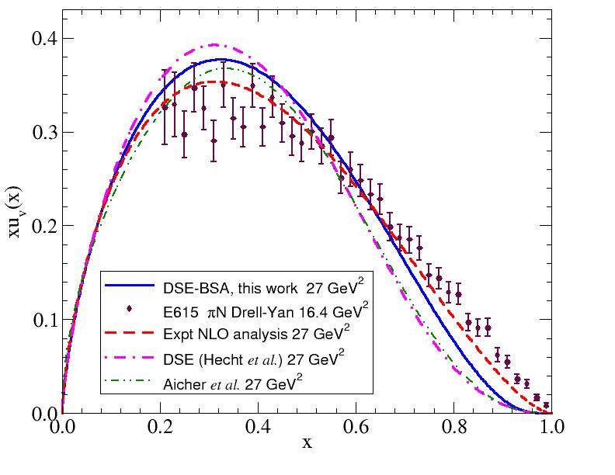
Current status of q_{v}^{π}(x)
Trang, Bashir, Roberts & Tandy, “Pion and kaon valence-quark parton distribution functions,” arXiv:1102.2448 [nucl-th], Phys. Rev. C 83, 062201(R) (2011) [5 pages]
Data
as reported byE615
DSE prediction (2001)

Slide 61
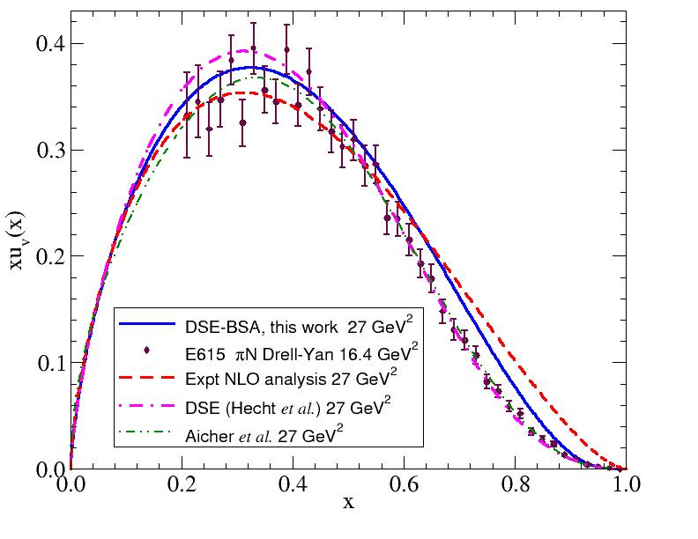
Current status of q_{v}^{π}(x)
Trang, Bashir, Roberts & Tandy, “Pion and kaon valence-quark parton distribution functions,” arXiv:1102.2448 [nucl-th], Phys. Rev. C 83, 062201(R) (2011) [5 pages]
Data after inclusion of soft-gluon resummation
DSE prediction and
modern representation of the data are
indistinguishable
on the valence-quark domain
Emphasises the value of using a single internally-consistent, well-constrained framework to correlate and unify the description of hadron observables

Slide 62
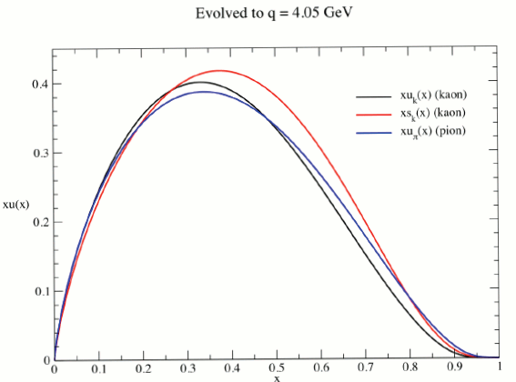
q_{v}^{π}(x) & q_{v}^{K}(x)
Trang, Bashir, Roberts & Tandy, “Pion and kaon valence-quark parton distribution functions,” arXiv:1102.2448 [nucl-th], Phys. Rev. C 83, 062201(R) (2011) [5 pages]
m_{s} ≈ 24 m_{u} & M_{s} ≈ 1.25 M_{u}
Expect the s-quark to carry more of the kaon’s momentum than the u-quark, so that xs_{K}(x) peaks at larger value of x than xu_{K}(x)
Expectation confirmed in computations, with s-quark distribution peaking at 15% larger value of x
Even though deep inelastic scattering is a high-Q² process, constituent-like mass-scale explains the shift
xu_{K}(x)
xs_{K}(x)
xu_{π}(x)

Slide 63
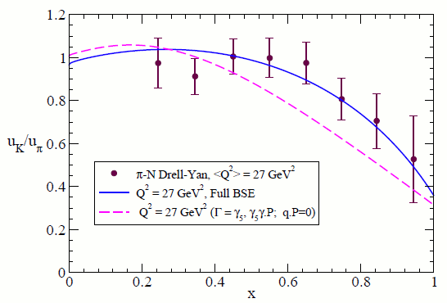
u_{K}(x)/u_{π}(x)
Trang, Bashir, Roberts & Tandy, “Pion and kaon valence-quark parton distribution functions,” arXiv:1102.2448 [nucl-th], Phys. Rev. C 83, 062201(R) (2011) [5 pages]
Drell-Yan experiments at CERN (1980 & 1983) provide the only extant measurement of this ratio
DSE result in complete accord with the measurement
New Drell-Yan experiments are capable of validating this comparison
It should be done so that complete understanding can be claimed
Value of ratio at x=0 will approach “1” under evolution to higher resolving scales. This is a feature of perturbative dynamics
Using DSEs in QCD, one derives that the x=1 value is
≈ (f_{π}/f_{K})² (M_{u} /M_{s})⁴ = 0.3
Value of ratio at x=1 is a fixed point of the evolution equations
Hence, it’s a very strong test of nonperturbative dynamics

Slide 64
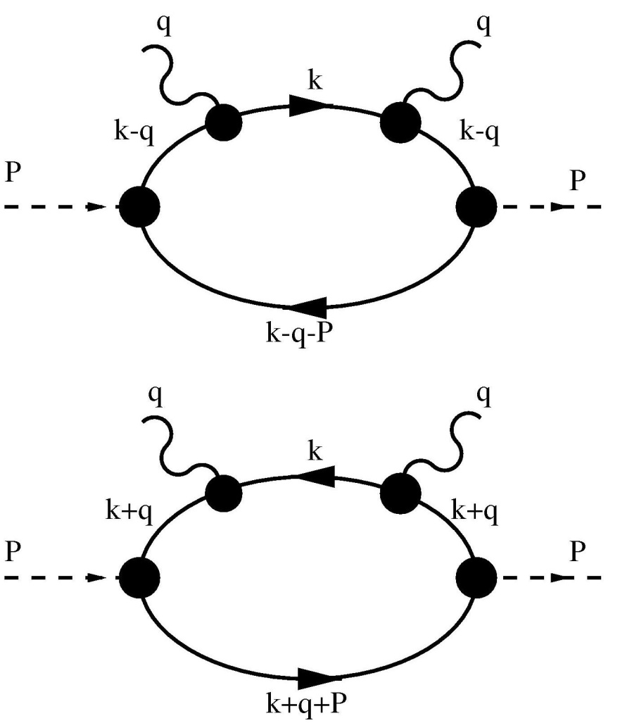
Reconstructing PDF from moments
Khitrin, Roberts & Tandy, in progress.
Suppose one cannot readily compute the PDF integral,
perhaps because one has employed a Euclidean metric, such as is typical of all nonperturbative studies with QCD connection
Preceding computations employed a
dirty trick to proceed from Euclidean
space to the light-front; viz.,
Spectator pole approximation:
S_{dressed}(p) → 1/(i γ·p + M)
for internal lines
Can one otherwise determine the
PDF, without resorting to artifices?

Slide 65
Reconstructing PDF from moments
Khitrin, Roberts & Tandy, in progress.
Rainbow-ladder truncation – general expression for PDF moments:
n²=0, n.P= -m_{π}
Consider vector-vector interaction with exchange (1/k²)^{n}, n=0 then
<x^{m}> = 1/(m+1)
To which distribution does this correspond?
Solve ∫₀¹ dx x^{m} u_{π}(x) = 1/(m+1) for u_{π}(x)
Answer u_{π}(x)=1 can be verified by direct substitution
Many numerical techniques available for more interesting interactions
π Bethe-Salpeter
amplitude
Dressed-quark
propagator
Dressed-quark-photon
vertex

Slide 66
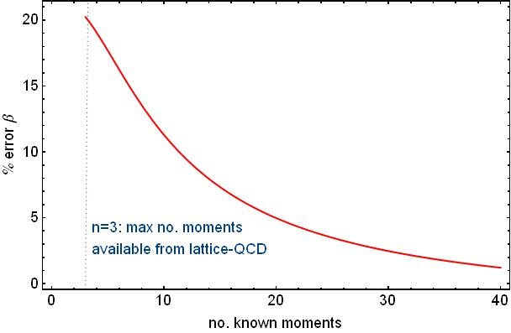
Reconstructing the Distribution Function
Khitrin, Roberts & Tandy, in progress.
Suppose one has “N” nontrivial moments of the quark distribution function & assume
u_{π}(x) ~ x^{α} (1-x)^{β}
Then, how accurately can one obtain the large-x exponent, β?
Available moments from lattice-QCD … not better than 20%
12 moments needed for 10% accuracy
Lower bound … For a more complicated functional form, one needs more moments.
With 40 nontrivial moments, obtain β=2.03 from 1/k² input

Slide 67
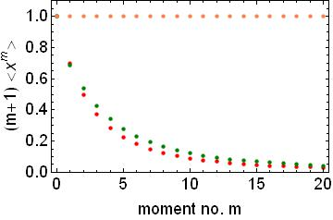
Euclidean Space Moments of the Distribution Function
Khitrin, Roberts & Tandy, in progress;
Si-xue Qin, Lei Chang, Yu-xin Liu, Craig Roberts and David Wilson, arXiv:1108.0603 [nucl-th], Phys. Rev. C 84 042202(R) (2011)
Best rainbow-ladder interaction available for QCD:
|π_{bound-state}> = Z_{D} |π_{dressed-quark-core}> + (1-Z_{D}) |meson-cloud>
Adjusted with one parameter to reflect inclusion of sea-quarks via pion cloud: Z_{D} = 0.87
Origin in comparison with ChPT; viz., dressed-quark core produces 80% of ≈ r_{π}² and chiral-logs produce ≈ 20%
Point particle
Kitrin et al.
Aicher et al., PRL 105, 252003 (2010)
Both have Q₀ ≈ 0.6 GeV

Slide 68
Pion’s valence-quark Distribution Amplitude
Moments method is also ideal for φ_{π}(x):
entails
Contact interaction
(1/k²)^{ν} , ν=0
Straightforward exercise to show
∫₀¹ dx x^{m} φ_{π}(x) = f_{π} 1/(1+m) , hence φ_{π}(x)= f_{π} Θ(x)Θ(1-x)
Pion’s Bethe-Salpeter wave function
Work now underway with sophisticated rainbow-ladder interaction: Khitrin, Cloët, Roberts & Tandy

Slide 69
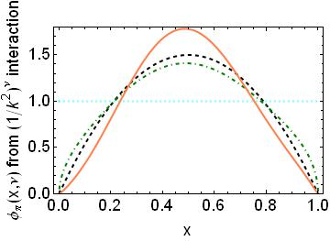
Pion’s valence-quark Distribution Amplitude
Using simple parametrisations of solutions to the gap and Bethe-Salpeter equations, rapid and semiquantitatively reliable estimates can be made for φ_{π}(x)
(1/k²)^{ν=0}
(1/k²)^{ν =½}
(1/k²)^{ν =1}
Again, unambiguous and direct mapping between behaviour of interaction and behaviour of distribution amplitude
Leading pQCD φ_{π}(x)=6 x (1-x)
Humped and flat distributions are strongly disfavoured by rainbow-ladder
QCD analyses of (1/k²)^{ν =1} interaction

Slide 70
Nucleon Structure Functions
Moments method will work here, too.
Work about to begin: Cloët, Roberts & Tandy
Based on predictions for nucleon elastic form factors, which, e.g., predicted large-Q² behavior of G_{E}^{n}(Q²):
Meantime, capitalise on connection between x=1 and Q²=0 …
Survey of nucleon electromagnetic form factors I.C. Cloët, G. Eichmann, B. El-Bennich, T. Klähn and C.D. Roberts arXiv:0812.0416 [nucl-th], Few Body Syst. 46 (2009) pp. 1-36

Slide 71
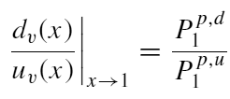
Neutron structure function at high-x
I.C. Cloët, C.D. Roberts, et al.
arXiv:0812.0416 [nucl-th], Few Body Syst. 46 (2009) 1-36
D. J. Wilson, I. C. Cloët, L. Chang and C. D. Roberts
arXiv:1112.2212 [nucl-th], Phys. Rev. C85 (2012) 025205 [21 pages]
Valence-quark distributions at x=1
Fixed point under DGLAP evolution
Strong discriminator between models
Algebraic formula
P₁^{p,s} = contribution to the proton's charge arising from diagrams with a scalar diquark component in both the initial and final state
P₁^{p,a} = kindred axial-vector diquark contribution
P₁^{p,m} = contribution to the proton's charge arising from diagrams with a different diquark component in the initial and final state.

Slide 72
Neutron structure function at high-x
I.C. Cloët, C.D. Roberts, et al.
arXiv:0812.0416 [nucl-th], Few Body Syst. 46 (2009) 1-36
D. J. Wilson, I. C. Cloët, L. Chang and C. D. Roberts
arXiv:1112.2212 [nucl-th], Phys. Rev. C85 (2012) 025205 [21 pages]
Algebraic formula
Contact interaction
“Realistic” interaction

Slide 73
Neutron Structure Function at high x
I.C. Cloët, C.D. Roberts, et al.
arXiv:0812.0416 [nucl-th]
D. J. Wilson, I. C. Cloët, L. Chang and C. D. Roberts
arXiv:1112.2212 [nucl-th], Phys. Rev. C85 (2012) 025205 [21 pages]
SU(6) symmetry
Deep inelastic scattering
– the Nobel-prize winning
quark-discovery experiments
Reviews:
S. Brodsky et al.
NP B441 (1995)
W. Melnitchouk & A.W.Thomas
PL B377 (1996) 11
N. Isgur, PRD 59 (1999)
R.J. Holt & C.D. Roberts
RMP (2010)
DSE: “realistic”
pQCD, uncorrelated Ψ
DSE: “contact”
0⁺ qq only
Melnitchouk et al.
Phys.Rev. D84 (2011) 117501
Distribution of neutron’s
momentum amongst quarks
on the valence-quark domain
Notes:
(48)

Slide 74
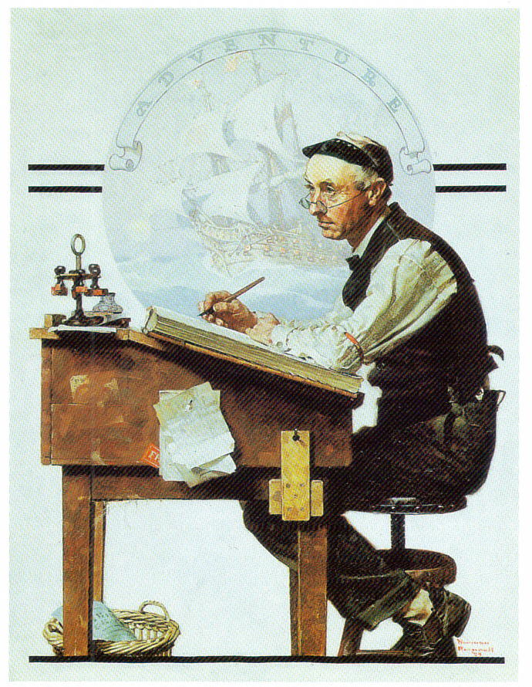
Epilogue

Slide 75
Epilogue
As Nature’s only example of an essentially nonperturbative fundamental theory, QCD is the most interesting part of the standard model.
Solving QCD requires more imagination than inventing yet another unconstrained and unconstrainable NGSM.
QCD’s Dyson-Schwinger equations provide a unique approach to continuum strong QCD, in which disparate observables:
meson and baryon spectra;
form factors;
distribution functions and amplitudes;
etc.,
are unified via an assumed form for the infrared behaviour of QCD’s β-function.

Slide 76
Epilogue
Light-quark confinement is not connected in any known way with a linear potential; not with a potential of any kind.
Light-quark confinement is associated with a dramatic change in the structure of the parton propagators.
Dynamical chiral symmetry breaking, the origin of 98% of visible matter in universe, is manifested fundamentally in an equivalence between the one- and two-body problem in QCD
Working together to chart the behaviour of the running masses in QCD, experiment and theory can potentially answer the questions of confinement and dynamical chiral symmetry breaking; a task that currently each alone find hopeless.

Slide 77
This is not the end

