Slide 1
Nuclear Structure Experiment (II)

Slide 2
The (Second) Plan
Trends in excitation spectra
Collective vs. single-particle
Vibration, rotation, …
Nuclear decay – measurements and more
Gamma-decay
Beta-decay
Alpha-decay

Slide 3
Patterns and Nuclear Structure: Excitation Spectra

Slide 4
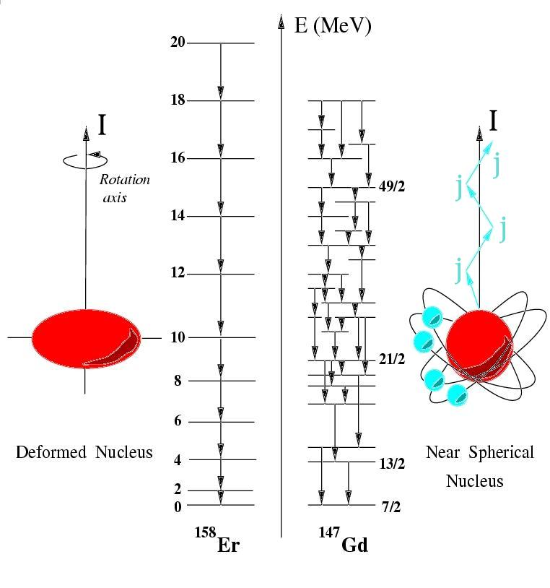
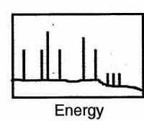
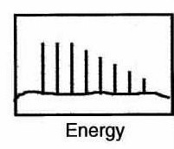
Level schemes – collective vs. single particle
Level Schemes Contain Structural Information
Collective Rotation
Single Particle Alignment

Slide 5
Nuclear excitations
4811
Single particle excitations
Within a independent particle model, a subset of nuclear excitations correspond to different configurations of protons and neutrons
408 keV
4403
404 keV
3999
437 keV
3562
862 keV
2875
p_{3/2}
1/2+
2599
3/2+
2578
28
564 keV
585 keV
f_{7/2}
3/2-
2014
20
20
d_{3/2}
d_{3/2}
3562 keV
s_{1/2}
s_{1/2}
3999 keV
2578/2599 keV
2014 keV
⁴⁷Ca
d_{5/2}
d_{5/2}
8
8
Protons
Neutrons
7/2-
0

Slide 6
Nuclear excitations
4811
Single particle excitations
Within a independent particle model, a subset of nuclear excitations correspond to different configurations of protons and neutrons
408 keV
4403
404 keV
3999
437 keV
3562
862 keV
2875
p_{3/2}
1/2+
2599
3/2+
2578
28
564 keV
585 keV
f_{7/2}
3/2-
2014
20
20
d_{3/2}
d_{3/2}
3562 keV
s_{1/2}
s_{1/2}
3999 keV
2578/2599 keV
2014 keV
⁴⁷Ca
d_{5/2}
d_{5/2}
8
8
Protons
Neutrons
7/2-
0

Slide 7
Nuclear excitations
4811
Single particle excitations
Within a independent particle model, a subset of nuclear excitations correspond to different configurations of protons and neutrons
408 keV
4403
404 keV
3999
437 keV
3562
862 keV
2875
p_{3/2}
1/2+
2599
3/2+
2578
28
564 keV
585 keV
f_{7/2}
3/2-
2014
20
20
d_{3/2}
d_{3/2}
3562 keV
s_{1/2}
s_{1/2}
3999 keV
2578/2599 keV
2014 keV
⁴⁷Ca
d_{5/2}
d_{5/2}
8
8
Protons
Neutrons
7/2-
0

Slide 8
Nuclear excitations
4811
Single particle excitations
Within a independent particle model, a subset of nuclear excitations correspond to different configurations of protons and neutrons
408 keV
4403
404 keV
3999
437 keV
3562
862 keV
2875
p_{3/2}
1/2+
2599
3/2+
2578
28
564 keV
585 keV
f_{7/2}
3/2-
2014
20
20
d_{3/2}
d_{3/2}
3562 keV
s_{1/2}
s_{1/2}
3999 keV
2578/2599 keV
2014 keV
⁴⁷Ca
d_{5/2}
d_{5/2}
8
8
Protons
Neutrons
7/2-
0

Slide 9
Nuclear excitations
Collective excitations
Many nucleons outside a closed shell contribute coherently to excitations
Vibrations and rotations (for non-spherical nuclei) have excitation energies comparable to single-particle energy excitations

Slide 10
Nuclear vibration
Treat nuclear vibrations as time-dependent deformation
n=3
0,2,3,4,6+
Give rise to characteristic excitation spectra – vibration phonons couple as angular momenta
i.e. Quadrupole vibrations
n=2
0,2,4+
n=1
2+
0+

Slide 11
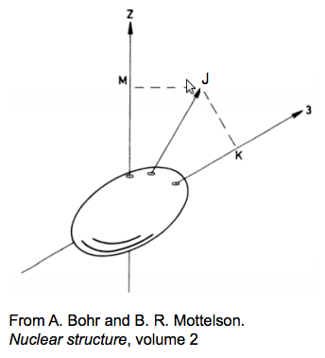
Nuclear rotation
Deformed nuclei can also undergo collective rotational motion; nuclear rotation is parameterized in the same way as classical rotors
6+
4+
E_{rot}(J) = ħ²/2I × J(J+1)
I = Moment of inertia
2+
0+

Slide 12
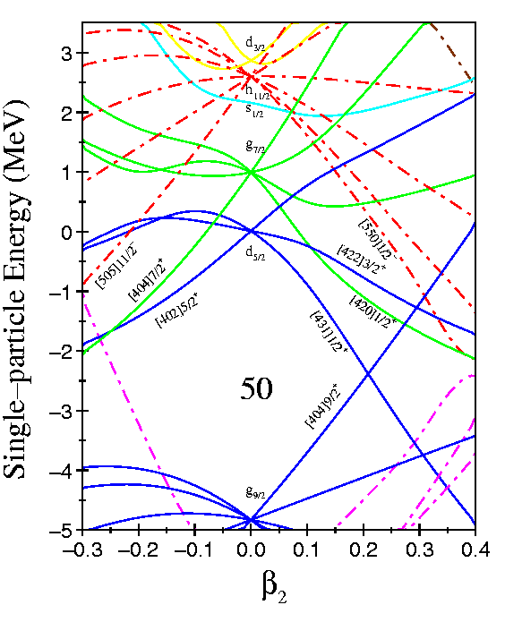
Deformation and the Nilsson model
Nuclear rotation is a collective excitation, but interfaces to single-particle structure
Nilsson model is a shell-model description in a deformed basis, which provides a good description in well-deformed nuclei
Oblate
“pancake”
Prolate
“football”
Sphere

Slide 13
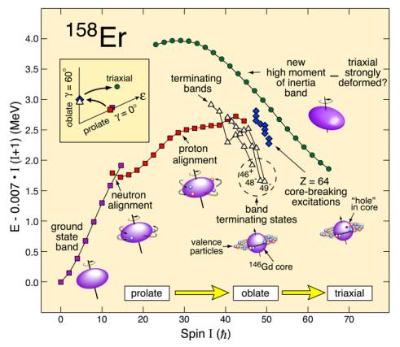
Moment of inertia in nuclei
Rigid body estimate for the moment of inertia is consistently larger than experimental data
Irrotational flow value (like a liquid drop…) is too small
Data puts the nuclear moment of inertia between these two limits; moment of inertia dynamic

Slide 14
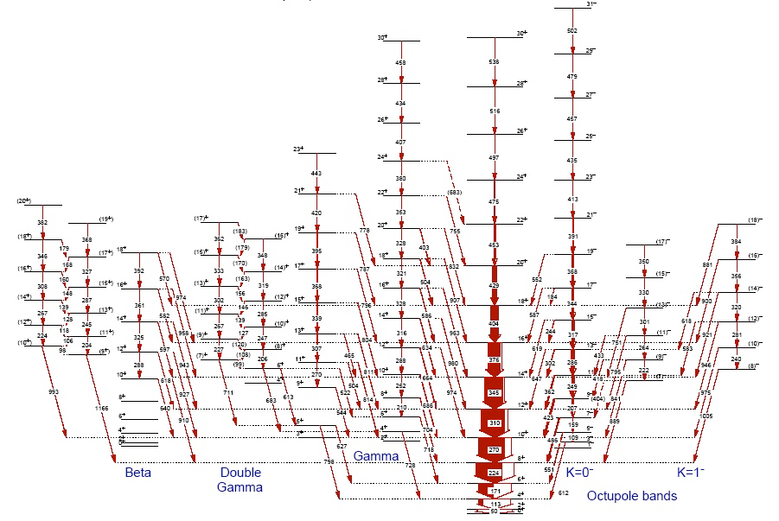
Excitations in the real world
Nuclei are not limited to a single type of excitation – vibration, rotation and single-particle configurations all coexist at similar excitation energies.
States near in energy with the same spin interact and interfere – nuclear wavefunctions are complex superpositions of ‘pure’ configurations.

Slide 15
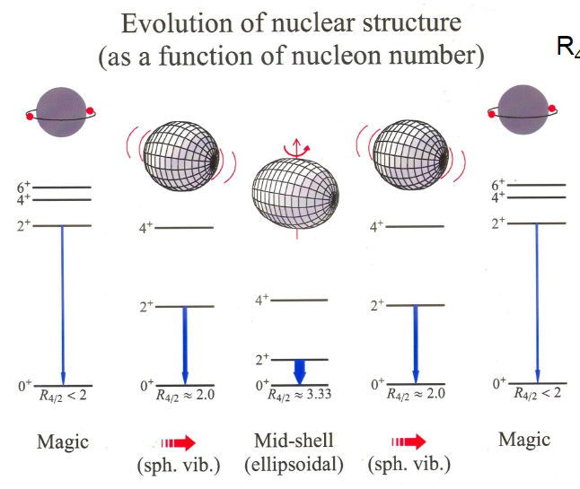
Simple patterns still tell us about structure

Slide 16
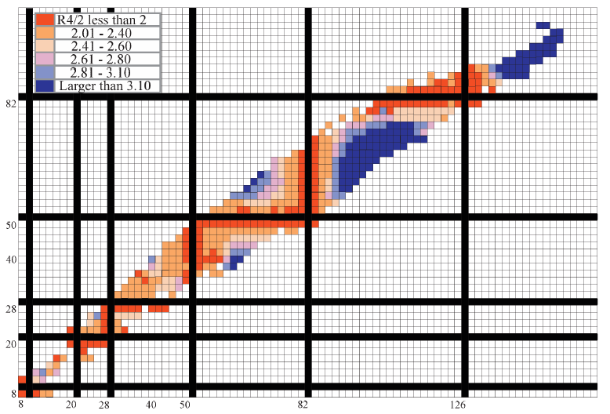
R_{4/2} – A powerful ratio

Slide 17
Nuclear Decay
Studying Level Schemes

Slide 18
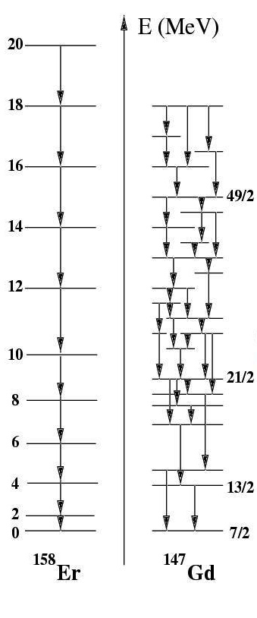
Studying Level Schemes
Excited states in nuclei can decay in a number of ways:
β⁺, β⁻, electron capture (EC) -- ¹⁷⁷Lu^{m}
Particle emission -- ⁵³Co^{m}, ²¹¹Po^{m}
Fission ²³⁹Pu^{m}
Internal conversion
Gamma-ray emission

Slide 19
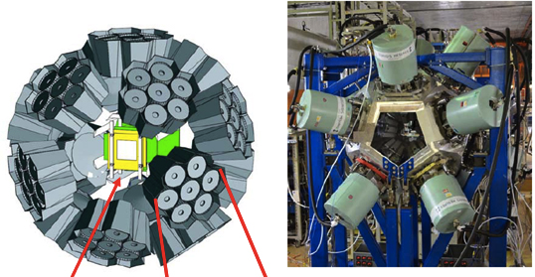
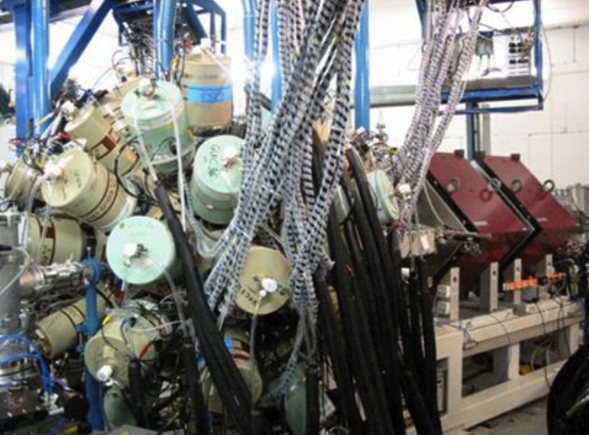
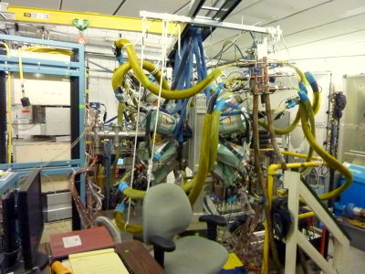
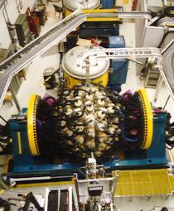
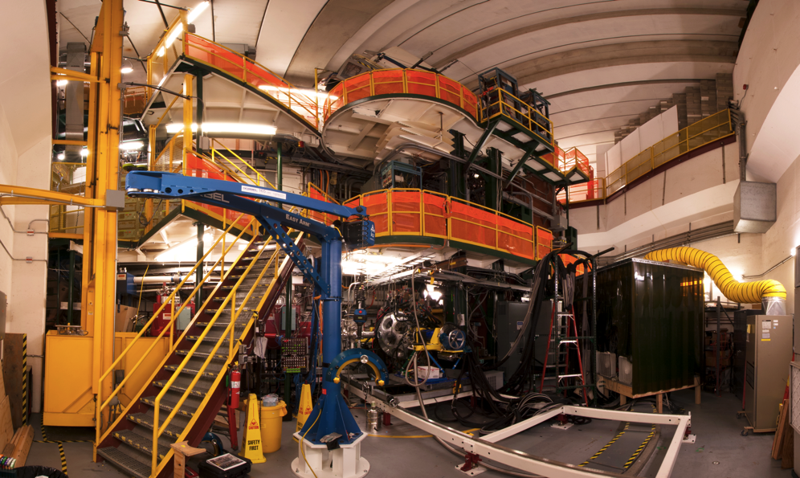
Nuclear Excited State Decay
EURICA Decay Spectroscopy at RIBF (RIKEN)
Heavy Element Studies at RITU
Nucleon knockout at the S800
β Decay at NSCL
Heavy-ion reactions with the FMA

Slide 20
Dominant Excited State Decay
Excited states in nuclei can decay in a number of ways:
β⁺, β⁻, electron capture (EC) -- ¹⁷⁷Lu^{m}
Particle emission -- ⁵³Co^{m}, ²¹¹Po^{m}
Fission ²³⁹Pu^{m}
Internal conversion
Gamma-ray emission
Nuclear properties from gamma-ray studies
Coincidence relation --> Level schemes
Angular distribution/correlation --> Multipolarity, spin
Doppler shifts --> excited state lifetimes
Linear polarization --> E/M, parity
Intensity of transitions --> B(E2)

Slide 21
Selection Rules
J_{i}^{π}
E_{i}
E_{γ} (L)
J_{f}^{π}
E_{f}

Slide 22
Selection Rules
J_{i}^{π}
E_{i}
E_{γ} (L)
J_{f}^{π}
E_{f}
The transition probability for at state decaying by transition of multipole order L is:
…

Slide 23
Selection Rules
J_{i}^{π}
E_{i}
E_{γ} (L)
J_{f}^{π}
E_{f}
The transition probability for at state decaying by transition of multipole order L is:
Reduced matrix element – i.e.

Slide 24
Selection Rules
J_{i}^{π}
E_{i}
E_{γ} (L)
J_{f}^{π}
E_{f}
The transition probability for at state decaying by transition of multipole order L is:
Reduced matrix element – i.e.
Weisskopf estimates
…
…

Slide 25
Properties of Gamma Decay
Energies --> spacing between nuclear levels

Slide 26
Properties of Gamma Decay
Energies --> spacing between nuclear levels
Lifetimes --> information about transition probabilities, links to nuclear matrix elements (structure!)

Slide 27
Properties of Gamma Decay
Energies --> spacing between nuclear levels
Lifetimes --> information about transition probabilities, links to nuclear matrix elements (structure!)
Intensities --> experiment dependent – generally relates to transition probabilities (branching ratios)
J₁^{π}
BR₁
BR₂
E₁
E_{γ1}
E_{γ2}
J₂^{π}
E₂
J₃^{π}
E₃

Slide 28
Properties of Gamma Decay
Energies --> spacing between nuclear levels
Lifetimes --> information about transition probabilities, links to nuclear matrix elements (structure!)
Intensities --> experiment dependent – generally relates to transition probabilities (branching ratios)
Knowledge of J_{i} and J_{f} limit the multipolarity (L) of gamma-ray transitions

Slide 29
Properties of Gamma Decay
Energies --> spacing between nuclear levels
Lifetimes --> information about transition probabilities, links to nuclear matrix elements (structure!)
Intensities --> experiment dependent – generally relates to transition probabilities (branching ratios)
Knowledge of J_{i} and J_{f} limit the multipolarity (L) of gamma-ray transitions
To measure multipole order (L) we can measure angular distributions
To determine E vs. M we need to measure polarization of the transition

Slide 30
Gamma-Ray Angular Distributions
Angular distribution of a gamma-ray depends on the values of m_{i} and m_{f}
m_{i} = -1
m_{i} = 0
m_{i} = 1
J_{i} = 1
m_{i} = 0
sin²θ
m_{i} = ± 1
1 + cos²θ
J_{f} = 0

Slide 31
Gamma-Ray Angular Distributions
If we produce unequal populations p(m_{i}) angular distributions W(θ) will be non-constant
Nuclear Orientation

Slide 32
Gamma-Ray Angular Correlations
Observation of a previous radiation selects an unequal mixture of populations p(m_{i})
J_{i} = 0
θ
γ₁
J_{m} = 1
γ₂
J_{f} = 0
First gamma defines z-axis -- θ₁ = 0
p(m_{m}) = 0 for m_{m} = 0
Distribution of γ₂ relative to γ₁ is m = ± 1 --> m = 0
W(θ) --> 1 + cos²θ

Slide 33
Studying Level Schemes?

Slide 34
Nuclear Decay
Studying Level Schemes
Nuclear Decay

Slide 35
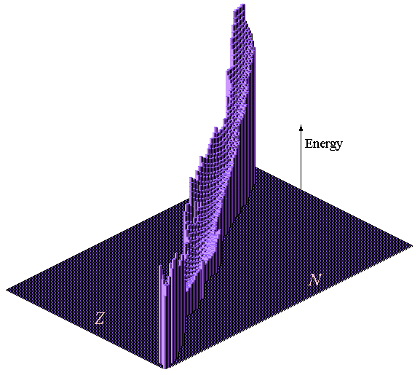
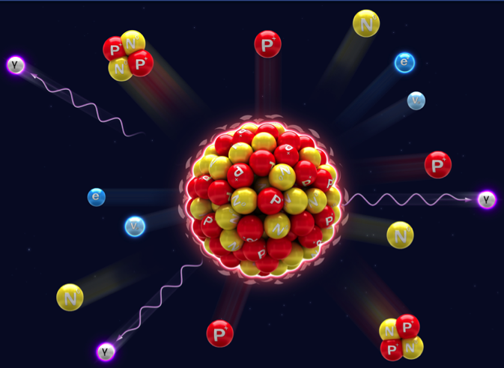
Nuclear ground-state decay
Nuclei decay toward stability (and a lower energy state) via one of four basic decay modes:
Alpha decay ( --> Z-2, N-2)
Beta(-) decay ( --> Z+1, N-1)
Beta(+) decay ( --> Z-1, N+1)
Fission ( --> 2 fragments + n)
1p & 2p radioactivity

Slide 36
Decay observables
Nuclear decay measurements allow access to a number of observables
Half-life information for decaying state
Energies for emitted particles (spectroscopic information in daughter nucleus)
Gamma-rays de-exciting daughter states populated in decay
Excited state spins and parities based on selection rules for primary decay and subsequent gamma decay

Slide 37
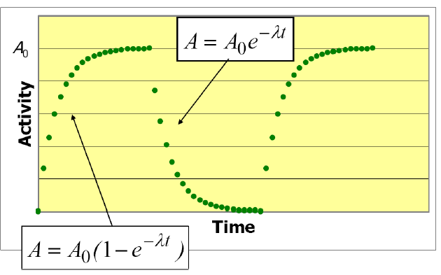
Decay half-lives
All radioactive decay modes obeys Poisson statistics and are described by straight-forward differential equations.
A = -dN/dt = λN
t_{1/2} = ln(2) / λ

Slide 38
Decay observables
Nuclear decay measurements allow access to a number of observables
Half-life information for decaying state
Energies for emitted particles (spectroscopic information in daughter nucleus)
Gamma-rays de-exciting daughter states populated in decay
Excited state spins and parities based on selection rules for primary decay and subsequent gamma decay

Slide 39
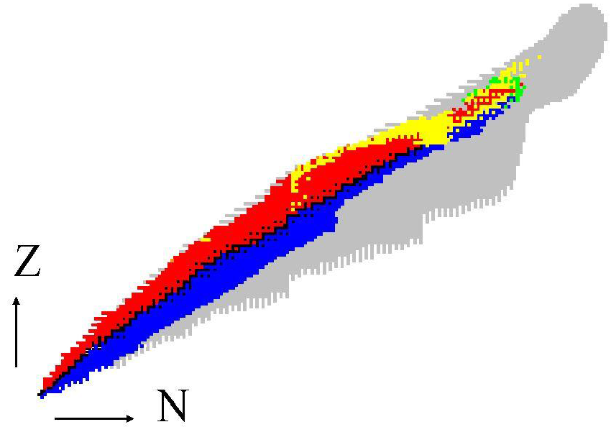
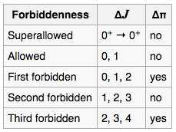
β Decay
The majority of nuclides on the chart decay via β⁺ or β⁻ decay
n --> p + β⁻ + ν_{e}
p --> n + β⁺ + ν_{e}
We can consider β-decay (and other decays) as a tool to populate excited states in daughter nuclei, but with a unique selectivity

Slide 40
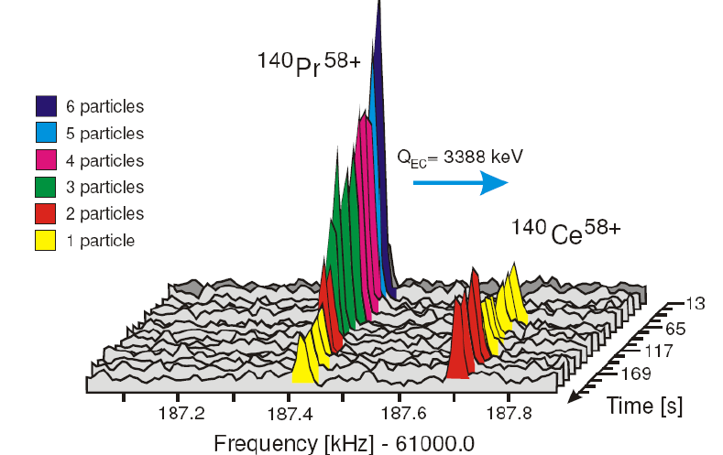
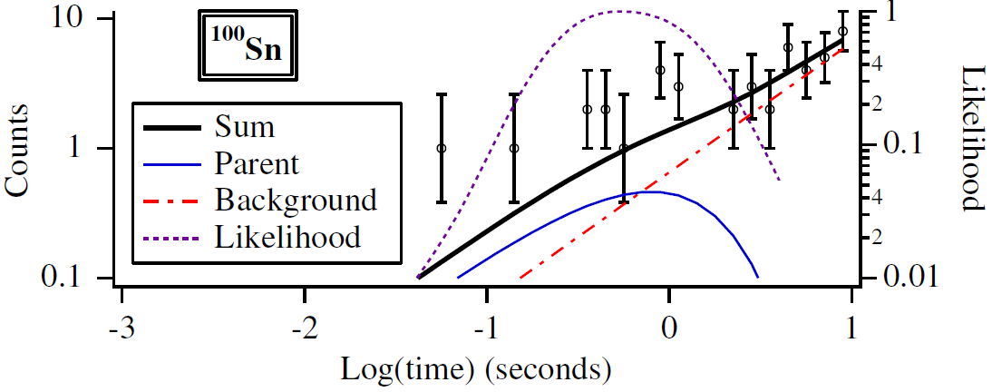
β-decay half-lives
Even with the most limited statistics, half-lives can be extracted
Equations of exponential decay are well known and can be applied using statistical techniques such as maximum likelihood to obtain half-lives from tens of observed decays
D. Bazin et al., PRL 101, 252501 (2008).
F. Bosch et al., Int. J. Mass Spectr. 251, 212 (2006).

Slide 41
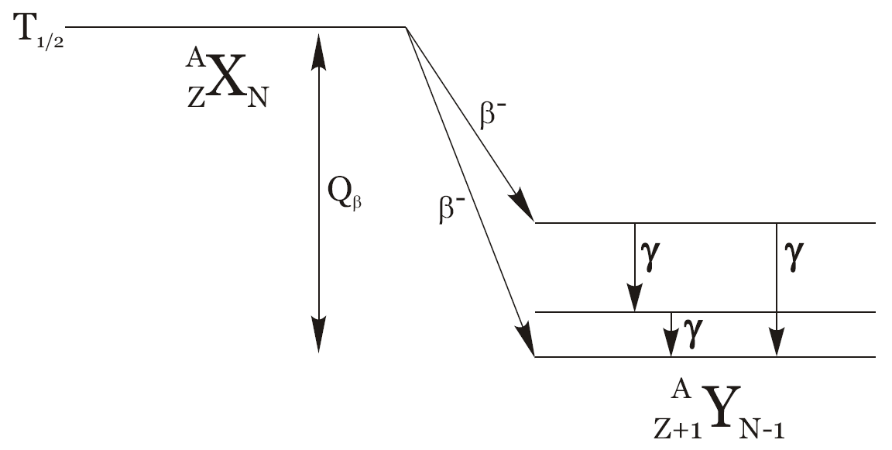
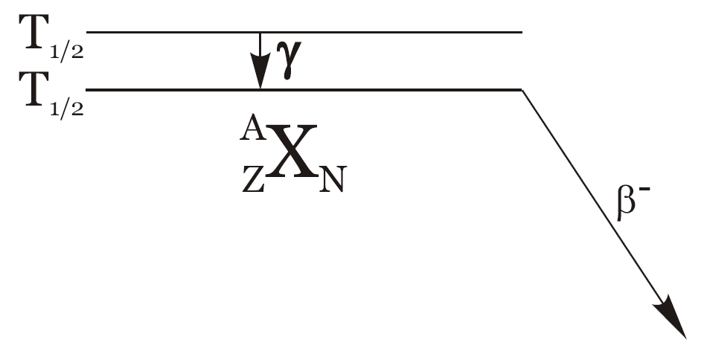
Implantation β decay spectroscopy
β-Delayed Gamma Spectroscopy
gamma rays following decay events provide information on low-level structure of daughter nuclei
Isomeric Decay
depending on the production mechanism, nuclei may be produced in long-lived excited states (isomeric states)
implantation-gamma correlation provides the possibility for isomer lifetime determination, if you look for gammas following an implantation

Slide 42
Implant-decay correlation technique
Decay particle (β, α, p etc.)
Nucleus of Interest
The use of highly-segmented detectors (usually Si or Ge) allows temporal and spatial correlations between implanted nuclei, and their subsequent decays → detect the implant and the decay to obtain half-lives and information on levels in the daughter relative to the parent ground state

Slide 43
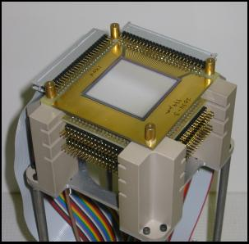
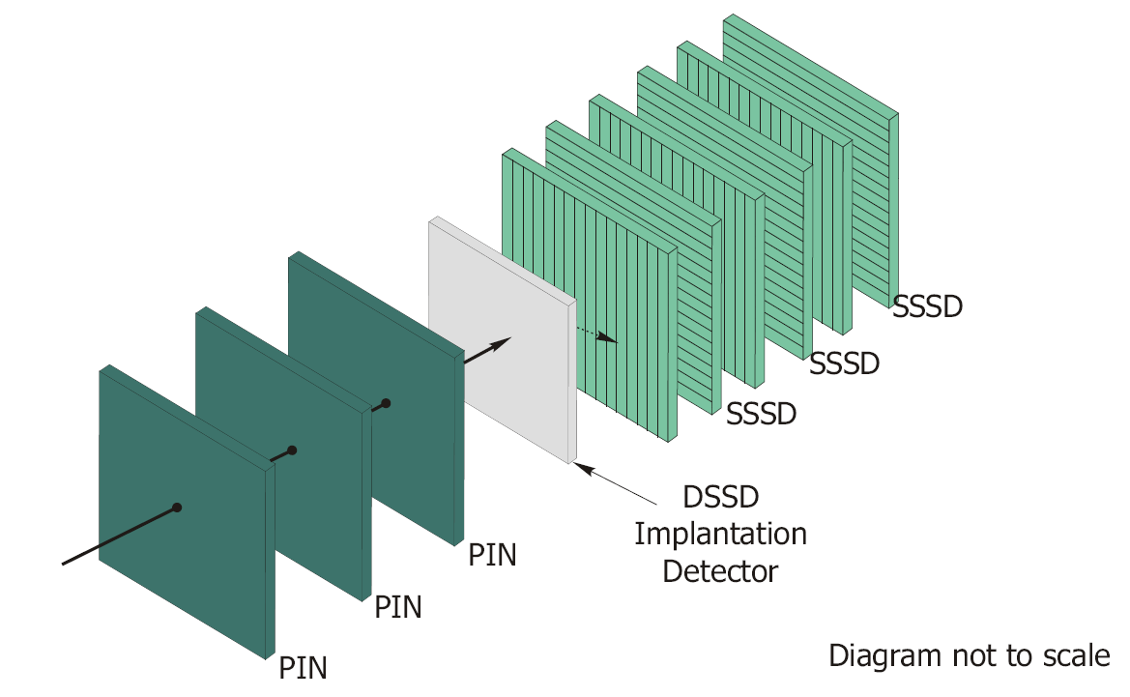
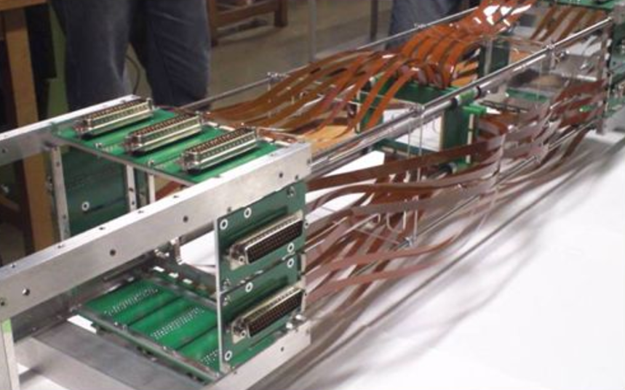
Implantation β-decay spectroscopy arrays
BCS at NSCL
WAS3ABI for EURICA at RIBF (RIKEN)

Slide 44
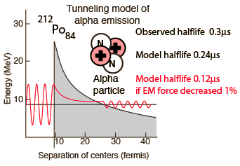
Alpha decay
α decay occurs only in heavier systems on the nuclear chart
Alpha decay however probes different aspects of the nuclear forces
Different selectivity in the process --> favour low L alpha emission

Slide 45
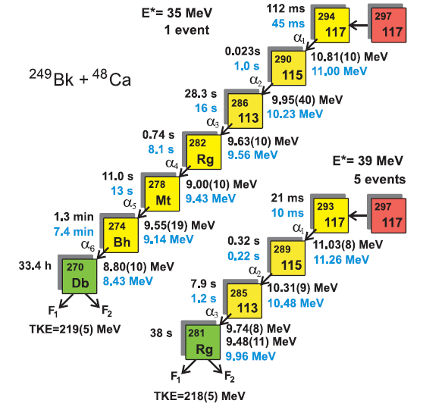
Alpha decay – heavy element structure
The heaviest nuclei decay via emission of ‘heavy’ particles – alpha decay – or by spontaneous fission
Since alphas and fission products are relatively easy to detect, even a single nucleus can provide significant information
Decay properties of element 117 alone, from only 6 events, provide experimental evidence supporting enhanced stability beyond Z = 111
Yu. Ts. Oganessian et al., PRL 104, 142502 (2010).

Slide 46
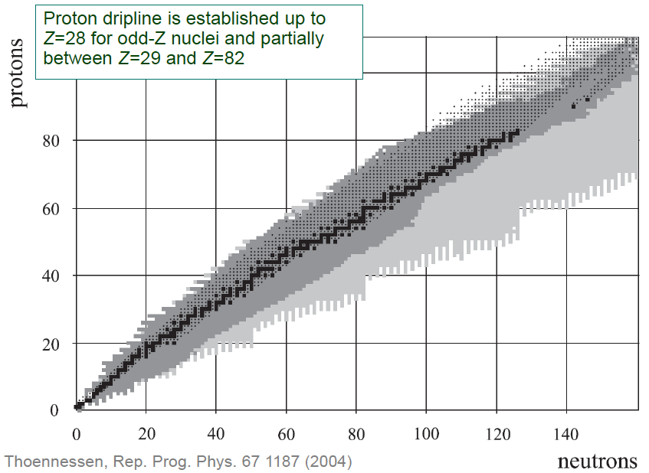
Proton dripline

Slide 47
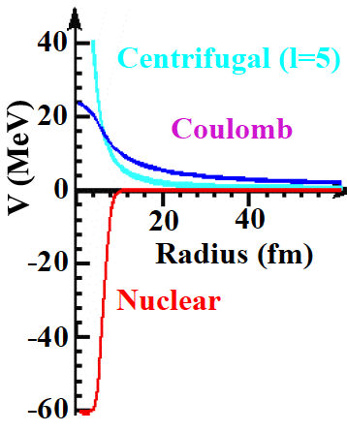
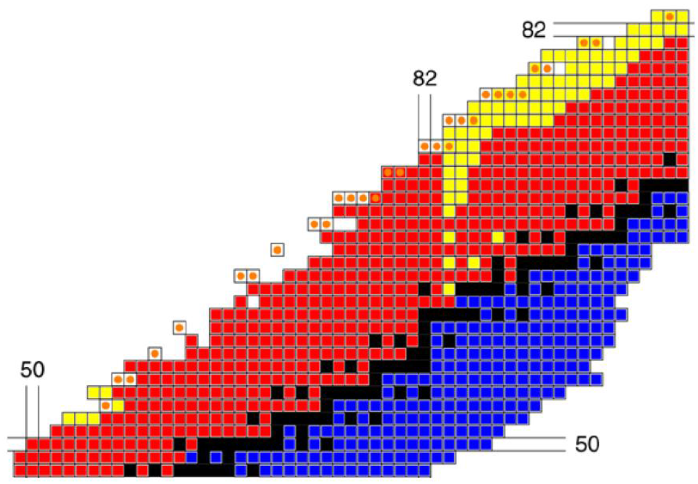
Proton decay
Even when the Q value for proton removal becomes positive, proton emission is hindered due to the Coulomb (and centrifugal) barriers --> radioactivity

Slide 48
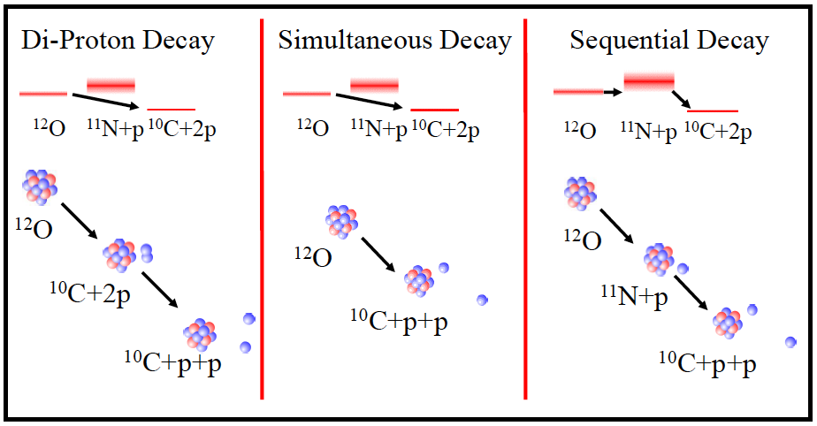
2p decay

Slide 49
Reactions and Excitation Spectra

Slide 50
Beyond excitation energies and spins?
4811
Can we probe the details of the wavefunction ‘directly’?
Is there a way to tell where the particles are in terms of single-particle states (even within a specific model)?
408 keV
4403
404 keV
3999
437 keV
3562
862 keV
2875
p_{3/2}
1/2+
2599
3/2+
2578
28
564 keV
585 keV
f_{7/2}
3/2-
2014
20
20
d_{3/2}
d_{3/2}
3562 keV
s_{1/2}
s_{1/2}
3999 keV
2578/2599 keV
2014 keV
⁴⁷Ca
d_{5/2}
d_{5/2}
8
8
Protons
Neutrons
7/2-
0

Slide 51
Selectivity of the reaction mechanism
Knockout / nucleon removal
Fusion – evaporation
Transfer
Deep inelastic
Scattering (elastic / inelastic)
Capture
Coulomb excitation

Slide 52
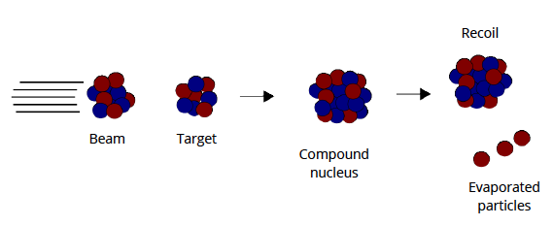
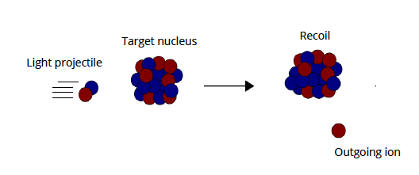
Fusion evaporation vs. direct transfer
A + b = C -> D + X
¹²C(¹⁸O,3n)²⁷Si*
Compound system has NO memory of its formation
Evaporated particle energies give excitation energies of final states
Two-body A(b,c)D
¹⁶O(d,p)¹⁷O*
Outgoing particle DO retain knowledge of transferred particles

Slide 53
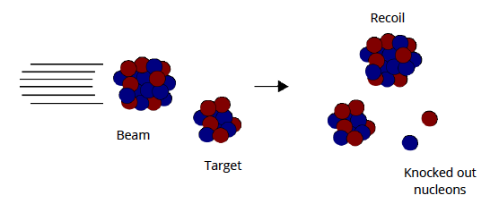
Knockout reaction vs. direct transfer
A + b = c – Xn - Xp
⁹Be(⁴⁴S,-1p1n)⁴²P*
Momentum distribution of recoil reflects orbital momentum transfer
Two-body A(b,c)D
¹⁶O(d,p)¹⁷O*
Outgoing particle DO retain knowledge of transferred particles

Slide 54
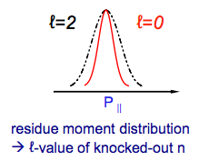
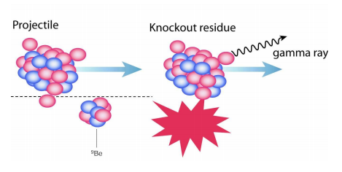
Nucleon knockout reactions
Intermediate energy beams (> 50 MeV/nucleon)
Sudden approximation + eikonal approach for reaction theory
Spectroscopic strengths --> exclusive cross-sections
Populated states in A-1 residue provide detailed measure of beam structure
Theoretical cross-section

Slide 55
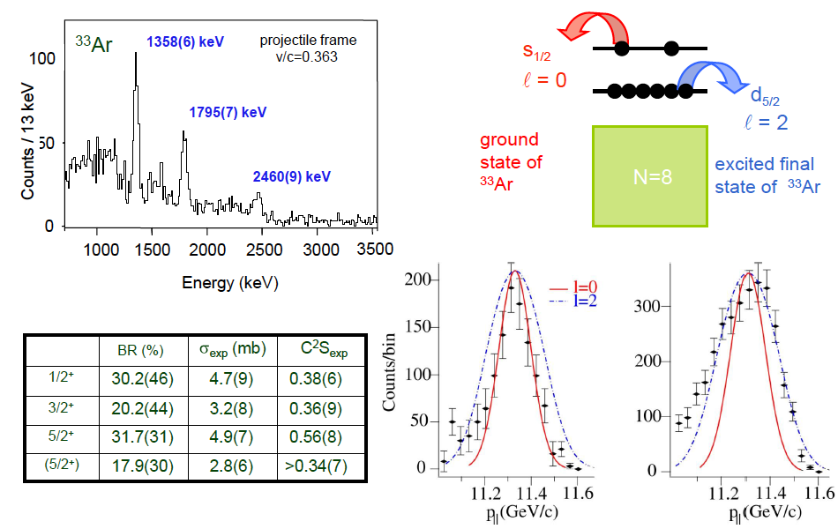
Neutron knockout – ⁹Be(³⁴Ar, ³³Ar)X
A. Gade et al., PRC 69, 034311 (2004).

Slide 56
Coulomb excitation

Slide 57
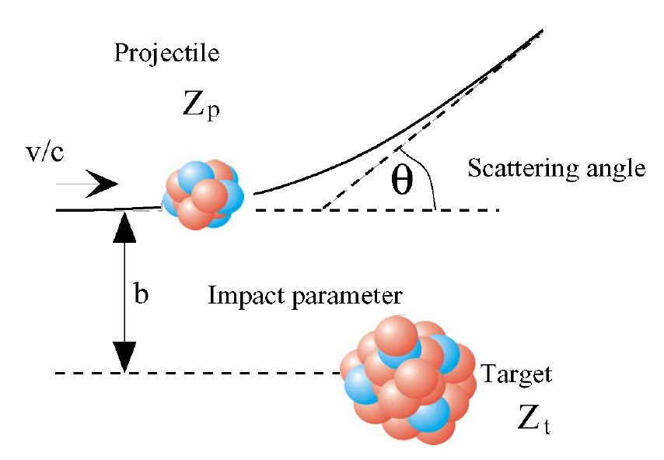
Collectivity: B(E2) from excitation probability
Coulomb excitation:
purely Coulomb interaction causes excitation of the nucleus of interest
well described interaction, and cross-section relates to transition matrix element, i.e. B(E2) for 0+ --> 2+ in even-even nuclei.

Slide 58
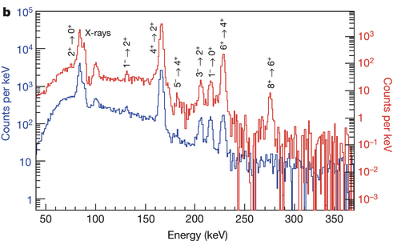
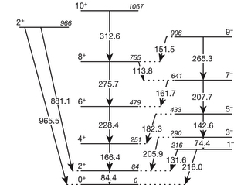
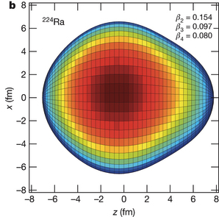
Pear shaped nuclei and atomic EDM
²²⁴Ra
L. P. Gaffney et al., Nature 497, 199 (2013).
Notes:
Larger Schiff moment (electric dipole distribution weighted by radius) – contributes to atomic Electric dipole moment

Slide 59
Excited state lifetimes

Slide 60
Lifetimes and transition probabilities
Transition probability for gamma-decay relates strongly to specific nuclear matrix elements --> provide a stringent test of theoretical wavefunctions
Consider the case of the first 2+ states in even-even nuclei
Lifetimes are of order ps --> how do we measure these lifetimes?

Slide 61
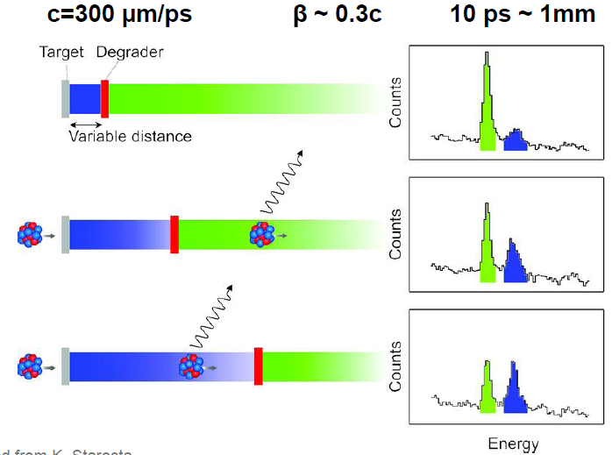
Recoil-distance (plunger) method
The lifetime of excited states in the range of 10-100s of ps can be measured by populating the state via Coulomb excitation or knock-out reactions, and observing the Doppler-shift of the decay gamma-ray.
Figure: Adapted from K. Starosta

Slide 62
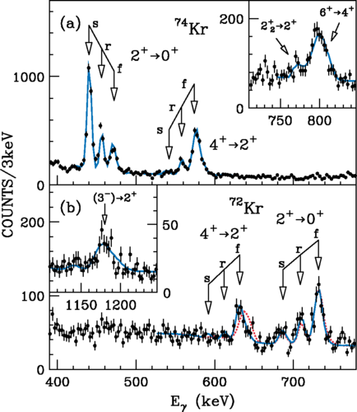
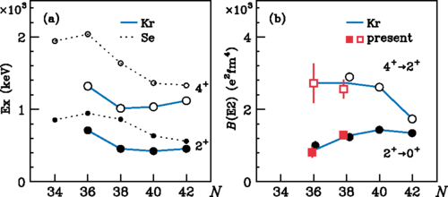
Lifetime in ^{72,74}Kr
Lifetimes are related to the reduced transition probabilities B(E2), which are an indicator for collectivity in the nuclear structure.
Here, the irregular behaviour for the 4+ and 2+ states suggest a rapid shape evolution in ⁷²Kr
H. Iwasaki et al., Phys. Rev. Lett. 112, 142502 (2014).

Slide 63
And what have I skipped?
‘Exotic’ decay modes
1p and 2p decay at the proton dripline
Neutron decay --> recent sequential 2n decay at NSCL
Resonance spectroscopy – properties of unbound states (beyond the proton and neutron driplines)
Reactions for spectroscopy and more --> deep inelastic reactions, multi-nucleon transfer, charge-exchange, etc.
And much, much more…

Slide 64
Summary
Excitation spectra and the properties of excited states round out the picture of “nuclear structure”
Complete separation from nuclear reactions and theory is not possible
Experimental approaches can be finely tuned to address physics questions – many aspects to tune to optimize any given measurement

