Slide 1
Nuclear Structure Experiment (I)
Heather L. Crawford
Nuclear Science Division
Lawrence Berkeley National Laboratory

Slide 2
The Plan
Some basics
Energy scales etc.
Nuclear landscape and how we get there
Nucleon driplines
Systematics in nuclear structure
Nuclear ground states: masses
Mass measurements
Other ground state properties

Slide 3
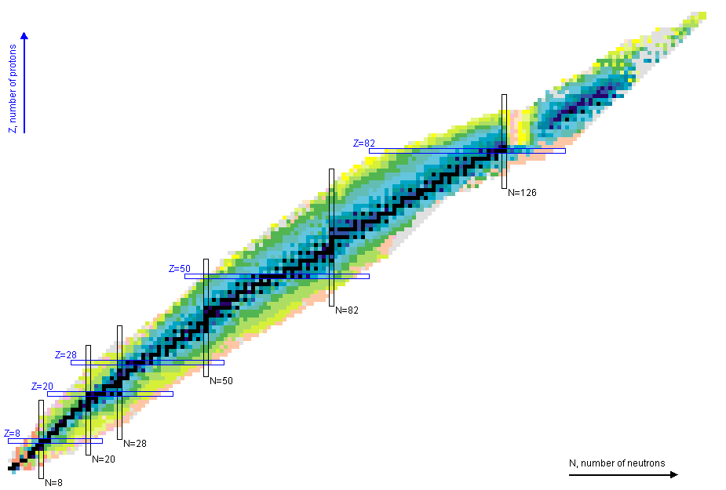
Nuclear landscape

Slide 4
Nuclear landscape
What are the limits of the nuclear chart?
Nucleon (proton/neutron) driplines
Super-heavy nuclei
How does structure change across the chart?
Extreme N/Z ratios?
Collective excitation modes?
Emergent phenomena?

Slide 5
Why study nuclear structure?
Studying exotic nuclei extends the range over which theories can be tested.
Goal: Establish the physical properties of exotic nuclei and their interactions (reactions) to constrain theory and improve predictive power

Slide 6
Why study nuclear structure?
Studying exotic nuclei extends the range over which theories can be tested.
Goal: Establish the physical properties of exotic nuclei and their interactions (reactions) to constrain theory and improve predictive power
Theory
Physical properties
Mass, decay lifetime, production cross-section, electric and magnetic moments, excited state properties (moments, energies, lifetimes), etc…
Note --> the observables in an experiment may or may not require interpretation to relate to physical properties

Slide 7
Observables
Ultimately, we would like to understand the wavefunction of nuclear states. But these are not observable quantities.
Observables:
Half-life, mass, decay modes, electric/magnetic moments, cross-sections, momentum distributions, transition probabilities, ….

Slide 8
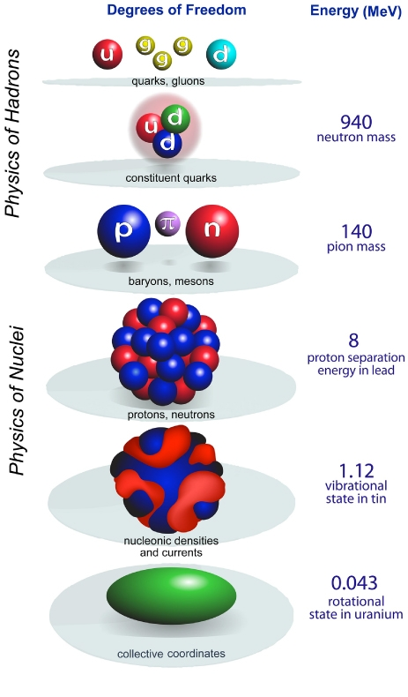
Scales: Energy and size
Nuclear structure physics
Figure: R J Furnstahl and K Hebeler 2013 Rep. Prog. Phys. 76 126301 doi:10.1088/0034-4885/76/12/126301

Slide 9
Scales: Energy and size
Nuclear structure physics
Molecular excitations:
E_{rot} << E_{vib} << E_{electric}
(μeV << meV << eV)
Nuclear excitations:
E_{rot} ~ E_{vib} ~ E_{electric}
(all MeV)
Molecular excitations are separable – wavefunctions can be treated as product of terms
Collective and single-particle excitations are all of a similar energy scale and interact
Figure: R J Furnstahl and K Hebeler 2013 Rep. Prog. Phys. 76 126301 doi:10.1088/0034-4885/76/12/126301

Slide 10
Exploring the Landscape: Making Exotic Nuclei

Slide 11
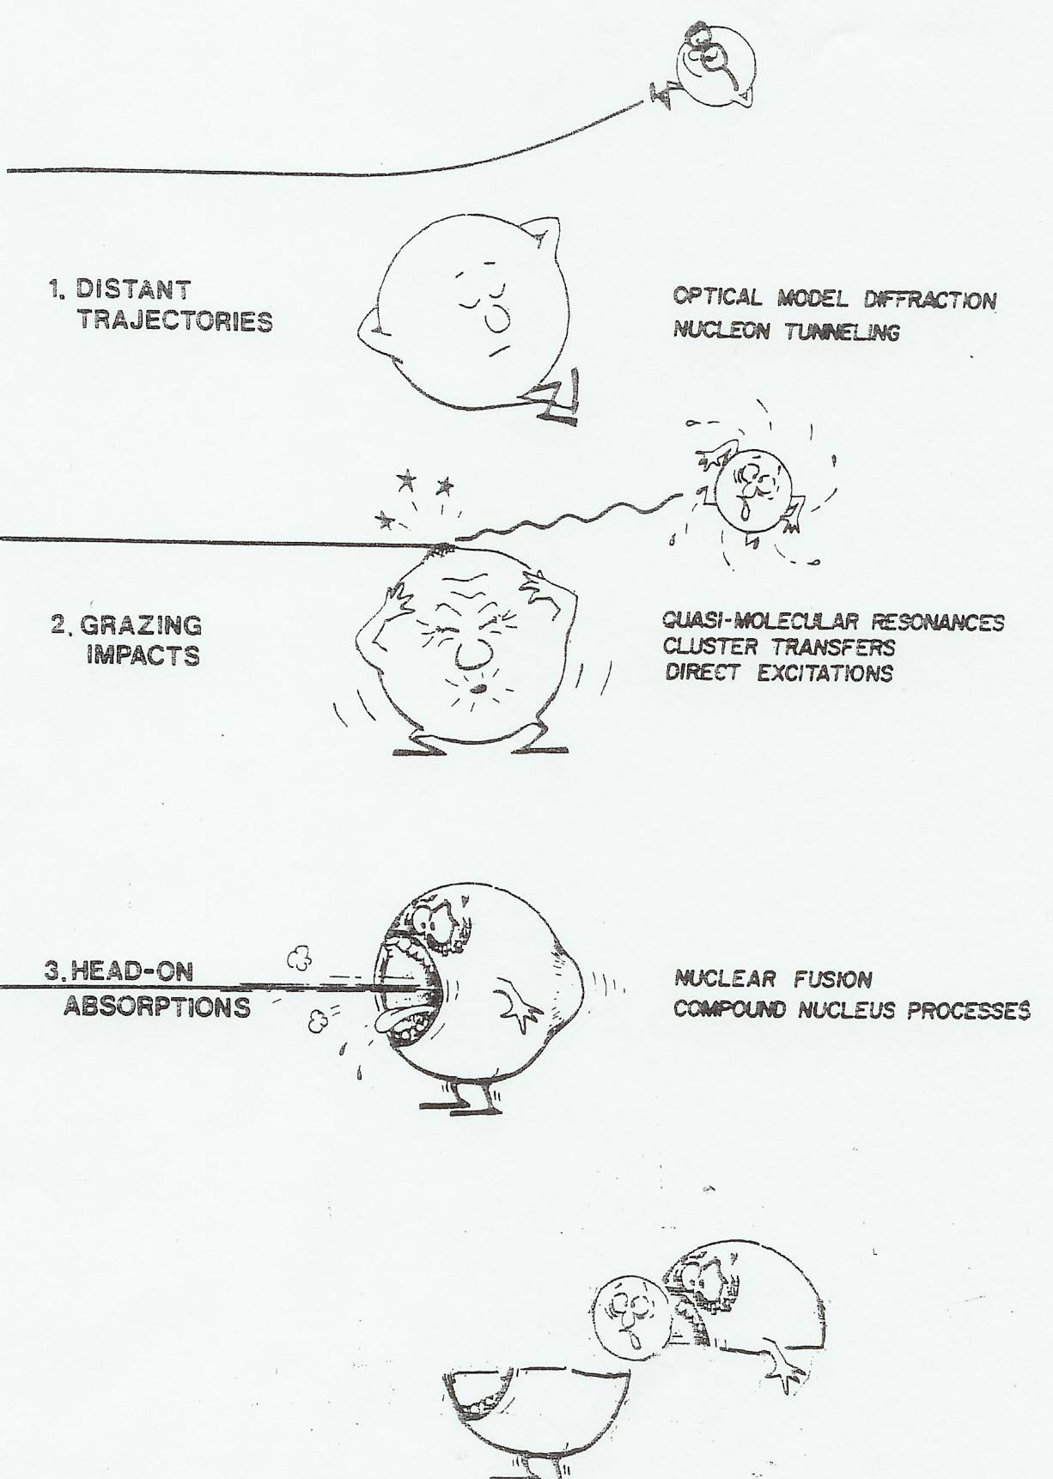
Making exotic nuclei
To study the most exotic nuclei we must first produce them. Using stable beam facilities and different combinations of targets + beams, a wide variety of exotic nuclei can be produced and studied.
Coulomb Excitation
Transfer, Deep Inelastic, Incomplete Fusion
Fusion-Evaporation
However, there are a finite # of combinations of stable beams + targets → make radioactive beams, and use these
Fragmentation
Figure: Borrowed from R.M. Clark, 2007 RIA Summer School

Slide 12
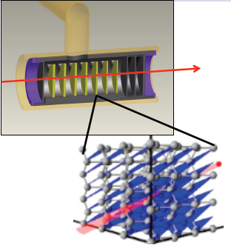
Isotope Separation On-Line (ISOL)
Examples of ISOL facilities:
TRIUMF (Canada)
HRIBF (USA)
SPIRAL/SPIRAL2 (France)
REX-ISOLDE/HIE-ISOLDE (CERN)
iTHEMBA - future radioactive beam facility (South Africa)
Accelerator
Thick, Hot Target
Ion Source
Fragment Separator
Post-Accelerator/ Experiment

Slide 13
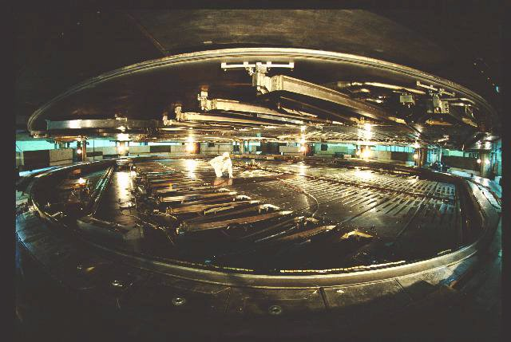
ISOL Facilities - TRIUMF
TRIUMF is home to the world’s largest cyclotron – accelerates H⁻ to 520 MeV, extracts as proton beam
Proton beam is sent into target hall, and interacts with thick targets (materials such as UC)

Slide 14
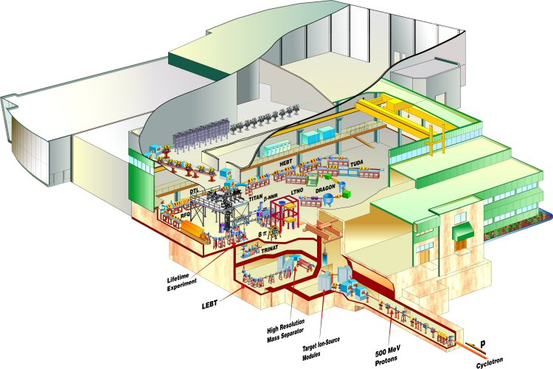
ISOL Facilities - TRIUMF

Slide 15
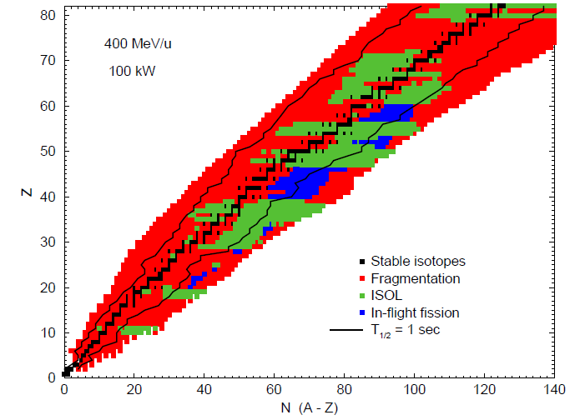
What can we make? – ISOL

Slide 16
Fragmentation + In-flight separation
Thin Production Target
Accelerator
Ion Source
Fragment Separator
Rare Isotope
Beams
Examples of fragmentation facilities:
NSCL (USA) --> FRIB
RIKEN (Japan)
GANIL (France)
GSI (Germany)

Slide 17
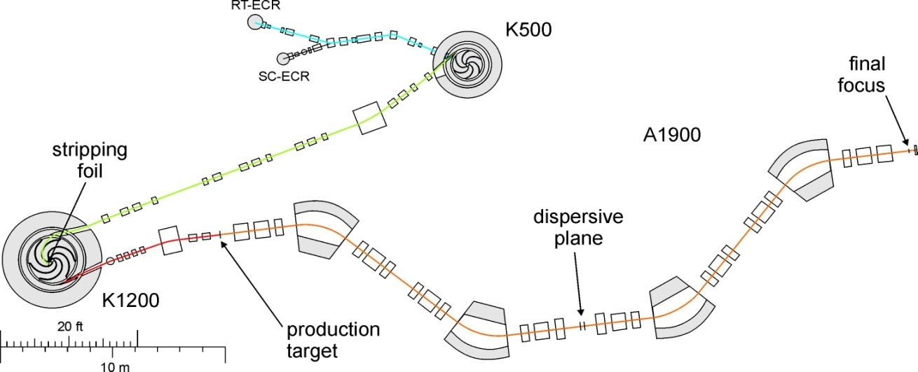
Fragmentation facilities - NSCL

Slide 18
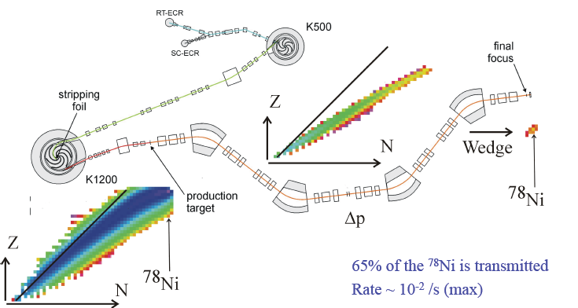
Fragmentation + separation: Example
⁸⁶Kr → ⁷⁸Ni

Slide 19
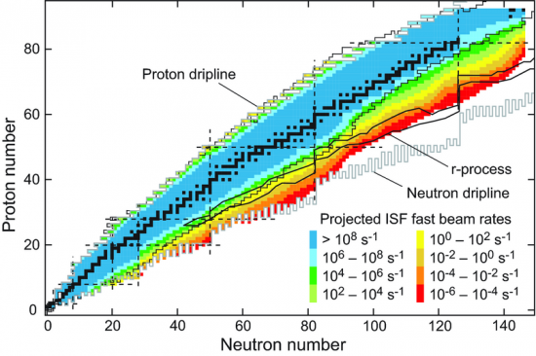
What can we make? – Fragmentation
Figure: NSCL White Paper, 2006

Slide 20
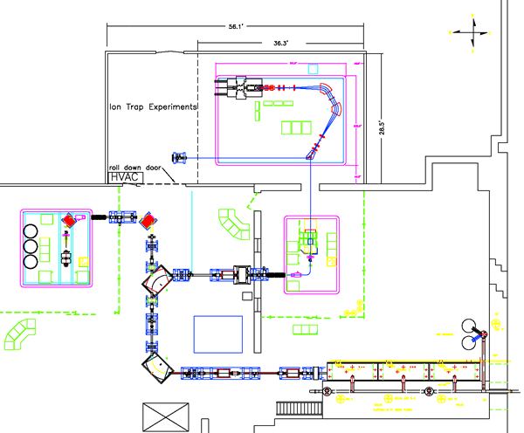
Fission-fragment accelerator
CARIBU (Californium Rare Ion Breeder Upgrade)
@ Argonne National Laboratory
Ci ²⁵²Cf source
Turns a source of neutron-rich isotopes, such as a spontaneous fission source, into a low-energy beam using a gas catcher and charge breeder
CARIBU: www.phy.anl.gov/atlas/caribu.html

Slide 21
Fission-fragment accelerator
CARIBU (Californium Rare Ion Breeder Upgrade)
@ Argonne National Laboratory
Ci ²⁵²Cf source
Turns a source of neutron-rich isotopes, such as a spontaneous fission source, into a low-energy beam using a gas catcher and charge breeder
Hands-on activity (1): Mass Measurements with a CARIBU beam
CARIBU: www.phy.anl.gov/atlas/caribu.html

Slide 22
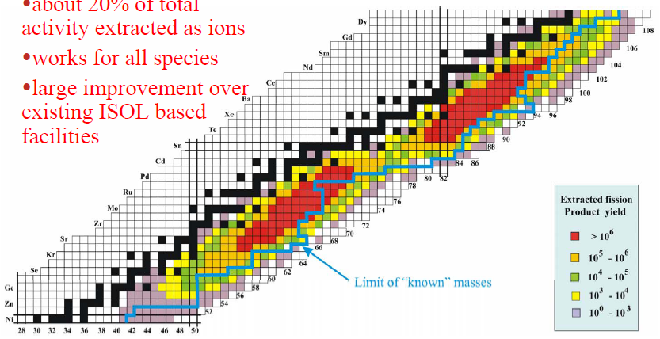
Fission fragment yields
Production has inherent selectivity – cannot produce all nuclei, but will provide an intense source of certain species.
Due to reacceleration, beams should, like in ISOL facilities be of very high quality.
Figure: CARIBU Upgrade presentation @ ATLAS User Group Workshop, 2004

Slide 23
On the horizon: Photo-fission production
²³⁸U Target
E- Linac
Ion Source
Fragment Separator
Post-Accelerator/ Experiment

Slide 24
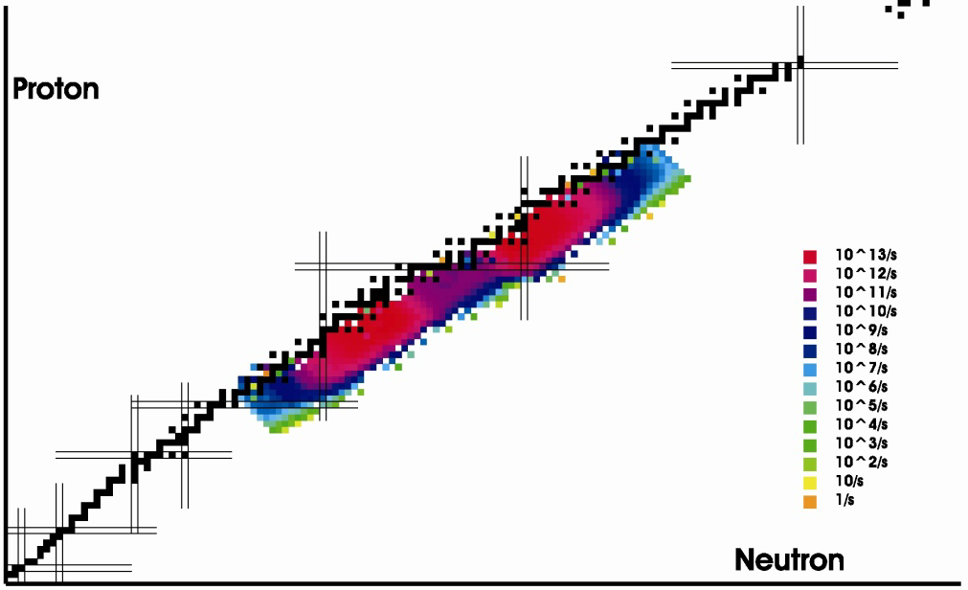
Photo-fission facility: ARIEL @ TRIUMF
ARIEL: www.triumf.ca/ariel

Slide 25
Question!
If you wanted to run an experiment on ⁴²Ar, where would you go to make the measurement?
TRIUMF (ISOL facility)
NSCL (fragmentation facility)
CARIBU (fission fragments)
RIKEN RIBF (fragmentation facility)

Slide 26
Question!
If you wanted to run an experiment on ⁴²Ar, where would you go to make the measurement?
TRIUMF (ISOL facility)
NSCL (fragmentation facility)
CARIBU (fission fragments)
RIKEN RIBF (fragmentation facility)

Slide 27
Existence?

Slide 28
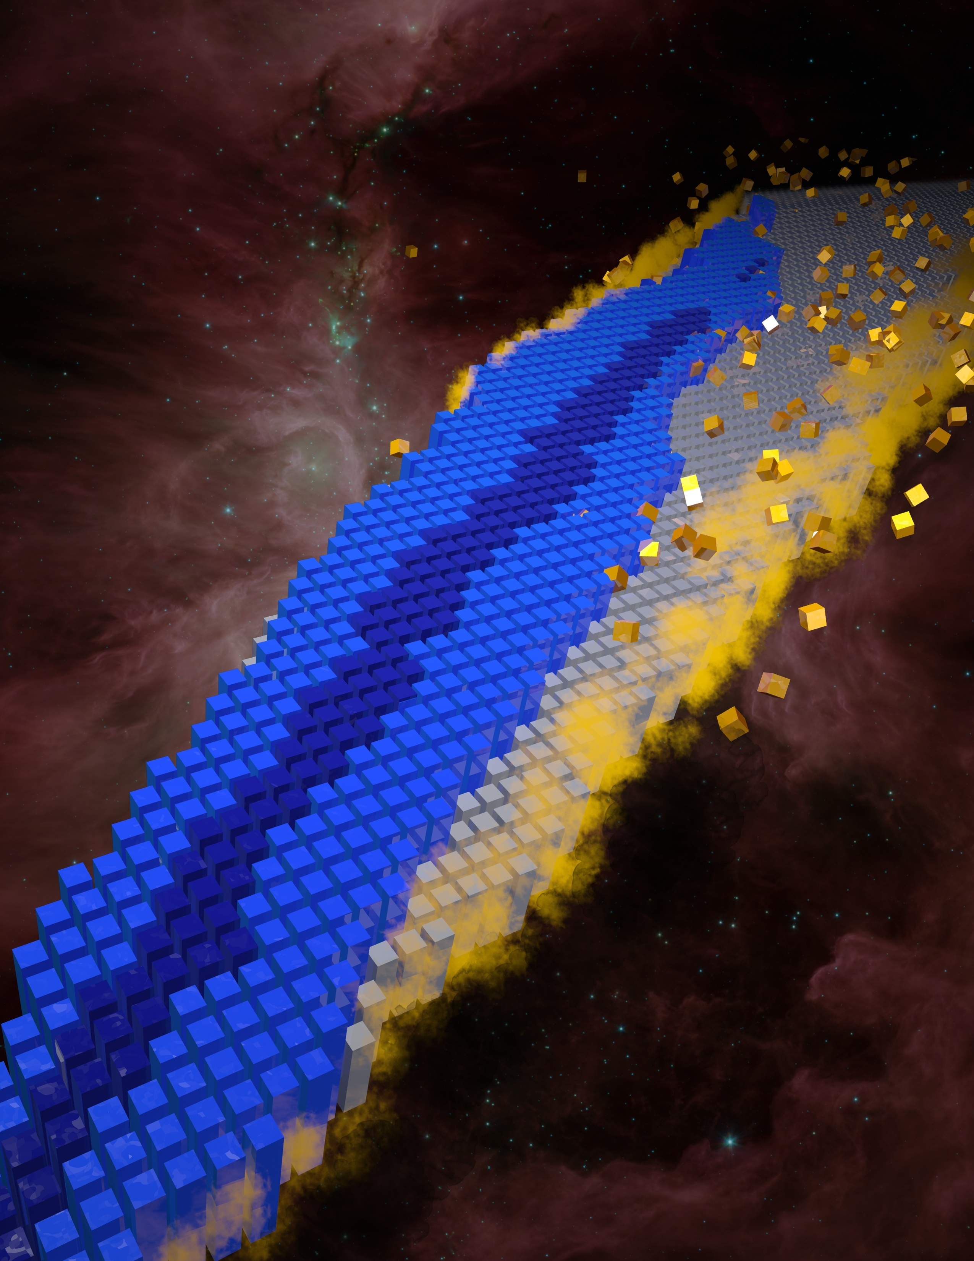
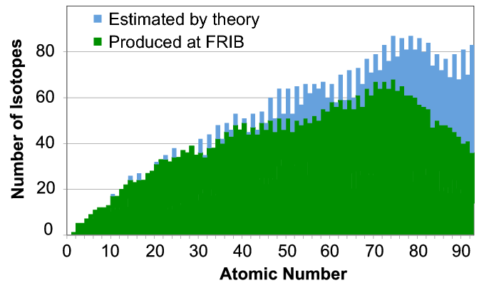
Nuclear landscape limits
254 stable isotopes have been observed;
more than 3000 isotopes have been made in laboratories;
as many as 6000-8000 are expected to possibly exist

Slide 29
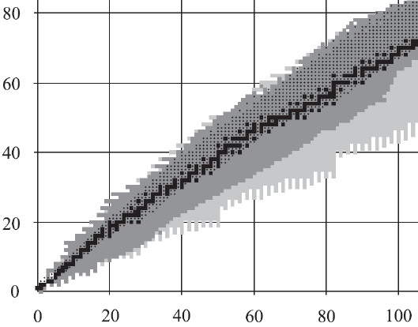
Locating the driplines
The limits of existence are defined by the proton and neutron driplines
S_{n} (or S_{p}) become positive --> neutron/proton are not bound; emission does not require energy input
At the neutron dripline, the definition is fairly straightforward – proton dripline, a little more complicated…

Slide 30
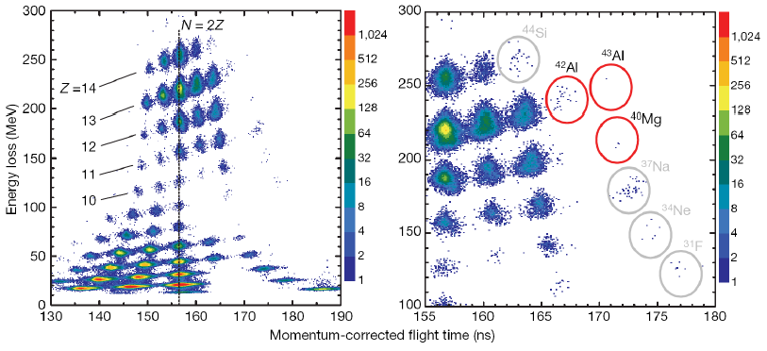
Production of ⁴⁰Mg
7.6 days of data at a primary beam rate of 5 x 10¹¹ particles/second
→ 3 ⁴⁰Mg, 23 ⁴²Al and 1 ⁴³Al
Absence of a nucleus also provides information – ²⁶O and ²⁸O for instance, or even ⁸Be
T. Baumann et al., Nature 449, 1022 (2007)

Slide 31
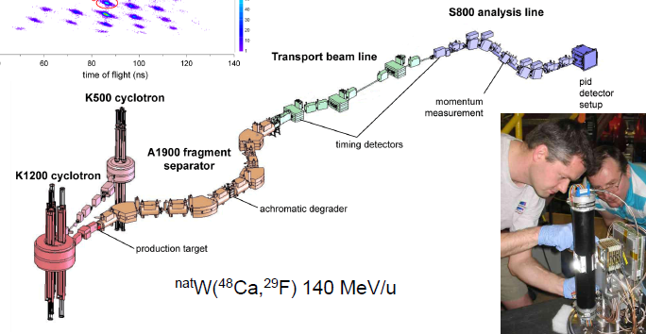
How was it done?
Need to make and uniquely identify the nucleus – most often use a combination of time-of-flight, and energy loss.
Energy Loss ∝ Z²
Time of flight ∝ A/Z, flight path length and magnetic rigidities
Long flight path, with two-stage separation
Target for fragmentation of primary beam (⁴⁸Ca)

Slide 32
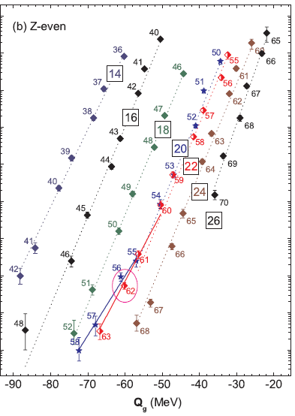
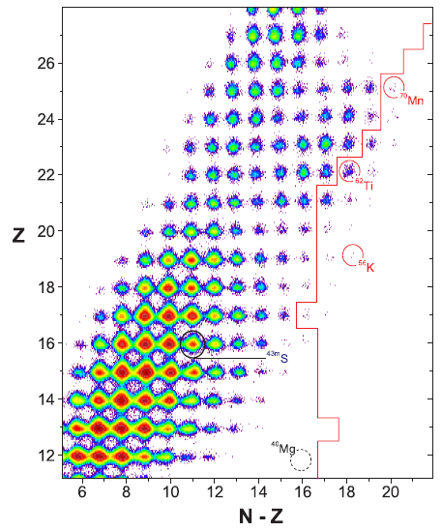
Fragmentation cross-sections
A change in the trend of fragmentation cross-sections indicates a change in the binding – enhanced binding suggestive of a change in nuclear structure?
O. Tarasov et al., PRL 102, 142501 (2009)

Slide 33
Patterns and Nuclear Structure

Slide 34
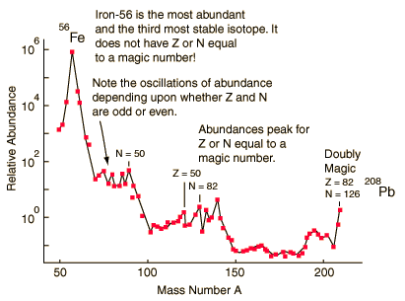
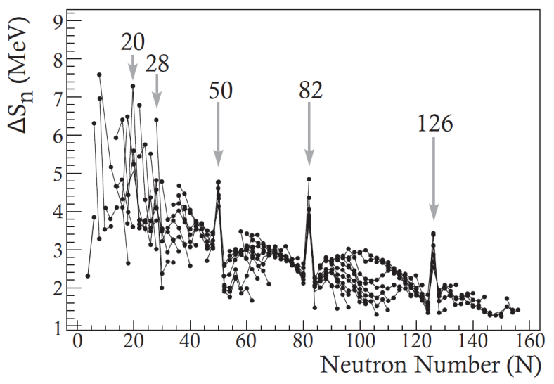
Nuclear magic numbers
Natural abundance of the isotopes shows peaks at particularly stable nuclei.
Similar indicators are found across the nuclear landscape, suggesting a nuclear shell structure.
Heaviest stable nucleus – ²⁰⁸Pb
₅₀Sn has 10 stable isotopes, 2 more than any other nucleus
Proton Number, Z
Neutron Number, N
Firestone, R.B. Table of Isotopes. Wiley, New York, 1996.

Slide 35
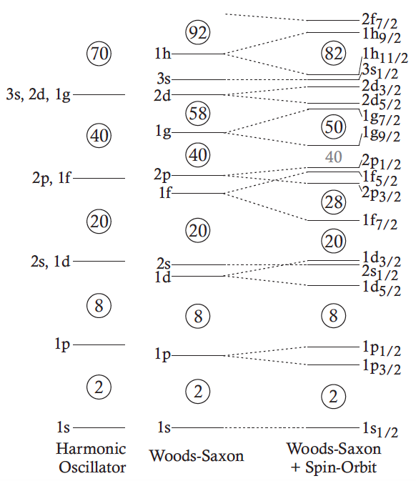
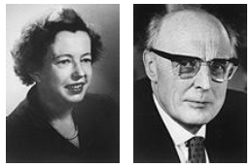
Nuclear shell structure
Maria Goeppert-Mayer & Hans D. Jensen
1963
Maria Goeppert-Mayer, Phys. Rev. 75, 1969 (1949).
O. Haxel, Phys. Rev. 75, 1766 (1949).

Slide 36
Nuclear shell structure
Single-particle levels in nuclei
Single-particle levels in the fermionic system are grouped into shells, with stabilizing gaps between groups of states at certain occupation numbers with “magic numbers” of protons and neutrons
Magic numbers
Magic numbers correspond to particularly stable structures (2, 8, 20, 28, 50, 82,…)

Slide 37
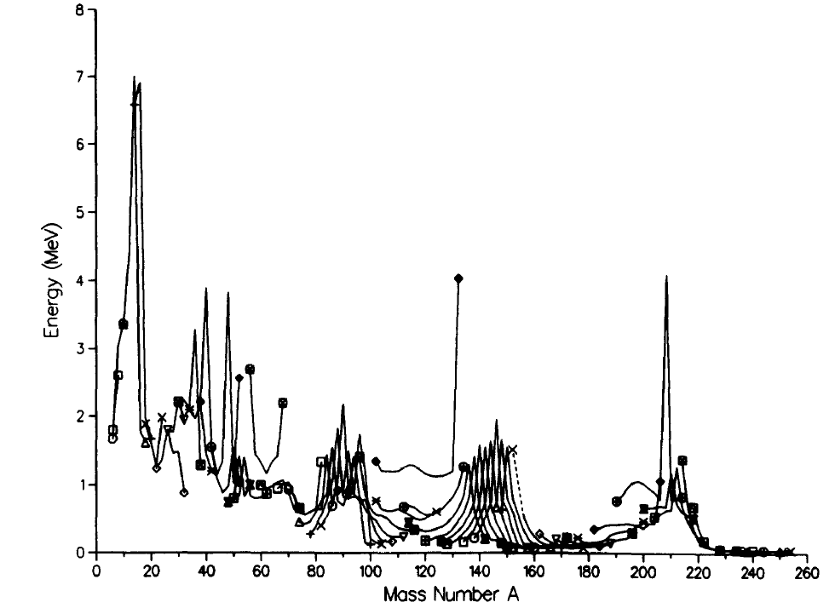
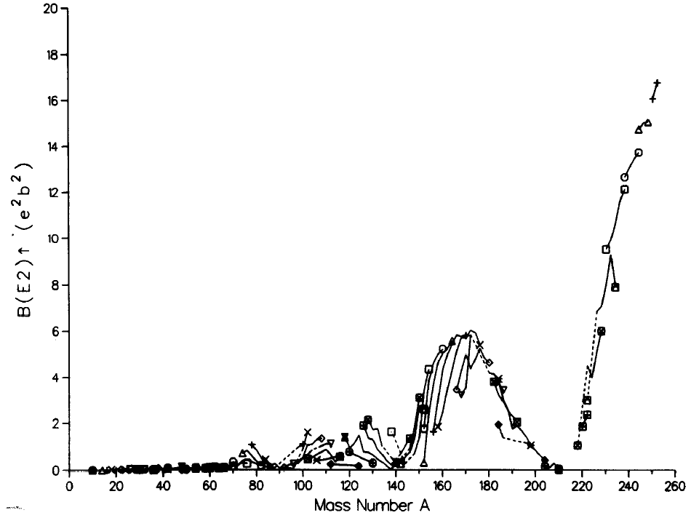
Nuclear shell structure signatures
To improve our understanding and descriptions of nuclei far from stability, we need to identify the location of shell gaps, and ideally the spacing between single-particle states in the most exotic nuclei.
2⁺
Transition probability, B(E2)
E(2+) as a function of Mass
E(2+)
N=50
N=20
N=82
N=28
N=126
E(2+) [keV]
0⁺
Even-even nuclei
Structure of Even-Even Nuclei
The ground state of even-even nuclei is always 0+, while the first excited state is usually a 2+ state. The energy of this state, and the cross-section to populate it are sensitive to details of the nuclear structure.
B(E2) as a function of Mass
B(E2) [e²b²]
Mass Number (A)

Slide 38
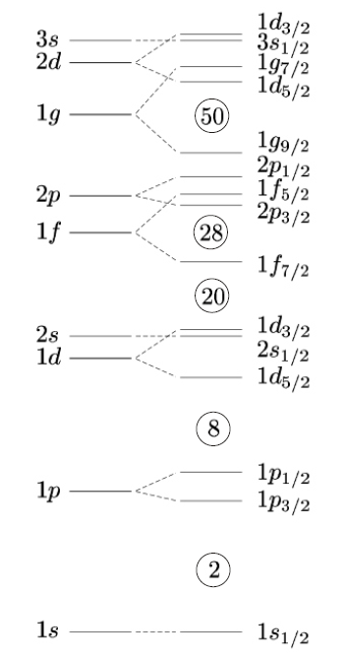
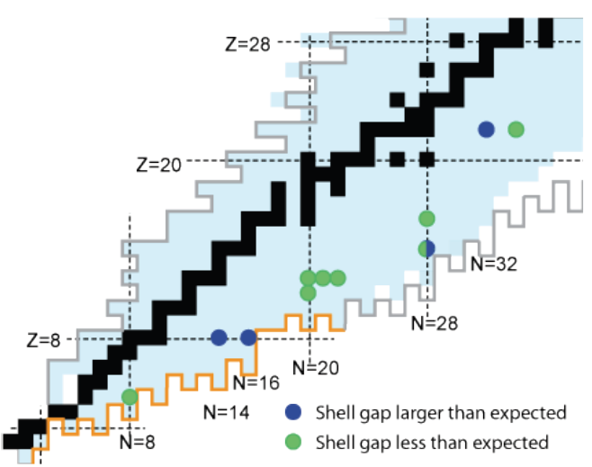
“Exotic” shell structure
A driving question in nuclear science:
Is the shell-model description static across the entire chart of nuclides?
Toward neutron drip-line
⇒
⇒?
Protons
Neutrons
Protons
Neutrons
Near the valley of β stability
Approaching the drip-lines

Slide 39
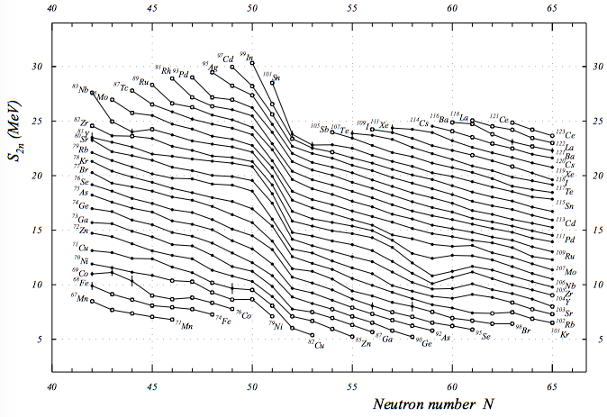
Masses and shells
Magic number N =50
Deformation from spherical

Slide 40
Mass Measurements

Slide 41
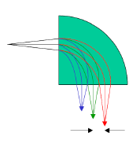
Mass measurements – Direct vs. indirect
Indirect measurements
Q-value measurements – decay and kinematics from two-body reactions
Direct measurements
Conventional mass spectrometry
Time-of-flight measurements
Spectrometer, multi-turn or multi-reflection
Frequency measurements
Penning traps, storage rings
A(a, b)B
Q = M_{A} + M_{a} – M_{b} - M_{B}

Slide 42
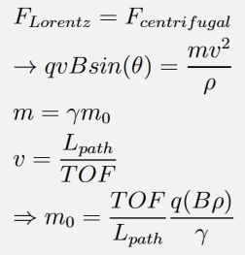
TOF mass measurements
Obtain mass based on equations of motion for charged particles through a magnetic system.
Measure multiple masses simultaneously
Accuracy Δm/m --> 10⁻⁶
Lifetimes down to ms
Measurement requires precision knowledge of TOF and magnetic rigidity (Bρ).
--> In practice, measure known masses to calibrate TOF measurements
Experimental equipment – long flight-path magnetic separator
--> TOFI @ LANL, SPEG @ GANIL, A1900+S800 @ NSCL…

Slide 43
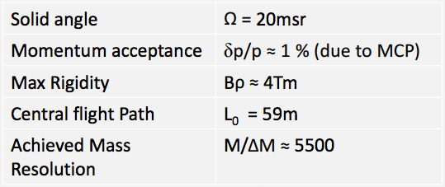
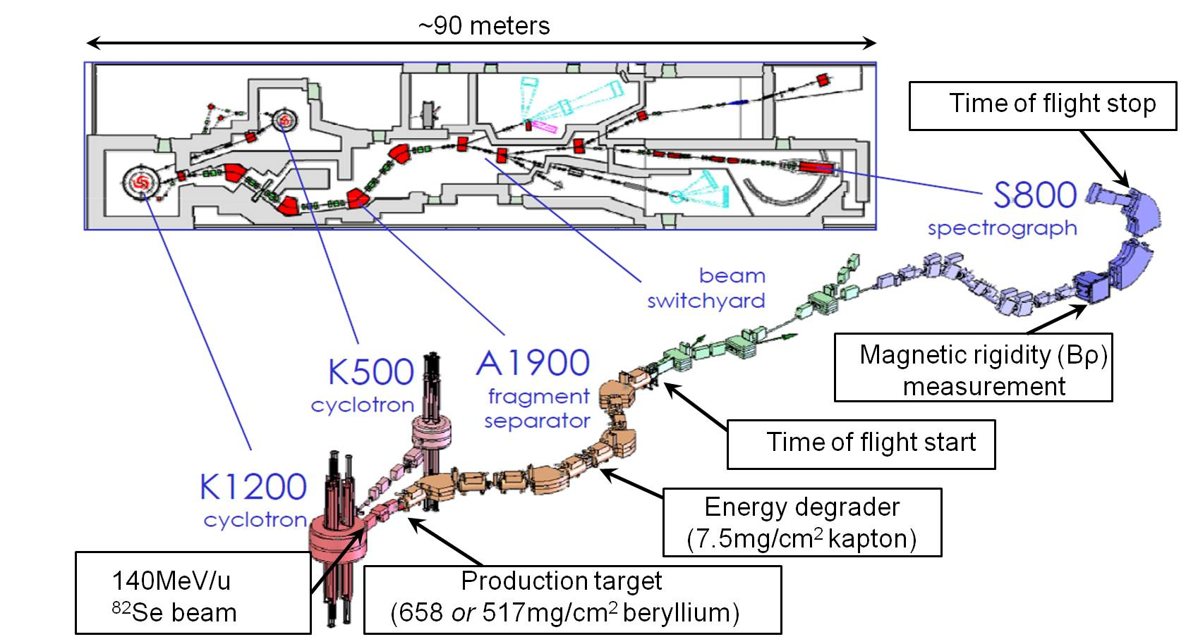
TOF mass measurements
Z. Meisel, PhD Thesis, 2015.

Slide 44
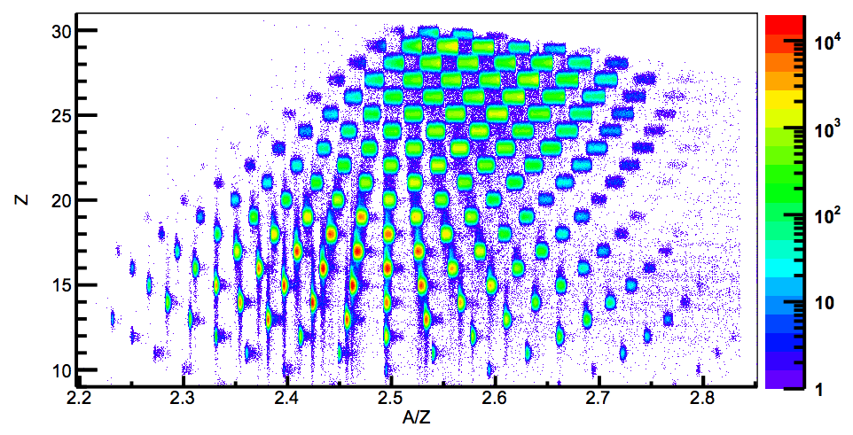
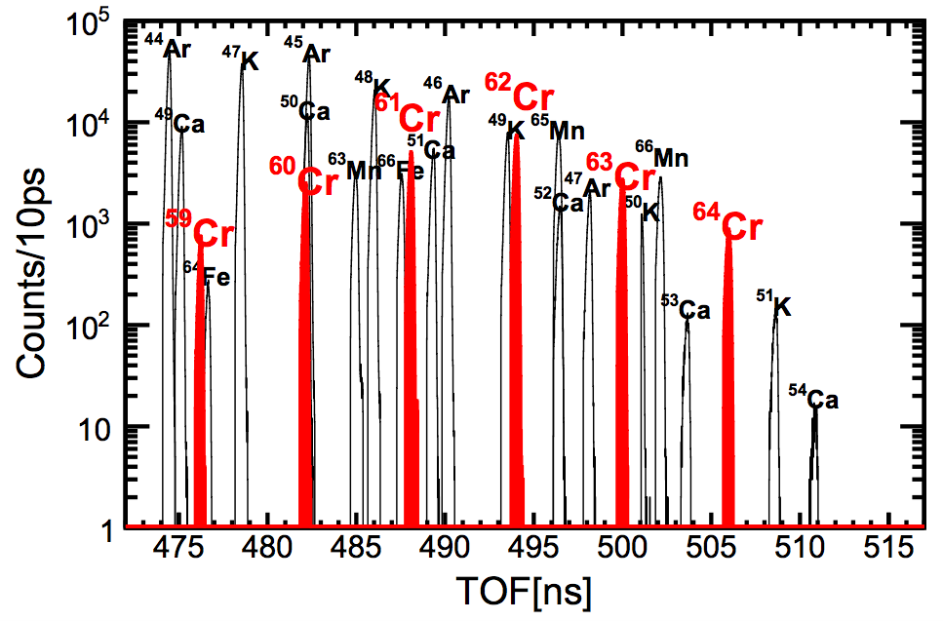
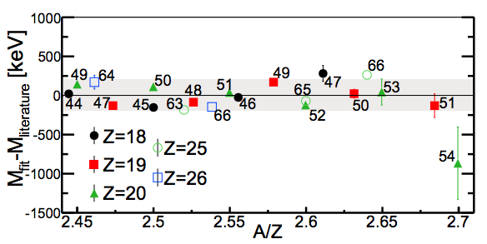
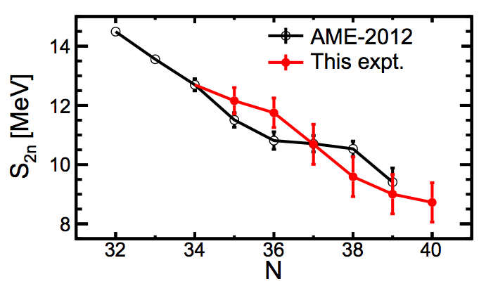
TOF mass measurements
Z. Meisel, PhD Thesis, 2015.

Slide 45
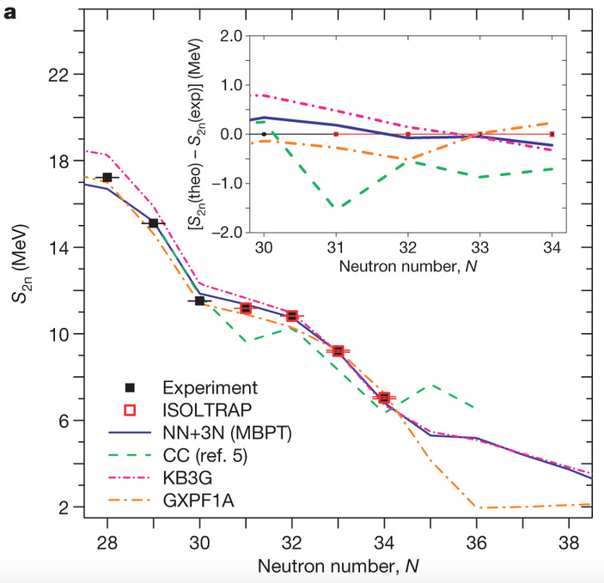
MR-TOF – ⁵⁴Ca at ISOLDE
TOF measurements require long flight path lengths; a method around this is to “reuse” the same flight distance – multi-reflection TOF
F Wienholtz et al. Nature 498, 346-349 (2013).

Slide 46
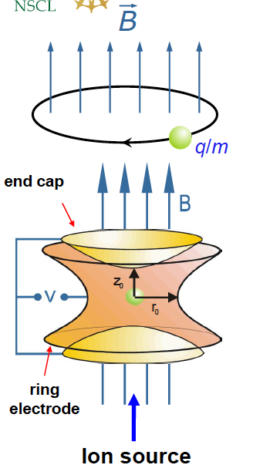
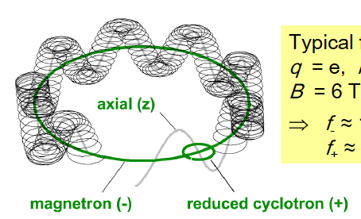
Penning trap mass measurements
Mass measurement comes from determination of the cyclotron frequency for the characteristic motion of the stored ions
Motion is superposition of three fundamental motions:
axial motion (f_{Z})
magnetron motion (f₋)
modified cyclotron motion (f₊)
--> f_{C} = f₊ + f₋
Notes:
For 6T field, f- is approx. 1kHz, f+ is approx 1 MHz

Slide 47
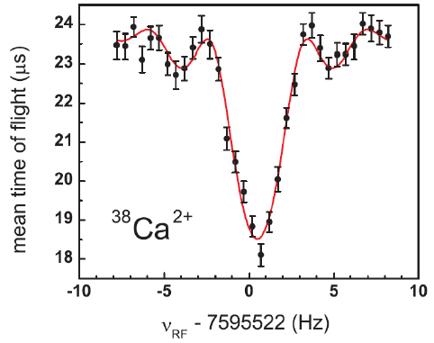
Traditional Penning trap mass measurements
Strong homogenous B field provides radial confinement; weak electric quadrupole field provides axial confinement
Excite cyclotron motion with multipolar RF (to excite cyclotron motion resonance)
Transform radial to axial energy and eject ions toward particle detector
Constantly measure reference ions as well to reduce systematic error in measurements (varying B field, etc.)
Measure TOF to detector
G. Bollen et al., Phys. Rev. Lett. 96, 152501 (2006).
Notes:
For 6T field, f- is approx. 1kHz, f+ is approx 1 MHz

Slide 48
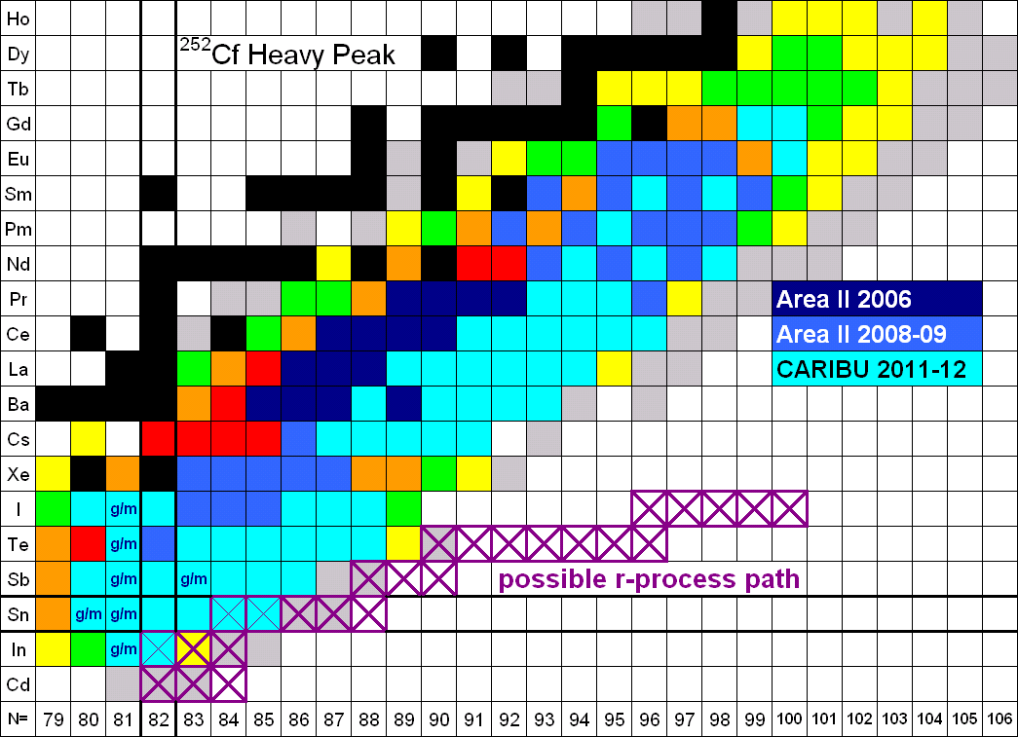
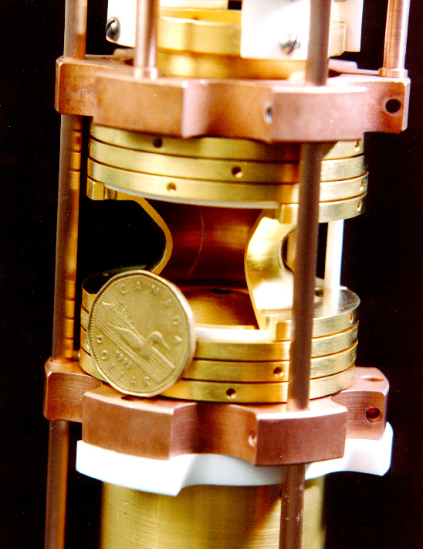
Penning trap mass measurements
Measurements with CARIBU beams at ANL with the Canadian Penning Trap (CPT) are filling in masses toward the astrophysically relevant r-process path
Hands-on activity (1): Mass Measurements with the CPT of a CARIBU beam
Guy Savard, 2013 GRETINA workshop, ANL

Slide 49
Question!
What technique would be best suited for measuring the (most accurate) mass of an exotic nucleus with a lifetime of about 10 ms?
Penning trap mass spectroscopy
TOF measurement at ISOL facility
TOF measurement at fragmentation facility
Decay Q-value measurement

Slide 50
Question!
What technique would be best suited for measuring the (most accurate) mass of an exotic nucleus with a lifetime of about 10 ms?
Penning trap mass spectroscopy
TOF measurement at ISOL facility
TOF measurement at fragmentation facility
Decay Q-value measurement

Slide 51
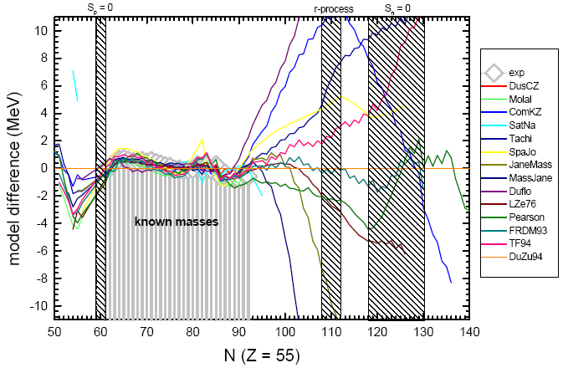
What can we predict?
Away from available data, predictions still vary widely.

Slide 52
Other Ground State Properties

Slide 53
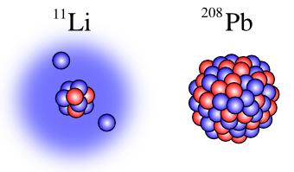
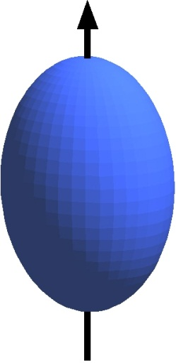
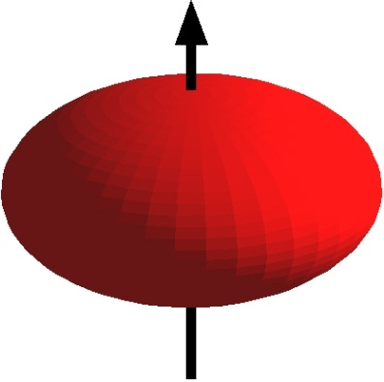
Beyond Masses…
Ground state properties alone tell us a huge amount about the nucleus.
Beyond masses, we are interested in
Nuclear matter and charge radii
Deformation – electric quadrupole moments
Spin and parity – magnetic dipole moments

Slide 54
Summary
Nuclear structure encompasses all aspects of the nucleus, and viewing the nuclear chart in a systematic way is key to our understanding
Exotic nuclei away from stability can be produced in a number of techniques, each with different pros and cons
ISOL (Isotope separation online)
Fragmentation
Fission sources
Existence is the first piece of information we ever have for a nucleus
Ground state properties are fundamental – masses are usually early indicators of changing structure; radii and nuclear moments provide more details

Slide 55
Other Ground State Properties
Radii and moments

Slide 56
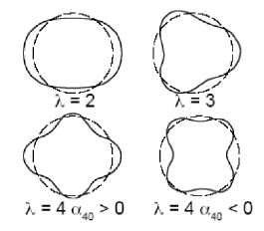
Nuclear radii and nuclear shapes
A fundamental property of the ground state is the shape and size of the nucleus – the nuclear radius provides insight into nuclear extent (matter and charge).
The nuclear shape can deviate from spherical, but usually maintains symmetry with quadrupole deformation.

Slide 57
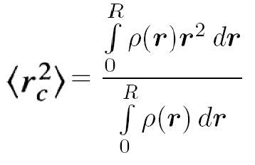
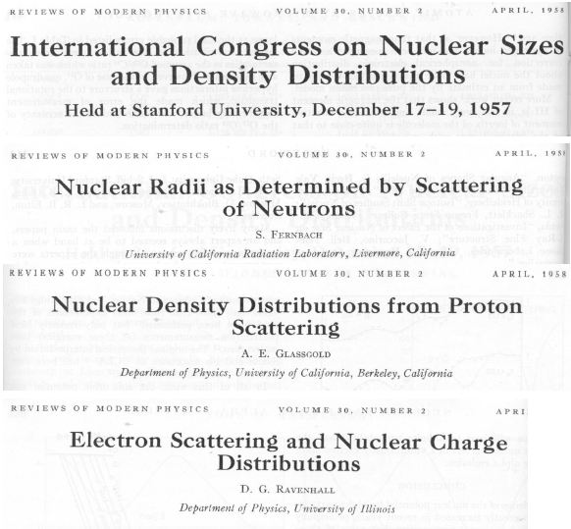
Nuclear radii definitions
Consider RMS radii (matter and neutron)
Nuclear quadrupole deformation
Near stability we know:
R = r₀A^{1/3}

Slide 58
Matter radii: total interaction cross-sections
I. Tanihata, J. Phys. G 22, 157 (1996).

Slide 59
Skins and halos
I. Tanihata, Phys. Rev. Lett. 55, 2676 (1985).

Slide 60
Laser spectroscopy for radii --> isotope shifts
The finite size and mass of the atomic nucleus has a distinct influence on the optical spectrum, which can be probed with high precision using laser spectroscopy.
R.F. Garcia Ruiz et al., arXiv:1504.04474v1
http://www.euroschoolonexoticbeams.be/site/files/nlp/LNP879_Chapter6.pdf

Slide 61
Ground state nuclear moments
Magnetic moment
m
Quadrupole moment
Q
N
bar magnet
shape of nucleus
S
a
b
Oblate: Q < 0
frisbee
Spherical: Q = 0
baseball
Prolate: Q > 0
football

Slide 62
Magnetic moments

Slide 63
Physics in magnetic moments
g-factors are sensitive to proton/neutron contributions to nuclear states – where collective properties may vary smoothly, proton and neutron contributions can vary substantially
G. J. Kumbartzki et al., Phys. Rev. C 85, 044322 (2012).

Slide 64
Hyperfine structure
Hyperfine structure refers to the splitting of a single electronic level for nuclei with I > 0

Slide 65
β-NMR/NQR technique
Beta-Nuclear Magnetic Resonance:
Use decay (β-/β+) as a detection tool; asymmetric emission for spin-polarized nuclei

Slide 66
Laser polarization
One method to achieve nuclear polarization is using lasers to create atomic polarization, which then couples to the nucleus.
Facilities around the world (i.e. TRIUMF) have or are commissioning laser systems to expand their experimental capabilities.

Slide 67
β-NQR of ¹¹Li at TRIUMF
¹¹Li is a neutron-halo nucleus – the matter radius of ¹¹Li is on the order of that of ²⁰⁸Pb – a measure of the quadrupole moment will provide more insight into the structure
www.triumf.ca/laser-spectroscopy/β-nqr-lithium-isotopes

