Slide 1
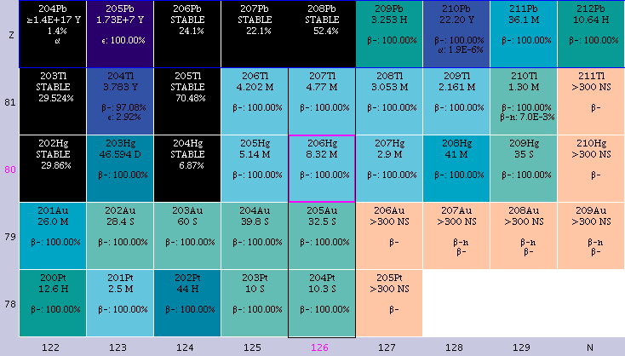
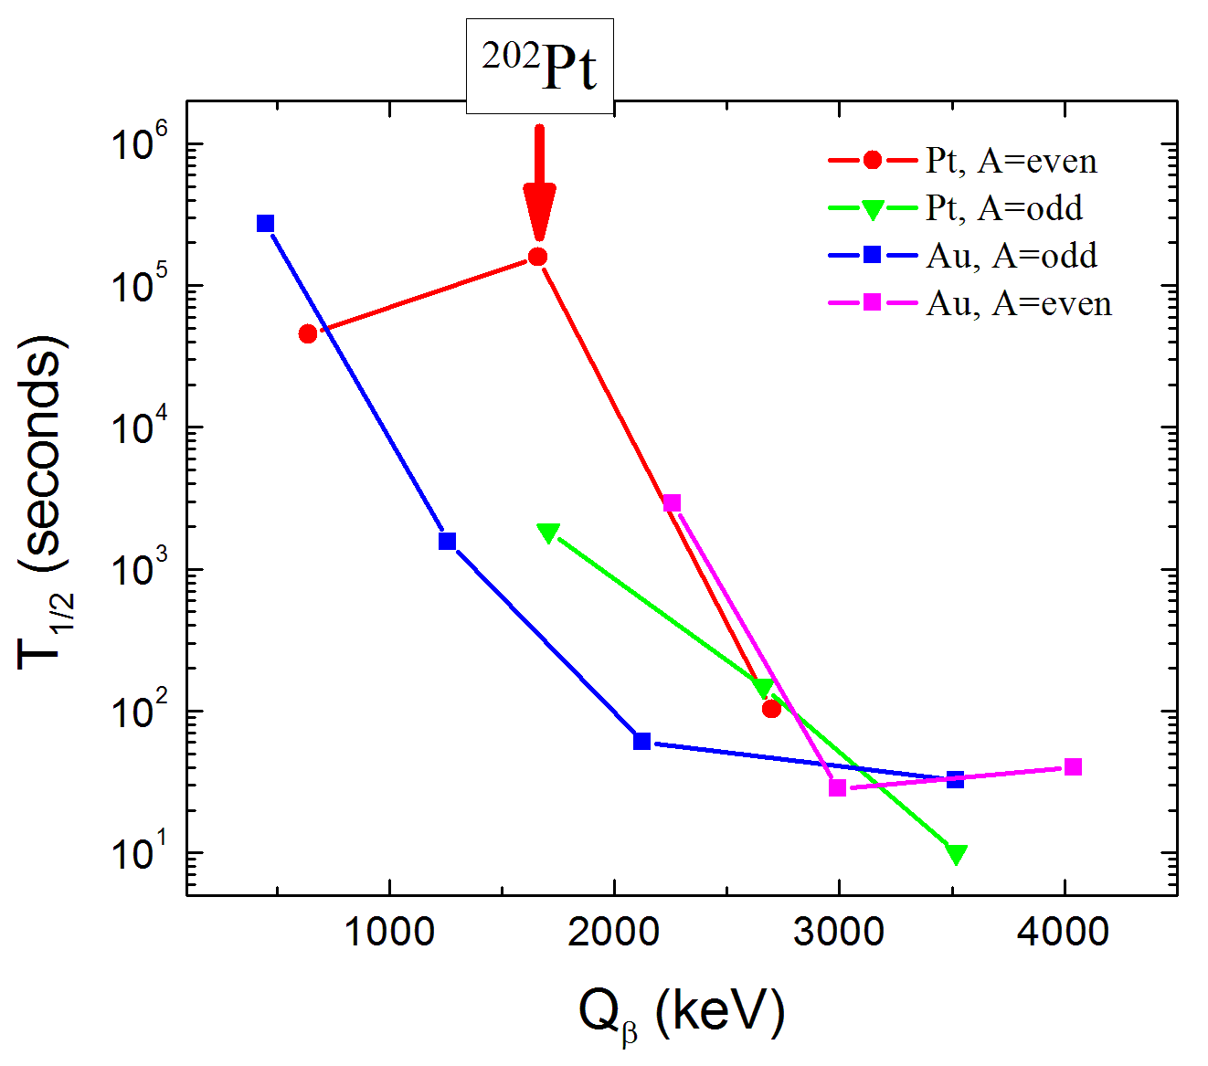
Nuclear Structure Studies South of ²⁰⁸Pb Using Multi-nucleon Transfer Reactions
BNL - U. Maryland - Oregon State U.
Nuclides south of 208Pb can be reached by Fragmentation of 208Pb and 238U as well as by transfer reactions
208Pb Transfer
G. Lane et al., NPA682, 71c (2001), PLB 606, 34 (2005).
M. Rejmund et al., ZPA 359, 243 (1997).
Anomalous T_{1/2}

Slide 2
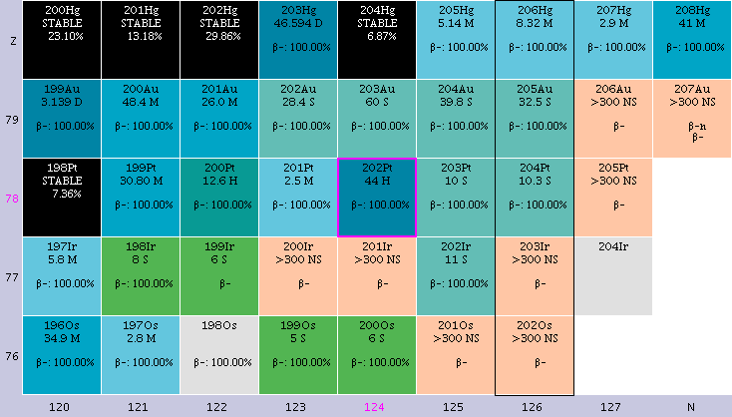
Approved ²⁰⁴Hg+²⁰⁸Pb/²³⁸U proposal
Recently completed ¹³⁶Xe+²⁰⁸Pb experiment (Loveland et al.)
Future:¹⁹⁸Pt,¹⁹²Os + ²⁰⁸Pb/²³⁸U ?

Slide 3
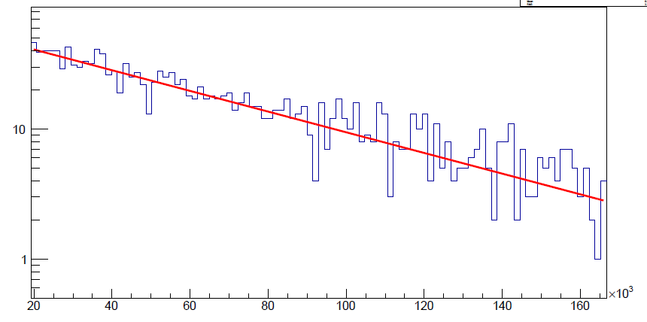
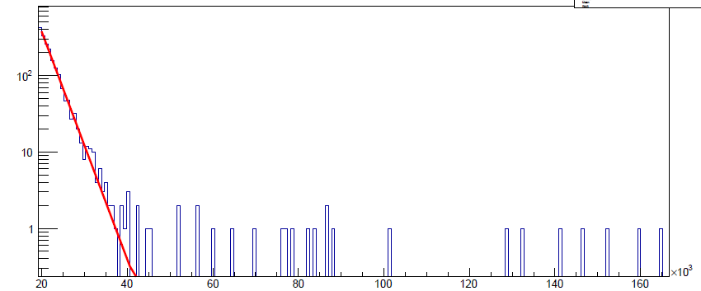
“Bonus” data from ¹³⁶Xe + ²⁰⁸Pb
Can we measure long T_{1/2}’s in deep-inelastic mess?
γ(t) – NO, but γγ(t) - YES
331-945 gated
²⁰¹Pb decay
T_{1/2}(lit) = 9.33 (3) hours
Counts
T_{1/2}(exp) = 9.6 (4) hours
Time (sec)
1436-463 gated
¹³⁸Cs decay
T_{1/2}(lit) = 33.4 (2) min
Counts
T_{1/2}(exp) = 33.7 (10) min
Time (sec)

Slide 4
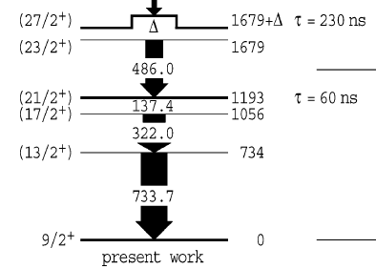
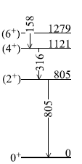
Deep Inelastic Reach
²¹¹Pb
3 neutron transfer
486
137
734-322 gate
G.J. Lane et al., Phys. Lett. B 606, 34 (2002)
4 neutron transfer
²¹²Pb
157
805-316 gate
A.I. Morales et al., Phys. Rev. C 89, 014324 (2014)

