Slide 1
Continued search for the
Fade out of collective enhancements Charity, Reviol, Sobotka [WU] & Chajecki [MSU-?]
Physics/History
Collective enhancements: REDISTRUBTUION of the MANY-BODY density of states from high ➔ low excitation energy for deformed nuclei.
At high T (sp occupation smeared out) ➔ deformed-to-spherical transition
and low-energy enhancements die.
We searched for this transition (at ANL) and did NOT find it (2007 PRC).
Conclusions: A transition (if it exists) is either more diffuse in E* than predicted (SU3 SM) AND/OR lower in E* than we looked. We also said (re SMMC) ….
Since then Yoram Alhassid has done exactly that
➔ his work suggests we have to look lower in E*.
Detailed excitation function study of 2, 3, and 4 n evaporation spectra of both
deformed and ~ spherical rare earths.

Slide 2
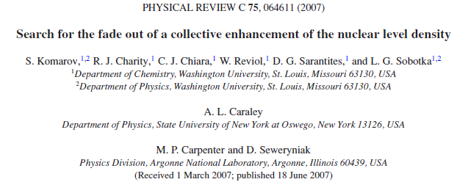
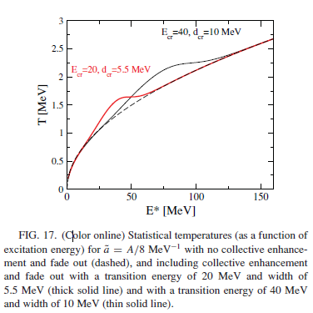
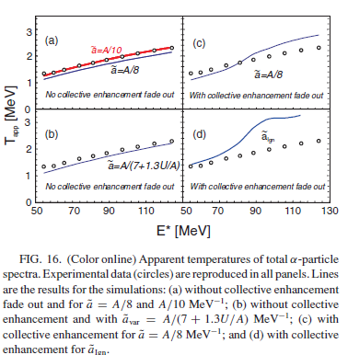
Our previous work
NO evidence for
Fade out found
E* > 50 MeV
EXPECTATIONS
With Col. En.
RESULTS
Without Col. En.

Slide 3
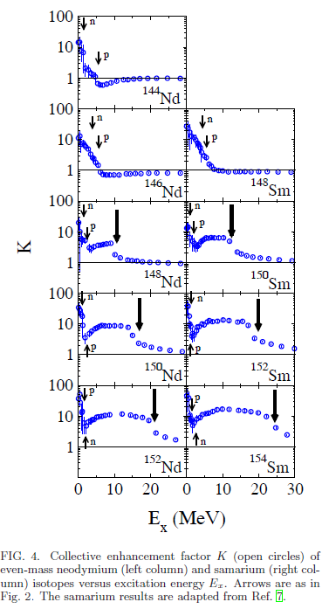
Alhassid’s recent results look E* ~ 15- 30 MeV (for deformed nuclei )
K =
Enhancement
factor
Do NOT expect to see transition (no Coll. En.) leading to ¹⁴⁴Nd residues
Do expect to see transition reflected in n-spectra (leading to) ¹⁵²⁻¹⁵⁴Nd residues.
NEED ➔Excitation functions of
high-quality neutron spectra leading from to nuclei with
10 MeV < E*< 30 MeV

Slide 4
Q-A Charity/Sobotka
Most important physics question (for stable beams)
Search for demise of collect enhancements
Either use fusion [as we did before➔ANL] or
(p,p’) or (a,a’) [as we did for GDR built on excited states with Thoennessen ➔TAMU]
How do these questions relate to the present priorities of the field.
Don’t know – Don’t care.
Accelerator and tech.
Interested in excellent beam timing & few meter n-TOF for intermediate angles in front of FMA WITHOUT GS or GRETINA.
Beam intensities should not be a problem.
TECH development
Unrelated to Collective Enhancements, we are interested in advancing tech. for large Si-strip arrays or arrays of PSD capable scintillators.
Our new HINP chip will be ready this fall. HUGH dynamic range (two simultaneous shapers) improved DISC.

