Slide 1
Laser Spectroscopy for Nuclear Structure
Charge Radii and Moments
Peter Mueller

Slide 2
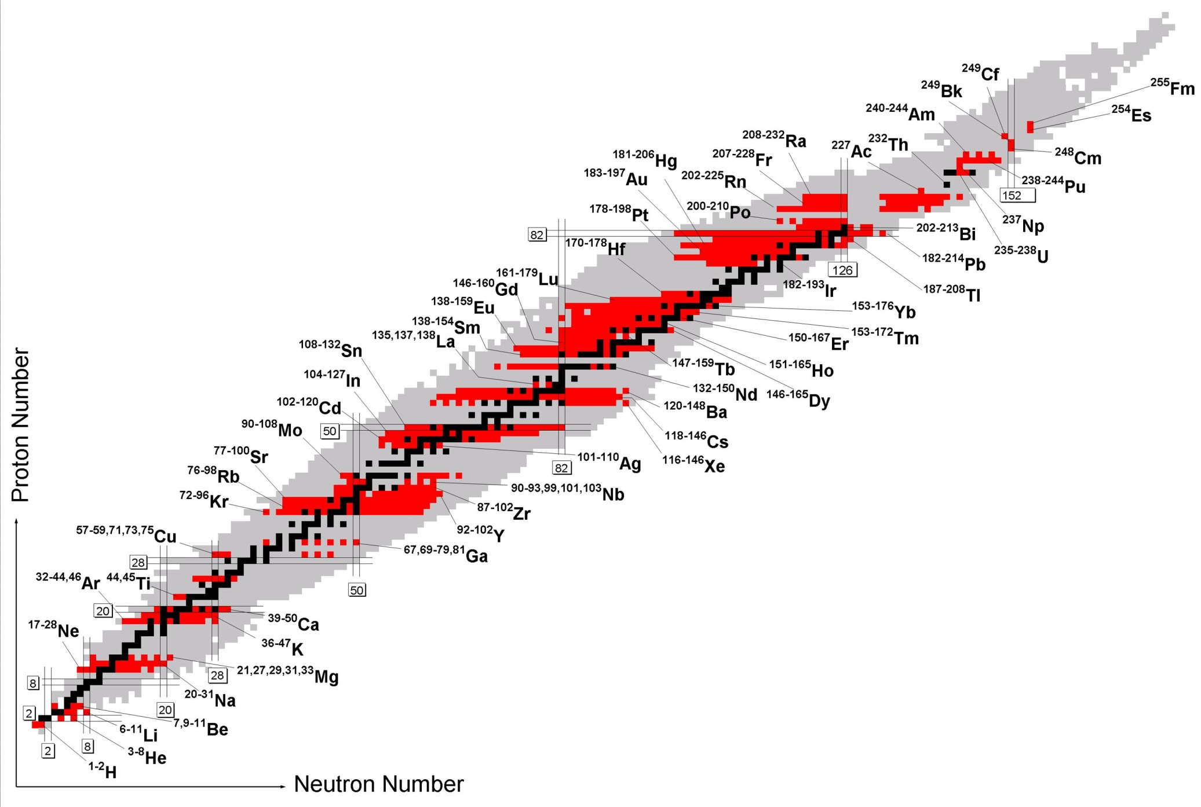
Laser Spectroscopy of Radioactive Isotopes
Nuclear charge radii +
nuclear moments
New opportunities with
CARIBU & ATLAS upgrade
https://www.gsi.de/en/start/forschung/forschungsfelder/appa_pni_gesundheit/
atomphysik/research/methoden/laserspektroskopie/survey.htm

Slide 3
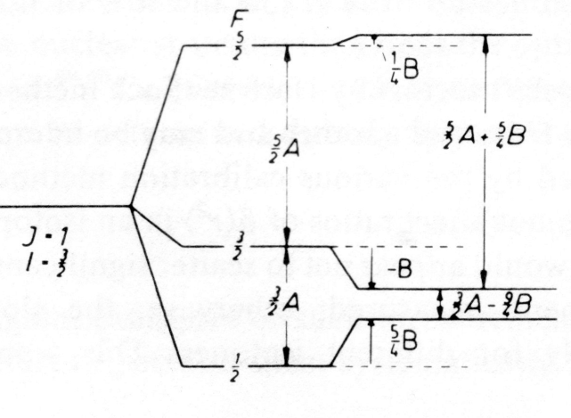
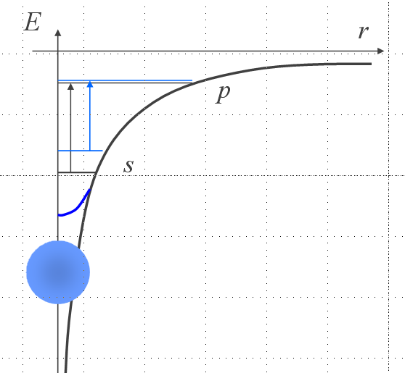
Laser Spectroscopy & Nuclear Structure
Nuclear ground state properties from atomic spectroscopy
Model independent, precision measurement
Atomic isotope shifts -> charge radii
Atomic hyperfine structure
-> nuclear spin and moments (single-particle & collective)

Slide 4
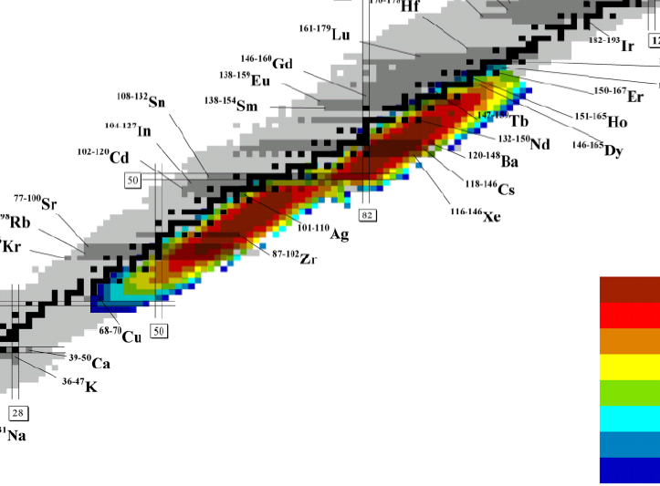
CARIBU Isotopic Menu for Laser Spectroscopy
Low-energy
yield, s⁻¹
> 10⁶
10⁵ - 10⁶
10⁴ - 10⁵
10³ - 10⁴
10² - 10³
10 - 10²
1 - 10
< 1

Slide 5
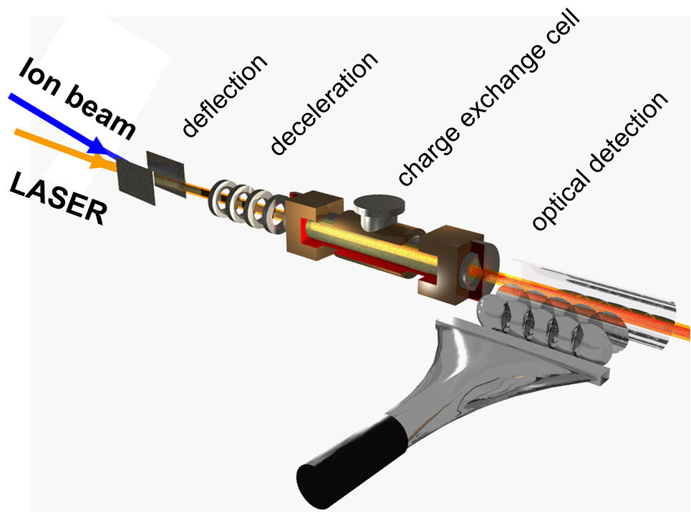
Collinear Laser Spectroscopy
High spectroscopic resolution
High sensitivity through bunched beams
Neutral atoms w/charge-exchange
  Measure for the first time: Pd, Sb, Rh, Ru, …
  Extend isotopic chains on: Mo, Nb, …

Slide 6
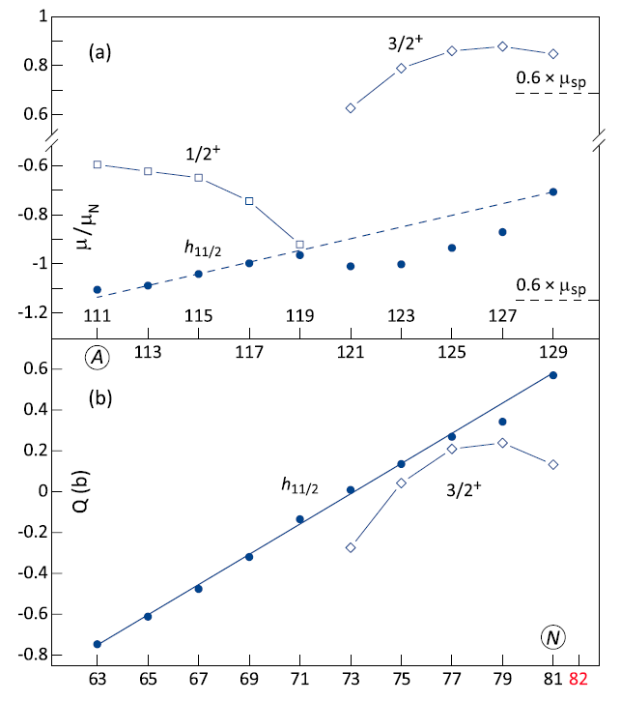
Collinear Spectroscopy of ¹⁰⁷⁻¹²⁹Cd @ ISOLDE
D.T. Yordanov et al., PRL 110, 192501 (2013)
“Simple Structure in Complex Nuclei”
Used RFQ cooler/buncher
Demonstrate UV excitation/detection
Extracted ground state dipole and
quadrupole moments up to N=82
Isomers discovered
With CARIBU:
Study isotope chain of Pd (up to N = 78)
Access to refractory elements

Slide 7

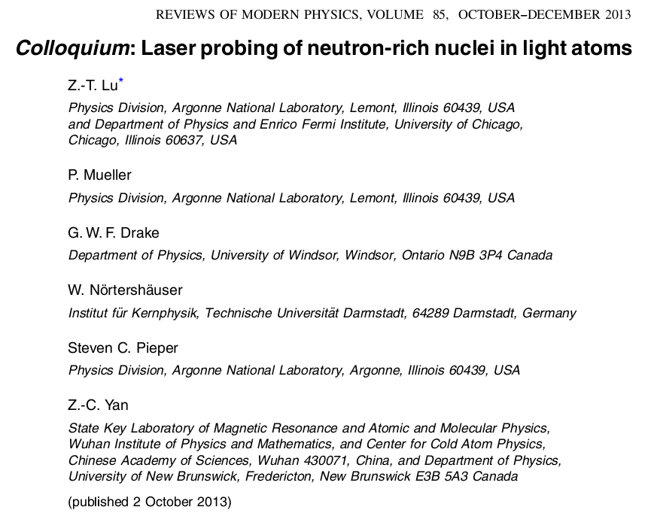
Light isotopes
7

Slide 8



The Boron-8 Collaboration
A. Leredde¹, Ch. Geppert³, A. Krieger^{2,3}, P. Mueller¹, W. Nörtershäuser²
¹ Physics Division, Argonne National Laboratory
² Institut für Kernphysik, TU Darmstadt
³ Institut für Kernchemie, Universität Mainz
8

Slide 9
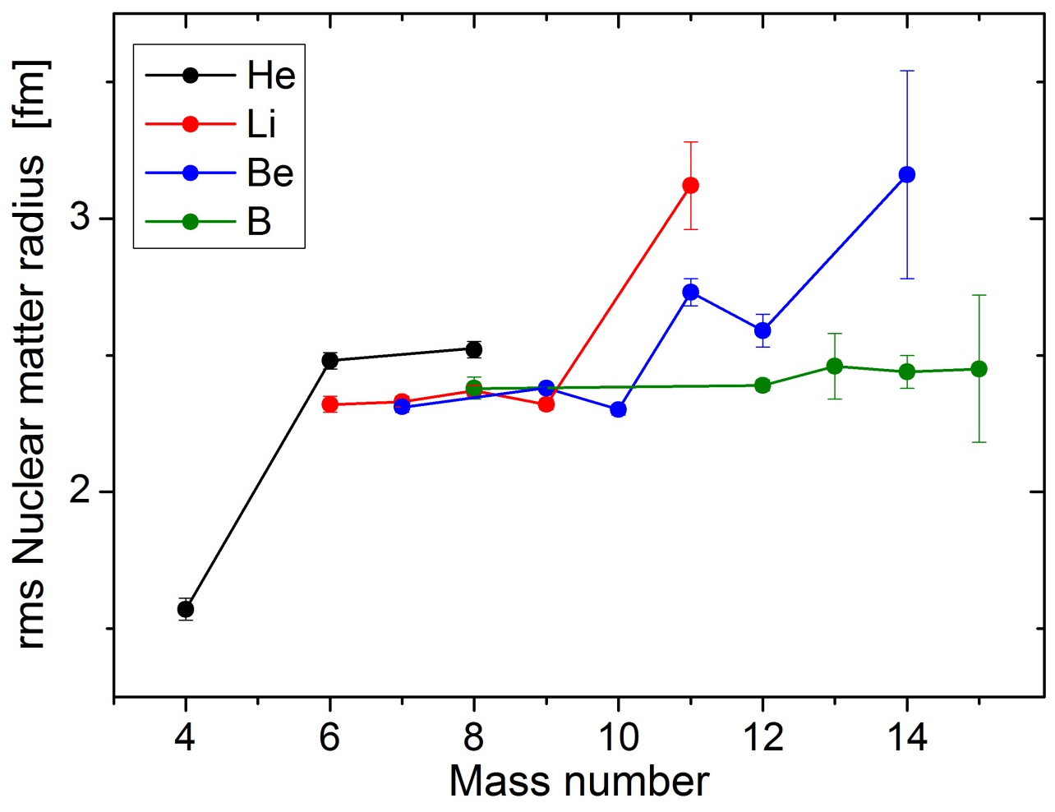
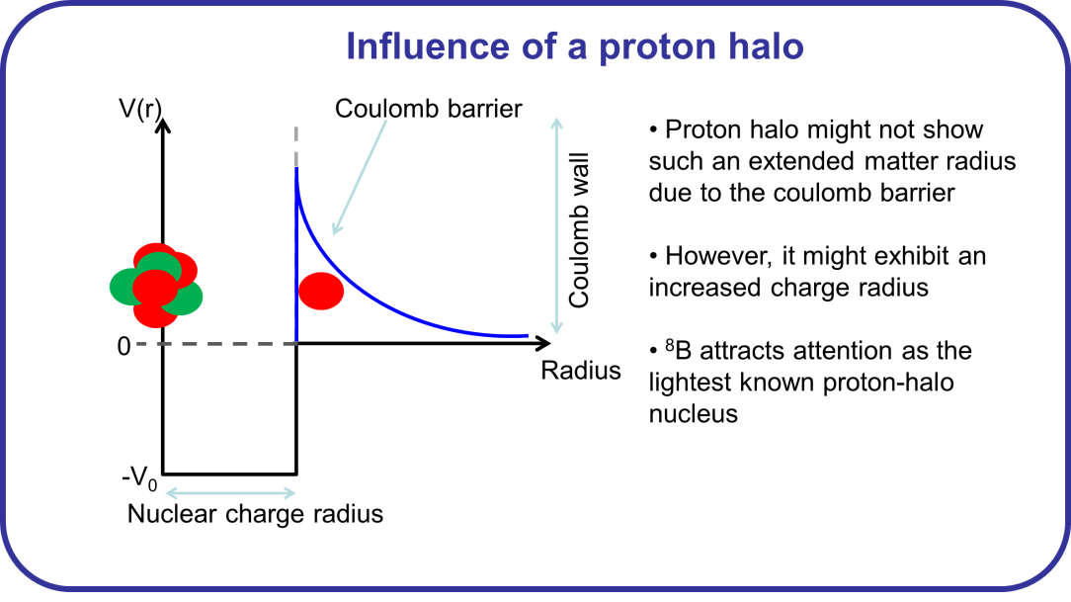
The „Proton Halo“ Nucleus ⁸B
Proton halo might not show
an extended matter radius
due to the coulomb barrier
9

Slide 10
⁸B in the FMD
Intrinsic densities of the proton-halo candidate ⁸B calculated in the fermionic molecular dynamics model (courtesy of T. Neff – GSI).
Simple picture of ⁸B:
⁷Be core in 3/2⁻ g. s. and a weakly bound proton in p_{3/2} orbital.

Slide 11
Laser Transitions in Boron Ionic Systems
B⁺: 4e⁻
Be-like
B²⁺: 3e⁻
Li-like
B³⁺: 2e⁻
He-like
2p ³P_{0,1,2}
2s 3s ³S₁
282 nm
324 nm
2s ³S₁ (~150ms)
2
1
0
2s 2p ³P_{J}
ΔE ≈ 200 eV
λ ≈ 6 nm
≈ 12 eV
2s 2p ¹P₁º
≈
1s ² 2p ²P_{3/2}
136 nm
1s ² 2p ²P_{1/2}
206.6 nm
206.8 nm
1s ² 2s ² ¹S₀
1s ² 2s ²S_{1/2}
1s ² ¹S₀
11

Slide 12
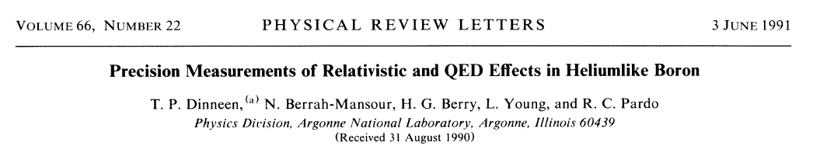
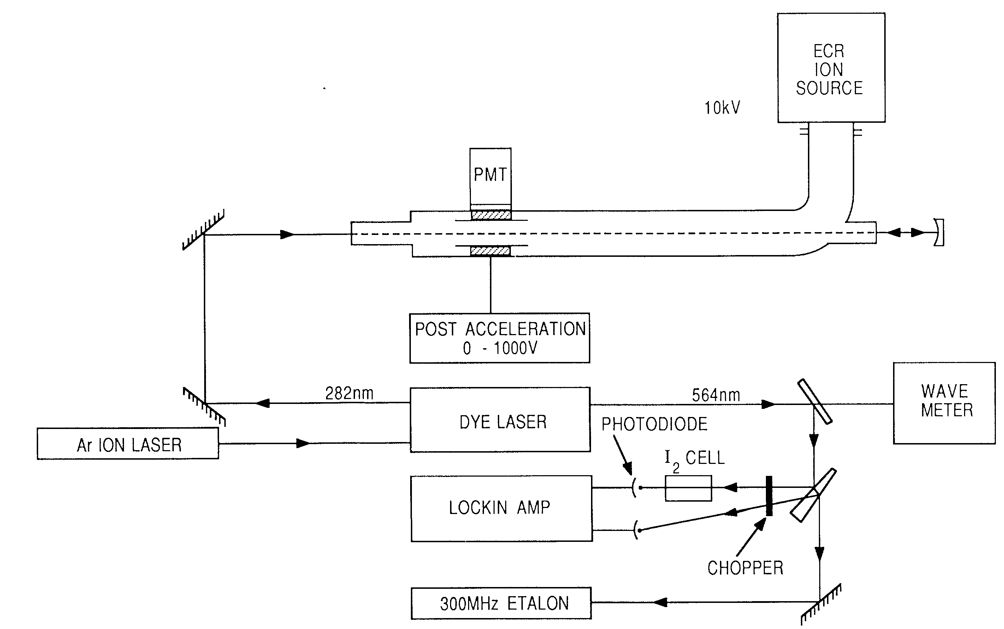
Laser Spectroscopy on Boron
2p ³P_{0,1,2}
282 nm
2s ³S₁ (~150ms)
12

Slide 13
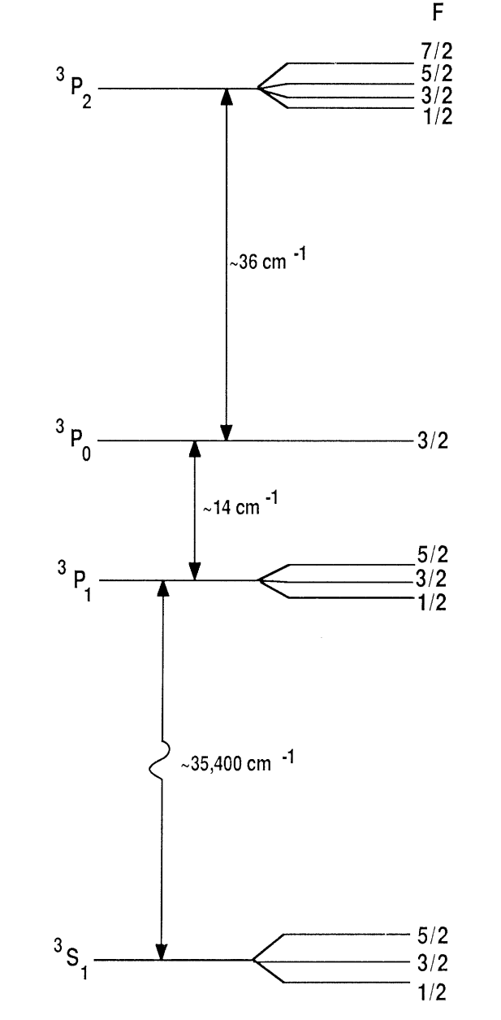
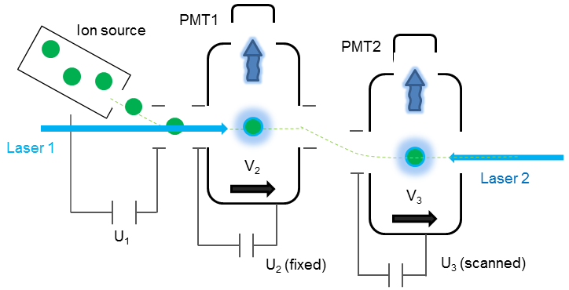
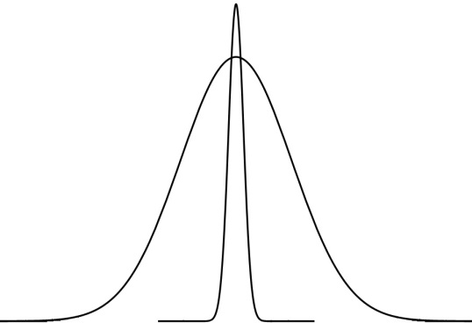
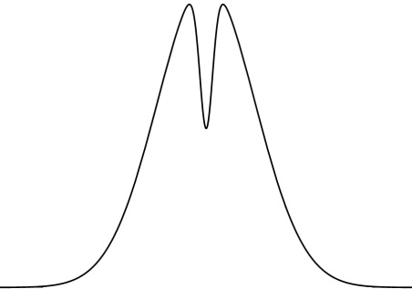




Linewidth Reduction: Pump and Probe
13

Slide 14
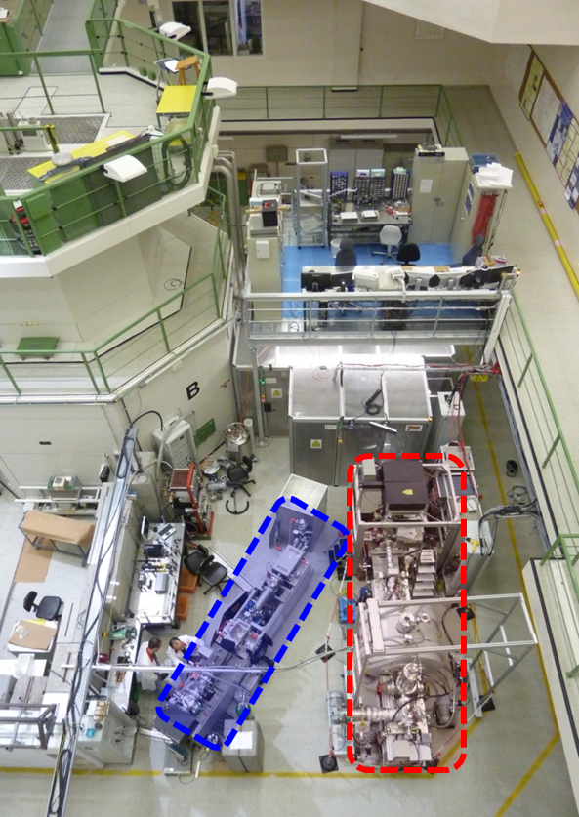

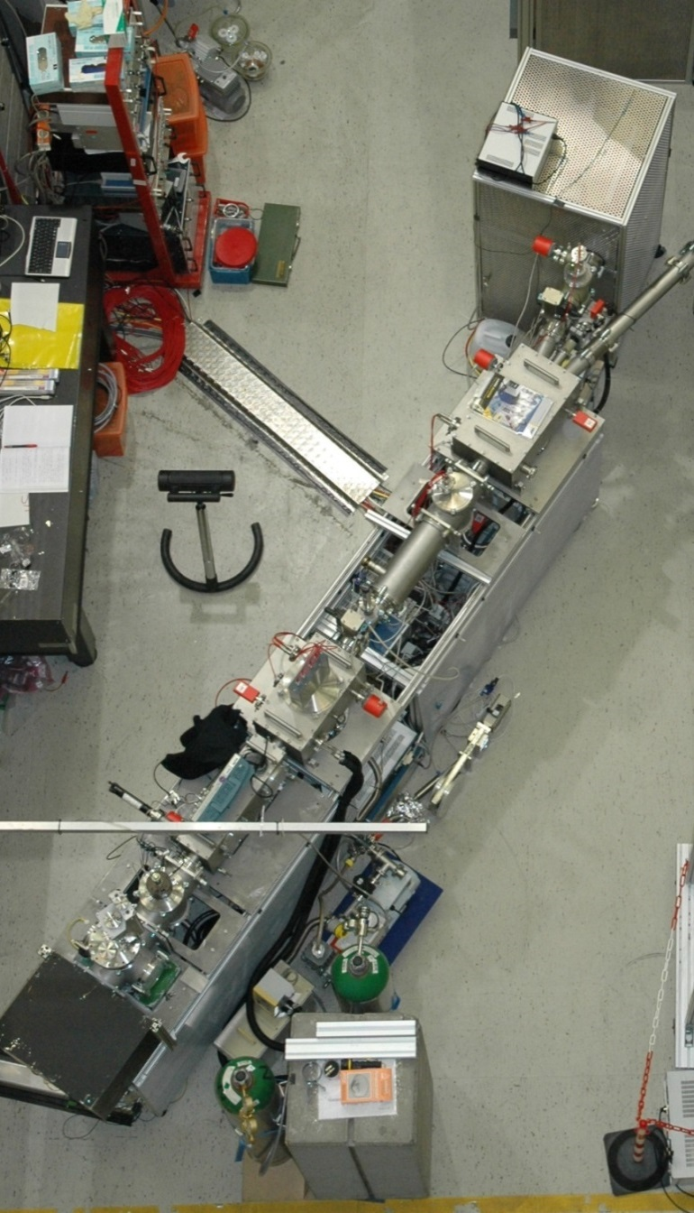

TRIGA-SPEC @ Mainz
LASPEC / MATS / SHIPTRAP
(Prototyping & Development)
14

Slide 15
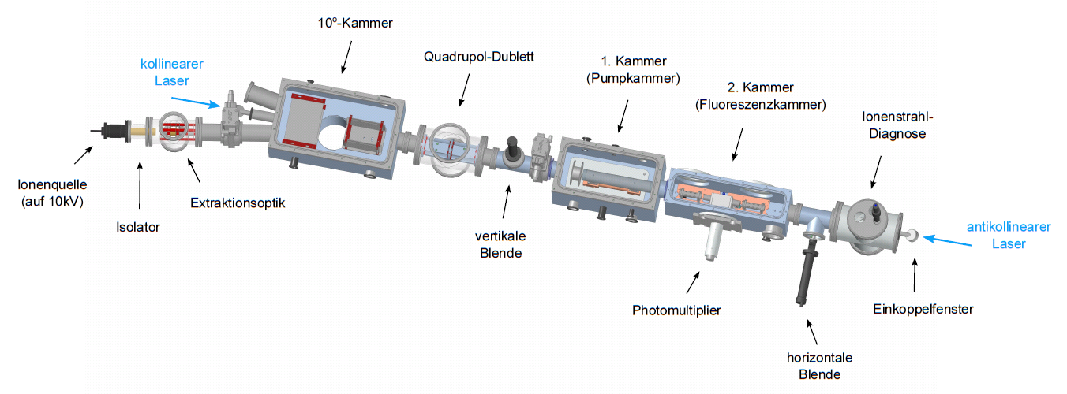
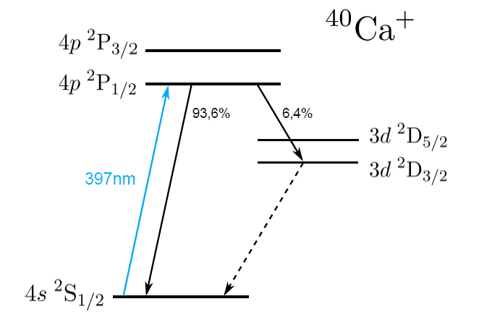
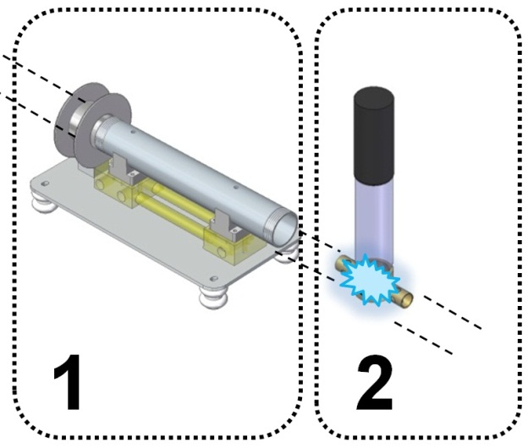
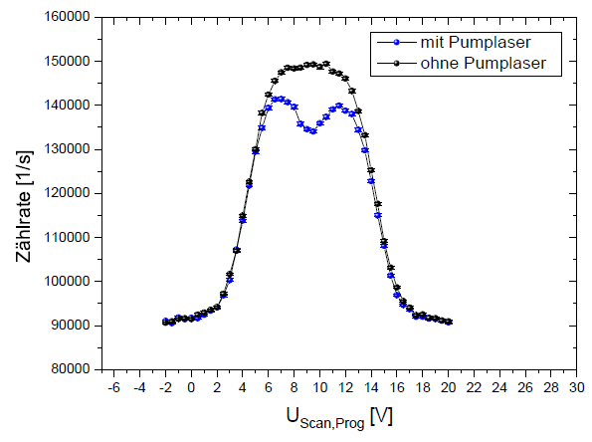
Test at TRIGA-LASER
ν_{a}
ν_{c}
+
+
+
+
+
+
15

Slide 16
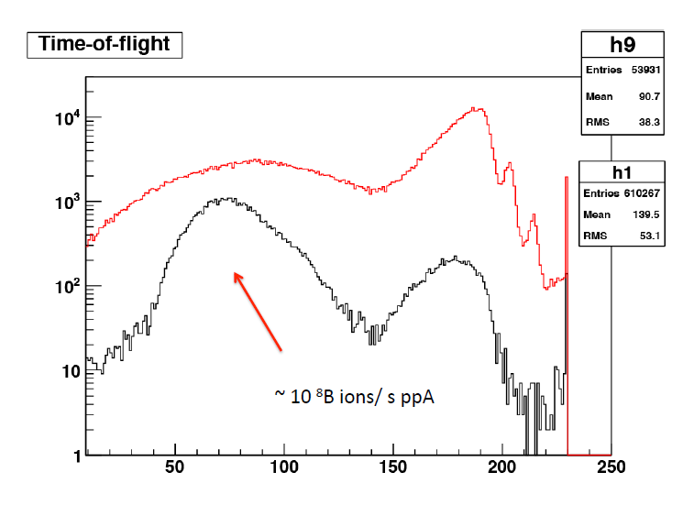
⁸B Production Tests
⁶Li(³He,n)⁸B
SC Solenoid, 0.6 T
⁴He Gas Catcher
⁶Li beam
~50 MeV
~100 pnA
Si detector
³He target cell
LN₂ cooled
MWPC
Particle ID
in MWPC via time-of-flight and position
-> ~ 10 ⁸B / ppA
behind gas catcher on Si-detector
-> ~ 1 count/s/ppA
2014 ATLAS intensity upgrade
~ 1 p μA ⁶Li
16

Slide 17
Roadmap to ⁸B at ANL:
Ion Production – Charge Breeding
Requirements for ⁸B???
Atomic theory ☑
Nuclear theory ☑
Ion production: In-flight method ☑
Stop, low energy B⁺ -> source
… gas catcher ☑
Charge breeding
… to B³⁺ or B⁴⁺ ☑
Populate metastable state
  … in source or charge-ex. ☑
High-resolution laser spec
… collinear laser spectroscopy
17

Slide 18
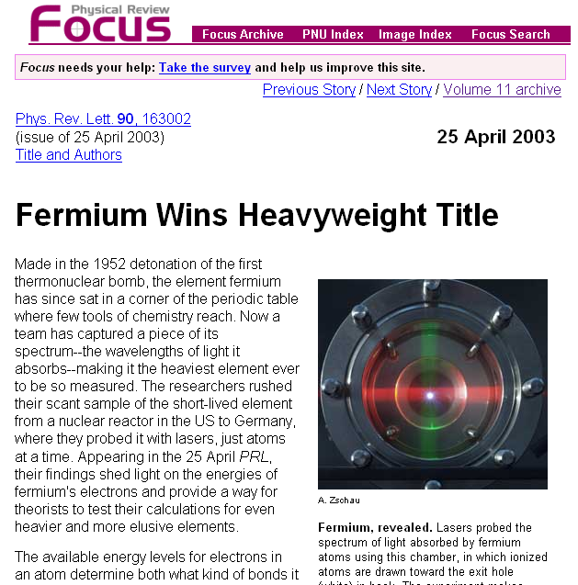
Fermium
Spectroscopy
²⁵⁵Fm (t_{1/2} = 20.1 h)

Slide 19
Nobelium Spectroscopy @ GSI/SHIP
M. Laatiaoui et al., Eur. Phys. J. D 68, 71 (2014)
Resonance ionization spectroscopy in buffer gas
Detection via alpha decay
Searched for predicted atomic levels, no clear signal observed yet

Slide 20
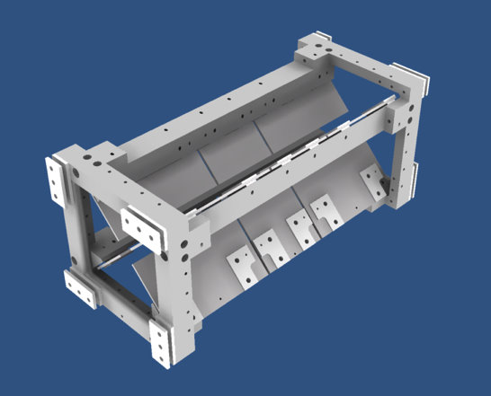
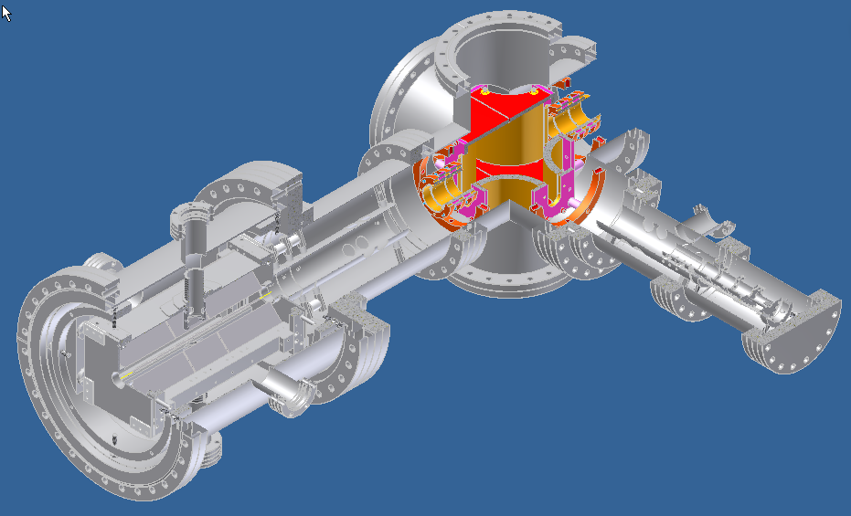
In-trap spectroscopy
Laser Beam
Ion Trap
90º Deflector
Ion Source
Linear Paul Trap
Matt Sternberg
Alexandra Carlson
Luis Brennan
open geometry, LN₂ cooled linear Paul trap
- buffer gas cooling
- large light collection efficiency
- few to single ion detection sensitivity

Slide 21
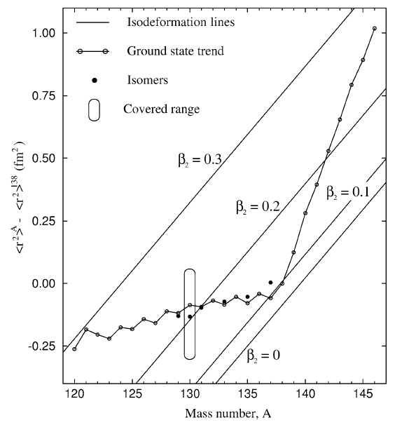
In-Trap Spectroscopy
Ba Isotopes
Linear Paul trap for spectroscopy
  Initially with neutron-rich Ba⁺
  Isotope shift + moments (HFS)
  Use RF cooler / buncher & transfer line
To investigate:
  optimized trap geometry and detection
  system
  Buffer gas cooling + quenching (with H₂)
  Cooling of trap with LN₂
Future:
  Yb⁺ -> No⁺ with ATLAS Upgrade
  Sympathetic cooling with Ba⁺/Y⁺ ?
  Indirect detection of No ions

Slide 22
Nuclear Spin Polarization in Solid Noble-Gas Matrix
LHe
Optical pumping
Atomic beam
B
Noble
gas ice
Substrate
LDRD supported
Zheng-Tian Lu
Chen-Yu Xu
Jaideep Singh
Capture atoms in solid noble-gas matrix (Ne … Xe)
Optical pumping in situ
Spin precession detection with SQUIDs (stable isotopes) or
decay asymmetry (radioactive isotopes)
Started feasibility studies for
  Optical pumping / nuclear polarization (initial tests with Yb)
  Measurements of nuclear magnetic moments (other rare earth, …)
  Single atom detection

Slide 23
Some concluding thoughts
New opportunities with ATLAS Upgrade (AIRIS, AGFA, A=126)
  High intensity beams for in-flight production of light isotopes
  Atomic spectroscopy of Nobelium and beyond with AGFA
Limitations on isotopic yields for laser spectroscopy
  Molecular fraction, Charge state distribution (2+/1+)
  Charge exchange in cooler/buncher or in-beam
  Population of metastable atomic states
Limitations in number of elements that can be done
  Not “universal technique”; each element different
Tight space limitations in CARIBU LE-beam area
  Need to wait until CPT moves out
  Benefits largely from extension of LE beams into tandem hall
Combination with decay spectroscopy ?
  Laser excitation provides high selectivity, i.e., isobaric & isomeric
  Resonance ionization to produce pure beams
  Laser polarization (in-matrix or in-beam)

Slide 24
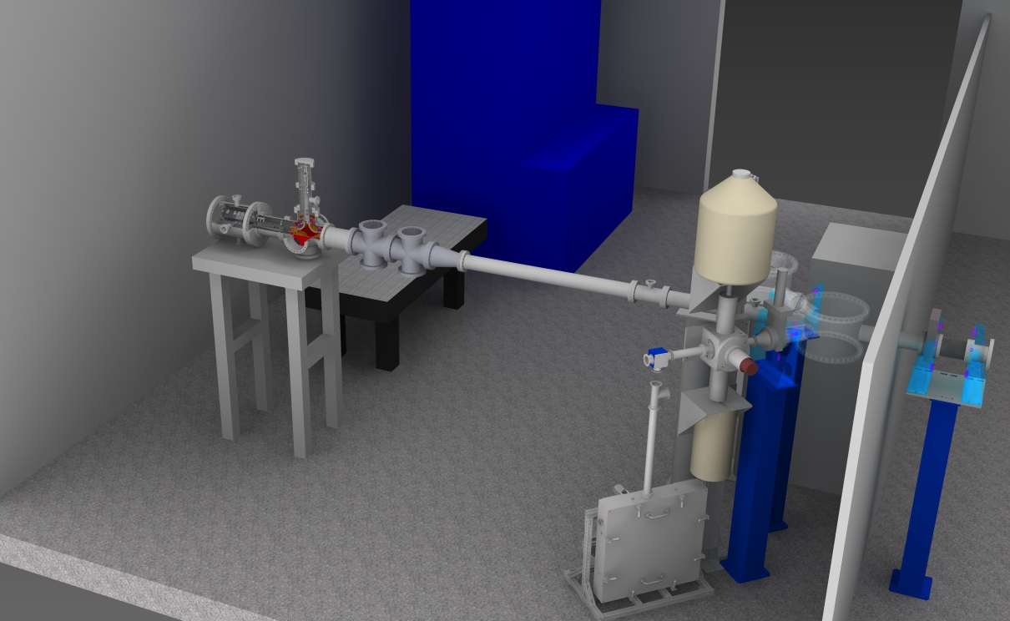
Laser Spectroscopy Layout at CARIBU
CARIBU low-energy beam area
Ion trap
Collinear beam-line
Limited area for low-energy experiments @ CARIBU
Installation only possible after Penning trap moved out end of 2014
Shared laser infrastructure for both experimental techniques

Slide 25
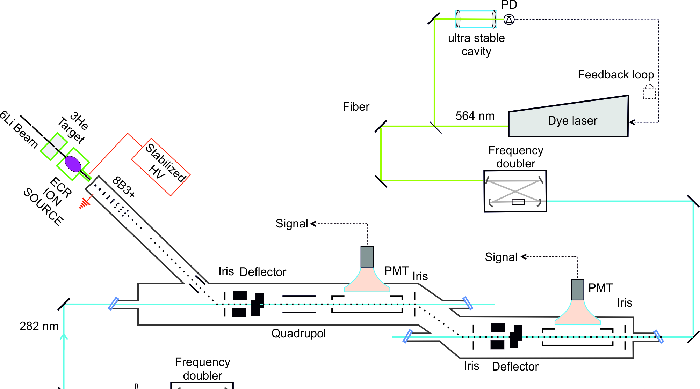
Collinear Setup for Light Isotopes (⁸B, ¹⁵C, ...)
Coupled to in flight production + gas catcher + ECR type ion source
Study charge radii of light isotopes
High spectroscopic resolution through pump/probe technique
25

Slide 26


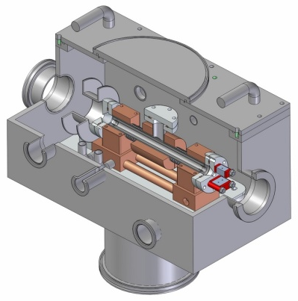
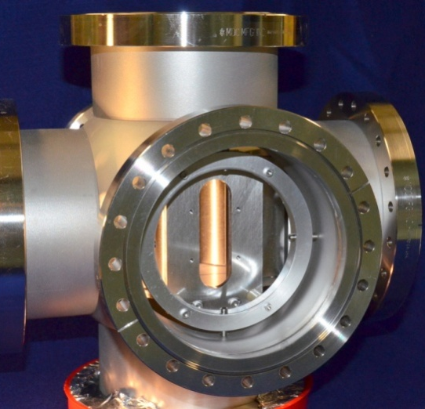
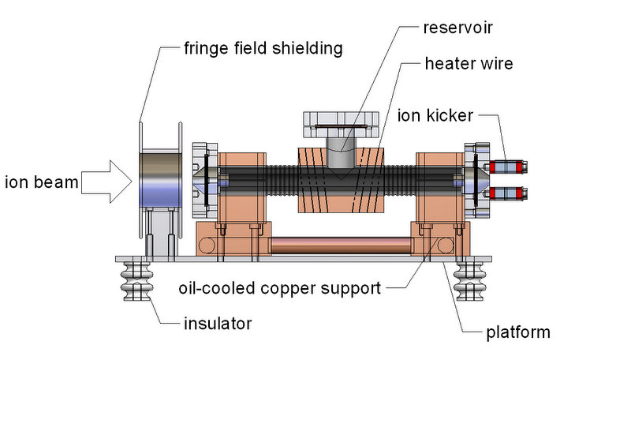
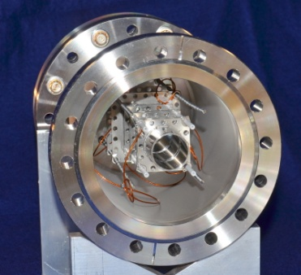
CARIBU Laser Laboratory
Laser Beam
Ion Trap
90º Deflector
Ion Source
Technical design of charge exchange cell (Mainz Univ.)
90° deflector Ion source
Ion beam line elements under construction
(with Mainz University & TU Darmstadt)
Offline tests in 2014, Installation in 2015
Ion optics elements assembly started
Off-line tests with Ba⁺ starting in 2015
High sensitivity: few to single ion
Open geometry, LN₂ cooled linear Paul trap
Buffer gas cooling
High spectroscopic resolution
High sensitivity through bunched beams
Measure for the first time: Pd, Sb, Rh, Ru
Extend isotopic chains: Y, Zr, Nb, Mo

Slide 27
Collinear Setup for CARIBU
In collaboration with W. Nörtershäuser (TU Darmstadt) & Ch. Geppert (U Mainz)
Low-energy (10 – 30 keV) ion beam line
  Compact modular setup with charge exchange and fluorescence detection
  Developed at Mainz University & TU Darmstadt
  Operated at TRIGA Reactor at Mainz University
Compact, solid state laser system (DPSS + Ti:Sa + Frequency Doubler)
Deflector
Charge Exchange
Fluorescence
Detection
Ion Source
27

Slide 28
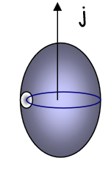
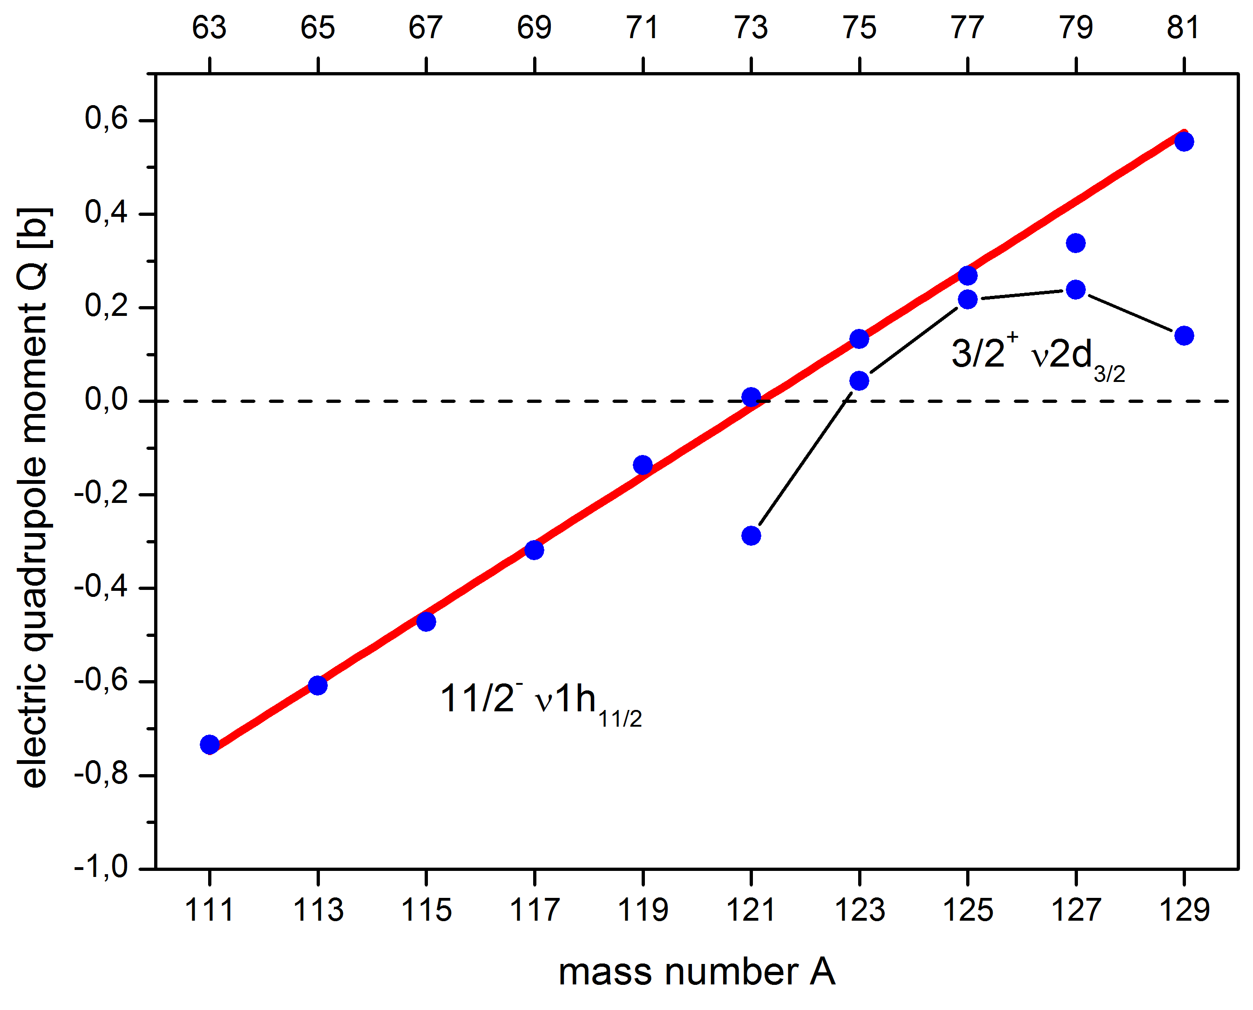

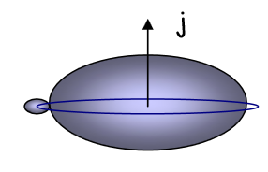
Simple Structure in Complex Nuclei
1h_{9/2}
92
1h
82
3s
1h_{11/2}
82
3s_{1/2}
70
2d
2d_{3/2}
68
2d_{5/2}
64
1g_{7/2}
58
1g
50
1g_{9/2}
50
Capacity of 1h_{11/2} niveau: 12 neutrons
→ 6 quad. moments
But: 10 quad. moments
Neutron pairs shared between the neighboring levels.
D. T. Yordanov et al., Phys. Rev. Lett. 110, 192501 (2013)

Slide 29
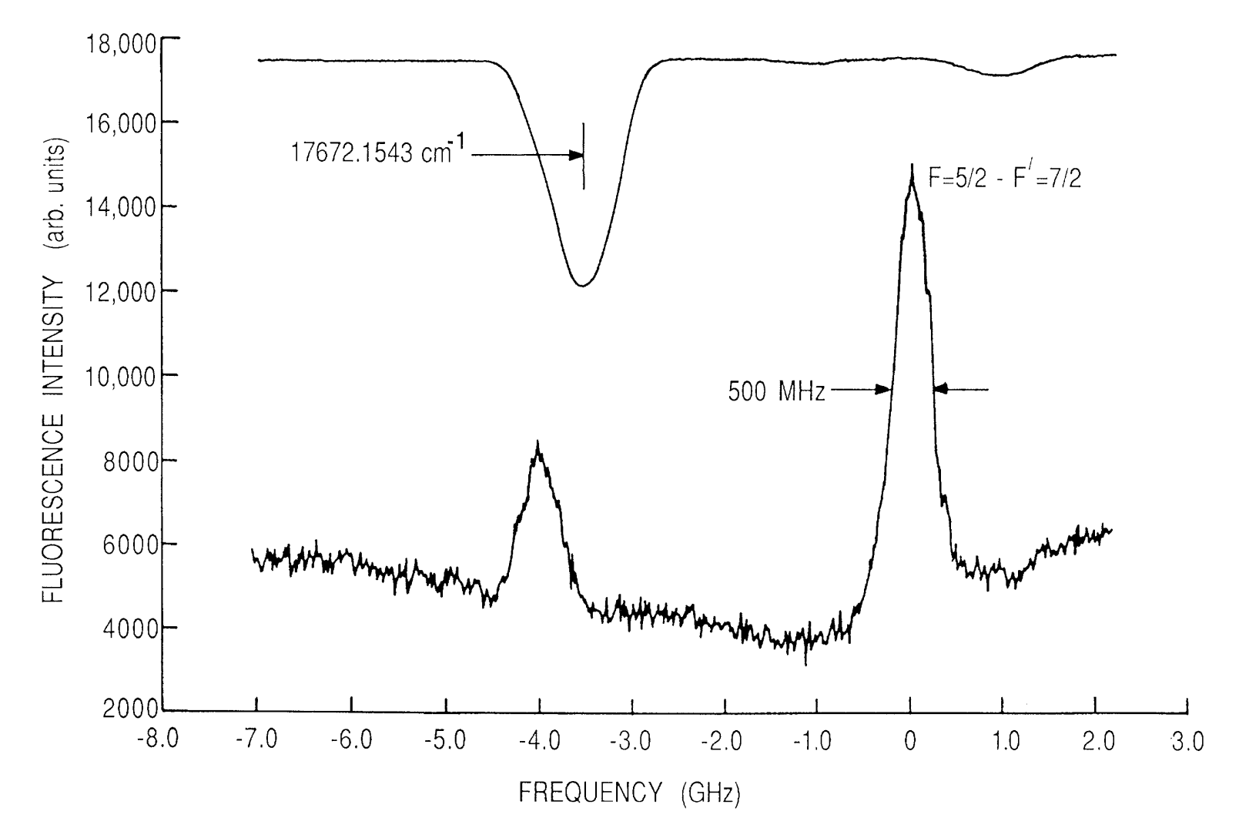
Laser Spectroscopy of ¹¹B
Iodine Reference
29

Slide 30
Shell-Model Prediction
slope determined by Q_{sp}
single neutron → oblate deformation (Q<0)
single neutron hole → prolate deformation (Q>0)
Extraction of Q_{sp:}

Slide 31

The atomic system of ⁸B (I=2)
1s2p ³P_{J} Fine- and Hyperfine Structure
1s 2p ³P₂ →1s 2s ³S₁ @ 282.5 nm
Transition Rates (× 10⁷ /s)
MHz
rel. ³P₂
F
F
4
16634
72.4
-12404
-20748
-24928
4
3
3
1s2p ³P₂
2
2
36.441 cm⁻¹
1
1
0
0
1.1
≈
3.4
4.6
1s2p ³P₀
2
1.6
3.0
4.6
-1570120
-1583500
-1591550
-1092480
3.1
2.7
1.6
16.379 cm⁻¹
≈
3
3
1s2p ³P₁
2
2
1
1
Calculations by G.W.F. Drake and Z.-C. Yan
31

Slide 32
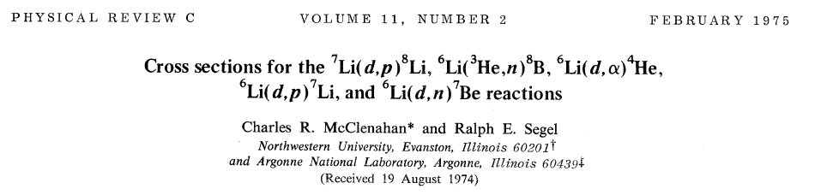
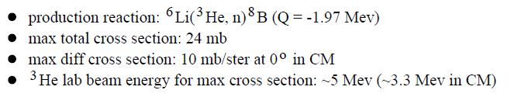
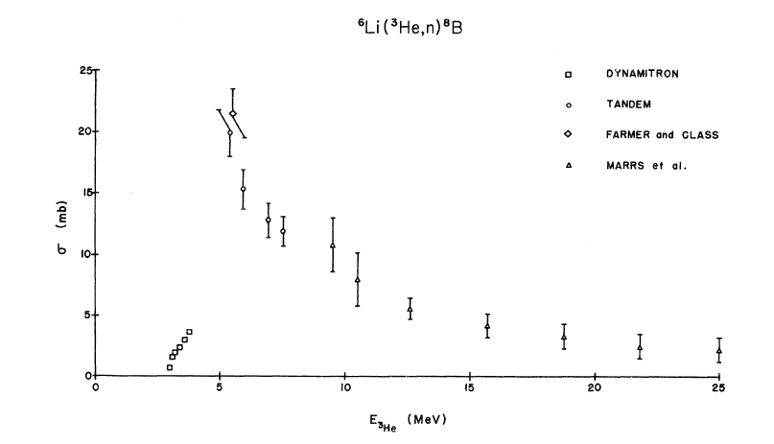
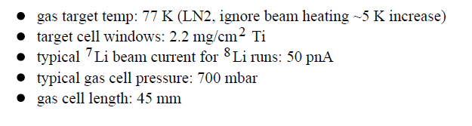
⁸B Production
In-flight production: ⁶Li(³He,n)⁸B estimated ⁸B production rate ~ 1 x 10⁷ /s
³He gas target
Gas stopper efficiency limited by saturation?
Beam intensity up to 1 uA
⁸B production of ~1x10⁷ s⁻¹ expected
Open questions:
How well can primary beam be suppressed?
32

Slide 33

Laser Spectroscopic Techniques
Collinear spectroscopy
In-trap spectroscopy
Laser Beam
Ion Trap
90º Deflector
Ion Source
High spectroscopic resolution
High sensitivity through bunched beams
Measure for the first time: Pd, Sb, Rh, Ru
Extend isotopic chains: Y, Zr, Nb, Mo
High sensitivity: few to single ion
Open geometry, LN₂ cooled linear Paul trap
Buffer gas cooling
Ion source and deflector constructed
Ion trap designed
Off-line tests with Ba⁺ 2015/16
Ion beam line elements designed
(with Mainz University & TU Darmstadt)
Offline tests in 2014, Installation in 2015

Slide 34
Laser Lab Layout @ CARIBU
Cf-252 source
80 mCi -> 1Ci
Gas catcher
AC
Laser Enclosure
(~ 6’ x 10’)
HEPA
Laser Table
(~ 3’ x 7’)
High-resolution
mass separator
δm/m > 1/20000
Ion Trap(s)
Tape Station
RF Cooler & Buncher
Collinear Beamline

Slide 35
Roadmap to ⁸B at ANL:
Ion Production
Requirements for ⁸B???
Atomic theory ☑
Nuclear theory ☑
Ion production: In-flight method
Stop, low energy B⁺ -> source
… gas catcher ☑
Charge breeding
… to B³⁺ or B⁴⁺
Populate metastable state
  … in source or charge-ex.
High-resolution laser spec
… collinear laser spectroscopy
35

Slide 36
Roadmap to ⁸B at ANL:
Ion Production
Requirements for ⁸B???
Atomic theory ☑
Nuclear theory ☑
Ion production: In-flight method
Stop, low energy B⁺ -> source
… gas catcher
Charge breeding
… to B³⁺ or B⁴⁺
Populate metastable state
  … in source or charge-ex.
High-resolution laser spec
… collinear laser spectroscopy
36

Slide 37
Roadmap to ⁸B at ANL:
Ion Production
Requirements for ⁸B???
Atomic theory ☑
Nuclear theory ☑
Ion production: In-flight method
Stop, low energy B⁺ -> source
… gas catcher
Charge breeding
… to B³⁺ or B⁴⁺
Populate metastable state
  … in source or charge-ex.
High-resolution laser spec
… collinear laser spectroscopy
37

Slide 38
Roadmap to ⁸B at ANL:
Ion Production – Charge Breeding
Need to produce low-energy (~20-50 keV) beam of metastable ⁸B³⁺ beam
Capture ⁸B in gas stopper and extract (10%)
Inject low emittance ⁸B⁺ beam from gas catcher into ECR source (10%)
Charge breed to B⁺ in ECR and accelerate to ~50 keV
  3+ efficiency of ~10% and metastable fraction of ~10% have been reported
  in the literature for neighboring C and Be
-> ~1x10³ metastable ⁸B³⁺ (comparable to ¹²Be measurement)
Alternatives:
Extract ⁸B⁺ in molecular form from gas catcher and break up in ECR
Extract ⁸B⁴⁺ from ECR and populate metastable state in charge exchange cell
Other Transitions ?
Questions
many ….
What are the efficiencies in each step?
38

Slide 39
Roadmap to ⁸B at ANL:
How to Increase Detection Efficiency ?
Collinear spectroscopy collinear/anticollinear (see beryllium)
Detection of XUV photon/ ion coincidence with extremely low background
Alternatively with bunched beam (ECR bunched extraction?)
Questions:
Energy spread from ECR?
Sensitivity of detection scheme?
HFS splittings and transition strength?
First steps:
Layout of collinear beamline
Simulating beamline (SimION)
Commissioning and testing of components at TUD/Mainz → Transport to ANL
Test with stable isotopes (-> improve absolute measurements for QED test)
39

