Slide 1
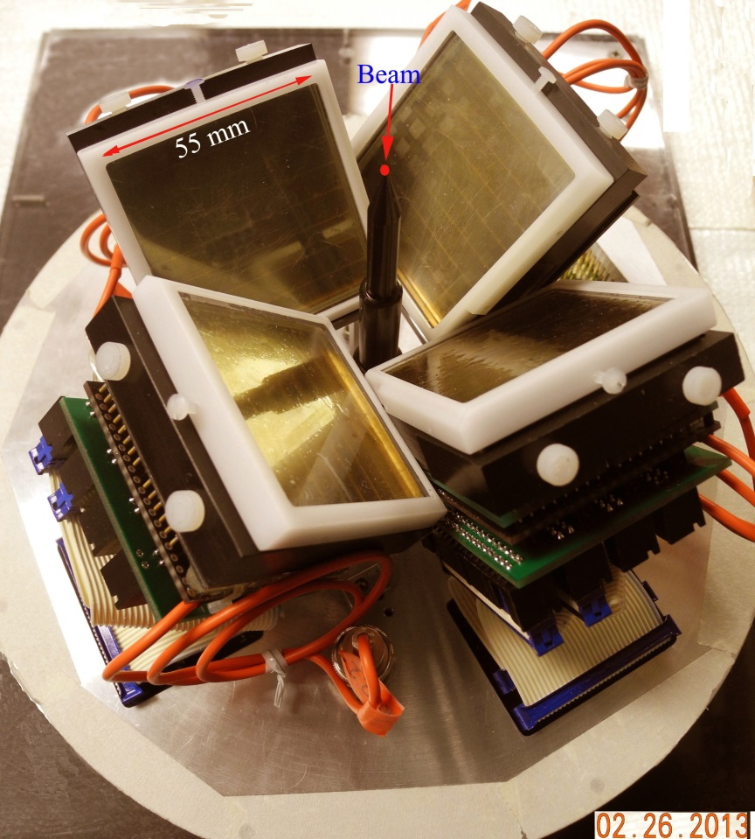
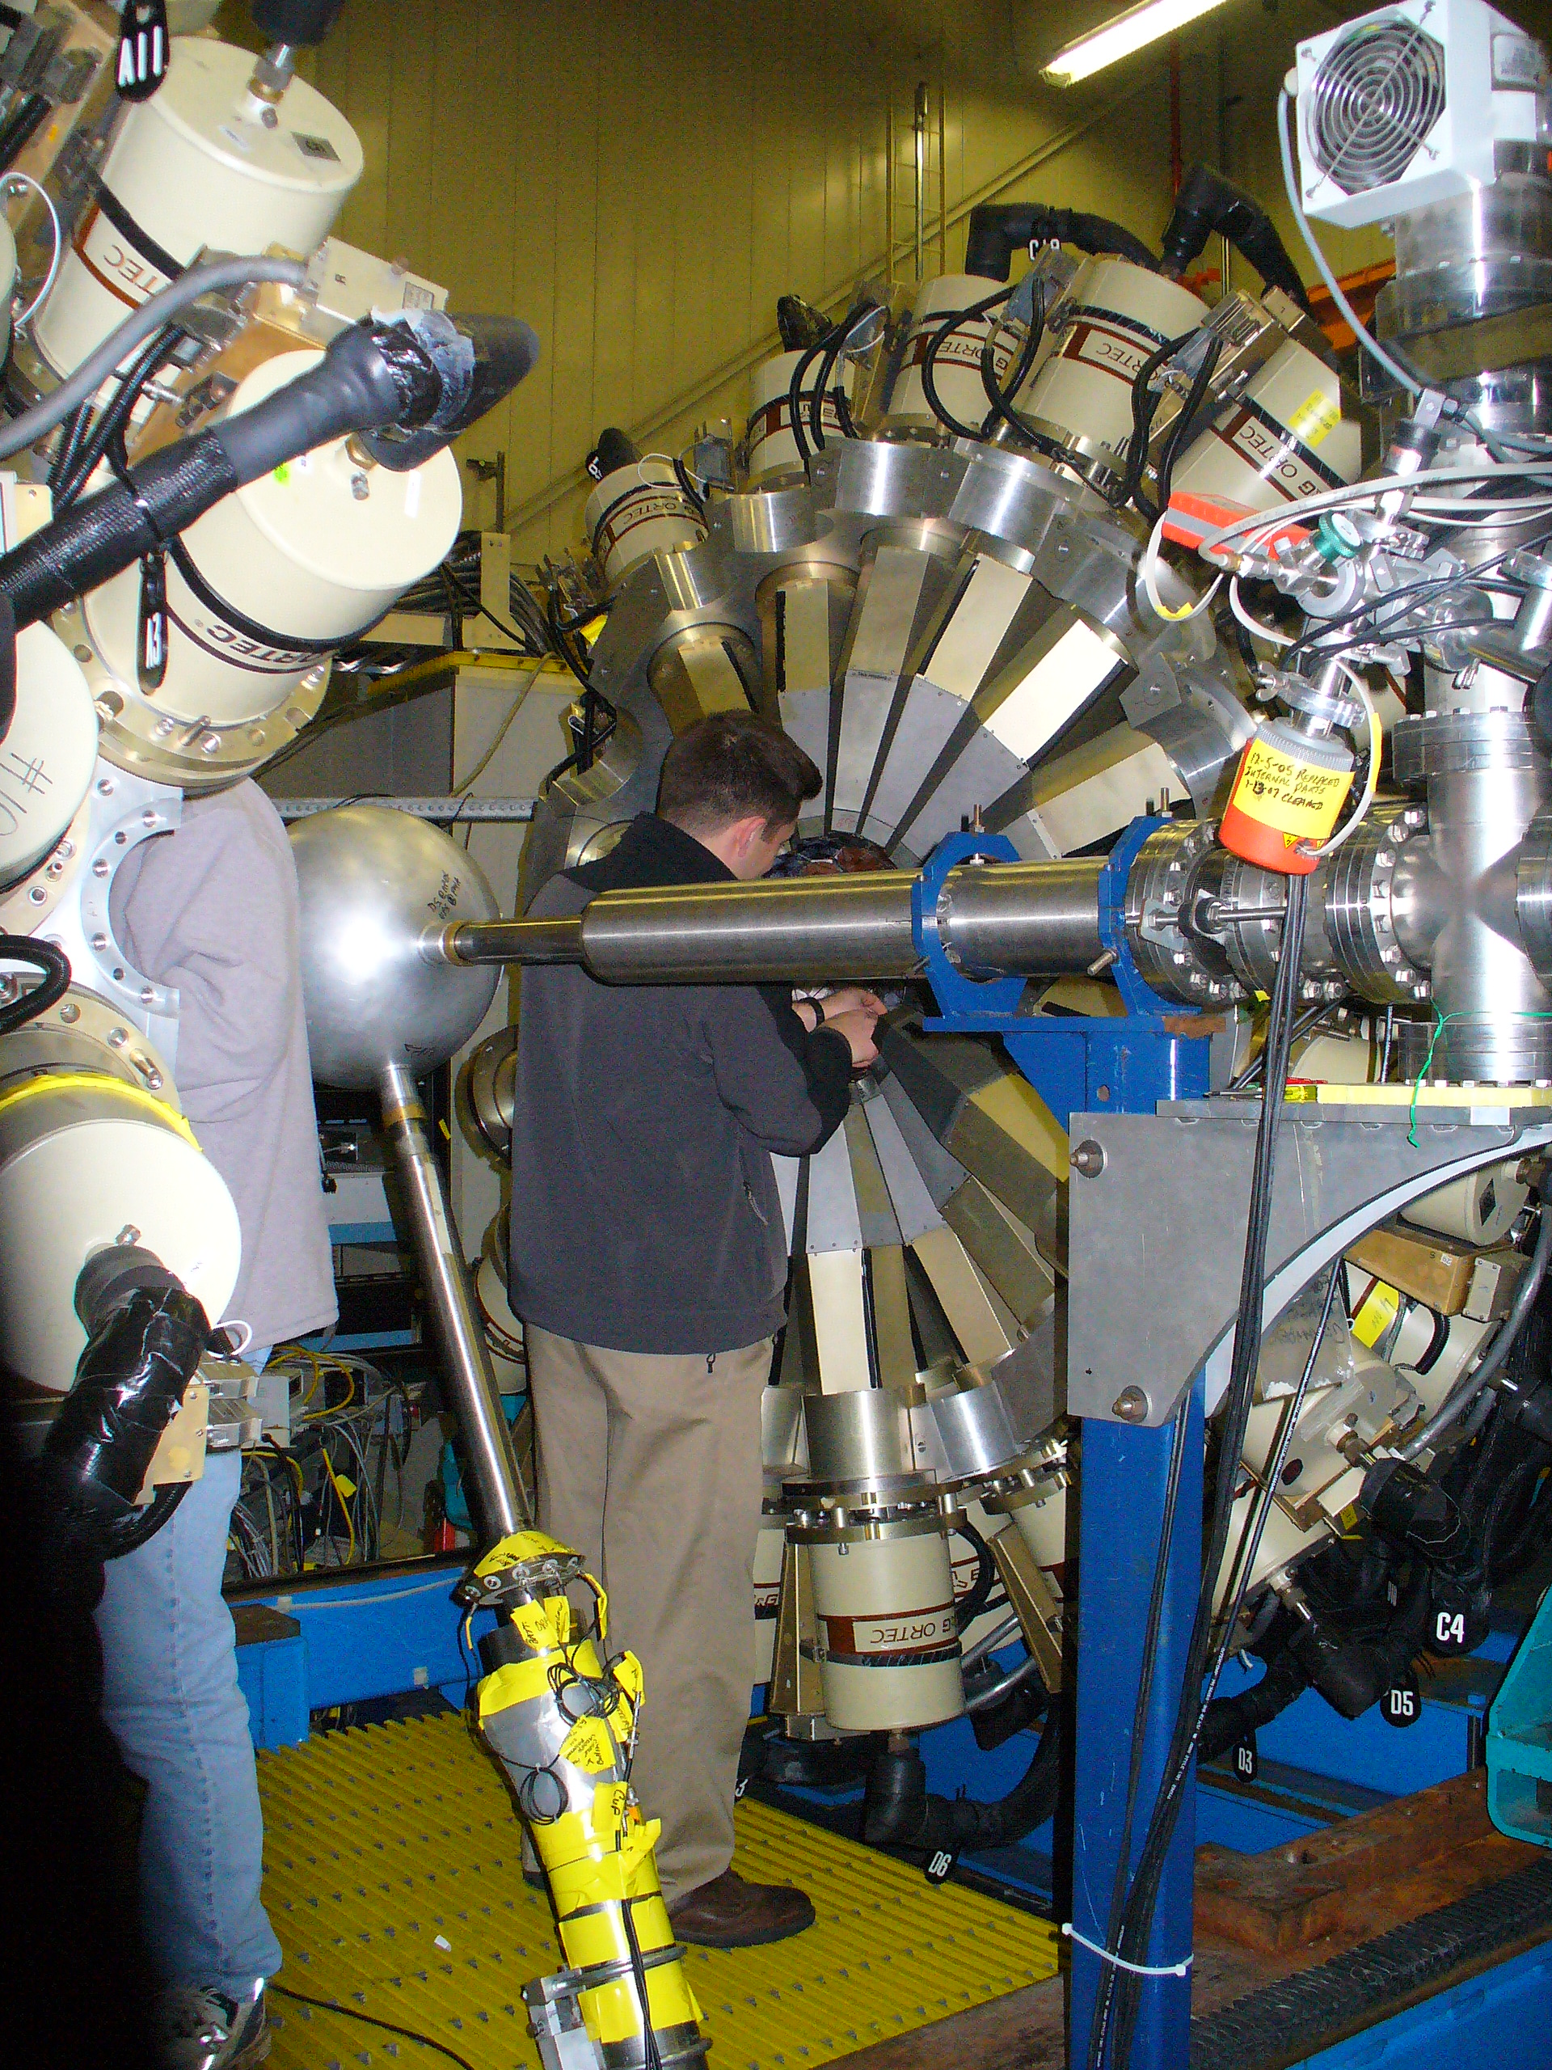
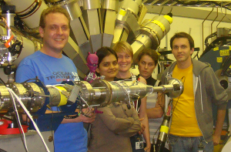
Exploring Exotic Nuclear Shapes at High Angular Momentum at ATLAS
D. J. Hartley
ATLAS Users Workshop 2014
Notes:
At high angular momentum
New GS picture
Pictures of phoswich,

Slide 2
A Common Theme
New experimental capabilities by combining Digital Gammasphere (DGS) with CARIBU and other devices (plunger, Phoswich Wall, LaBr₃) will allow for the investigation of exciting nuclear structure phenomena

Slide 3
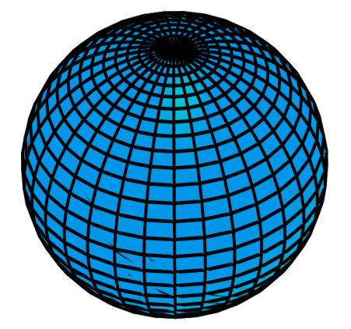
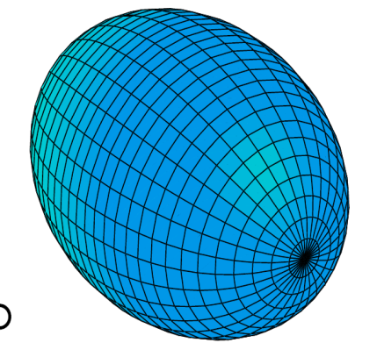
Search for Stable Triaxial Deformation
Pot. Energy Surfaces
γ ~ 25˚
OBLATE
TRIAXIAL
γ = 60˚
γ = 0˚
PROLATE
Deformation ε₂

Slide 4
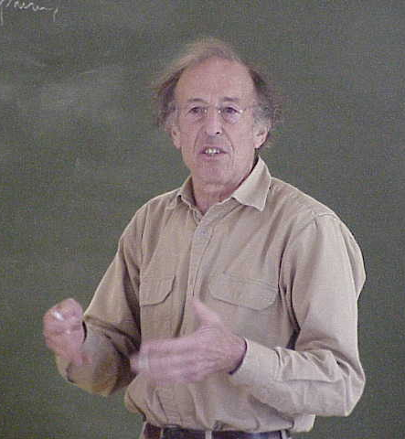

Search for Stable Triaxial Deformation
Pot. Energy Surfaces
Robust triaxial shapes have been sought after for decades!
“The study of rotational motion in nuclei with asymmetric shapes is potentially a field of broad scope.”
Bohr and Mottelson Vol. 2 pg. 176,
It is only in this last decade that triaxial strongly deformed shapes have been observed. (eg. wobbling modes in Lu nuclei and now the ultra-high spin Er results.)
γ ~ 25˚
OBLATE
TRIAXIAL
γ = 60˚
γ = 0˚
PROLATE
Deformation ε₂

Slide 5
Triaxiality and Shape Co-existence in N-rich Zr/Mo/Ru Region
Washington Univ., ANL, Milano, Krakow, Notre Dame, Mississippi State Univ., LBNL
Theory suggests triaxial shapes along with prolate/oblate shape competition
Recent lifetime analysis suggests even-even nuclei may be prolate, γ-soft rotors
Exploration needed in the odd-A systems and to search for evidence of triaxiality

Slide 6
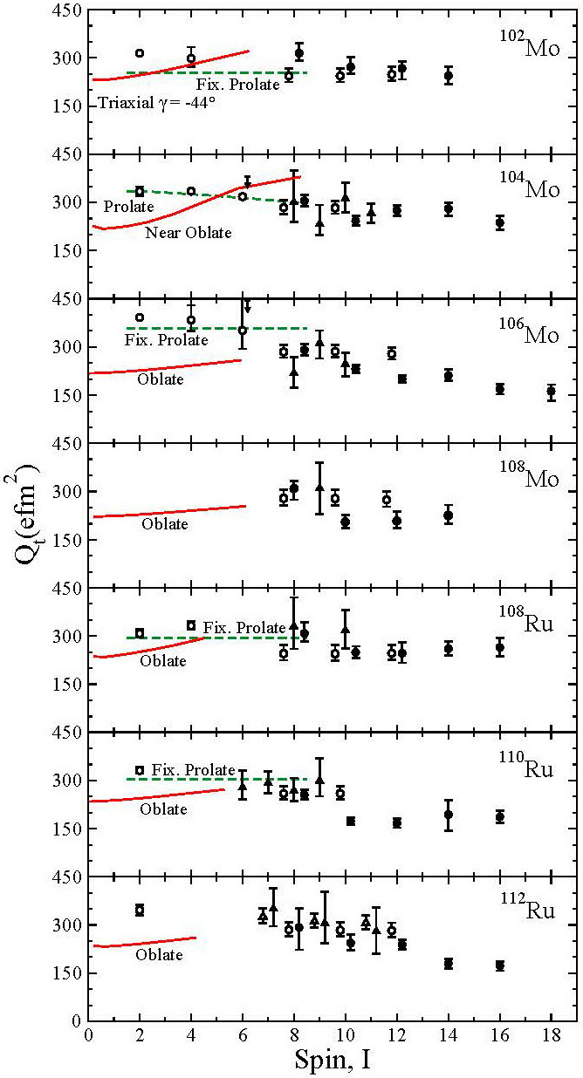
Q_{t}(I) data
Full symbols: this work
Open symbols: literature
circles = gsb, triangles = γ band
Downslope with spin:
Suggests γ ∼ 0° (prolate) → γ > 0°
Rules out oblate, near-oblate shapes
(Same conclusions from ℑ⁽¹⁾ data)
Theoretical calculations
“Cranked relativistic Hartree-Bogoliubov”
Green, dashed: prolate
Red, full: oblate, near oblate
¹⁰⁴Mo can be best described by theory
Snyder et al., Physics Letters B 723, 61 (2013)
6

Slide 7
Future Plans
Odd-A nuclei may be better triaxial candidates
Accepted experiment on ^{105,106}Nb (CARIBU + GS + Phoswich Wall) – Milano, Krakow, ANL, & Washington
Proposing another Cf source experiment to perform lifetime analysis - Washington
  Plunger + Phoswich Wall + GS

Slide 8
Wobbling in Neutron-Rich Nuclei?
Notre Dame, Mississippi St. Univ., LBNL
Neutron-rich nuclei in the Mo/Ru are predicted to be triaxial in or near their ground states
Is wobbling observed at low spins in even-even nuclei?
Coulex CARIBU beams with GS or Gretina
Need to use arrays with CHICO2
S.J. Zhu et al., Int. J. Mod. Phys. E 18, 1717 (2009)

Slide 9
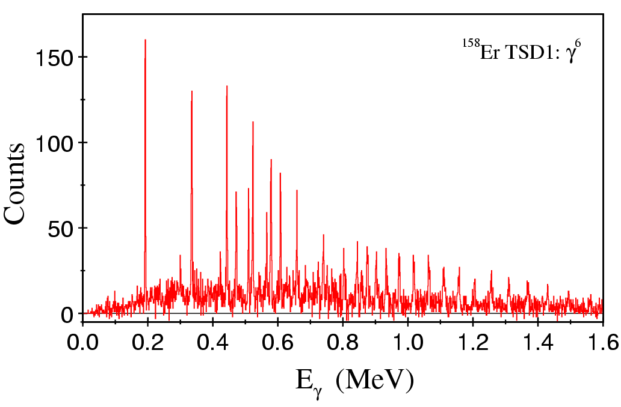
Characteristics of Triaxial Ultrahigh-Spin Bands Near N=90
Florida State, US Naval Academy, Liverpool, Daresbury
Experimentally measure spin (none are currently known)
Determine quadrupole moments
Determine configurations for structures
¹⁵⁸Er

Slide 10
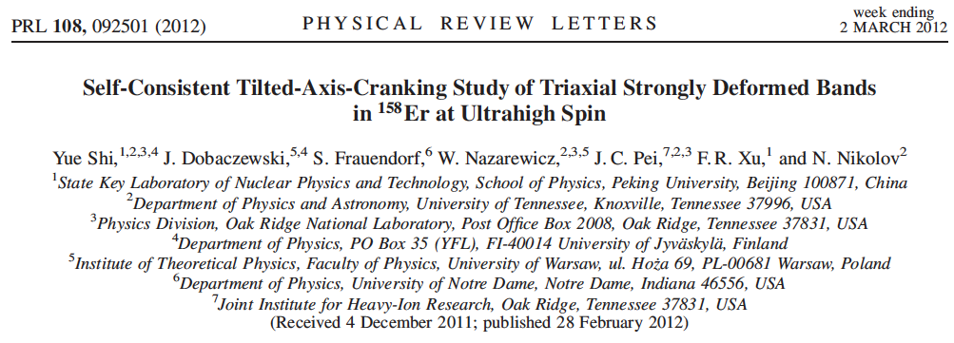
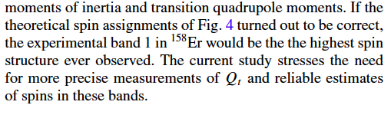
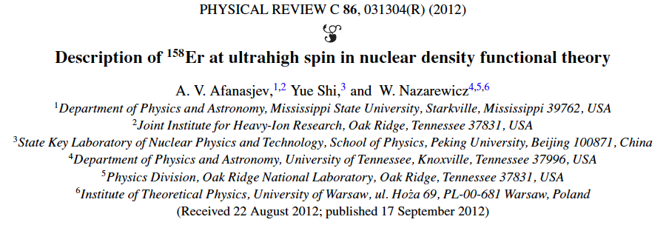
Recent Theoretical Interest

Slide 11
73 | ¹⁶²Ta | ¹⁶³Ta | ¹⁶⁴Ta | ¹⁶⁵Ta | ¹⁶⁶Ta | ¹⁶⁷Ta | ¹⁶⁸Ta | ¹⁶⁹Ta
72 | ¹⁶¹Hf | ¹⁶²Hf | ¹⁶³Hf | ¹⁶⁴Hf | ¹⁶⁵Hf | ¹⁶⁶Hf | ¹⁶⁷Hf | ¹⁶⁸Hf
71 | ¹⁶⁰Lu | ¹⁶¹Lu ? | ¹⁶²Lu | ¹⁶³Lu | ¹⁶⁴Lu | ¹⁶⁵Lu | ¹⁶⁶Lu | ¹⁶⁷Lu
70 | ¹⁵⁹Yb | ¹⁶⁰Yb | ¹⁶¹Yb | ¹⁶²Yb | ¹⁶³Yb | ¹⁶⁴Yb | ¹⁶⁵Yb | ¹⁶⁶Yb
69 | ¹⁵⁸Tm | ¹⁵⁹Tm | ¹⁶⁰Tm | ¹⁶¹Tm | ¹⁶²Tm | ¹⁶³Tm | ¹⁶⁴Tm | ¹⁶⁵Tm
68 | ¹⁵⁷Er | ¹⁵⁸Er | ¹⁵⁹Er | ¹⁶⁰Er | ¹⁶¹Er | ¹⁶²Er | ¹⁶³Er | ¹⁶⁴Er
67 | ¹⁵⁶Ho | ¹⁵⁷Ho | ¹⁵⁸Ho | ¹⁵⁹Ho | ¹⁶⁰Ho | ¹⁶¹Ho | ¹⁶²Ho | ¹⁶³Ho
Z N | 89 | 90 | 91 | 92 | 93 | 94 | 95 | 96
Ultra high-spin TSD
Wobbling
TSD

Slide 12
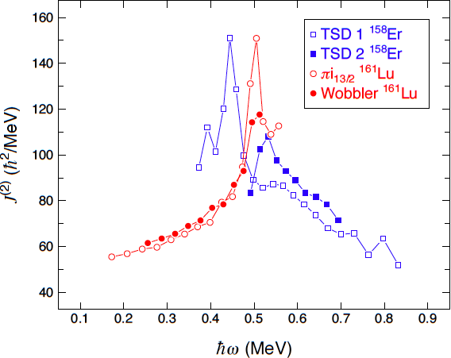
Find Both UHS and Wobbler in Same Nucleus (¹⁶¹Lu)
Clearly UHS and Wobbling bands are different structures
However, since they are both strongly deformed and based on triaxial shapes the UHS may feed strongly into a low-spin Wobbling structure if both are found in the same nucleus

Slide 13
Future UHS/Wobbling Experiments
Measure relative quadrupole moment of UHS band and Wobbling structure of ¹⁶¹Lu
Measure quadrupole moments of other UHS bands to understand underlying structure similar to A~150 nuclei
Wobbling in UHS Minimum?
DGS is a must to do these in a reasonable time

Slide 14
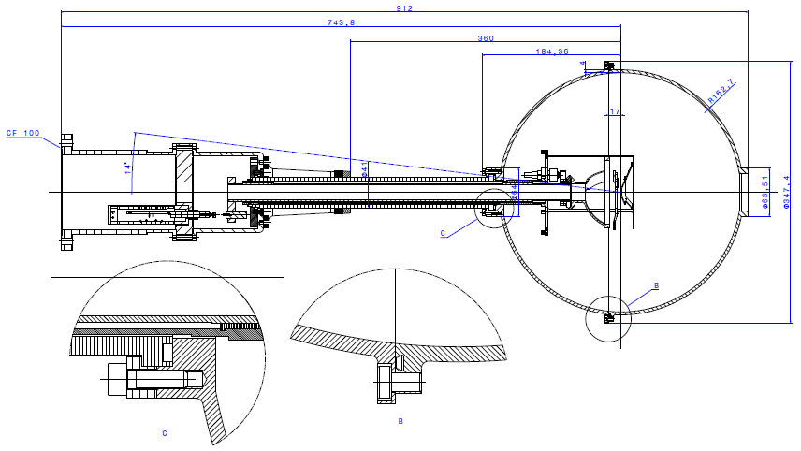
Measuring the Evolution of Shapes Through Lifetime Measurements
Darmstadt/Yale
Use plunger with stable ATLAS beams and CARIBU beams
Combine GS or X-array with LaBr₃ array to measure lifetimes
Plunger for Reaccelerated RIB Beams
Will fit into GS or GRETINA
Couple with CHICHO2, Phoswhich Wall, etc.

Slide 15
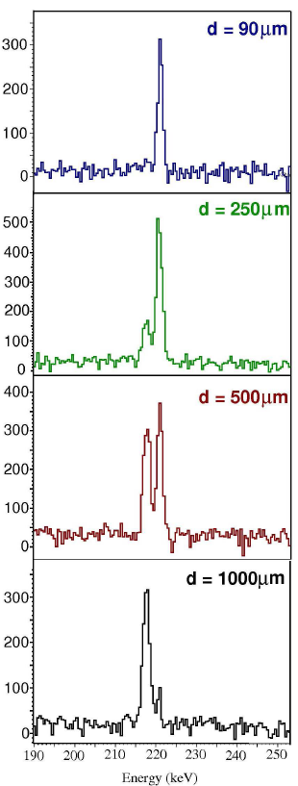
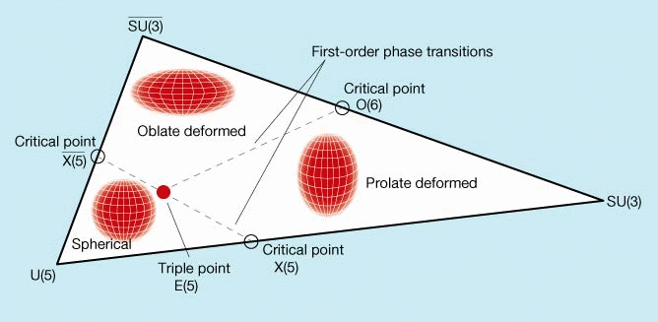
Better Understanding of Nuclear Shape Evolution
Darmstadt/Yale
Standard RDDS Plunger Experiments
Search for new shape/phase-transitional regions, e.g., p-rich Ce/Nd/Sm isotopes
Needs ATLAS,
GammaSphere
Centrifugal Stretching
Probe specific nuclei
For a new benchmark:
Partial Dynamical
Symmetries
For example:
Certain states (e.g., GSB)
exhibit part of a (dynamical)
symmetry (SU(3), O(6), ...)
¹⁷⁰Hf
Q_{T}(J)/Q_{T}(2)
M. Smith, V. Werner, et al.,
PRC87, 044317 (2013)
-> see work by Leviatan, van Isacker, Pietralla, Casten, ....

Slide 16
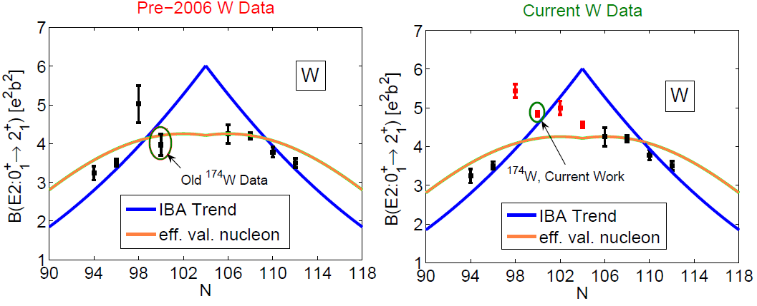
What's going on at N=98? Fast Timing with LaBr₃ & GS
Fast Timing Experiments using electron spectroscopy and/or LaBr₃ reveal peculiarity
Needs ATLAS Stable Beam
?
(measured with LaBr₃)
¹⁷⁶W : J.-M. Regis et al. NIM A 606 (2009)
¹⁷²W, ¹⁷⁸W : M. Rudigier et al. Nucl. Phys. A 847 (2010)

Slide 17
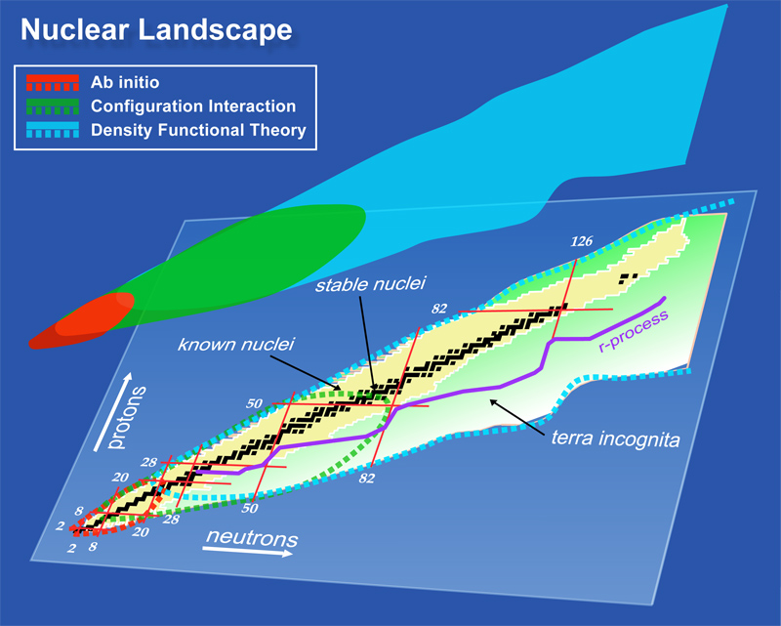
Testing Advanced Shell Model Calculations in the A=80 Region
Florida State University
New shell model calculations are now available to describe mass 80 nuclei
Explore structures in this evolving region
Start with ⁸³Mo
“Borrowed” from Witek Nazarewicz

Slide 19
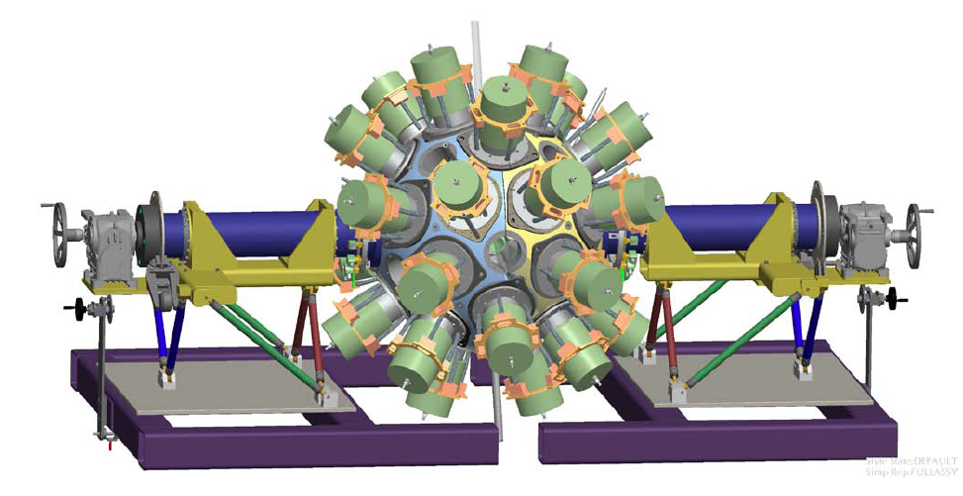
Further Into the Future…
GRETA

Slide 20
Extra Slides

Slide 21
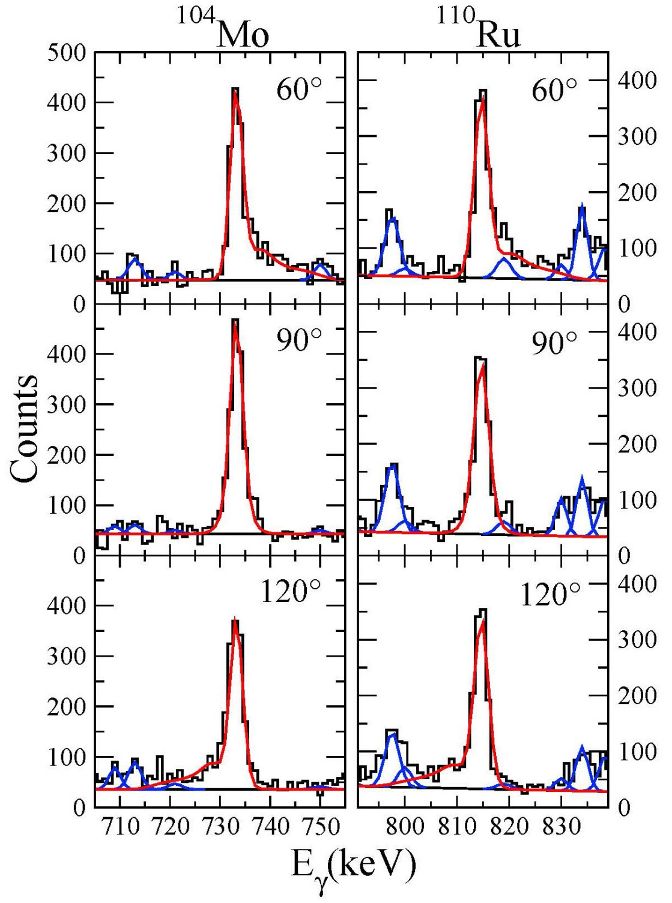
10⁺₁
²⁵²Cf Source Experiment*
Strength | 230 μCi
Arrangement | Pt backing (440 mg/cm²), Au leaf
HERCULES | Fragment ToF and pulse height, fission-axis direction
Gammasphere | ToF start time, γ-ray energy and time
Running time | 18 d
# Correlations | 2.1 × 10⁹ (fragment-γ⁴)
* Using the infrastructure at ATLAS
Angle: < Fission Axis, Gammasphere ring
Red: analyzed, blue: contaminant peaks
Snyder et al., Physics Letters B 723, 61 (2013)
21

Slide 22
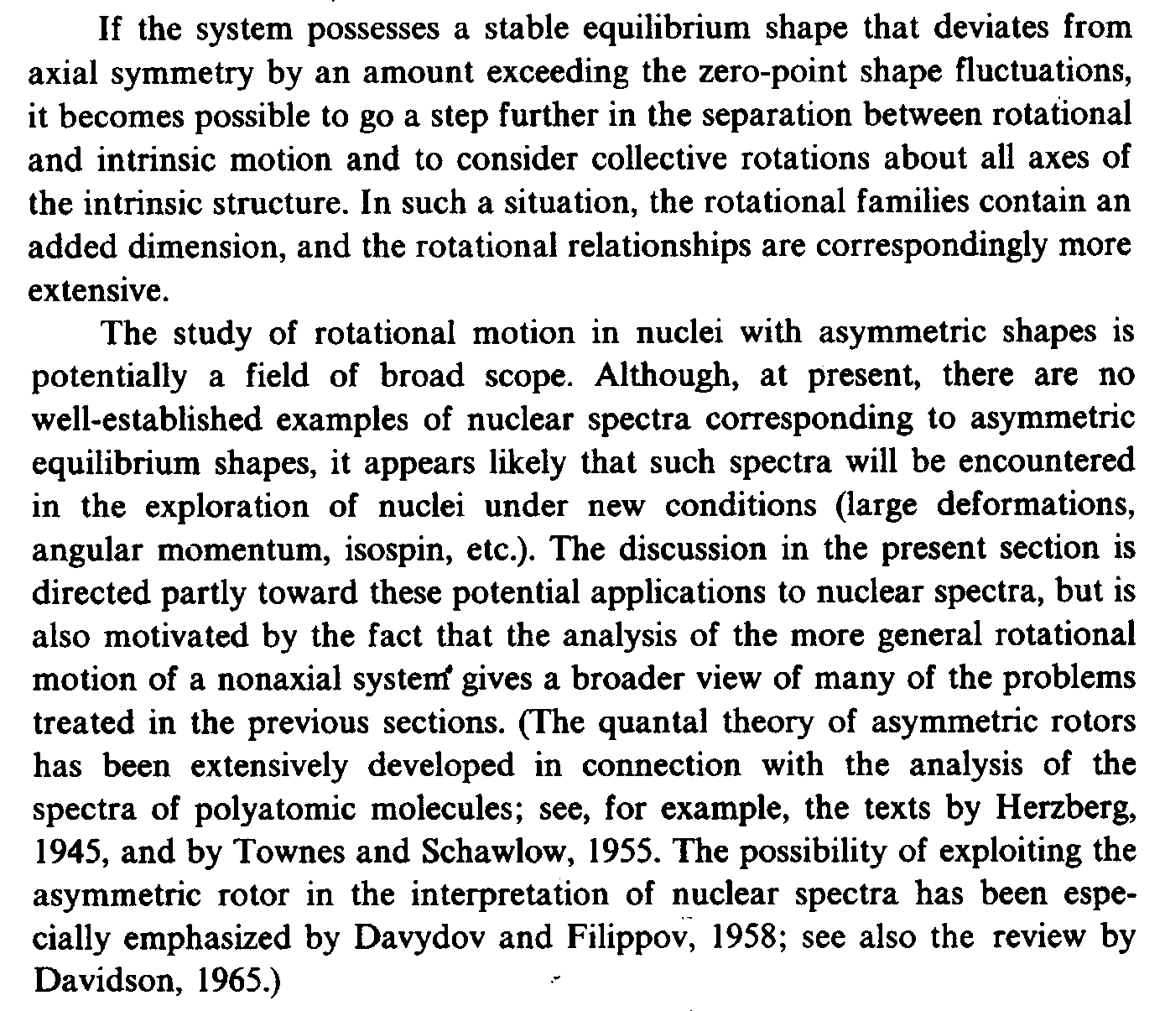
Bohr & Mottelson Vol. II, p. 176

Slide 23
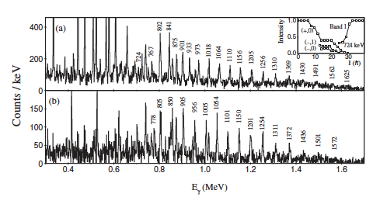
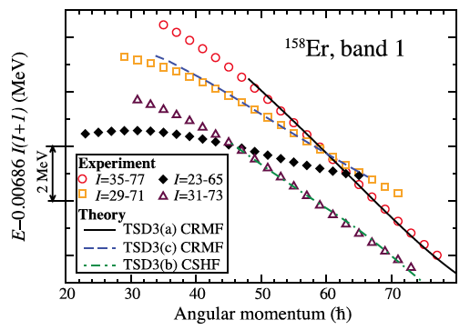
Measure Spin of Ultrahigh-Spin TSD Bands
USNA, Florida St. Univ., Liverpool, Daresbury
Ultrahigh-spin bands in ^{157,158}Er
- E.S. Paul et al., PRL 98, 012501 (2007)
A.V. Afanasjev, Yue, Shi, and W. Nazarewicz, PRC 86, 031304(R) (2012)

Slide 24
New Reaccelerated RIB Plunger Underway
Developed by Yale (VW) and Cologne, Si Disk to be purchased by TU Darmstadt
Will fit into GammaSphere, GRETINA, MiniBall, AGATA, ...
Will be able to couple to other auxiliaries like CHICO2, PhoSwitch Wall

Slide 25
Roadmap for Theory of Nuclei
...provides the guidance
Overarching goal:
To arrive at a comprehensive microscopic description of all nuclei and low-energy reactions from the the basic interactions between the constituent nucleons
Nazarewicz

