Slide 1
Beta-decay correlation in atom traps
Peter Müller

Slide 2
⁶He Collaboration
P. Mueller, A. Leredde, T.P. O’Connor, K. Bailey
Physics Division, Argonne National Laboratory
A. Garcia, M. Sternberg, D. Zumwalt, R. Hong, Y. Bagdasarova,
H.E. Svanson, G. Harper, F. Wauters
CENPA, University of Washington
X. Flechard, E. Liennard
LPC Caen
O. Naviliat-Cuncic
NSCL, Michigan State University
$ PM DOE Early Career Research Grant, DOE CENPA, LPC $
Undergrads, PhD, Postdoc

Slide 3
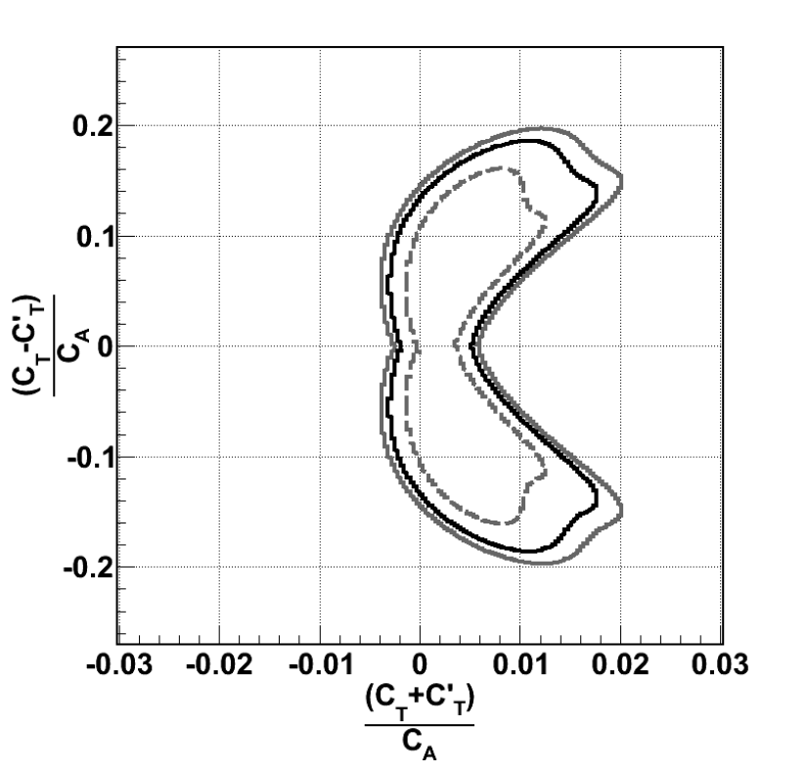
Weak Interaction Studies
ß-Decay Rate
J.D. Jackson, S.B. Treiman, H.W. Wyld, Nucl. Phys. 4 (1957) 206
Standard Model
Only V-A terms
a_{SM} = -1/3 for GT
a_{SM} = +1 for Fermi
Beyond Standard Model
Exotic couplings have not been
excluded beyond the 5-10% level
a = +1/3 for pure tensor GT
GT transition sensitive to C_{T} & C_{T}’
δa/a = 1%
from ⁶He decay
Johnson, Pleasonton,
Carlson, PhysRev 1963
Right-handed
δa/a = 0.1%
Left-handed
F. Wauters, A. Garcia, R. Hong, PRC 89, 025501 (2014)

Slide 4
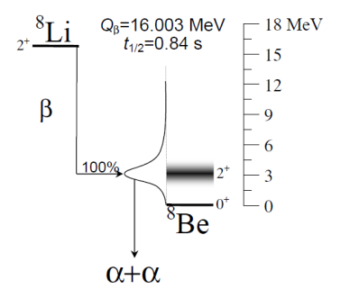
Weak Interaction Studies: β−ν Angular Correlations
Atom Trap
Ion Trap
²¹Na
⁶He
0⁺
Q_{β}=3.510 MeV
t_{1/2}=0.808 sec
β
100%
1⁺
n
²¹Na
³²Ar
^{38m}K
C. Statowa et al., PRD 18, 3970 (1978)
P.A. Vetter et al., PRC 77, 035502 (2008)
E.G. Adelberger et al., PRL 83, 1299 (1999)
A. Gorelov et al., PRL 94, 142501 (2005)
⁶Li

Slide 5
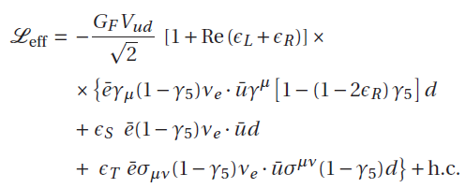


LHC vs. LE Couplings
Quark-lepton level Lagrangian
Left-handed neutrinos
If the scale of New Physics (NP) is much larger than the energy reach at LHC …
…the CC processes at LHC can be described by the same effective interaction Lagrangian as in β decays
4 complex couplings left
Possible imaginary parts for ε_{R}, ε_{S}, ε_{T}

Slide 6
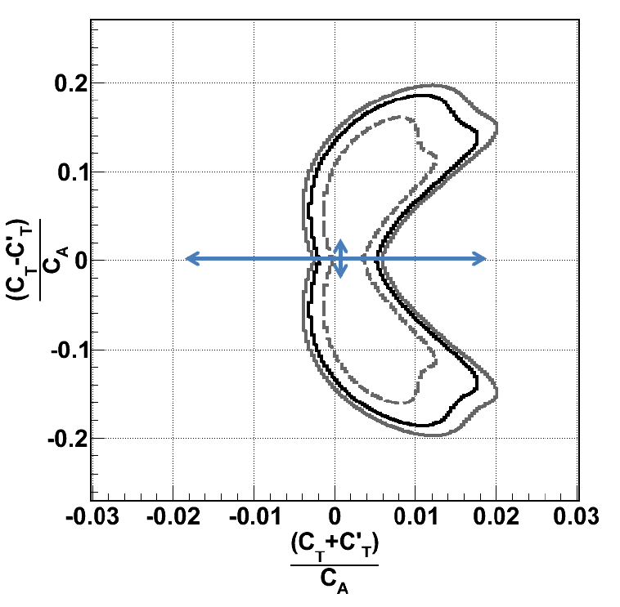
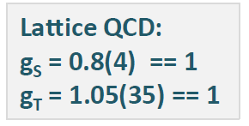
Projected Limits for LHC
Limits from V. Cirigliano, M. Gonzalez-Alonso, M.L. Graesser, arXiv:1210.4553
LHC 2012, 7 TeV, 5 fb⁻¹
Comparable with
0.05% a measurement
for right handed
neutrino cpl.

Slide 7
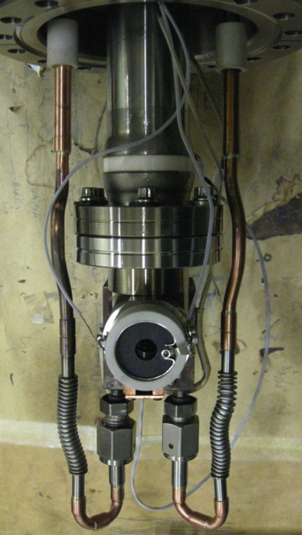
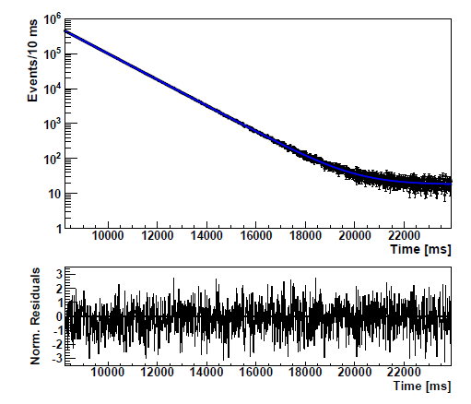
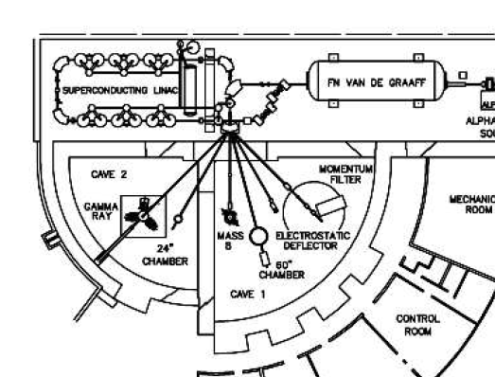

⁶He Production at CENPA, U Washington
⁷Li(d,³He)⁶He reaction
10 μA d, 18 MeV
~1x10¹⁰ ⁶He/s extracted
⁶He lifetime measurement
A. Knecht et al., NIM A 660, 43 (2011)
Li Target
t_{1/2}=
Compare with
ab-initio calculations
of |M_{GT}| to obtain g_{A}
in nuclear medium
CENPA Tandem Accelerator Facility
A. Knecht et al., PRL 108, 122502 (2012)
A. Knecht et al., PRC 86, 035506 (2012)
P. Mueller Comparative Review Fundamental Symmetries June 2013

Slide 8
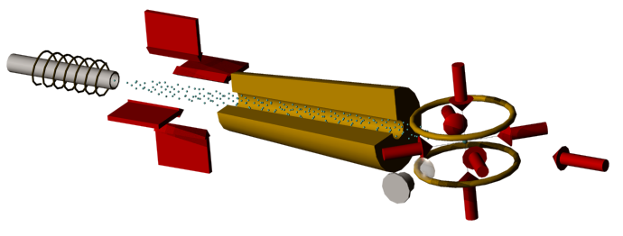
Atom Trapping of ⁶He (and other noble gases)
Atom Trap Setup
706 nm
1083 nm
⁶He Rates
@ source 5x10⁹ s⁻¹
Capt. efficiency = 2x10⁻⁷
@ trap 1000 s⁻¹
He level scheme
3 ³S₁
Image
706 nm
2 ³P₂
Trap
1083 nm
2³S₁
1¹S₀

Slide 9
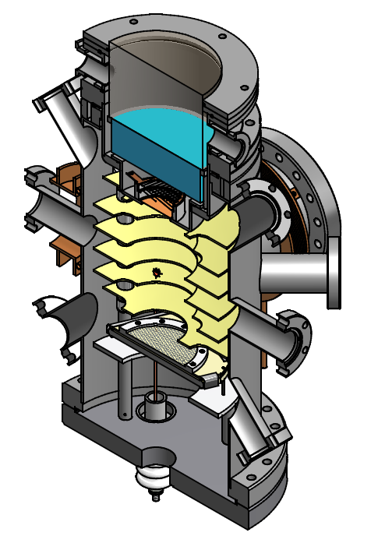
Beta-Decay Study with Laser Trapped ⁶He
Recoil time-of-flight spectrum
(MC simulation)
β-Detector
a
= +1/3
Trapped ⁶He
a
Counts
= -1/3
⁶Li recoil ion
detector
250
300
350
400
450
Time of Flight, ns
Atom trap properties
Highly selective capture
No RF fields or space charge
Low temperature sample (<mK)
Tight spatial confinement (< 100μm)
~1x10⁹ ⁶He/s production yield
trapping rate ~2x10³ ⁶He/s
~0.1% statistics in ~4 weeks beam time

Slide 10
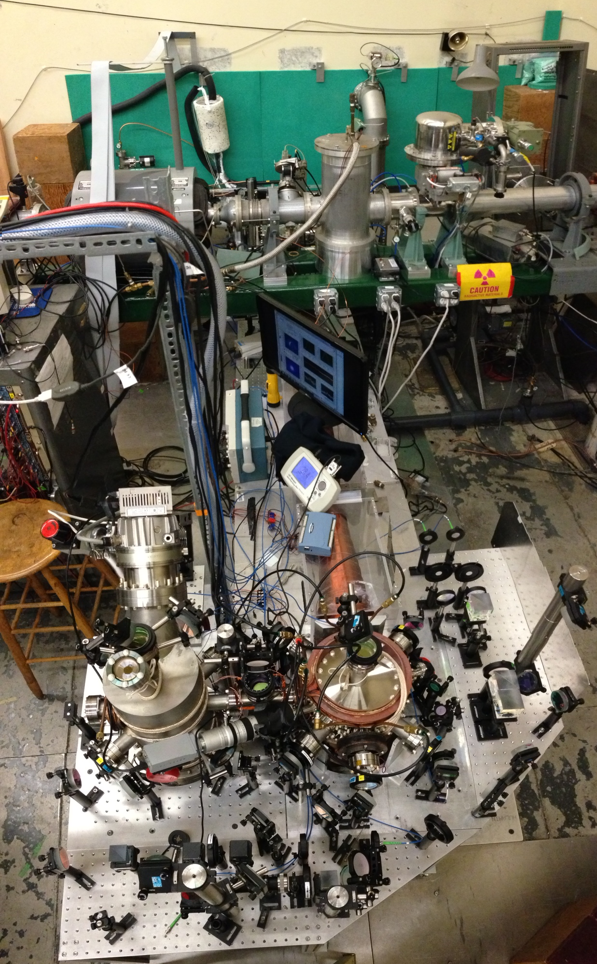
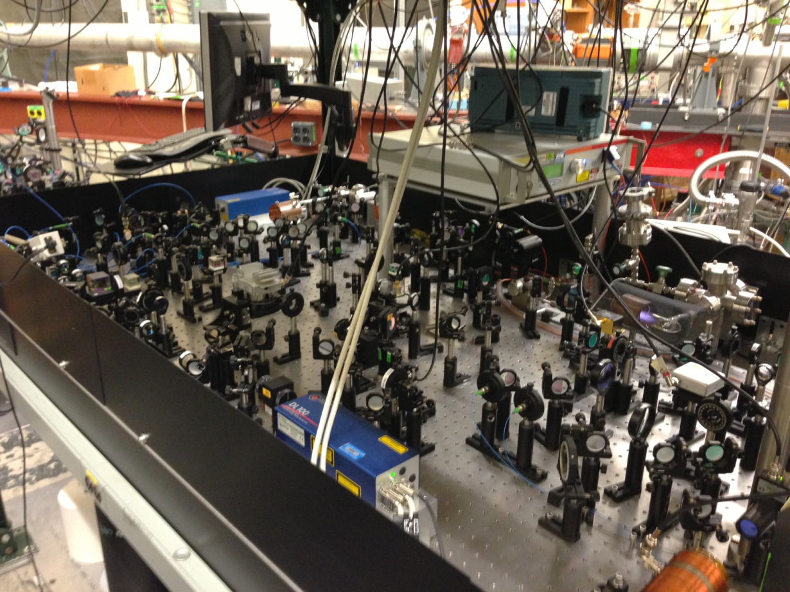
Helium MOT
Setup @ CENPA

Slide 11
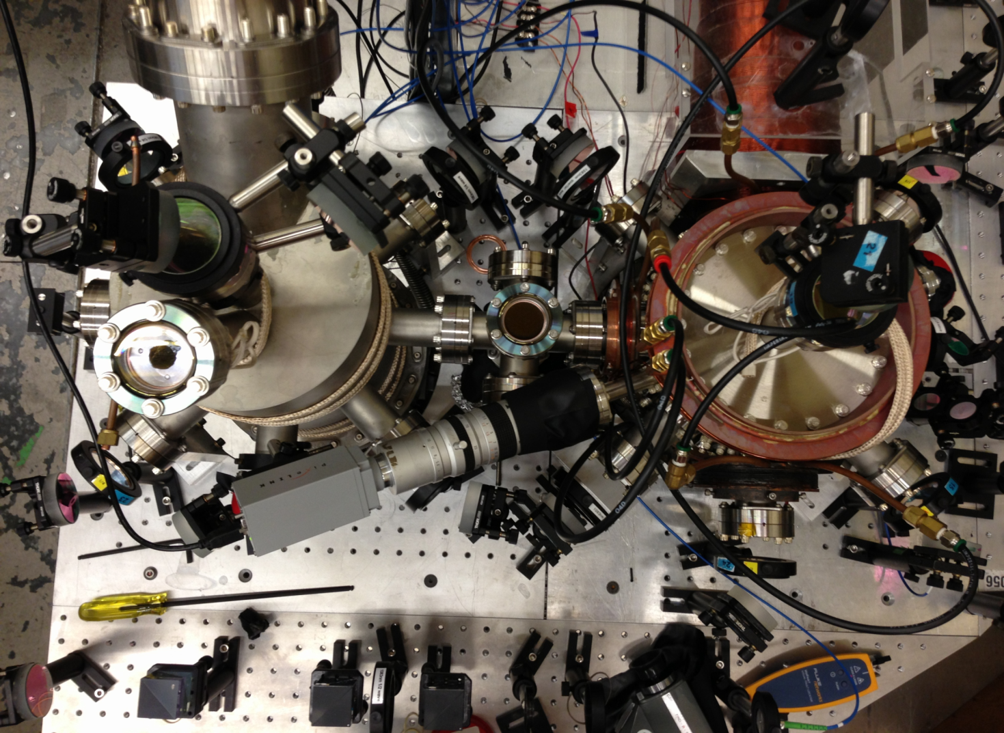
MOT to MOT transfer
Reduce background from
un-trapped ⁶He through
diff. pumping
Separate MOT functions
capture vs. detection
Optical “push” beam
Transverse cooling
> 60% transfer in 15 ms
MOT2
MOT1

Slide 12
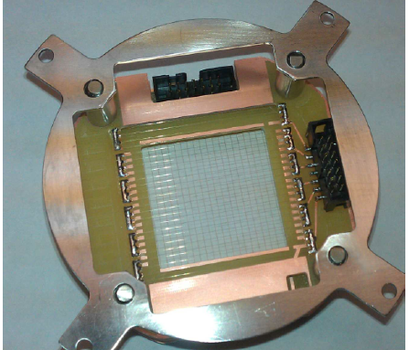
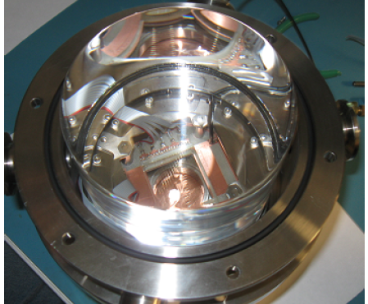
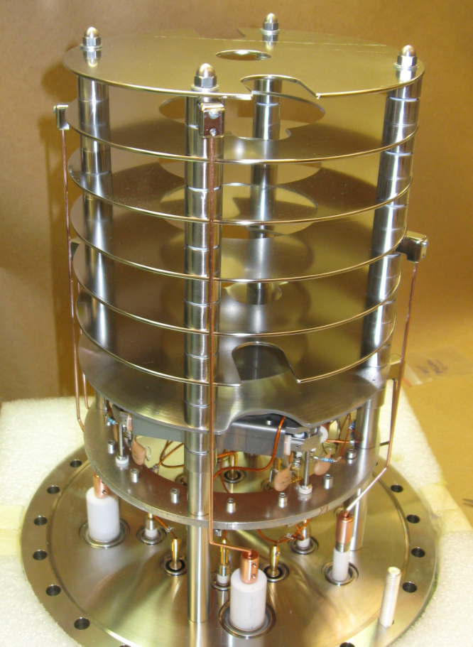
Detector System Developed
Beta det. - MWPC
Beta-detector (U Washington)
Multi-wire proportional chamber: X,Y
Scintillator: T_{start},E
E-Field / HV suppl. (Argonne, U Washington)
Uniform electric field with optical access
Up to 2 kV/cm, dE/E < 0.1%
Recoil-Ion detector (LPC Caen)
Multi-channel plate, delay line: X,Y, T_{stop}
  100 μm position resolution
  100 ps timing resolution
Scint.
HV Electrodes
MCP
P. Mueller Comparative Review Fundamental Symmetries June 2013

Slide 13
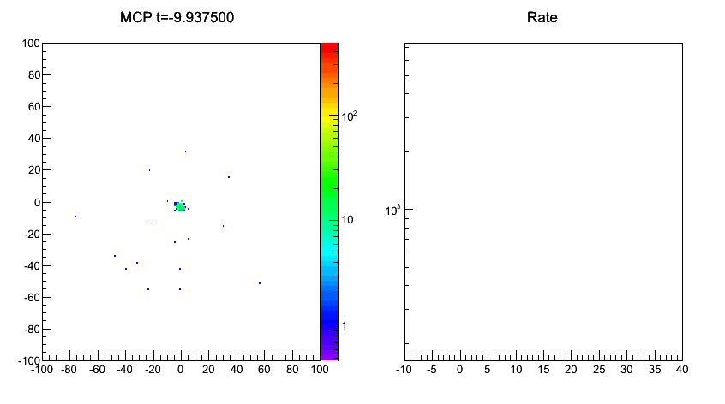
⁴He trap diagnostics with MCP

Slide 14
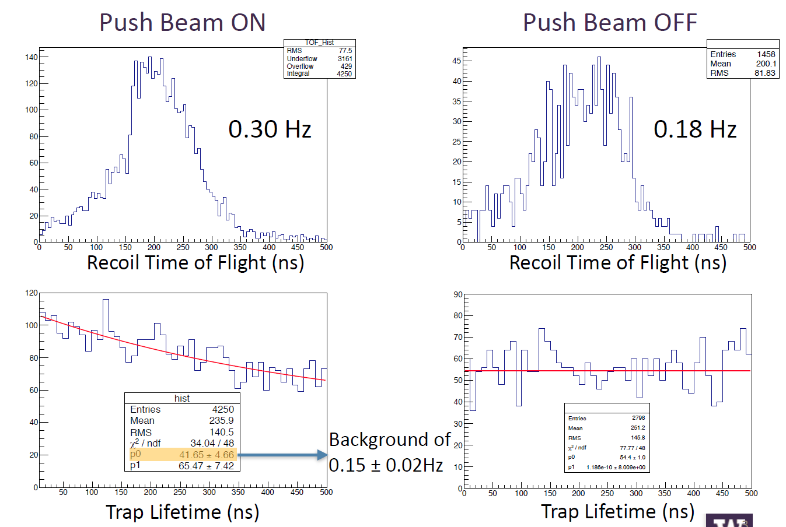
First coincidence signals
October 2013

Slide 15
Status and Outlook
What we have
intense ⁶He source 1x10¹⁰ atoms/s
trap(s) and detector system
detailed numerical simulation (Geant4 + COMSOL + ion tracker)
Short term goals (2014)
collect data for da/a ~ 1% statistics
study systematic effects (experiment & simulations)
Mid term goals (end of 2015)
Upgrade traps and detectors
Collect data for da/a < 0.5%
Long term goals/questions (2016 …)
beyond the 0.1% limit -> new detector concepts
improve trapping efficiency -> metastable population
Other isotopes (noble gases) -> optical polarization
  ¹⁹Ne: D , ³⁵Ar: a,A
    -> 10⁷-10⁸ s⁻¹ at ATLAS
Requirements for ATLAS
High intensity beams -> 1 – 10 puA
target close to exp. area (noble gases) -> tunnel + “BGO area”
Long beam times -> multi user operation

