Slide 1
Reactor Antineutrino Anomaly
E.A. McCutchan, A.A. Sonzogni, T.D. Johnson
National Nuclear Data Center

Slide 2
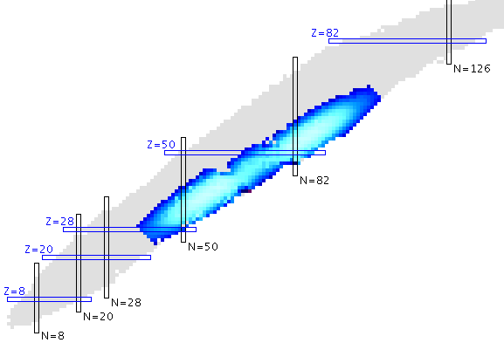
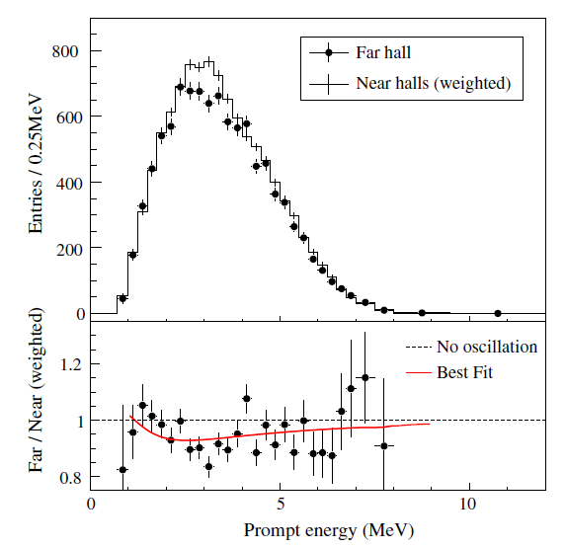

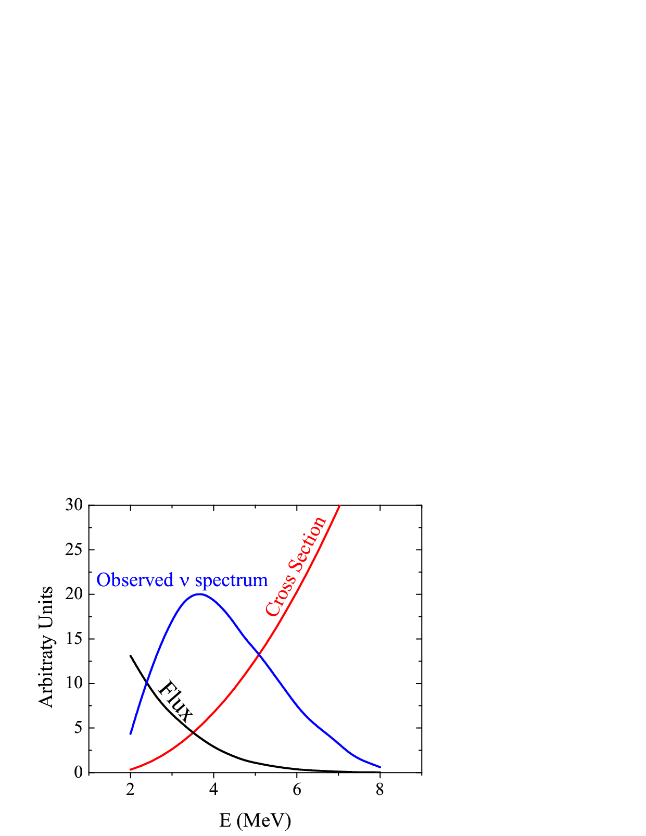
Anti-neutrinos from reactors
Principal Contributors
²³⁵U, ²³⁸U, ²³⁹Pu, ²⁴¹Pu
Detection through inverse β decay on proton
Daya Bay
F.P. An et al., Phys. Rev. Lett. 108, 171803 (2012)

Slide 3
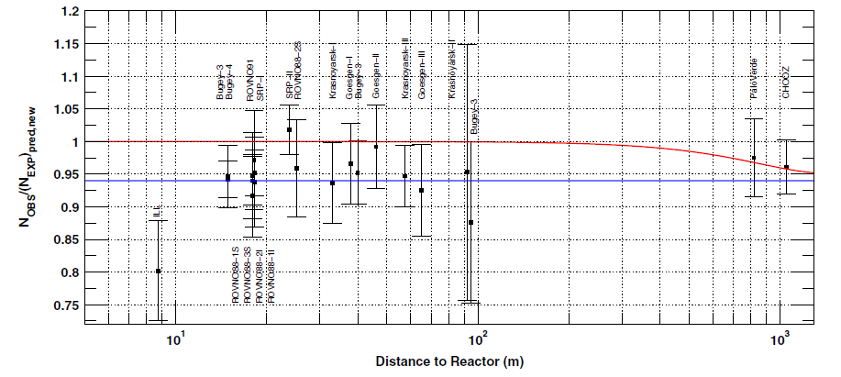
What is the “Reactor Anomaly”?
Survey of 19 short baseline (<100 m) reactor antineutrino experiments
Number of Observed/Predicted = 0.943 ± 0.023
(Deviation from 1.0 at 98.6 % C.L.)
G. Mention et al., Phys. Rev. D 83, 073006 (2011).
Result confirmed (1.4σ from 1.0)
in C. Zhang et al., Phys. Rev. D 87, 073018 (2013).

Slide 4
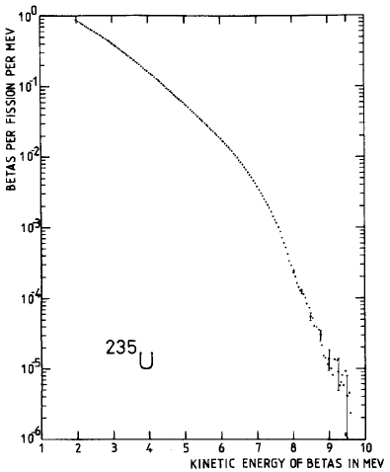
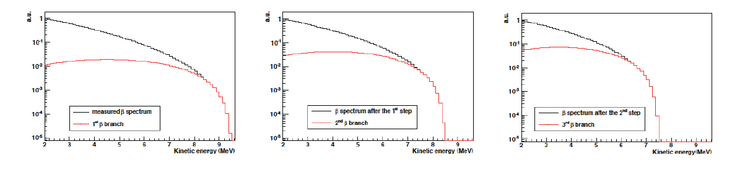
How to determine “predicted”?
Conversion method
Total β spectrum measured in 1980’s
at ILL for ²³⁵U, ²³⁹Pu, ²⁴¹Pu
Fit using ~30 “virtual” branches

Slide 5
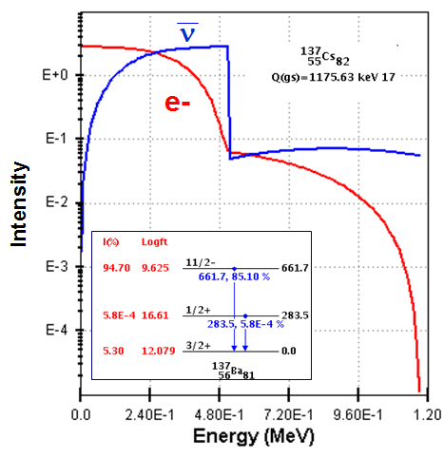
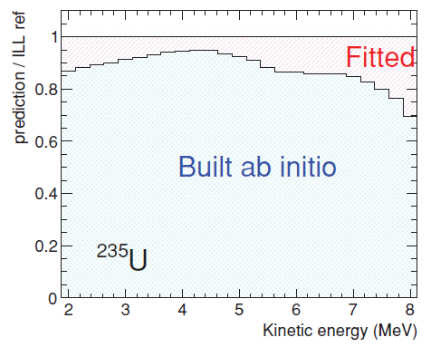
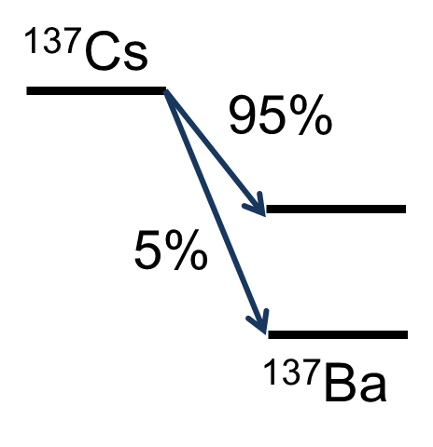

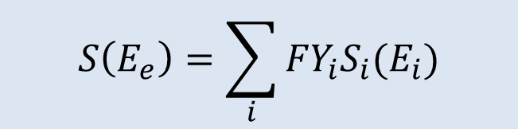
How to determine “predicted”?
Summation method
Hybrid method
(or ab-initio method)
Single nucleus – sum β branches*intensity
Th. A Mueller et al.,
Phys. Rev. C 83, 054615 (2011)
Ab-initio with known data = 90%
Total – sum β spectrum*fission yield
Conversion with 5 virtual branches
$$S\left(E_{e}\right)=\sum_{i}{{FY}_{i}S_{i}(E_{i})}$$

Slide 6
What are the implications?
Many possible explanations
Predicted Antineutrino spectrum is incorrect
Experimental bias in all 19 experiments
New physics at short baselines
Existence of a 4th sterile neutrino
Would impact θ₁₃ results

Slide 7
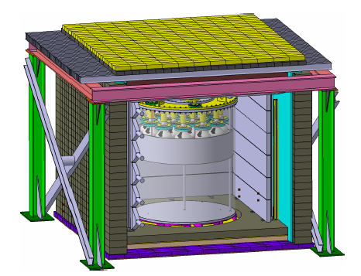
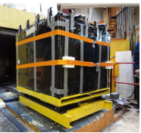
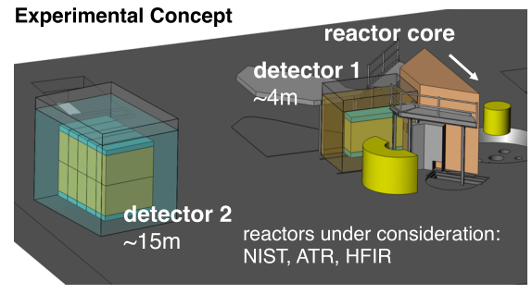
Efforts by the Neutrino Community
Numerous Very Short Baseline Experiments ranging from operating to planning stages
Nucifer, France
Neutrino-4, Russia
PROSPECT, USA
Operational, D=7m
Nearly Operational, D=6-13m
Conceptual
CORMORAD – Italy, PANDA – Japan, SOLiD - France

Slide 8
What can our community contribute ?

Slide 9
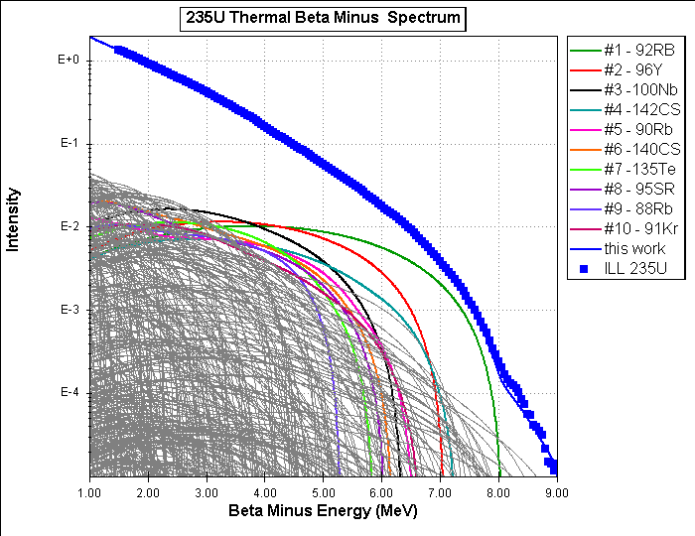

Slide 10
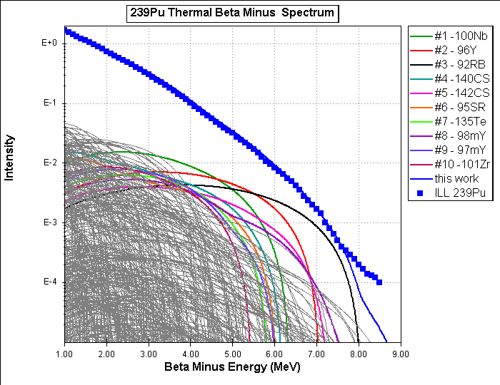

Slide 11
Main Contributors at 4.5 MeV
235U
37-Rb-92
39-Y-96
41-Nb–100
55-Cs-142
37-Rb-90
55-Cs-140
52-Te –135
38-Sr-95
239Pu
41-Nb-100
39-Y-96
37-Rb–92
55-Cs-140
55-Cs-142
38-Sr-95
52-Te-135
39-Y- 98m
241Pu
39-Y-96
41-Nb-100
55-Cs – 142
52-Te- 135
37-Rb-92
55-Cs- 140
53-I- 137
39-Y-99
238U
39-Y-96
37-Rb-92
41-Nb –100
55-Cs-142
52-Te-135
39-Y-99
55-Cs-143
53-I-138
These top 8 contribute 30%-40% to the overall spectrum

Slide 12
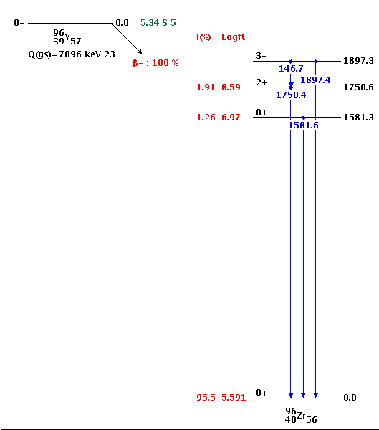
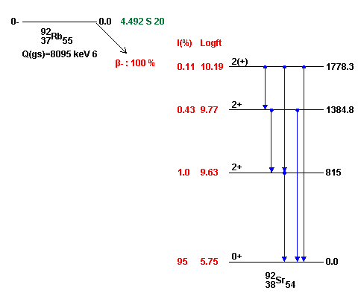
What do these have in common?
First forbidden non-unique, ground-state to ground-state transition accounting for 95% of beta intensity
Need precise measurements of g.s. to g.s. (or g.s. to low-lying states) β intensity

Slide 13
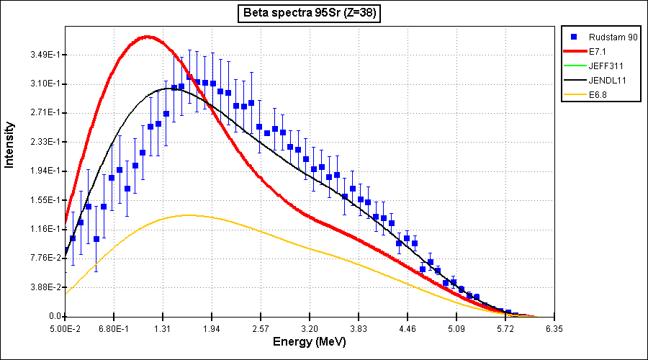
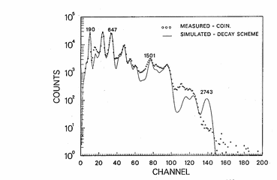
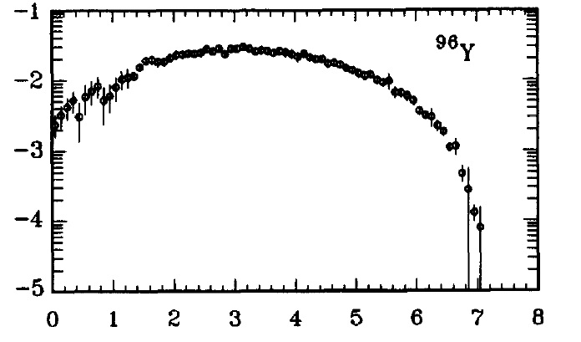
Complete data trumps all
Total Absorption Gamma-ray Spectroscopy (TAGS)
Direct Beta-Spectrum Measurements
Greenwood et al., + few Valencia
Rudstam et al., At.Data Nucl.Data Tables 45, 239 (1990)
TAGS
Rudstam
Precise measurements of the β spectrum itself
Talk by Nick Scielzo in next session
and/or
New TAGS measurements

Slide 14
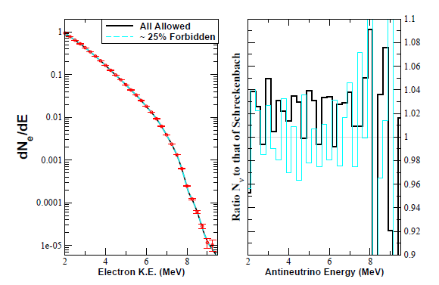
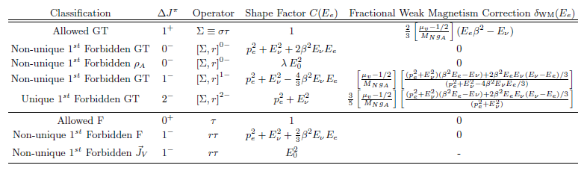
Allowed versus Forbidden Transitions
A.C. Hayes et al., arXiv:1309.4146v3
Again, see talk by Nick Scielzo in next session

Slide 15
Summary
Reactor anomaly provides nice link between neutrino physics and nuclear structure physics
Neutrino community investing significant time and effort but they need our help to sort out all the pieces
CARIBU is well suited both in beams and detector systems to address the main issues
Problem is difficult but not impossible

Slide 16
Main Contributors at 6 MeV
235U
37-Rb-92
39-Y-96
55-Cs – 142
37-Rb- 93
39-Y-98m
37-Rb- 94
35-Br – 86
39-Y-98
239Pu
37-Rb-92
39-Y-96
55-Cs – 142
39-Y-98m
37-Rb- 93
41-Nb- 104m
41-Nb- 104
37-Rb- 94
241Pu
37-Rb-92
39-Y-96
55-Cs – 142
41-Nb- 104
39-Y-98m
37-Rb- 93
41-Nb- 104m
53-I-138
238U
37-Rb-92
39-Y-96
55-Cs – 142
37-Rb- 93
39-Y-100
51-Sb- 135
37-Rb- 94
50-Sn-133

Slide 17
Why these?
Large Q value
Large cumulative fission yield
Large beta-feeding to low-lying states
235U
37-Rb-92
39-Y-96
55-Cs – 142
37-Rb- 93
39-Y-98m
37-Rb- 94
35-Br – 86
39-Y-98
<beta> (MeV)
3.887
3.205
2.924
2.155
2.530
2.020
1.944
2.996
FY
0.048 (0.048)
0.047 (0.060)
0.029 (0.027)
0.035 (0.036)
0.019 (0.011)
0.015 (0.016)
0.019 (0.016)
0.011 (0.019)
FY * <beta>
0.19 (0.19)
0.15 (0.19)
0.085 (0.079)
0.075 (0.078)
0.048 (0.028)
0.030 (0.032)
0.037 (0.031)
0.033 (0.057)

Slide 18
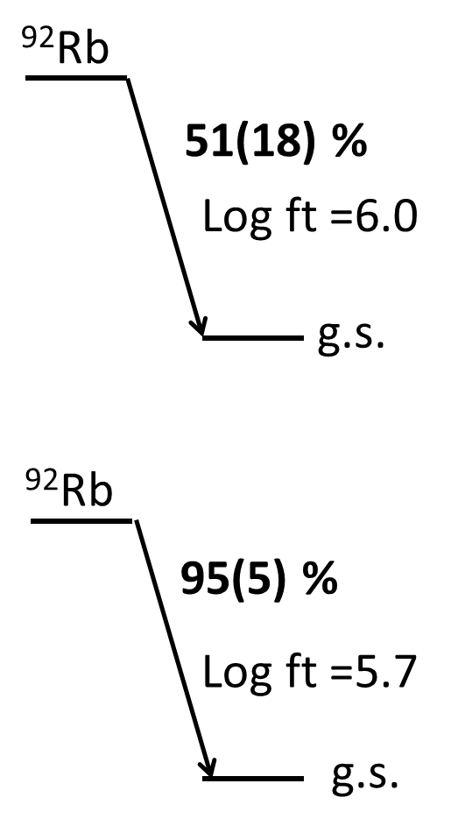
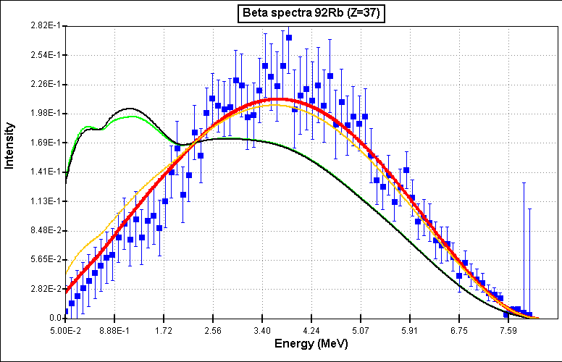
Conflicting Results on ⁹²Rb decay
50%
95%

Slide 19
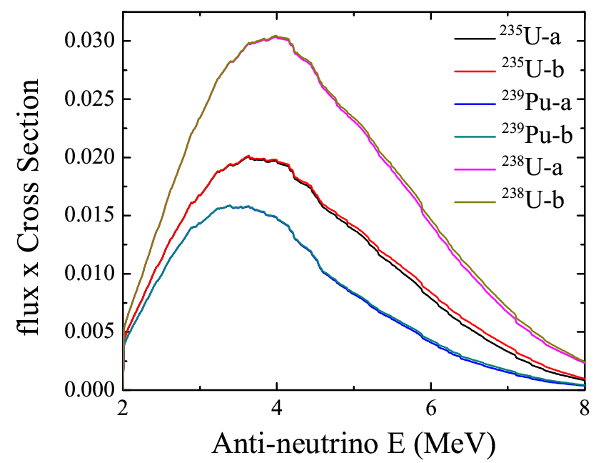
One small nucleus, one big effect
⁹²Rb
a) 2000 ENSDF
51(18) %
g.s.
b) Update with
new data
⁹²Rb
95(5) %
g.s.

Slide 20
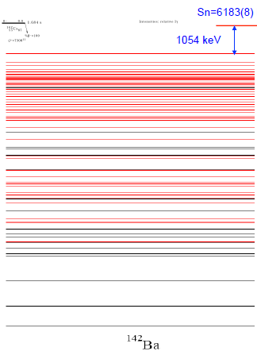
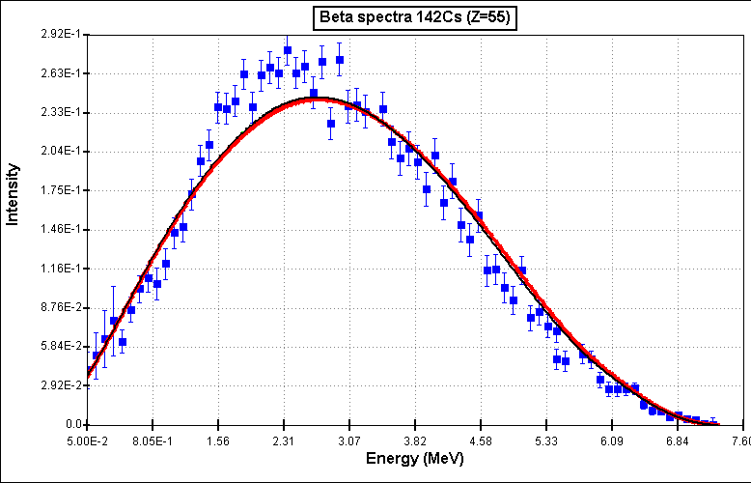
¹⁴²Cs decay: Case closed
Reasonable agreement between discrete line data and Rudstam
71 Levels
217 placed gamma’s
20 Levels
~30 placed gamma’s
~80 unplaced gamma’s
Courtesy of S. Zhu -ANL

Slide 21
Main Contributors at 6 MeV
235U
37-Rb-92
39-Y-96
55-Cs – 142
37-Rb- 93
39-Y-98m
37-Rb- 94
35-Br – 86
39-Y-98
239Pu
37-Rb-92
39-Y-96
55-Cs – 142
39-Y-98m
37-Rb- 93
41-Nb- 104m
41-Nb- 104
37-Rb- 94
241Pu
37-Rb-92
39-Y-96
55-Cs – 142
41-Nb- 104
39-Y-98m
37-Rb- 93
41-Nb- 104m
53-I-138
238U
37-Rb-92
39-Y-96
55-Cs – 142
37-Rb- 93
39-Y-100
51-Sb- 135
37-Rb- 94
50-Sn-133

Slide 22
Closer look at ^{104,104m}Nb
No Rudstam data
No TAGS data
No discrete line data !!!
(γ’s from mixed source, no β feedings could be determined)
Beta-spectra are from CGM calculation

Slide 23
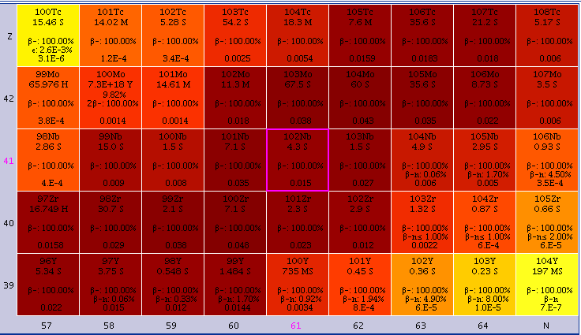
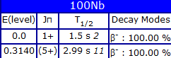
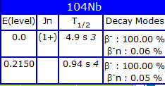
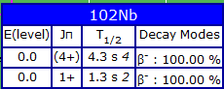
Neutron-rich Nb’s
Q=6384
CFY=0.057
Q=7210
CFY=0.028
Q=8100
CFY=0.0036
²³⁹Pu:

Slide 24
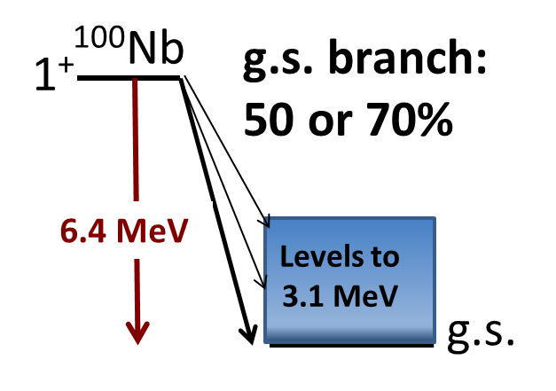
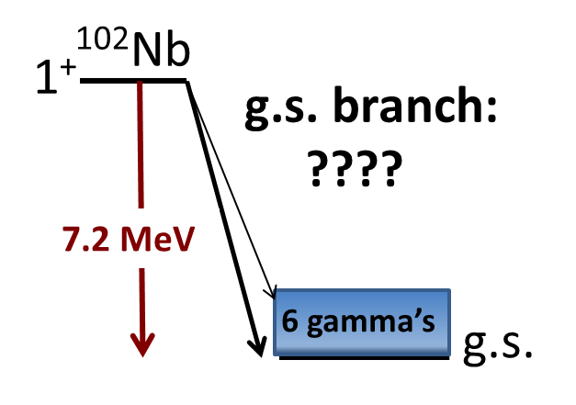
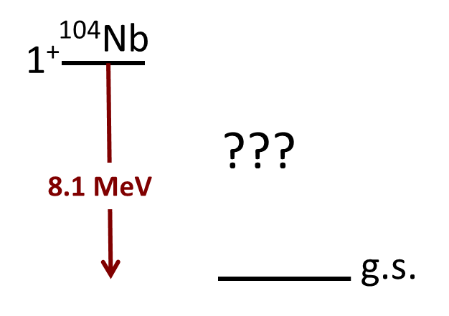
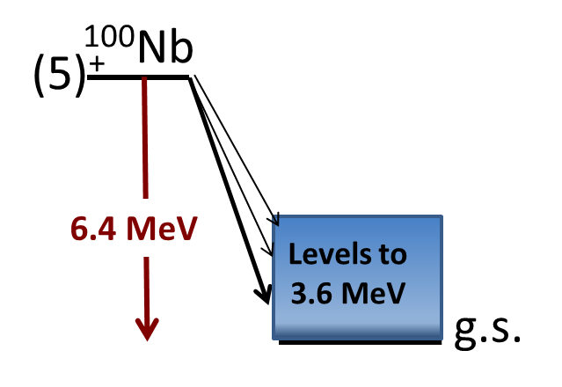
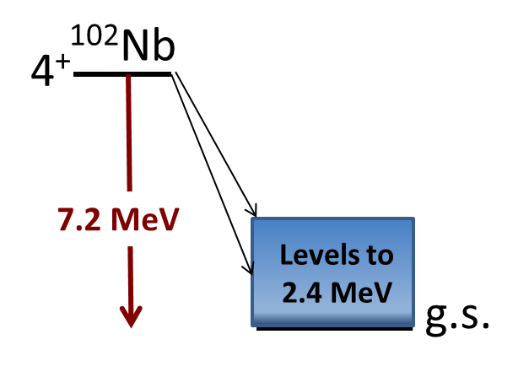
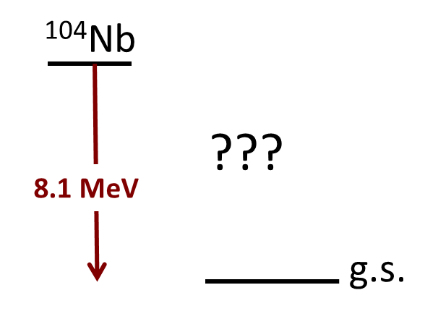
Very limited data
 | EEM | ELP | EEM | ELP | EEM | ELP
1+ | 0.79 | 2.55 | 2.4 | 2.4 | 3.06 | 2.46
4+/5+ | 2.21 | 2.01 | 2.1 | 2.3 | 3.06 | 2.46

Slide 25
Main Contributors at 6 MeV
235U
37-Rb-92
39-Y-96
55-Cs – 142
37-Rb- 93
39-Y-98m
37-Rb- 94
35-Br – 86
39-Y-98
239Pu
37-Rb-92
39-Y-96
55-Cs – 142
39-Y-98m
37-Rb- 93
41-Nb- 104m
41-Nb- 104
37-Rb- 94
241Pu
37-Rb-92
39-Y-96
55-Cs – 142
41-Nb- 104
39-Y-98m
37-Rb- 93
41-Nb- 104m
53-I-138
238U
37-Rb-92
39-Y-96
55-Cs – 142
37-Rb- 93
39-Y-100
51-Sb- 135
37-Rb- 94
50-Sn-133

Slide 26
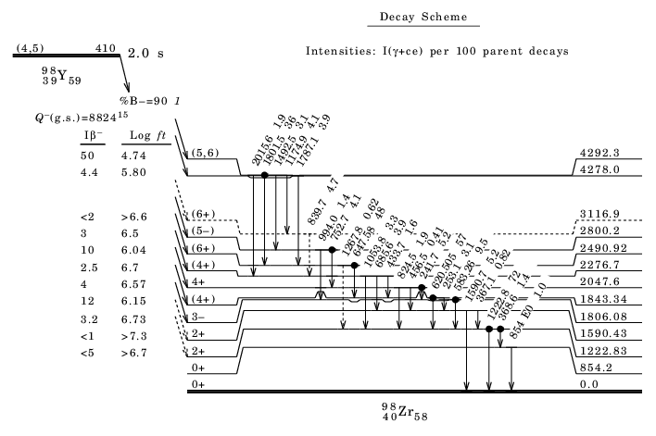
Beware of “false positives”

Slide 27
Other energy regions of the spectrum
²³⁵U main contributors to anti-neutrino spectra
Nucleus | % at 3 MeV
54-Xe-137 | 3.519
55-Cs-139 | 3.259
39-Y - 94 | 3.120
40-Zr- 99 | 3.010
41-Nb-100 | 2.916
41-Nb- 98 | 2.830
39-Y – 92 | 2.812
41-Nb-101 | 2.654
Nucleus | % at 4 MeV
41-Nb-100 | 4.872
37-Rb- 92 | 3.694
39-Y - 96 | 3.545
52-Te-135 | 2.994
39-Y - 94 | 2.897
55-Cs-140 | 2.780
39-Y - 95 | 2.646
54-Xe-139 | 2.606
Nucleus | % at 5 MeV
37-Rb- 92 | 9.171
39-Y - 96 | 7.475
41-Nb-100 | 6.592
55-Cs-142 | 4.585
55-Cs-140 | 4.153
52-Te-135 | 3.636
39-Y - 99 | 3.460
38-Sr- 95 | 3.435
“Top three”
Rudstam γ’s
Rudstam β’s and/or TAGS
“High priority”
Reminder : There are others that don’t even make the list !!

Slide 28
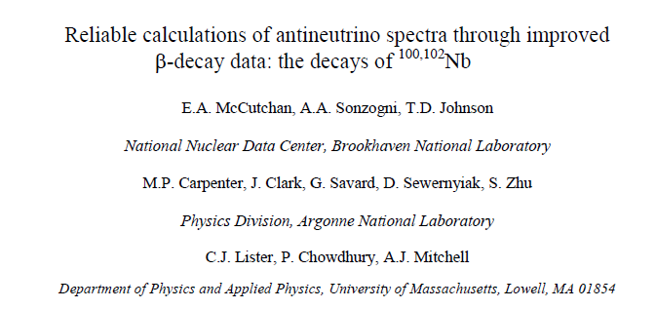
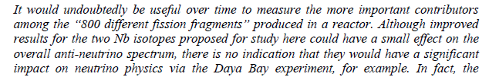
How to “fit in” with nuclear structure
Nucleus | % at 4 MeV
41-Nb-100 | 4.872
37-Rb- 92 | 3.694
39-Y - 96 | 3.545
52-Te-135 | 2.994
39-Y - 94 | 2.897
55-Cs-140 | 2.780
39-Y - 95 | 2.646
54-Xe-139 | 2.606
Nucleus | % at 5 MeV
37-Rb- 92 | 9.171
39-Y - 96 | 7.475
41-Nb-100 | 6.592
55-Cs-142 | 4.585
55-Cs-140 | 4.153
52-Te-135 | 3.636
39-Y - 99 | 3.460
38-Sr- 95 | 3.435

Slide 29
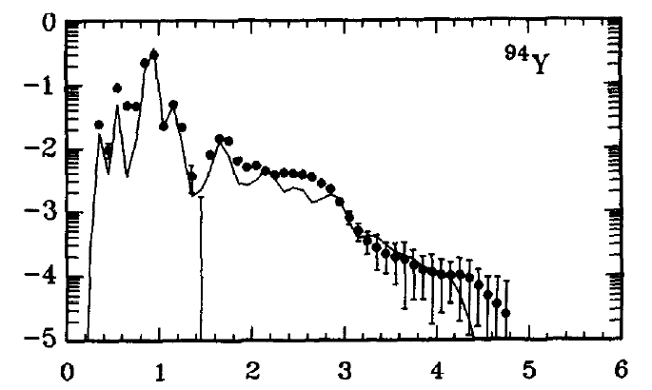
Rudstam’s data
Measured beta and gamma single spectra for the decay of 80+ fission products
Betas
Plastic (ΔE) + HPGe(E), high E
Si(Li) with Plastic (veto), low E
Gammas
NaI(Tl) crystal
The obtained mean energies are very useful for decay heat calculations
Rudstam et al., At.Data Nucl.Data Tables 45, 239 (1990)

