Slide 1
Neutron Spectroscopy with Ion Traps for Astrophysics
Astrophysics Working Group
ATLAS/CARIBU User’s Meeting 2014
May 15, 2014
Nicholas Scielzo
Experimental Nuclear Physics Group

Slide 2
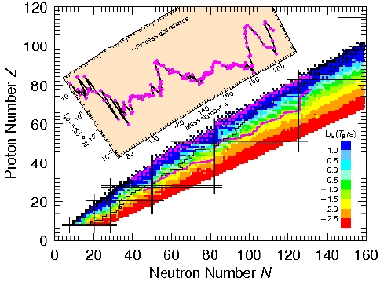
Rapid neutron-capture process nucleosynthesis
r process responsible for production of ~half heavy elements in very neutron-rich HED environments
Neutrons added through successive rapid (n,γ) reactions
Very neutron-rich isotopes are produced
At some point (n,γ) is balanced by (γ,n) until β decay occurs
At high enough masses, fission breaks up nuclei
Abundance pattern extracted from Solar System and certain metal-poor stars in halo of galaxy
Final abundances determined from astrophysical conditions (n density, temp.) and nuclear properties
S_{n} (masses)
β-decay half-lives
(n,γ) cross sections
fission properties
β-delayed neutron emission (P_{n})
r-process path
stability
Peter Moller, LANL

Slide 3
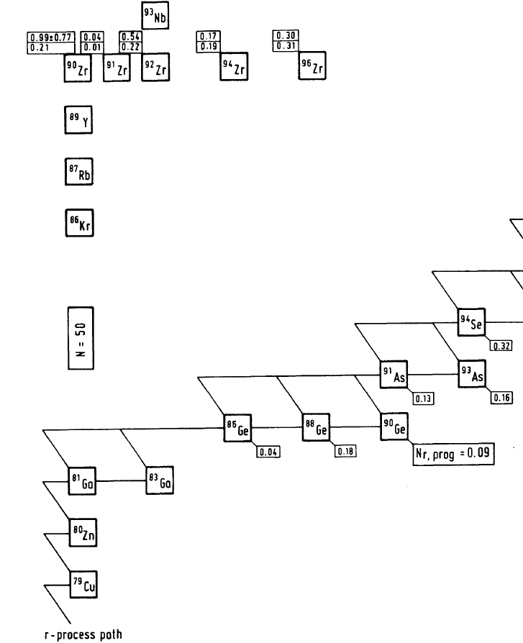
β-delayed neutron impact on understanding r-process nucleosynthesis
stable nuclei
At end of r process, exotic short-lived nuclei β decay back to stability
During multiple decays, β-delayed neutron emission can change mass of nuclei
P_{n} branching ratios influence final mass distribution
Also provide additional neutrons during freeze out
?
P_{n}~40%?
n
r process path
(very neutron rich!)
K.-L. Kratz et al., Astron. Astrophys. 125, 381 (1983)

Slide 4
New approach to neutron spectroscopy… without detecting neutrons
Perform delayed-neutron spectroscopy by detecting recoiling daughter ions emerging from an ion trap
β
ν
β (1 MeV): ~0.01 keV recoil
n (1 MeV): ~10 keV recoil
n
Identify neutron emission from larger nuclear recoil.
Avoid neutron detection.
Neutron emission
Need: Access to low-energy nuclear recoil
Way to precisely measure recoil energies
Efficient for any isotope with t_{1/2} > 50 ms
Use ion trap… measure recoil energy from TOF

Slide 5
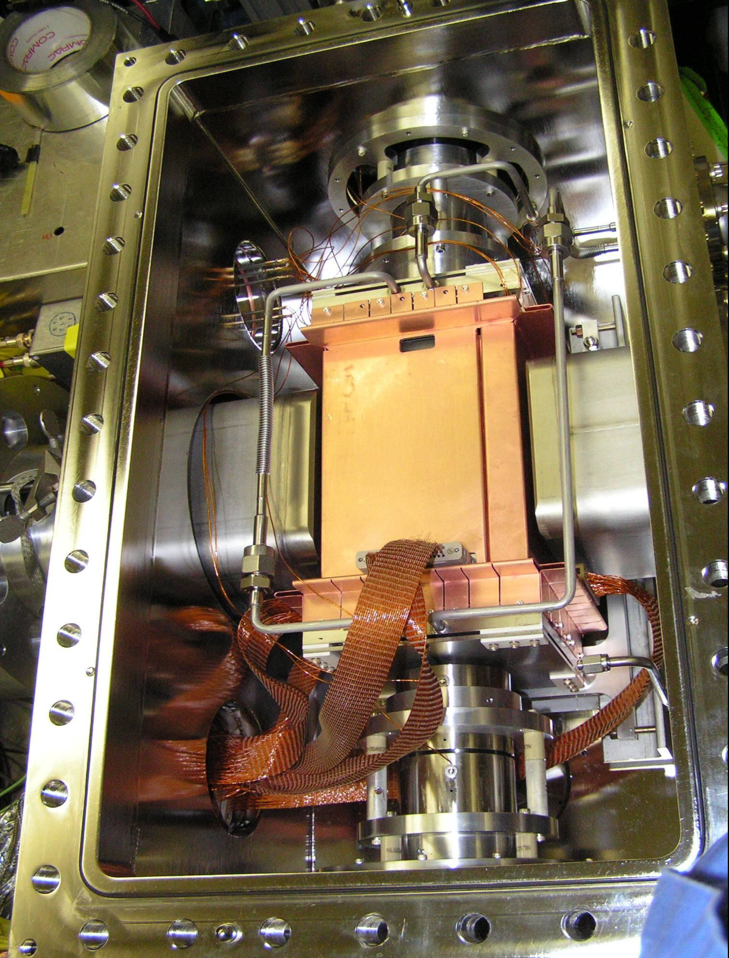
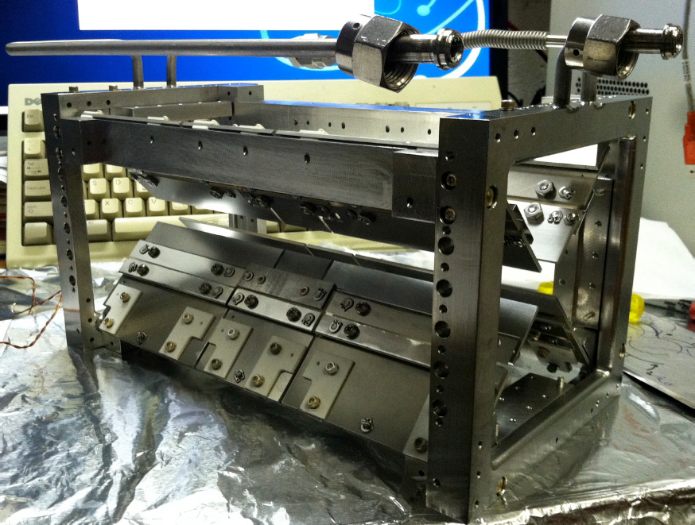
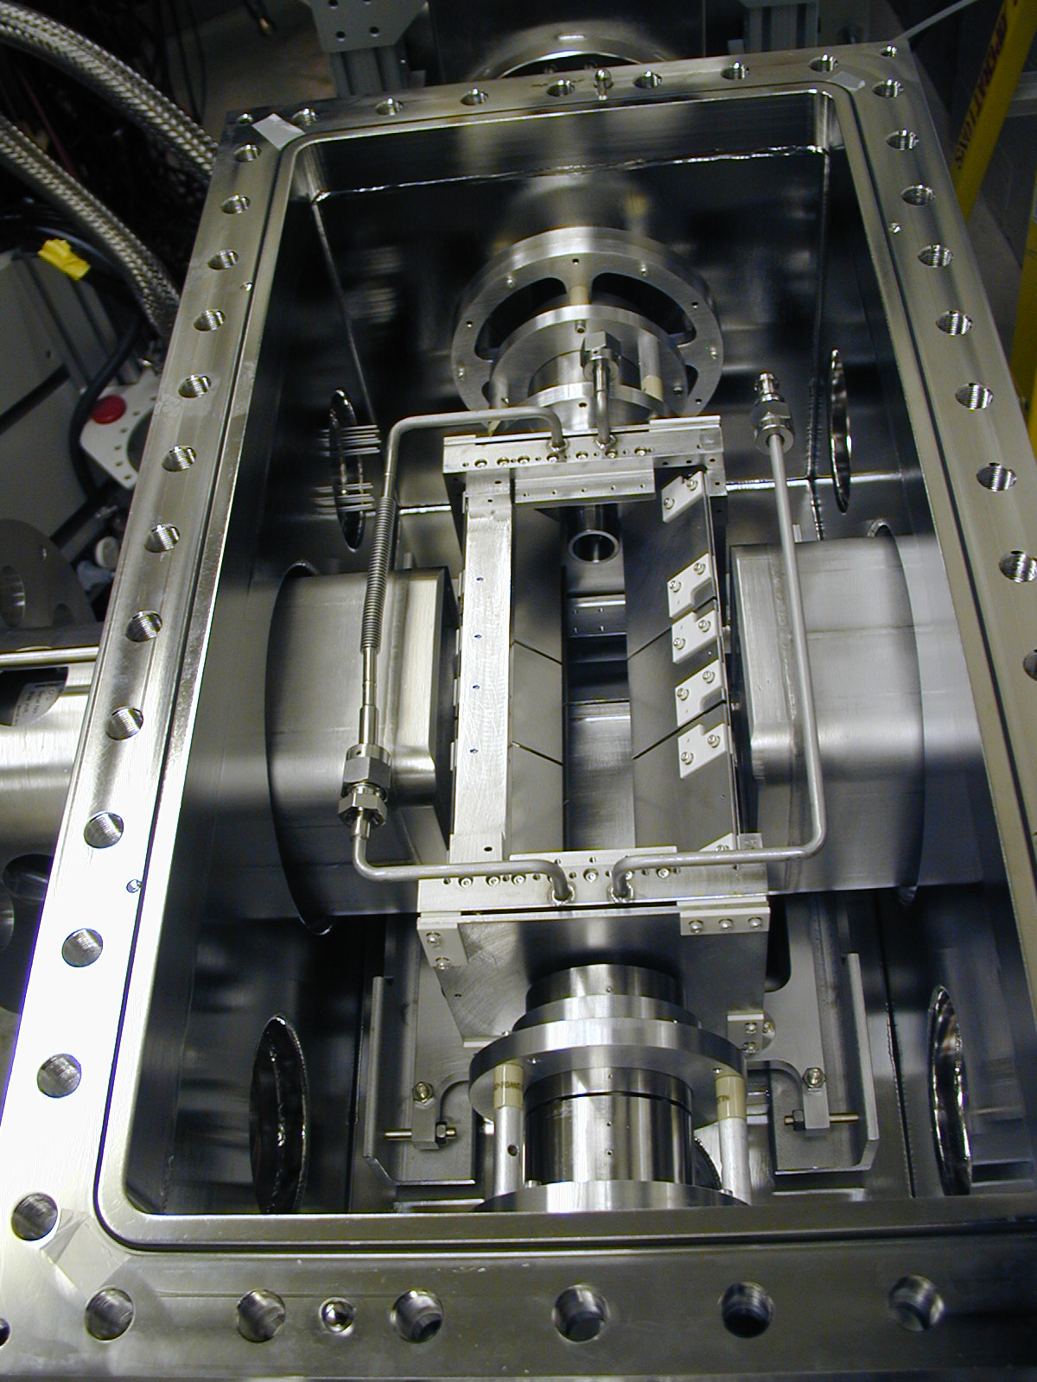
The Beta-decay Paul Trap
Works for any element
Confine up to 10⁵-10⁶ ions at once
Hold for >200 sec
Accessible half-life > 50 ms
Confine in ~1-mm³ volume

Slide 6
Outfit the Beta-decay Paul Trap with different radiation detectors
Principles
Trap βn precursors as ions
Cool by He gas to ~1-mm³ volume
Ions decay from rest at trap center
Trigger on β’s using plastic
Measure recoil time of flight (TOF) to MCP
β (+γ) gives lower energy recoil (< 170 eV)
β+n gives higher energy recoil (up to 14 keV)
Advantages
Measurement of both P_{n} and E_{n}
High efficiency and good E_{n} resolution
Insensitive to background γ’s & n’s
Near-Gaussian E_{n} detector response
Efficiency nearly independent of E_{n}
Many checks of systematic effects
Challenges
Trapping field perturbs ion trajectory
Ion cloud size
¹³⁷I → ¹³⁷Xe* + β⁻ + ν
¹³⁶Xe + n
MCP
¹³⁶Xe⁺⁺
Plastic
ΔE-E
HPGe
β
¹³⁷I⁺
n
Trap electrodes
ν
HPGe

Slide 7
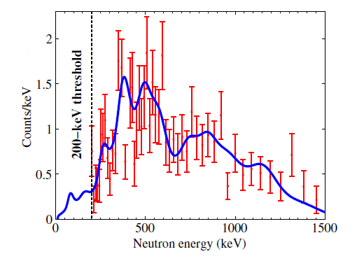
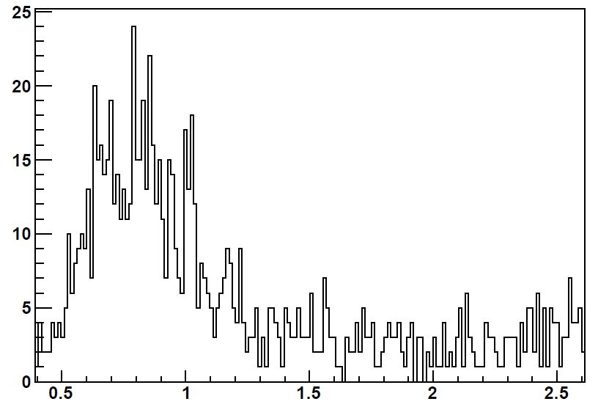
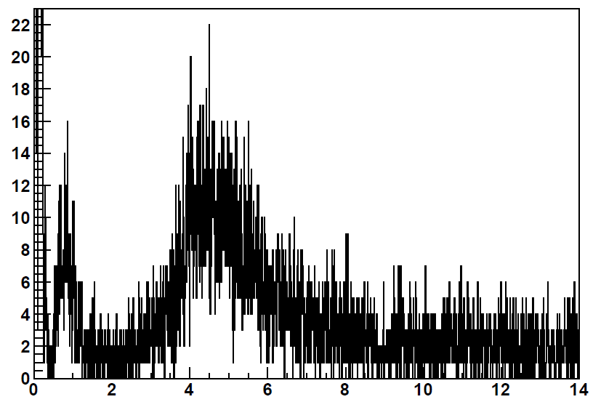
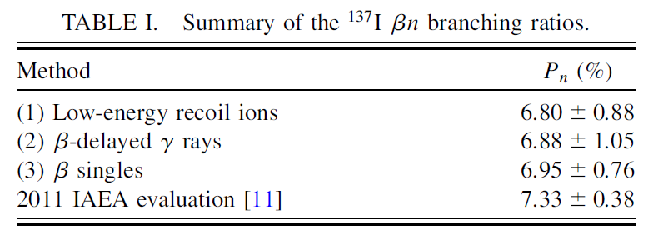
Data collected with ¹³⁷I⁺ beam of 30 ions/sec from an offline 1-mCi ²⁵²Cf source
¹³⁷I β decay in the trap (P_{n}=7%)
¹³⁶Xe ions following neutron emission
β-delayed neutron energy spectrum
Counts/13 ns
¹³⁷Xe ions following β decay
Counts/6.5 ns
Time of flight (μs)
Time of flight (μs)

Slide 8
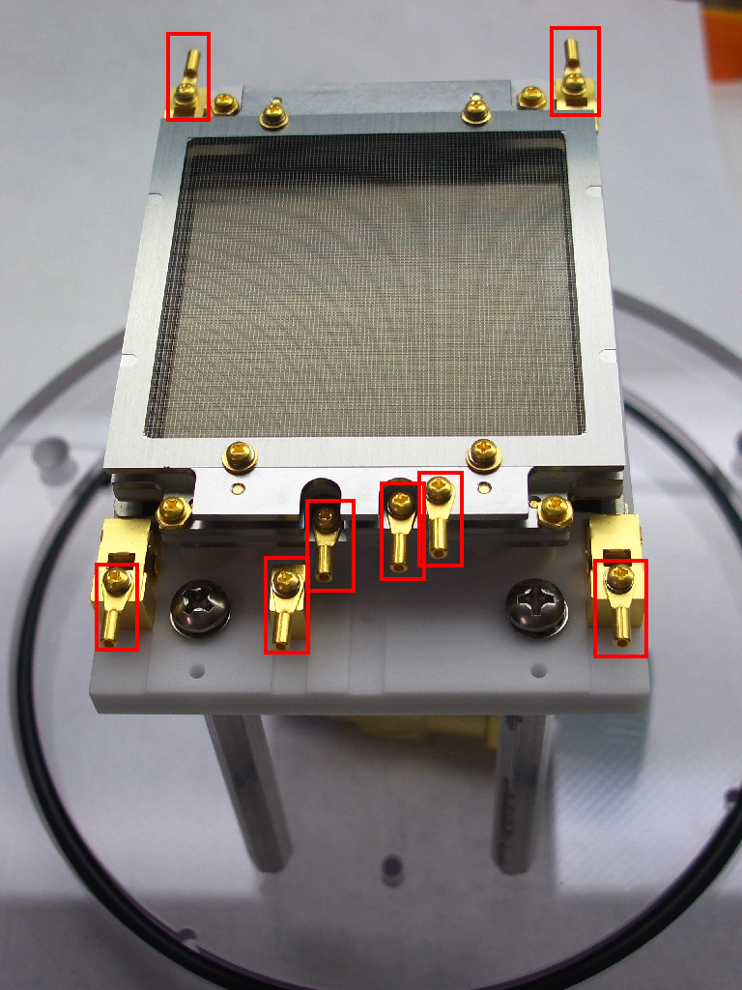
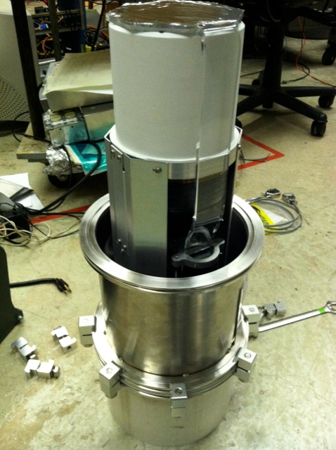
Upgrades → higher statistics and reduced systematic effects
HPGe
Increase β efficiency + spectroscopy
2× ΔE-E plastic scintillators subtend ~10%
Detector in rough vacuum separated from UHV by 10-μm window
Increase recoil-ion efficiency and improve measurement of E_{n}
2× 50x50-mm² MCP subtend ~10%
Position sensitivity (<1 mm) allows path length reconstruction
Different β-ion angle combos
Reduce E_{n} threshold → better separation of β and βn recoils
Electrodes closer to center
RF applied only to ends of electrodes
MCP
V_{rf} = 85 V
Plastic
ΔE-E
11mm
MCP
HPGe
Trap electrodes
Plastic
ΔE-E

Slide 9
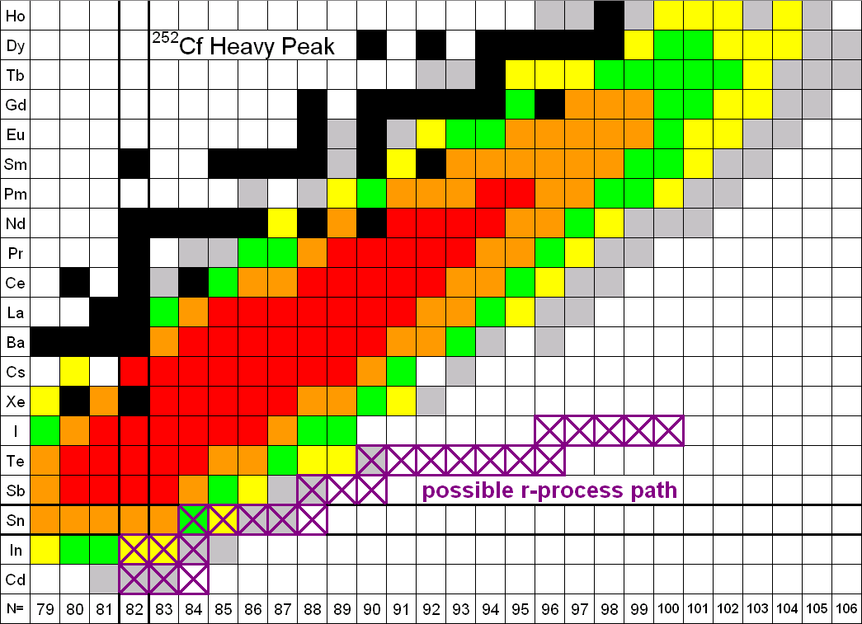
BPT moved down to the CARIBU Low-Energy Experimental Hall –Nov.-Dec. 2013 Measurement Campaign
Ions/sec at BPT
10² -10³
10¹ -10²
~10¹
^{144,145}Cs
^{137,138,140}I
^{134,135,136}Sb

Slide 10
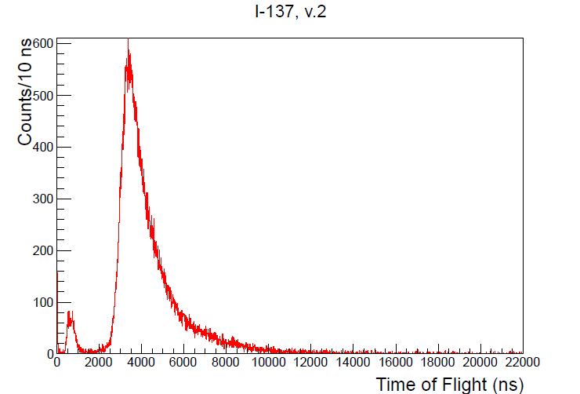
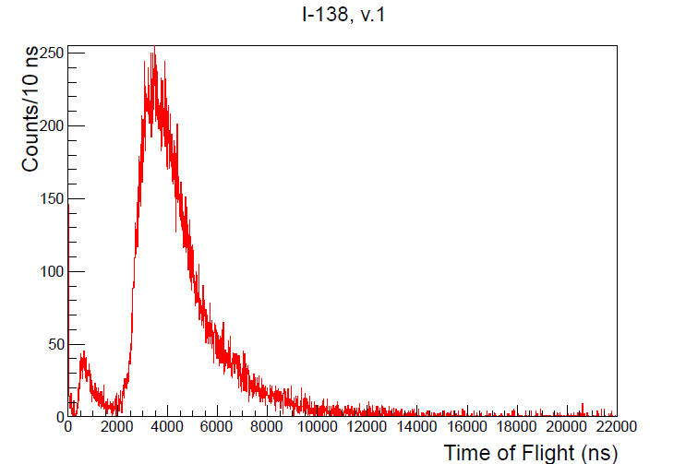
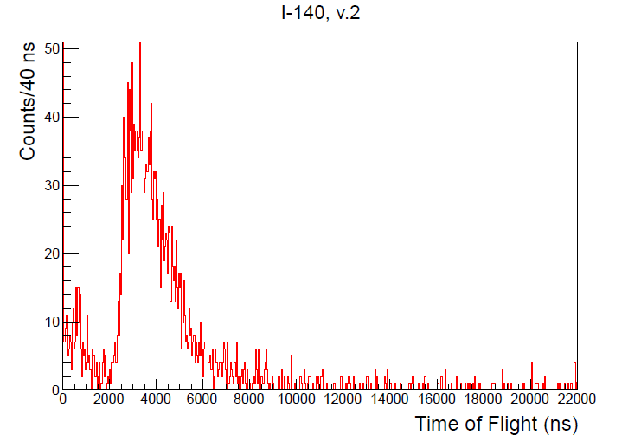
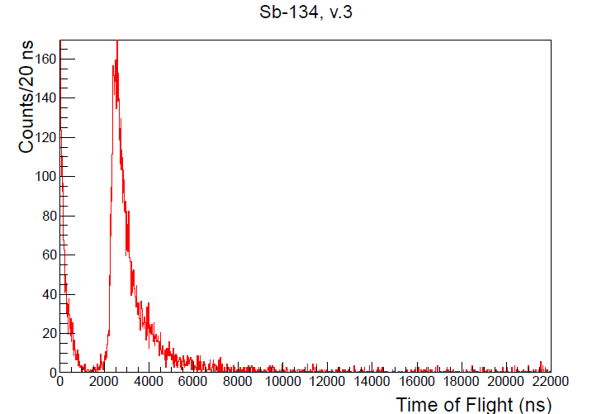
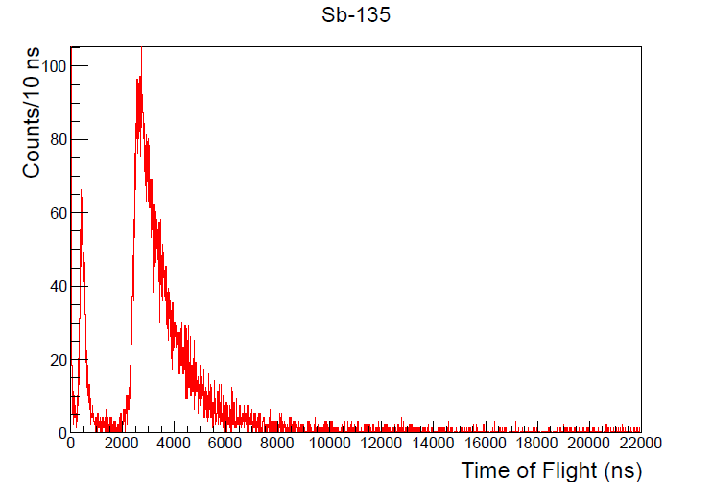
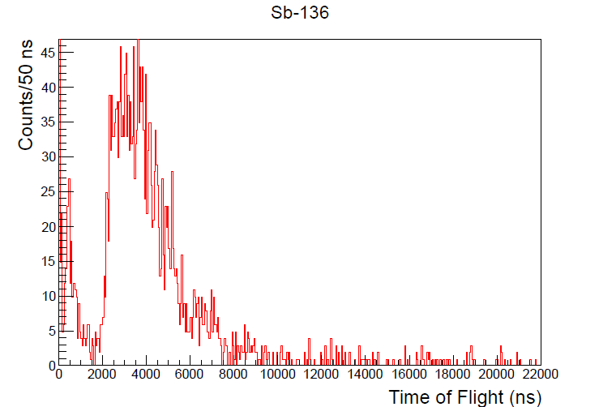
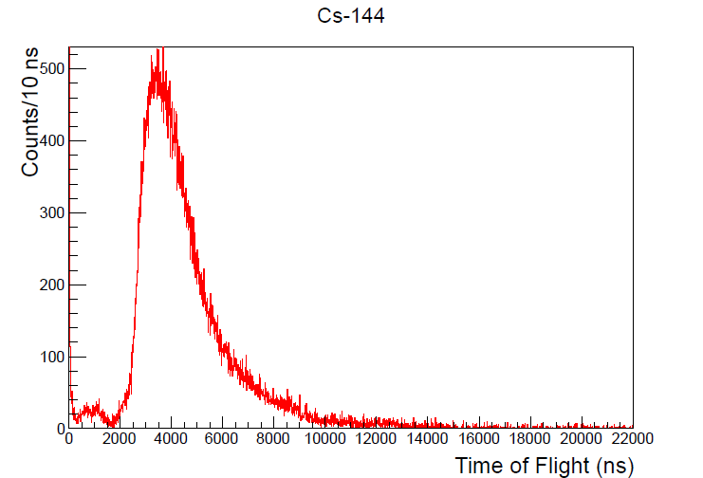
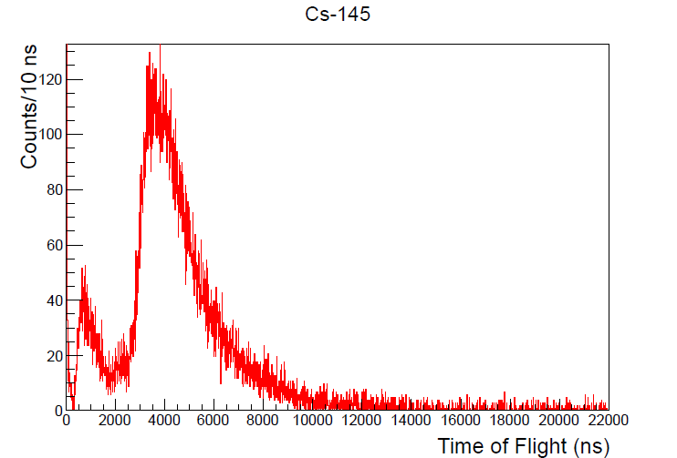
Analysis of this data is underway…
¹³⁷I
¹³⁸I
¹⁴⁰I
¹³⁴Sb
¹³⁵Sb
¹³⁶Sb
calibration
¹⁴⁴Cs
¹⁴⁵Cs

Slide 11
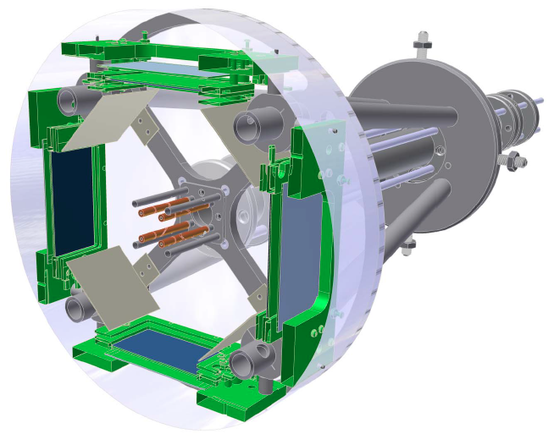
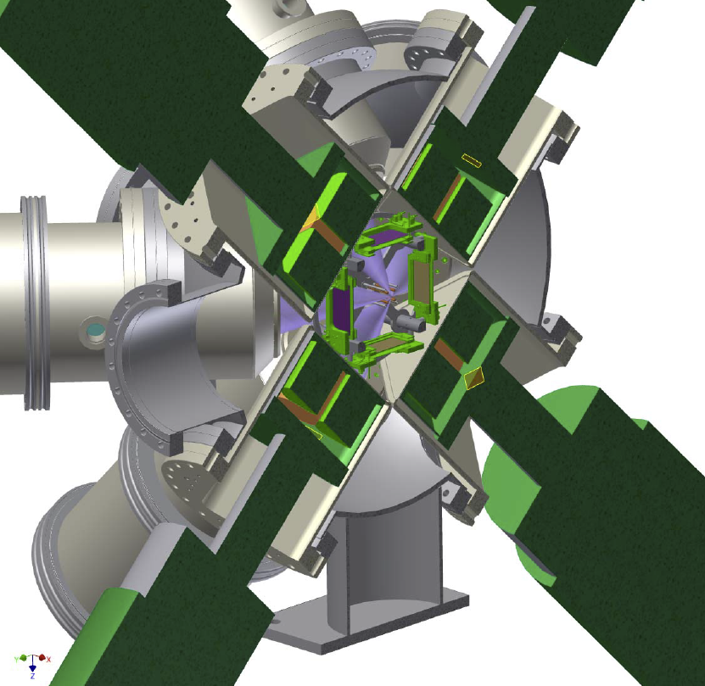
Design for a dedicated trap
Compact rod structure for electrodes → minimize perturbation on recoil ions
Larger detector array (x4 increase in coincident eff. vs. 2013) → 4 MCPs, 8 ΔE-E plastic scintillators, 4 HPGe clovers
Couple to a low-energy CARIBU beamline
A. Levand (ANL)

Slide 12
Existing/future capabilities
 | Proof-of-Principle (2011) | Upgraded trap (2012-2013) | New ion trap (2015)
Trap radius | 17 mm | 11 mm | 7 mm
V_{rf} | 200 V | 100 V | ~30 V
E_{n} resolution | 10-20% | 5-10% | 5-10%
E_{n} threshold | 200 keV | 100 keV | ~50 keV
β threshold | 150 keV | 50 keV | 25 keV
β-ion coinc. eff. | 0.04% | 0.7% | 3%
Sensitivity | ~20 ions/s | ~1 ion/sec | ~0.1 ion/s

Slide 13
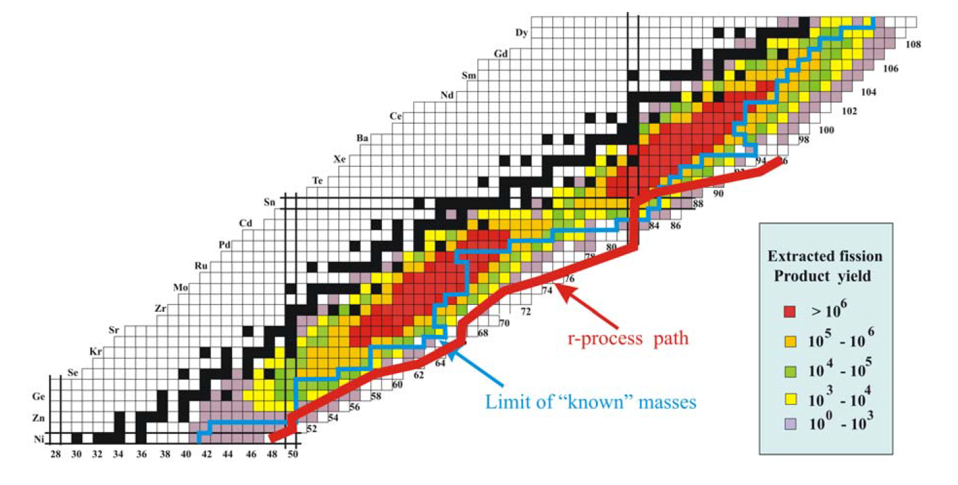
Ultimate reach of ion-trap approach is ~0.1 ion/sec (any isotope shown in color)
In addition to beam intensity, to reach most neutron-rich isotopes also need suppression of isobars by >10²
Can collect high-quality data on isotopes near/on the r process path

Slide 14
Ion Trap Collaborators
Graduate Students
Postdoctoral Researchers
N.D. Scielzo, A. Czeszumska, E.B. Norman, S. Padgett, R.M. Yee,
G. Savard, S. Caldwell, J.A. Clark, A.F. Levand, A. Perez Galvan, M. Burkey
A. Aprahamian, S. Marley, N. Paul, S. Strauss, K. Siegl
F. Buchinger, R. Orford
C.J. Chiara, J. Harker
R. Segel
K.S. Sharma, G. Morgan

