Slide 1
classical novae, type I x-ray bursts, and ATLAS
Alan Chen
Department of Physics and Astronomy
McMaster University

Slide 2
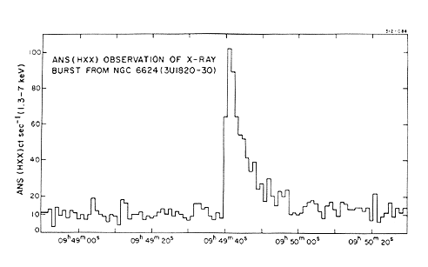
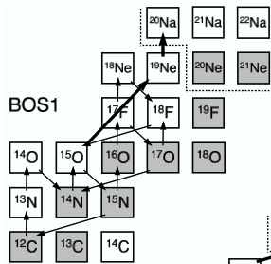
rare isotopes in stars: type I x-ray bursts
model:
  binary star system
  accretion on neutron star
  thermonuclear runaway
observations: light curves
research areas:
  Breakout from the Hot-CNO cycles
  rp-process: path, endpoint, synthesis
  αp-process → key reactions
experiments: proton-rich rare isotopes
  (p,γ) and (α,p) reactions
  mass measurements

Slide 3
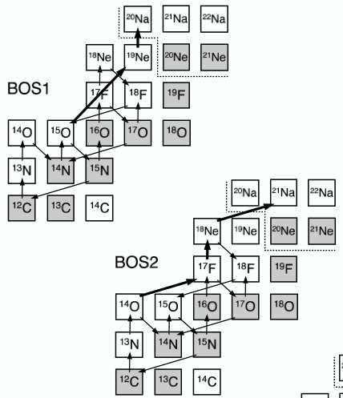
rp-process: beginnings
explosive hydrogen-helium burning (T > 0.5 GK)
→ breakout from the Hot-CNO cycles
¹⁵O(α,γ)¹⁹Ne
¹⁹Ne(p,γ)²⁰Na
¹⁸Ne(α,p)²¹Na
¹⁴O(α,p)¹⁷F
¹⁷F(p,γ)¹⁸Ne
[figure adapted from C. Iliadis (2007)]

Slide 4
rp-process, cont’d
after breakout from Hot-CNO cycles:
  (α,p) and (p,γ) on proton-rich nuclei → production of heavier elements
  energy generation and timescale set by “waiting-point” nuclei:
    e.g., ³⁰S, ⁵⁶Ni, ⁶⁴Ge, ⁶⁸Se
  reaction flow: competition between β-decay and reactions
  (α,p) and (p,γ) reaction rates:
  often calculated with statistical models (e.g., Hauser-Feshbach)
  need experimental verification

Slide 5
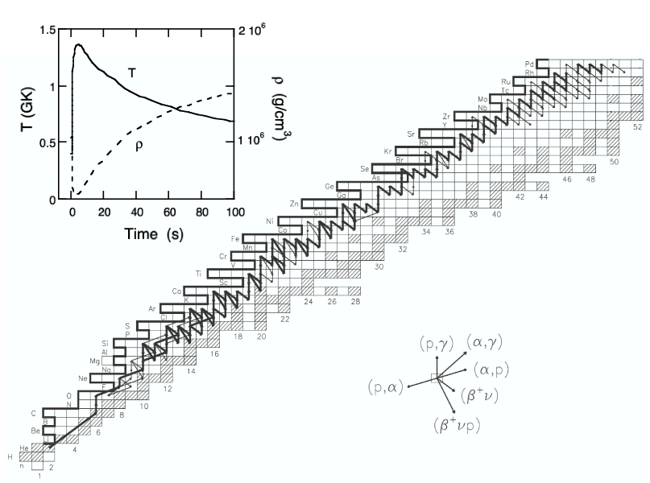
rp-process, cont’d
[type I x-ray burst – neutron star: 1.3M_{sun} , R = 8 km, T_{peak} = 1.4 GK, τ = 100 s]
αp-process
WP: ²²Mg, ²⁶Si, ³⁰S, ³⁴Ar
(α,p) cross sections
rp-process
WP: ⁵⁶Ni, ⁶⁴Ge, ⁶⁸Se, ⁷²Kr
⁵⁷Cu(p,γ)⁵⁸Zn
Q-values for ⁶⁴Ge(p,γ)⁶⁵As
⁶⁸Se(p,γ)⁶⁹Br
[nucleosynthesis study: A. Parikh et al., Ap.J.Supp. Ser. (2008); PRC (2009)]

Slide 6
thermonuclear reaction: narrow resonances
partial widths of entrance
and exit channels
Breit-Wigner formula:
resonance energy
total width
resonance energy: needs to
be measured precisely
“resonance strength” ωγ
[broad resonances: widths are energy-dependent → calculate reaction rate analytically]

Slide 7
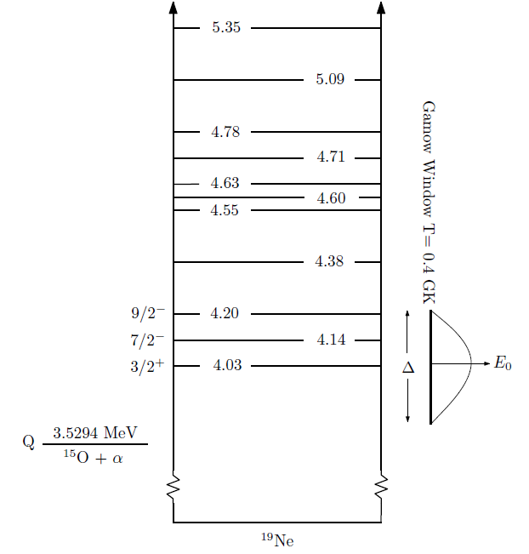
¹⁵O(α,γ)¹⁹Ne
Breakout reaction from the Hot CNO cycles
Direct measurement not feasible
Need B_{α} for 4.033 MeV state of ¹⁹Ne

Slide 8
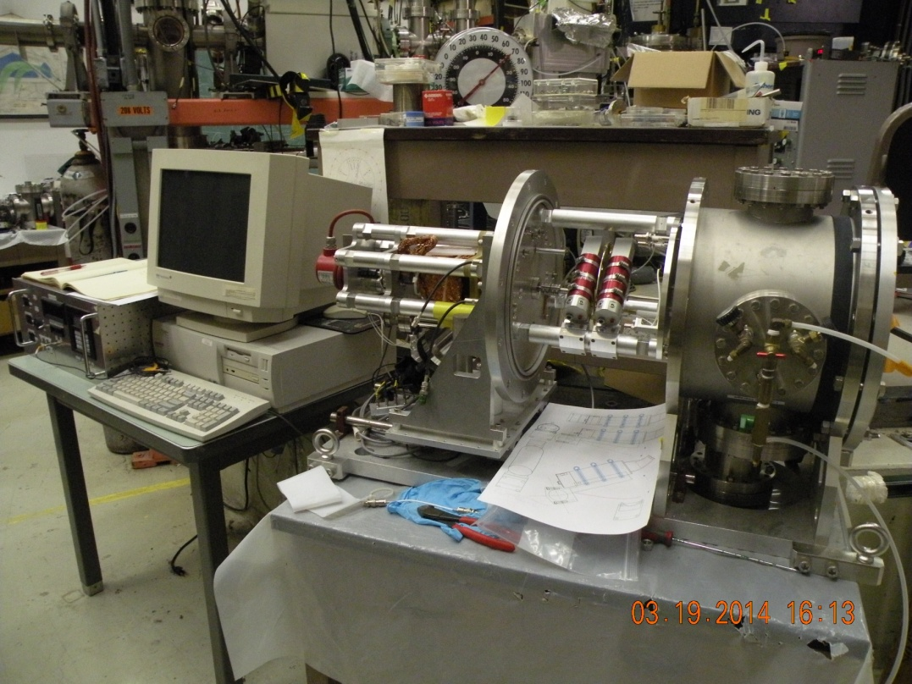
¹⁵O(α,γ)¹⁹Ne
B_{α} for 4.033 MeV state of ¹⁹Ne: new technique
ATLAS:
¹⁹F beam
gas cell
catcher foil + wheel
custom NaI detectors
Approved for test run

Slide 9
(α,p) reactions
Time-inverse measurements, so far
¹⁷F(p,α)¹⁴O, ²¹Na(p,α)¹⁸Ne, ²⁵Al(p,α)²²Mg, ²⁹P(p,α)²⁶Si, ³³Cl(p,α)³⁰S, ³⁷K(p,α)³⁴Ar
→ undetermined contributions from reactions to excited states
Direct measurements are needed
Approaches:
AIRIS + HELIOS (inc. cryogenic gas cell and high-rate ionization chamber)

Slide 10
HELIOS Gas Target
Multiple window flanges allow for different target thicknesses (1, 2 and 3 mm)
For backward angle measurements:
  upstream window:
    diameter = 0.31”
    θ_{lab} > 94°
  downstream window:
    diameter = 0.25”
    θ_{lab} < 72°
Effective target thicknesses of e.g. ~65 μg/cm² for 700-mbar ³He (2-mm gas cell)
Best resolution: ~ 270-keV FWHM (using 1 mg/cm² Kapton window)
entrance/exit window
fan for solid targets, FC, source, etc.
input/output gas lines
lines for LN₂ cooling
Notes:
best resolutions *so far* achieved during 14C(d,p) run

Slide 11
HELIOS Ionization Chamber
Alternating anode and grounded grids:
  grid separation: 1.7 cm
  wire spacing: 2-mm
  x and y position sensitivity
Commissioned Feb/March 2013:
  ²⁸Si+¹²C, ²⁸Si+Au, ⁸⁶Kr(d,p), CARIBU beam, ¹⁴C(d,p), ¹⁴C(³He,d)
Results:
  rates of > 400 kHz (pileup ~ 10 – 30 %)
  energy resolution better than 5%

Slide 12
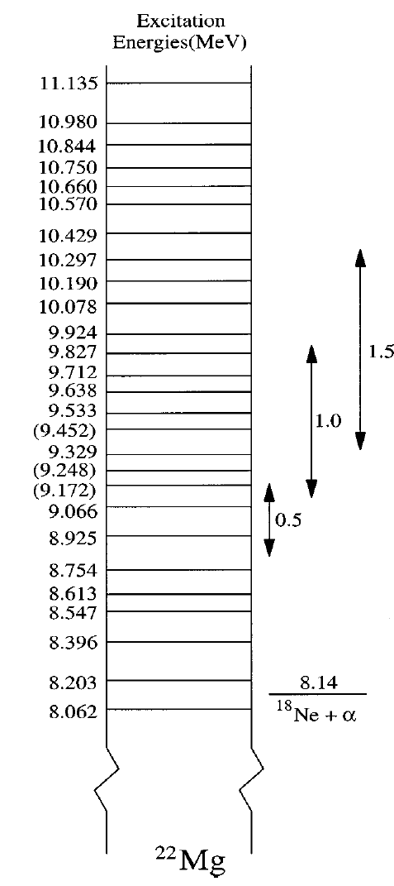
¹⁸Ne(α,p)²¹Na
Breakout reaction from Hot-CNO cycles
Experiments:
transfer reactions
time-inverse with RIBs

Slide 13
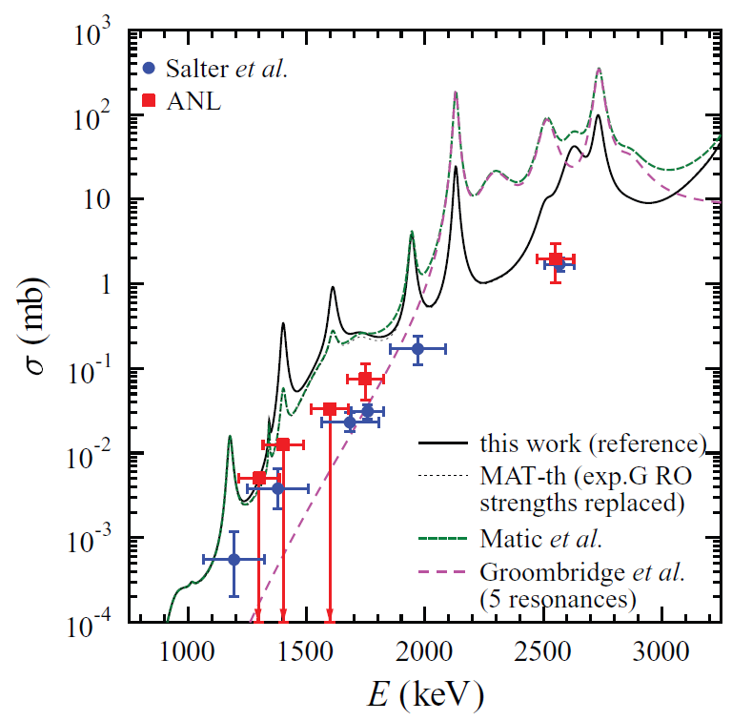
¹⁸Ne(α,p)²¹Na with HELIOS
Gamow window: E_{cm} ∼ 1 – 2 MeV
E(¹⁸Ne) = 1 – 1.5 MeV/A
Gas cell: 500 mbar @ 90K: 25 μg/cm²
20% detection efficiency
AIRIS: 10⁵ pps
Ecm ∼ 1.97 MeV:
cross section ∼ 1 mb
40 – 50 counts in a week
Matic, Mohr (2013)

Slide 14
(α,p) reactions
Approaches:
AIRIS + HELIOS (inc. cryogenic gas cell and high-rate ionization chamber)
good energy resolution for protons
limited solid angle coverage
Alternative: use AGFA to detect recoils
full angular coverage
good separation of beam contaminant contributions
no resolution

Slide 15
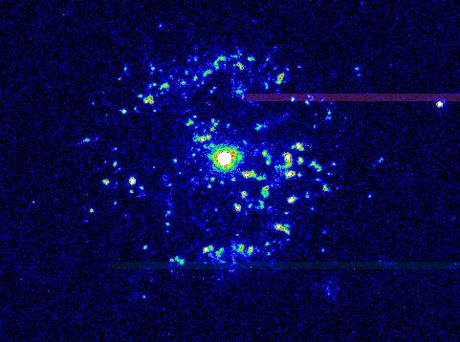
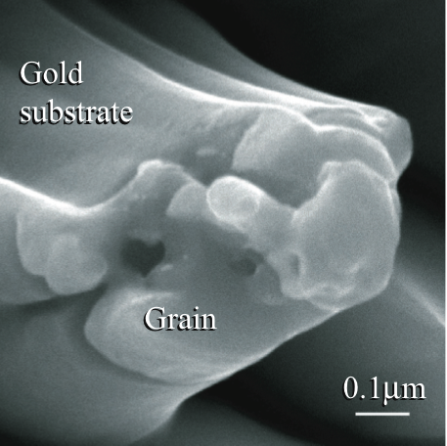
rare isotopes in stars: classical novae
models:
  binary star system
  accretion on white dwarf
  thermonuclear runaway
observations: ejecta spectroscopy
presolar meteoritic grains
research areas:
  Ne-Na, Mg-Al cycles
  reactions affecting synthesis of:
  - γ-emitters (e.g., ¹⁸F, ²²Na, ²⁶Al)
  - isotopes in meteoritic grains
  - elements in ejecta
experiments: proton-rich rare isotopes
  (p,γ) and (p,α) reactions
  ¹⁸F(p,α)¹⁵O, ²⁵Al(p,γ)²⁶Si, ³⁰P(p,γ)³¹S
[Nova Pyxidis]

Slide 16
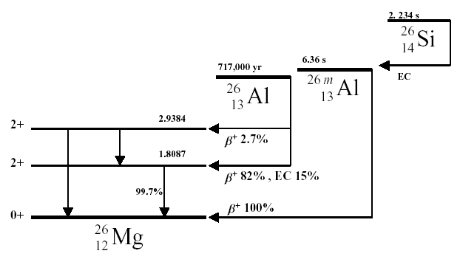
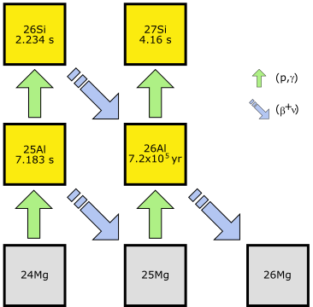
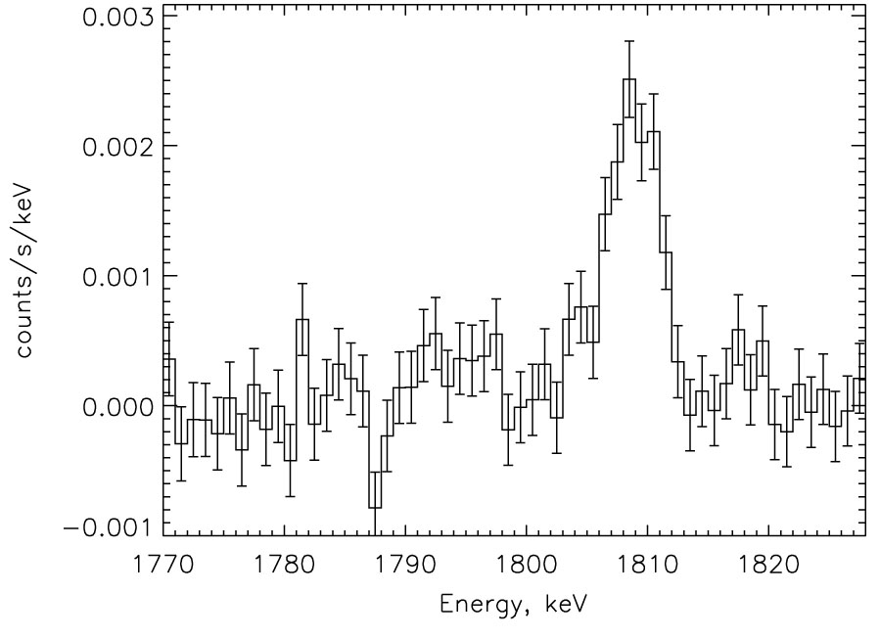
the nuclear origin of galactic ²⁶Al
RHESSI
important reactions:
²⁶Al(p,γ)²⁷Si
²⁵Al(p,γ)²⁶Si [Iliadis et al. Ap. J. (2002)]

Slide 17
nova nucleosynthesis at phosphorus
[silicon abundances: competition between phosphorus (p, γ) and β⁺ ]
³⁰P(p,γ)³¹S
...
...
³⁰S
³¹S
³²S
...
...
...
²⁸P
²⁹P
³⁰P
³¹P
...
[2.5 min]
[p,γ]
β⁺
...
²⁷Si
²⁸Si
²⁹Si
³⁰Si
...
...
...
...
...
[ ³⁰P(p,γ)³¹S: also important in x-ray bursts → reaction flow]

Slide 18
nova nucleosynthesis at phosphorous (cont’d)
[José et al., Ap.J. (2001) and Iliadis et al., Ap.J. (2002)]
variation in ³⁰P(p, γ)³¹S rate → changes A ≈ 30-40 abundances by factors of 2 – 10
drives the nuclear activity toward heaviest elements produced (A ≈ 40)
→ reaction rate has large uncertainties (∼ x 20)
∴ need more experiments, but direct
measurement not feasible

Slide 19
nova nucleosynthesis at ATLAS
Use (³He,d) as a surrogate for (p,γ): HELIOS
Examples:
²⁵Al(p, γ)²⁶Si → AIRIS: 10⁷ pps
³⁰P(p, γ)³¹S → AIRIS: 10⁷ pps

