Slide 1
Application Nuclear Data Needs
Tim Johnson, Libby McCutchan, Alejandro Sonzogni
National Nuclear Data Center

Slide 2
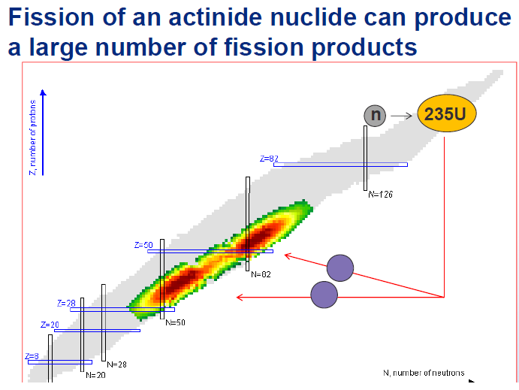


Slide 3
Different radiation types, different issues…
Gamma rays → Gamma decay heat, forensics
Beta transititions → Beta decay heat, antineutrinos
Beta delayed neutrons → Delayed nu-bars
All of them very correlated, macroscopic measurements need precise experimental values from places like ATLAS
Impact of TAGS data (Greenwod et al, Algora et al) has been crucial.

Slide 4
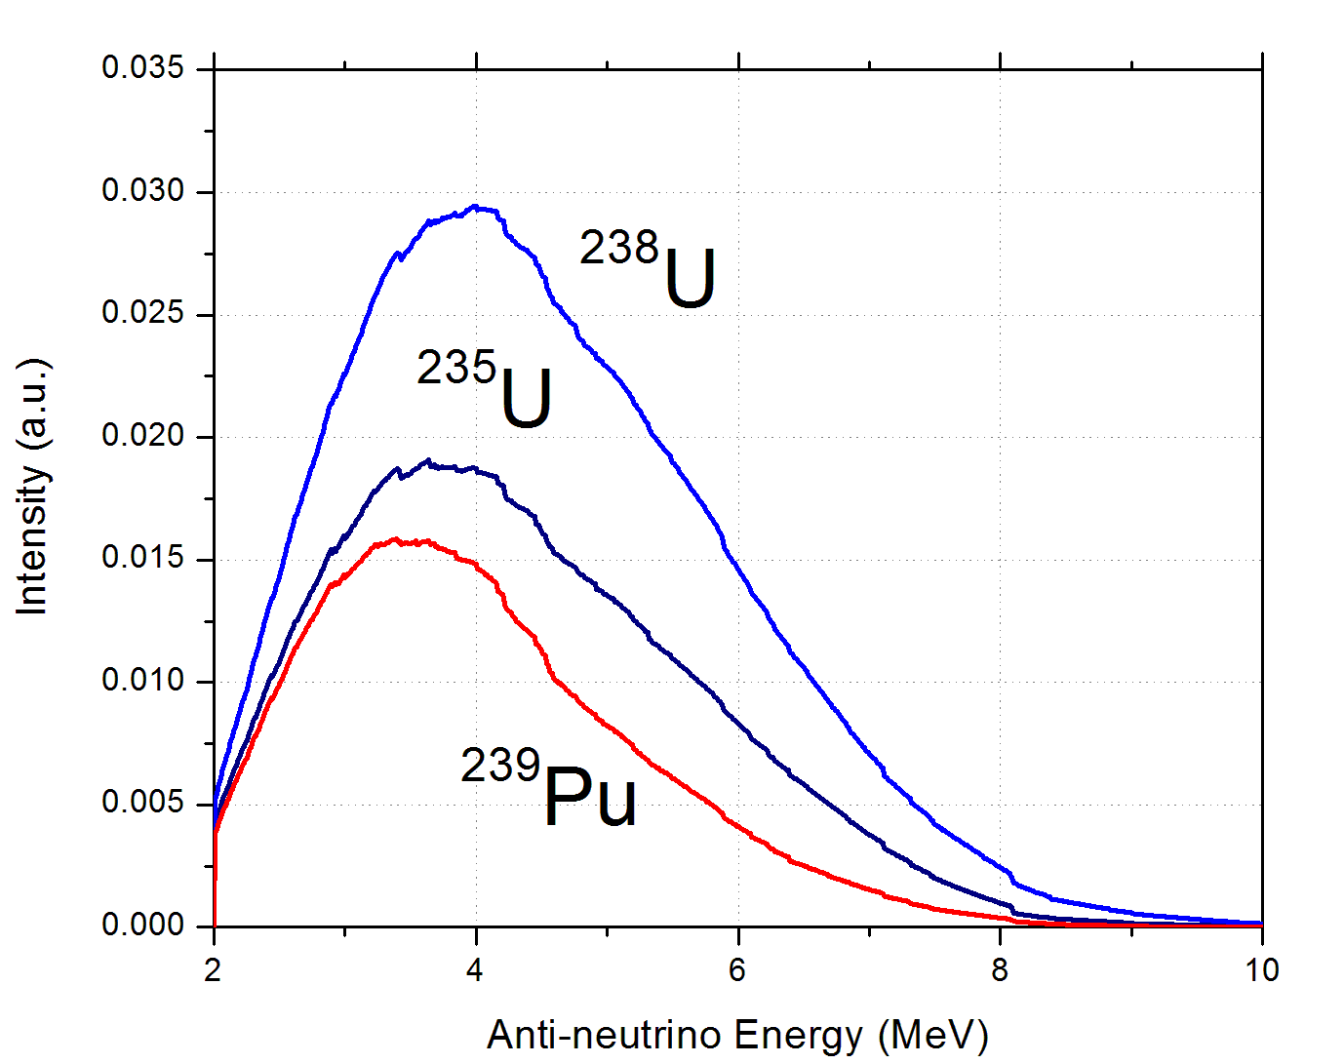
Anti-neutrino Signal, neutrino spectrum x cross section
^{235,238}U and ²³⁹Pu produce a different signal, in shape, maxima and multiplicity

Slide 5
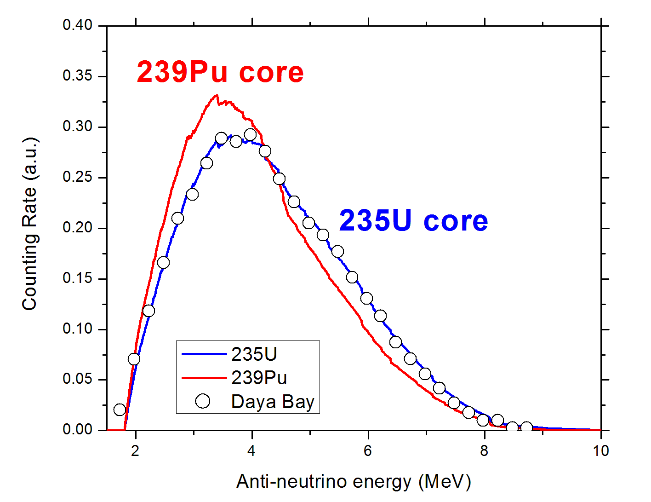
NNDC calculations on the Daya-Bay signal shape = spectrum x cross section
235U signal has a shoulder at around 6 MeV
F.P. An, PRL 108, 171803 (2012),

Slide 6
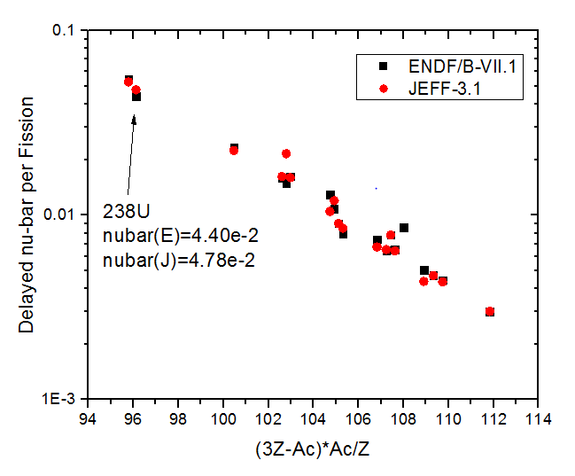
Following Loaiza et al. & Than Dat et al., the recommended delayed nubars (delayed average neutron multiplicity per fission) are plotted for a number of systems.

Slide 7
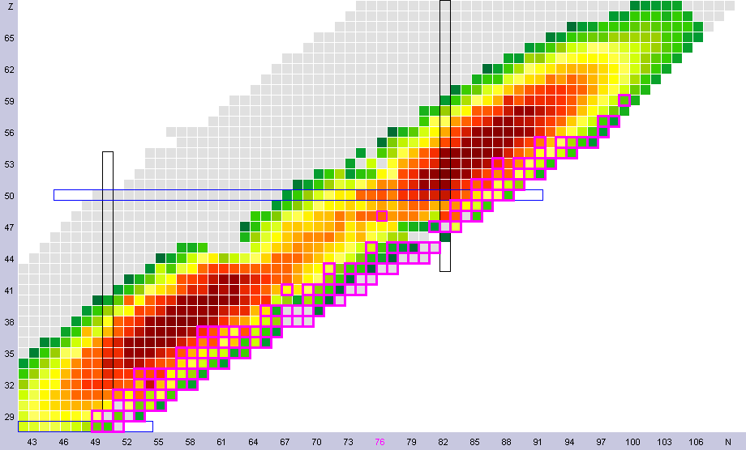
Chart colored by 235U fission yields, highlighted by Qβn>0
Many βn emitters have high fission yield values, in particular Br (Z=35), Rb (Z=37), I (Z=53) and Cs (Z=55)

Slide 8
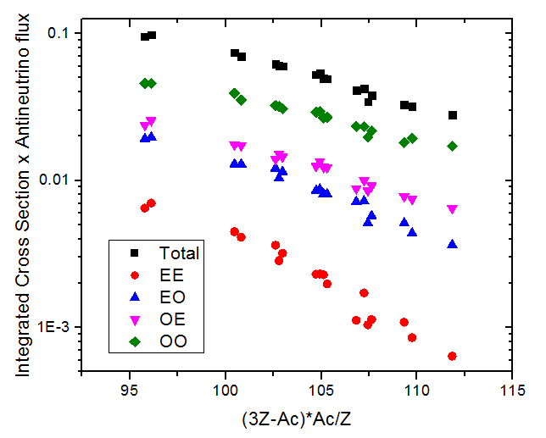
Contributions from nuclei with different degrees of Z and N evenness

Slide 9
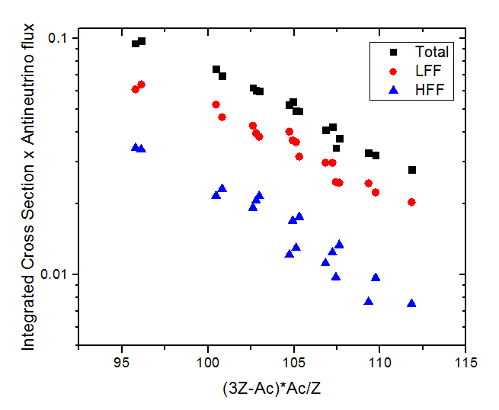
Contributions from nuclei from the Light and the Heavy fission fragments

Slide 10
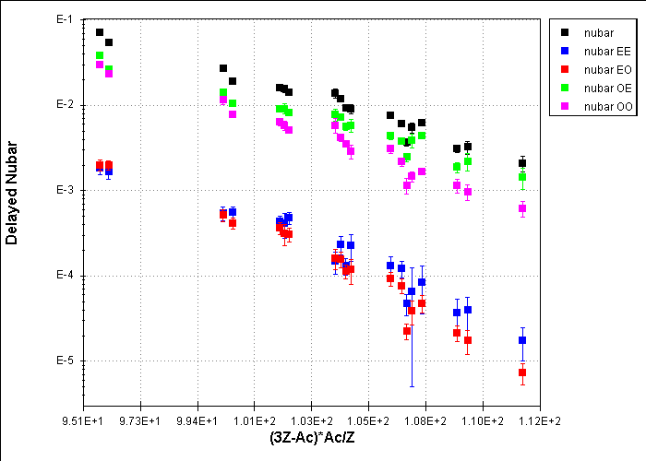
Same plot as before, but for delayed nubars
232Th
238U
235U
238Np
241Pu
233U
239Pu
252Cf
Odd-Z
Even-N nuclides, such as 87Br contribute ~50-65%.

Slide 11
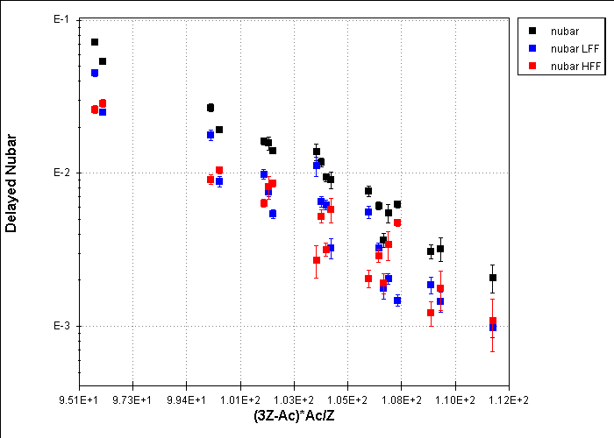
As before, but plotting lighter and heavier fission fragments contributions
232Th
238U

Slide 12
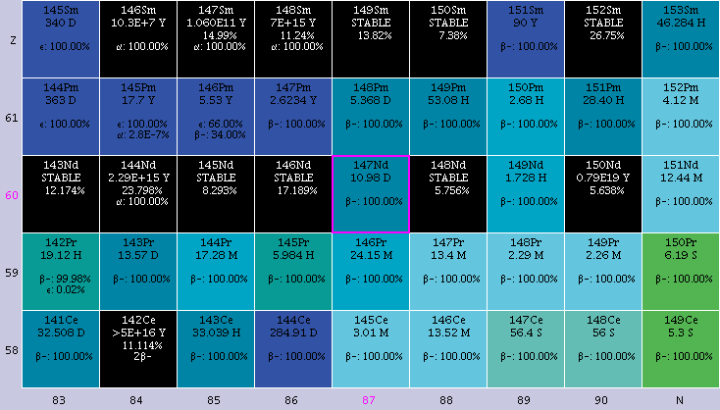
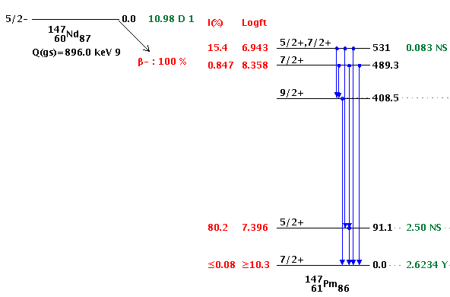
Another example, 147Nd decay
A precise knowledge of the GS to GS Iβ and 91.1 Iγ is needed
Eγ=531.0 Iγ=13.4 (3)%
Cumulative fission yield=2.25%
Eγ=91.1
Iγ=28.1 (7)% α=2.03
Iβ <0.15 % or
Iβ<5 %

Slide 13
Conclusions
Precise Decay Schemes are needed for many neutron rich nuclides, including:
TAGS data.
Beta Shapes, beta absolute intensities, in particular ground state to ground state.
Beta-delayed Neutron Probabilities and Neutron Spectra.
Gamma energy and absolute intensities.

