Slide 1
AMS at ATLAS May 16, 2014
Richard Pardo

Slide 2
Outline
Features of ATLAS for AMS
‘High’ beam energy
Sophisticated detector systems allow unique ‘Z’ ID into A~150
FMA and associated detector system
Enge Spectrograph and associate detector system
Stable operation and sophisticated control
Work underway to approach flexibility of dedicated AMS facility.
Development of laser ablation system to improve cross-talk
Current AMS activity focus:
¹⁴⁶Sm
Astrophysical chronometer (T_{½} = 68 M years)
Nuclear Physics data
(α, γ) σ
(n, γ ) σ
Actinide Integral neutron capture cross-sections for reactor studies and design (MANTRA)

Slide 3
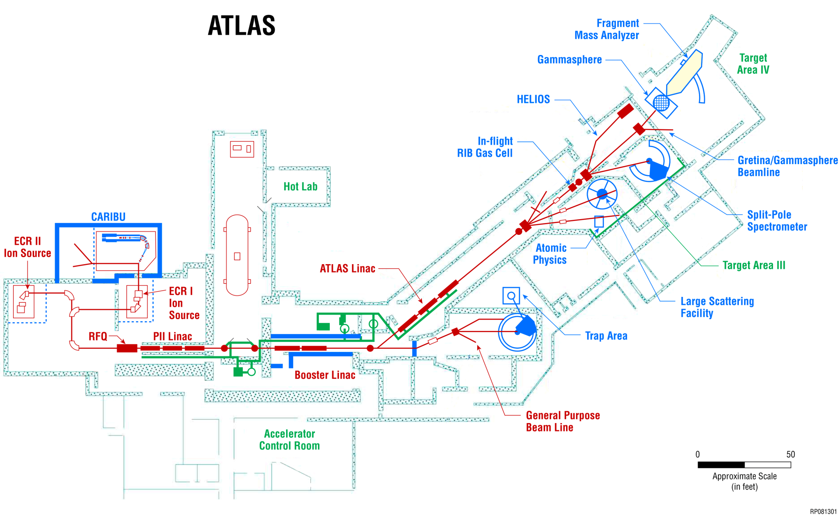
ATLAS AMS Typical Configuration
Fragment Mass Analyzer
Split-pole Spectrograph
ECR-II Ion Source
PII LINAC
Booster Linac

Slide 4
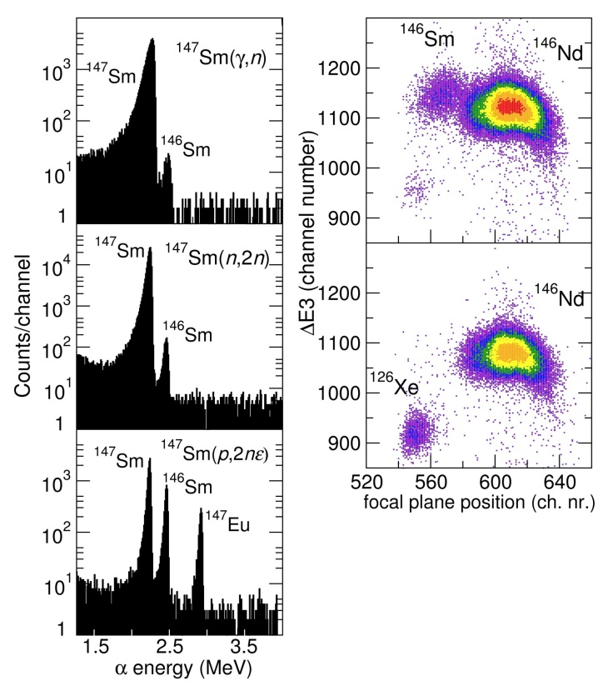
ATLAS Features Important for AMS
ATLAS is the only AMS facility where mid-heavy nuclides (A~100-150) can be uniquely identified
Requires ensuring high-energy reliability of ATLAS (E > 8-9 MeV/u)
Reliable, rapid switching between different M/q species
AMS measurements require stability
Recent ATLAS upgrades are contributing to this
RFQ repeatability and reliability is excellent
New cryostat resonators operate in new ‘driven’ mode
VCX PIN diodes eliminated

Slide 5
MANTRA: An Integral (n, γ) Cross-Section Measurement
Objective of the experiment:
Infer effective neutron capture cross-sections of most actinides of interest for reactor physics in fast and epithermal spectra (a few fission products are also considered)
Consistency of the fast and epithermal data (i.e. same samples, same fabrication protocols, same PIE protocols, same experimentalists, etc…)
Uses multi-collector ICM-MS and AMS at ATLAS to measure nuclei produced during ~60 day neutron irradiations in the ATR at INL
Approximately 30 unique samples will need to be measured. Desired precision is better than 5%.

Slide 6
Three filters provide different neutron energy regimes
Effect of neutron filters on the neutron spectrum in the samples
Irradiation is performed at the ATR at Idaho National Laboratory

Slide 7
MANTRA: An Integral (n, γ) Cross-Section Measurement
Objective of the experiment:
Three neutron spectra
Seven actinide ‘mother’ materials.
²³⁵U, ²³⁸U, ²³⁷Np, ²⁴²Pu, ²⁴⁴Pu, ²⁴³Am, ²⁴⁸Cm
Plus the original un-irradiated material
Approximately 28 unique samples will need to be measured.
Desired precision is better than 5%.
Significantly more complex and precise than most AMS experiments at ATLAS.
Drives the need for significant accelerator and ion source improvements.

Slide 8
Facility Improvements Required for MANTRA
ATLAS Improvements required for achieving MANTRA Goals
Laser ablation of material into the source
Goal is reduced cross-talk between samples
Higher total efficiency
Multi-sample changer
Holds up to 20 samples
Allows rapid cycling between samples
Control system programmable to allow rapid configuration changes
All dipoles set by gauss
Magnetic quadrupoles set using a specific pattern to reduce hysteresis effects
Multiple (M/q) configuration stored
Rapid switching between configuration automatically by master clock
Normalization by beam current at source or base material measurement at detector
Precise attenuation with non-resonant beam sweeper.

Slide 9
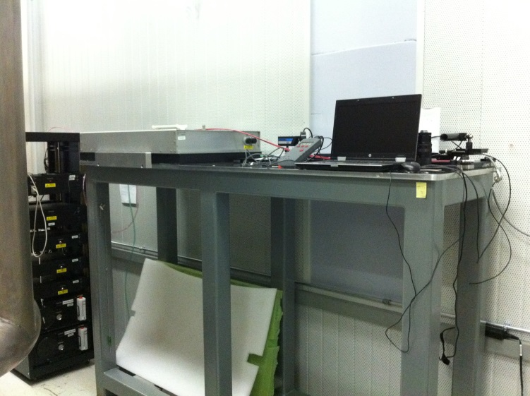
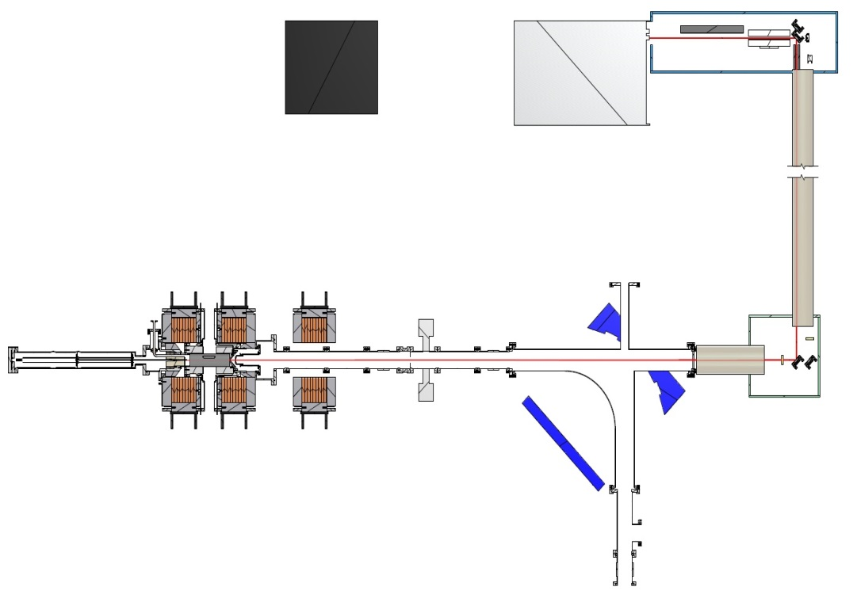
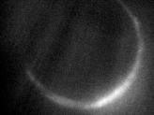
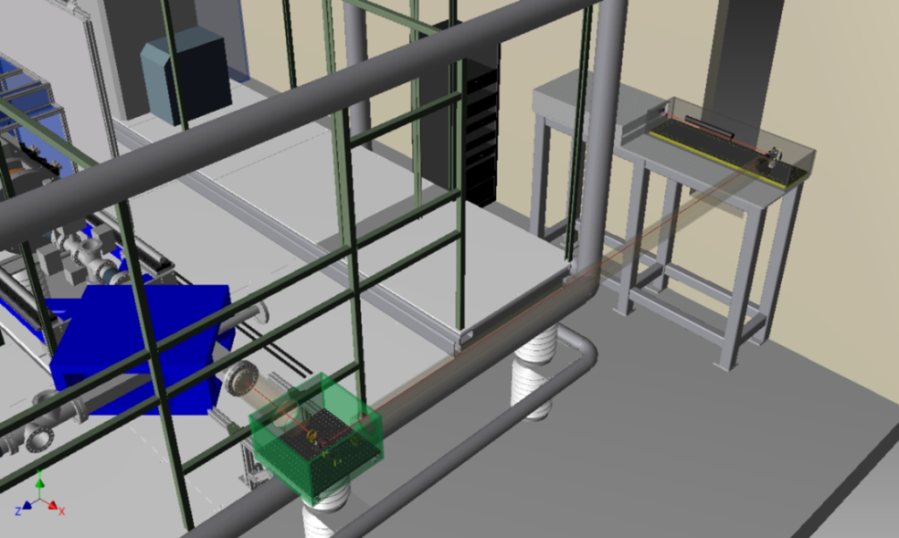
Laser Ablation into ECR Ion Source
3mm
Laser
ECR
Laser
Optical elements
Multisample Changer
Beam Out to Linac
5 mJ/pulse, 1064 nm,
10 picosecond pulses
0.5 mm diameter beam spot
Cos θ angular distribution
Laser placed off platform and focused through ECR with 4m lens
Laser reliability and performance still not as good as desired.
Bending magnet
Focusing lens
High voltage platform

Slide 10
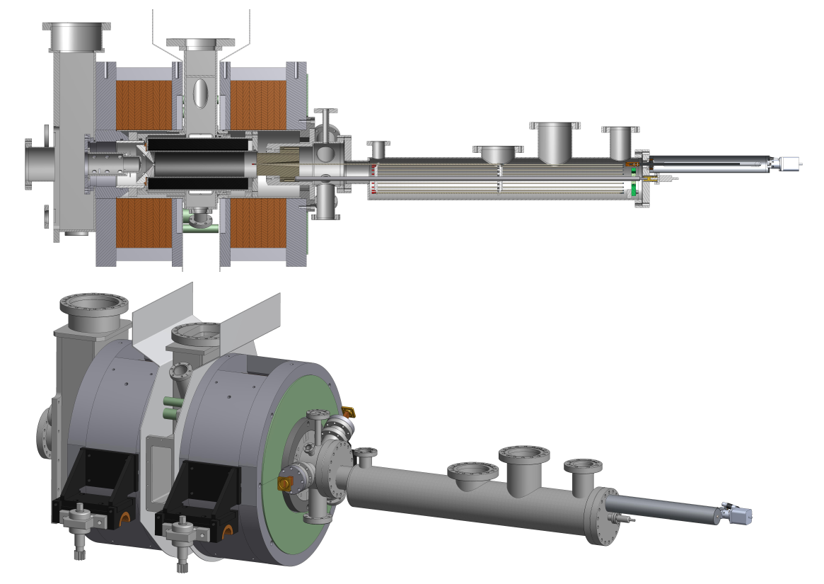
Multi-Sample Changer for Source
Multi-sample changer at ion source
20 samples on retractable rods
Allows rapid switching between samples
Positions samples slightly off-axis of source
First tests with changer have gone extremely well.

Slide 11
AMS Demands Benefit ATLAS Operation
The needs of the AMS program have driven significant improvements at ATLAS
Laser ablation of material into the source and Multi-sample changer
Successful development of laser ablation will benefit ATLAS Operation
Less source contamination
Ability to rapidly switch beams
Less start-up time
Control system improvements speed ATLAS beam changes.
All dipoles set by gauss
Magnetic quadrupoles set using a specific pattern to reduce hysteresis effects
Multiple (M/q) configuration stored
Rapid switching between configuration automatically by master clock
Normalization by beam current at source or base material measurement at detector
Precise attenuation with non-resonant beam sweeper.
Push to go to an M/q of 8 for the heaviest beams
Important for actinide AMS
Higher beam currents for other programs.
Runs for actual irradiation measurements should be ready to begin in August.

Slide 12
Summary
Use of ATLAS for Accelerator Mass Spectroscopy provides unique capabilities, especially for mid-mass regime
Actinide AMS with ATLAS makes use of in-place equipment and ion source expertise

Slide 13
MR-TOF for High Sensitivity Mass Spectroscopy

Slide 14
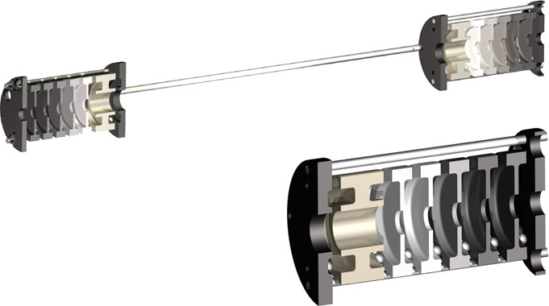
MR-TOF for Mass Spectroscopy

