Slide 1

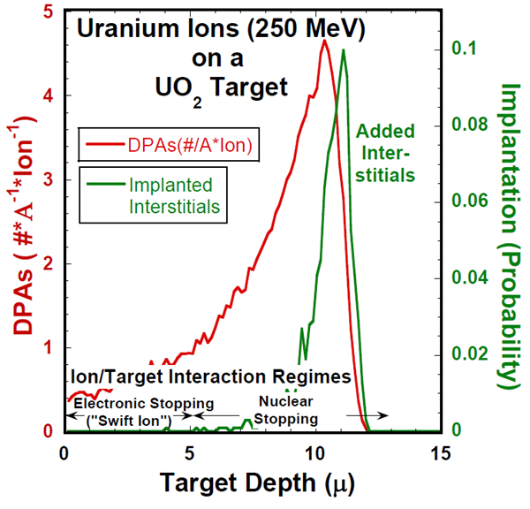
Extreme Materials (XMAT)
In Situ Studies of Materials in their working environments:
1) Ion – neutron equivalence (with theory)
* High peak damage and damage rates
* Rapid turnaround
2) Fission Fragment Damage for Fuels
Proposal for uranium micro-beam linac at the APS for reactor fuel and structural materials studies
1 MeV/u heavy ions up to uranium includes “fission fragments” such as Kr and Xe
MSD, NE, APS, PHY initiative
On-going studies at ATLAS
Bragg peak at 6 MeV/u

Slide 2

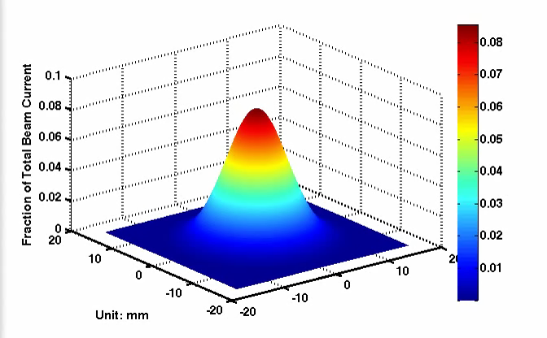
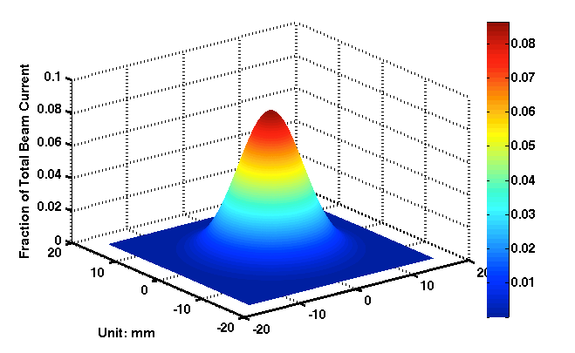
Xe Ion Irradiations of the fuel specimens at ATLAS
Ion irradiation – much higher dose rate compared to in-reactor irradiation
High Energy (compared to <1 MeV) – bulk irradiation damage (removal of surface effects)
High Energy Ion irradiation – realistic representation of fission fragment damage in nuclear fuels
Sides from Di Yun, NE
What is dose rate for an LWR?
10 mm dia. Aperture
Low dose
Ion Irradiation: ~100 dpa/day
Medium dose
High dose
Xe Ion Beam Profile
V.S.
~3000 times more efficient
High dose &
High dose rate
Stage in Position
Reactor:
~10 dpa/year
Medium dose & Medium dose rate
Adjusting the beam profile
Low dose &
Low dose rate
Reactor
Shutter
Quadruple Wire Scanner
Aperture
Magnetic Quadruple
Magnetic Quadruple
Beam Profile Control
Beam Profile Scan
Irradiation area control
Sample Stage
Notes:
The high-energy Xe Ion Beam irradiation experiment is described here.
The beam profile was measured by a Quadruple Wire Scanner, and it was controlled by the Magnetic Quadruple.
Then we adjust the beam profile to attain the various dose range we were aiming for: high dose with high dose rate, medium dose with medium dose rate, and low dose with low dose rate.
Here is the question: what is the dose rate for a Light Water Reactor, an LWR? Where is it in the beam profile? We want to study the materials staying in reactor for years. The ion irradiation is the most efficient way to study the irradiation damage for the materials. About 3000 times more efficient!
After adjustment, we inserted our sample stage in a position where beam will hit. Then we opened the shutter and let the beam hit the aperture. We are using the aperture to control the beam size to get the 10mm diameter beam. All 19 samples of different fuel materials were irradiated by ONE SINGLE ION BEAM
Finally, our samples were irradiated to different dose with different dose rate. Each one of the samples get a great amount of dose per day, even the one in the outer ring of low dose get 10s of dpa per day.

Slide 3
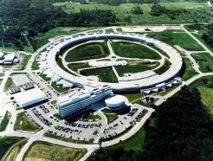
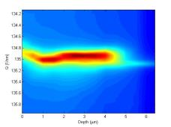
X-ray characterization of irradiated fuel specimens
Example: irradiation induced fuel swelling
APS Sector 34
Micro-beam: 0.5×0.5 μm²
Characterization of High Energy Xe Ion Damage in U-10Mo Metallic Alloy Fuel
Micro X-ray Diffraction
Measurement
Measurement
Computation
Depth
Surface
Computation
U-Mo
Xe Ion Irradiations
Depth
Surface
Notes:
With the ion-irradiated specimens, we have used the state-of-the-art technique, the synchrotron radiation technique to study the irradiation damage.
The next two slides describe some examples of the experiments for using synchrotron X-ray to analyze irradiation effects in nuclear fuel and cladding materials.
Our U-10Mo Metallic Alloy Fuel samples have been ion-irradiated (with Xe) at ATLAS, shown in last slide. We would like to probe the damage region experimentally and computationally as well.
One of the limitations for using ion irradiation to study irradiation effects in materials is the range of ion damage, usually within several microns. We need a technique with sub-micron probe size and high flux with 3D mapping. These are necessary to analyze the ion damage in such a small region.
Where can we get this probe? At sector 34 of the APS. No where in the world except APS can provide a high-flux X-ray with 3D mapping and sub-micron resolutions. This is also called micro-diffraction. The beam size is 0.5 micron. From the micro X-ray diffraction pattern (the color picture), we can directly probe into the region modified by ion damage, from either peak broadening or lattice strain. These information provide key insights to the understanding of the irradiation induced fuel swelling. The results also provide direct proof of our simulation. (Lower right sigures)

Slide 4

X-ray characterization of irradiated cladding specimens
Example: irradiation induced hardening
40 dpa
ATLAS experiment:
  Target temperature: 400ºC
  Dose: 40 dpa at the sample gauge
  Ion source: Iron, 86 MeV
APS experiments:
  In-situ tensile study (stop for in-depth X-ray scan)
  Irradiated zone VS. unirradiated zone
ATLAS Ion irradiation
Applied Stress
Unirradiated zone
Peak broadening
X-ray diffraction scan
Irradiated zone
High-energy X-ray
Dose
Damaged region: 8 μm from surface (estimated by SRIM )
Irradiated zone
Lattice straining
Unirradiated zone
surface
APS experiment
Notes:
We also irradiated nuclear cladding materials, specifically, HT-9, a fast reactor cladding, with iron self-ion irradiation at ATLAS. The objective of the experiment is to investigate the irradiation induced hardening in this material. After the ATLAS irradiation, we performed in-situ tensile experiment at the APS, sector 1-ID, with high energy X-ray. The figure on the top right gives a schematic of the irradiation dose delivered to the specimens. The damage region is about 8 micron into the irradiated surface. We measured the diffraction peak broadening and lattice strain of the damaged region and compared with those of the un-irradiated region (figures on the bottom right). It is evident that dislocation density in the ion irradiation damaged region was much higher than un-irradiated region before loading. Dislocation density increased systematically with increased load for the un-irradiated region while the dislocation density of the irradiated region stayed nearly un-changed which is a reflection of the effect of hardening. At necking, the bulk (un-irradiated region) dislocation density reached the level of dislocation density of the irradiated region. Lattice strain was also observed to increase systematically in the bulk region upon loading while it stayed nearly un-changed for the irradiated region. This is another reflection of the effect of irradiation hardening.

