Slide 1
ATLAS Capabilities Today
May 15, 2014
Richard Pardo

Slide 2
Outline
Overview of ATLAS Intensity Upgrade
  Phase I: RFQ installation and PII reconfiguration
  Phase II: New Booster cryostat and reconfiguration
  Main goals:
    Improved transmission
    Excellent high current performance
Current
  Un-irradiated samples used to test laser/ECR performance
    Yield check
    Background check
  Test accelerator system scaling improvements
  Test overall ‘clock’ program
  Test FMA/detector system
  Explore operating mode options

Slide 3
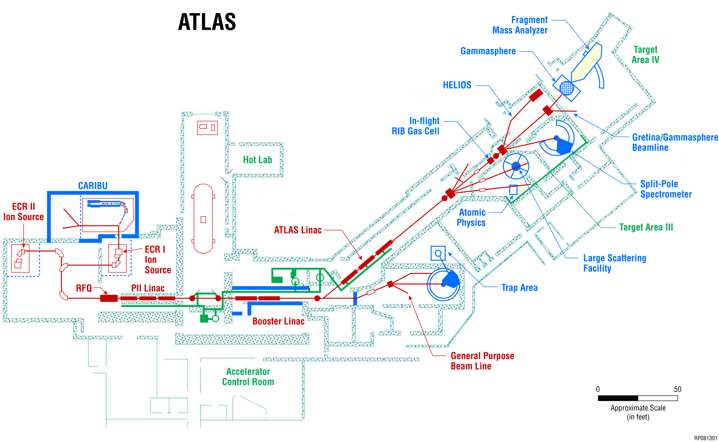
ATLAS Upgrade Activities: Two Phases
Improved transmission
Good high current performance
Phase I
January 2013
Phase II
March 2014

Slide 4
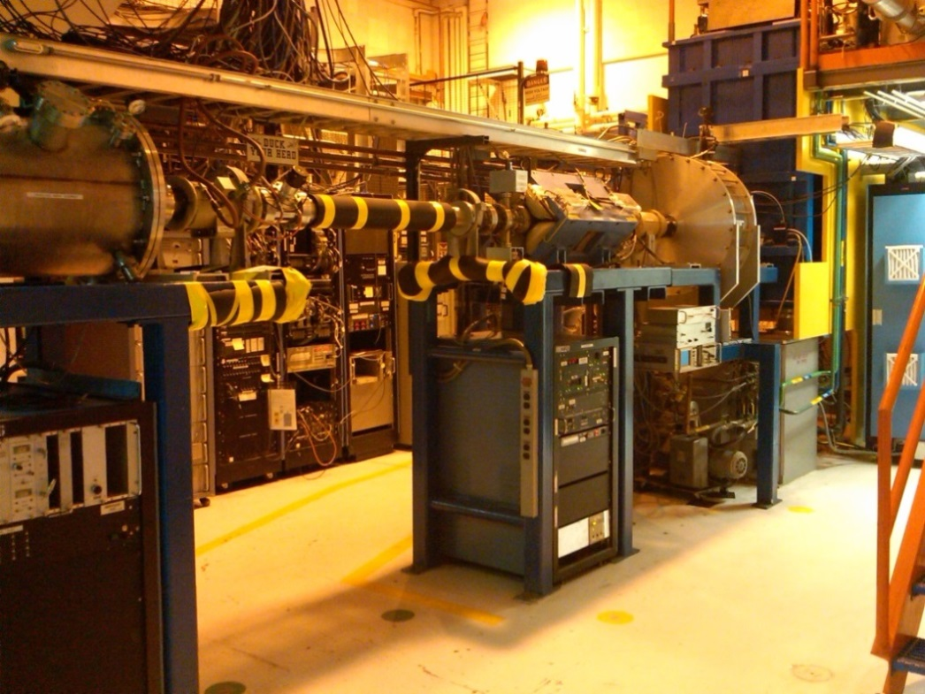
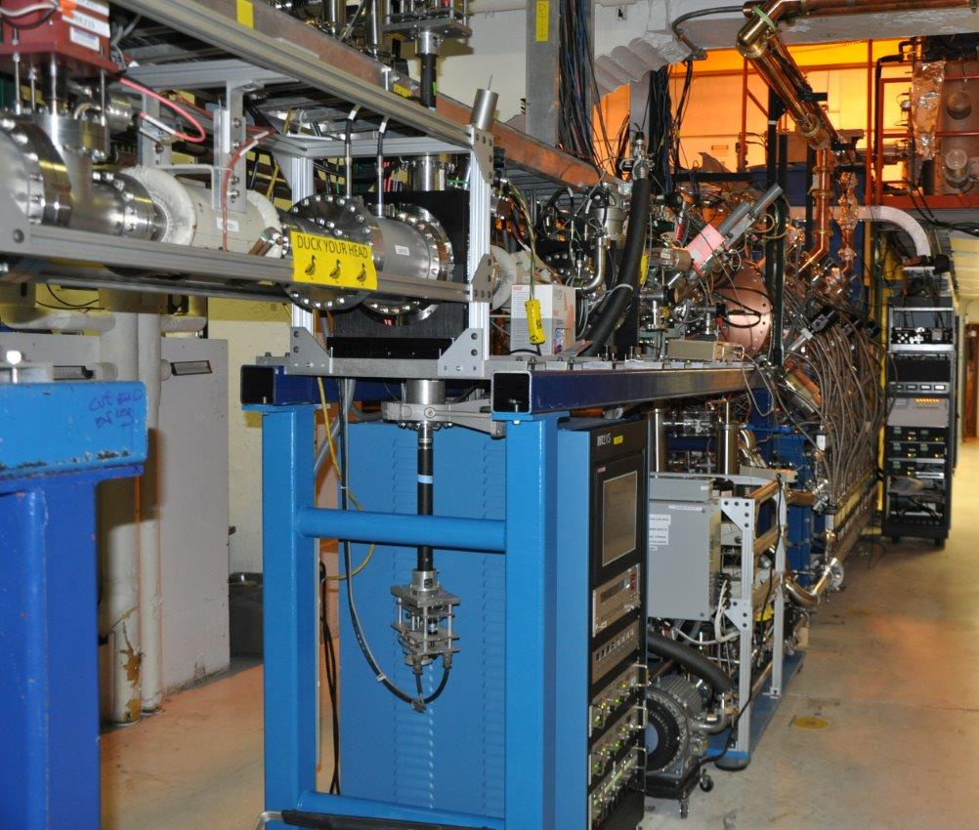
ATLAS Upgrade Project – Two Major Phases
Phase I: Replace first three linac resonators with new RFQ linac section
  Completed in January 2013
  Ran accelerator from January to May 2013
  Included March 2013 MANTRA test run
  Excellent overall performance
  Planned improvements
    Circulators to protect RF Amplifiers at high power
    Full computer control and monitoring
  Before After

Slide 5
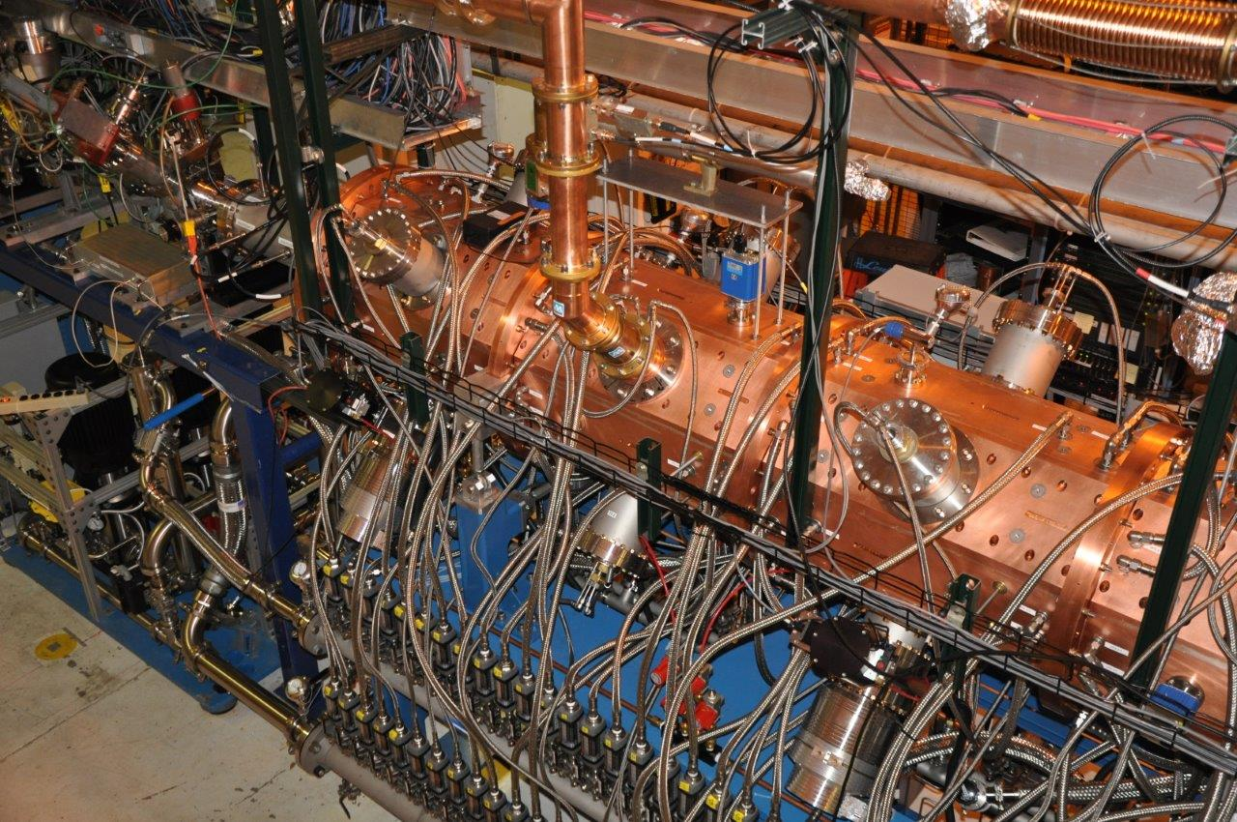
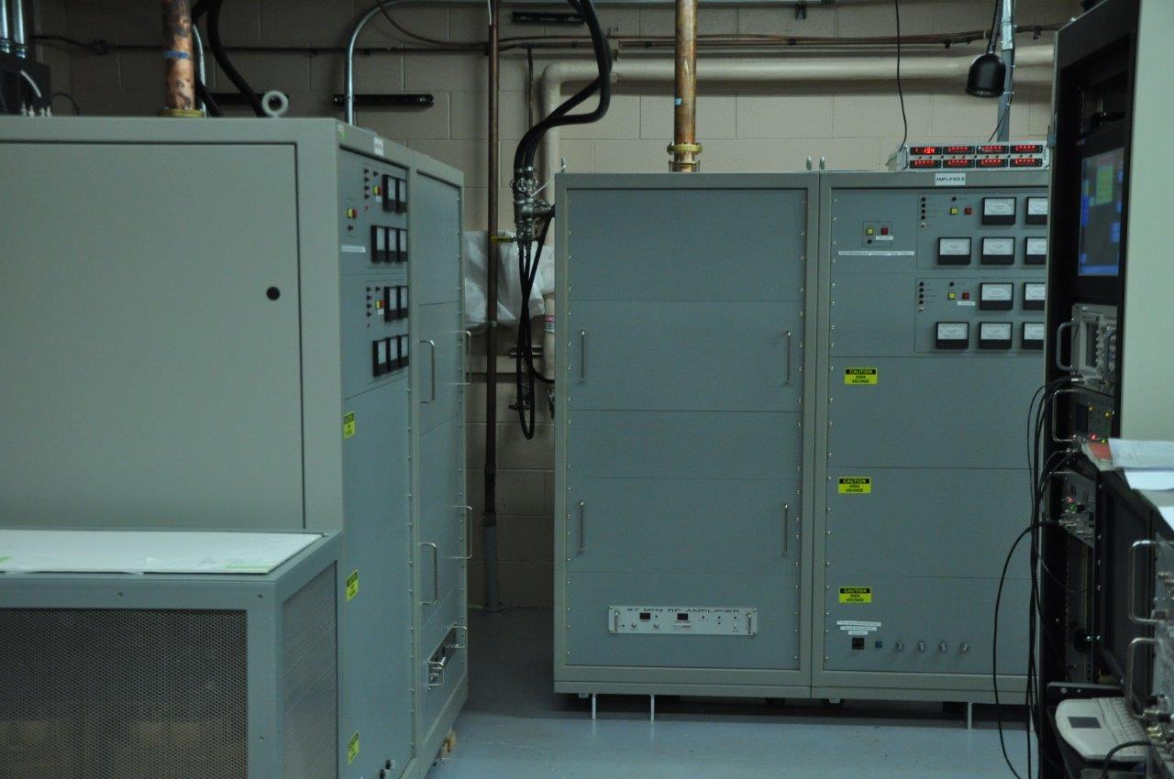
Top view of new RFQ Linac

Slide 6
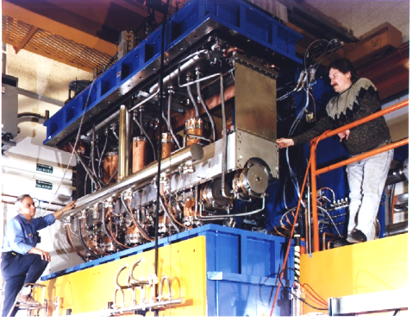
PII cryostat reconfiguration
RFQ output energy is 293 keV/u
First three PII resonators have bad effect on beam optics
Therefore these resonators were retired from use in PII
Beam

Slide 7
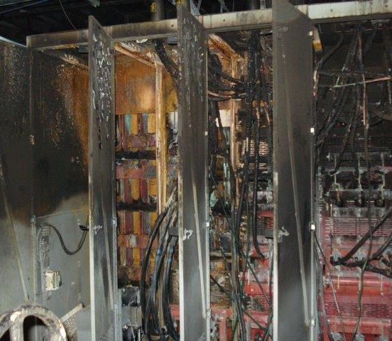
Phase II: Center (“Booster”) Section Rebuild
Accelerator shutdown began in last days of May 2013
Early start due to complete failure of major ATLAS Power Substation
  Relatively new substation
  Loose high-current connectors (???)
  Full power restored in October 2013
Complete disassembly and rebuild of the center of the accelerator
  New cryostat of seven resonators (7 new resonators replaced 16 old resonators)
  World-record accelerating field performance
Restart of facility began in January 2014
  PII beam acceleration and low-energy irradiation.
“Full” operation restored March 2014
Over $1M total cost to Laboratory

Slide 8
ATLAS Upgrade Activities: Second Phase
New Booster Cryostat and complete Booster Rebuild
Phase I
Phase II

Slide 9
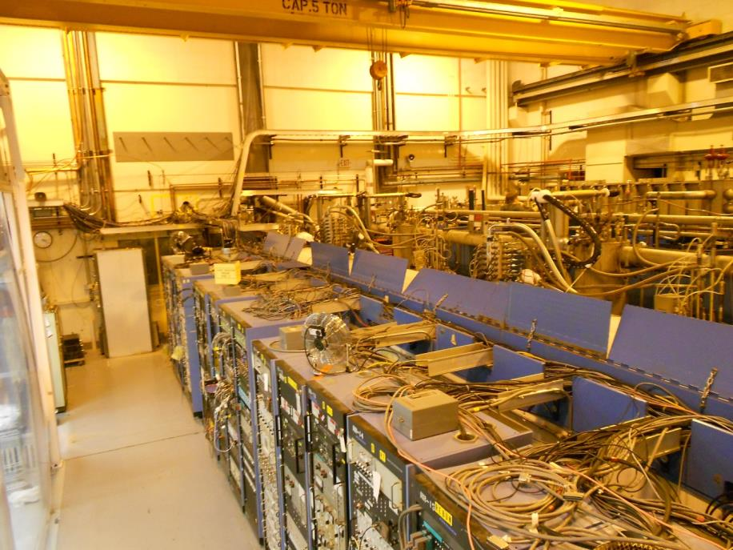
Before Project “Booster” Room
Booster Room June 10, 2013

Slide 10
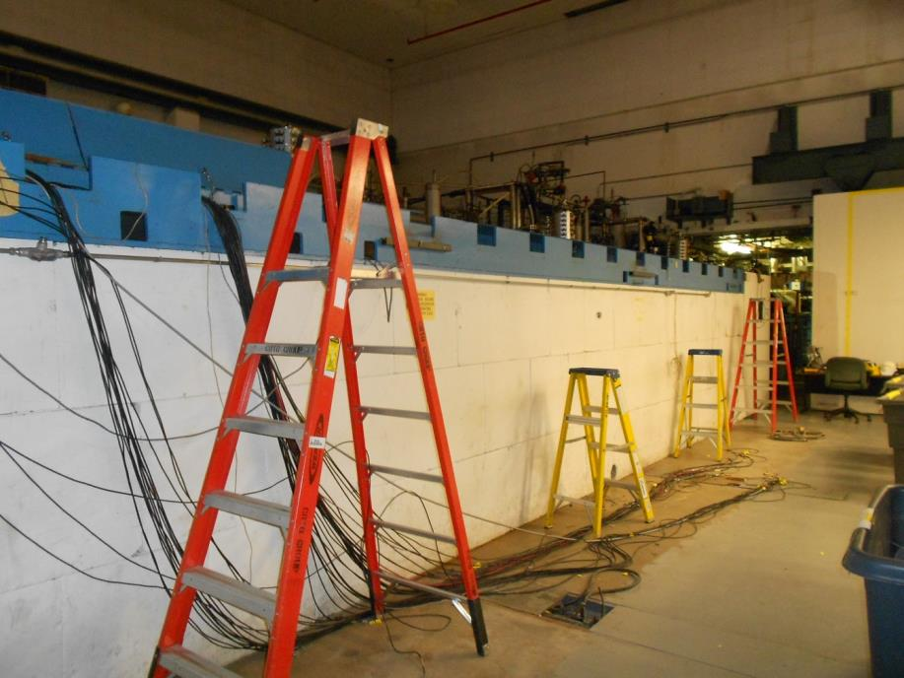
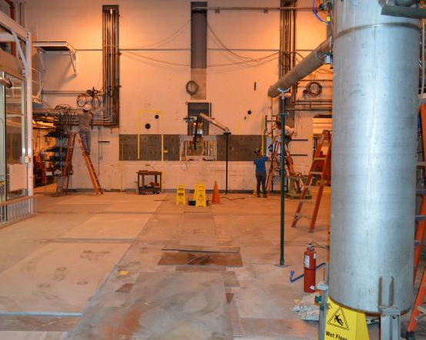
Booster Upgrade Progress
June 12, 2013 August 8, 2013

Slide 11
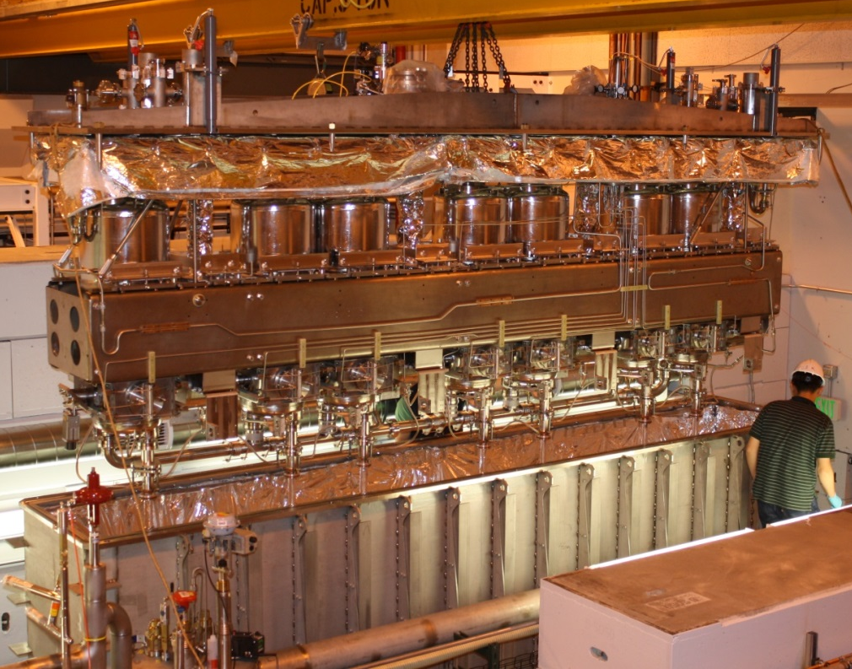
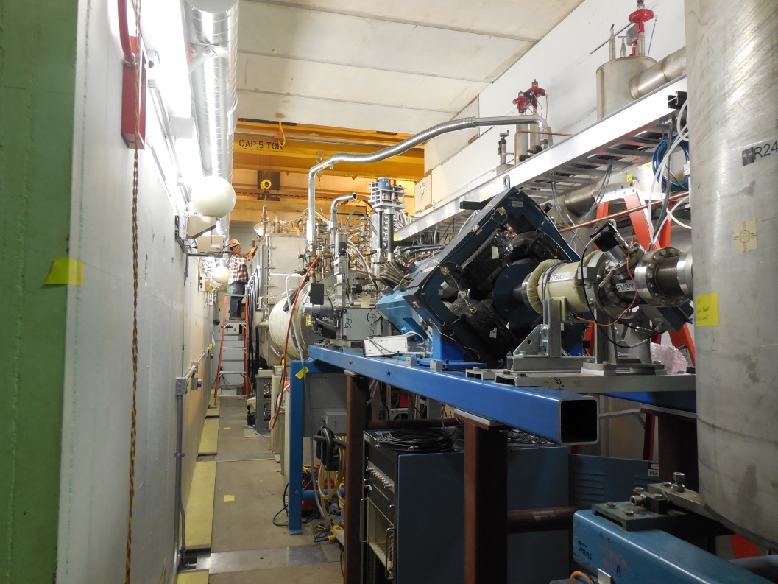
Phase II: Center (“Booster”) Section Rebuild
November 2013 January 2014

Slide 12
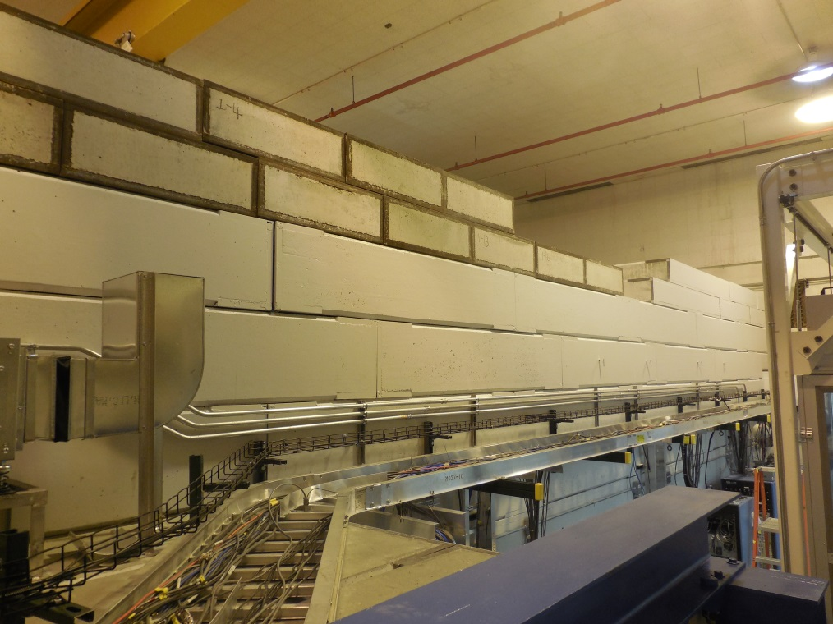
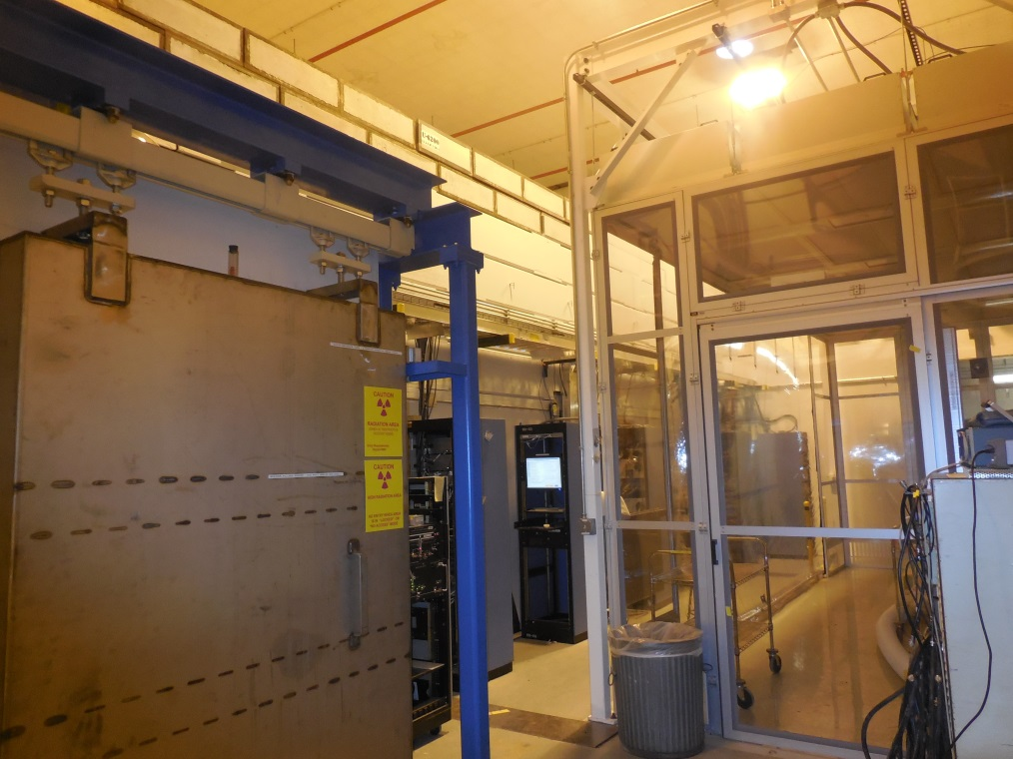
Phase II: Center (“Booster”) Section Rebuild
March 2014 April 2014

Slide 13
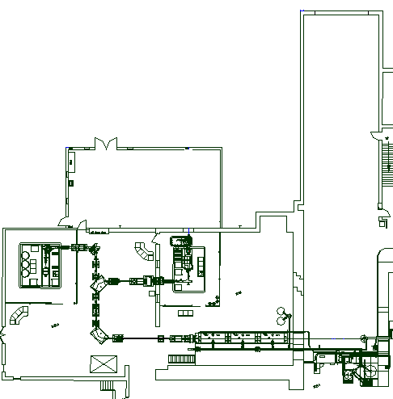
Facility Configuration Changes
Tandem now retired
  All beam lines disconnected
  Beginning the process of SF₆ disposal
  One lab interested in entire tandem system
Tandem vault plans
  South section for ATLAS operation
  North section for ion source and Accelerator R&D Development
  Central section for expanded stopped beam research area
Ion Source and Accelerator Dev.
New low-energy experimental area
ATLAS Operations
EBIS

Slide 14
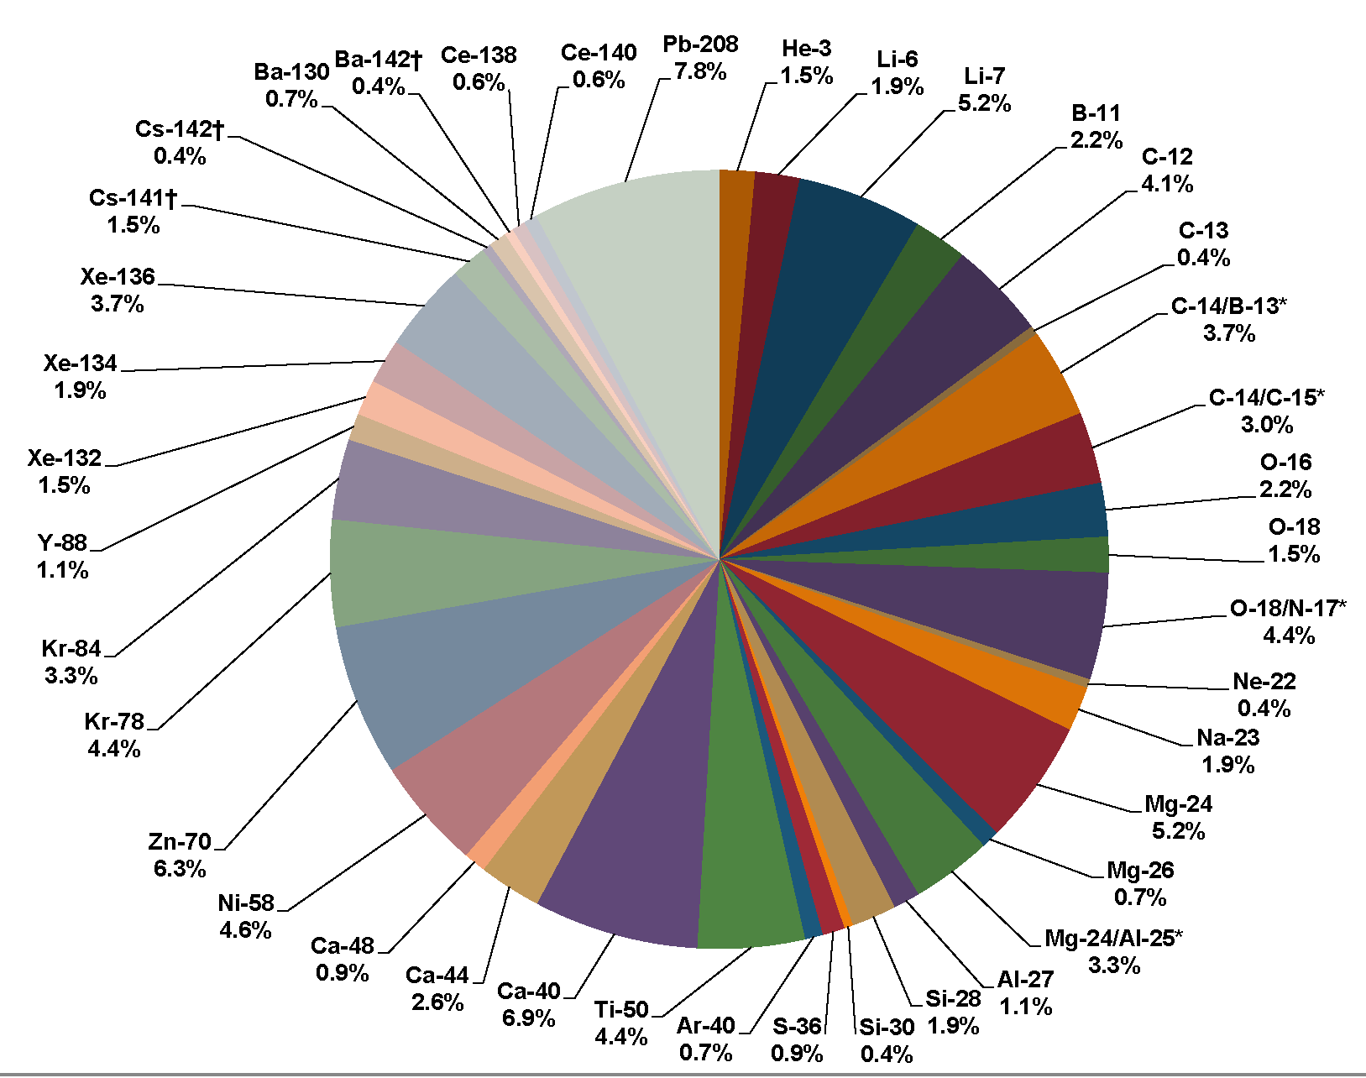
ATLAS Present Beam Properties
ATLAS Beams for FY2012
Beam Types
Any stable isotope beam available
  In principle.
  See ATLAS website for current ‘normal’ list.
In-flight Radioactive Beams
  Charge exchange, 1-2 nucleon transfer.
  20 isotopes produced so far.
  Poorer beam quality than stable ions
    Purity
    Energy spread
    Emittance and beam size
CARIBU Fission Fragment Beams
  Goal of routine operation by end of 2014.
  Beam properties same as stable ions
  See later talk on overall status.
High Current performance
  Long term goal measured in pμA at target (eventually ~10 pμA )
  Recently demonstrated up to 7 pμA through PII

Slide 15
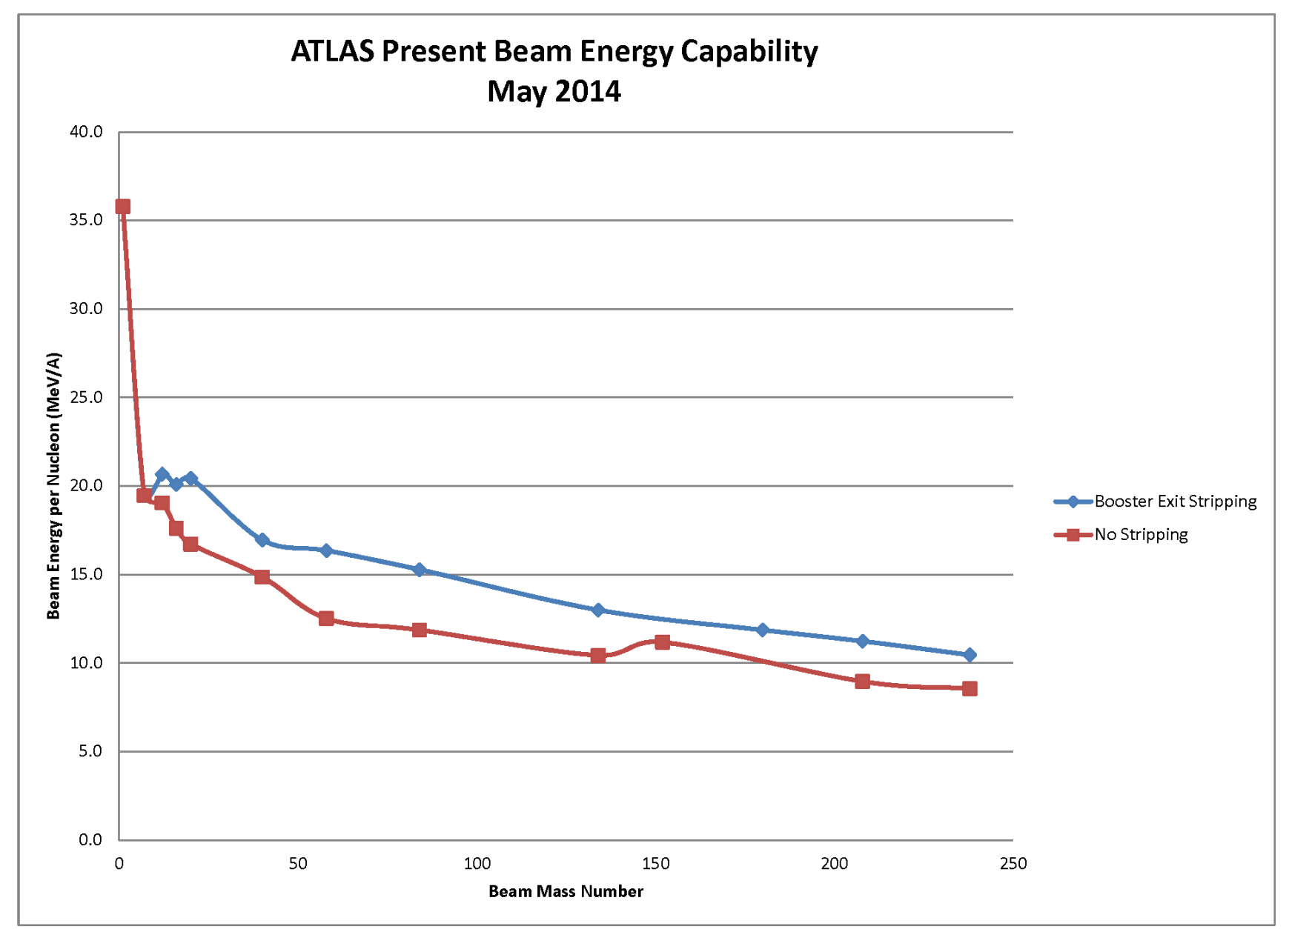
Available Beam Energy
*
* ATLAS Operations Envelope limits all beams to energy < 23 MeV/A

Slide 16
Summary
ATLAS has now returned to full technical operation
All major capabilities are now available
  Some further improvements are ongoing
  Major facility improvements underway or actively planned:
    AGFA
    EBIS (and move of RF test facility)
    AIRIS
    Tandem removal and changes to vault
Four new operators are in training
  Limits operation to 5.33 days/week
  Additional operating time should be possible in July.
  Full staff restored by October 2014.

