Slide 1
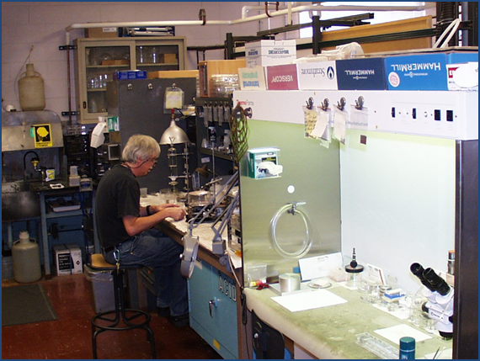
A Proposal for the Future of the Physics Division Target Laboratory: (CATS)
John P. Greene
Target Development Engineer
Argonne National Laboratory
Physics Division
"A unique asset of the ANL program is their target manufacturing capabilities. This expertise at ANL allows highly specialized targets to be prepared for various beam experiments at many laboratories. It is important that these capabilities be maintained given the continuing demands for such targets."
Report of the NSAC Subcommittee on Low Energy Nuclear Physics, November 15, 2001

Slide 2
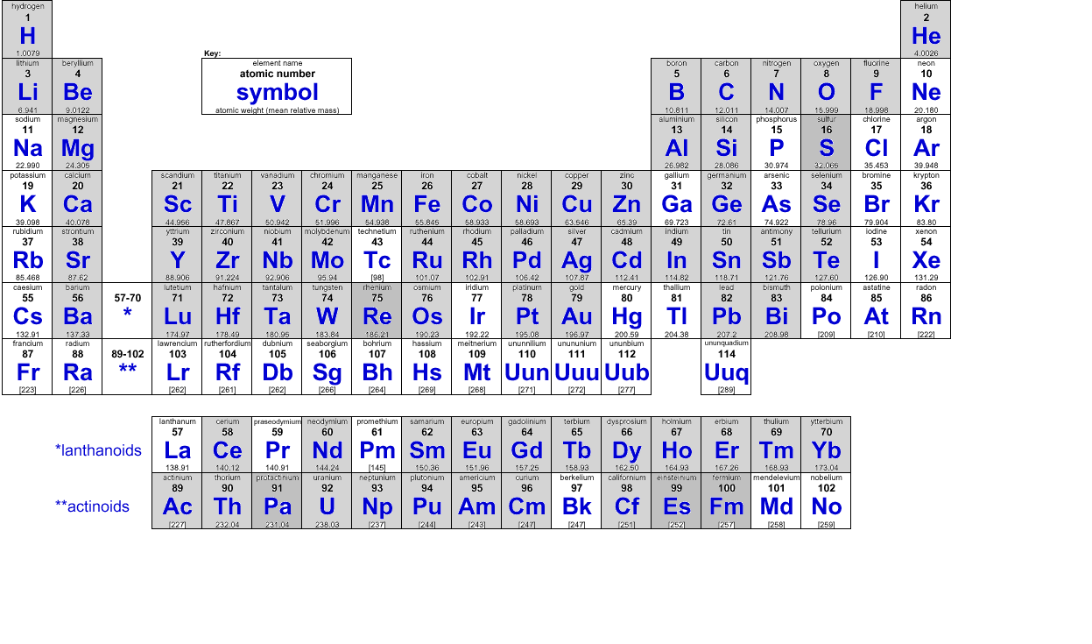
Physics Division Target Laboratory
Introduction & Overview
The Physics Division operates a target development laboratory that produces targets and foils of various thicknesses and on substrates, depending on the requirements, for experiments performed at ATLAS.
The targets are prepared from both naturally occurring materials and stable isotopes that are supplied either in pure, elemental form or as chemical compounds. Targets are made not only for the Physics Division but also for other divisions at the Laboratory and occasionally for other laboratories and universities.
for a description of the target lab, see - NIMA 282 (1989) 191-193, NIMA 362 (1995) 201-204
" Finally, an urgent need that cuts across the whole experimental program now and in the future is the capability to have enriched stable isotopes for targets and the manpower and expertise to fabricate these essential targets. After investing so significantly to create such exotic beams together with building the sophisticated detector systems needed to record the reaction signals, we must not forget that without the right target, an experiment will not be successful. This target capability has largely been ignored by most laboratories, but is critical to the future of our subject. This issue must be considered and discussed as the community moves to new and upgraded RIB facilities.“ HRIBF White Paper, January, 2010
2

Slide 3
Physics Division Target Laboratory
Introduction & Overview
http://www.phy.anl.gov/targetlab

Slide 4
A Proposal for the Future of the Physics Division Target Laboratory:
The National Center for Accelerator Target Science (CATS) - Janssens, Greene
Introduction (…a little history)
Over the past decade the need for targets for the low-energy nuclear physics community was expressed in several venues; user meetings & workshops, operational reviews, etc. With recent lab closures the demand for challenging targets has been increasingly difficult to address. In addition, the number of people producing targets has dramatically diminished. There is a real risk that the required knowledge & expertise will no longer be available in the near future.
Serious discussions took place at the Low Energy Community Meeting at ANL in ‘12
  Target Laboratory Presentation, ANL August 17-18, 2012
  an ad-hoc Working Group was established
Target Laboratory Questionnaire
  Written responses were received from 20 individuals & institutions
2013 Science & Technology Review at ATLAS
  Target Laboratory Proposal was presented

Slide 5
A Proposal for the Future of the Physics Division Target Laboratory:
The National Center for Accelerator Target Science (CATS) - Janssens, Greene
Target Lab Questionnaire (2012)
The purpose of this note is to try to identify more precisely the target-making needs of our community. In preparation of the upcoming Low Energy Community meeting, we are interested in your opinions on this matter. Specifically, we would appreciate your views on the following questions:
(1) What are your current target needs (types of targets, number required per year, etc.)?
(2) At the present time, how are your target needs met (who makes them, how reliable is fabrication, is timely delivery a challenge, etc.)?
(3) Would you support the creation of a national target-making facility? If so, how would the concept proposed at last year's User meeting have to be augmented or modified to fulfill your needs?
We very much hope to hear from you. As we plan to present the findings at the dedicated session during the upcoming Low Energy Community workshop.
We thank you very much in advance for your input!
Sincerely yours,
John P. Greene and Robert V.F. Janssens

Slide 6
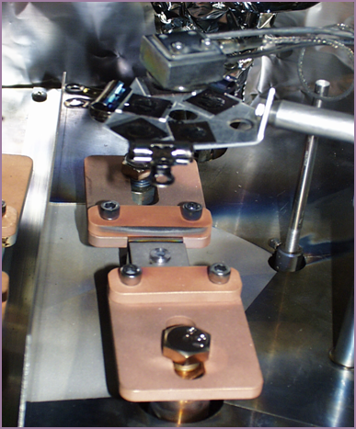
A Proposal for the Future of the Physics Division Target Laboratory:
The National Center for Accelerator Target Science (CATS) - Janssens, Greene
OBJECTIVES
Serve the low-energy community by producing targets whenever possible by either manufacturing them or by directing requests to other facilities best able to perform the task
Train individual investigators and students in target making in order to provide a workforce capable to address present and future needs
Carry out R&D activities dedicated to novel production techniques and optimization of existing ones
Develop an inventory of existing targets as well as stable isotope that will serve as a pool available to the community
Evaporation set-up for isotopic Te deposition onto C backing foils
NIMA 590 (2008) 76-78

Slide 7
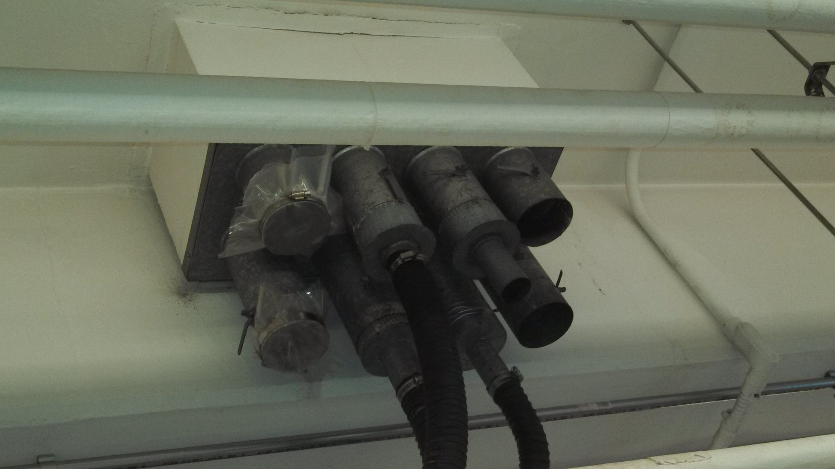
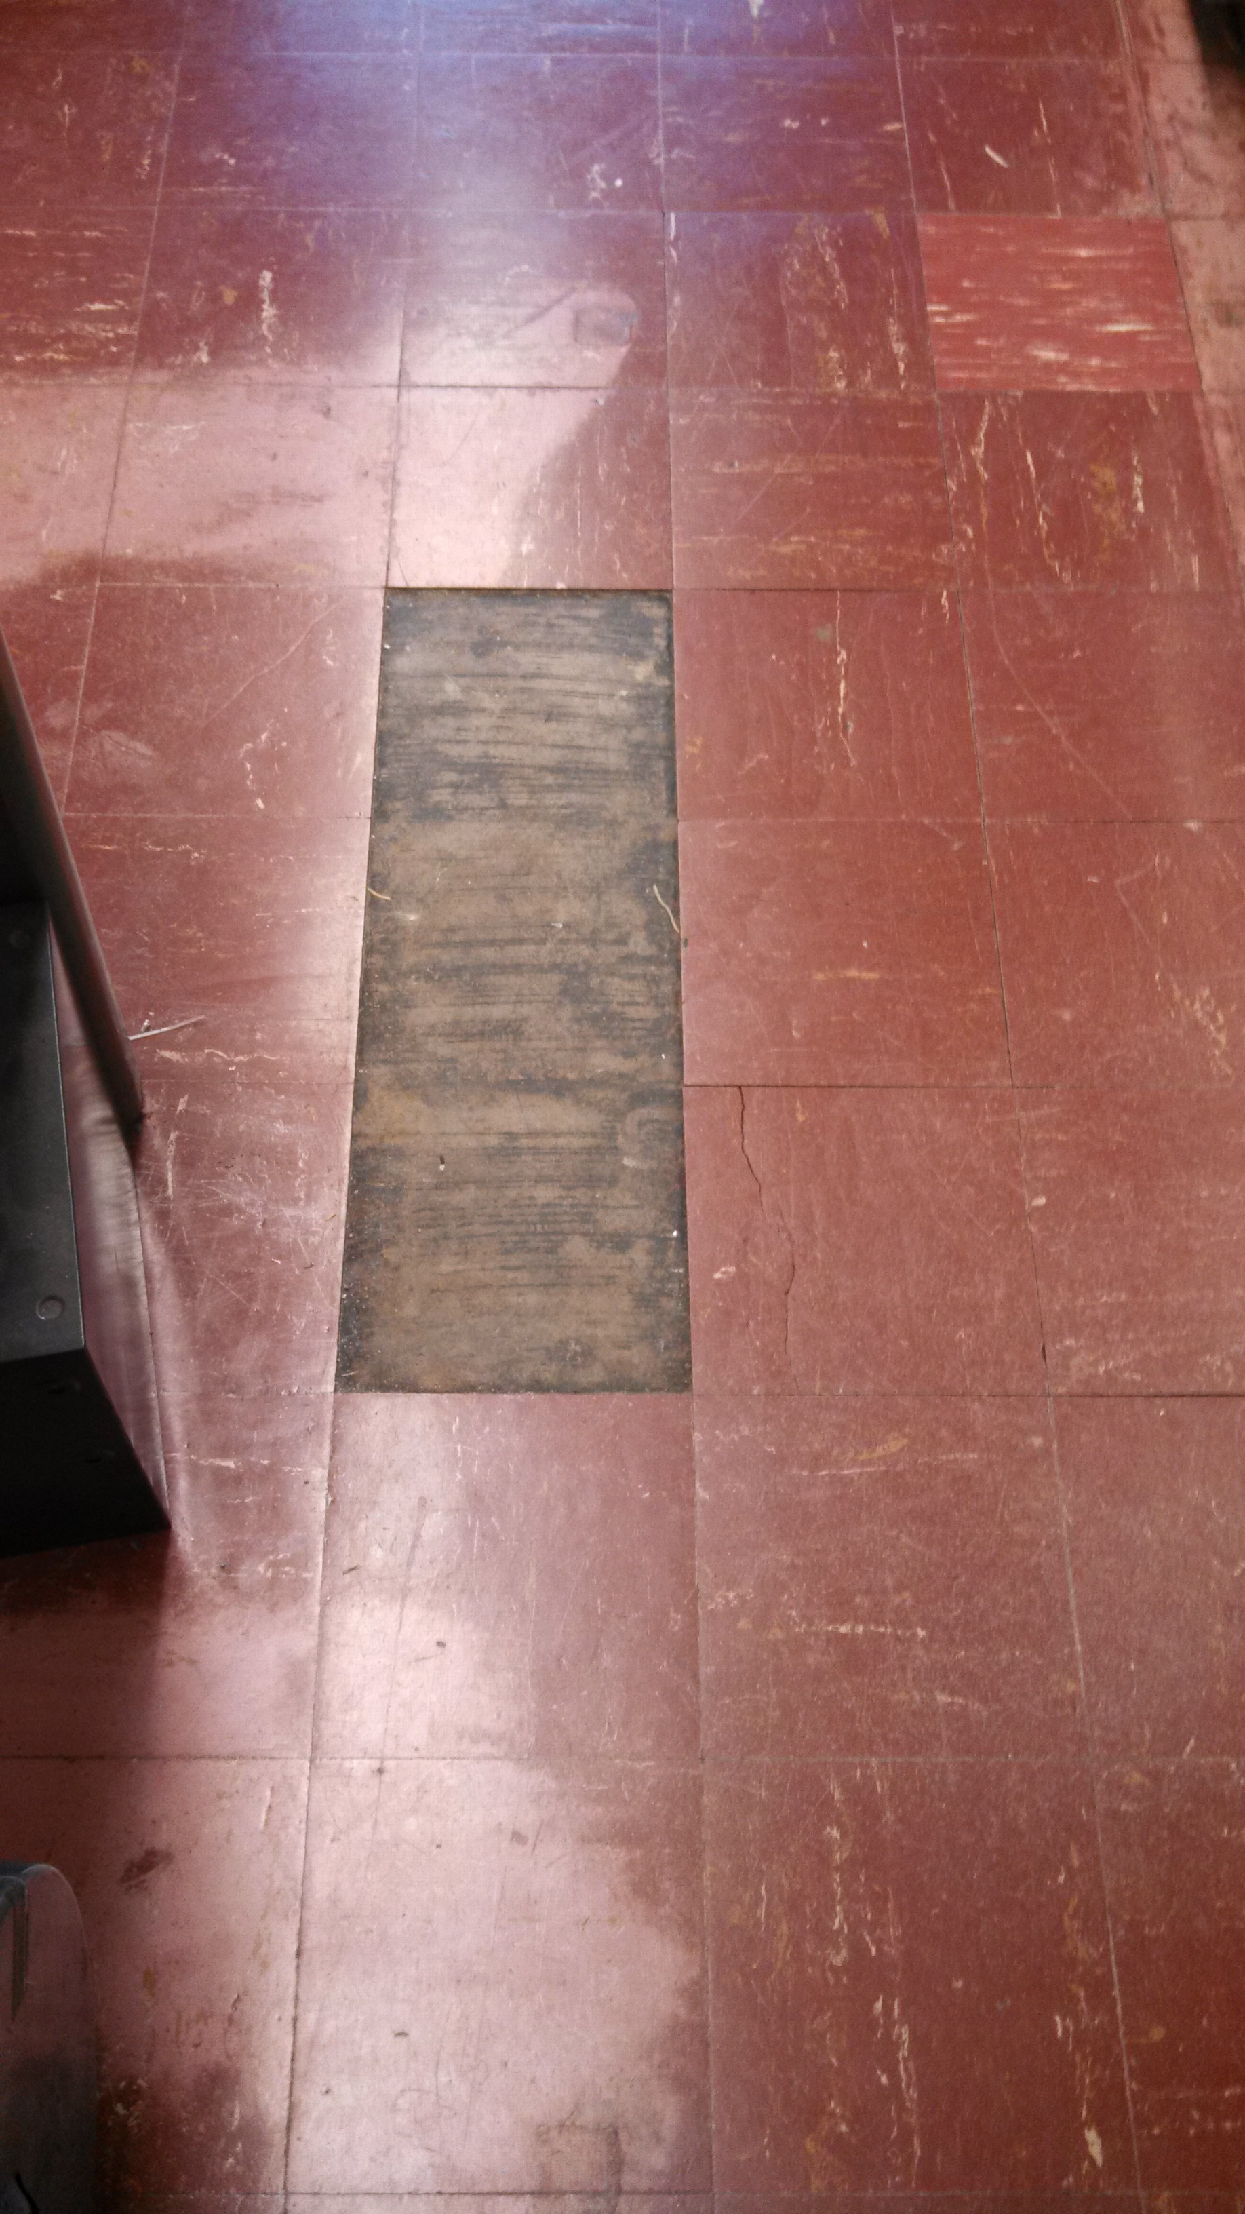
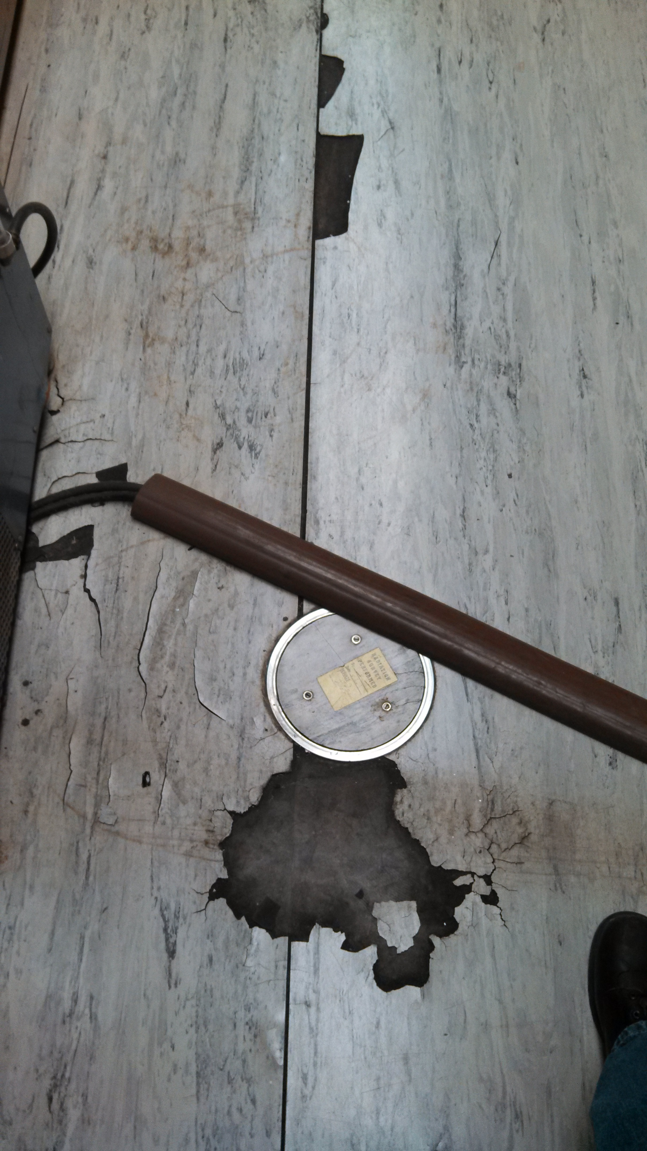
A Proposal for the Future of the Physics Division Target Laboratory:
The National Center for Accelerator Target Science (CATS) - Janssens, Greene
A Path Forward: Equipment
  New electron beam evaporator
    Currently investigating vendor proposals
  Refurbish pumps and exhaust systems
    Additional electrical utilities
  Existing radioactive target facility upgrade
    Recycle surplus evaporator(s)
    Install utilities / replace flooring
A Path Forward: Manpower
  Postdoctoral Fellow
    Background in Nuclear Chemistry
  Continued student involvement
  Visiting scientists (from INTDS, etc…)
    Training new target practitioners
Vacuum pump exhaust system – R154
Flooring – R154
Flooring – H174

Slide 8
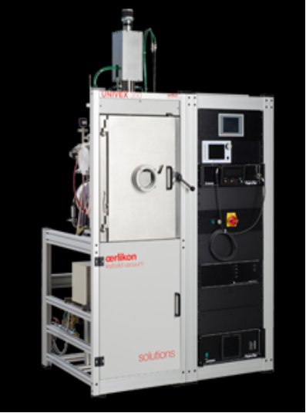
A Proposal for the Future of the Physics Division Target Laboratory:
The National Center for Accelerator Target Science (CATS) - Janssens, Greene
A full proposal was written (Janssens)
  Circulated first in-house
  Distributed to the low-energy community for comments
Overwhelming support from many institutions
Proposal was submitted to DOE NP November 22, 2013
Initial feedback from DOE was to contact the radioisotope production folks (BNL & LANL)
  Response from LANL - proposal collaboration for Sb targets
Oerlikon UNIVEX 350
Universal Lab Coater

Slide 9
A Proposal for the Future of the Physics Division Target Laboratory:
The National Center for Accelerator Target Science (CATS) - Janssens, Greene
Commercial & Specialist Suppliers
  Isotopic materials
    Oak Ridge Isotope Sales
      Maintains full fabrication capabilities
      HFIR for actinide depositions
    Trace Sciences International
      Limited fabrication capabilities
    Gases – Isotec, (now) Aldrich
    Carbon foils (including ¹²C & ¹³C)
      ACF-Metals, Incorporated
    Micro-foils Company
      Offering remaining Karasek inventory
  Metal (mono-isotopic) foils
    Goodfellow USA
    Alfa-Aesar
  Plastics (for CH₂)
    Goodfellow USA
  Large area Al foils (CARIBU)
    Advent Research Materials

Slide 10
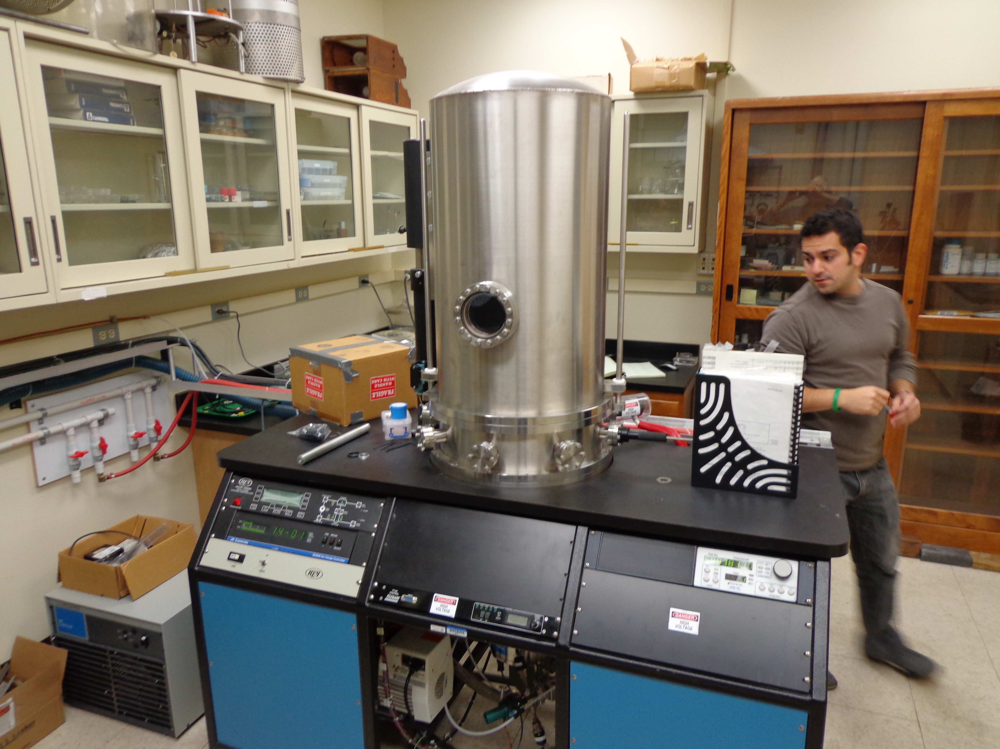
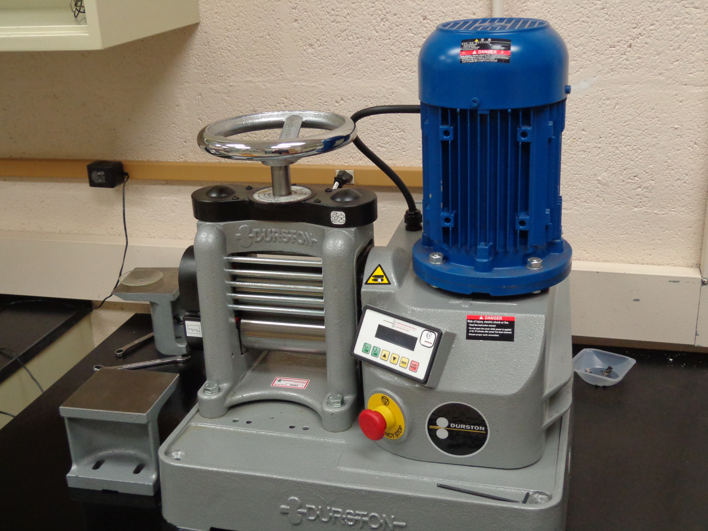
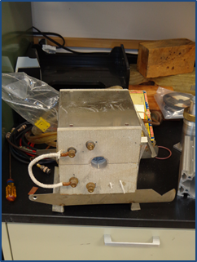
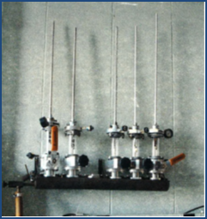
Outreach to the Community
Notre Dame Target Lab
  Helping with equipment procurement
    Electron Beam Evaporator
    Rolling Mill
  Training target maker
    One trip to Notre Dame so far
    Their target maker will visit ANL
  Providing assistance as needed
    Targets (especially for student thesis projects)
    Technical Support
  Providing surplus equipment
    Reduction Furnace from µMatter
    Vacuum Target Storage from Stonybrook

Slide 11
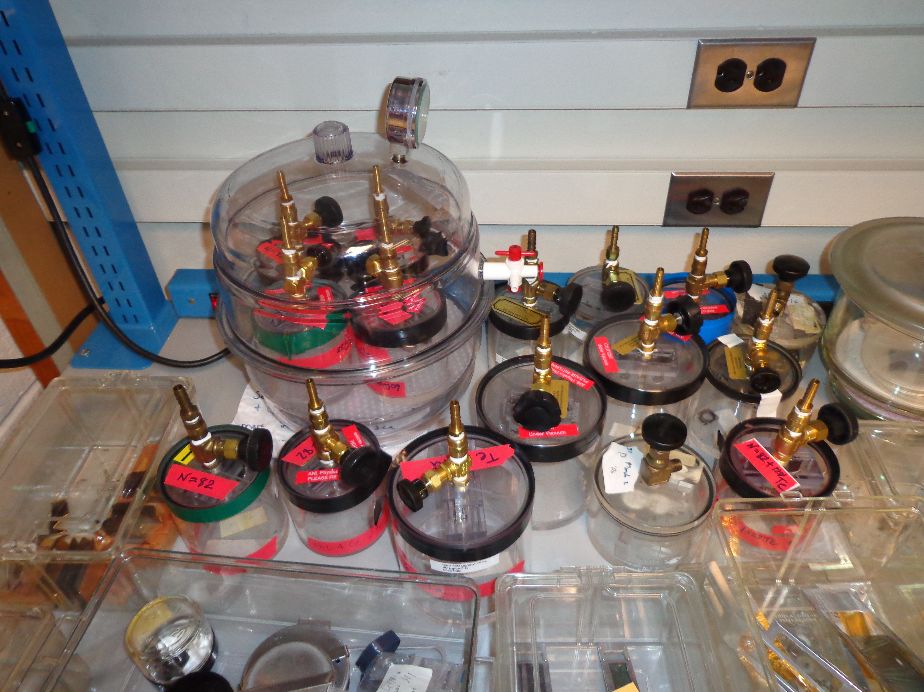
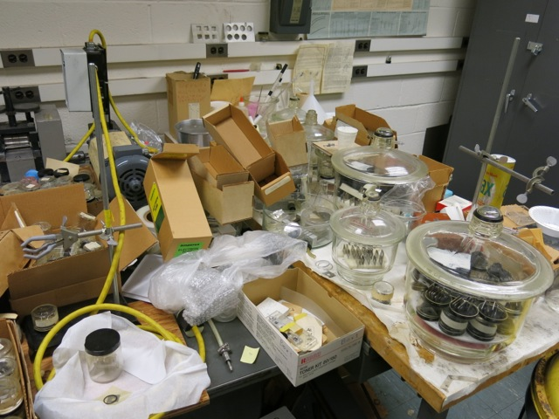
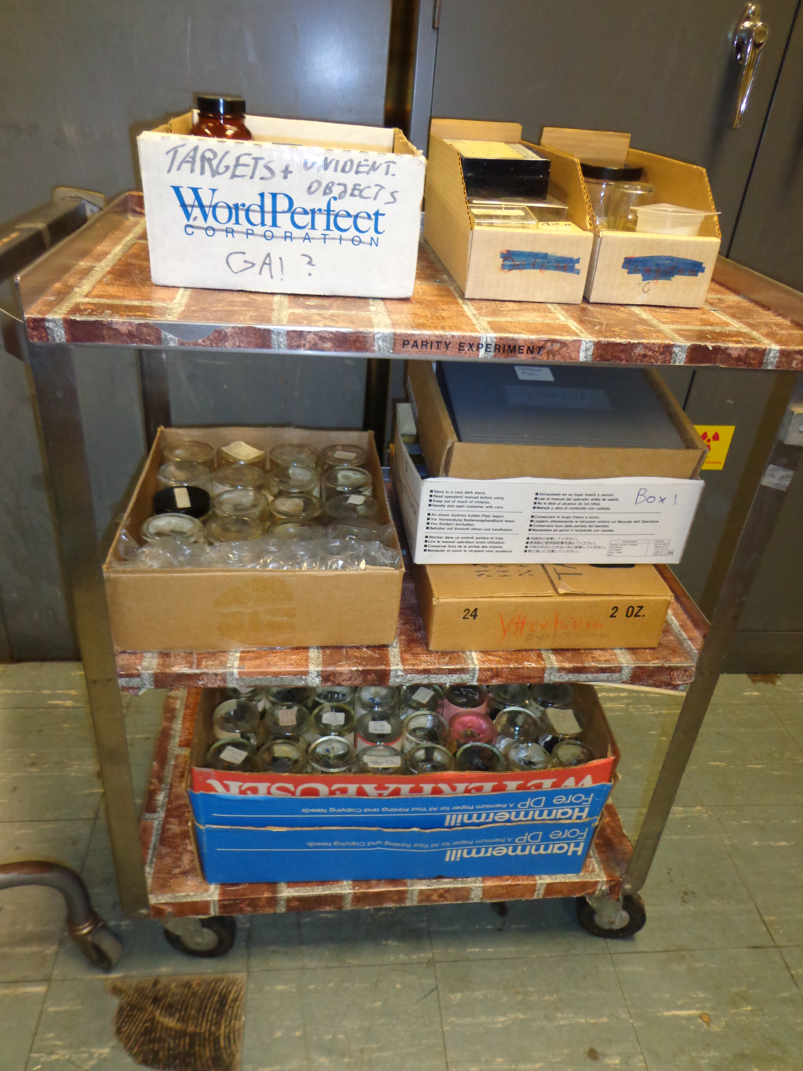
Outreach to the Community
WNSL, Yale
Target and Separated Isotope
  Rescue & Recovery
  Work out details with Yale & DOE
  Organized Lab/targets
Physics Div. targets returned to ANL.
Organized into targets worth saving.
Returned to ANL.

Slide 12
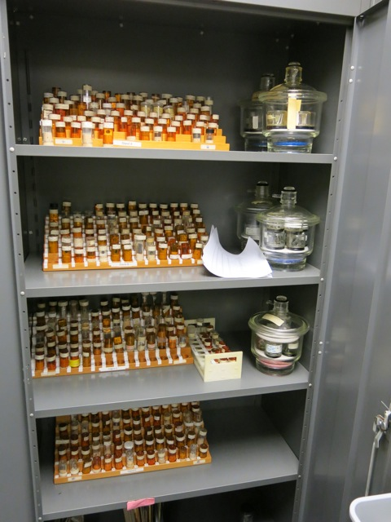
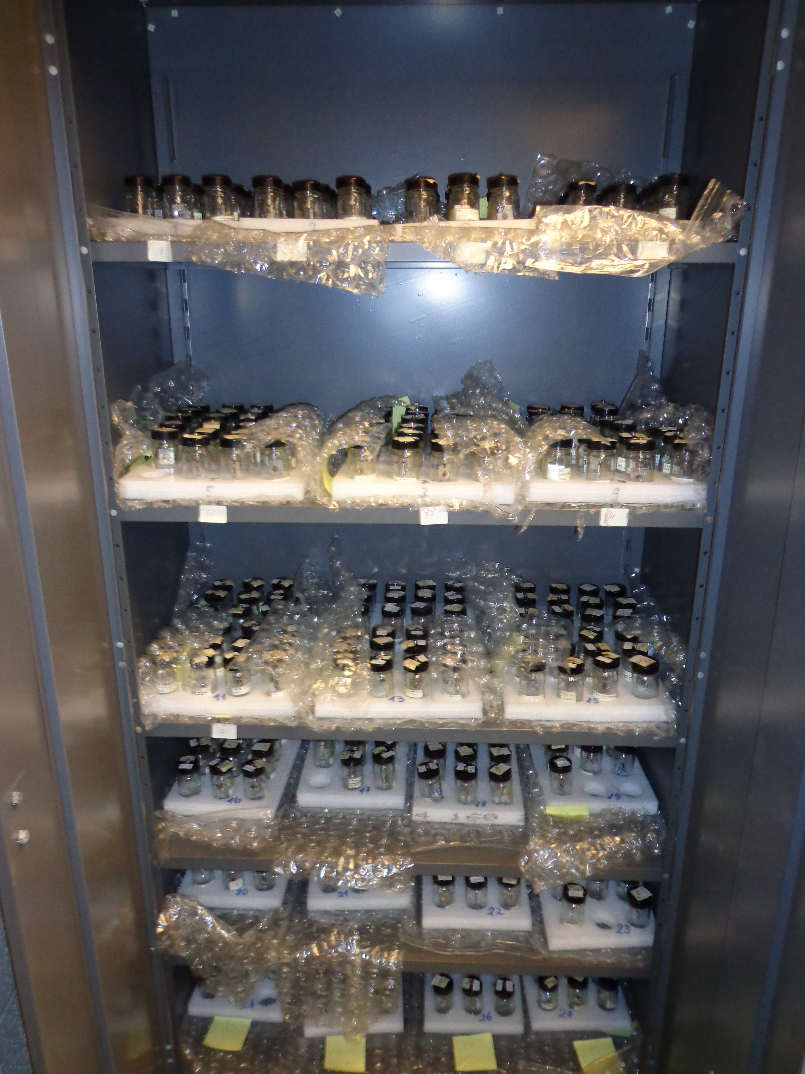
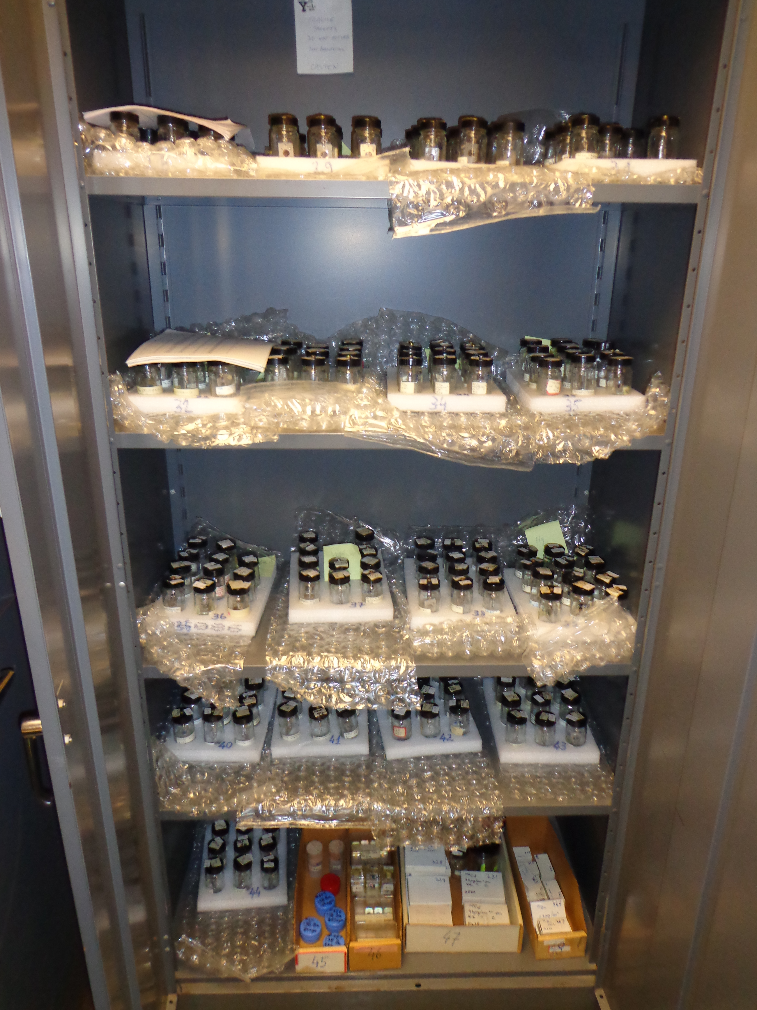
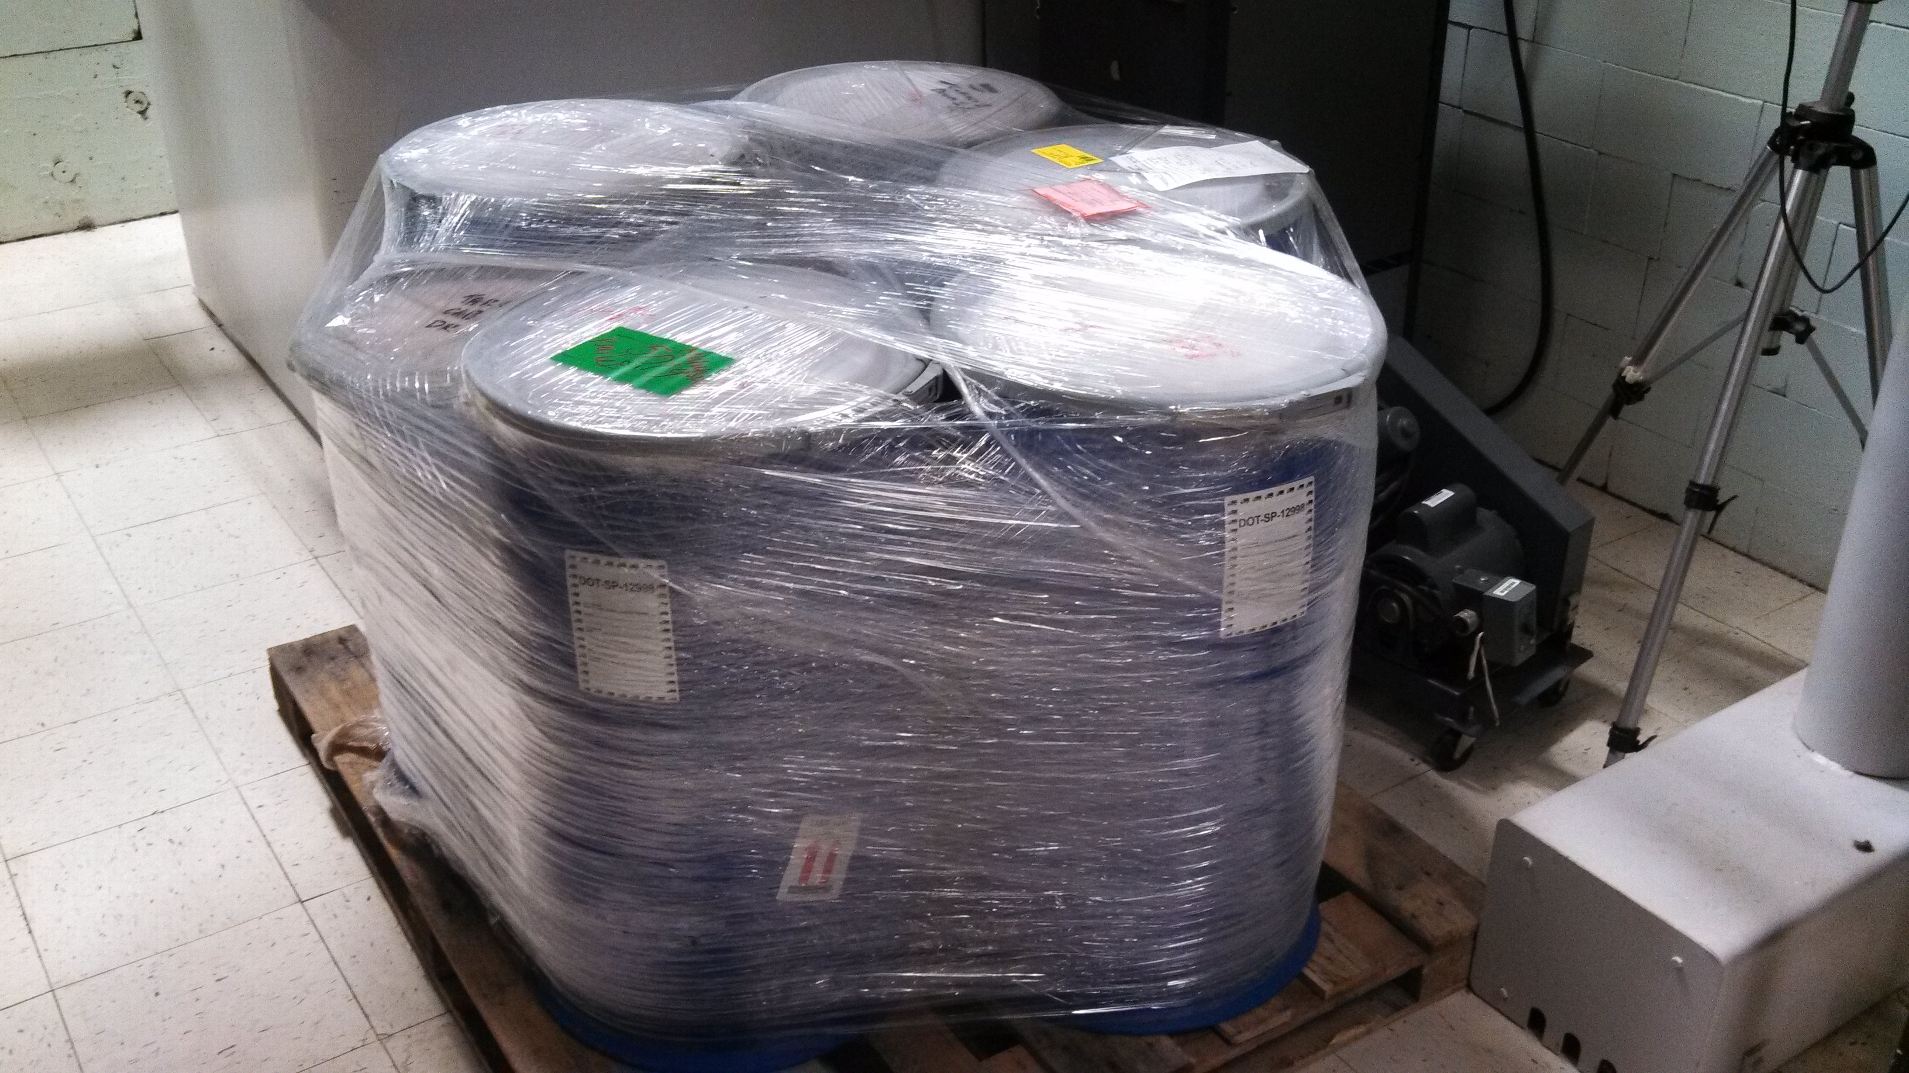
Outreach to the Community
WNSL, Yale
Targets and Separated Isotope (WNSL Isotope Inventory.pdf)
  Rescue & Recovery
  Hope to make them available to the low-energy community
Brookhaven targets
WNSL Brookhaven targets.pdf
Los Alamos targets
WNSL Los Alamos Targets.pdf
Recent arrival of targets at ANL

Slide 13


The International Target Community
International Nuclear Target Development Society
Worldwide network of membership.
  Established and maintains a listserve for online queries
Encourages the sharing of techniques developed,
or being developed.
  Biennial international conferences
  Maintains an extensive online Bibliography
Publishes the techniques of target preparation
and related topics.
  Conference proceedings are online (NIM, JRNC)
  Annual Newsletter
Mentor people new to target preparation.
  Frank Karasek Scholarship
Provides modest financial support for INTDS
conference attendance.
INTDS current involvement:
President (2012-2016)
Member of the Editorial Committee
Newsletter Editor (‘03 to present)

Slide 14
Physics Division Target Laboratory – Future Directions
Future Directions, GRETINA, AGFA, REAx
fribusers.org/3_GROUPS/18_TARGET/target.html
“The availability of the needed target making capabilities, and a trained workforce, is a must for successful experiments at FRIB, and at other accelerators.”
Report of the Scientific Advisory Committee, February 20-22, 2010

