Slide 1
Gammasphere-ORRUBA: Dual Detectors for Experimental Structure Studies
ATLAS User Meeting, May 15-16 2014
Andrew Ratkiewicz
Rutgers University

Slide 2
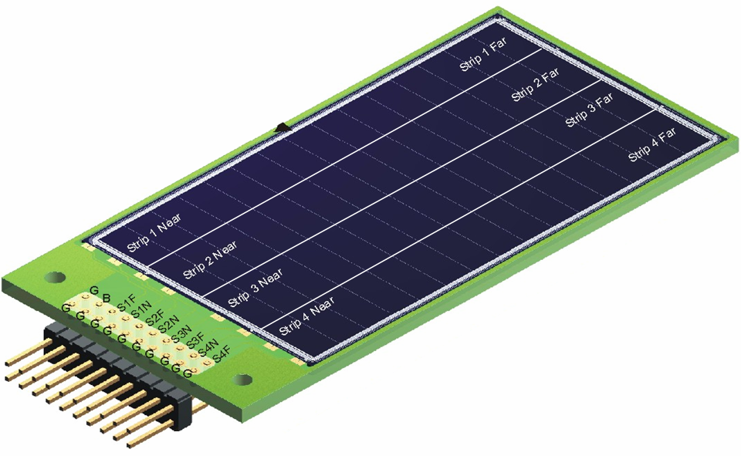
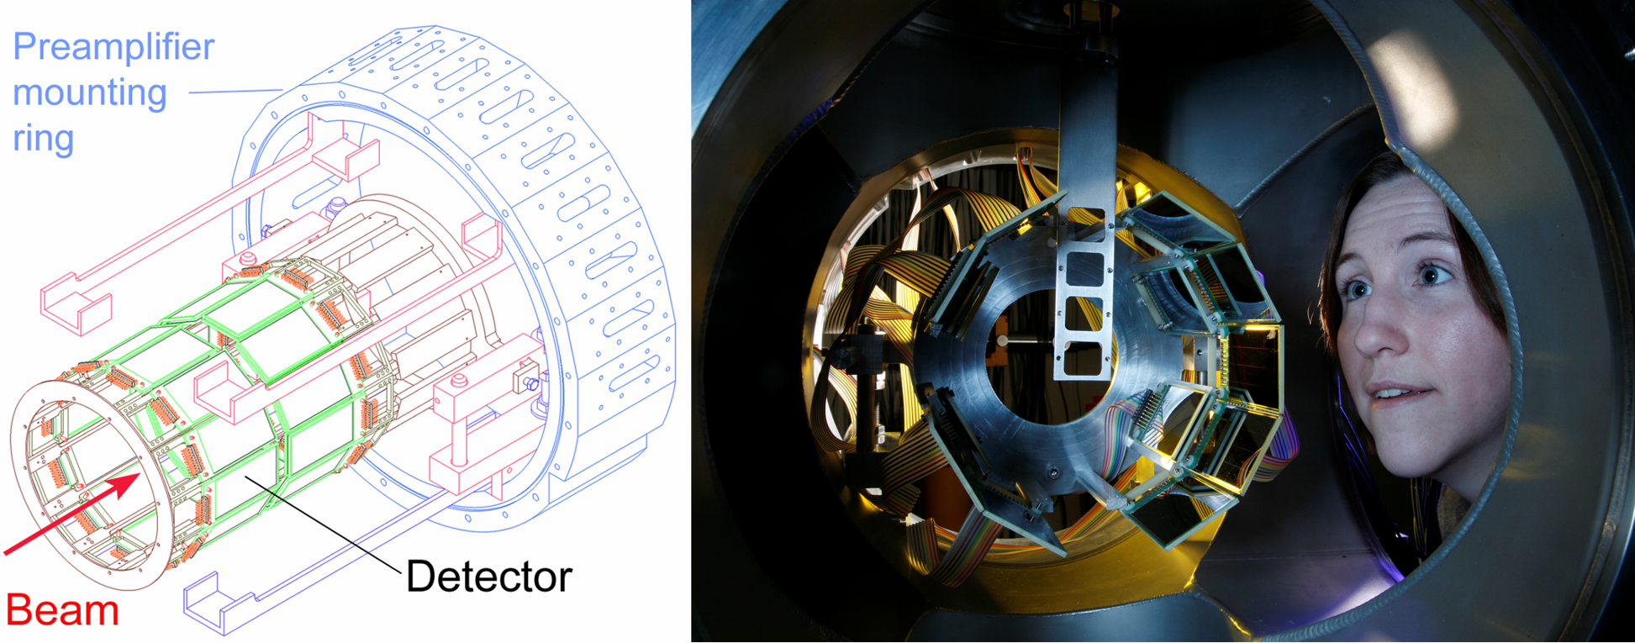
ORRUBA
Barrel array of ion-implanted silicon strip detectors
Custom resistive design used to achieve good position resolution (~1mm) without requiring 1000s of electronics channels
2 rings – θ < 90°: 12 telescopes (1000μm R + 65μm NR)
– θ > 90°: 12 detectors (1000μm R)
ORRUBA gives ~80% φ coverage over θ = 45° → 135°
288 electronics channels

Slide 3
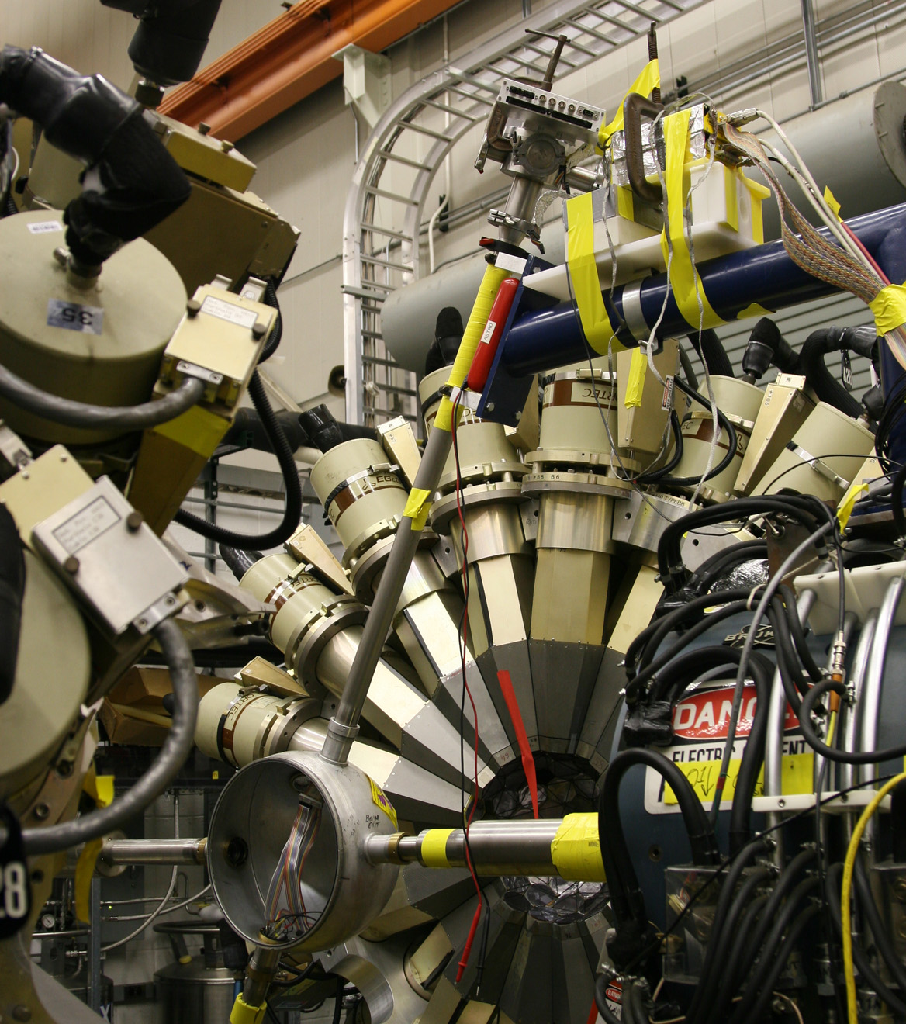
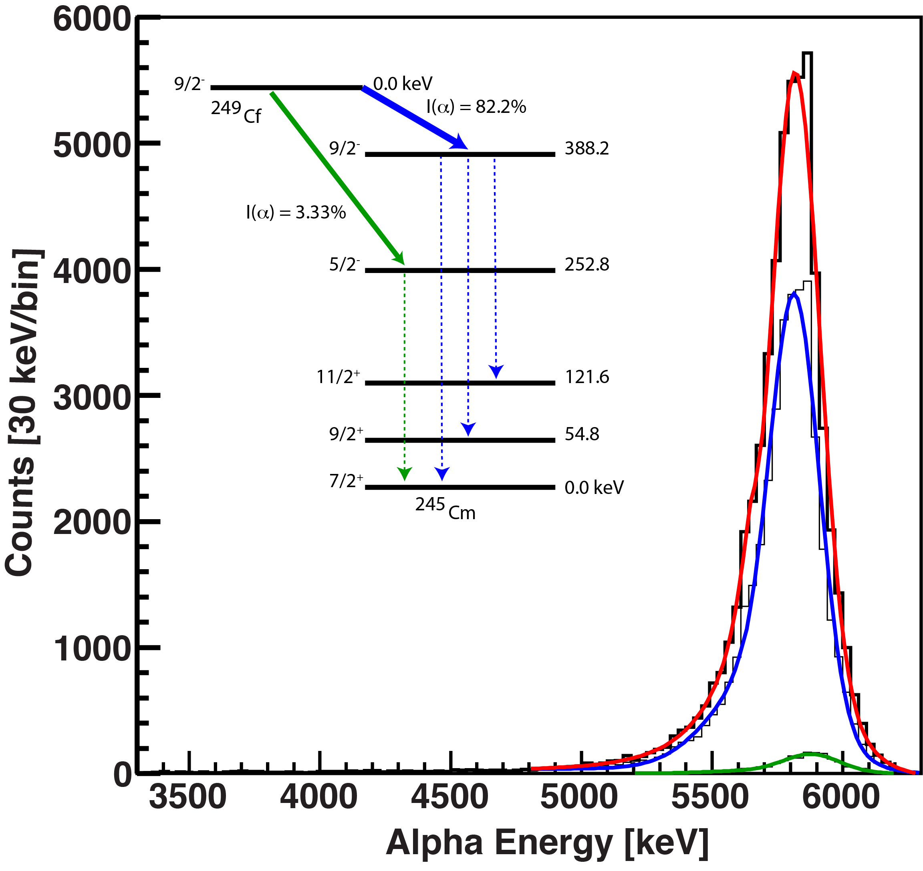
Proof-of-Principle Test
Instrumented using RAL shaping amps and Darek’s CAMAC ADCs. Also used GRETINA digitizers.
Used a ²²⁸Th source for calibrations, ²⁴⁹Cf source for α-γ coincidence measurement.
Poor shielding, long signal cables before preamplifiers led to significant degradation in energy resolution (~2 relative to normal).
→ Design these features out.
> 5 feet

Slide 4
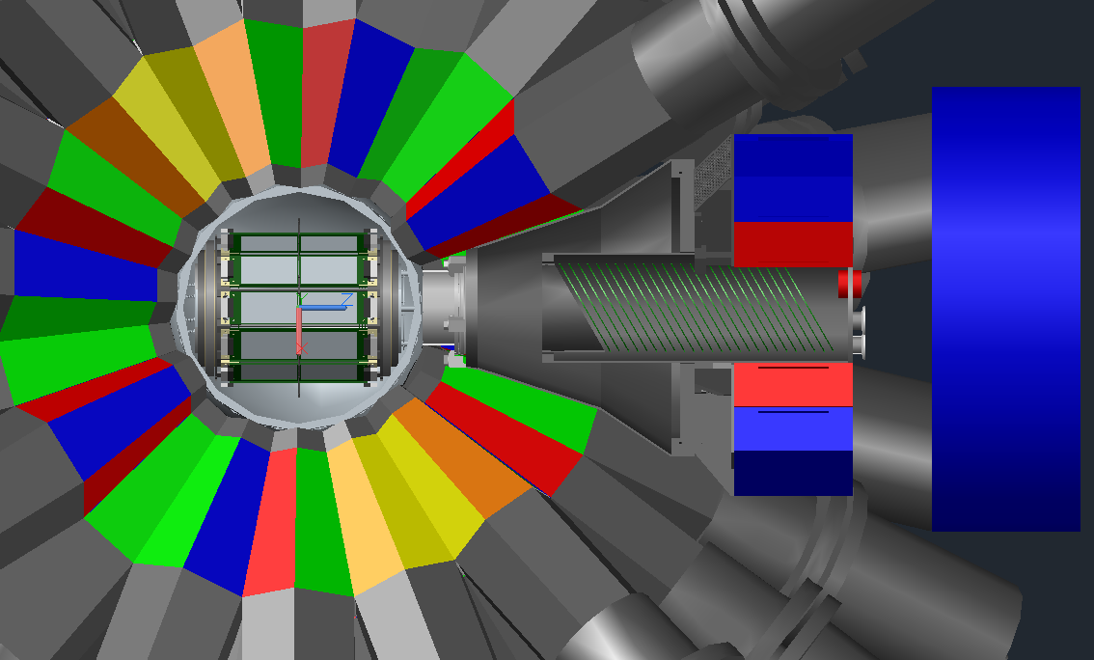
Design
Produced AutoCAD® model of GS to aid design. Goals:
Less than two feet between detectors and PAs.
Install with minimal modifications to Gammasphere.
Detect recoils too rigid for FMA with high rate (>0.2 MHz) ion counter.
Run standalone, with FMA/AGFA, or with ionization counter.
Cover a large fraction of the polar angle with silicon, be able to measure (e.g.) (d,p), (d,t) simultaneously.

Slide 5
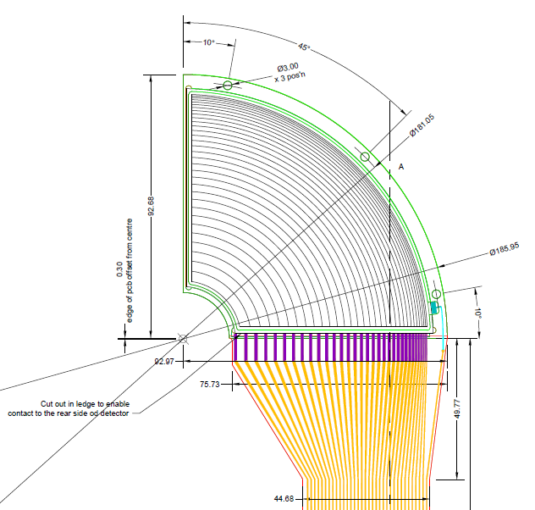
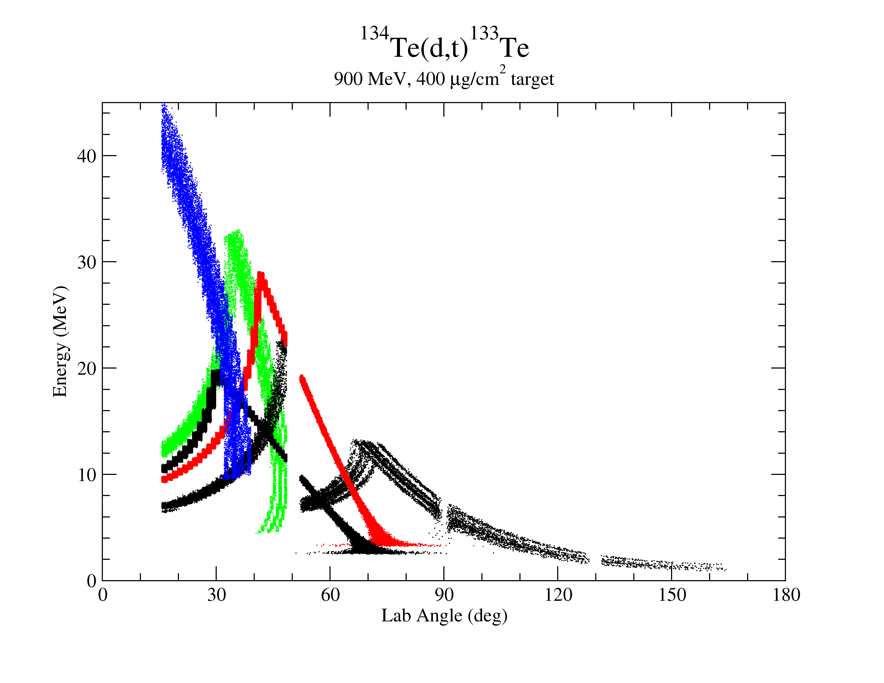
Endcap Detectors
Endcap detectors were designed and purchased.
Variable strip pitch to achieve angular resolution sufficient to measure (d,t).
³He from (d, ³He)
Tritons from (d,t)
Elastically scattered deuterons
Instrument up to three layers of detectors (tritons and PID).
Entire array covers ~75% of the polar angle between 15-165 degrees.
Elastically scattered protons
Protons from (d,p)
Forward endcap
Barrel
Backward endcap
Courtesy S.D. Pain

Slide 6
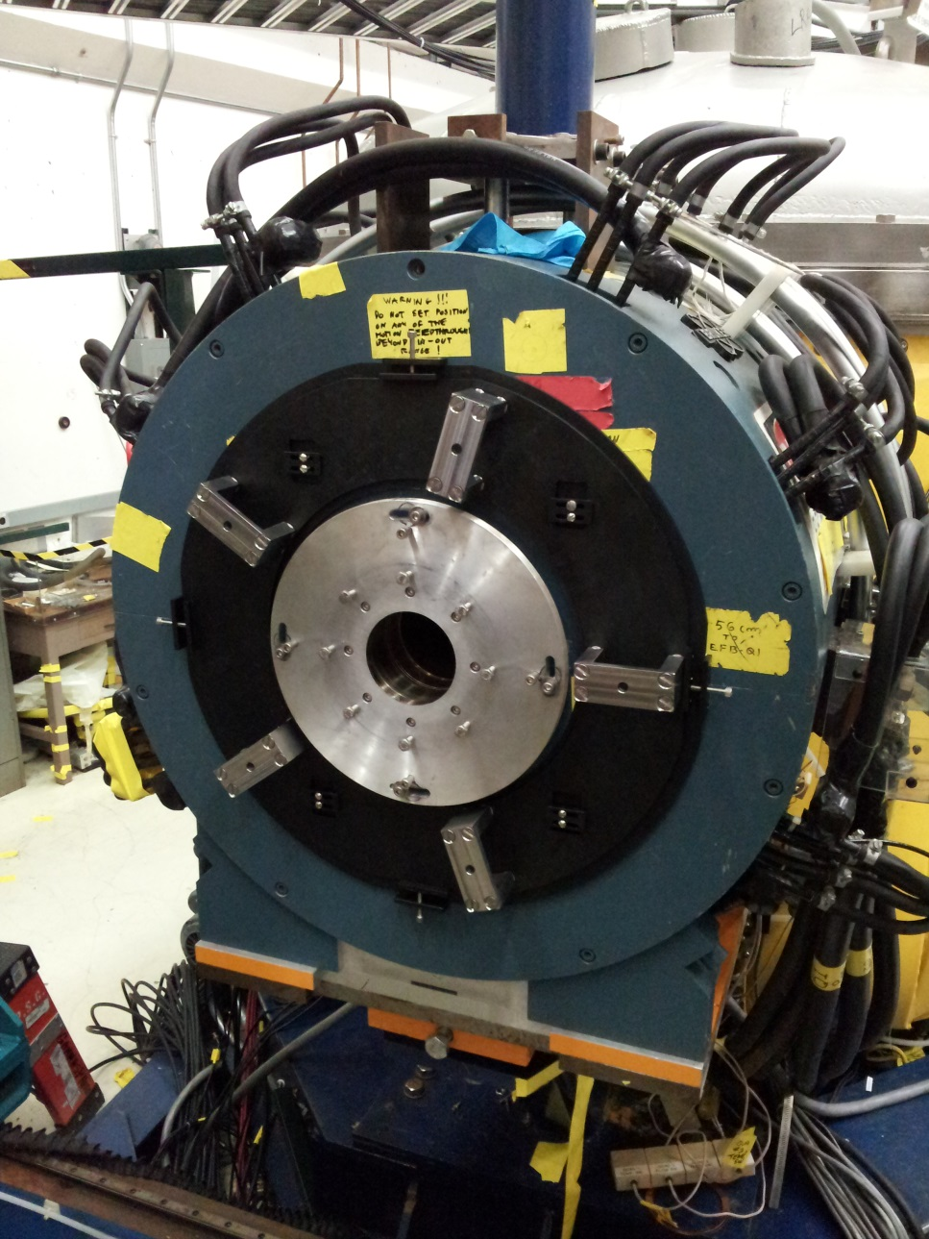
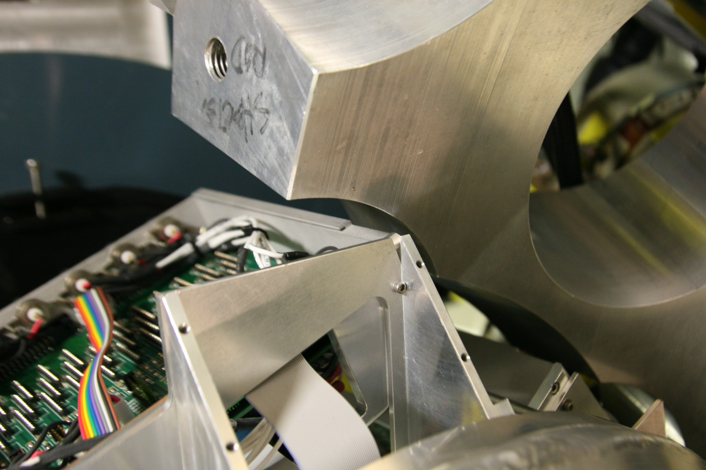
Engineering Test
Supporting collar attaches to the yoke of the FMA quad.
The collar translates in X and Y to facilitate alignment.
Preamps fit (mm to spare!) in the 17 degree ring of Gammasphere.

Slide 7
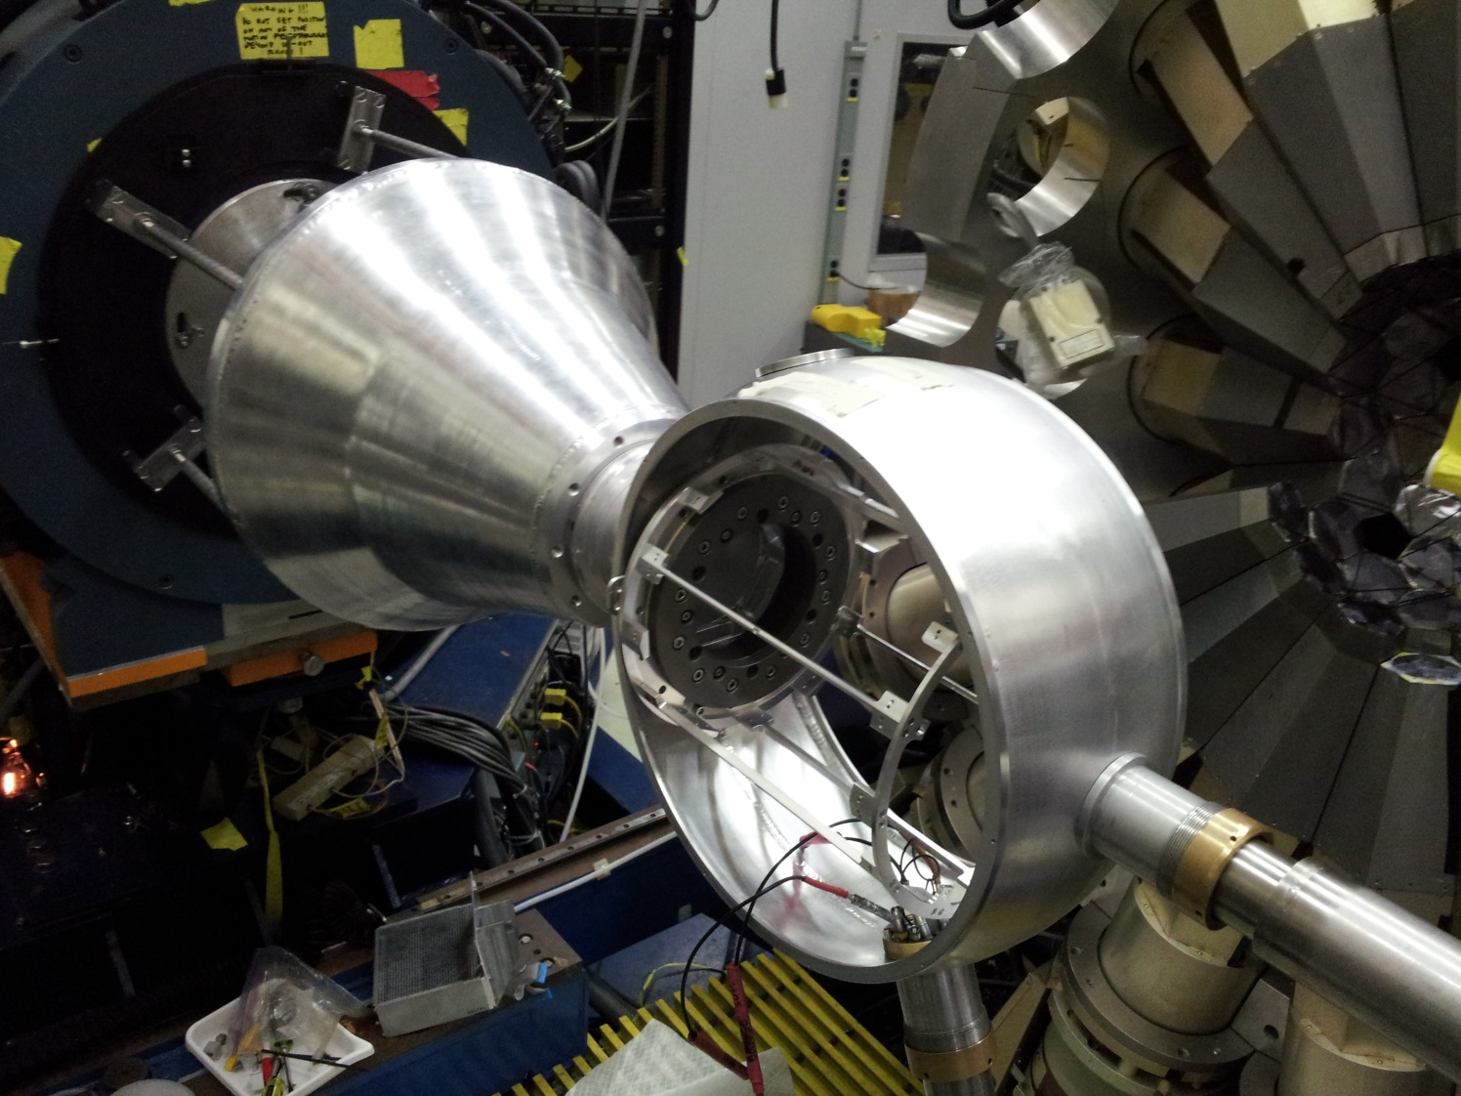
Engineering Test
Supporting collar attaches to the yoke of the FMA quad.
The collar translates in X and Y to facilitate alignment.
Preamps fit (mm to spare!) in the 17 degree ring of Gammasphere

Slide 8
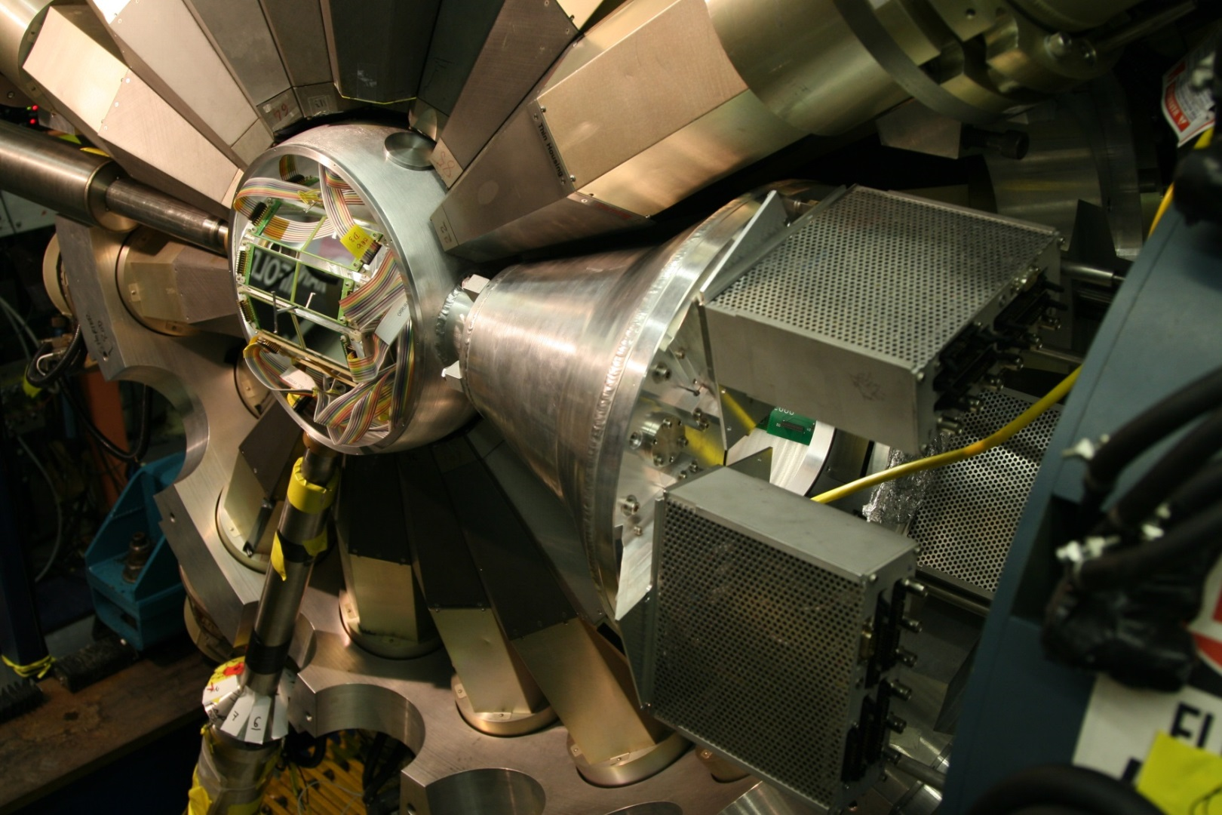
Engineering Test
Mechanical test a success.
Holds vacuum.
Took data (counting ²⁴⁹Cf) with analog GS for α-γ coincidences, but our focus was on using the GRETINA digitizers at the focal plane of the FMA.

Slide 9
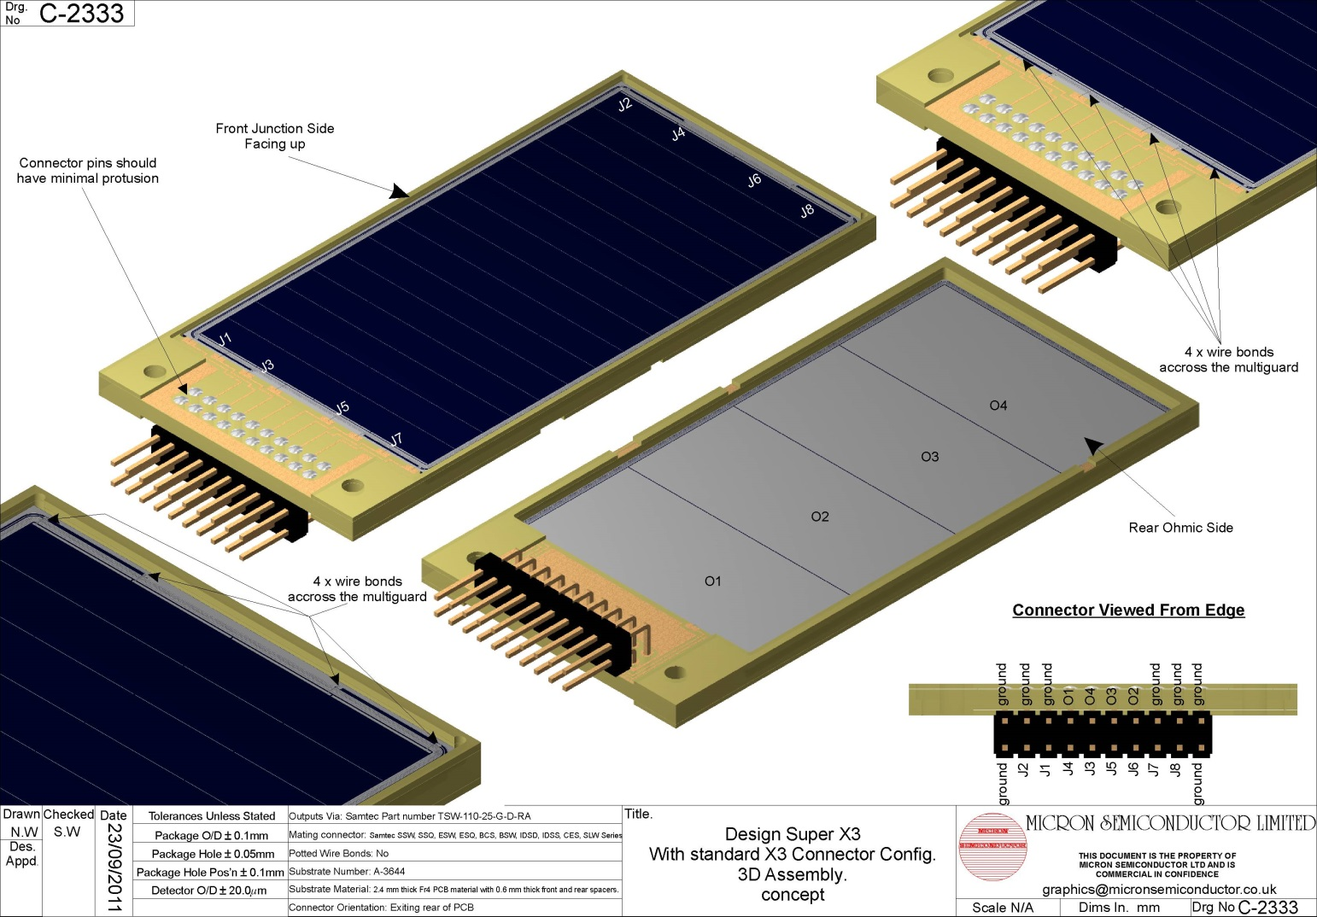
Digital GODDESS
SuperX3 detectors (high resolution position from front, energy from back)
Standard trapezoidal filter, varied integration and delay parameters to optimize filter for energy and position.
m
k
m
Detector pulse
m
m
k
Filtered pulse

Slide 10
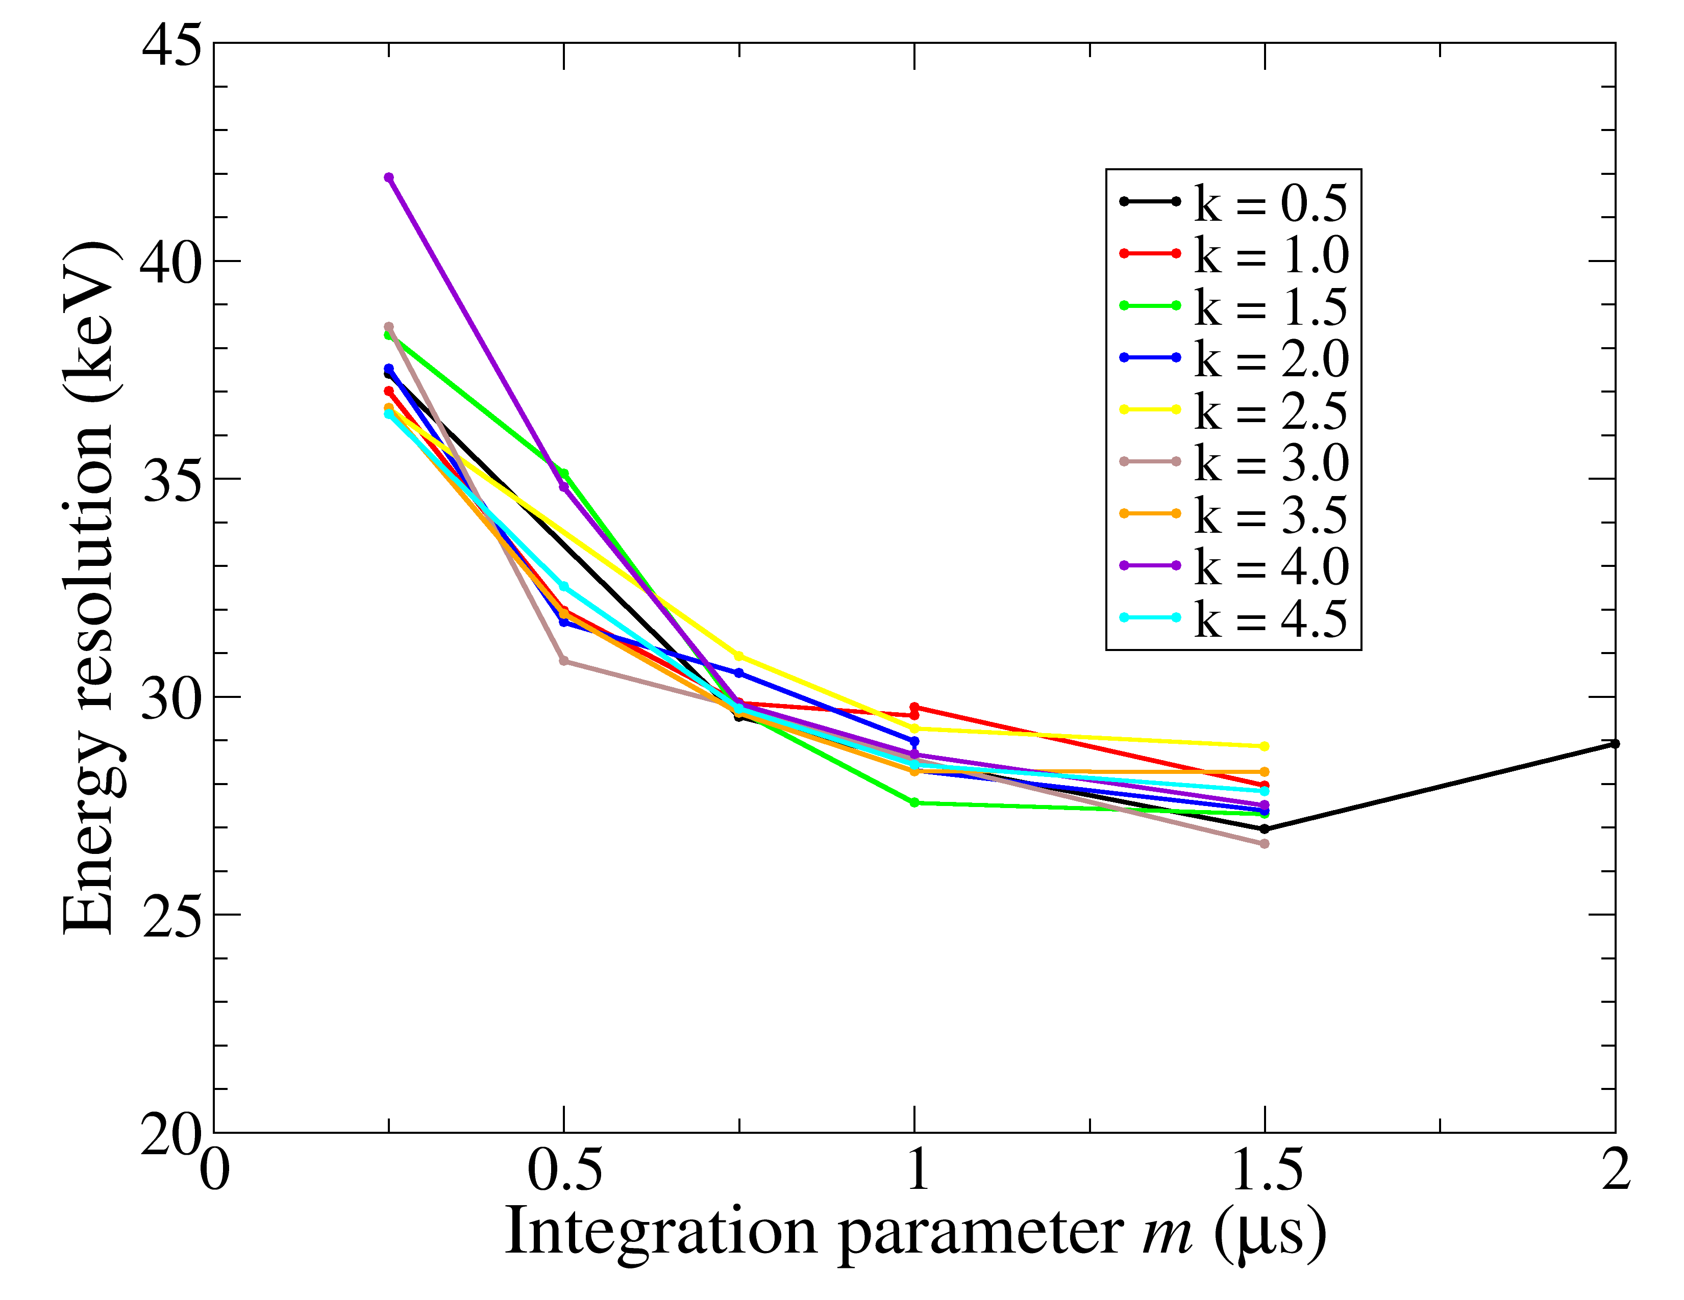
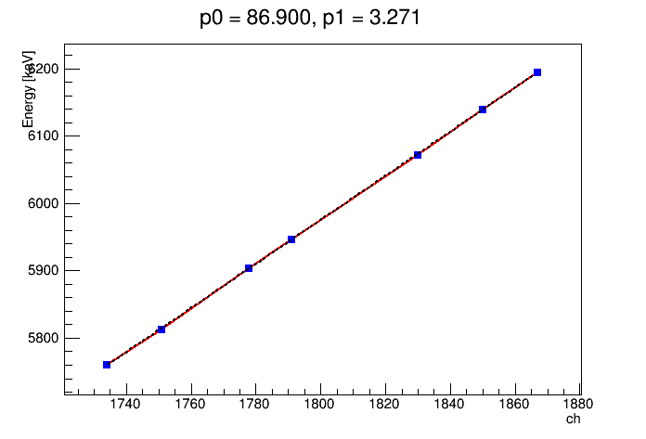
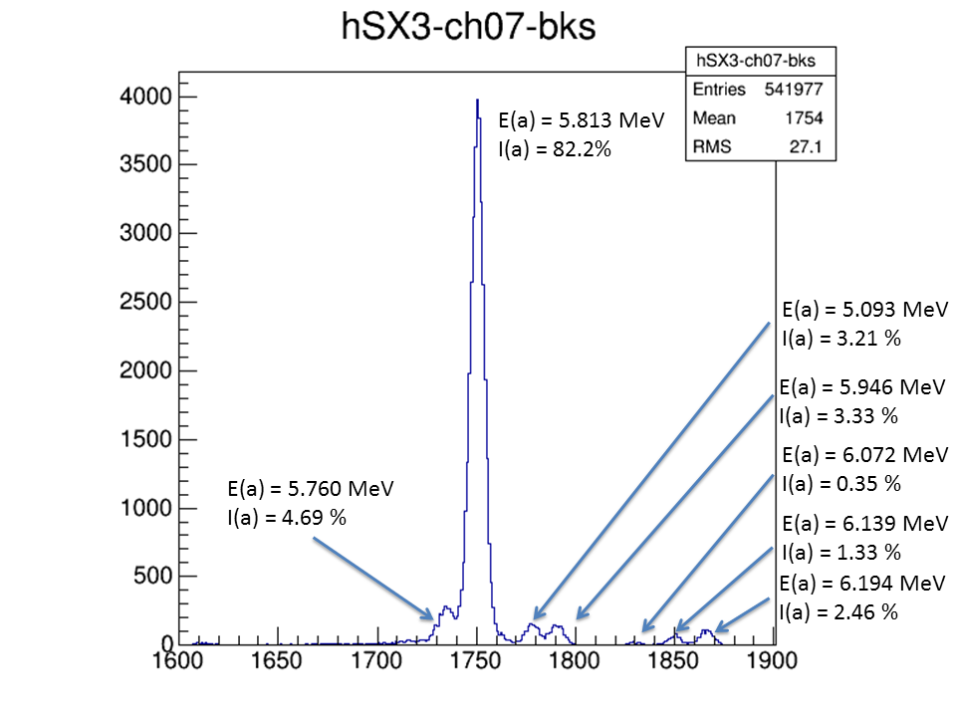
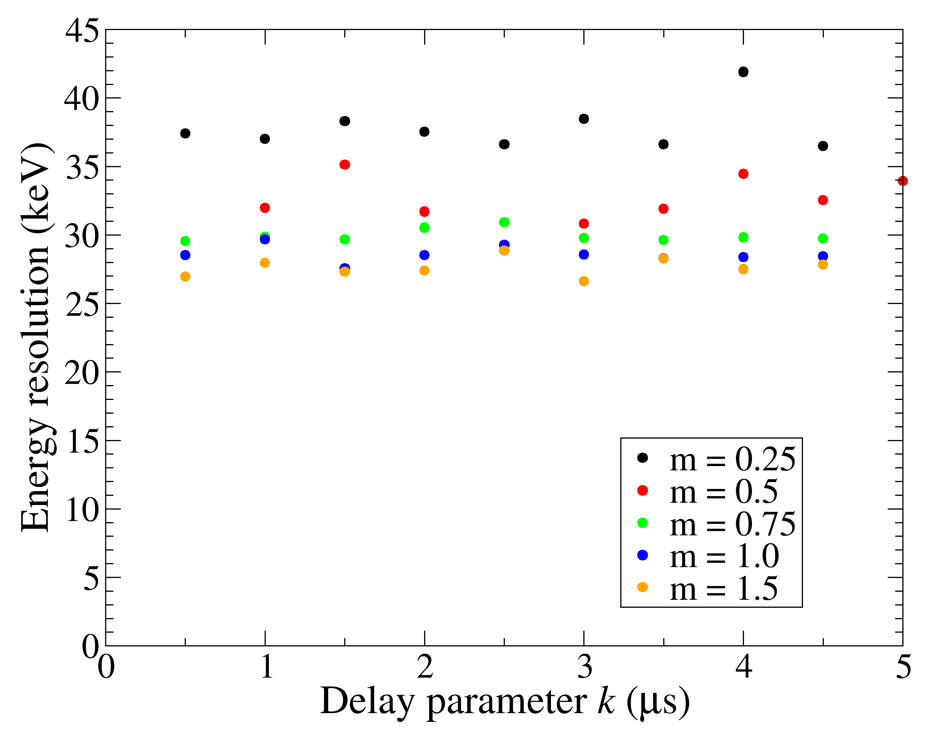
GODDESS Energy Resolution
28 keV energy resolution!

Slide 11
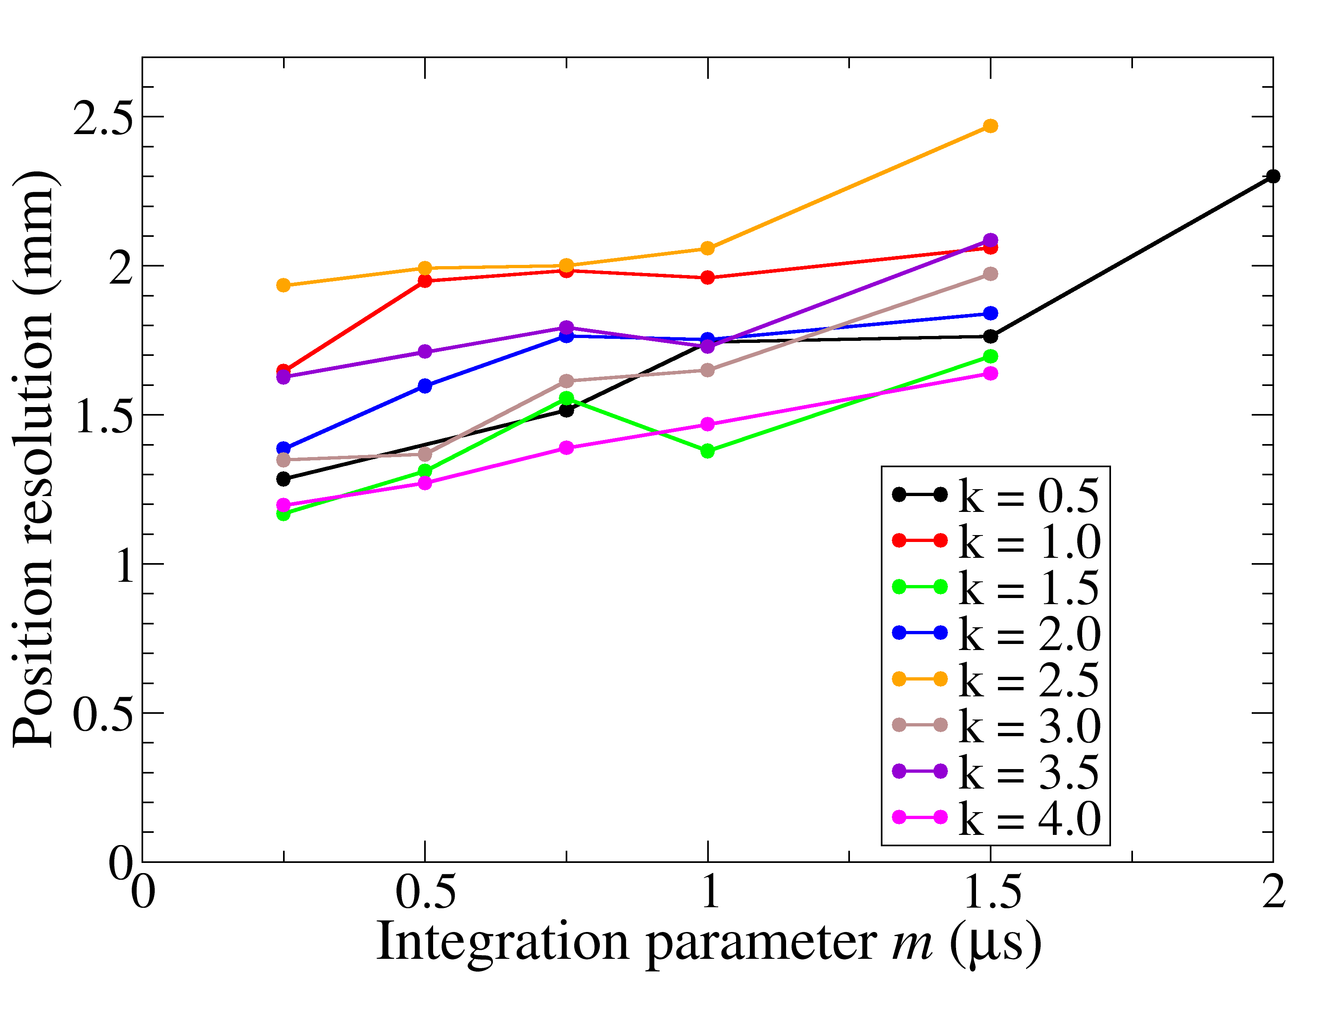
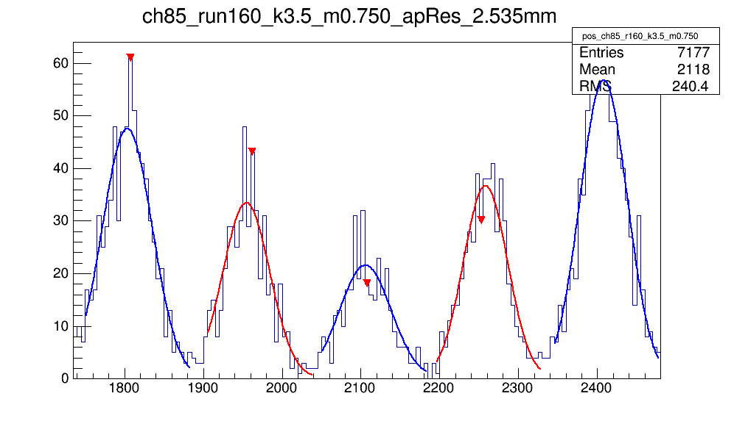
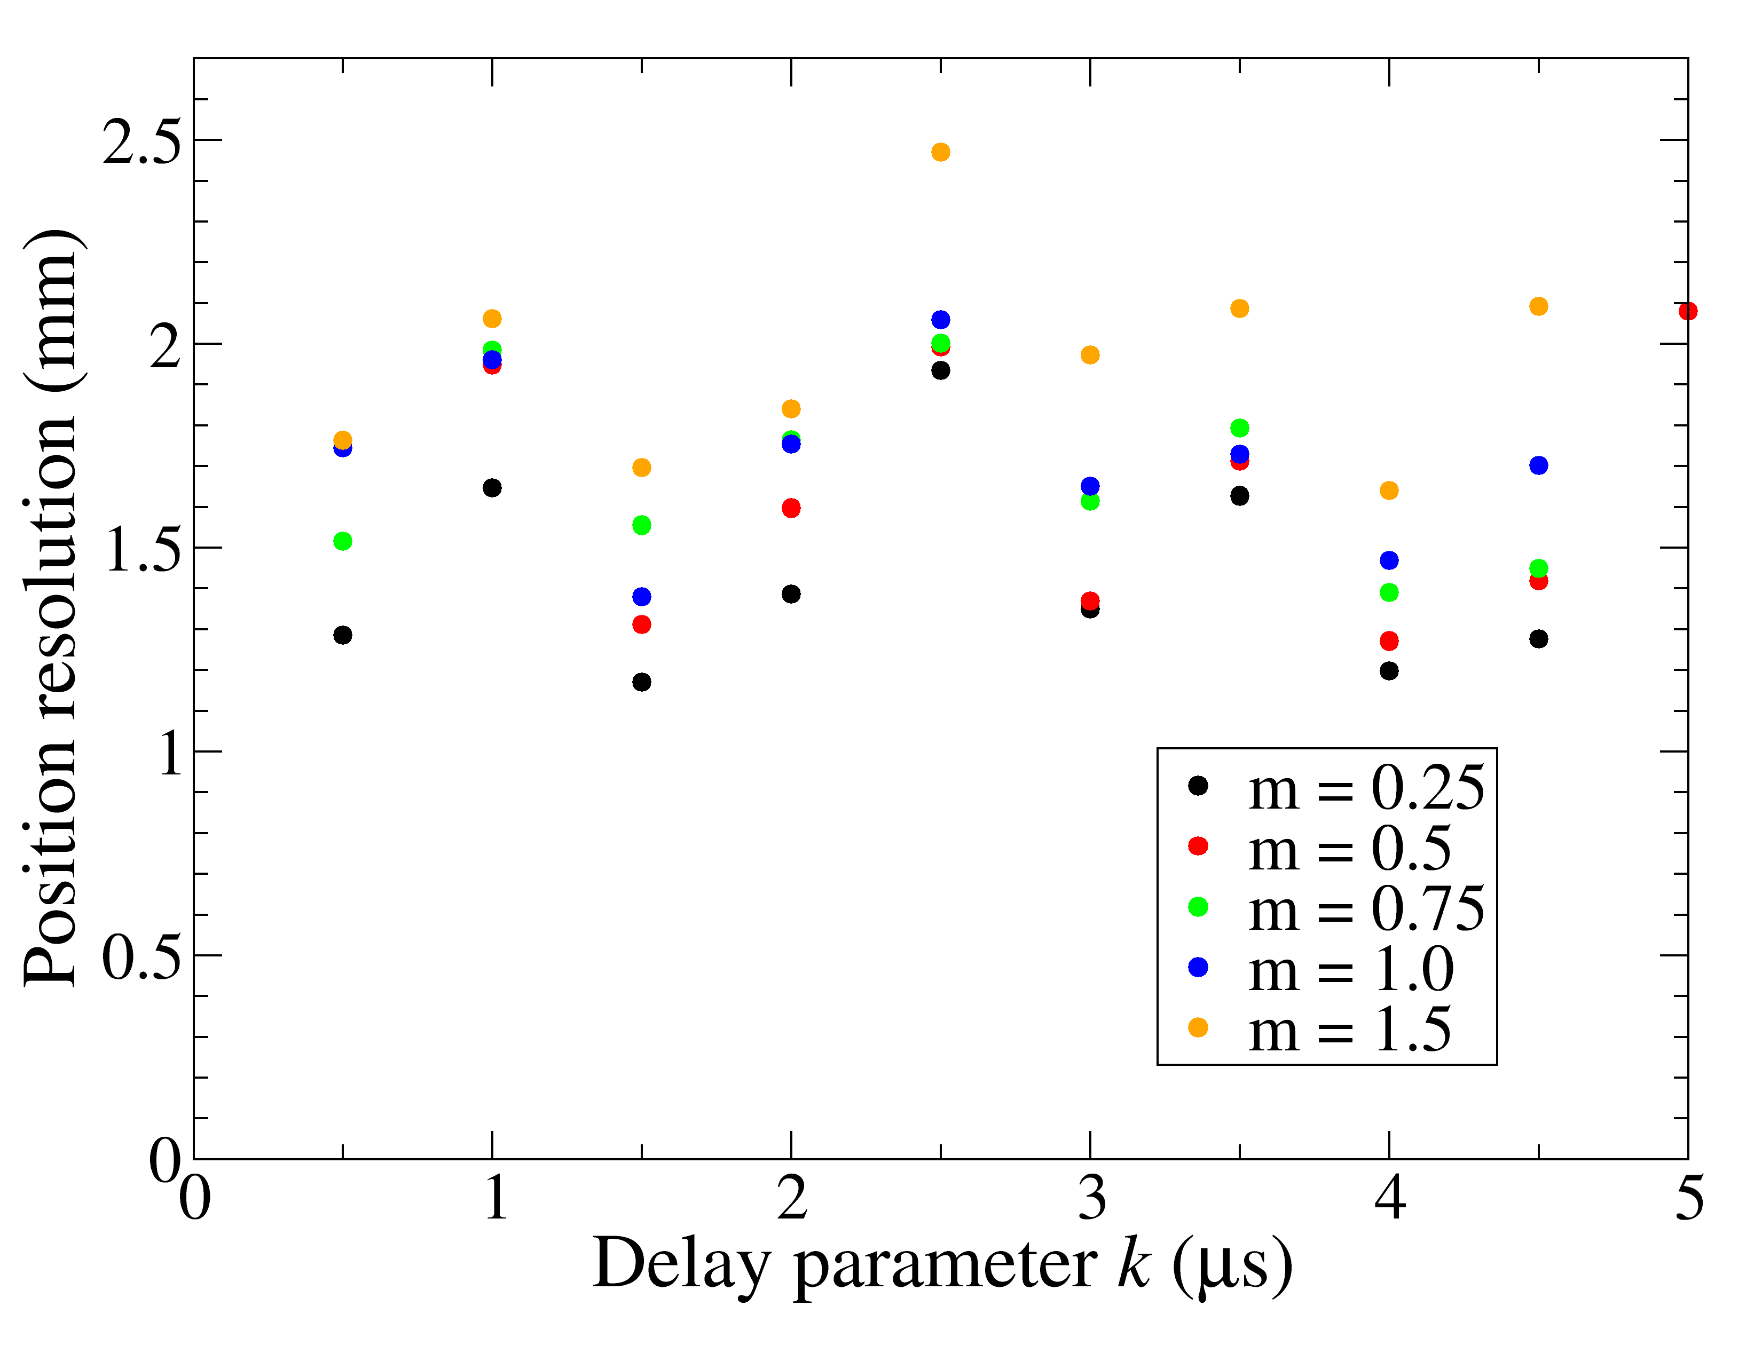
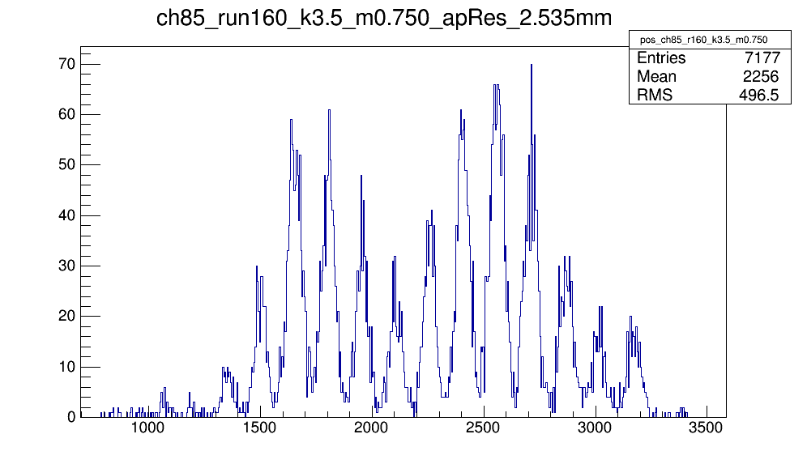
GODDESS Position Resolution
< 1.2 mm position resolution!

Slide 12
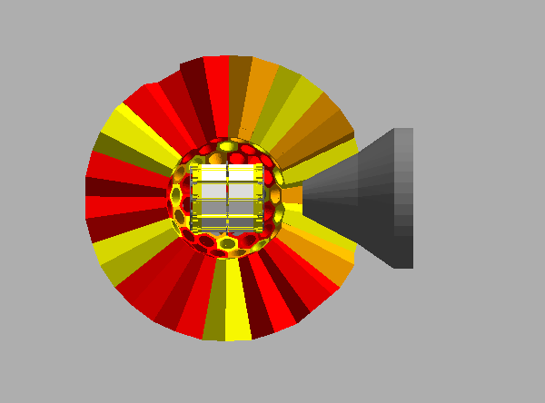
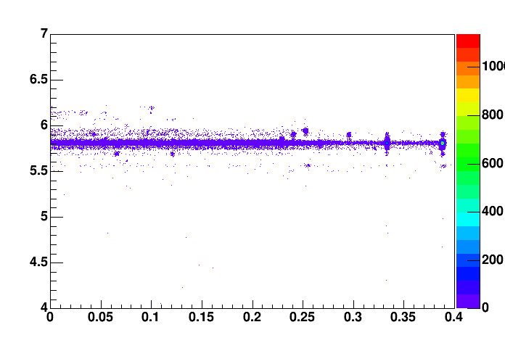
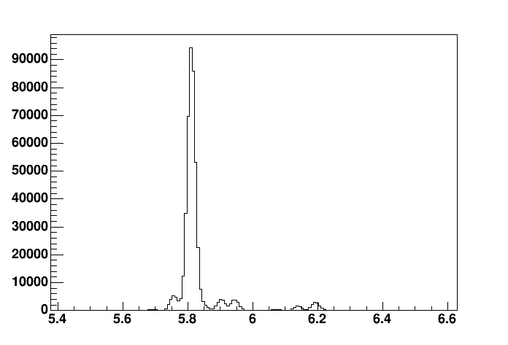
AutoCAD® and GEANT4 models
Courtesy T. Baugher
GODDESS AutoCAD® model imported into GEANT4.
Simulation will help assess the impact of silicon mounting infrastructure on γ-ray attenuation.

Slide 13
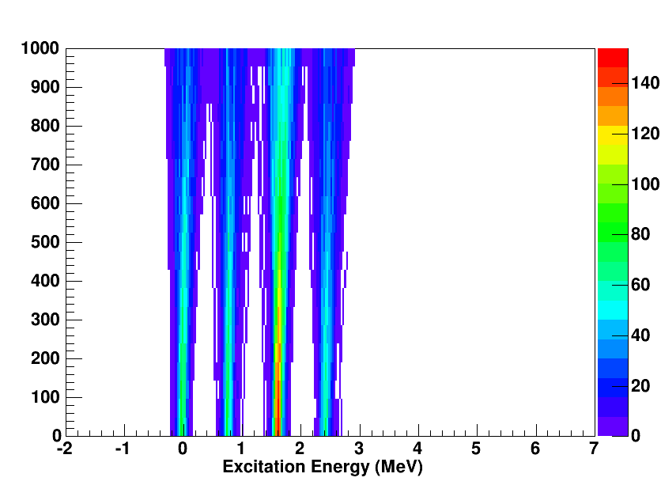
Impact of Target Thickness on Resolution
Target Thickness (μg/cm²)
Notes:
~215 keV at 1.6 MeV for 1000 ug/cm2
~88 keV at 1.6 MeV for infinitely thin target (~ factor of three)

Slide 14
Status
GODDESS is a powerful device, designed for the simultaneous measurement of multiple reactions.
AutoCAD® model of GODDESS produced.
GEANT4 simulation underway.
Vacuum chamber constructed, successfully tested for mechanical fit with Gammasphere and vacuum integrity.
Excellent energy resolution (28 keV FWHM).
< 1.2 mm position resolution, improvements underway.
Construction of high-rate ionization chamber ongoing, completed IC to be tested at ORNL with beam this summer.
four approved measurements:
“Coupling the ORRUBA and Gammasphere arrays”, Pain (4+2 days)
“Validating (d,pγ) as an (n,γ) surrogate”, Cizewski (5 days)
“(d,pγ) with neutron-rich Xe and Te with CARIBU”, Pain (7 days)
“Near-threshold levels in ¹⁹Ne and the ¹⁸F(α,p) rate”, Bardayan (4 days)
Ready for beam in near future.

Slide 15
A. Ratkiewicz¹, S.D. Pain², J.A. Cizewski¹, C.M. Shand^{1,3}, T. Baugher¹, L. Afanasieva⁴, S. Burcher¹, J.C. Blackmon⁴, M.P. Carpenter⁵, S. Hardy^{1,3}, K.L. Jones⁶, R.L. Kozub⁷, S. Lonsdale^{1,3}, I. Marsh², W.A. Peters^{2,6}, D. Seweryniak⁵, and S. Zhu⁵.
¹Department of Physics and Astronomy, Rutgers University, New Brunswick, NJ 08903 ²Physics Division, Oak Ridge National Laboratory, Oak Ridge, TN 37831
³Department of Physics, University of Surrey, Guildford, Surrey, GU2 7XH, UK ⁴Department of Physics and Astronomy, Louisiana State University, Baton Rouge, LA 70803
⁵Physics Division, Argonne National Laboratory, Argonne, IL 60439
⁶Department of Physics and Astronomy, University of Tennessee, Knoxville, TN 37996 ⁷Physics Department, Tennessee Technological University, Cookeville, TN 38505
Thanks to UTK Machine Shop, Charles Reed, John Rohrer.

Slide 16
Thank you for your attention

Slide 17
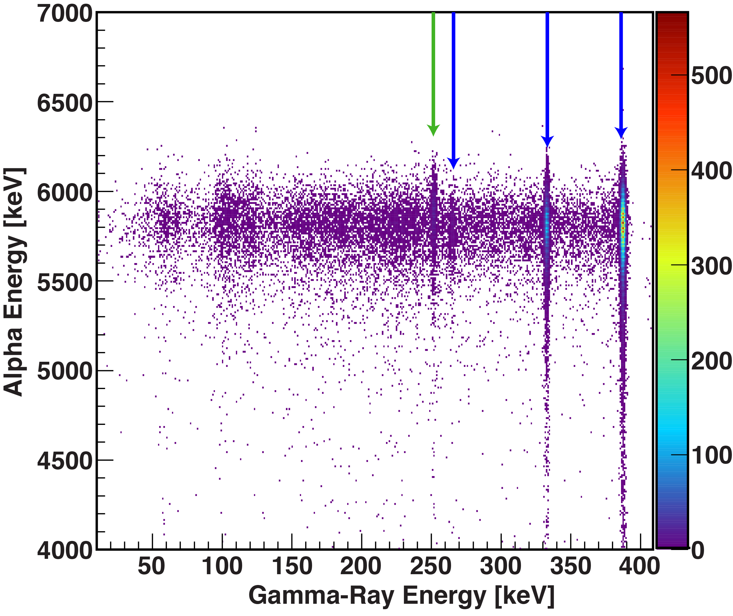
Proof-of-Principle Measurement
Red: ungated
Blue: gated on decay of 9/2⁻ state
Green: gated on decay of 5/2⁺ state
Relative yields for the two α-decay branches match known values within experimental uncertainty.
Fitting the gated peaks allows characterization of the un-gated spectrum.

Slide 18
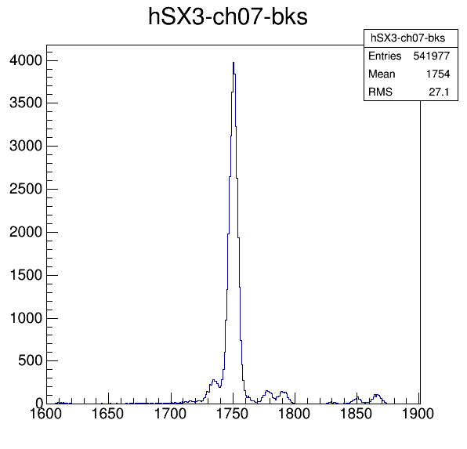
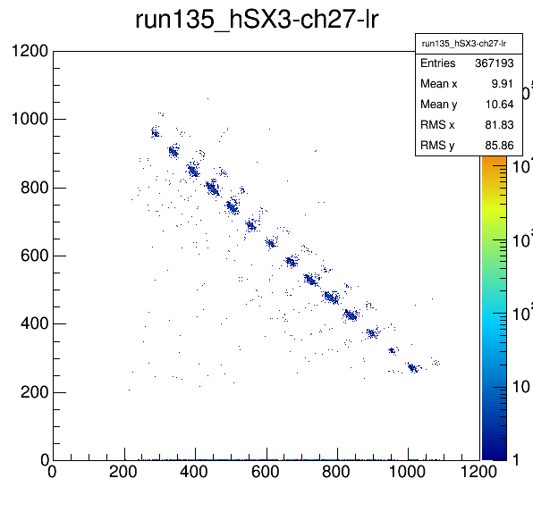
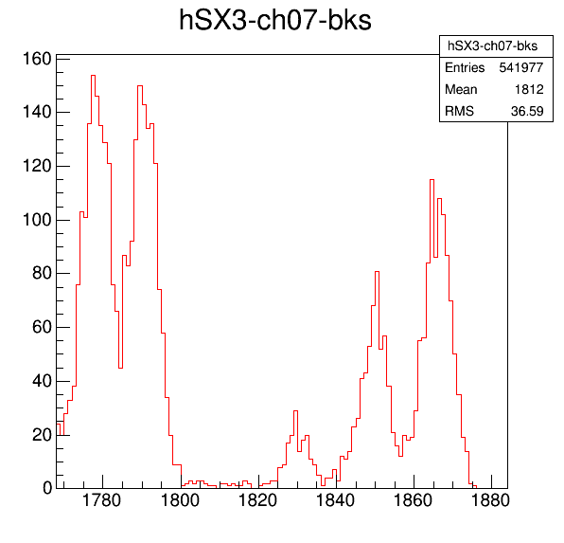
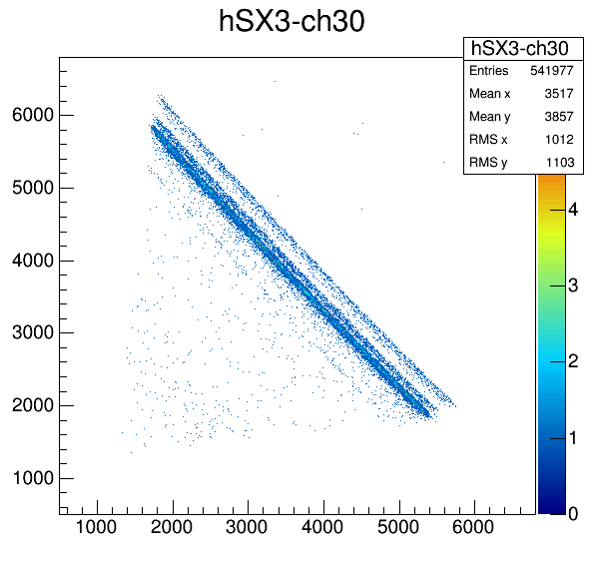
Engineering Test
E(α) = 5.813 MeV
I(α) = 82.2%
E(α) = 5.903 MeV
I(α) = 3.21 %
E(α) = 5.760 MeV
I(α) = 4.69 %
E(α) = 5.946 MeV
I(α) = 3.33 %
E(α) = 5.903 MeV
I(α) = 3.21 %
E(α) = 6.139 MeV
I(α) = 1.33 %

Slide 19
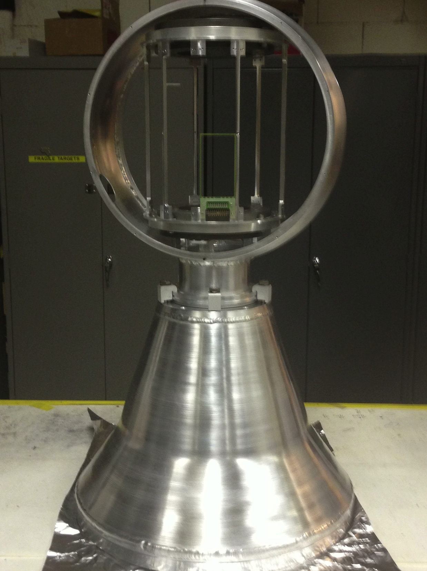
Design
Signals cables run through 4” beam pipe at end of scattering chamber to a funnel-shaped “flowerpot”, ~60 cm long (normal cable length).
Scattering chamber and flowerpot are made of spun aluminium.
10 preamplifier modules (72 channels each) coupled to lid of flowerpot.
Three possible modes:
Standalone
Coupled to a high-rate ion counter
Coupled to the FMA
None of these configurations require modifications to standard operating conditions for FMA or GS.
Entire assembly weighs ~50 lbs and is supported by the FMA.

Slide 20
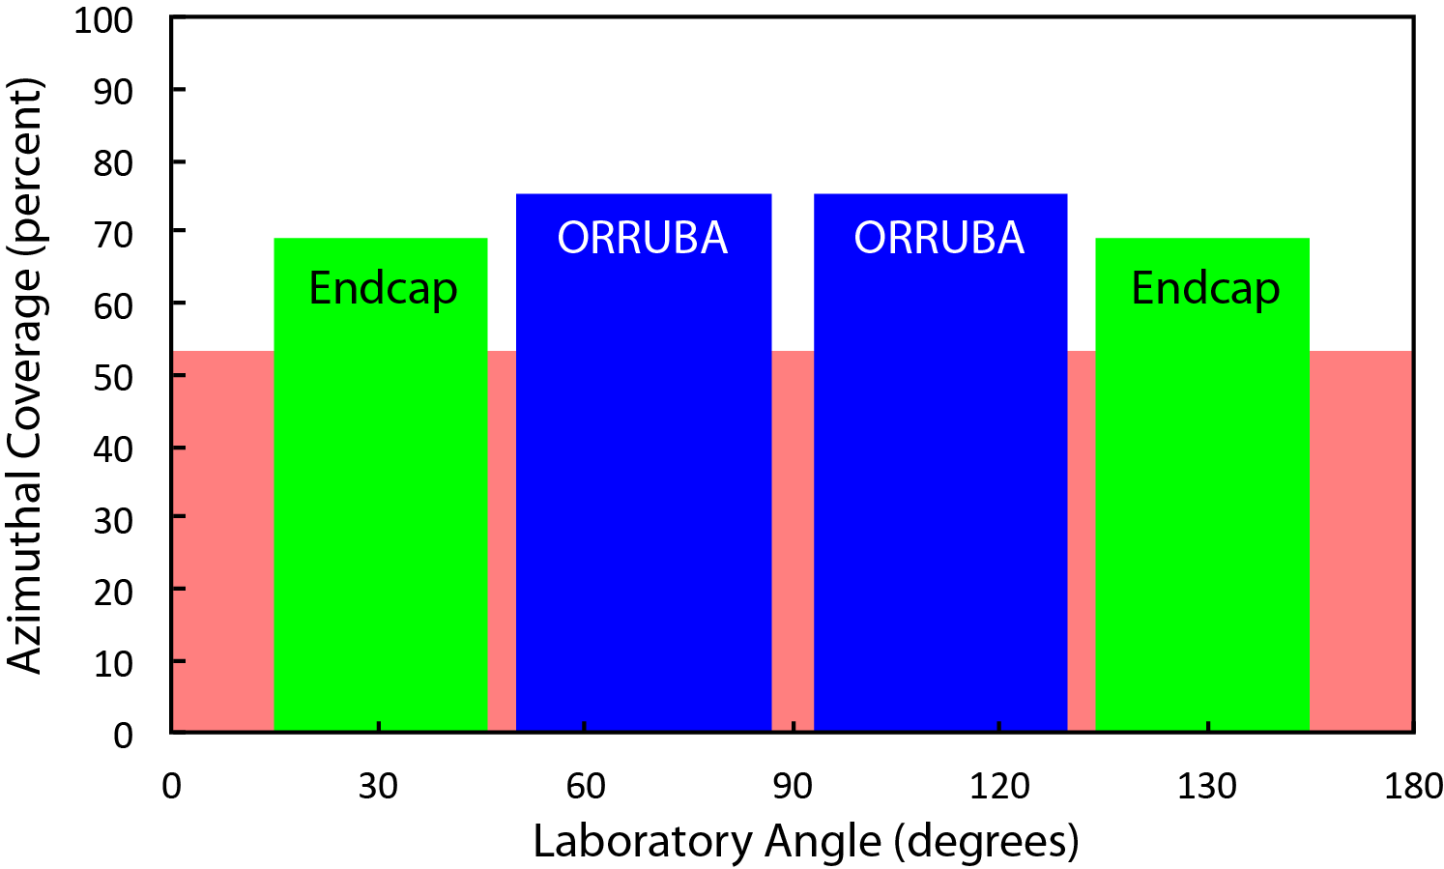
Large Angular Coverage of ORRUBA + EC...
The endcaps are designed with 32 annular strips (variable pitch, for constant angular coverage), leading to energy resolution dominated by target effects rather than detector performance.
ORRUBA and the endcaps cover 53% of the azimuthal angle from 0-180 degrees in the lab frame.
Notes:
Need 400 channels to service the endcaps if two are ganged together such that you read out 16 strips. That is four more than available with full ORRUBA implemented, so it doesn’t matter.

