Slide 1
AGFA – the Argonne Gas-Filled Analyzer
Presentation at the 2014 ATLAS User’s Meeting
May 15-16, 2014
Birger B. Back

Slide 2
Our role:
ATLAS Strategic Plan, November 2009
Effective long-term operation of the accelerator
Development of new accelerator capabilities to enable new high priority research opportunities
Effective support of the experimental program
Development of new experimental capabilities to pursue new high-priority research opportunities
Nurturing the scientific and technical base of the low-energy research community and helping to develop the high-quality workforce for future initiatives.
User advise and support needed for the instrument development plan

Slide 3
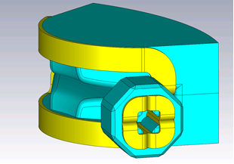
AGFA and the ATLAS intensity upgrade: intense beams – maximize physics reach
AGFA: High efficiency separation of reaction products
  Study exotic nuclei produced with very small cross sections

Slide 4
Argonne Gas-filled Fragment Analyzer-AGFA
Collaboration
B.B. Back, R.V.F. Janssens, W.F. Henning, T.L. Khoo, J.A. Nolen, D.H. Potterveld,
G. Savard, D. Seweryniak, Argonne National Laboratory
M. Paul, Hebrew University, Jerusalem, Israel
P. Chowdhury, C.J. Lister, University of Massachusetts Lowell
W.B. Walters, University of Maryland
P.J. Woods, University of Edinburgh
K. Gregorich, Lawrence Berkeley National Laboratory
W. Loveland, Oregon State University

Slide 5

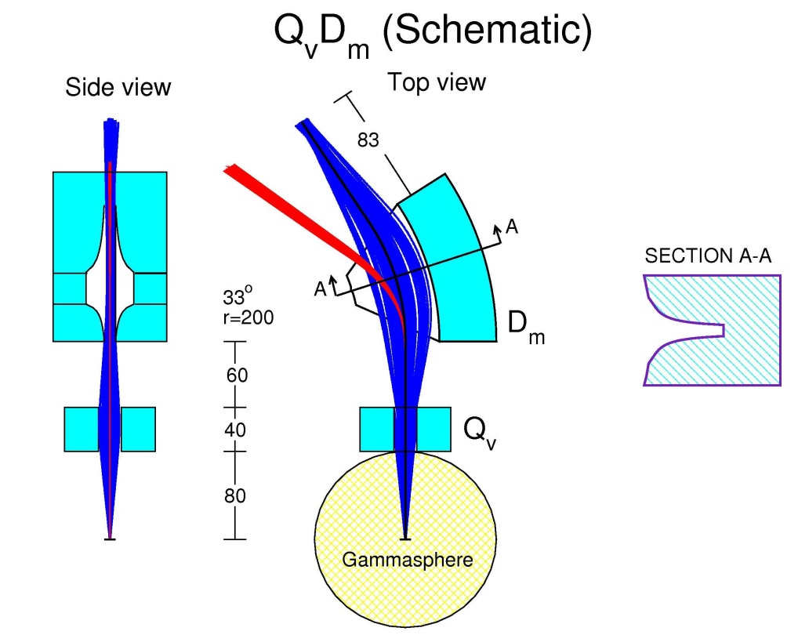
Unique design (Potterveld)
Vertical Horizontal
D_{m}
Q_{v}
⁴⁸Ca+²⁰⁸Pb
Three functions:
Vertical focussing
Horizontal focussing
Horizontal bend
Short length and large acceptance achieved with two magnetic elements
Q1: vertical focusing
D1: 38º bend and horizontal focusing

Slide 6
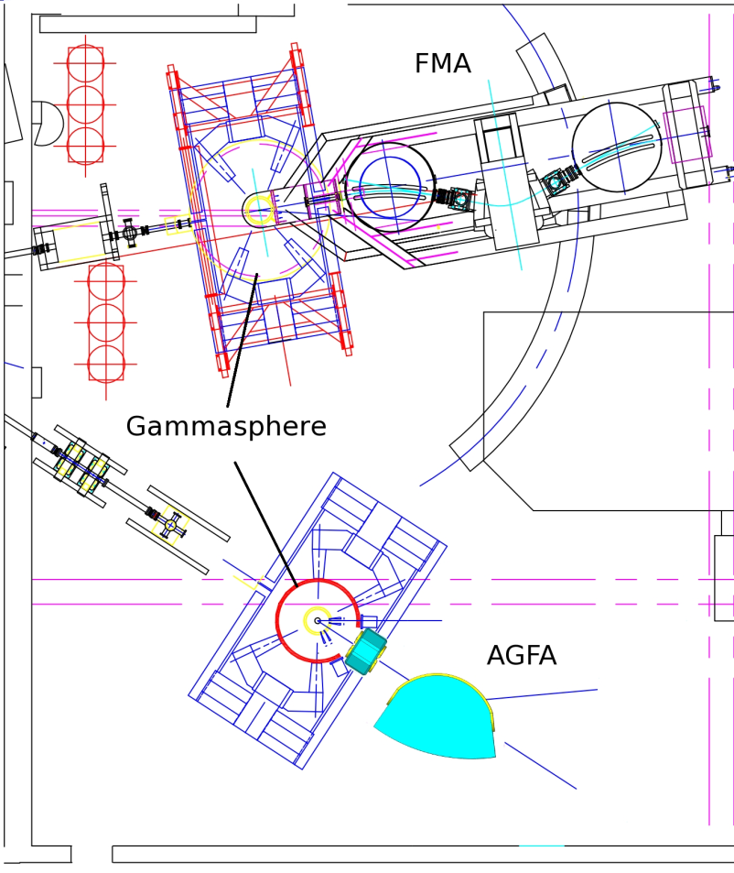
AGFA – FMA – Gammasphere – Gretina in Area 4
Purpose:
High efficiency separation
  Gammasphere at target position
  Evaporation residues
    Superheavy nuclear structure and fission barriers
    ~¹⁰⁰Sn region
    Heavy proton emitters
    Other uses
  Deep-inelastic products
    N-rich nuclei e.g. N~126
With Digital Gammasphere this is a unique capability
AGFA: 50-95% Efficiency
FMA: Less efficiency, m/q measurement

Slide 7
Integration with Gammasphere
Target to quad front: 80cm

Slide 8
Heavy element reaction
Distribution at focal plane
64x64 mm² DSSD
200 MeV
⁴⁸Ca+²⁰⁸Pb → ²⁵⁴No+2n
Efficiency: 71%
Figure 15: Left: X-Y image of ²⁵⁴No recoils at the focal plane. The grey area corresponds to that a covered by a 64x64mm² DSSD. Right: Projections onto the horizontal (lower panel) and vertical (upper panel) where the grey area indicates the extent of the DSSD.

Slide 9
“¹⁰⁰Sn reaction”
Distribution at focal plane
64x64 mm² DSSD
182 MeV
⁵⁴Fe+⁵⁴Fe → ¹⁰⁶Te+2n
Efficiency: 95%
Figure 16: Same as Fig. 15, but for the reaction 182MeV ⁵⁴Fe+⁵⁴Fe→¹⁰⁶Te+2n with 10 Torr He gas in AGFA.

Slide 10
AGFA relative to existing separators

Slide 11
Beam suppression for ¹⁰⁶Te recoils
Reaction: ⁵⁴Fe(⁵⁴Fe,2n)¹⁰⁶Te, 182 MeV
Figure 17: Focal plane distributions of ¹⁰⁶Te recoils (blue) and beam particles (red) in AGFA (left panel) and RITU (right panel) for a 10 Torr He gas pressure in both separators.

Slide 12
AGFA technical specifications

Slide 13
Budget

Slide 14
Status and schedule
July 2013: Tentative DOE approval – request Project Management Plan (PMP)
Sept 2013: Project Management Plan submitted to DOE for review
Nov 2013 – now: Modifications to Project Management Plan
Aug 2014: AGFA review
Oct 2014: Start project
Oct 2016: Start experimental program

Slide 15
Thank you

