Slide 1
Explore the nuclear structure of fission fragments using GRETINA/CHICO2
GRETINA User Workshop, Argonne National Lab
March 1, 2013
Ching-Yen Wu

Slide 2
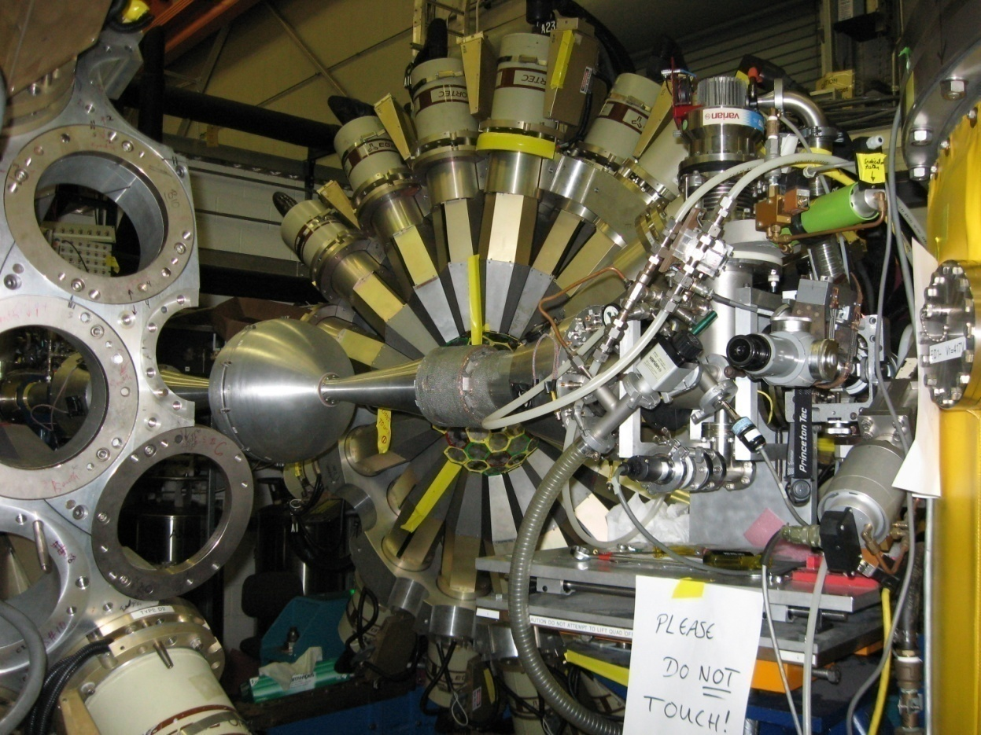
Gammasphere/CHICO at ANL, 2008
Gammasphere/CHICO setup in front of FMA
¹⁷⁸Hf on ²⁰⁸Pb at E_{lab}=984 MeV
TOF vs position
Doppler-shift corrected γ spectrum
E_{γ} (keV)

Slide 3
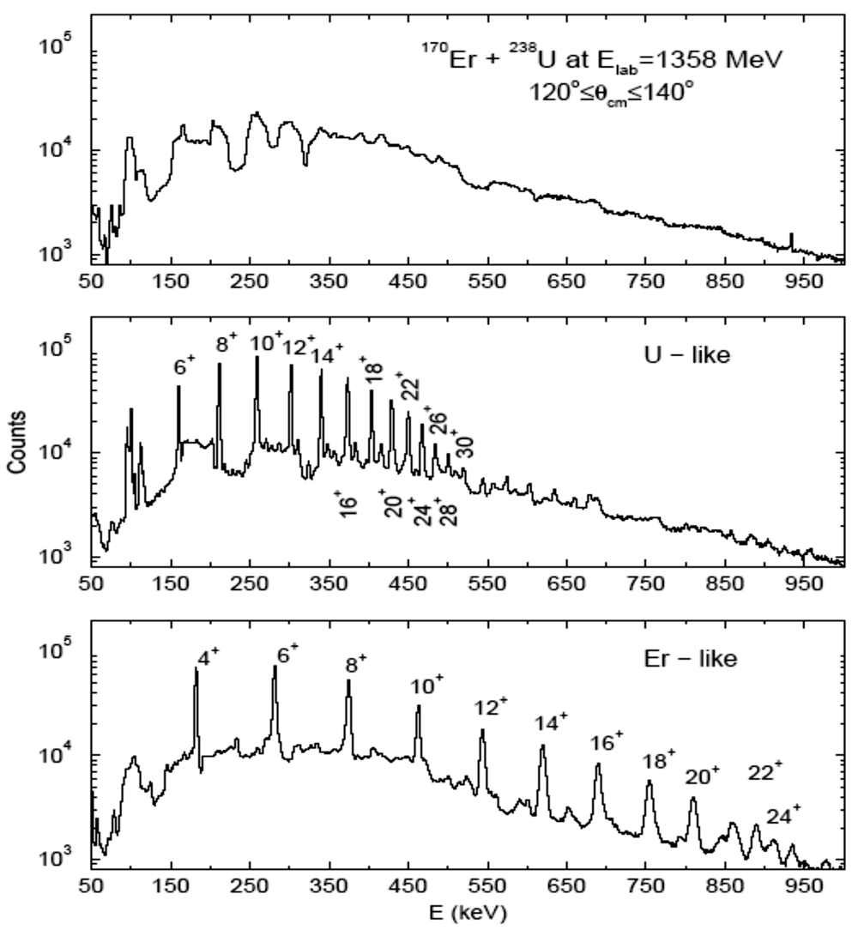
Precision Doppler-shift correction
1358 MeV ²³⁸U on ¹⁷⁰Er; Phys. Rev. C61, 21305(R) (2000)
Raw data
Corrected for U-like particles
Corrected for Er-like particles

Slide 4
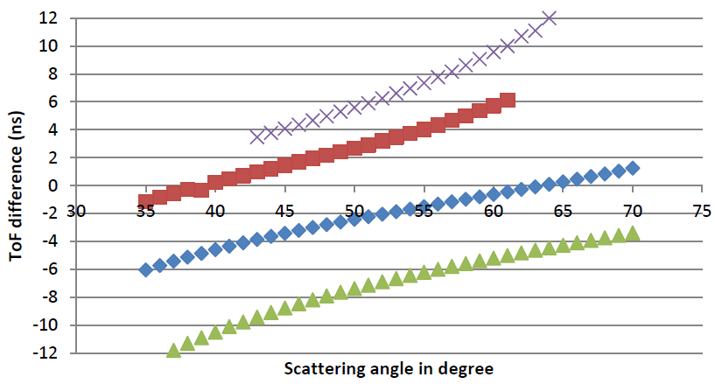
Two-body kinematics for ¹⁴⁴Ba experiment
⁹²Zr on ²⁰⁸Pb
¹⁴⁴Ba on ²⁰⁸Pb
Beam contamination such as ⁹²Zr and ⁹²Mo can be removed

Slide 5
LLNL/Rochester physics program – radioactive beam
Prolate to oblate (shape) transition
  Shapes in ^{110,112}Ru and ^{114,116}Pd; measured by the sign of electromagnetic static matrix element
  H. Hua, C.Y. Wu, D. Cline et al., PLB 562, 201 (2003)
Spherical to deformed (shape) transition
  Shape coexistence in Sr-Zr isotopes
  Deformation in ^{98,100}Sr and ^{100,102,104}Zr; measured by the magnitude of electromagnetic transition matrix element
Evolution of octupole (collectivity) in Ba (A=144 and 146) isotopes
isomerism
ANL Workshop
4/8/2006

Slide 6
Systematics of Pd isotopes with A ≥ 110
Mass | E_{ex} (2⁺) (keV)
108 | 434
110 | 374
112 | 349
114 | 333
116 | 340
118 | 379
Shape transition from prolate to oblate for the Pd isotopes predicted to occur at ¹¹¹Pd by the finite-range droplet model (P. Moller et al., At. Data Nucl. Data Tables 59, 185 (1995) and ¹¹²Pd by the relativistic mean-field theory (G.A. Lalazissis et al., At. Data Nucl. Data Tables 71, 1 (1999)

Slide 7
Case study – shape measurement for ¹¹⁶Pd
¹¹⁶Pd on 1 mg/cm² ²⁰⁸Pb at E_{Lab} = 400 MeV
M(E2; 2⁺ → 0⁺) = 0.76 eb, M(E2; 2⁺ → 2⁺) = − 0.72 eb
θ_{lab} (degrees) | Yield (2+→0+) (mb) |  | Pro/Obl
bin size | Prolate | Oblate
45 5 | 60.4 | 71.0 | 0.85
55 5 | 45.1 | 56.2 | 0.80
65 5 | 31.6 | 41.6 | 0.76
115 10 | 8.29 | 12.5 | 0.66
130 10 | 3.72 | 5.66 | 0.66
145 10 | 2.46 | 3.76 | 0.65

Slide 8
Case study
Beam intensity: ¹¹⁶Pd – 8.1 x 10⁴ pps (CARIBU proposal)
Calculation assuming 10⁴ pps
GRETINA efficiency ~ 30% at Eγ = 340 keV
23 counts/day for θ = 145º (10º bin)
Statistics better than 10% obtained with 5 days of beam-on-target
Alternative: ¹¹⁶Pd on ⁵⁸Ni to reduce the burden of analysis
Applied for ¹¹⁰Ru (3.6 x 10⁵ pps), ¹¹²Ru (9.2 x 10⁴ pps), and ¹¹⁴Pd (1.8 x 10⁵ pps)

