Slide 1
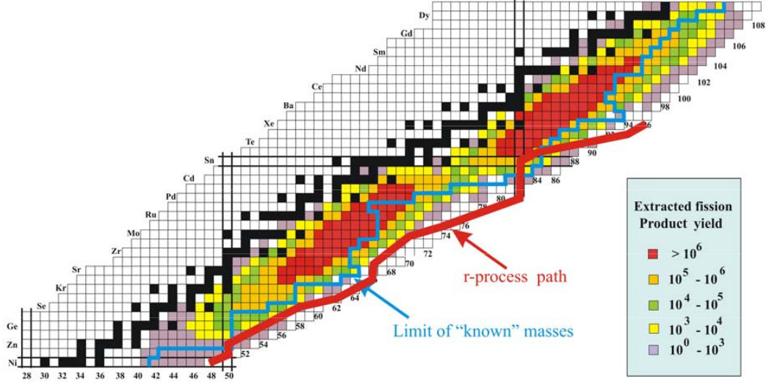
Coulomb excitation of even
¹⁰⁸⁻¹¹²Ru and ¹⁰⁴⁻¹⁰⁸Mo isotopes
Juho Rissanen
Nuclear Structure Group, Lawrence Berkeley National Laboratory
Notes:
Show where Mo and Ru isotopes are located

Slide 2
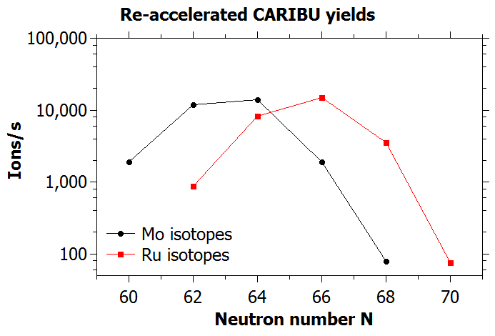
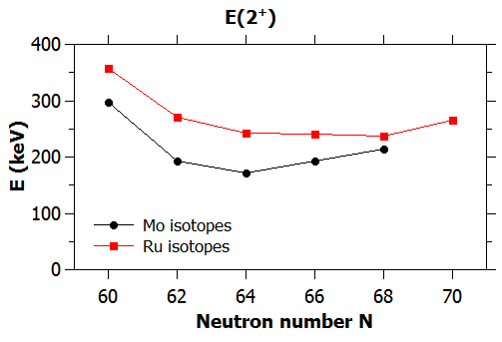
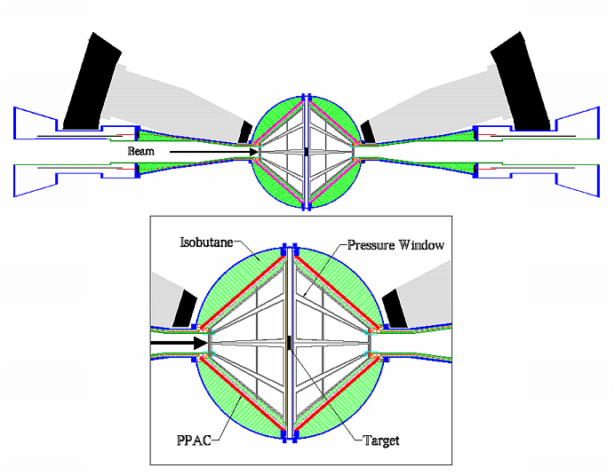
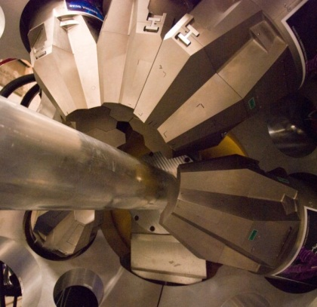
COULEX with GRETINA and CHICO2
Highest CARIBU yields at Z≈42,N≈64 in the lower mass region (¹⁰⁶Mo)
Reaccelerated beams of refractory elements
low E(2+) -> high B(E2) -> high Coulomb excitation cross-section
Multiple Coulex of Ru/Mo isotopes on heavy target at “safe” energies
December 2012
GRETINA
CHICO2
Good Doppler correction -> better energy resolution
Notes:
High yields, high cross-section
Refractory elements
Multiple coulex
Good energy resolution

Slide 3
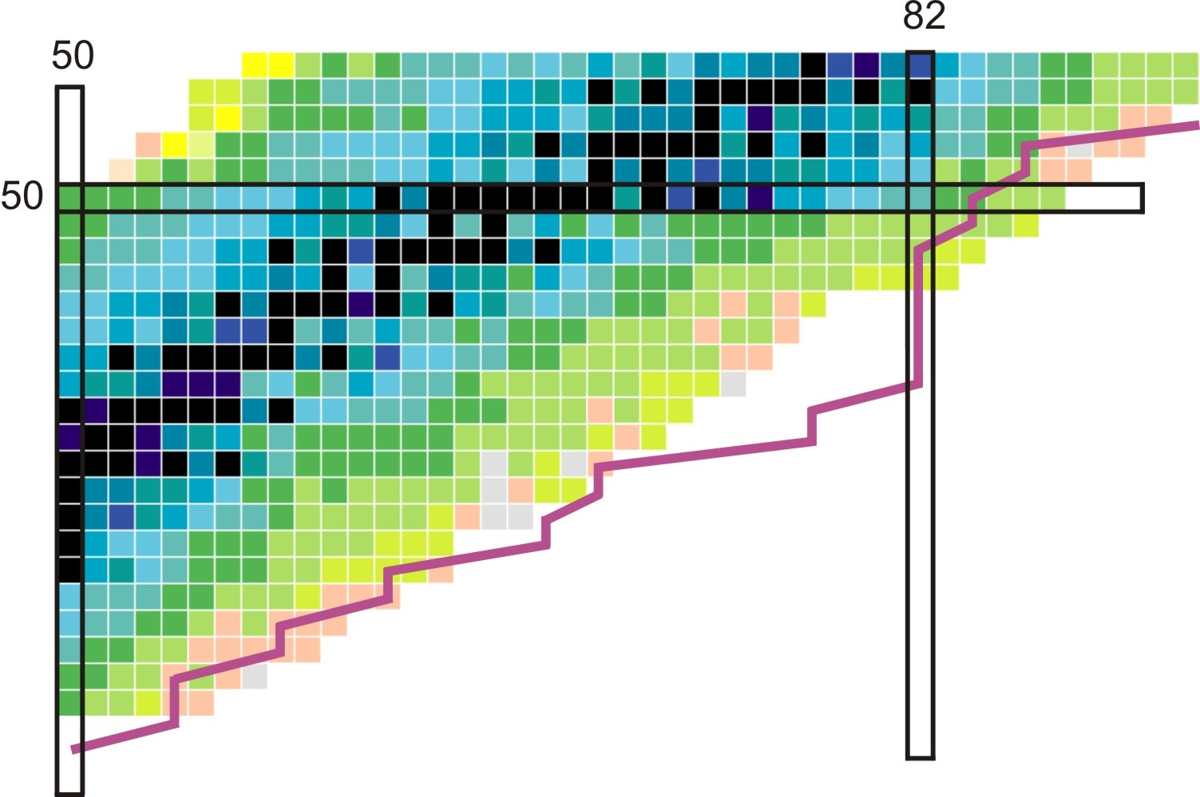
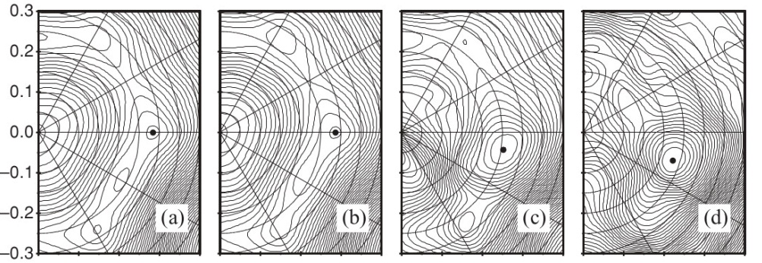
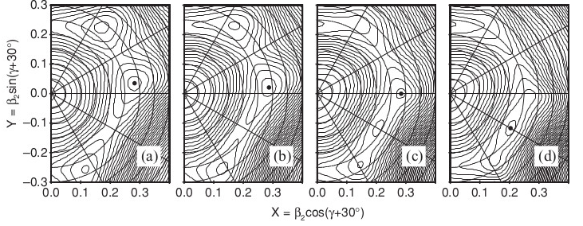
Physics motivation, nuclear shapes
r-process path
Variety of different shapes
Ru
Mo
prolate
oblate
triaxial
82
¹¹²Ru
Ru isotopes
50
Shape evolution vs mass?
Faisal et al., PRC 82, 014321 (2010)
Shape evolution vs spin?
ħω=0
ħω=0.2 MeV
ħω=0.4 MeV
ħω=0.6 MeV
N=64
N=66
N=68
N=70
Notes:
Triaxiality

Slide 4
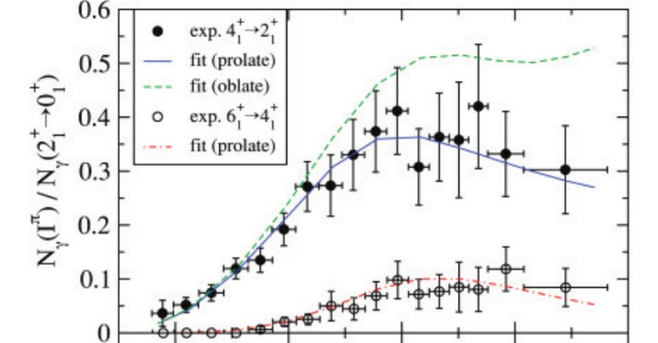
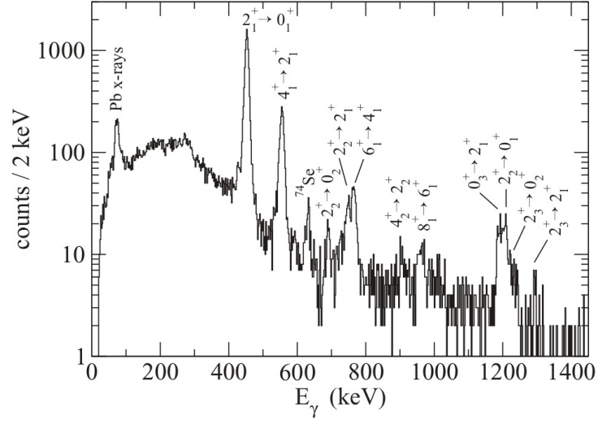
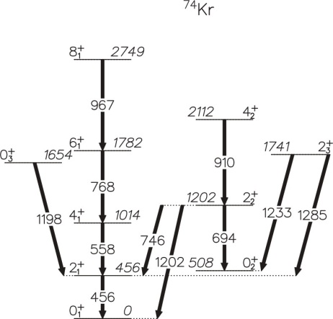
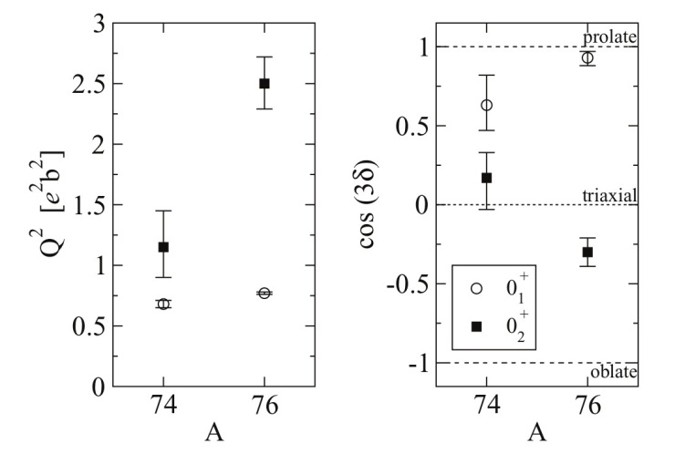
Shape coexistence in Kr isotopes
Coulomb excitation of ^{74,76}Kr beams with ²⁰⁸Pb target at GANIL at safe energies
High-statistics data allows determination of deformation parameters Q and cos(3δ) for different states
θc.m.
≈beta
≈gamma
⁷⁴Kr, 150 hours, 1E4 beam intensity, ≈99% pure
Clement, PRC 75, 054313 (2007)
Notes:
Determination of the gamma parameter is important especially for the Ru and Mo isotopes.

Slide 5
Summary
GRETINA+CHICO+CARIBU allows Coulomb excitation studies of neutron-rich Ru and Mo isotopes
Systematic studies of the shape evolution vs. I,Z in the A=110 region (prolate, oblate, shape coexistence, triaxiality)
What are the experimental limitations?
  Beam intensity?
    With December 2012 performance, ^{104,106}Mo possible in 12 days of beam time. 3 x increase allows ¹⁰⁸Mo also
  Beam purity? How well the impurities are known?
  Beam energy, ΔE?
Thanks for your attention

Slide 6
Backup slides

Slide 7
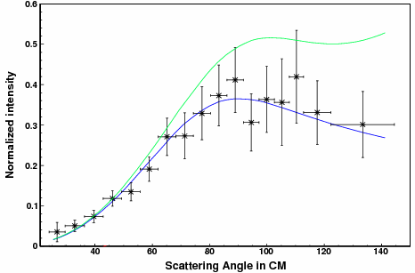

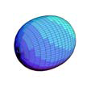
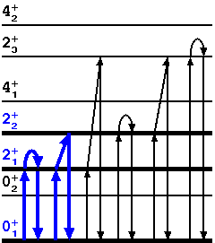
Analysis
Gamma intensities ->CE cross-section
Mo and Ru isotopes, level schemes known, some level lifetimes known
-> input everything to GOSIA code
vary parameters -> try to extract diagonal matrix elements
-> static quadrupole moment Q₀ for a given state
Rather complete set of matrix elements needed
M_{f}
I_{f}
dσ/dΩ=f[B(E2),Q], 2nd order
I_{i}
Nuclear reorientation effect

Slide 8
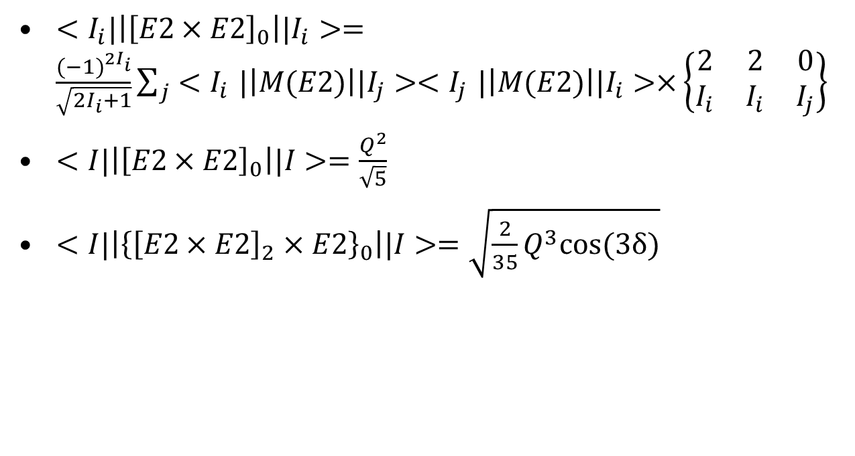
Some mathematics
Measurable matrix elements
$<I_{i}|\left|{\left[E2×E2\right]}_{0}\right||I_{i}>=\frac{{(−1)}^{2I_{i}}}{\sqrt{2I_{i}+1}}\sum_{j}{{<I}_{i}|\left|M(E2)\right||I_{j}>{<I}_{j}|\left|M(E2)\right||I_{i}>×}\left\{\begin{matrix}2 & 2 & 0 \\ I_{i} & I_{i} & I_{j}\end{matrix}\right\}$
$<I|\left|{\left[E2×E2\right]}_{0}\right||I>=\frac{Q^{2}}{\sqrt{5}}$
$<I|\left|{\left\{{\left[E2×E2\right]}_{2}×E2\right\}}_{0}\right||I>=\sqrt{\frac{2}{35}Q^{3}cos⁡(3δ)}$
Q is a quadrupole
deformation parameter
(Bohr’s β)
cos (3δ) is a triaxiality
parameter (Bohr’s γ)

Slide 9
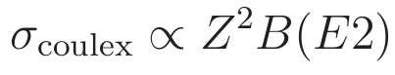
Experiment
¹⁰⁶Mo: B(E2)=1.31
⁷⁴Kr: B(E2)=0.84
->σ(¹⁰⁶Mo)≈ σ(⁷⁴Kr) x 1.6
Is the mass resolution good enough?
~1 mg/cm² thick ²⁰⁸Pb target
factor of 2 down in gamma efficiency
More intense beam appreciated to measure several cases / beam time
Good gamma energy/position resolution needed to tolerate beam impurities
10 000 counts in photopeak needed

Slide 10
Beam time days
Factor of 2 down in gamma efficiency
10000 counts in a photopeak
Isotope | σ_{CE} vs Kr | Beam vs Kr | Beam time days
¹⁰⁸Ru | 1.2 | 0.8 | 12.5
¹¹⁰Ru | 1.3 | 1.5 | 6.7
¹¹²Ru | 1.4 | 0.4 | 26
¹⁰²Mo | 1.1 | 0.2 | 57
¹⁰⁴Mo | 1.6 | 1.2 | 6.5
¹⁰⁶Mo | 1.6 | 1.4 | 5.7
¹⁰⁸Mo | 1.9 | 0.2 | 35

Slide 11
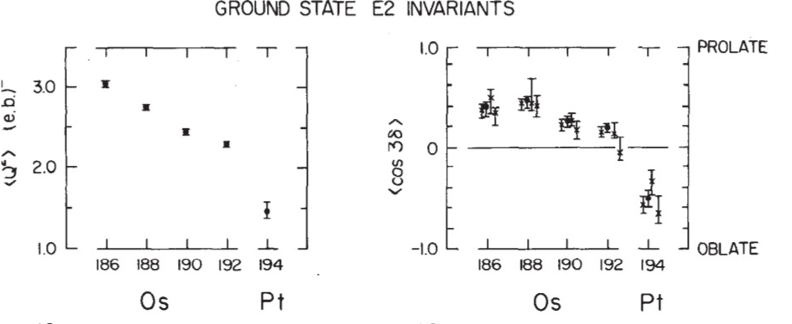
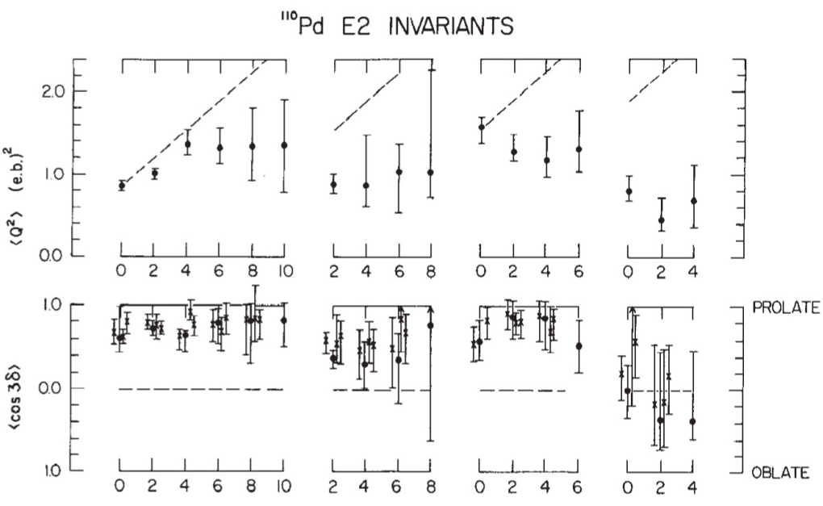
Other examples
Q, cos 3δ vs mass
Cline Ann. Rev. Nucl. Part. Sci. 36, 683 (1986)
Q, cos 3δ vs spin
g.s. band
γ band
0⁺₂ band
0⁺₃ band

