Slide 1
Introduction
David Radford
ORNL Physics Division
Workshop on Future GRETINA Science Campaigns
ANL, March 1, 2013

Slide 2
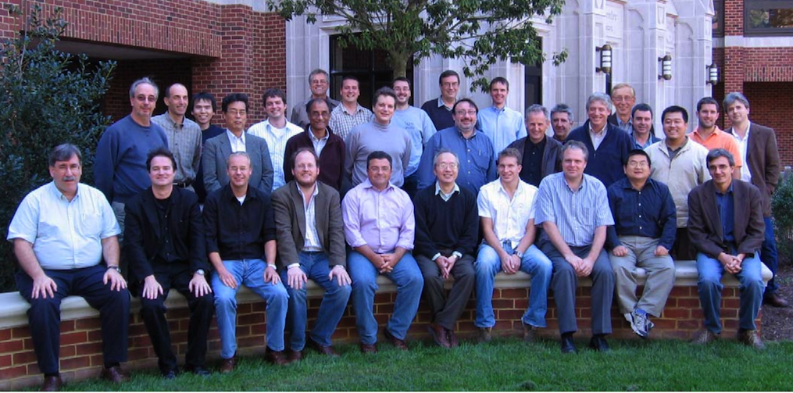
Richmond Workshop
“Optimizing GRETINA Science: A workshop dedicated to planning the first rounds of operation”
October 14 - 15, 2007 University of Richmond, Richmond, Virginia
Two years after CD-2A/3A
Same month as CD-2B/3B approval to start full construction
3½ years before completion (CD-4)
Notes:
2
2
DOE, John Anderson, Reviewers, collaborating institutions, …

Slide 3
Richmond Workshop
“Optimizing GRETINA Science: A workshop dedicated to planning the first rounds of operation”
October 14 - 15, 2007 University of Richmond, Richmond, Virginia
Focus of the meeting:
How to best optimize the discovery potential and physics impact of GRETINA following its completion, taking advantage of unstable and stable beams at various sites
Unanimous agreement that GRETINA would be :
Assembled, tested, and commissioned at LBNL
Then rotated among the national laboratories of MSU, ORNL, and ANL
Also discussed the physics opportunities and infrastructure issues at each lab, and unanimously converged on the sequence order for the first cycle.
Notes:
3
3
DOE, John Anderson, Reviewers, collaborating institutions, …

Slide 4
GRETINA Physics Schedule
Engineering runs in Cave-4C, LBNL 88-Inch Cyclotron
Started April 2011, ran for 4 months
Original Plan (Richmond U Workshop)
Commissioning runs at LBNL BGS, 88-Inch Cyclotron
Heavy element physics for ~4 months
6-month Science Campaigns; 2012 – 2013
MSU (NSCL)
ORNL (HRIBF)
ANL (ATLAS/Caribu)
Notes:
4
4

Slide 5
GRETINA Physics Schedule
With the closure of HRIBF, schedule needed to be rearranged
Modified Plan (recommended by GAC, approved by DOE)
Extend commissioning runs at BGS (LBNL 88-Inch Cyclotron) by three months
Heavy element physics for 7 months.
Move to NSCL for extended (~12 months) science campaign
Move to ATLAS (ANL) now delayed until June
Notes:
5
5

Slide 6
What’s Next?
Plan for GRETINA to operate at ATLAS/CARIBU until some time in 2014
This meeting is for us to talk about how GRETINA can be most productive, both here at ANL and after that time
How to best optimize the discovery potential and physics impact of GRETINA?
Look for lessons learned from operations at BGS and NSCL
Plan for a productive campaign at ATLAS
Discuss options for timing and location of next campaign(s)
Involve users in efforts to incrementally improve the performance of GRETINA
Work towards the construction of GRETA
Notes:
6
6

Slide 7
Users Executive Committee
When GRETINA entered the physics phase, a Users Group and UEC were formed, with elections in June 2012.
This meeting is organized by the UEC.
Paul Fallon (LBNL) - Chair
Ingo Wiedenhoever (Florida State U.)
Alexandra Gade (NSCL)
Shaofei Zhu (ANL)
Partha Chowdhury, as GAC representative
This group will need to adopt a UG charter; draft developed by GAC
Mailing List: gretina-users@lists.physics.fsu.edu
http://lists.physics.fsu.edu/cgi-bin/mailman/listinfo/gretina-users
Notes:
7
7

Slide 8
Project People
Original Contractor Project Manager: I-Yang Lee (LBNL)
New manager: Augusto Macchiavelli (LBNL)
GRETINA Advisory Committee (GAC):
David Radford (ORNL) (Chair)
Con Beausang (U. of Richmond)
Mike Carpenter (ANL)
Partha Chowdhury (U. Mass. Lowell)
Doug Cline (U. of Rochester)
Mario Cromaz (LBNL)
Mark Riley (Florida State U.)
Demetrios Sarantites (Washington U.)
Dirk Weisshaar (MSU / NSCL)
Working Groups and chairs
Physics M. A. Riley (FSU)
Detectors A. O. Macchiavelli (LBNL)
Electronics D. C. Radford (ORNL)
Software M. Cromaz (LBNL)
Aux. Detectors D. G. Sarantites (WUSTL)
Notes:
8
8

Slide 9
Summary
Thank you, I-Yang!
We will hear how GRETINA has been having a very successful campaign at NSCL
It’s important that it produce great physics at ATLAS
It’s time to consider where it will go next, and when
GRETINA is only the first stage of GRETA
Its performance still needs to be optimized
We need to make a strong case for GRETA
Notes:
9
9

