Slide 1
Future plans for GRETINA science and operations

Slide 2
Meeting Goals
to discuss the science opportunities and provide technical information for these [ANL] experiments
- Focus of yesterdays talks and discussions
(ii) to plan for the next round of GRETINA experiments following the stay at ATLAS.
- todays focus
Our discussions today will be input to a report to DOE (from the GUEC) on a proposed plan for Gretina operations
One can consider three timeframes
Present – 2014 (includes Gretina@ANL)
2015 (GUEC view: the main focus of the report and most “time-urgent”)
2016 + (longer term, obviously very important but not really possible to map out today, but do need to start thinking/working on this)

Slide 3
Timeframes (high level view)
Present – 2014
2015
2016 +
… within each time there are things to discuss and figure out
 | 2013 | 2014 | 2015 | 2016
Current Plan | NSCL ANL
Proposed (to be endorsed) |  | NSCL |  | *
* Develop the plan for 2016+ within the next 12-18 months.
- Science opportunities within US and overseas ?

Slide 4
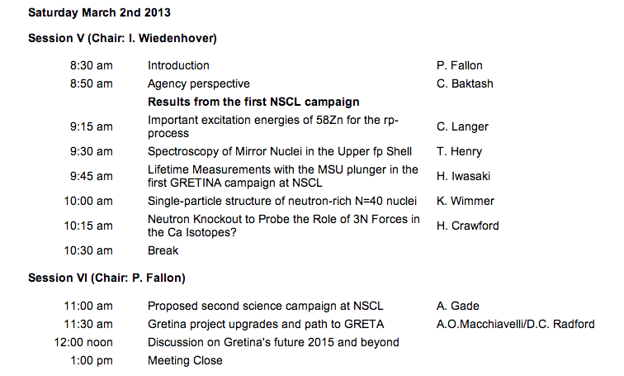
Workshop On Future GRETINA Science Campaigns – Agenda Day 2

