Slide 1
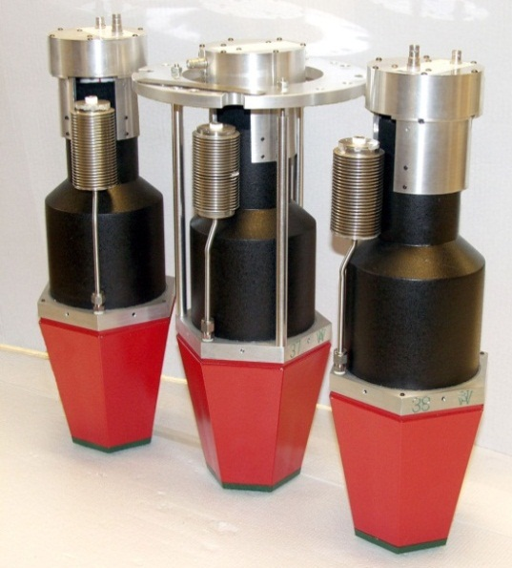
N~Z studies with Gretina and neutron detectors
W. Reviol, D. Rudolph, D.G. Sarantites, C.J. Chiara, D. Seweryniak
Washington U. / Lund U. / U. of Maryland / ANL
Gretina Workshop, ANL, March 2013
Neutron-Shell Detectors
35 hexagonal, tapered detectors.
BC501A liquid scintillator.
Active scintillator length 15 cm.
n-γ separation: PSD and ToF.
“Coverage”, efficiency for a r = 25 cm
shell: 28% 4π, ε(1n) > 30%.
Fast detectors, no severe rate limitation.
Hence useful in FMA experiments.
D.G. Sarantites et al., NIMA530, 473 (2004)
Notes:
1
NS has ~13-year history with GS (+MB+FMA), many successes.

Slide 2
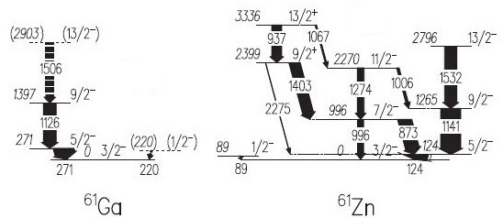
Fusion-evaporation experiments with Gretina@FMA
Better energy resolution than Gammasphere (important for large E_{γ}).
Better linear-polarization sensitivity than Gammasphere.
For N ~ Z studies, neutron detection adds to reaction-channel selectivity.
Some future projects
Nearly unbound odd-Z, N=Z-1 nuclei (⁵⁷Cu, ⁶¹Ga, ⁶⁵As) via *xn channels
Prompt proton (g_{9/2}) emission competing with γ decay
Isospin symmetry, shape changes, tunneling…
9/2⁺ not seen;
⁶¹Ga → ⁶⁰Zn?
L-L. Andersson et al., PRC71, 011303(R) (2005)
Notes:
2
2
Suggested 100-MeV 24Mg(39K,2n), but 39K not listed on ATLAS beams list?? Previous study used (40Ca,p2n).
In 61Zn, the 9/2+ is n(g9/2), for 61Ga it would be p(g9/2) and could thus p decay.

Slide 3
Fusion-evaporation experiments with Gretina@FMA
Better energy resolution than Gammasphere (important for large E_{γ}).
Better linear-polarization sensitivity than Gammasphere.
For N ~ Z studies, neutron detection adds to reaction-channel selectivity.
Some future projects
Nearly unbound odd-Z, N=Z-1 nuclei (⁵⁷Cu, ⁶¹Ga, ⁶⁵As) via *xn channels
Prompt proton (g_{9/2}) emission competing with γ decay
Isospin symmetry, shape changes, tunneling…
β tagging in ¹⁰⁰Sn region with FMA+DSSD
Not as selective as discrete proton- or α-decay tags.
Ndets reduce background from dominant, less exotic isobars.
Gretina: γ polarizations to locate h_{11/2}.
Octupole correlations in the neutron-deficient Ba/Te region
In many cases, bands are identified but assumed to have opposite parity.
Notes:
3
3

Slide 4
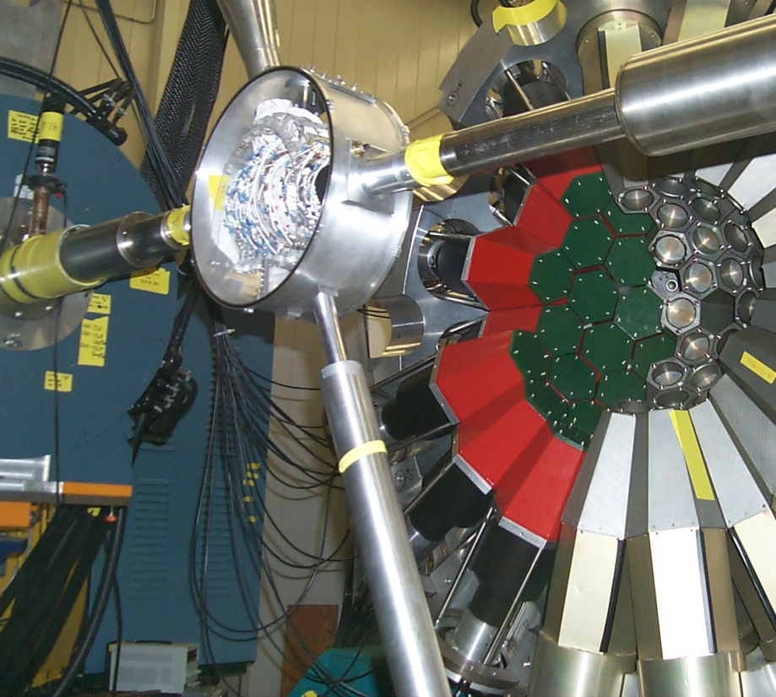
Neutron Shell was designed for use with Gammasphere
[How] will it work with Gretina?
At 30cm, θ_{min} ~ 55º and
Ndets only on one side ➔ ε_{NS,Gr}/ε_{NS,DGS} ~ 0.2;
ε_{FMA,Gr}/ε_{FMA,DGS} ~ 4.
QUAD
With Gretina at back
hemisphere, gain some,
ε_{NS,Gr}/ε_{NS,DGS} ~ 0.3.
QUAD
Pulling Gretina back to
60cm improves this to
ε_{NS,Gr}/ε_{NS,DGS} ~ 0.45,
but at the cost of ε_{FMA}.
QUAD
[In all cases, ε_{γ,Gr}/ε_{γ,DGS} ~ 1 because Ndets do not displace any Ge with Gretina.]
Recover forward n’s with a plane of Ndets perpendicular to beamline?
Notes:
Mechanical components along the axis—not trivial to use it for beamline, but represents limiting case.
Have not accounted for higher eff and less scattering due to the lower E’s.

Slide 7
Notes:
7
7

Slide 9
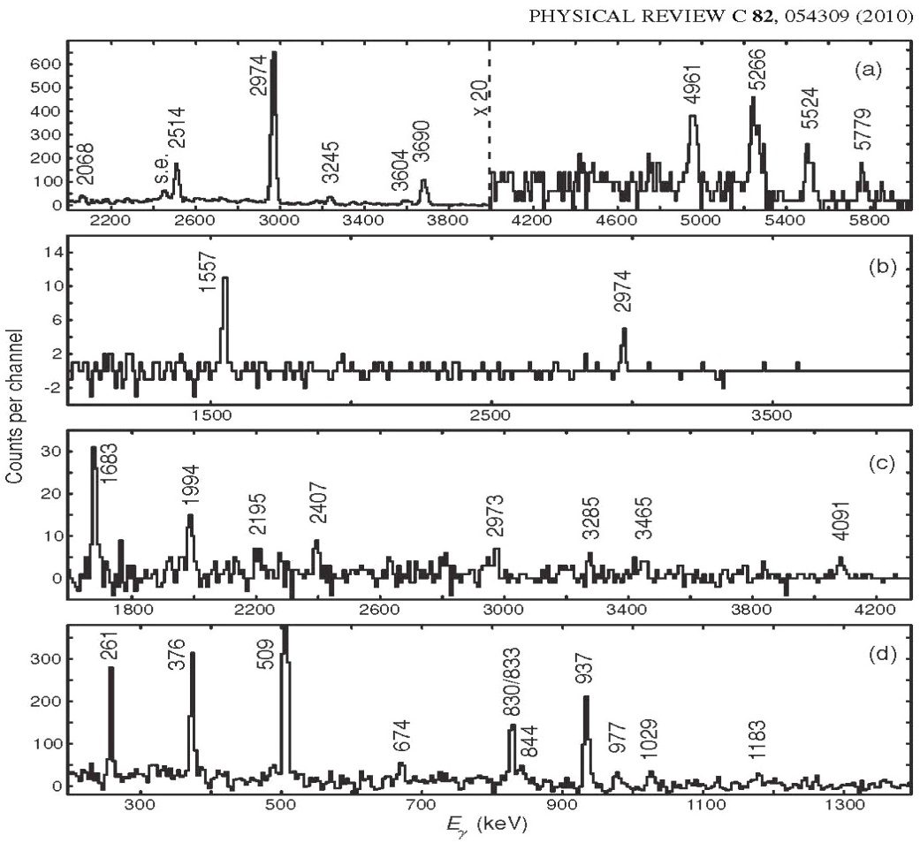
A past example: N = Z ⁵⁴Co
²⁸Si(³²S,αpn) E_{lab}=130 MeV
D. Rudolph et al.
⁵⁴Co
high-spin
parallel
transitions
low-spin transitions
(gate 5524 keV)
Setup: 30 n detectors in Gammasphere
⁵⁴Co: no hint for collectivity.
The Neutron Shell provides selectivity at N ≤ Z
Notes:
9
9

Slide 10
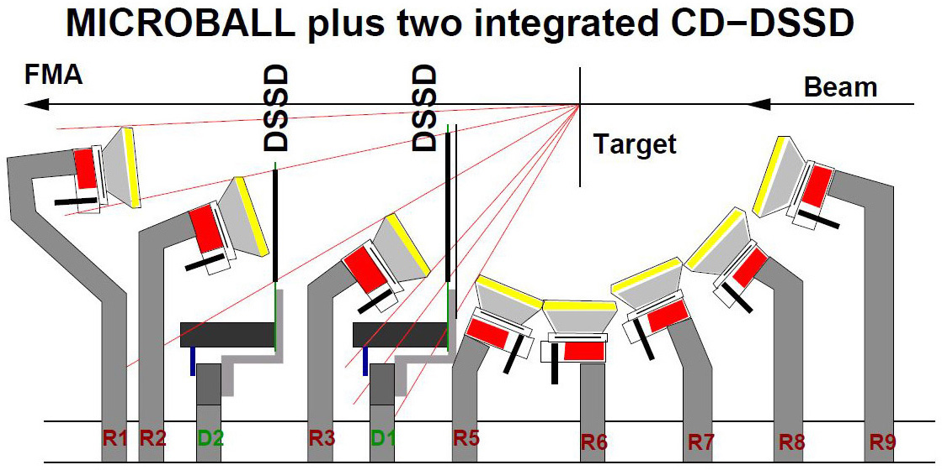
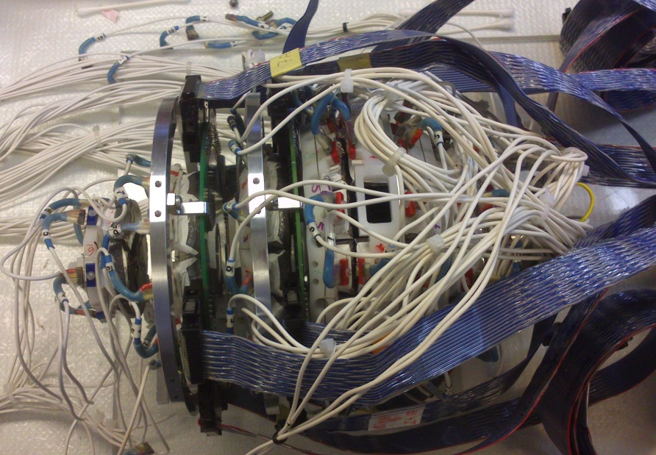
Improved ability for in-beam proton-decay studies
Microball
→ high efficiency
CD DSSD
→high granularity
ΔE-E capability
x
x no Ring 4
D. Rudolph et al.
Notes:
10
10
10

Slide 11
Isospin mixing in mirror pairs—relies on comparisons of E1 transitions.
Also in N=Z nuclei (should be “forbidden” between states of same T).
R. Orlandi et al., PRL103, 052501 (2009).
⁴⁰Ca(³²S,αn) and ⁴⁰Ca(³²S,αp)

