Slide 1

GRETINA at ATLAS:
Two Possible Experiments
Augusto O. Macchiavelli
Nuclear Science Division Lawrence Berkeley National Laboratory
Workshop On Future GRETINA Science Campaigns
ANL -- March 1-2, 2013
Work supported under contract number DE-AC02-05CH11231.

Slide 2
Quadrupole Collectivity of Neutron-rich Carbon Isotopes
The Carbon isotopes provide an interesting ground to study the evolution of shell structure with isospin and the influence of weak binding.
  Experimentally accessible up to the drip line, systematically examine spectroscopic information
  Opportunity to understand how the proton and neutron degrees of freedom are coupled near the drip line
E2 Transition rates offer a unique probe to isolate these effects.
Quantitative test of models requiring a consistent description from stability to the dripline.
In particular No-core and ab-initio
A weakening of the proton p_{3/2}-p_{1/2} spin-orbit splitting due to the tensor force with the d_{5/2} neutrons increases the proton contribution in the 2⁺ .

Slide 3
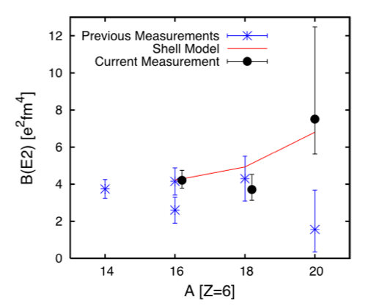

N. Imai et al., PRL 92, 062501 (2004)
M. Wiedeking et al., PRL 100, 152501 (2008)
H. J. Ong et al., PRC 78, 014308 (2008)
Z. Elekes et al. PRC 79, 011302(R) (2009)
M.Petri et al. ²⁰C: PRL 107, 102501 (2011)
¹⁶C: Submitted to PRC
P.Voss et al. ¹⁸C: PRC 86, 011303(R) (2012)
Shell Model: WBT interaction (B.A.Brown)
Reduced πp_{3/2}-p_{1/2} spin-orbit splitting
S. Raman et al., ADNDT 78, 1 (2001)
3.74 e²fm⁴

Slide 4
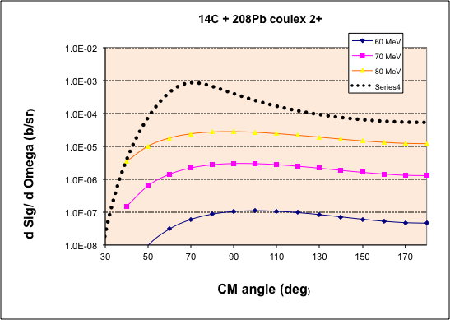
Transfer
Safe angle

Slide 5
Possible Experiment
GRETINA ( 2+ -> 0+ gamma; Eff ~0.02 )
and CHICO2 (kinematic selection)
Current ~ 1pnA
²⁰⁸Pb target ~0.5mg/cm2
Sigma ~ 0.01mb
N_{counts} in 7MeV peak ~ 1000 in 5 days.

Slide 6
Pairing Phase Transition in Neutron Rich Nuclei
Properties of pairing phonons near ¹³²Sn doubly magic nuclei, transition to superfluid.
Do we expect a different behavior ?
Opportunity to study the density dependence of nucleon pairing. Cross sections to 0⁺ and first excited 0+ and 2⁺ show sensitivity to the volume/surface nature of pairing correlations.
(cf. M. Matsuo, Nuclear Structure 2010)
(t,p) reactions in reverse kinematics with HELIOS
→tritium target ??

Slide 7
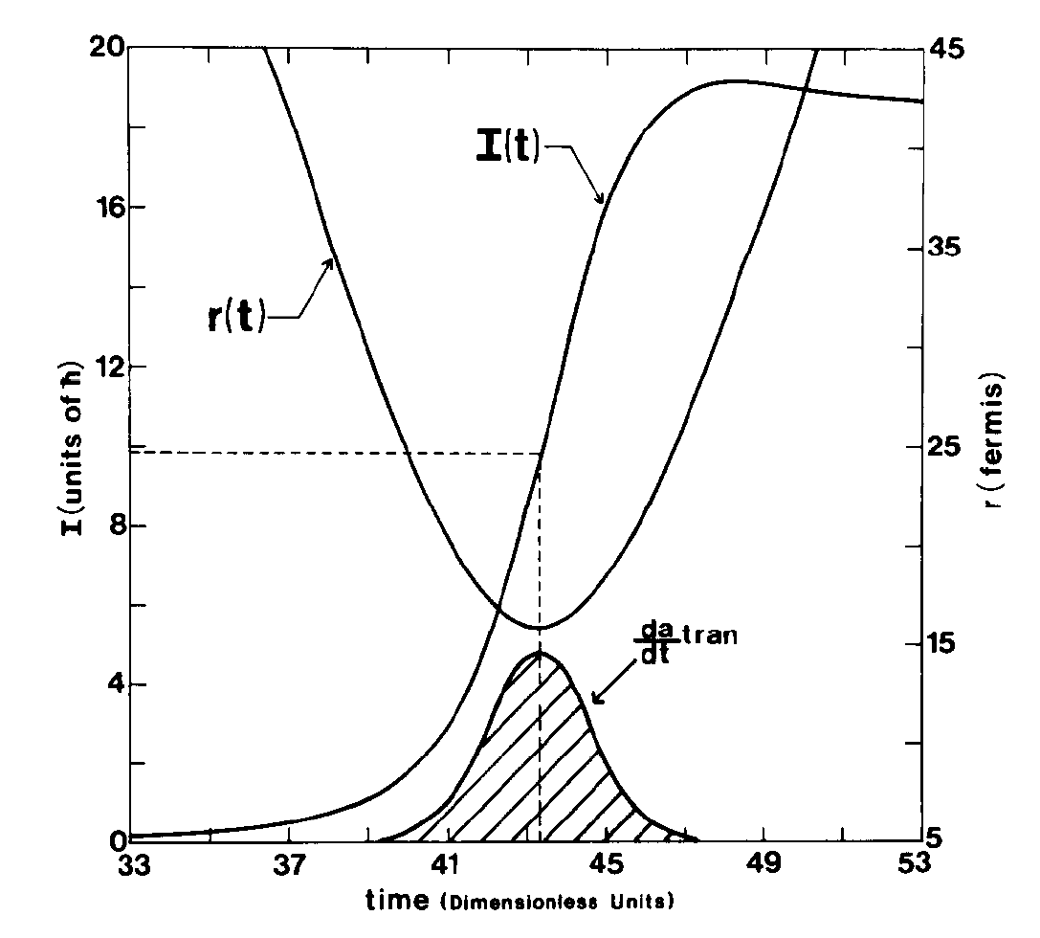
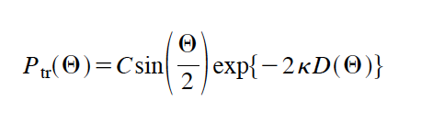
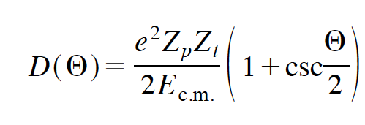
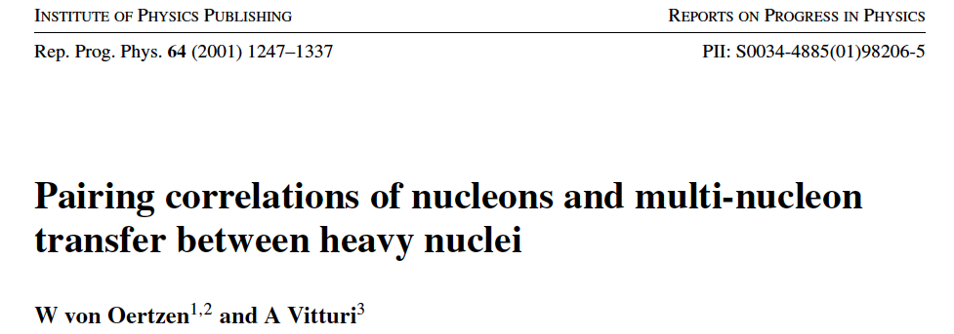
Can we consider Heavy Ion Transfer ?
ΔM/M, ΔL/L and ΔE/E << 1
Large Sommerfeld parameter η>>1
Semi-classical description
 Classical trajectory and tunneling

Slide 8
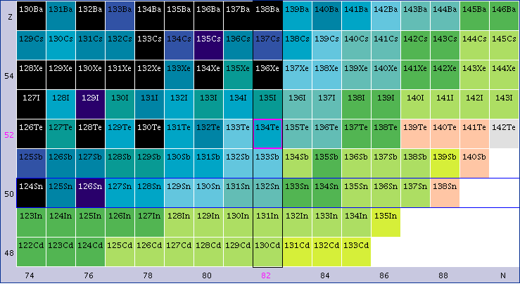

Slide 9
P(D₀)
1n
Compare
P_{1n}² with P_{2n}
-> EF
2n
1n²
D₀ (θ)
EF(A) = P_{2n}(^{A}Xe)/P_{1n}²(^{A}Xe)/ P_{2n}(¹³⁶Xe)/P_{1n}²(¹³⁶Xe)

Slide 10
Possible Experiment
GRETINA and CHICO2 (Kinematic selection)
^{132,136,138(140)}Xe beams from CARIBU (purity monitoring)
Current ~ 1x10⁵ part/sec
⁵⁸Ni target ~ 1mg/cm²
Sigma ~ 10mb
N_{counts} in 2⁺ →0⁺ gamma ~ 150 counts/day

