Slide 1
Nuclear Structure Theory
Exotic Beam Summer School 2012
August, 4-11th 2012
Nicolas Schunck

Slide 2
The dawn of nuclear physics
1896: Discovery of radioactivity (Becquerel)
1911: Discovery of the nucleus (Rutherford experiment)
1932: Discovery of the neutron (Chadwick)
1935: Bethe-Weiszaker mass formula
1939: Discovery of (neutron-induced) fission
1949: Shell model (Goeppert-Mayer, Jensens)
1951: Collective model (Bohr, Mottelson, Rainwater)
1957: Nuclear superfluidity (Bohr, Mottelson)
Since then: Nuclear forces, many-body methods (HF, HFB, RPA, GCM, Green function, etc.)

Slide 3
Prerequisites
Basic notions of physics: orders of magnitude, scales, the 4 elementary interactions (gravitation, electromagnetism, weak and strong nuclear force)
Basic notions of nuclear science: [k,M,G]eV, fm, nucleons, charge Z and mass numbers A, isotop[n]es, etc.
Basic notions of quantum mechanics
Wave function encodes all information about a quantum system
Schrödinger equation gives the wave-function
Energy of the system, and its evolution in time is dictated by the Hamiltonian,
Hamiltonian spectrum (eigenvalues of operator) can be
Discrete: bound-states, localized
Continuous: continuum, resonance, delocalized scattering states
To an observable (measurable) quantity corresponds a Hermitian operator

Slide 4
Part I Properties of Atomic Nuclei

Slide 5
From Molecules to Quarks
Quantum mechanics rules supreme: Wave-functions, Schrödinger/Dirac equation, spin, Hamiltonian, eigenvalues/eigenvectors, etc.
Many-body systems: Fock space, second quantization, field theory
Fermions: Pauli exclusion principle, Fermi-Dirac statistics

Slide 6
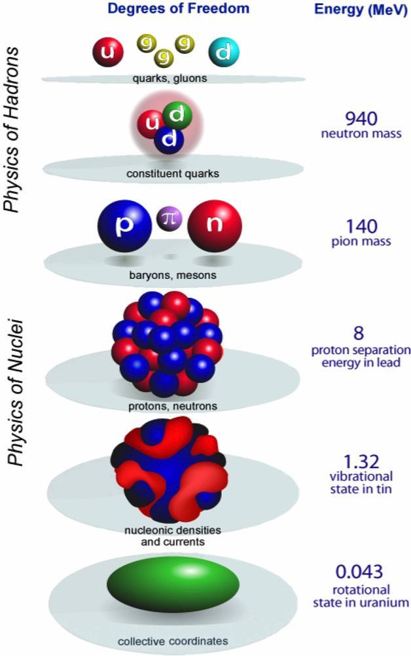
Atomic Nuclei
Energy scale covers 6 orders of magnitude!
Importance of using the right degrees of freedom: computing rotational states in uranium from quarks and gluons simply makes no sense!
Basic degrees of freedom:
Quarks, gluons: QCD
Nucleons, mesons: hadronic physics, relativistic quantum field theory
Nucleons, densities of nucleons: non-relativistic nuclear structure
From "Universal Nuclear Energy Density Functional: Computing Atomic Nuclei," G.F. Bertsch, D.J. Dean, and W. Nazarewicz, SciDAC Review 6, 42 (2007)

Slide 7
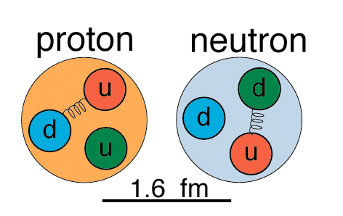
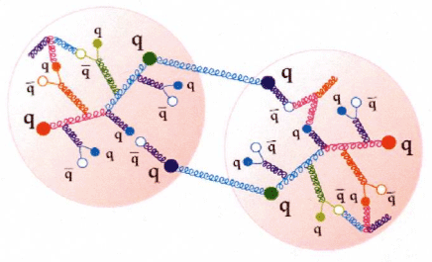
Nuclear Constituents
In nuclear structure, nucleons (neutrons and protons) are treated (most often) as point-like particles…
… even though they are in fact composite objects
The many-body system of QCD
Ground-state, excited states, etc.
Characteristics
Mass ≈ 940 MeV
Size ≈ 1.6 fm
Charge: +e (proton), 0 (neutron)
Relativistic theories also consider mesons ( ) explicitly
http://fafnir.phyast.pitt.edu/particles/sizes-2.html
From "Nuclear Physics, The Core of Matter, the Fuel of Stars", National Research Council (1999)

Slide 8
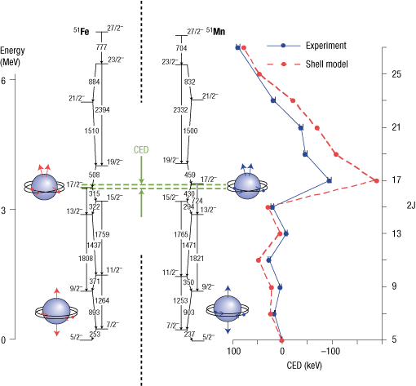
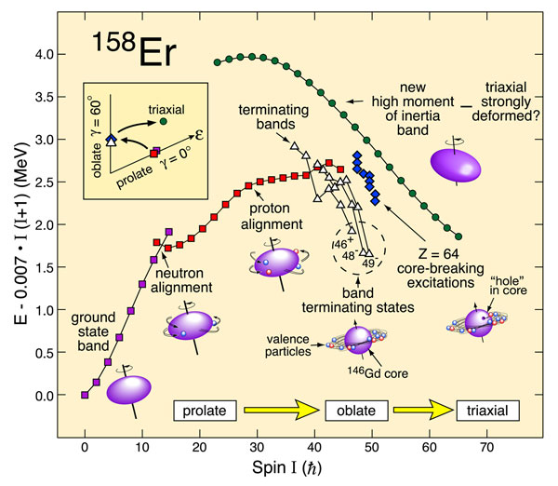
Spin and Isospin
Nucleons have orbital angular momentum and intrinsic spin, leading to total spin
Total angular momentum of the nucleus is denoted by I
Ground-state spin (for odd nuclei only, see pairing)
High-spin physics
From D. D. Warner, M. A. Bentley and P. Van Isacker, “The role of isospin symmetry in collective nuclear structure”, Nature Physics 2, 311 (2006)
Neutrons and protons are two faces of the same coin, leads to concept of isospin:
Vector operator
Third component has two eigenvalues, -1/2 (neutrons) and (+1/2) protons
Isospin of nucleus is noted T
Isoscalar, isovector

Slide 9
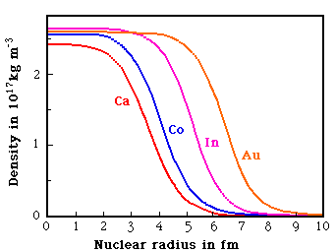
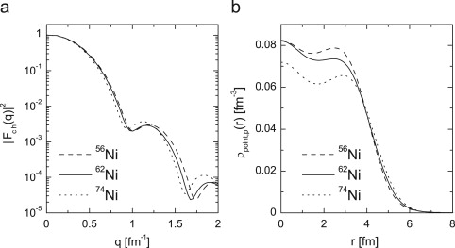
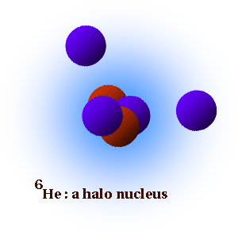
Nuclear Radii
Radius goes approximately like R ≈ 1.2 A^{1/3} fm
Density constant in the interior, falls off sharply on the surface
Neutron density much harder to extract than proton density
In exotic nuclei: Neutron skins, halos
From Prof. N. Spooner online course, The University of Sheffield,
http://physics-database.group.shef.ac.uk/phy303/phy303.html
A.N. Antonov, et al., “The electron–ion scattering experiment ELISe at the International Facility for Antiproton and Ion Research (FAIR) — A conceptual design study”, Nucl. Instrum. Meth. A 637, 60 (2011)

Slide 10
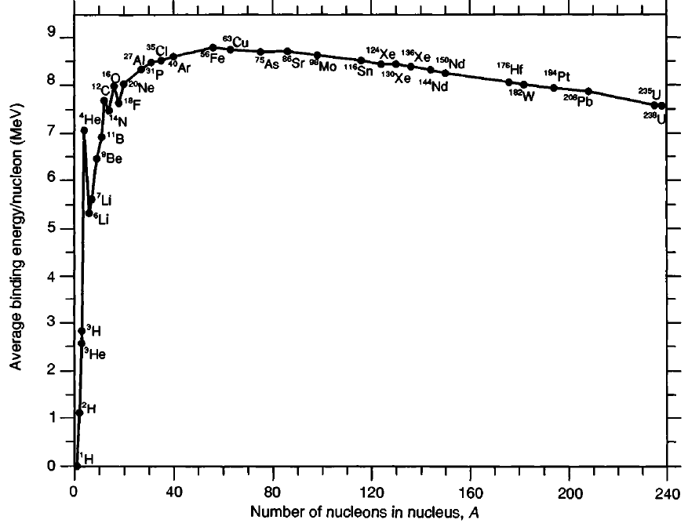
Binding Energies
Global trend follows liquid drop formula, structure-less nucleus
Nucleus = Quantum liquid drop with volume, surface, isospin , effects
Refinements include pairing, deformation, diffuseness of the surface, etc.
Introducing deformation explains (qualitatively) vibrational, rotational spectra and nuclear fission
From S.G. Nilsson and I. Ragnarsson, in Shapes and Shells in Nuclear structure, Cambridge University Press (1995)
From Wikipedia, “Semi-Empirical Mass Formula”,
http://en.wikipedia.org/wiki/Semi-empirical_mass_formula

Slide 11
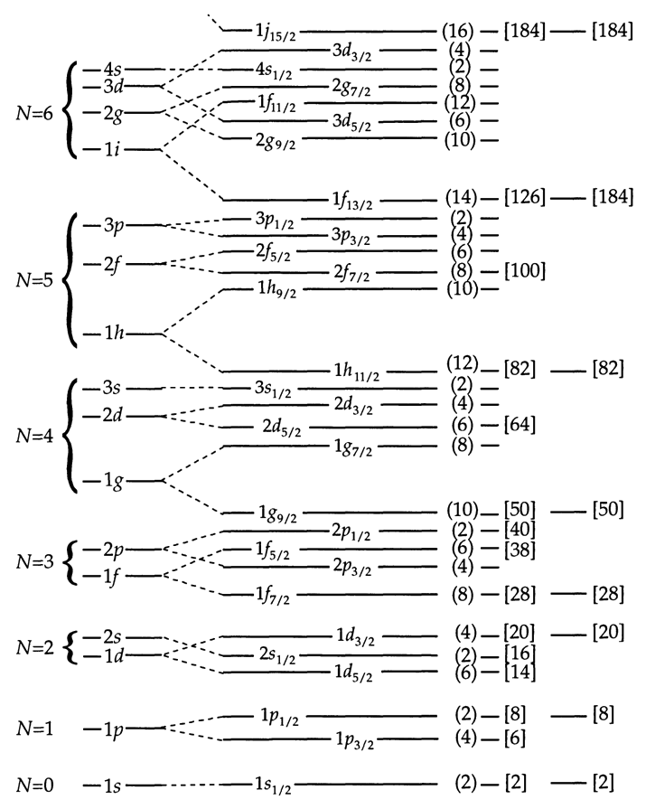
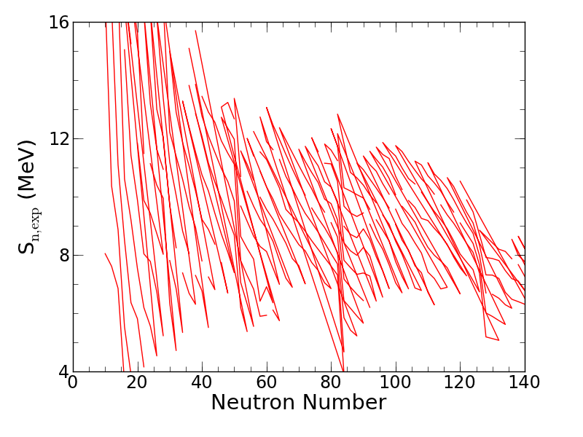
Shell Effects and Magic Numbers
50
82
126
Nucleus = independent nucleons in a quantum well (mean-field) together with a spin orbit force and Coulomb
Root of the independent particle model (see later)

Slide 12
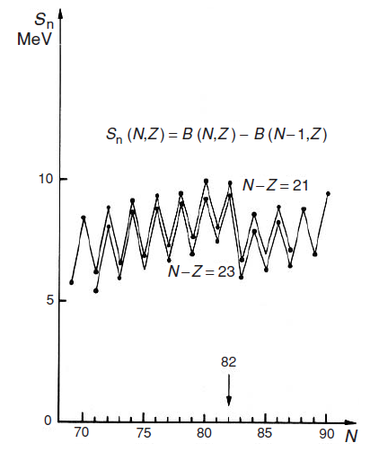
Nuclear Pairing
From D.A. Brink and R.A. Broglia, in “Nuclear Superfluidity – Pairing in Finite Systems”, Cambridge University Press (2005)
Even-even nuclei more bound than odd-even or odd-odd
Cooper pairs of nucleons with opposite spins
Nuclear g.s. always 0⁺ for e-e
First excited state ≈ 2Δ in e-e
Theory of nuclear superfluidity based on concept of quasi-particle
Bardeen-Cooper-Schieffer (BCS), Hartree-Fock-Bogoliubov (HFB), Bogoliubov-de Gennes (BdG)
Nucleus = quasi-particle vacuum…

Slide 13
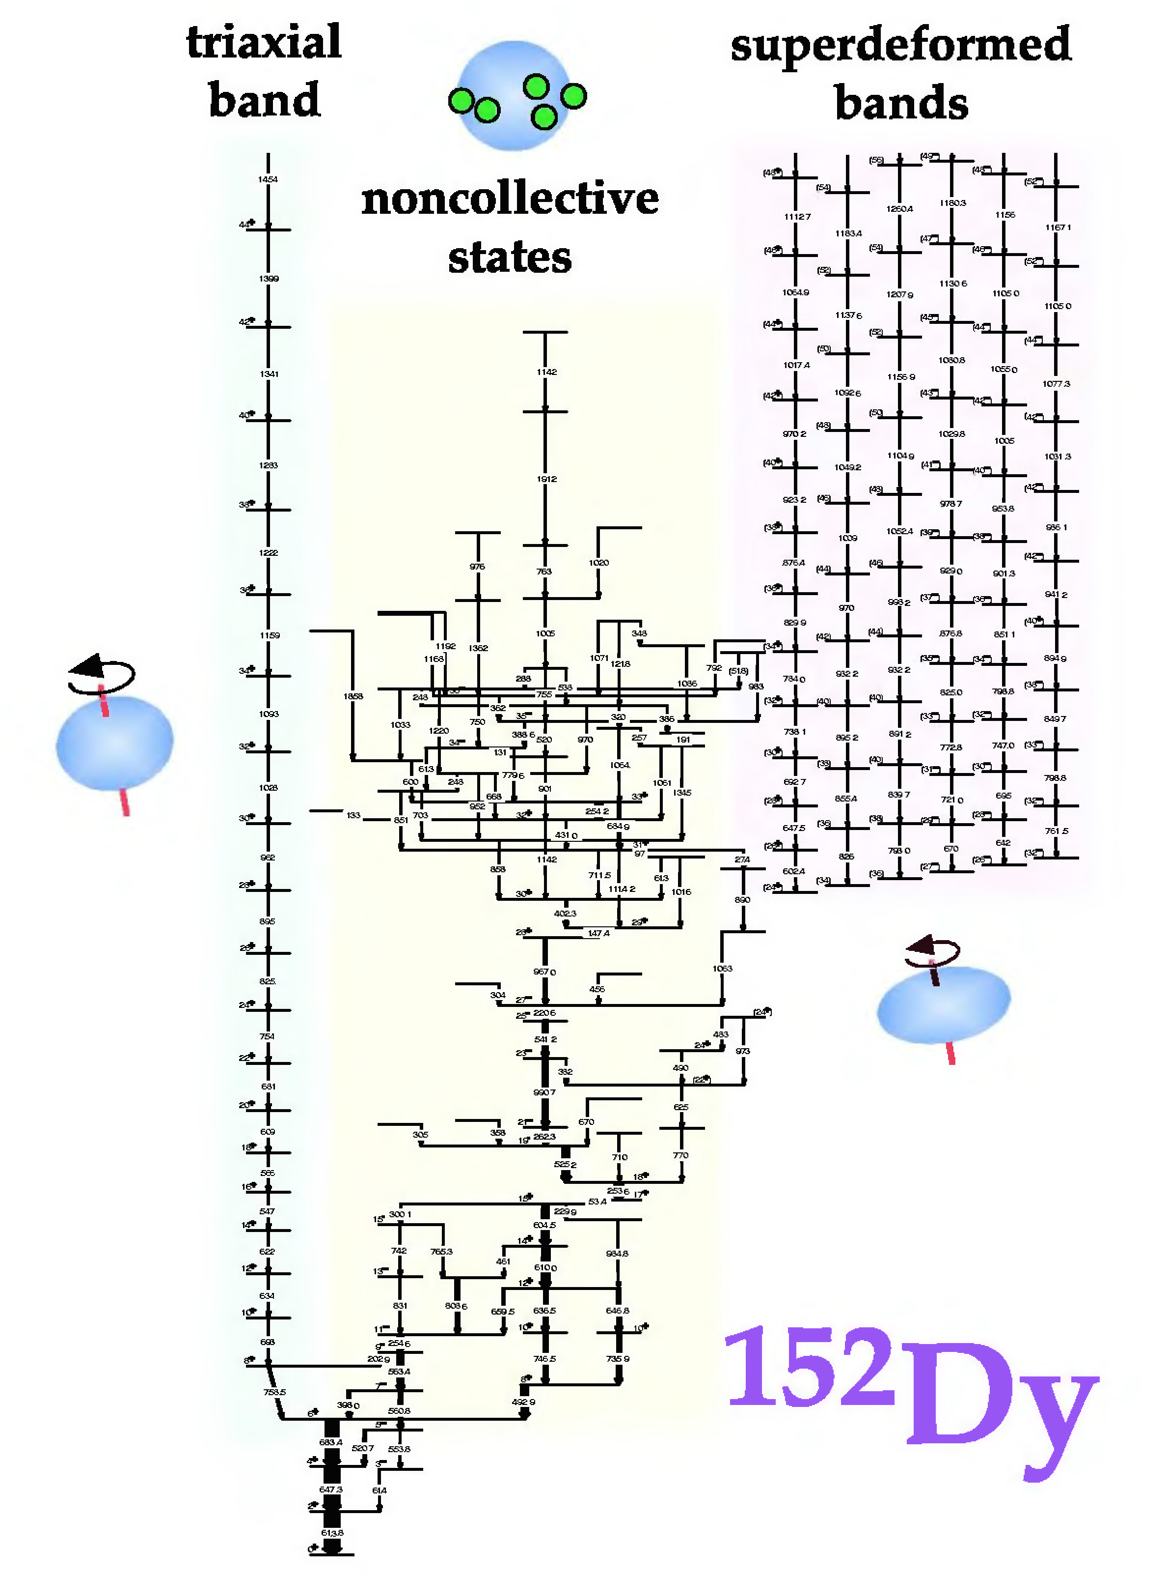
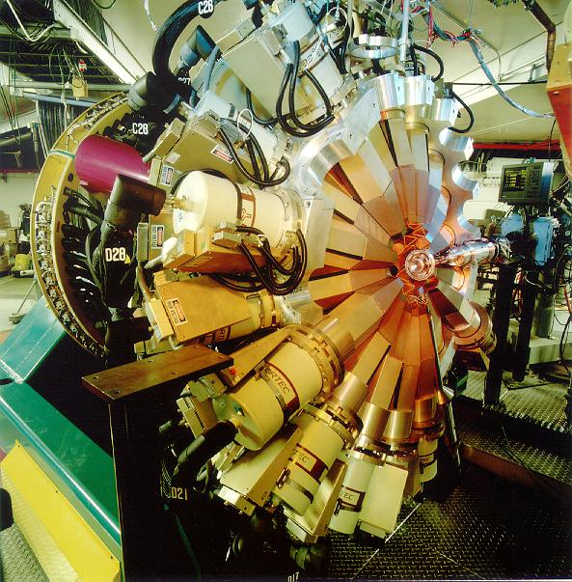
Nuclear Spectroscopy
Incredible variety of excited states!
Regular bands
I(I+1) behavior: rotational
nℏΩ behavior: vibrational
Regular bands signatures of nuclear collectivity (deformed liquid-drop like)
Bands with no visible patterns are signature of single-particle effects (shell-effects)
Experimental precision of the order of the keV (or even less) vs theoretical precision at best of ~500 keV for ground-state masses!
From W. Nazarewicz, in An Advanced Course in Modern Nuclear Physics, J.M. Aria, M. Lozano (eds.), Springer (2001)

Slide 14
Part II Models of Nuclear Structure

Slide 15
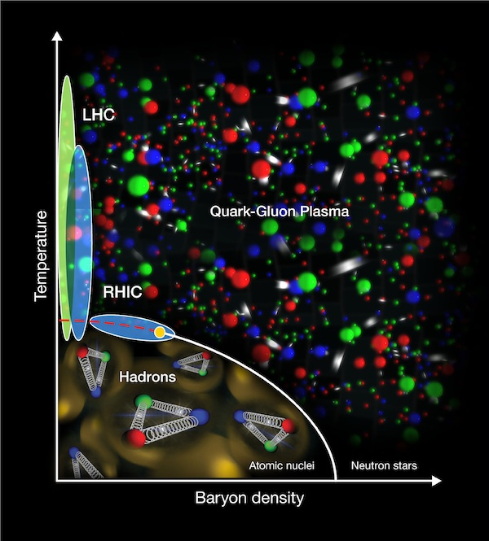
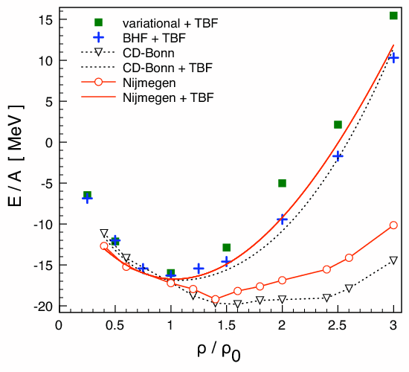
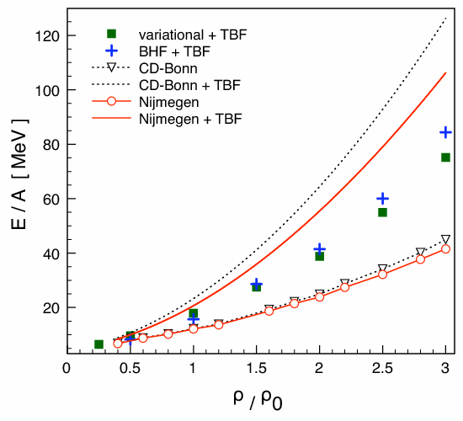
Tools (1/2) Nuclear Matter
Nuclear matter: infinite system governed by strong interaction
Different energy scales (QGP versus atomic nuclei) = different degrees of freedom (quarks and gluons versus neutrons and protons)
Used in nuclear structure to benchmark nuclear models: Saturation point of binding energy as function of density should be at ρ = ρ₀ ≈ 0.16 fm⁻³
From Jacak, et al., “The Exploration of Hot Nuclear Matter”, Science 20, 310-314 (2012)
From V. Soma and P. Bozek, “In-medium T matrix for nuclear matter with three-body forces: Binding energy and single-particle properties”, Phys. Rev. C 78, 054003 (2008)

Slide 16
Tools (2/2) Symmetries
Why symmetries?
Help understand patterns in experimental data
Help constrain models (see in a few slides)
“Ordnung muß sein”
Shopping list of symmetries that can/will play a role in nuclear structure
Basic symmetries: translational invariance, rotational invariance, Galilean invariance, isospin invariance, parity invariance, time-reversal invariance
Point symmetries: D2h, etc.
Algebraic symmetries: SU(4) symmetry (Wigner supermultiplet), SU(2) symmetry (seniority), SU(3) symmetry (Elliott model), IBM symmetries
Tools: group theory, representation theory, etc.

Slide 17
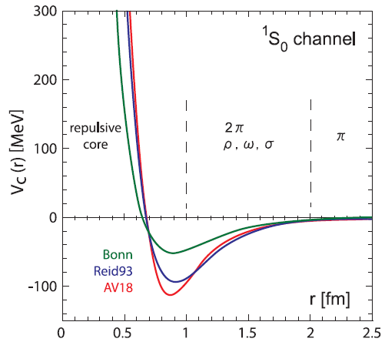
Nuclear Forces (1/3) Phenomenological Interactions
Take nucleon-nucleon potential (or force, or interaction)
Depends in principle on all coordinates of particle 1 and 2: spatial coordinates, momentum, spin and isospin
Can be local (in space and/or momentum and/or spin and/or isospin) = no dependence on prime indexes …or non-local
Symmetries constrain the form of the interaction
Spatial form factors are “free” to choose, constrained by scattering data
From R. Furnstahl, "Atomic Nuclei at Low Resolution“, workshop on Perspectives of the Ab Initio No-Core Shell Model, TRIUMF (2011)
Hard-core: divergence at small r
Finite-range: dies off at r → ∞

Slide 18
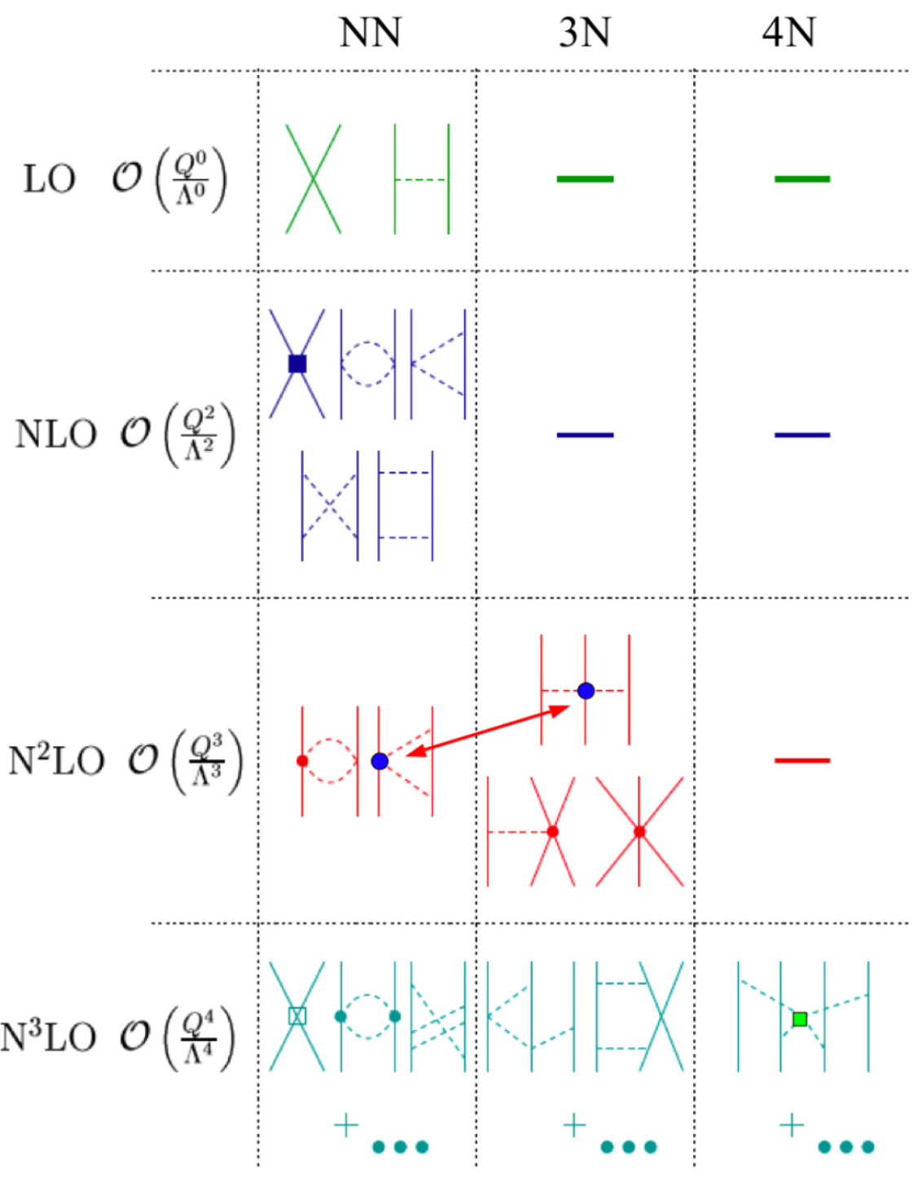
Nuclear Forces (2/3) Effective Field Theory
A systematic, rigorous method to construct NN, NNN, NNNN, etc., potentials
Interaction carried by mesons (pions)
Perturbation expansion implies “things should converge”
Used in ab initio or shell model approaches (see later)
Still contains free parameters (fitted on scattering data)
First 4N forces being looked at
Indirect link with QCD
Main question mark: does it actually converge?

Slide 19
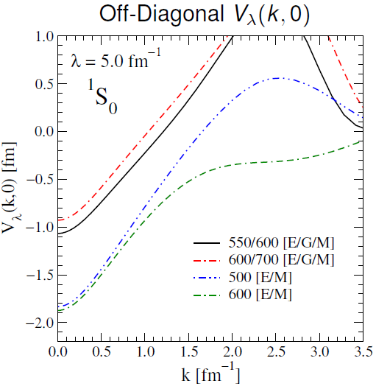
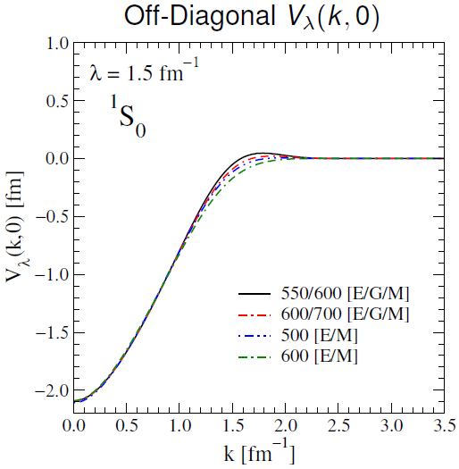
Nuclear Forces (3/3) Renormalization
Out-of-the-oven realistic interactions not necessarily very useful
Hard-core: high-energy stuff not captured by theory based on meson exchange
Shell-model: interaction is not the same anyway if all nucleons are involved, or if some are frozen (see later)
Solution: renormalization using similarity renormalization group (SRG) or Lee-Suzuki schemes
Results in so-called V_{lowK} interactions
From R. Furnstahl, "Atomic Nuclei at Low Resolution“, workshop on Perspectives of the Ab Initio No-Core Shell Model, TRIUMF (2011)

Slide 20
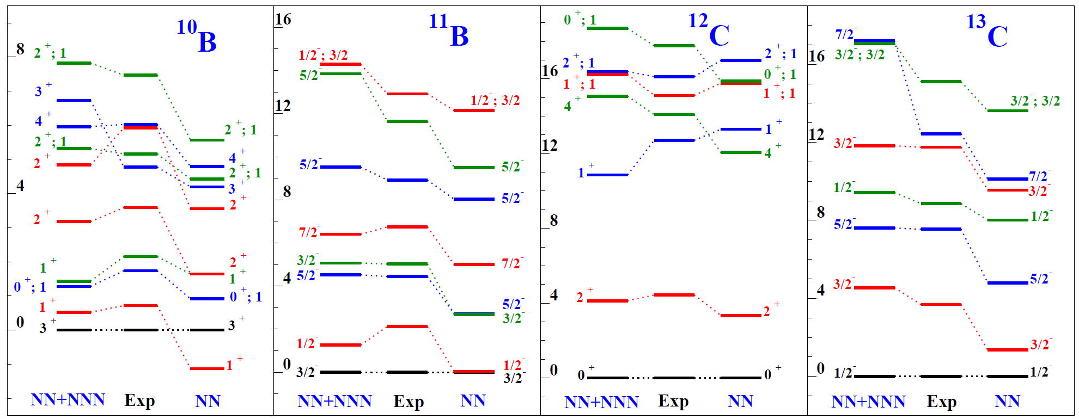
Ab Initio Approaches (1/2) From Nucleons to Nuclei
“Brute-force” method:
Start with a realistic interaction (possibly softened)
Diagonalize the resulting Hamiltonian in a large basis of many-body states
From A. Poves, “The Standard Nuclear (Shell) Model: a Primer”, International School on Exotic Beams, Santiago de Compostela, September 4-11 2010

Slide 21
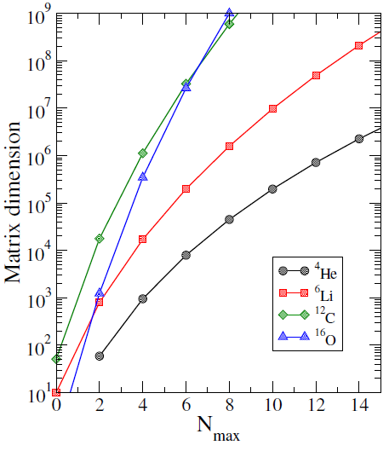
Ab Initio Approaches (2/2) Discussion
Pros:
Exact solution: from true (in-medium) nucleon potentials to atomic nuclei
Encompasses structure and reactions in a consistent framework
Cons:
Intrinsically limited to very small nuclei (even in the long term)
It all depends on the interaction (no tweaking): what if EFT fails down the road?
From R. Furnstahl, "Atomic Nuclei at Low Resolution“, workshop on Perspectives of the Ab Initio No-Core Shell Model, TRIUMF (2011)

Slide 22
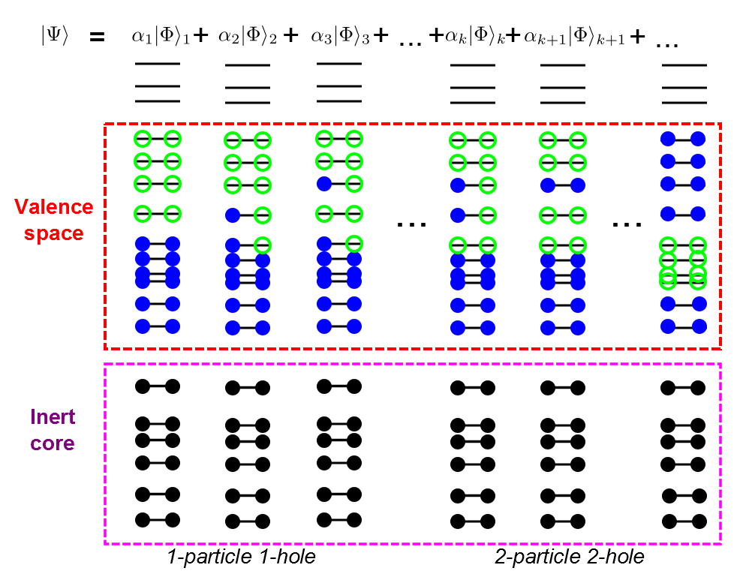
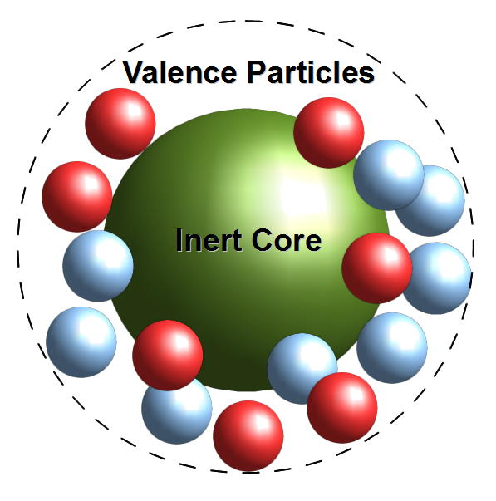
Nuclear Shell Model (1/3) From Ab Initio to Shell Model
Ab initio in heavier nuclei: “neglect” some nucleons
Concepts:
Inert core of independent nucleons
Valence space of correlated nucleons
Interaction tailored to the valence space = configuration interaction
Choice of the valence space depends on the nucleus/problem
The shell model wave-function is built from individual wave-functions, the coefficients of the expansion are determined in the calculation

Slide 23
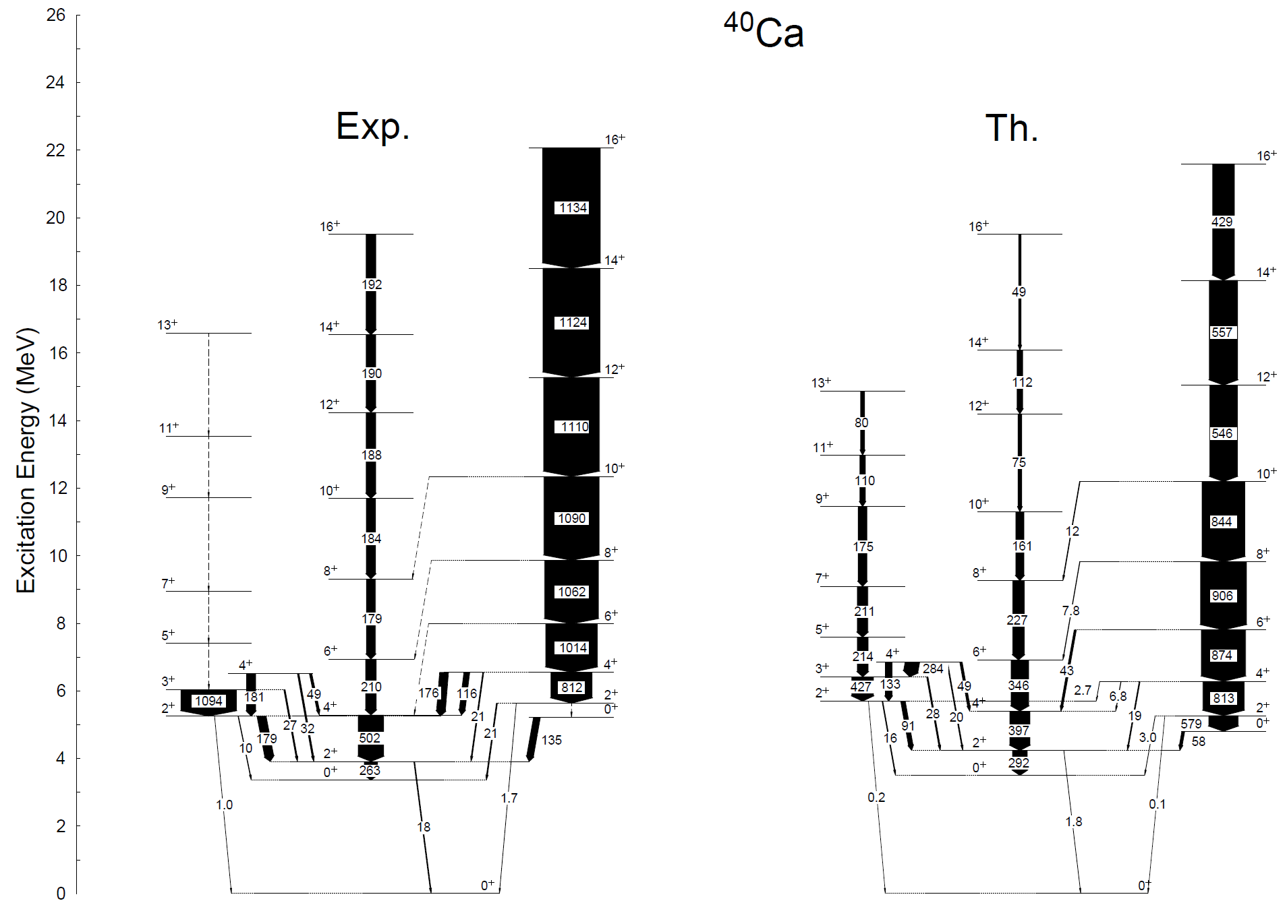
Nuclear Shell Model (2/3) Example of capabilities
Energies
Spins
e.m. transition probabilities
From A. Poves, “The Standard Nuclear (Shell) Model: a Primer”, International School on Exotic Beams, Santiago de Compostela, September 4-11 2010

Slide 24
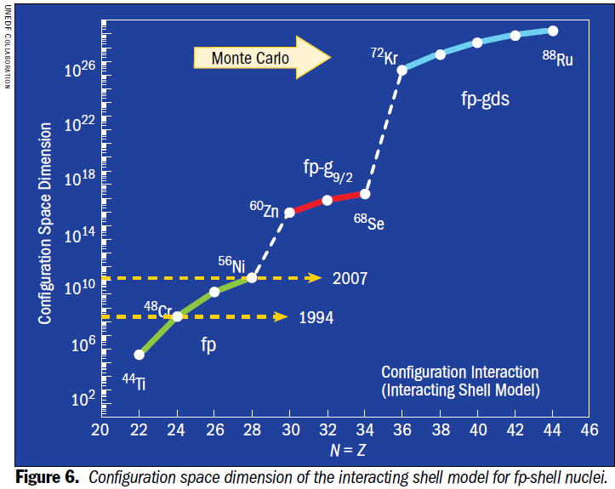
Nuclear Shell Model (3/3) Discussion
Pros:
The most accurate and precise theory on the market
Computes measurable observables (e.m. transitions, moments, energies, etc.)
Cons:
Local theory: interaction is highly dependent on model space = on the nucleus
Size of model space is a limitation (similar to ab initio)
Struggles to capture collective excitations (by design)
From"Universal Nuclear Energy Density Functional: Computing Atomic Nuclei," G.F. Bertsch, D.J. Dean, and W. Nazarewicz, SciDAC Review 6, 42 (2007)

Slide 25
Mean-field Theory (1/5) Independent Particle Model
Common feature of ab initio and shell model: find the fully correlated nuclear wave-function
Mean-field theory: the nucleus as a set of independent protons and neutrons moving in a quantum potential well
Characteristics:
Nuclear wave-function is an anti-symmetrized product of the nucleon wave-functions φ_{i}(r) (Slater determinant)
Nucleon wave-functions φ_{i}(r) obey the Schrödinger equation, where the potential V(r) is the mean-field
Basic degree of freedom: the (one-body) density of particles ρ(r)
Hard-core manifestation of the Pauli exclusion principle: mean-free path of nucleons inside the nucleus is large, independent particle approximation not that crazy…

Slide 26
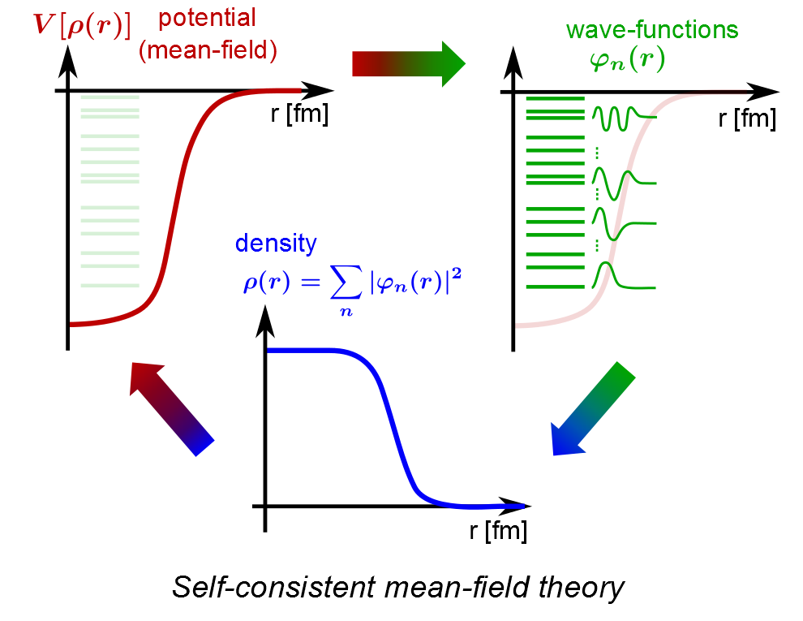
Mean-field Theory (2/5) Spherical Hartree-Fock
Starting points:
A nuclear interaction v(r₁,r₂) (known)
A Slater determinant for the nucleus (to be determined)
Goal: find the Slater determinant, (equivalently, the density ρ)
Method: Minimize the energy defined as the expectation value of the Hamiltonian on the Slater determinant
Resulting equations are non-linear: V depends on ρ which depends on the φ_{i}(r) which depend on V
Produces magic numbers, reasonable values for binding energies, radii, etc.
The self-consistent loop: the mean-field is constructed from the effective interaction, instead of being parameterized

Slide 27
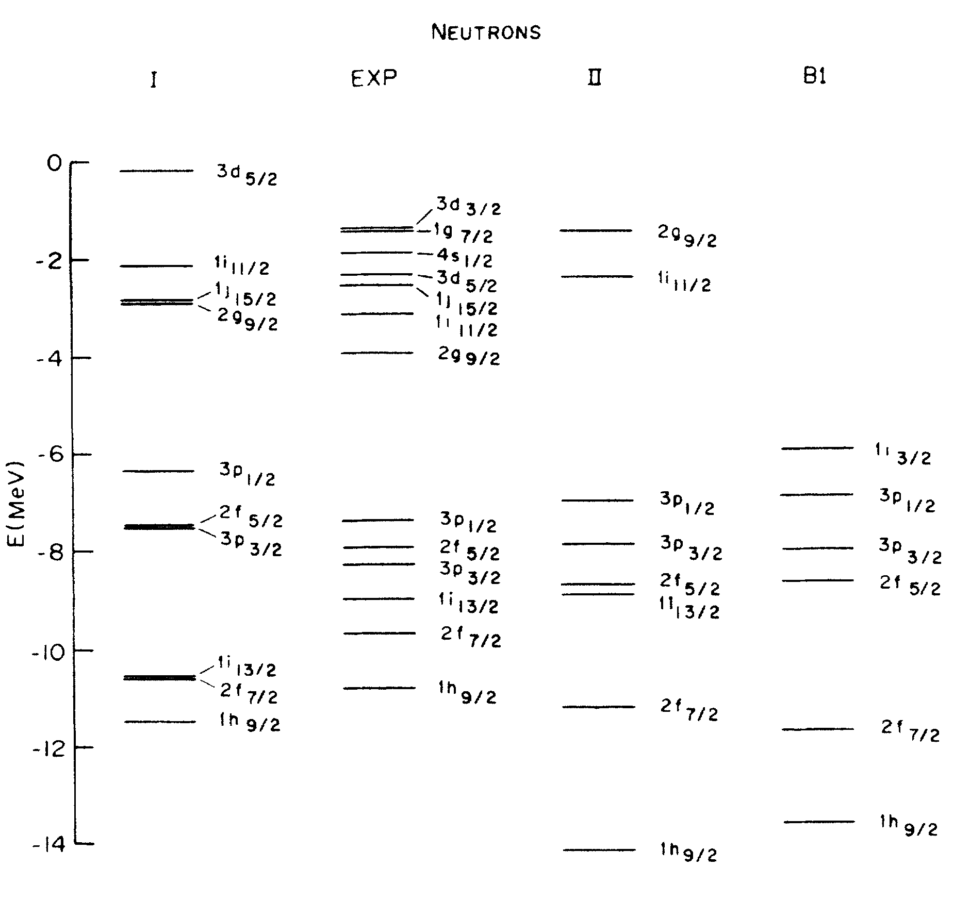
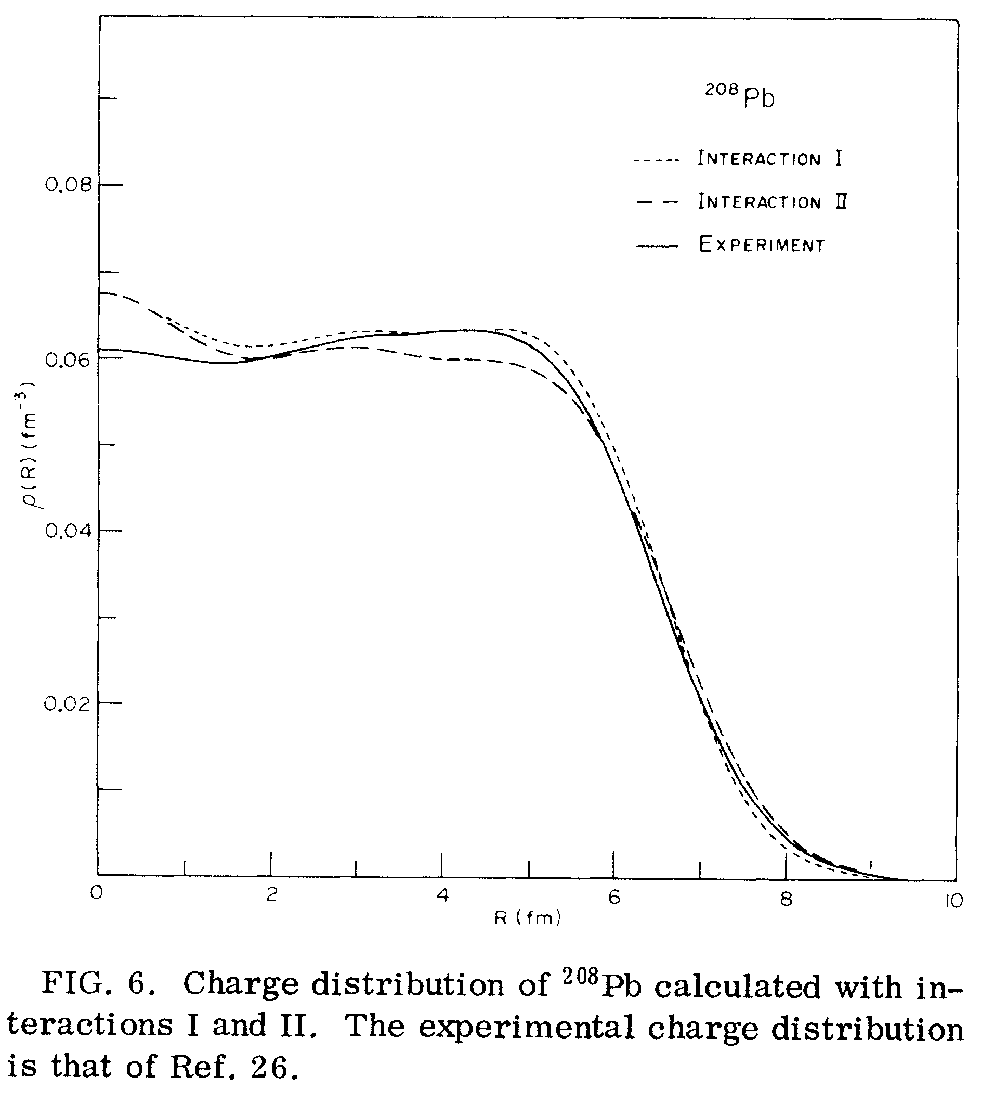
Mean-field Theory (2/5) Spherical Hartree-Fock
From D. Vautherin and D.M. Brink, “Hartree-Fock Calculations with Skyrme’s Interaction. I. Spherical Nuclei”, Phys. Rev. C 5, 626 (1972)

Slide 28
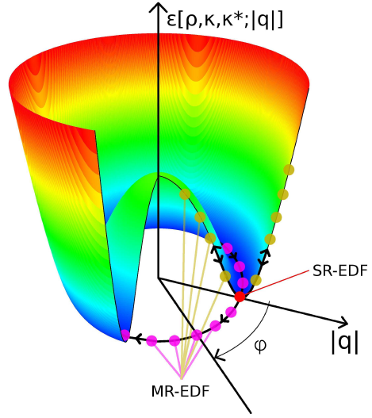
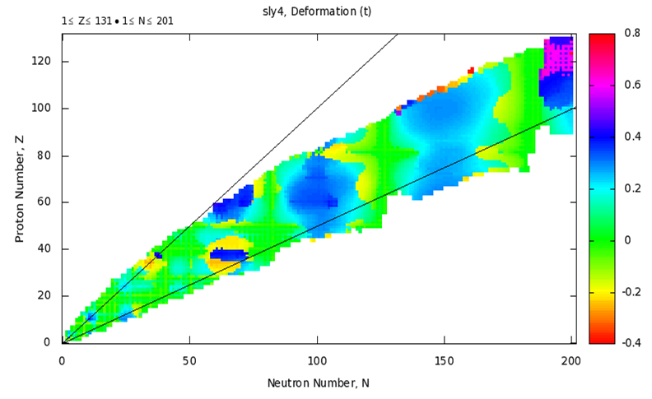
Mean-field Theory (3/5) Deformed Hartree-Fock
Spherical HF is not consistent with picture of a deformed liquid drop and collective excitations
Solution: allow density to break rotational invariance of original interaction ⇒ spontaneous symmetry breaking
Nuclei become deformed and are characterized by a number of collective coordinates q_{i} representing the nuclear shape
From T. Duguet lecture in Euroschool on exotic beams, Jyvaskyla, Finland (2011)
From http://massexplorer.org (down at the moment…)

Slide 29
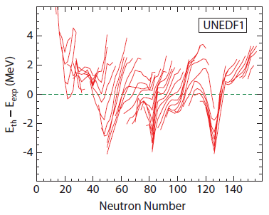
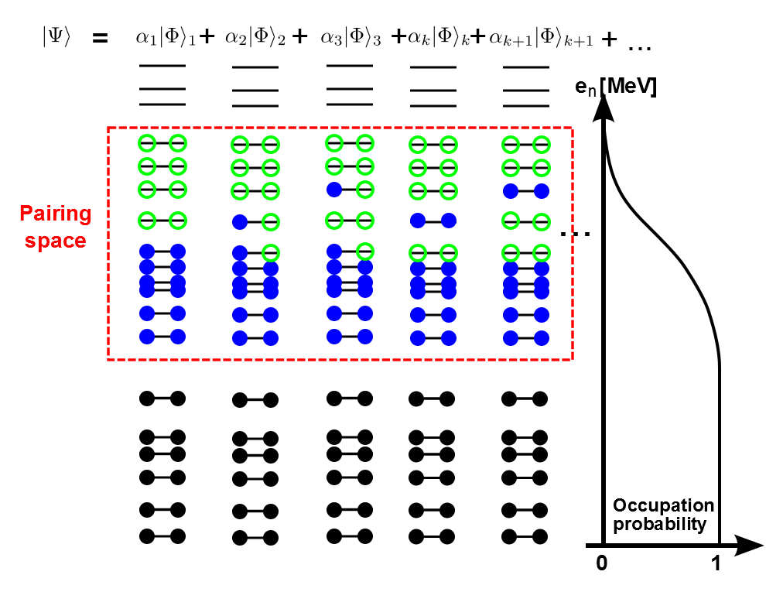
Mean-field Theory (4/5) Hartree-Fock-Bogoliubov Theory
Deformed Hartree-Fock is not consistent with observation that g.s. of e-e nuclei have J^{π} = 0⁺ ⇒ put particles in pairs of opposite spins
Move from particles to quasi-particles: superposition of particles and holes
Analog to a shell model restricted to very specific p.-h. excitations
Deformed HFB theory is the cornerstone of the modern nuclear mean-field
From M. Kortelainen et al, Nuclear density optimization: Large deformations”, Phys. Rev. C 85, 024304 (2012)

Slide 30
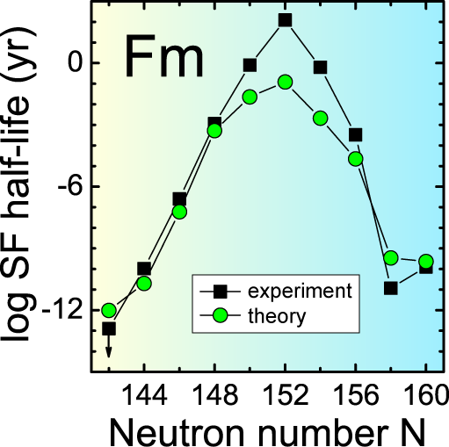
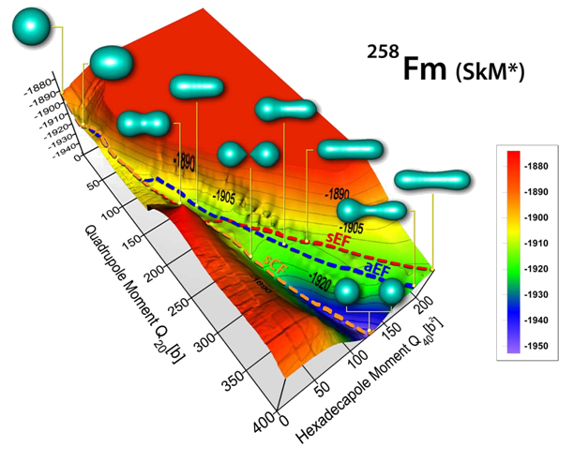
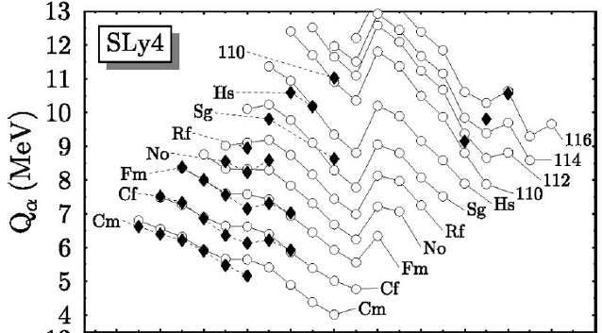
Mean-field Theory (5/5) Discussion
Pros
The only global theory of nuclear structure that can be applied to all nuclei
One (effective) interaction for all nuclei, everything else is prediction
Cons
Accurate but not always very precise
Spontaneous symmetry breaking in intrinsic reference frame hinders comparison with data (angular momentum, electromagnetic transitions, moments, etc.)
From M. Bender, P.-H. Heenen and P.-G. Reinhard, “Self-consistent mean-field models for nuclear structure”, Rev. Mod. Phys. 75, 121 (2003)

Slide 31
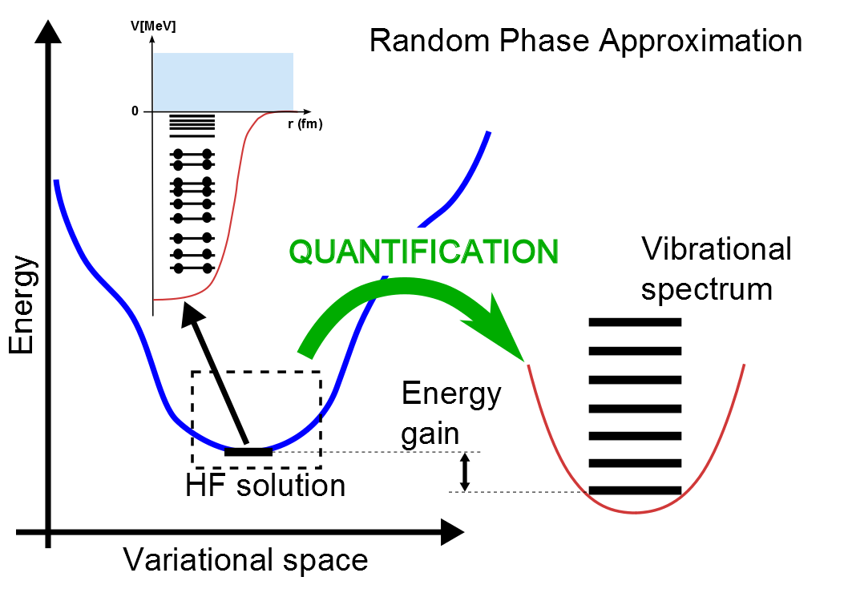
Beyond Mean-Field (1/4) Random Phase Approximation
HFB solution= minimum of the energy
Taylor expansion up to second order suggests energy profile is like harmonic oscillator
Quantification yields vibrational spectrum where lowest state is the correlated ground-state
Extension: response function
Predicts low-lying 2+ states, giant resonances, etc.
Same interaction as in HFB, only ansatz for the wave-function is changed!
RPA g.s. is a superposition of 1p1h states

Slide 32
Beyond Mean-Field (2/4) Projection Techniques
Mean-field breaks symmetries: rotational invariance, translational invariance, parity, etc.
Nuclear quantum numbers such as J, π are lost
Mathematical technique to restore these (spontaneously) broken symmetries
Formal difficulties + computationally intensive limit their use
Projection on angular momentum: from spherical mean-field, energy decreases is symmetry is broken. Projection restores the symmetry, decreases further the energy and produces an energy spectrum with good quantum numbers

Slide 33
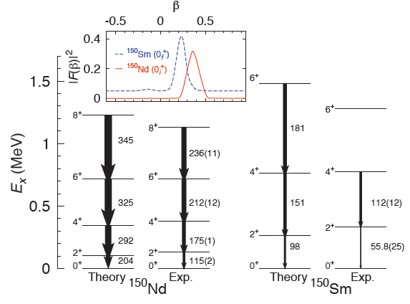
Beyond Mean-Field (3/4) Generator Coordinate Method
Yet another step: use the same interaction to describe collective excitations
Idea: mix (quantum-mechanical sense) deformed HFB states using the variational principle
Old idea (Hill and Wheeler, 50^{ies}) that could not be implemented until recently because of computational cost
Provides framework to
Restore broken symmetries
Describe collective excitations
Formal difficulties + computationally intensive limit its use (exact same problems as projection
From T.R. Rodríguez, G. Martinez-Pinedo, “Energy density functional study of nuclear matrix elements for neutrinoless ßß decay”, Phys. Rev. Lett. 105, 252503 (2010 )

Slide 34
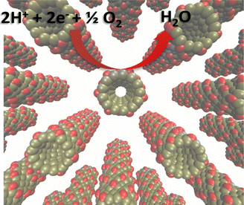
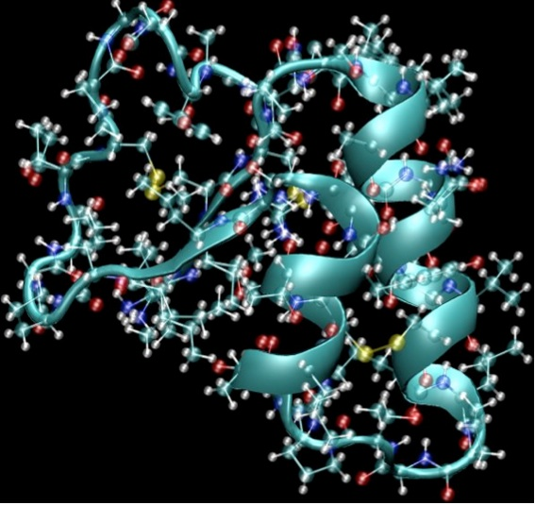
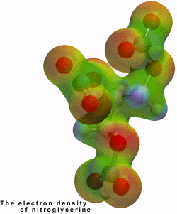
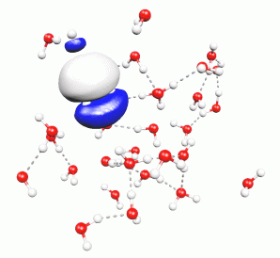
Beyond Mean-Field (4/4) Toward Density Functional Theory
Nuclear mean-field and beyond mean-field extensions provide ideal framework…
… but not really applicable with today effective interactions because of their density dependence v(r₁,r₂, ρ(r₁-r₂))
Density Functional Theory (DFT) from atomic physics
Formally identical to HFB
Forget about interaction, start from energy density functional
Encode many-body correlations (s.p., RPA, GCM) directly in the energy functional
Analogs of Kohn-Sham, Hohenberg-Kohn theorems suggest it should work…
I. Matanović. C. Kent, F.H. Garzon, and N.J. Henson, “Density Functional Theory Study of Oxygen Reduction Activity on Ultrathin Platinum Nanotubes”, J. Phys. Chem. C (2012)
S. Reine et al, “An efficient density-functional-theory force evaluation for large molecular systems”, J. Chem. Phys., 133, 044102 (2010)
http://www.nobelprize.org/
http://www.mpip-mainz.mpg.de/

Slide 35
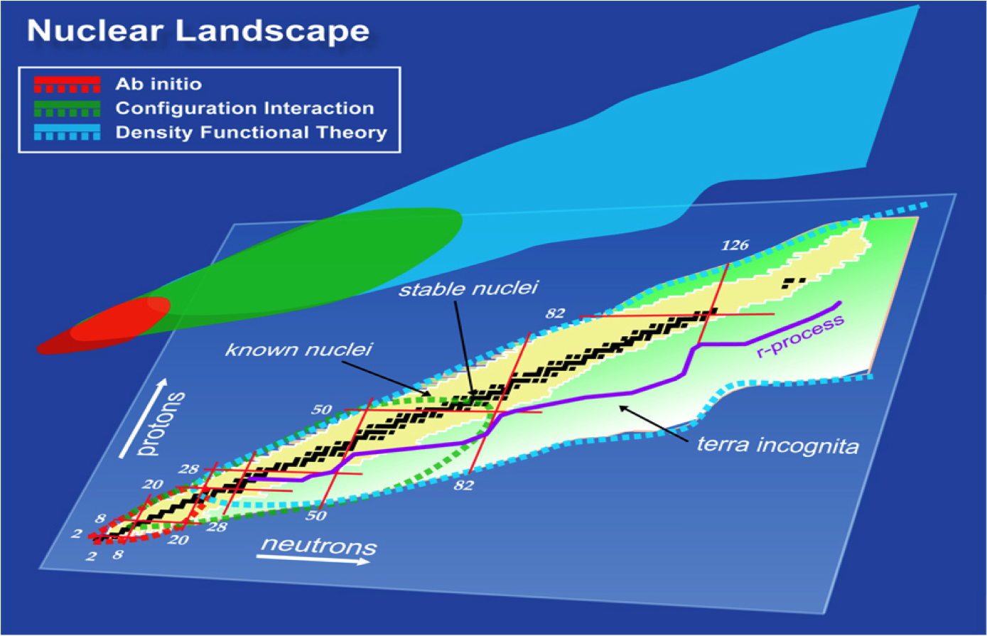
Wrap-Up (1/3) Hierarchy of Nuclear Models
Bottom line: there isn’t a single theory of atomic nuclei but a variety of complementary approaches
UNEDF (2007-2012), NUCLEI (2012-2017): two attempts of nuclear theorists to get organized (unedf.org) and build nuclei from nucleons built from quarks and gluons

Slide 36
Wrap-Up (2/3) The Big Questions
Disclaimer: This slide reflects my personal opinion only and shall not be taken as a holy truth
Paradigm shift: “A fundamental change in approach or underlying assumptions”
Systematic construction of realistic nucleon potentials from effective field theory (from Weinberg’s idea)
Applications in structure, reaction of light nuclei with consequences for astrophysics, NIF, etc.
Guides development of energy functionals in heavy nuclei
Use of leadership class computers in ab initio, shell models and mean-field/DFT like approaches
Enables undreamt of applications
Grows into a field of its own: computational nuclear physics, the third leg of nuclear science

Slide 37
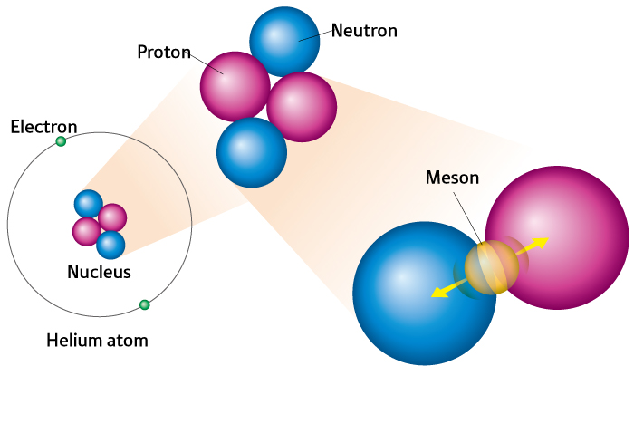
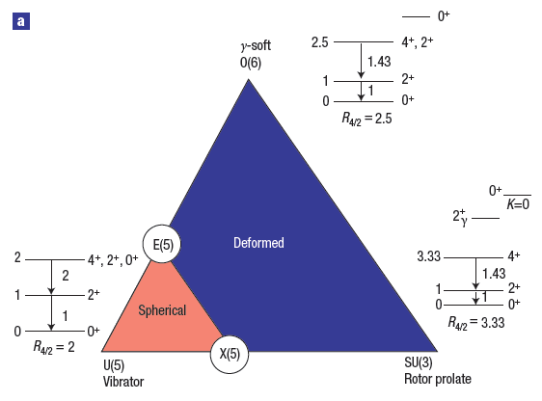
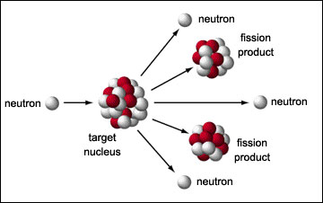
Wrap-Up (3/3) Some of what has not been covered
Coupling to the continuum: Few-body techniques, Gamow shell model, halos, etc.
Relativistic mean-field theory of nuclear structure
Fission, fusion, nuclear dynamics
Interacting Boson Model (IBM) and algebraic approaches to nuclear structure
From R. Casten, Nature Physics 2, 811 (2006)

