Slide 1

Nuclear reactions – experiment (II)
…
Nuclear Astrophysics with exotic nuclei and rare ion beams
Decay spectroscopy for nuclear astrophysics
Livius Trache
Texas A&M University and IFIN-HH Bucharest
Exotic Beam Summer School 2012
ANL Aug 5-10, 2012

Slide 2
5. Applications to Nuclear Astrophysics
Direct measurements – at stellar energies, or close
Indirect methods – measurements at lab energies -> stellar energies
Indirect methods in NPA with RNB (w. examples from TAMU)
  A. Coulomb dissociation
  B. Transfer reactions (ANC method)
  C. Breakup of loosely bound nuclei
  D. resonant spectroscopy – β-decay, resonant elastic scattering, etc
  E. Trojan Horse Method (non-RNB so far! Just starting …)

Slide 3
Radiative capture reactions
Projectile X
* Radiative capture reactions A(p,γ)B, A(α,γ), A(n,γ)
* Non-resonant or resonant reactions.
* At low energy, the probability that the incoming
charged particle penetrates the Coulomb barrier:
* The cross section – astrophysical S-factor:
* Reaction rate per particle pair (integrate over E distr):
Reactions (that matter) take place in the Gamow energy window.
Direct, or non-resonant part
γ
Plane
Wave
^{Target}
^{A}
^{Target}
^{A}
Final Orbit
Nucleus B
Coulomb Barrier
Stars are cold!
E_{p}=10s-100s keV
Projectile
Potential V(r)
Distance
r
to determine
Nuclear
Radius R_{n}
* C. Rolfs and W. Rodney, “Cauldrons in the Cosmos”.
Notes:
Nuclear capture reactions play a major rule in defining our universe.
In direct reactions, the nucleon transferred quickly and proceed directly from the initial state to the final state without forming an intermediate compound nucleus or state.
These reaction are called also Peripheral, the primary goal is to determine these rates.
It is nonresonant since it occurs at all projectile energies with a cross section varying smoothly with energy.
The probability that the incoming particle penetrates the coulomb Barrier is given by this formula, where η is the Sommerfeld parameter.
The cross section for a charged particle is a function of this penetrating probability and the square of the De Broglie wavelength which reflects the aspect of the quantum mechanics this introduces 1/E factor.
S(E) is the constant of the relation, and named as Astrophysical factor (S-factor).
The reaction rate for the nonresonant case is given by:
The convolution between the MB distribution function and the tunneling function through Coulomb barrier leads to the Gamow peak near the effective energy burning E_{o} that allow several nuclear reactions to occur.

Slide 4
M. Smith & E. Rehm
+ fission
barriers ?!
mass, T_{1/2}
resonances
site, path?!
mass, T_{1/2}
Dir+reson
Two big problems:
- reactions in stars involve(d) radioactive nuclei ⇒ use RNB
- very small energies and very small cross sections ⇒indirect methods

Slide 5
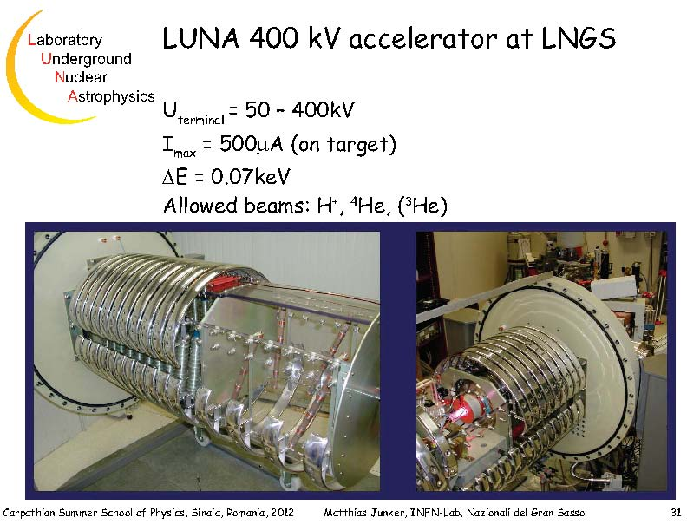
5a

Slide 6
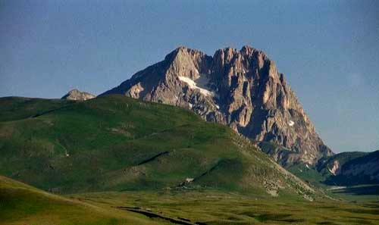
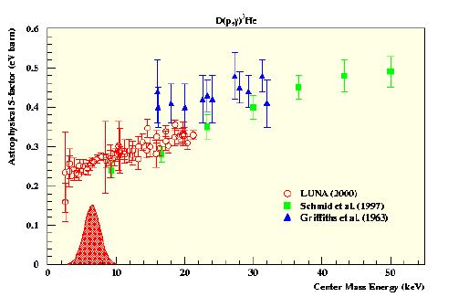
EXPERIMENTAL SOLUTIONS
IMPROVEMENTS TO REDUCE THE BACKGROUND
(UNDERGROUND LABORATORY)
Use of laboratory with natural shield
( underground physics-for instance LUNA experiment at LNGS-Italy )
²H(p,γ)³He
GRAN SASSO
NO EXTRAPOLATION
GAMOW ENERGY

Slide 7
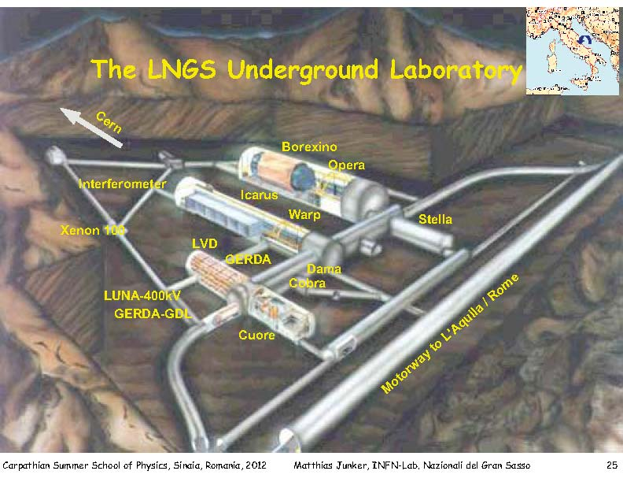

Slide 8
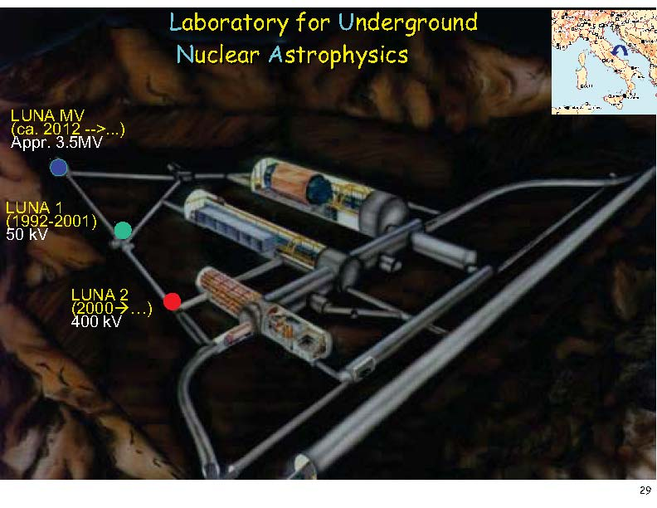

Slide 9
5b) Indirect methods for nuclear astrophysics
Measurement at lab energies
Comparison with (reaction) calculations
Extract (nuclear structure) information
Need good additional knowledge (data).
Reliable absolute values
Compare with
direct measurements
Calculate astrophysical S-factor
or reaction rates

Slide 10
Techniques used to determine (p,γ) reaction rates
Work at TAMU on nuclear astrophysics
  indirect methods (p- or n-transfer)
  RNBs or stable beams
Lessons learned:
  Seek the relevant quantities (ex: SF vs ANC)
  Model or parameter independent
  Combination of methods is useful – availability important
  Need more in terms of supportive information for reliable calculations: theories, models (and codes), effective n-n interactions, systematics … → still need good stable beam data
  OMP, reaction models, …

Slide 11
A. Coulomb dissociation
p
γ
E_{p}
Radiative capture - direct process
  X(p,γ)Y
Photodissociation - inverse process
  Y(γ,p)X
    Use detailed balance theorem
virtual photons – Coulomb Dissociation
⁷Be
S_{p}
⁸B
p
E_{p}
γ
S_{p}
⁷Be
⁸B

Slide 12
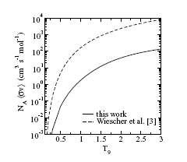
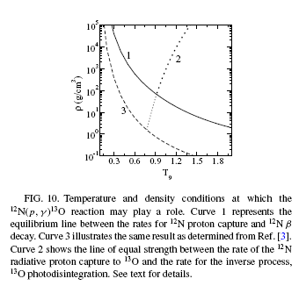
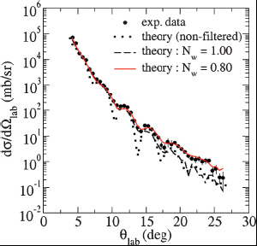
¹⁴N(¹²N,¹³O) proton-transfer react ⇒ ¹²N(p,γ)¹³O (rap proc)
ANC, S-factor 0-2 MeV
Reaction rate
Transfer & elastic @12 MeV/u
TAMU MARS ¹²N beam 2⋅10⁵ pps
A. Banu et al, Phys Rev C 79, 025805 (2009)

Slide 13
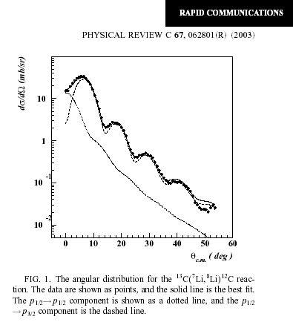
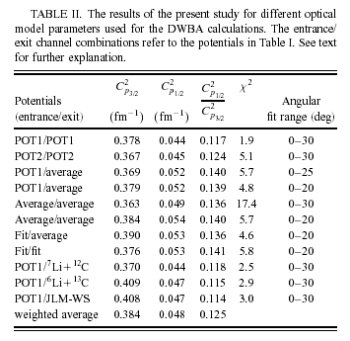
Neutron transfer – ¹⁴N(⁷Li,⁸Li)¹³C
Study mirror reaction – neutron transfer with stable beam to obtain information on ⁸Li
Use charge symmetry ⁸Li - ⁸B
Results:
C²_{tot}(⁸B)= 0.455 ± 0.047 fm⁻¹
S₁₇(0) = 17.6 ± 1.7 eV b
&
Mixing ratio C²(p_{1/2})/C²(p_{3/2})=0.13(2)
LT e.a., PRC 67, June 2003

Slide 14
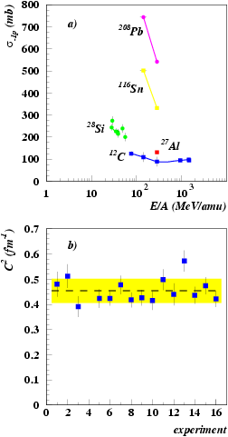
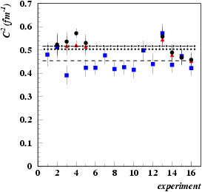
Example: Summary of the ANC extracted from
⁸B breakup with different interactions
Data from:
F. Negoita et al, Phys Rev C 54, 1787 (1996)
B. Blank et al, Nucl Phys A624, 242 (1997)
D. Cortina-Gil e a, EuroPhys J. 10A, 49 (2001).
R. E. Warner et al. – BAPS 47, 59 (2002).
J. Enders e.a., Phys Rev C 67, 064302 (2003)
All available breakup cross sections on targets from C to Pb and energies 27-1000 MeV/u give consistent ANC values!
Summary of results:
LT ea, PRL 87, 2001
LT ea, PRC 67, 2004
⁷Be(p,γ)⁸B (solar neutrinos probl.):
p-transfer: S₁₇(0)=18.2±1.7 eVb
Breakup: S₁₇(0)=18.7±1.9 eVb
Direct meas: S₁₇(0)=20.8±1.4 eVb

Slide 15
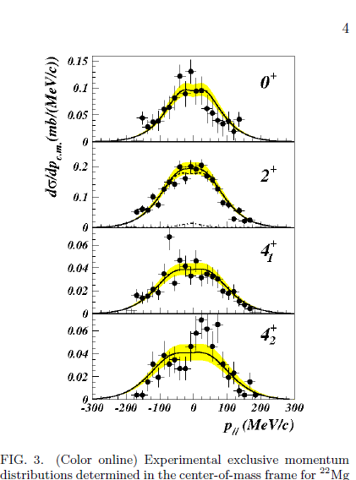
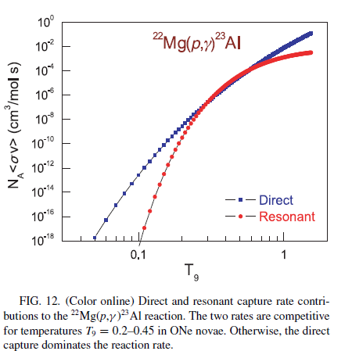
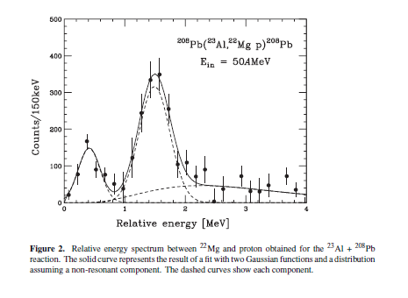
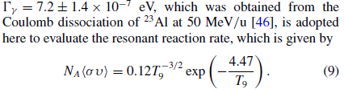
Complementarities: Coulomb and nuclear dissociation
[46] T. Gomi, T. Motobayashi et al, JPG 31 (2005)

Slide 16
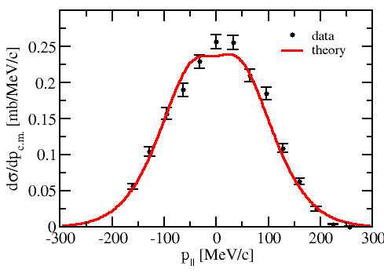
Results from ²⁴Si breakup
C²(²⁴Si_{gs}) = 62.4 ± 7.1 fm⁻¹
SF = 2.5 -2.9
=> first exp determination of
the direct comp of ²³Al(p,γ)²⁴Si !
²²Mg(p,γ)²³Al(p,γ)²⁴Si
seq. 2p capture imp in XRB
Note: exp made with 30 pps!
A. Banu et al, PRC 85 (2012)

Slide 17
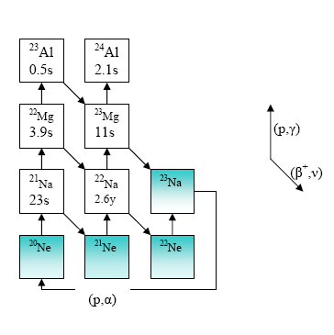
Explosive H-burning in novae: “²²Na observation”
- novae: explosive H-burning of accreting material in binaries star-WD. ~ 30/yr.
- γ rays from the decay of long-lived isotopes like ²⁶Al have been detected
- E=1.275 MeV γ ray following the decay of ²²Na predicted, but not observed by space gamma-ray telescopes
²⁴Si
140 ms
NeNa cycle
²²Na depletion in novae: how does it happen?
what are the stellar reaction rates for the ²²Mg(p,γ)²³Al and ²²Na(p,γ)²³Mg?
- what about ²²Mg(p,γ)²³Al(p,γ)²⁴Si seq. 2p capture? Imp in XRB

Slide 18
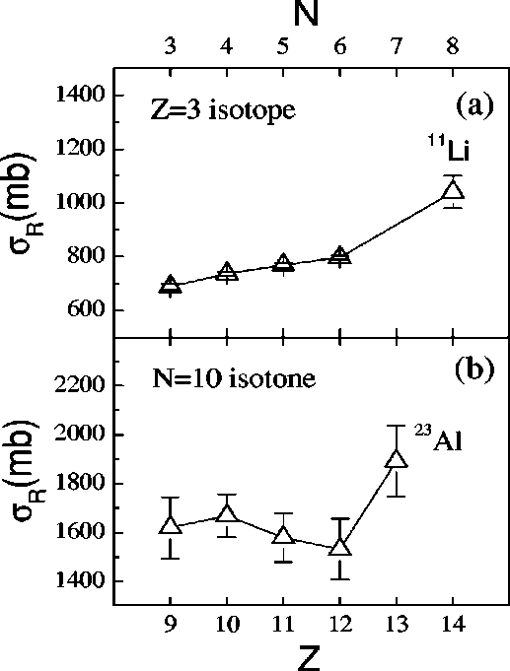
Questions to nuclear structure: “²³Al structure and consequences on ²²Mg(p,γ)²³Al reaction rate”
- is ²³Al a proton-halo nucleus ?
Nuclear physics input to NA!!!
Sp = 142 keV
X. Z. Cai et al.,
PRC 65, 024610 (2002)
a case of “level inversion” towards p-rich nuclei ?
  g.s. of mirror nuclei ²³₁₀Ne₁₃ vs. ²³₁₃Al₁₀
what are the gound state spin and parity of ²³Al_{gs} ?
1/2⁺
1017 keV
550 keV
gs
gs
5/2⁺
huge
Thomas-Ehrman effect ?!
²³Ne
²³Al

Slide 19

Summary 5 b)
Indirect methods w RNB – valuable tool for nuclear astrophysics
Accuracies of 10-15% can be obtained
Q: Good enough?!
For better accuracies more work needed, including systematic studies and development of structure and reaction theories (and codes):
  Work close to proton drip line makes continuum important, antisym, etc…
Combination of methods is important
Q: what are the most imp reactions ?!

Slide 20
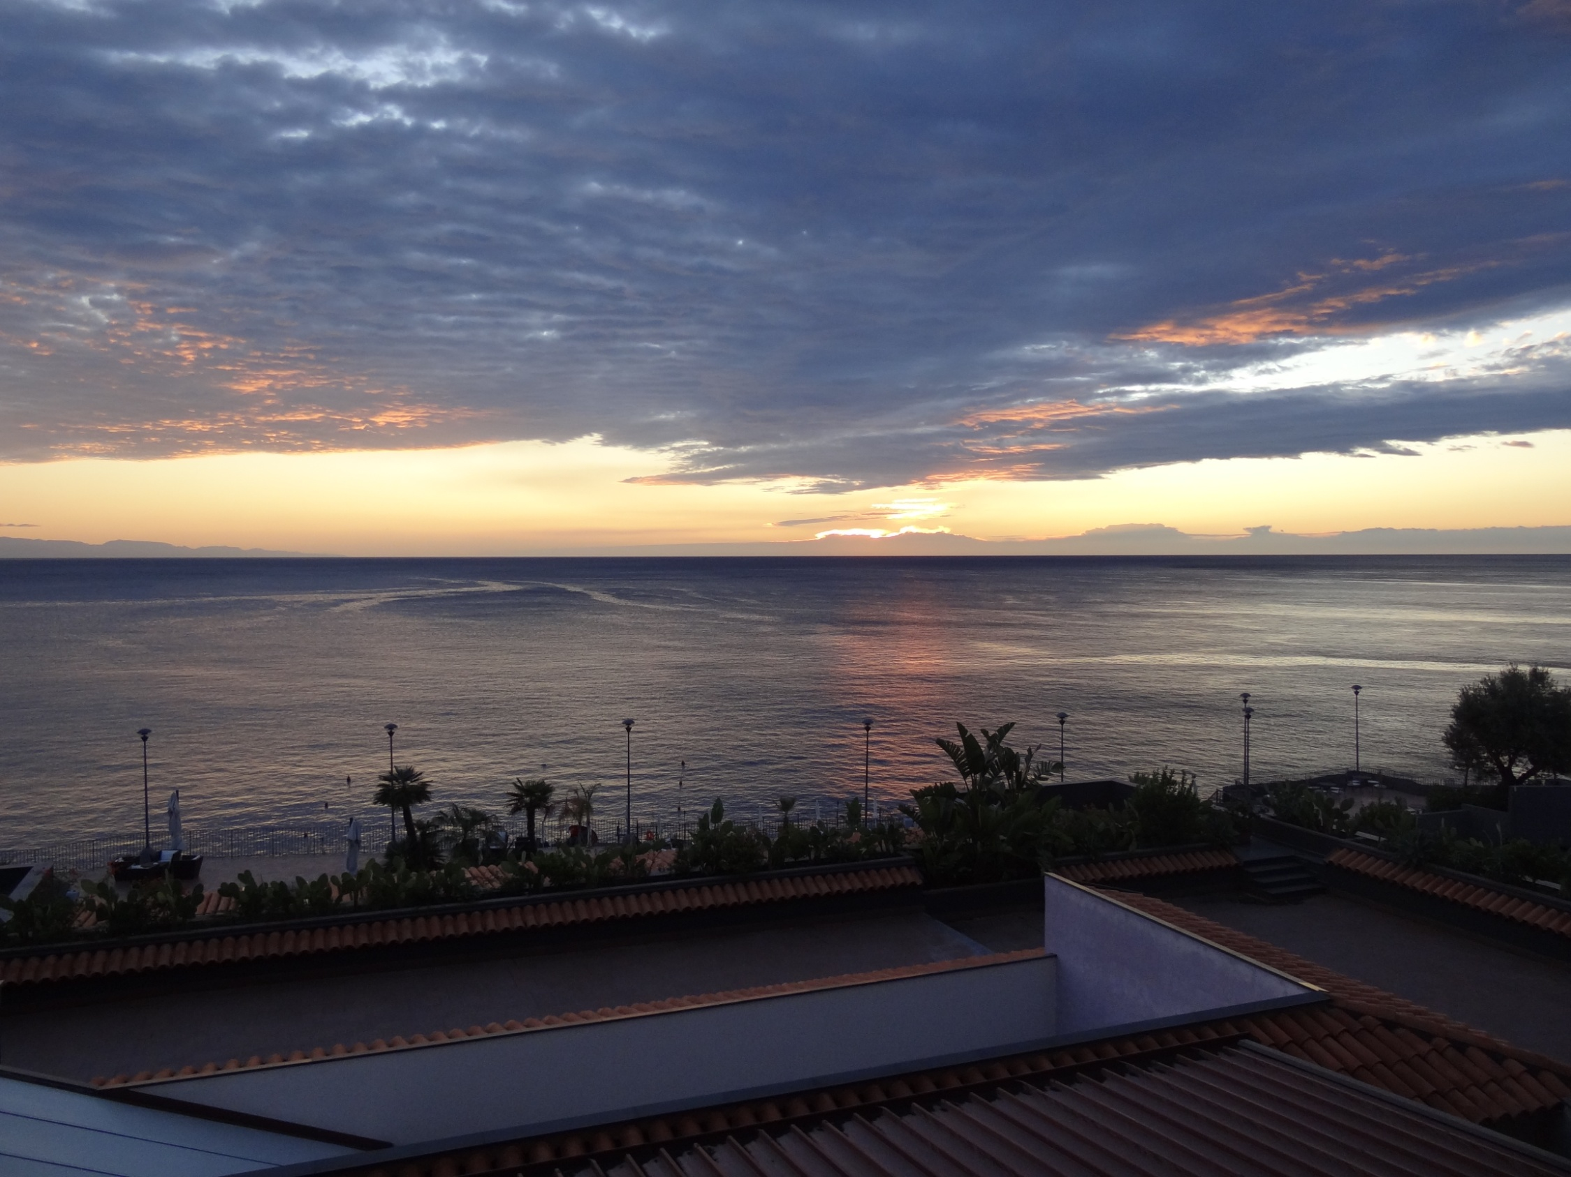
Decay spectroscopy for nuclear astrophysics

Slide 21
Motivation
Proton capture – a class of reactions important in nuclear astrophysics
  Radiative proton capture reactions: X(p,γ)Y
Reactions take place in a narrow range of energies: (Gamow window) due to Coulomb repulsion & Maxwell distribution
Stars are cold! E_{p}=10s -100s keV
Can have: non-resonant (continuum) and resonant capture
* C. Rolfs and W. Rodney, “Cauldrons in the Cosmos”.

Slide 22
Resonant Reaction Rate
* Resonant reaction is a two-step process.
* The cross section (Breit-Wigner):
* The contribution to the reaction rate:
where
Stars are cold!
E_{p}=10s-100s keV
* C. Rolfs and W. Rodney, “Cauldrons in the Cosmos”.
to determine
ωγ= resonance strength
Notes:
The resonant reaction through isolated and narrow resonances is a two step process.
The process involves two matrix elements, first is the formation of the compound state E_{r} and the other matrix describes the gamma decay of E_{r.}
The cross section value for the resonant reaction is given by this formula, where (J-part) represents the statistical weight that the spins of the projectile and target will lead to the final angular momentum angular momentum of the excited states. This excited state is characterized by an energy width or the resonant term.
For a narrow resonance, the Maxwell-Boltzmann distribution changes very little over the resonance region, so the reaction rate is approximated to this formula.
Where the width ratio γ is referred to the resonance strength.

Slide 23
also ³⁸Ca, ⁴⁶V, ⁵⁷Cu, ⁶²Ga, …
³¹Ar
³²Ar
³³Ar
³⁴Ar
³⁵Ar
³⁶Ar
= studied at TAMU
³⁰Cl
³¹Cl
³²Cl
³³Cl
³⁴Cl
³⁵Cl
sd-shell : resonant components
dominant
²⁷S
²⁸S
²⁹S
³⁰S
³¹S
³²S
³³S
³⁴S
= planned
²⁵P
²⁶P
²⁷P
²⁸P
²⁹P
³⁰P
³¹P
²³Si
²⁴Si
²⁵Si
²⁶Si
²⁷Si
²⁸Si
²⁹Si
³⁰Si
²¹Al
²²Al
²³Al
²⁴Al
²⁵Al
²⁶Al
²⁷Al
²⁰Mg
²¹Mg
²²Mg
²³Mg
²⁴Mg
²⁵Mg
²⁶Mg
¹⁹Na
²⁰Na
²¹Na
²²Na
²³Na
p-shell : direct component
dominant or important
¹⁶Ne
¹⁷Ne
¹⁸Ne
¹⁹Ne
²⁰Ne
²¹Ne
²²Ne
¹⁴F
¹⁵F
¹⁶F
¹⁷F
¹⁸F
¹⁹F
stable
¹²O
¹³O
¹⁴O
¹⁵O
¹⁶O
¹⁷O
¹⁸O
used at TAMU
¹¹N
¹²N
¹³N
¹⁴N
¹⁵N
(p,n) possible
⁹C
¹⁰C
¹¹C
¹²C
¹³C
¹⁴C
¹⁵C
(p,2n) possible
⁸B
⁹B
¹⁰B
¹¹B
⁷Be
⁸Be
⁹Be
Notes:
Prospects with MARS

Slide 24
Decay spectroscopy
Resonant Capture
a two-step process
5/2⁺
Energy
Selection rules
²³Al
Coulomb Barrier
Γ_{p}
p
Γ_{γ}
Radius
S_{p}
Resonance strength
Conditions:
Q_{EC} >S_{p}+2m_{e}c²
J=3/2+, 5/2+, 7/2+
γ+²³Mg← ²³Mg*←²²Na+p
²³Mg
5/2⁺, 7/2⁺ ← 3⁺+1/2⁺ +0⁺
Nuclear Potential
Same compound system: ²³Mg
Resonant contributions to reaction rate:
Lower proton energies most important, but very difficult:
  lower branching
  increased exp difficulties (det windows, background, etc…)
ωγ=(2J+1)/(2j+1)(2I+1)b_{γ}b_{p}*Γ
Need energy, J_{r} and resonance strength
Notes:
24

Slide 25
Decay spectroscopy
Beta- and beta-delayed proton-decay
Explosive H-burning in novae
&
IAS in T_{z}=-3/2 nuclei
Isospin mixing
GT strength distribution
²²Na depletion in novae
²³Al→²³Mg* ⇒ ²²Na(p,γ)²³Mg*
& ²²Mg(p,γ)²³Al
bottleneck r. in novae
³¹Cl→³¹S* ⇒ ³⁰P(p,γ)³¹S*
See Jordi’s list!

Slide 26
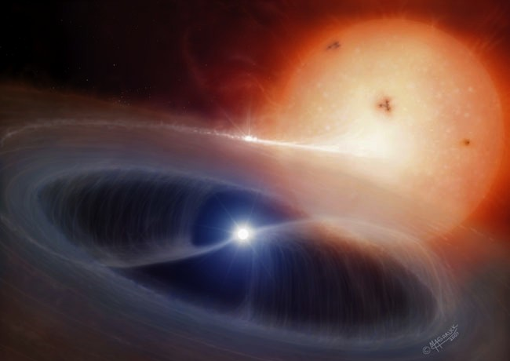
Explosive H-burning in novae: “²²Na production”
- novae: explosive H-burning of accreting material in binaries star-WD. ~ 30/yr.
- γ rays from the decay of long-lived isotopes like ²⁶Al have been detected
- E=1.275 MeV γ ray following the decay of ²²Na predicted (Clayton, Hoyle), but not observed by space gamma-ray telescopes
NeNa cycle
T_{1/2}=2.6 yr
Q: why?!
Novae model(s) inappropriate?!
Nuclear data incorrect?! Not enough
²²Na produced or depleted?!
²²Na depletion in novae: how does it happen?
what are the stellar reaction rates for the ²²Mg(p,γ)²³Al and ²²Na(p,γ)²³Mg?

Slide 27

²³Al
MARS
In-flight RB production
²⁴Mg 48A MeV
²³Al 40A MeV
Purity: 90%, or >99% after en degrader
Intensity: ~ 4000 pps
First time - very pure & intense ²³Al
Primary beam ²⁴Mg @ 48A MeV – K500 Cycl
Primary target LN₂ cooled H₂ gas p=1.6-2 atm
Secondary beam ²³Al @ 40.2A MeV
(p,2n) reaction

Slide 28
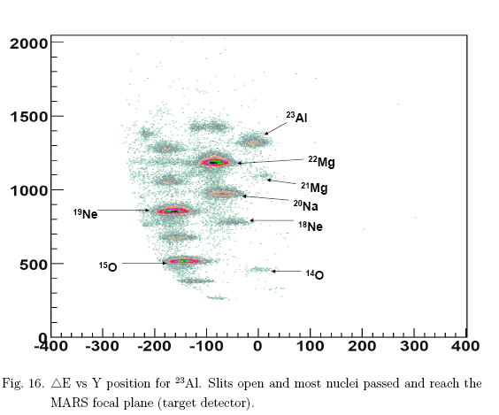
Isotope selection with MARS
N=Z-2
N=Z-3
N=Z-1
E
Pos ~ q/m
²⁴Al used for en and eff calibration
of Ge detector to E_{γ}=8 MeV
Final cut with focal plane slits

Slide 29
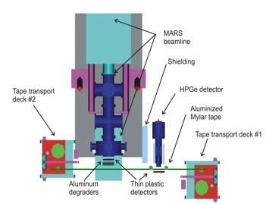
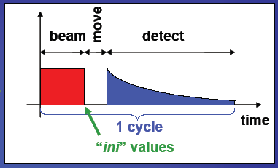
β decay study of pure RB samples

Slide 30
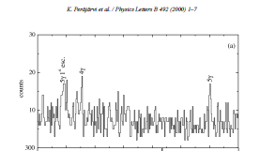
²³Al β-γ coincidence spectrum
IAS
BGO

Slide 31
²³Al β-decay results
First clean and intense ²³Al source
Found decay scheme
established g.s. J^{π}=5/2⁺ (not 1/2⁺) [VE Iacob ea, PRC 74, Oct 2006; also A. Ozawa ea, PRC 74, Aug 2006 from magn mom meas] ⇒ ²²Mg(p,γ)²³Al not important for depletion of ²²Na in novae
absolute branching ratios (not easy or common!)
measured T_{1/2}=446(4) ms (<1% accuracy) - w. γ-ray multiscaling
and absolute log ft
identified IAS E*=7802.9(5) keV by logft=3.31(2) – meas!
used IMME to get new ²³Al mass ⇒ S_{p}(²³Al)=143(3) keV
  Note: after mass meas in Jyvaskyla, became best IMME check! and S_{p}=141.11(43) keV
Located IAS & state at E*=7787 keV – important resonance in ²²Na(p,γ)²³Mg

Slide 32
²³Al β-decay results
First clean and intense ²³Al source
Found decay scheme
established g.s. J^{π}=5/2⁺ (not 1/2⁺) [VE Iacob ea, PRC 74, Oct 2006; also A. Ozawa ea, PRC 74, Aug 2006 from magn mom meas] ⇒ ²²Mg(p,γ)²³Al not important for depletion of ²²Na in novae
absolute branching ratios (not easy or common!)
measured T_{1/2}=446(4) ms (<1% accuracy) - w. γ-ray multiscaling
and absolute log ft
identified IAS E*=7802.9(5) keV by logft=3.31(2) – meas!
used IMME to get new ²³Al mass ⇒ S_{p}(²³Al)=143(3) keV
  Note: after mass meas in Jyvaskyla, became best IMME check! and S_{p}=141.11(43) keV (A. Saastamoinen ea, PRC 80, 2009)
Located IAS & state at E*=7787 keV – important resonance in ²²Na(p,γ)²³Mg

Slide 33
PRC 80, 044330 2009

Slide 34
²³Al β-decay results
First clean and intense ²³Al source
Found decay scheme
established g.s. J^{π}=5/2⁺ (not 1/2⁺) [VE Iacob ea, PRC 74, Oct 2006; also A. Ozawa ea, PRC 74, Aug 2006 from magn mom meas] ⇒ ²²Mg(p,γ)²³Al not important for depletion of ²²Na in novae
absolute branching ratios (not easy or common!)
measured T_{1/2}=446(4) ms (<1% accuracy) - w. γ-ray multiscaling
and absolute log ft
identified IAS E*=7802.9(5) keV by logft=3.31(2) – meas!
used IMME to get new ²³Al mass ⇒ S_{p}(²³Al)=143(3) keV
  Note: after mass meas in Jyvaskyla, became best IMME check! and S_{p}=141.11(43) keV
Located IAS & state at E*=7787 keV – most important resonance in ²²Na(p,γ)²³Mg

Slide 35
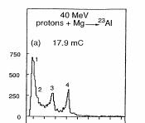
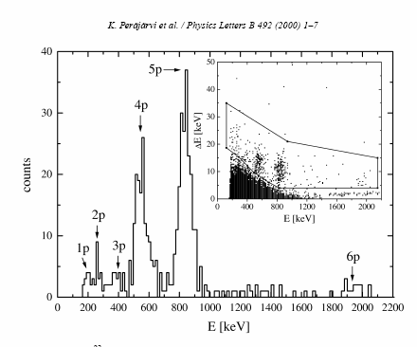
Tighe ea, LBL 1995
Perajarvi ea, JYFL 2000
(p,γ) vs p-decay
5/2+
²³Al 0.446(4)s
Q_{ec}=12240keV
Proton br. total=?!%
β⁺
²²Mg(p,γ)²³Al
β⁺
?!%
9548
8456
8164
8003
7877
p
IAS: ft=2140 s +/-5%
7803 IAS 5/2+
7787 (7/2)+
6985 5/2+
6575 5/2+
2905 (3,5/2)+
2359 1/2+ NO!
2051 7/2+
450 5/2+
0 3/2+
?!%
²²Na
Sp=7580 keV
E=207 keV => ΔE=16 keV
Unusually strong
isospin mixing! (?!)
²²Na(p,γ)²³Mg
resonances
Most important:
ωγ₇₇₈₇=__._?! meV
VE Iacob, et al., PRC 74, Oct. 2006
& Y Zhai thesis
²³Mg

Slide 36
Method: implantation in very thin Si detectors!
MARS implantation station
Energy degrader
275 mm
OD Φ=150 mm
thermocooler
connectors
64 mm
>110 mm
E=E_{p}+kE_{recoil}+<ΔE_{β}>
18” dia chamber
Φ=80 mm
p-detector – v. thin DS Si strip 65 or 45 μm
W1-65 BB2-45
β-detector – thick Si det 1 mm
γ-detector – HPGe 70% effic
Pulsed beam

Slide 37
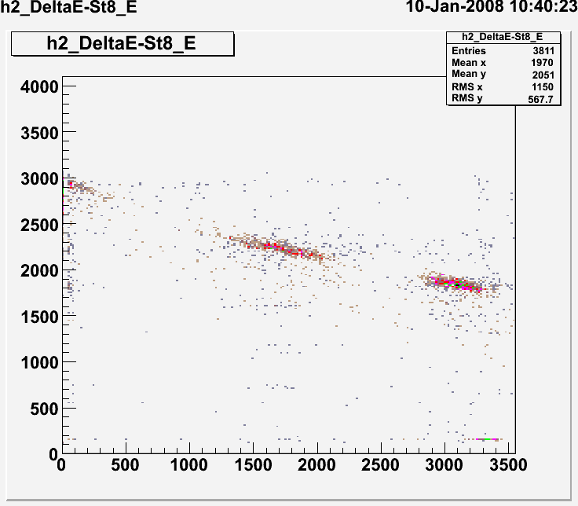
Si 1000 μm
Si strip
61 μm
17 μm
“HI telescope mode” – control implantation
Signal=E_{ΗΙ}
Signal=ΔE_{HI}
HI
Δp/p=+/-0.25%
proton
36°
β
ΔE (p)
Gamma-ray
30°
0°
Signal=ΔE_{β}
Signal=E_{p}+ΔE_{β}
“β-proton mode”
measure simultaneously:
β-proton and
β−γ coinc.
Si stops protons:
½ 65 μm E_{p}<1.5 MeV
E (β)

Slide 38
²³Al β-delayed p-decay sp – after bkg subtraction
Resonances for ²²Na(p,γ)²³Mg
Gamow window
866
579
267
207
1204
367
394
440
E=223 keV IAS
Antti Saastamoinen et al., PRC 83, 2011
“world record”

Slide 39
β allowed GT
Superallowed F
ωγ=(2J+1)/(2j+1)(2I+1)b_{γ}b_{p}*Γ
5/2⁺
Most important resonance:
E_{res}=207 keV
ωγ=1.4 meV (+.5,-.4)
Γ from τ=10(3) fs Jenkins ea, PRL 2004
²³Al
(5/2, 7/2)⁺
p
IAS, 5/2⁺ T=3/2
 | Eres (keV) | Eexc (keV) | br-p (of 100 beta)
 | 207 | 7787 | 0.14(3)%
IAS | 223 | 7803 | ?!
 | 267 | 7848 | 0.18(4)%
 | 337 | 7917 | 0.03(1)%
 | 443 | 8024 | 0.02(1)%
 | 579 | 8160 | 0.28(1)%
 | 866 | 8447 | 0.41(1)%
 | 1204 | 8785 | 0.02(1)%
 |  | total | 1.22(5)%
?!
7787 (7/2)⁺
3⁺
3.7%
²²Na + p
78.2%
18.0%
7/2⁺
5/2⁺
3/2⁺, T=1/2
Rare case (2nd known!) s of γ & p-branching
measured simultaneously !
²³Mg

Slide 40
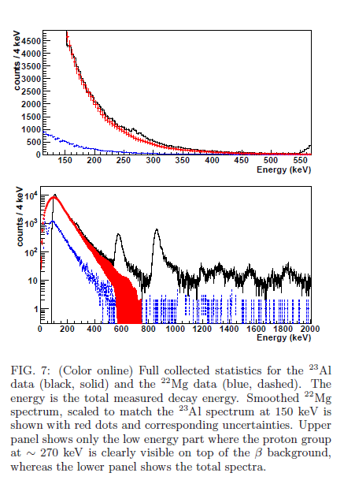
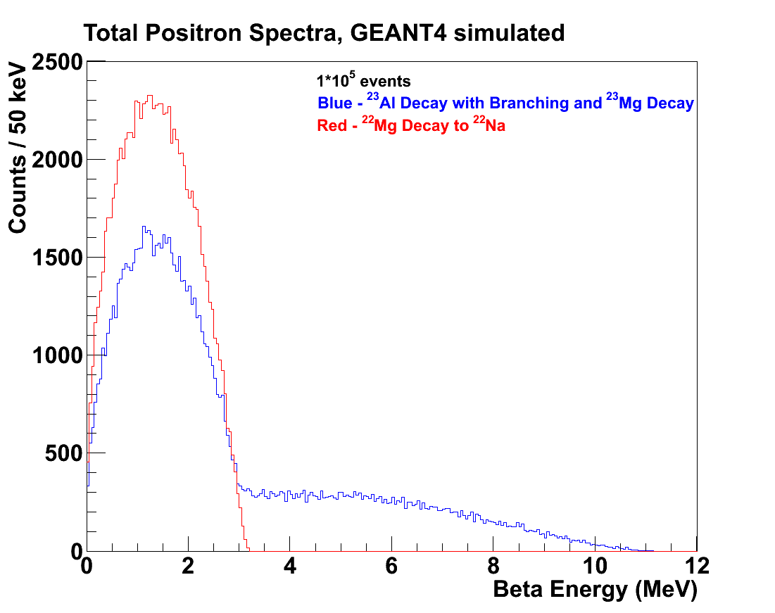
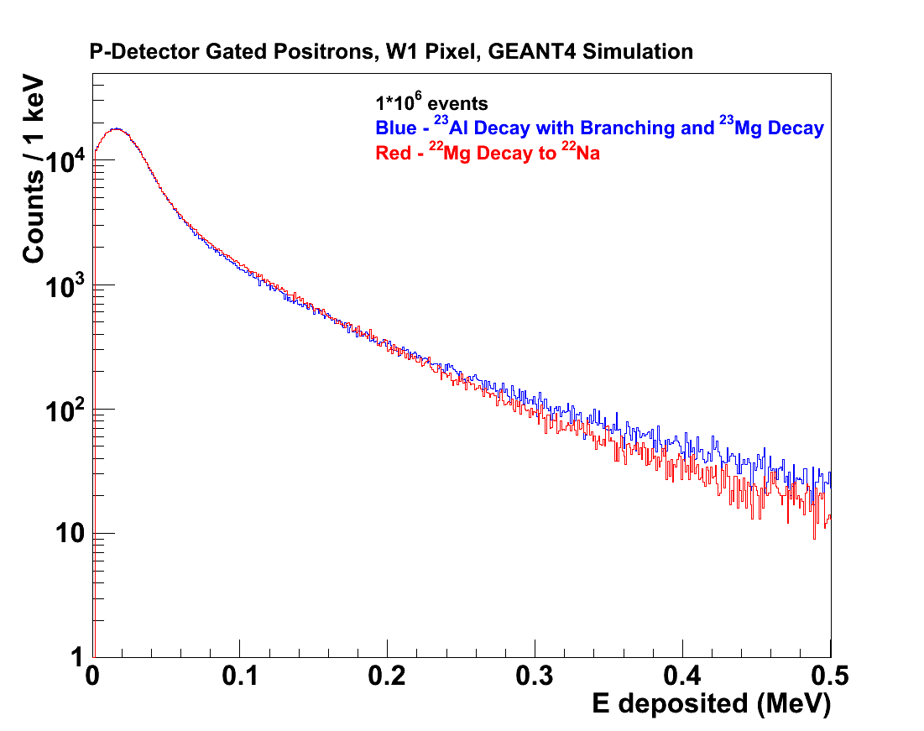
Full disclosure!
Background subtracted using decay of ²²Mg (not a proton emitter)

Slide 41
²³Al βp meas with Si det
Low energy beta background hurts!

Slide 42
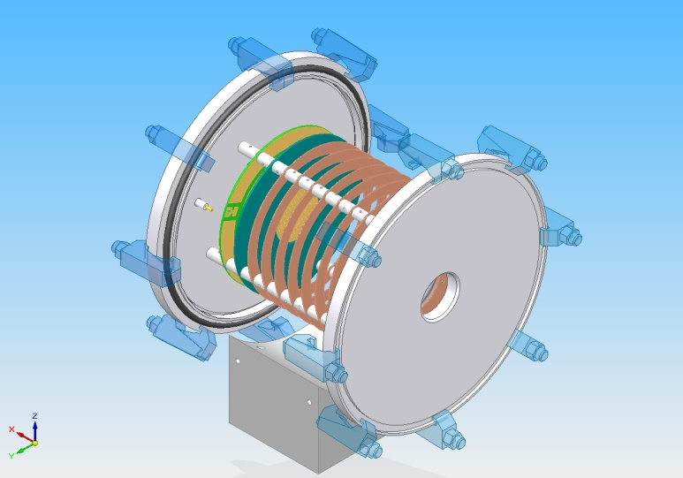
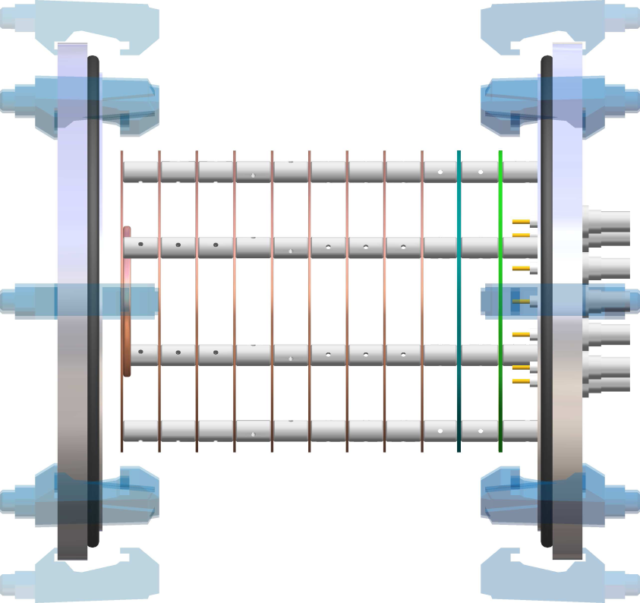
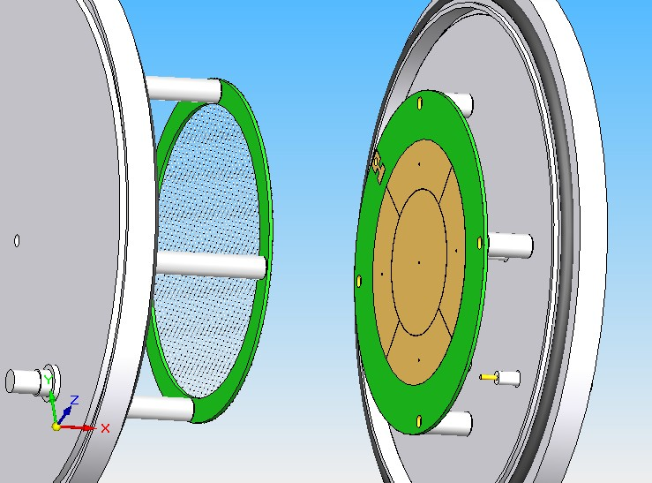
Solution: ASTROBOX
Last spring
emitted proton
electrons
beam
E Pollacco (CEA Saclay) proposed:
Gas detector w MICROMEGAS
Low proton energies (~1-200 keV), good resolution (5-10%)
Reduced β background

Slide 43
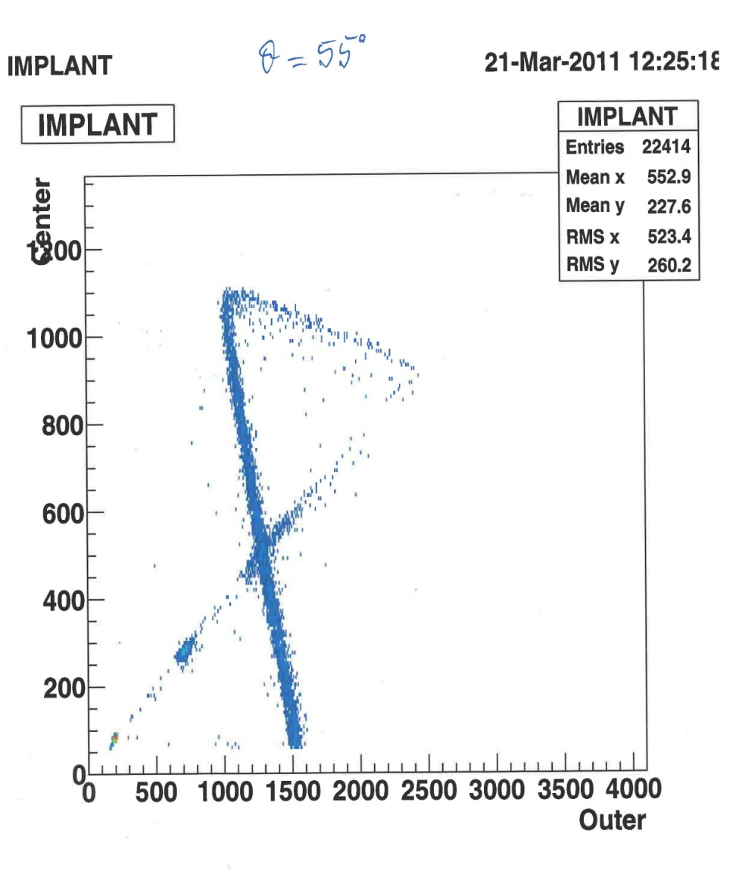
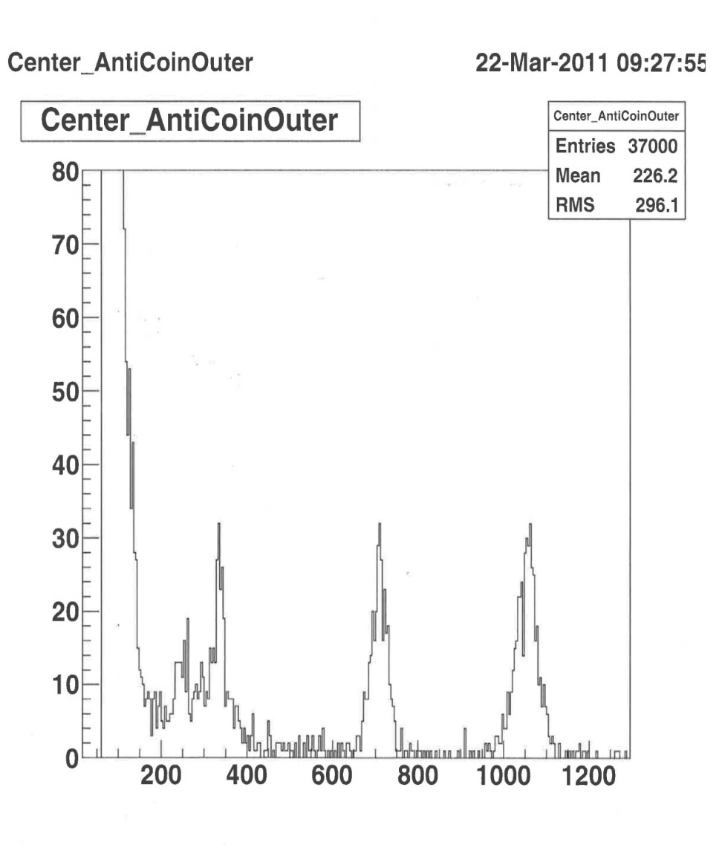
Run0311B: ²³Al βp-decay with ASTROBOX
Implantation control
Off-beam spectrum
Outer-far
betas
234 IAS?!
866
267
579
Center
detector
206 keV
Outer + center
337

Slide 44
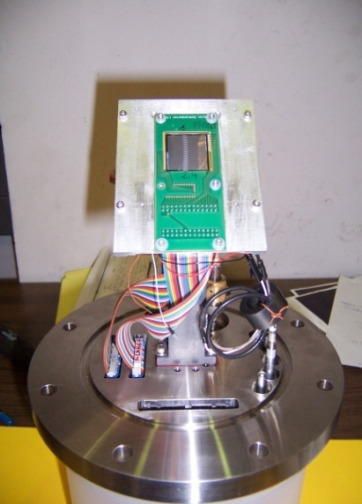
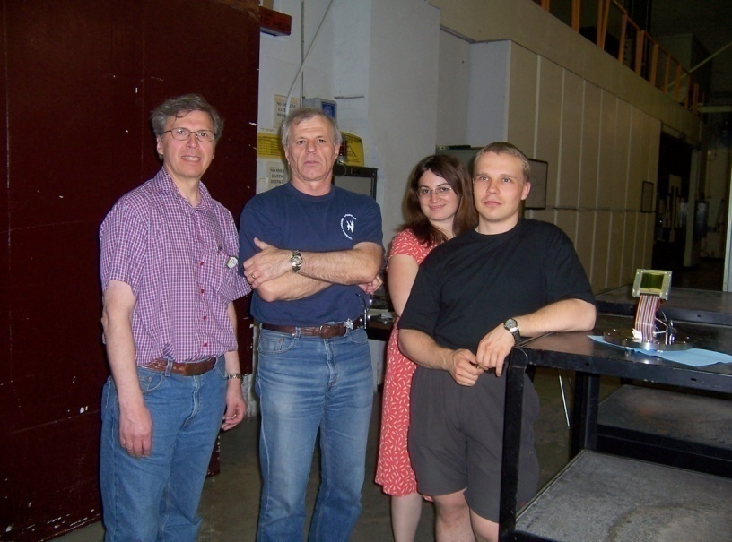
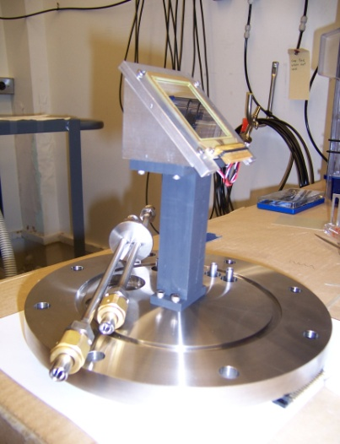
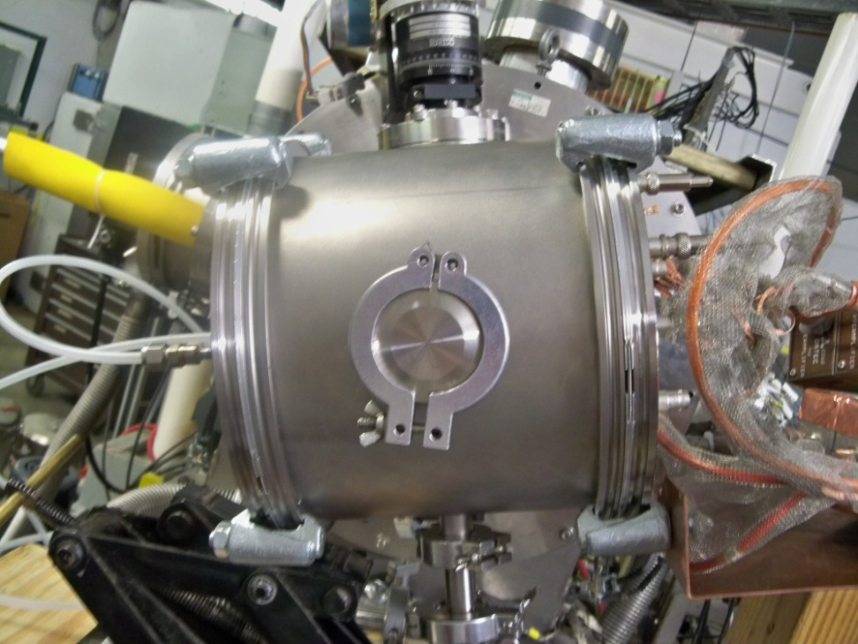
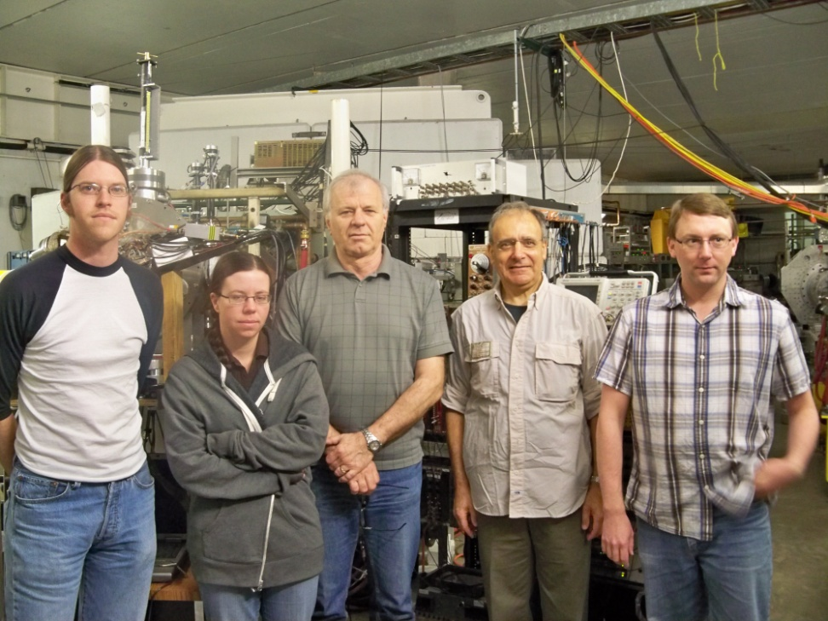
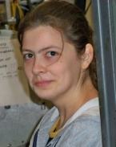
A few images are worth a thousand words!
W1-65 det 16 x 16 strips 3.1 mm
BB2-45 det 24 x 24 strips, 1 mm

Slide 45
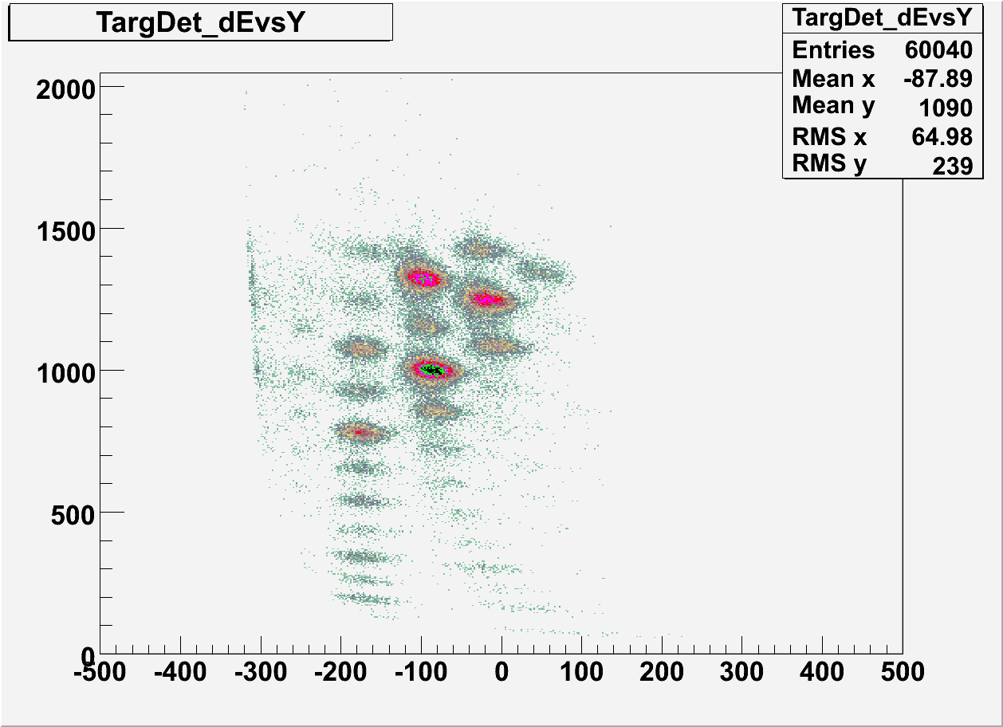
³¹Cl production and separation
Energy (a.u.)
³²Cl
³¹Cl
²⁹S
Position (0.1 mm) = q/m

Slide 46
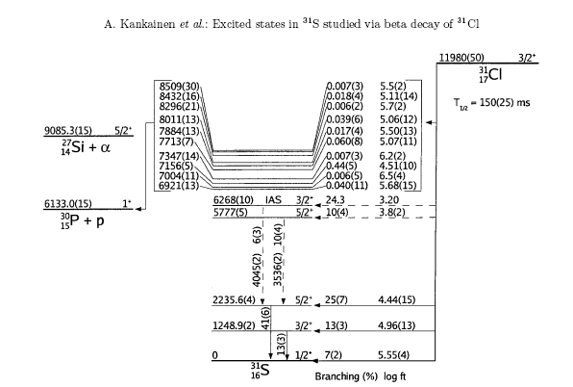
³¹Cl β-decay - status 2006/present exp
Old: Τ_{1/2} =150(25) ms
New: T_{1/2} = 190(1) ms
S_{p}=6.133 MeV

Slide 47
³¹Cl β-decay results
First clean and intense ³¹Cl source
established β-decay scheme
determined relative branching ratios
measured T_{1/2}=190(1) ms (<1% accuracy)
identified IAS E*=6279.5±0.3±1.5 (syst) keV and its decay
used IMME to get new, more precise ³¹Cl mass ME(³¹Cl)=-7064(8) keV ⇒ Q_{EC}=11,980(8) keV and S_{p}(³¹Cl)=289(8) keV (imp for ³⁰S(p,γ)³¹Cl !)
found precise energy of E*=6256(1) keV ⇒ E_{res}=123(2) keV – important reson in ³⁰P(p,γ)³¹S
did not find IAS proton branching (at E_{p}=146 keV – very difficult !!)

Slide 48
Results β-delayed p-decay
Technique works well – can go to E_{p}~100 keV and, maybe, lower
Can work with lifetimes ~100 ms or less
Very selective: can separate well beam cocktails (by implantation depths)
Very sensitive: could obtain results for ²¹Mg, ²⁹S at rates ~ 1-10 pps in 8 hrs
Could study very weak branches (e.g. ²⁰Mg 50 pps) Strengths:
  Good isotope separation (MARS)
  In-flight production: need 30-50 MeV/u (can be implanted)
  ASTROBOX opens new possibilities

Slide 49
Collaborators
M McCleskey, E Simmons, A Spiridon, BT Roeder, G Tabacaru, RE Tribble, JC Hardy, VE Iacob, A Banu* – Cyclotron Institute, Texas A&M University (* now at J Madison University, VA)
PJ Woods, T Davinson, G. Lotay – Univ of Edinburgh
J Aysto, A Saastamoinen, A Jokinen – Univ of Jyvaskyla
MA Bentley – Univ of York
E Pollacco et al. –CEA Saclay

Slide 50
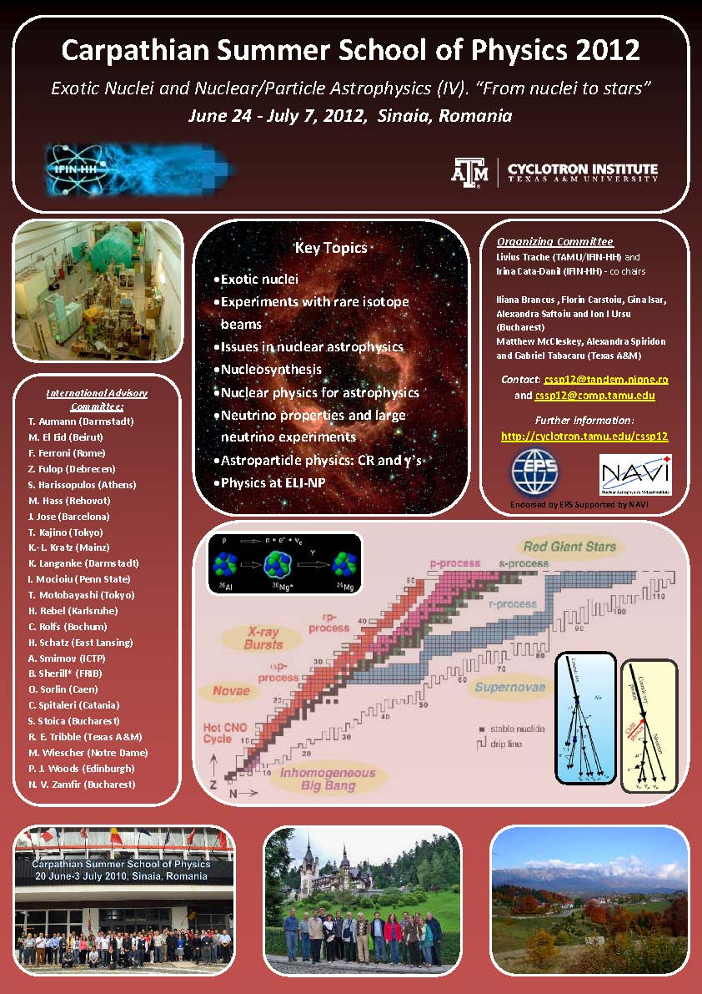
If you want:
one of Europe’s four best schools in NA
(with St. Tecla, Granada/Beirut and … Russbach), older (in wine’s sense!) than all together
to combine NA with exotic nuclei, neutrinos and particle astrophysics
mountains in summer
to see Dracula’s castle in original
see Karl-Ludwig, Carlos, Shawn, Jordi in person, Mounib, Claudio, Iolanda …
to see me (not speaking) again
Come to the
Carpathian Summer School
Sinaia, Romania
June 24 – July , 2012
Need visa: apply by March 31
No visa: apply by June 1

Slide 51
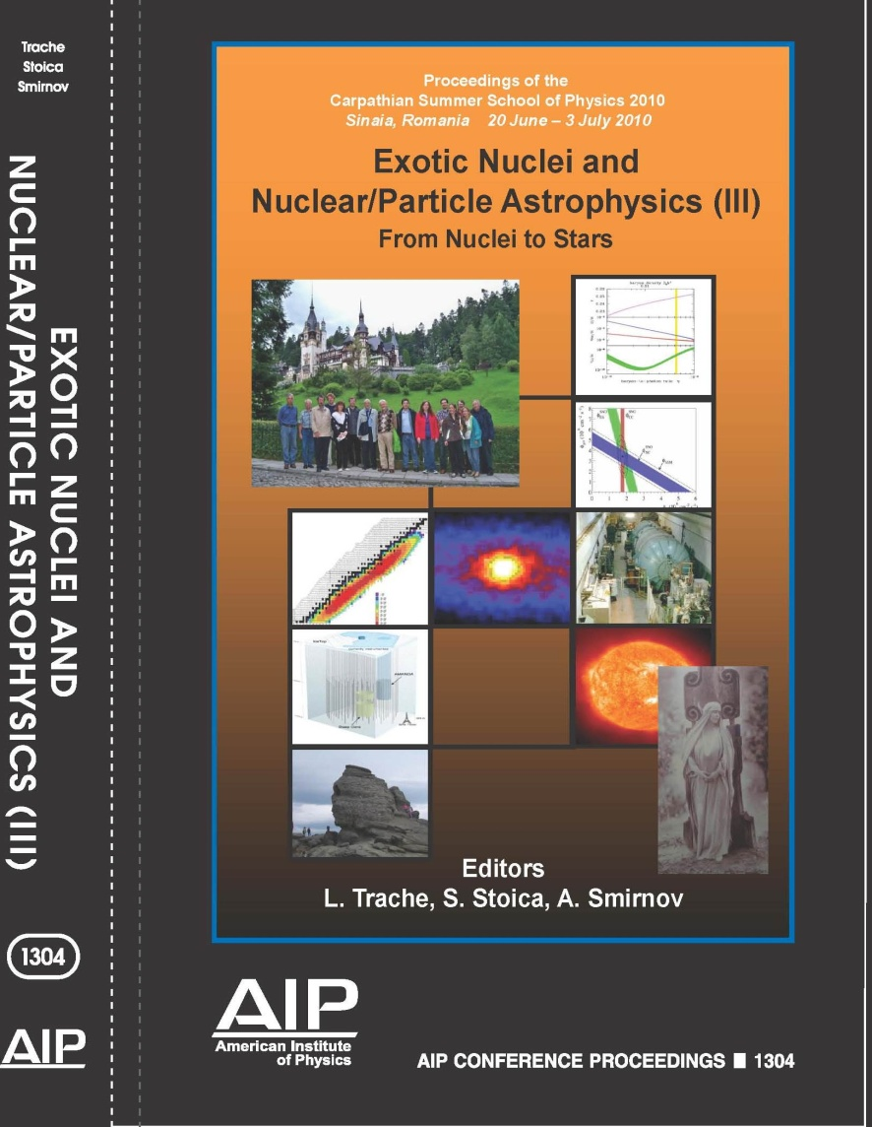
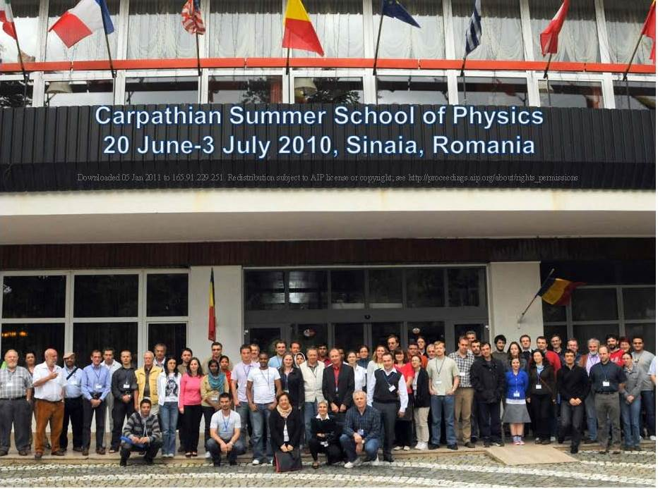
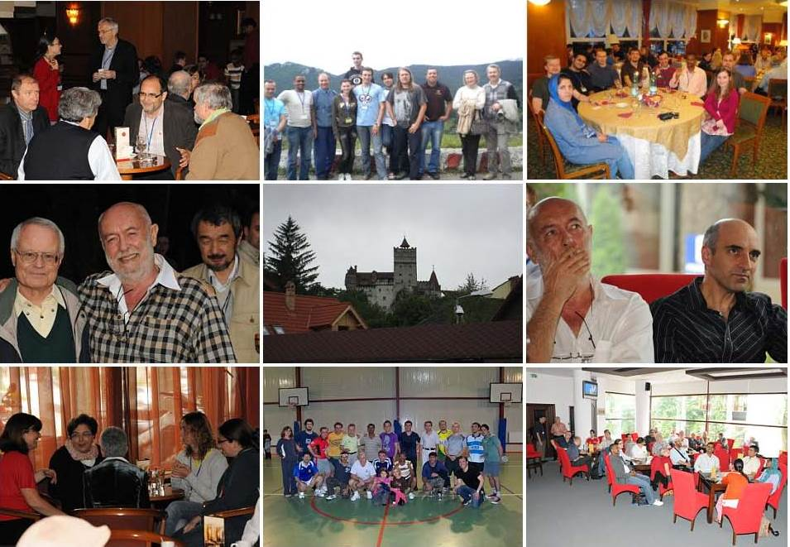
Carpathian Summer School of Physics
Sinaia, Romania, June 24-July 7, 2012
livius_trache@tamu.edu

Slide 52


Extreme Light Infrastructure
2006 – ELI on ESFRI Roadmap
ELI-PP 2007-2010 (FP7)
  ELI-Beamlines (Czech Republic)
  ELI-Attoseconds (Hungary)
  ELI-Nuclear Physics (Romania)
Project Approved by the European Competitiveness Council (December 2009)
ELI-DC (Delivery Consortium): April 2010
Courtesy NV Zamfir (IFIN-HH Bucharest)
52

Slide 53
ELI – Nuclear Physics Research
Nuclear Physics experiments to characterize laser – target int.
Photonuclear reactions.
Exotic Nuclear Physics and astrophysics
complementary to other NP large facilities (FAIR, SPIRAL2).
Applications based on high intensity laser and very brilliant γ beams.
Complementary to the other pillars
ELI - Nuclear Physics
in ‘Nuclear Physics Long Range Plan in Europe’ as a major facility
53

Slide 54
ELI – NP Experiments (1)
Stand-alone High Power Laser Experiments
Nuclear Techniques for Characterization of Laser Interaction with Matter
Stopping Power of Charge Particles Bunches with Ultra-High Density
Laser Acceleration of very dense Electrons, Protons and Heavy Ions Beams
Laser-Accelerated Th Beam to produce Neutron-Rich Nuclei around the N = 126 Waiting Point of the r-Process via the Fission-Fusion Reaction
A Relativistic Ultra-thin Electron Sheet used as a Relativistic Mirror for the Production of Brilliant, Intense Coherent γ-Rays

Slide 55



