Slide 1

Nuclear reactions - experiment for nuclear structure, reaction mechanisms and nuclear astrophysics
Livius Trache l-trache@tamu.edu
Cyclotron Institute, Texas A&M University and
Institute for Physics and Nuclear Engineering Bucharest, Romania
Exotic Beam Summer School 2012
ANL Aug 5-10, 2012

Slide 2
Summary
Introduction
  Nuclear reactions: vocabulary/definitions
Rare Isotope Beams
  RIB production
  RIB reaction specifics
Types of reactions
  Elastic scattering
  Inelastic scattering
  Direct reactions: one nucleon transfer, few nucleons
  Breakup at intermediate energies
  Resonant elastic scattering – TTIK method
  In-flight decay spectroscopy
  multifragmentation
Instrumentation
Applications to Nuclear Astrophysics

Slide 3
Nuclear reactions
1
Reactions are basic tools to study nuclei (nuclear structure) and nuclear forces
Other tools:
  Mass measurements
  Decay studies
Measurement at lab energies
Comparison with (reaction) calculations
Extract (nuclear structure) information
Need good additional knowledge (data).
Reliable absolute values

Slide 4
Nuclear reactions
before
after
detector
product
projectile
target
+
θ
Residue (recoil)
Projectile + target -> reaction product(s)+ r. residue(s)
  Scattering: 1+2-> 1+2
  Two-body reactions: 1+2 ->3*+4*
  Multifragmentation r: 1+2 -> 3+4+5+ …
Kinematic conditions: incident energy , scattering (react) angle
  Normal kinematics: Mp<Mt. Inverse kinematics: Mp>Mt
  E_{lab} -> E_{cm}= (Mt/(Mp+Mt))E_{lab} (non-relativistic)
Measure cross section: σ=nr detected/incident p per area/nr target nuclei
Spectra: σ=f(Q_{fi}) (reveal states of quantum system(s))
Angular distributions: dσ/dΩ= f(θ) (info on space charact of inter region)
Excitation functions: σ=f(E_{inc}) (info on time charact of interaction)
Momentum distributions (info on size)

Slide 5
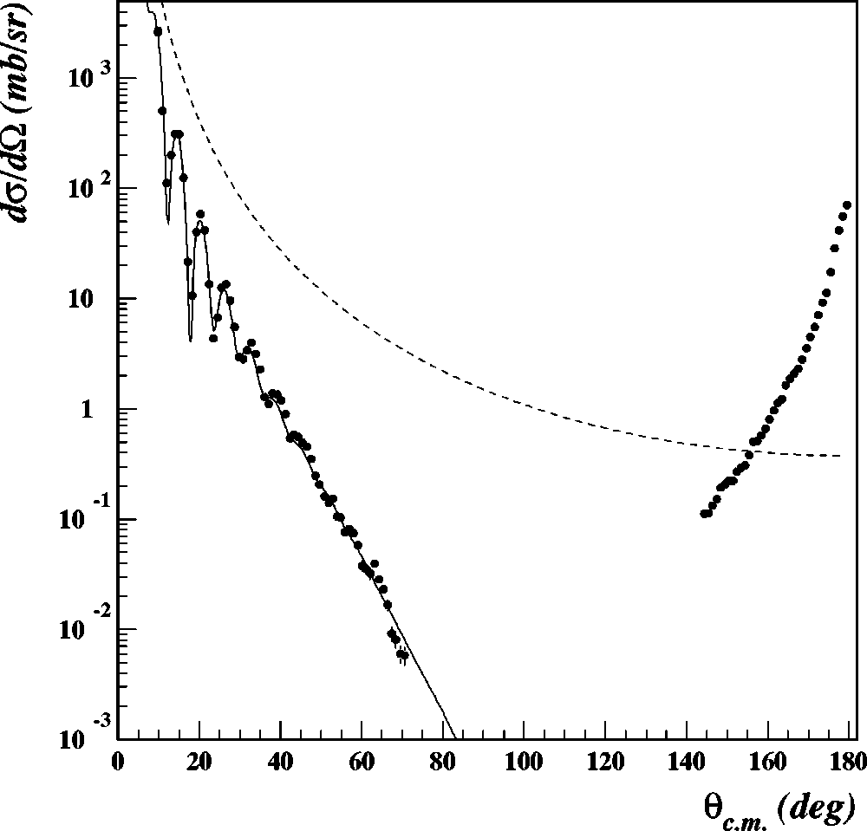
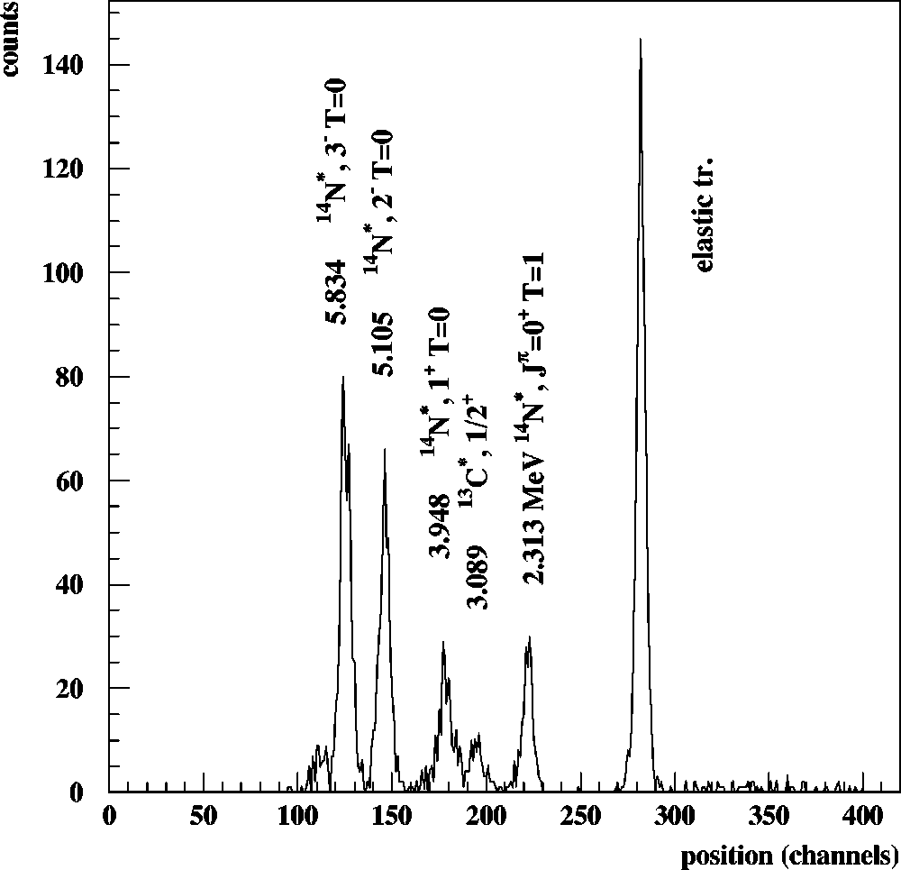
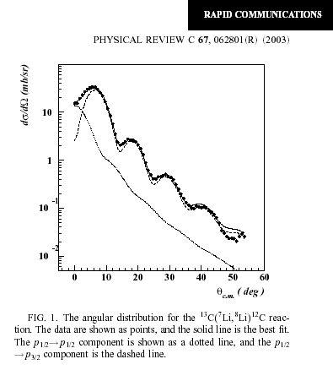
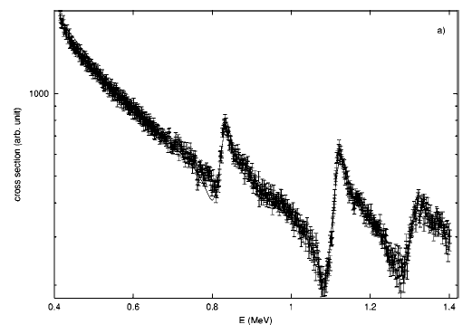
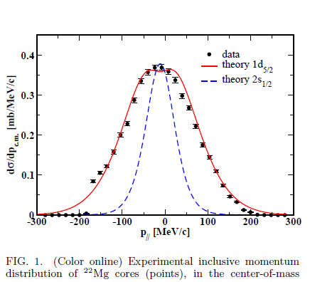
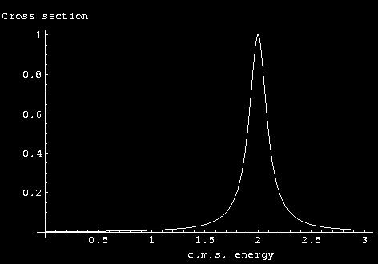
Typical measurements
Energy spectrum: ¹³C(¹⁴N,¹³C)¹⁴N
Angular distribution ¹³C(⁷Li,⁸Li)¹²C
Excitation fct: σ=f(E_{inc})
Momentum distrib: dσ/dp ²³Al-> ²²Mg+p
²¹Na(p,p)²¹Na

Slide 6
2. Exotic nuclear Beams
EB or RIB (Rare Isotope Beams)
RIB production
  ISOL technique: prod by reactions -> separation -> reacceleration
  In-flight: reaction prod separated -> secondary beams
    Fragmentation reactions (E/A> 25-50 MeV/u)
    Reactions in inverse kinematics (fusion-evaporation, direct reactions)
RIB specifics
  Lower intensities
    Stable beams: 1-100 pnA => 10⁹ – 10¹¹ pps
    RIB: 1-10⁷ pps
  Lower resolutions: energy, angle
  Large background
Imply:
  Detectors w higher efficiency (4π coverage?!)
  Clean data with coincidences (γ-part, part-part, etc)
  Beam identification
  Full kinematics reconstruction
  New instruments, new experimental methods

Slide 7
3
Types of reactions
  Elastic scattering
  Inelastic scattering
  Direct reactions: one nucleon transfer, few nucleons
  Breakup at intermediate energies
  Resonant elastic scattering – TTIK method
  In-flight decay spectroscopy
  Multifragmentation

Slide 8
Elastic scattering
3 a)
1+2→1+2
Elastic scattering: no energy transf to internal excit
good, sensitive probe of surface and (sometimes!) of interior of nuclei
Angular distributions measured on a large range:
  small angles probe surface
  Larger angles probe more toward interior
Described with Optical Model Potentials (OMP)
  Phenomenological
  Semi-microscopic: double folding
Figura Di Pietro here
Excitation function reveal resonances in CN

Slide 9
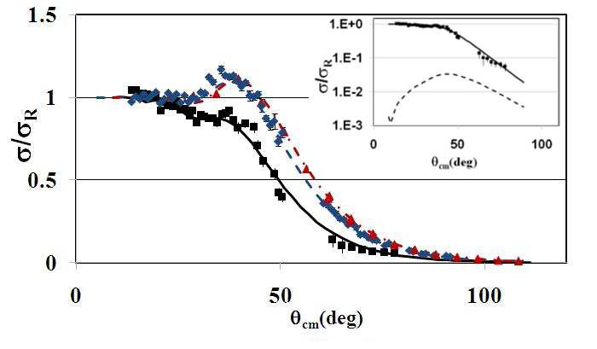
Elastic scattering, if well understood and used, can give important information about the structure of the two partners and about the reaction mechanism.
Example (by A. Bonaccorso) for ^{9,10,11}Be on ⁶⁴Zn.
From A di Pietro et al, PRL 2010.
Elastic scattering is used to extract Optical Model Potentials needed in DWBA
FIG. 1: Color on line. Elastic-scattering angular distributions
on ⁶⁴Zn: ⁹Be(triangles), ¹⁰Be (diamonds) and ¹¹Be (squares) .
The lines represent the OM calculations for ⁹Be(dot dashed),
¹⁰Be (dashed) and ¹¹Be (full line). The inset shows the mea-
sured AD (symbols) and OM fit (full line) for the ¹¹Be+⁶⁴Zn
system together with the result of the OM calculation for the
inelastic excitation of ¹¹Be( 1/2⁻, Ex=0.32 MeV) (dashed line).

Slide 10
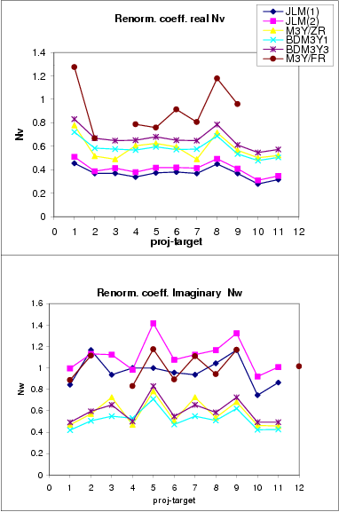
OMP: wide systematics loosely bound stable p-shell nuclei

Slide 11
Semi-microscopic double folding potentials for nucleus-nucleus collisions
Double folding procedure:
HFB densities (to best match the surfaces)
tried various effective interactions (M3Y, DDM3Y, JLM, etc…)
Settled for JLM
Smearing w. range parameters t_{V}=1.2 fm, t_{W}=1. 75 fm
Renormalizations needed N_{v}, N_{w}
JLM - uses eff inter of Jeukenne, Lejeune and Mahaux (PRC 16, 1977)
n-nucleus Bauge ea (PRC 58, 1998):
  energy and density dependent
  independent geometry for real and imaginary potentials
  normalization independent of partners
  reproduce ELASTIC and TRANSFER data
Checked for loosely bound p-shell nuclei stable beams ~ 10 MeV/u
  Found N_{v}=0.37(2) N_{w}=1.0(1), t_{V}=1.20 fm, t_{W}=1. 75 fm
Extended to RNB: ⁷Be, ⁸B, ¹¹C, ¹²N, ¹³N, ¹⁷F on ¹²C, ¹⁴N targets

Slide 12
JLM works for elastic & transfer
JLM works for a range of energies
E/A=15-50 MeV/u
Works for transfer reactions

Slide 13
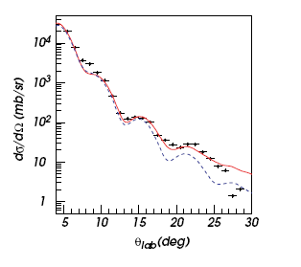
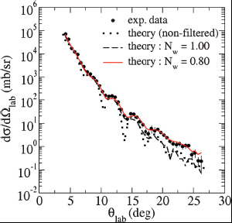
⁷Be on melamine
Optical Model Potentials
for Nucleus-Nucleus collisions
for RNBs
TAMU exps
@ 12 MeV/u
G. Tabacaru ea,
PRC 73, 025808 (2006)
Essential to make credible DWBA calc needed in transfer studies
Have established semi-microscopic double folding using JLM effective interaction:
Established from exps with stable loosely bound p-shell nuclei: ^{6,7}Li, ¹⁰B, ¹³C, ¹⁴N … @ 10 MeV/u
Independent real and imaginary parts, energy and density depend.
Parameters: renormalization coeff. (Nv~0.4-0.5, Nw=1.0)
Predicts well elastic scatt for RNBs: ⁷Be, ⁸B, ¹¹C, ¹²N, ¹³N, ¹⁷F
Good results for transfer reactions (tested where possible)
L. Trache ea, PRC 61 (2000)
F. Carstoiu ea, PRC 70 (2004)
F. Carstoiu & LT, PRC 85 (2012)
ORNL exps
@ 10 MeV/u
¹²N on melamine
J. Blackmon ea,
PRC 73, 034606 (2005)
A. Banu ea, PRC 79, 2009.

Slide 14
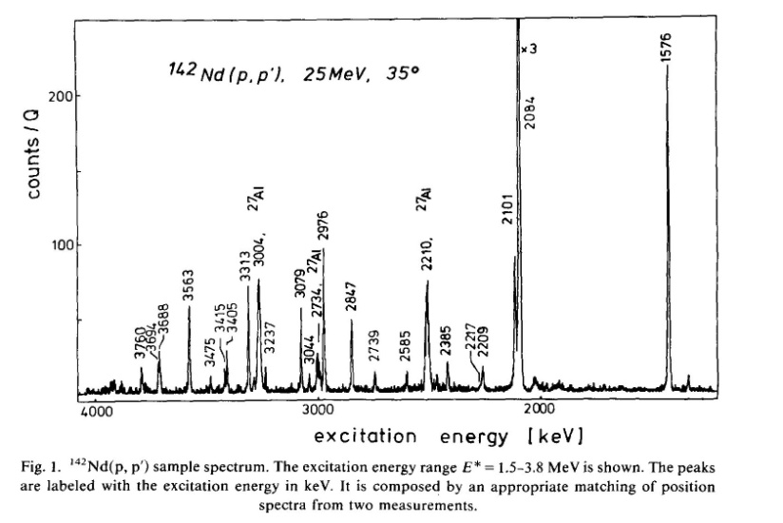
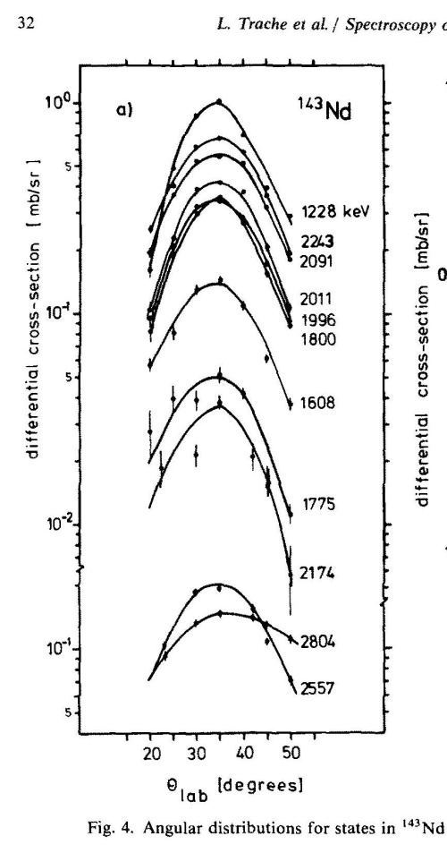
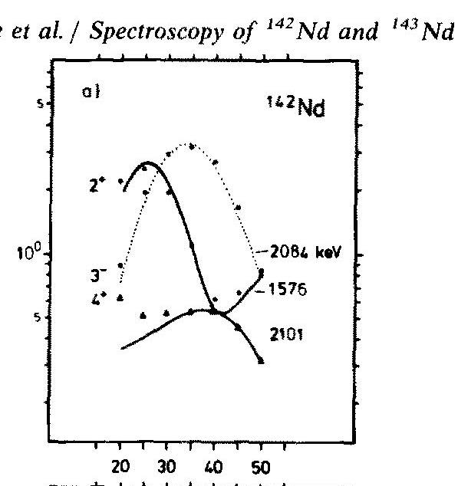
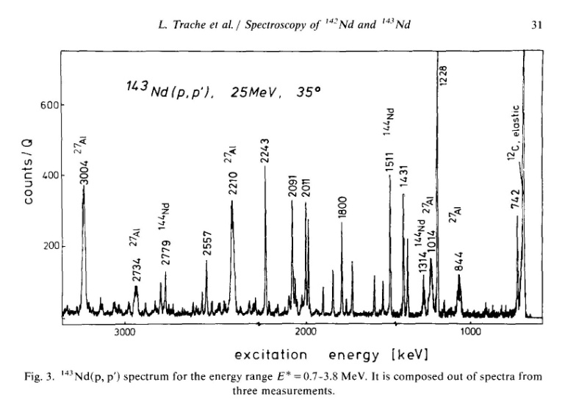
Inelastic scattering
3 b
1+2 -> 1+2*
Selective to collective excitations
  Quadrupole excitations
  E2: 0⁺ →2⁺
  Octupole excitations
  E3: 0⁺ → 3⁻
^{Extract B(E2), B(E3)}
^{actually G}_{IS}^{(L=2,3)}

Slide 15
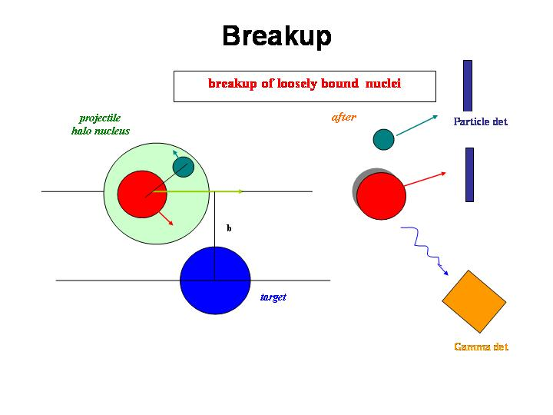
Transfer and nucleon-removal reactions
3 c,d
Give information about the single particle (fermionic) degrees of freedom in nuclei
Single nucleon transfer
Multinucleon transfer
Alpha transfer …
  measure angular distributions
  Determine: njl, spec factor, ANC
Pair transfer – info on pairing vibrations = collective mode
Breakup (nucleon-removal) at intermediate energies:
    measure momentum distributions
    Determine: njl, spec factor, ANC …

Slide 16
Spectroscopic factors and ANCs
Spectroscopic factors – definition
ANC …
Overlap integrals I^{A}_{Bp} and their asympt behavior
C²_{nlj}=S_{nlj}*b²_{nlj} , where b_{nlj} is the s.p. ANC
With (some) assumptions, we get, for major comp. and one-step:
For transfer:
For break-up:

Slide 17
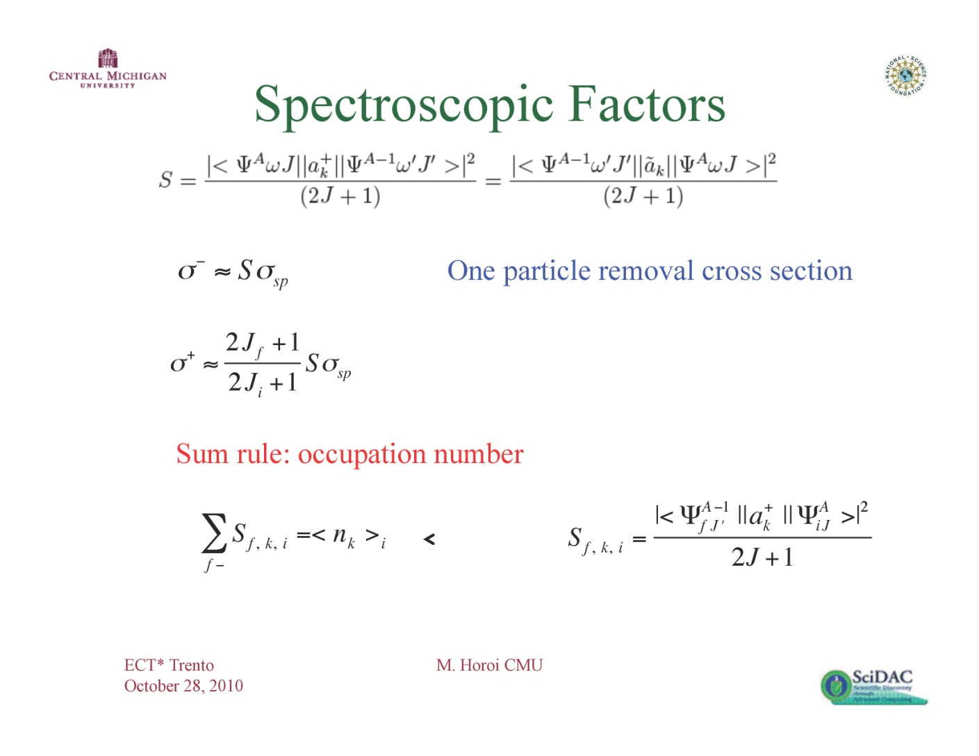
As used in shell model calculations

Slide 18
Spectroscopic factors and ANCs
Spectroscopic factors – definition
ANC …
Overlap integrals I^{A}_{Bp} and their asympt behavior
C²_{nlj}=S_{nlj}*b²_{nlj} , where b_{nlj} is the s.p. ANC
With (some) assumptions, we get, for major comp. and one-step:
For transfer:
For break-up:

Slide 19
ANC in peripheral reactions: radiative proton capture, transfer and breakup
transfer happens here
breakup happens here
(p,γ) happens here
Shape in asymptotic region given by Whittaker fct.
Only normalization (ANC) unknown and needed!

Slide 20

c) Transfer reactions: the ANC method
Depend on OMP
* n Factors !!!
Transfer reaction B+d→A+a peripheral (absorption)
  Transfer matrix element:
Depend on geom (r₀,a) of
proton-binding potential < 20-40%
ANC - independent on binding potential geometry!
OMP knowledge crucial for reliable absolute values!
Semi-micr proc. JLM interaction (LT ea, PRC, 2000)
NA: proton-nucleus also peripheral
(Christy and Duck, 1963
Parker and Tombrello, 1964)
Notes:
The DWBA cross section is parameterized in terms of spectroscopic factors of the initial and final nuclei and can be written as:
Add more comments
In this transfer reaction two possibilities can occur. If X and B are the same nuclei, we have an elastic exchange reaction, and the DWBA cross section is expressed in terms of C4. If X and B are not the same, one has to know the ANC for the other vertex from an independent measurement.

Slide 21
From MARS group at Texas A&M University
Transfer reactions. Major results:
  ANC technique firmly established for transfer reactions
    Proton transfer for radiative proton capture in Nucl Astrophysics ⁷Be(p, γ)⁸Β, ¹¹C(p,γ)¹²N, ¹²N(p, γ)¹³O, ¹³N(p, γ)¹⁴O, ⁹Be(p, γ)¹⁰B, ¹³C(p, γ)¹⁴N, ¹⁴N(p, γ)¹⁵O, ¹⁵N(p, γ)¹⁶O
    Use of neutron transfer and mirror symmetry for ANC proposed and tested:
      (⁷Li,⁸Li) for (⁷Be,⁸B) → ⁷Be(p, γ)⁸B ( S₁₇)
      (²²Ne,²³Ne) for (²²Mg,²³Al) →²²Mg(p, γ)²³Al
      (¹⁷O,¹⁸O) for (¹⁷F,¹⁸Ne) →¹⁷F(p, γ)¹⁸Ne
    Optical Model Potentials for nucleus-nucleus collisions from double-folding procedure using JLM eff inter. Needed in DWBA. Established with stable beams and tested for RNBs: ⁷Be, ⁸B, ¹¹C, ¹²N, ¹³N, ¹⁷F, …

Slide 22
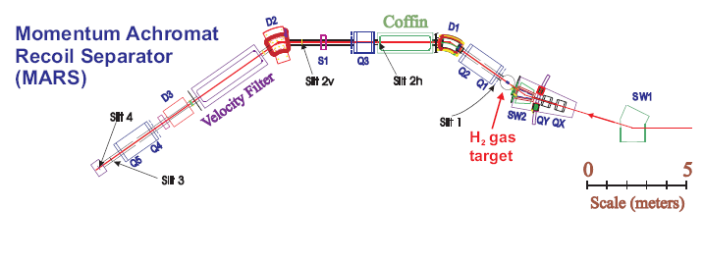
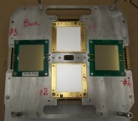
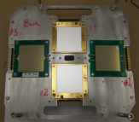

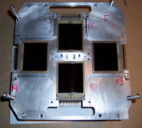

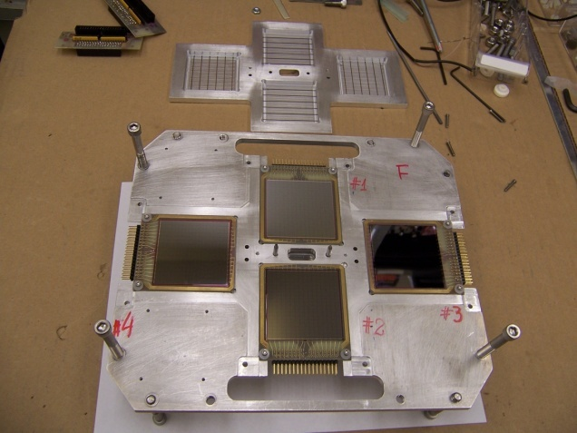
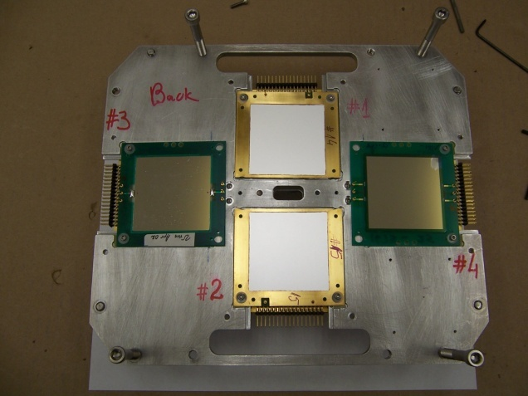
Cross sections for (p,γ) from p-transfer reactions with RNB from MARS
(Faraday Cup)
(Faraday Cup)
Er
-
det
.
.
12
12
C
C
Δ
Δ
E
E
-
-
det
det
. (PSSD)
. (PSSD)
12
12
N
N
Melamine target
Melamine target
¹²N @12 MeV/u
99% pure, 4 mm dia
Melamine target
¹²C @23 MeV/u
H₂ cryotarget
Four telescope
system (“the cross”):
ΔE – PSD 65, 110 μm
E – 500 μm

Slide 23
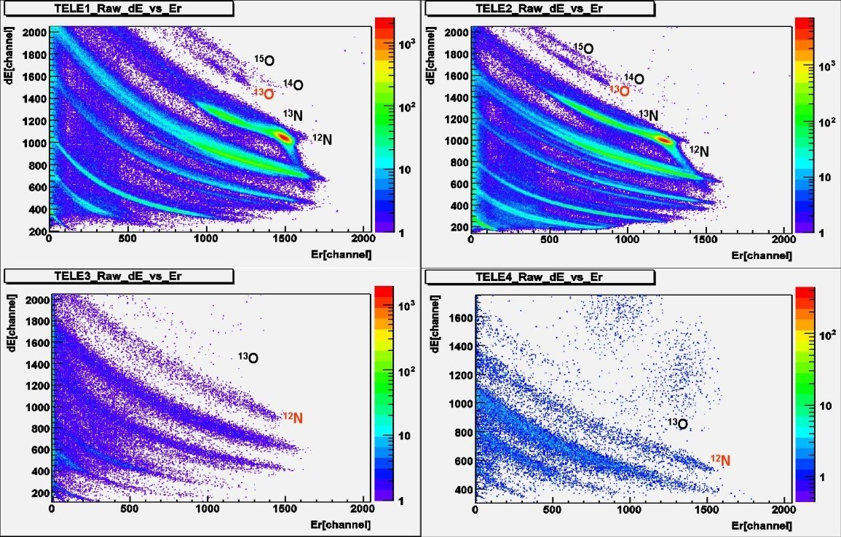
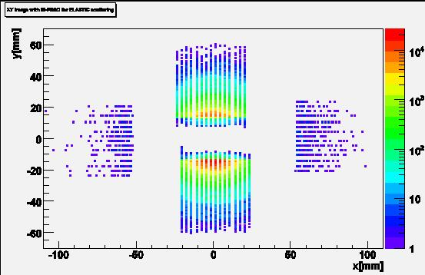
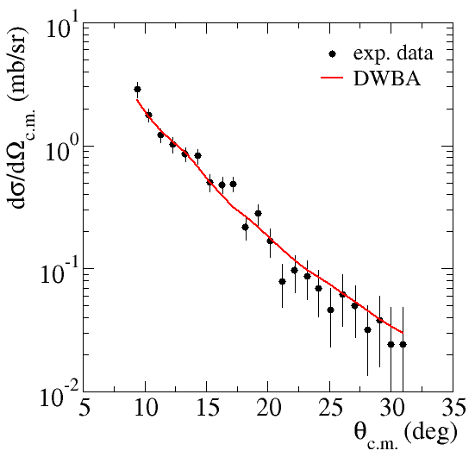
Example ¹²N @12 MeV on N₆C₃H₆ and C
Primary beam: ¹²C @ 23 MeV/u 150 pnA
Secondary beam: ¹²N @12 MeV/u 2x10⁵ pps
Elastic θ_{cm} =8-60 deg.
Fit OMP from folding JLM– no param adjust!
Transfer ¹⁴N(¹²N,¹³O)¹³C – fit w. DWBA extract ANC
¹²N(p,γ)¹³O rate evaluated from ANC
C²_{p1/2} (¹³O g.s.)=2.53±0.30 fm⁻¹
Notes:
Take the results part (right low) out and add the new elastic scatt ang distribution

Slide 24
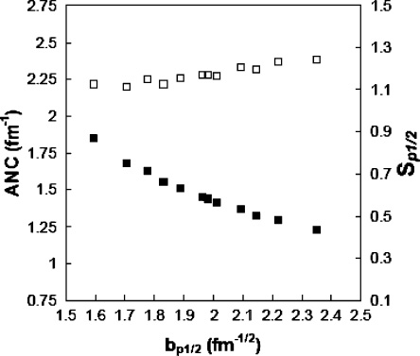
¹⁴N(¹²N,¹³O) proton-transfer react ⇒ ¹²N(p,γ)¹³O (rap proc)
ANC, S-factor 0-2 MeV
Reaction rate
Transfer & elastic @12 MeV/u
TAMU MARS ¹²N beam 2⋅10⁵ pps
dependence on the geometry of proton
binding potential (r₀,a) →b_{nlj}
A. Banu et al, Phys Rev C 79, 025805 (2009)

Slide 25
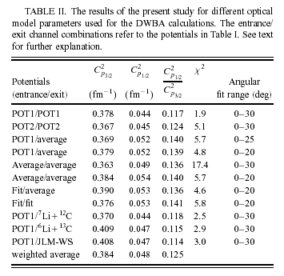
Neutron transfer – ¹⁴N(⁷Li,⁸Li)¹³C
Study mirror reaction – neutron transfer with stable beam to obtain information on ⁸Li
Use charge symmetry ⁸Li - ⁸B
Results:
C²_{tot}(⁸B)= 0.455 ± 0.047 fm⁻¹
&
Mixing ratio C²(p_{1/2})/C²(p_{3/2})=0.13(2)
LT e.a., PRC 67, June 2003

Slide 26
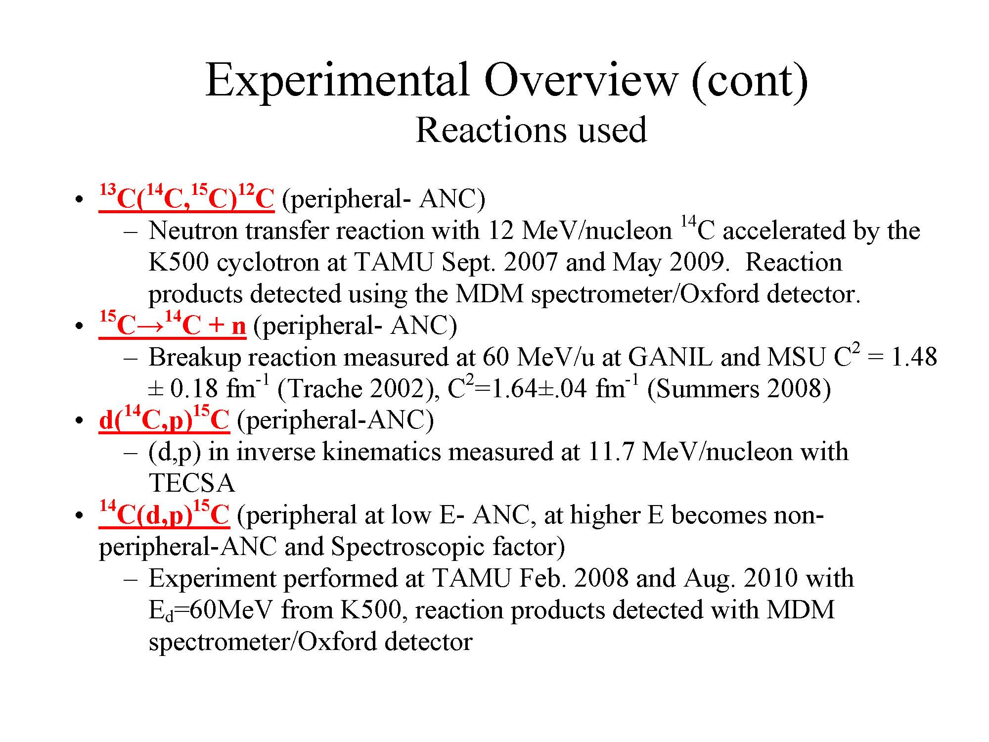
Problem: ¹⁴C(n,γ)¹⁵C

Slide 27
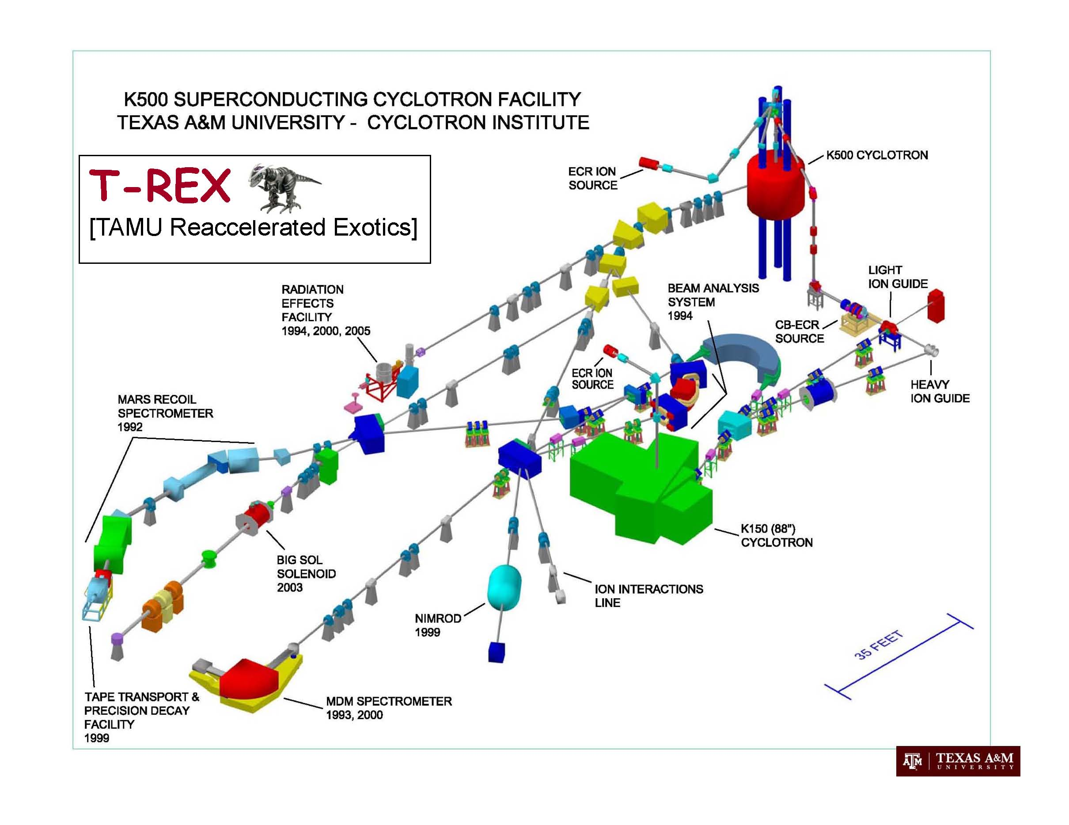

Slide 28
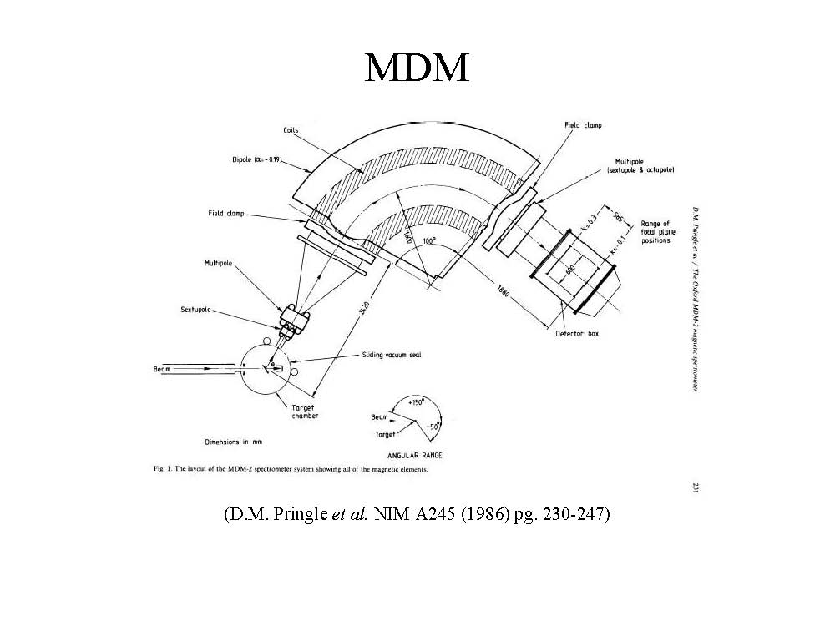
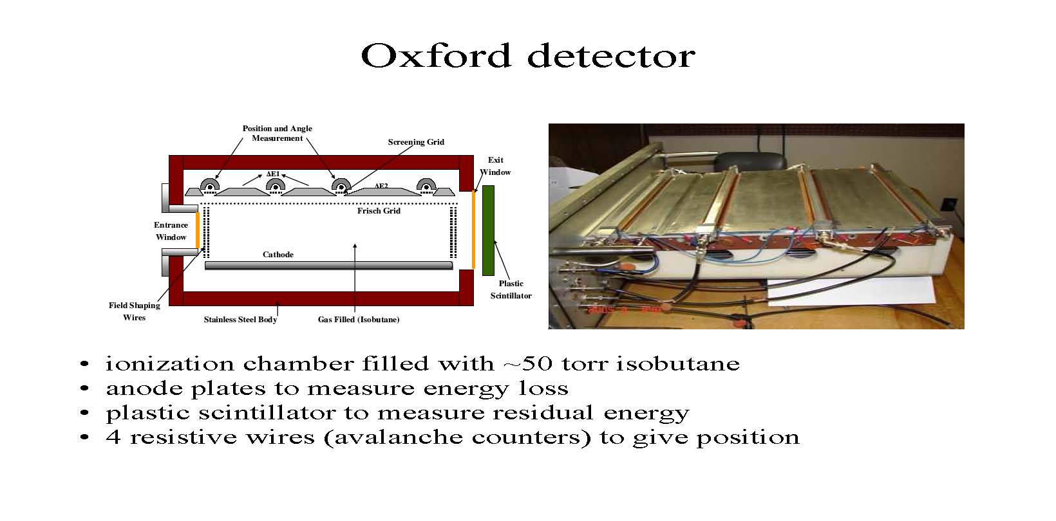
MDM spectrometer
Raytrace reconstruction allows good
angular resolution (~0.2 deg) with a
Large angle covering 4 deg (lab)

Slide 29
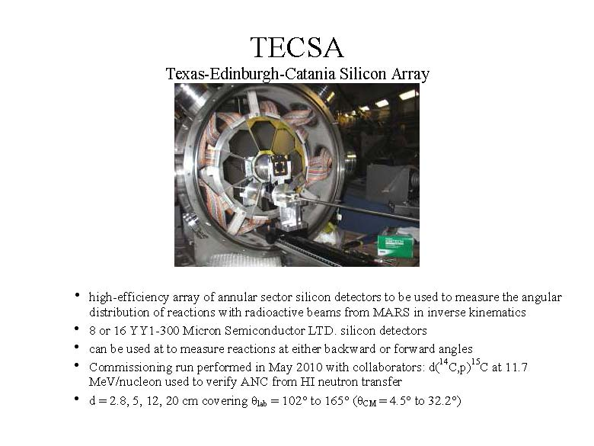

Slide 30
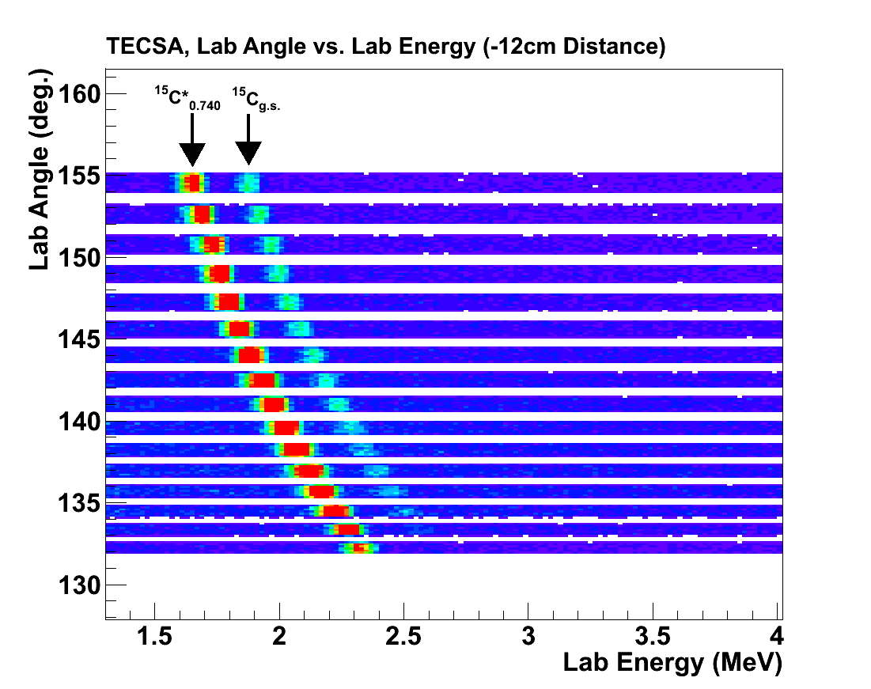
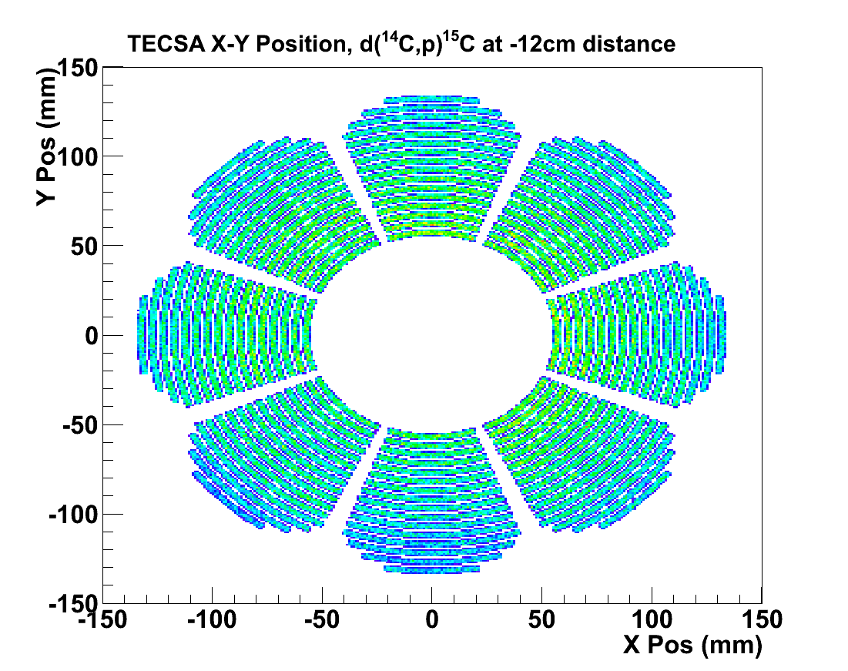
TECSA – d(¹⁴C,p)¹⁵C results
BT Roeder et al, NIM A634 (2011)71

Slide 31
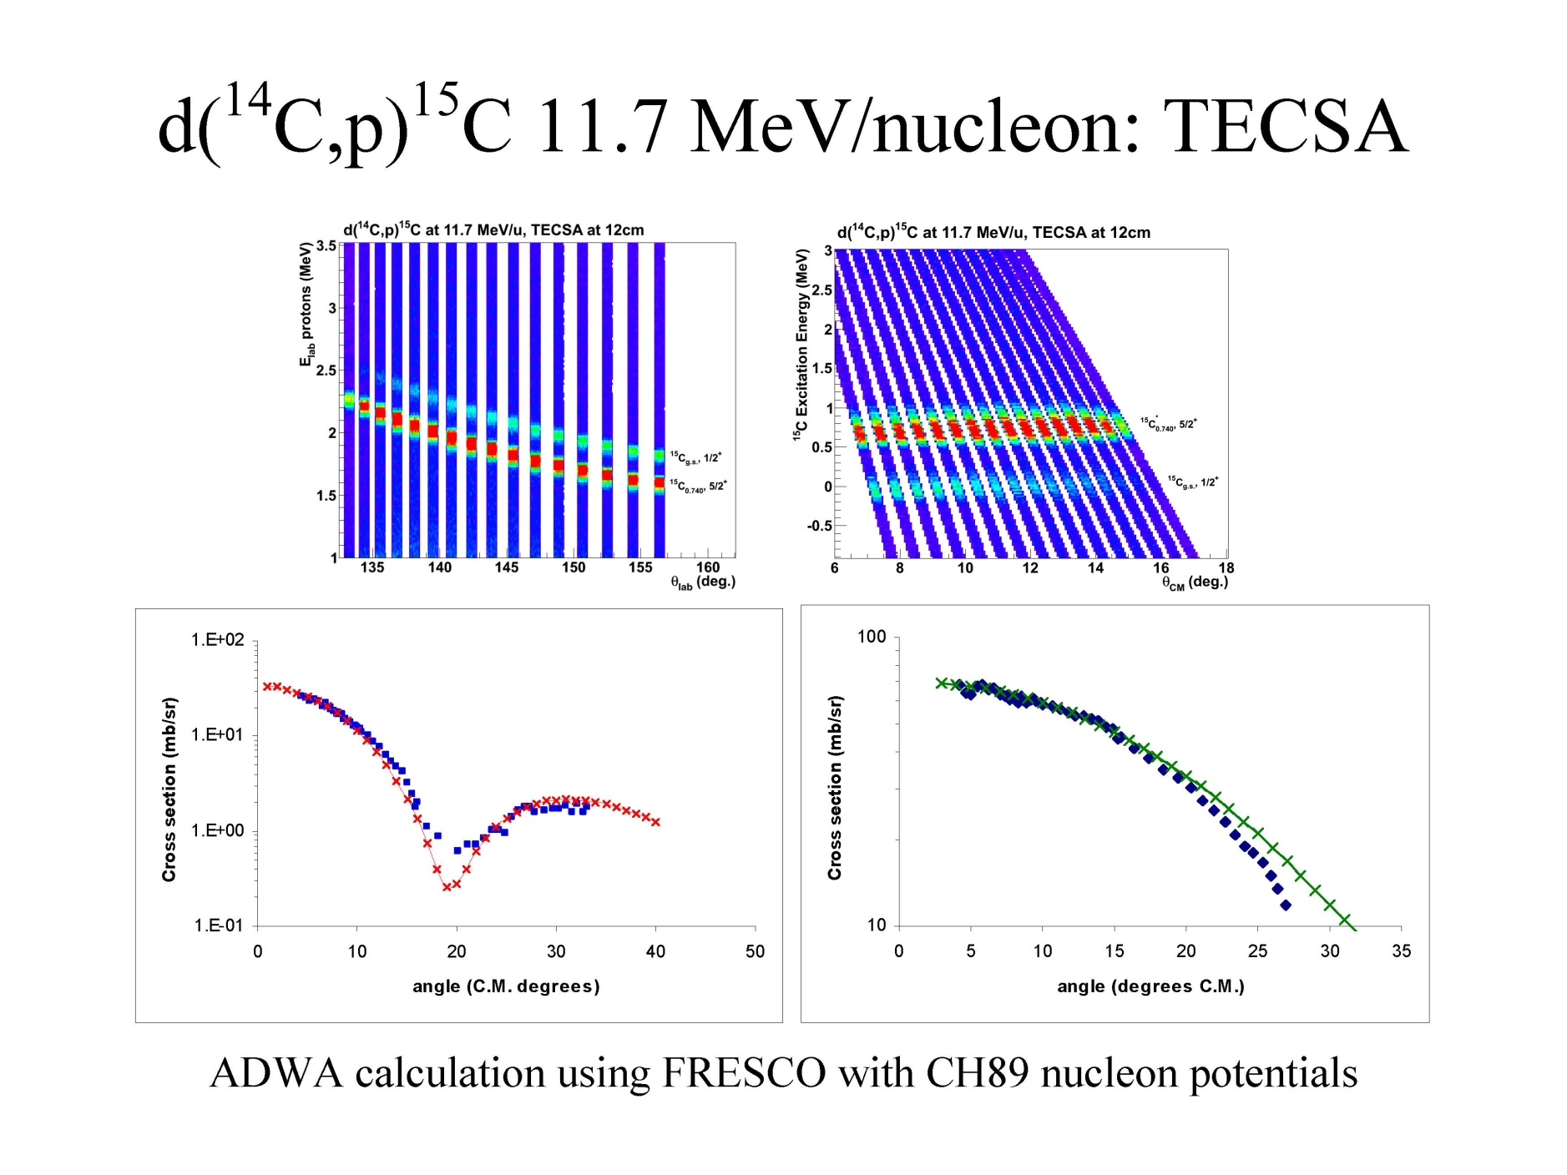

Slide 32
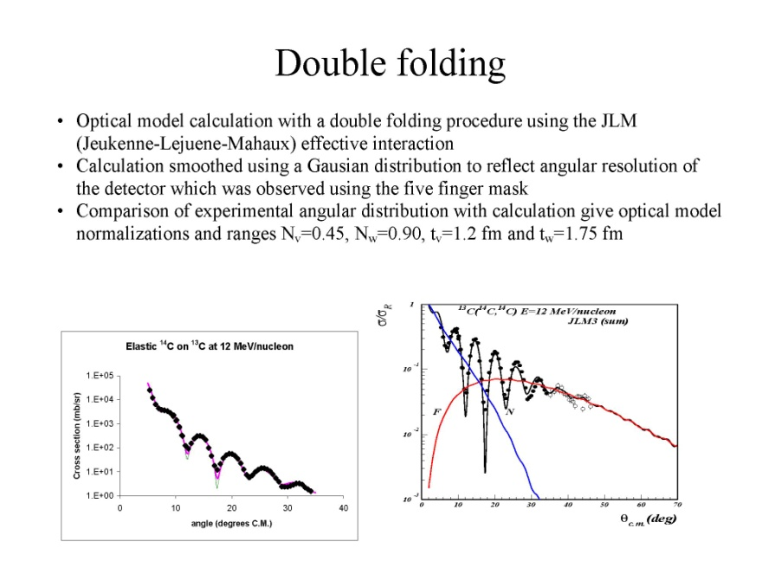
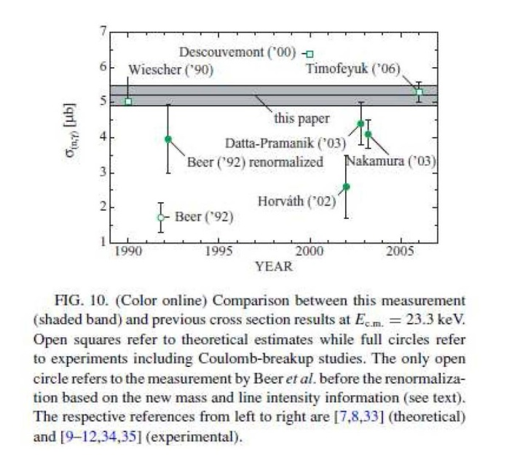
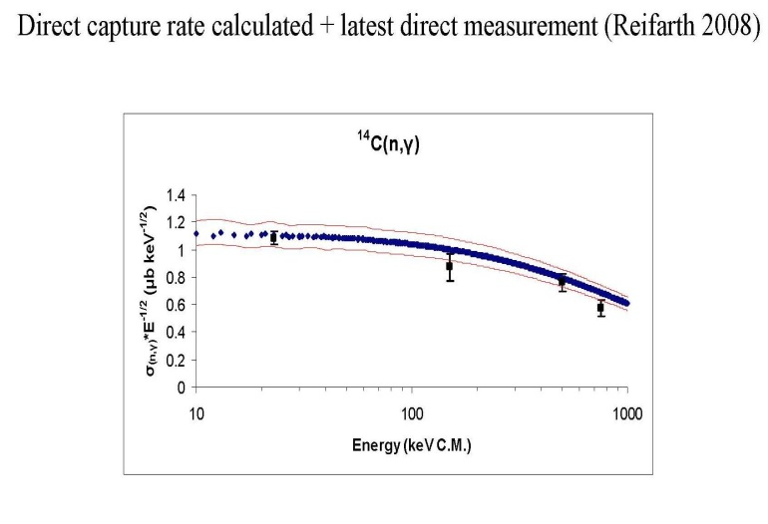
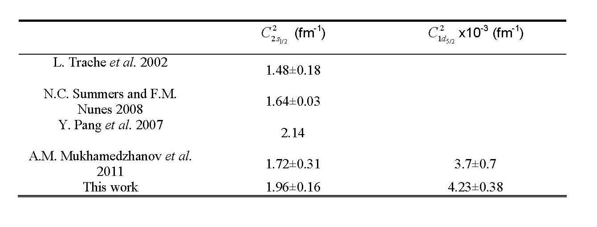
Results ¹⁴C(n,γ)¹⁵C
¹⁴C+¹³C elastic
¹⁴C(n,γ)¹⁵C exp-theory
ANC
Matthew McCleskey, thesis, TAMU, Aug 2011

Slide 33
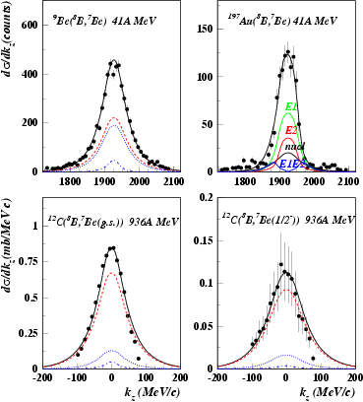
Breakup (one-nucleon removal r.)
3 d
Momentum distributions → nlj
Cross section → ANC (only!!!)
Gamma rays → config mixing
Need: V_{p-target} & V_{core-target}
and reaction mechanism
Calc: F. Carstoiu; Data: see later

Slide 34
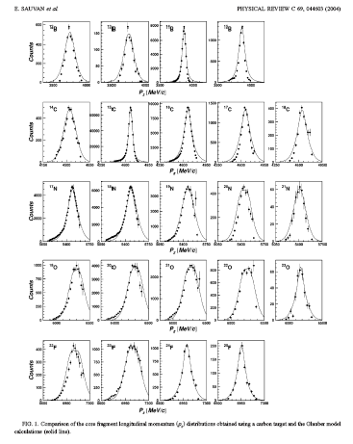
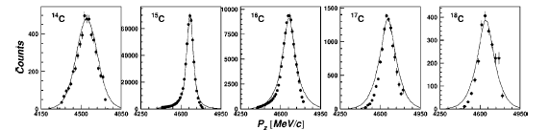
One-nucleon removal = spectroscopic tool
Example of momentum distributions – all types!
E. Sauvan et al. – PRC 69, 044503 (2004).
Cocktail beam: ¹²⁻¹⁵B, ¹⁴⁻¹⁸C, ¹⁷⁻²¹N, ¹⁹⁻²³O, ²²⁻²⁵F
@ 43-68 MeV/nucleon.
normal
halo
2s_{1/2}
Config mixing

Slide 35
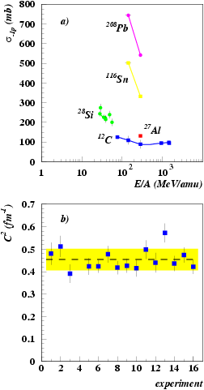
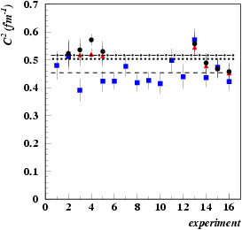
Example: Summary of the ANC extracted from
⁸B breakup with different interactions
Data from:
F. Negoita et al, Phys Rev C 54, 1787 (1996)
B. Blank et al, Nucl Phys A624, 242 (1997)
D. Cortina-Gil e a, EuroPhys J. 10A, 49 (2001).
R. E. Warner et al. – BAPS 47, 59 (2002).
J. Enders e.a., Phys Rev C 67, 064302 (2003)
All available breakup cross sections on targets from C to Pb and energies 27-1000 MeV/u give consistent ANC values!
Summary of results:
LT ea, PRL 87, 2001
LT ea, PRC 67, 2004

Slide 36
Calc w various effective interactions
A. Glauber model with folded potentials
1) JLM -uses the G-matrix effective interaction of Jeukenne, Lejeune and Mahaux (PRC 16, 1977) tested before because:
• independent geometry for imaginary part
• normalization independent of partners and energy
• reproduces ELASTIC and TRANSFER data
for loosely bound p-shell nuclei with experimentally determined renormalizations (⁷Be, ⁸B, ¹¹C and ¹³N on ¹²C, ¹⁴N)
found no renorm for imaginary pot Nw=1.0 at 10 MeV/u. Assumed correct at all energies !!!
2) the free t-matrix NN interactions of Franey and Love (PRC 31, 1985)

Slide 37
Various effective interactions (cont’d)
B. Glauber model calc in the optical limit
Use three ranges for interactions, to check the sensitivity:
3) zero-range μ→0
4) “standard” μ=1.5 fm for all terms
5) “Ray”, ranges for each term, as determined by L. Ray (PRC 20, 1979)
Test how the calculations reproduce other observables: reaction cross-sections
(p, ⁷Be and ⁸B on a ¹²C target) and total cross sections (p on ¹²C).
No new parameters!!!

Slide 38
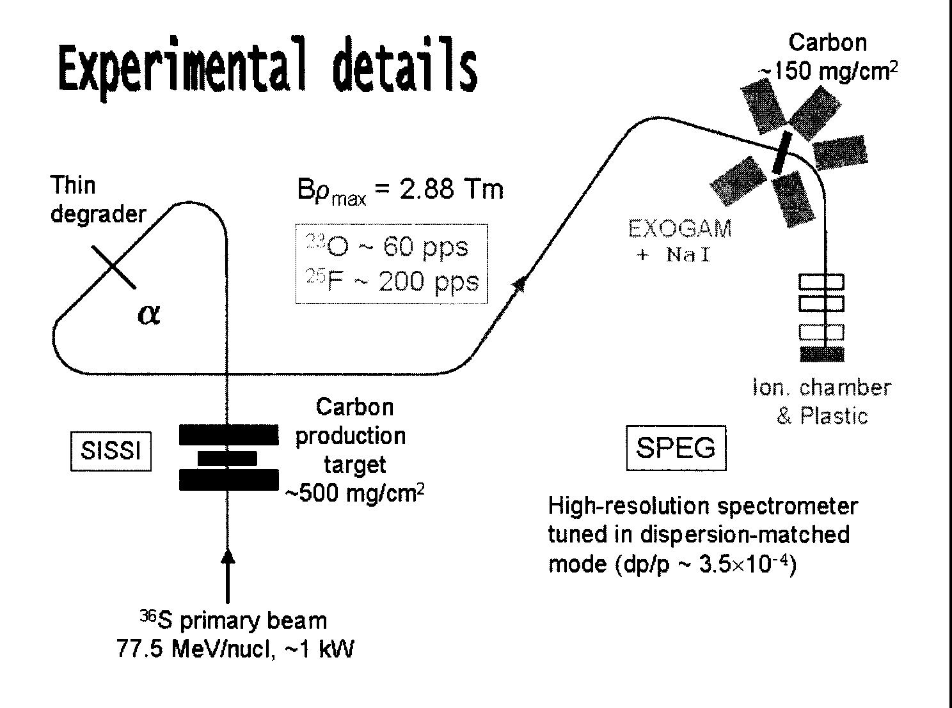
^{E491 exp.} @ GANIL
Gamma-ray detectors:
8 EXOGAM clovers 4% effic.
12 NaI crystals 6% effic.
LDC
Trifoil
183
Cocktail beam
(mid-target energies):
²⁴Si 53 MeV/u
²³Al 50 MeV/u
²²Mg 47 MeV/u
²¹Na 43 MeV/u
²⁰Ne 39 MeV/u
MCP
444
large angular acceptances:
4° (horiz. & vertic. planes)
broad momentum acceptance:
Δp/p = 7%
³²S primary beam
95 MeV/u, ~ 400 W
Banu et al., NIC10 2008 &
PRC 84, 015803 (2011)

Slide 39
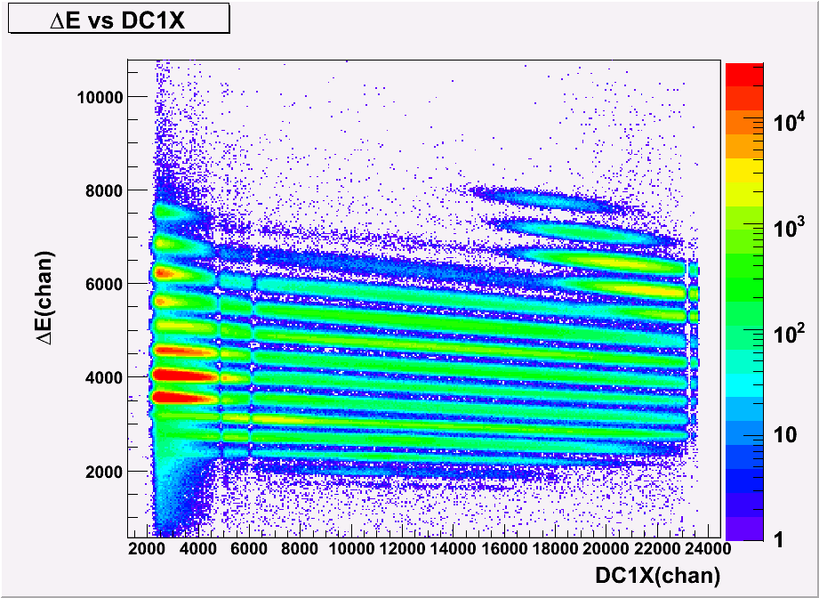
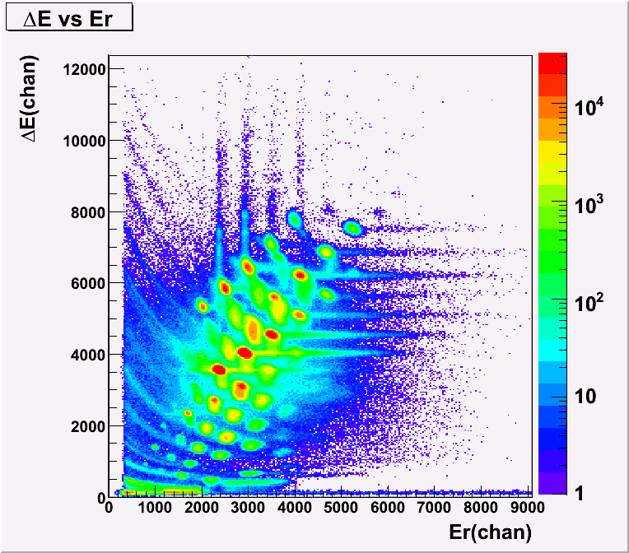
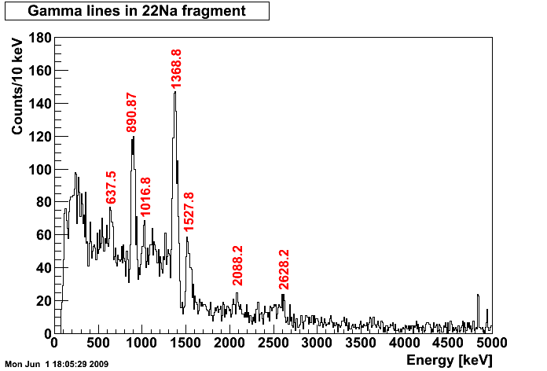
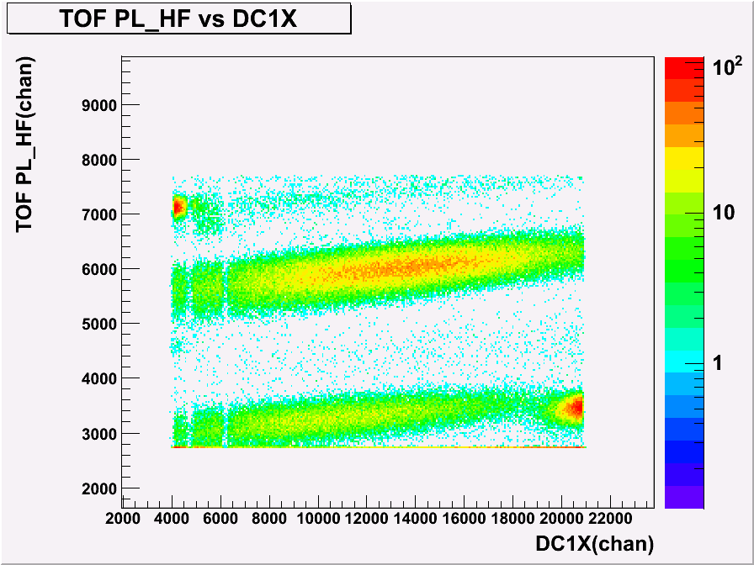
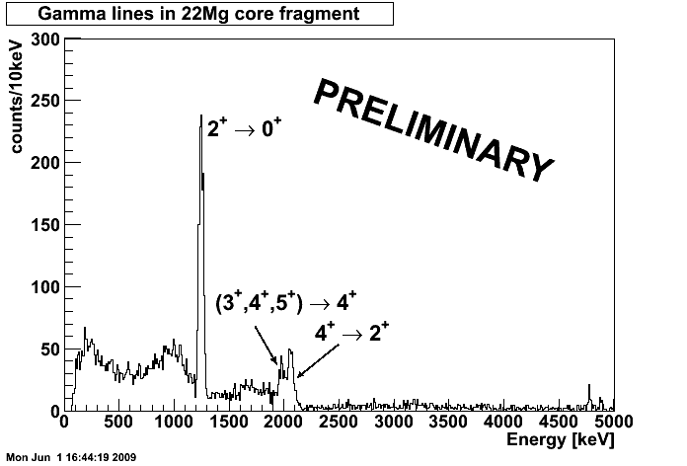
GANIL E491 exp
¹²C(²²Mg,²²Na)¹²N
Charge exchange
(new & unexpected)
²³Al→²²Mg+p
Proton removal
(sought)

Slide 40
Results from ²³Al breakup
4₂+
1985
4₁+
2061
2+
1247
0+
²²Mg
config. mixing of ²³Al ground state
2⁺-> 0⁺
Γ(²³Al)~200 MeV/c and J^{π}=5/2⁺
If b² is s.p. ANC:
C²=b² σ_{exp}/σ_{calc}
=3.90 ± 0.44 × 10³ fm⁻¹
4₂⁺-> 4₁⁺
4₁⁺-> 2⁺
₁

Slide 41

Complementarities: Coulomb and nuclear dissociation
Similar results from mirror system: ²²Ne+n->²³Ne
¹³C(²²Ne,²³Ne)¹²C n-transfer @12MeV/u
assuming S_{n}=S_{p}

Slide 42

Results from ²⁴Si breakup
C²(²⁴Si_{gs}) = 62.4 ± 7.1 fm⁻¹
SF = 2.5 -2.9
²²Mg(p,γ)²³Al(p,γ)²⁴Si
seq. 2p capture imp in XRB
Note: exp made with 30 pps!
A. Banu et al, PRC 85 (2012)

Slide 43
3e
Resonant elastic scattering: TTIK method
beam stops
E_{in}
E_{in}-ΔE₁
E_{in}-ΔE₂
“Standard” excitation functions:
  measure, change energy and measure again…
Thick Target Inverse Kinematics (TTIK) method: scattering on p gas =>measure the excitation function for elastic scattering (at 180º) in one single measurement.
Can study the properties (level structure) of the compound nucleus
K.P.Artemov et al.,
Sov. J. Nucl. Phys. 52, 408 (1990)
43

Slide 44
Resonance scattering in the valley of stability
and at the drip line
(N,Z-1)+p
Stable nucleus case
Drip line nucleus case
Level density
is too high
Too close to
the threshold
Cannot be
populated
in resonance
scattering
(N,Z-1)+p threshold
(N,Z)
(N,Z)
(N,Z)
4
4
4

Slide 45
Motivation
Proton Dripline
¹⁶Ne
−1.4
¹⁷Ne
+1.5
¹⁸Ne
+3.9
¹⁹Ne
+6.4
²⁰Ne
+12.8
Black – Stable
Pink – EC or β⁺ Decay
Yellow – p Decay
Orange – 2p Decay
¹⁴F
?
¹⁵F
−1.5
¹⁶F
−0.54
¹⁷F
+0.6
¹⁸F
+5.6
¹⁹F
+7.9
¹²O
−1.8
¹³O
+1.5
¹⁴O
+4.6
¹⁵O
+7.3
¹⁶O
+12.1
¹⁷O
+13.8
¹⁸O
+15.9
¹⁴F, ¹⁵F are unbound; 2-3 nucleons beyond proton-dripline Have not been previously studied (difficult to access).
Study of light, exotic nuclei provides a good test of ab-initio (NCSM) shell model calculations.
Addition of a single nucleon can significantly change properties of a light nucleus (e.g. proton separation E)
Search for ^{14,15}F with ^{13,14}O+p resonant elastic scattering.

Slide 46


Experiments – Search for ^{14,15}F
¹⁴N Beam
38 MeV/u
30 MeV/u ¹³O
80% pure
¹³O beam ~ 5000 pps from p(¹⁴N,¹³O)2n (Q =-29.1 MeV).
  Purity 80%, main contaminants – ¹⁰C (10%), ⁸B (4 %).
¹⁴O beam ~ 10⁴ pps from p(¹⁴N,¹⁴O)n
  Purity 80%, main contaminant – ⁷Be (20%).

Slide 47


Experiment – ¹³O+p → ¹⁴F
TTIK method ( < 10 MeV/u)
Figure : G.G. Chubarian
¹³O
¹⁴F
¹³O beam from MARS; E_{in} =149 MeV
CH₄ pressure: 13.6 psi and 15.0 psi.
¹³O beam stops in CH₄ gas, scatters protons.
Check calibration with ¹⁴O+p → ¹⁵F (measured before).
Check/subtract carbon bkg. with ¹³O+CO₂
¹⁵F: V. Goldberg et al. – PRC 69, 031302(R) (2004)
¹⁴F: ibidem, PL B692, 307 (2010)

Slide 48


¹⁴O+p→¹⁵F
5/2⁺
1/2⁺
1/2⁺
we slowed down ¹⁴O beam from 30 MeV/u to ~11 MeV/u.
The excitation function was measured E_{cm}=0.8-5 MeV.
W.A. Peters et al. – PRC 68, 034607 (2003)
V. Goldberg et al. – PRC 69, 031302(R) (2004)

Slide 49




Expectations: R-matrix calculations
Evident resonant structures in the spectrum.
R-matrix parameters for expected single-particle structure.

Slide 50

TTIK method
Scattering Chamber/Target
¹⁴O Beam
57 MeV ~2*10⁵ Hz
Helium ~0.8atm
¹⁴O 32.5 MeV
Notes:
2p coincident
E-TOF, for SPORTTIK

Slide 51
3
Types of reactions
  Elastic scattering
  Inelastic scattering
  Direct reactions: one nucleon transfer, few nucleons
  Breakup at intermediate energies
  Resonant elastic scattering – TTIK method
  In-flight decay spectroscopy
  Multifragmentation

Slide 52

3f) In flight decay spectroscopy
from R. Charity (Wash Univ) – at CSSP12, Sinaia, Romania, June 24-July 7, 2012

Slide 53




Basics of method

Slide 54




2p decay of nuclei (gs) and states

Slide 55




(some) results

Slide 56



Nuclear Equation of State
(from atomic nuclei to neutron stars)
3g) Multifragmentation
A. Steiner et al, Phys. Rept. 411 (2005) 325
from SJ Yennello, CSSP12

Slide 57

phase diagram of water
nuclear matter
caloric curve of water
nuclear matter
Water & Steam
Steam (Gas)
Temperature
Ice & Water
Water (Liquid)
Ice (Solid)
Heat Input

Slide 58



Large granularity arrays: NIMROD
228 modules
  Si/CsI
  Some Si/Si/CsI
  Ion Chambers
14 rings
3.6º-167º
Neutron Ball
S. Wuenschel et al. NIMA doi:10.1016/j.nima.2009.03.187
Notes:
58
4 rings to 6, 46 det to 108, si coverage

Slide 59
4. Instrumentation (very incomplete!)
High efficiency detector systems
  Example HIRA (MSU, WU, IU)
Complex systems: measure different types of reaction products (charged part, neutrons, gammas)
  e.g. SAMURAI @ RIBF
high granularity detector systems
  HIRA, ORRUBA, ANASEN, TUDA, TECSA at TAMU
Large amount of data to handle => fast, compact analog and digital electronics, acq and data handling computers

Slide 60



S800 focal plane
detectors
HiRA
With 20 Identical detectors HiRA is highly configurable for different physics experiments.
Quadrupoles

Slide 61




¹⁰C experiments at TAMU set of 4 dE (64 um) - E (1500 um) Si telescopes
~ 400 Si ch
From L. Sobotka, WU in St. Louis
ASICs
Outside vacuum

Slide 62


Slide 63

The TECSA detector system
(Texas-Edinburgh-Catania Silicon Array)
Specifications:
16 Micron Semiconductor type YY1 silicon detectors.
  2 planes x 8 dets/each possible,
  or 8 telescopes in one plane.
16 strips per detector sector – (256 channels total)
Detectors are 300μm thick.
2 plates & 2 possible configurations – “flat” and “lampshade”.
Forward and backward angles
Intended for (d,p) experiments in inverse kinematics & others

Slide 64




Slide 65
Conclusions
Reactions with RIBs are the future of nuclear physics studies
ISOL or in-flight production techniques
Specificities:
  low rates and
  relatively poor beam characteristics
  large background
Need instrumentation efforts:
  large facilities
  complex detection systems
  handling of large amount of data
Need new interpretation theories & approximations
Support data from experiments with stable beams

Slide 66
Collaborators
R.E. Tribble, A. Banu*, CA Gagliardi, AM Mukhamedzhanov, M McCleskey, E Simmons, A. Spiridon, B. Roeder –Texas A&M University
F. Carstoiu – IFIN-HH Bucharest
E491 exp: TAMU &:
  N. Orr et al. (LPC Caen), P. Chomaz et al. (GANIL Caen), W. Catford et al. (Univ of Surrey), M. Chartier et al. (Univ of Liverpool), R. Lemmon, M. Labiche (Daresbury), M. Freer et al. (Univ of Birmingham), F. Negoita (IFIN Bucharest)
L. Sobotka, R Charity et al (Washington Univ, St. Louis, MO)

