Slide 1
Ultra-high Q superconducting cavities from accelerators for increased coherence of 3D quantum systems
Alexander Romanenko
Intersections between Nuclear Physics and Quantum Information
30 March 2018

Slide 2
Outline
Superconducting RF (SRF) cavities in particle accelerators
Appeal of SRF cavities for quantum systems
  Ultra-high Q > 10¹⁰ factors are routine
  Decades of expertise in surface engineering and underlying superconducting RF science
Progress towards the “quantum” implementation at FNAL
  Clarification of the TLS role
  First measurements at T < 20 mK

Slide 3
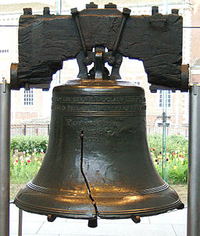
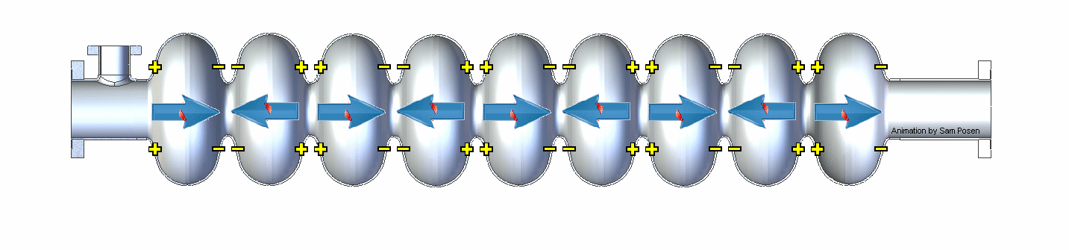
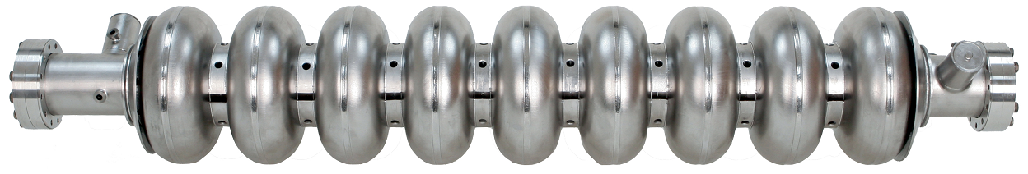
How are Particles Accelerated in Modern Machines?
Superconducting radiofrequency (SRF) cavities
High quality EM resonators: Typical Q₀ > 10¹⁰
Over billions of cycles, large electric field generated
Particle beam gains energy as it passes through
Input RF power at 1.3 GHz
Slowed down by factor of approximately 4x10⁹
~1 m
Images from linearcollider.org, WIkipedia
Notes:
say like RLC circuit, Point out currents on surface, with small R because it is superconducting

Slide 4
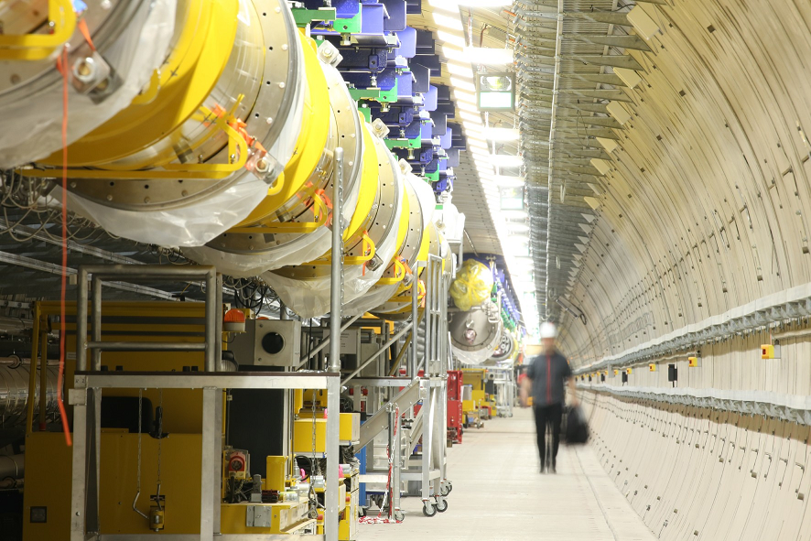
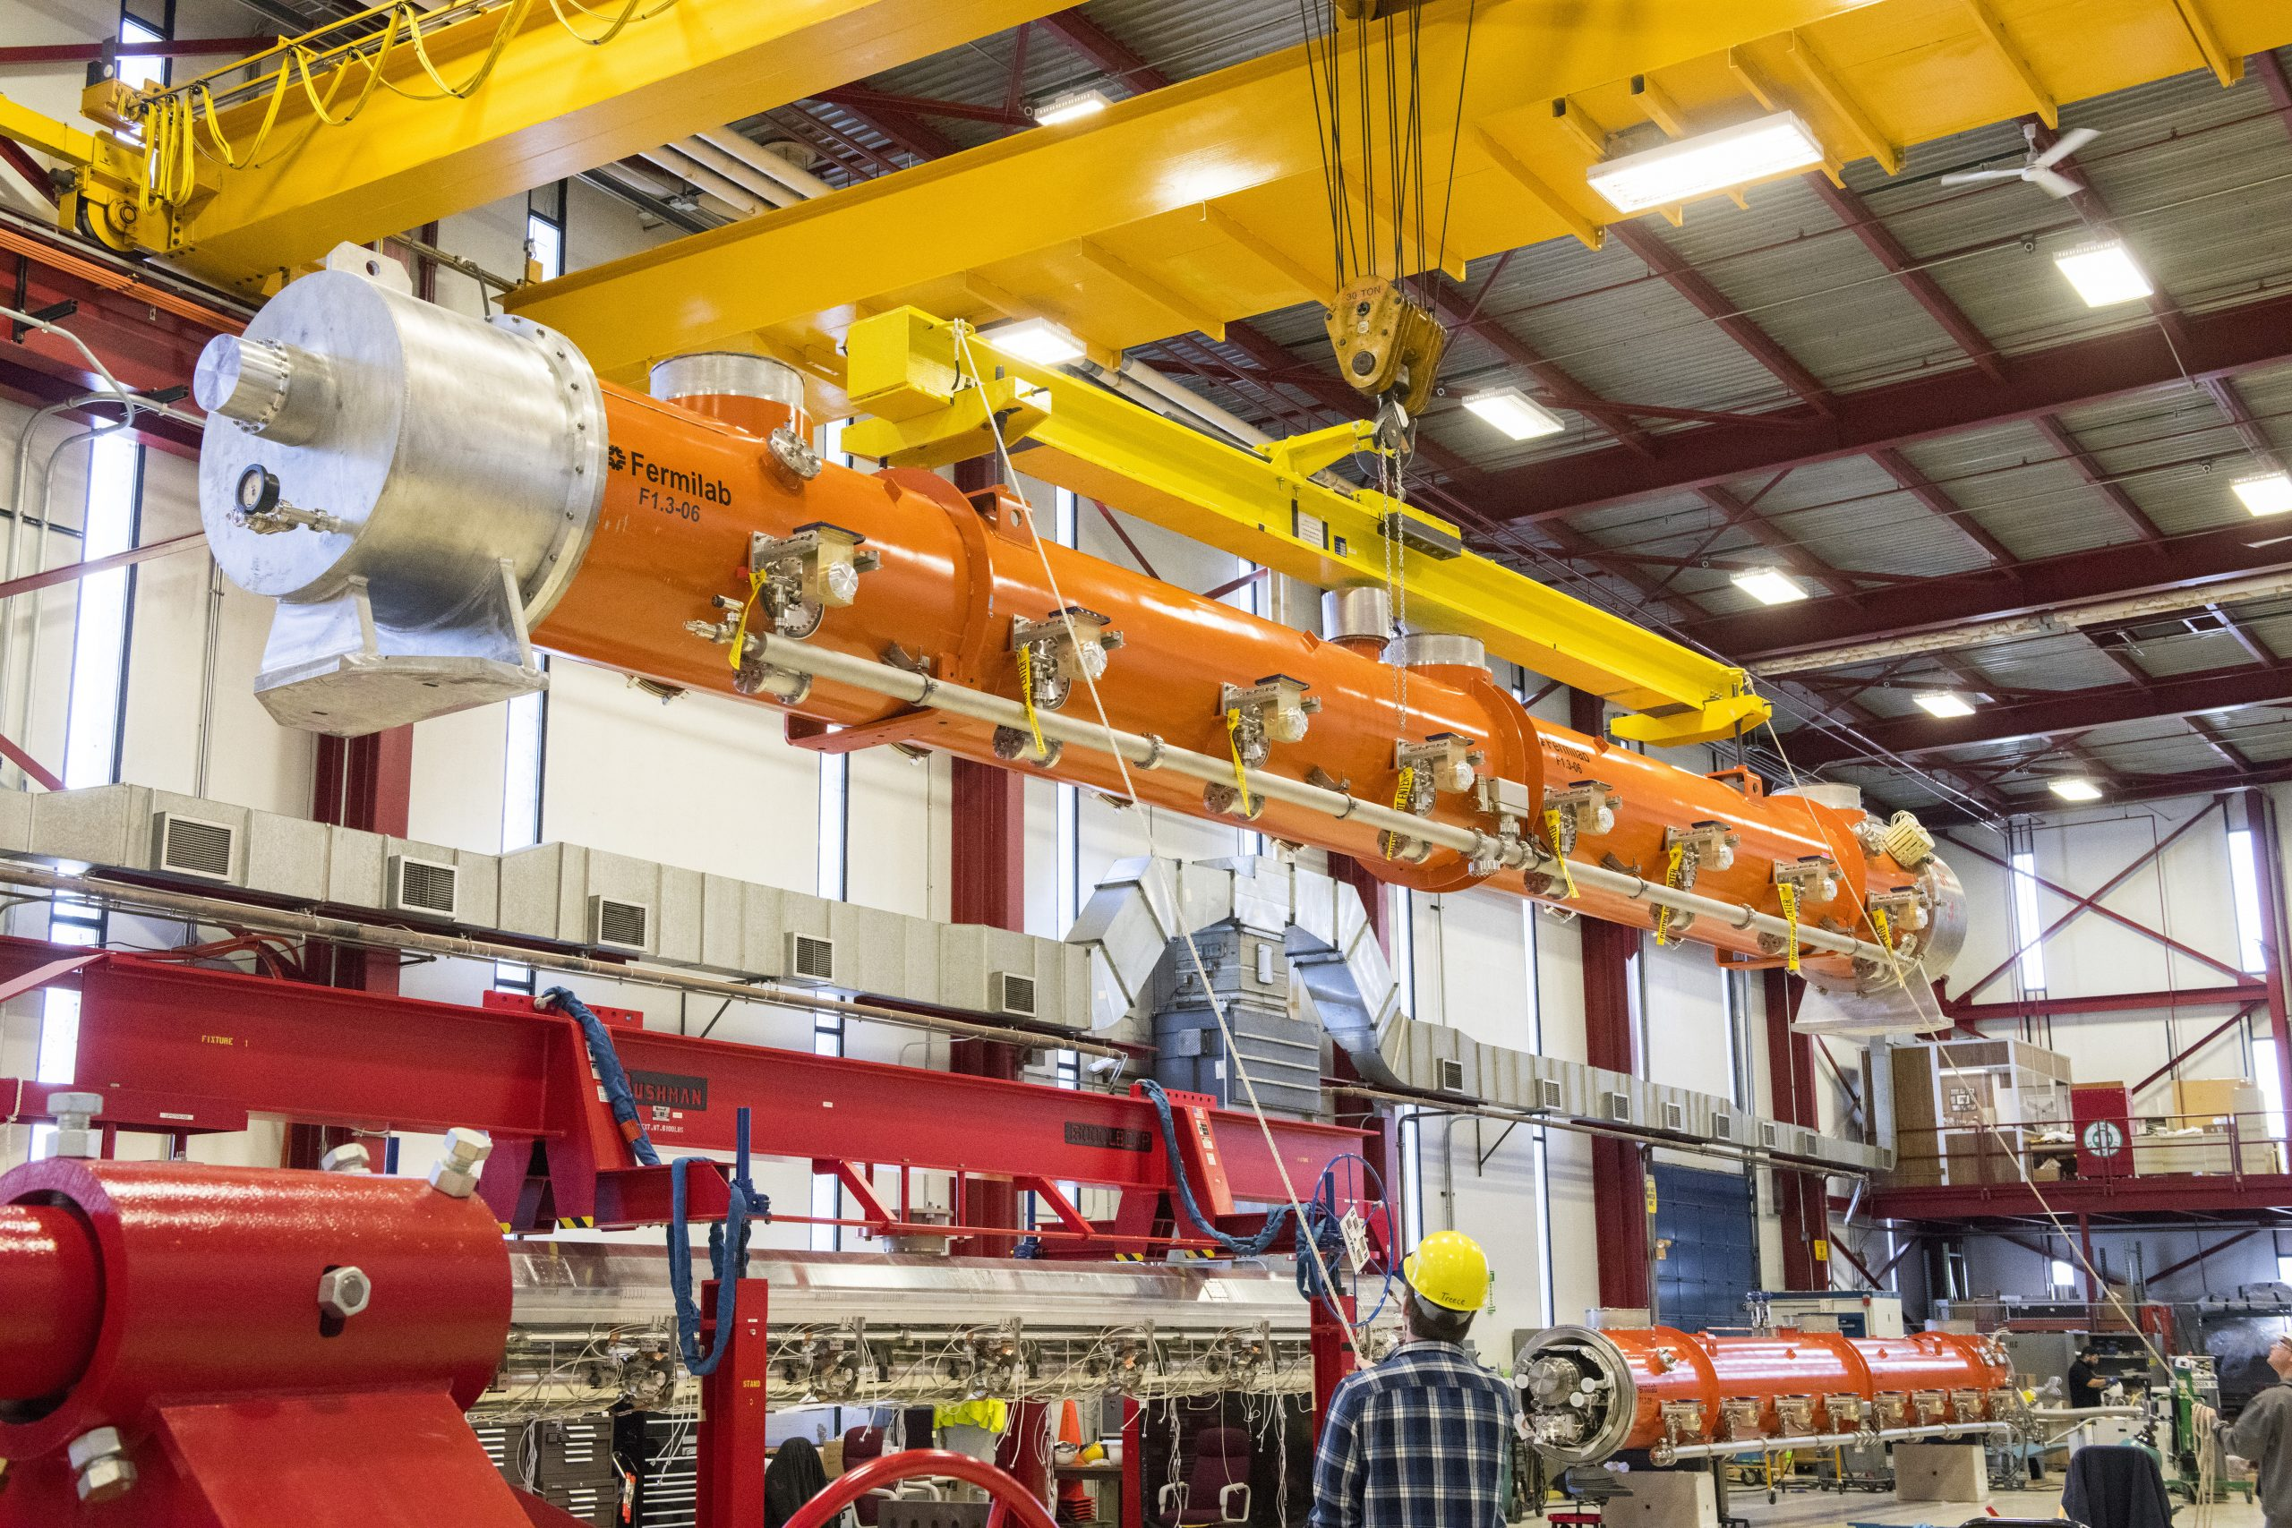
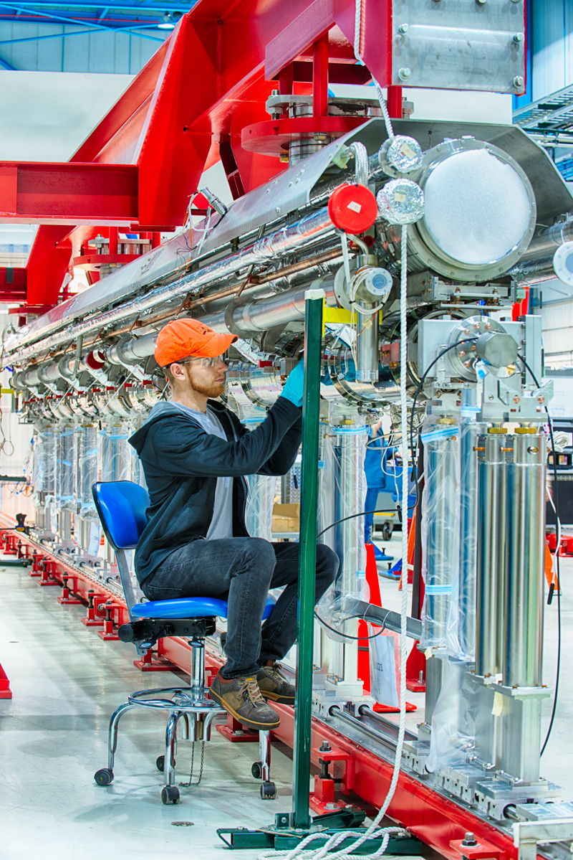
Modern large scale accelerators are based on SRF
European XFEL
LCLS-II at SLAC
Fermilab is building half (17+) of cryomodules
~1000 cavities
Specification:
Q > 10¹⁰ @ 2K, 23.6 MV/m
Q > 2.7 x 10¹⁰ @ 2K, 16 MV/m

Slide 5
Quantum Computing: 3D circuit QED architecture
State-of-the-art quality factors Q in quantum computing are ~10⁸
Machined Aluminum host cavity
H. Paik et al, Phys. Rev. Lett. 117, 251502 (2016)

Slide 6
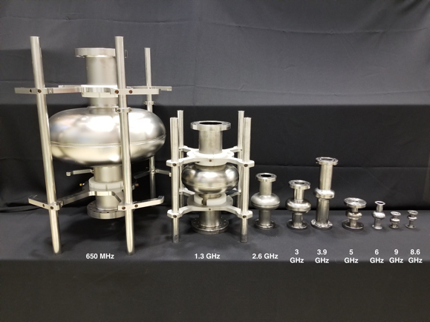
High Q SRF cavities for improved coherence
Q > 10¹¹
Potential of up to ~10 seconds of coherence
Q ~ 10⁸
1-cell Fermilab cavities of various frequencies
M. H. Devoret and R. J. Schoelkopf, Science 339, 1169–1174 (2013)

Slide 7
RF Penetration Layer drives the performance
Image from linearcollider.org
<0.1% of thickness
RF fields
RF fields
Niobium ~3 mm
RF currents
~100 nm
Helium cooling
Engineering the surface layer is crucial to performance

Slide 8
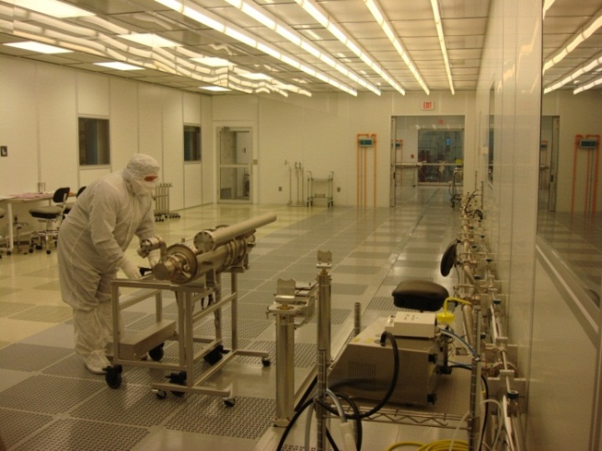
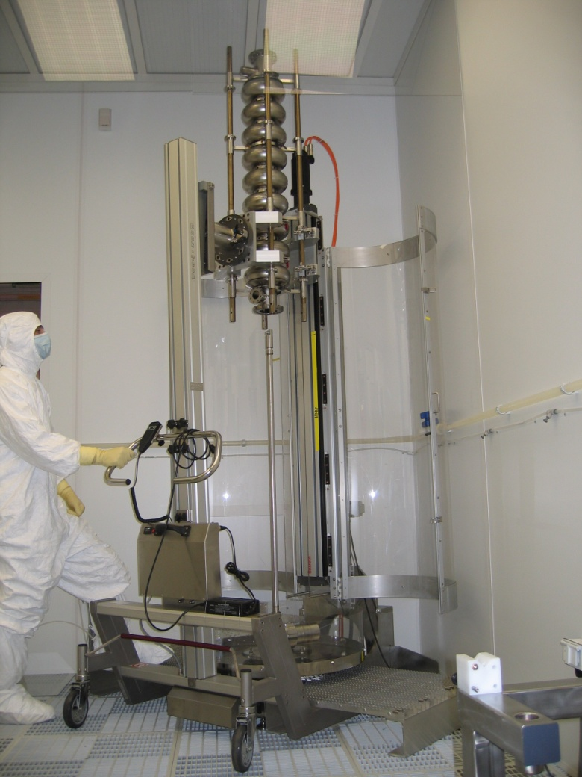
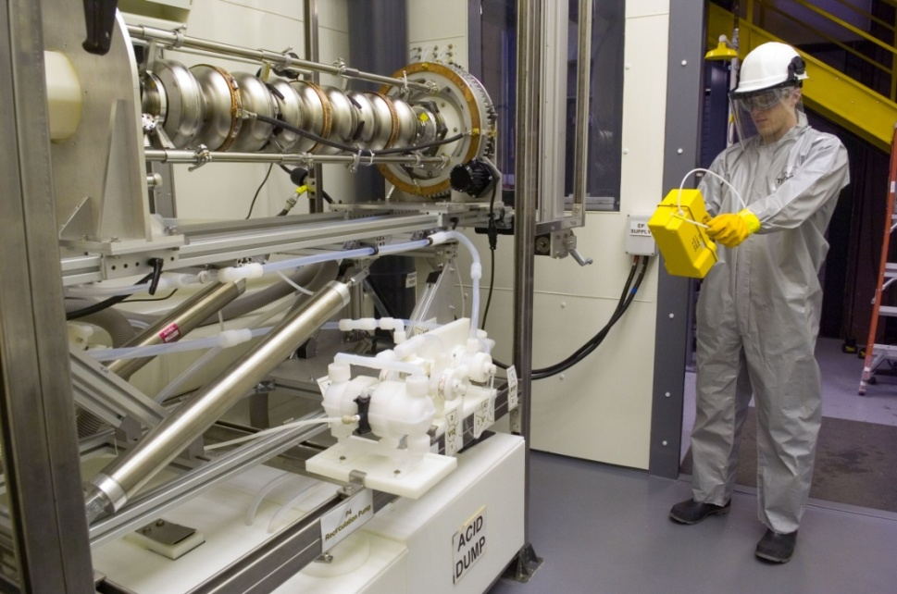
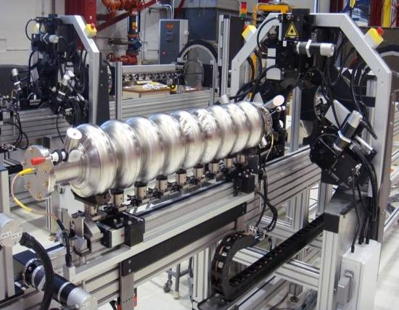
Major SRF Infrastructure at Fermilab (necessary to achieve high performance/high Q)
Class 10 clean room/high pressure
water rinsing
clean room assembly
Furnace treatment
electropolishing
tuning

Slide 9
Can we translate high Q expertise in SRF cavities to ‘quantum regime’?
First task: what is the cause of the low field Q slope and what happens with Q as we decrease the field further?
Second task: what happens at lowest T < 20 mK?

Slide 10
Renewed importance of the low field Q slope
How will the best cavities we have behave at ultralow fields for various possible applications?
Quantum computing/memory
Dark sector searches
Gravitational effects
….
1.3 GHz
1.5K
A. Romanenko et al, Appl. Phys. Lett. 105, 234103 (2014)

Slide 11
Saturation of Q decrease
1.3 GHz
T=1.5K
A. Romanenko and D. I. Schuster, Phys . Rev. Lett. 119, 264801 (2017)
Good news: low field Q saturates at Q>3 x 10¹⁰
Now measured down to
<N> ~ 1000 photons

Slide 12
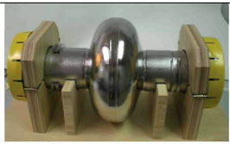
Direct probing in the new regime with single cell cavities
f = 1.3 GHz, TM₀₁₀ mode

Slide 13
Single shot measurements
Q > 10¹⁰ cannot be measured using standard network analyzer techniques
Instead -> decays from PLL state with bandpass filtering (10-1000 Hz around resonance) instead
Q_{L}=2πfτ

Slide 14
Various cavities/surface treatments investigated
Changes within penetration depth have little effect
Oxide growth/change -> strong increase in very low field dissipation

Slide 15
From 2D resonator world
Two level systems in the dielectric as a cause
J. Gao, PhD Thesis, Caltech, 2008
J. Zmuidzinas, Annu. Rev. Condens. Matter Phys. 2012. 3:169–214

Slide 16
Two level systems in the natural niobium oxide?
According to Martinis et al, Phys. Rev. Lett. 95, 210503 (2005) -> electric field effect
Nb
Nb₂O₅
100 nm
5 nm
Nb
Nb₂O₅
A. Romanenko and D. I. Schuster, Phys . Rev. Lett. 119, 264801 (2017)

Slide 17
What happens at lowest T < 20 mK, low powers?

Slide 18
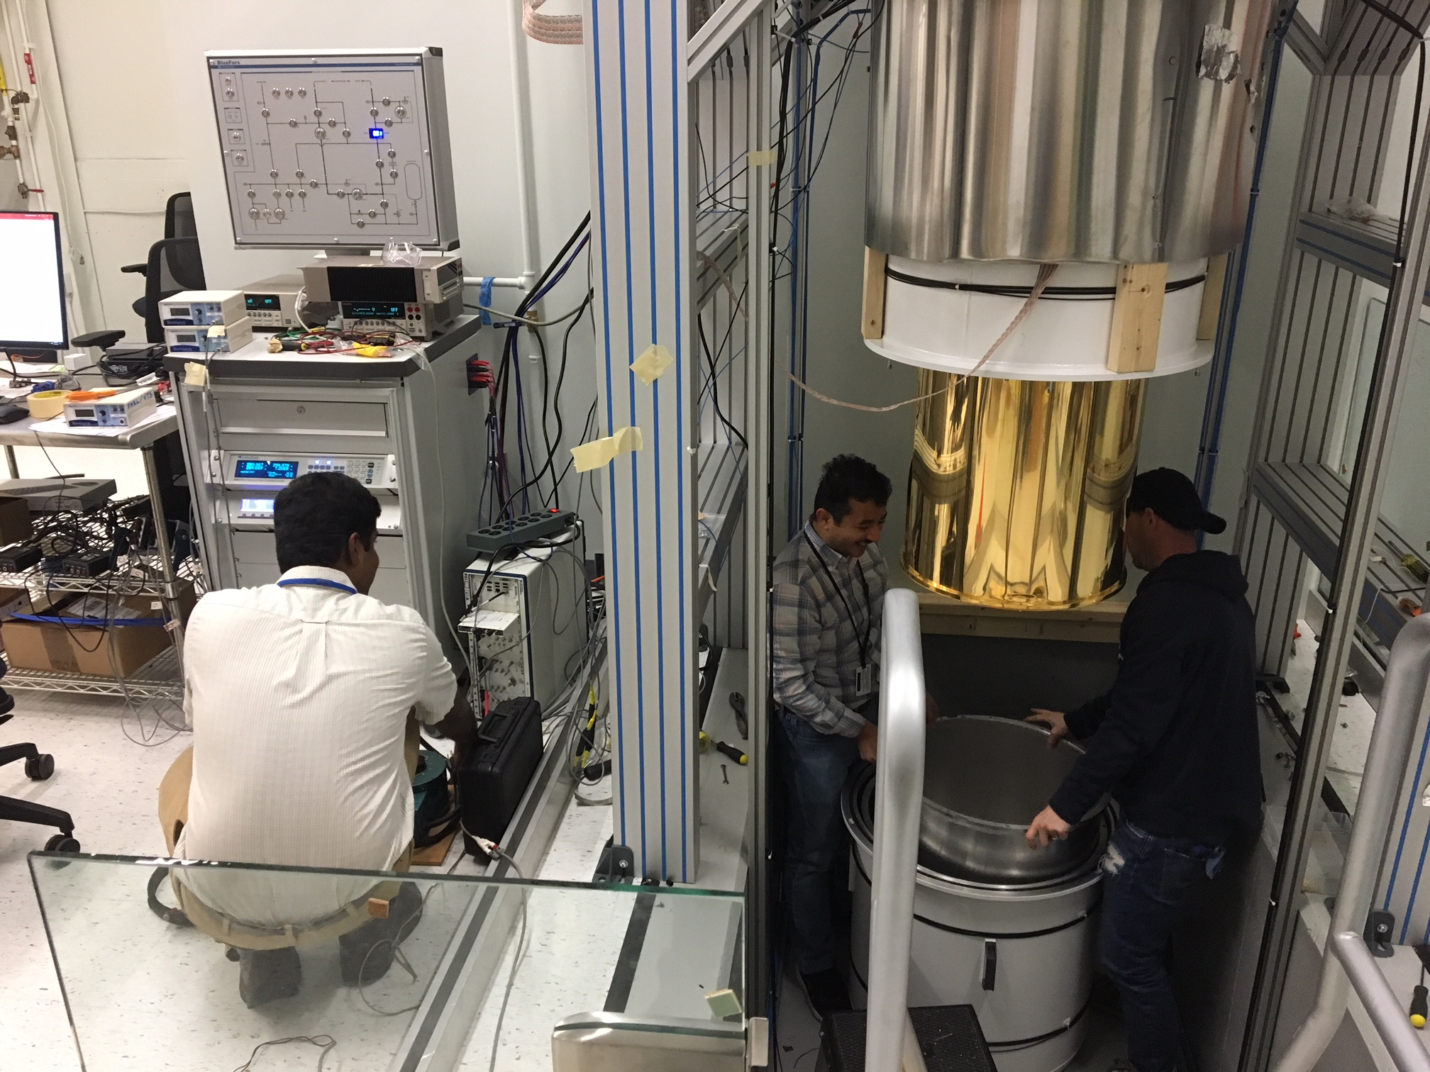
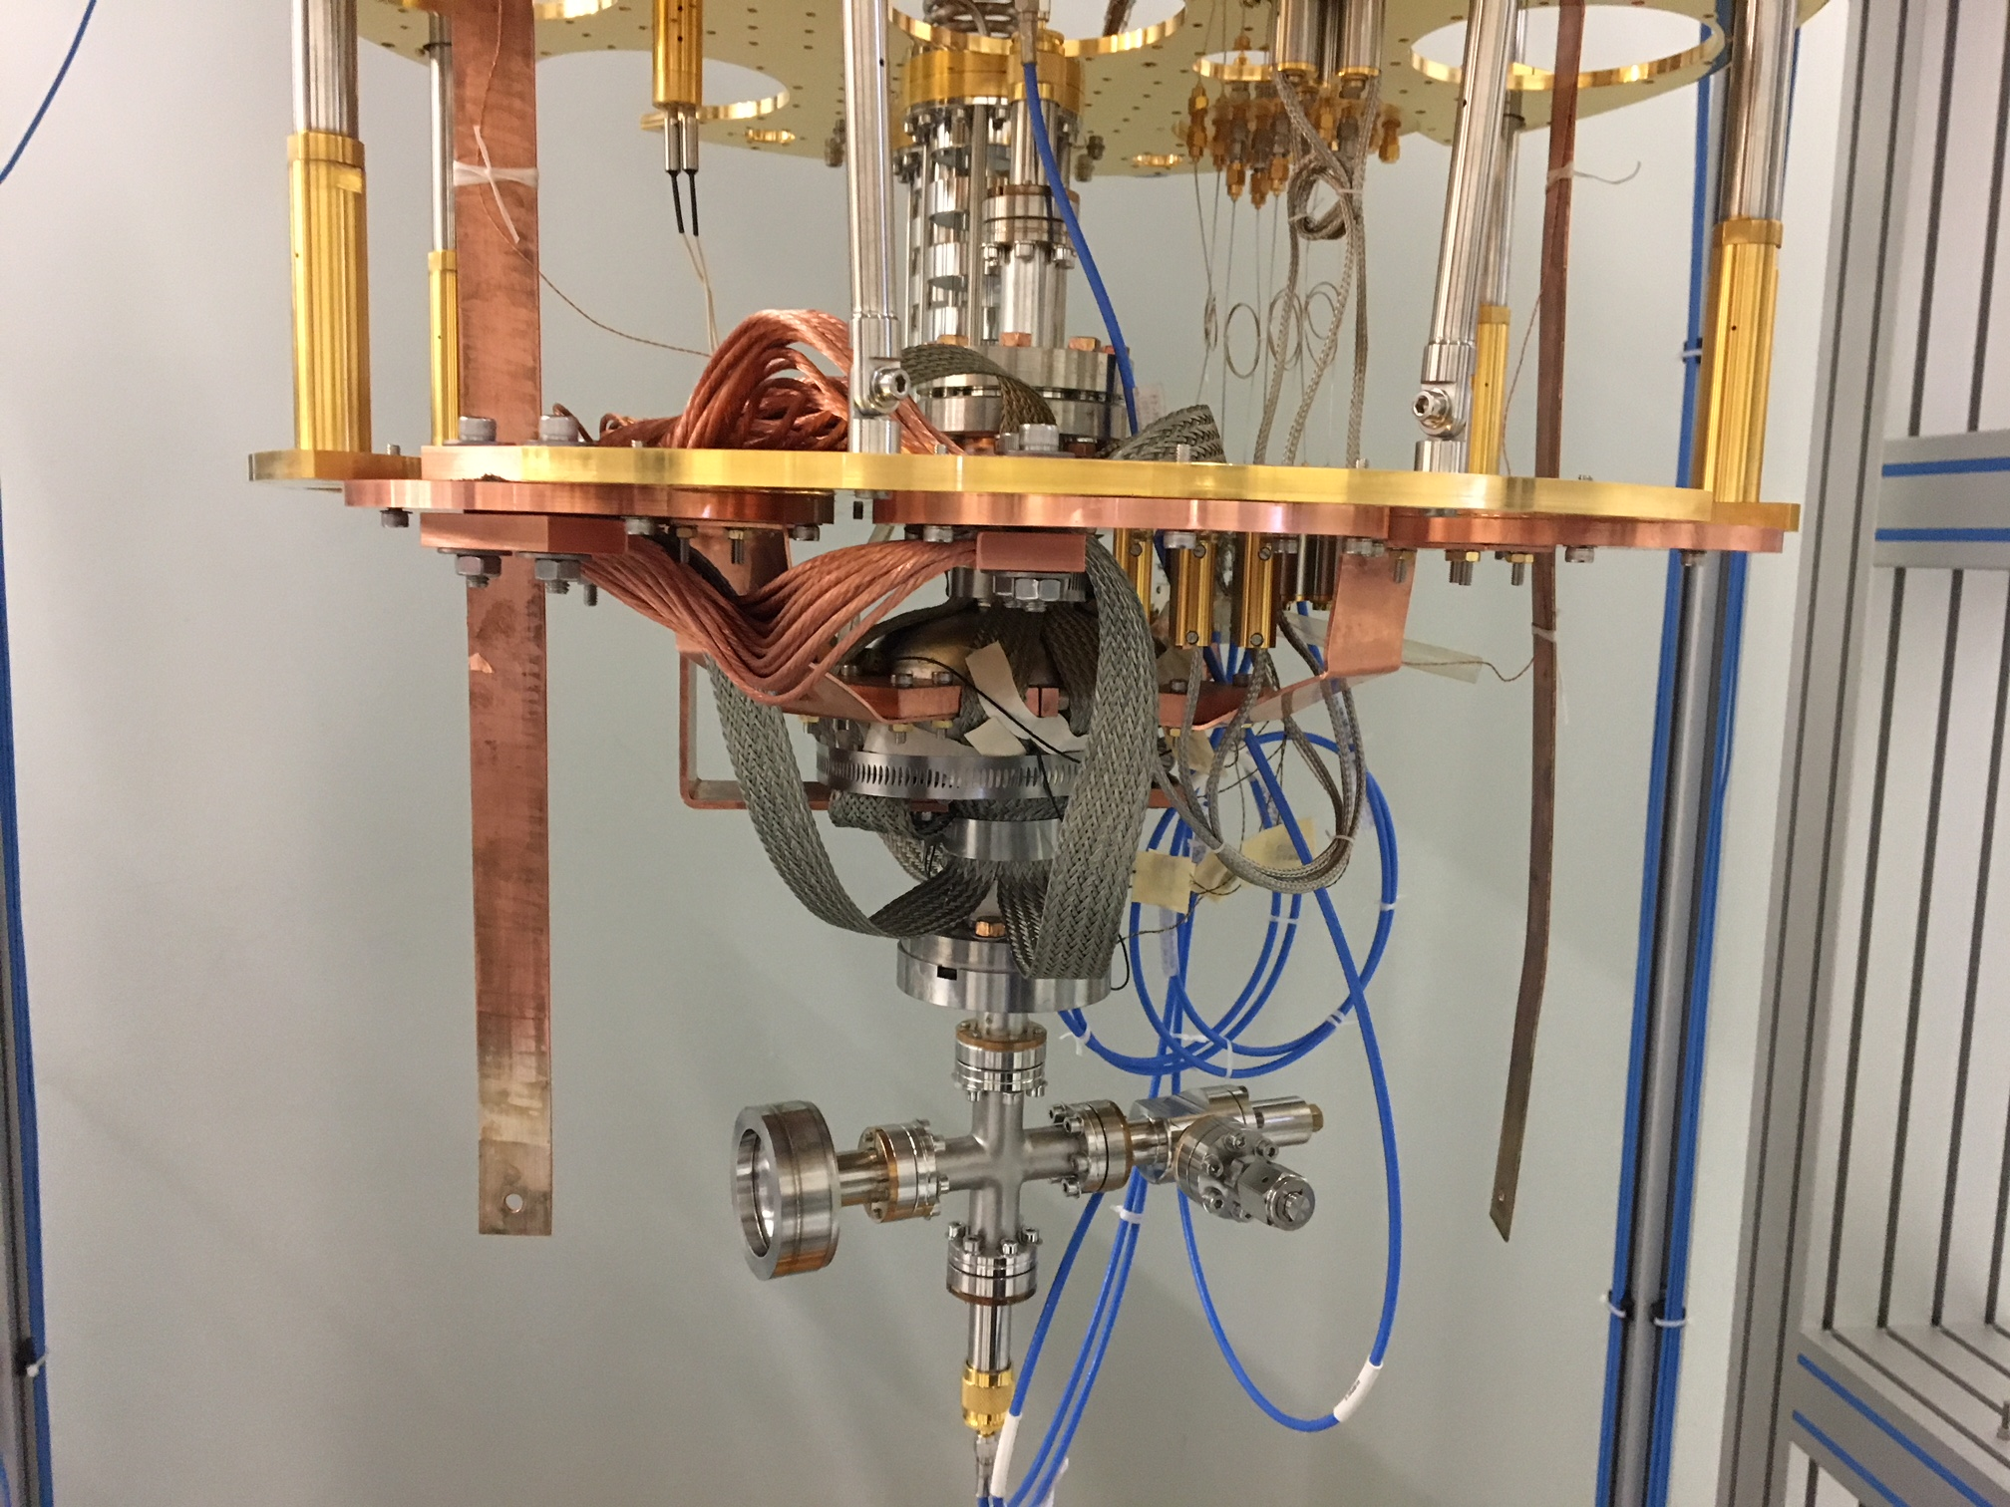
2.6 GHz 1-cell cavity

Slide 19
First try: Q at T ~ 12 mK, down to ~1000 photons
Q ~ 2 x 10⁹
τ ~ 100 ms : >10x better than previous records
E ~ 1000 photons
Publication with full details in preparation

Slide 20

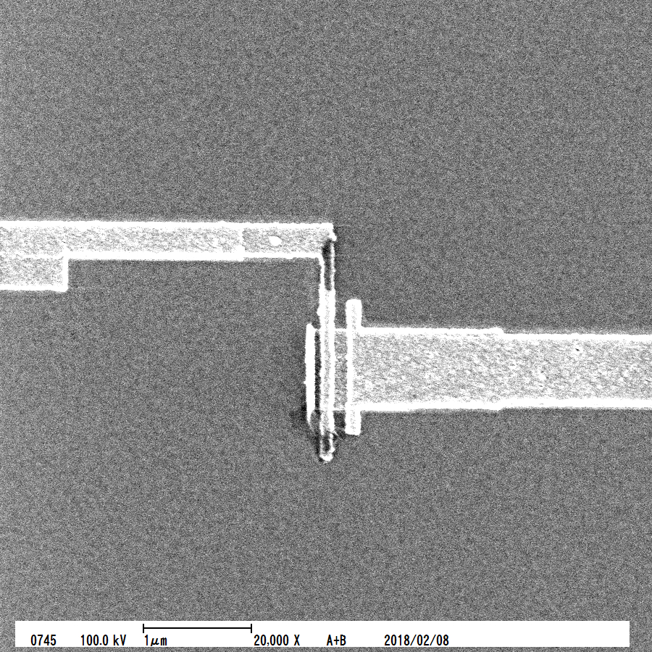
Immediate plans
Couple a very high Q SRF cavity with the transmon qubit to probe the achievable coherence times
Collaborations with:
Univ. of Wisconsin (Madison):
Prof. Robert McDermott
Chris Wilen
NIST: D. Pappas

Slide 21
Summary
Accelerator ultra-high Q microwave 3D cavity expertise can enable a qualitative jump on achievable photon lifetimes/coherence
  Complex accelerators with hundreds of Q > 10¹⁰ cavities are routine, Q >10¹¹ is the state-of-the-art
Very high Qs can be translated to ”quantum” regime
  Demonstrated Q ~ 2 x 10⁹, τ ~ 100 msec at 12 mK, 1000 photons at the first try
First 3D-SRF qubits are to be tested shortly

