Slide 1
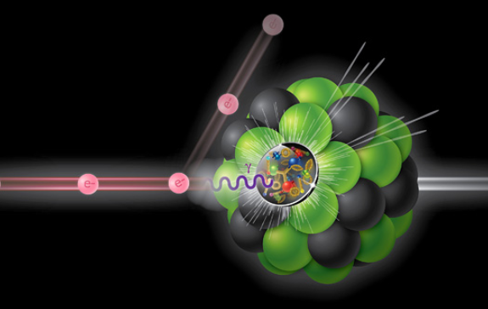
Challenges in Building a Detector for
The ELECTRON-ION COLLIDER
Electron – Ion Deep-Inelastic Scattering
JosÉ Repond
Wednesday March 28th, 2018
Intersections between Nuclear Physics and Quantum Information
Argonne National Laboratory

Slide 2
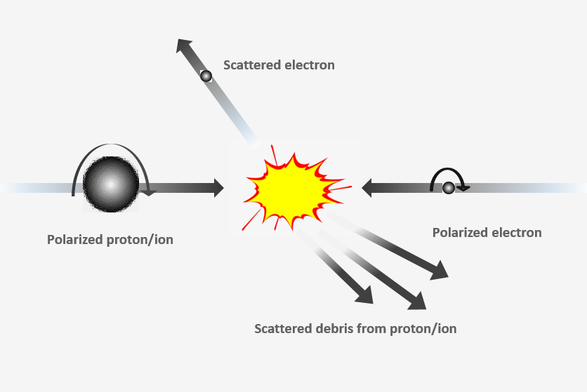
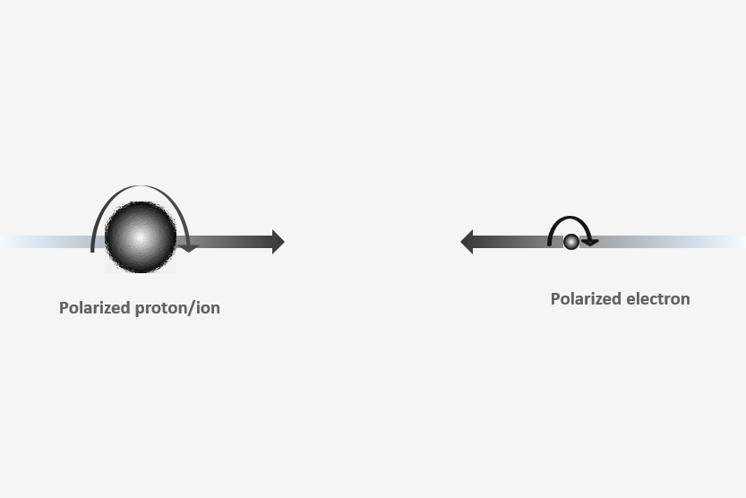
What is the EIC – Electron-Ion Collider?
Planned facility for Nuclear Physics
Collision of (polarized) electrons and (polarized) protons/ions
60 – 250 GeV
5 – 18 GeV
Detector
Beam crossings every 2.1 ns → Very high luminosity = 10³⁴ cm⁻²s⁻¹

Slide 3


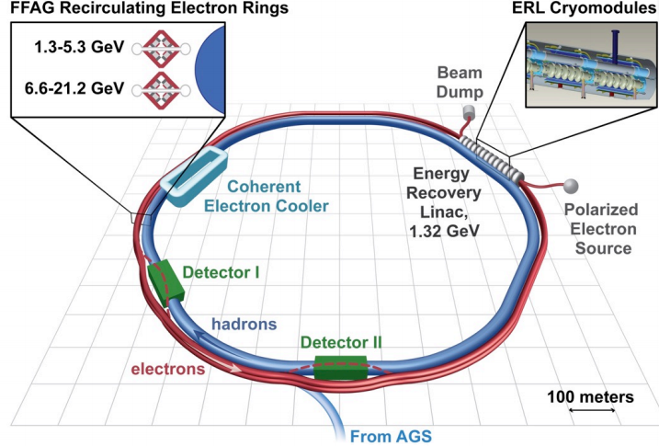
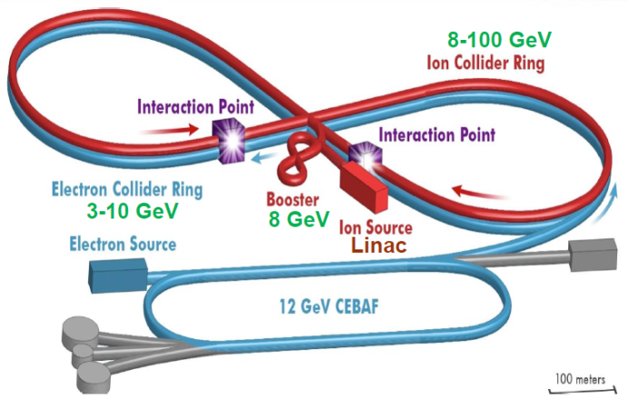
Where will the EIC be? What will it look like?
2 machines needed: an electron machine and a proton/ion machine
Beams stored in storage rings, collide at interaction points
Two national laboratories with part of the equipment
Has a proton/ion machine (RHIC)
Needs an electron ring
Has an electron machine (CEBAF)
Needs a proton/ion machine
Site selection in the next few years

Slide 4
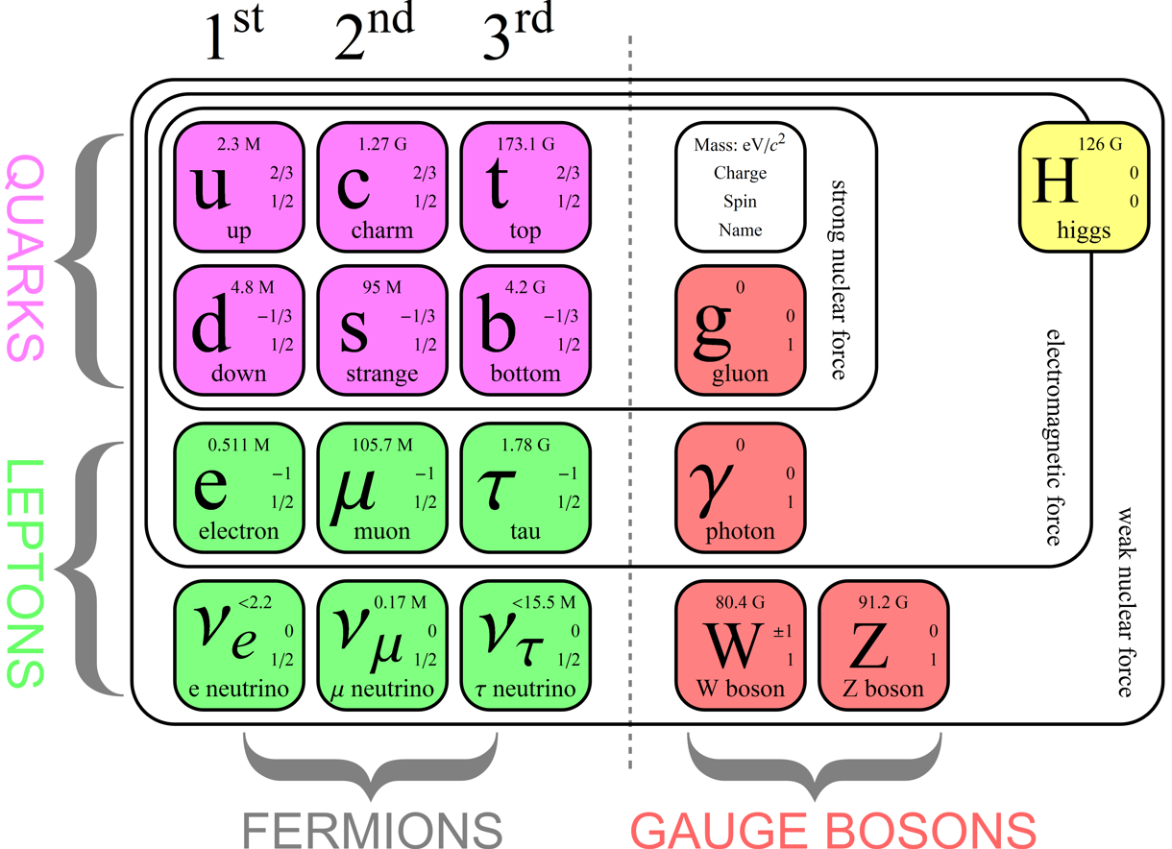
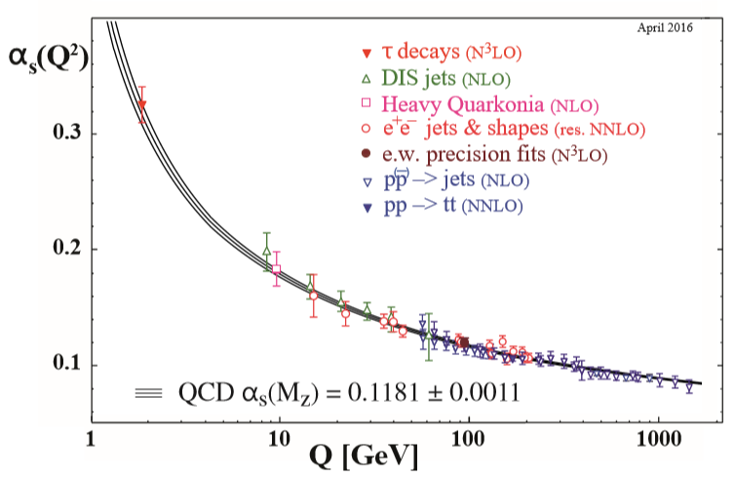
Excursion I: Standard Model of Particle Physics
Strong force described by
Quantum Chromodynamics (QCD)
• High-energy part/short distances
Exact calculations (perturbative)
Tested in countless experiments
• Low-energy part/long distances
Large coupling (non-perturbative)
More difficult to calculate
Interactions described by models or
on the lattice
Much less explored
Emphasis of the
Electron-Ion Collider

Slide 5
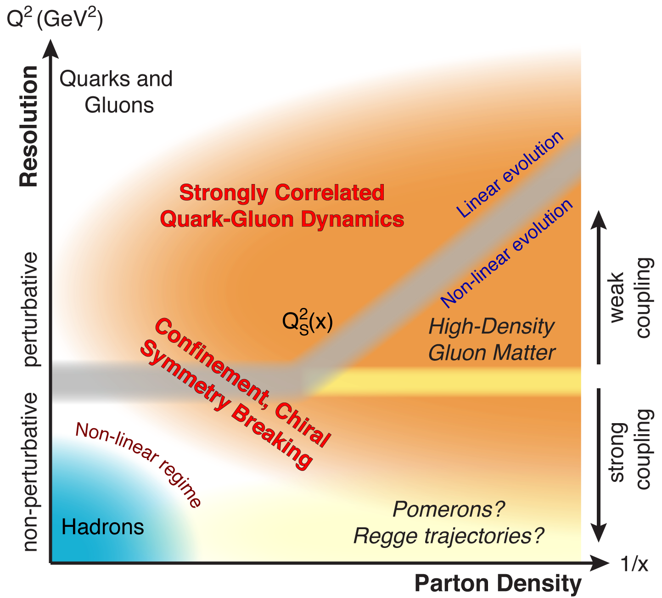
What will the EIC do?
Study all aspects of Quantum Chromodynamics
Questions to be addressed by the EIC
Where is the glue in the nucleon?
Where is the glue in the nucleus?
What makes the spin of the nucleon?
What confines hadrons to be colorless?
Does the gluon density saturate at low-x?
Is there intrinsic charm in the nucleon?
How is the mass of the nucleon generated?
Many more questions…

Slide 6
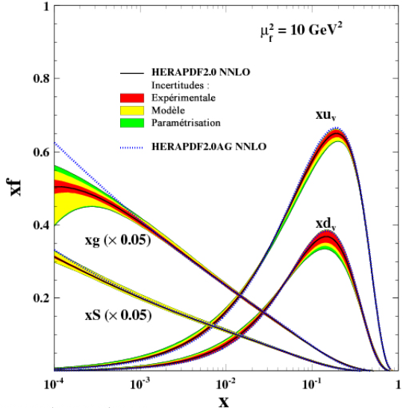
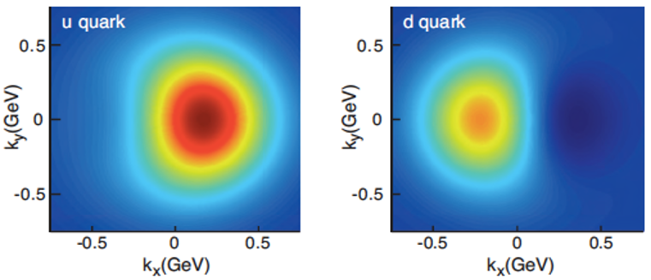
Example I: Tomography of the nucleon
• We have very good knowledge of the parton content of the proton
u,d,sea quarks and gluons
→ As a function of the longitudinal momentum x = E_{parton}/E_{proton}
• The EIC will investigate the parton content of the proton/nucleus as a function of
Transverse position b_{T}
Transverse momentum k_{T}
• Quark flavor separation requires excellent particle identification
→ Separation of pions, kaons, and protons (electrons and muons are easy!)
Proton TMD’s – predicted quark
densities versus transverse
momentum. Proton polarized in
the y-direction.

Slide 7
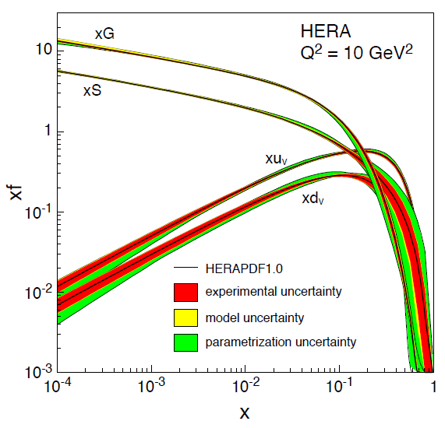
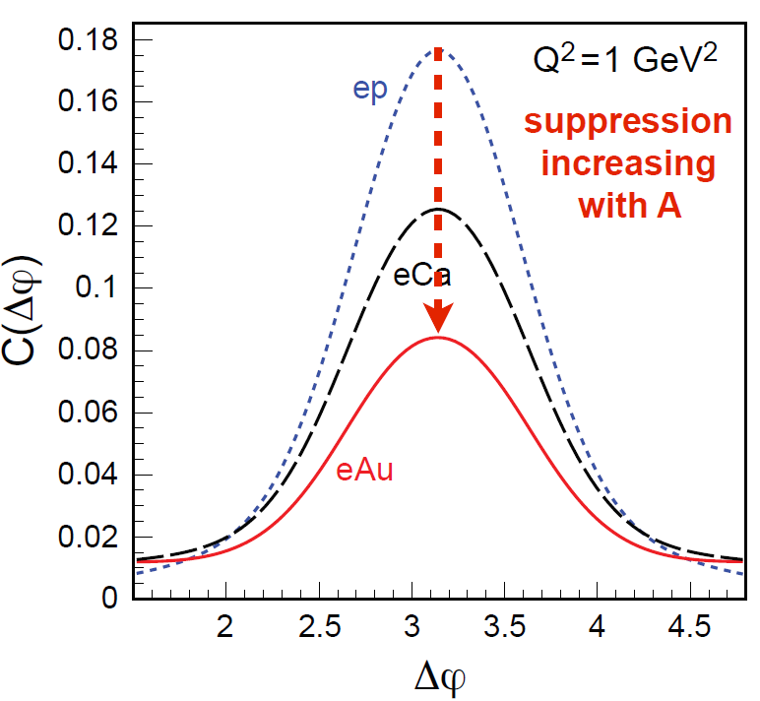
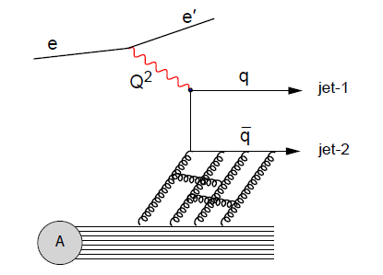
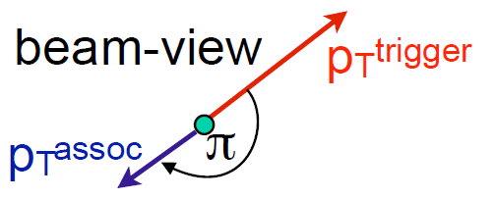
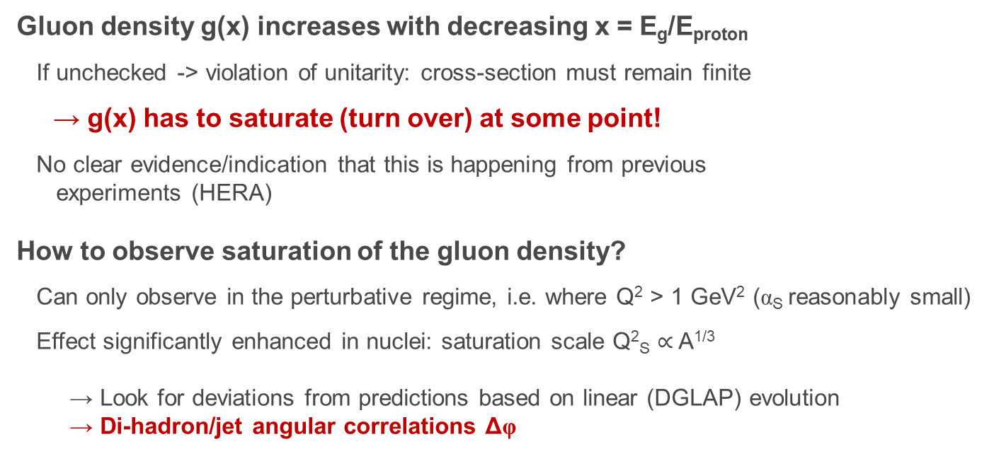
Example II: Saturation of the gluon density?
Gluon density g(x) increases with decreasing x = E_{g}/E_{proton}
If unchecked -> violation of unitarity: cross-section must remain finite
→ g(x) has to saturate (turn over) at some point!
No clear evidence/indication that this is happening from previous
experiments (HERA)
How to observe saturation of the gluon density?
Can only observe in the perturbative regime, i.e. where Q² > 1 GeV² (α_{S} reasonably small)
Effect significantly enhanced in nuclei: saturation scale Q²_{S} $∝$ A^{1/3}
→ Look for deviations from predictions based on linear (DGLAP) evolution
→ Di-hadron/jet angular correlations Δφ

Slide 8

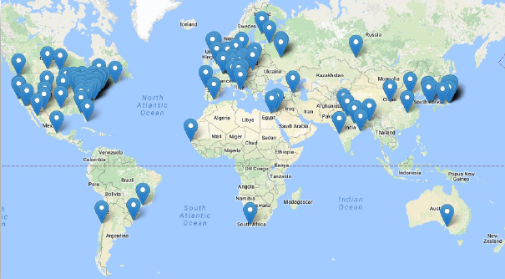


Current status of the EIC
The 2015 LONG RANGE PLAN for NUCLEAR SCIENCE
We recommend a high-energy high-luminosity polarized Electron Ion Collider as the
highest priority for new facility construction following the completion of FRIB.
We recommend vigorous detector and accelerator R&D in support of the
neutrinoless double beta decay program and the Electron Ion Collider
EIC User Group
Established in 2016, now counting more than 900 members
Community Review of EIC Accelerator R&D for the Office of Nuclear Physics
Established Accelerator R&D priorities in February 13, 2017 report
Review by the National Academy of Sciences
Started in early 2017
Duration: 18 months
To be followed by CD0 (expected in FY 2019)

Slide 9

Overview – Argonne’s EIC Activities
Argonne involved in all aspects of the planned project
• Accelerator design/developments
• Theory calculations/predictions
• Physics/detector simulations
• Detector R&D
• Computing
Challenges
The emphasis of this talk

Slide 10
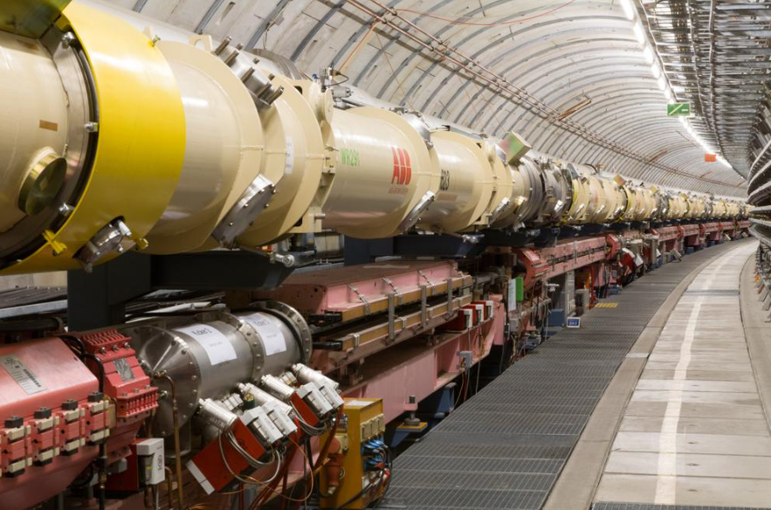
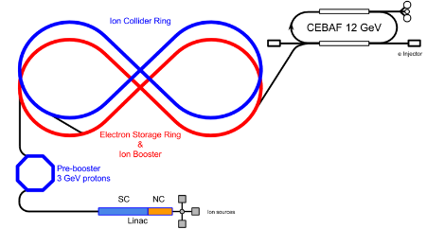
Challenges of the EIC: Accelerator
High luminosity: L ~ 10³⁴ cm⁻²s⁻¹
2 – 3 orders of magnitude higher than HERA (ep collider: 1992 – 2007)
→ High beam currents (both electron and hadron)
→ Ion beam cooling (requirements beyond state-of-the-art!)
Polarization of ions
Sources exist for protons and deuterium, but not for other light nuclei
→ How to maintain the polarization?
Interaction region design and synchronization for different collision energies
Electrons 5 – 18 GeV ↔ protons/ions 60 – 250 GeV
Background suppression
EIC: combination of electron and hadron machine
Synchrotron radiation from electrons → reduced vacuum → proton/ion – gas events
→ Design of masks, vacuum system

Slide 11
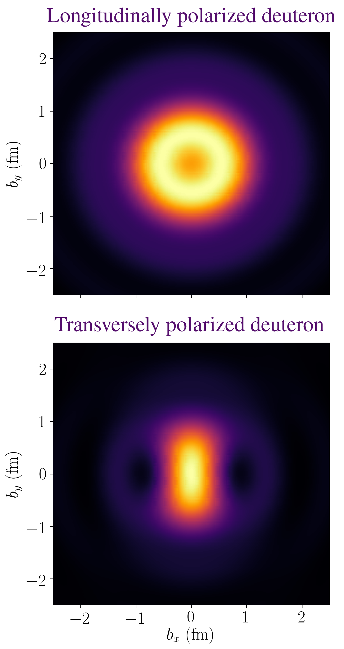
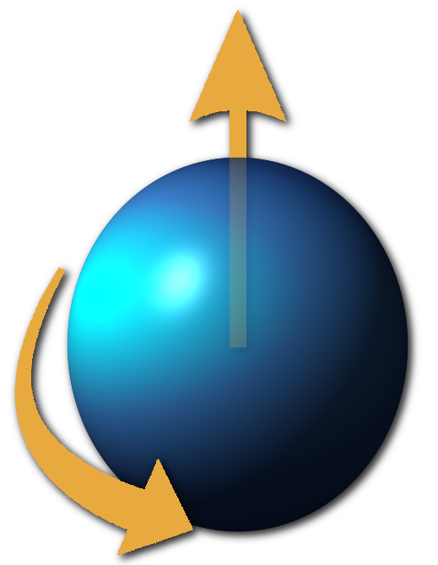
Challenges of the EIC: Theory: 3D Imaging of Nuclei
The EIC needs realistic predictions for the 3D densities of
quarks/gluons in nuclei
We are performing such a calculation, the first of its kind
The calculations are done using a relativistic contact model
The calculations are completely compatible with relativity, which is
necessary for symmetries and conservation laws to be observed
Emphasis is being put on polarized ions
A polarized ion is spinning in a specific direction
This special polarization direction allows more detailed structures to
be seen (pictures →)
These calculations will strengthen the physics of the EIC
Computing challenges
Managing large data files and integration
with event generators

Slide 12
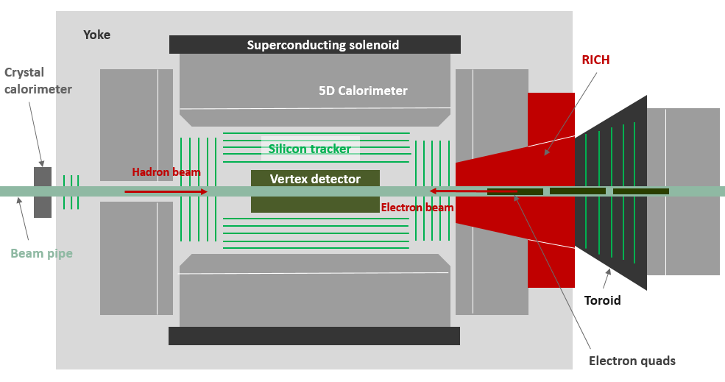
Excursion II: The Argonne Concept of an EIC Detector
TOPSiDE
5D Concept
Energy E
Position x,y,z
Time t
Salient features
4π detector (hermetic coverage)
Multi-purpose detector (no need for another specialized detector)
Mostly based on silicon sensors (tracker, electromagnetic calorimeter)
Each particle measured individually (optimized for Particle Flow Algorithms)
Particle identification (pion-kaon separation) performed by Time-of-Flight (tracker and calorimeter)
Imaging calorimetry (tens of millions of readout channels)
Coil on the outside (not to degrade calorimetric measurements)
Toroid in the forward direction (to obtain a momentum measurement)
Special detectors in the forward direction (Ring Imaging Cerenkov for Particle ID, debris taggers)

Slide 13
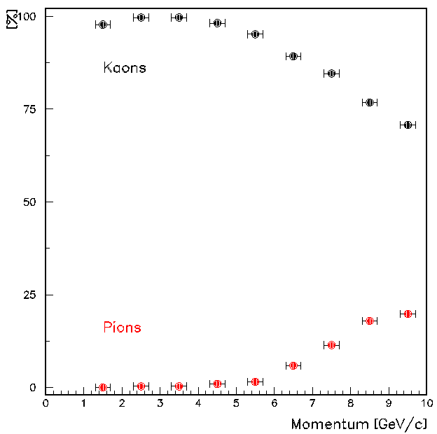
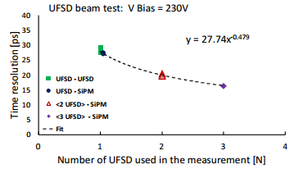
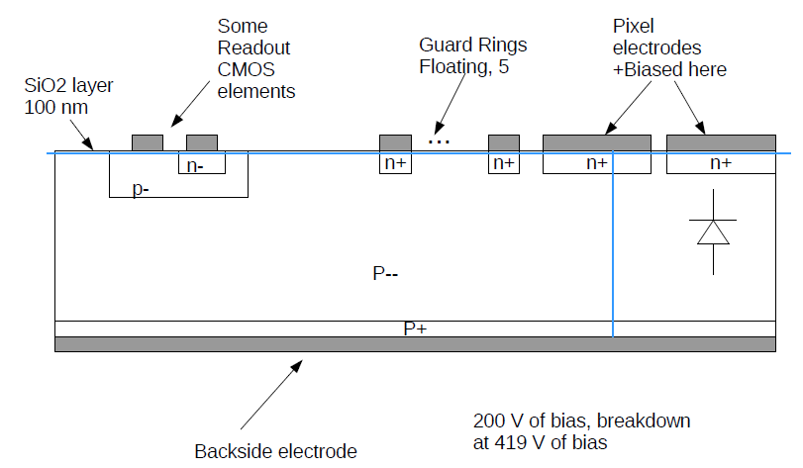
Challenges of the EIC: Central detector
Ultra-fast Silicon Detectors
Needed for particle identification (time-of-flight)
Simulation study showed that a time resolution of the
order of σ_{time} ~ 10 ps is needed
To date resolutions of σ_{time} = 27 ps have been achieved
with the LGAD technology
→ Amplification layer forces electrons to drift
(and not just diffuse)
Kaons identified as kaons
Times smeared with
10 ps resolution
Pions identified as kaons
HVCMOS (cheaper!) not explored yet
Initiated simulations
Next step insertion of amplification layer
arXiv:1608:08681

Slide 14
Challenges of the EIC: Central detector
Magnets
Large central magnet with a field of ~2.5 Tesla
Forward magnet (dipole or toroid)
→ Interference? Field in the area of the RICH?
Cerenkov detector
Needed in the forward direction to identify particles with high momenta (10 – 50 GeV/c)
Only known technology is a gaseous Ring Imaging Cherenkov counter
→ How to collect the light? Interference with magnetic fields?
TOPSiDE

Slide 15
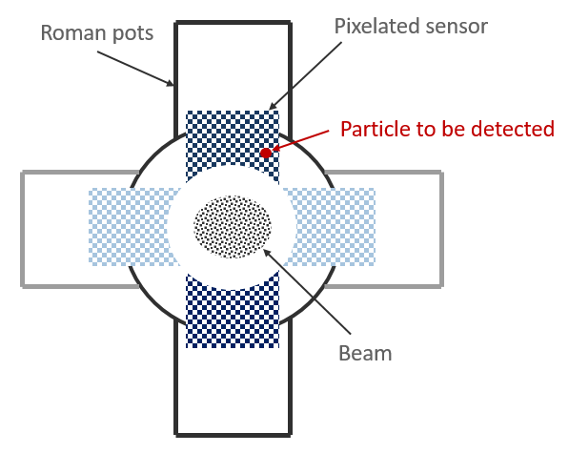
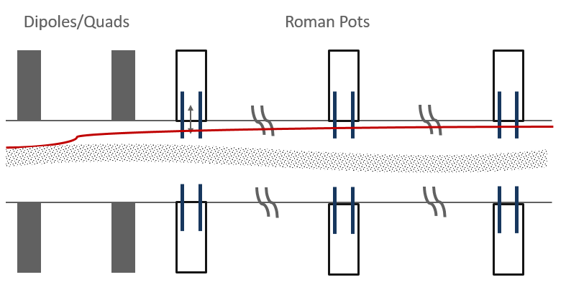
Challenges of the EIC: Forward detector
Breakup of the proton/ion
Creates debris into the forward cone
All particles (protons, neutrons, photons, nuclei) need to be identified and measured
These particles have momenta lower than the colliding protons/ions
Technique
Use storage ring dipole magnets as analyzers
Insert position sensitive detectors downstream into the beam pipe
Measure positions, reconstruct tracks → momentum
Measure time-of-flight → particle ID
Challenge
Radiation hard sensors handling high particle rates
Providing excellent timing
Options
Silicon strip detectors
Superconductive nanowire detectors
Beam pipe

Slide 16
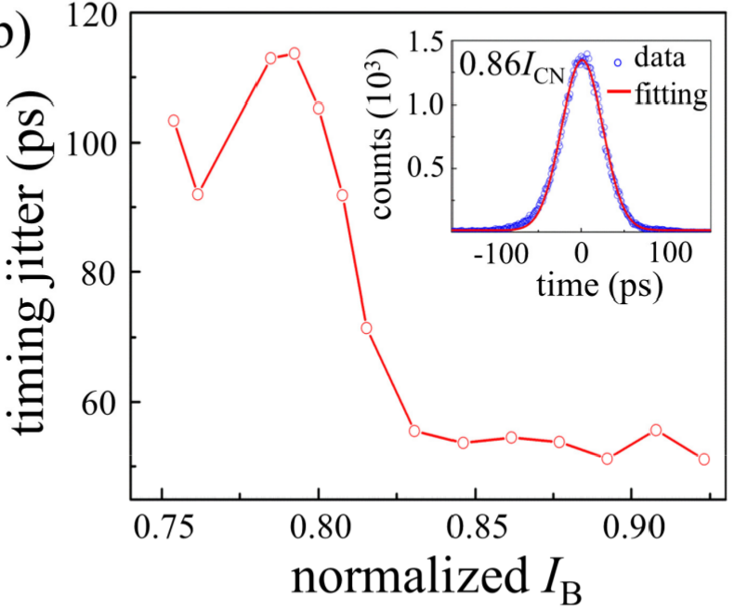
Excursion III: Superconductive Nanowires
Principle of operation
(i) Thin, superconductive wire biased just below the critical current
(ii) A traversing particle heats the wire
(iii-v) The wire becomes normal conductive
(vi) The wire recovers and becomes superconductive again
Detection technique
Measure change in bias current
Detector insensitive while normal conductive → single particle counter
Characteristics
Good efficiency, up to 50%
Fast signals, good timing resolution → down to tens of picosecond
Spatial segmentation → (almost) anything is possible
Forward debris detector
Good candidate? → We will find out…

Slide 17
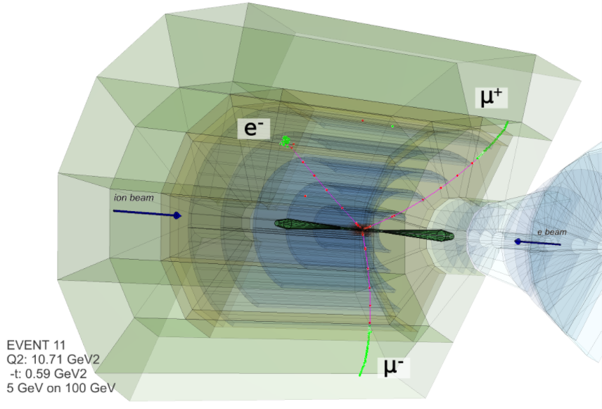
Excursion IV: Simulating the detector response
Benefits of simulations
Estimate the performance of various detector concepts/designs
Estimate the measurement precision to be achieved
Optimize the detector concept/design
Simulation tool chain
Task | Tool
Generate collision events | Lepto, PYTHIA8, Milou….
Transport of particles through matter | GEANT4
Digitizing the response (making it look like real data) | Digitizer, e.g. RPC_sim
Reconstruct tracks | Genfind, Genfit…
Reconstruct particles | Pandora PFA
Depository for events | HepSim
Analyze events | Root
Event display
Assembled, but further being developed

Slide 18
Challenges of the EIC: Simulations
Data model
Needed to link tools, factorize the tasks, foster collaborations…
Easily maintainable model
Detector geometry
Unified, parametrized description → one source for all tools
Digitizers
Silicon sensors
RPC pads (HCAL)
Cerenkov (light collection)
Generic tracking
Independent of details of geometry
Changes in geometry do not require retuning
Generic particle reconstruction
Independent of geometry
Done
Done
Ongoing/challenging
Almost done
Ongoing/Challenging

Slide 19
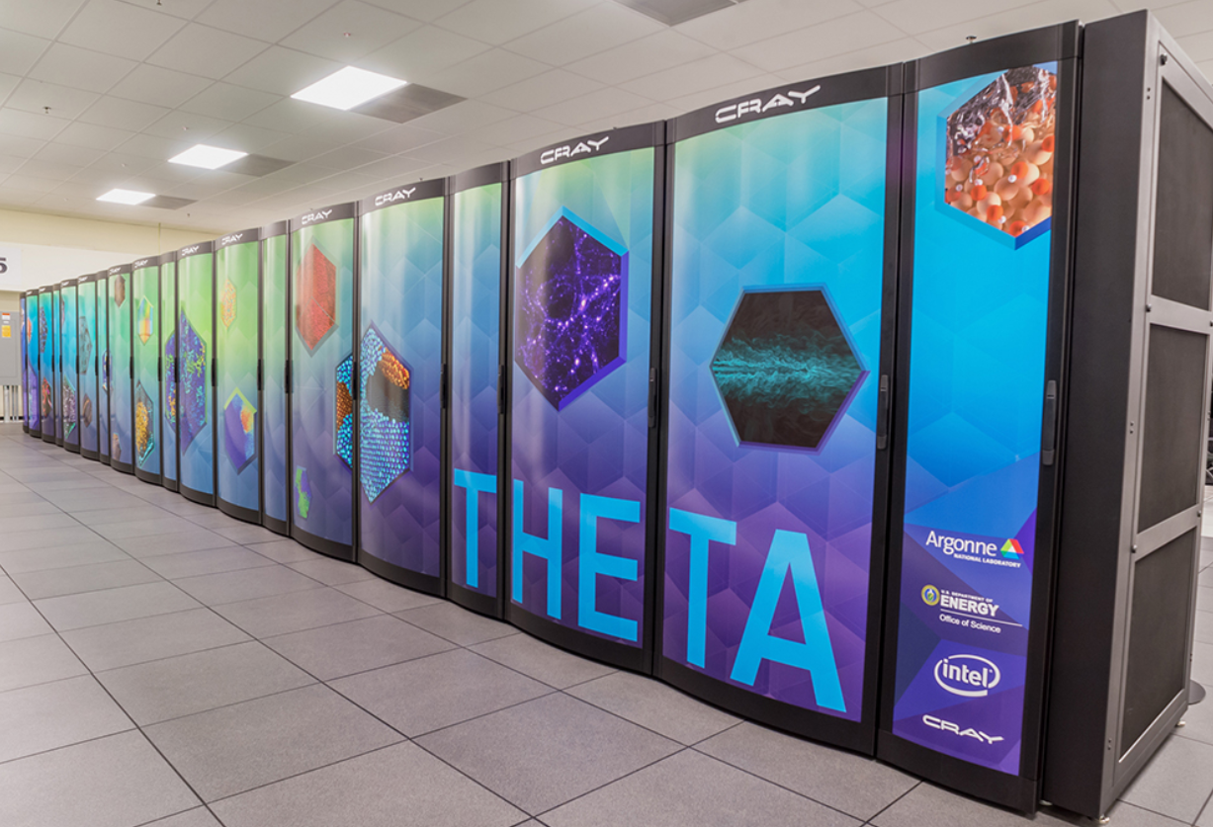
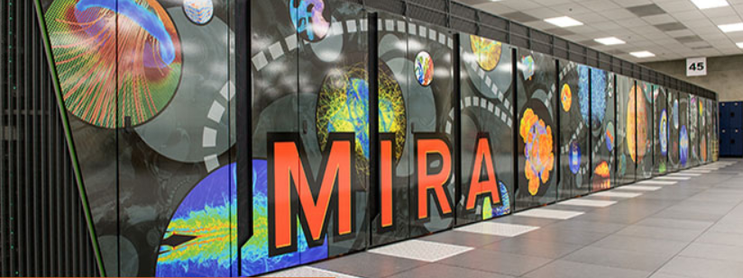
Challenges of the EIC: Computing
Computing for the next decade: Argonne’s EIC HUB
Hub provides critical organization to
• Exploit fully current computing resources
• Develop sophisticated, novel algorithms
(parallel algorithms, deep learning, neutral nets…)
• Position ourselves for the use of next generation computing
(Exa-scale and/or quantum computing)
Challenges
Orchestrate the many moving parts of computing related to the EIC
Data management, job execution, version control, bench marking…
Develop a dynamic front-end user interface which can
be used for the next decade by the entire EIC community
(Collaboration with CELS has started)
Position Argonne as leaders in computing for the EIC

Slide 20
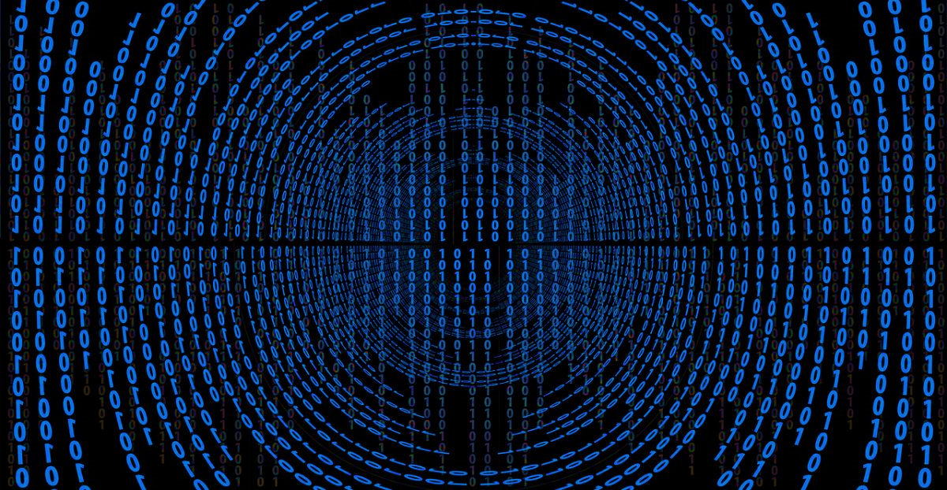
Conclusions
QIS and colliding beam experiments?
Not aware of any overlap/cross-fertilization
EIC theoretical calculations and QIS?
Can quantum simulators be used for QCD calculations, which in turn might
be relevant for the EIC? → Adam Freese’s talk
Fast timing and QIS?
At the moment, hedging our bets on ultra-fast silicon detectors (UFSDs)
Are there other sensors, which can be used in trackers, calorimeters?
- Boundary condition I: cooling requires a cryostat (inert material -> to be avoided)
- Boundary condition II: sensor needs to measure times ( to 10 ps) and deposited energy
- Boundary condition III: sensor needs to be finely segmentated
Forward debris detection and QIS?
Possibility of using nanowires
(these are quantum devices in the sense that they are either superconducting or not)
Can the cooling cope with the high particle rates?
The EIC and QIS

