Slide 1
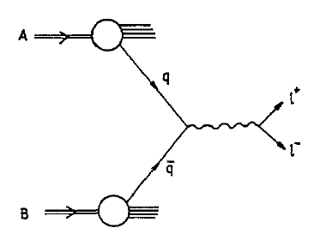
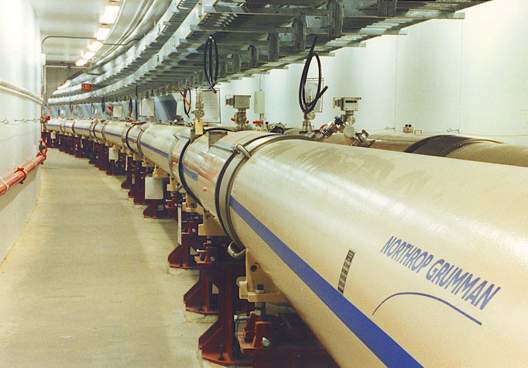
» Drell Yan @ RHIC «
Oleg Eyser
ECT* Workshop on Drell Yan Physics and the Structure of Hadrons
May 21-25, 2012, Trento, Italy

Slide 2
RHIC as Polarized Proton Collider
Absolute Polarimeter (H jet)
RHIC pC Polarimeters
Siberian Snakes
BRAHMS / AnDY
Spin Flipper
STAR
PHENIX
Siberian Snakes
Spin Rotators
Partial Snake
Polarized Source
Strong Snake
Helical Partial Snake
LINAC
AGS
200 MeV Polarimeter
BOOSTER
Rf Dipole
AGS Internal Polarimeter
AGS pC Polarimeter

Slide 3
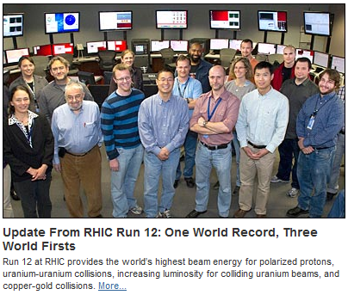
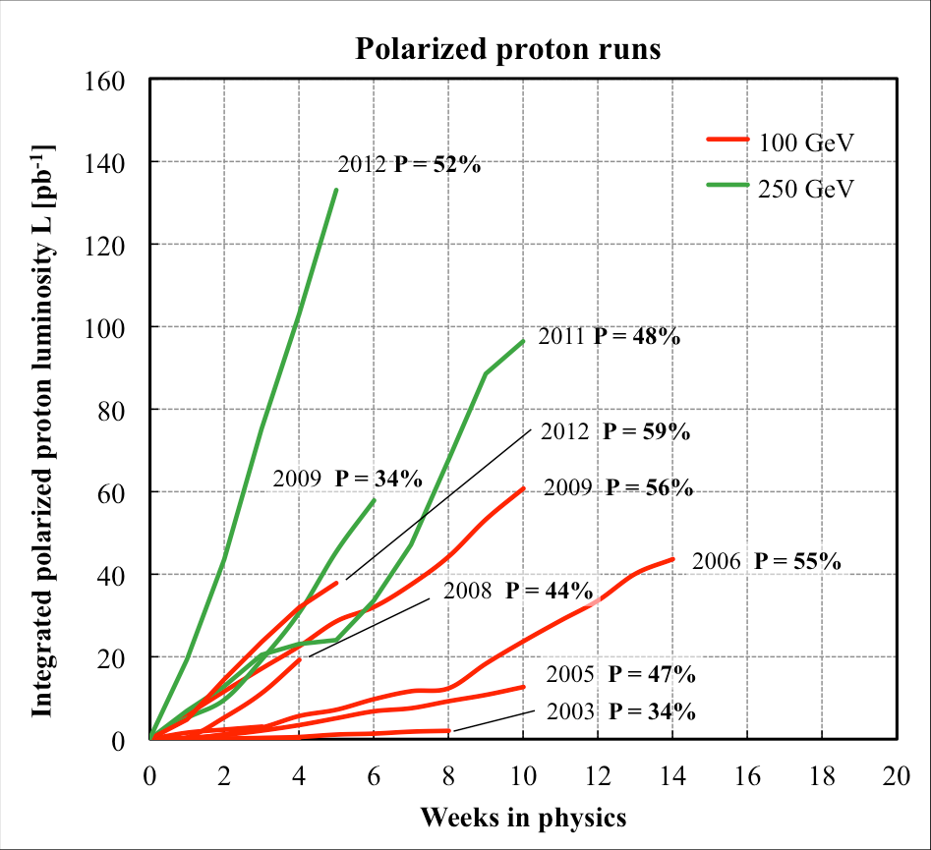
transverse
200 GeV
500 GeV
trans.
long./trans.

Slide 4
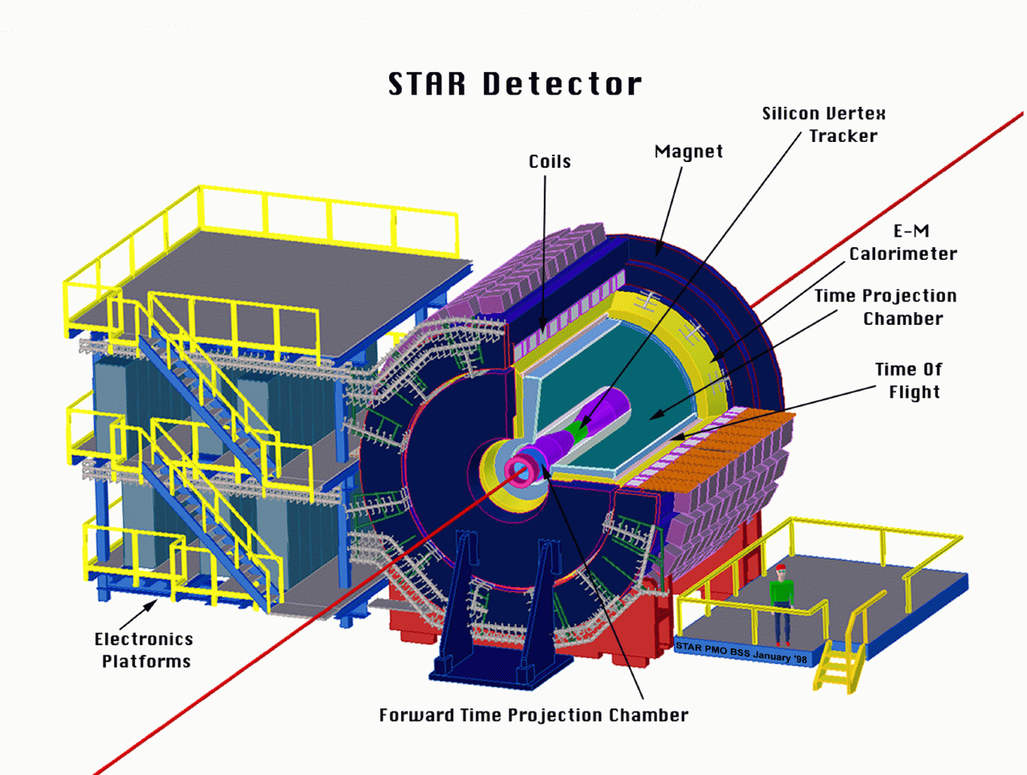
STAR
The STAR Detector

Slide 5
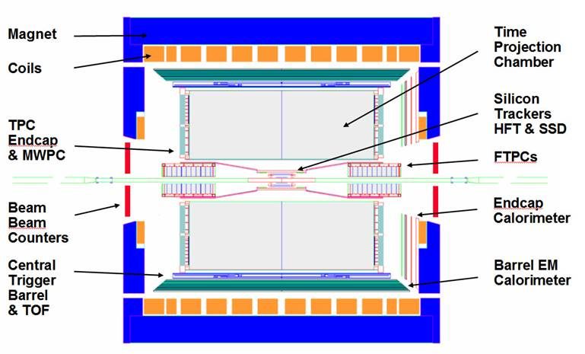
The STAR detector
FPD+
FMS

Slide 6
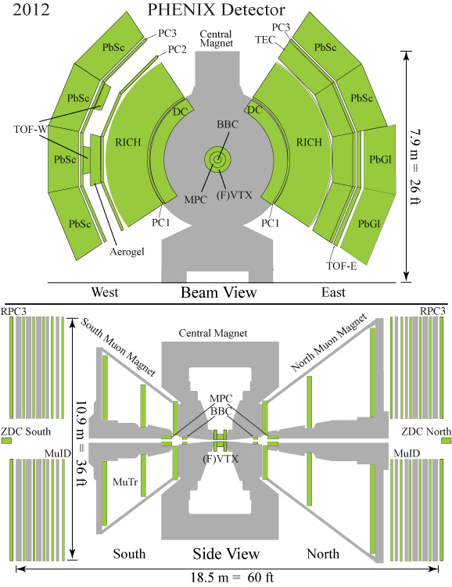
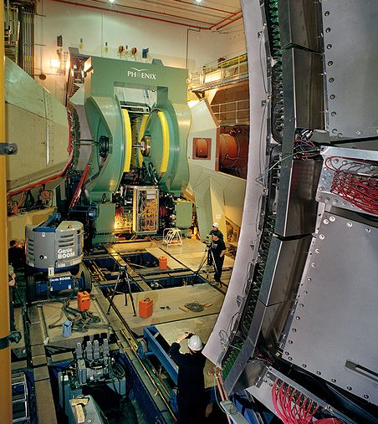
The PHENIX Detector

Slide 7
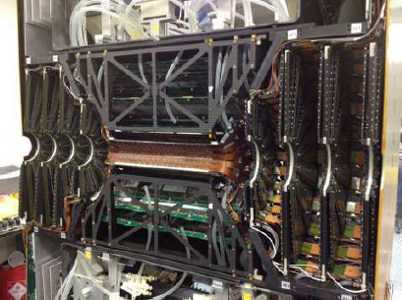
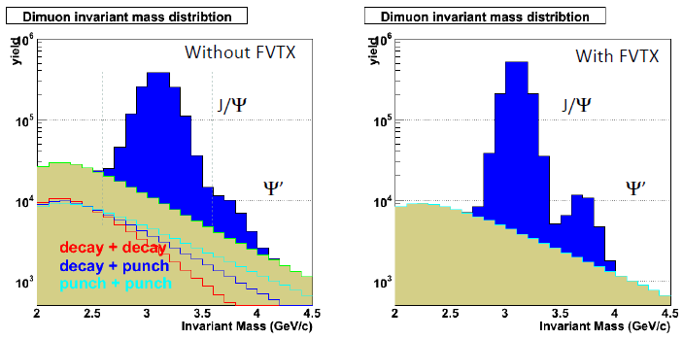
New micro-vertex detectors
VTX & FVTX
Commissioned in runs 11 & 12
Resolution
Hit < 25 μm
DCA < 200 μm
Expected improvement on J/Ψ

Slide 8
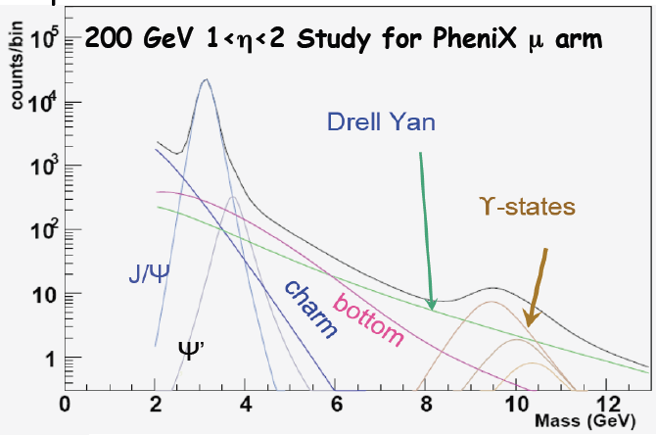
Drell-Yan Spectrum

Slide 9
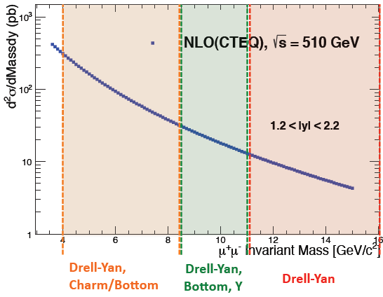
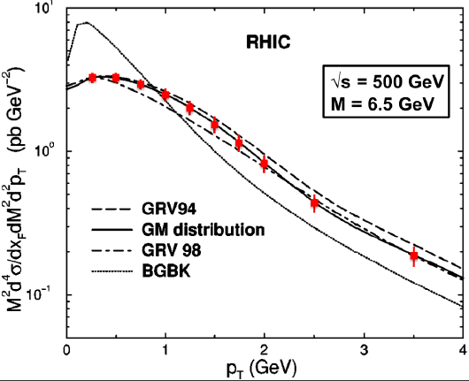
Drell-Yan Feasibility with PHENIX
PHENIX projection: √s = 510 GeV
Integrated luminosity 50 pb⁻¹
PHENIX muon arms: 1.2 < η < 2.2

Slide 10
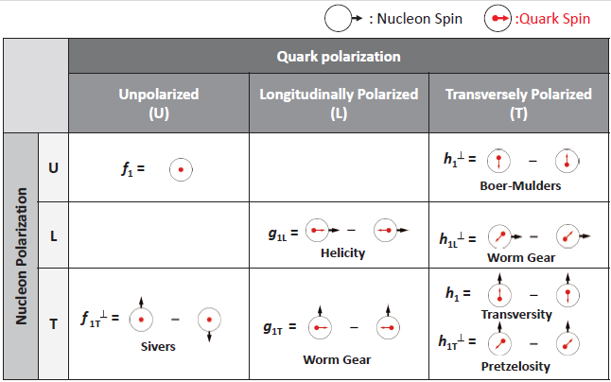
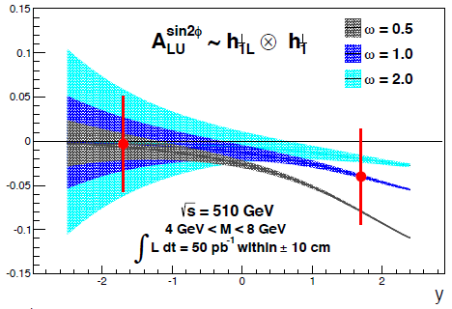
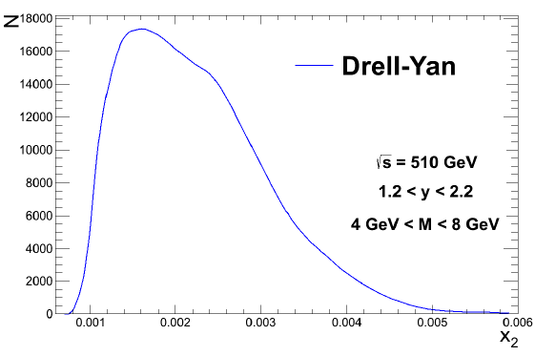
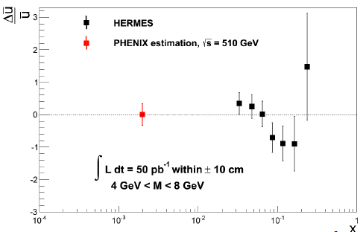
Polarized Drell-Yan with PHENIX?
arxive:1108.4974 (Lu, Ma, Zhu)
projection

Slide 11
Conclusion?
RHIC can provide luminosities to measure Drell-Yan production
Projected luminosities in upcoming run ≈ 300 pb⁻¹
Beam polarizations are >50%
Will have longitudinal polarization in the near future… highest priority is the W-program
What are the important questions for a compelling physics program?
“We have an infinite number of questions that we can work on.” Penn Jillette

Slide 12
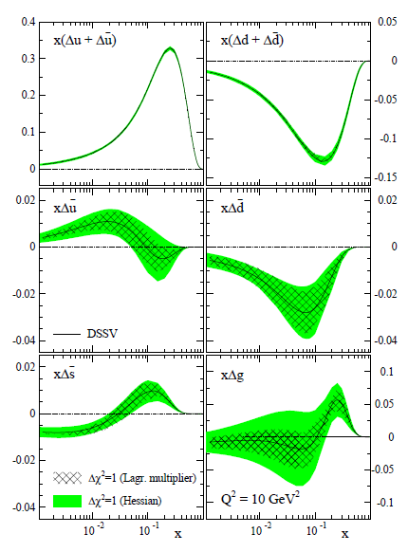
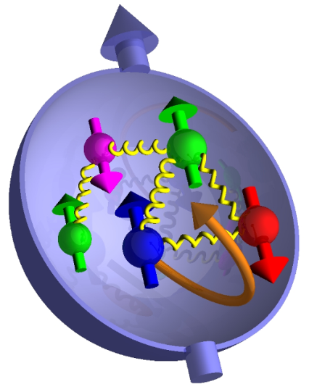
The Proton Spin Structure
Polarization experiments
Helicity
Valence quarks
Sea quarks
Gluons
Transversity
momentum
momentum
What is the connection to orbital angular momentum?
DSSV arXiv:0904.3821

Slide 13
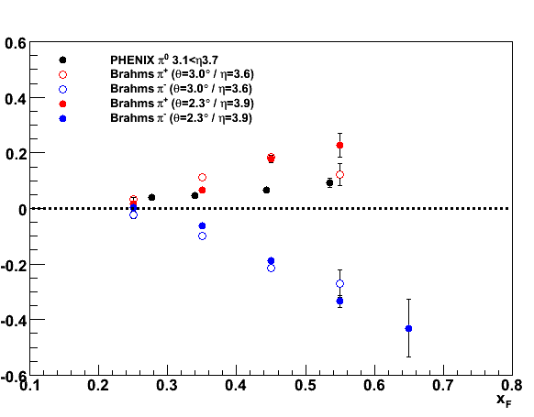
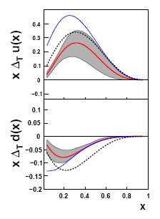
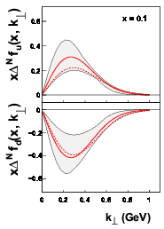
Transverse Asymmetries
√s = 4.9 GeV
√s = 6.6 GeV
√s = 19.4 GeV
u/d
1:0
2:1
1:1
Transversity
Sivers
u
u
√s = 62.4 GeV
d
d

Slide 14
Initial state interaction
Sivers effect
Hard Scattering
Transversity
Twist-3
Final state interaction
Collins effect
Transverse Asymmetries
Inclusive A_{N} (central/forward)
Jet/hadron correlations (back-to-back)
Interference fragmentation functions
Jet correlations/structure
Drell-Yan Comparison with siDIS (sign change) Map out the kinematic range
Upgrades
Upgrade plans

Slide 15
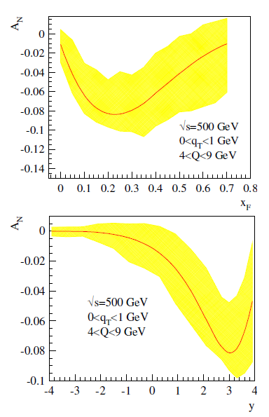
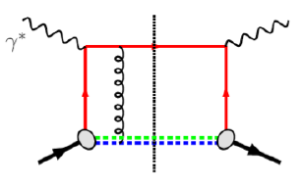
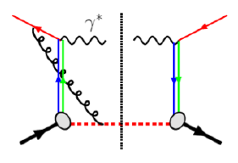
A_{N}(DY)
PHENIX muon arms
Solid factorization
No fragmentation
Direct correlation of intrinsic transverse quark momentum to the proton spin
Fundamental QCD test
Sign of asymmetry compared to SIDIS

Slide 16
Kinematics

Slide 17
Drell-Yan @ RHIC
Demonstrate that large-x_{F} low-mass di-leptons from the Drell-Yan process can be discriminated from background in √s=500 GeV p↑+p collisions
Measure the analyzing power for Drell-Yan production with sufficient statistical precision to test the theoretical prediction of a sign change for DY in relation to semi-inclusive deep inelastic scattering
Determine if detection of Drell-Yan di-leptons requires magnetic analysis ⇒ critical for future facilities at RHIC

Slide 18
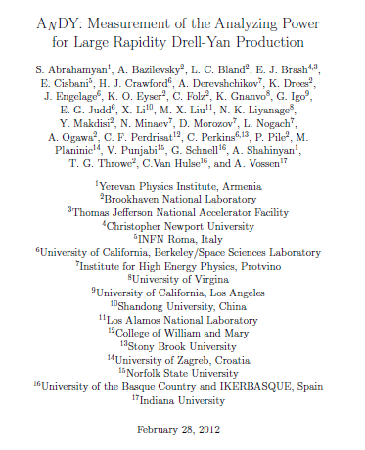
Reminder
Absolute Polarimeter (H jet)
RHIC pC Polarimeters
Siberian Snakes
AnDY
BRAHMS / PP2PP
Spin Flipper
STAR
PHENIX
Siberian Snakes
Spin Rotators
Partial Snake
Polarized Source
Strong Snake
Helical Partial Snake
LINAC
AGS
200 MeV Polarimeter
BOOSTER
Rf Dipole
AGS Internal Polarimeter
AGS pC Polarimeter
Letter of intent (2010): Feasibility test of large rapidity Drell-Yan production

Slide 19
AnDY - Staging
Polarized proton runs at √s = 500 GeV
2011
2012
2013
HCal + newly constructed BBC at IP2 to establish the impact of a 3rd IR operation and to demonstrate the calibration of HCal to get first data constraints on charged hadron backgrounds
HCal + EmCal + neutral/charge veto + BBC for zero-field data sample with L_{int}≈150 pb⁻¹ and P≈50% to observe di-leptons from J/ψ, Υ, and intervening continuum.
HCal + EmCal + neutral/charge veto + BBC + split-dipole for data sample with L_{int}≈ 150 pb⁻¹ and P=50% to observe di-leptons from J/ψ, Υ, and intervening continuum to address whether charge sign discrimination is required

Slide 20
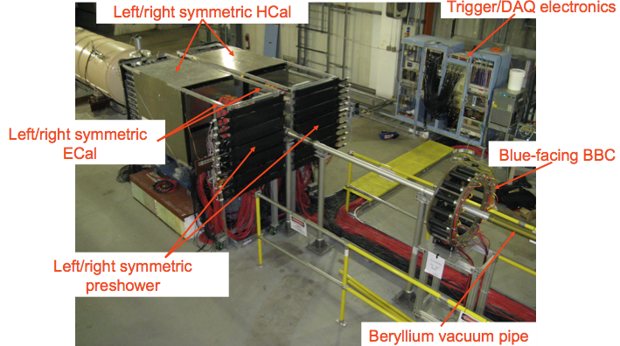
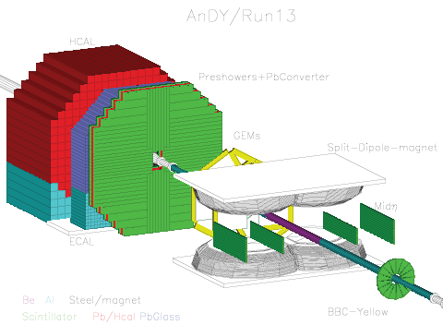
AnDY

Slide 21
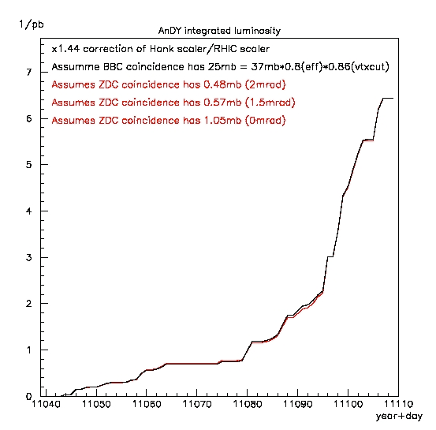
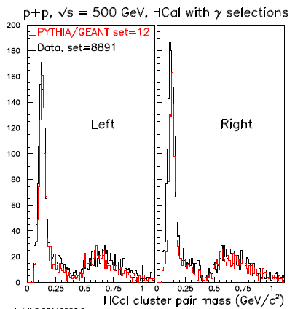
AnDY performance
6.5 pb⁻¹
different crossing angles
Successful collisions at AnDY
Minimal impact on other IPs
Proximity association with ECal
HCal energy scale ≈ 5%

Slide 22
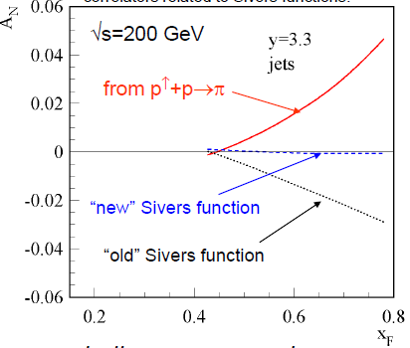
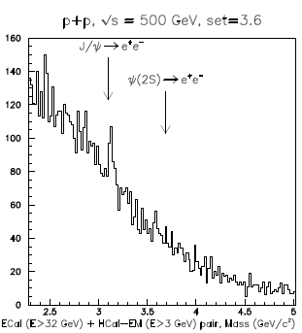
AnDY performance
Finalize the jet-energy scale
≈ 20% of hadronic corrections needed
Cluster pair mass
(including BBC MIP)
≈120 J/Ψ out of 3.5·10⁷ triggers

Slide 23
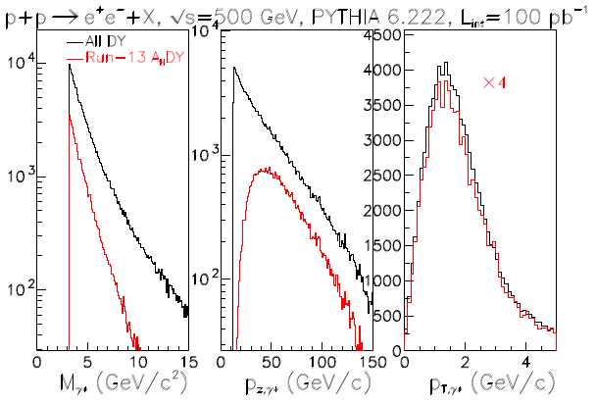
From di-leptons to Drell-Yan
SIDIS kinematics
12 < p_{z} < 75 GeV/c
p_{T} < 2 GeV/c
≈10⁴ di-electrons / 100 pb⁻¹
Expect > 4 σ measurement of A_{N}
(assume P ≈ 50% and A_{N} ≈ 0.1)

Slide 24
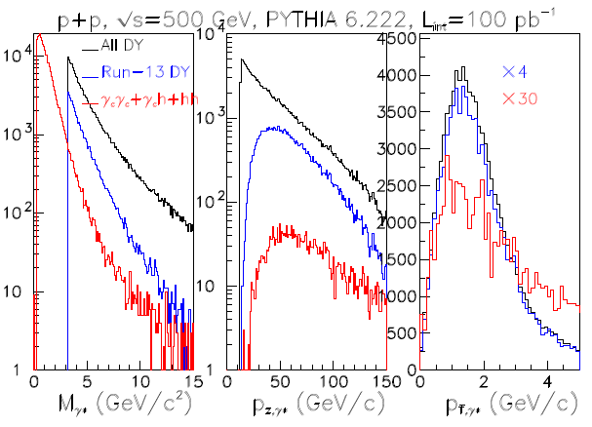
Background from QCD jets
Fast MC for long. shower profile based on 0.5 pb⁻¹ full GEANT simulation
Energy fraction cut:
Remaining electrons 99%
Hadron rejection 82%
Preshower (1 cm Pb)
Remaining electrons 98%
Reject hadron 86%
Scintillator
Reject photons 98%
Remaining electrons 86%

Slide 25
Polarized Drell-Yan @ RHIC
It is generally acknowledged that the scientific merit of the program is very high.
The AnDY timeline is very tight and the manpower is limited.
Are there other long-term options?
PHENIX upgrade
STAR upgrade

Slide 26
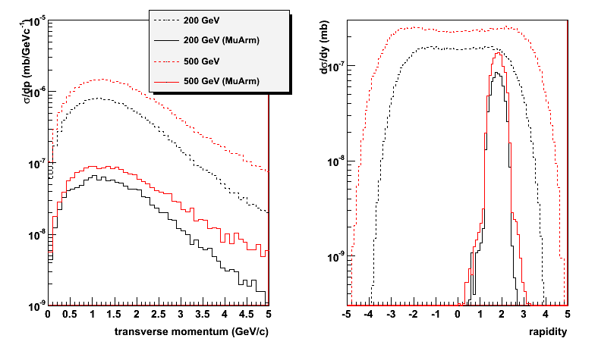
Cross sections
Partonic luminosities increase with √s
Large A_{N} for y > 2 (more forward than current PHENIX muon arms)

Slide 27
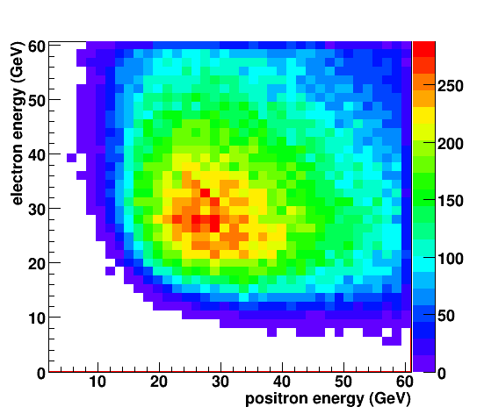
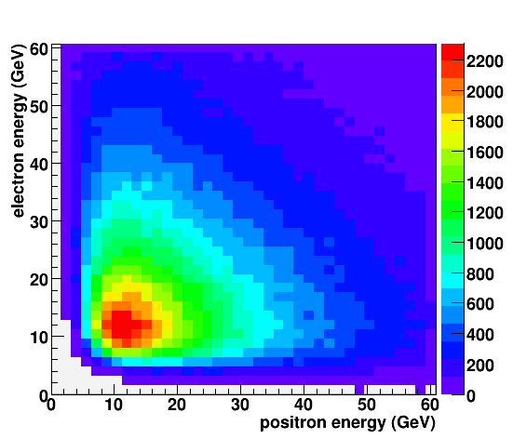
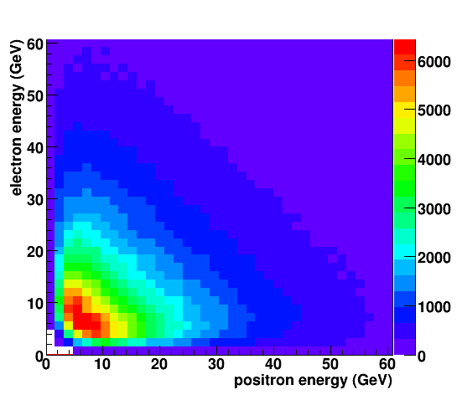
Drell-Yan lepton pairs
Leptons have high energy
Energies are very correlated

Slide 28
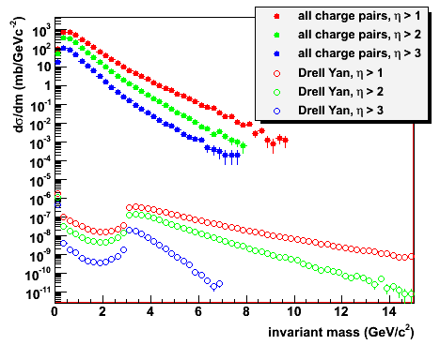
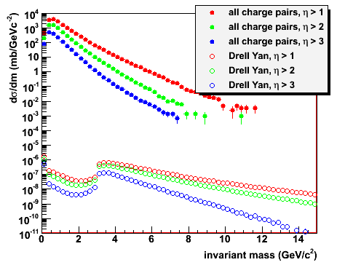
QCD 2→2 background
All charged particle pairs between J/Ψ and ϒ
Hadron suppression 10³-10⁴ needed at 500 GeV
√s = 200 GeV
√s = 500 GeV

Slide 29
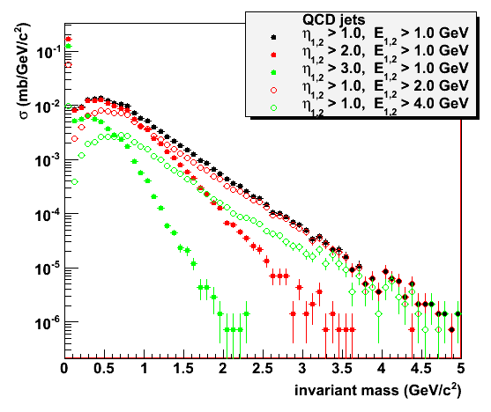
Background rejection
Electrons and positrons from hard QCD processes are uncorrelated
Opening angles are comparable to Drell Yan: detector acceptance
Lepton energies of Drell Yan decays are large
Energy cut removes QCD background at small m_{inv}
Large masses in QCD background favor mid-rapidity
Energy asymmetry has not been instrumented yet

Slide 30
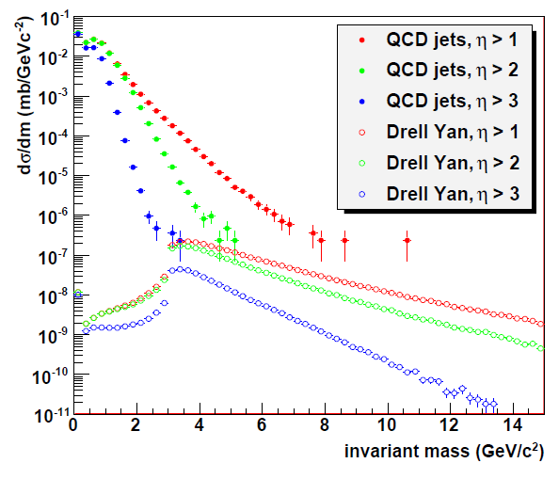
Drell-Yan at forward rapidities
Parametrized fast MC for detector smearing
Drell Yan signal
3 – 10 GeV/c²
Energy cut
E_{1,2} > 2 GeV
Forward rapidities
Effectively no background left
Statistically limited
Drell Yan for m_{inv} < 3 GeV/c² not physical (PYTHIA settings)

Slide 31
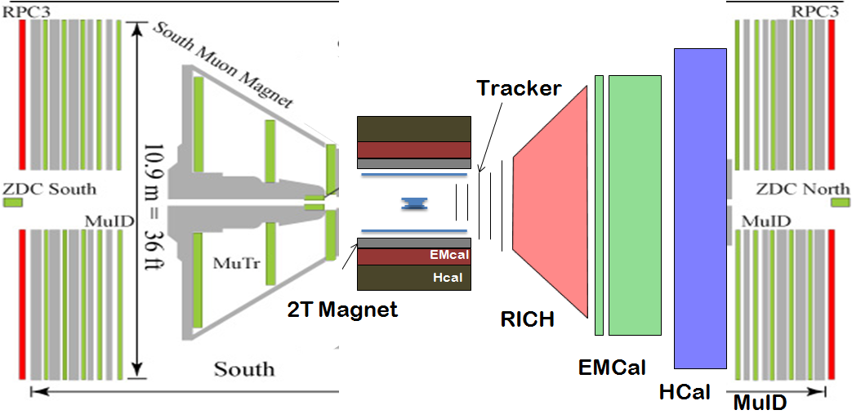
PHENIX future
To be described in an MIE $ 20M
Needs additional funding

Slide 32
STAR future
FMS
HCAL
DX magnet
beam pipe
FMS
HCAL
Compact E+Hcal
W powder scintillator?
Threshold RICH for electron ID
Magnetic field and tracker
How important is charge sign?

Slide 33
Summary
RHIC can deliver luminosities for Drell-Yan measurements
Would be the first polarized Drell-Yan production in collider
Current W-program uses longitudinal polarization
Feasibility studies will use data from run 11++
PHENIX & STAR are working on long-term upgrade plans that include Drell-Yan
More simulations needed for detector layout and design
AnDY as feasibility test has achieved parts of its goals at large rapidities

Slide 34
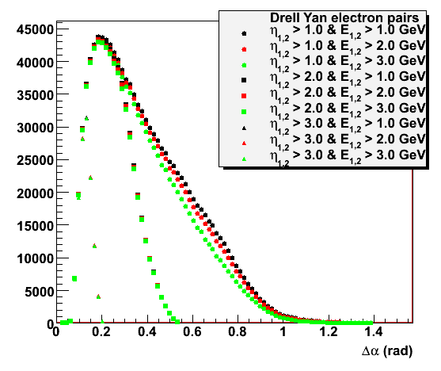

Slide 35
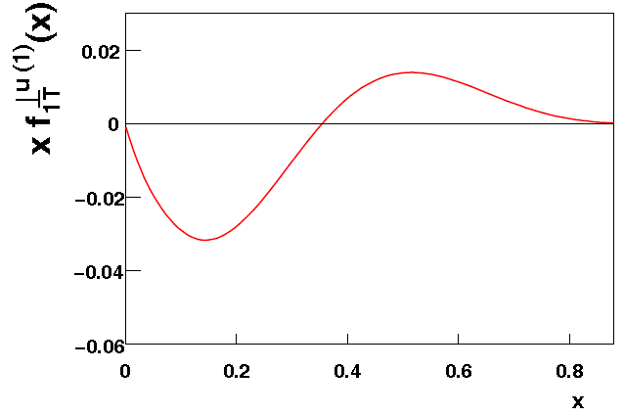
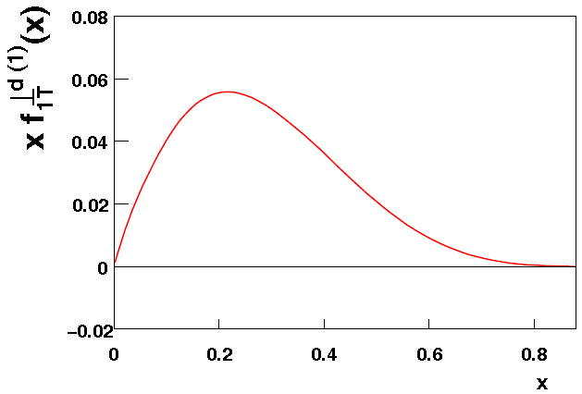
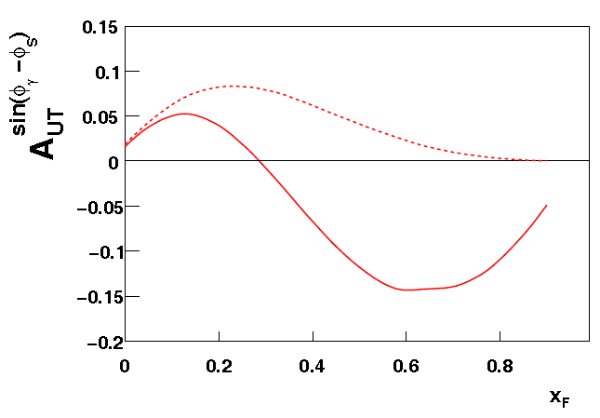
A. Prokudin, Z.-B. Kang
arXiv:1201.5427 [hep-ph]
Input
HERMES
COMPASS
STAR π⁰
Functional form similar to DSSV
u quark Sivers
d quark Sivers
SIDIS
PP
Need to map out Drell-Yan Sivers over a wide kinematic range

